Slide 1
Large Scale Processing of Water Column Sonar Data
to a Cloud Native Zarr Format
Rudy Klucik — Software Engineer, Associate Scientist II
rudy.klucik@noaa.gov
Cooperative Institute for Research in Environmental Sciences at the University of Colorado Boulder
and
NOAA National Centers for Environmental Information
Throughput Computing, July 8th, 2024

Slide 2
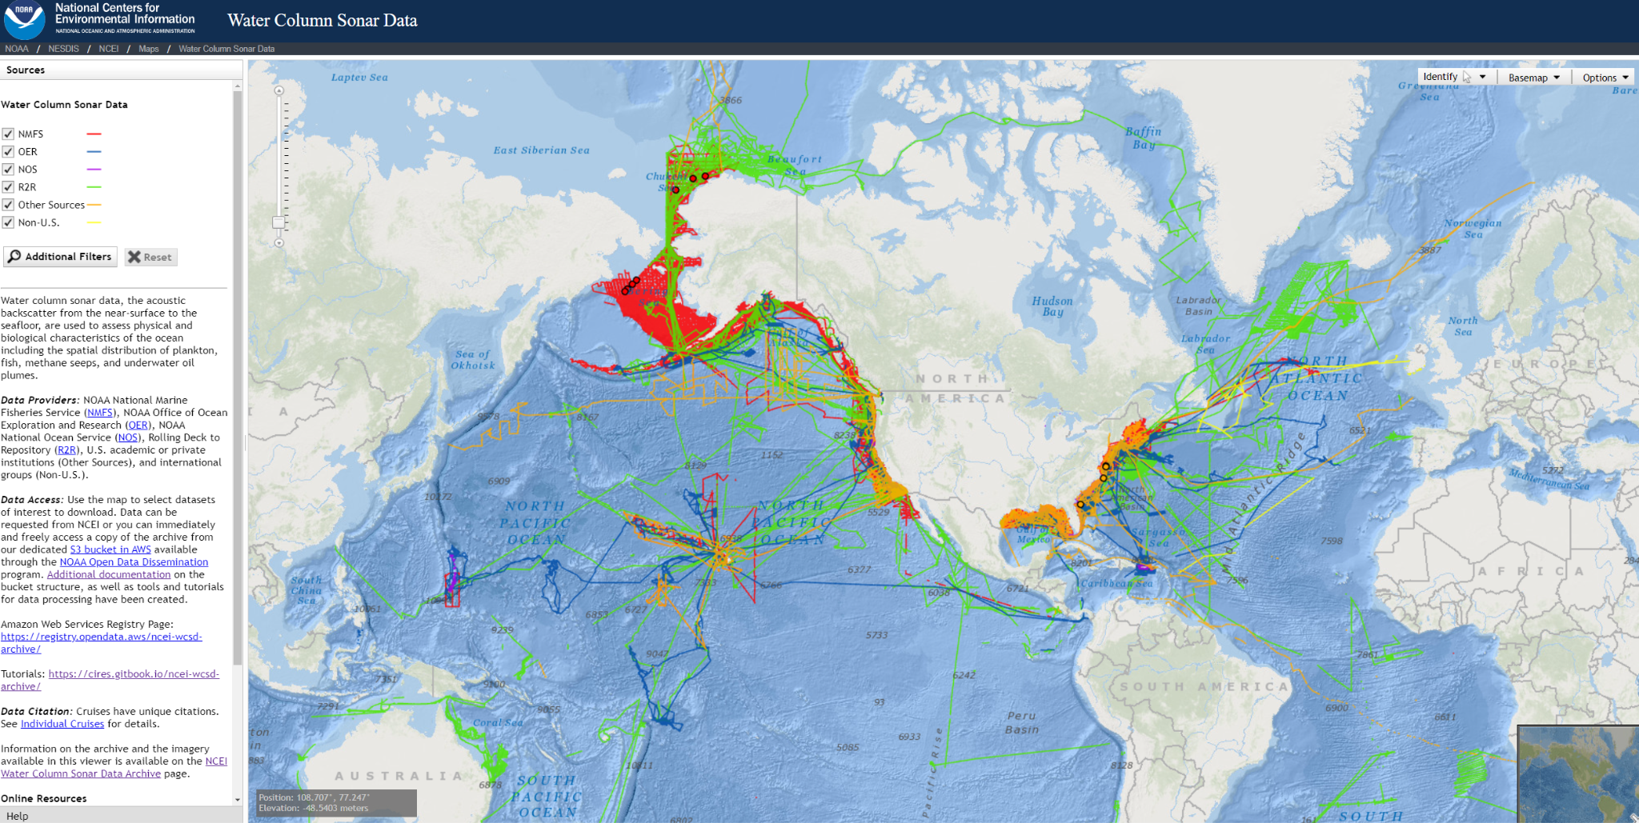
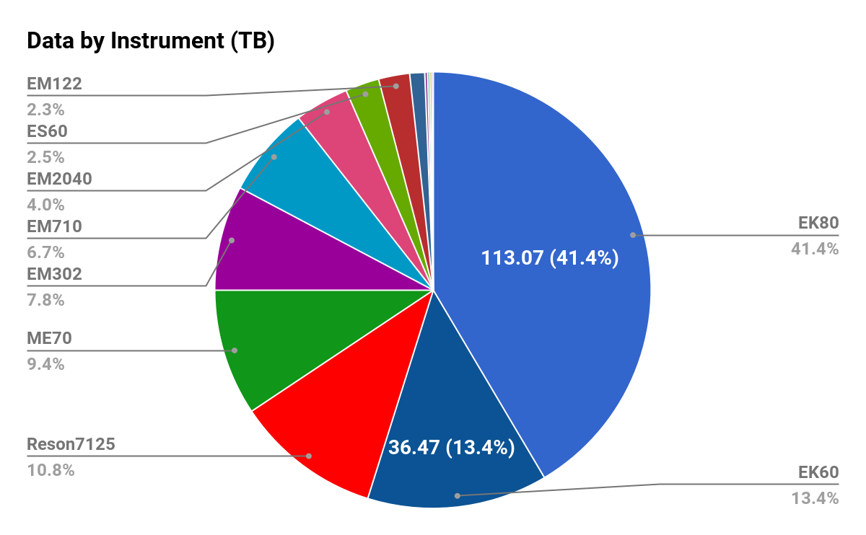
www.ncei.noaa.gov/products/water-column-sonar-data
Notes:
NOAA collects active acoustic sonar data for a variety of uses. Water column sonar data focus on the domain from the near surface of the ocean down to the seafloor. Some uses of this data include mapping of fish schools and other mid-water marine organisms including plankton, phytoplankton, and zooplankton; assessing biological abundance; species identification; and characterization of marine habitats. Other uses include mapping underwater gas seeps and remotely monitoring undersea oil spills.
We have about 300 TB of sonar water column data.

Slide 3
NOAA Open Data Dissemination (NODD):
https://noaa-wcsd-pds.s3.amazonaws.com/index.html#data/raw/Henry_B._Bigelow/HB0706/EK60/
https://echopype.readthedocs.io/en/stable/
to this:
https://noaa-wcsd-zarr-pds.s3.amazonaws.com/index.html#level_1/Henry_B._Bigelow/HB0706/EK60/
and then consolidated into this:
https://noaa-wcsd-zarr-pds.s3.amazonaws.com/index.html#level_2/Henry_B._Bigelow/HB0706/EK60/
EchoFish
Notes:
Two NODD buckets
Using echopype to do conversion into cloud-native & open data format.

Slide 4
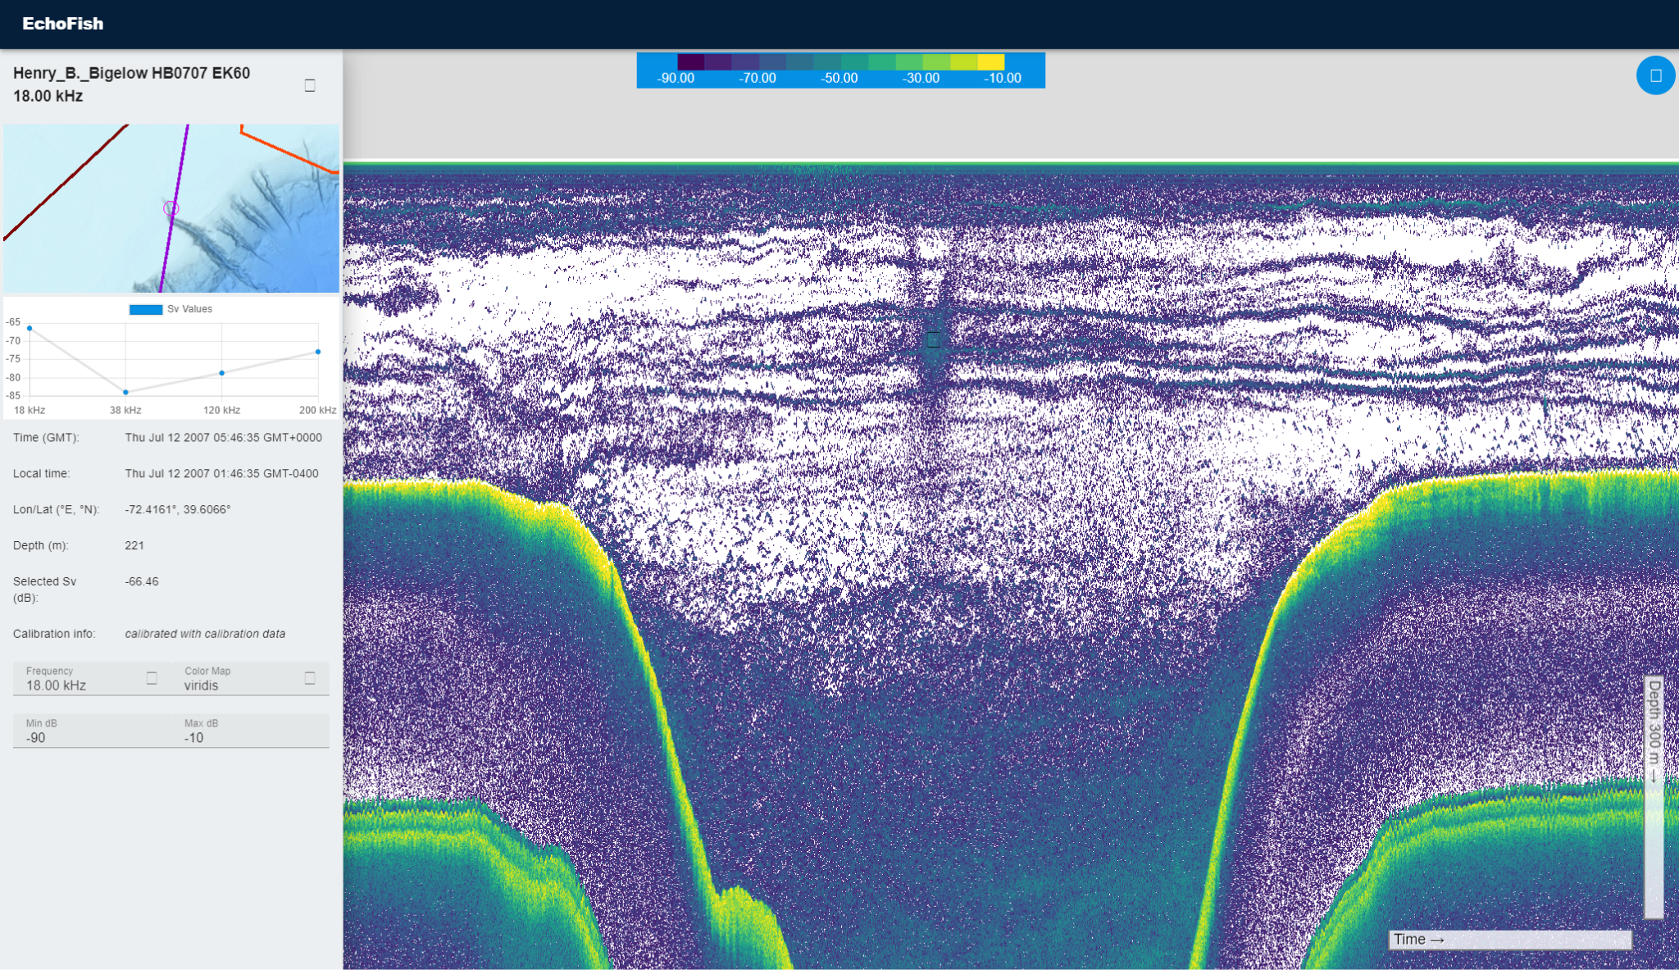
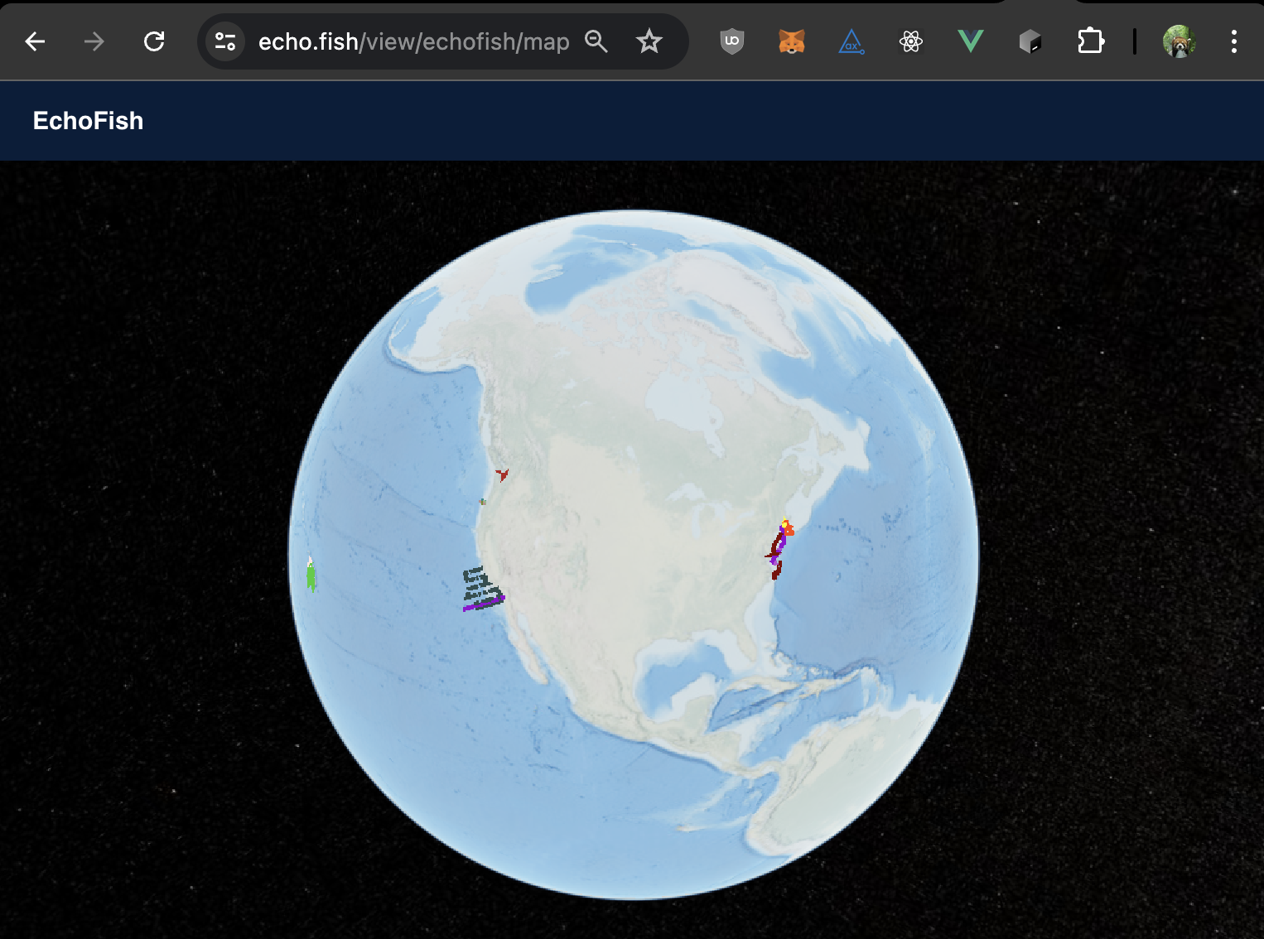
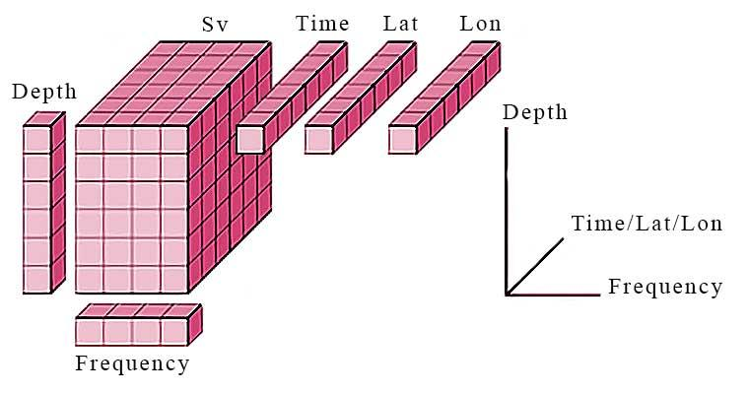
← Ocean Surface →
Map→
Plot→
+
Details→
Depth →
Time →
Notes:
This is the sea surface, Time is increasing in the X direction, Depth is increasing in the Y direction
The map viewer shows the sonar backscattering strength, SV measured in decibels, dB.
With the same data that users would use for their python, R, or matlab data science or machine learning, we are able to on the fly generate the data visualization.

Slide 5
Data Visualization Directly from the Zarr Store

Slide 6
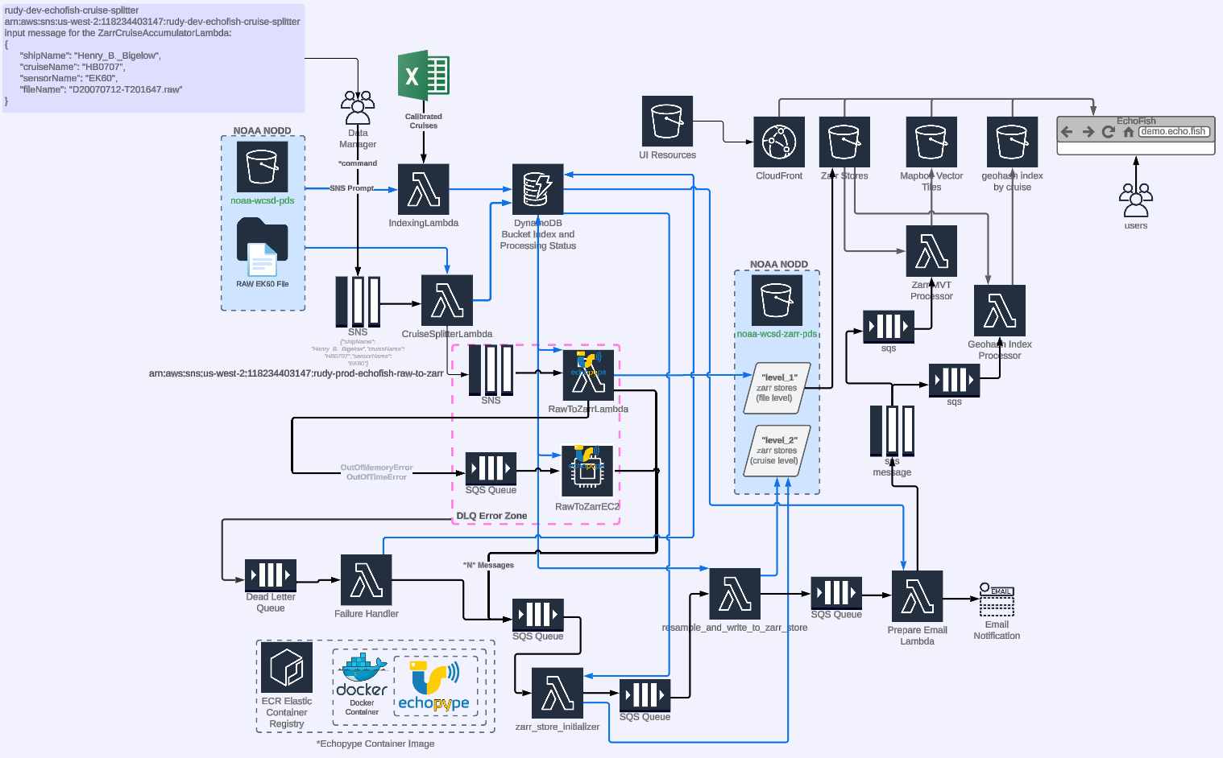
AWS Architecture → Efficient Computationally but Expensive
Notes:
Cloudformation Templates
Dynamodb → keeping record of processing status
Cost estimate >$10,000 to process all the ek60 data

Slide 7
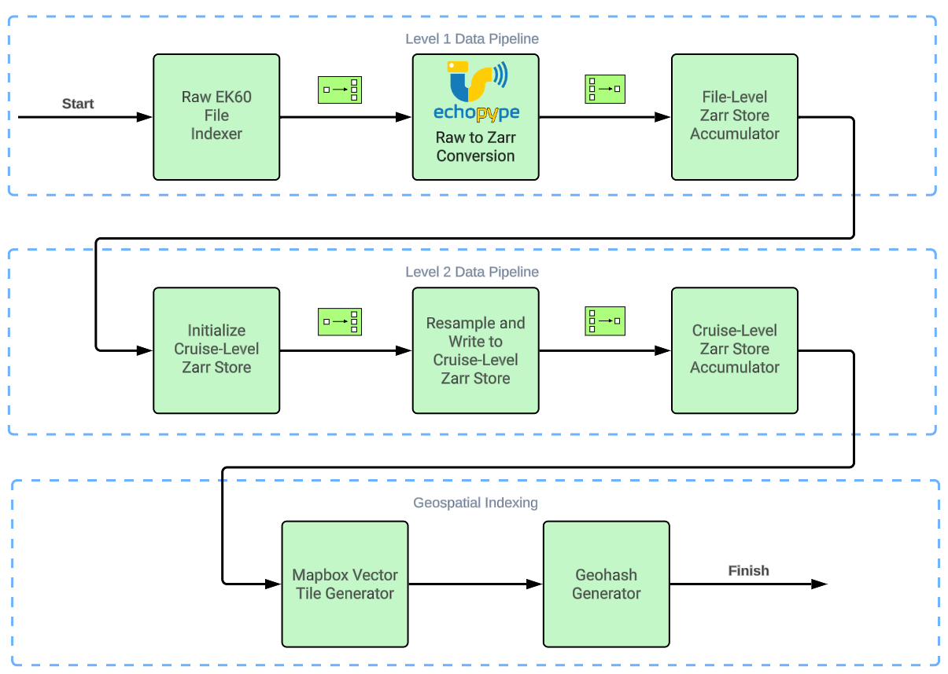
Simplified Pipeline
Notes:
Scatter gather pattern:
https://www.enterpriseintegrationpatterns.com/patterns/messaging/BroadcastAggregate.html

Slide 8
NCAR — Boulder, Colorado
“Distributed High Throughput Computing — High-throughput computing (HTC) is the execution of computational work in the form of numerous, self-contained tasks to optimize their overall completion across available computing resources. Specialized by the OSG, distributed high-throughput computing (dHTC) involves the operation of HTC-optimized infrastructure across many independent, collaborating administrative domains.”
Notes:
I first learned about HTC in January 2024. My PI, Carrie Wall Bell helped organize a meeting between a CO-PI, Dr. Christine Lv (a CU computer science professor), my supervisor and senior software engineer, Chris Slater, and myself. We met with Douglas Schuster, the NCAR acting director for the Computational and Information Systems Laboratory, and Brian Bockelman, representing research computing from the Morgridge Institute and an OSG Services and Technology lead
https://osg-htc.org/about/introduction/
Image attr: https://www.bouldercoloradousa.com/listings/national-center-for-atmospheric-research-%28ncar%29/375/

Slide 9
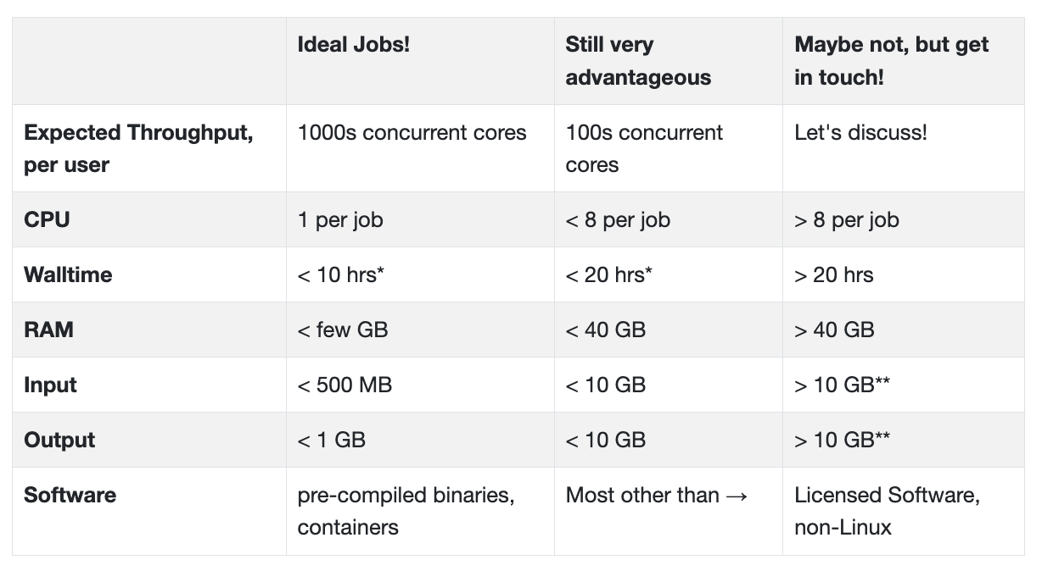
“What types of work run well on the OSPool”
https://osg-htc.org/services/open_science_pool.html
Notes:
AWS lambda, 15 minute timeout, 10 GB memory, 6 vCPU

Slide 10
Starting Point for Refactoring Code
https://osg-htc.org/services/open_science_pool.html
“The hardest job will be your first one.” — Rachel Lombardi
Github repos:
https://github.com/OSGConnect/tutorial-quickstart
Languages: R, Python, Julia, Matlab, Java, bash, etc.
Debugger → Logging
Important → Freedom to Fail → “condor_rm”
Virtualizing environment with libraries including echopype
Package installation & Searching +SingularityImages
https://github.com/OSGConnect/tutorial-ScalingUp-Python

Slide 11
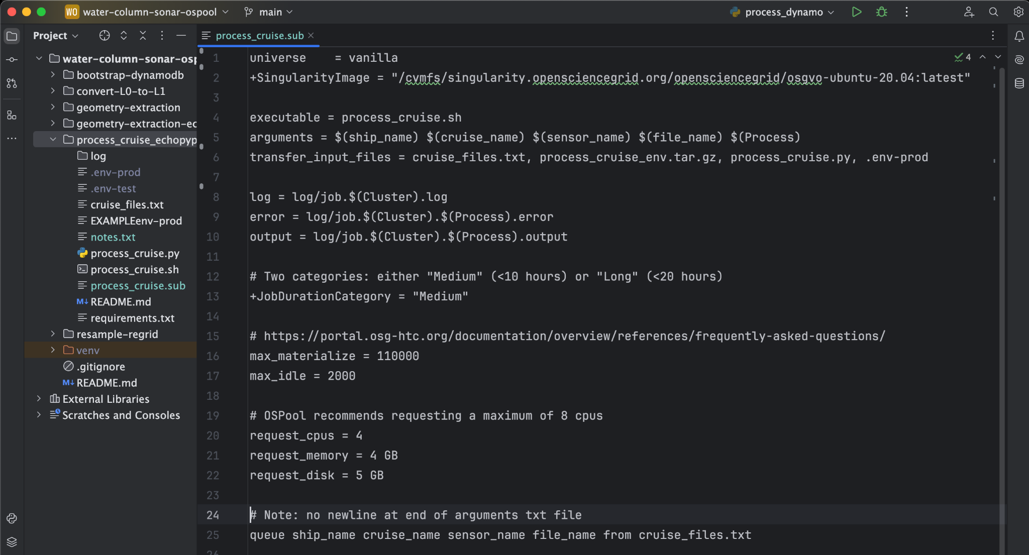
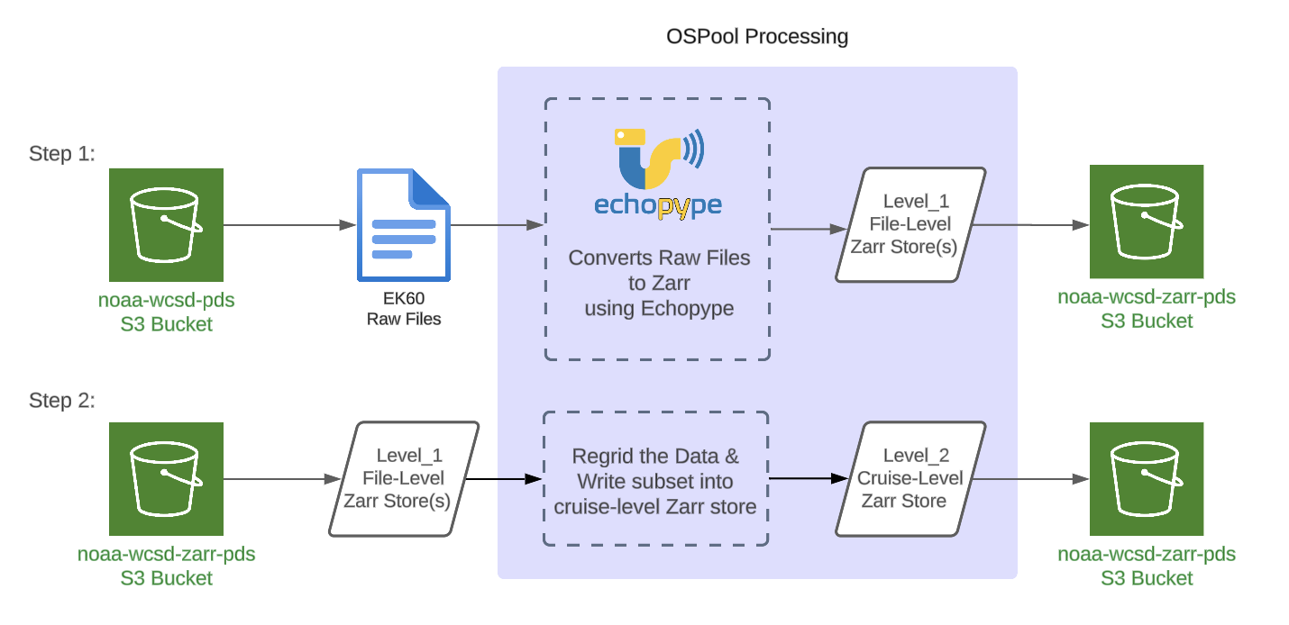
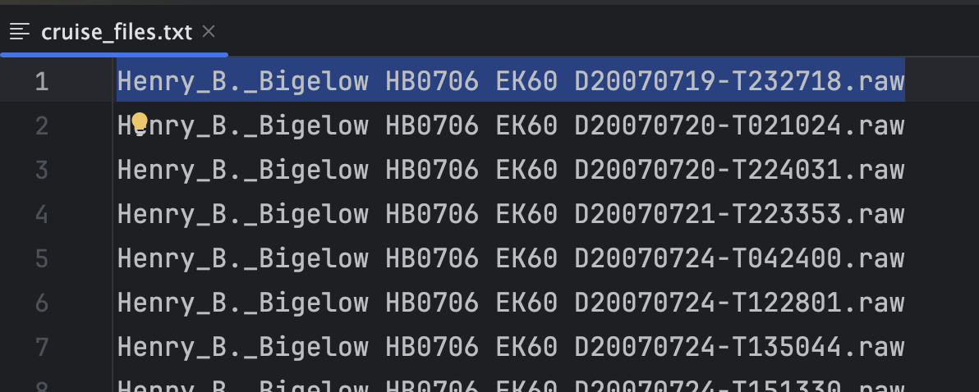

Slide 12
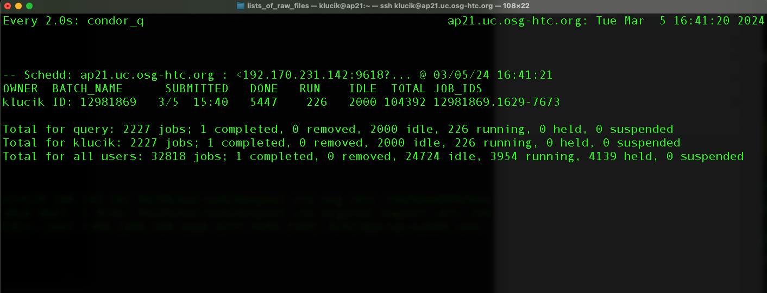
Challenges
When submitting condor jobs, typically a few or more jobs can fail for reasons that are difficult to determine:
Large memory expansions during decompression
Nodes randomly going offline → Tracking bash exit code w/ logging
Older slower computing resources
Security → dotenv & canary tokens
Jobs can be resubmitted. Still looking for the most efficient way of tracking & resubmitting failed condor jobs

Slide 13
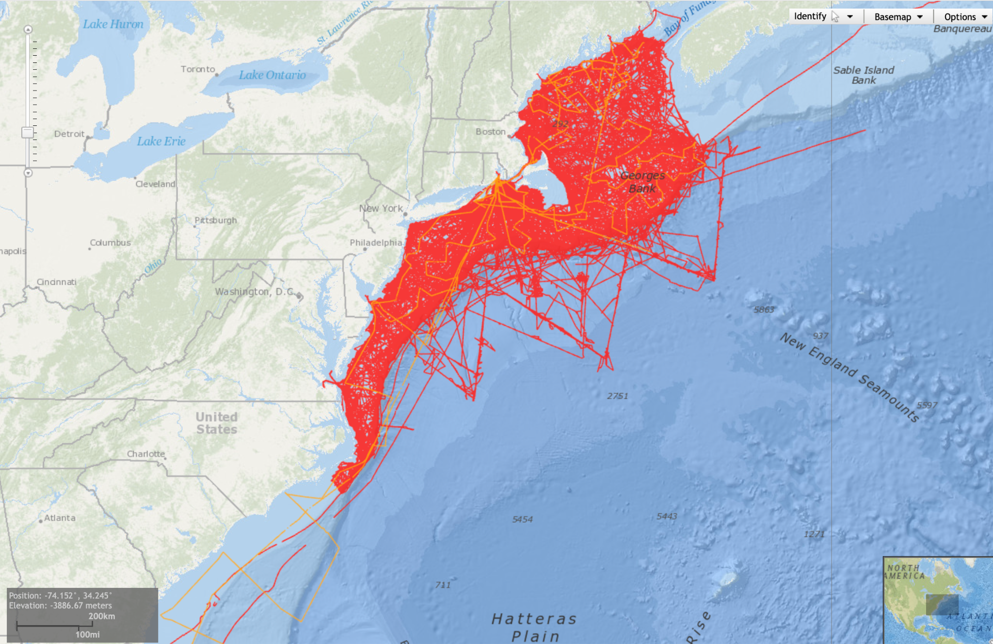
Successes
Have converted all EK60 data in our archive to Level 1 data
Have converted 52 of 54 EK60 cruises for the Henry Bigelow to Level 2 data
Created GeoJSON linestrings for all EK60 cruises → Consolidated into PMTiles
Prompted others to onboard into OSPool, Chris Slater → NOAA, World Ocean Database
https://www.ncei.noaa.gov/products/world-ocean-database
Notes:
Esri & oracle map viewer
Northwest atlantic

Slide 14
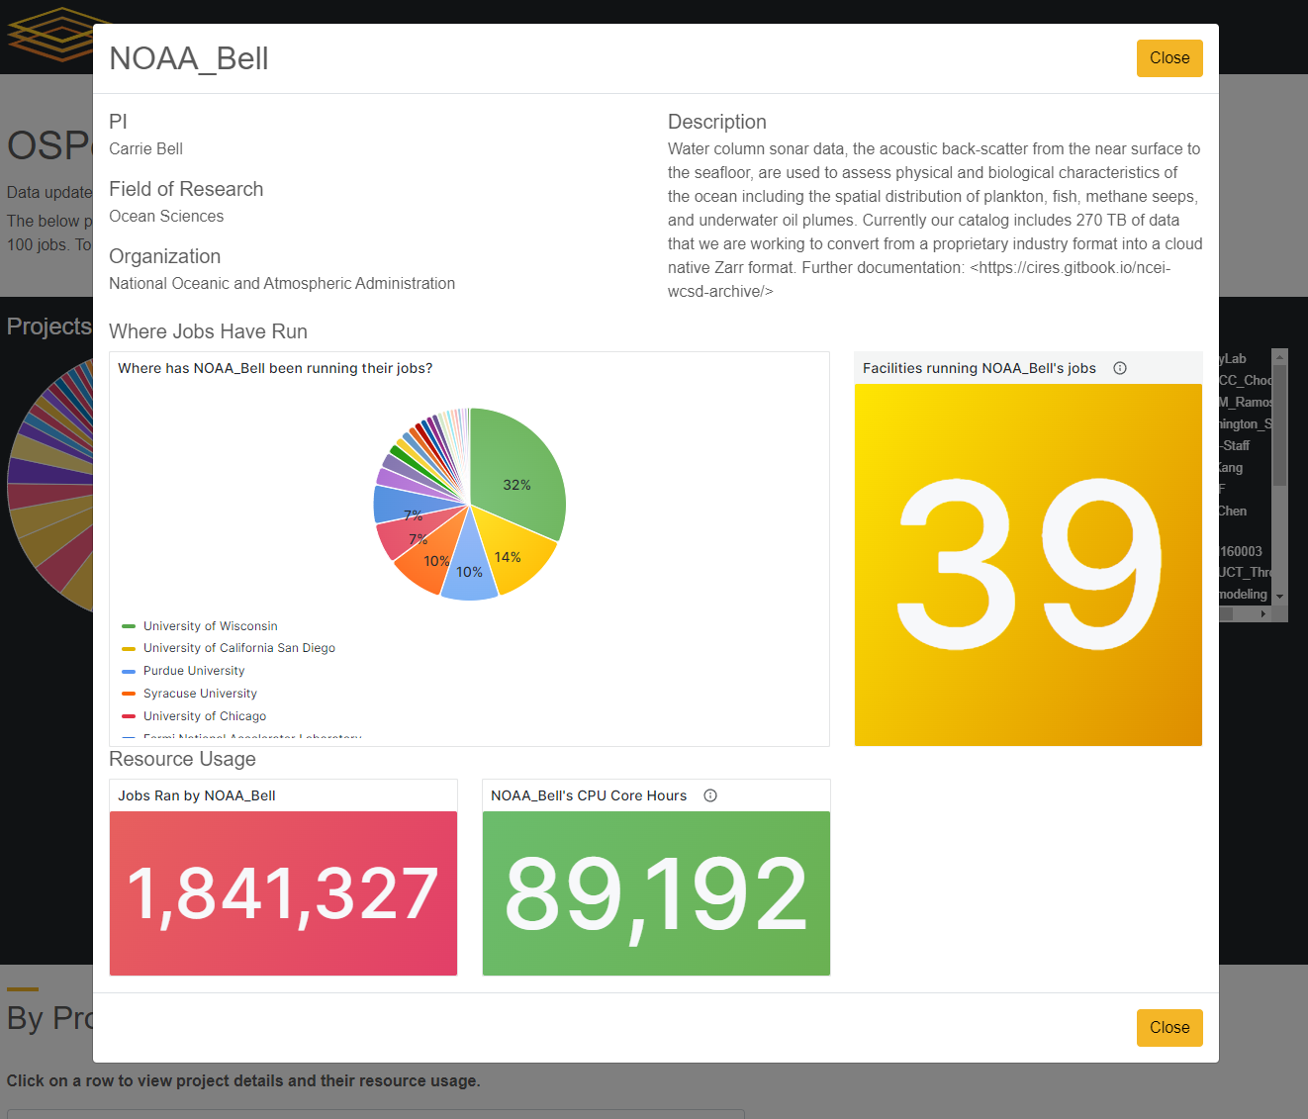
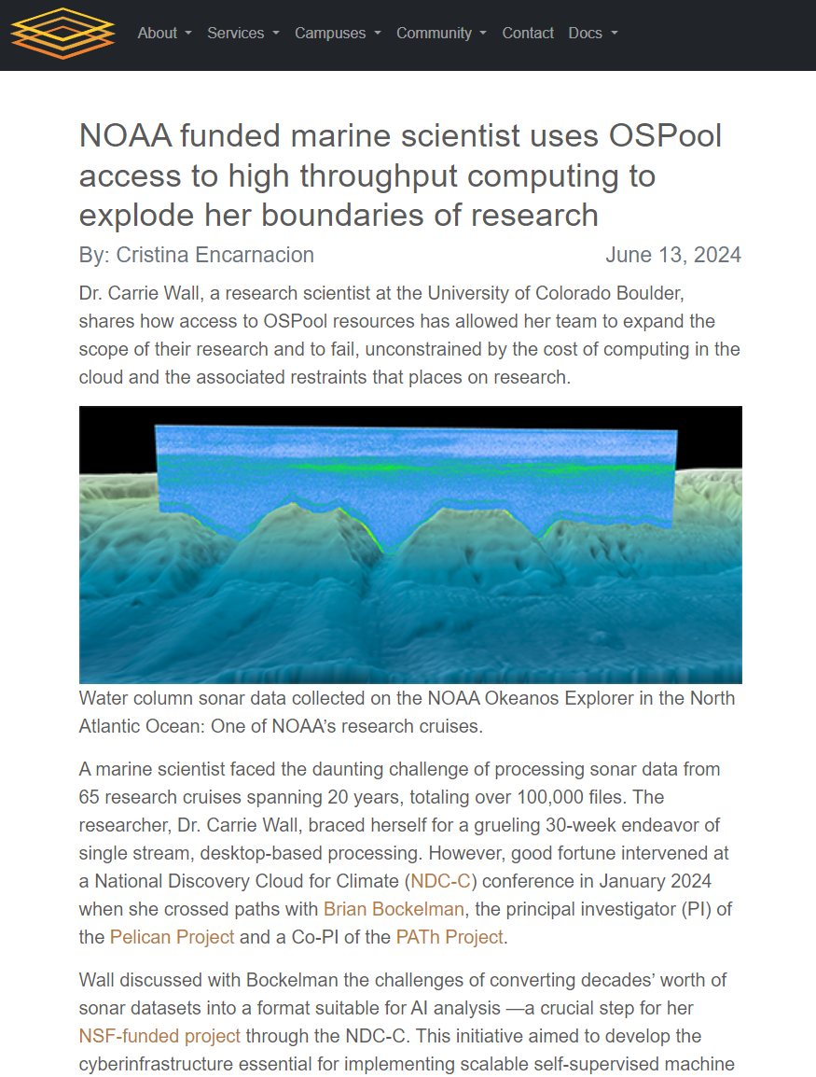
https://osg-htc.org/projects.html?project=NOAA_Bell
https://osg-htc.org/spotlights/noaa-on-the-ospool.html
Notes:
https://osg-htc.org/projects.html?project=NOAA_Bell

Slide 15
Next Steps:
DAGMAN → orchestrating multiple stages of a pipeline (similar to AWS Step Functions)
Parallel Zarr writes → process synchronizer & shared file system requirement
Thank you, Questions…
Rudy Klucik
rudy.klucik@noaa.gov
CIRES, University of Colorado Boulder and NOAA National Centers for Environmental Information

Slide 16
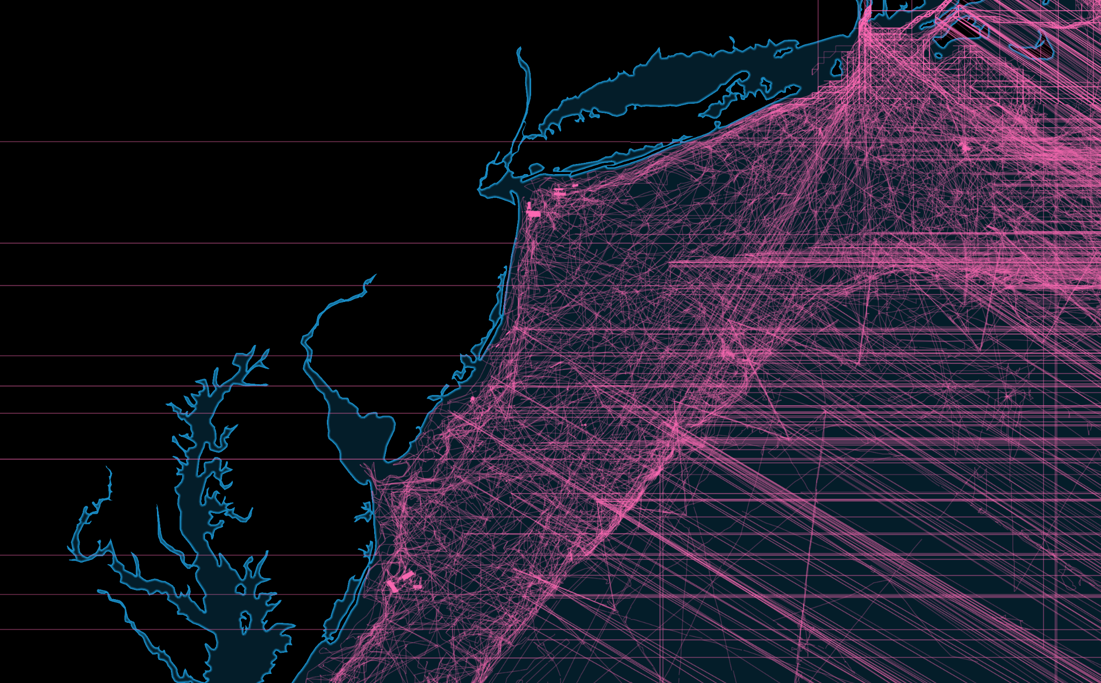
Additional:
PMTiles

