Slide 1

NSF Campus Cyberinfrastructure Program (CC*) and OSPool/OSDF
HTC’24
Kevin Thompson
Program Director, kthompso@nsf.gov
Office of Advanced Cyberinfrastructure
Computer & Information Science & Engineering
July 9, 2024

Slide 2
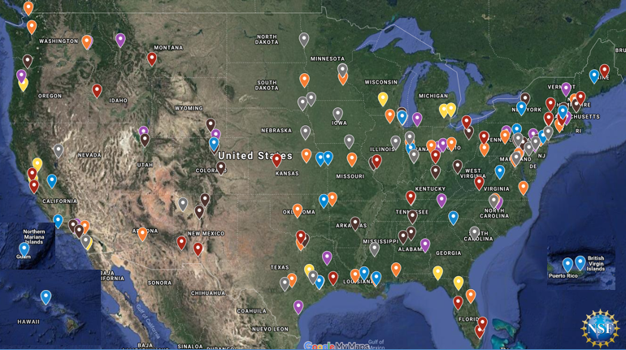
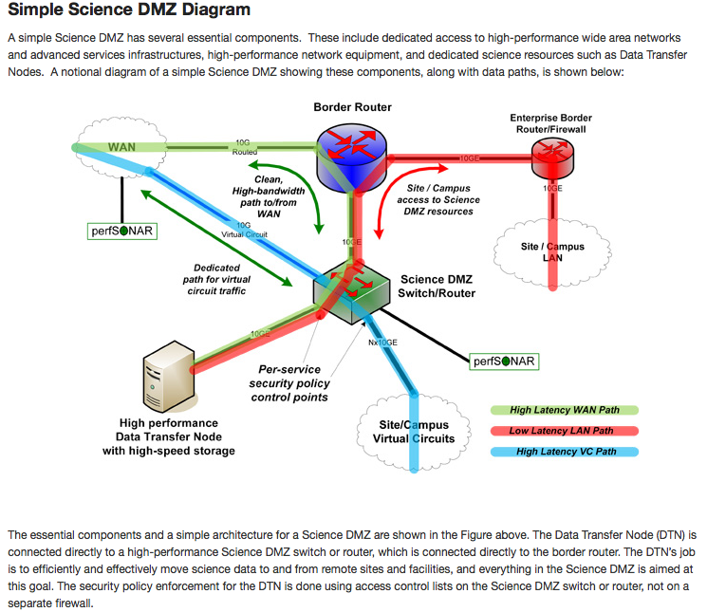
The Campus Cyberinfrastructure (CC*) Program
Networking as a fundamental layer and underpinning of Cyberinfrastructure, driven by scientific R&E needs
Most awards go to 10/100+ Gbps Campus networking upgrades, external connectivity to the national R&E fabric, and campus border redesign prioritizing science traffic.
>500 awards totaling >$100M have been made across 50 states and jurisdictions in CC* since 2012
CC* emphasizes strong campus level partnerships between researchers/teachers and campus IT leadership

Slide 3
Campus Cyberinfrastructure (CC*)
Must be science driven
Must have a campus Cyberinfrastructure Plan (except Strategy awards)
Seek to create partnerships – researchers, educators, IT organization
Networking & Cybersecurity
Area 1: Data Driven Networking Infrastructure
Campus up to $700K
Region up to $1.4M
Technical solution; network management plan and diagram; leverage community
Area 2: Computing and the Computing Continuum
Campus up to $700K
Region up to $1.4M
Multiple science drivers and needs; architecture; 20% is shared, typically through PATh
Area 3: Network Integration and Applied Innovation
Small up to $500K
Large up to $1M
Networking R&D applied to the campus network with graduate student involvement
Area 4: Data Storage and Digital Archives
Campus up to $700K
Region up to $1.4M
Multiple science drivers and needs; architecture; 20% is shared, typically through OSDF
Area 5: Strategy
Campus up to $100K
Region up to $200K
A grant to help teams plan for a full proposal!
No CI plan; Funds community building activities; No hardware
Proposals for the Campus must address campus-wide needs, not a single research project.
Proposals for the Region must address needs of multiple small or under resourced institutions. These can be led by a regional research lead organization.
$15-$20M in FY24 in expected funding
See NSF 24-530 for details. Next deadline: October 15, 2024.
Program Officers: Amy Apon, awapon@nsf.gov and Kevin Thompson, kthompso@nsf.gov

Slide 4
CC* Area#2 - Computing and the Computing Continuum for the Campus or Region
Campus awards up to $700,000 total for up to 2 years
NSF encourages campus-level proposals in this program area from under-resourced institutions and strong preference will be given to proposals demonstrating a compelling need for access to campus and distributed computing resources.
Campus proposals may request funding for the acquisition of a shared, high-performance network-connected compute resource available to scientific computing users on campus and outside of campus.
The program area promotes a coordinated approach incentivizing multi-campus and national resource sharing as enabled by the OSG Consortium, an NSF-supported fabric of distributed scientific computing services that federate computing capacity across more than 150 institutions that delivered 2.6 billion CPU hours of scientific computing in calendar year 2023.
Current and previous awardees in Campus area within the last 5 years are not eligible to apply to this area.
See solicitation for further guidance.

Slide 5
CC* Area#2 - Computing and the Computing Continuum for the Campus or Region
Region awards up to $1,400,000 total for up to 2 years
Proposals for the Region in this area include all of the guidance and requirements of campus-level proposals and expand the impact and usage of the compute resource on multiple small and under-resourced campuses identified in the proposal. Proposals for the Region:
  promote coordinated approaches in scientific computing resources serving scientific computing needs spanning a state's or region's small and under resourced institutions.
  are led by regional and state research and education leadership organizations.
  may request funding for the acquisition of a shared, high-performance network-connected compute resource available to scientific computing users across a defined set of campuses.
  are required to address computing needs spanning multiple under-resourced institutions. A proposal focusing on a single campus but submitted as a proposal for the Region will be returned without review.
  fund computing resources primarily used by the targeted small and under resourced institutions.

Slide 6
More on Area#2 – 20% Sharing
All Area (2) proposals should commit to a minimum of 20% shared time and describe their approach to making the computing resource available as a shared resource external to the state/region and the institution(s) being primarily served. Proposals are strongly encouraged to address this requirement by joining the Partnerships to Advance Throughput Computing (PATh) campus federation ( https://path-cc.io) and adopting an appropriate subset of PATh services to make the resource available to researchers on a national scale. Proposals are encouraged to include a letter of collaboration from the selected platform and describe how they will track and report on meeting the 20% extramural usage goal each year. Institutions in need of technical direction/expertise during their proposal development are encouraged to engage the NSF-funded PATh project at: https://path-cc.io.

Slide 7
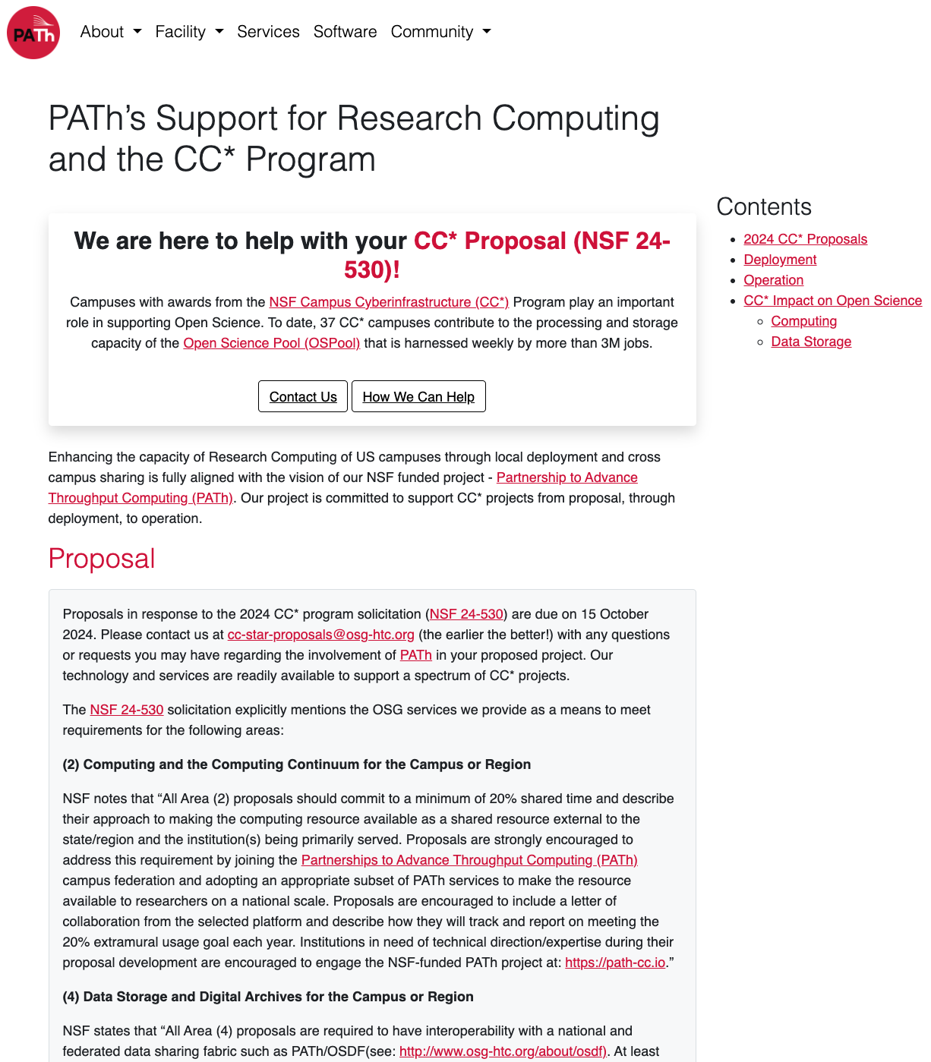
Path-cc.io/services/research-computing

Slide 8
Sharing capacity with OSG services
The fabric of distributed computing services provided by the OSG enables campuses to share their computing capacity with the national S&E community via the Open Science Pool (OSPool)
  Any researcher affiliated with a US research institution can harness the OSPool capacity via Access Points provided by the PATh NSF Project
  Any US institution can contribute capacity to the OSPool
  OSG services enable science collaborations and campuses to build and operate private distributed computing environments across >130 sites that deliver over 2B core hours annually

Slide 9
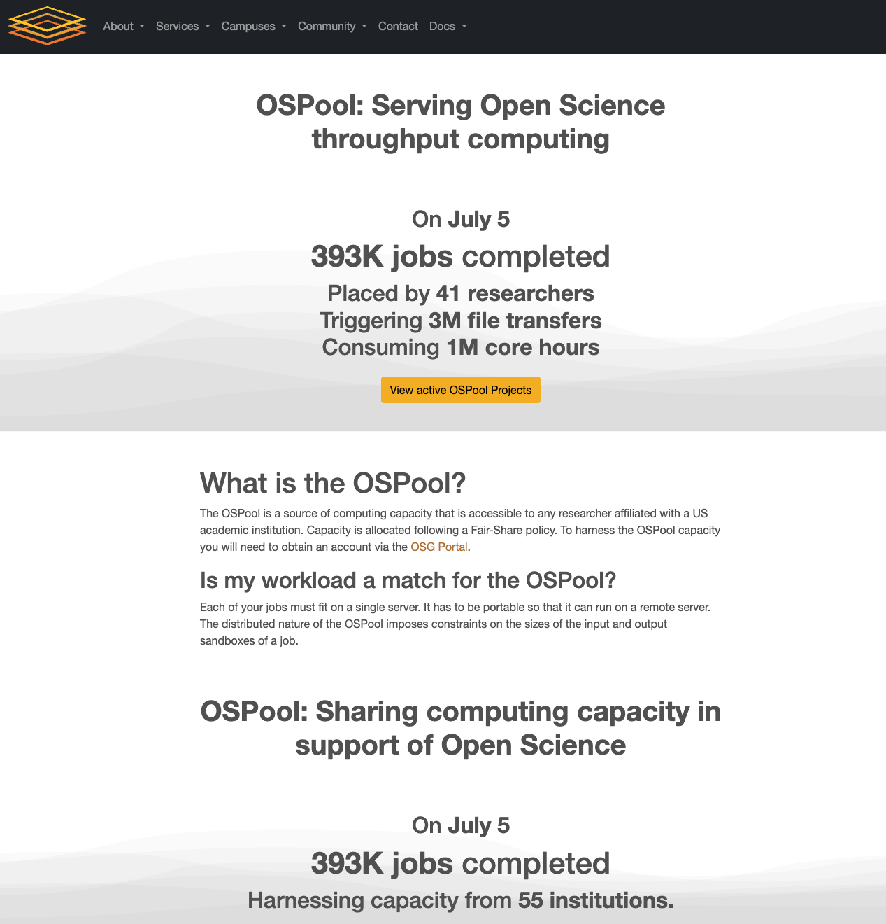
OSPool on July 5
(osg-htc.org/services/open_science_pool.html)

Slide 10
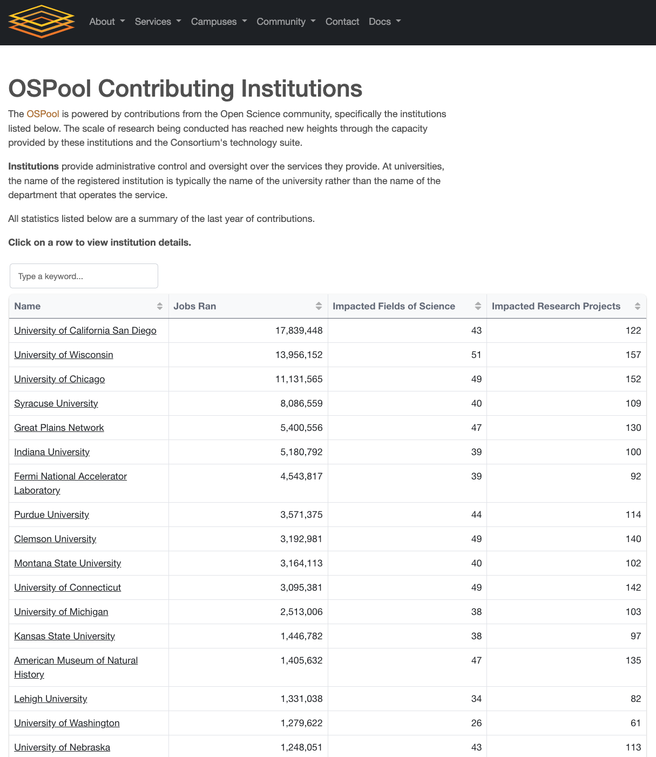
Who Contributes?
(https://osg-htc.org/services/open_science_pool/institutions)

Slide 11
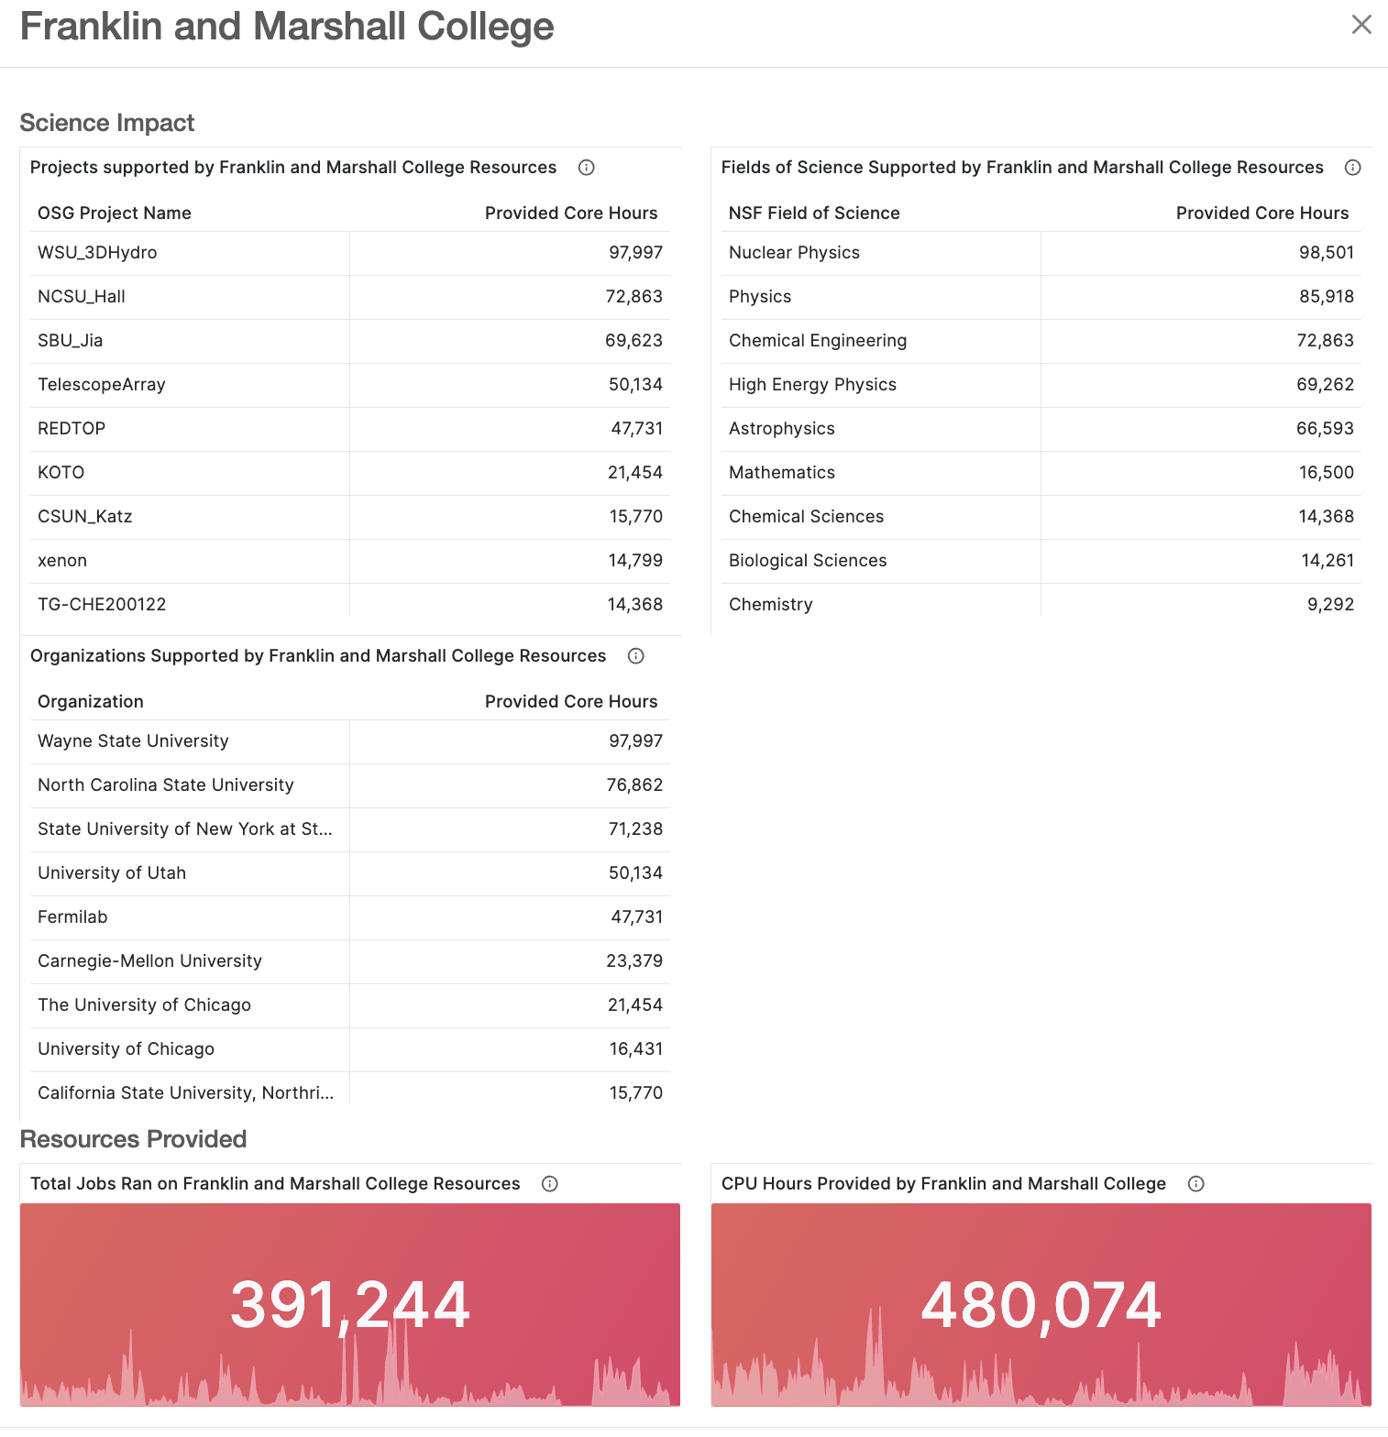
Institution drill down example

Slide 12
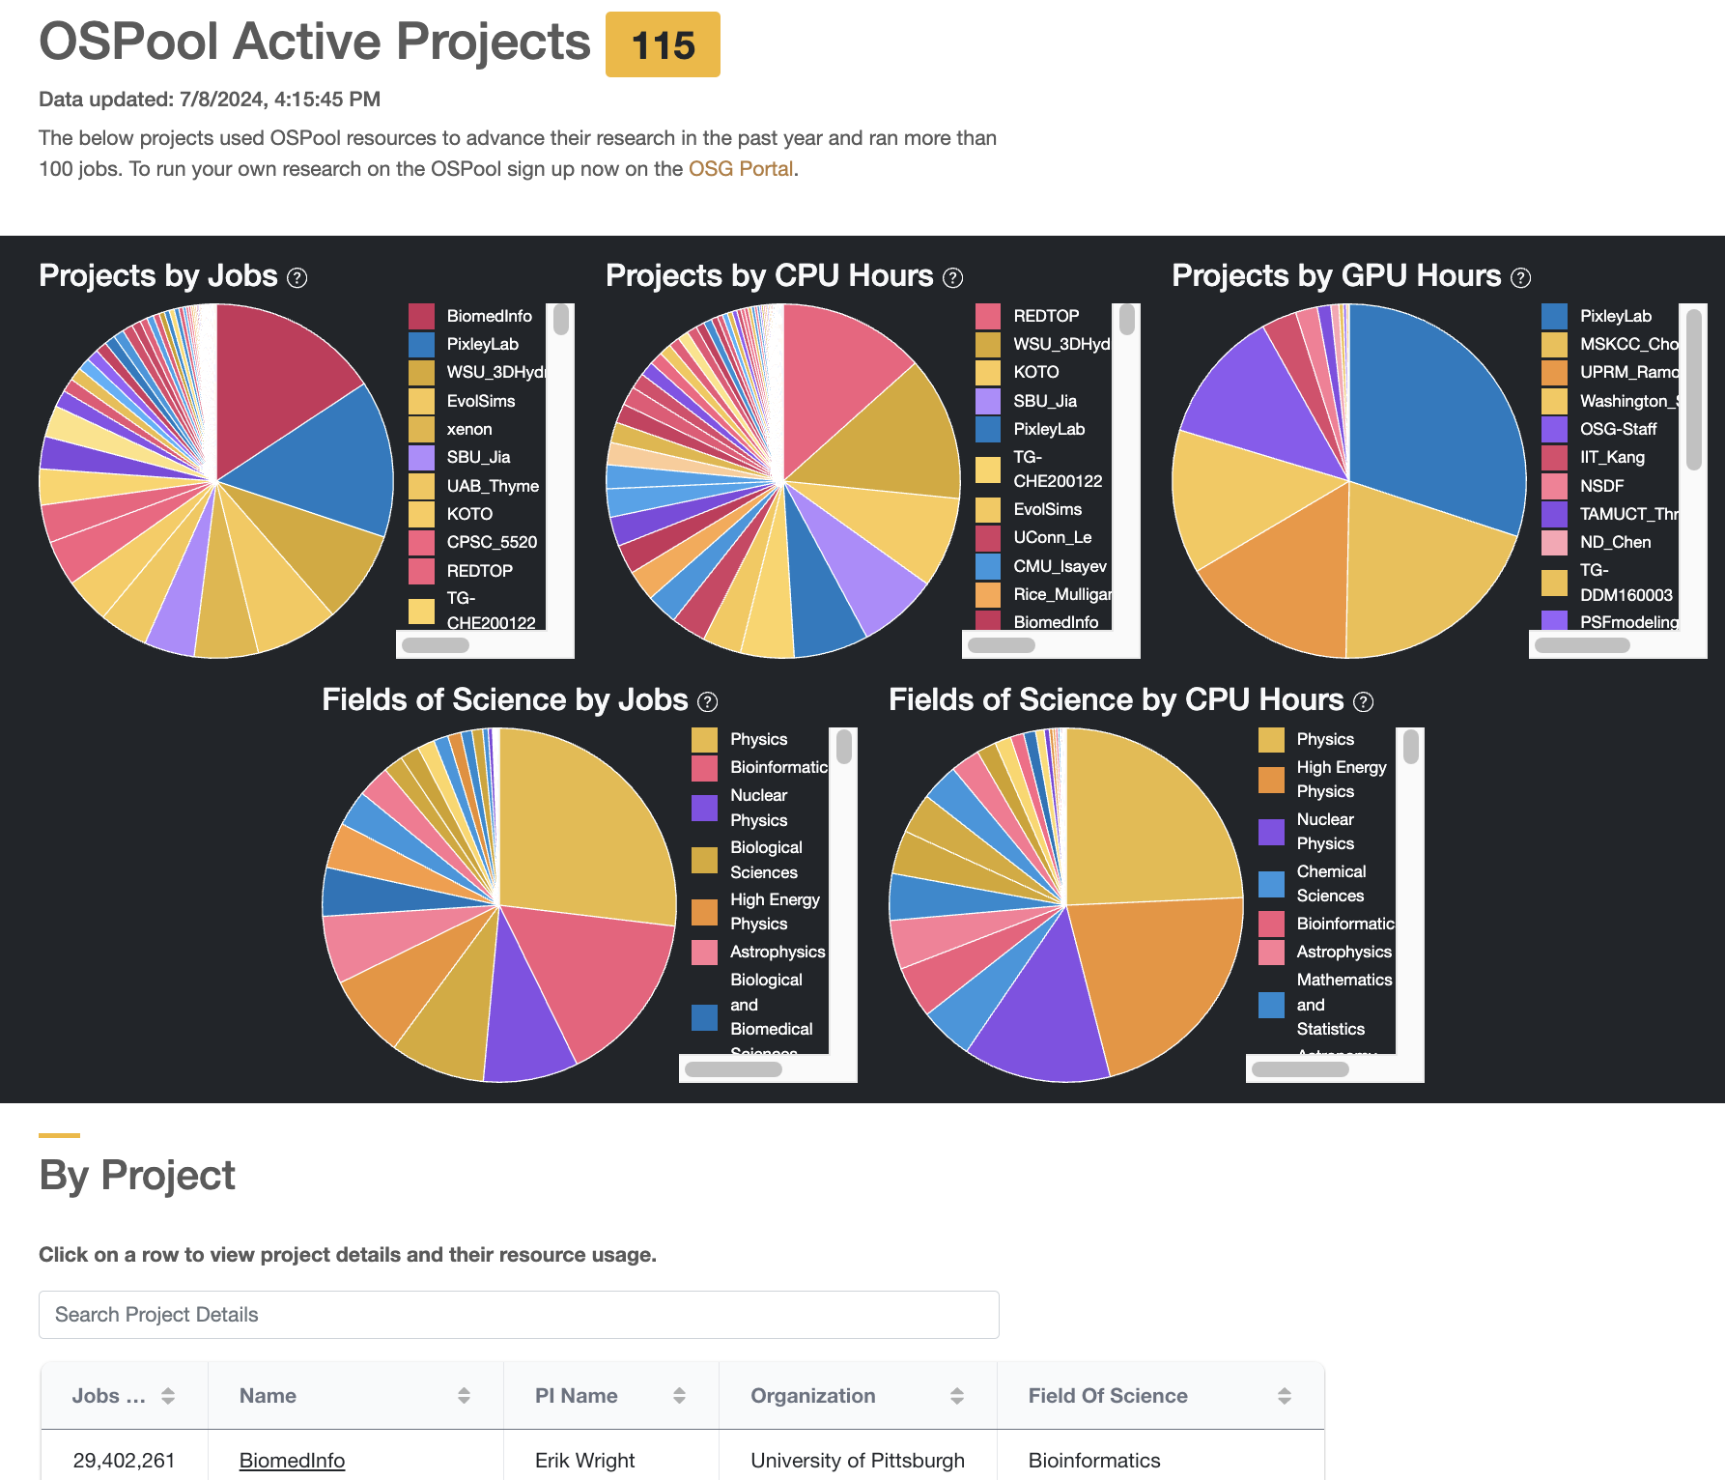
OSPool Active Projects

Slide 13
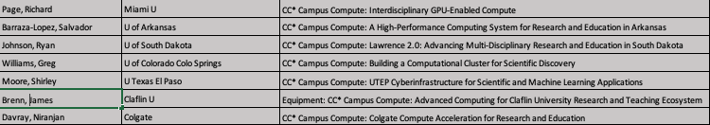
Most Recent Set of Awards in CC* Campus and Regional Computing from 23-526
(Total active awards: ~20 campus, ~10 regional)

Slide 14
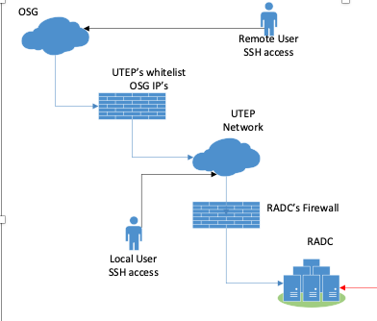
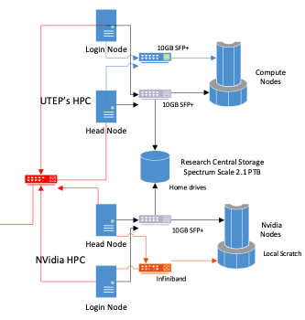
CC* Campus Compute: UTEP Cyberinfrastructure for Scientific and Machine Learning Applications |  | Shirley Moore (PI), Deepak Tosh (Co-PI), Paras Mandal (Co-PI) University of Texas at El Paso NSF Award #: 234717 Start date: April 1, 2024 End date (estimated): March 31, 2026
 | Technical Approach Integrate new NVIDIA H100 DGX and HGX systems with existing campus HPC cluster Share GPU resources with the broader academic research community through participation in the Open Science Grid Implement sharing using SLURM and NVIDIA multi-instance GPU (MIG) Collaborate with UTEP Information Resources and CSTECH to provide application onboarding, tutorials, account management, and user support and to assess progress towards project goals Advisory Committee consisting of representatives from science drivers, colleges of science and engineering, and students
Project Goals Provide researchers in computational science and engineering fields with access to state-of-the-art GPU-accelerated hardware and software resources for scientific simulation and machine learning Meet the requirements of science drivers that address important societal and national problems in the areas of renewable energy, advanced manufacturing, advanced materials, electric power systems, cybersecurity, and quantum computing Increase use of HPC and skills in using state-of-the-art HPC technologies across scientific disciplines Equip students with skills and experience needed for future careers in HPC and large-scale machine learning | Project Tasks Year 1 Order/install/test equipment Documentation and tutorials Launch project/onboard science drivers/education users Install/test perfSONAR servers Connect UTEP cluster with OSG Evaluate project launch and progress towards project goals Analyze network monitoring/perfSONAR data |  | Project Tasks Year 2 Update software stack and network configuration based on data analysis Revise documentation and tutorials Participate in OSG All-hands meeting Conduct quarterly surveys of NVIDIA cluster users Collect data/write final report
UTEP HPC+NVIDIA Cluster Design

Slide 15
CC* Area#4 – Data Storage and Digital Archives for the Campus or Region
Campus Award size up to $700,000 total for up to 2 years.
This program area promotes coordinated approaches in scientific storage, data management, and digital archives and incentivizes multi-campus and national resource sharing. Awards in this area reflect NSF principles and guidance in the community's stewardship of data from NSF funded research, and particularly aim at supporting the data lifecycle. As described below for the Data Management Plan, proposals should adhere to the findable, accessible, interoperable, and reusable (FAIR) principles and guidance from NSF described in the Dear Colleague Letter (DCL) on Effective Practices for Data: https://www.nsf.gov/publications/pub_summ.jsp?ods_key=nsf19069.
Storage proposals for the Campus address campus-wide storage needs in the proposal. A proposal focusing on a single science domain or project use will not be considered for funding.
New this year: Storage proposals for the Region (up to $1.4M) adopt all the requirements and guidance of a campus storage proposal and target the research and education data needs spanning multiple small and under-resourced institutions in a region.

Slide 16
Sharing Storage Requirement in Area#4
All Area (4) proposals are required to have interoperability with a national and federated data sharing fabric such as PATh/OSDF (see: http://www.opensciencegrid.org/about/osdf). At least 20% of the disk/storage space on the proposed storage system should be made available as part of the chosen federated data sharing fabric. Proposals should describe the interaction with data sharing fabric beyond simply naming it.

Slide 17
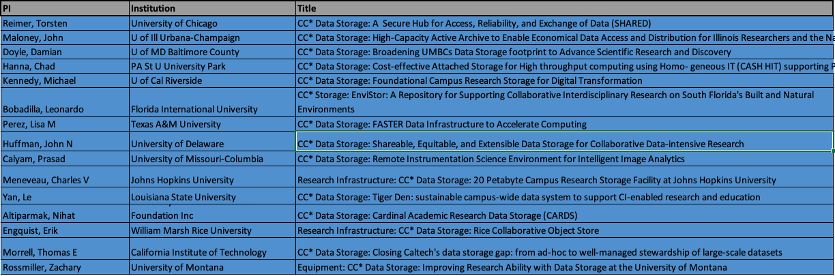
Recent CC* Data Storage Awards from 23-526
(~18 total active campus storage awards)

Slide 18



CC* Storage: EnviStor: A Repository for Supporting Collaborative Interdisciplinary Research on South Florida’s Built and Natural Environments (award # 2322308)
Leonardo Bobadilla, Mike Kirgan, Julio Ibarra, Jason Liu, Jayantha Obeysekera
Goals
Intellectual Merit
The goal is to build “EnviStor: A Repository for Supporting Collaborative Interdisciplinary Research on South Florida’s Built and Natural Environments.” which will provide a robust database management system (DBMS) with efficient integration essential for interdisciplinary modeling.
EnviStor will be transformative in facilitating multidisciplinary research by significantly reducing constraints when generating copious amounts from research built and natural environments. It will facilitate inter and intra-campus capabilities augmenting the current FIU storage capabilities from the Terabyte to the Petabyte scale.
The design and implementation will follow the FAIR principles to maximize reusability and interoperability. Our system will provide an unprecedented benefit to the research community in the region as a clearing house for environmental and engineering data products, with interoperability features that will help fundamental research and multidisciplinary research.
The system will receive data streams from various research activities including data from sensors, satellites, simulations, and high-resolution scientific instruments
Broader Impacts
Approach
High-impact applications: Scientific advances in this project will enable cost-effective data storage and sharing for many important applications, including the assessment of reef ecosystem health, rising sea levels and flooding monitoring and modeling, harmful algae blooms, water contamination, and wildlife habit loss.
Research Involvement from Underrepresented Groups:.EnviStor will provide opportunity for students at FIU (75% of them coming from underrepresented groups in STEM) to enhance their knowledge of database management and focus on interoperability
Encouraging Inter and Trans-disciplinary research: Envistor will encourage researchers to use a centralized and secure location to store and share their data across. This will promote interoperability, convergence and accelerate innovation disciplines.
EnviStor architecture will add a new high-capacity Petabyte-scale Lustre storage system to FIU’s storage environment. The Lustre file system provides low-latency, high-performance, and cost-effective architecture for computational resources that can scale to PBs of data.

Slide 19
CC* Futures
NSF CISE/OAC is likely to issue another CC* solicitation in FY25
  TBD on 1 or 2 deadlines
  Computing and Storage areas are popular…
  CC* remains committed to campus level resource sharing
NSF always welcomes community feedback on its programs and solicitations

Slide 20
Thanks!

