Slide 1
Processing Historic Wisconsin Aerial Photography with High Throughput Computing Resources
Throughput Computing 2024
Jim Lacy State Cartographer’s Office ~ Department of Geography ~ University of Wisconsin-Madison

Slide 2
We Have a Data Problem
~100,000 images to convert to Cloud Optimized GeoTIFF (“COG”) format for Web apps and public distribution
Roughly 15TB
This could easily take an estimated 1.0 to 1.5+ months of processing time running on a local PC using our typical methods
Is there a better way???

Slide 3
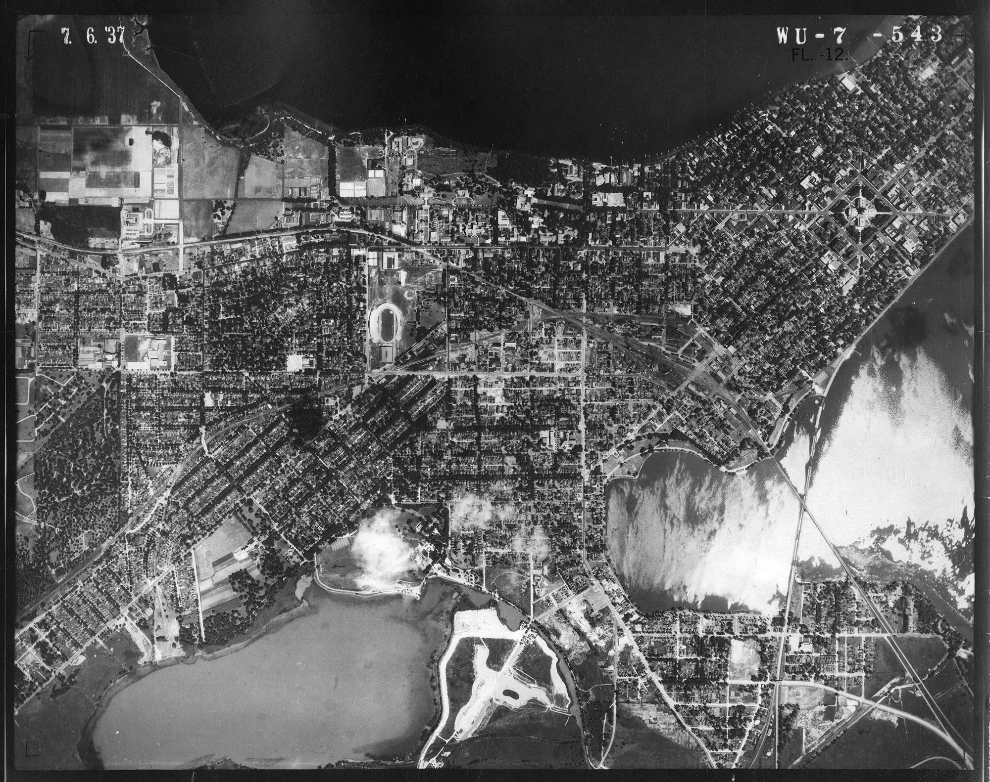
Some Context

Slide 4
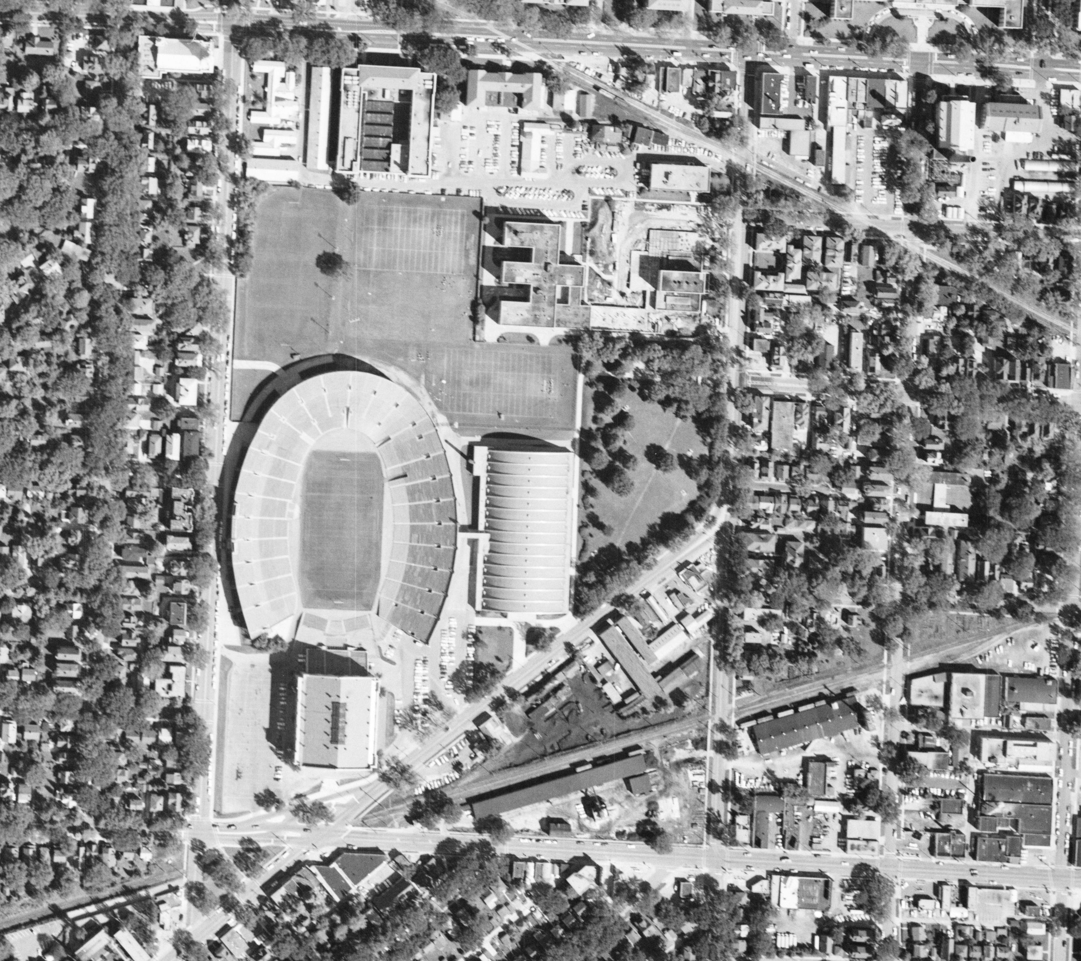

Slide 5
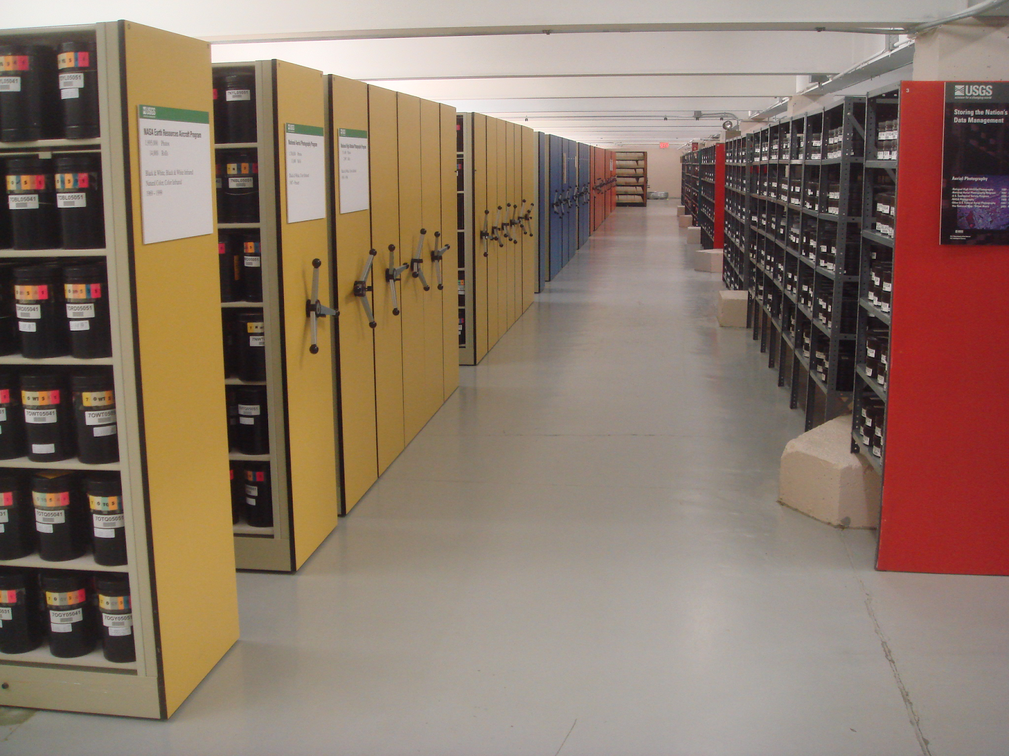

Slide 6
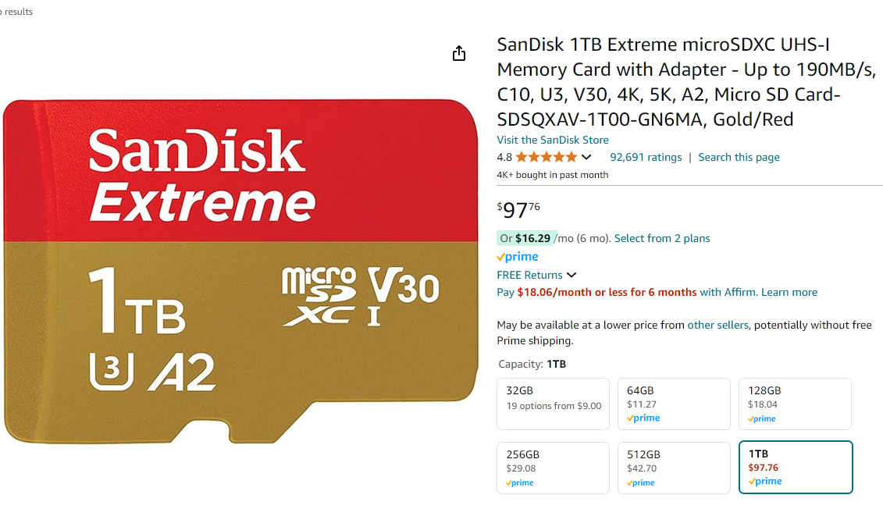
Falling Storage Costs Makes This Work Possible!
Notes:
This is insane if you’ve been around for awhile!

Slide 7
Hmmm… What Are My Typical “Serial” Options?
Batch processing in GIS software
Python script(s)
GDAL command line inside batch script(s)
Notes:
GIS = Geographic Information System
GDAL = an open source data processing package/library

Slide 8
Case Study: Dane County, WI
88 input files
41.2 GB
4-band GeoTIFFs with 0.60m spatial resolution
Convert to COG and generate jpegs on local PC = 93 minutes
Total output data = 59.4 GB
Honestly not bad for a single county!
But… it would take an estimated 79 hours to process 4,483 files for the statewide dataset

Slide 9
Enter: UW Center for High Throughput Computing
Multi-disciplinary center with home in UW Computer Science
Somewhere around 20,000 compute cores available
Free (to UW fac/staff/students… big thank you to VCRGE/CS/WARF!)
Lots of help docs, workshop, dedicated staff available to assist
Copious amounts of (temporary) disk space if you act responsibly and clean up after yourself

Slide 10
Let’s Try This in Parallel
Local PC Model = Sequentially loop through 4,483 files… process, then repeat
CHTC Model = process 4,483 files in PARALLEL… all input images are processed at the same time(ish)*
* The number of jobs you can run at a given moment depends upon other users on system and what you request for resources (CPU, disk, memory.) During tests, I observed up to 500 of my files processing at the same time.

Slide 11
Case Study Revisited: Dane County, WI
Local PC = 93 minutes
The CHTC Way = 5 minutes!

Slide 12
Let’s Scale Up to Wisconsin
Data transfer to CHTC = 9.25 hours*
Data processing = 1.5 hours
Data transfer back to Science Hall = 12 hours*
CHTC Total (compute + transfer overhead) = 22.75 hours
Net savings of ~56.25 hours vs local PC processing for this example
* Before I discovered Globus!

Slide 13
But Wait, There’s More!
Challenges and Barriers to Entry

Slide 14
Challenge #1: Data Transfers
How long does it take to get the input files TO the CHTC, and output files BACK to our server?
Attempt #1 (estimate) of statewide data using the standard “scp” transfer method: 3 days there + 4 days back = was this a waste of time?
(Remember: local method was about 3.3 days of processing)

Slide 15
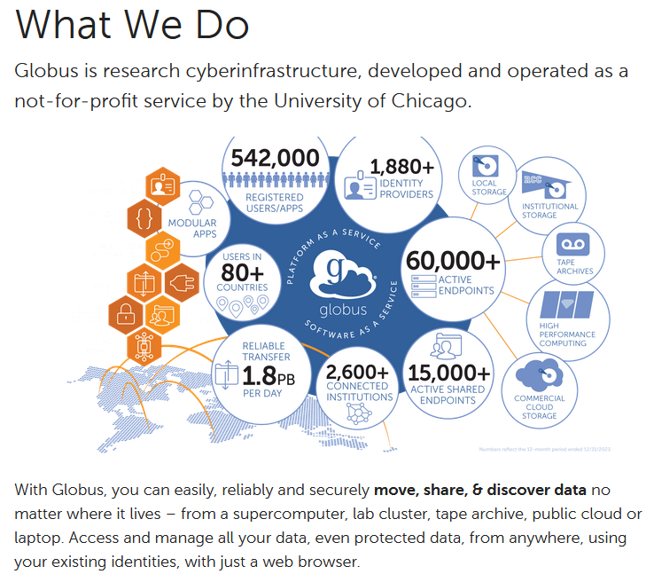
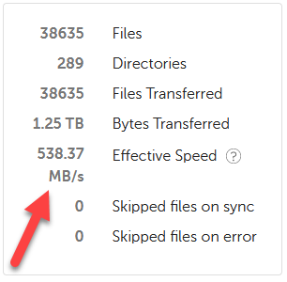
Globus is Your Friend!

Slide 16
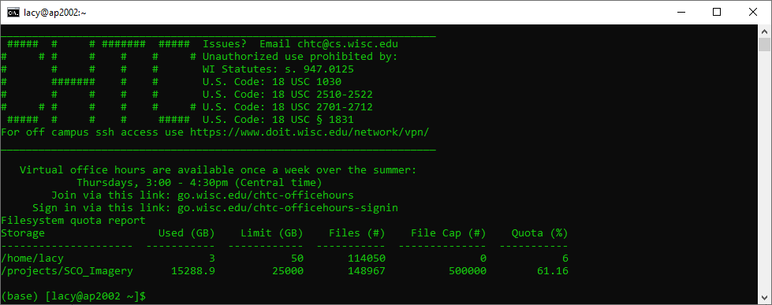
Challenge #2: Command Line Can Be Scary

Slide 17
Challenge #3: Impatience
You need to invest time to save time
Requires knowledge of Unix, shell scripts, command line principles… all things I already knew
Required about 16 hours of learning/experimenting/reaching out for help
Start small, test, scale up from there

Slide 18
Mitigating the Challenges…
Smart people dedicated to helping users like me
Gentle conceptual introductions to command line and batch processing in general
“Cookbooks” with lots of examples
Work to create connections in the user community … help them learn from each other

Slide 19
Kudos… it takes a team!
UW-Madison Center for High Throughput Computing (CHTC)
CHTC Facilitators (Christina K., Rachel L., Andrew O.)
UW-Madison Geography Project Team (Jaime M., Hayden E.)
UW-Madison Division of Information Technology Storage Team (Kevin K., Phillip D., Mark K.)
UW-Madison Research Data Services (Michael L.)
Morgridge Institute (Justin H., Brian B.)

