Slide 1
Modeling cellular morphology using machine learning
Advancing Biology through High throughput computing
Juan C. Caicedo Ph.D.
HTC 2024
Madison, WI, July 8 2024

Slide 2
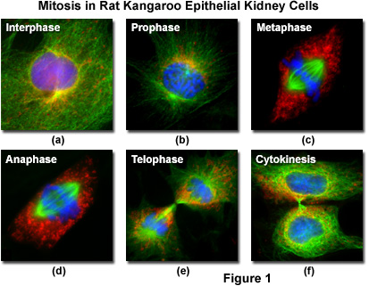
Imaging reveals cellular phenotypic variation
Cell-cycle stages
Compound treatments
Eitaki, M., et al. Vincristine enhances amoeboid-like motility via GEF-H1 / RhoA / ROCK / Myosin light chain signaling in MKN45 cells. BMC Cancer 12, 469 (2012).
https://micro.magnet.fsu.edu/cells/fluorescencemitosis/index.html
Notes:
Imaging has been fundamental for many discoveries.
Using microscopy imaging we can observe the cell cycle stages.
We can also see the response of cells to chemical treatments.
And we can recognize cell types due to their shapes.
Phenotypic variation can be observed in microscopy images.
And the variation that we observe has been shown to be biologically meaningful.

Slide 3
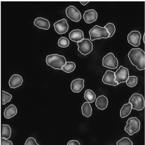
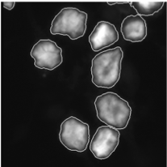
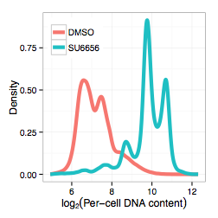
Screen for specific phenotypes using images
Treatment for AMKL (leukemia)
DMSO
SU6656
DNA stain with outlines identifying the nuclei
Clinical trials underway for Alisertib in adults with AMKL.
Wen Q, et al. (2012). Cell 150(3):575-89

Slide 4
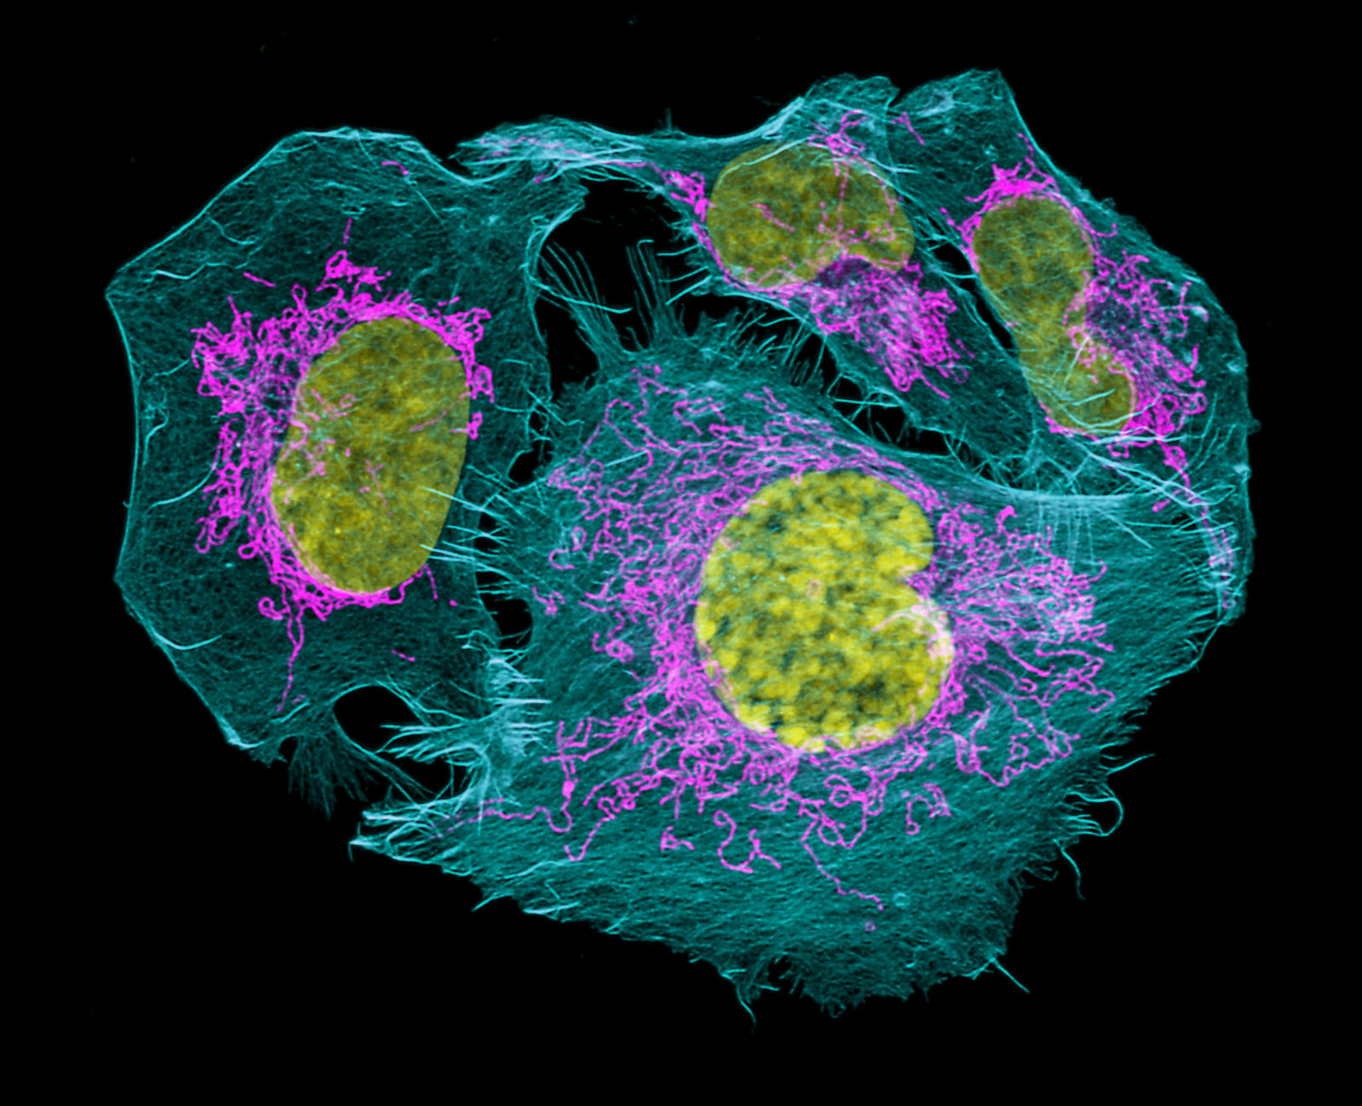
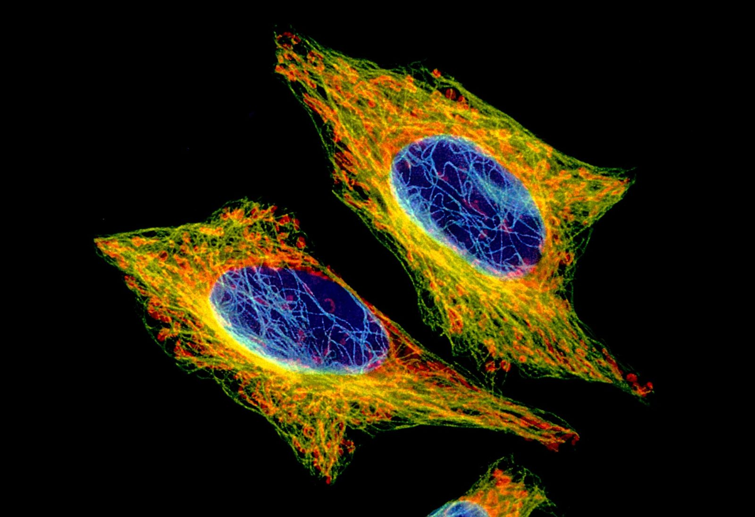
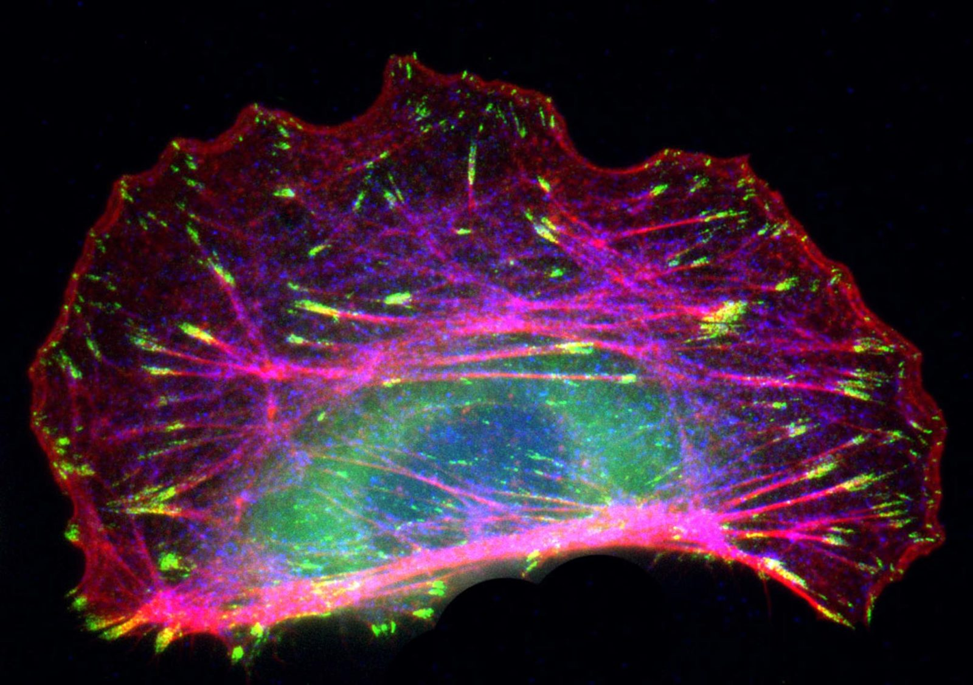
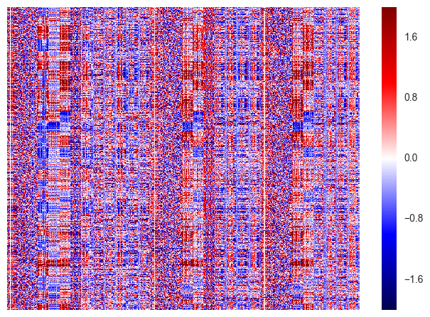
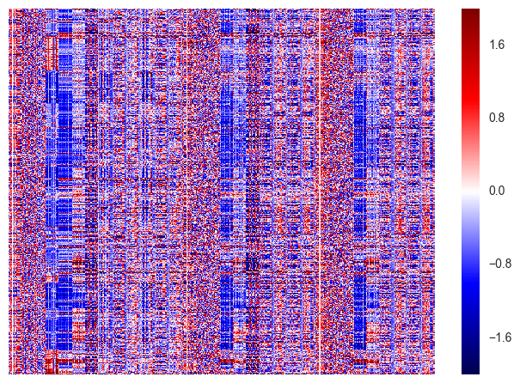
Image-based cell profiling
1. Raw images
2. Segmented images
3. Single-cell feature matrices
4. Population profiles of treatments
Are treatments
significantly different / effective?
5. Downstream statistical analysis
Caicedo, et al. 2017 Nature Methods

Slide 5
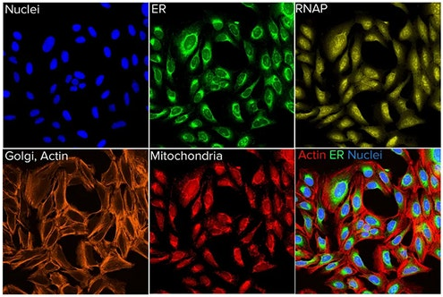
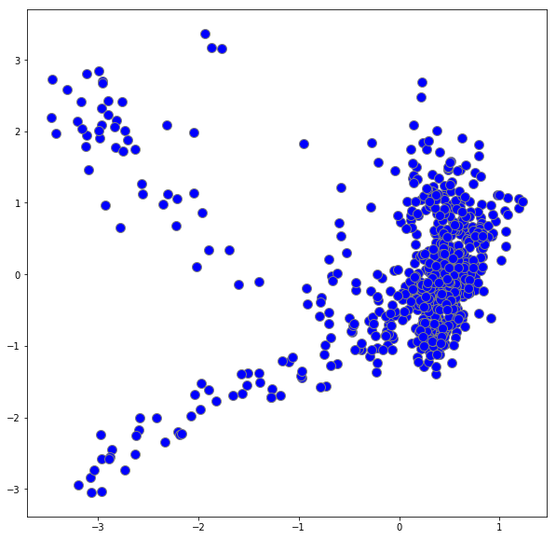
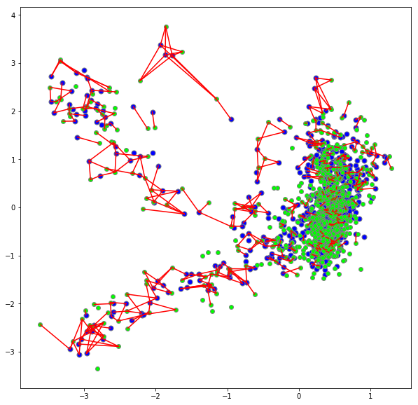
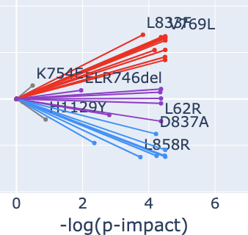
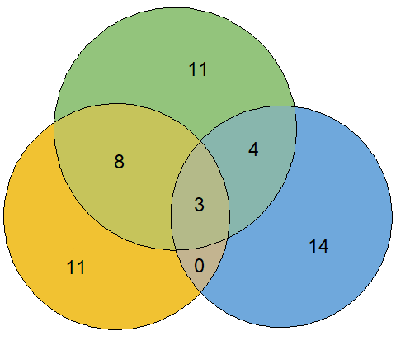
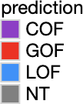
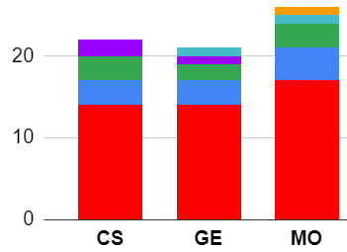
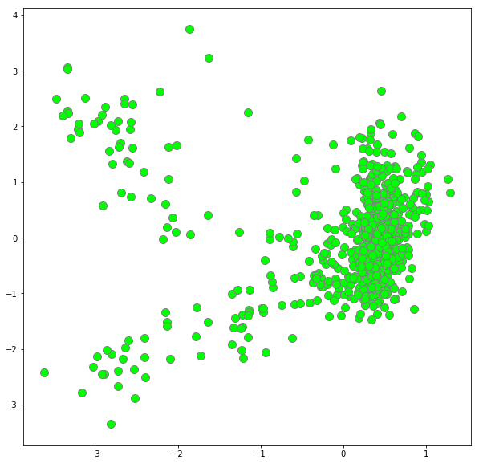
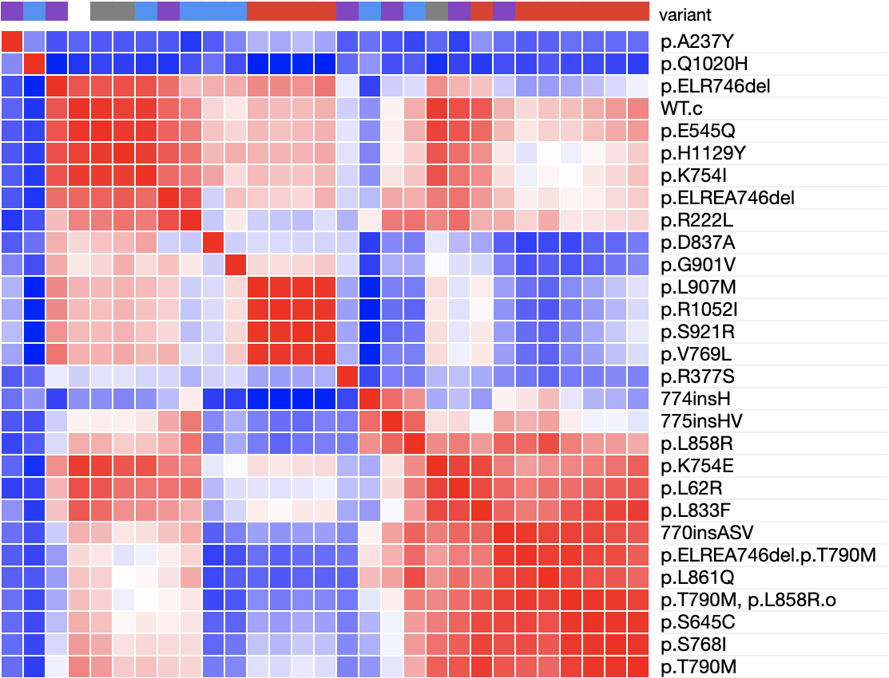
Imaging data informs biomedical research
Drug Discovery
Functional Genomics Research
Control
EGFR Wild Type
EGFR Mutant
CCA space
MO
Worm
11
Parasite
Yeast
KRAS_p.G12V
4
Fungal
Morphology
8
3
GE
Cell-based
CS
Biochemical
Bacterial
0
14
EGFR_p.S645C
1.0
Chemical structures (CS)
0.4
Gene expression (GE)
Gene Expression
Same allele across platforms
Morphology (MO)
-0.2
Notes:
Scale
Why nobody did it before?

Slide 6
Cell segmentation

Slide 7
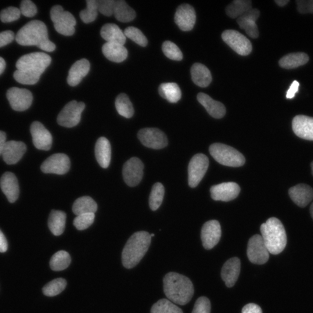
Nucleus segmentation problem
Segmentation
Otsu’s thresholding method
Notes:
The problem of identifying single cells can be formulated as an image segmentation problem, where the goal is to identify regions of the image or groups of pixels that belong to the same object of interest. Single cells can be identified by their nuclei. And here is an example of how to segment an input image to generate the desired output, which is single nuclei identified with a different number or color in this case.
There are several classical algorithms for accomplishing this task, which can be configured and tuned to solve some cell segmentation problems. But in general, these have limitations and cannot produce the desired output correctly all the time. In this case, we see a simple thresholding algorithm failing to separate a few objects of interest correctly. The good news is this can be solved with machine learning algorihtms.

Slide 8
Problem: where are the micronuclei?
Very small compared to nucleus
Low intensity (dim)
Confused with noise
Difficult to detect by eye
Difficult to segment with existing tools
Example input
Manual annotation
Micronucleus
Nucleus

Slide 9
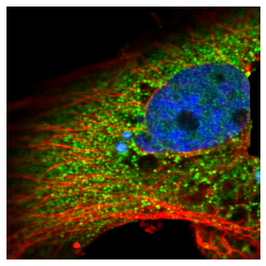
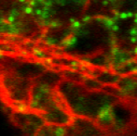
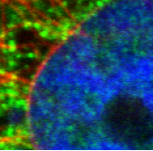
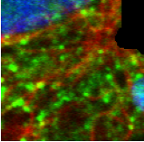
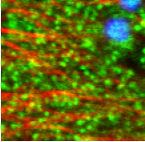
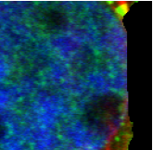
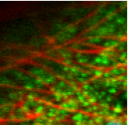
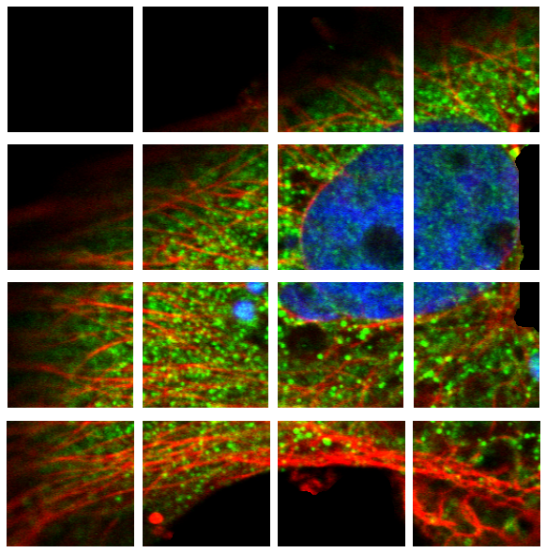
A transformer-based segmentation model
Vision Transformer Network
256x256
Input
Probability map
Output Tokens
Self-attention layers
32x32
64x64
128x128
256x256
Segmentation head
0
1
2
3
4
5
6
7
8
9
Linear projection of patches
Tokenized image
Sequence of patches
32x32

Slide 10
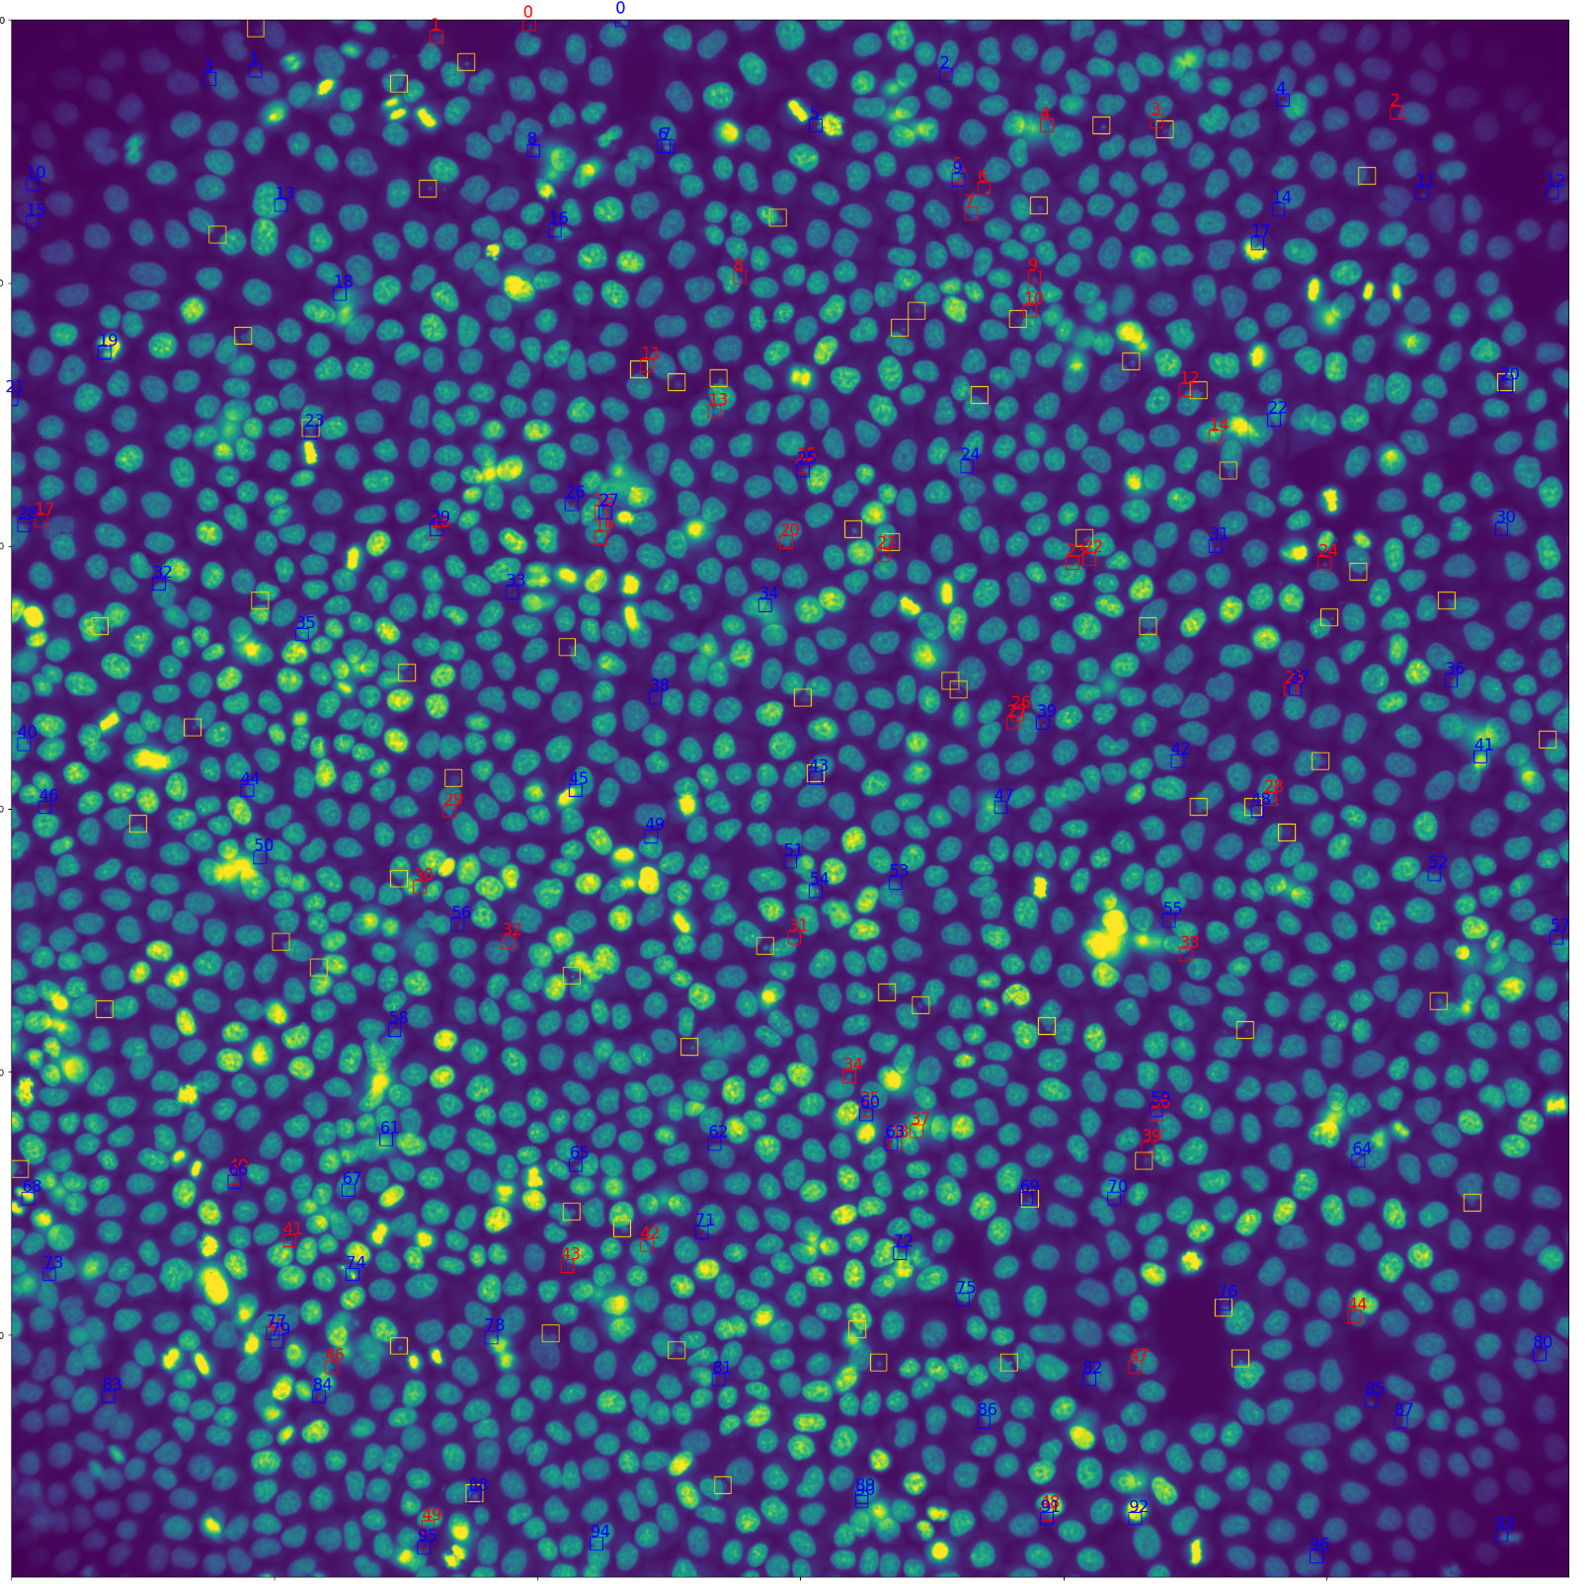
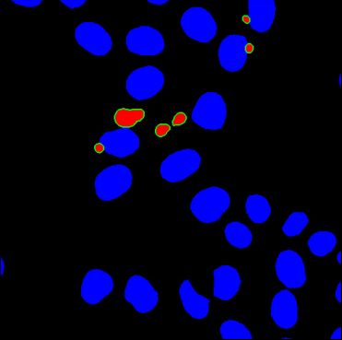
Experimental setup
18 manually annotated images
Image size: 2,960x2,960 pixels
Each image has ~80 objects of interest
Randomly sample crops of 256x256 pixels
Leave-one-out cross validation
Train on 17 images
Evaluate on held-out image
Densely sample all crops of 256x256
Explore hyper-parameters
Architecture
Training settings

Slide 11
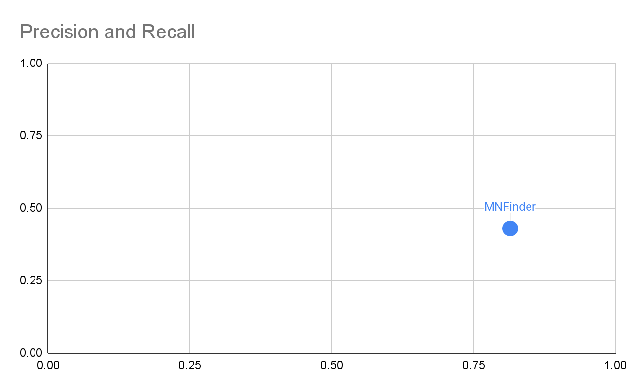
Baseline model
Precision: 0.81465 Recall: 0.42912

Slide 12
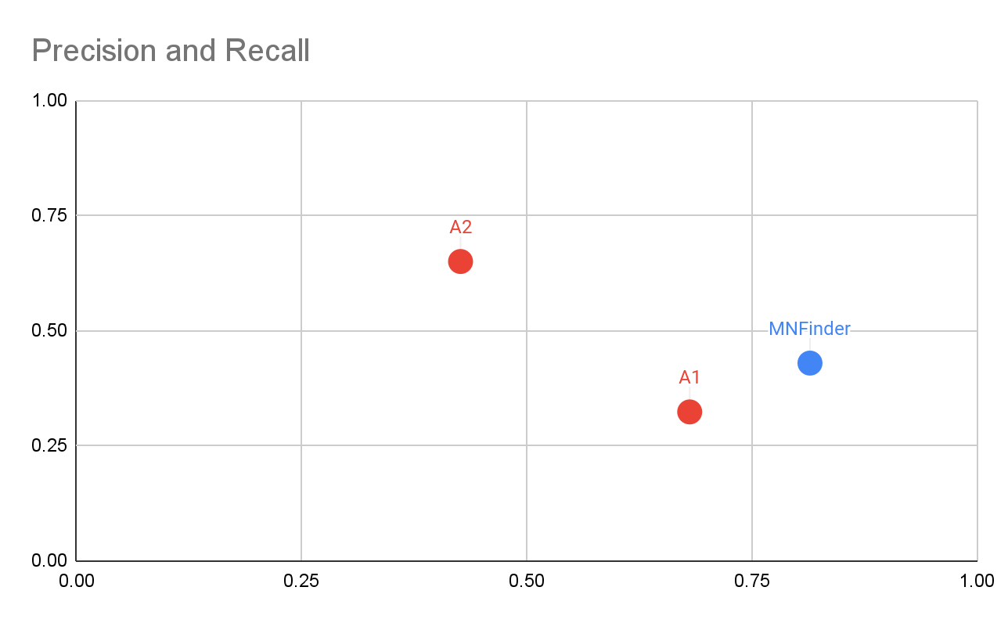
Experiments
Precision: 0.81465 Recall: 0.42912
Precision: 0.68104 Recall: 0.32303
Precision: 0.42653 Recall: 0.64992
A: Frozen backbone

Slide 13
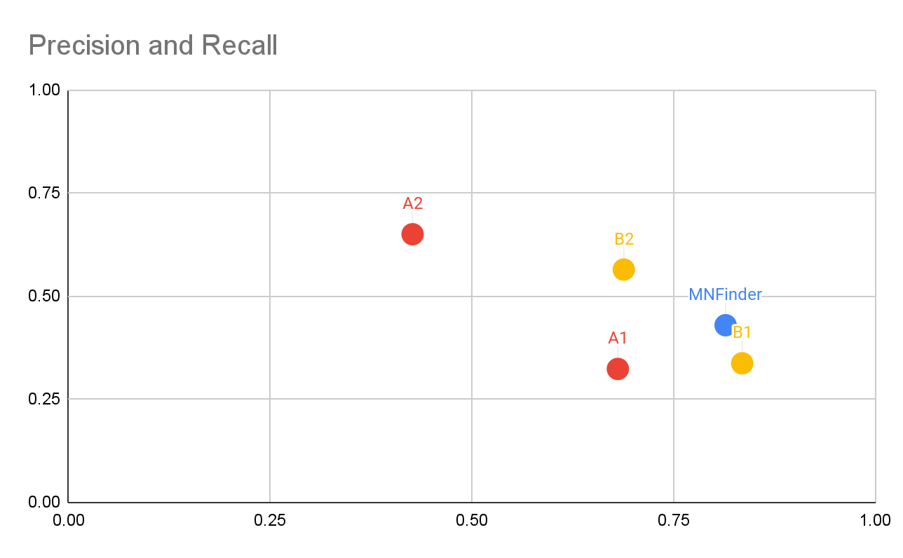
Experiments
Precision: 0.81465 Recall: 0.42912
Precision: 0.8352 Recall: 0.3367
Precision: 0.6884 Recall: 0.56416
A: Frozen backbone
B: Fine tuning transformer

Slide 14
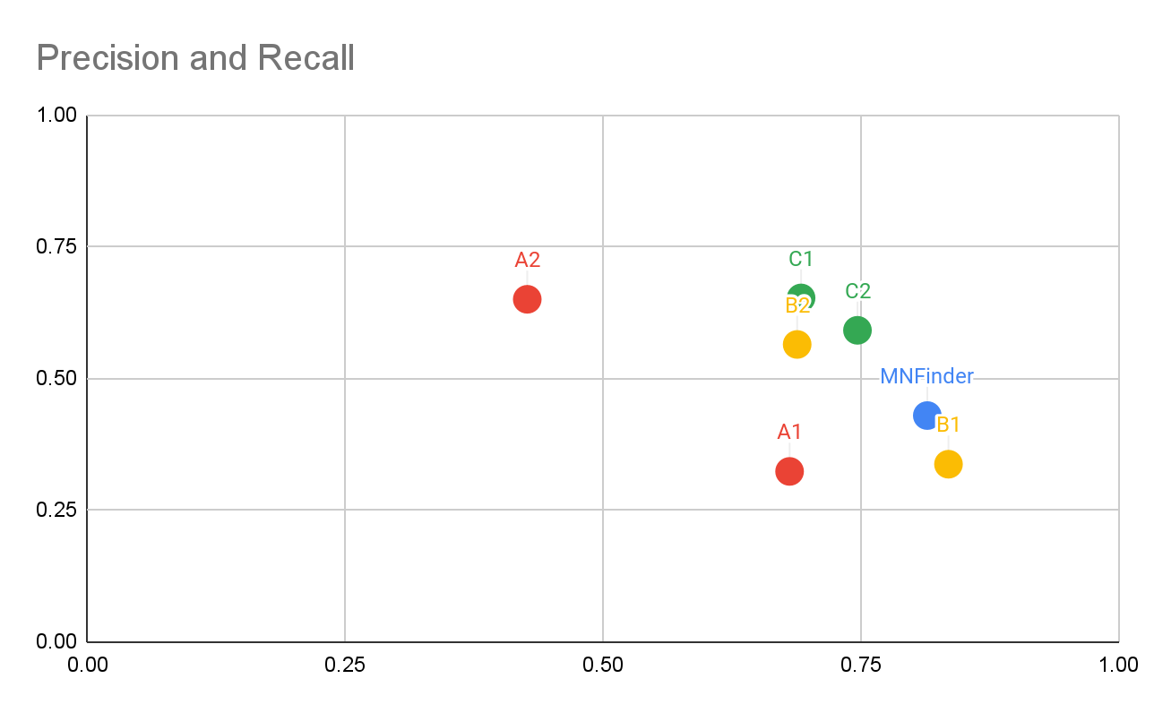
Experiments
Precision: 0.81465 Recall: 0.42912
Precision: 0.6922 Recall: 0.6525
Precision: 0.7469 Recall: 0.591
A: Frozen backbone
B: Fine tuning transformer
C: Output resolution 128

Slide 15
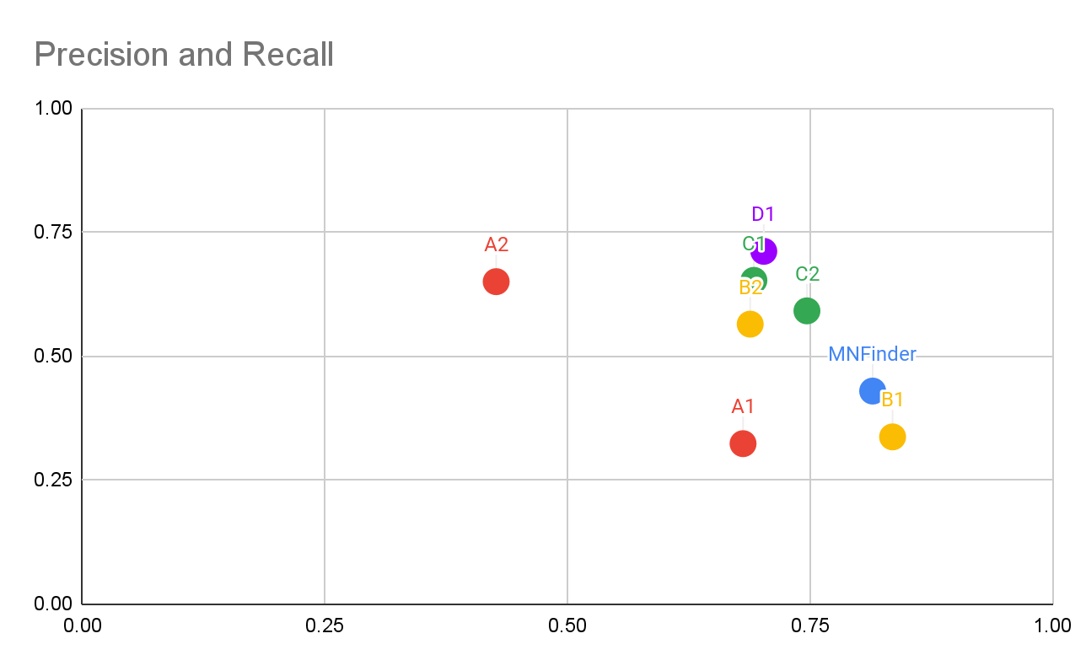
Experiments
Precision: 0.81465 Recall: 0.42912
Precision: 0.7024 Recall: 0.71113
A: Frozen backbone
B: Fine tuning transformer
C: Output resolution 128
D: Training with more data

Slide 16
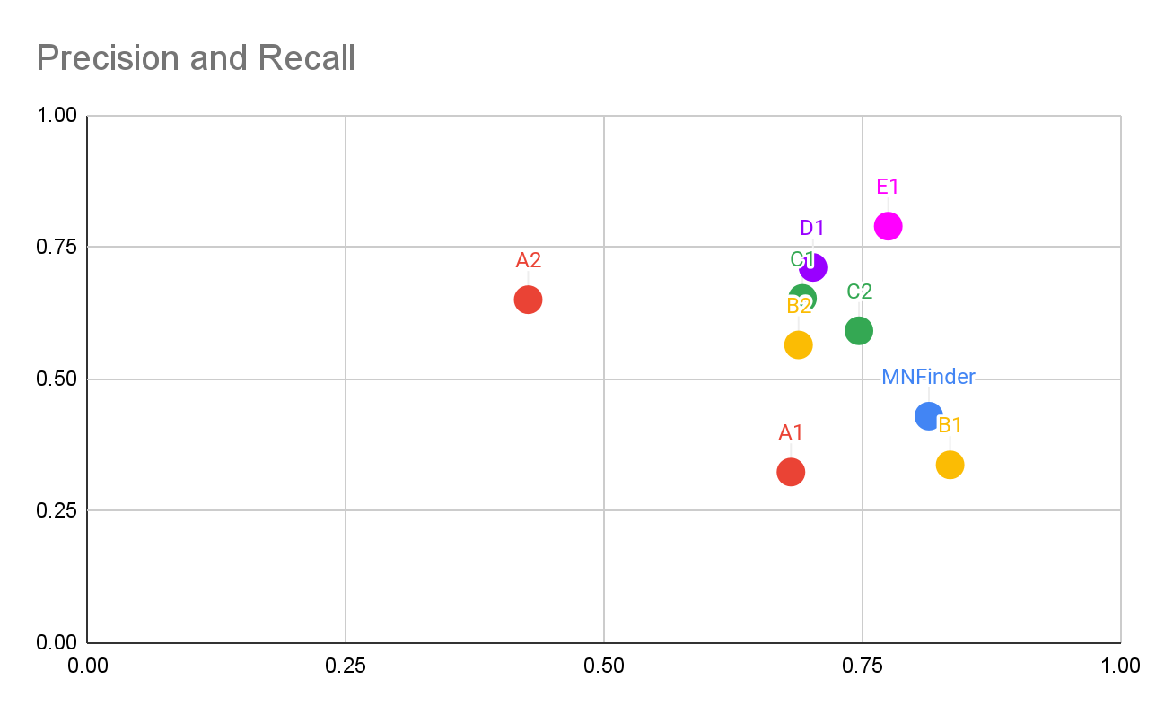
Experiments
Precision: 0.81465 Recall: 0.42912
Precision: 0.77526 Recall: 0.78932
A: Frozen backbone
B: Fine tuning transformer
C: Output resolution 128
D: Training with more data
E: Adding LayerNorm

Slide 17
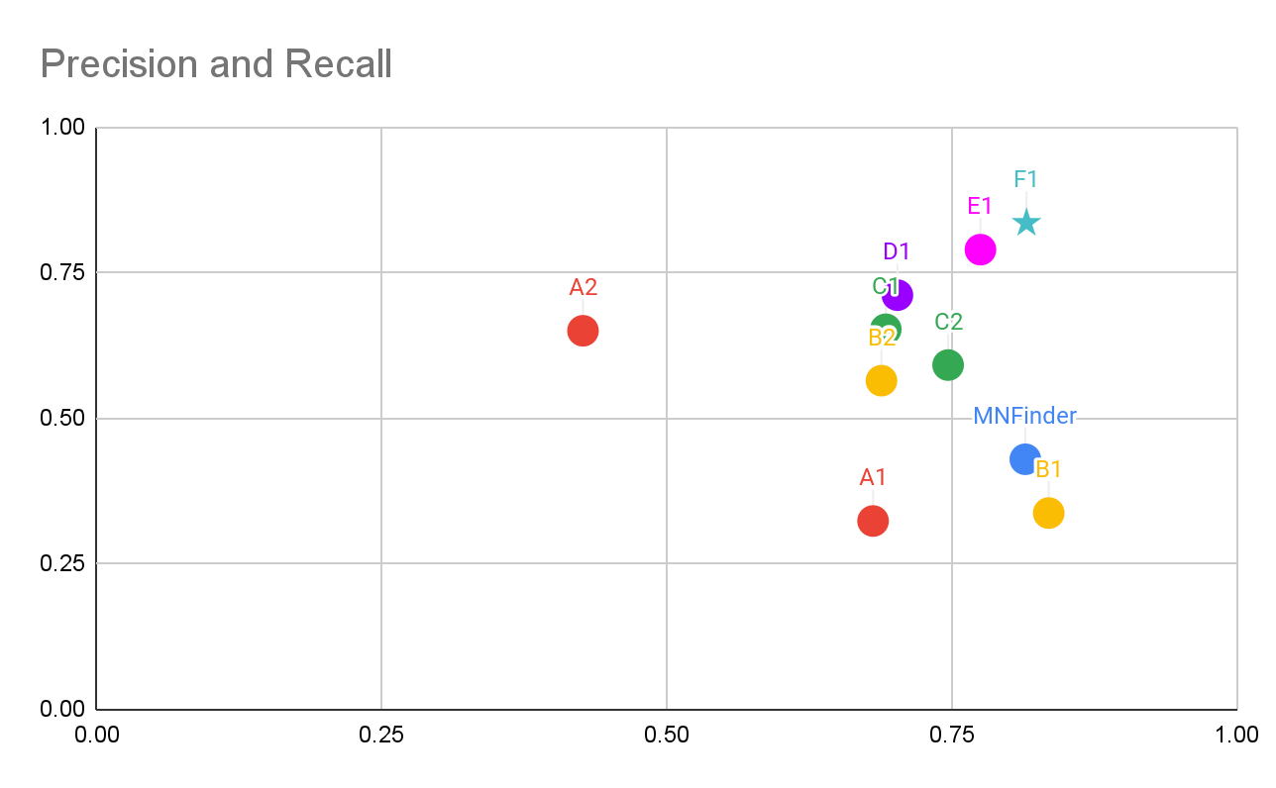
Final result
Precision: 0.81465 Recall: 0.42912
Precision: 0.8157 Recall: 0.8352
A: Frozen backbone
B: Fine tuning transformer
C: Output resolution 128
D: Training with more data
E: Adding LayerNorm
F: Screen images

Slide 18
Cell phenotyping

Slide 19
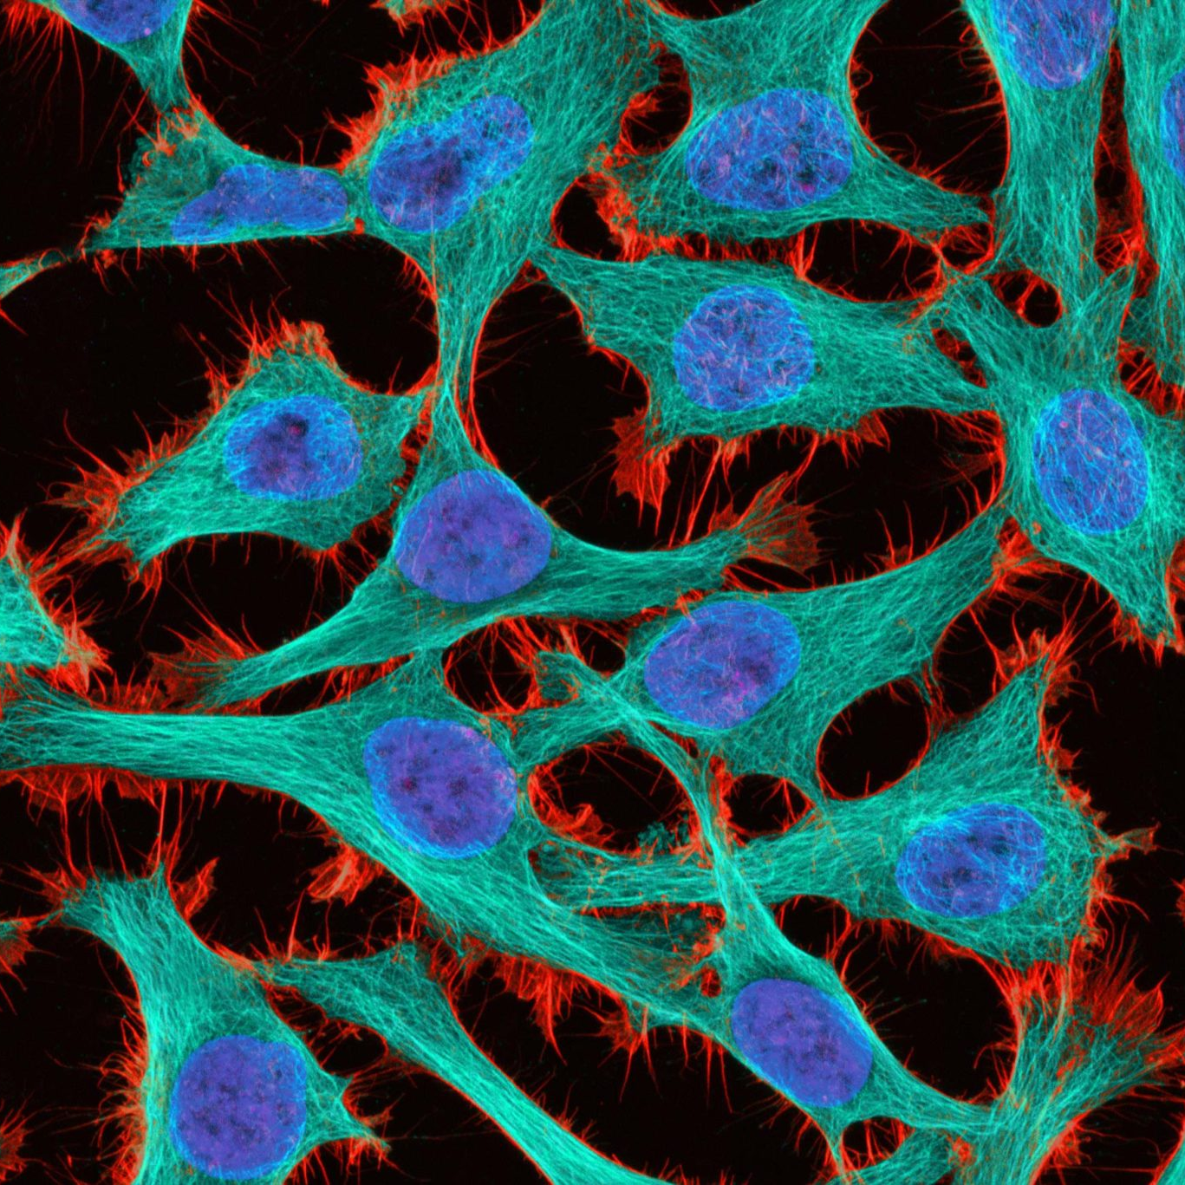
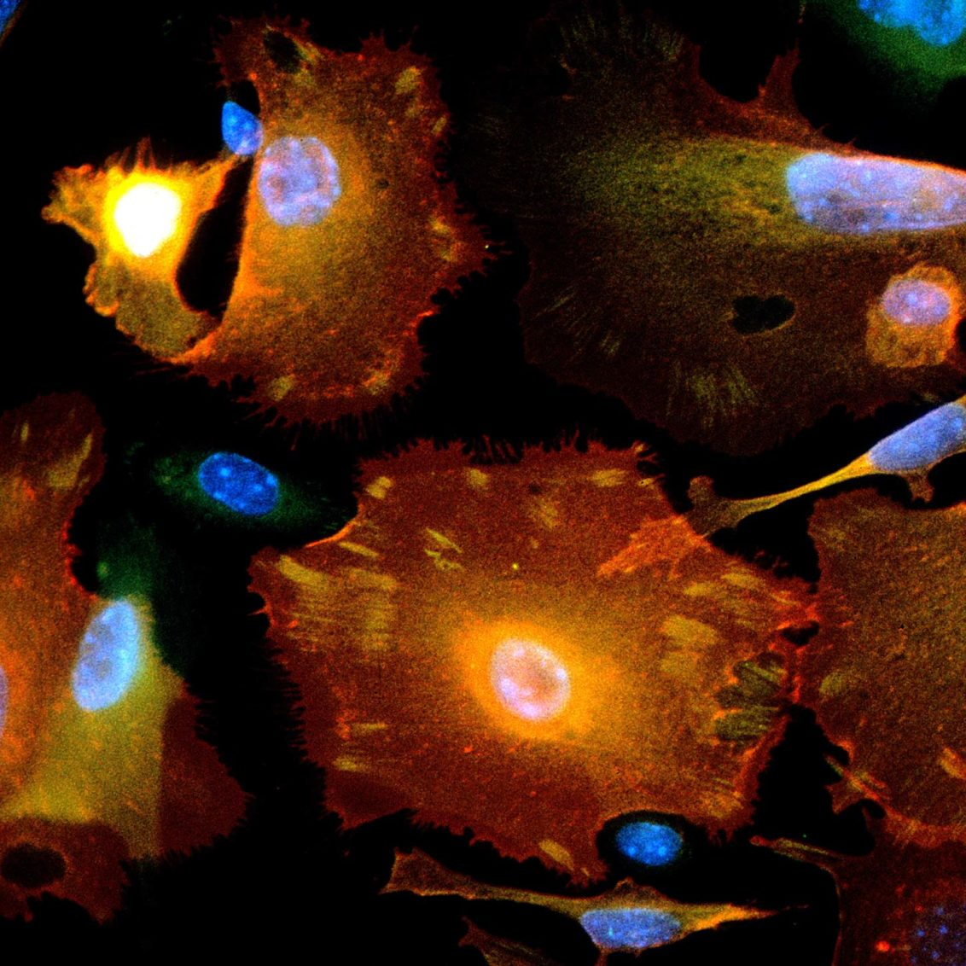
Can we create a generalist bioimage analysis model?

Slide 20
High-content screening^{(a)}
RGB natural images
3 channels
Human protein atlas^{(b)}
ImageNet pretrained models are designed for 3 channel, RGB images
4 channels
Cell Painting^{(c)}
5 channels
Highly multiplexed immunofluorescence^{(d)}
10+ channels
Adapted from (a) https://bmcmolcellbiol.biomedcentral.com/articles/10.1186/1471-2121-9-42/ (b) https://www.kaggle.com/c/human-protein-atlas-image-classification/ (c) https://www.broadinstitute.org/ (d) https://www.nature.com/articles/s41587-019-0207-y/
Notes:
Adapted from (a) https://bmcmolcellbiol.biomedcentral.com/articles/10.1186/1471-2121-9-42/ (b) https://www.kaggle.com/c/human-protein-atlas-image-classification/
(c) https://www.broadinstitute.org/
(d) https://www.nature.com/articles/s41587-019-0207-y/

Slide 21
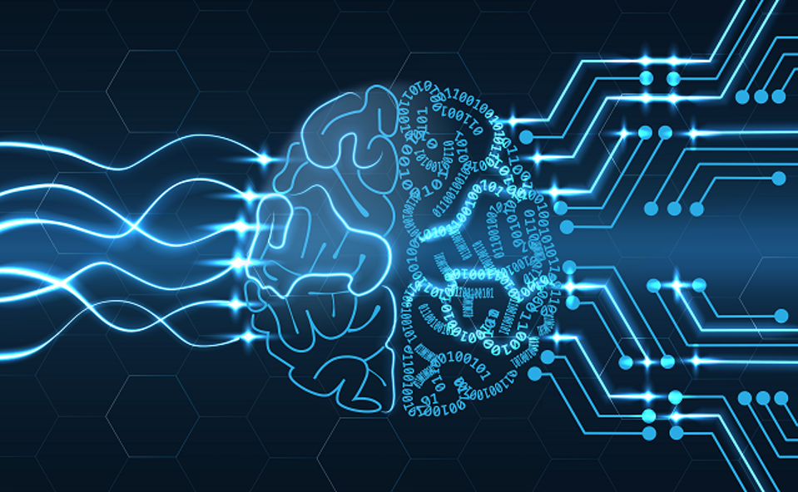
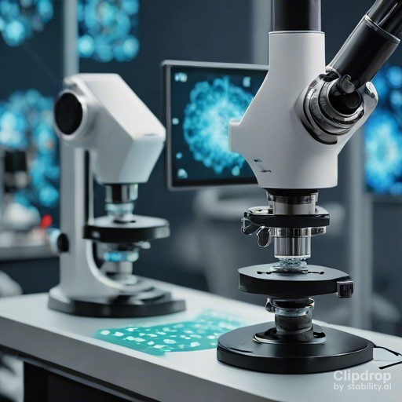
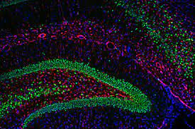
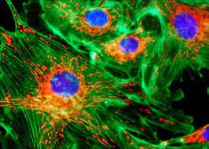
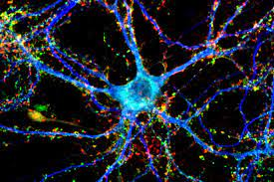
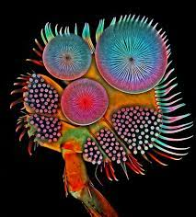
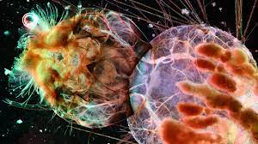
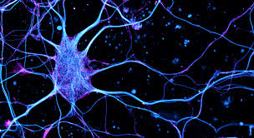
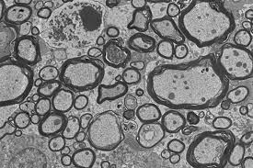
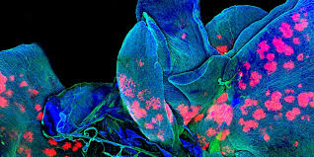
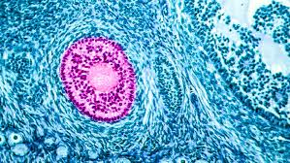
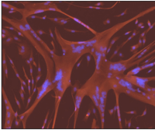
Learning from images at scale
Millions of images
High-throughput computing
Image-based discoveries
Notes:
Large datasets are required
Large scale computing power is necessary
The transition here: what are the challenges of HTC?
Make a transition to set up
The uniqueness of our institute: cutting edge biological research + advanced computing
Mention some of the repositories: example, we asked for all the studies in IDR.
I needed a place where this could be done: computing and foundational research

Slide 22
Data sources
Powered by
30 studies ~5M images
10 TB
70 studies ~20M images
75 TB
12 laboratories ~40M images
120 TB

Slide 23
Self-supervised representation learning
Goal: discover biologically relevant cellular features without human supervision
Vision Transformer Network
Self-distillation with no labels
Input cell
Global views
Output
Teacher Network
Self-attention layers
Single-cell
image
Features
Self-supervision
0
1
2
3
4
5
6
7
8
9
Local views
Linear projection of patches
Student Network
Features
Tokenized image
Sequence of patches
Doron, et al. "Unbiased single-cell morphology with self-supervised vision transformers." bioRxiv (2023).

Slide 24
A single model to recapitulate all studies
Protein localization
Cell-cycle stages
Replicate findings from about 100 publicly available imaging studies
Use the model to power biological discoveries at Morgridge and UW
Compound treatments

Slide 25
Summary
Imaging
Representation
Generalization
Applications
Imaging encodes rich phenotypic information
Machine learning identifies useful biological variation
From specialized methods to foundation model
Unbiased features have many biological applications

Slide 26
Gratitude
Research Computing
Brian Bockelman
Justin Hiemstra
Andrew Maier
Morgridge Institute
CHTC Team
Biomedical Imaging
Boston University
Broad Institute
University of Helsinki
Columbia University
Meta AI
Nikita Moshkov
John Peters
Other past and future members
Caicedo Lab
Tyler Thompson
Zayn
Kayali
Yifan
Ren
Aditya Pillai

