Slide 1
Cache-ing in on
Email: jkramborger@health.ucsd.edu

Slide 2
Who Are We?
Addiction research laboratory at the UC San Diego in the School of Medicine Department of Psychiatry and member of the Preclinical Addiction Research Consortium.
Can We Predict the Future?
Most research is during self-administration (SA), so can we identify vulnerable populations from activity and behavior before SA?
Self-Administration Paradigms (60 Chambers)
Operant chambers (Bottom Left) allow animals to “self-administer” drugs of abuse by pressing levers and how behaviors relate to addiction
Machine Vision and Videography
Activity before SA predicting behavior during SA and addiction traits
Olivier George
Professor
Department of Psychiatry
olgeorge@health.ucsd.edu
Notes:
My name is Jarryd Ramborger, I am a Staff Research Associate in the Dr. Olivier George Lab at the UC San Diego School of Medicine Department of Psychiatry. We area also apart of the Preclinical Addiction Research Consortium at UCSD, a conglomerate of labs facilitating the development of experimental therapeutics for substance use disorders.
And the big question we currently have that I will show at the end of this talk is: Can we predict the future? Specifically, most research focuses on behavior during a self-administration session, so can we identify vulnerable populations from activity before a self-administration session? And the answer is (click next)

Slide 3
Who Are We?
Addiction research laboratory at the UC San Diego in the School of Medicine Department of Psychiatry and member of the Preclinical Addiction Research Consortium.
Can We Predict the Future?
Most research is during self-administration (SA), so can we identify vulnerable populations from activity and behavior before SA?
Self-Administration Paradigms (60 Chambers)
Operant chambers (Bottom Left) allow animals to “self-administer” drugs of abuse by pressing levers and how behaviors relate to addiction
Machine Vision and Videography
Activity before SA predicting behavior during SA and addiction traits
YES!
Olivier George
Professor
Department of Psychiatry
olgeorge@health.ucsd.edu
Notes:
YES as ill show you at the end.
We have 60 chambers where rats can lever press for drug known as self-administration, and we use these measures along with machine vision and videography to study the activity before the self-administration sessions to predict addiction.

Slide 4
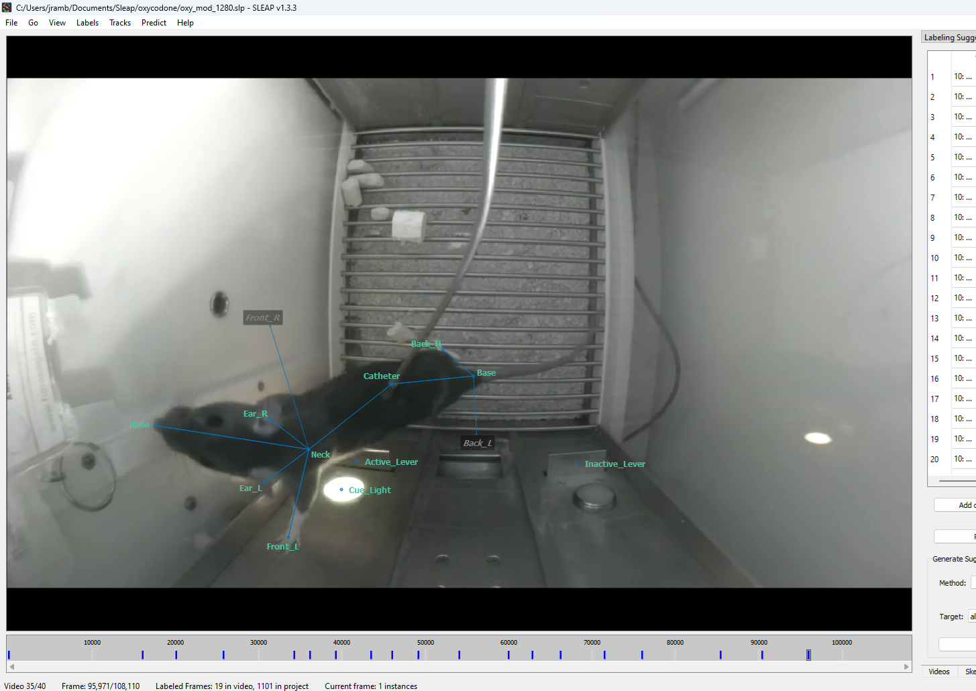
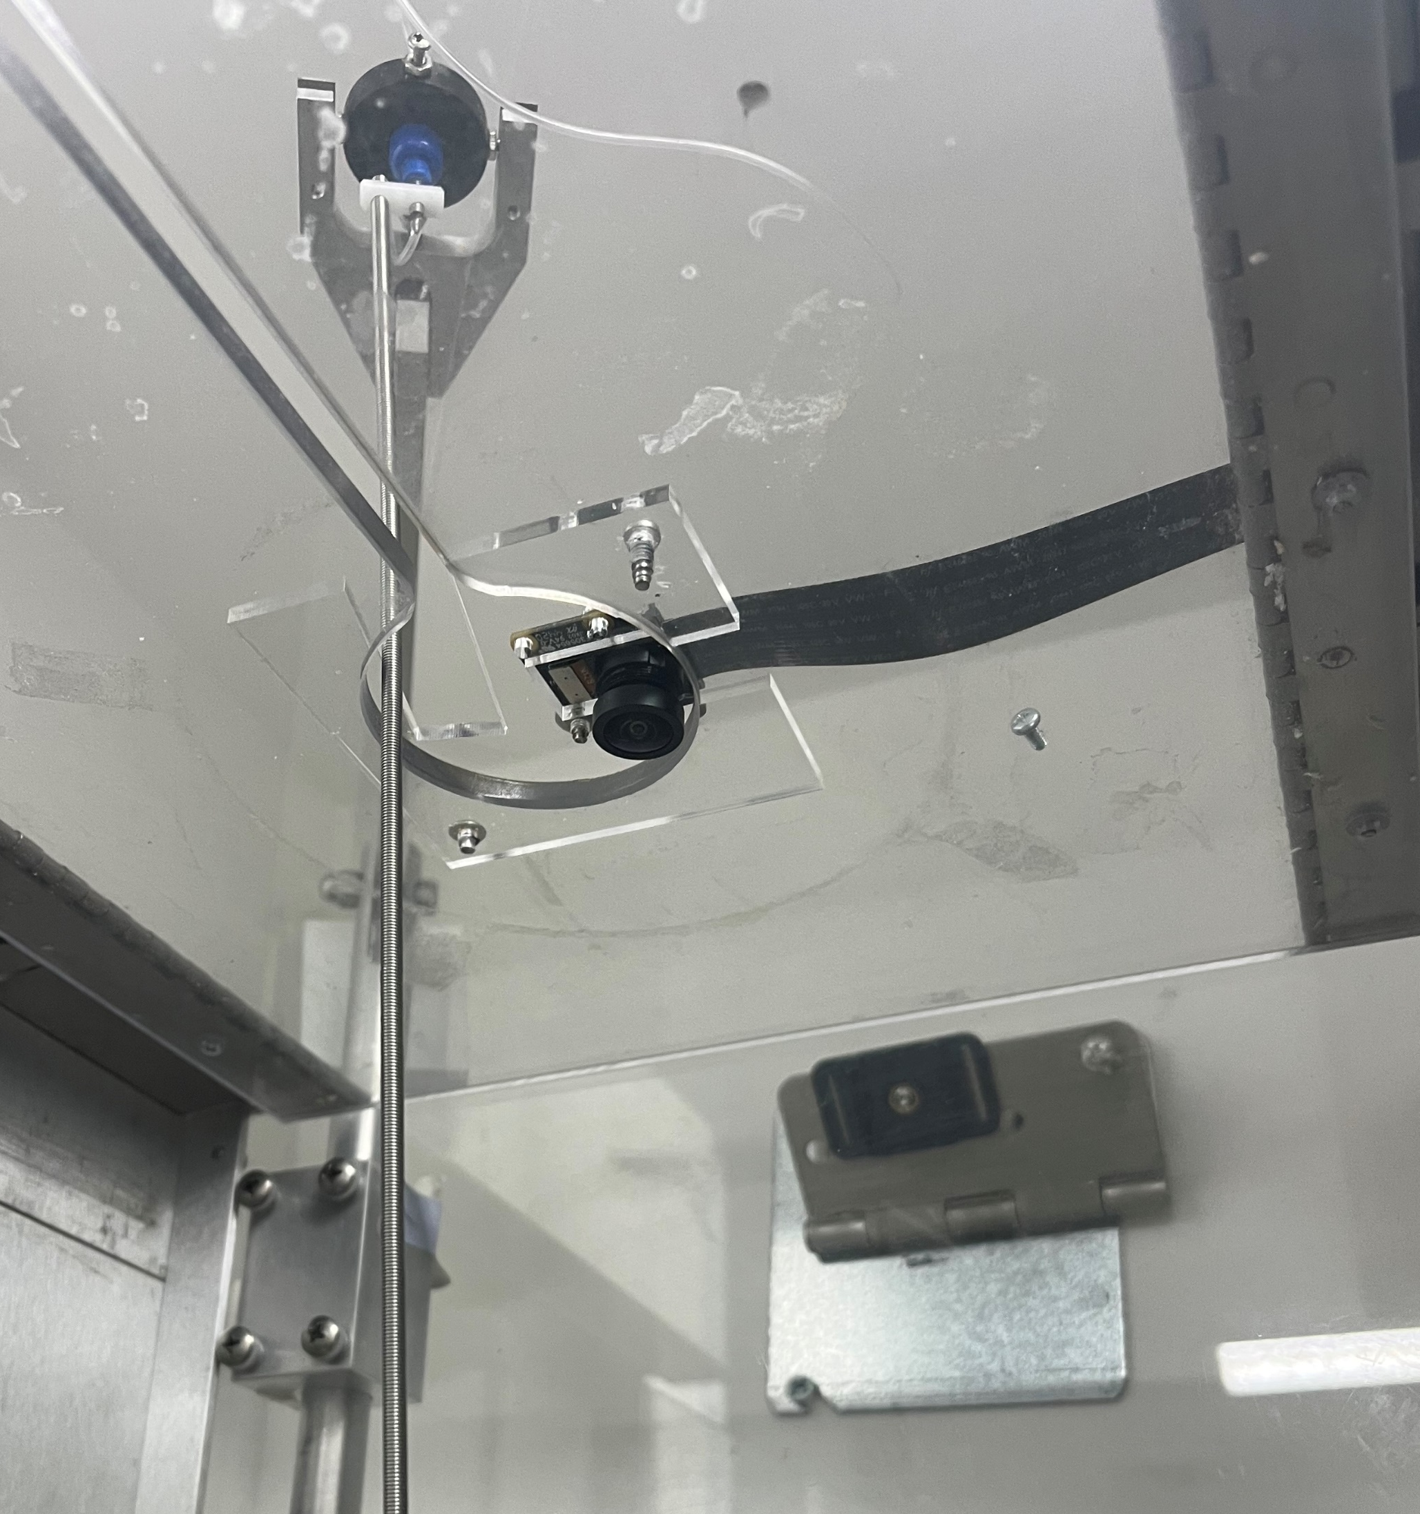
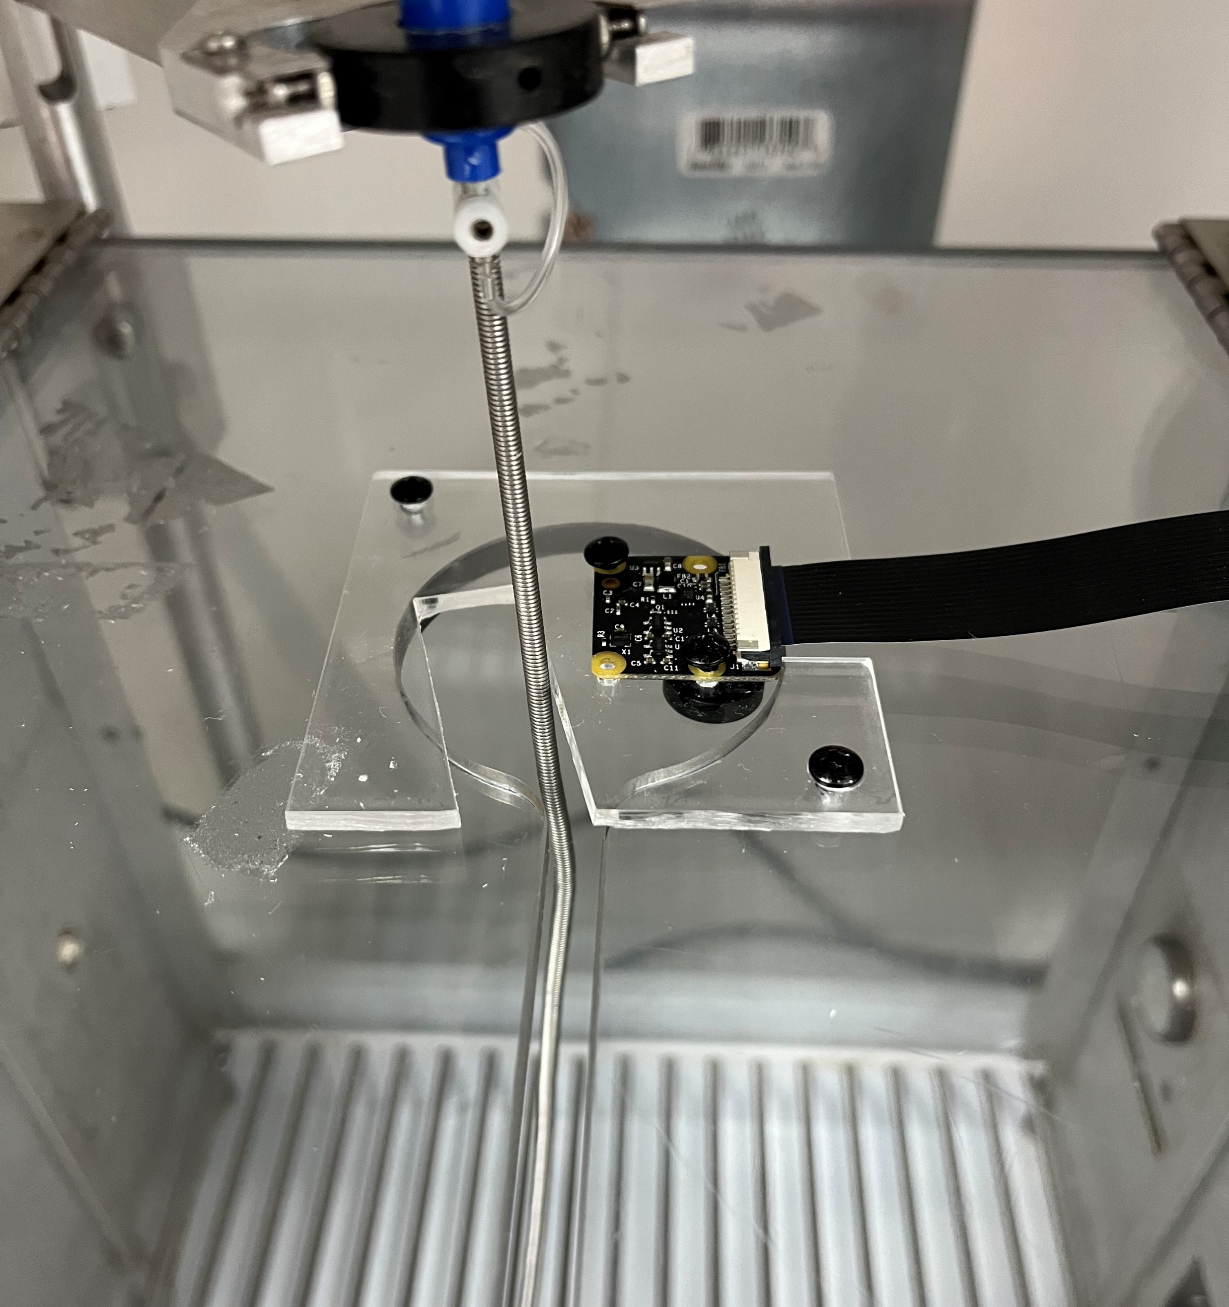
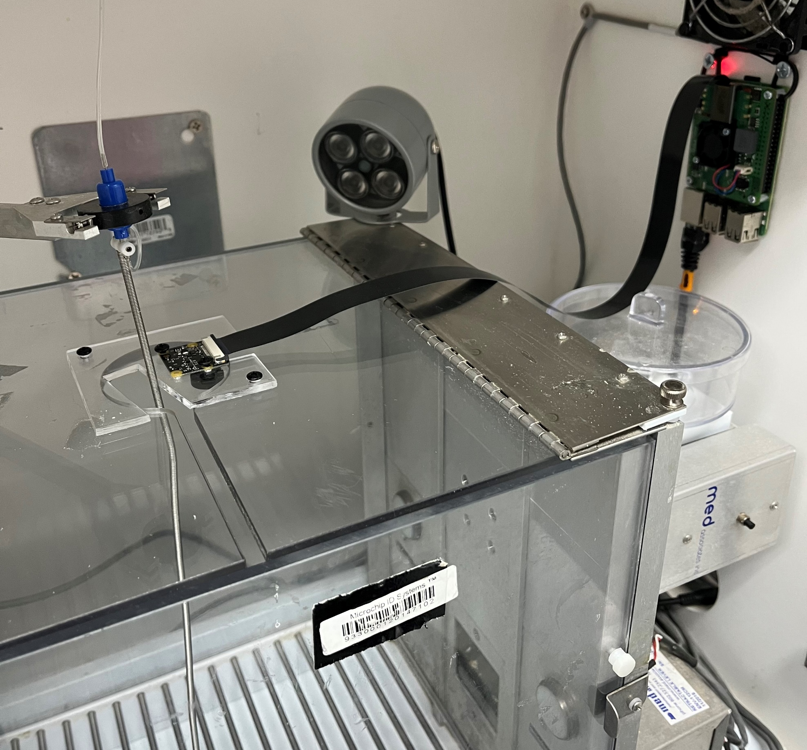
Why do we need HTCondor?
Raspberry Pi Cameras using PiRATeMC
Cheap credit card sized computers capable of attaching small cameras to for recording or still images (3 Small Frames too the Left)
Implementation of Social LEAP Estimates Animal Poses (SLEAP)
Use of machine learning and vision to train models to identify objects in a video
One of many open-sourced pose-estimation software developments for video-tracking animal models
Simple GUI (Left) and comprehensive guides, as well as responsive discussion forum
Home: https://sleap.ai/index.html
Discussion Forum: https://github.com/talmolab/sleap/discussions
With GPU PC, tracking takes ~1hour, therefore 120 videos a day for 30 sessions = LONG TIME
Meaning Advanced computer and components for high-throughput processing and analyses
Notes:
So then the question is, why do we need high-throughput computing?
Recent additions to the lab have been Raspberry Pis and their cameras. Raspberry Pis are credit card sized computers as you can see on the inside wall of this sound attenuated chamber in the right small image here, the ribbon cable running to the camera, and the different views of its installation on top of the operant chamber connected to a device we designed and laser cut from acrylic. And these cameras allow us to get images as the one you saw on the last slide and on this one to study the rat’s behavior apart from pre-defined measures.
How we accomplish this is the implementation of Social LEAP Estimates Animal Poses, better known as (SLEAP) as the fun title of this presentation points to. SLEAP is an open-sourced pose-estimation program that uses supervised machine learning and computer vision to track the animal by preset keypoints such as the base of the tail, the tip of the nose, etc as you can see in the image here, and all of this is done on their incredibly simple and user-friendly GUI as this image is a screenshot of. Also on their home page they have a step-by-step walkthrough as well as a very responsive and helpful discussion forum on their GitHub.
But using SLEAP on personal computer with a GPU still analyzes one of our videos in roughly 1hr, which, as mentioned before, 60 chambers with 2 cohorts becomes about 120 videos a day for 30 days equals to a significant amount of processing time. Meaning, advanced means of processing and analysis are needed

Slide 5
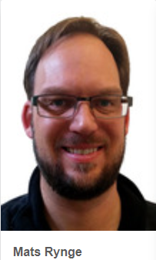
Most Beneficial?
What Helped Me?
Webpage “Submit High Throughput Computing (HTC) Workloads (OSG Documentation)”
Overview: Submit Jobs to OSPool using HTCondor
My submit file is a copy of the one found on this page just edited for my project
Easily Submit Multiple Jobs
The video available on this page helped understand the multiple job logic and flow https://www.youtube.com/watch?v=m7dQChJH5LU
Office Hours
Office Hours
Office Hours
Office Hours
Office Hours….
Notes:
So that brings me to the OSPool. I heard about it from my Primary Investigator Dr. Olivier George. And after my meeting with Showmic on how the system roughly works, the resources useful to me are the documentation on the OSPool website such as submitting jobs and submitting multiple jobs and their videos and powerpoints were super useful, including the simple diagram you see in the top left picture here. But easily what has been the MOST beneficial is office hours. Office hours, office hours, office hours. These 3 gentleman have been incredibly informative, can pop in a the specified times on Tuesdays and Thursdays, and they will do their best to assist. Specifically Andrew, his creativity in on just about every bit of my workflow, able to take things I think up and put them into code for me to implement, but all in all, each have played a part at some point in the process that brings me here today.

Slide 6
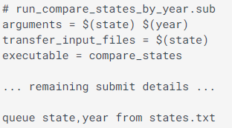
How it Started: Overview
Notes:
So how it all started was a little rough at first and I don’t have my old codes anymore since adapting the workflow, but what I use now is not very different from then aside form trimming some fat off some areas or more efficient methods.
But in general, we all operate with the elements in the yellow highlighted area here on our own access points and home directories. For those unfamiliar with the OSPool, essentially you have your submit file which tells the super pc what you want down and where to gather those elements from, your scripts to be carried out at each execution point, and where those files are to be taken from.
So using the example form the OSPool website, you submit your job to HTCondor, it says these arguments are to be taken in, these arguments are to be taken from this text file so in this example they are state and year, and as you can see from the text file you have state and year, and each one of these alone are sent to an execution point, thereby turning your 1 computer into many computers.

Slide 7
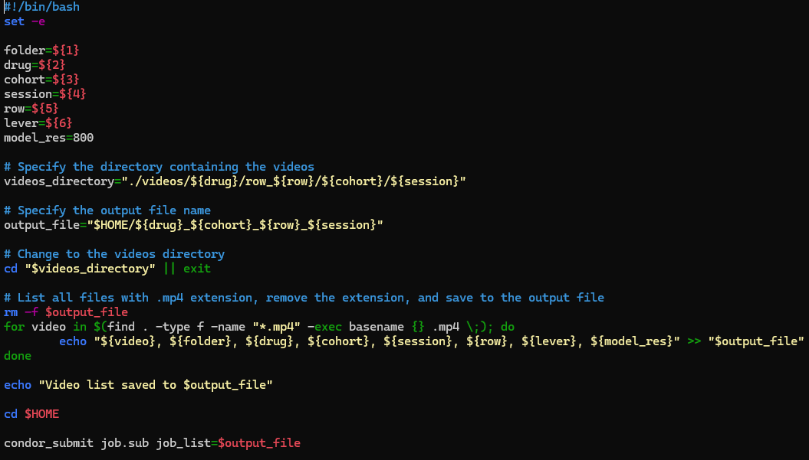
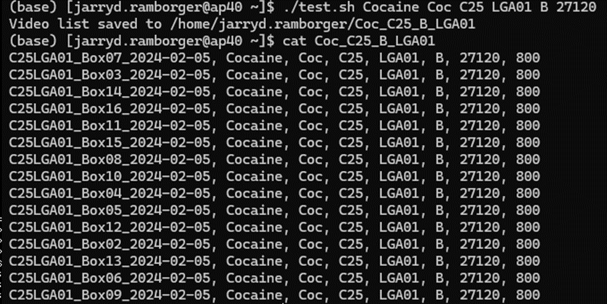
How it Started: Data Preparation
How My Data gets to the Pool
How I create a list to iterate
Execution of list file
Highly advise!
Notes:
So for myself, what does that look like?
As mentioned, we have 60 chambers in 4 rows, and each of these rows has a mini-computer that is connected to and operates all the Raspberry Pis in that row and handles the resulting videos. So what I need is a way to get those videos to the OSPool, so I wrote this code that allows me to pass arguments into it, so in this example it would be “Coc” for Cocaine, the cohort, and the session specifically for it to fetch those videos from my mini and sends them to the OSPool into where they should go in the videos directory.
Now once on my access point, as mentioned prior many times should be stored in a list of some kind that can be called to then fetch them to send to the different execution points instead of say submitting a job for each video individually. So This code here on the write is one that takes in arguments that then outputs a list file corresponding to the videos we just sent over and also as arguments later on each execution point.
So for the bottom left list file example, when executed with the many arguments, as you can see here you have video, folder, drug, cohort, session, row, etc corresponding to each video and subsequent actions later on the execution point
Something I highly advise as this yellow arrow suggests is that I added at the bottom of this code the job submission code to easily make my list and then submit the job file instead of once the list is made to then type this line of code afterwards. Saves some time and is super easy and ensures the right job is submitted instead of maybe making many lists and submitting each individually afterwards.

Slide 8
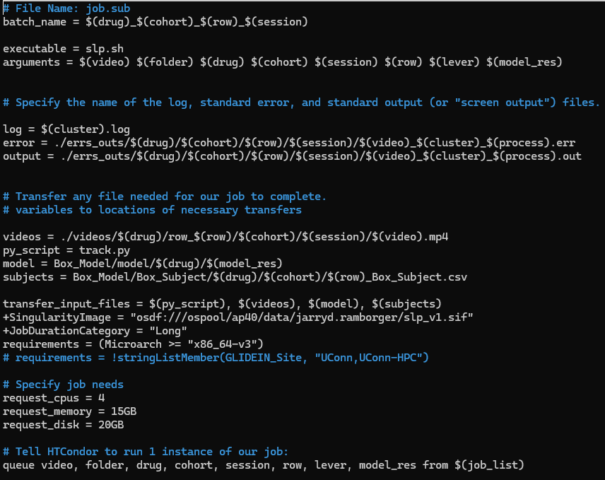
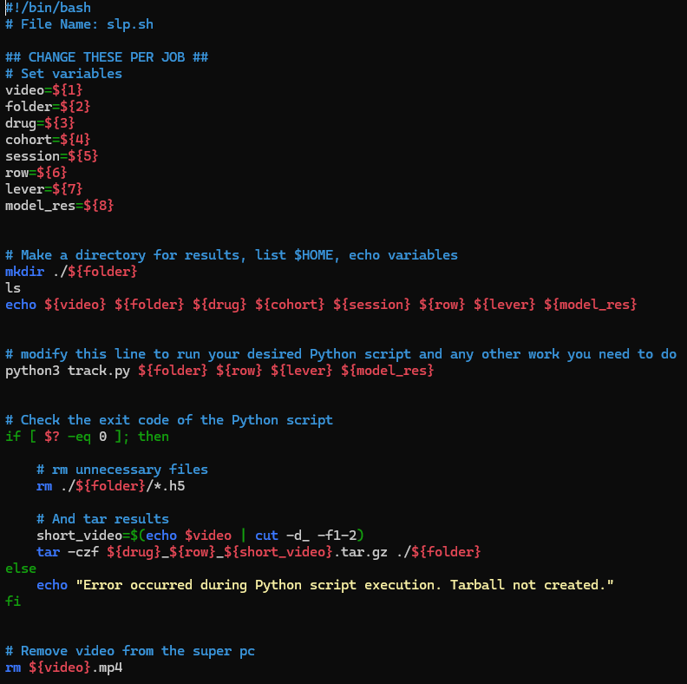
How it Started: Job Submission
Executable File
Submit File
Notes:
So in terms of job submission, this snapshot on the left is of my submit file. So this is the form that you tell HTCondor to do, telling it where files should come from, where results should then go to, where your different individual jobs should come from as the bottom portion shows, and what these jobs may need so as to arrive on the proper execution point.
So the executable that then is sent to the execution point as shown at the top here is on the right side, and as shown the arguments from our list file, that specified in the sub file, are taken into this file to then run each individual job on the execution point. Mine here creates a folder to save the results in, runs my python script to then track the videos with SLEAP with its own arguments here, and then tarballs the results and sends them back to me.

Slide 9
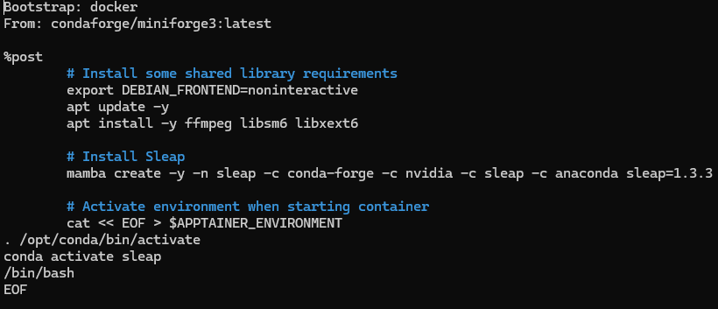
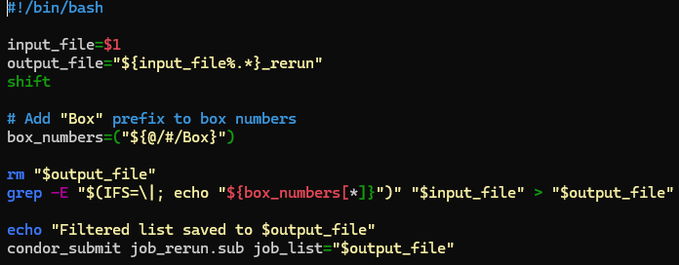
How it is Going: Developments
~/
Few Helpful Additions…
Singularity Docker
Submit_rerun.sh
From List Creation File
Notes:
So that was a quick overview of some of my files, and this here is how my home directory currently looks. As you can see in blue a couple of directories, specifically those for the different drugs results files to go and the video files directory.
The big changes and additions that have been super helpful have been this singularity that Andrew wrote up for me. Instead of tarballing the sleap environment and sending it to en execution point and it unpacking over there I now send over a singularity docker virtual environment that has limited issues of my jobs ending up on sites that don’t have certain requirements I need for my jobs to run.
Another as mentioned before was this simple line at the end of the list creation executable.
And also, given there can be issues that occur and needing to resubmit jobs, I wrote up this rerun script that, instead of having to resubmit all the jobs or going to the video folder and moving things around to submit just a single one of the videos, instead this script takes in the original list, I specify which of the videos needs to be reran, and it submits it all on its own and as “rerun” at the end of the list name. So If I have 16 jobs from a single list and 2 had issues, I can cancel those 2 while the others continue to run, and then resubmit those two without affecting the original job submission

Slide 10
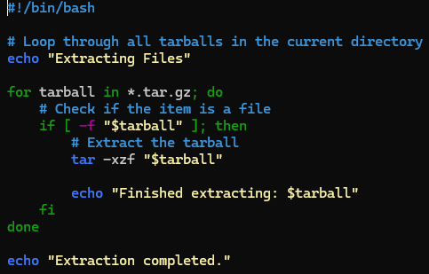
How it is Going: Two Lines, Multiple Jobs
1. PC to Pool
Submit_rerun.sh
2. List Creation file
Extract Tarballs
Yes
No
6. Issues?
5. .sh executed
4. job.sub executed
3. Creates list, submits
Notes:
And when everything is put together, what that comes down to is with essentially 2 lines of code, I can run multiple jobs and process multiple videos at one time.
So to recap, 1 line of code send the videos form the mini pc to my access point, another line of code creates my list of videos and submits them, and the execution point takes care of the rest as the jobs are submitted, the executed is ran at each job site, and when all is said and done if there was an issue, I run my rerun script and send that job back through the cycle, and if there are no issues then I run my extraction script that unpacks every tarball in my home directory and each file is sent to whichever drug the videos were for.

Slide 11
High Throughput Computing
Before HTC:
60 Chambers, 2 cohorts simultaneously, ~30 sessions = ~3600 videos
Last 2 cohorts were a total of 3641 videos
At ~1hr on PC = ~150 days to completion
With HTC:
~240 videos at one time for ~6hrs to 3days = ~4 - 45 days to completion
Cohorts last ~45-50days including weekends
Notes:
And lastly, why HTCondor has bee so incredibly useful is, as mentioned prior, with 60 chambers, 2 cohorts simultaneously for about 30 sessions each can result in up to 3600 videos. Our last 2 cohorts just completed a few weeks ago was 3641 videos. And at roughly 1hr a video that comes out to about 150 days, and this is if you can perfectly buttress each job back-to-back for that time.
But with the HTCondor, I have found that I can run about 240 videos and their resulting files, and that can take anywhere from a few hours to 3 days per job as a wide estimate as the execution points are only using CPU power, and that in the end comes out to about 4 to 45 days at the very most to complete all 3600 videos, and our cohorts last 45-50 days on average including weekends. Massive difference.
And this here is a snapshot of jobs I was just running the other day, and as you can see 178 are running at one time currently. Incredible difference.

Slide 12
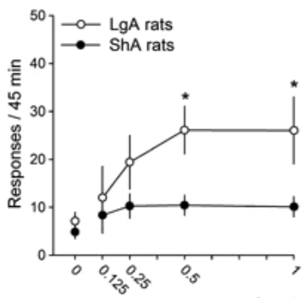
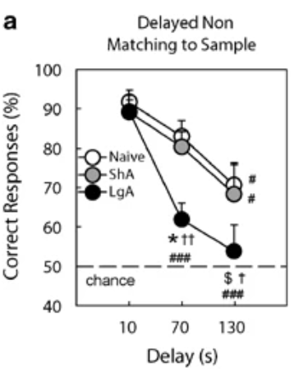
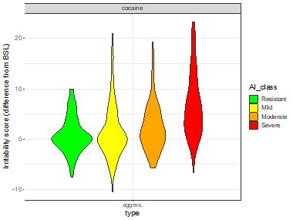
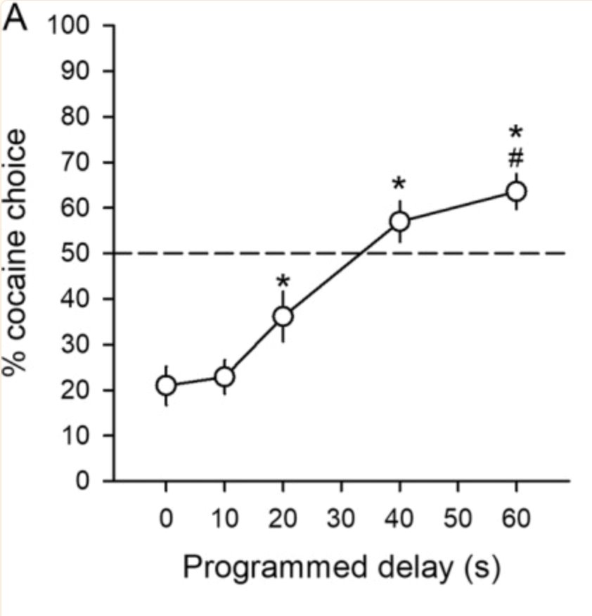
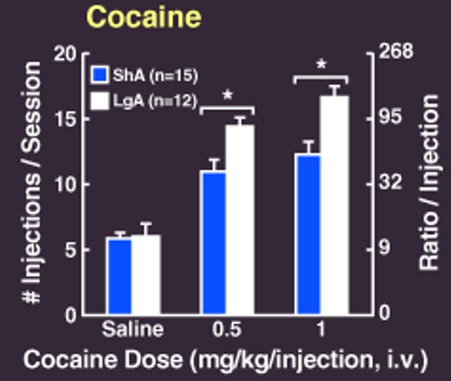
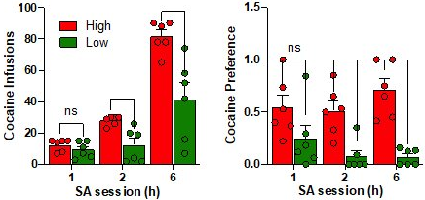
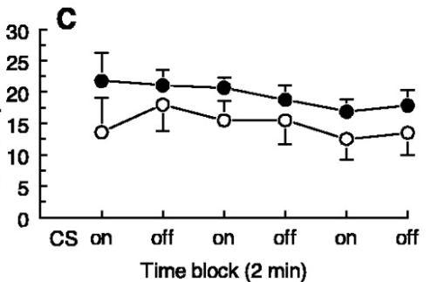
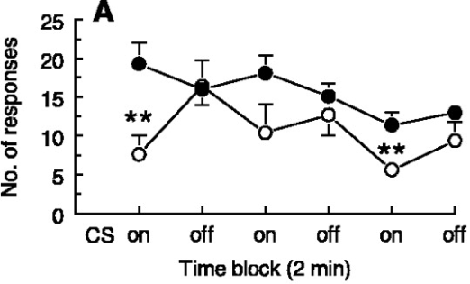
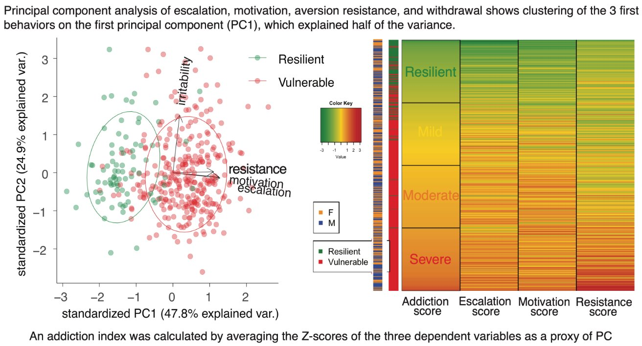
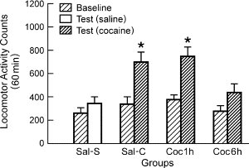
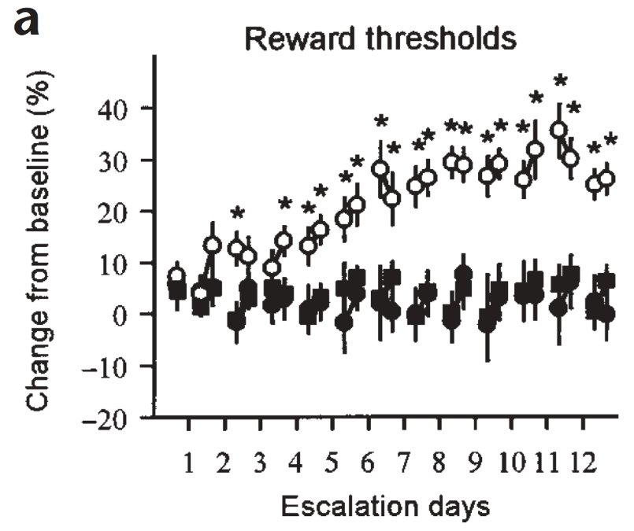
Addiction Index Characterization and DSM-5 Criteria
Loss of control​
Social impairment​
1. Use larger amount/faster
2. Failure to quit
3. Lots of time
4. Craving
5. Fail school/work/home​
6. Interpersonal issues​
7. Loss of activities​
Wee, 2008
Canchy, 2021
Ahmed, 2006
Irritability
George, 2008
Ahmed, 1998
Irritability Score (Diff. From BSL)
Sedighim, 2021
Risky
De Guglielmo et al., 2023
8. Hazardous use
9. Adverse consequences
Vanderschuren & Everitt, 2004
Pharmacology
10. Tolerance​
11. Withdrawal​
Ben-Shahar, 2005
Ahmed, 2002
Notes:
So that brings us now to how HTCondor is impacting our research.
So when it comes to addiction, many labs have devised ways to quantify addiction vulnerability. Along with that is the operationalization of the diagnosis of Substance Use Disorders found in the 5th edition of the Diagnostics and Statistical Manual of Mental Disorders. SUDs are often characterized by 4 areas of impact with 11 different criteria and meeting a number of criteria leads to a diagnosis from mild to sever Substance Use Disorder. One big finding is the impact of long access sessions over short access sessions that will thred through many of these experiments. Short access tends to be sessions lasting up to 2hrs, while long access can something along the lines of 4+ hrs, ours specifically are for 6hrs for Cocaine and 12hrs for oxycodone.
So over the years, labs have conducted experiments focusing on certain criteria that show this occurring in animal models.
You have the Loss of Control subgroup, where use is escalating to larger amounts in faster time, failure to quit or motivation to use or craving, and lots of time thinking of or trying to use substances.
In terms of social impairment such as failures to meet responsibilities like school, work, or other requirements, interpersonal issues, or loss of interest in usual activities and preferring drugs.
Or risky type behaviors like hazardous use or resistance to adverse consequences such as a contingent foot shock.
And lastly pharmacological type criteria such as tolerance to the drug, or when stopping the drug you feel withdrawal effects.
Our lab specifically have used such information gather from our own experiments to calculate an Addiction Index score by z-scoring measures of escalation, motivation, and resistance to adverse consequences to identify vulnerable groups, showing such groupings can explain up to roughly 48% of the variability in the data.
One thing to note before moving on is in relation to this locomotion study which specifically showed that rats given short access to drug for 1 hr after a period of abstinence saw a significant increase in locomotion to a cocaine injection, while those who had long access for 6hrs did not see such a response, implying tolerance. There is a lot of data on the locomotor response to novelty in rats and propensity for addiction. Essentially when a rat is placed in a new environment, how much they move around or explore the space is predictive of addiction-like behaviors. But, if presented with the area for consecutive days you see an eventual decrease of this effect as the animal is implied to have learned the area.

Slide 13
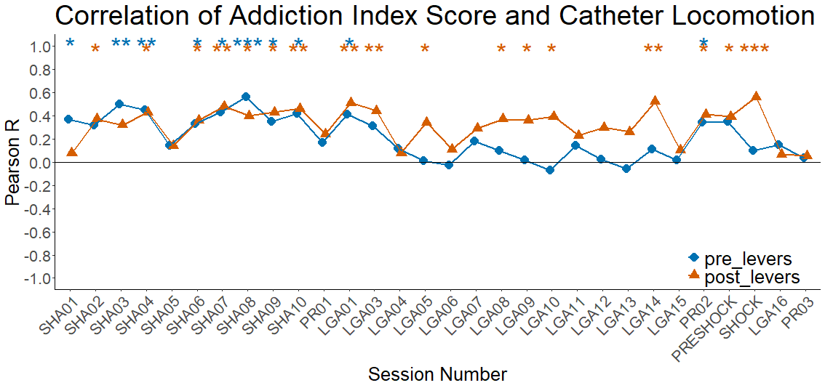
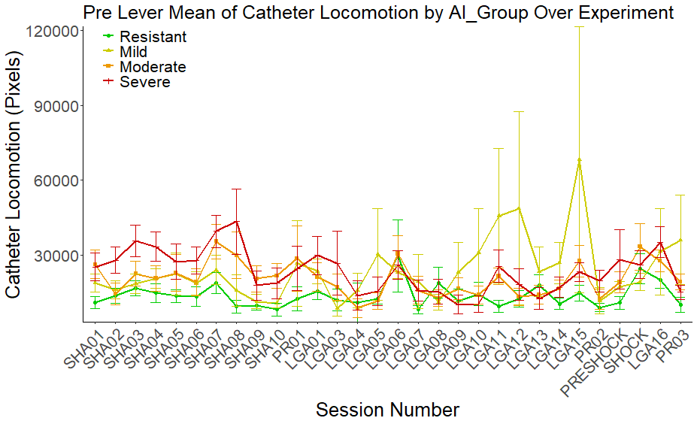
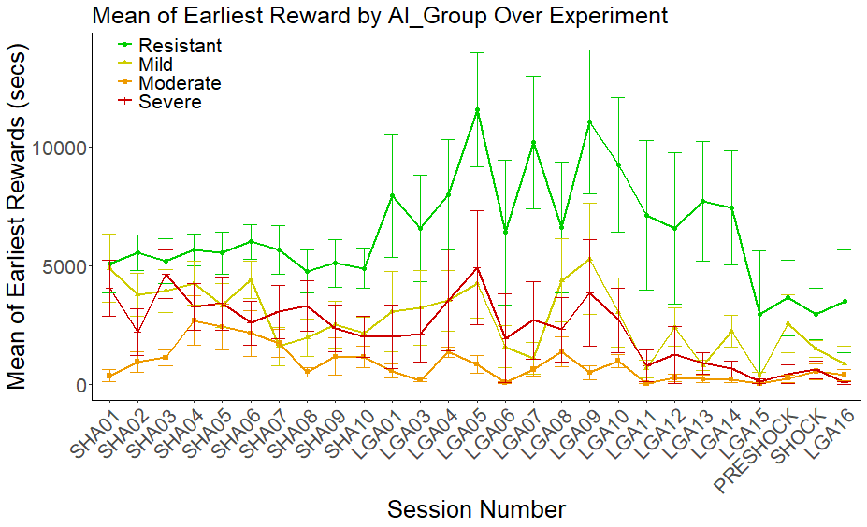
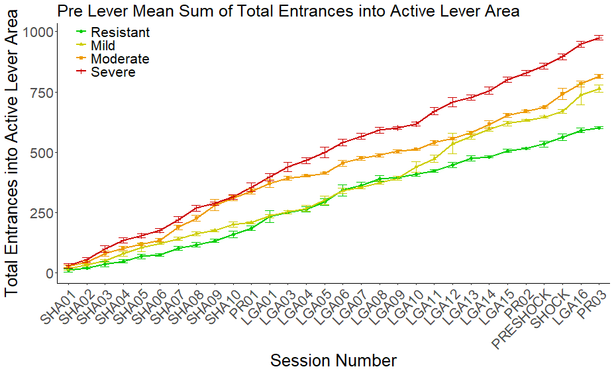
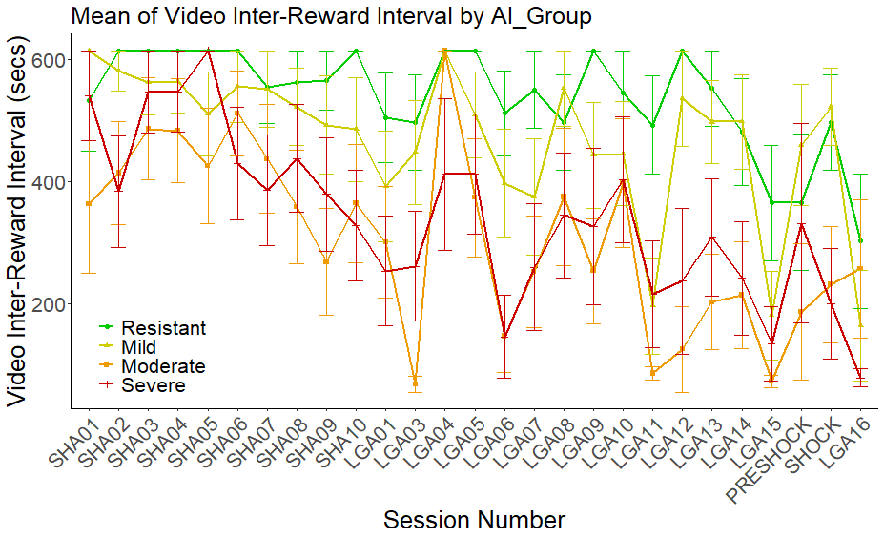
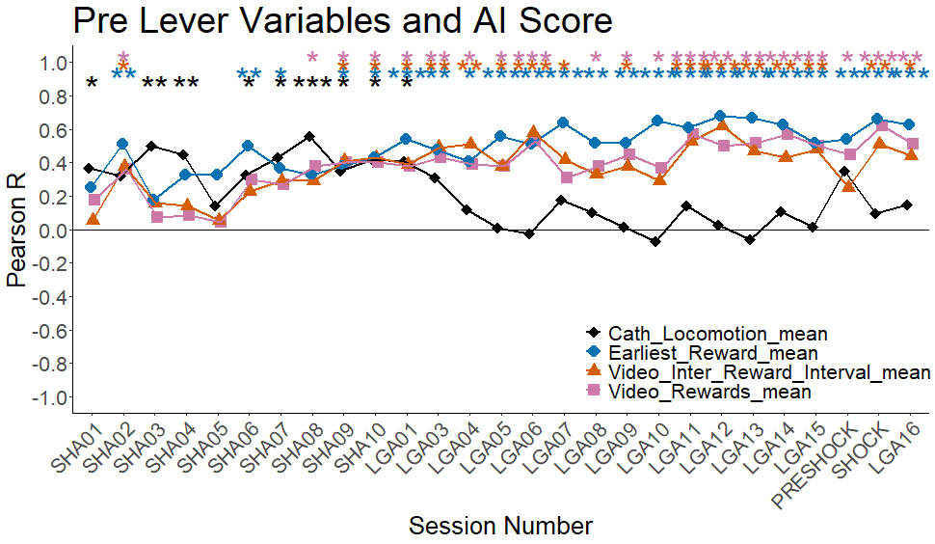
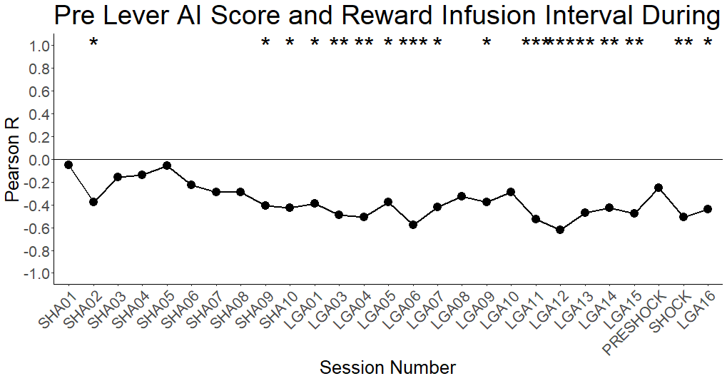
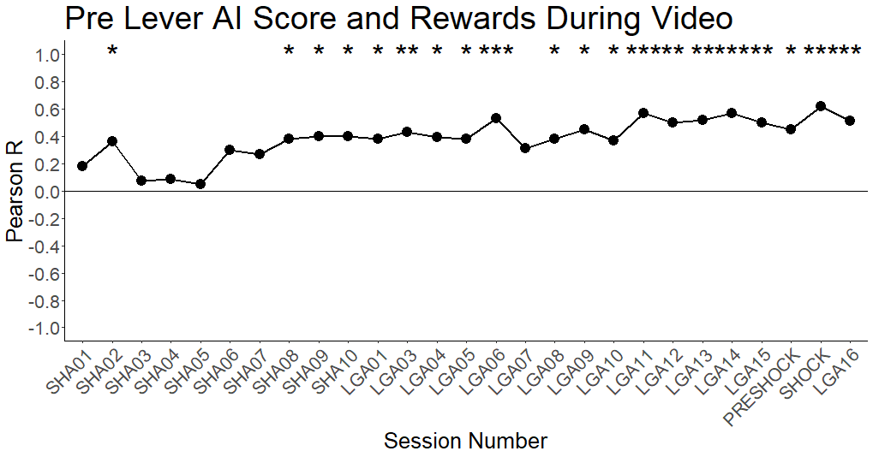
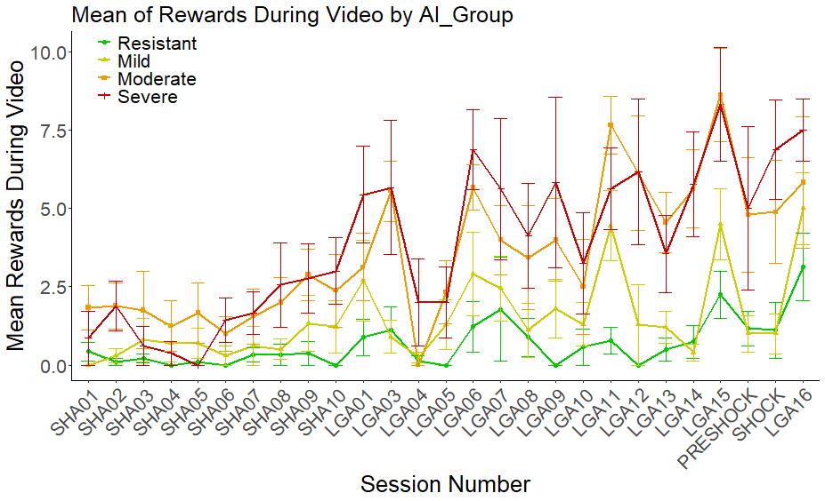
Addiction Index and Machine Vision
Video Length = ~20mins
Pre/Post Levers = ~10mins
Short-Access = 2hrs
Long-Access = 6hrs
Big Q: Can we predict vulnerability from PRE-session activity?
Locomotion
Earliest Reward
Active Area Entrances
Rewards During Video Measures
AI Score and Reward Infusion Interval During Video
Correlations with AI Score
AI Score and Rewards During Video
Notes:
So that brings us to the use of machine vision and SLEAP in conjunction with our Addiciton Index, and specifically, given all the experiments on the prior page are in-session effects, again our big question is can we predict vulnerability from pre-session activity of the rat as in behaviors of the rat before the levers extend to start the session, and the answer is YES. But how soon can we predict it, what behaviors are occurring, what exactly is happening, etc. Are you seeing what is called a conditioned place preference where if a rat is put into a device of two joined chambers, and in one off the chambers they are given drug and when placed in the center to see where they go they often go to the chamber in which they received drug.
So for our experiments, after truncating csv files form different sessions over the experiment to be the same length, results shown here are video lengths of about 20 minutes, so about 10 mins each for pre lever and post lever data. So on the top left here for locomotor activity pre levers correlated with our addiction index measures, you see with this blue line that there is significance up until about Long access 1, showing a decrease in novelty to their chamber, as well as for the orange line showing post lever activity that it too is spotty with significance, implying some tolerance to the drug effects. And when you look at the means of each group over the experiment, the severely vulnerable rats in red here you see at about short access 8 a sharp drop off that then stays lower than short access 1 for almost the entire experiment.
So then trying to see what is occurring at this point in time, when you look at some measures in the post lever data, you see that for rewards that are occurring only in this 10minute block of time, that the number of rewards at the bottom here and the interval between rewards, as in the time between each lever press that results in an infusion, that at about Short access 8 you see the significance in correlation with the addiction index to start to occur. Similarly, if this is happening as such then what about the earliest reward, or what is termed as latency, how quickly are they beginning to press once the levers extend, and when you look at the 4 groups here you can see that over time the moderate in orange and severe in red see decreases in this latency around the same time. Something very interesting is at this point between Short access 10 and long access 1 is a progressive ratio session, and you see this led to an increase in latency for the resistant addiction group in green. Very interesting.
Along this same vein, is when you then look at the summation of total entrances the groups on average are making into the active lever area of the chamber than before the levers extend you see the more severe groups in orange and red start to break away for the other two groups right around this same time, showing further a learning of the system and anticipation of the drug.
And lastly, when you plug many of these measures onto the same graph and correlate them with the addiction index, you see that the time when all 4 are significant is right at sessions short access 9 and 10 and long access 1 before you see pre lever locomotion fall away and the other 3 measures continue to be significant. And the question is, what is occurring here? What behavioral shift are we seeing that we can measure and trace back to what session prior and is it predictive of even late experimental conditions.

Slide 14
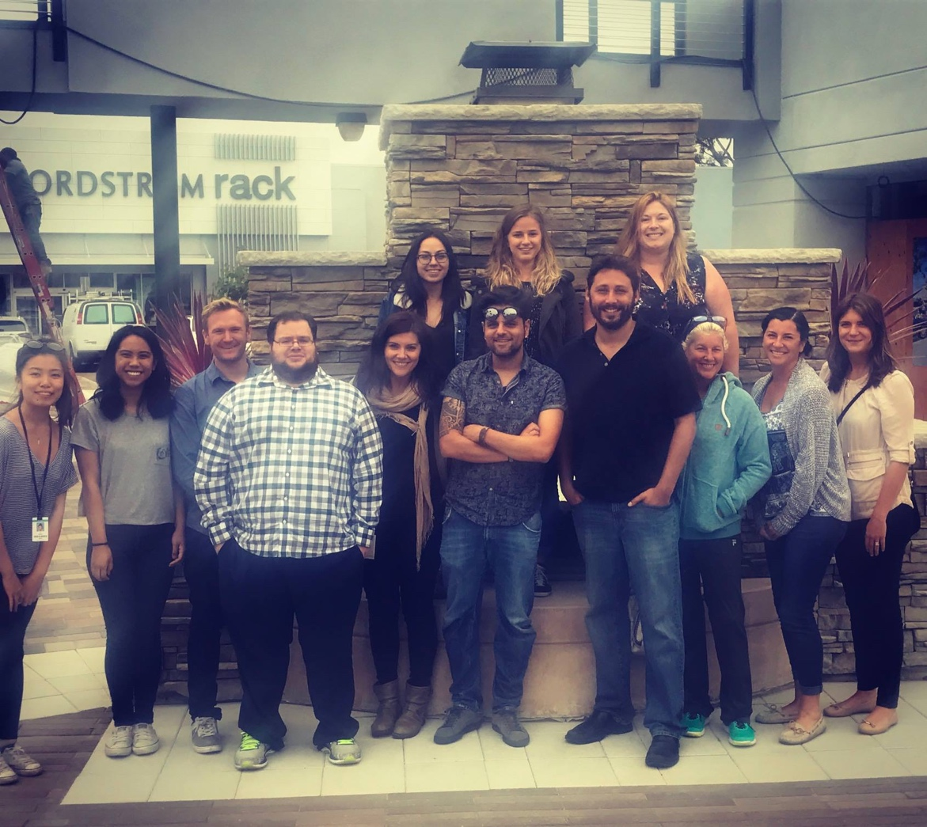
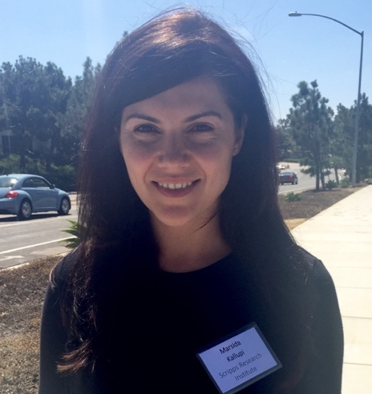
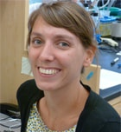
WWW.DRUGABUSERESEARCH.ORG
WWW.ADDICTIONBIOBANK.ORG
WWW.BRAINADDICTION.ORG
Thank you!
Biobank
Manager
Asst. Prof.
Asst. Proj. Scientist
Dr. de Guglielmo
Dr. Kallupi
Dr. Carrette
Dr. Schweitzer
Lisa Maturin
Postdocs
Graduate Students
Selene Bonnet-Zahedi Lauren Smith
Research Assistants
Collaborators
Andres Collazo
Abe Palmer
Francesca Telese
Dr. Shankar
Dr. Sneddon
Dr. Plasil
Dr. Avelar
Dr. Simpson
Dr. Kimbrough
Molly Brennan
Ben Sichel
Dyar Othman
Jarryd Ramborger
Angelica Martinez
Brent Boomhower
Lani Tieu
McKenzie Pavlich
Sharona Sedighim
Jarryd Ramborger
Staff Research Associate 1
Department of Psychiatry
jkramborger@health.ucsd.edu
@BrainAddiction

