Slide 1
Back to the Basics of DAGMan
Automating Workflows via DAGMan
By: Cole Bollig
Software Developer for CHTC
Throughput Computing 2024

Slide 2
Why use DAGMan?
AUTOMATION
DAGMan provides a way for the researcher to organize HTCondor jobs into workflows to be automatically submitted.
DAGMan guarantees jobs run in a particular order as described by the researcher.
This is useful for jobs that require the output of another job as input.
Output
Input
Simulation
Results.out
Analysis

Slide 3
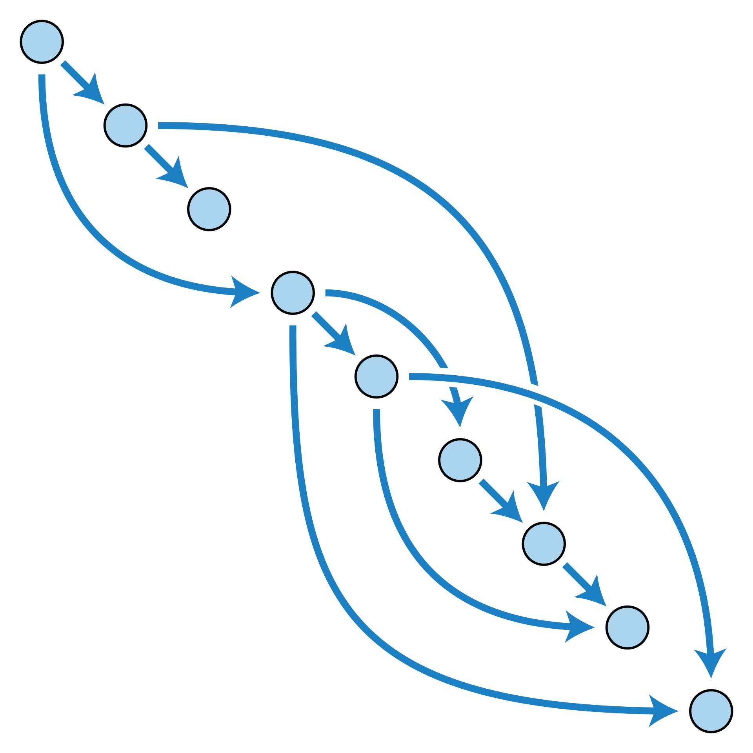
What is DAGMan?
DAGMan stands for Directed Acyclic Graph (DAG) Manager
Directed Acyclic Graph (DAG):
A topological ordering of vertices (“nodes”) established by directional connections (“edges”)
The acyclic aspect requires a start and end with no looped repetition.
Directed Acyclic Graph - Wikipedia
HTCondor DAGMan Documentation

Slide 4
What is a DAGMan Node?
Node
A node is a unit of work comprising of up to three parts:
(Optional) A PRE Script.
(Required) A list of one or more jobs. The core of a node!
(Optional) A POST Script.
PRE Script
List of Jobs
Awesome-Science.sub
executable = ./find_waldo.py
arguments = ”--scan --retry 3”
input = “book.png”
output = “found.png”
request_disk = 3GB
request_cpus = 4
queue 100
POST Script
Note: DAGMan views a list of jobs as a single entity. Meaning all must succeed to be considered successful.

Slide 5
Simple Example
diamond.dag
(dag_dir) /
Diamond DAG visualized
JOB A A.sub
JOB B B.sub
JOB C C.sub
JOB D D.sub
PARENT A CHILD B C
PARENT B C CHILD D
A.sub B.sub
C.sub D.sub
diamond.dag
(other job files)
A
Creates
Nodes
(A,B,C,D)
B
C
Creates
Edges
D
Note: All parts of the DAG (nodes, edges, modifications) must be declared in the DAG description file prior to submission.

Slide 6
Running a DAG

Slide 7
Submitting a DAG
DAG Submission commands:
condor_submit_dag dag_file
htcondor dag submit dag_file
$ htcondor dag submit diamond.dag
DAG 6 was submitted.
$ condor_submit_dag diamond.dag
-----------------------------------------------------------------------
File for submitting this DAG to HTCondor : diamond.dag.condor.sub
Log of DAGMan debugging messages : diamond.dag.dagman.out
Log of HTCondor library output : diamond.dag.lib.out
Log of HTCondor library error messages : diamond.dag.lib.err
Log of the life of condor_dagman itself : diamond.dag.dagman.log
Submitting job(s).
1 job(s) submitted to cluster 6.
-----------------------------------------------------------------------
condor_submit_dag Man Pages

Slide 8
What happens?
Submitting a DAG to HTCondor produces an HTCondor scheduler universe job for the DAGMan process (DAGMan job proper).
Lots of files produced:
Informational DAG files
*.dagman.out
*.nodes.log
*.metrics
DAGMan job proper files
*.condor.sub
*.dagman.log
*.lib.err
*.lib.out
= DAG progress/error output
= Collective job event log (Heart of DAGMan)
= JSON formatted DAG information
= Submit File
= Job Log
= Job Error
= Job Output
Notes:
- The * is replaced by the name of the DAG file submitted to DAGMan.

Slide 9
Monitoring a DAG
Simply use condor_q to view the DAG in queue
Use –nobatch –dag to see a broken-out view of the DAG and running jobs (with associated node names).
Can even use condor_watch_q
$ condor_q
-- Schedd: COLES_AP@ : <127.0.0.1:49473?... @ 07/06/23 10:14:23
OWNER BATCH_NAME SUBMITTED DONE RUN IDLE TOTAL JOB_IDS
cole diamond.dag+6 7/6 10:14 _ _ 1 4 7.0
$ condor_q –nobatch -dag
-- Schedd: COLES_AP@ : <127.0.0.1:49473?... @ 07/06/23 10:14:25
ID OWNER SUBMITTED RUN_TIME ST PRI SIZE CMD
6.0 cole 7/6 09:18 0+00:00:11 R 0 0.5 condor_dagman ...
7.0 |-A 7/6 09:18 0+00:00:00 I 0 0.1 /bin/sleep 15

Slide 10
Checking a DAGs status
htcondor dag status <Job-Id>
[cabollig@ap2002 ~]$ htcondor dag status 1746219
DAG 1746219 [science.dag] has been running for 09:33:35
DAG has submitted 184 job(s), of which:
41 are held.
138 have completed.
5 have failed.
DAG contains 328 node(s) total, of which:
[#] 138 have completed.
[=] 41 are running: 41 jobs.
[-] 121 are waiting on other nodes to finish.
[!] 23 will never run.
[!] 5 have failed.
DAG had at least one node fail. Only 91.46% of the DAG can complete.
[#####################################===========--------------------------------!!!!!!!!!] DAG is 42.07% complete.

Slide 11
All Things Come to an End
Ideally everything runs smoothly, and the DAG completes successfully.
But just in case…
A
Node Failure = DAG failure
DAGMan will try to make as much forward progress until no more nodes can be executed due to dependencies.
If any of a nodes associated jobs fail (non-zero exit code) then the node is failed.
B
C
D

Slide 12
All Things Come to an End
Ideally everything runs smoothly, and the DAG completes successfully.
But just in case…
A
What happens when a DAG fails?
DAGMan produces a rescue file *.rescue001
Simply fix any issues and resubmit the DAG. DAGMan will read the most recent rescue file to skip rerunning already successfully completed nodes.
B
C
D

Slide 13
Other DAGMan Features

Slide 14
DAGMan Node Scripts
Scripts provide a way to preform tasks at key points in a node’s lifetime. Each script type has different execution time.
Pre Scripts run before a Node’s jobs are submitted to the Schedd.
Post Scripts run after a node jobs have exited the Schedd queue.
All DAGMan scripts run on the Access Point (AP) and not the Execution Point (EP).
Node
PRE Script
example.dag
JOB A job1.sub
SCRIPT PRE A verify.sh
SCRIPT POST A check.sh $RETURN
List of Jobs
POST Script
DAGMan Scripts Documentation
Notes:
-Script tasks should not be computationally heavy (consider making a node)
-Managed by DAGMan and not the AP
-Used to help cut down unecessary tasks that create lots of overhead if the job ran it

Slide 15
Automatically Retry a Failed Node
Retry a node up to N times when said node has failed for any reason (PRE Script Failed, an associated job failed, POST Script failed)
When retired all parts of the node are re-run. PRE Script, POST Script and the entire list of jobs (even those previously successful).
Use UNLESS-EXIT to short circuit retry
RETRY NodeName N
JOB A job1.sub
JOB B same.sub
JOB C same.sub
JOB D job4.sub
RETRY D 5 UNLESS-EXIT 3
PARENT A CHILD B C
PARENT B C CHILD D
diamond.dag
DAGMan Retry Documentation

Slide 16
Reusing Components with VARS
Using the VARS command in the DAG description file creates macros to be used by the job submit description.
Allows one job submit description to be used for many DAG nodes.
Can pass custom Job Ad attributes to the node’s jobs using My. syntax.
Also has special macros
$(JOB) becomes node name
$(RETRY) becomes current retry attempt
diamond.dag
same.sub
JOB A job1.sub
JOB B same.sub
JOB C same.sub
JOB D job4.sub
VARS B country=“USA”
VARS C country=“Canada”
PARENT A CHILD B C
PARENT B C CHILD D
executable = my_script.sh
arguments = $(country)
log = $(country)-$(cluster).log
error = $(country)-$(cluster).err
output = $(country)-$(cluster).out
queue
DAGMan VARS Documenation

Slide 17
SUBDAG EXTERNAL
sample.dag
JOB A job.sub
SUBDAG EXTERNAL SIM simulation.dag
JOB C job.sub
SCRIPT POST SIM …
RETRY 10 SIM
PARENT A CHILD SIM
PARENT SIM CHILD C
To the parent DAG it is just a single node
Can use RETRY
Can have Pre and POST Script
Submits as another DAG to the Schedd that has its own DAGMan job process and output files.
DAG file and nodes don’t need to exist at submission time of parent DAG
Good for running sub-workflows where the number of jobs is not predefined
A
SIM
SUBDAG That runs and manages its own DAG in the Queue to analyze some data.
C
DAGMan Sub-DAGs Documentation

Slide 18
Dynamically Run N Nodes
Useful for when the number of nodes is not known at submission time.
inner.dag
parent.dag
A
B1
B2
B3
JOB A job.sub
SUBDAG EXTERNAL B inner.dag
JOB C job.sub
B
B4
B5
B6
inner.dag
JOB B1 job.sub
JOB B2 job.sub
JOB B3 job.sub
…
JOB B99 job.sub
JOB B100 job.sub
B7
B8
BN
C

Slide 19
SPLICE
A
Splices have their nodes merged into the parent DAG
Allows easy reusability
Low strain on the Access Point (AP)
All splice files must exist at submit time
Pre and Post scripts cannot run on splices as a whole
Splices can not use the RETRY capability
SPLICE X
X+A
X+B
X+C
X+D
X+E
JOB A job.sub
SPLICE X cross.dag
JOB C job.sub
PARENT A CHILD X
PARENT X CHILD C
sample.dag
C
DAGMan Splicing Documentation

Slide 20
Questions?

