Slide 1
Throughput Machine Learning in CHTC
Ian Ross
Data Engineer, Center for High Throughput Computing

Slide 2
Outline
Artificial Intelligence and Machine Learning – a too-brief overview
Throughput Machine Learning
Example use cases
ML workflows and usage in CHTC
Ongoing work
Future plans

Slide 3
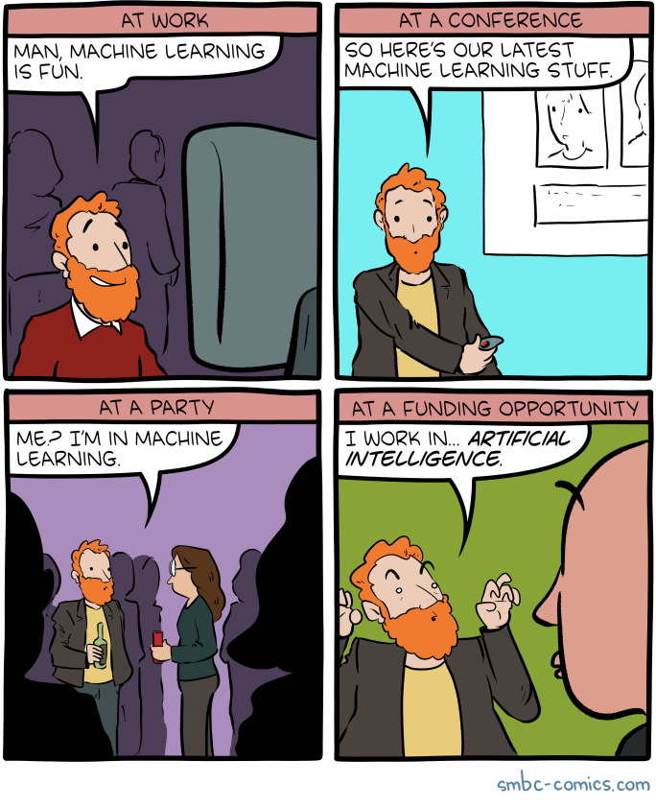
AI/ML – a too-brief overview
Artificial intelligence – Methods and software to enable machines to observe, identify, and react to stimuli to achieve a defined goal
Machine learning – Algorithms and practices to enable machines to recognize patterns in data and generalize to new data to achieve tasks without instruction
  Subset of AI

Slide 4
Artificial Intelligence
Machine Learning
Deep learning
Using artificial neural networks to capture
connections and strengths (weights)
between inputs and outputs
Generative AI
Models trained to generate data
similar to that used to train
Large language models

Slide 5
Data science
Artificial Intelligence
Data engineering
Machine Learning
Deep learning
Using artificial neural networks to capture
connections and strengths (weights)
between inputs and outputs
Generative AI
Models trained to generate data
similar to that used to train
Large language models

Slide 6
Data science
Statistics
Artificial Intelligence
Data engineering
Machine Learning
Bioinformatics
Deep learning
Using artificial neural networks to capture
connections and strengths (weights)
between inputs and outputs
Generative AI
Models trained to generate data
similar to that used to train
Large language models

Slide 7
We care about these things primarily
as tools and techniques that
enable new and novel SCIENCE
…but there are complications
Data science
Statistics
Artificial Intelligence
Data engineering
Machine Learning
Bioinformatics
Deep learning
Using artificial neural networks to capture
connections and strengths (weights)
between inputs and outputs
Generative AI
Models trained to generate data
similar to that used to train
Large language models

Slide 8
AI and ML – inherent challenges
Data and computing needs can be immense
GPUs bring their own layer of complexity
  Dropouts, user education, administration, cost, availability
Ecosystem moves fast and everybody wants to be first
  Copy-paste recipes propagate faster than truly educational ones
  Software stacks with similar, but not quite the same, interface (recipe challenges – more to come)
Training can be a long process
  Checkpointing required

Slide 9
AI and ML – inherent challenges
Data needs can be immense
Ecosystem moves fast and everybody wants to be first
  Copy-paste recipes propagate faster than truly educational ones
  Software stacks with similar, but not quite the same, interface (recipe challenges – more to come
GPUs bring their own layer of complexity
  Dropouts, user education, administration, cost, availability
Training can be a long process
  Checkpointing required
These are not new challenges! User education, scheduling, data movement, workflow orchestration… “There is nothing new under the sun”

Slide 10


Slide 11
Throughput machine learning in CHTC
Throughput machine learning applies our tried and tested technologies to ML applications
  Data movement… but at a much bigger scale (and potentially across nodes)
  Checkpointing… but at an epoch boundary (and potentially across nodes)
  DAGMan… but with a few extra bells and whistles (and potentially across nodes)
Resources (GPUs) are a bit more “valuable” and policy is king
  Prioritization, scheduling, pre-emption
Three use cases to highlight familiarity and new twists..

Slide 12

Throughput machine learning – Use case 1
I have 18 million scientific articles, and I want to search for, extract, and synthesize information across them! This is a high-throughput inference problem!

Slide 13

I have 18 million scientific articles, and I want to search for, extract, and synthesize information across them! This is a high-throughput inference problem!
I can help with the LLM+RAG side of things!
Jason Lo, DSI collaborator

Slide 14
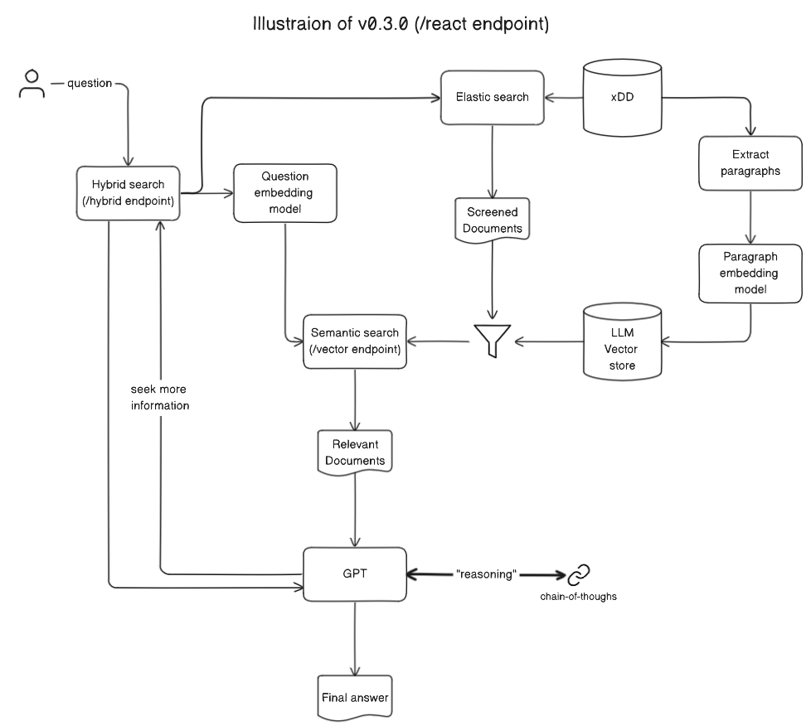
Throughput inference
Using existing models for inference in traditional high-throughput approaches (with or without GPUs)
Examples:
  Embedding
    Vector or scalar representations of input data
  Predictions
  LLM security studies
Notes:
Text preprocessing (CPU) and paragraph embedding using a dense-passage retrieval model (GPU), deployed on sets of documents within CHTC
Input: Text; Output: vector representations of paragraphs

Slide 15
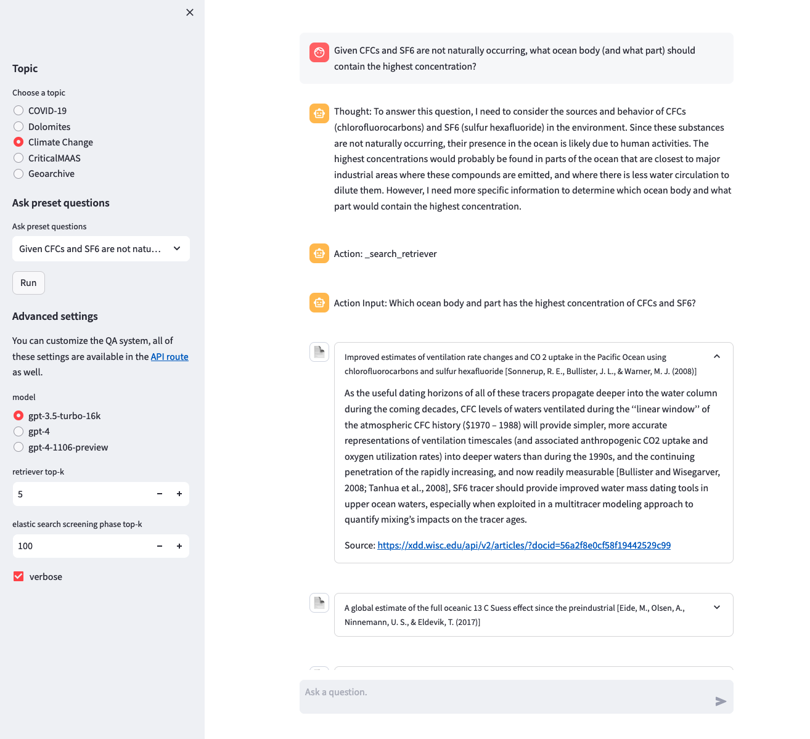

Slide 16

Throughput machine learning – Use case 2
I want to train many models, empirically measure their predictive power, and use those models to drive scientific exploration.

Slide 17
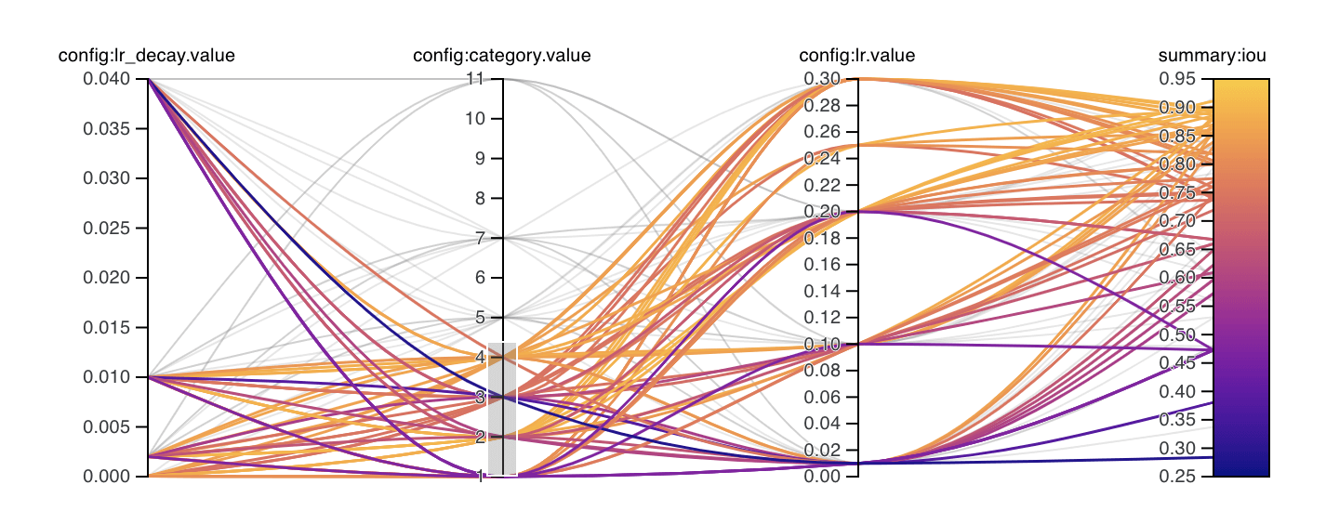
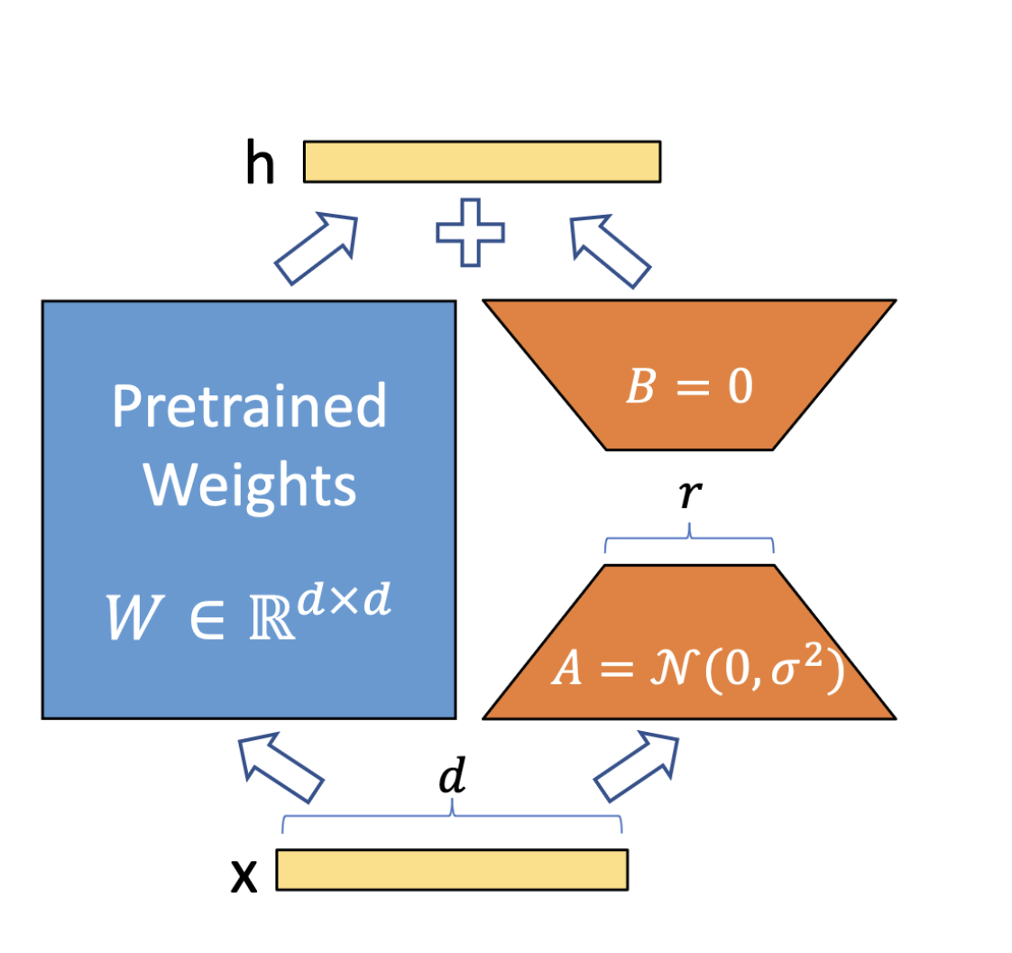
Throughput Training
Training (potentially many) relatively small models to drive additional inference or science work
Examples:
  Hyperparameter optimization
  Ensemble learning
  Fine-tuning
  Ablation studies
From https://docs.ultralytics.com/guides/hyperparameter-tuning/
LoRA: Low-Rank Adaptation of Large Language Models (https://arxiv.org/pdf/2106.09685)

Slide 18

Throughput machine learning – Use case 3
I want to create a foundation model for bioimaging and want to scale training across multiple nodes!

Slide 19
Multi-node training in CHTC
Aka what can we do with existing tools?
Challenges:
  Heterogeneous resources (solved with requirements)
  Asynchronous resource acquisition (pytorch elastic)
  Nodes involved need a rendezvous server address (solved with DAG)
  Performance
    TBD… but won’t compare to the big dogs in the LLM fight.

Slide 20
Multi-node training in CHTC (POC)
train.dag
gpuworker_sub.template
PROVISIONER RANK0 gpu.sub
JOB WORKER gpuworker.sub
SCRIPT PRE WORKER injectRank0Name.sh
…
executable = train.sh
arguments = SERVER_IP_ADDRESS_GOES_HERE SERVER_PORT_GOES_HERE
requirements = (GPUS_MaxSupportedVersion > 12000) && (GPUs_GlobalMemoryMb >= 32000) && machine != "SERVER_IP_ADDRESS_GOES_HERE”
…
gpu.sub
…
executable = train.sh
arguments = rank0 9640
transfer_input_files = train.py, train.sh, /usr/lib64/python3.9/site-packages/htcondor/htchirp/htchirp.py
…
injectRank0Name.sh
train.sh
#!/bin/sh
# A prescript for the workers to inject
# the address and port of the rdzv server
# into their submit file.
# We assume this is in a file in the
# cwd named "rank0_contact"
read name port < rank0_contact
sed -e "s/SERVER_IP_ADDRESS_GOES_HERE/${name}/g" \
-e "s/SERVER_PORT_GOES_HERE/${port}/g" < gpuworker.sub.template \
> gpuworker.sub
…
if [ "$1" = "rank0" ]
then
# rank0 port
h=$(hostname)
p=$2
echo "$h $p" > contact_file
python3 htchirp.py put contact_file rank0_contact
rm contact_file
else
h=$1
p=$2
fi
torchrun --nnodes 1:2 --nproc_per_node 1 --rdzv_backend c10d --rdzv-id 1 --rdzv-endpoint "$h:$p"
…

Slide 21

Multi-node training in CHTC (POC)
1. Provisioner (rank0) node starts
Execute Point
Access Point

Slide 22
Multi-node training in CHTC (POC)
Provisioner (rank0) node starts
Provisioner node chirps back address and port
Execute Point
Access Point

Slide 23
Multi-node training in CHTC (POC)
Provisioner (rank0) node starts
Provisioner node chirps back address and port
  2a. rank0 torchrun starts (🧮)
Execute Point
Access Point
🧮

Slide 24
Multi-node training in CHTC (POC)
Provisioner (rank0) node starts
Provisioner node chirps back address and port
  2a. rank0 torchrun starts (🧮)
3. Pre-script for worker node runs, injecting rank0 job address into worker submit template
Execute Point
Access Point
🧮

Slide 25
Multi-node training in CHTC (POC)
Provisioner (rank0) node starts
Provisioner node chirps back address and port
  2a. rank0 torchrun starts (🧮)
3. Pre-script for worker node runs, injecting rank0 job address into worker submit template
4. Worker node runs and torchrun starts (🧮) with rank0 node defined as rendezvous server
Execute Point
Access Point
🧮
🧮

Slide 26
ML workflows and usage in CHTC
A (very) unscientific survey
Training vs inference:
  60/40 split training to inference
Software stack:
  Pytorch (~60%), parabricks, Lightning
Domains: Bioinformatics, LLMs, empirical ML (bias detection), …
Notable feedback:
  “For what it’s worth, more physical gpus of moderate size (16GB memory) is much more preferable for my purposes than an H100 with 80GB memory.”
  “We are super thankful for the the CHTC providing GPU support, as this research would not have been possible without it!”

Slide 27

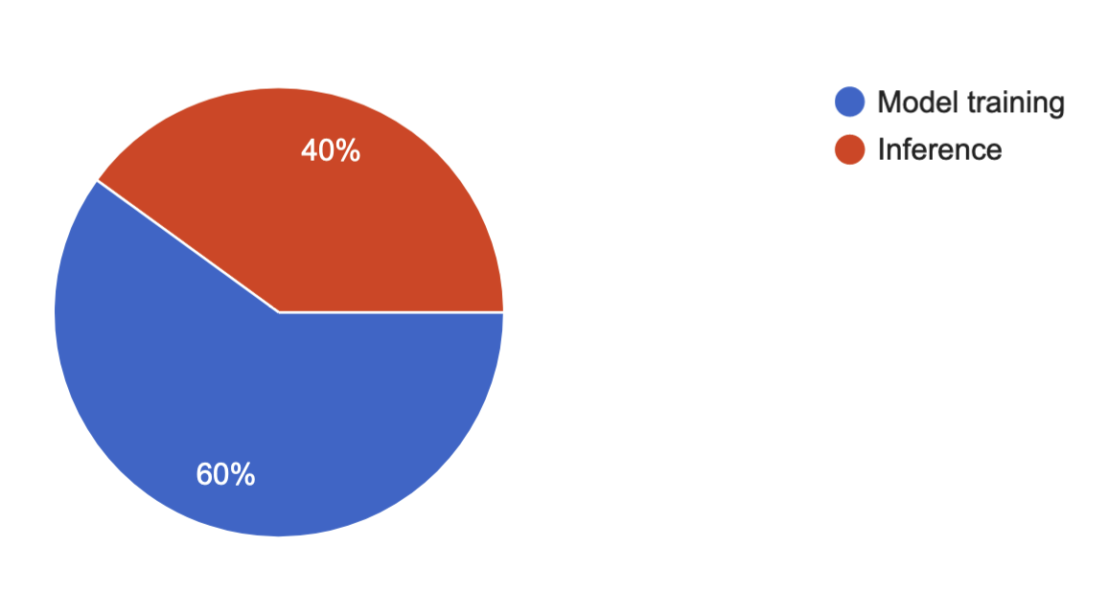
Ongoing work
Pelican/pytorch integration
Tutorials, documentation, recipes
  https://github.com/CHTC/templates-GPUs
  https://chtc.cs.wisc.edu/uw-research-computing/machine-learning-htc
Additional DAG workflows
  Evaluation + early abort
More surveys and resource understanding

Slide 28
Future plans
Answers to:
  How does the heterogeneity of resources and availability impact a checkpointed + restarted training process?
  How do we effectively move datasets for training (and inference!)?
  What, if any, gaps exist in enabling users to handle large ensemble trainings?
…and where-ever AI developments and this community take us.

