Slide 1
Monitoring HTCondor in HEPCloud's Decision Engine using Prometheus and Grafana
Ilya Baburashvili
Throughput Computing 24
07/11/2024

Slide 2
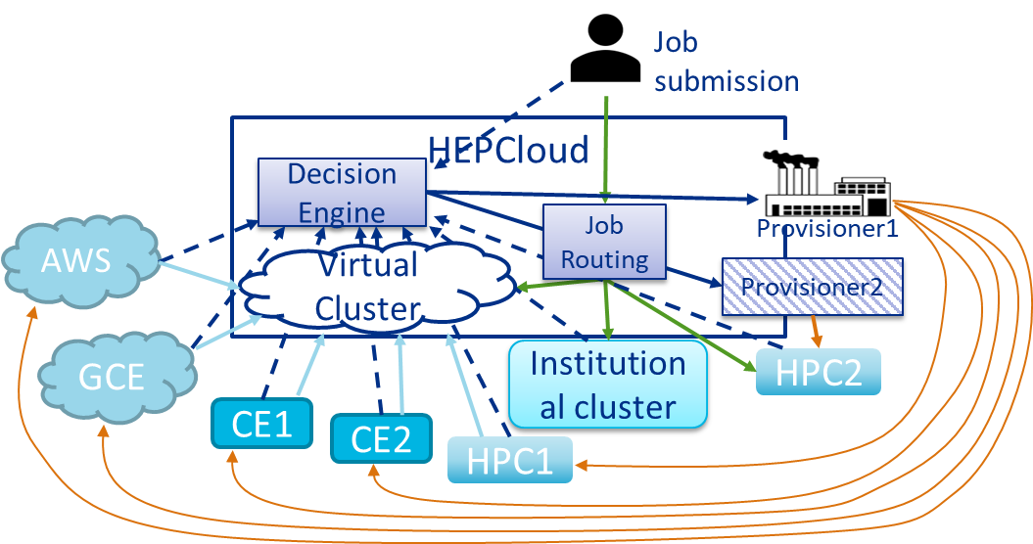
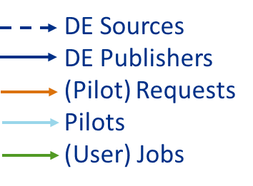
HEPCloud
Provides efficient and cost-effective provisioning of computing resources
Uses both local and remote resources
Resources provided based on:
Job requirements
Cost
Resource availability
Priority
Decision Engine
Notes:
User Jobs are submitted through HTCondor and placed in a job queue,schedd
Glideins are submitted through HTCondor
Glideins become resources in a HTCondor pool and are matched with jobs
Decision Engine collects data about jobs, Glideins, and resource status through HTCondor

Slide 3
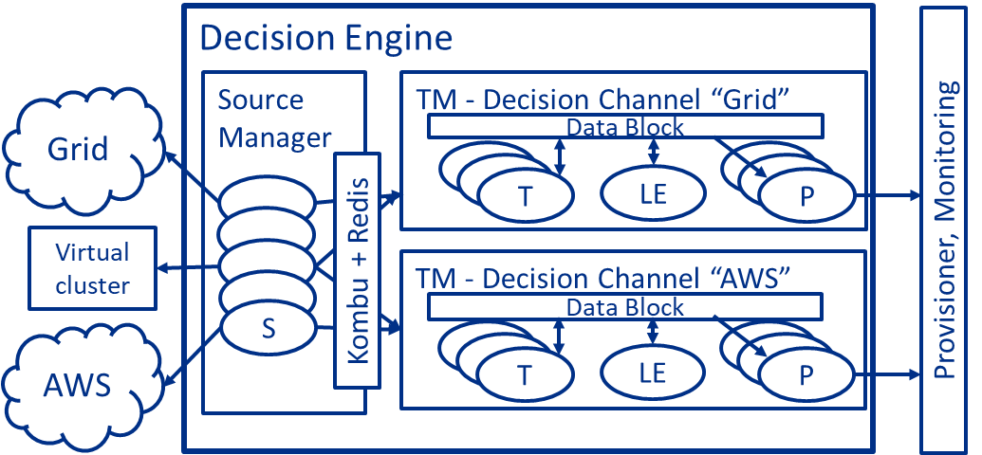
Decision Engine
Minimizes job execution time while taking into account costs and other constraints
Modules - Source, Transform, Logic Engine, Publisher
Source Manager - periodically runs Sources
Task Manager – manages execution of Modules for a Data Block

Slide 4
Decision Engine Modules
Source – retrieves information from external sources and Data Blocks and publishes it to interested channels triggering Decision Cycle
Transform – first stage of Decision Cycle. Takes in data from Sources, manipulates it, and stores in Data Blocks
Logic Engine – uses facts (Python Booleans) to construct rules used to generate decisions
Publisher – takes in data from Data Blocks and publishes it to external systems

Slide 5
Prometheus Metrics
Prometheus is an open-source software developed by SoundCloud for event monitoring
Uses a time series database to record metrics
PromQL – query language used to retrieve time series data
Metrics can then be visualized through dashboards using Grafana

Slide 6
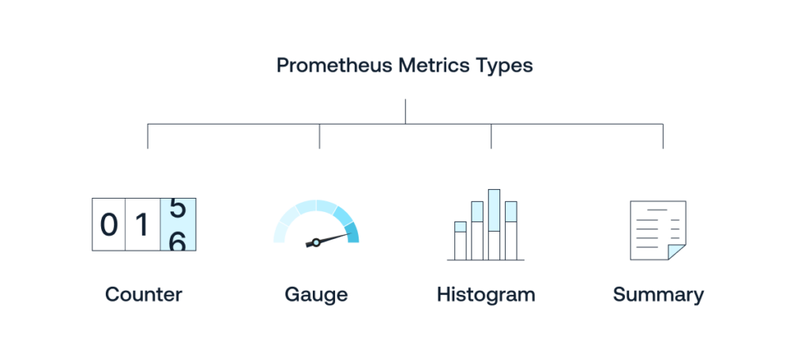
Types of Prometheus Metrics
Counter - single numerical value that can only increase or be reset to zero
Ex. number of HTTP requests served
Gauge – single value that can increase and decrease
Ex. Current memory usage
Histogram – count of sample observations within configurable buckets.
Ex. Request response times
Summary – similar to histogram, but with configurable quantiles.

Slide 7
Decision Engine Metrics
Added to Decision Engine Prometheus metrics to track various aspects of how DE is running:
Overall health of Decision Engine
Time it takes to run commands and perform operations
Status of running jobs
Data acquired from sources
Number of Glideins and jobs running

Slide 8
De-client Metrics
Use Prometheus Histogram to track runtime duration of de-client commands such as:
de-client --status - prints status of all sources and channels (BOOT, ACTIVE, STEADY, IDLE)
de-client --show-de-config - prints server configuration
de-client --start_channel
de-client --stop_channel
De-client commands control various aspects of Decision Engine
Starting and stopping a specific channel or all channels
Getting the status of Decision Engine

Slide 9
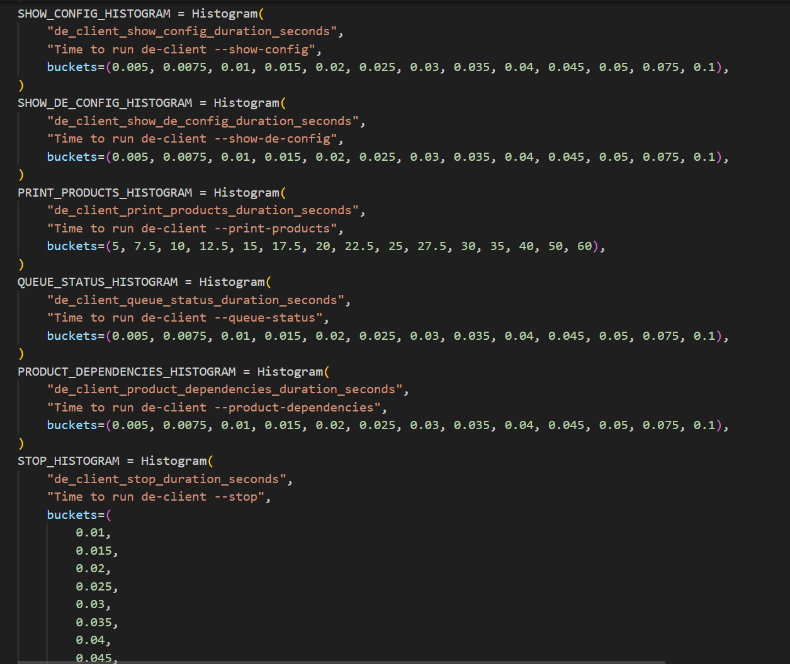
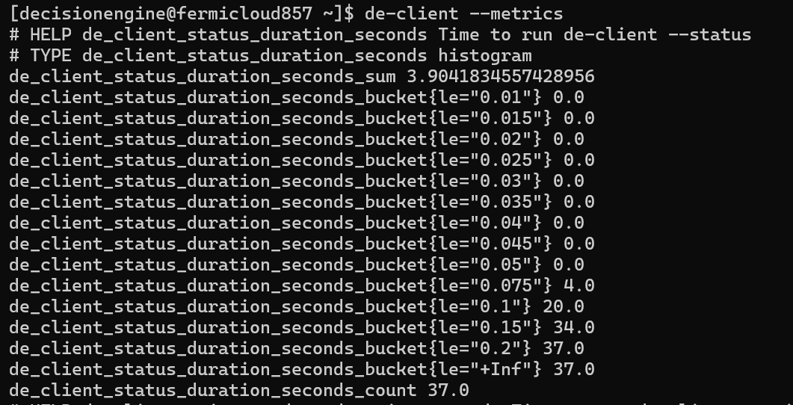
Tracking duration of de-client commands using Prometheus Histogram
Prometheus histograms use buckets to track duration
Useful for tracking runtime of de-client commands
Metrics available also via de-client --metrics
For testing and configuring histogram buckets, de-client commands were run continuously in a loop to establish the range of time they fall into.

Slide 10
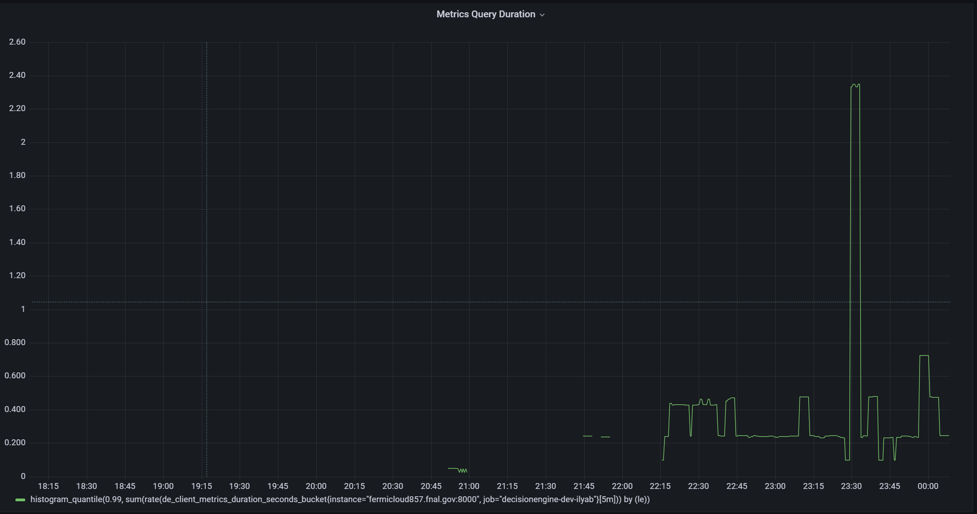
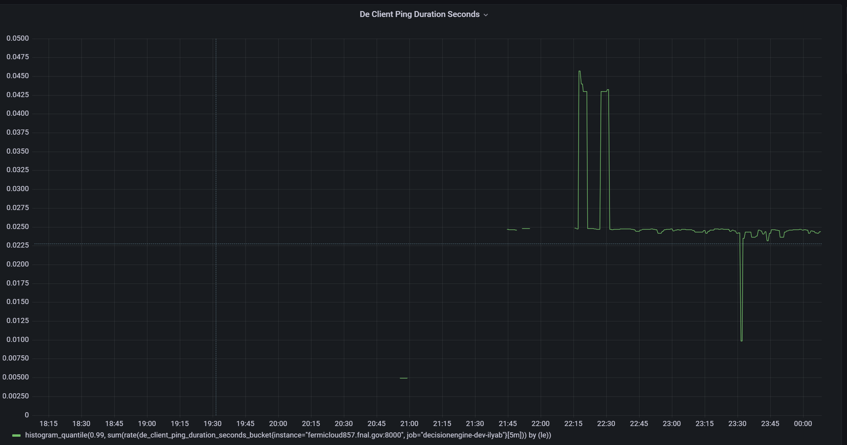
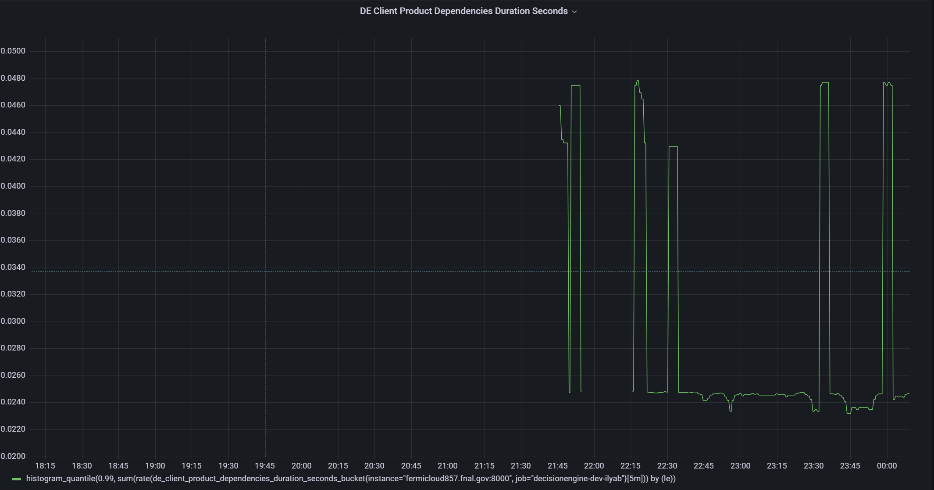
Visualizing de-client metrics using Grafana

Slide 11
Tracking durations of Transform, Logic Engine, Publisher, and Source
Also contains metrics to track performance of Decision Engine Modules:
de_logicengine_last_run_timestamp_seconds, de_transform_last_run_timestamp_seconds, de_publisher_last_run_timestamp_seconds, de_source_last_acquire_timestamp_seconds
Use Gauge to obtain last timestamp when module was run
de_logicengine_run_seconds, de_transform_run_seconds, de_publisher_run_seconds, de_source_acquire_seconds
Use Histogram to track duration modules took to run

Slide 12
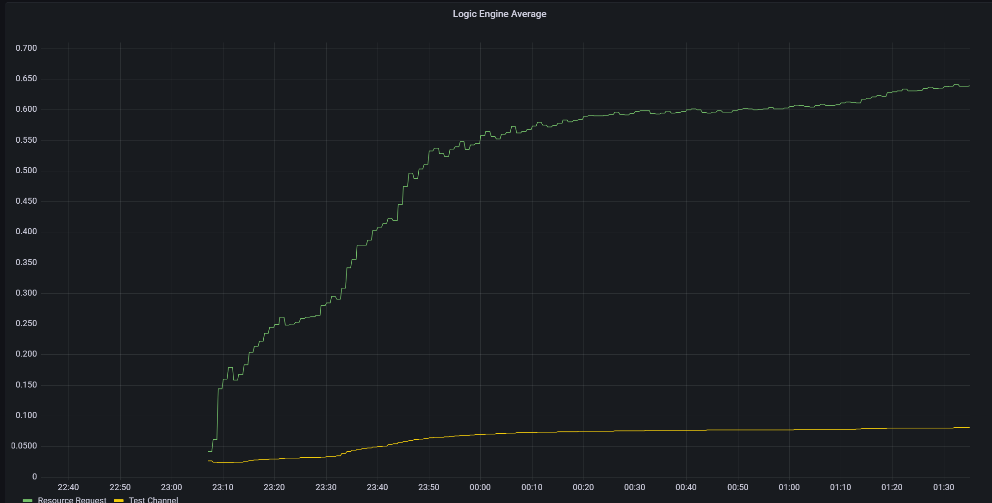
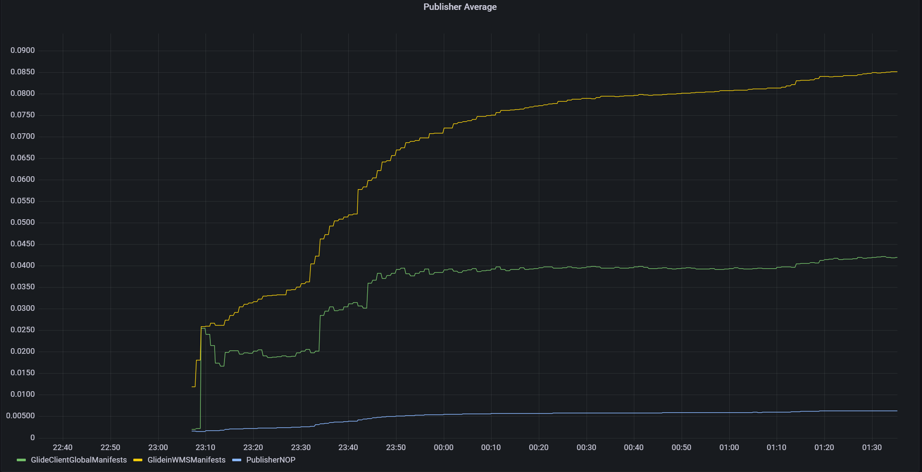
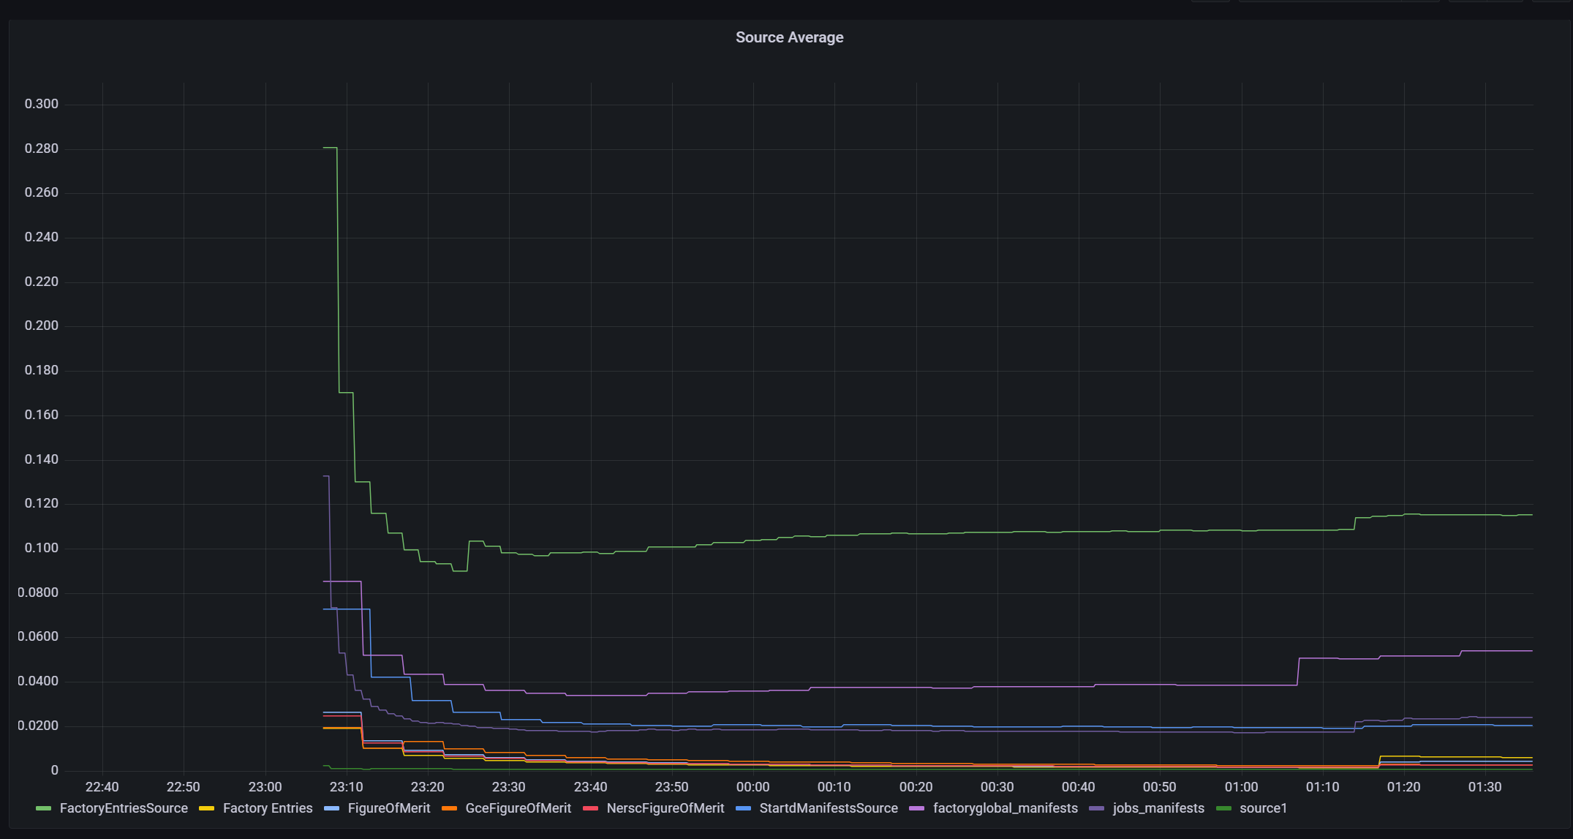
Tracking durations of Transform, Logic Engine, Publisher, and Source
Grafana dashboard contains panels that track runtimes of all module types
Transforms, Logic Engines, Publishers, Sources

Slide 13
Tracking durations of Transform, Logic Engine, Publisher, and Source
Also contains panels for each transformation separately

Slide 14
Job and Glidein Metrics
Job metric:
dem_htcondor_jobs_status_count - gauge which tracks the number of user jobs classified by job status:
idle, running, removed, completed, held, transferring_output, suspended
Glidein metrics:
dem_htcondor_slots_status_count – gauge which tracks number of glideins available for the client based on status.
Idle, Busy, Retiring, Vacating, Suspended, Benchmarking, Killing, None
dem_htcondor_cores_count - gauge which tracks number of active cores by state
dem_htcondor_cores_histogram - histogram of active cores by state
dem_htcondor_memory_count – gauge which tracks amount of memory used by state
dem_htcondor_memory_histogram - histogram of memory used by state
Claimed, Unclaimed, Owner, Matched, Preempting, Backfill, Drained

Slide 16
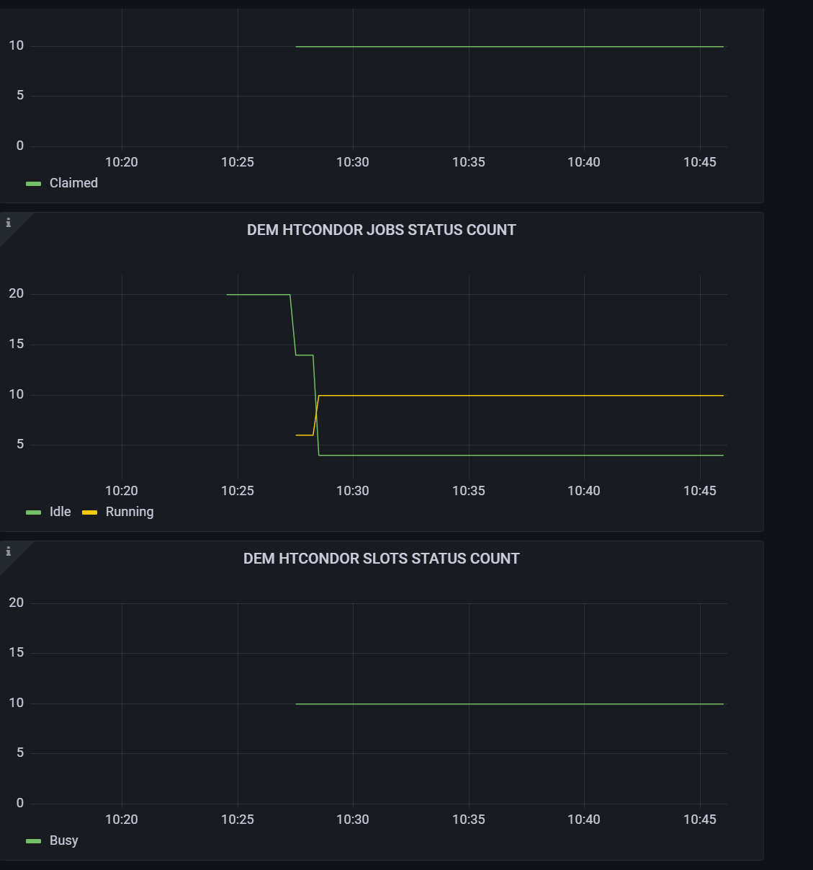
Dashboard for Job and Glidein metrics

Slide 17
Acknowledgments
This presentation has been authored by Fermi Research Alliance, LLC under Contract No. DE-AC02-07CH11359 with the U.S. Department of Energy, Office of Science, Office of High Energy Physics (FERMILAB-SLIDES-22-033-SCD).
This presentation has been authored by Fermi Research Alliance, LLC under Contract No. DE-AC02-07CH11359 with the U.S. Department of Energy, Office of Science, Office of High Energy Physics (FERMILAB-SLIDES-22-033-SCD).
HEPCloud Team - Marco Mambelli, Shreyas Bhat, Namratha Urs, Bruno Coimbra, Skyler Foster

Slide 18
Summary
Some aspects of how Decision Engine runs, and its decision-making process may be hard to understand
The use of Prometheus metrics and Grafana dashboards provides an easier means to visualize the internal mechanisms of Decision Engine, understand what’s happening at any particular moment, and troubleshoot errors

