Slide 1
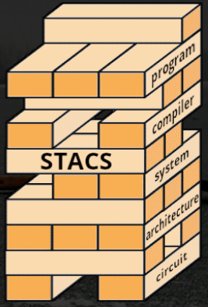
Working from Both Ends to Bridge the Gap Between Silicon and Human Cognition
High Throughput Computing - July 2024
Ranganath (Bujji) Selagamsetty
Robert Klock
Joshua San Miguel
Mikko Lipasti
Notes:
PHARM - Predictive High-Performance Architecture Research Mavens
STACS - SYSTEMS AND TECHNOLOGIES ACROSS THE COMPUTING STACK

Slide 2
Outline
Neuromorphic computing: the bridge between silicon and biology
Top-down: Drawing inspiration from the auditory cortex for DNS
Broad design exploration of network parameters (CHTC GPUs)
Bottom-up: Improving current CPU architectures for stochastic workloads
Characterisation of Random Number Generation schemes (CHTC CPUs)
Future Work and Opinions
Notes:
Primer on what our groups are doing
Touch on our two approaches: top down (SNN models for denoising) and bottom up (stochastic workloads)
For us, neuromorphic computing is about bridging the gap between computers and brains

Slide 3
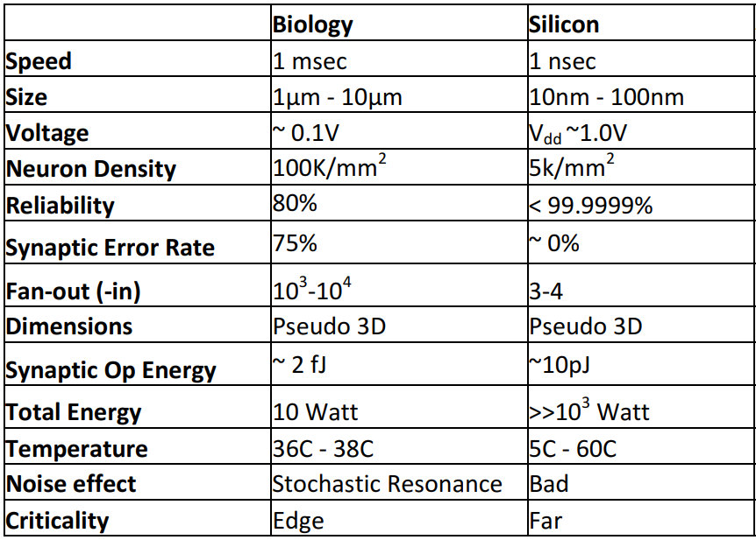
Neuromorphic Computing
“The opportunity lies in combining the best of biology and silicon”
Approaches from different directions:
Top-down: understand the brain for better algorithms
Bottom-up: accelerate existing computing systems for cognitive programs
* Table 1 from Schuller, Ivan K., Stevens, Rick, Pino, Robinson, and Pechan, Michael. Neuromorphic Computing – From Materials Research to Systems Architecture Roundtable. United States: N. p., 2015. Web. doi:10.2172/1283147.
Notes:
Brains and computer chips are each good at specific things, so we try to leverage the best of both worlds
When we say top-down, we mean that we try to understand the brain better and use that as inspiration for better computing
When we say bottom up, we mean to accelerate conventional computing methods for understanding cognition
Boilerplate “here’s how chips have an advantage” and “here’s how brains have an advantage”

Slide 4
Top-down: Study Auditory Cortex for DNS
Speech denoising is a non-trivial, popular task
Microsoft DNS
Intel N-DNS
ANNs struggle, ears are proficient
Look to human anatomy for inspiration
What inspiration can we glean from the brain?
Rich data encoding from the pinna…
Energy efficiency from temporal computing in spiking neural networks…
Notes:
Our specific top-down problem is for speech denoising.
Microsoft introduced the Deep Noise Suppression Challenge
Intel developed its own flavor with Neuromorphic computing as the focus
While artificial neural networks struggle with this problem, an efficient, reasonably accurate solution exists in nature already:
the ascending auditory pathway in humans
There are many techniques to improve audio quality, and mileage often varies by compute requirements
We have a signal - in our case a person speaking, and we have a noise. Noise can be stationary, like white noise, or non-stationary, like construction noise. We add non-stationary noise to our signal

Slide 5
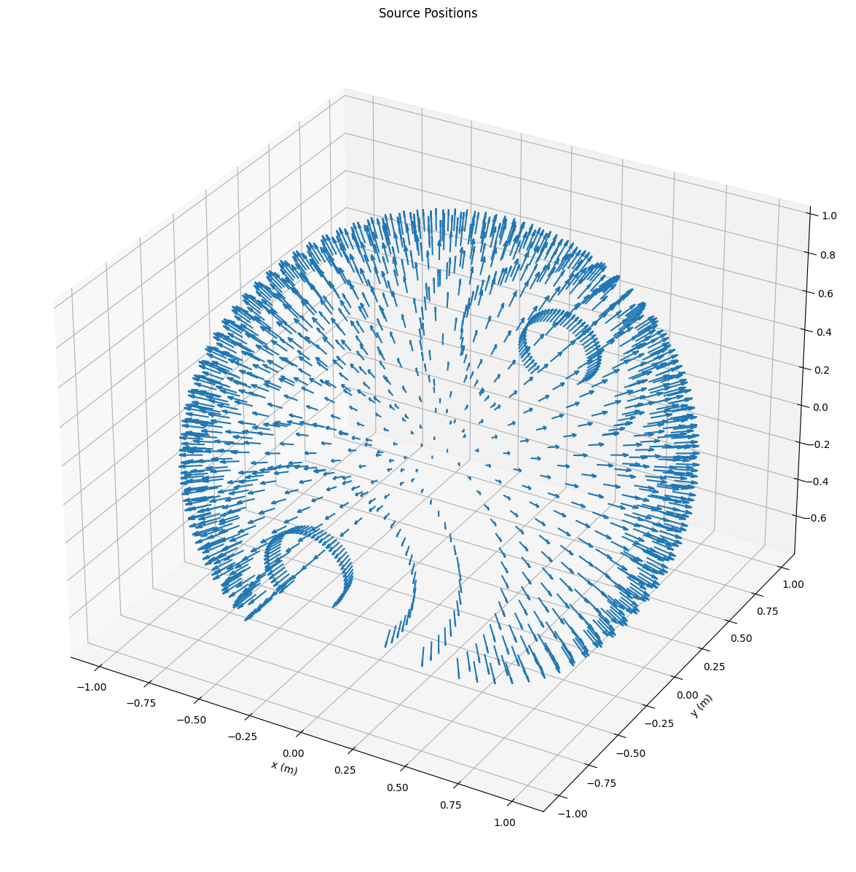
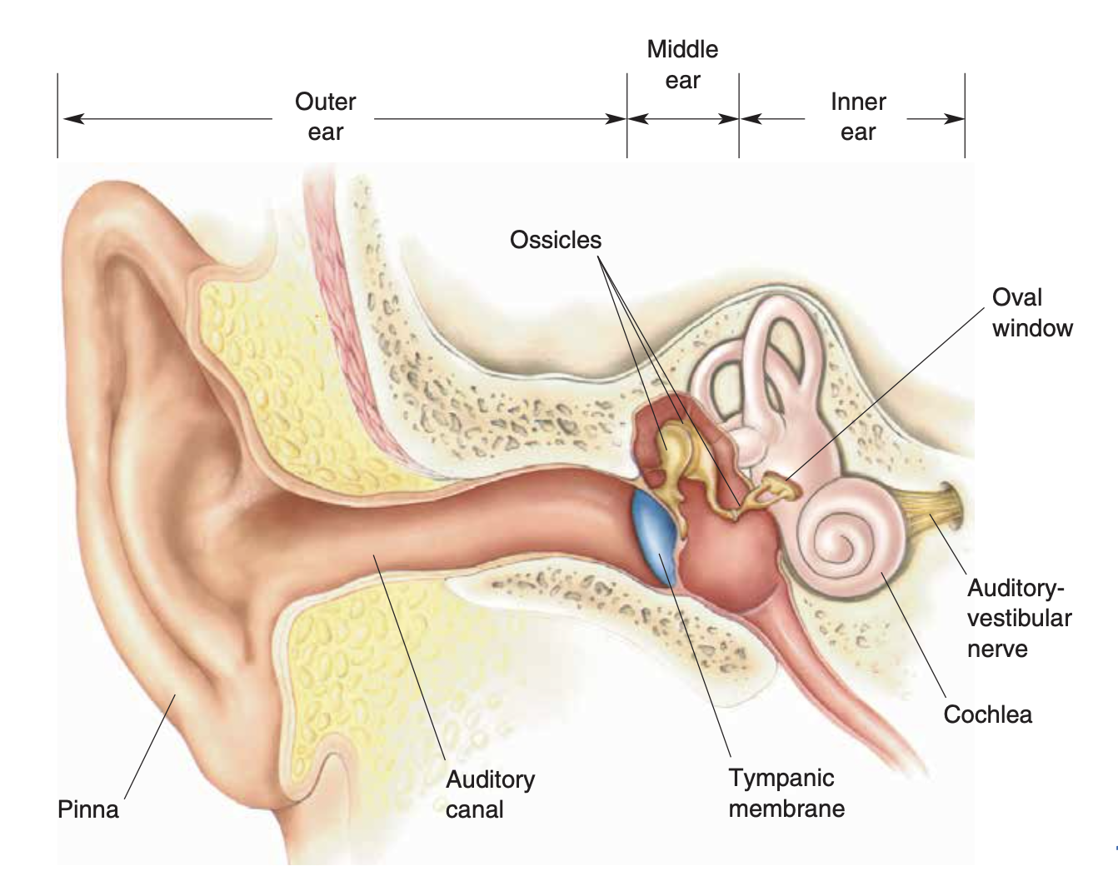
Speech & Noise Position for Denoising
Noise
Speech
CIPIC dataset allowed us to analyze 1250 possible sound source orientations
* Adapted from: Bear, Mark F. Neuroscience : Exploring the Brain — Fourth edition.
Notes:
In the real world, sound enters our ear from all around us. Its pretty rare to have signal and noise come from the same place. For example, if you’re trying to hear your friend at a party, you may turn your towards them and away from the crowd.
We wont dive into the details of anatomy, but I want you to notice that the auditory-vestibular nerve (point to it) is way far in from the outer ear. By the time its been processed into a neural signal, the sound has undergone many transformations. While we’ve grown accustomed to their looks, ears are pretty weirdly shaped. One effect of this is that sounds bounce around in all sorts of ways before they reach the auditory canal.
These surfaces reflect sound waves and physically implement notch filters
We believe this is has an effect on the brain’s ability to successfully recover a signal from the noise. And to test this, we used HTC resources to run a wealth of simulations to find if signal and noise locations affect the ability to recover a clean signal. We want to simulate all different orientations, and there’s clearly a lot of combinations.

Slide 6
Developing the GPU Workflow (1)
CHTC
GPULab
CHTC
Submit Server
1. Submit training job
Notes:
If we had it our way, our workflow would be this simple. Submit a training job to CHTC, let it run, and collect our data. However, we had to add some steps to everything working

Slide 7
Developing the GPU Workflow (2)
DockerHub
(ndns:v47_cuda12.1.1)
11.19 GB
CHTC
GPULab
2. NDNS Image pulled
CHTC
Submit Server
1. Submit training job
Notes:
In order to run our simulations, we use a host of tools provided by Intel to evaluate and train our system. In order to match their requirements, we had to develop and re-develop a docker image 47 times to get it to successfully run on CHTC. The size of the Docker Image itself is 11 gigs. Once unpacked, it becomes larger.
This arrow is green, indicating that CHTC manages this portion of the job.
==
I would emphasize that this took many iterations to successfully build this docker image (currently on version 47). This isn’t a jab at CHTC, but rather at Intel for making their requirements unclear.
Showing results is ideal. The Pinna results (the heatmaps, each square takes ~15 hours and HTC cut down time from months to week(s))
Slide 1: Overall idea - denoising, bio-inspired computing
Slide 2: HTC flow - clean up current slide
Slide 3: Results
Slide 4: Future work
6-7 minutes

Slide 8
Developing the GPU Workflow (3)
GitHub
IntelDNS forked repo
DockerHub
(ndns:v47_cuda12.1.1)
3. Repo pulled
11.19 GB
CHTC
GPULab
2. NDNS Image pulled
CHTC
Submit Server
1. Submit training job
Notes:
Once we have our container set up we clone our github repository and its requisite submodules. This lets us develop on personal computers and silo off runs to CHTC
We use pytorch in our development to simulate a spiking neural network

Slide 9
Developing the GPU Workflow (4)
GitHub
IntelDNS forked repo
DockerHub
(ndns:v47_cuda12.1.1)
3. Repo pulled
11.19 GB
CHTC
GPULab
2. NDNS Image pulled
CHTC
Submit Server
1. Submit training job
346 GB
258 GB
CHTC LFS System
/staging/groups/lipasti_pharm_group
4. Dataset copied over
Notes:
We then copy over our dataset of signals and noises, amounting to around 260 gigs, from a shared file system. This is one of the most time consuming parts of our workflow, while transferring the files is relatively quick, unpacking them takes a large amount of time.
Should also mention that arrows in blue are managed and coordinated by us, but the arrow in green in taken care of by CHTC.

Slide 10
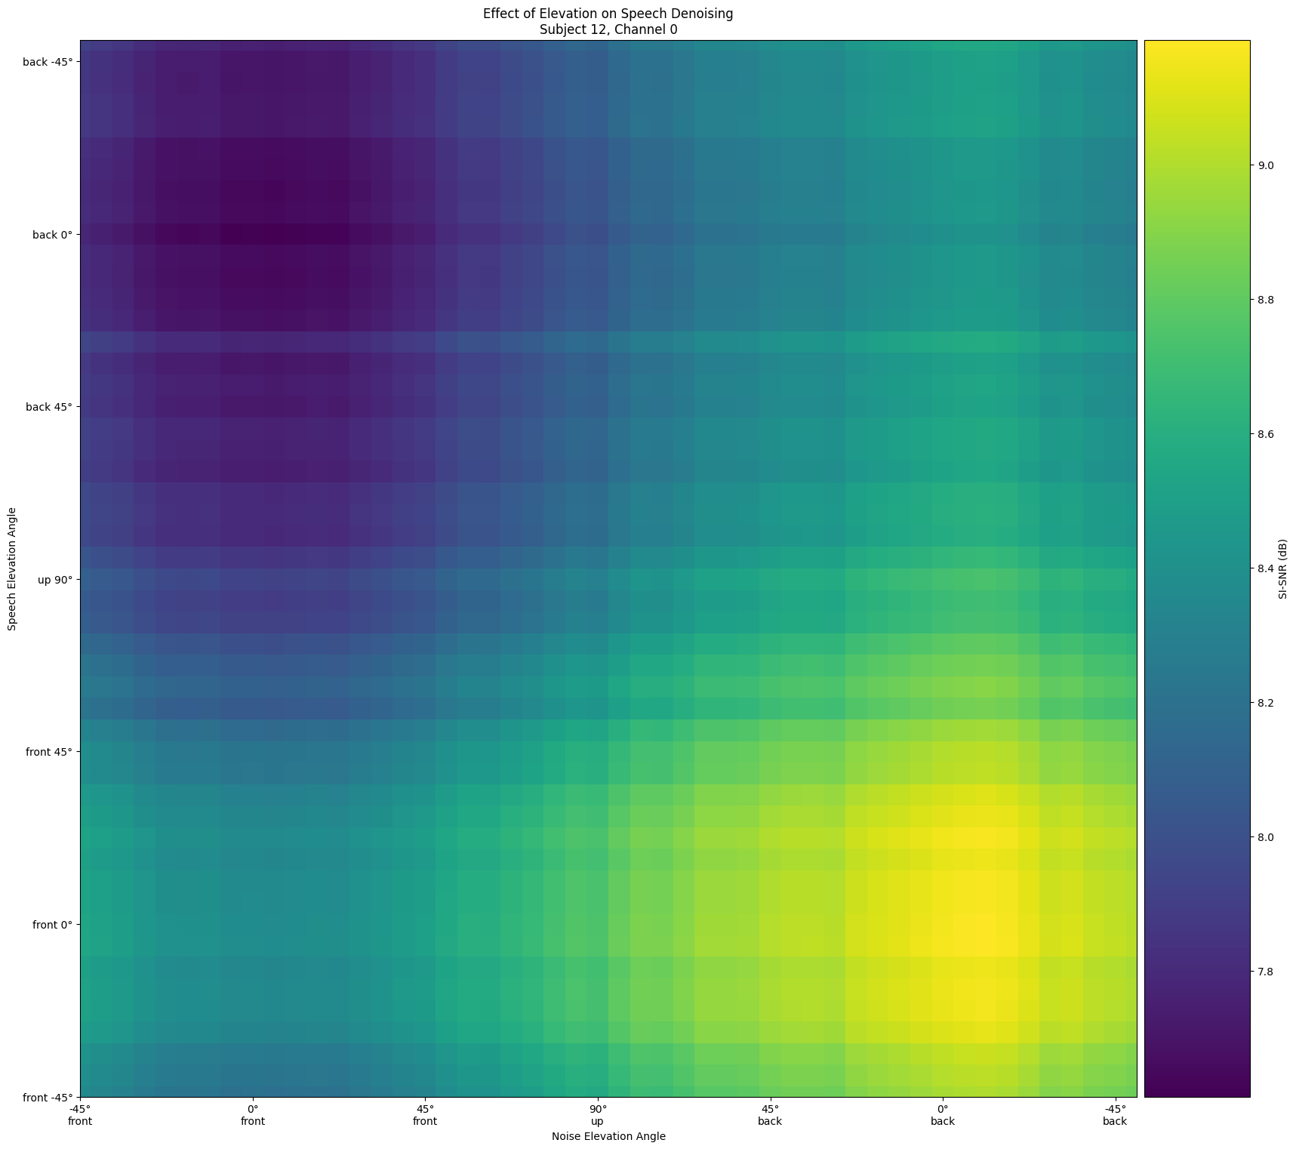
Pinna Results (Baseline)
Each trial took ~ 1 hour
Macro scale patterns impossible to view without the computing scale that CHTC provides
Notes:
By using HTC, we are able to run large scale parameterization sweeps to identify important patterns. Here, we ran about 2500 simulations, each taking about an hour, to understand how the colocated positions of noise and signals affect the pinna’s ability to denoise a noisy signal. By using HTC we were able to cut this simulation time down from months to weeks and uncover a clear preference for having noise to the rear of the pinna and having signals to the front of the pinna.
Faster because they dont have to pass through the network. Any pair itself doesnt tell us much, but the macro patterns emerge and give us the result we expect – a good sanity check.
** Make sure to spend some time here noting horizontal and vertical axes and the peaks and valleys **
===
We are interested in using the positions of a noise and a signal in the denoising process. Real-world experiences rarely have a noise and a signal co-located, and we are curious about the ear’s ability to physically process non-co-located sounds
We use CHTC resources to process this. Overtime, we have conducted hundreds of experiments exploring the changes in performance of denoising based on where signals and noises are coming from. You can see on the left a result suggesting that performance peaks when a signal is directly in front of an ear and the noise is directly behind it. It follows to that performance is worst when the positions are flipped.
This slide: Denoising effect of the pinna, showing a clear preference for signal in front an noise in back
Next Slide: Denoising effect of the pinna with an SNN. Makes sense because colocated noise and signal have similarly bad performance regardless of their shared location, but performance improves once they are seperated

Slide 11
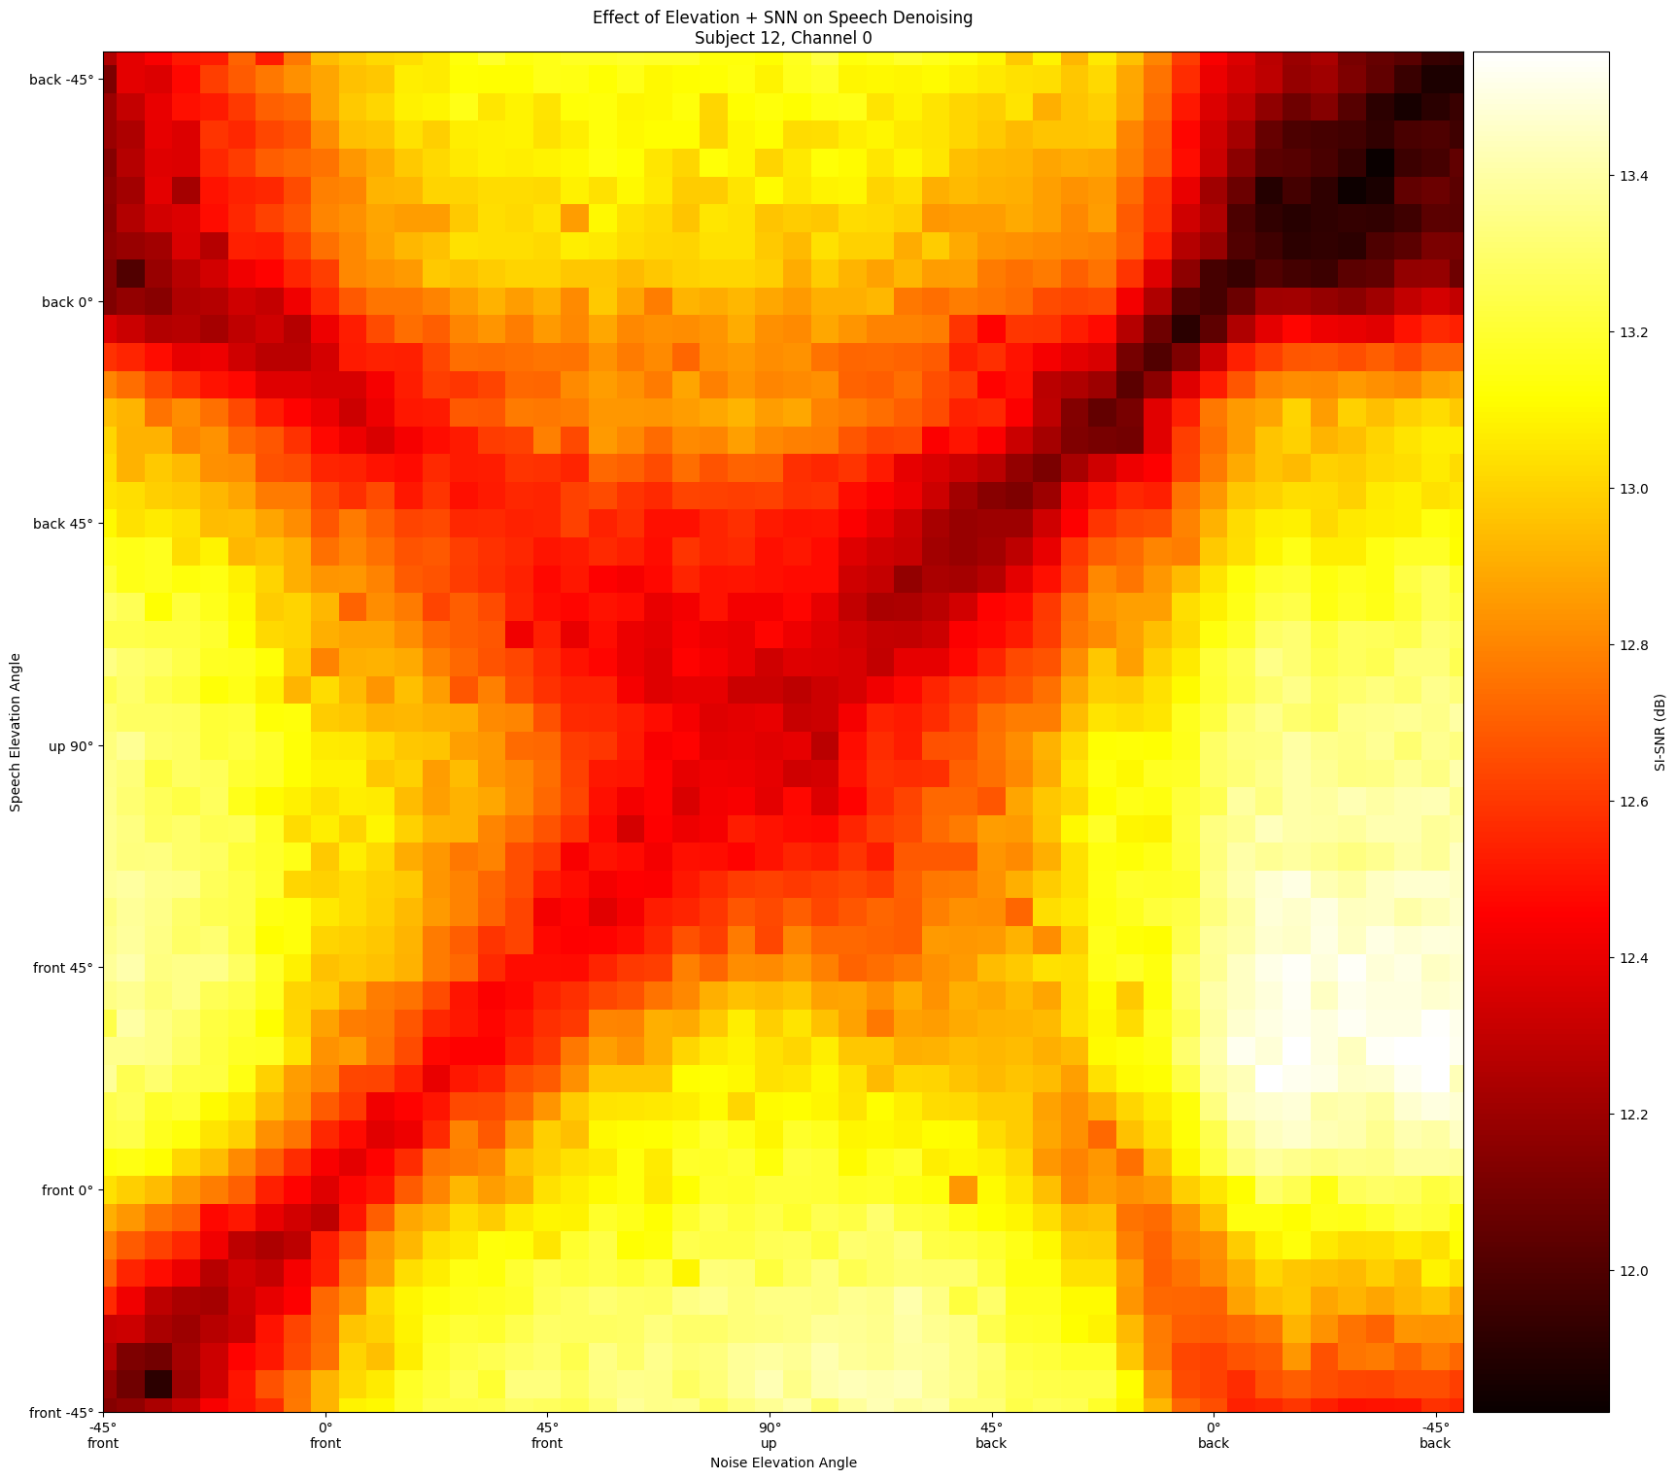
SNN Results (Development)
Macro scale patterns impossible to view without the computing scale that CHTC provides
Each trial took ~ 4 hours
Notes:
We ran a similar experiment, this time pairing a a spiking neural network with a pinna, to unveil a new surface of improved performance and a clear pattern of subpar results when noise and signals are co-located. Each pixel in this heatmap took around 4 hours and was completed in a matter of weeks
The peak here is seen when the noise is to the rear and the signal is slightly above the pinna. We don’t know why but surmise it has something to do with the asymmetry of the ear.
Need the whole landscape
50 x 50 grid, 2500 different trials
==
We are interested in using the positions of a noise and a signal in the denoising process. Real-world experiences rarely have a noise and a signal co-located, and we are curious about the ear’s ability to physically process non-co-located sounds
We use CHTC resources to process this. Overtime, we have conducted hundreds of experiments exploring the changes in performance of denoising based on where signals and noises are coming from. You can see on the left a result suggesting that performance peaks when a signal is directly in front of an ear and the noise is directly behind it. It follows to that performance is worst when the positions are flipped.
Left: Denoising effect of the pinna, showing a clear preference for signal in front an noise in back
Right: Denoising effect of the pinna with an SNN. Makes sense because colocated noise and signal have similarly bad performance regardless of their shared location, but performance improves once they are seperated

Slide 12
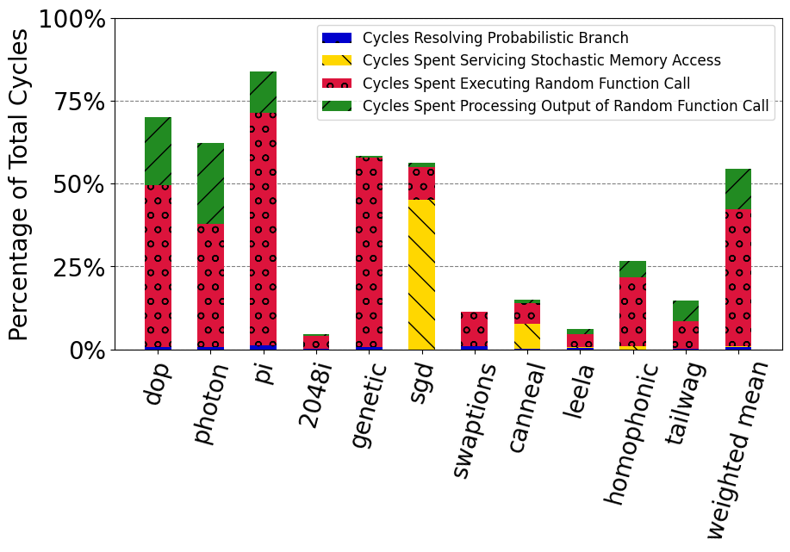
Bottom-up: Neuromorphic Workloads are Stochastic
Key Insight: random number generation and downstream, dependent operations are expensive
To develop StAccato, a hardware accelerator for stochastic workloads, how can we compare RNG quality?

Slide 13
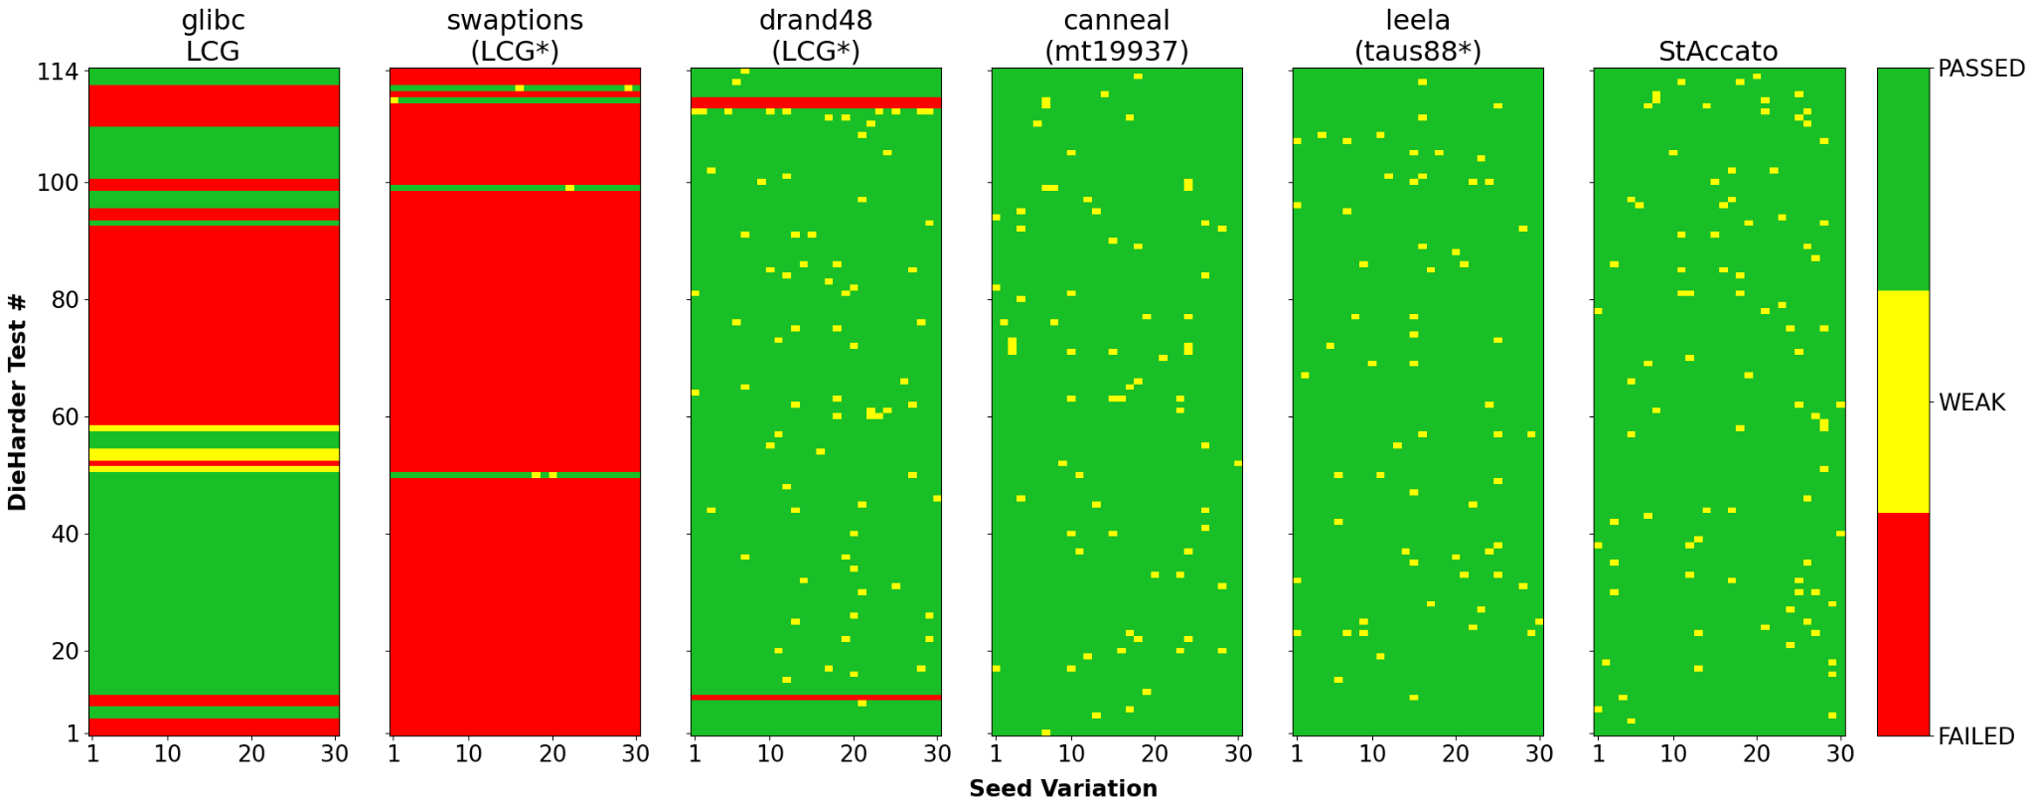
Dieharder
Great, StAccato is better than simple RNG, but by how much?
Simple
Complex
In Between
Each trial took ~ 6 hours

Slide 14
Scaling the Problem
Throughput problem demanding large amounts of CPU hours, but minimal restrictions:
Lightweight docker image with Dieharder installed
Single requested CPU, 512MB memory, 1MB storage
~need CPUs past 2011
Workload is ideal for CHTC’s ~40K CPU cores
Problem well defined in a single 34 line submit file (+config list)
Launched 6 RNGs x 5 trials per rate x 100 different rates from
~2.1 compute years completed in ~3 weeks!

Slide 15
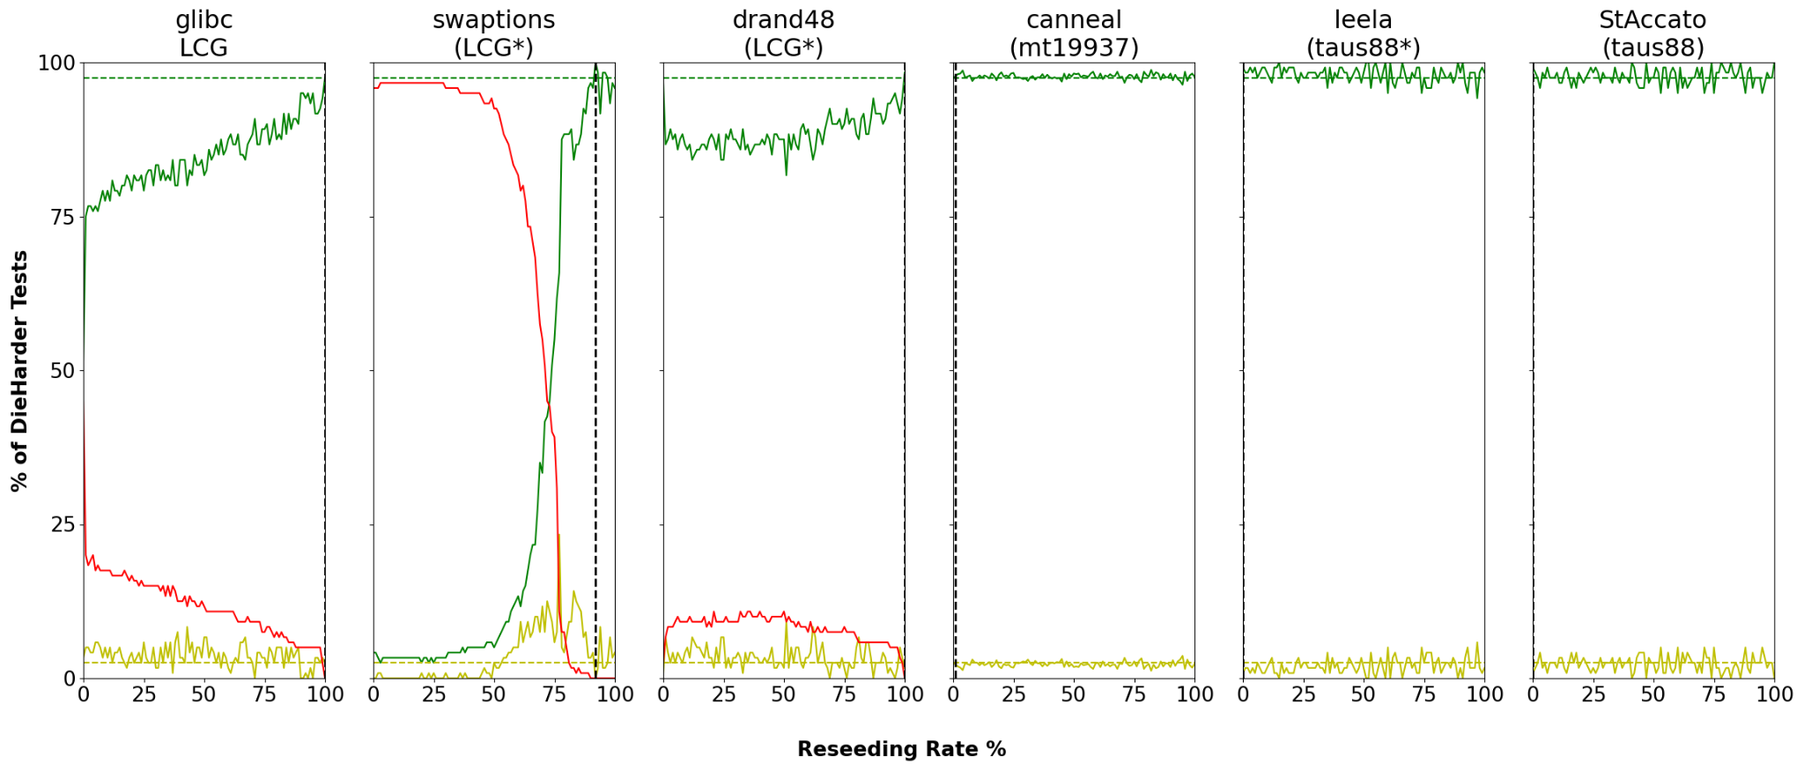
Comparative Dieharder Results
The timeliness of this analysis was only possible via CHTC
StAccato is as good as the best of them!
* Submission is currently under review

Slide 16
Current Outlook and Next Steps
Current Outlook:
CHTC fairly easy to use and very flexible for a wide variety of studies
Minor pain points using the GPU system
simultaneous profiling during GPU sim (resolved in an update)
non-deterministic crashes (only in < 6% of runs)
runtime variability for repeat tasks
Next CHTC features to explore
Checkpointing to support long running GPU sims (> a week)
Thorough sweep of model hyper-parameters (width, depth, fft bins, etc.)
Better coordination of job resources in allocation request and during runtime
Desirable features from CHTC in the future
Vendor variety (AMD GPUs)

Slide 17
Thank You!

