Slide 1
cgroupV2 What lies beneath? Greg Thain

Slide 2
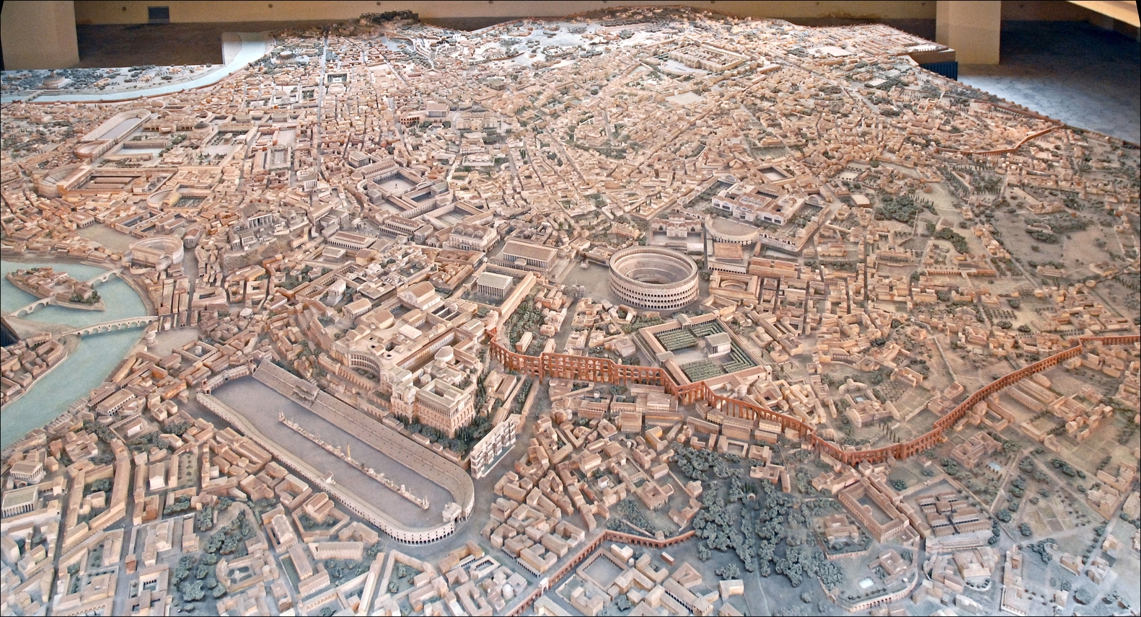
Times Roman View of new Ariel
Arial View of
old Roman times

Slide 3
11 Years ago… cgroup (v1) added to HTCondor

Slide 4
11 Years ago… cgroup (v1) added to HTCondor

Slide 5
11 Years ago… cgroup (v1) added to HTCondor

Slide 6
Cgroups v1 up to EL8
1
11

Slide 7
Cgroups v2: EL9 (and RHELatives)
2
11

Slide 8
cgroups: a kernel feature

Slide 9
https://www.youtube.com/watch?v=8fi7uSYlOdc
Thanks, TimC!

Slide 10
Linux File System Layout

Slide 11
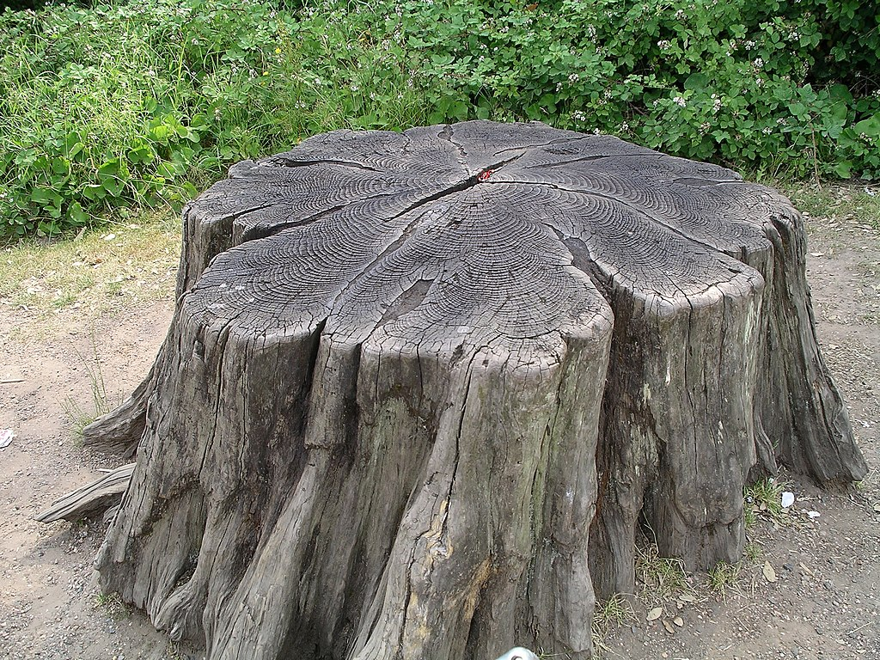
dev
home
proc
sys
tmp
gthain
null
some_file

Slide 12
dev
home
proc
sys
tmp
fs
gthain
null
cgroup
some_file

Slide 13
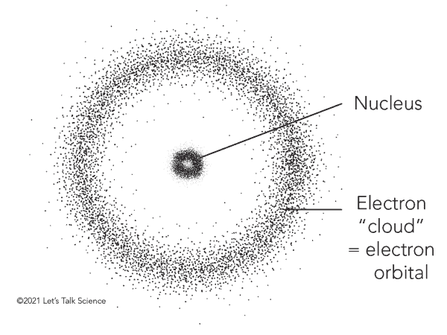
Unix Philosophy:
"Everything is a file"
dev
home
proc
sys
tmp
Real Story:
"Every* object has a name in the single global, hierarchical directed namespace" (including cgroups)
fs
gthain
null
cgroup
some_file

Slide 14
Sidebar to the Sidebar
Tremendous power in single namespace
One reason for the success of the www
Should HTCSS / OSpool have one?
What would that look like?

Slide 15
Double reverse over the sidebar
# mkdir /sys/fs/cgroup/test # cd /sys/fs/cgroup/test # ls
# cat cgroup.procs # echo $$ > /sys/fs/cgroup/test/cgroup.procs
# cat cgroup.procs # cat memory.current

Slide 16
Use sys tools: systemd-cgtop
# systemd-cgtop Control Group Tasks %CPU Memory Input/s Output/s
/ 7723 9303.6 109.1G 0B 77.9K
system.slice 5158 9230.5 194.0G 0B 62.4K
system.slice/htcondor 1061 7816.9 115.9G 0B 7.8K
system.slice/htcondor/slot1_36@e4096.chtc 40 596.4 177.0M - -
system.slice/htcondor/slot1_8@e4096.chtc.wisc 40 596.3 178.2M - -
system.slice/htcondor/slot1_1@e4096.chtc.wisc 41 596.3 179.0M - -
system.slice/htcondor/slot1_32@e4096.chtc.w 40 596.3 180.6M - -
system.slice/htcondor/slot1_6@e4096.chtc.w 39 596.1 180.3M - -
system.slice/htcondor/slot1_35@e4096.chtc. 40 596.1 178.9M - -

Slide 17
sys
fs
cgroup

Slide 18
Cgroups: Two Abstractions
First is "cgroup"
Appears as directory
With fs permission bits
Contains zero or more process
Tree-structured
(no symlinks)
Created by users (or systemd) You pick the name
/sys/fs/cgroup
groupA
groupB
groupA1
groupB1

Slide 19
Second abstraction: "controller"
Appears as a file under cgroup
Created by kernel (unremovable by users)
Names fixed by kernel
With fs permission bits
Some read-only Some write-only Some read-write Monitor/Control group's process
Some hierarchical, others not
/sys/fs/cgroup
groupA
cgroup.procs
memory.current
cgroup.kill

Slide 20
Three Tiers of rules for cgroups
Every process is in exactly one cgroup
(inherited from parent process) Process tree not necessarily cgroup tree
Only leaf cgroups hold processes!
To move a process to new cgroup: Both target and COMMON ANCESTOR must be writeable (arch rule).

Slide 21
Leaf rule example
/sys/fs/cgroup
Processes CANNOT live here
groupA
groupB
Processes can live here
groupA1
groupB1

Slide 22
"Arch" rule example
/sys/fs/cgroup
To move proc from
groupA2 to groupB2: A1 must be writeable B1 must be writeable "common ancestor", also e.g Group A
groupA
groupB
groupA1
groupB1

Slide 23
Three Tiers of rules for cgroups
Every subtree has one process allowed to write to it (one writer rule) ((default: systemd))
Systemd cgroup naming convention:
*.service – where service unit pids live *.slice – interior nodes used for managing *.scope – leaf nodes used for dynamic
Pid Eins

Slide 24
HTCondor's unit file
[Service]
EnvironmentFile=-/etc/sysconfig/condor
ExecStart=/usr/sbin/condor_master -f
Delegate=true

Slide 25
/sys/fs/cgroup
[Service]
EnvironmentFile=-/etc/sysconfig/condor
ExecStart=/usr/sbin/condor_master -f
Delegate=true
system.slice
master
condor.service
port
schedd
shadow

Slide 26
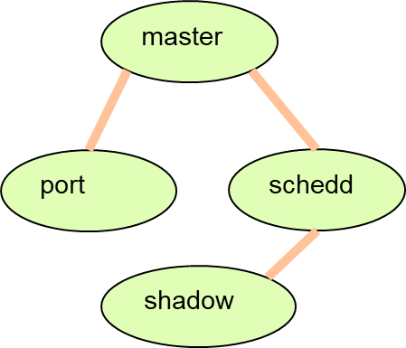
What cgroup to put jobs into?
/sys/fs/cgroup
htcondor
system.slice
Violates one writer rule Should we all live under one?
condor.service

Slide 27
What cgroup to put jobs into?
/sys/fs/cgroup
htcondor
system.slice
One writer rule satisfied Leaf rule violated!
Bonus: supports recursion
condor.service

Slide 28
[Service]
EnvironmentFile=-/etc/sysconfig/condor
ExecStart=/usr/sbin/condor_master -f
Delegate=true
DelegateSubgroup=leaf
/sys/fs/cgroup
system.slice
One writer rule satisfied Leaf rule satisfied!
Bonus: supports recursion
condor.service
leaf
htcondor

Slide 29
/sys/fs/cgroup/system.slice/condor.service/
htcondor
cgroup.procs
slot1
cgroup.kill
Job Processes
cpu.weight
Job Wrapper
cpu.stat
memory.max
matlab
memory.peak
grep
memory.events

Slide 30
GPUs

Slide 31
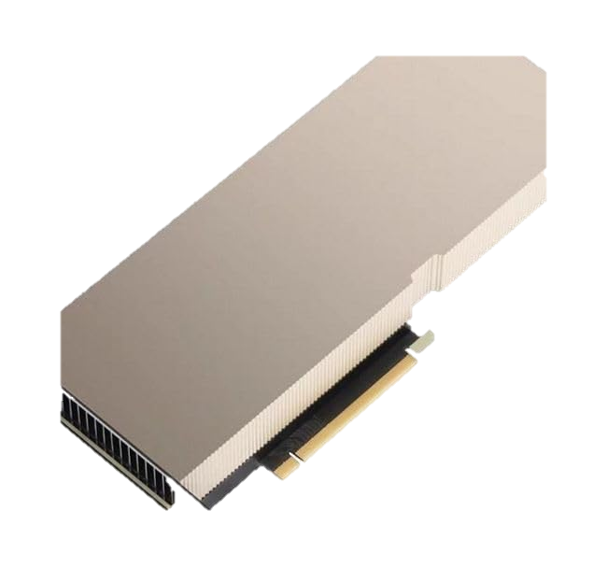
Hiding GPUs
$ nvidia-smi
+-----------------------------------------------------------------------------------------+
| NVIDIA-SMI 550.54.14 Driver Version: 550.54.14 CUDA Version: 12.4 |
|-----------------------------------------+------------------------+----------------------+
| GPU Name Persistence-M | Bus-Id Disp.A | Volatile Uncorr. ECC |
| Fan Temp Perf Pwr:Usage/Cap | Memory-Usage | GPU-Util Compute M. |
| | | MIG M. |
|=========================================+========================+======================|
| 0 Tesla P100-PCIE-16GB On | 00000000:3B:00.0 Off | 0 |
| N/A 37C P0 33W / 250W | 1030MiB / 16384MiB | 1% Default |
| | | N/A |
+-----------------------------------------+------------------------+----------------------+
| 1 Tesla P100-PCIE-16GB On | 00000000:D8:00.0 Off | 0 |
| N/A 33C P0 31W / 250W | 4496MiB / 16384MiB | 0% Default |
| | | N/A |
+-----------------------------------------+------------------------+----------------------+

Slide 32
GPUs have NO PROTECTION
Any job can read OR WRITE to ANY gpu on the system! Cause of crashes, hangs, incorrect data in CHTC, elsewhere!
Could be most common problem source

Slide 33
Hiding GPUs
$ export CUDA_VISIBLE_DEVICES=gpu-1234
$ nvidia-smi
Fri Jul 5 12:21:43 2024
+-----------------------------------------------------------------------------------------+
| NVIDIA-SMI 550.54.14 Driver Version: 550.54.14 CUDA Version: 12.4 |
|-----------------------------------------+------------------------+----------------------+
| GPU Name Persistence-M | Bus-Id Disp.A | Volatile Uncorr. ECC |
| Fan Temp Perf Pwr:Usage/Cap | Memory-Usage | GPU-Util Compute M. |
| | | MIG M. |
|=========================================+========================+======================|
| 0 Tesla P100-PCIE-16GB On | 00000000:3B:00.0 Off | 0 |
| N/A 37C P0 33W / 250W | 1030MiB / 16384MiB | 1% Default |
| | | N/A |
+-----------------------------------------+------------------------+----------------------+
HTCondor sets this environment variable for the job to tell it which GPU to use
executable = gonkulate Request_Memory = 1024 Request_Disk = 40960 Request_Cpus = 1 Request_GPUs = 1

Slide 34
Hiding GPUs
$ export CUDA_VISIBLE_DEVICES=gpu-1234
$ unset CUDA_VISIBLE_DEVICES
$ nvidia-smi
Fri Jul 5 12:21:43 2024
+-----------------------------------------------------------------------------------------+
| NVIDIA-SMI 550.54.14 Driver Version: 550.54.14 CUDA Version: 12.4 |
|-----------------------------------------+------------------------+----------------------+
| GPU Name Persistence-M | Bus-Id Disp.A | Volatile Uncorr. ECC |
| Fan Temp Perf Pwr:Usage/Cap | Memory-Usage | GPU-Util Compute M. |
| | | MIG M. |
|=========================================+========================+======================|
| 0 Tesla P100-PCIE-16GB On | 00000000:3B:00.0 Off | 0 |
| N/A 37C P0 33W / 250W | 1030MiB / 16384MiB | 1% Default |
| | | N/A |
+-----------------------------------------+------------------------+----------------------+
| 1 Tesla P100-PCIE-16GB On | 00000000:D8:00.0 Off | 0 |
| N/A 33C P0 31W / 250W | 4496MiB / 16384MiB | 0% Default |
| | | N/A |
+-----------------------------------------+------------------------+----------------------+
If job sets this environment variable…

Slide 35
/sys/fs/cgroup/system.slice/condor.service/
htcondor
slot1
executable = gonkulate Request_Memory = 1024 Request_Disk = 40960 Request_Cpus = 1 Request_GPUs = 1

Slide 36
Hiding GPU with eBPF
$ nvidia-smi
+-----------------------------------------------------------------------------------------+
| NVIDIA-SMI 550.54.14 Driver Version: 550.54.14 CUDA Version: 12.4 |
|-----------------------------------------+------------------------+----------------------+
| GPU Name Persistence-M | Bus-Id Disp.A | Volatile Uncorr. ECC |
| Fan Temp Perf Pwr:Usage/Cap | Memory-Usage | GPU-Util Compute M. |
| | | MIG M. |
|=========================================+========================+======================|
| 0 Tesla P100-PCIE-16GB On | 00000000:3B:00.0 Off | 0 |
| N/A 37C P0 33W / 250W | 1030MiB / 16384MiB | 1% Default |
| | | N/A |
+-----------------------------------------+------------------------+----------------------+

Slide 37
STARTER_HIDE_GPU_DEVICES = false

Slide 38
Delegation

Slide 39
/sys/fs/cgroup/sys.slice/cnd.service
htcondor
slot1
$ chown slot1 job_unix_user

Slide 40
/sys/fs/cgroup/sys.slice/cnd.service
htcondor
slot1.scope
$ chown slot1.scope job_unix_user
slot1
subjob1
subjob2

Slide 41
Base batch & glidein support needed
Local Batch | HTCondor | Slurm | K8s | HTCondor
Glidein/Pilot | HTCondor | HTCondor | HTCondor | Dirac

Slide 42
Help me to enable delegation on slurm and k8s!

Slide 43
cgroupV2 What lies beneath? Greg Thain // Center for High Throughput Computing Funded by NSF Award Number: OAC-2030508

Slide 44
BONUS
Memory limits and OOM
Inheriting memory limits
Left-transform
Problems with docker – jobs in own cgroup
Ssh-to-job
starting condor via sh vs systemd
Future procd-free world
Local universe jobs in cgroup

Slide 45
Memory

Slide 46
C is for Control!

