Slide 1



What's new in the
HTCondor Software Suite (HTCSS) ?
What's coming up?
HTC 24 – Madison, WI
Todd Tannenbaum
Center for High Throughput Computing
University of Wisconsin-Madison

Slide 2
Release Numbering Scheme
New Major version each summer
Major Version number = year of release (23, 24, 25, …)
Two release series for each major version:
  LTS ("Long Term Support") Channel: only bug fixes, please!
  Feature Channel: gimme the latest greatest features!
The two most recent LTS series will be supported e.g.
  Summer 2025: Version 25.0.0 will be released. Support for v24.0.x and v25.0.x; support for 23.0.x will end.

Slide 3


Two Parts to this Talk
The "Laundry List"
What's Cooking?
http://survey.htcondor.com/

Slide 4

Since HTC 23, there were 11 LTS releases and 13 Feature releases incorporating 140 enhancements and 90 bug fixes.

Slide 5
Highlights on the web, full details in the Manual
Highlights:
https://htcondor.org/htcondor/release-highlights/
Details:
https://htcondor.readthedocs.io/en/latest/version-history/index.html
Documented all the new features / mechanisms that have been added at each version
Notes about "gotchas" when upgrading from version X to Y

Slide 6
Administrator Upgrade Help Script
Besides information in the Manual about incompatibilities when upgrading versions, wouldn't it be great if a tool existed to help admin check the gotchas? We listened…
New tool condor_upgrade_check assists administrators upgrading an HTCondor instillation between major version (i.e. V23 -> V24)
Intended for use by those running LTS release of HTCondor.
Checks current installation and setup for well known incompatibilities and informs administrator of actions to take to resolve said issues.

Slide 7
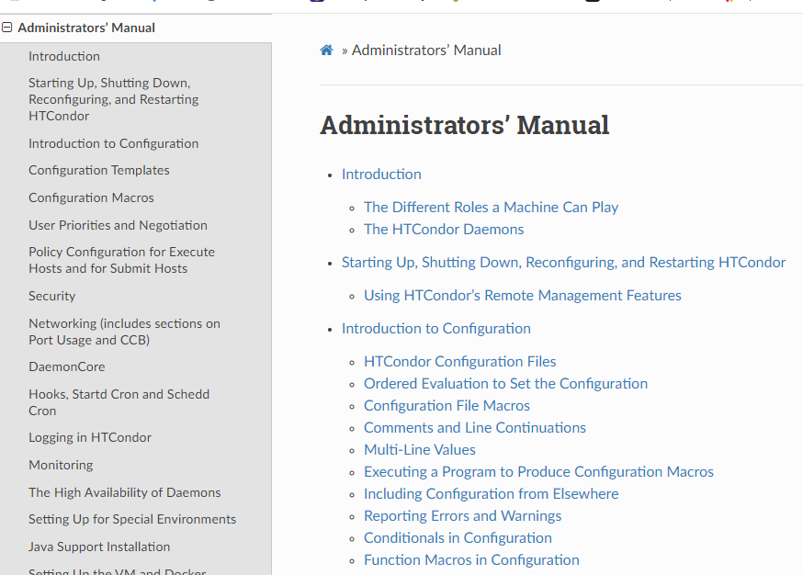
Previously the Manual was..
Random Topic
Random Topic
Random Topic
Random Topic
Notes:
The previous manual was not well organized. In fact, the order of subjects in the administrators' manual mainly reflected the order in which features were added to the system, not any order that a human should read them, or makes sense to find

Slide 8
Feedback from HTC 23:
"We use the manual a lot"
- could you please improve it?
"Especially the index, heavily used"
+ Dictum from Miron:
"HTCondor is a Software Suite: AP, EP, CM are separate products"

Slide 9
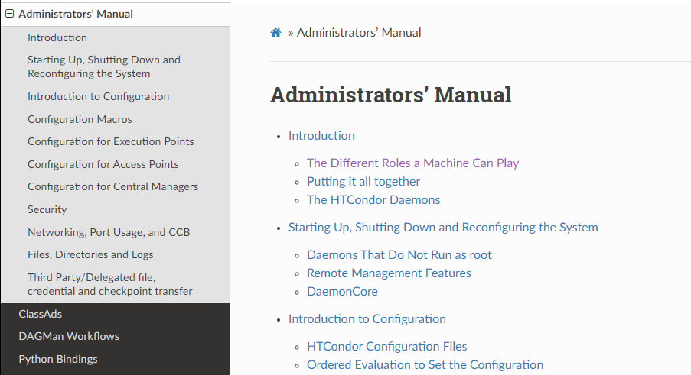
24.x Admin manual
EP Subsection
AP Subsection
CM Subsection
Notes:
So, in 23.x we reorganized the admin manual around AP, EP and CM, with a handful of addition cross-cutting concerns (like logging, networking and security)

Slide 10
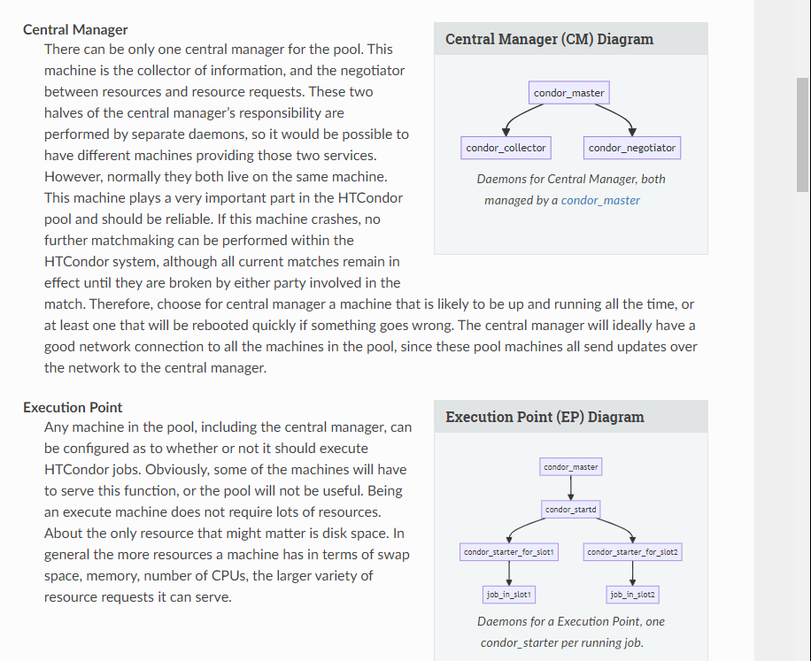
Added diagrams to manual
Notes:
And we added many diagrams to the manual, in a way that is easy to edit and add additional ones.

Slide 11
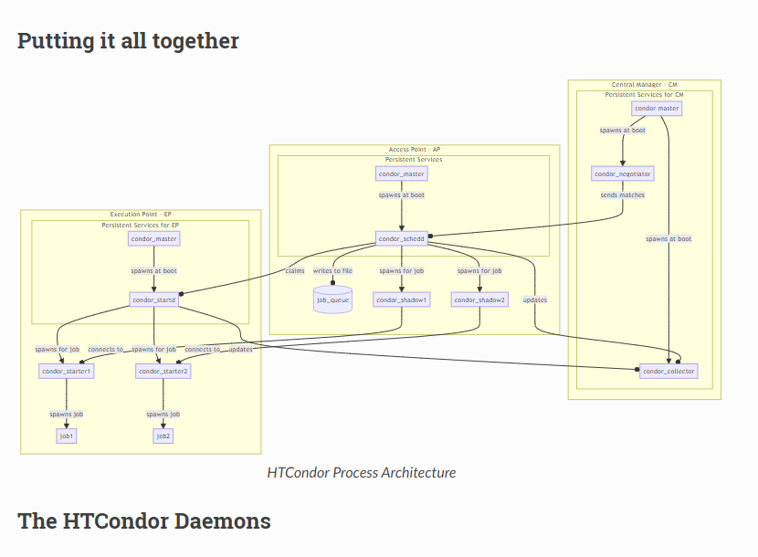

Slide 12
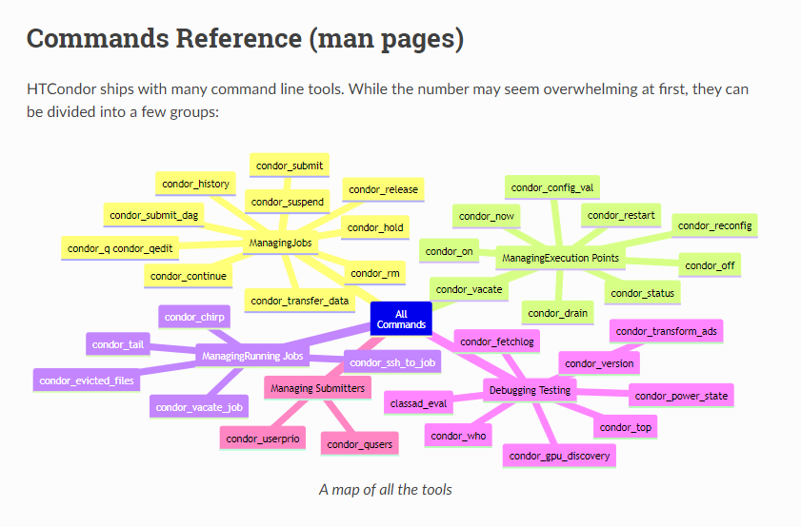

Slide 13
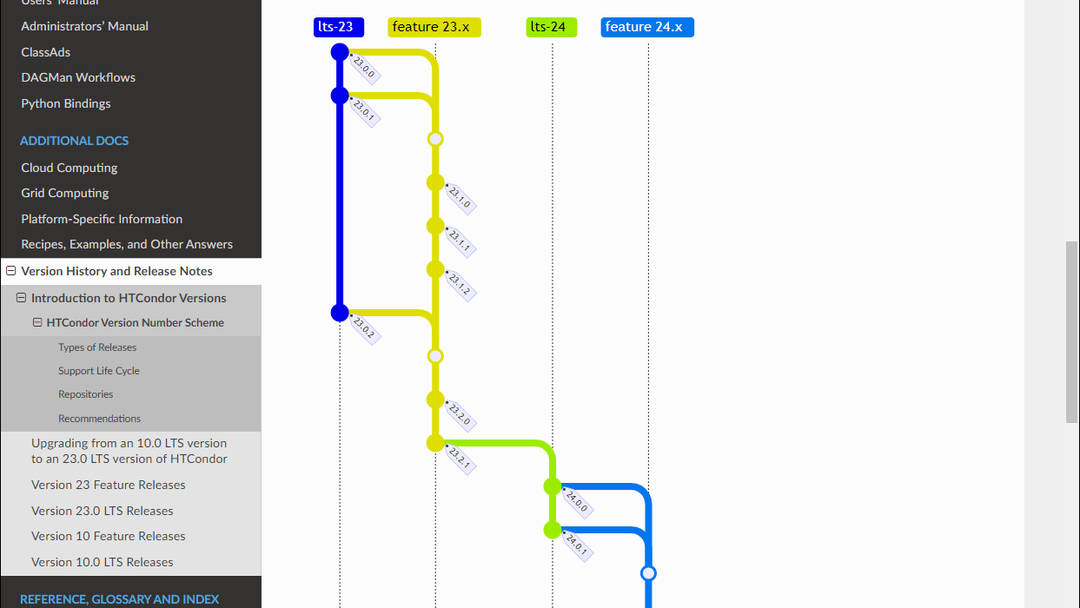

Slide 14
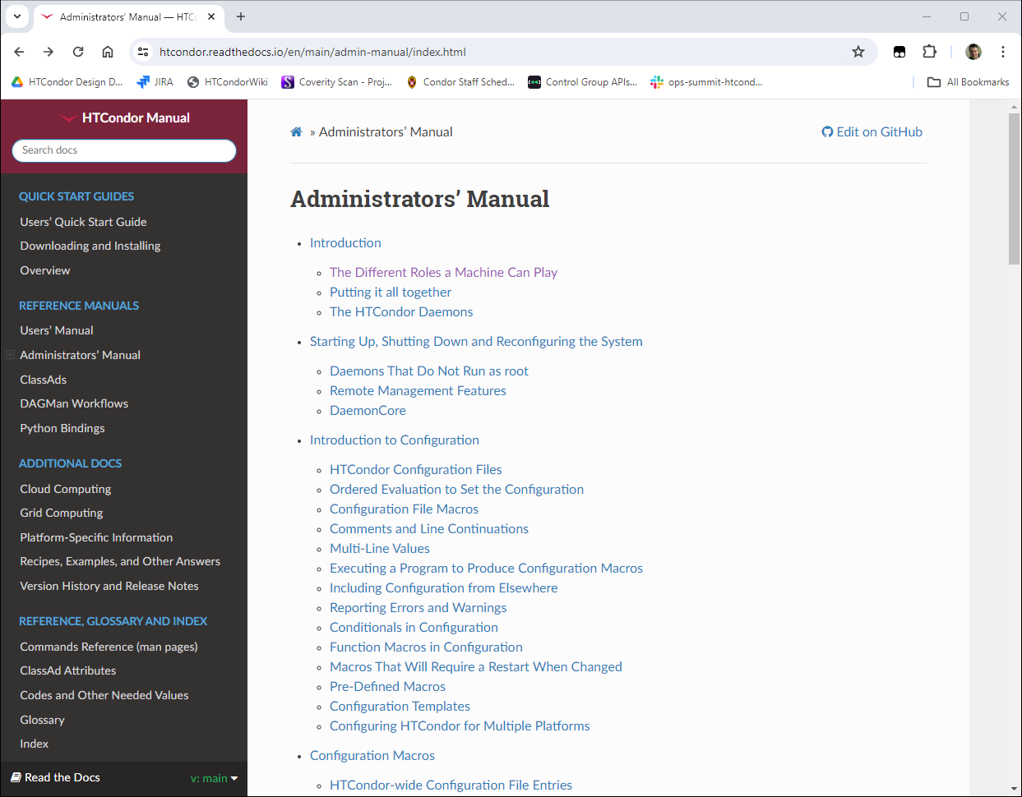
Moving recipes to manual
Notes:
We had a lot of how-to, FAQs and recipes off in an wiki that was hard to find, infrequently used, and often out of date. We are now in the process of moving these to the manual proper, and cleaning them up.

Slide 15
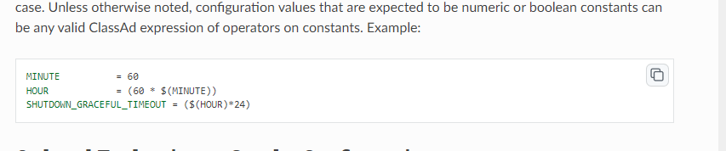
Copy Button!

Slide 16
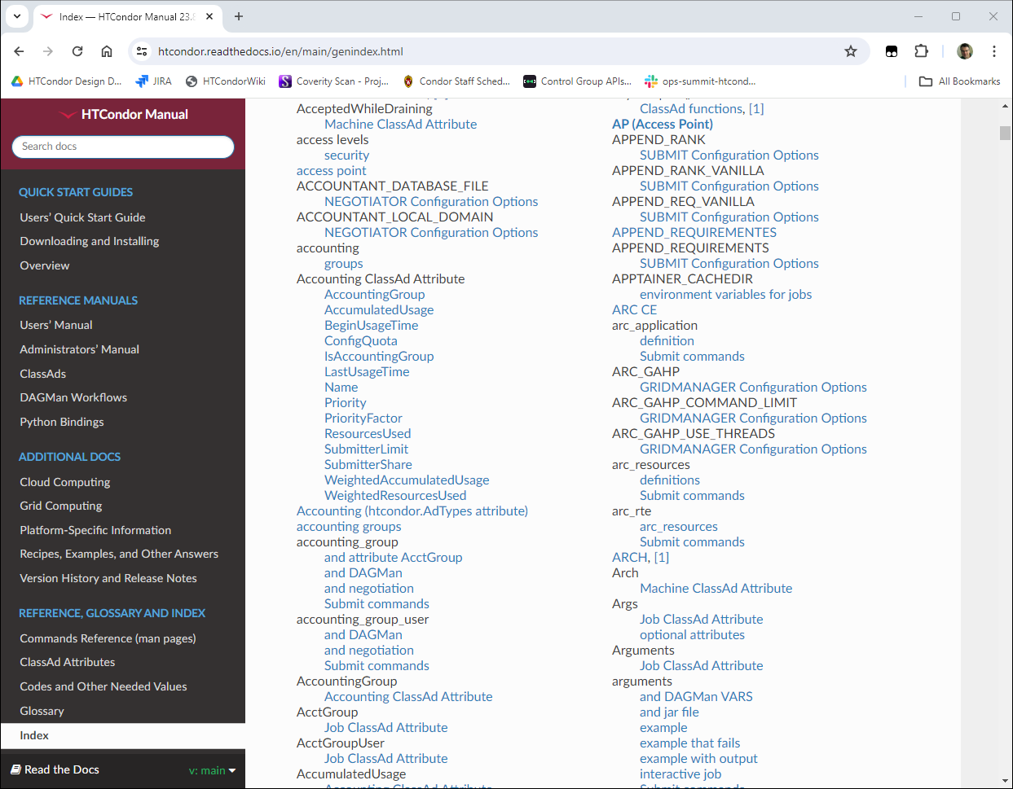
Many improvements to index
Notes:
And we've made many improvements to the index, including creating checkers that validate that every classad attribute, submit command and configuration knob has an index entry. Please give it a try.

Slide 17
Cgroup v2 improvements
"cgroups" = Linux mechanism for placing a limit on resource usage of a job
Addition of Cgroup v2 support was Required for EL9 and Debian 12
HTCondor 23 gives jobs writeable "delegated" cgroups
  -> Enables "The Dream": glideins can then have better resource management!
Local universe jobs now in cgroups
Set startd MEMORY to memory limit if it starts in a cgroup
Cgroups directly in proc, not via the procd
  → Means we can scale > 256 slots per startd ☺

Slide 18
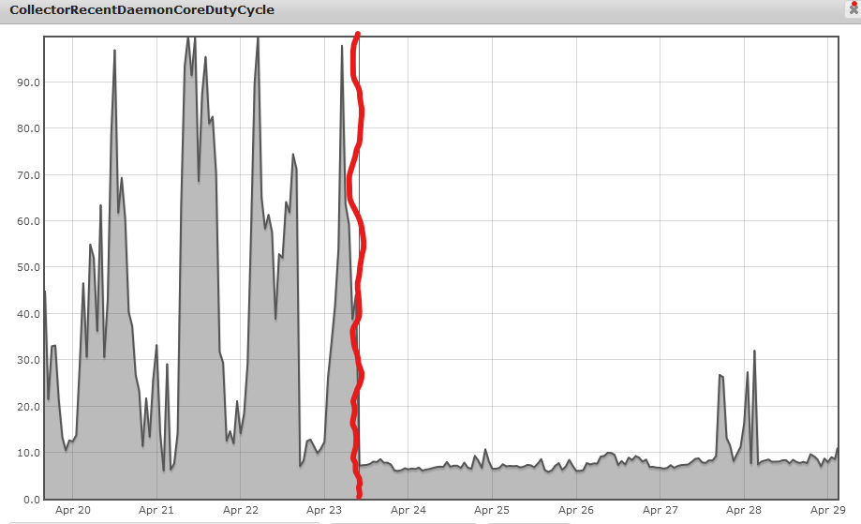
Improvement in ClassAd memory and CPU usage
(OSPool, ~80k slots)
23.6 before
red line
23.7 after
red line

Slide 19
Packaging Updates / New Platforms / OSes
Support for Debian 12 (Bookworm)
Support for Ubuntu 22.04 (Noble Numbat)
Support for openSUSE LEAP 15
HTCondor Docker images are now based on Alma Linux 9
HTCondor Docker images are now available for the ARM64 CPU architecture
Python Bindings for ARM64 available with PIP
Apptainer and Pelican included in the tarballs
Debian and RPM packages line up (same names and structures)

Slide 20
File Transfer Enhancements
Submit macro preserve_relative_paths = True
  transfer_input_files = result_data/x
  ends up creating 'result_data/x' on EP job sandbox, not 'x'.
OSDF (Pelican) File Transfer Client comes with HTCSS, so can use it out of the box
transfer_input_files = osdf:///foo/xxx/yyy

Slide 21
Job Epoch History
Write the current Job Ad for each run instance of a job to a specified history file.
Enable by setting JOB_EPOCH_HISTORY=/path/to/filename
Query all job epochs from from history via
condor_history -epochs
Query from the python bindings via jobEpochHistory()
condor_adstash can store job epoch ads in Elastic Search along with history ads

Slide 22
Persistent User records in the schedd
A user record must exist for each job owner
  Created automatically by submitting a job
    Default behavior, but can be turned off
  Created by an admin running condor_qusers -add
New tool : condor_qusers
  Add, enable, disable and edit user records
    Disabled users cannot submit new jobs
  Also python bindings for these commands
Allows the schedd to separate who owns a job from who to impersonate when running the job.

Slide 23
Saved DAG Progress
Added new saved progress file for a DAG in V10.5.0 that is kind of like a video game save
  File is similar too a rescue file
  Written at the first start of a specified node
Example Workflow Visualized
Setup
S1
Simulation 1
sample.dag
S2
…
SAVE_POINT_FILE S1
SAVE_POINT_FILE S2 post_simulation1.save
SAVE_POINT_FILE S3 ./post_simulation2.save
SAVE_POINT_FILE S4 ../../foo/mid_analysis.save
…
Simulation 2
S3
Analysis Part 1
S4
Analysis Part 2
Link to DAGMan Save Point File Documentation
Notes:
-Allows a DAG to be restarted from a certain part of progress.
-Good for rerunning a DAG from a certain part in the DAG

Slide 24
Evolving new command line user interface
htcondor <noun> <verb>
  "htcondor job submit", "htcondor job status", …
  "htcondor dag submit", "htcondor dag status", …
  "htcondor jobset submit", "htcondor jobset status", …
  "htcondor annex create", "htcondor annex status", …
  "htcondor eventlog read"
Legacy tools (condor_q, condor_submit, condor_history, …) not going anywhere…
Notes:
htcondor job status gives information about a single job given a job id

Slide 25
condor_q - looking at one running job
$ condor_q 123.45
-- Schedd: login04.osgconnect.net : <192.170.231.217:9618?... @ 07/12/23 21:43:13
OWNER BATCH_NAME SUBMITTED DONE RUN IDLE TOTAL JOB_IDS
toddt ID: 123 7/12 21:37 _ 1 _ 10000 123.45
Total for query: 1 jobs; 0 completed, 0 removed, 0 idle, 1 running, 0 held, 0 suspended
Notes:
Using the legacy tool "condor_q", this is what the output looks like when given a single job id

Slide 26
condor_q - looking at the details
$ condor_q –l 123.45
AccountingGroup = "group_opportunistic.EvolSims.toddt"
AcctGroup = "EvolSims"
AcctGroupUser = "anushd"
AllowedExecuteDuration = 72000
Args = "44"
AutoClusterId = 3232
BytesRecvd = 0.0
BytesSent = 0.0
ClusterId = 36371245
Cmd = "/home/anushd/cluster_code/cwrapper.sh"
CommittedSlotTime = 0
CommittedSuspensionTime = 0
CommittedTime = 0
CondorPlatform = "$CondorPlatform: X86_64-CentOS_7.9 $"
CondorVersion = "$CondorVersion: 10.6.0 2023-06-26 PackageID: 10.6.0-0.656423 RC $"
CoreSize = 0
CpusProvisioned = 1
…
Notes:
If you want to see more information, most users resort to using the "-long" option which display all 150+ attributes about a job. But which ones do most users care about? What are they named? What units are the values (KBs, MBs, GBs, …) ?

Slide 27
New Job Status
$ htcondor job status 123.45
Job 123.45 is currently running on host exec221.chtc.wisc.edu.
It started running again 2.1 hours ago.
It was submitted 3.6 hours ago.
Its current memory usage is 2.5 GB out of 4.0 GB requested.
Its current disk usage is 3.8 GB out of 5.5 GB requested.
It has restarted 2 times.
Goodput is 80% (0.5 hours badput, 2.1 hours goodput).
Notes:
Here is the output using the new command-line tool. The most common desired information is displayed in plain English.

Slide 28
What about a DAGMan workflow?
$ htcondor dag status 223
DAGMan Job 223.0 [simple.dag] has been running for 52 days 04:12:46.
DAG has submitted 382 individual job(s), of which:
45 are running.
10 are idle.
0 are held.
162 have completed successfully
DAG has failed nodes but will continue until all possible work is finished: 5 nodes failed.
10 nodes waiting to begin.
24 nodes running.
Goodput is 92%
[###########=======----------------] 34% complete.
Notes:
Sample output from "htcondor dag status", to see status about a DAGMan job….

Slide 29
htcondor eventlog read …
$ htcondor eventlog read my_log_file
Job Host Start Time Evict Time Evictions Wall Time CPU Usage
79.0 foo 7/6 17:24 7/6 17:25 1 0+00:01:00 0+00:00:52
80.0 foo 7/6 17:35 7/6 17:36 1 0+00:01:00 0+00:00:52
81.0 foo 7/6 17:43 7/6 17:44 1 0+00:01:00 0+00:00:53
Notes:
"htcondor eventlog" encapsulates tools to present the information in a job event log file

Slide 30
And with group-by
$ htcondor eventlog read –group-by GLIDEN_Site my_log_file
Site CPU Usage Job Starts Job Successes Job Failures
MWT2 0+01:13:00 59 57 2
NWICG_NDCMS 0+00:50:20 2 1 0
UConn-HPC 0+00:05:00 2 1 0
UColorado_HEP 0+00:51:11 2 1 0
NMSU-Discovery-CE 0+04:24:01 7 5 0

Slide 31
File Transfer Enhancements
Submit macro preserve_relative_paths = True
  transfer_input_files = result_data/x
  ends up creating 'result_data/x' on EP job sandbox, not 'x'.
OSDF (Pelican) File Transfer Client comes with HTCSS, so can use it out of the box
transfer_input_files = osdf:///foo/xxx/yyy

Slide 32

EP Disk Reservation and Enforcement
Allows HTCondor to utilize the Linux Logical Volume Manager to provide isolated work environments and strong disk usage enforcement for jobs executing on EP’s.
  No LVM ? EP will create a loopback filesystem on the fly!
  Introduced in v23.5.2
  Requires an HTCondor EP running on Linux as root
Look in the Manual for config knob STARTD_ENFORCE_DISK_LIMITS

Slide 33
Job Epoch History
Introduced V10.3.0
Write the current Job Ad for each run instance of a job to a specified history file.
Enable by setting JOB_EPOCH_HISTORY=/path/to/filename
Query all job epochs from from history via condor_history -epochs
Query from the python bindings via jobEpochHistory()
Coming soon: condor_adstash can store job epoch ads in Elastic Search along with history ads

Slide 34
HTCondor Python Bindings Version 2
The version 1 bindings depend on an unsupported library (boost.python), so we needed to do something to make sure the bindings would remain available.
Bindings are intended to be generally compatible; import htcondor2 as htcondor should mostly just work.
  However: We removed some of the things marked as deprecated in the version 1 bindings, and will be deprecating a few other APIs that are not widely used
Win for users: Compared to version 1, the new version 2 bindings will be much less picky about the specific version of Python interpreter being used ☺

Slide 35



"Container Universe"
EP advertises container runtimes available, and uses whichever one can get the job done
Now EP does a lot of testing of container runtimes
and the container image to determine if errors
are the system's fault or the job's fault
New world order:
container_image = /cvmfs/my/image/dir/
# Or container_image = docker://Debian
# Or container_image = myImage.sif
# Or container_image = http://xxx/image.sif

Slide 36
Containers, cont.
First class EP support for a default container image to use
  EP can be configured by the administrator to always run jobs inside a specified container (unless the job brings along its own container)
Apptainer is included/packed into HTCSS EP Product
  Allows an EP to run containers without requiring the admin to install any additional software
Todo: Deal with Docker Hub banning

Slide 37
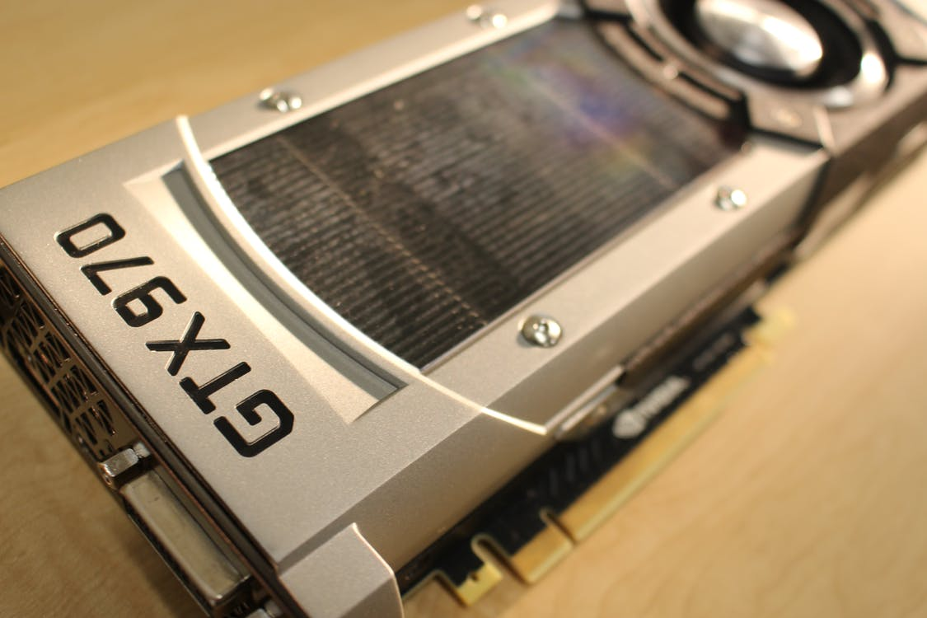
GPU Scheduling Activities
HTCondor has long been able to
  detect GPU devices and schedule GPU jobs
  monitor/report job GPU utilization
New: Support for heterogenous GPUs in one server
  E.g. a server with two different models of GPU cards
  NVIDIA Multi-Instance GPU (MIG) partitioning
New: Jobs can only see the GPU devices
assigned by the EP by using cgroup
device namespaces
New: Support for AMD ROCm
More first-class keywords in submit file
Submit File Example:
Executable = foo.exe
RequestGPUs = 1
gpus_minimum_capability = 7.0
gpus_minimum_memory = 16GB
Queue

Slide 38
First-class Backfill pslots
Motivating Scenario: I want my GPU rich server to give priority to GPU jobs, but backfill with CPU-only jobs
A p-slot provisioned from a shadow set of resources that tracks contention with the primary set of resources
  SLOT_TYPE_<N>_BACKFILL = TRUE
BACKFILL slots have special attributes
  BackfillSlot = true
  ResourceConflict = "Memory, GPUs, GPU-aabbccdd"
ResourceConflict given the names of the resources that contend with an active primary slot

Slide 39
Ex: Backfill the CPUs on a GPU node
# make a TYPE_1 primary P-slot and give it all of the resources
#
use FEATURE : GPUs
use FEATURE : PartitionableSlot(1, 100%)
SLOT_TYPE_1_START = TARGET.RequestGpus > 0
# make a TYPE_2 backfill P-slot with 90% of the shadow resources and no GPUs
#
SLOT_TYPE_2_BACKFILL = true
use FEATURE : PartitionableSlot(2, 90%, GPUs=0)
SLOT_TYPE_2_PREEMPT = size(ResourceConflict?:"") > 0
# The backfill slot should only run jobs that opt in as BackfillJob
SLOT_TYPE_2_START = TARGET.BackfillJob
Will likely expose ☝ as "use policy: PreferGPUJobs"

Slide 40
Better Job Disk Space Management
EP can effectively isolate disk space across jobs
  Look in the Manual for config knob STARTD_ENFORCE_DISK_LIMITS
  Allows HTCondor to utilize the Linux Logical Volume Manager (LVM) to create an ephemeral file systems for the job's sandbox, providing an isolated work environment and strong disk usage enforcement for jobs executing on EP’s.
    Uses LVM or makes a loop-back file system if LVM not setup
  Reserves space on disk for the job
  Enables EP to perform fast disk usage queries and cleanup.
  Introduced in V23.5.2
  Requires an HTCondor EP running on Linux as root

Slide 41
New ClassAd for the EP
Single ad for the STARTD as a whole
  Not suitable for matchmaking.
For use in
  Querying the STARTD address
  Monitoring Overall health and usage of the EP
  Detected/provisioned/in-use resources on the EP as a whole
Requires a newer condor_collector
  Collector version 23.2 or later to store these ads
  Collector version 23.7 or later to query these ads (without using -any)
Notes:
ENABLE_STARTD_DAEMON_AD=true, false, or AUTO
AUTO checks version of the collector, requires 23.8

Slide 42
CE Improvements
CE Dashboard (for hosted CE's at first…)
condor_ce_test_token: new tool to generate short lived SciTokens to more easily test resource provisioning requests to the CE
condor_ce_upgrade_check: new tool helps look for compatibility problems before upgrading your CE
condor_ce_trace: can now test batch system integration without needing to have a SciToken
GPUS: Ensure that jobs requesting GPUs land on HTCondor EPs with GPUs

Slide 43
CE Upgrade to v24
There is a new, more powerful syntax for expressing job routes on your CE
  Must use the new syntax in v24
  Will include a tool to help you change your route syntax to the new style
  Details at https://htcondor.com/htcondor-ce/v6/configuration/job-router-overview/#route-syntaxes

Slide 44
New defaults – might be surprising
Dropping support for multiple queue statements in a single submit file
(Use queue foreach, etc.)
Partitionable Slots will be enabled by default (instead of static partitioning)
The job’s executable will no longer be renamed to ‘condor_exec.exe’
GPU discovery is enabled on all Execution Points by default

Slide 45
What's Cooking in the Kitchen…
http://survey.htcondor.com/

Slide 46
Tight Integration with
Pelican (OSDF)

Slide 47
Self-Checkpointing Applications
Self-checkpointing jobs have been a success, especially on the OS Pool, where runtimes are shorter and frequently interrupted.
By default, self-checkpointing jobs store their checkpoints on the AP at which they were placed. This adds a lot of file -transfer and -storage load on the AP.
We've therefore been working on the ability to store checkpoints to third-party services including Pelican (OSDF). We are current testing the initial implementation with OSPool users.

Slide 48
Pelican Local Cache on the EP
Cache files coming from OSDF (Pelican) on the EP
use feature:PelicanCache
or use feature:PelicanCache( size of cache )
Especially thinking about caching Apptainer container images (SIF files)! (as a viable alternative to CVMFS?…)
Up next: AP control over which files are cached on the AP or not

Slide 49
Propagation of Errors Pelican->HTCSS
Really Bad…
Transfer input files failure at execution point slot1_1@node2228.cluster.ldas.cit while receiving files from access point condor-f5. Details: Error from slot1_1@node2228.cluster.ldas.cit: FILETRANSFER:1:non-zero exit (11) from /usr/libexec/condor/stash_plugin. |Error: (...Path...)P(...Path...)e(...Path...)l(...Path...)i(...Path...)c(...Path...)a(...Path...)n(...Path...) (...Path...)C(...Path...)l(...Path...)i(...Path...)e(...Path...)n(...Path...)t(...Path...) (...Path...)E(...Path...)r(...Path...)r(...Path...)o(...Path...)r(...Path...):(...Path...) (...Path...)P(...Path...)r(...Path...)o(...Path...)b(...Path...)l(...Path...)e(...Path...)m(...Path...) (...Path...)i(...Path...)n(...Path...)i(...Path...)t(...Path...)i(...Path...)a(...Path...)l(...Path...)i(...Path...)z(...Path...)i(...Path...)n(...Path...)g(...Path...) (...Path...)t(...Path...)h(...Path...)e(...Path...) (...Path...)P(...Path...)e(...Path...)l(...Path...)i(...Path...)c(...Path...)a(...Path...)n(...Path...) (...Path...)C(...Path...)l(...Path...)i(...Path...)e(...Path...)n(...Path...)t(...Path...) (...Path...)c(...Path...)o(...Path...)n(...Path...)f(...Path...)i(...Path...)g(...Path...)u(...Path...)r(...Path...)a(...Path...)t(...Path...)i(...Path...)o(...Path...)n(...Path...):(...Path...) (...Path...)I(...Path...)n(...Path...)v(...Path...)a(...Path...)l(...Path...)i(...Path...)d(...Path...) (...Path...)f(...Path...)e(...Path...)d(...Path...)e(...Path...)r(...Path...)a(...Path...)t(...Path...)i(...Path...)o(...Path...)n(...Path...) (...Path...)v(...Path...)a(...Path...)l(...Path...)u(...Path...)e(...Path...) (...Path...)o(...Path...)s(...Path...)g(...Path...)-(...Path...)h(...Path...)t(...Path...)c(...Path...).(...Path...)o(...Path...)r(...Path...)g(...Path...):(...Path...):(...Path...) (...Path...)T(...Path...)i(...Path...)m(...Path...)e(...Path...)o(...Path...)u(...Path...)t(...Path...) (...Path...)w(...Path...)h(...Path...)e(...Path...)n(...Path...) (...Path...)q(...Path...)u(...Path...)e(...Path...)r(...Path...)y(...Path...)i(...Path...)n(...Path...)g(...Path...) (...Path...)m(...Path...)e(...Path...)t(...Path...)a(...Path...)d(...Path...)a(...Path...)t(...Path...)a(...Path...):(...Path...) (...Path...)G(...Path...)e(...Path...)t(...Path...) (...Path...)"(...Path...)h(...Path...)t(...Path...)t(...Path...)p(...Path...)s(...Path...):(...Path...)/(...Path...)/(...Path...)o(...Path...)s(...Path...)g(...Path...)-(...Path...)h(...Path...)t(...Path...)c(...Path...).(...Path...)o(...Path...)r(...Path...)g(...Path...)/(...Path...).(...Path...)w(...Path...)e(...Path...)l(...Path...)l(...Path...)-(...Path...)k(...Path...)n(...Path...)o(...Path...)w(...Path...)n(...Path...)/(...Path...)p(...Path...)e(...Path...)l(...Path...)i(...Path...)c(...Path...)a(...Path...)n(...Path...)-(...Path...)c(...Path...)o(...Path...)n(...Path...)f(...Path...)i(...Path...)g(...Path...)u(...Path...)r(...Path...)a(...Path...)t(...Path...)i(...Path...)o(...Path...)n(...Path...)"(...Path...):(...Path...) (...Path...)c(...Path...)o(...Path...)n(...Path...)t(...Path...)e(...Path...)x(...Path...)t(...Path...) (...Path...)d(...Path...)e(...Path...)a(...Path...)d(...Path...)l(...Path...)i(...Path...)n(...Path...)e(...Path...) (...Path...)e(...Path...)x(...Path...)c(...Path...)e(...Path...)e(...Path...)d(...Path...)e(...Path...)d(...Path...) (...Path...)((...Path...)C(...Path...)l(...Path...)i(...Path...)e(...Path...)n(...Path...)t(...Path...).(...Path...)T(...Path...)i(...Path...)m(...Path...)e(...Path...)o(...Path...)u(...Path...)t(...Path...) (...Path...)e(...Path...)x(...Path...)c(...Path...)e(...Path...)e(...Path...)d(...Path...)e(...Path...)d(...Path...) (...Path...)w(...Path...)h(...Path...)i(...Path...)l(...Path...)e(...Path...) (...Path...)a(...Path...)w(...Path...)a(...Path...)i(...Path...)t(...Path...)i(...Path...)n(...Path...)g(...Path...) (...Path...)h(...Path...)e(...Path...)a(...Path...)d(...Path...)e(...Path...)r(...Path...)s(...Path...))(...Path...) (Version: 7.7.4) ( URL file = )|

Slide 50
Better… but not there yet…
Transfer input files failure at execution point slot1_1@node2228.cluster.ldas.cit while receiving files from access point condor-f5. Details: Pelican Client Error: Attempt #3: from dtn-pas.cinc.nrp.internet2.edu:8443: read tcp 172.16.33.4:45582->163.253.29.17:8443: read: connection reset by peer (0s elapsed, 0s since start); Attempt #2: from its-condor-xrootd1.syr.edu:8443: read tcp 172.16.33.4:39255->128.230.247.232:8443: read: connection reset by peer (0s elapsed, 0s since start); Attempt #1: from osg-new-york-stashcache.nrp.internet2.edu:8443: read tcp 172.16.33.4:37508->163.253.72.2:8443: read: connection reset by peer (0s since start) (Version: 7.9.2; Site: VU-AUGIE)

Slide 51
Simpler User Experience for jobs w/ Tokens:
Let the AP fetch tokens from issuers on behalf of the user

Slide 52
The "Glidein Manager" Activity

Slide 53
The Glidein Manager - Problem Statement
Capacity in the OSPool is provisioned through input provided by multiple stakeholders
  Centrally managed Glidein Factory specifies HTCondor and GlideinWMS binaries used across the entire pool
  Research Organizations apply configuration to Glideins at runtime via the GlideinWMS Frontend
This leads to complications in system observability and updatability
The Glidein Manager will provide organizations a central location to specify both binaries and configuration for their Glideins

Slide 54
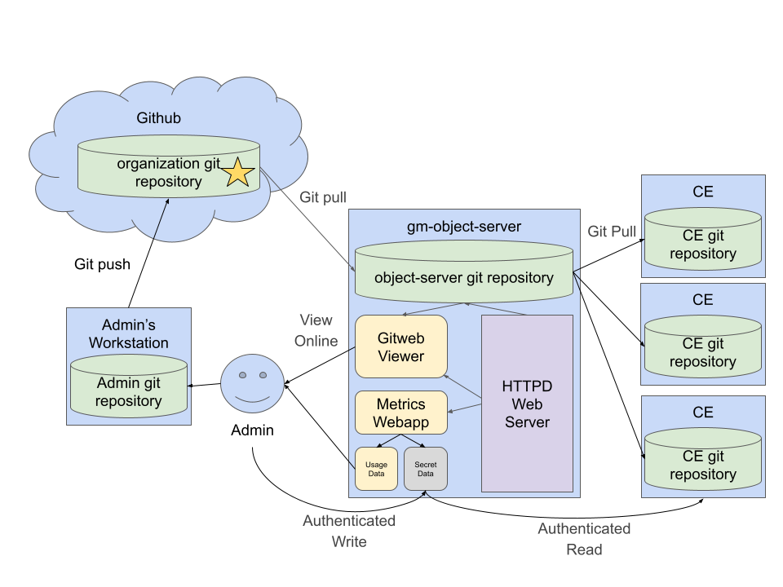
The Glidein Manager
New service that provides Organizations a central location to specify executable versions and config for their Glideins
Git Server that mirrors an upstream repository
  - Utilize popular GitOps workflows
Hosts config files and executable
specifications as structured text
Allows executables and config to be
versioned in lockstep via Git commits
Collects usage metrics and generates
reports

Slide 55


Side Lesson: Kubernetes Operators
Kubernetes - Popular container orchestration service
Kubernetes Operator - Privileged container within a cluster that programmatically manages other containers
  Built in Go via several well-supported Open Source SDKs
Glideins can be run as containers within a Kubernetes Cluster
A Kubernetes Operator that creates Glidein containers can act as a Compute Entrypoint

Slide 56
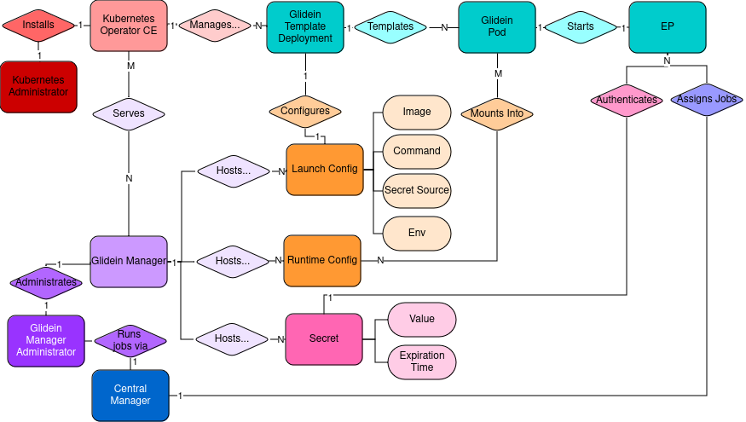
The Glidein Manager:
Kubernetes Operator CE Edition
Kubernetes Operator that acts as a Compute Entrypoint for a cluster,
Translates versioned config data from a Glidein Manager into Glidein-running resources in its cluster
  launching Glideins via autoscaling deployment
Updates resources within its cluster
when new Git commits are pushed to
the Glidein Manager
Lets cluster owners allocate resources
to research organizations, and research organizations configure how those
resources are used

Slide 57
HPC Annex
Added Delta (at NCSA) and Perlmutter (NERSC)…
…looking at how to "template" adding an HPC site so you could add your own

Slide 58

Thank you! https://htcondor.org
http://survey.htcondor.com/
This work is supported by NSF under Cooperative Agreement OAC-2030508 as part of the PATh Project. Any opinions, findings, and conclusions or recommendations expressed in this material are those of the author(s) and do not necessarily reflect the views of the NSF

