Slide 1
Connecting Pelican to Your Data
Justin Hiemstra
Research Software Engineer & Pelican Developer
July 9, 2024

Slide 2
Serving Two Sides of the Same Coin
Pelican has two distinct types of users…

Slide 3
Serving Two Sides of the Same Coin
Pelican has two distinct types of users…
I want to access data!
Data might need to integrate with…
HTC Workflows
PyTorch dataloaders
Visualization tools
Browser clients

Slide 4
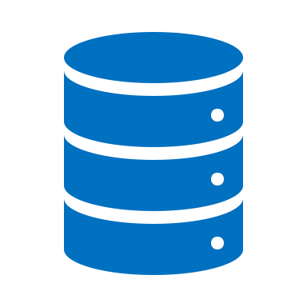
Serving Two Sides of the Same Coin
Pelican has two distinct types of users…
I want to share my data!
I want to access data!
Data might come from…
A hard drive in the lab
AWS/S3
An HTTP Server
Wherever YOU keep your data!
Data might need to integrate with…
HTC Workflows
PyTorch dataloaders
Visualization tools
Browser clients

Slide 5
Serving Two Sides of the Same Coin
Pelican has two distinct types of users…
Pelican's job:
To connect data providers with data consumers

Slide 6
Serving Two Sides of the Same Coin
But right now we're focused on this person
Pelican's job:
To connect data providers with data consumers

Slide 7
Dataset Sharing Powers Open Science

Slide 8
Dataset Sharing Powers Open Science

Slide 9
Dataset Sharing Powers Open Science
We have some function or algorithm…

Slide 10
Dataset Sharing Powers Open Science
We have some function or algorithm…
that uses some kind of data…

Slide 11
Dataset Sharing Powers Open Science
We have some function or algorithm…
that uses some kind of data…
to produce some kind of result we care about

Slide 13
Dataset Sharing Powers Open Science

Slide 14
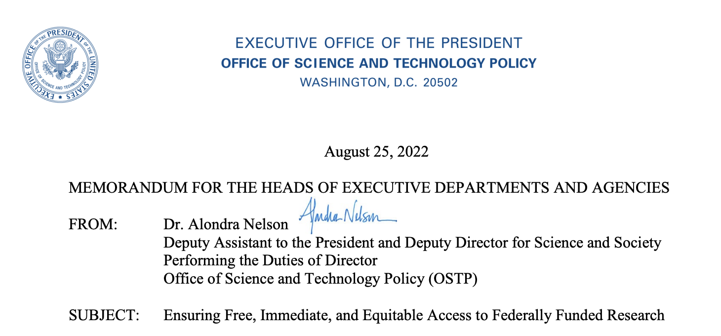
Why You Should Federate Your Data

Slide 15
Why You Should Federate Your Data

Slide 16
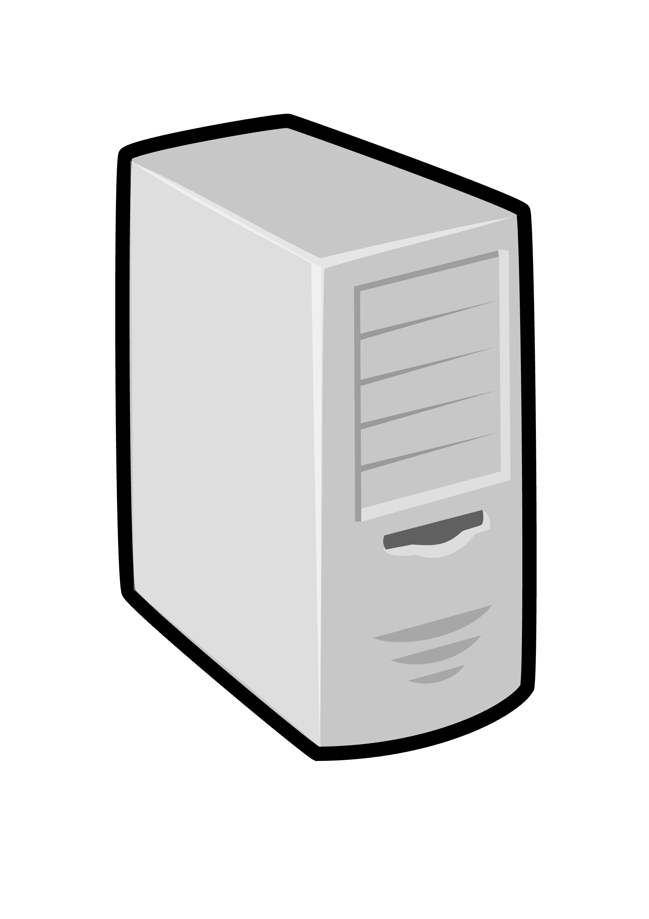
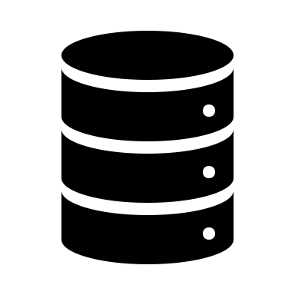
Why You Should Federate Your Data
Execution Endpoints
Source 1
Output
Source 2
…
…
Source N
Results

Slide 17
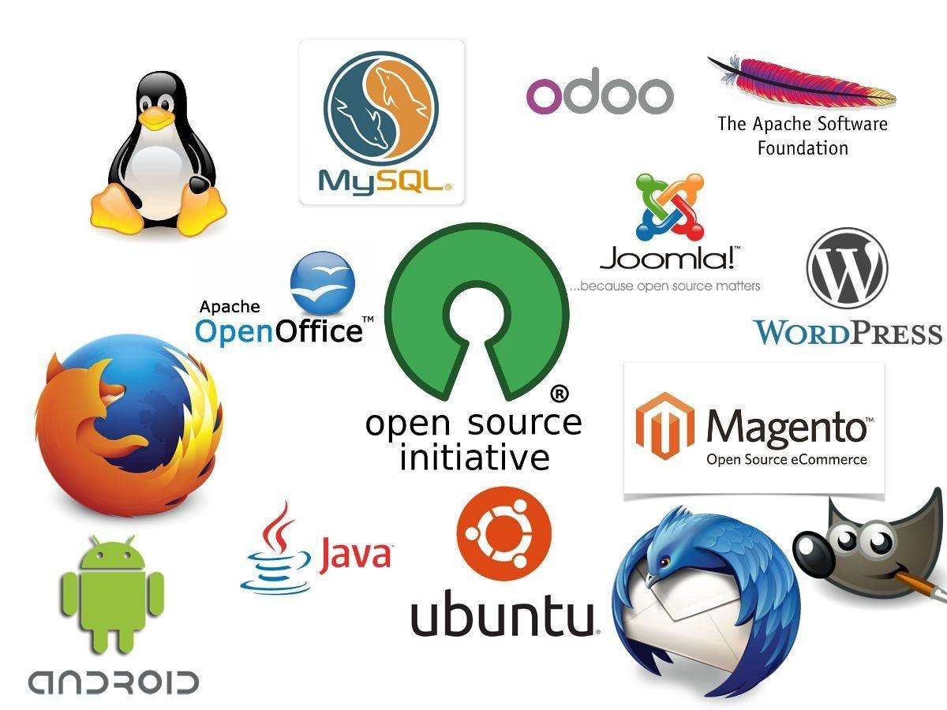
Why You Should Federate Your Data

Slide 18
Why You Should Federate Your Data
BUT:
Maybe you still want to control who has access
Maybe you only want to join the federation for a limited time
Your data lives in an uncommon repository that consumers might not be familiar with

Slide 19
You've decided to federate your data…
🎉 great choice, by the way! 🎉

Slide 20
You've decided to federate your data…
🎉 great choice, by the way! 🎉
The process begins with serving an Origin

Slide 21
But First!
Data in Flight - Delivering Data with Pelican Tutorial
1:30 PM - 2:45 PM
To participate in the hands-on portion of the tutorial, you must register before end-of-day Tuesday
Registration link and more information is available in the "session details" page in the schedule.
go.wisc.edu/cfsl43

Slide 22
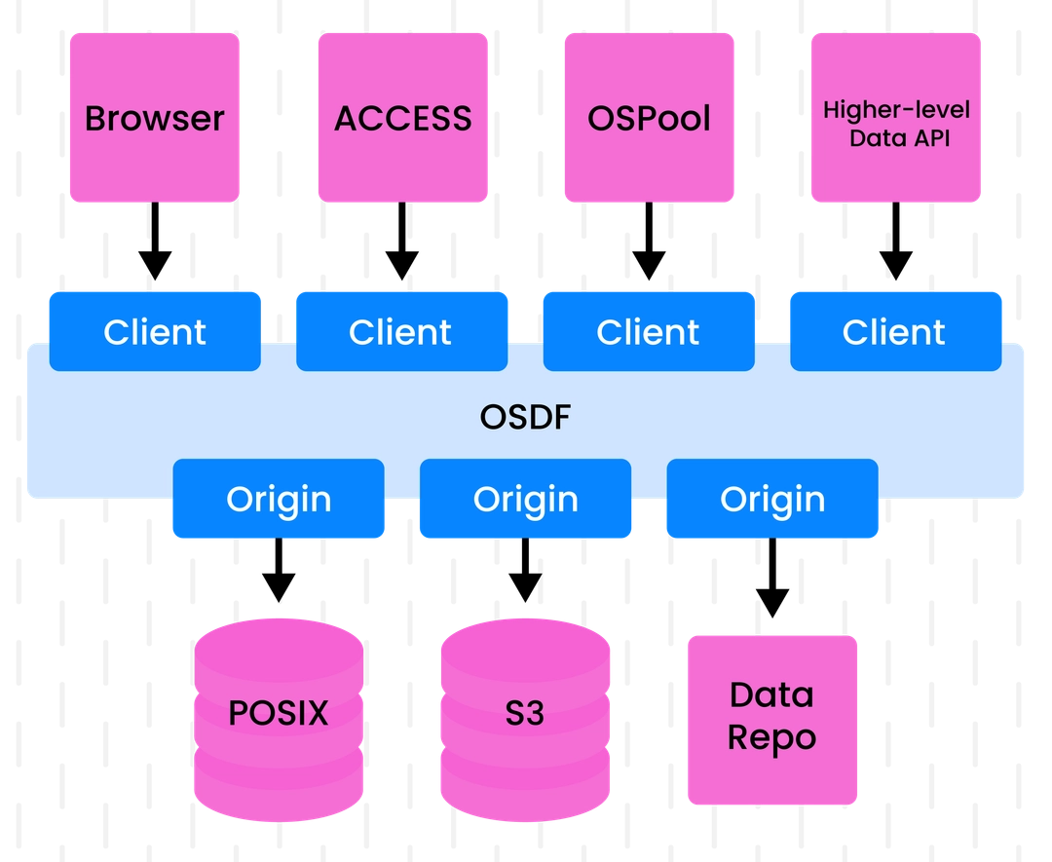
What's an Origin for?
Origins act as an adapter plug
They translate object requests between data repositories and the federation
They homogenize data access – users don't need to know the backend technology
They're also tasked with translating access policies/controls
They provide access to monitoring, so you know what's happening to your data
*
Note: Data is accessed via an Origin, not from it

Slide 23
Origin Architecture
Pelican Origins join a Pelican Process:
Browser interface
Monitoring
Configuration
With an XRootD Process
Access/Authorization
Data movement
Federation Central Services
Pelican Registry
Pelican Director
Origin
Data Repo
XRootD Process
Pelican Process
FederationPrefix: /weather
StoragePrefix: /my-bucket
Hostname: my-origin.com

Slide 24
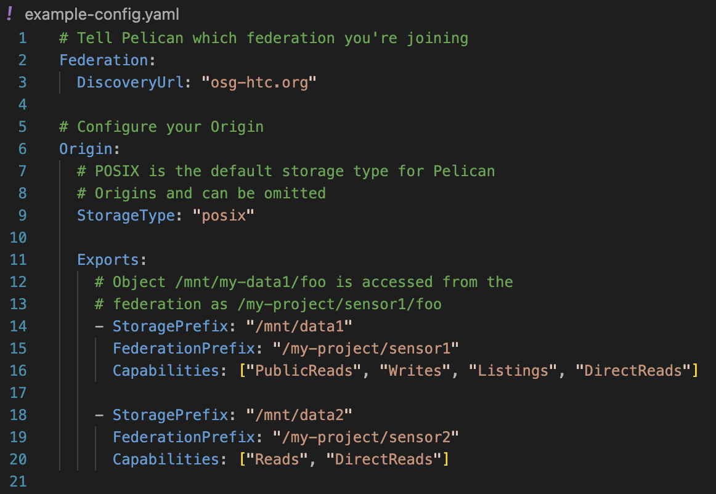
Things to Know & Choices to Make
Setting up an Origin requires knowing a few fundamentals:
Your federation's hostname

Slide 25
Things to Know & Choices to Make
Setting up an Origin requires knowing a few fundamentals:
Your federation's hostname
The federation prefix at which your data will be accessed

Slide 26
Namespacing with Federation Prefixes
Federation prefixes (aka namespace prefixes) allow you to map objects from the data repository into the federation:
/mnt/data1/foo → /my-project/sensor1/foo
Rules:
POSIX-style filepaths
Restrictions on some special chars: ~ . $ * \
Paths must be absolute, e.g. /some/path not some/path

Slide 27
Things to Know & Choices to Make
Setting up an Origin requires knowing a few fundamentals:
Your federation's hostname
The federation prefix at which your data will be accessed
The "capabilities" you give your Origin/prefix

Slide 28
Origin/Prefix "Capabilities"
Origin administrators control how their data is accessed through the Origin/prefix's declared capabilities
Reads: Objects can be read, but require an authorization token
PublicReads: Objects can be read via the Origin by anyone.
Writes: Objects can be written back to the data repository via the Origin. Always requires a token!
Listings: Not yet supported by all Origin backends, this allows object discovery in a namespace (think "ls").
DirectReads: The Origin is fine being contacted directly by clients, skipping any caching/staging.

Slide 29
Things to Know & Choices to Make
Setting up an Origin requires knowing a few fundamentals:
Your federation's hostname
The federation prefix at which your data will be accessed
The "capabilities" you give your Origin/prefix
TLS credentials and a hostname (optional)

Slide 30
Supported Repository Backends
POSIX – our bread and butter
S3 – The new kid on the block, quickly gaining popularity
HTTP – Generic HTTP servers
XRoot – Used to export origins that only speak root protocol
Globus – Experimental. Want to try it out for us?
Where should we go next?

Slide 31
JWTs, Scitokens, and WLCG Oh My!
Token Description
Authorization in Pelican takes the form of JSON Web Tokens (JWTs)
Origin
Origins
Caches
Repository Access Secrets

Slide 32
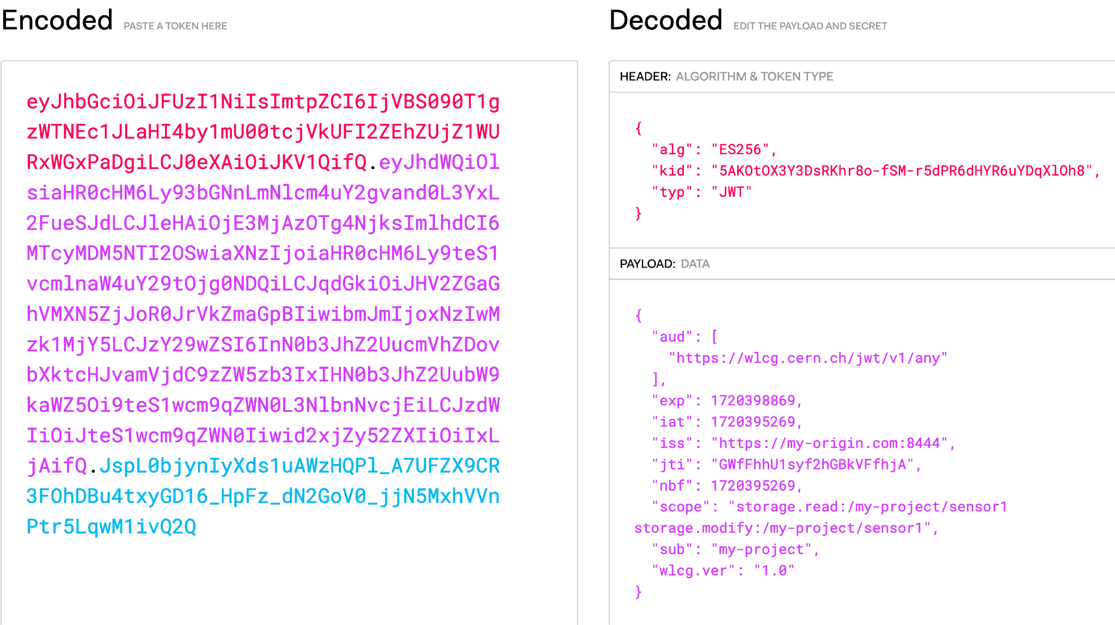
Source: https://jwt.io/

Slide 33
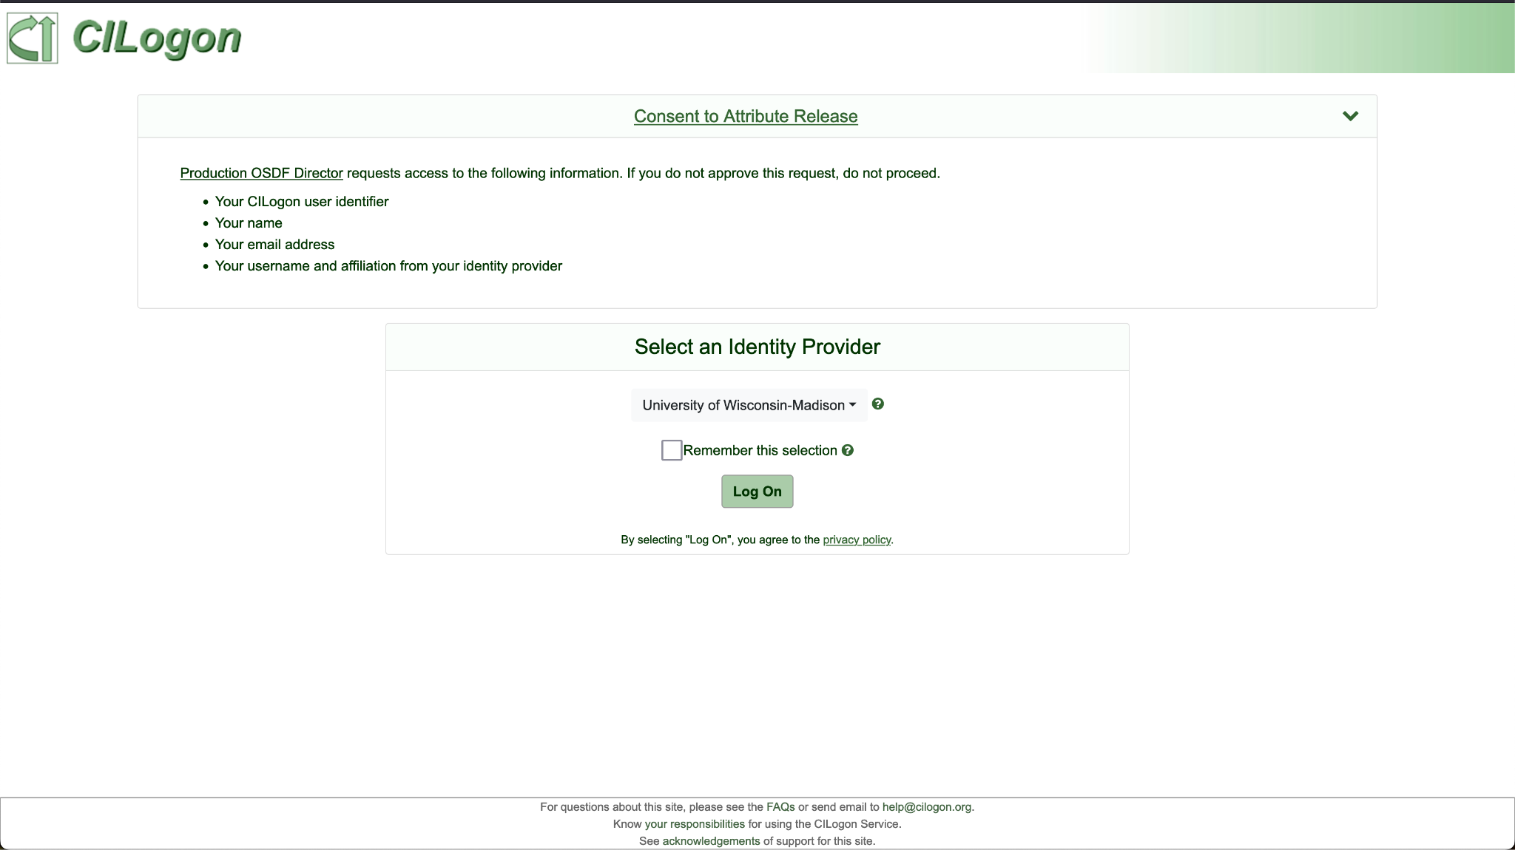

Slide 34
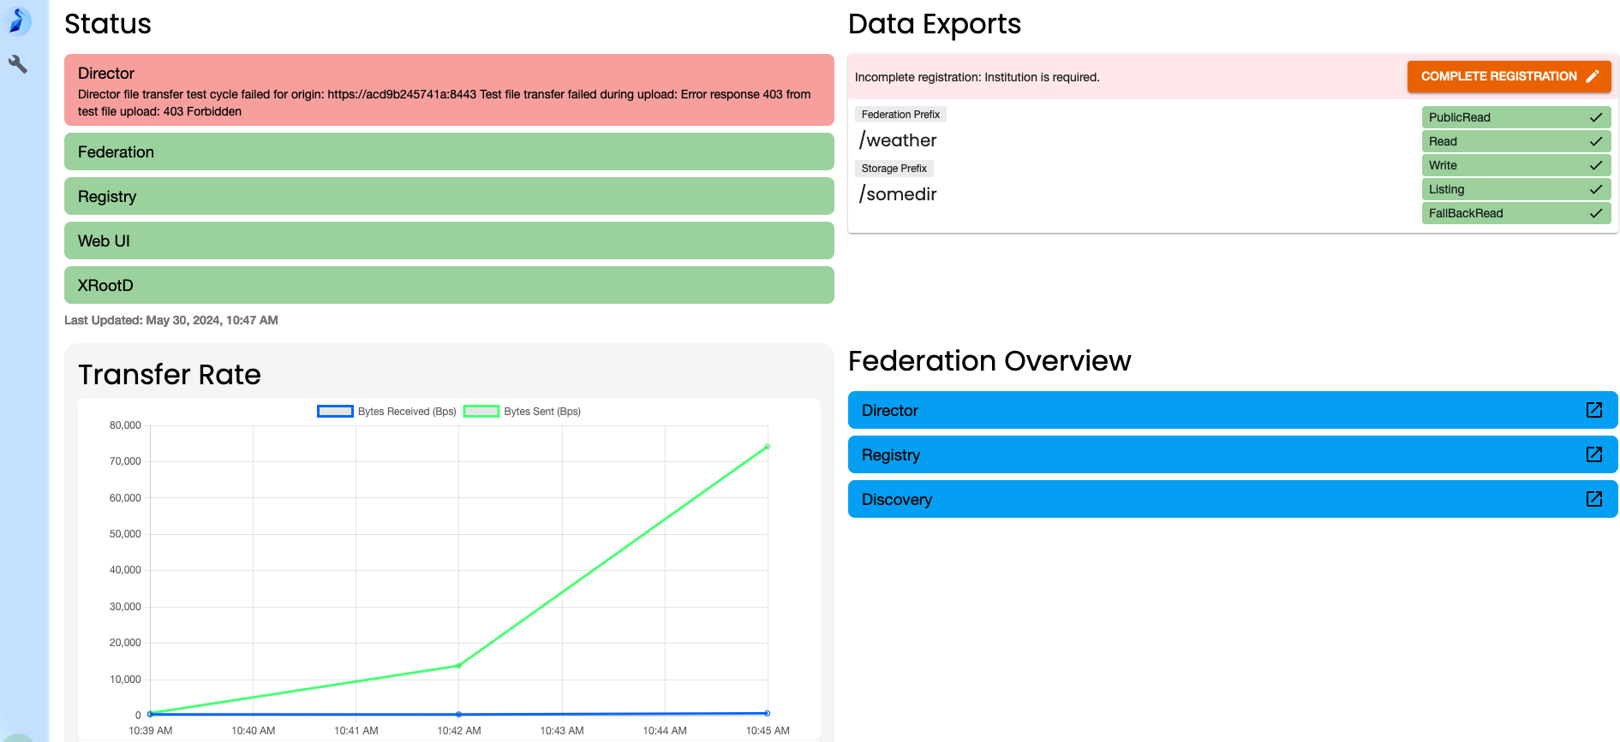
Start your Engines Origins!

Slide 35
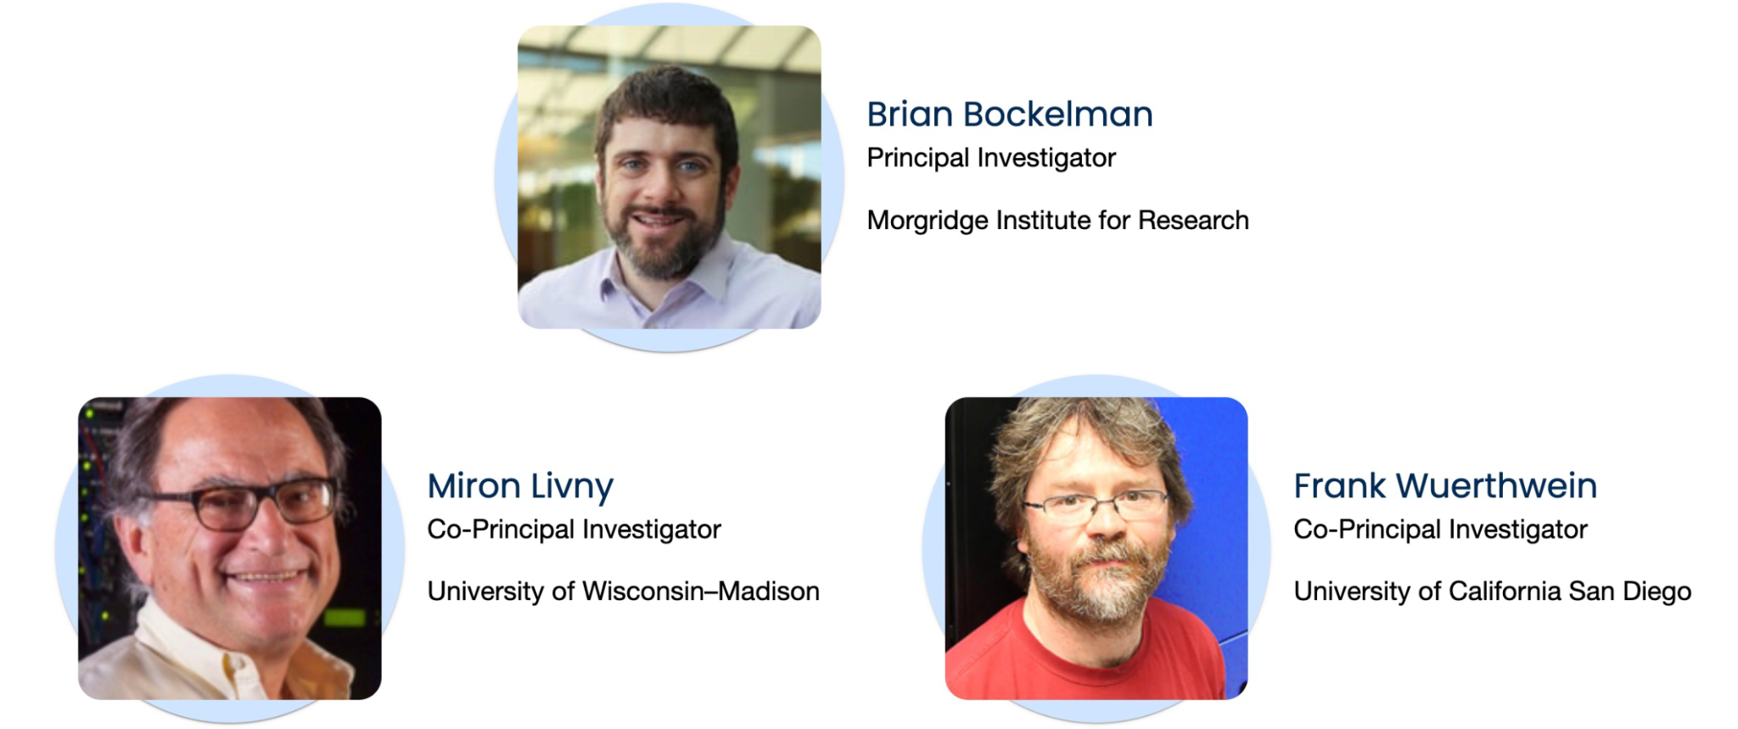
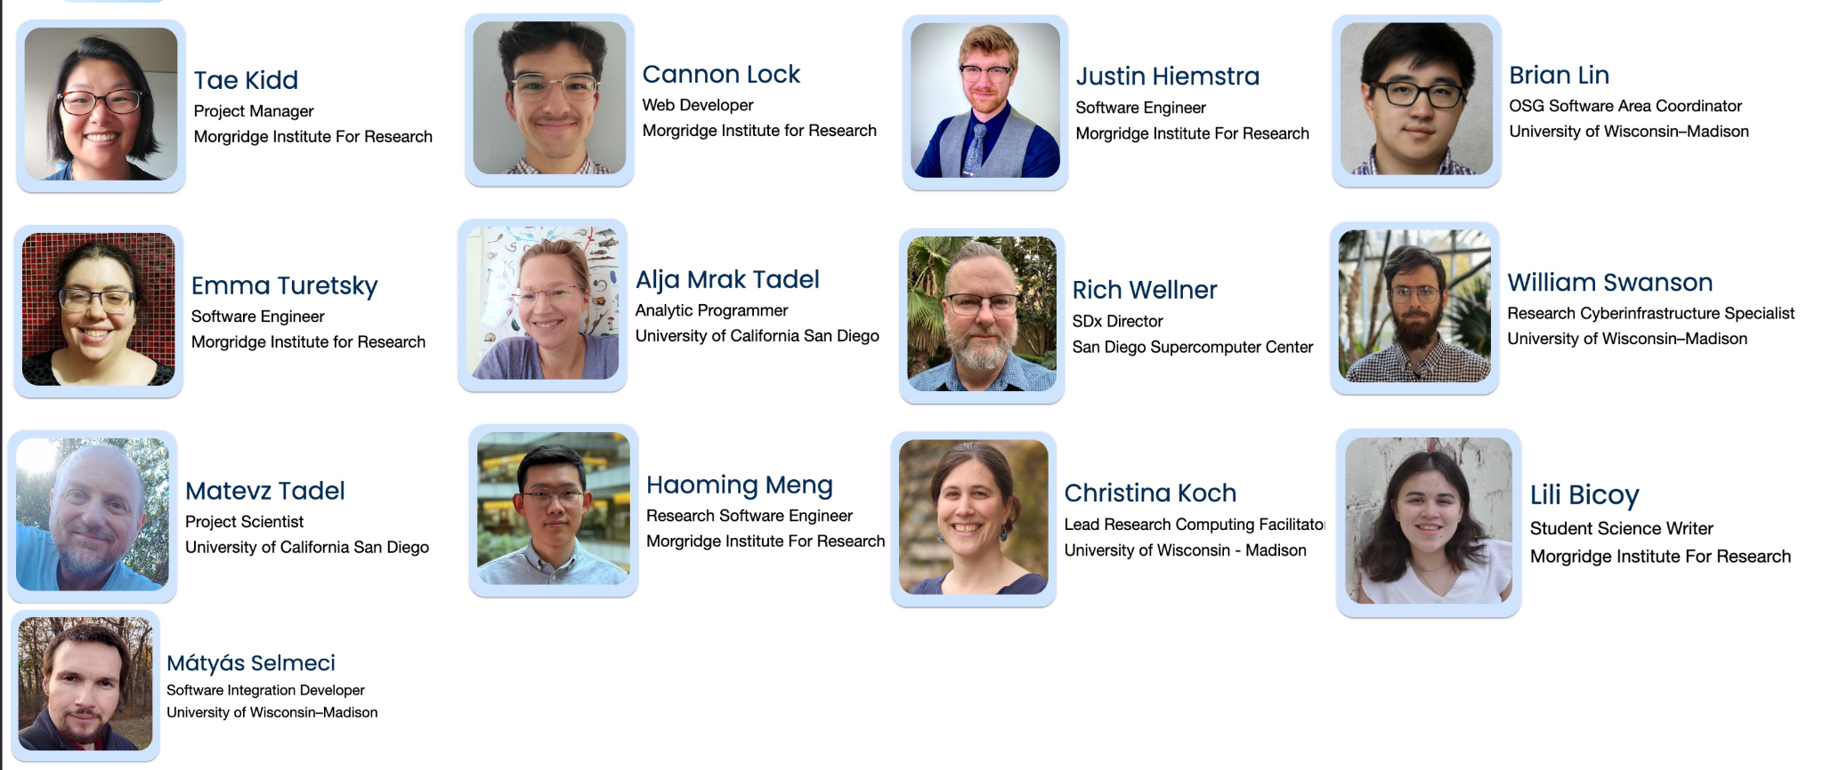
The Pelican Team looks forward to having an impact on your project!
This project is supported by the National Science Foundation under Cooperative Agreements OAC-2331480. Any opinions, findings, conclusions or recommendations expressed in this material are those of the authors and do not necessarily reflect the views of the National Science Foundation.

Slide 36
But Last!
Data in Flight - Delivering Data with Pelican Tutorial
1:30 PM - 2:45 PM
To participate in the hands-on portion of the tutorial, you must register before end-of-day Tuesday
Registration link and more information is available in the "session details" page in the schedule.
go.wisc.edu/cfsl43

