Slide 1
Data in Flight:
Delivering Data with Pelican
Andrew Owen, PhD
Research Computing Facilitator
CHTC/OSG
Notes:
https://agenda.hep.wisc.edu/event/2175/sessions/3189/#20240710

Slide 2
Goal
Enable those interested in contributing to the OSDF (Open Science Data Federation) by introducing and guiding the use of the software that runs the OSDF (Pelican).

Slide 3
Objectives
At the end of this training, participants will be able to:
Describe what the Pelican Platform is able to do.
Identify potential use cases for using the Pelican Platform.
Define core concepts in the Pelican data federation architecture, including "origin" and "data federation".
Access (public) data from a Pelican data federation.
Walk through the steps needed to deploy a (public) Pelican data origin on top of an existing data repository.

Slide 4
Agenda
Part 1: Introduction (20 min)
OSPool and the Open Science Data Federation (OSDF)
Pelican and the OSDF
Structure of a Pelican Data Federation
Contributing to a Pelican Data Federation
Part 2: Hands-on Tutorial (55 min)
Using the Pelican Client to Transfer Data
Configuring Your Pelican Origin
Initialize and Serve Your Pelican Origin
Transferring Data with Your Pelican Origin

Slide 5
Part 1: Introduction

Slide 6
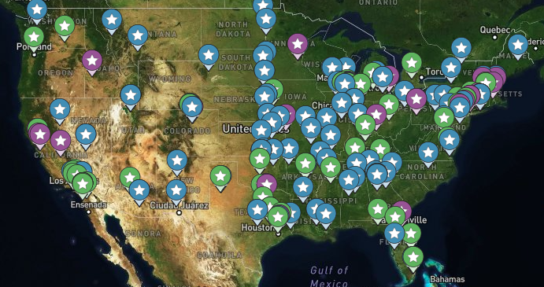
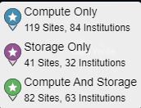
OSPool and the Open Science Data Federation (OSDF)
The OSPool is a High Throughput Computing system distributed across most of the United States, that runs 500,000 - 1,000,000+ jobs per day

Slide 7
OSPool and the Open Science Data Federation (OSDF)
With distributed computing comes the need for data distribution that works at large scale and large volume
Submitting Jobs Here*
Could run anywhere!

Slide 8
OSPool and the Open Science Data Federation (OSDF)
Submitting many jobs that use the same large file can quickly flood the network
10,000 jobs
x
10 GB input file
x
1 transfer / job
=
100,000 GB network transfer

Slide 9
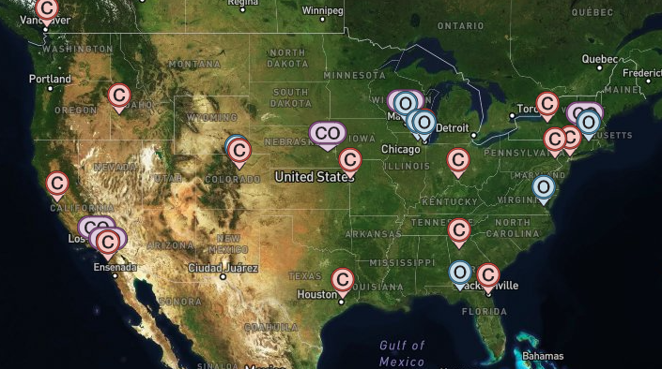
OSPool and the Open Science Data Federation (OSDF)
Enter the OSDF - a system of data caches that can stage large, repeatedly used files closer to the actual compute resources
10,000 jobs
x
10 GB input file
x
1 transfer total
=
10 GB network transfer

Slide 10
OSPool and the Open Science Data Federation (OSDF)
Total OSDF usage in the continental USA for June 2024 = 24.9 PB read (OSPool usage accounts for 10% of this = 2.5 PB read)
Corresponds to 10 GB/s (80 Gbps) - 80% of a 100G network pipe
The cache system was used for >97% of transfers (saves >75Gbps in network traffic)
More information in "Deployment Scale and Use of OSDF" session: https://agenda.hep.wisc.edu/event/2175/contributions/30968/
Notes:
OSDF total usage = 24.9 PB in June 2024 for continental USA. OSPool usage accounts for 10% of this total usage.

Slide 11
Pelican and the OSDF
Just like how OSG uses
HTCondor as the software that runs the OSPool,
OSG is transitioning to use
Pelican as the software that runs the OSDF.
The benefits for the OSDF (as the flagship instance of Pelican):
More reliable, robust software stack
Lots more room for new features, improvements
More extensible to other contributors and data stores

Slide 12
What is Pelican?
Pelican is a software platform for creating data federations, which serves to unite data contributors with data consumers under a single namespace.
Data contributors can connect existing datastores to a data federation while maintaining their access policies
Data consumers can easily access data objects in the data federation without needing to know anything about the underlying infrastructure

Slide 13
What is Pelican?
Like HTCSS, the Pelican Platform is an open-source software being developed at CHTC (Center for High Throughput Computing) at University of Wisconsin - Madison
pelicanplatform.org
Overall goals for Pelican development include
empowering infrastructure for target domains, such as climate data
supporting a wide range of storage backends to support user needs
making the setup and use of Pelican services convenient and easy

Slide 14
Structure of a Pelican Data Federation
What is a Data Federation?
A collection of decentralized, autonomous data repositories working together to make their data broadly available to other members of the federation under a minimally-centralized structure.
More information in "Introducing Pelican: Powering the OSDF": https://agenda.hep.wisc.edu/event/2175/contributions/30967/

Slide 15
Structure of a Pelican Data Federation
How is data used?
Data is accessed through a unified namespace regardless of where the data comes from or what type of storage is used to host it. Some or all of the contributed data can be restricted to specific, authenticated members of the federation

Slide 16
Structure of a Pelican Data Federation
How is a Pelican Data Federation identified?
A Pelican Data Federation is identified by its Federation URL.
For example, the OSDF uses osg-htc.org.
This URL can be used by any Pelican component to find the necessary metadata to communicate to other components of the Federation

Slide 17
Structure of a Pelican Data Federation
What are the components of a Pelican Data Federation?
A Pelican Data Federation (such as the OSDF) has the following components:
Client used by the data consumers
Origin run by the data contributors
Cache run by contributors or federation owners to stage data "closer" to the destination
Director run by federation "owner", directs access requests to the proper Origin/Cache
Registry run by federation "owner", records identities of federation components

Slide 18
Structure of a Pelican Data Federation
Client
A user can access data in a Federation using the Pelican Client (CLI tool or other interface).
In their access request, a user provides:
The Federation URL
The name of the desired object in the Federation's namespace
Authorization token (if data access is restricted)

Slide 19
Structure of a Pelican Data Federation
Origin
The Origin is a service that runs in front of the data store by the data contributor, and is the interface between the data store and the Federation.
The Origin
provides a namespace prefix which denotes where in the Federation namespace its data can be found.
is the adapter between the storage backend and the Federation
provides fine-grained access control to the data store

Slide 20
Structure of a Pelican Data Federation
Cache
The Cache service is run on a strategically placed server and acts as temporary data store for copies of data being transferred within a Federation.
By default, data downloaded from a Federation is transferred via a Cache, which keeps a copy so that future downloads only need to transfer from the Cache server, and not via the Origin server
The Cache maintains the same access restrictions as the Origin server the data came from

Slide 21
Structure of a Pelican Data Federation
Director
The Director service is operated by the Federation "owner", and is responsible for tracking what (registered) components are online, redirects access requests to appropriate components.
Data does not actually move through the Director.

Slide 22
Structure of a Pelican Data Federation
Registry
The Registry service is operated by the Federation "owner", and is a list of the identities of components within the Federation.
When a new component is brought online, it registers its identity with this service. The Federation "owner" has ultimate control over this list, and thus who can be registered within the Federation.
Clients do not have to be registered in order to access the Federation, though they may need to authenticate themselves with individual Origins.

Slide 23
Data Access in a Pelican Data Federation
A Pelican URL is used to specify object locations within a Data Federation:
pelican://osg-htc.org/weather/cloud.jpg
Defines a metadata lookup protocol
The federation’s hostname/root
The desired object name
where
/weather/cloud.jpg
Namespace Prefix
Object name

Slide 24
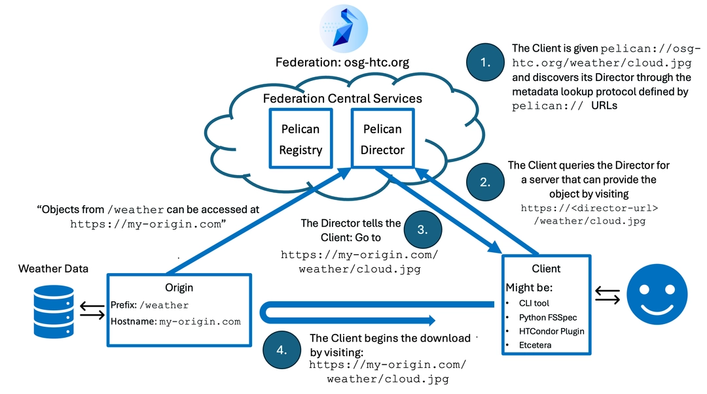
Data Access in a Pelican Data Federation

Slide 25
Data Access in a Pelican Data Federation
More information in "Pelican under the hood: how the data federation works": https://agenda.hep.wisc.edu/event/2175/contributions/31334/

Slide 26
Contributing to a Pelican Data Federation
If serving public data,
Have a server with a registered web domain, and connected to your data store
Configure the Origin service to run on the server
Run the Origin service
Register the Origin service with the Federation "owner"
If serving private data, or enabling write to your data store, the above +
Configure authentication services
Be able to generate tokens for approved users to read/write from your store

Slide 27
Contributing to a Pelican Data Federation
More information in "Connecting Pelican to your data": https://agenda.hep.wisc.edu/event/2175/contributions/31335/

Slide 28
Part 2: Hands-on Tutorial

Slide 29
Tutorial Setup
You will be guided through how to run your own Origin to serve public data to an existing data federation using Pelican.
We are providing you with a login to a virtual machine that has a registered domain name and where you can launch Docker containers.
Materials are posted on GitHub:
Go to github.com/PelicanPlatform/training-origin
Commands used in this presentation are also provided in the README on GitHub

Slide 30
Tutorial Setup
github.com/PelicanPlatform/training-origin
*You must have registered in advance to get access to a virtual machine*
Use your COmanage username to login via SSH: ssh <comanage-username>@pelican-train.chtc.wisc.edu
After logging in, this should redirect you to your virtual machine, named in the format "trainee@pelicantrain20##"
Login again using a second window
Full step-by-step instructions are provided in the GitHub README

Slide 31
Tutorial Setup
github.com/PelicanPlatform/training-origin
Clone the tutorial materials to your virtual machine
Make sure you are in your home directory cd $HOME
Clone the materials from GitHub git clone https://github.com/PelicanPlatform/training-origin

Slide 32
Using the Pelican Client to Transfer Data
The Pelican Client can be used to get and put objects from an existing Data Federation
Available as a standalone binary from the Pelican Platform website
https://docs.pelicanplatform.org/install
No installation required to use the Pelican Client!

Slide 33
Using the Pelican Client to Transfer Data
"Install" the Pelican client
Move into the provided pelican-client directory cd $HOME/training-origin/pelican-client
Download the Pelican client (link copied from Pelican website) wget https://github.com/PelicanPlatform/pelican/releases/download/v7.9.2/pelican_Linux_x86_64.tar.gz
Decompress the client tar -xzf pelican_Linux_x86_64.tar.gz
The pelican binary is inside of the newly created pelican-7.9.2 directory

Slide 34
Using the Pelican Client to Transfer Data
A Pelican URL is used to specify object locations within a Data Federation:
pelican://osg-htc.org/weather/cloud.jpg
Defines a metadata lookup protocol
The federation’s hostname/root
The desired object name
To download an object using the client, use the command:
pelican object get <Pelican URL> <desired name>

Slide 35
Using the Pelican Client to Transfer Data
Use the client to download this test object from the OSDF
<Pelican URL> = pelican://osg-htc.org/ospool/uc-shared/public/OSG-Staff/validation/test.txt
Move into the directory with the pelican binary cd $HOME/training-origin/pelican-client/pelican-7.9.2
Use the "pelican object get" command to download the object
./pelican object get <Pelican URL> ./downloaded-test.txt
Look at the contents of the file cat downloaded-test.txt # Hello, World!

Slide 36
Configuring Your Pelican Origin
To serve your own Origin, Pelican team recommends using their provided Docker container, but configured to run your Origin
You'll need:
web host certificates for the server running the Origin
a set of "issuer" credentials (Pelican can generate)
a couple of open ports
Pelican specific configuration file describing the above and the location of the data being served
By default, Pelican will look in /etc/pelican for what it needs. We'll mount the necessary files into that location when running the Docker container

Slide 37
Configuring Your Pelican Origin
Prepare the Origin directories
Move to the provided pelican-origin directory cd $HOME/training-origin/pelican-origin
Explore the file structure ls -R
[optional] Modify the contents of test.txt vi $HOME/training-origin/pelican-origin/data/test.txt

Slide 38
Configuring Your Pelican Origin
The prepared directory has the following structure:
$HOME/training-origin/pelican-origin
├── config
│ └── pelican.yaml
├── data
│ └── test.txt
└── start-origin.sh
The pelican.yaml file will be mounted into /etc/pelican
The data folder will be mounted as /data
Notes:
Explain the directory structure and how it relates to the Docker container

Slide 39
Configuring Your Pelican Origin
Pelican follows the OpenID Connect (OIDC) protocol for authentication.
Your Origin needs an "issuer" key pair to authenticate itself with the federation, and to use for authenticating data access.
When your Origin connects to a federation for the first time, the Registry of that federation associates the Origin's domain with the issuer key pair
Recommend pre-generating the issuer key pair and providing the location in the Pelican config (otherwise Pelican will automatically generate a new pair each time the service is started..)

Slide 40
Configuring Your Pelican Origin
Generate the Issuer JWK
Move to the Origin config directory cd $HOME/training-origin/pelican-origin/config
Generate the issuer key pair using the Pelican binary ../../pelican-client/pelican-7.9.2/pelican generate keygen
Should now have the issuer key pair [ config]$ ls issuer.jwk issuer-pub.jwks pelican.yaml

Slide 41
Configuring Your Pelican Origin
Your directory should now have the following structure:
$HOME/training-origin/pelican-origin
├── config
│ ├── issuer.jwk
│ ├── issuer-pub.jwks
│ └── pelican.yaml
├── data
│ └── test.txt └── start-origin.sh
The .jwk files will be mounted into /etc/pelican
Notes:
Explain the directory structure and how it relates to the Docker container

Slide 42
Configuring Your Pelican Origin
By default, Pelican looks at /etc/pelican/pelican.yaml for its configuration.
The prepared pelican.yaml file is in $HOME/training-origin/pelican-origin/config/
This will be mounted into the Docker container to the correct location.
Let's look at the contents.

Slide 43
Configuring Your Pelican Origin
# Configuring the server running the origin
# Remember the following are the paths *inside* of the Docker container
Server:
# Pre-generated using 'pelican generate keygen'
IssuerKey: "/etc/pelican/issuer.jwk"
IssuerJWKS: "/etc/pelican/issuer-pub.jwks"
# Pre-generated by sysadmin of node
TLSCertificate: "/etc/hostcert.pem"
TLSKey: "/etc/hostkey.pem"
Hostname: "<vm-name>.chtc.wisc.edu"
This section details keys, certificates for the web host running the Origin

Slide 44
Configuring Your Pelican Origin
# Configuring the federation to join
Federation:
DiscoveryUrl: "https://osdf-itb.osg-htc.org"
All you need to specify for the federation is the Discovery URL.
Pelican will use this to find the necessary details for connecting to the federation.
(this specific one is for the OSDF test instance)

Slide 45
Configuring Your Pelican Origin
# Configuring the origin service and the data its serving
Origin:
EnableDirectReads: true
Exports:
# Each namespace has a section the looks like this:
- FederationPrefix: "/HTC24-<vm-name>"
StoragePrefix: "/data"
Capabilities: ["PublicReads", "Listings", "DirectReads"]
For your Origin, objects in /data (in the Docker container) will be available within the Federation via the /HTC24-<vm-name> namespace

Slide 46
Configuring Your Pelican Origin
Edit the contents of the configuration file
Using CLI editor, open the pelican.yaml file
vi $HOME/training-origin/pelican-origin/config/pelican.yaml
Replace <vm-name> with the name of your virtual machine For example, Before: Hostname: "<vm-name>.chtc.wisc.edu" After: Hostname: "pelicantrain2001.chtc.wisc.edu"
Save the file

Slide 47
Initialize and Serve Your Pelican Origin
To run the origin, we will use a script start-origin.sh, which contains:
docker run --rm -it \
-p 8444:8444 -p 8443:8443 \
-v $(pwd)/config/issuer.jwk:/etc/pelican/issuer.jwk \
-v $(pwd)/config/issuer-pub.jwks:/etc/pelican/issuer-pub.jwks \
-v /etc/hostcert.pem:/etc/hostcert.pem \
-v /etc/hostkey.pem:/etc/hostkey.pem \
-v $(pwd)/config/pelican.yaml:/etc/pelican/pelican.yaml \
-v $(pwd)/data:/data \
hub.opensciencegrid.org/pelican_platform/origin:v7.9.2 \
serve -p 8444
Opens ports
Mounts in issuer keys
Mounts in web host certificates
Mounts in
Pelican config
Mounts in data being served
Launch Origin
on port 8444
Pelican-provided Docker container for Origin

Slide 48
Initialize and Serve Your Pelican Origin
Start the Pelican Origin
Make sure you are in the correct directory cd $HOME/training-origin/pelican-origin
The Docker command is inside of the start-origin.sh script. Run the script: ./start-origin.sh
Leave the container running, don't cancel or close out of window!

Slide 49
Initialize and Serve Your Pelican Origin
You will be prompted to initialize the admin interface:
Pelican admin interface is not initialized
To initialize, login at https://<vm-name>.chtc.wisc.edu:8444/view/initialization/code/ with the following code:
185819
Open your link in a web browser and enter your code
Create a password (optional for this tutorial, strongly recommended for production)
Explore the web interface

Slide 50
Transferring Data with Your Pelican Origin
Once your Origin connects to the federation, your Origin can serve data to the federation
A client requests an object from your namespace (/HTC24-<vm-name> in this case) by asking the Director service
Director service looks up what caches or origins serve that namespace, and redirects client to appropriate server
Your Origin receives request for data and allows or denies based on access rules. In this case, anyone (PublicReads) can pull the data

Slide 51
Using the Pelican Client to Transfer Data
To pull data via your Origin, need to provide the Pelican URL to the object:
Defines a metadata lookup protocol
The federation’s hostname/root
The desired object name
pelican://
osdf-itb.osg-htc.org/
HTC24-<vm-name>/test.txt
Federation Prefix
Object name
In the following slides,
<Pelican URL> =
pelican://osdf-itb.osg-htc.org/HTC24-<vm-name>/test.txt

Slide 52
Transferring Data with Your Pelican Origin
To start, will use a special option to download the data directly from your Origin's store. Remember to leave the Docker container running!
Move to the client directory cd $HOME/training-origin/pelican-client/pelican-7.9.2
Get your object using your Pelican URL and the ?directread option
./pelican object get <Pelican URL>?directread ./directread-test.txt
Check the contents of the object you downloaded cat directread-test.txt (should be whatever is in your test.txt)
pelican://osdf-itb.osg-htc.org/HTC24-<vm-name>/test.txt

Slide 53
Transferring Data with Your Pelican Origin
Next, download the file using from a cache instead of directly from the Origin's datastore. This is the default behavior of Pelican
Move to the client directory cd $HOME/training-origin/pelican-client/pelican-7.9.2
Get your object using your Pelican URL and no special option
./pelican object get <Pelican URL> ./cacheread-test.txt
Check the contents of the object you downloaded cat cacheread-test.txt (should be whatever is in your test.txt)
pelican://osdf-itb.osg-htc.org/HTC24-<vm-name>/test.txt

Slide 54
Transferring Data with Your Pelican Origin
Pelican uses a caching system to stage (repeatedly used) data closer to the destination.
By default, Director directs requests to a cache
If the cache does not have the object, the cache requests the object from the appropriate Origin
Once the cache has the object, it can be downloaded by the Client.
The next time the Client requests the object, the Cache will provide it without asking the Origin (but it maintains the access rules of the Origin)
Careful! Changes to objects in the Origin are not propagated to the caches!

Slide 55
Transferring Data with Your Pelican Origin
What happens if an object is cached, but is changed at the Origin?
In the Client folder, remove the previously downloaded objects cd $HOME/training-origin/pelican-client/pelican-7.9.2 rm directread-test.txt cacheread-test.txt
Rename the object in the Origin's data directory cd $HOME/training-origin/pelican-origin/data mv test.txt renamed-test.txt
Using the client, try to download test.txt with(out) the ?directread option cd $HOME/training-origin/pelican-client/pelican-7.9.2 ./pelican object get <Pelican URL> ./cacheread-test.txt
./pelican object get <Pelican URL>?directread ./cacheread-test.txt
pelican://osdf-itb.osg-htc.org/HTC24-<vm-name>/test.txt
Notes:
The regular transfer successfully downloads 'test.txt', because it was previously pulled via a cache. The directread fails because 'test.txt' no longer exists at the Origin (it is now 'renamed-test.txt')

Slide 56
Additional Exploration
Work with a neighbor and try to download data from each other's origin datastore
What information needs to be communicated to the client user?
Stop the origin
What happens when you try to download data from the namespace served by the origin, with and without ?directread ?
Change the contents of the object at the origin
What are the contents of the object when downloaded without and with ?directread ?
Restart the origin, modify the config to disable public read
Now what happens when you try to download the data?

Slide 57
Additional Considerations
Authenticating data transfers
Origin needs to be configured with an authentication method
Data provider generates tokens accepted by the Origin, distributes to users
To put/get using the client, use one of the generated tokens
More about this in our upcoming PEARC24 tutorial!

Slide 58
Additional Considerations
Joining the OSDF
Some minor configuration changes
Contact us for more information!
We'll have a conversation about the data you want to contribute, and what is needed to make it happen

Slide 59
Concluding Remarks

Slide 60
Next Steps
More information on Pelican:
https://pelicanplatform.org
https://docs.pelicanplatform.org
More information about the OSDF:
https://osg-htc.org/services/osdf.html

Slide 61
Trainings and Getting Help
Today's tutorial - HTC24 session page
July 22nd - PEARC24 Pelican Tutorial
Learn the basics of Pelican, running your own Origin, and the authentication methods used for securing data transfers
4 hours, afternoon session, in-person
First half will be similar to today's tutorial
Second half will cover authentication
For OSDF support, see: support@osg-htc.org
For Pelican support, see: help@pelicanplatform.org

Slide 62
Questions?

