Slide 1
Advanced debugging with eBPF and Linux tools

Slide 2
Background
New set of Linux "performance" tools
I don't see our community using them much
They can save hours! Days!
Not really an "HTCondor" talk
But real reason for this talk is …

Slide 3
What do experts say?
"It depends"
But I'm not an expert here, so "I don't know"

Slide 4
A word on "Advanced"

Slide 5
Go Install these packages! NOW!
$ sudo yum install perf
$ sudo yum install bpftrace bcc $ sudo apt-get install linux-perf
$ sudo apt-get install bpfcc-tools

Slide 6
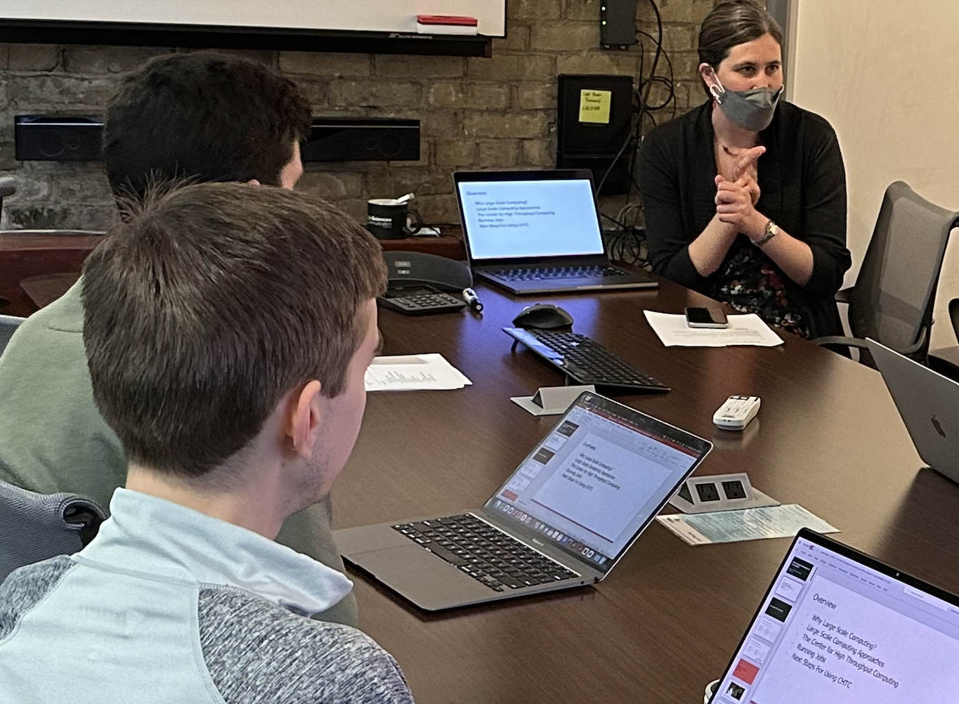
Motivating example
Job takes 20 minutes to run on researcher's laptop is taking 20+ hours to run on our "fast" cluster HTC computers –
WHY?
(also: running right now)

Slide 7
Initial investigation on EP
$ condor_ssh_to_job 17012325
Welcome to slot1_2@e2550.chtc.wisc.edu!
Your condor job is running with pid(s) 3437472.
$ uptime
11:11:56 up 127 days load average: 183.74, 181.60, 181.89
[gthain@e2550 ~]$ grep -c ^processor /proc/cpuinfo
256
$ ps auxww | grep 3437472
gthain 3437472 4364 1328 ? Ds 11:03 7:33 science_job

Slide 8
Essence of Debugging: Binary Search
What I know right now:
What I want to know:

Slide 9
perf trace command
$ sudo /bin/bash
Password:
# perf trace –p 3437472 –duration 10
Only show syscalls
whose duration is at least 10 milliseconds (why 10?)
-p <pid to trace>

Slide 10
"Duration" of a syscall
Duration is real time
Some long durations are (probably) OK:
e.g., sleep
But sleep is not a syscall – "nanosleep" is
Also, the sleep-like calls:
select, epoll, futex

Slide 11
perf trace command
# perf trace –p 3437472 –duration 10
95.705 (63.135 ms): futex(val: 895) = 0
95.411 (63.417 ms): futex(val: 895) = 0
95.694 (63.155 ms): futex(val: 895) = 0
95.714 (63.126 ms): futex(val: 895) = 0
95.741 (63.098 ms): futex(val: 895) = 0
…

Slide 12
perf trace command
# perf trace –p 3437472 –duration 10 –e '!futex'
But only show
NOT (!)
Futex calls

Slide 13
perf trace command
# perf trace –p 3437472 –duration 10 –e '!futex'
5.3 (821.412 ms): read(fd: 3</staging/big_file>, …) = 8192
7.5 (738.578 ms): read(fd: 3</staging/big_file>, …) = 8192
7.7 (819.972 ms): read(fd: 3</staging/big_file>, …) = 8192
8.6 (828.883 ms): read(fd: 3</staging/big_file>, …) = 8192
WHOAH!
Way too big!
/Staging is on ceph…

Slide 14
Solution: call ceph admin
Call ceph admin, inform fs system
Ceph admin understands problem, fixes it
5 minute later, job starting running fast

Slide 15
perf trace command -- after
# perf trace –p 3437472 –duration 10 –e '!futex'
5.3 (21.412 ms): read(fd: 3</staging/big_file>, …) = 8192
7.5 (17.578 ms): read(fd: 3</staging/big_file>, …) = 8192
7.7 (89.972 ms): read(fd: 3</staging/big_file>, …) = 8192
8.6 (28.883 ms): read(fd: 3</staging/big_file>, …) = 8192
And the job finished in roughly 20 minutes!

Slide 16
Why not grep?
# perf trace –p 3437472 | grep –v 'futex'

Slide 17
Super simplistic Linux model
"trace pid x"
All results
Linux
Kernel
What happens if kernel can not keep up? (Common if a lot of data coming back)
User Space program
(perf)

Slide 18
Two choices
Drop
Don't send info, just drop on floor
Block
Slow down traced process

Slide 19
# perf trace
1056.747 ( 0.478 ms): ... [continued]: read()) = 8192
LOST 47 events!
1056.747 ( 0.568 ms): ... [continued]: read()) = 8192
LOST 45 events!
1056.747 ( 0.654 ms): ... [continued]: read()) = 8192
LOST 39 events!
1056.747 ( 0.741 ms): ... [continued]: read()) = 8192
LOST 53 events!
1056.747 ( 0.853 ms):... [continued]: read()) = 8192
LOST 8 events!
LOST 38 events!

Slide 20
All results
Linux
Kernel
User Space program
(perf)

Slide 21
All results
Linux
Kernel
User Space program
(perf)
grep

Slide 22
Why not strace?
strace blocks, not drops Performance isn't biggest problem but is one Impact on traced processes is.
Strace uses ptrace(2), slow, clunky, generic

Slide 23
A word on "performance"

Slide 24
Use case: perf trace --summary
We added htcondor eventlog read
For sanity check, checked memory and cpu performance (with time) – MUCH SLOWER

Slide 25
condor_userlog simple, compute
1.) Reads event log file
2.) Deserializes
3.) Prints out one line per event
$ condor_userlog /var/log/condor/GlobalEventLog | head
Job Host Start Time Evict Time Wall Time Good Time CPU Usage
269288.7 172.22.60.140 9/10 00:36 9/10 00:36 0+00:00 0+00:00 0+00:00
269288.7 172.22.60.138 9/10 00:36 9/10 00:36 0+00:00 0+00:00 0+00:00
269288.7 172.22.60.61 9/10 00:36 9/10 00:36 0+00:00 0+00:00 0+00:00

Slide 26
htcondor eventlog read VS condor_userlog
$ time condor_userlog /var/log/condor/GlobalEventLog > /dev/null
real 0m36.707s
user 0m17.462s
sys 0m19.243s
Does this look odd? Any ideas?

Slide 27
# perf trace --summary condor_userlog GlobalEventLog> /dev/null
Summary of events:
condor_userlog (1917553), 56611085 events, 100.0%
syscall calls errors
------ -------- --------- -----
stat 11821024 0
fstat 10828288 0
gettimeofday 5413529 0
read 221032 0
write 19018 0
brk 1017 0

Slide 28
# perf trace -e stat --call-graph dwarf condor_userlog
1990.826 ( 0.263 ms): condor_userlog/2262058 stat(filename: 0xea3ef543, statbuf: 0x7ffd30495fd0) = 0
_xstat (inlined)
__tzfile_read (/usr/lib64/libc-2.28.so)
tzset_internal (/usr/lib64/libc-2.28.so)
__tzset (/usr/lib64/libc-2.28.so)
__GI_timelocal (inlined)
ULogEvent::readHeader
ULogEvent::getEvent (/usr/lib64/libcondor_utils_10_7_0.so)
ReadUserLog::readEventNormal
ReadUserLog::rawReadEvent
ReadUserLog::readEventWithLock
main (/usr/bin/condor_userlog)

Slide 29
# time condor_userlog GlobalEventLog > /dev/null
real 0m35.446s
user 0m17.486s
sys 0m17.960s
# time TZ=GMT condor_userlog GlobalEventLog > /dev/null
real 0m28.592s
user 0m18.112s
sys 0m10.480s

Slide 30
How to get at all info in kernel?
Without sending all info over wall for userspace to reduce
Linux
Kernel
User Space program
(perf)
Useful
info

Slide 31
Summary is tiny percentage.How do we just get it from kernel?
Linux
Kernel
User Space program
(perf)
Useful
info

Slide 32
eBPF: send code to data
Linux
Kernel
User Space program
(perf)
Useful
info

Slide 33
eBPF: send code to data
Linux
Kernel
User Space program
(perf)
Useful
info
summary

Slide 34
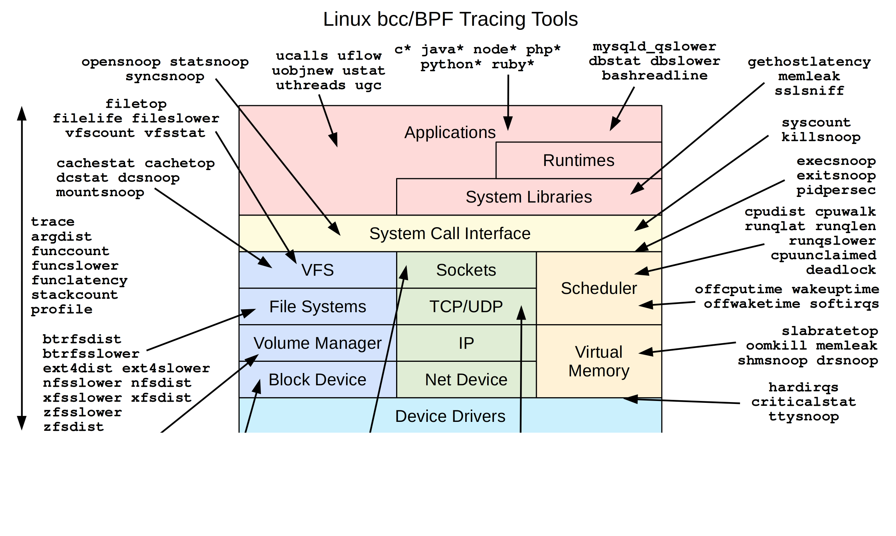
eBPF: big

Slide 35
eBPF: enormous

Slide 37
( yet )

Slide 38
Historical Aside
(2014)
inspired by
inspired by
(2005)
(1994)

Slide 39
Greg's (surely wrong) eBPF summary
A constrained 16 register assembly language
non-Turing complete – remind you of ???
With compilers for C, Python, other source
And built-in aggregating data structures With a (jit) implementation in the kernel Can be triggered on any kernel probe
Allow some (re) programing of the kernel

Slide 40
Two reactions:
OMG – This can't be good
Cool
Security?
Stability of kernel?
Complexity
Ultimate Power
I can think of 8 uses…
When can I start?

Slide 41
Start with pre-built tools…
Command | Action
execsnoop | Traces all exec pcall
opensnoop | Traces all file open
biolatency | Display block (disk) latency
biosnoop | Traces block access
tcpconnect | Traces all tcp connect
tcpaccept | Traces all incoming tcp
gethostlatency | Traces all DNS lookups

Slide 42
e.g. execsnoop
DaemonCoreDutyCyle
is > 0.95 on AP – Why?
(you DO watch DCDC?)
Aside: HTCSS good at noticing,
not so good at isolating

Slide 43
# execsnoop
TIME(s) PCOMM PID PPID RET ARGS
0.602 condor_shadow 2421138 2903754 0 /usr/sbin/condor_shadow 7.15
0.940 sh 2421145 2421144 0 condor_q
0.944 condor_q 2421145 2421144 0 /usr/bin/condor_q
1.828 sh 2421159 2421158 0 condor_q
1.830 condor_q 2421159 2421158 0 /usr/bin/condor_q
2.268 sh 2421165 2421164 0 condor_q
2.271 condor_q 2421165 2421164 0 /usr/bin/condor_q
2.618 sh 2421170 2421169 0 condor_q
2.621 condor_q 2421170 2421169 0 /usr/bin/condor_q
3.023 sh 2421178 2421177 0 condor_q
3.026 condor_q 2421178 2421177 0 /usr/bin/condor_q

Slide 44
$ watch –n 0.1 condor_q
Please don't do this. Can kill an AP
use "condor_watch_q" instead "-n 0.1" means 10 Hz
We killed the "watch", AP returned to normal.

Slide 45
# execsnoop
TIME(s) PCOMM PID PPID RET ARGS
0.602 condor_shadow 2421138 2903754 0 /usr/sbin/condor_shadow 7.15
0.940 sh 2421145 2421144 0 condor_q
0.944 condor_q 2421145 2421144 0 /usr/bin/condor_q
1.828 sh 2421159 2421158 0 condor_q
1.830 condor_q 2421159 2421158 0 /usr/bin/condor_q
2.268 sh 2421165 2421164 0 condor_q
2.271 condor_q 2421165 2421164 0 /usr/bin/condor_q
2.618 sh 2421170 2421169 0 condor_q
2.621 condor_q 2421170 2421169 0 /usr/bin/condor_q
3.023 sh 2421178 2421177 0 condor_q
3.026 condor_q 2421178 2421177 0 /usr/bin/condor_q
Notice the time diffs here? Not 10 Hz, at all mean sched

Slide 46
Aside: why so common?
google "watch condor_q"…

Slide 47
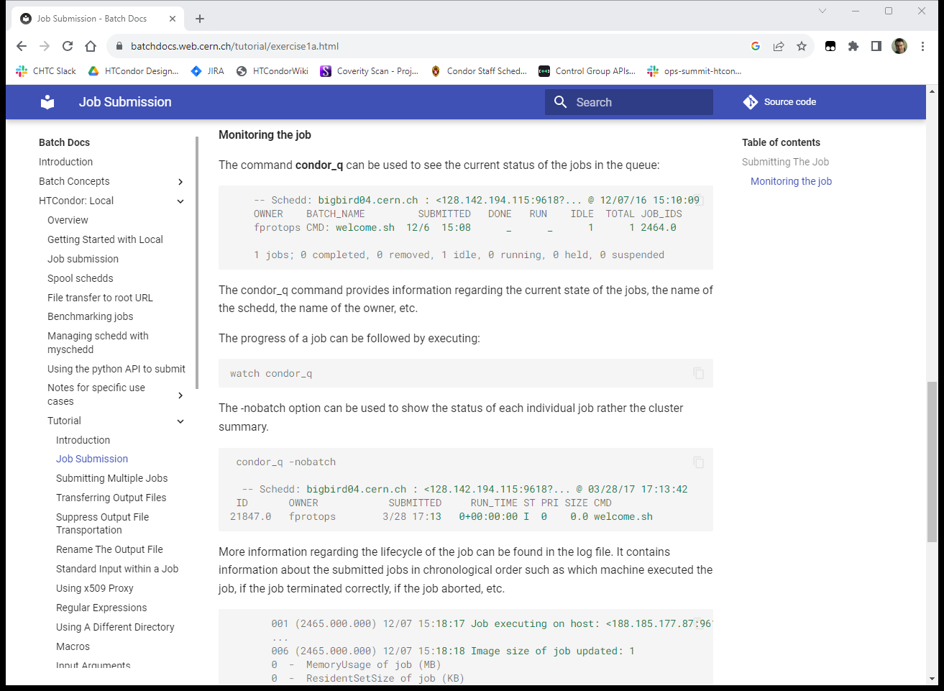
Who?
What ?

Slide 48
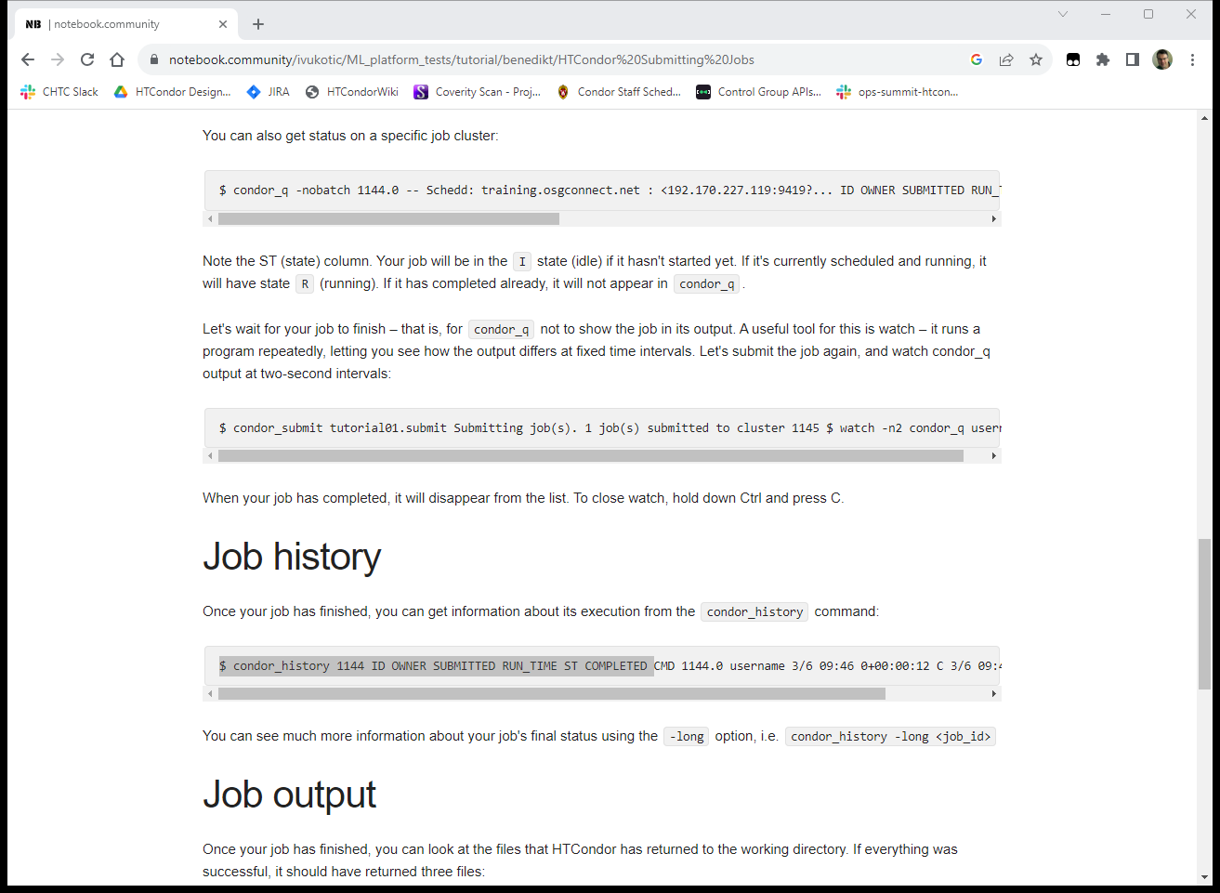
sigh

Slide 49
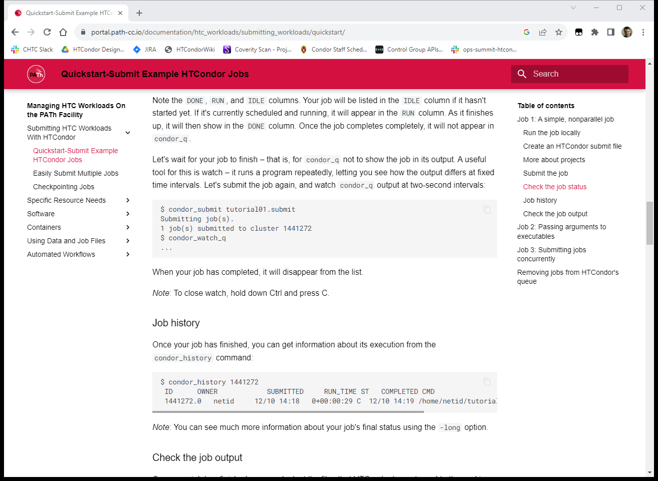

Slide 50
Why is "watch condor_q" so bad? And how can we get some insight?

Slide 51
# perf trace –p pid_of_schedd
1268.509 ( 0.002 ms): getpid() 2903754
1268.520 ( 0.011 ms): write(fd: 5<SchedLog>) =79
1268.534 ( 0.002 ms): rt_sigprocmask() = 0
1268.540 (147.908 ms): clone(flags: VFORK) = 301
1416.507 ( 0.008 ms): close(fd: 55) = 0
Condor_q forks schedd (clone)
Here speed-of-light is ~ 8Hz

Slide 52
Why is clone/fork slow?
Roughly linear in memory size of schedd
(what happened to CoW? – page tables)
Why is schedd big?

Slide 53
condor_q -all -tot
-- Schedd: submit-1.chtc.wisc.edu : <1.2.3.4:5>
40713 jobs; 0 completed, 0 removed, 19281 idle, 3321 running, 18111 held, 0 suspended
Held jobs aren't free Maybe don't keep them forever

Slide 54
Back to eBPF

Slide 55
bpftrace – easy mode to eBPF
Using bcc, even python is hard – why? bpftrace is a much easier to use language
Modelled on AWK (!)

Slide 56
Bpftrace programs have…
Begin with block of kernel #include files… BEGIN/END tag with block of source code probe tag with block of source code
some magic globals blocks can use
Global maps/HashTables, printed on exit
Kind of like AWK!

Slide 57
Aside: What's a probe?
Place to attach code
Many different kinds, more being added… For now, three probe types:
kprobe:func | On entry to kernel function named func
kretprobe:func | On any return from kernel function named func
tracepoint::syscall:open | On entry to syscall open, even if name changes

Slide 58
#!/usr/bin/bpftrace
#include <net/sock.h>
BEGIN {printf("Tracing network traffic.");}
kretprobe:sock_recvmsg
{
@recv_bytes[pid, comm] = sum(retval);
}

Slide 59
Attaching 2 probes...
Tracing network traffic.
@recv_bytes[1614012, condor_shadow]: 38
@recv_bytes[1135048, condor_shadow]: 38
@recv_bytes[1499055, condor_shadow]: 38
@recv_bytes[2023650, condor_shadow]: 38
@recv_bytes[861103, condor_shadow]: 593
@recv_bytes[2336929, condor_shadow]: 596
@recv_bytes[2263702, condor_shadow]: 599
@recv_bytes[2263433, condor_shadow]: 599
@recv_bytes[1459336, condor_shadow]: 606
@recv_bytes[1065538, condor_shadow]: 607
@recv_bytes[1808916, condor_shadow]: 610

Slide 60
What's the best thing about AWK bpftrace?
One Liners!

Slide 61
A sampler platter of them
Stolen from: https://github.com/iovisor/bpftrace/blob/master/doc

Slide 62
print file, proc for all opens
# bpftrace –e \
'tracepoint:syscalls:sys_enter_openat { printf("%s %s\n", comm, str(args.filename)); }'
snmp-pass /proc/cpuinfo
snmp-pass /proc/stat
snmpd /proc/net/dev
snmpd /proc/net/if_inet6

Slide 63
syscall counts by process
# bpftrace -e 'tracepoint:raw_syscalls:sys_enter { @[comm] = count(); }'
Attaching 1 probe...
^C
@[bpftrace]: 6
@[systemd]: 24
@[snmp-pass]: 96
@[sshd]: 125

Slide 64
syscall counts by process
# bpftrace -e 'tracepoint:syscalls:sys_exit_read /pid == 18644/ { @bytes = hist(args.ret); }'
@bytes:
[0, 1] 12 |@@@@@@@@ |
[2, 4) 18 |@@@@@@@@@@@@@@@@@@@ |
[4, 8) 0 | |
[8, 16) 0 | |
[16, 32) 0 | |
[32, 64) 30 |@@@@@@@@@@@@@@@@@@@@@@@@@@@@@@@@@@@@@@@@|
[64, 128) 19 |@@@@@@@@@@@@@@@@@@@@ |

Slide 65
Histogram of bytes read
# bpftrace -e 'tracepoint:syscalls:sys_exit_read
/pid == 18644/ { @bytes = hist(args.ret); }'
@bytes:
[0, 1] 12 |@@@@@@@@ |
[2, 4) 18 |@@@@@@@@@@@@@@@@@@@ |
[4, 8) 0 | |
[8, 16) 0 | |
[16, 32) 0 | |
[32, 64) 30 |@@@@@@@@@@@@@@@@@@@@@@@@@@@@@@@@@@@@@@@@|
[64, 128) 19 |@@@@@@@@@@@@@@@@@@@@ |

Slide 66
Histogram of bytes read
# bpftrace -e 'tracepoint:syscalls:sys_exit_read
/pid == 18644/ { @bytes = hist(args.ret); }'
@bytes:
[0, 1] 12 |@@@@@@@@ |
[2, 4) 18 |@@@@@@@@@@@@@@@@@@@ |
[4, 8) 0 | |
[8, 16) 0 | |
[16, 32) 0 | |
[32, 64) 30 |@@@@@@@@@@@@@@@@@@@@@@@@@@@@@@@@@@@@@@@@|
[64, 128) 19 |@@@@@@@@@@@@@@@@@@@@ |

Slide 67
Final use case -- IGWN
IGWN had network overload, but hard time tracking down to single job
Pretty sure it was file xfer (or maybe sched?)
HTCondor keeps stats in history file
But only after xfer completes – too late

Slide 68
Great Programers copy
bpftrace ships with "tcpsnoop"
Almost does what I wanted
But per user, not per process

Slide 69
#!/bin/bpftrace
#include <net/sock.h>
#include <linux/cred.h>
#include <linux/sched.h>
#include <linux/uidgid.h>
BEGIN
{
printf("Per User shadow network usage. Ctrl-C to stop\n");
clear(@recv_bytes);
clear(@send_bytes);
}

Slide 70
kprobe:sock_recvmsg,
kprobe:sock_sendmsg
{
$sock = (struct socket *)arg0;
$family = $sock->sk->__sk_common.skc_family;
/* Set a flag to ignore non-IP (unix domain sockets) */
if ($family == AF_INET || $family == AF_INET6) {
@inetsocket[tid] = 1;
} else {
@inetsocket[tid] = 0;
}
}

Slide 71
kretprobe:sock_recvmsg
{
if (( (comm == "condor_schedd") || (comm == "condor_shadow")) && (@inetsocket[tid] && retval < 4294967000)) {
$ct = (struct task_struct *)curtask;
$cred = (struct cred *)$ct->cred;
$euid = $cred->euid.val;
@recv_bytes[$euid, comm] = sum(retval);
}
delete(@inetsocket[tid])
}

Slide 72
kretprobe:sock_sendmsg
{
if ((comm == "condor_schedd") || (comm == "condor_shadow")) &&
(@inetsocket[tid] && retval < 4294960000)) {
$ct = (struct task_struct *)curtask;
$cred = (struct cred *)$ct->cred;
$euid = $cred->euid.val;
@send_bytes[$euid, comm] = sum(retval);
}
delete(@inetsocket[tid])
}

Slide 73
@recv_bytes[1000, condor_schedd]: 1297
@send_bytes[1000, condor_schedd]: 296
@send_bytes[24755, condor_shadow]: 799
@send_bytes[21454, condor_shadow]: 799
@send_bytes[21046, condor_shadow]: 1566
@send_bytes[23265, condor_shadow]: 3026
@send_bytes[20589, condor_shadow]: 15856
@send_bytes[21506, condor_shadow]: 6954623
@send_bytes[23201, condor_shadow]: 12239630

Slide 74
eBPF futures: mutation
Originally read-only
Some limited mutation
Replacing k8s networking sidecars
Device limiting (see tomorrow)
Future ???

Slide 75
eBPF: Ultimate POSIX intervention?
Should HTCondor have 1st class bpf?
If so, who controls? Submitter? Admin? Usually need root/CAP_BPF – worthwhile
What tracing info wanted from jobs?
all file opens? User selects from menu?

Slide 76
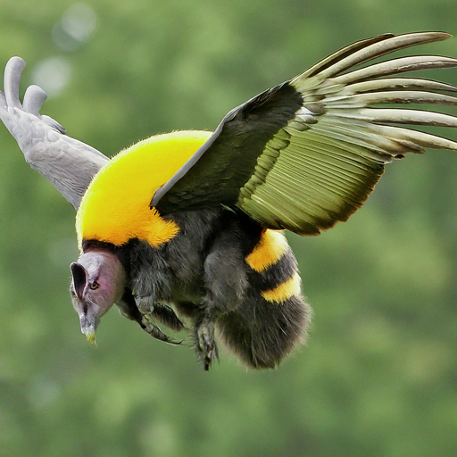

Slide 77
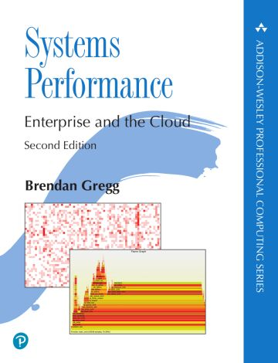
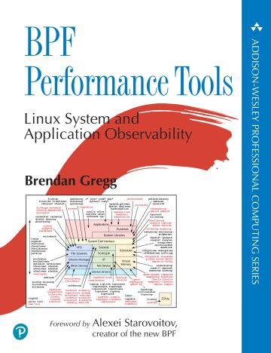
References
bpftrace
https://github.com/iovisor/bpftrace/blob/master/doc
Perf testing in general
https://www.brendangregg.com

Slide 78
Conclusion
This was not a HTCSS talk – is that ok?
eBPF/perf tools are powerful and under used
Bpftrace is an easy entry
This is just the beginning…

