Slide 1
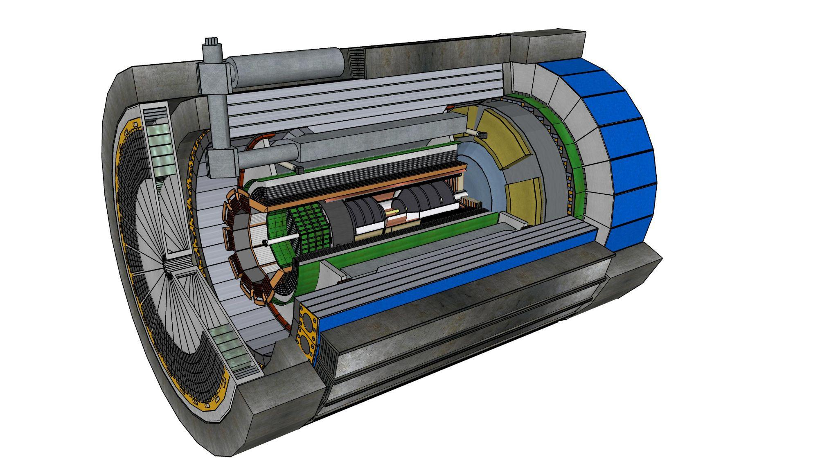
The ePIC Simulation Campaigns: Experience so far on the OSG and Future Use Cases
Sakib Rahman
(Brookhaven National Laboratory)
On behalf of the ePIC Production WG
10 July 2024

Slide 2
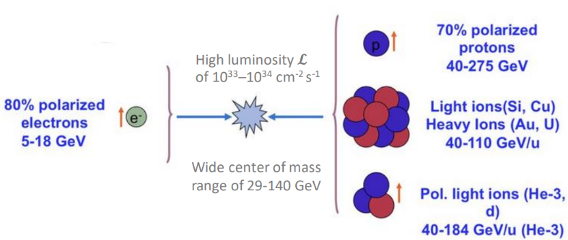
Introduction
ePIC, the first experiment at the future Electron-Ion Collider (EIC), will be realized in partnership of host labs - Brookhaven National Laboratory and Jefferson Lab.
OSG infrastructure used to run large-scale monthly simulation production campaigns (~ 1M Corehours per month and growing) - the basis for detector and physics studies in preparation for Technical Design Report.
International collaboration with 173 institutions worldwide will provide insight into the nucleon and nucleus down to the scale of sea quarks and gluons leveraging unique and versatile EIC beam specs.
Develop distributed computing capabilities in advance of operations phase.
Sakib Rahman

Slide 3
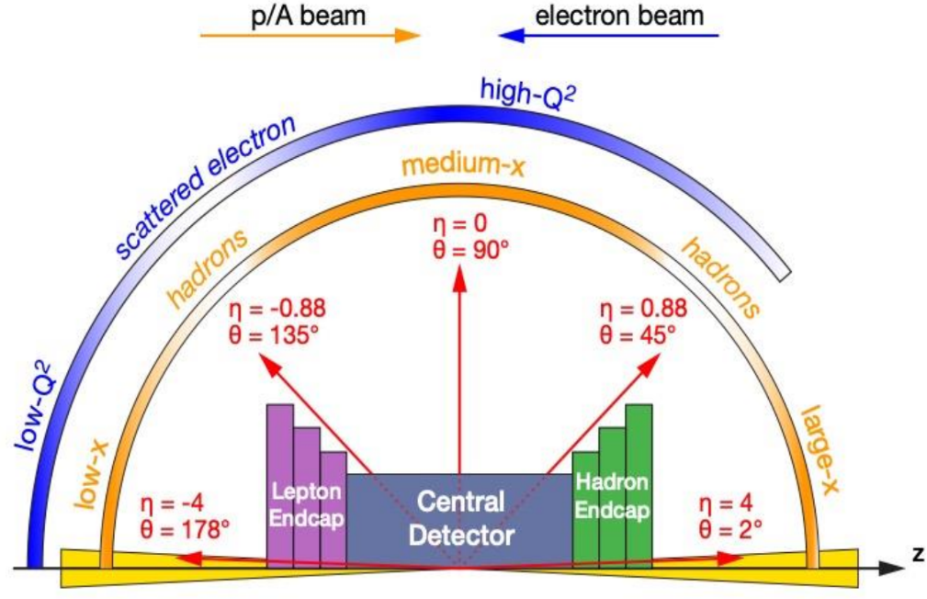
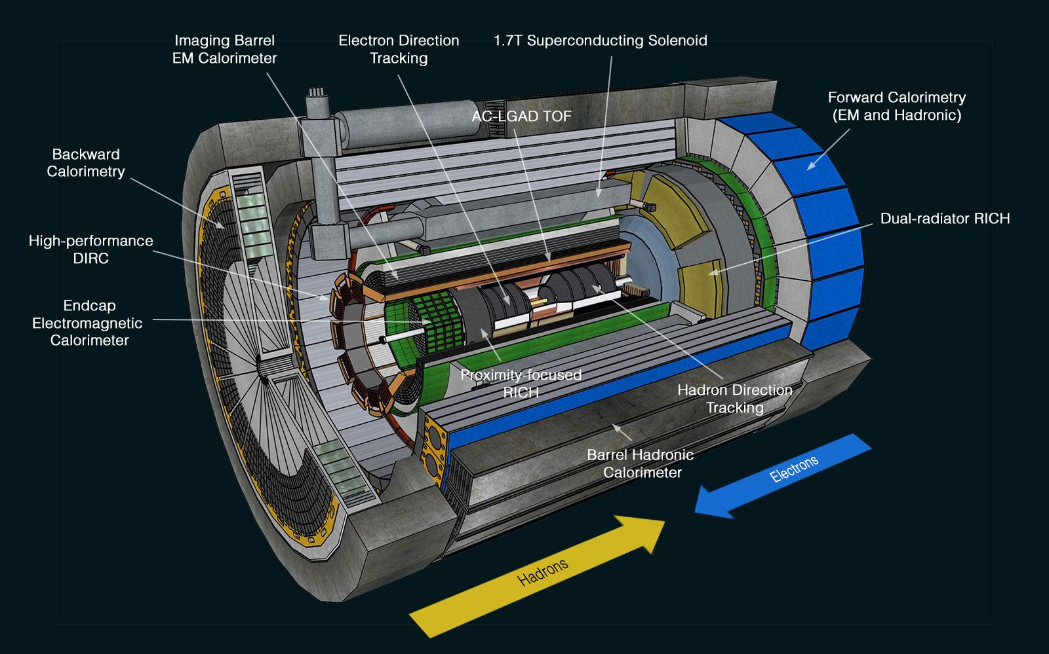
Multi-purpose detector to measure all final-state particles of interest with full acceptance and good resolution.
Uniquely designed for asymmetric beam energies.
High-precision Si detectors for tracking particle trajectories in 1.7 T magnetic field.
Detector
EM and hadronic calorimeters for particle energy and jet measurements.
Ring Imaging Cherenkov, AC-LGAD Time of Flight, hpDIRC, etc. for particle ID.
Far forward and far backward systems allow measurement of particles close to beamline.
ePIC Central Detector
Wide kinematic coverage provided by central detector + far forward/far backward systems.
Sakib Rahman

Slide 4
Simulation Campaigns
Continuous deployment of software for detector and physics studies.
Regular update of production outputs enabling the modeling of physics and background processes, detector and readout, etc. and testing/development of reconstruction algorithms.
Some of the Datasets and Monte Carlo Generators In Production:
DIS (pythia6-eic for minimum bias, pythia8)
Exclusive
DVMP (EpIC)
DEMP (DEMPgen)
DIFFRACTIVE_PHI (SARTRE)
Backgrounds
Proton Beamgas (pythia8)
Electron Beamgas (GETaLM)
Merged = Beamgas+SynRad
List is continuously growing as per requests from Physics Working Groups (PWGs).
Goals
Timely validation and quality control for simulation production on data sets that require significant time and resources.
Monthly Campaign Strategy
Week 1: Verification and Validation
Week 2: Targeted Development
Week 3+4: Charters and taxis (user requests)
Sakib Rahman
Tagged Train Release (s)

Slide 5
Currently datasets in production are estimated to consume ~ 1M Corehours per monthly campaign. Demand growing every month.
Why choose Throughput Computing and OSG?
Parallelism and Ease of Scaling
Able to run up to 10k jobs simultaneously on OSG resources.
Common Interface Template
Can use the HTCondor submit template without the need to adapt it to specific sites.
Ease of access management
Collaborators from diverse institutional affiliations can authenticate through CILogon and access OSG resources.
Excellent Support System
Weekly OSG-PATh meetings, support ticketing system, broad user base and experiences to learn from.
Sakib Rahman

Slide 6
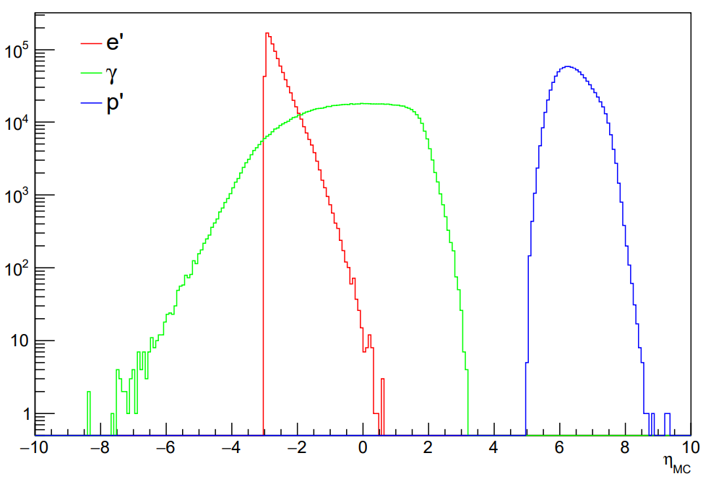
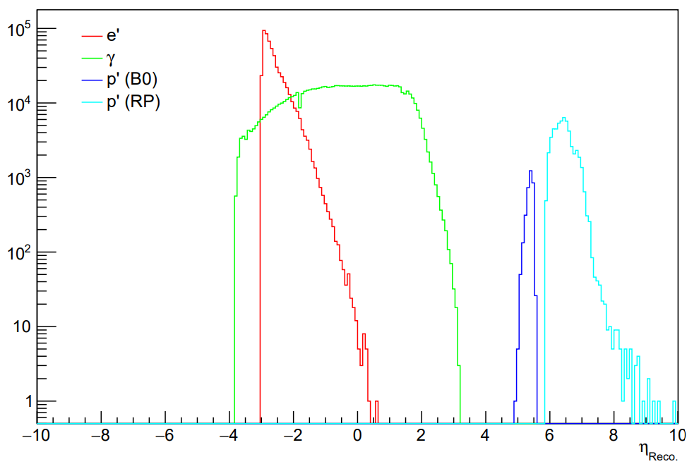
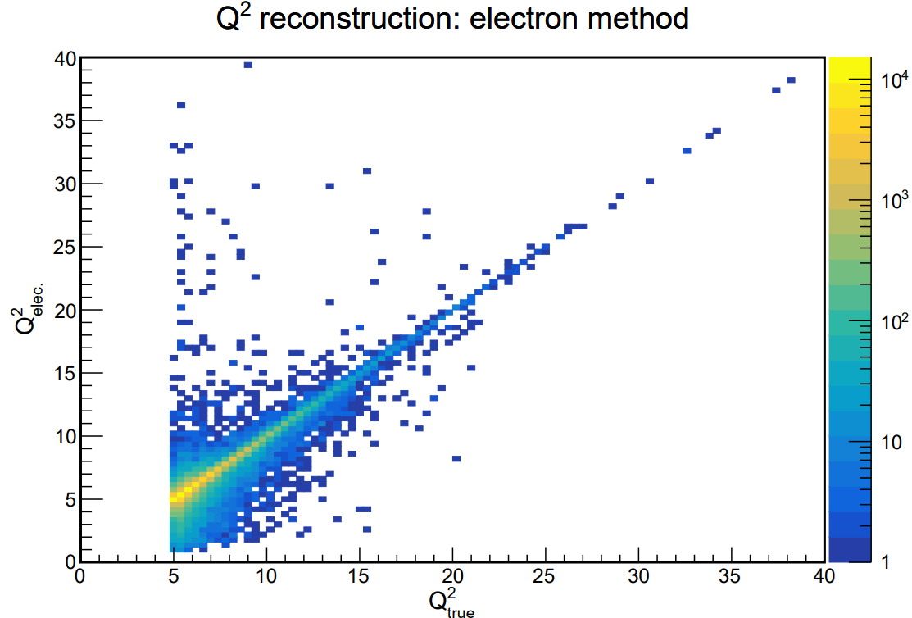
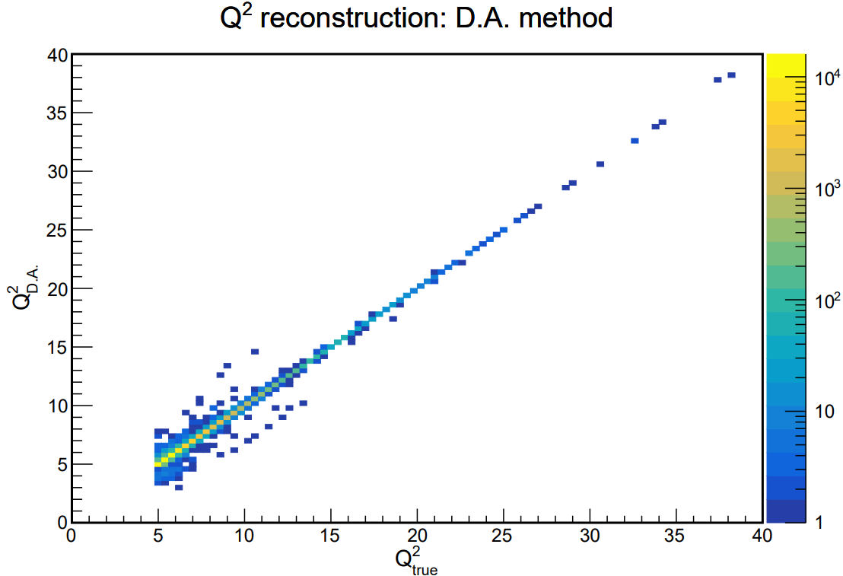
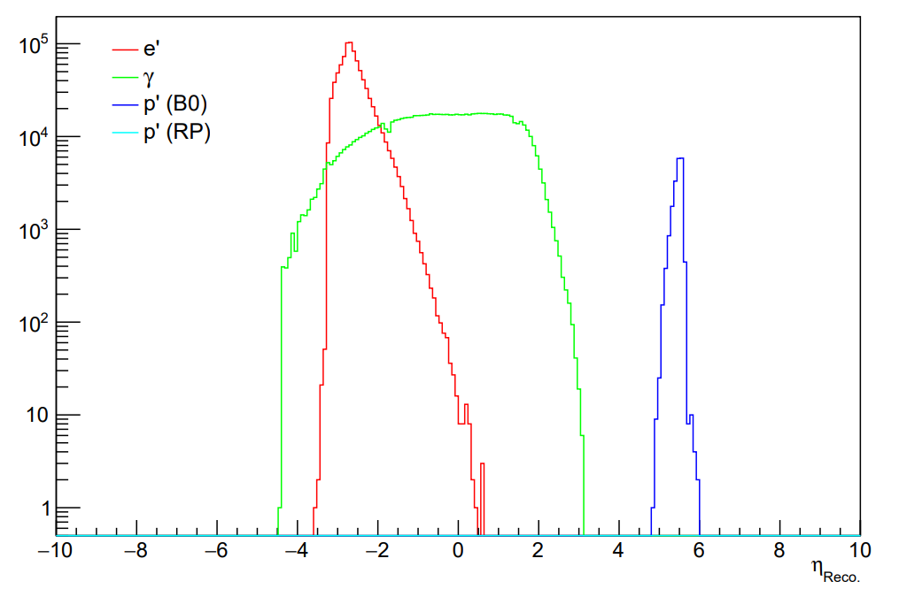
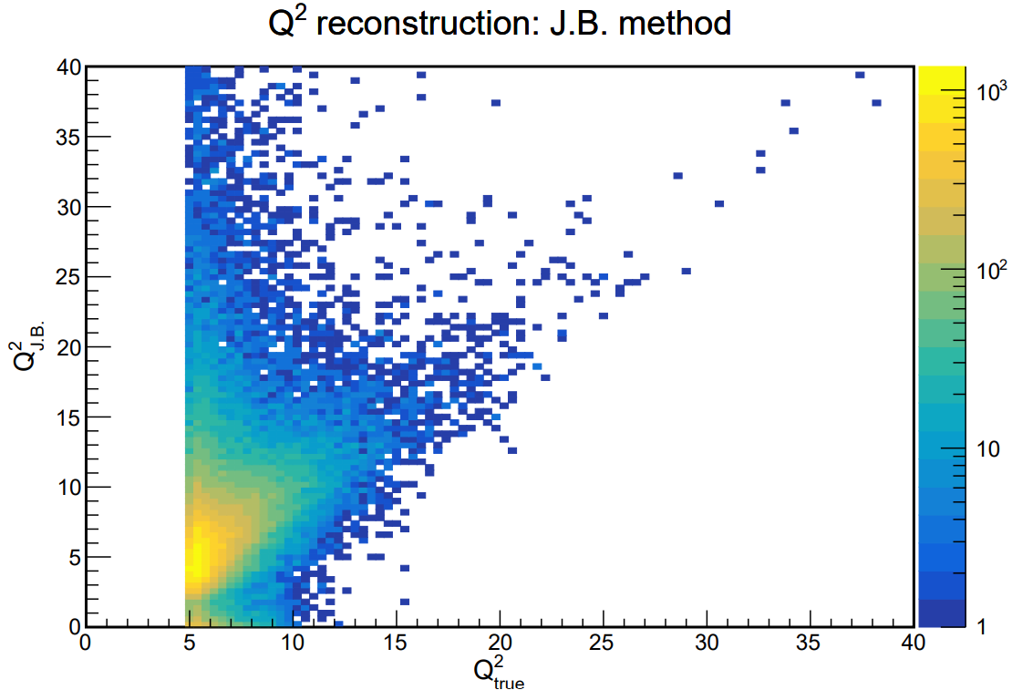
Leveraging OSG: Examples of Physics Analysis with Simulation Campaigns
Electron-Proton Deeply Virtual Compton Scattering
Credit: O. Jevons (Glasgow)
Relevant for nucleon tomography, origin of mass and spin.
Electron PID crucial and FF region critical for final state proton.
Elastic Electron-Proton Scattering
Credit: B. Schmookler (UC Riverside)
Significance: Highest Q² ever measured for elastic e-p scattering, and it would be the first time the elastic cross-section is measured at a high-energy collider.
Evaluation of different Q² reconstruction methods using monthly production 24.04.0.
Fixed
Missing Roman Pots?
10x100, monthly production 24.06.0
Evaluation of detector/physics performance and prompt identification of software issues enabled by regular campaign outputs.
10x100, monthly production 24.04.0
Sakib Rahman

Slide 7
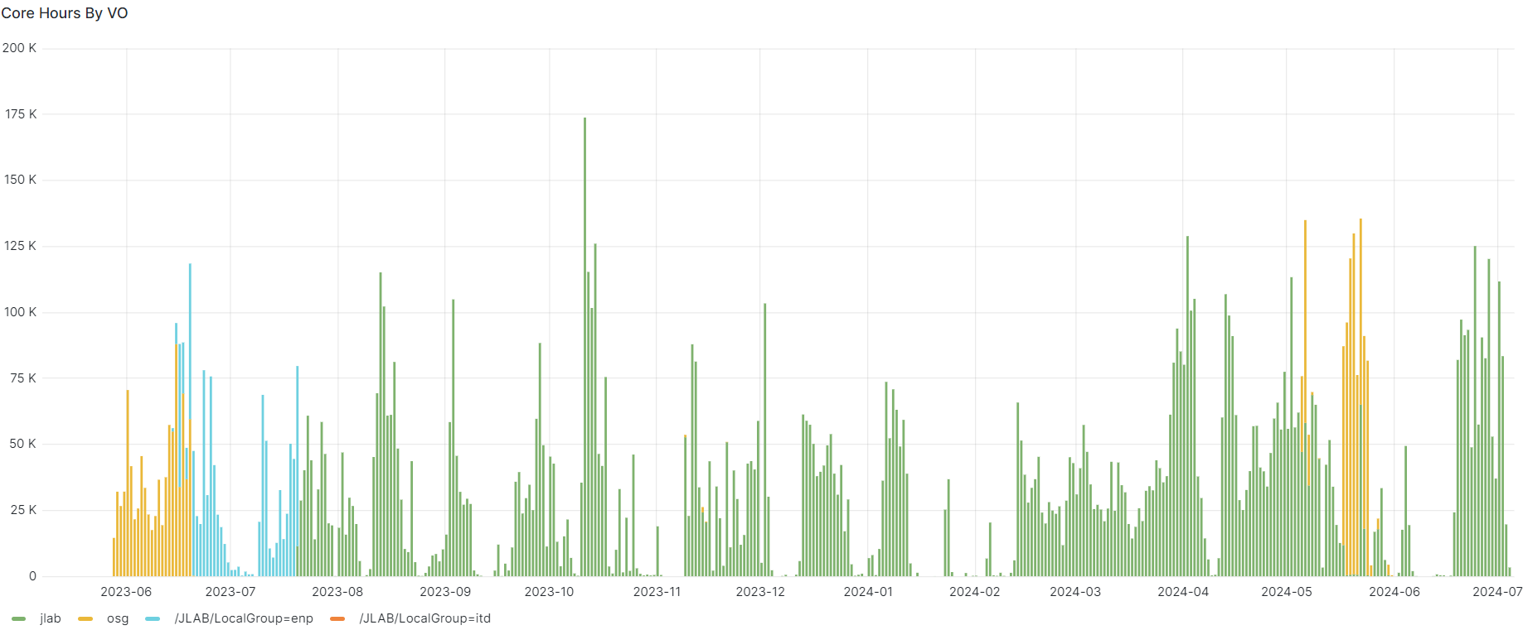
Leveraging OSG: Synergy Among Institutions Contributing Resources
Two fully operational submit nodes maintained by Jefferson Lab and OSG.
Access to resources from international institutions: Alliance Canada integrated into the ePIC pool and INFN-CNAF
integration is next.
Participation in regular meetings with Subatomic Physics National Team-Canada and OSG-PATh.
Write accessible XRootD server at Jefferson Lab and S3 storage at Brookhaven Lab.
Top 5 Contributing Sites
SU ITS
SDSC
MWT2 ATLAS UC
WISC PATH
BNL ATLAS Tier 1
Production Rucio server in process of being deployed at Jefferson Lab.
Nearly 14 M Corehours since May 2023 produced over 300 TB output
Sakib Rahman

Slide 8
Current Production Workflow
CI/CD: Container deployed to CVMFS and calculate timing data CSV files for each dataset.
HTCondor submit script template - configuration, timing info, credentials, etc.
Shell scripts build submit scripts from template for each dataset real time during submission.
Pre-submit
Currently the outputs are written back to S3 storage at BNL and a cron job syncs BNL S3 with JLab XRootD. Aim to transition to direct XRootD write only.
Input Datasets in hepmc3.tree.root format streamed over from JLAB XRootD.
Run simulation workflow on OSG resources.
Post-submit
Sakib Rahman

Slide 9
Executed On Submit Node
Lightweight Production Scripts and Templates
https://github.com/eic/job_submission_condor
HTCondor Submit Script
Requirements
Requirements = HAS_SINGULARITY == TRUE && HAS_CVMFS_singularity_opensciencegrid_org == TRUE && OSG_HOST_KERNEL_VERSION >= 31000
request_cpus = 1
request_memory = 3.5 GB
request_disk = 5 GB
max_idle = 500
Project and Singularity Image
+ProjectName="ePIC"
+SingularityImage="/cvmfs/singularity.opensciencegrid.org/eicweb/eic_xl:24.07.0"
Job Exit Policy
on_exit_hold = (ExitBySignal == True) || (ExitCode != 0)
Dealing with Failed Jobs
If failure rate is high across sites, review ePIC software and container release.
If OSG site-specific, update blacklist and release:
+UNDESIRED_Sites = "Comma-separated list of sites"
EXAMPLE
EBEAM=18 PBEAM=275
DETECTOR_VERSION=24.07.0
DETECTOR_CONFIG=epic_brycecanyon
JUG_XL_TAG=24.07.0-stable
./scripts/submit_csv.sh
osg_csv
hepmc3 DIS/CC/18x275/minQ2=100/DIS_CC_18x275_minQ2=100.csv
2
Environment variables
Shell script
eic-shell singularity container regularly deployed to cvmfs by CI/CD pipeline. Spack is used for package management.
Template variables
Executed On Job Nodes
https://github.com/eic/simulation_campaign_hepmc3
scripts/run.sh
integrated into cvmfs container /cvmfs/singularity.opensciencegrid.org/eicweb/eic_xl:24.07.0
Sakib Rahman

Slide 10
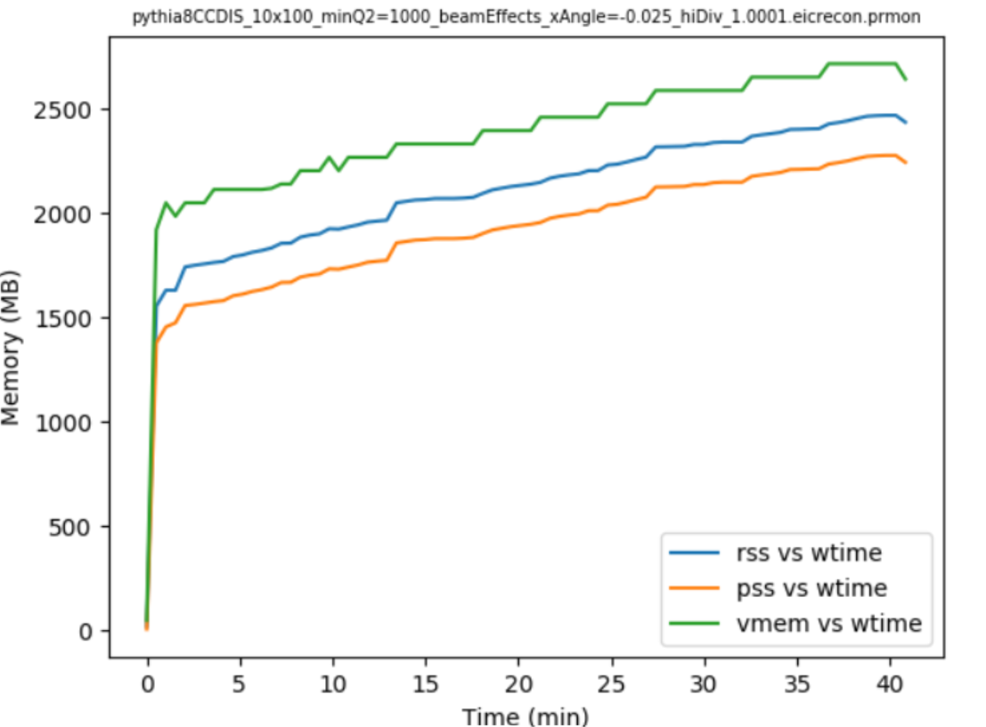
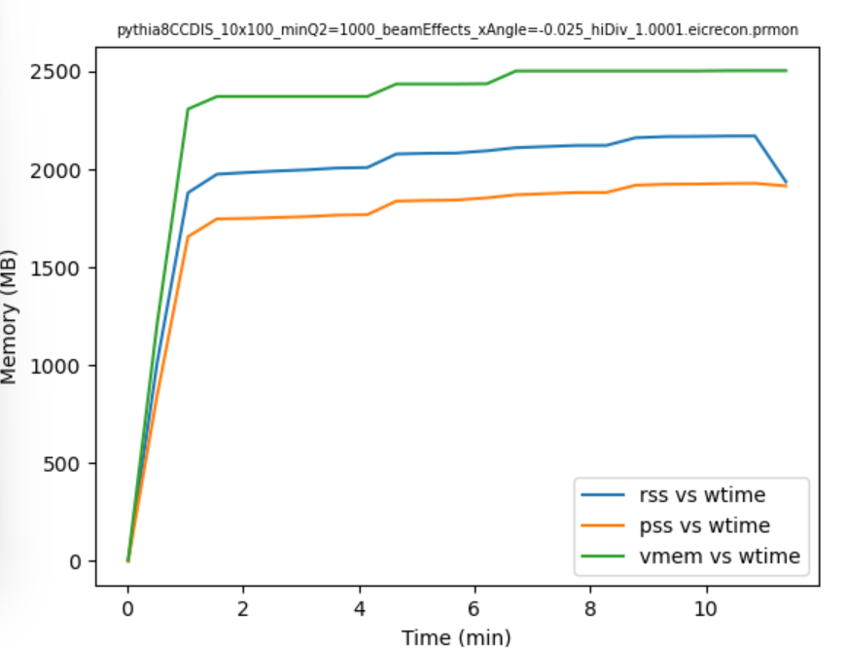
Lessons Learned
Redundancy is helpful. Issues related to low throughput on one submit node or another could be tracked down through comparative testing.
Monitoring and profiling of outputs was essential to track down memory leaks causing high failure rates and be more efficient in terms of memory requests.
Monitoring for XRootD connectivity issues from specific sites was important since we stream input data over XRootD.
Monitoring destination storage was important to avoid running into disk/file system issues. Developing unit tests to run frequent checks. Again redundancy was helpful to avoid downtime.
Sakib Rahman

Slide 11
How Can We Improve Our Workflow?
Complete integration of Rucio into production. Remaining tasks are settling on naming schema and access management via tokens.
Upgrade to workload management system? PanDA or similar, under evaluation.
Integrate storage sites with OSDF. Abstract away issues related to token authentication and auto-renewals.
Event generation within jobs? Working on version control for generators and datasets.
Sakib Rahman

Slide 12
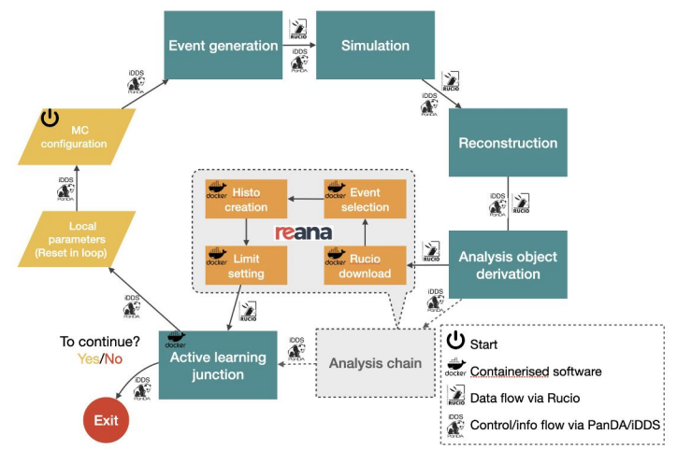
Potential Future Use Cases
Training ML Models in CI/CD Pipeline
AID2E (2 year project supported by DOE NP)
Multi-Objective Bayesian Optimisation (MOBO) for detector design taking into account intrinsic detector performance, physics performance and costs. Developing monitoring tools and dashboards for various metrics.
ML models used for reconstruction tasks need to be retrained on specific triggers (significant geometry changes, updates to magnetic fields, etc.)
Figure out a way to deploy snakemake workflows on dedicated GPU resources.
Adapt PanDA/iDDS AI/ML services to support MOBO workflow. Future integration with OSG.
Scope: ePIC and beyond
Sakib Rahman
Credit: Tadashi Maeno (BNL)

Slide 13
Summary
ePIC, the inaugural experiment at the Electron-Ion Collider (EIC), involves 173 institutions exploring nucleon and nucleus structure with advanced EIC beam capabilities.
Large scale simulation campaigns for physics/detector studies and to develop distributed computing capability ahead of operations.
OSG provides standard interface, streamlined access management, parallelism and ease of scaling alongside excellent support system.
Production campaigns currently use tagged cvmfs-hosted container and lightweight shell scripts/HTCondor submit templates.
Aim to complete integration of Rucio into production, explore workload management systems, and on-the-fly event generation.
Future assistance may be required to deploy ML model training workflows on GPU resources via OSG.
Sakib Rahman

