Slide 1
Research Computing and Interactive Services
Miron Livny
Vilas Research Professor
John P. Morgridge Professor of Computer Science
Director UW Center for High Throughput Computing
Technical Director of the OSG

Slide 2
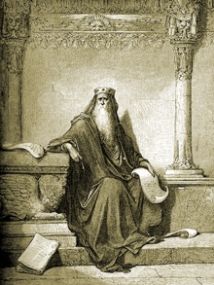
The words of Koheleth son of David, king in Jerusalem ~ 200 A.D.
Only that shall happen
Which has happened,
Only that occur
Which has occurred;
There is nothing new
Beneath the sun!
Ecclesiastes Chapter 1 verse 9
Ecclesiastes, (קֹהֶלֶת, Kohelet, "son of David, and king in Jerusalem" alias Solomon, Wood engraving
Gustave Doré (1832–1883)

Slide 3
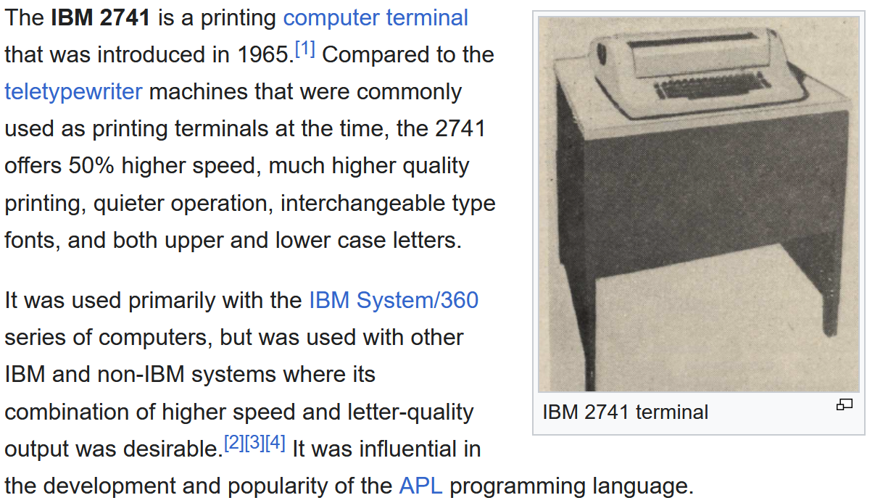

Slide 4
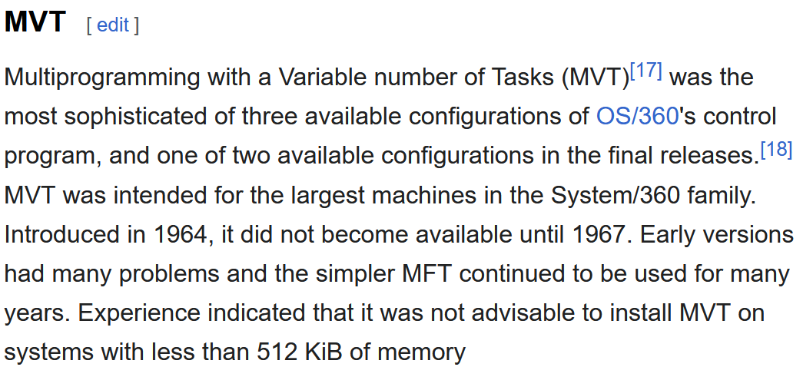
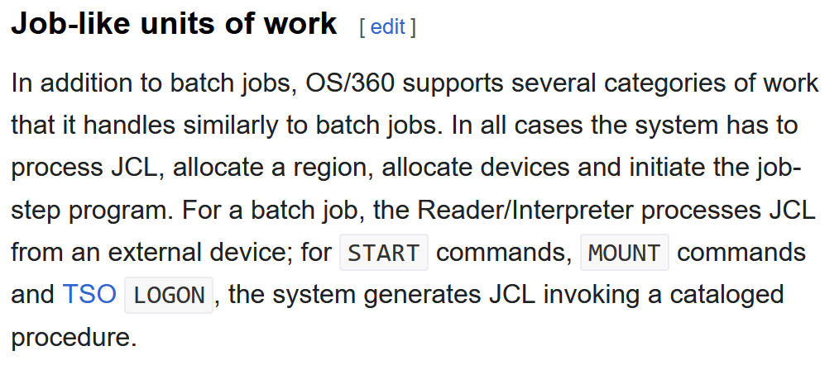

Slide 5
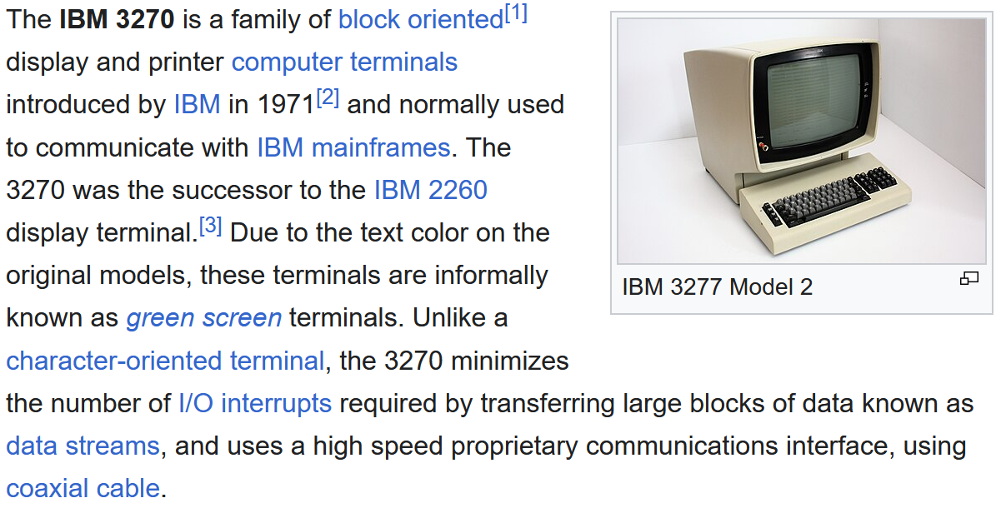

Slide 6
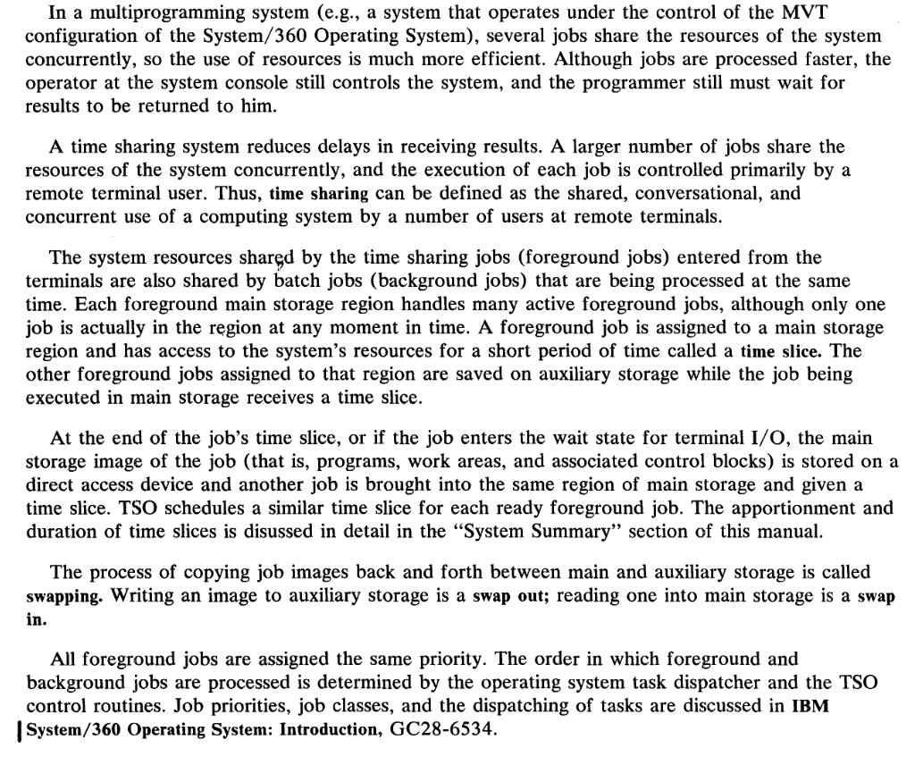

Slide 7
Unless we have unbounded capacity, we must use timesharing

Slide 8
How quickly can capacity be allocated to an Interactive request?
Use free capacity
Swap-out a request holding capacity
Killing a request holding capacity
Denay the request

Slide 9
How long to keep the capacity assigned to an interactive request?
Swap-out the request by the end of the time-slice
Kill the request by the end of the time-slice
Limit the number of requests per researcher

Slide 10
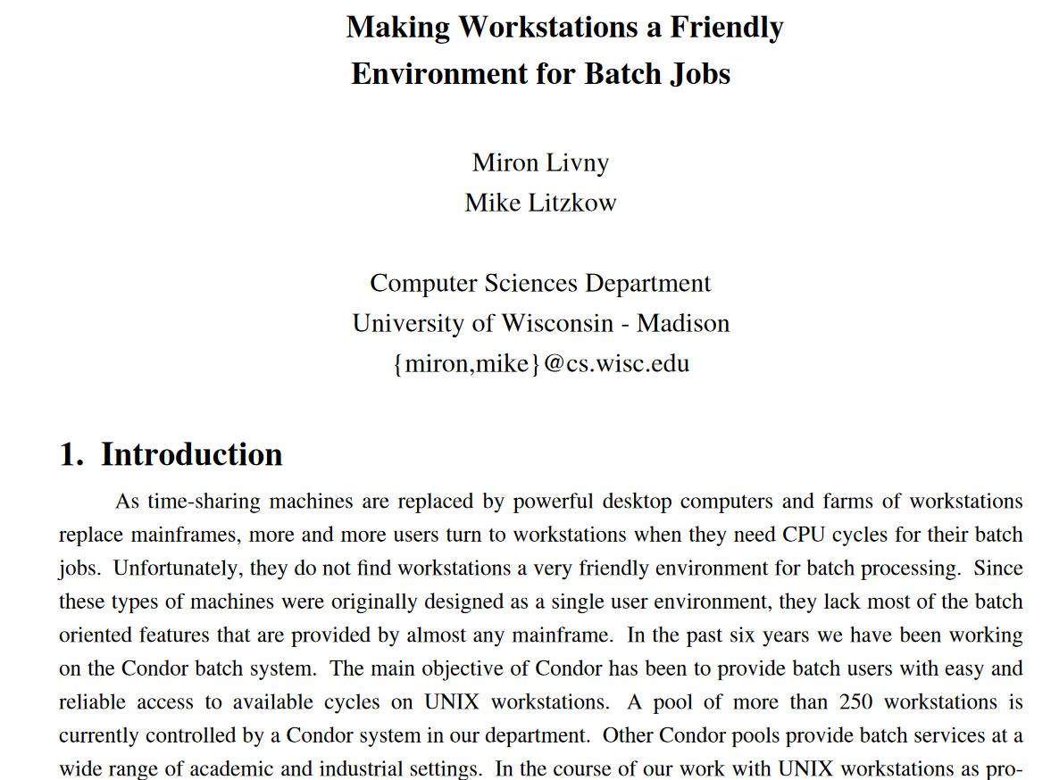

Slide 11
HTCSS has the mechanisms to support interactive workloads. Who can give us a policy?

