Slide 1
Providing Value to Campuses Part II: The HTCondor-CE Dashboard HTC 24 - July 2024 - Madison, WI USA
Todd Tannenbaum
Center for High Throughput Computing
Department of Computer Sciences
University of Wisconsin-Madison

Slide 4
So, who is benefiting from my contribution?

Slide 5
So, who is benefiting from my contribution?
And how effectively is my contribution being used?

Slide 6
So, who is benefiting from my contribution?
Got it! The HTCondor CE for my campus should know this!
If only I could look at a web page to learn what the CE already knows….
And how effectively is my contribution being used?
HTCondor CE =
HTCondor Compute Entrypoint
Notes:
The HTCondor-CE software is a Compute Entrypoint (CE) for campuses that are part of a larger computing federation (e.g. the Open Science Pool). As such, HTCondor-CE serves as a "door" for incoming resource allocation requests (RARs) — it handles authorization and delegation of these requests to a site's local batch system, such as Slurm, HTCondor, PBS, and others.

Slide 7
What's a CE in 60 seconds or less
Contributing Campus
Slurm Cluster

Slide 8
What's a CE in 60 seconds or less
Contributing Campus
Slurm Cluster
Slurm Front-End

Slide 9
What's a CE in 60 seconds or less
Contributing Campus
Slurm Cluster
Slurm Front-End
SSH

Slide 10
What's a CE in 60 seconds or less
Contributing Campus
Slurm Cluster
Slurm Front-End
HTCondor
CE
SSH

Slide 11
What's a CE in 60 seconds or less
Contributing Campus
OSPool
Slurm Cluster
IGWN
Slurm Front-End
USCMS
HTCondor
CE
SSH

Slide 12
OSG Campus Services can host your CE
Contributing Campus
OSPool
Slurm Cluster
IGWN
Slurm Front-End
USCMS
HTCondor
CE
SSH
OSG Campus Hosted Services Cloud

Slide 13
OSG Campus Services can host your CE
Contributing Campus
OSPool
Slurm Cluster
IGWN
Slurm Front-End
USCMS
HTCondor
CE
SSH
SSH
OSG Campus Hosted Services Cloud

Slide 14
HTCondor-CE Dashboard Activities
Changed HTCondor-CE to monitor contributed resources
Store metrics about the CE itself and contributed resources
Monitor "Health" of the CE
Is it running? Can it connect to the front-end? Can it communicate with Slurm / HTCondor / PBS / etc? Is it overloaded?
Create lightweight web page to show what is happening
Designed for minimal dependencies: all javascript in the browser, no backend Grafana or similar services
Contributing campus can customize and embed charts

Slide 15
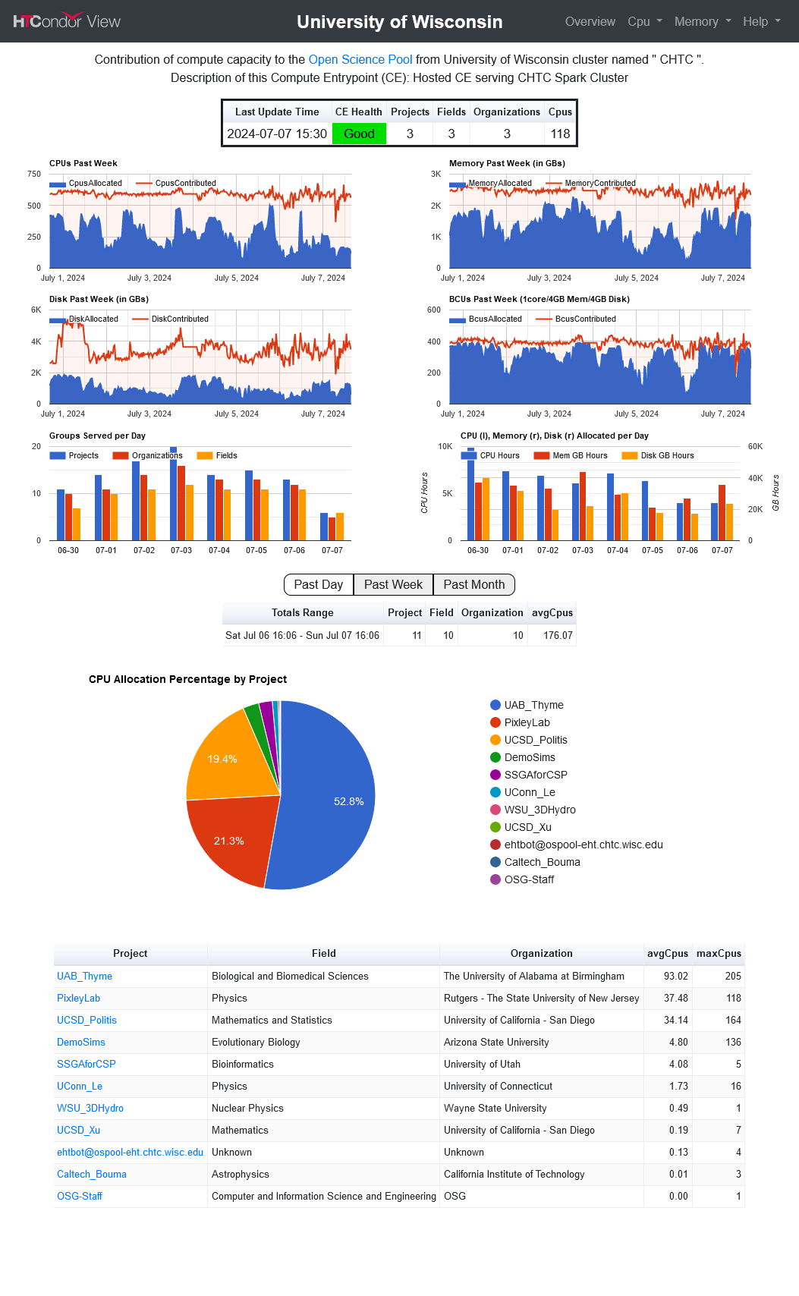

Slide 19
This work is supported by NSF under Cooperative Agreement OAC-2030508 as part of the PATh Project. Any opinions, findings, and conclusions or recommendations expressed in this material are those of the author(s) and do not necessarily reflect the views of the NSF.

