Slide 1
GlueX in the integrated global infrastructure for distributed computing
Throughput Computing 2024, July 8-12, Madison
Richard Jones, University of Connecticut
need for elastic capacity
myths and realities
adaptation to OSG+OSDF
This work is supported by the U.S. National Science Foundation under grant 2209480

Slide 2
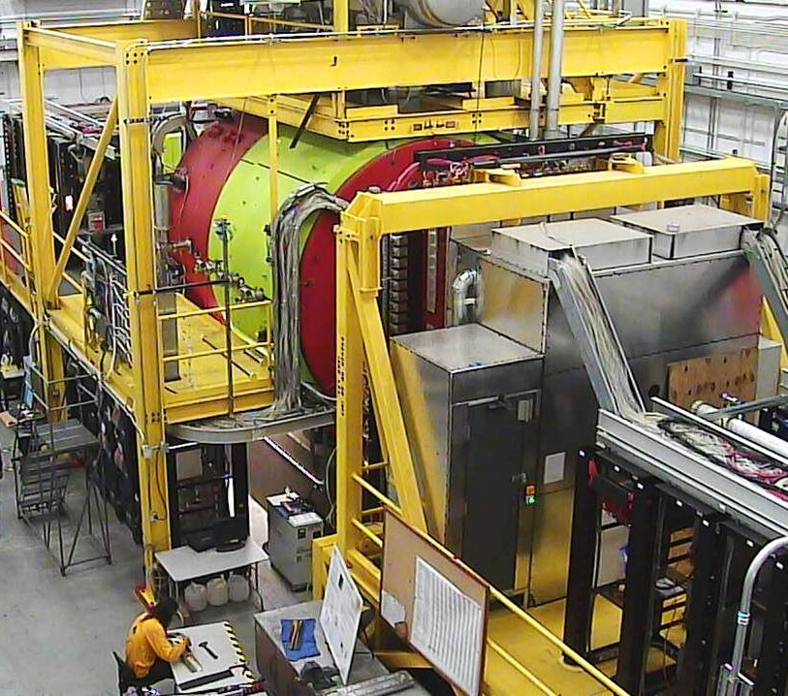
Background: the Gluex experiment
GlueX at Jefferson Lab
9 GeV photons, fixed target
Scientific program
search for exotic mesons
threshold charmionium states
dark matter searches, rare 𝜼 decays
Primakov, pion polarizability
commissioned: 2014-2016
Phase 1 run: 2017-2019
Phase 2 run: 2020-2025
Phase 3 run: approval pending

Slide 3
Evolution: beyond simulation?
GlueX offline computing resource needs (GlueX-doc-3813)
35 Mcore-hr/yr - detector simulation, primarily on OSG
130 Mcore-hr/yr - experimental event reconstruction
Jefferson Lab compute facility (total 70 Mcore-hr/yr, calibration and analysis)
NERSC (proven option, but allocations are limited)
recalibrate, test
reconstruct..
analyze.
pub

Slide 4
GlueX need: elastic capacity
from GlueX Computing Report, A. Austregesilo slide 3, May 14, 2024:
Looking down the road to GlueX Phase 3, starting in ca. 2026?
beam intensity x2 relative to Phase 2

Slide 5
GlueX need: elastic capacity
Two possibilities:
wait 1-2 years for 2023 results from HPC
exploit untapped capacity with HTC

Slide 6
GlueX tradition: our mythology
myth: a shared story that guides and unites
Monte Carlo simulation is appropriate for OSG.
Event reconstruction needs HPC resources.

Slide 7
GlueX tradition: our mythology
myth: a shared story that guides and unites
Monte Carlo simulation is appropriate for OSG.
Event reconstruction needs HPC resources.
HTC
OSG
HPC

Slide 8
GlueX tradition: our mythology
myth: a shared story that guides and unites
Monte Carlo simulation is appropriate for OSG.
Event reconstruction needs HPC resources.
BUT:
GlueX event reconstruction is inherently HTC!

Slide 9
GlueX tradition: our realities
realities: shared experience behind our myths
our recon framework was developed for HPC
our recon workflows assume HPC (entire nodes)
new effort required:
adaptation of applications, workflows to HTC
better means for access to raw data

Slide 10
GlueX adaption: part 1
1 HPC job (CORI)
1 HTC job (OSG)
DB
DB
logs...
chunk of objects stream (20GB)
32 cores
128 GB
64 thread
REST (5GB)
input sequence
HPC node
output sequence

Slide 11
GlueX adaption: part 1
1 HPC job (CORI)
1 HTC job (OSG)
DB
DB
DB
DB
logs...
chunk of objects stream (20GB)
32 cores
128 GB
64 thread
1 core
4 GB
2 thread
REST (5GB)
input sequence
HPC node
output sequence
input slice
HTC unit
output

Slide 12
GlueX adaption: part 1
1 HPC job (CORI)
1 HTC job (OSG)
DB
DB
DB
DB
logs...
chunk of objects stream (20GB)
32 cores
128 GB
64 thread
1 core
4 GB
2 thread
REST (5GB)
input sequence
HPC node
output sequence
input slice
HTC unit
output
8 hour jobs
10 MB/s i/o rate
whole-node alloc.

Slide 13
GlueX adaption: part 1
1 HPC job (CORI)
1 HTC job (OSG)
DB
DB
DB
DB
logs...
chunk of objects stream (20GB)
32 cores
128 GB
64 thread
1 core
4 GB
2 thread
REST (5GB)
input sequence
HPC node
output sequence
input slice
HTC unit
output
8 hour jobs
10 MB/s i/o rate
whole-node alloc.
2-4 hour jobs
0.3 MB/s i/o rate
single core alloc.

Slide 14
GlueX adaption: raw data stream over xrootd
20 GB (from tape)
prestart (may be missing)
compressed event blocks ~60MB each, variable
term block (mandatory)
begin of run (mandatory)
2
3
4
. . .
n
n+1
n+2
n+3
n+4
. . .
333
334
335
3
3
6
2
3
4
5
6
300 MB (delivered to HTC job over xrootd)
prefixed block word count

Slide 15
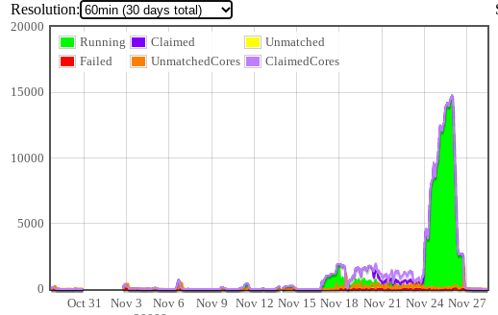
GlueX adaptation: a feasibility study
10 runs reconstructed on OSG
1880 raw 20GB files
35 TB, 600M events
500k core-hr
mapping onto osg user jobs
4 cpu-hr / 1-core job
68 jobs / evio file
126,000 jobs
using Traffic Advisor
no dataflow
orchestration
highlights
completed in 3 days, see plot
15,000 running cores, peak
job completion rate >90%

Slide 16
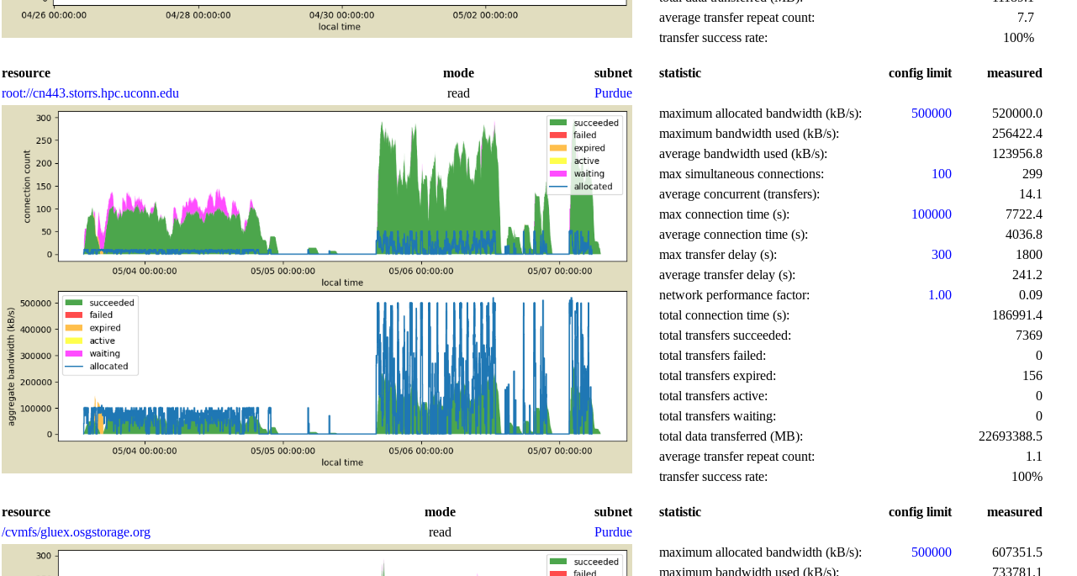
GlueX adaptation: Traffic Advisor web service

Slide 17
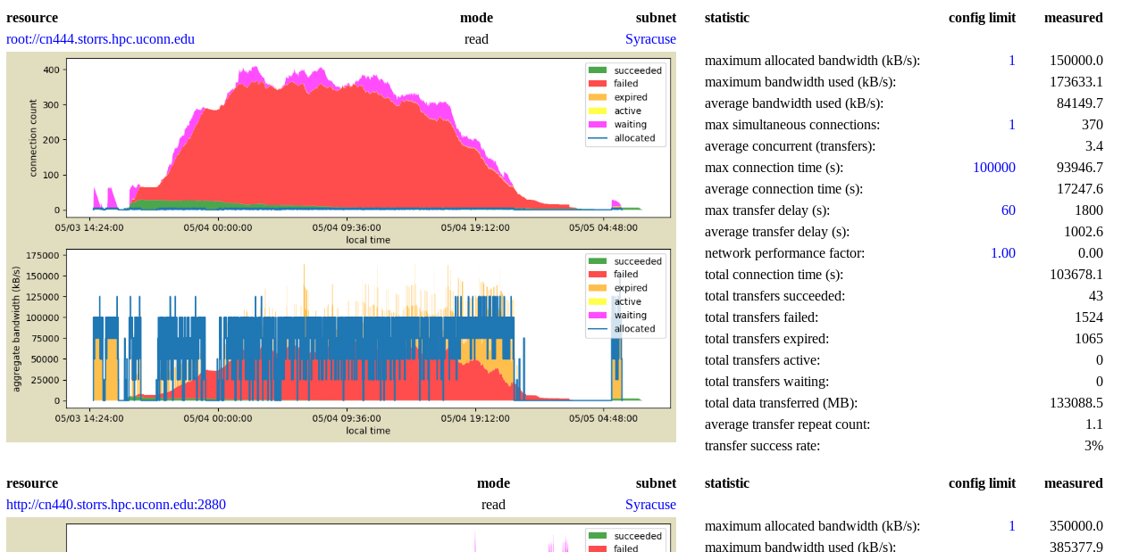
GlueX adaptation: Traffic Advisor web service

Slide 18
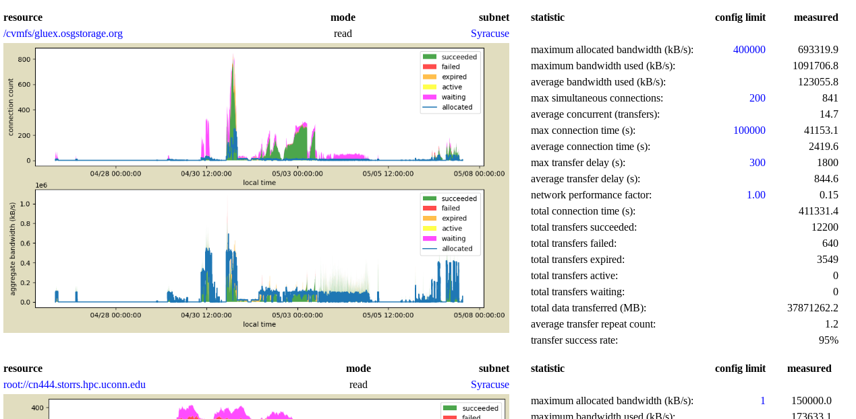
GlueX adaptation: Traffic Advisor web service

Slide 19
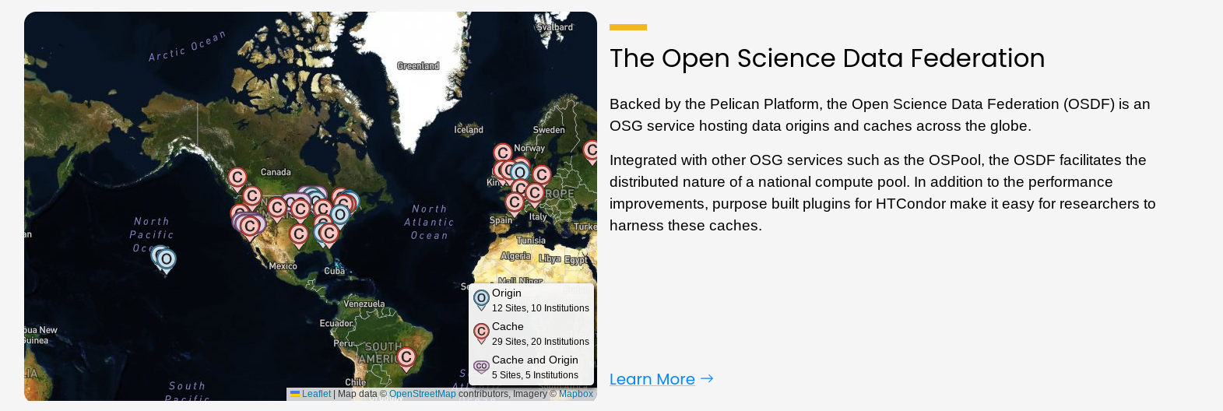
GlueX adaptation: outcomes of feasibility study
myth dispelled?
yes and no...
effective deployment awaits enhanced data access

Slide 20
GlueX data access: reducing friction with OSDF
Coming soon for GlueX@jlab:
lab-wide data release policies that regulate access
cilogon-based token infrastructure to support above
a new JLab OSDF origin for raw data access
GlueX
submit node
OSDF
registry, caches
OSDF
origin
SCICOMP cache

Slide 21
GlueX data access: reducing friction with OSDF
Coming soon for GlueX@jlab:
lab-wide data release policies that regulate access
cilogon-based token infrastructure to support above
a new JLab OSDF origin for raw data access
GlueX
submit node
OSDF
registry, caches
OSDF
origin
SCICOMP cache

Slide 22
Conclusions
GlueX is underserved by current HPC resource allocations
HTC on OSG is a demonstrated but untapped resource
data access barriers are the present bottleneck
JLab storage integration into OSDF will have near-term impact
GlueX
submit node
OSDF
registry, caches
OSDF
origin
SCICOMP cache

Slide 23
Backup

Slide 24
Gluex challenge: dataflow choreography
Goal: port an application optimized for HPC to run on HTC
output must be byte-for-byte identical to HPC for same input data
source code must be identical to HPC, binary compatibility not required
Data distribution strategy:
Split up the input data into schedulable chunks (2 core-hr)
20GB evio file = 1.4M events = 130 core-hr
340 evio blocks / file
5 evio blocks / job
70 jobs / evio file
Merge results after processing
much smaller data volume
can be performed on the SE as part of post-job validation
utilities already exist for merging (eg. hadd, eviocat, etc.)

Slide 25
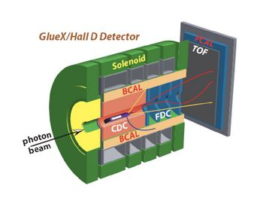
raw data reconstruction on shared HTC
OSDF
xrootd
UCONN
the challenge of data distribution:
1.0GB/s staged on tape at Jlab
150MB / core-hr reconstruction rate
65k cores in steady-state to keep up
Is this scale feasible on shared HTC?
HPC
PSC
NERSC

Slide 26
an effective, light-weight solution
what changed in the xrootd client interface?
all existing preload library functionality retained
added: recognition of a specially formatted xrootd url at open
overlap of processing, fetching next block
To access the full input file, use the standard xrootd url
root://cn440.storrs.hpc.uconn.edu/gluex/rawdata/Run071728/hd_rawdata_071728_000.evio
To get a subset with just 2 evio blocks + BOR + term
root://cn440.storrs.hpc.uconn.edu/gluex/rawdata/Run071728/hd_rawdata_071728_000.evio:14,16

Slide 27
how NOT to subset a 20GB raw data file
Split data to 300MB files on the SE prior to job submission
introduces extra step in processing
doubles load on the SE
not necessary
Tell event reader to skip forward N events before start of processing
increases total data transfer load by factor ~35
large cpu load increase from block unpacking
assumes we know in advance how many events per file
Tell event reader to skip forward N blocks before start of processing
still need to know when to stop
requires modification of the reconstruction software
violates goal to run the same software release on all production sites

Slide 28
an effective, light-weight solution
customize the XRootD Posix preload client library
no modifications to the Gluex software stack
no modifications to the xrootd protocol, OSDF infrastructure
changes are local to the OSG singularity container
correctness can be verified prior to running production
maintainable as a fork of the XRootD client github repo

Slide 29
what happened in this time?
data had already been staged from JLab to UConn (staging time not included)
data distribution governed by a postgres database
a. jobs “checked out” chunks of data via database transaction at job start
b. successful completion of chunks registered to database at job exit
c. reservations expired periodically, uncompleted chunks recycled
all jobs were identical, no predefined job-data association

Slide 30
what happened in this time?
jobs were submitted from UConn submit node gluex.phys.uconn.edu
shared same gluex factory with regular GlueX simulation jobs
standard gluex queue, no special boosted privileges
input data pulled during processing by osg worker
output copied back to UConn SE at job exit
job outputs automatically merged
performed by cron job running on the UConn-HTC cluster (colocated with SE)
one-step merging, verification, and push of merged results to Jlab
not everything worked perfectly...

Slide 31
what worked well?
postgres database as a management hub
jobs requested their work from the database when they started up
jobs returned their exit code and completion time when they finished
no problem with scaling
~5 jobs starting/finishing per second
merger cron job multiplicity scaled to keep up with job output
management was hands-off -- watch but do not touch!
only failed slices were reprocessed (1% of a full raw data evio file)
recycling unprocessed slices was immediate -- within seconds!
output merging + verification + push to Jlab done in one step

Slide 32
where were the difficulties?
reconstruction app. memory footprint: RSS = 5.5GB @ 1 worker thread !!
reconstruction library alone = 1.4GB -- good!
there are a lot of plugins -- 29 of them
most of the bloat comes from root histograms -- 17,000 mostly TH2I
remove the 5 worst offenders = 2.5GB -- kinda ok, not ideal
thread explosion
reconstruction code had a strange behavior, required intervention
hanging transfers pushing output back to JLab
enagaged with UConn NetOps to resolve this
very difficult to diagnose problems at the JLab firewall from outside
connections were being unpredictably dropped -- hanging sockets
investigated further with JLab NetOps -- hanging communication

Slide 33
Results and assessment
robust performance by redundant dcache xrootd server “doors”:
6 instances: cn440...445, but only needed one
door functions only to forward connections to “movers” on “pool” hosts
input + output storage spread equally over 38 hosts
internal network 100Gb/s infiniband
external network 10Gb/s ethernet
at peak, load remained reasonable (50 simultaneous transfers, 2 min. max)
no long-lived sockets, all connections fetch just one block and disconnect
no problems observed with database transaction rates, all good!
BUT results were not byte-by-byte identical to HPC production -- unrelated to OSG

Slide 34
concluding comment: enabling role of OSDF
UConn dcache SE is a OSDF origin (UConn-HPC_StashCache_origin)
750TB of shared network-visible storage
used for staging input + output to/from tape @ Jlab
data are read-once during reconstruction
raw data not suitable for caching
nevertheless, OSDF data access was a major advantage!
xrootd access via OSDF worked well
many sites have limited direct network access to offsite
accessing through the OSDF url often factor 10 x faster than direct
sites have configured special routes for OSDF access -- enables this capability

Slide 35
Backup slides

Slide 36
an effective, light-weight solution
what XRootD components needed to be touched?
github fork rjones30 / xrootd from master on 11/12/2020
updates enclosed in #ifdef EVIO_BLOCK_SUBSET_EXTENSION
src/XrdPosix/XrdPosixFile.hh (40 added lines)
src/XrdPosix/XrdPosixFile.cc (37 added lines)
src/XrdPosix/XrdPosixXrootd.cc (237 added lines)

