Slide 1
The new GlideinWMS credentials model and the new challenges it presents
Bruno Coimbra
FERMILAB-SLIDES-24-0167-CSAID

Slide 2
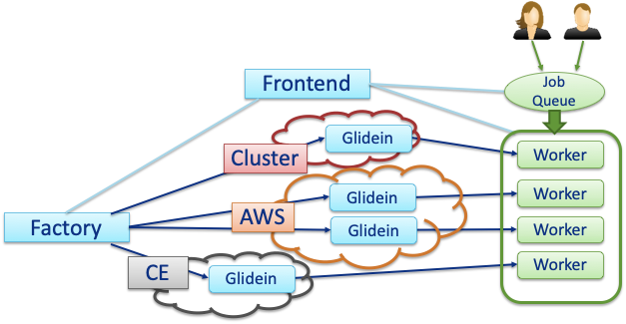
GlideinWMS
GlideinWMS is a pilot-based resource provisioning tool for distributed High Throughput Computing
Provides reliable and uniform virtual clusters
Leverages HTCondor pools and capabilities

Slide 3
New GlideinWMS Credentials Model
Hierarchical credential types
All credentials have a set of common methods and attributes
Factory and Frontend operations are agnostic to the credential type
Credential types can be inferred from a string or file
Credential
Token
X509Cert
RSAKey
Text
Generator
SciToken
IdToken

Slide 4
New GlideinWMS Credentials Model
Credential Purposes
Determine how a credential is used (e.g. CE authentication)
Allow to create list of credentials to be sent along with the Glidein
Credential Parameters
Credential qualifiers are now independent parameters (e.g. VMID, VMTYPE)
New auth_method implementation
auth_method="scitoken,grid_proxy;vmid;vmtype"

Slide 5
New GlideinWMS Credentials Model
Generators
A new generator framework extend the current functionality of credential generators
The same framework can be used to generate security parameters
Built-in generators can be used straight from a configuration file
<credential
absfname="RoundRobinGenerator”
context="{'items': ['cred1', 'cred2', 'cred3'], 'type': 'text'}"
purpose="payload"
security_class="frontend"
trust_domain="grid"
type="generator”
/>
<parameter
name="VMId”
value="RoundRobinGenerator"
context="{'items': ['vm1', 'vm2', 'vm3'], 'type': 'string'}"
type="generator"
/>

Slide 6
Challenge: identifying a token type
Inferring credential types brings a new challenge when dealing with tokens
It’s easy to infer a credential is a token (JWT)
It’s not so easy to determine which token type (SciToken vs IDTOKEN)
Some token attributes give us hints of its type
SciTokens and IDTOKENs use different encryption methods
“jti” along with the issuer might help us differentiate both formats
SciTokens usually define “ver” as “scitoken:2.0”
It would be helpful to specify claims to help us identify these token types from generic JWTs
WLCG tokens require “wlcg.ver”

Slide 7
Challenge: providing fallback credentials to HTCondor CE
The new auth_method allow for multiple credentials to be used to authenticate with CEs
HTCondor CE accepts a list of authentication methods
Used only during the negotiation phase
The first accepted credential (and only the first) is used for authentication
The CE won’t try other credentials of the agreed type if the first one fails
The CE won’t try other authentication methods if the first one fails
If some kind of authentication method fallback was implemented on the CE we could reduce the complexity of GlideinWMS submissions

Slide 8
Challenge: renewing tokens after submitting a job
Ongoing discussion…
Tokens live shorter than grid proxies
Payload tokens submitted with Glideins will often expire while the it’s in queue
A mechanism to renew tokens after Glideins are submitted is necessary
We could implement a solution on the GlideinWMS side
A native HTCondor implementation of this feature would be cleaner and address other use cases

Slide 9
Thank You!
New challenges:
Identify token types
Implement credentials fallback on CEs
Renew SciTokens after jobs are submitted
This work was produced by Fermi Research Alliance, LLC under Contract No. DE-AC02-07CH11359 with the U.S. Department of Energy, Office of Science, Office of High Energy Physics. Publisher acknowledges the U.S. Government license to provide public access under the DOE Public Access Plan DOE Public Access Plan

