Slide 1
Rucio/SENSE/XRootD
Justas Balcas
Software Engineer
ESnet
Throughput Computing 2024
Madison, Wisconsin
2024-07-10

Slide 2
Presentation agenda
Introduction: What is SENSE?
Innovative Pilot Prototypes:
Integrating SENSE and Rucio for USCMS/CMS
XRootD Loop Tests
Real Time Monitoring
Interactive Demo Time (video)
Charting the Path Forward: Next Steps

Slide 3
Rucio/SENSE/XRootD
Introduction: What is SENSE?

Slide 4
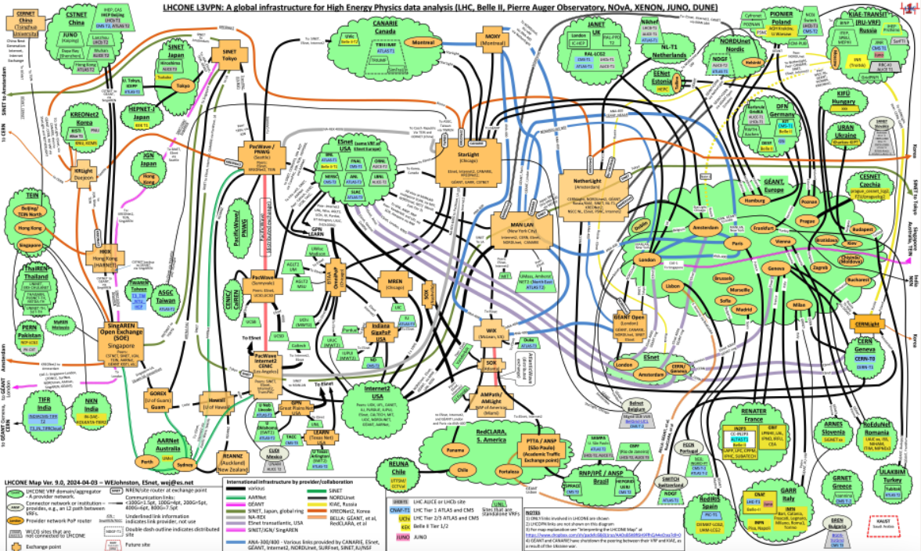
What is SENSE?
Map Credit: Bill Johnston

Slide 5
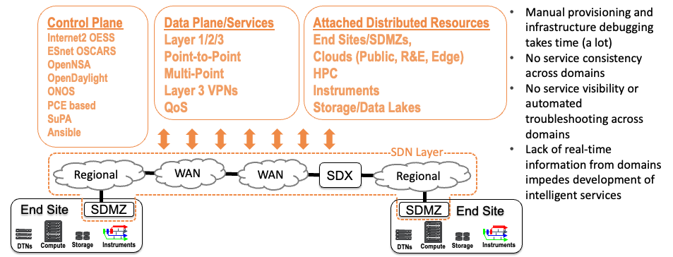
What is SENSE?

Slide 6
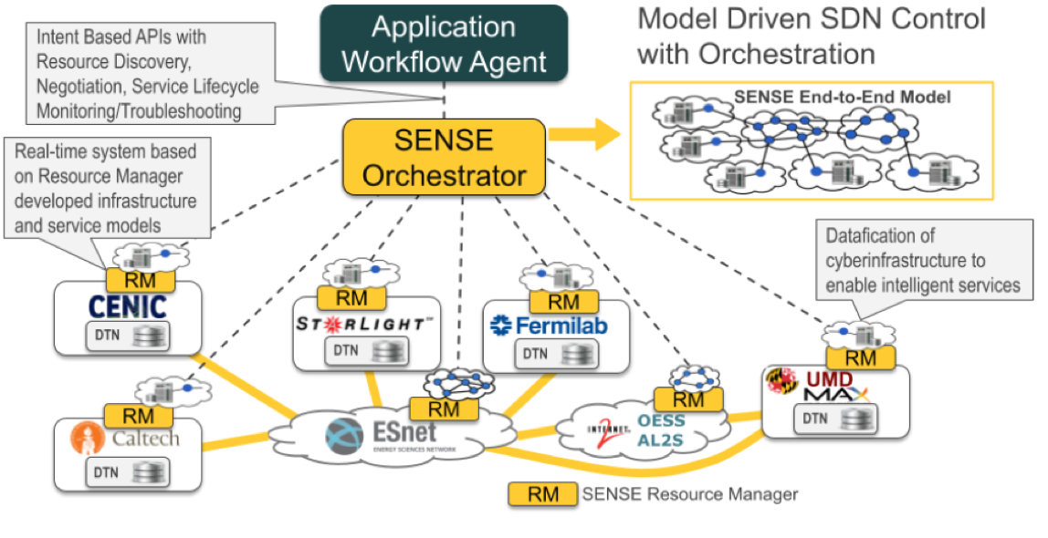
Future of Network Automation

Slide 7
Rucio/SENSE/XRootD
IPP (1): Integrating SENSE and Rucio

Slide 8
SENSE and Rucio/FTS/XRootD Interoperation
Rucio identifies groups of data flows which are "high priority"
SENSE takes flows from the site edge and "Traffic Engineers" paths across the WAN and End Sites
Scientific Data Management and Movement
Suite
Rucio
DMM
SENSE Orchestrator
Enables use of "multiple paths between sites" and provision of "deterministic" network resources to workflows
Primary system for LHC and others
FTS
SENSE Network RM
SENSE
Site RM
SENSE
Site RM
WAN
End Site
End Site
XRootD
(Data Transfer System)
XRootD
(Data Transfer System)

Slide 9
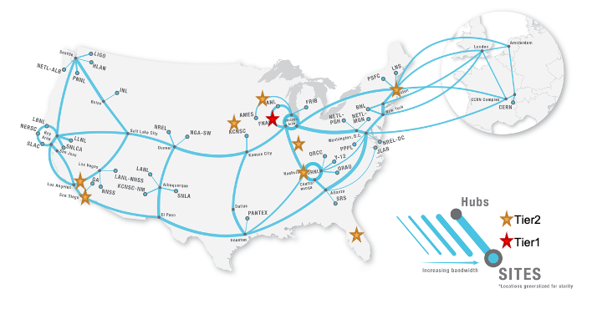
SENSE and Rucio for USCMS

Slide 10
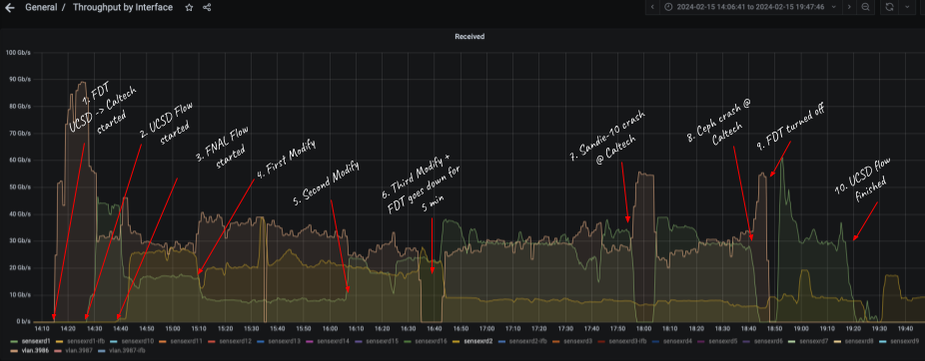
SENSE and Rucio for USCMS (During DC24)

Slide 11
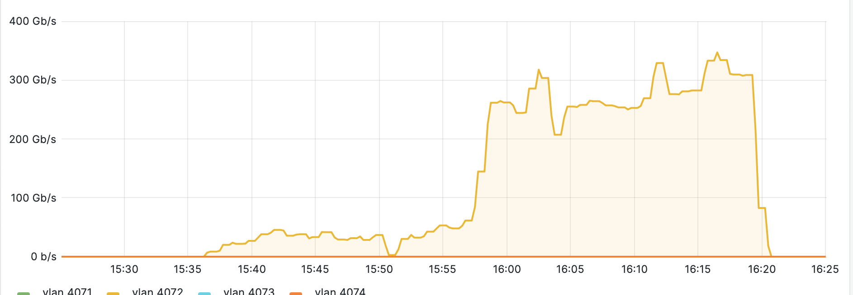
SENSE and Rucio (Caltech Production storage)

Slide 12
Current Status of SENSE and Rucio deployment
Currently deployed:
Fermilab T1 testbed with dCache storage;
Caltech (Production Ceph, Local NVMe)
UCSD (Local NVMe)
Nebraska (Production Ceph)
Modify Feature in SENSE (without tearing down circuit)
DMM interaction between Rucio, SENSE and FTS3
CHEP 2024 Presentation (accepted as a talk)

Slide 13
Next steps for SENSE deployment
Future Installations:
Purdue (without Switch control)
Vanderbilt
KIT
CERN
Quality of Services Analysis:
Soft/Hard QoS on WAN
Soft/Hard QoS on LAN
Soft/Hard QoS on Host
Storage capabilities testing

Slide 14
Rucio/SENSE/XRootD
IPP (2): XRootD Loop tests

Slide 15
Goals and Focus areas
Can we sustain 400Gbps to/from the site using XRootD HTTPs?
Where are the Software limitations? (1-to-1)
How does latency affects throughput?
How do jumbo frames affect throughput?
Should hyperthreading be ON or OFF for storage endpoints?
What is the overhead when adding storage (local NVMe Raid, DFS)?

Slide 16
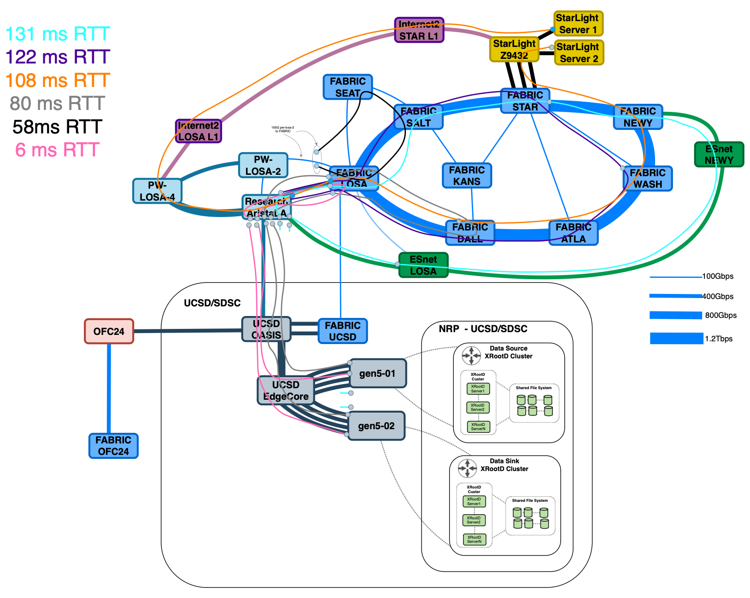
SENSE/Fabric/XRootD/PRP/Kubernetes/Multus
2 Servers:
2U Supermicro (SYS-621H-TN12R)
2x 32 core CPU (Intel Gold 6430)
1TB DDR5 (64GB DDR5-5600)
12x Samsung PM1733A
(Raid0, 42TB)
400G NVIDIA CX7

Slide 17
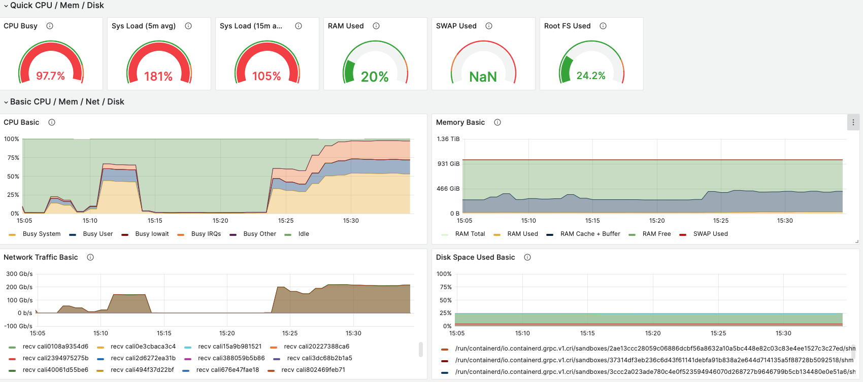
SENSE/Kubernetes/Multus/XRootD/Fabric/NRP
More details at CHEP 2024 (Poster)

Slide 18
SENSE/Rucio/LHC/XRootD
IPP (3): Real Time Monitoring

Slide 19
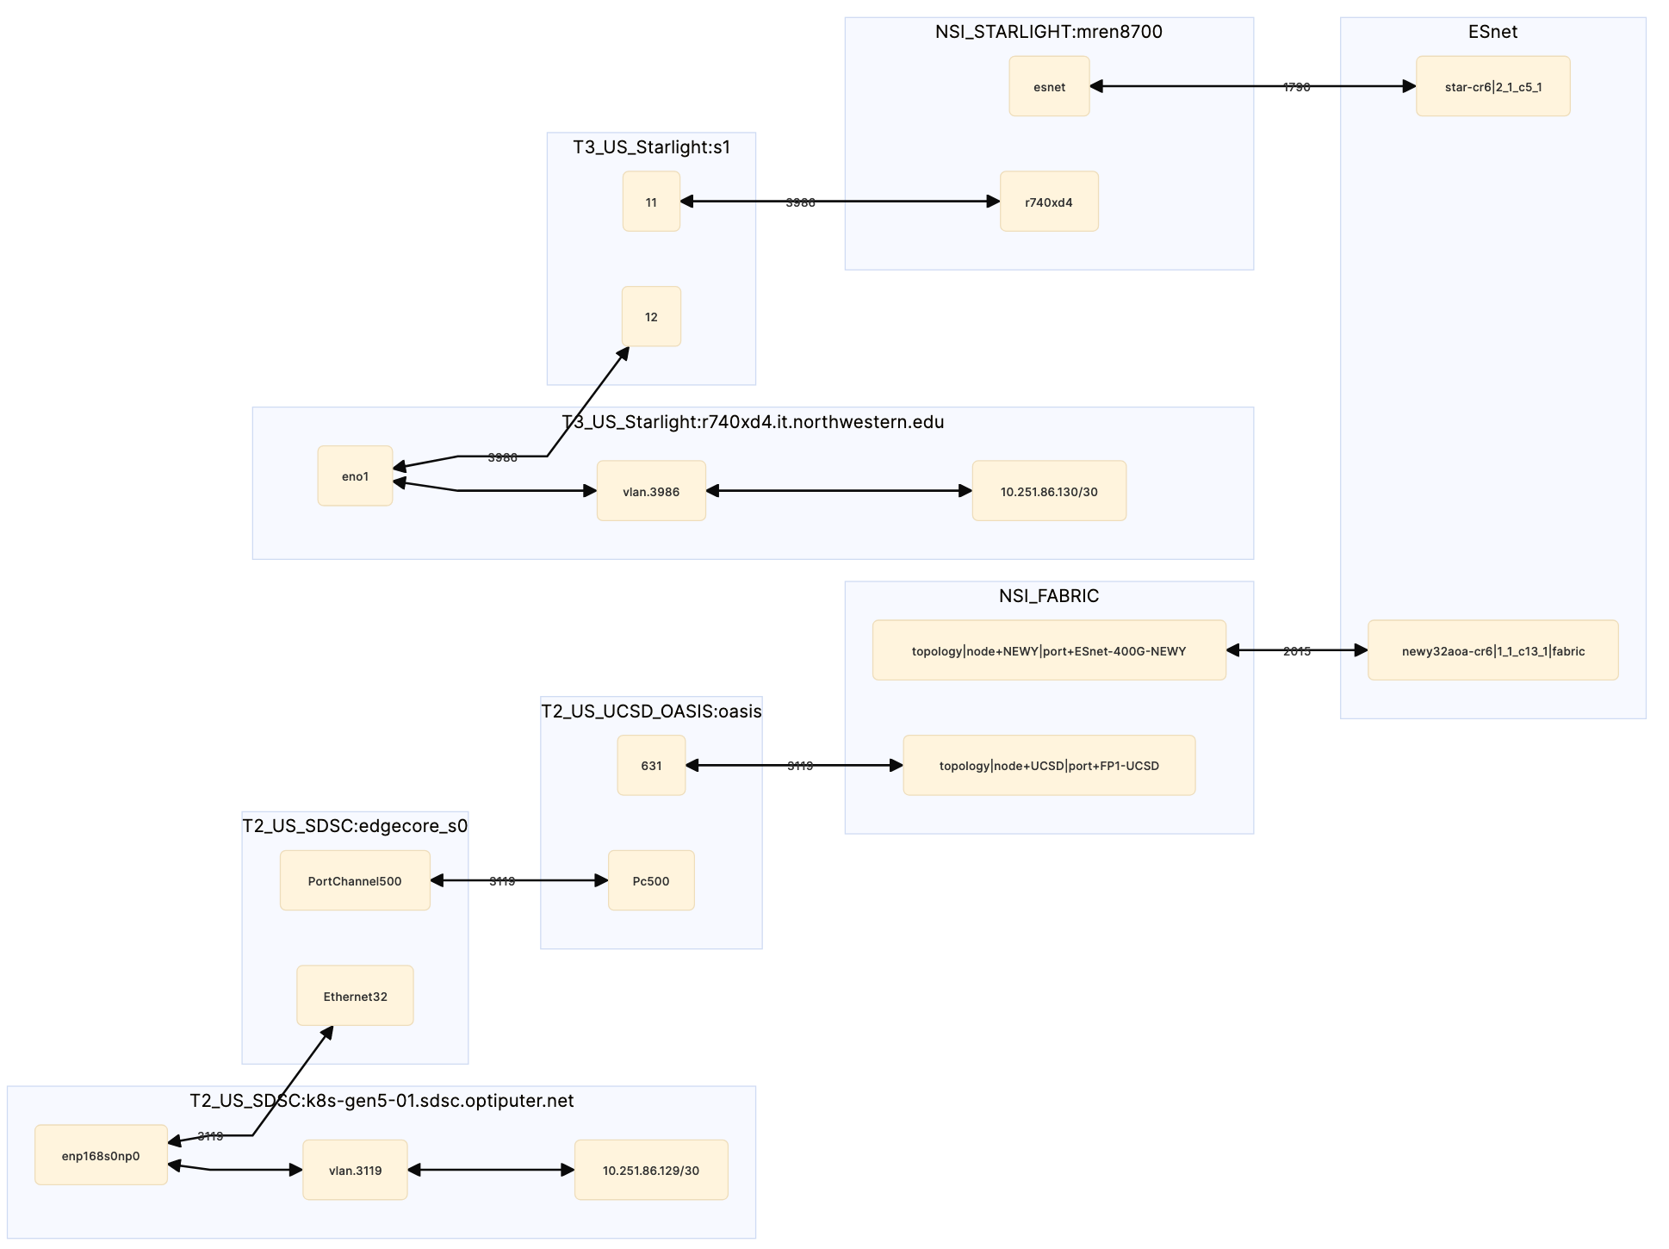
First Real Time Monitoring release
Coverage:
All SiteRM Sites
ESnet Stardust
In discussion:
Internet2
SDSC
Starlight

Slide 20
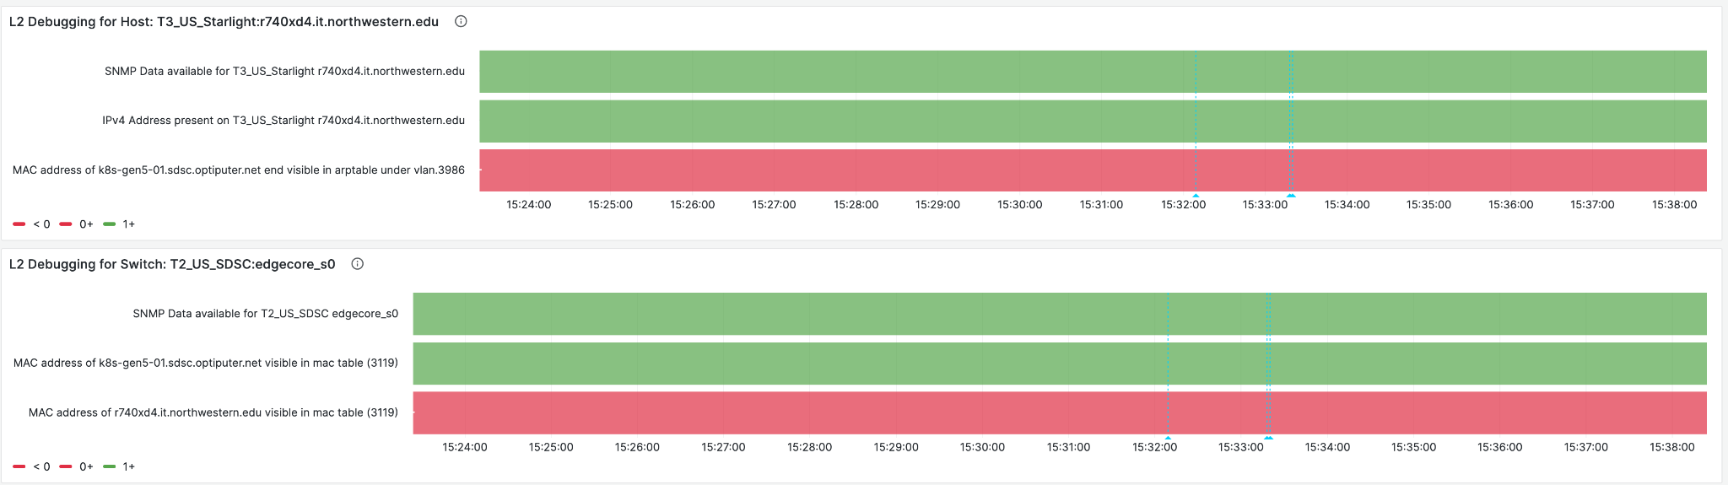
First Real Time Monitoring release

Slide 21
Rucio/SENSE/XRootD
Interactive Demo time (video)

Slide 22
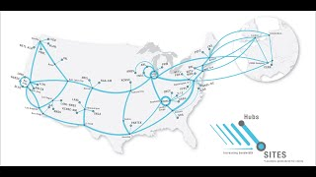
Demo time

Slide 23
Next Steps
Sites without network control:
Smart NIC, router on server, router at ESnet
Production storage test’s (DCache, EOS, Ceph)
Launch FTS3 and XRootD on demand (SENSE + Janus).
Network bandwidth sharing and allocations between experiments
Explore other experiments and use of SENSE/Rucio (ATLAS/DUNE/LIGO)

Slide 24
Special thanks to many colleagues
Frank Würthwein, Jonathan Guiang, Aashay Arora, Diego Davila, John Graham, Dima Mishin, Thomas Hutton, Igor Sfiligoi, Harvey Newman, Maria Spiropulu, Justas Balcas, Raimondas Sirvinskas, Preeti Bhat, Marcos Schwarz, Sravya Uppalapati, Andres Moya, Tom Lehman, Inder Monga, Xi Yang, Chin Guok, John MacAuley, Hans Trompert, Evangelos Chaniotakis, Joe Mambretti, Sana Bellamine, Christopher Bruton, Oliver Gutsche, Asif Shah, Chih-Hao Huang, Dmitry Litvinsev, Phil Demar, Andrew Melo, David A Mason, Garhan Attebury, Hans Trompert
and many others from NRE communities

Slide 25
Backup slides

Slide 26
