Slide 1
2024 Summer Fellows

Slide 2
Where In The World Am I?
Neha Talluri
Mentor: Jason Patton

Slide 3
What is a Glidein?
A glidein runs on shared resources to create more execution points
Glideins assess the worker node they are on by gathering information and utilizing pre-configured data
Location of a Glidein is currently not discovered or provided
Institutions may not be co-located with the resource
Notes:
Now while I love the space of introspective questions and hypotheticals, that is not the space I am working in. Luckly, the space I have been working is within the OSPool and specifically glideins.
My one line explanation of a glidein is that
A Glidein is a job that contains a wrapper script sets up an execution point on a shared resource.
A glidein can receive information through discovery or provided information.
Wrapper scripts help discover information about the worker nodes environment
Discovery:
Detect software such as singularity
Identify OS on the system
Provided information comes from human written configurations such as the OSG Topology repo
Provided:
Institutional Owner
Site name
Resource name
Currently location of a glidein is not currently discovered or provided by the scripts or configurations.
While institutional owner information is sometimes available, the resource a glidein lands on is not always co-located with the owner
CLICK

Slide 4
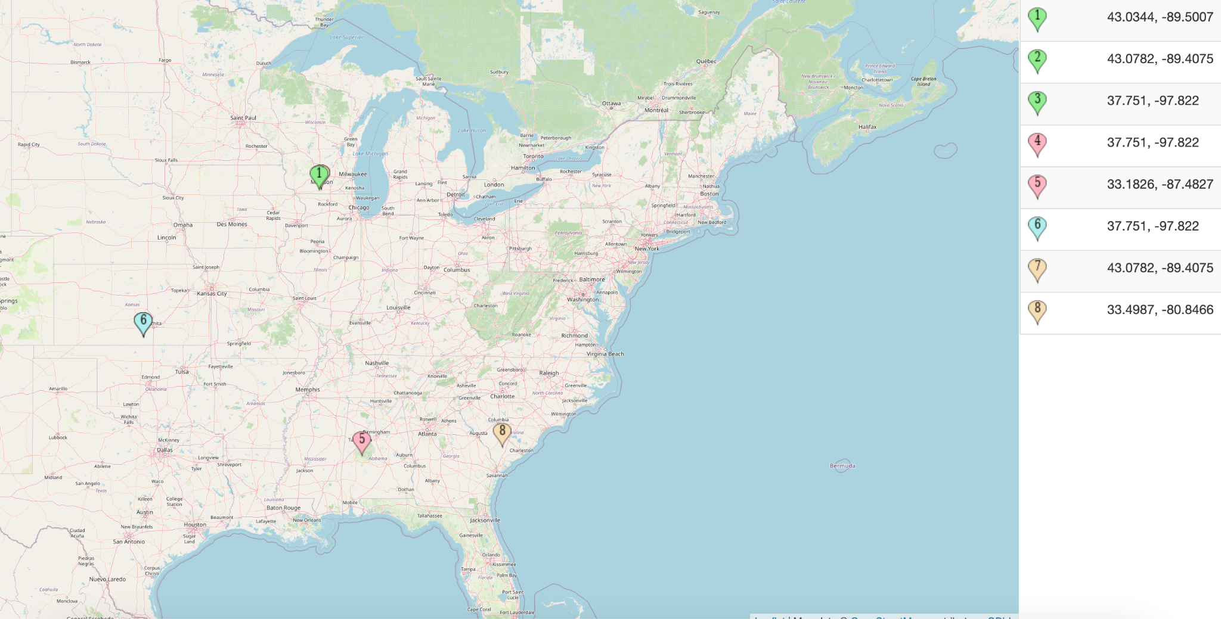
IP Geolocation Problematic
Kansas
problem
Notes:
One of the obvious ideas is to use IP geolocation if institutional owner isn’t an option
Resolve IP addresses with a database like MaxMind
Determine that a glidein is running in locations such as Wisconsin or Alabama
CLICK
Problem occurs when IP addresses don’t resolve to accurate physical coordinates.
I deemed as the “Kansas Problem”
Instead of returning null when a location is undetermined from an IP, the database returns back center of the US
Suggests glideins are operating in middle of a lake in Kansas, which is highly unlikely
This seems to be a problem with IPv6 addresses

Slide 5
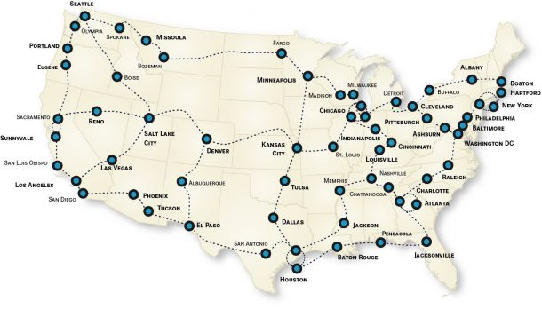
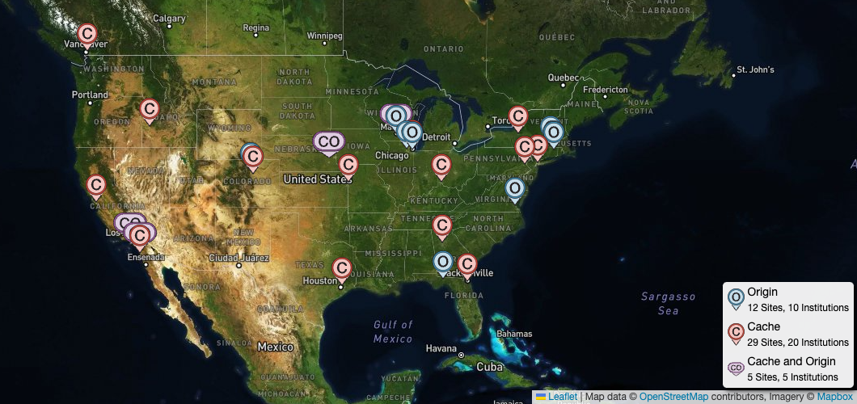
“Where Am I?”
Location: is the distance to some known entity
Distance: Network latency and hops
Answer “Where are glideins in relation to known entities?”
Entities = OSDF Caches
Notes:
For this problem, latitude and longitude or an institutional owner isn’t enough to answer “where am i?”
To answer this question, 3 things needed to be defined
For location, I’m defining it for now to be the distance from a glidein to some known point or entity, rather finding an absolute location.
One way to define distance to a location is through network latency and number of router hops returned by traceroute.
This makes more sense than physical distance, something like miles, because network paths are not as straightforward as direct lines on a map.
The paths as more complex “series of pipes”
Rather than thinking “Where am I?”, the question can be posed as - “Where are glideins in relation to known entities?”.
try to contextualize the location of a glidein in relation to an entities such as caches or other resources.
CLICK

Slide 6
What I’ve Been Doing
Learning the glideinWMS system through running OSPool jobs and kicking off glideins
Developing glidein scripts to gather network information and advertise this information to the machine ad and glidein logs
Figuring out how to answer “Where am I?”
Testing IP geolocation using different IP addresses
Figuring out how to use tracepath to figure out latency and hops
Notes:
Learning how glideins work
How the glideinWMS system works through running OSPool jobs and how it kicks off glideins
Developing glidein scripts to gather network information and advertise this information
Exploring what software is available to a glidein from a worker node
For example we found tracepath is more widely available than traceroute
Figuring out how to answer the question “Where am I?”
Tried the obvious answer of ip geolocation, but turns out it’s not as useful as it seems
gathering public IPs and and retested IP geolocation which still ended up with the kansas problem
Figuring out how to use network tools to answer the question
Such as tracepath to figure out latency and hops
CLICK

Slide 7
Questions?
Notes:
With all of that, I leave it to you any comments and questions.

Slide 8
Machine Learning for OSPool Failure Classification
Thinh Nguyen
Mentor: Justin Hiemstra
Notes:
Time: 4:03

Slide 9
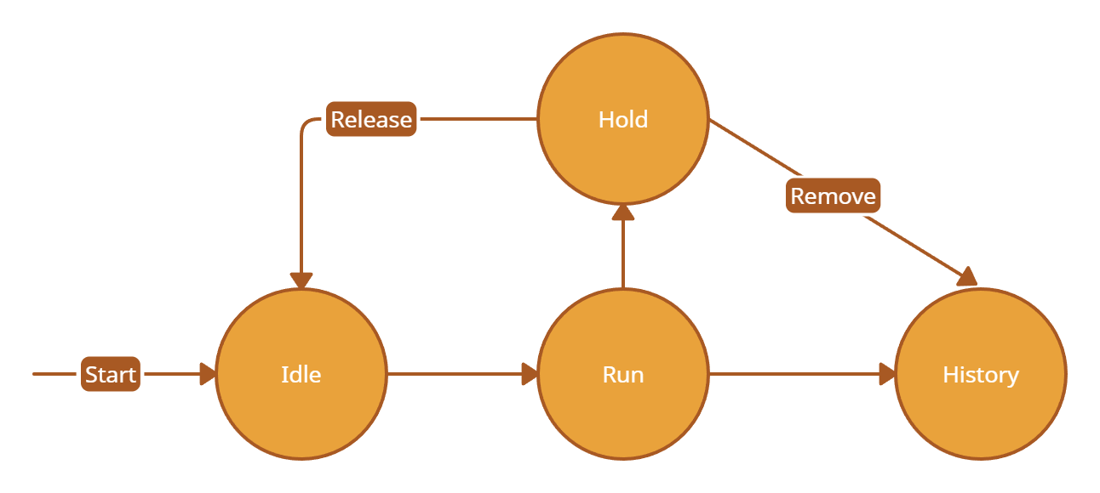
An Example
Lifecycle of a job
During a job’s execution it can go on hold for various reasons
User’s discretion to release or remove it
Notes:
What is the standard lifecycle of a job?
Why does it go on hold?
Let the user decide to release or not

Slide 10
Using AI to Make the Inference
Why AI?
OSPool is a Dynamic system
Continual learning

Slide 11
Usage

Slide 12
How?
Each job has a log file describing its lifecycle
Format these logs into a time-series structure
Use model that accounts for temporal patterns
e.g. Long Short-Term Memory (LSTM) neural network

Slide 13
Bonus
Can the model provide information as to why the job went on hold?

Slide 14
Thank you,
Questions?
https://github.com/super10099/Machine-Learning-for-OSPool-Failure-Classification

Slide 15
Expanding Pelican Origin Monitoring
Patrick Brophy
Notes:
Time: 4:04

Slide 16
Who Am I?
My name is Patrick Brophy
I am a senior at UW Madison studying computer science
CHTC Fellow working with Haoming Meng
London
Lucky
Notes:
I am a senior at UW Madison studying Computer Science
I am a CHTC fellow working with Haoming Meng
CLICK

Slide 17
Problem: Diagnosing an Origin’s Health
Pelican Origins are the backbone to a data federation
Connects and Serves an object store
Origins are critical within a federation, no origins -> no data
If an origin goes down so does the data that it was serving
A staging device can’t stage data if it can’t access an origin
Diagnosing why an origin is failing is difficult with the current tooling
Notes:
The problem is diagnosing an Origin’s health is HARD
Origins are the backbones to a data federation
When an origin is down so is the data is was serving,
meaning staging devices won’t be able to stage any objects from an origin
Currently diagnosing an origin is hard with the current tooling
My project is made of two parts:
Better communicating the data we collect already
Collecting more data
CLICK

Slide 18
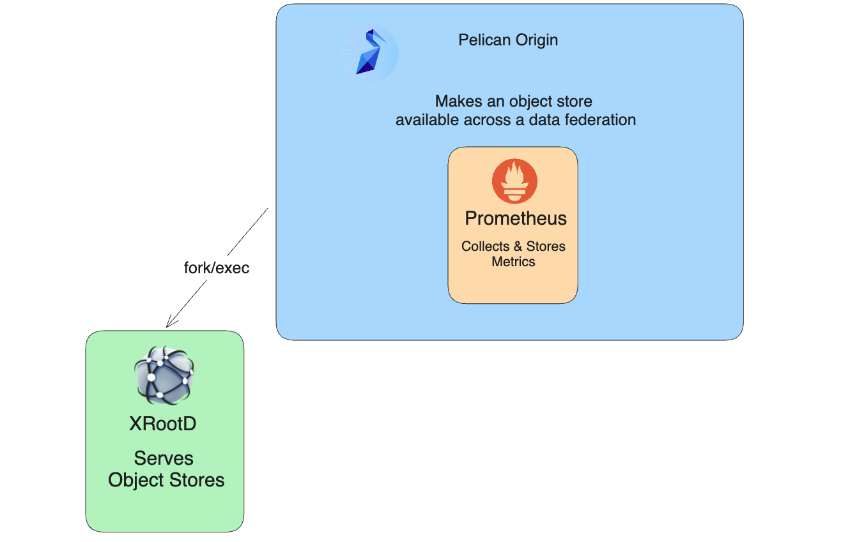
Origin Architecture
Notes:
To address the first part, we need to understand the Pelican Origin architecture
An origin has 2 sub components: XRootD and Prometheus
XRootD runs as a subprocess of an Origin and is responsible for serving object stores
CLICK
If XRootD dies, then an Origin won’t be able to make any of the objects available across the federation
This also means that any monitoring data that we are collecting from XRD will not be available either
CLICK
The way we run Prometheus is very untraditional
We use Prometheus as a library within Pelican.
Normally Prometheus runs as its own service
This means that when Pelican is down, so is Prometheus
But also Prometheus could cause Pelican to go down as well!
This also means that any metrics that are reported with a down period in between are faulty

Slide 19
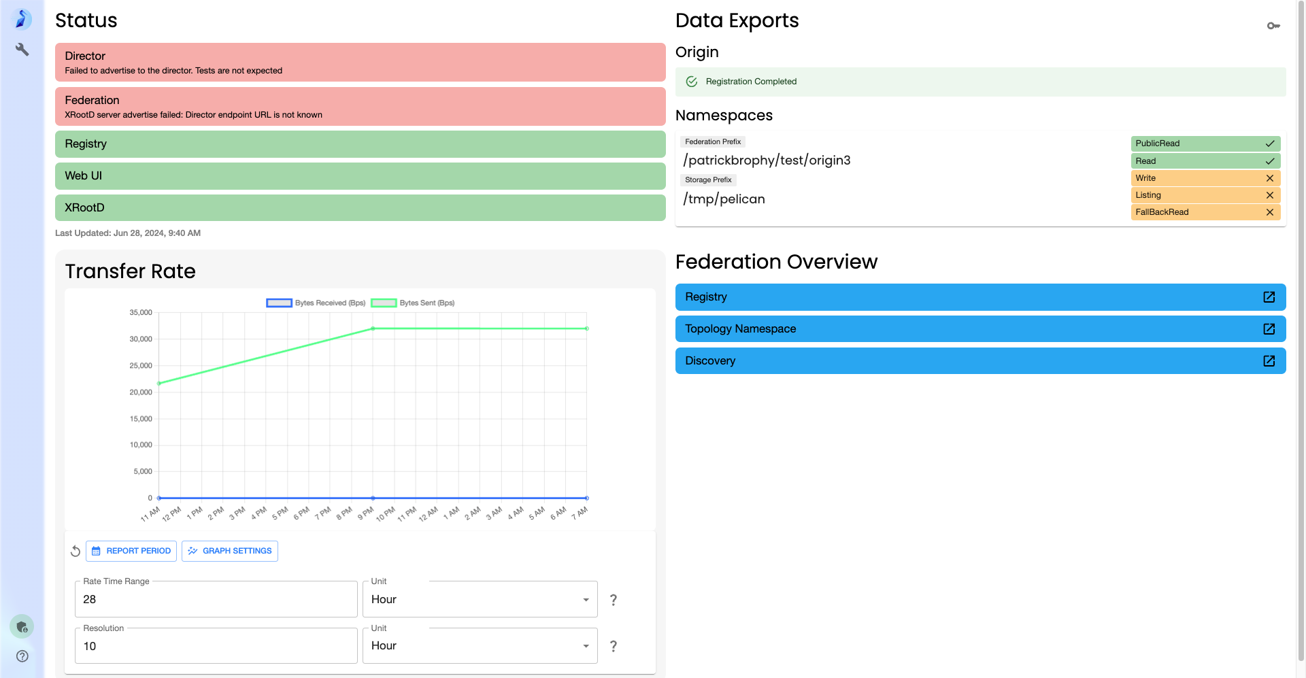
Existing Origin Web UI
Notes:
So with those challenges in mind, here is the current origin web ui
CLICK
So in the upper left you can see a status bar for different services
CLICK
Below that you can see a transfer rate graph
This is currently all that is available and there is definitely more needed to better diagnose an Origin
CLICK

Slide 20
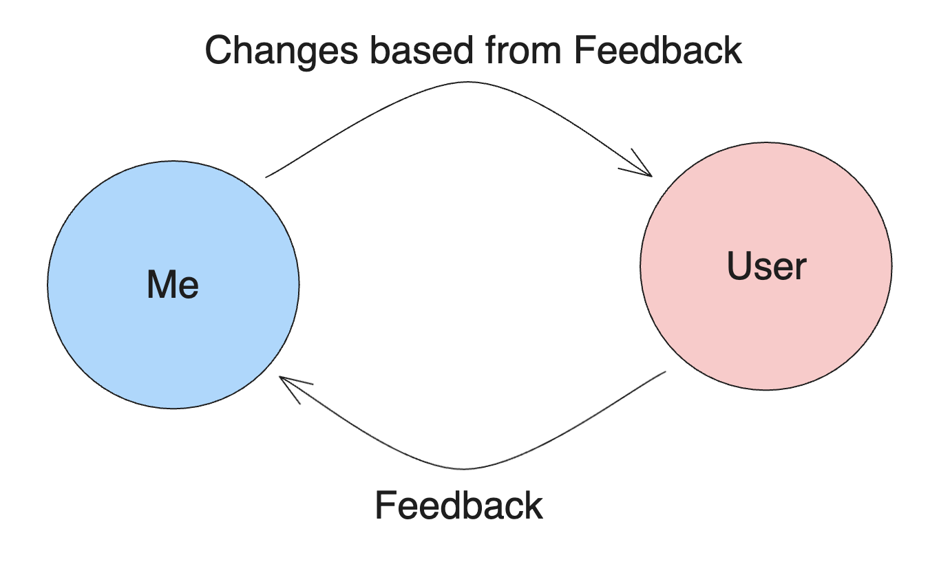
Improving the Dashboard
I conducted a user study with several Pelican system admins from CHTC and OSDF
Feedback from system admins guided design choices
Notes:
So to improve the dashboard I conducted a user study with Pelican sys admins from CHTC and OSDF
This created a feedback loop
And so this is new mock dashboard I designed in Grafana
CLICK

Slide 21
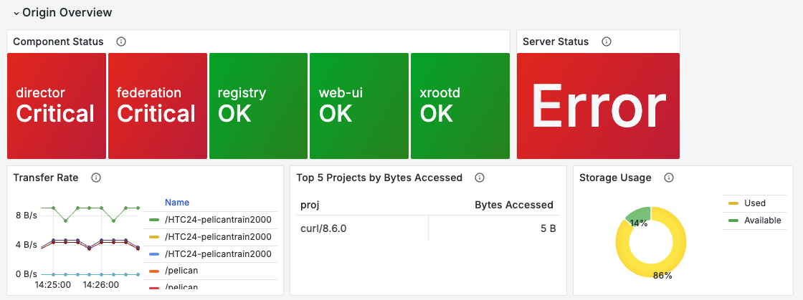
Notes:
So this is the origin overview row of the dashboard
You can see a similar component status panel and beside it a server status panel
The server status panel says “Error” if anyone of the components is critical
Below that you can a transfer rate for different paths
Beside that you can a Top 5 projects by bytes accessed
Where it says curl is where the name of the project would be which is populated in the User Agent header
And lastly the storage used and available within the object store
CLICK

Slide 22
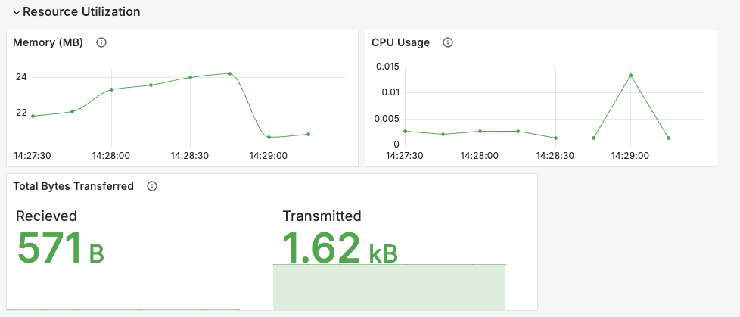
Notes:
On this panel you can see things like memory usage, cpu usage and bytes transferred and received
CLICK

Slide 23
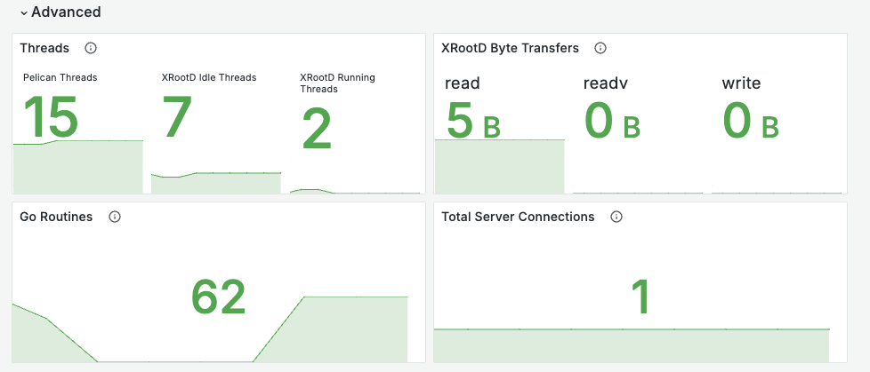
Notes:
Lastly, this row has panels of more advanced metrics such as Pelican and XRootD threads and server connections
CLICK

Slide 24
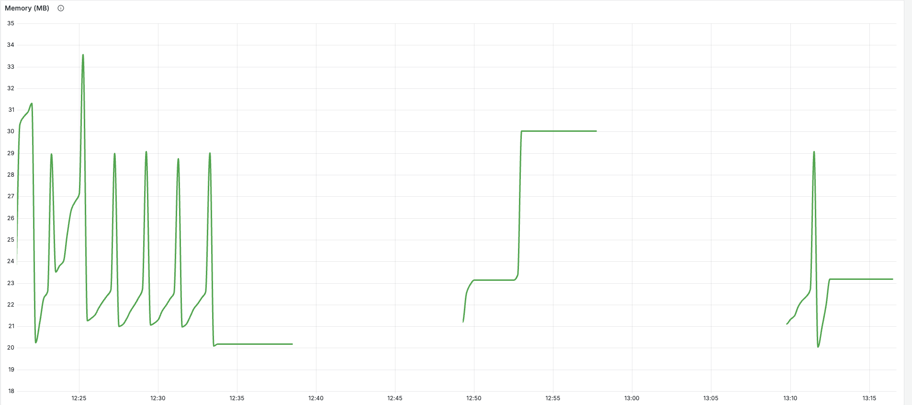
Notes:
So with this new dashboard, we have to consider notifying and reporting important metrics to both system administrators, users, and others like the NSF
This a plot of memory usage but that really isn’t the point
What is glaring though, is the large holes in the graph
These holes are origin outages, in these cases this was me restarting origin a few times on my laptop
If we are to make reports of things like number of objects served and we didn’t mention an outage that occurred that wouldn’t give the most transparent understanding
CLICK

Slide 25
What’s Next?
More Metrics!
XRootD protocol-level (HTTP) metrics
Alerting users of issues such as outages or warnings
Reporting performance metrics for some period of time (day, week, month)
Staging Device miss rate
# of Objects accessed
Total bytes transferred
Notes:
So whats next
I will be developing more metrics both at the XRootD level and at the Origin level.
With time permitting expanding my efforts into other Pelican services like the staging device
I will be implementing alerting for system admins
Lastly, generating reports for an origin which could include metrics like staging device miss rate, number of objects accessed, the total bytes transferred
CLICK

Slide 26
Thank you!
Please come and ask me questions!
Notes:
Thank you for your attention
Please come and ask me questions!

Slide 27
Integrating Pelican with Pytorch
CHTC Summer Fellow: Kristina Zhao
Mentor: Ian Ross, Emma Turetsky
Notes:
Time: 4:33
Hi everyone, my name is Krsitina, and I am a summer fellow in CHTC. Today I’m going to introduce my project, which is integrating pelican with Pytorch.

Slide 28
Integrating Pelican with Pytorch
Introduction
Pelican
PyTorch
HTCondor
Dataset stores the samples and their corresponding labels
DataLoader wraps an iterable around the Dataset to enable easy access to the samples.
Notes:
So Let’s we start with introduction of related things. Though the presentation this morning, I think we are all familiar with Pelican,which is a software platform for federating dataset repositories together and delivering the objects to computing capacity. And then, Pytorch is a machine learning library, all AI researcher should be familiar with it, it’s used for applications such as computer vision and natural language processing. And HTCondor, is a software which help us running our job in OSPool, therefore we can use more computing resources to accelerate model training.
As we can see in this graph, in a standard workflow, we grab data from pelican, and then using pytorch to consume and prepare the data. The dataloader module in PyTorch will batch the data to make it ready to be trained. And finally, we hope to use using HTCondor to make all the things run in OSPool.

Slide 29
Integrating Pelican with Pytorch
Problem
Data Accessibility
Large Size
Remote
Performance:
low metadata latency
high data throughput
Notes:
So, what’s the problems currently exist?
In the aspect of data accessibility, it’s always easy when things is small. We can just download the dataset on local file system and then train. However, when scale up, there can be some challenges. Especially when the data is remote. For example, what if your disk is smaller than the dataset? You are not able to download the whole dataset, so what we need to do is chruk the data in to pieces, or implement lazy reading. We can also have something like a slide window to stream the dataset, load some of them each time and train on it. And also, if the dataset is pretty big, you may need hours or days to download it, then you CPU or GPUs will be idle, so this will be waste of resource. We don’t want this happen.
As for performance, accessing data on remote file systems can often be rather slow compared to local storage. So, how should we achieve low latency and high throughput in the circumstance of large and remote data volumes?

Slide 30
Integrating Pelican with Pytorch
Goals
Streamlined Workflows
CLI → Pelicanfs (implement fsspec)
Smoother integration
Less time on tools
Efficient Data Handling
Make our AI Researchers happier 😄
Notes:
So, our goal is to solve these problem. First, we want to streamlined the workflows. Before, we can only use CLI tool of pelican to fetch the data from origin. In this way, you need to do data downloading and model training separately. There’s gaps between multiple tools. We hope to fill the gaps to achieve a smoother integration. For example, the pelicanfs, which wrote by my mentor Emma, implement the fsspec. fsspec is a python specification for a file-system interface. By following the specification, we can access different backends in the same way, without learning implementation of each backend. So with pelicanfs, we can write a python script to download the data, and start training at the same time. I can remember when I took deep learning course in UW-Madison, we first learn the concept of model training, things like neural network, forwarding and backforwarding, it’s not very hard to understand. However when it comes to practice by coding, things changes. I think for AI Researchers, they hope to focus on the model. However before start training, they always need to spend a lot of time to prepare, whether the environment, data, and any other tools. We hope to simplify the using of the tools. So AI researchers could spend less time on learning tools, but focus on the core, which is model.
Finally, we want make AI researchers happier and more productive.

Slide 31
Integrating Pelican with Pytorch
Methodology
Research
Pelican, fsspec, Pytorch data flows and requirements
Real world scenario: File format, file size, resource, limitation, …
Benchmark
Develop tools/libraries
Tutorial and Documentation
Notes:
So, how should we achieve all of these goals?
First, as a new fellow here, although I have been familiar with pytorch, I still did a lot of research about it, and also pelican, fsspec, htcondor.
How they consume the data, what kind of data they consume. Also, in real world scenario, what kind of file format and file size do people usually use? How big is the disk and memory usually be?

Slide 32
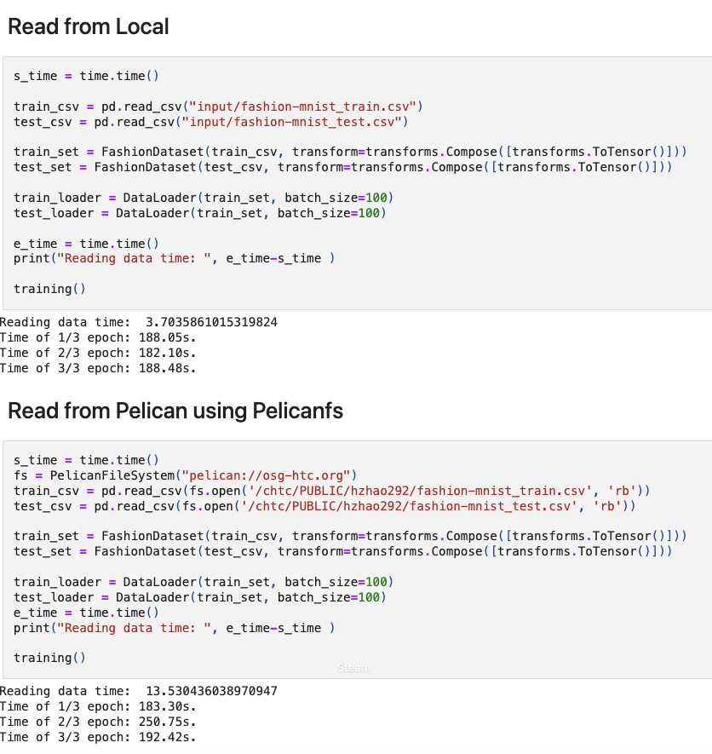
Integrating Pelican with Pytorch
Methodology
Research on Pelican and PyTorch data needs
Benchmark
local
Pelicanfs
Pelicanfs + Local Cache
Pelicanfs + zip file
Develop tools/libraries
Tutorial and Documentation
Notes:
After having a basic understand, we will start benchmarking, which is the primary thing I do right now. I have done benchmarking on a small dataset, fashion-MNIST. And switching to a much bigger dataset, ImageNet right now. In this way, we can intuitively see the performance differences between different ways of reading data. We hope to give researchers a rough idea of ​​what to expect before they start using it. When the dataset is small, loading from remote repository may significantly slow the training. However, if the there are millions of parameters to train, it may t. Besides, only know problem when you actually implement it,...

Slide 33
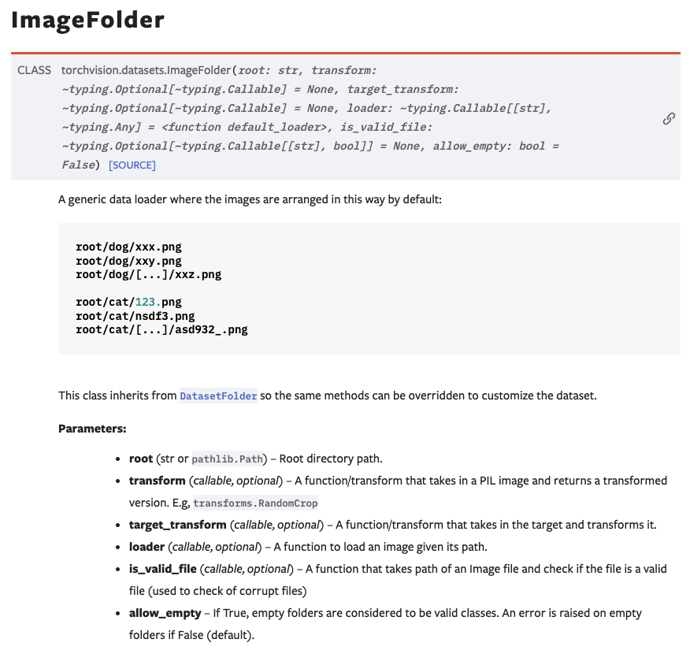
Integrating Pelican with Pytorch
Methodology
Research on Pelican and PyTorch data needs
Benchmark
Develop tools/libraries
Pelicanfs
Pelican connector?
Tutorial and Documentation
Notes:
So, the third one will be develop tools and libraries

Slide 34
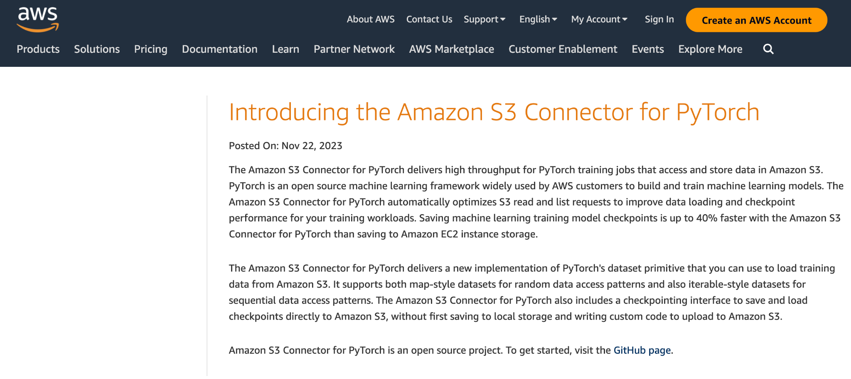
Integrating Pelican with Pytorch
Methodology
Research on Pelican and PyTorch data needs
Benchmark
Develop tools/libraries
Pelicanfs
Pelican connector?
Tutorial and Documentation

Slide 35
Integrating Pelican with Pytorch
Methodology
Research on Pelican and PyTorch data needs
Benchmark
Develop tools/libraries
Tutorial and Documentation

Slide 36
Integrating Pelican with Pytorch
Thank you!
Discussion and Problems welcome!
Kristina Zhao
hzhao292@wisc.edu

Slide 37
Enhancing the Building of the OSG Container Images
Pratham Patel
Notes:
Time: 5:00
Slide nunbers

Slide 38
Who Am I?
Hometown: Beloit, WI
Senior at UW-Madison studying CS & DS
I’m pretty awesome…
Just deal with it!

Slide 39
Enhancing the OSG Container Build System
A Three-Phase Approach to Versatility and Efficiency
Abstract:
CHTC builds images for sites to run and for use internally.
Images are based on upstream OS container images
We build all images at least once a week
Focus:
Adding versatility and streamlining the build process within the OSG images repository.
Three-phase approach:
Customizable build instructions for each image.
Dynamic trigger for external repositories.
Compatibility and support for ARM-based systems.
Notes:
A very basic overview of the OSG container build system:
(read bullets off slides here)

Slide 40
1
Image X
1
2
3
4
5
OSG 3.6 + EL7
OSG 23 + EL9
6
7
8
9
10
Build Parameters
11
12
13
14
15
Development
Testing
Release
16
17
18
19
20
21
22
23
24
25
26
27
Multiply that by 27 images built multiple times a week and we run into issues…
6 individual build for image X
Notes:
For some image X we have multiple parameters that are used to build the image
The product of these parameters is equivalent to the number of times this image X is built
Each build of this image X is some variation of these parameters
In the case for image X we build the image 6 times
This causes redundant image builds that we may not need
If we multiply these parameters across all the images in the repo then we run into issues

Slide 41
Background
Current State:
GitHub Actions Workflow:
Automates building and pushing container images.
Triggered by specific conditions and events.
Monolithic Design:
Lack of flexibility in the build process.
All images built using a single, unified workflow.
Additional Features:
Not supported for ARM architecture.
47
Notes:
The current state of the images repo defines a workflow that automates the building and pushing of container images for the OSG based on specific triggers and conditions.
This lacks the flexibility we are looking for as the images are being built in a monolithically designed architectural way.
There is no ARM-based support for building these images

Slide 42
Project Requirements
Versatility:
Mechanism for custom build processes through a unique configuration file.
Default instructions in absence of unique configuration file.
Trigger Mechanism:
Located in the images repository.
Activates updates with Pelican and other external repositories.
ARM Compatibility:
Add support for building native ARM-based systems.
Aim for ARM-optimized Pelican images.
Notes:
Firstly, the system must allow for the customization of build processes through some mechanism for images, in this case i’ve decided to go with a config file within the image directories; in the absence of such a file, default build instructions will be applied.
A critical component involves the implementation of a trigger mechanism that has information about external repositories, but in this case the Pelican repository, which activates updates with the external Pelican repository upon certain conditions.
Adding ARM-based support for building these images

Slide 43
Solution
Phase 1: Customizable Build Instructions
Objective: Establish an advanced image repository framework with configurable build instructions.
Implementation Paths:
Dynamic parameters for building images.
Modularize workflow into reusable components.
Phase 2: Triggering the Pelican Repository
Objective: Integrate with the external repositories using a trigger.
Implementation Paths:
Create some trigger in the images repository.
Use GitHub Actions to monitor and trigger Pelican repository and others.
Develop GitHub Action in Pelican repository to handle the trigger for updates.
49

Slide 44
Conclusion
Summary:
Implementing a three-phase approach that enhances flexibility, efficiency, and future-readiness.
Custom build instructions, trigger for external repositories like Pelican, and ARM-based support.
Next Steps:
Refine customizable build instructions
Work with Pelican team to determine trigger strategies

Slide 45
CHTC Fellowship:
Tracking Server Inventory and Elevation
Ben Staehle
Notes:
Time: 4:56
Tips/thoughts from Christina:
Script out / practice the intro to get started then switch to just notes

Slide 46
Who am I?
My name is Ben Staehle
Madison native - currently at UW-Madison
This summer - CHTC Fellowship
Working with Joe Bartkowiak on
“Tracking Server Inventory and Elevation”
Willow
Me

Slide 47
What are we solving?
CHTC maintains more than 1200 assets
System administrators are responsible for maintaining inventory records
Interested stakeholders include UW-Madison, Morgridge Institute for Research
Previous internal asset tracking was cumbersome
2
Notes:
CHTC is responsible for more than 1200 assets of varying types - (switches, rack-mounted servers, routers)
Spread across 5 datacenters in the madison area - PATh facility has assets in NE, NY, FL, and Madison
Servers break down, move around, change purpose, enter and leave CHTC
As you might be able to imagine, juggling manual management, and organization can be a tall order
Because these are technical assets, they all end up in locked server rooms - administrators end up being the ones with physical access
Therefore it makes sense for system admins. To be the ones who manage inventory
We have great system admins, but as you might expect, they’re busy administrating!
Administering our research computing systems requires a lot of attention and it’s reasonable understand how inventory management might become an afterthought at times
Assets are purchased through stakeholders such as UW-Madison or the Morgridge Institute for Research, these organizations also track asset inventory (say for accounting purposes as an example)
So it is important for CHTC to have accurate internal records
Both to be in sync with records kept and used by related organizations
And for our own sake, having easy access to inventory data and records saves time and relieves headaches for system administrators
Current system involves a manually updated spreadsheet tracking asset data and elevation
Inventory tracking isn’t new to CHTC but…
As you can imagine - A 1200 row spreadsheet that requires manual updates from very busy system administrators might not be our ideal solution
In all seriousness, it’s easy for a manual spreadsheet to get out of sync with external records and itself
And losing trust in the spreadsheet means more time spent convincing ourselves we have the right information. In that case, the spreadsheet isn’t doing what we need
So, what is the alternative to “the inventory spreadsheet of doom”?

Slide 48
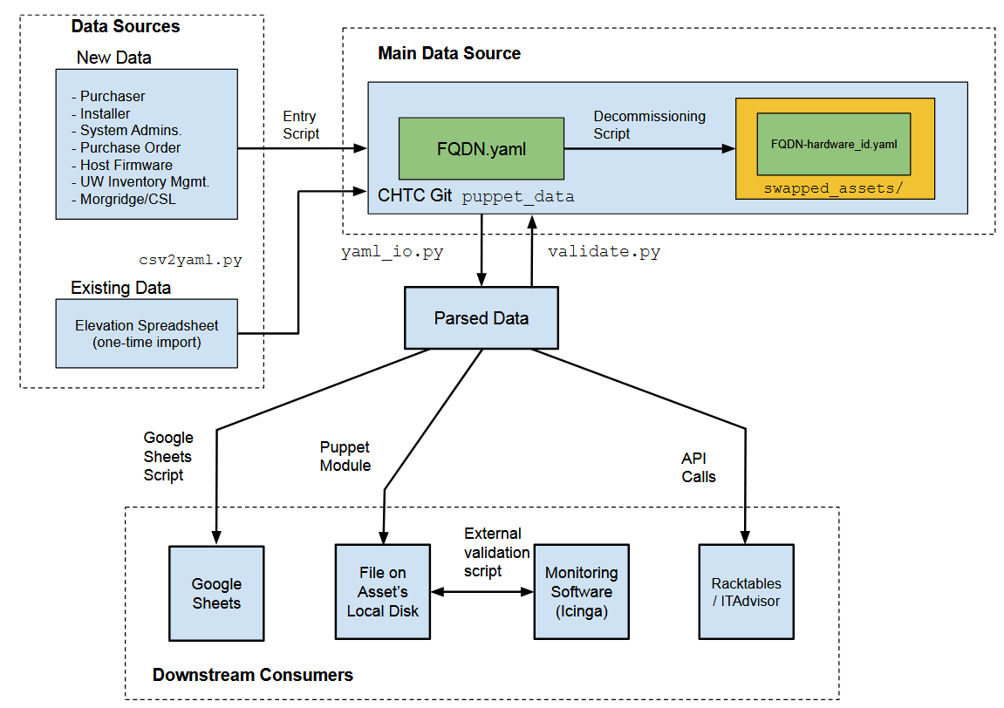
3
Notes:
In a sentence - We want to bring the data closer to administrators
A suite of Python scripts
To facilitate this, have a series of Python scripts to help perform tasks such as entering, removing, and validating asset data
If data isn’t valid when it enters, then we defeat one of the major purposes of this system
What do we mean by “Bringing Data Closer to Administrators”
One place administrators spend a large amount of their time is within our configuration management system
Luckily - this system already has representations of the majority of our assets - including all those rack-mount servers we talked about
These representations are in the form of YAML configuration files
Also quite conveniently - Config. Management is tracked by Git - which means it has history and all the other niceties that come along with Git
So, simply put, we’re putting asset data in Git-tracked YAML
Data Validation
On the topic of data related errors…
A notable challenge our project approaches is data validity
Reality is messy sometimes - humans make mistakes - data is not always perfect because the world it represents isn’t always perfect
But we still care about maintaining trustworthy data, so what’s the plan?
A data validation script will bring missing or invalid data to the attention of system administrators so that it can be addressed
This can be accomplished by ensuring data makes sense with respect to itself and in terms of the real world
External Integrations
We have this validated data, what to do with it?
This new inventory system will allow for a “modular” style interface to be used for scripts to export data to various external services
It is completely reasonable that non-technical folks may prefer looking at a Google Sheet rather than digging around the command line (opportunity for Linux nerd joke? Maybe too much)
The overall goal here it to provide initial tools, but also an interface that can be easily expanded upon in the future

Slide 49
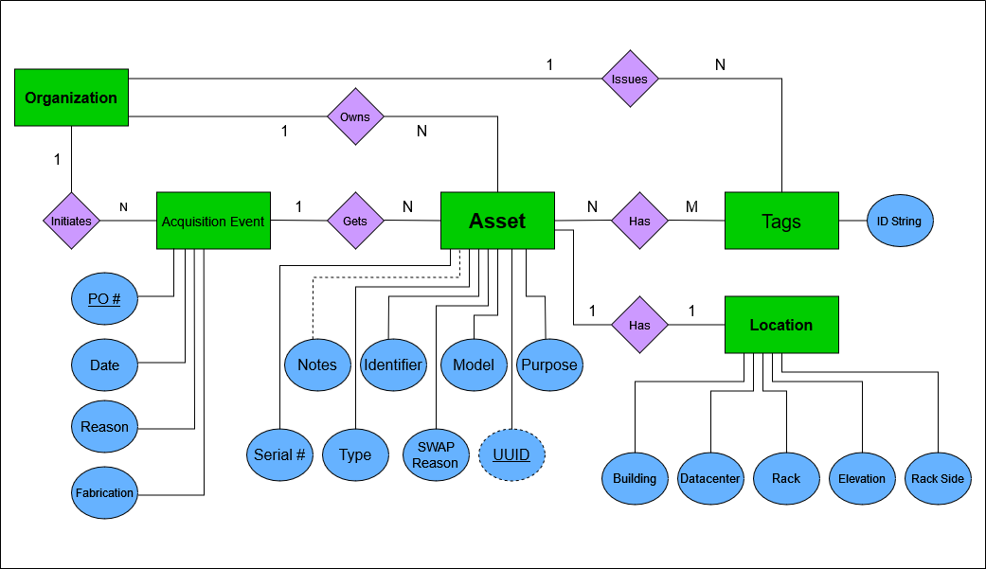
4
Notes:
In a project dealing with data, such as this one, It’s not terribly surprising that an important part of our project so far has been designing a data model
However, at first, we came in thinking our data design was already set, but it needed a bit more thought
At first we had a very “asset centric” view of the problem - realized that a few of what we thought were attributes should really be entities
Our current data model didn’t need to be as complicated as it was
To help clarify the relationships we are dealing with, we sat down and worked out an Entity-Relationship diagram - turned out to be a very helpful experience
Creating and iterating this diagram helped me identify complexities - without touching any code
“think before you type” has made implementation go more smoothly

Slide 50
Thank you!
Questions?

Slide 51
Performance Monitoring in the Schedd
Wil Cram
Greg Thain

Slide 52
The Motivation
Access Point
The Schedd process handles commands
Sometimes it slows down without warning
How to find the root cause?
Admins: who is the problem?
Schedd
condor_q
condor_submit
condor_rm
Notes:
The schedd handles your user’s commands. …, …, For the admins: who or what is the problem?

Slide 53
Definition 1.1
A task is an object with an associated “time cost”
A queue is an object that accepts incoming tasks and works on them one at a time

Slide 54
The Problem
Consider a queue Q with categories 1,2,…,n
The queue records the total time spent processing each category
How do we determine real-time data about this system?

Slide 55
Enter Sampling
We can record the totals every x seconds
The time spent over some window is new_runtime - old_runtime
We can divide by the sum of totals to get a relative proportion
This tells us what is taking up time in the queue
Notes:
Well guess what…

Slide 56
The Schedd is a Queue!
(Basically)

Slide 57
The Schedd:
Operates on tasks one at a time
Has categories (commands, handling jobs, etc.)
Publishes totals through ClassAds

Slide 58
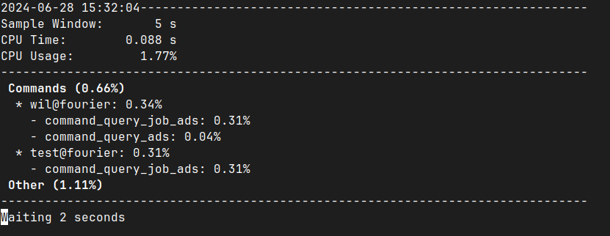
Trivial, Right?
<- How???
Notes:
Seems alright, but how do we get the CPU time?

Slide 59
Wrong!
Condor publishes the average % of time that CPU is recently “busy”(20min window)
Multiply by window size to get CPU time?
If the percentage doesn’t move much, sure

Slide 60
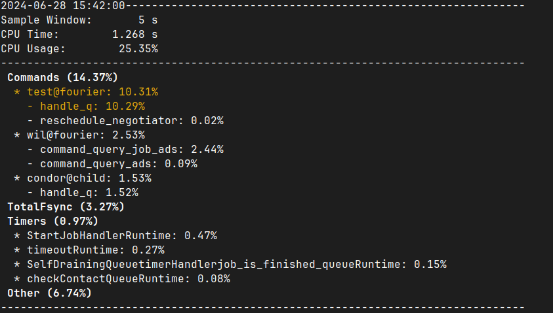

Slide 61
Wrong!
Condor publishes the average % of time that CPU is recently “busy”(20min window)
Multiply by window size to get CPU time?
If the percentage doesn’t move much, sure
This average falls behind during a traffic spike
Notes:
This average can fall way behind the instantaneous value during a traffic spike

Slide 62
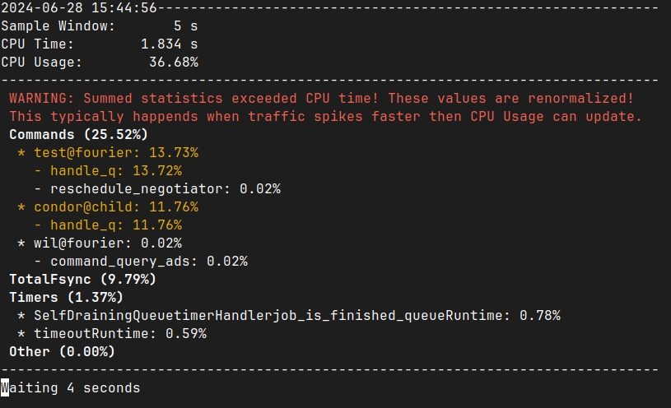

Slide 63
Wrong!
Condor publishes the average % of time that CPU is recently “busy”(20min window)
Multiply by window size to get CPU time?
If the percentage doesn’t move much, sure
This average falls behind during a traffic spike
We trust our own recent totals
However, we lose information

Slide 64
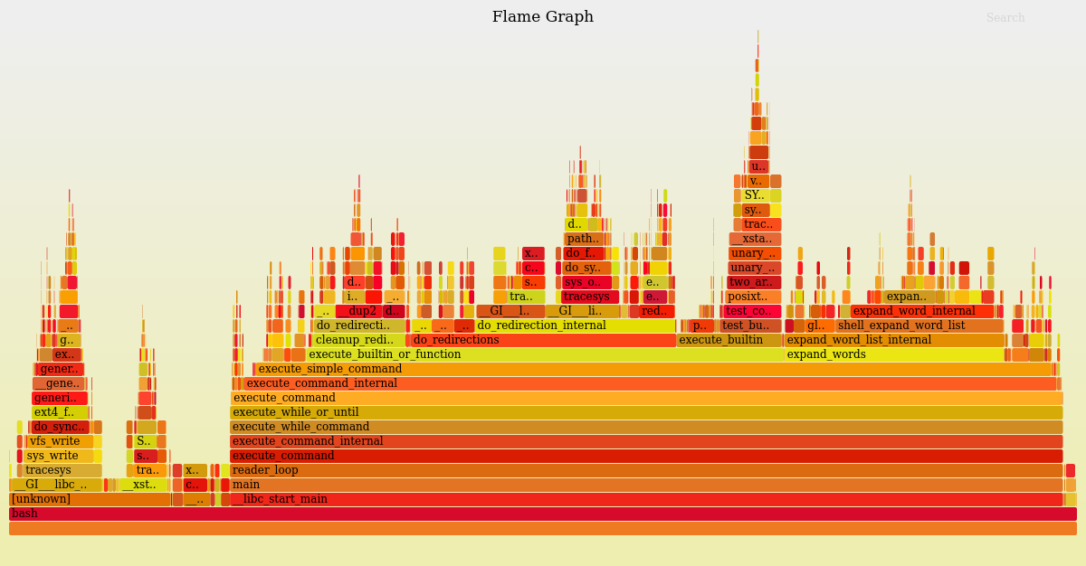
Future Plans
Improving visibility at a glance
More process coverage
Give intelligent warnings to users
“User condor_q_spammer has taken over 25% of busy time for the past hour. Maybe don’t let them do that?”

