Slide 1
OSG Campus Services
Tim Cartwright, OSG Campus Coordinator
Christina Koch, Research Computing Facilitation Lead
Center for High Throughput Computing & PATh Project
University of Wisconsin–Madison

Slide 2
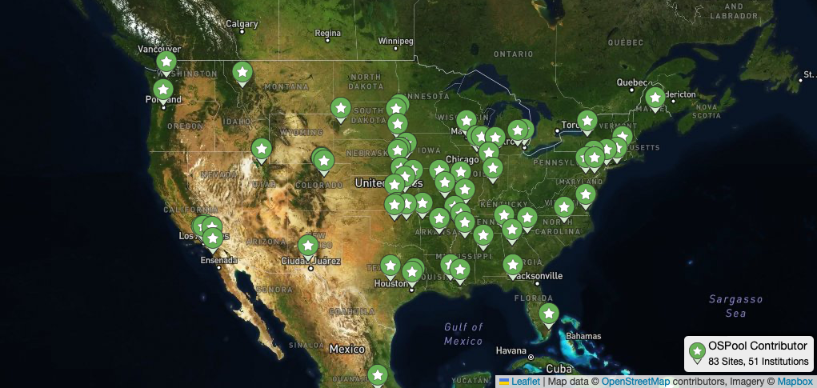
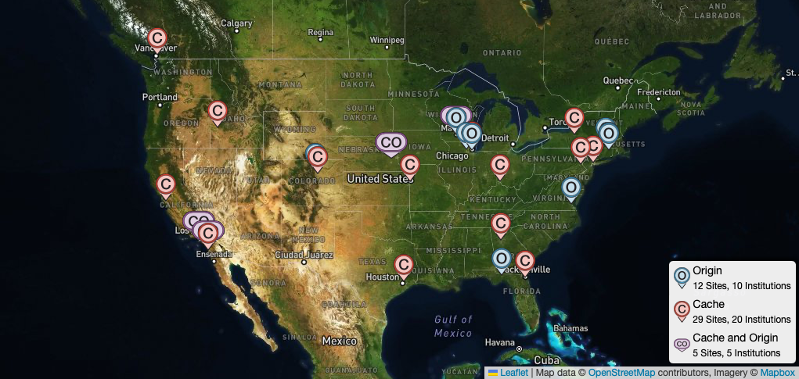
What We Do
We help
campuses share compute and storage capacity with researchers
and
researchers access and benefit from that capacity
to reduce barriers to discovery for all of Open Science

Slide 3
Services for Contributors

Slide 4
Summary of Services (also, Tuesday talk)
Planning
Prepare you to describe sharing plan in proposal; provide letter of collaboration
Discuss your process, technical details, and responsibilities (you and us)
Offer suggestions on hardware and software configurations
Integration
Plan and carry out the integration itself
Host and operate certain services on your behalf – e.g., HTCondor-CE, OSDF Origin
Support you throughout process; email, meetings, documentation – whatever works
Operations
Monitoring: We proactively watch for issues and repair or contact you as needed
Accounting: Show you what you’re contributing and who that helps (CE dashboard!)
Support: Respond to requests, update software, host Campus Meet-Ups, etc.

Slide 5
Why Contribute?
Join a national-scale CI ecosystem, contribute to great research
Learn about HTC, advise your researchers on getting access
Connect with the community, share ideas to hone local systems
Maximize usage of purchased capacity
Fulfill a promise made in a grant proposal (e.g., CC*)…

Slide 6
NSF CC* 2024 — 15 Oct 2024 Deadline
Area 2: Computing & the Computing Continuum (Campus or Region)
For “a shared, high-performance network-connected compute resource”
Campus ≤ $700,000, Region ≤ $1,400,000; ≤ 2 years; ≥ 50% for HW
Area 4: Data Storage and Digital Archives (Campus or Region)
“a shared, high-performance network-connected data storage resource”
Campus ≤ $700,000, Region ≤ $1,400,000; ≤ 2 years; ≥ 50% for HW
Area 5: Strategy (Campus or Region)
“support PIs and teams requiring resources and time to coordinate and develop an approach to CC*-related activities”; ≤ $100K for 1 year

Slide 7
Services for Researchers

Slide 8
Researchers can use the OSPool today
If researchers on your campus would benefit from what we provide, they can start right away.
Fill out an account request form
Meet with us
Start running work
Researchers can use a test environment to prototype workloads at any time before or after creating an account.
https://portal.osg-htc.org/application
5
min

Slide 9
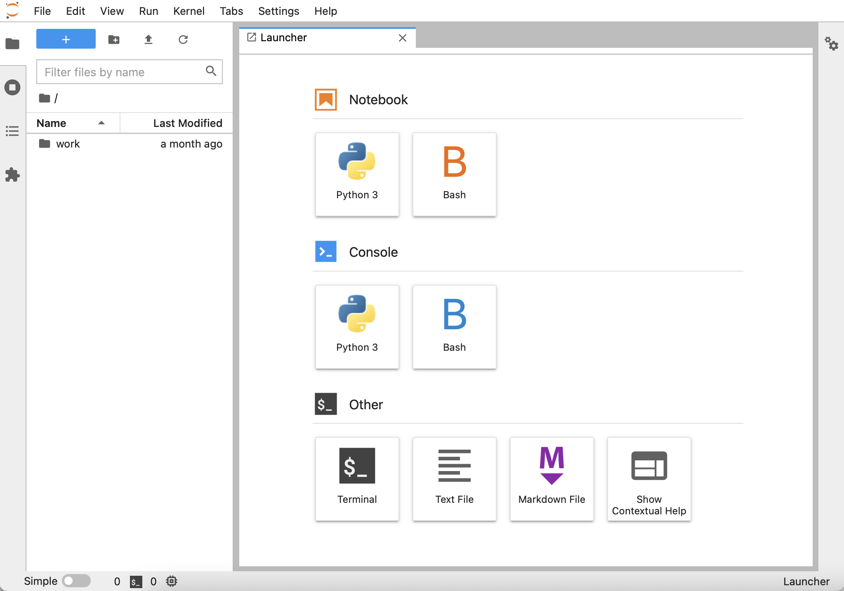
Quick Start with Notebooks
OSPool Notebooks: Jupyter-based interface
to an HTCondor Access Point
https://notebook.ospool.osg-htc.org

Slide 10
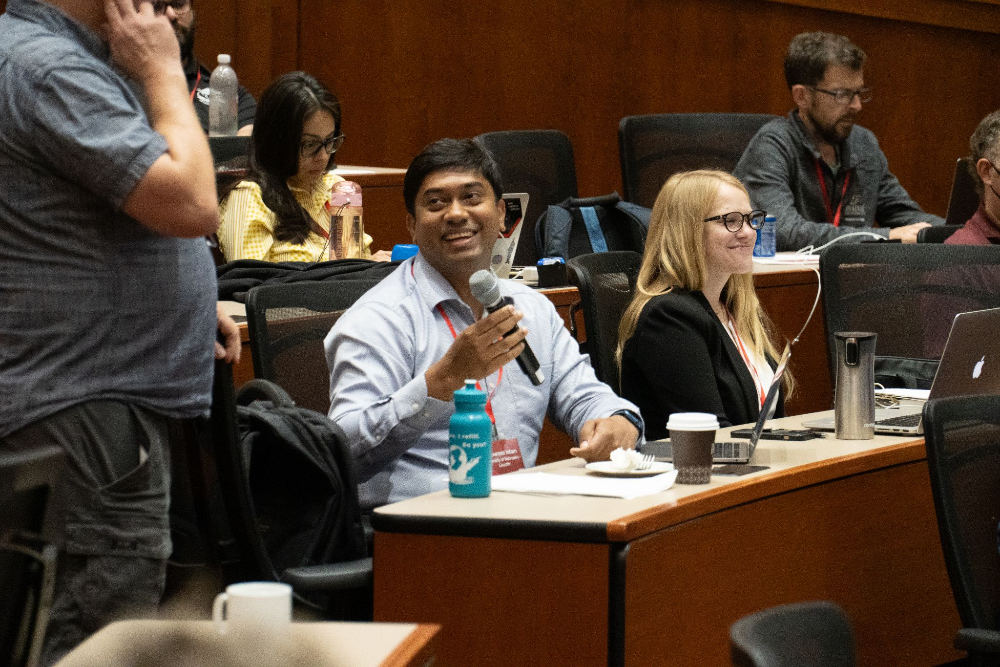
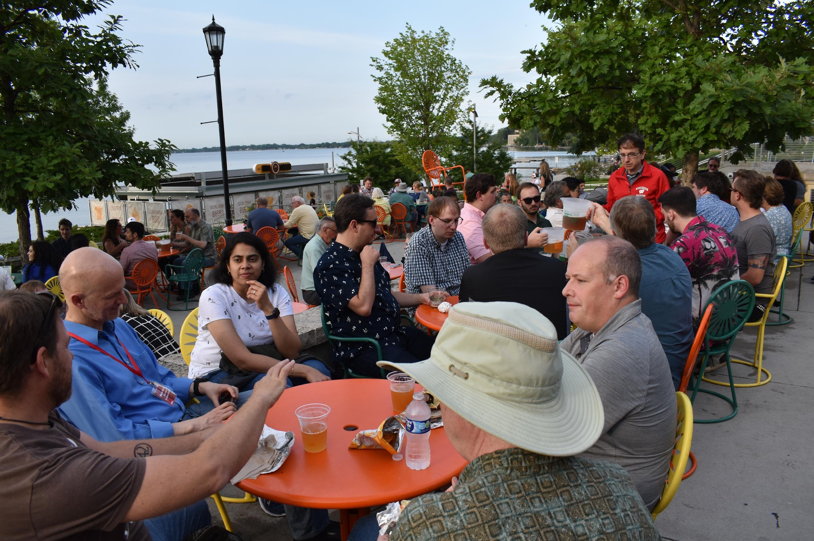
Join Our Community
Don’t do everything on your own!
One-on-one Help: consultations and office hours
Asychronous Help: email and documentation
Training: monthly training, annual OSG School
Community Events: HTC24, Campus Meet-Up

Slide 11
Technical Overview

Slide 12
OSPool Provisioning
OSPool
Campus A Cluster
Campus A HTCondor-CE
Capacity
Access Points
⁞
⁞
Capacity
Idle Job Info
Campus Z Cluster
Campus Z HTCondor-CE
OSPool
GlideinWMS
Front-End
Capacity Requests
GlideinWMS
Factory
Capacity Requests (aka Glidein Jobs)

Slide 13
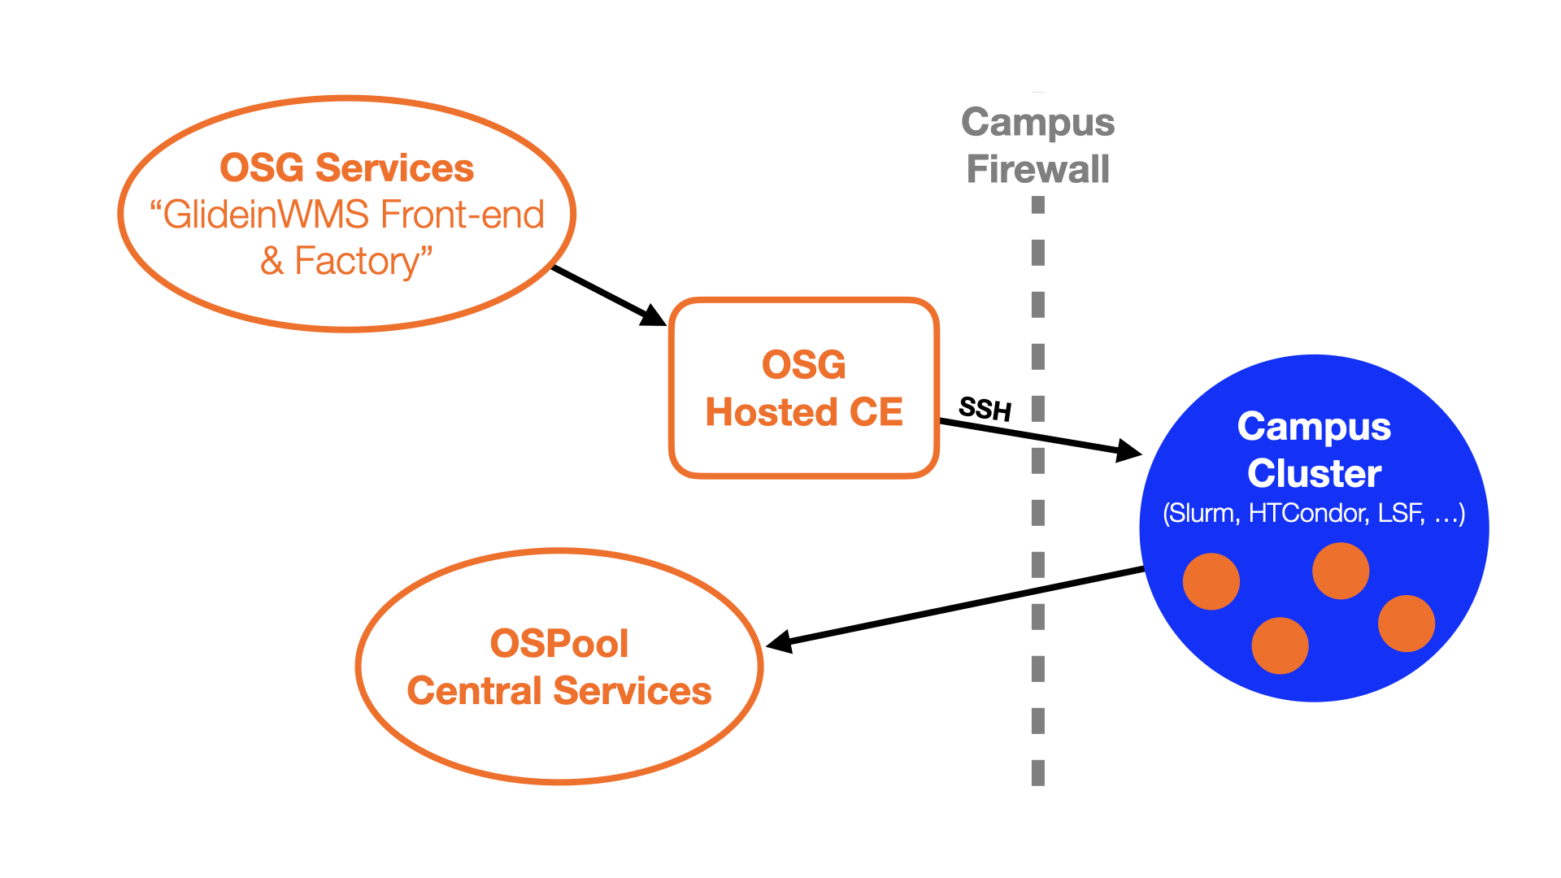
OSPool Provisioning Details
For a batch scheduler:
CE requests capacity (as jobs) based on demand
Scheduler may run req.s
Our SW creates Execution Point & adds to OSPool
Using containers:
You start containers to share
Rest is the same

Slide 14
OSDF: Architecture
OSDF
Campus B Origin
Campus B Object Store
Registry
Registers
Registers
Registers
Campus A Origin
Registers
Director
Cache 2
Campus A Object Store
Cache 1

Slide 15
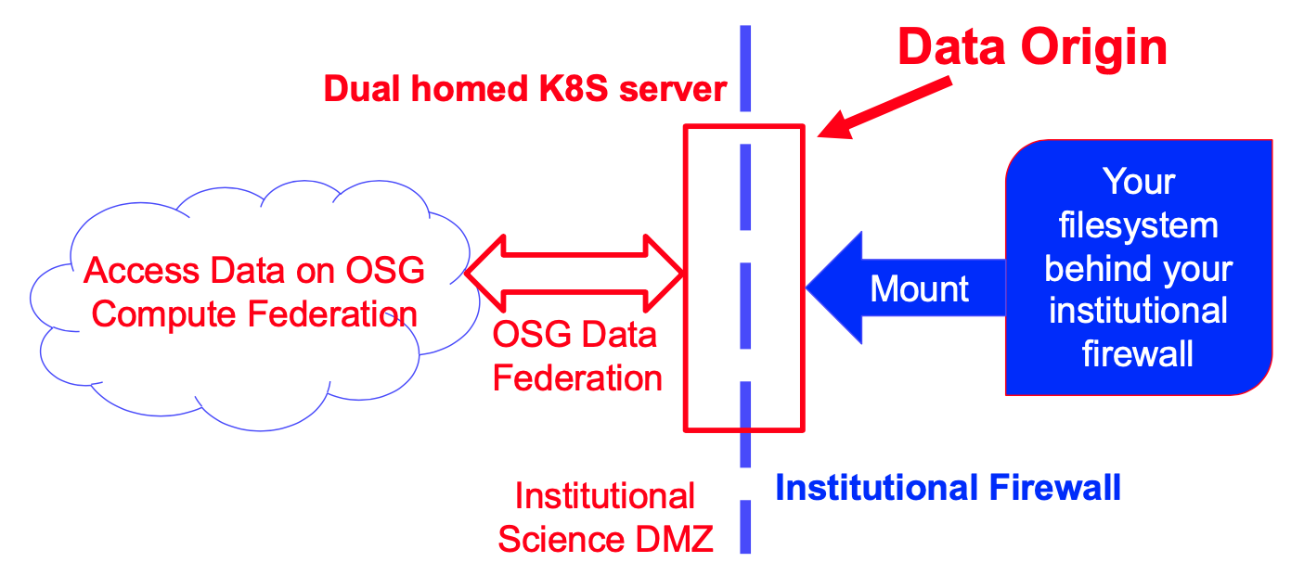
OSDF Origin Details
Underlying FS can be whatever (more or less); access is public/protected
Mount only what you want to expose
Origin node just needs Kubernetes, we do the rest

Slide 16
OSPool and OSDF: Usage
Access Points
Job
Assigned to EP (Slot)
Job
Requests Data
EP A1
OSDF
to Director
OSPool
Data Delivered
to cache/origin

Slide 17
Questions?
This material is based upon work supported by the National Science Foundation under Grant Nos. 2030508. Any opinions, findings, and conclusions or recommendations expressed in this material are those of the author(s) and do not necessarily reflect the views of the National Science Foundation.

