Slide 1





Subtraction and Residual PDFs: heavy-quark treatments in global QCD analyses
Marco Guzzi
with
Pavel Nadolsky and Keping Xie
15th Conference on the Intersections of Particle and Nuclear Physics CIPANP2025, University of Wisconsin-Madison, WI, June 9, 2025

Slide 2
Motivations
Exp data at current and future colliders continue to extend on a wider range of collision energies and so do modern global analyses of proton PDFs

Slide 3
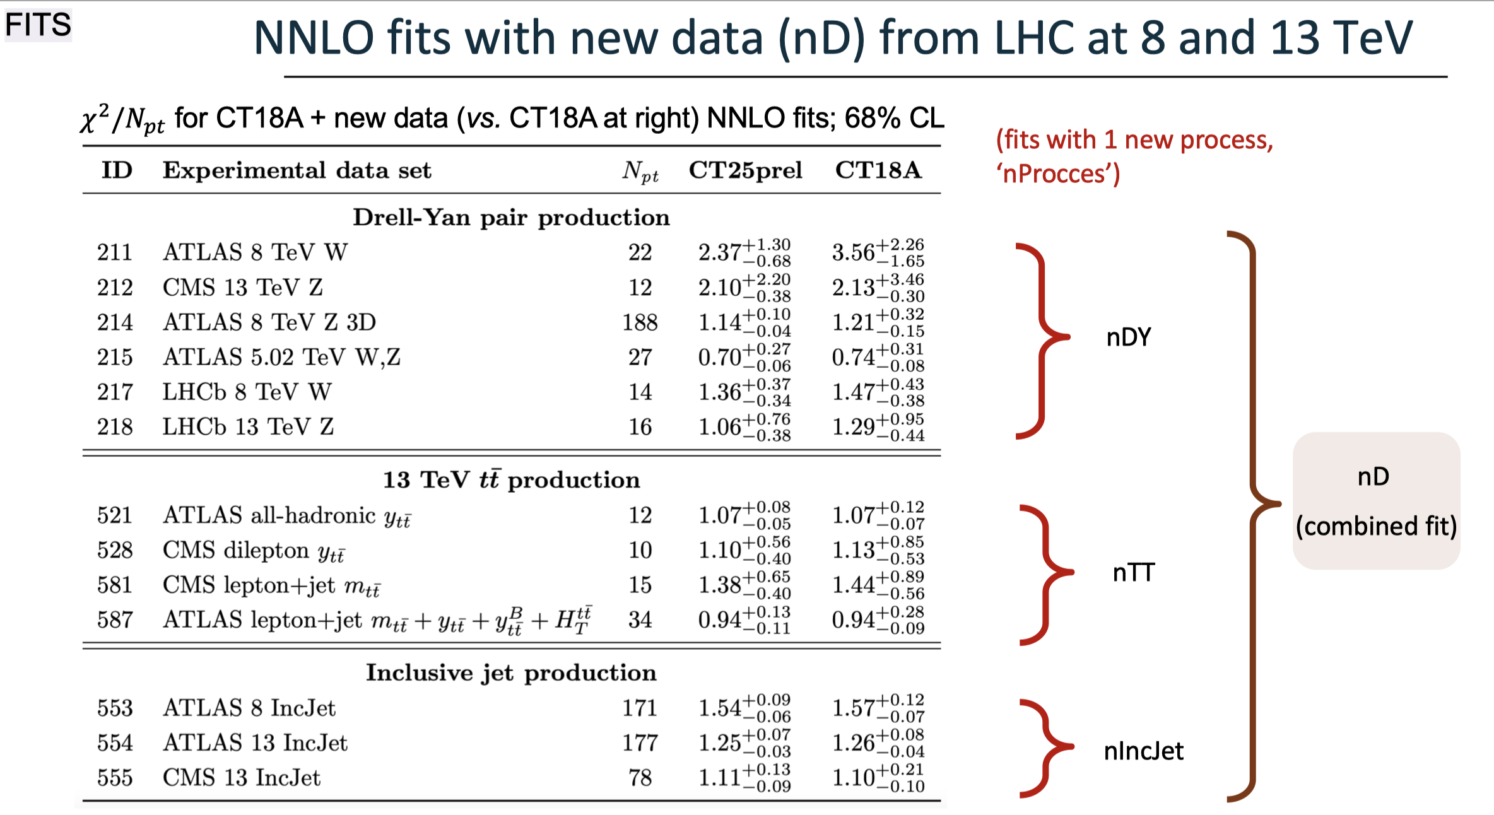

Towards new CTEQ (CT25) PDFs
Preliminary
also dijet data,
but don’t
(officially)
know how to
combine with
inclusive jets
776 new data points from DY, $t\overline{t}$ and jets for CT25

Slide 4

Motivations
Exp data at current and future colliders continue to extend on a wider range of collision energies and so do modern global analyses of proton PDFs.
Increased sensitivity to mass effects, e.g., phase-space suppression, large radiative corrections to collinear $Q\overline{Q}$ production: magnitude comparable to $NNLO$ and $N^{3}LO$ corrections. Need a consistent General Mass Variable Flavor Number (GMVFN) scheme

Slide 5
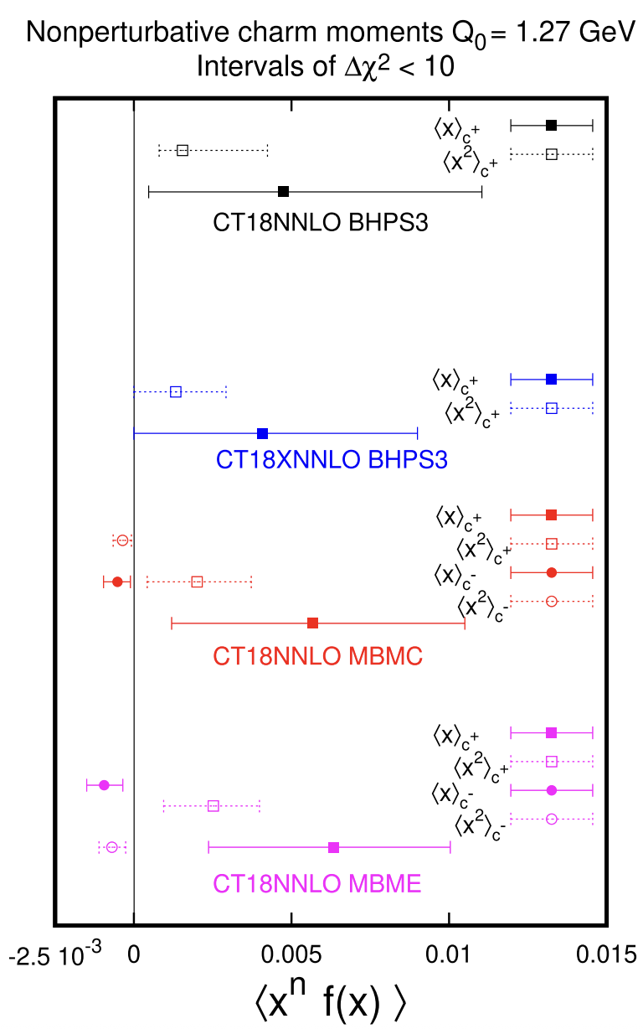
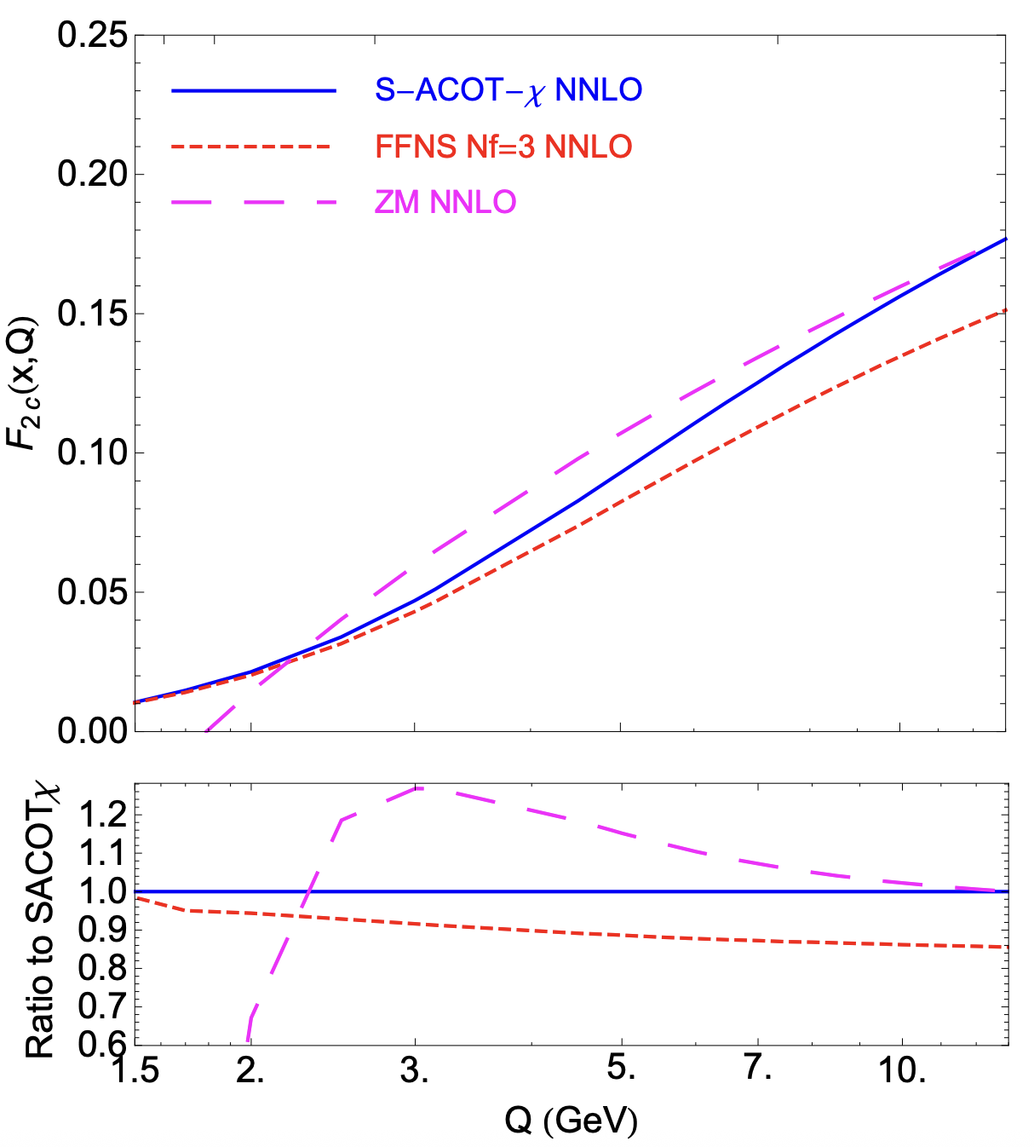
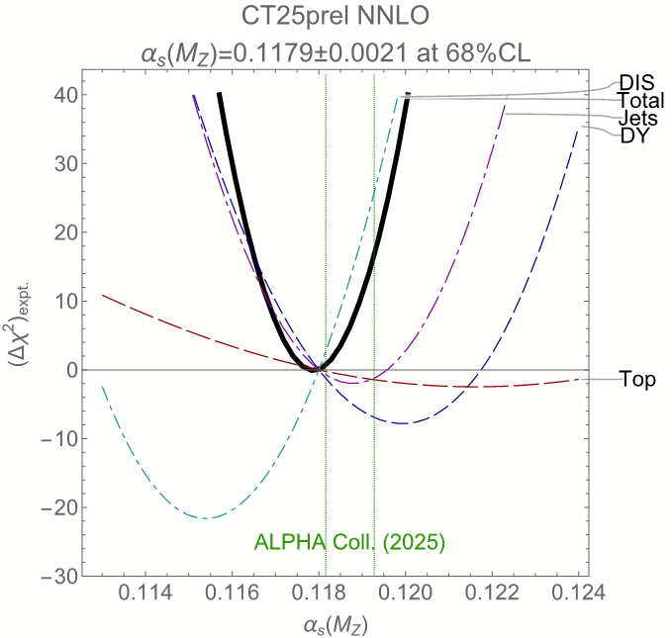
impact on many important observables
DIS structure Functions
Preliminary
MG, Nadolsky, Lai, Yuan, PRD 2012
Figure by P. Nadolsky (2025)
MG, Hobbs, Xie, Nadolsky, Yuan, PLB 2023

Slide 6
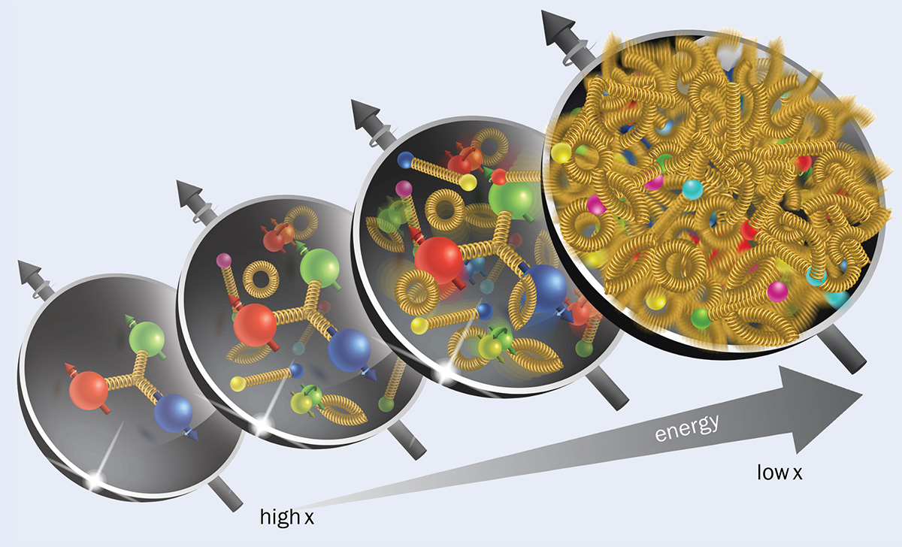
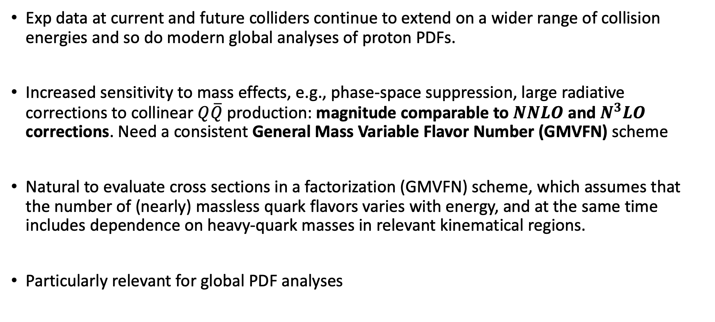
Motivations
Exp data at current and future colliders continue to extend on a wider range of collision energies and so do modern global analyses of proton PDFs.
Increased sensitivity to mass effects, e.g., phase-space suppression, large radiative corrections to collinear $Q\overline{Q}$ production: magnitude comparable to $NNLO$ and $N^{3}LO$ corrections. Need a consistent General Mass Variable Flavor Number (GMVFN) scheme
Natural to evaluate cross sections in a factorization (GMVFN) scheme, which assumes that the number of (nearly) massless quark flavors varies with energy, and at the same time includes dependence on heavy-quark masses in relevant kinematical regions.
Particularly relevant for global PDF analyses

Slide 7
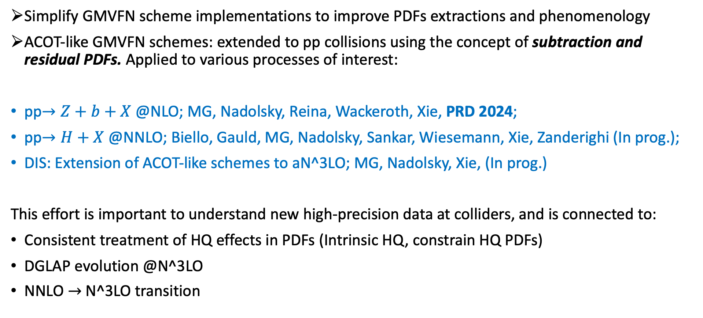
Outline/Goals
Simplify GMVFN scheme implementations to improve PDFs extractions and phenomenology
ACOT-like GMVFN schemes: extended to pp collisions using the concept of subtraction and residual PDFs. Applied to various processes of interest:
pp$→Z+b+X$ @NLO; MG, Nadolsky, Reina, Wackeroth, Xie, PRD 2024;
pp$→H+X$ @NNLO; Biello, Gauld, MG, Nadolsky, Sankar, Wiesemann, Xie, Zanderighi (In prog.);
DIS: Extension of ACOT-like schemes to aN^3LO; MG, Nadolsky, Xie, (In prog.)
This effort is important to understand new high-precision data at colliders, and is connected to:
Consistent treatment of HQ effects in PDFs (Intrinsic HQ, constrain HQ PDFs)
DGLAP evolution @N^3LO
NNLO $→$N^3LO transition

Slide 8
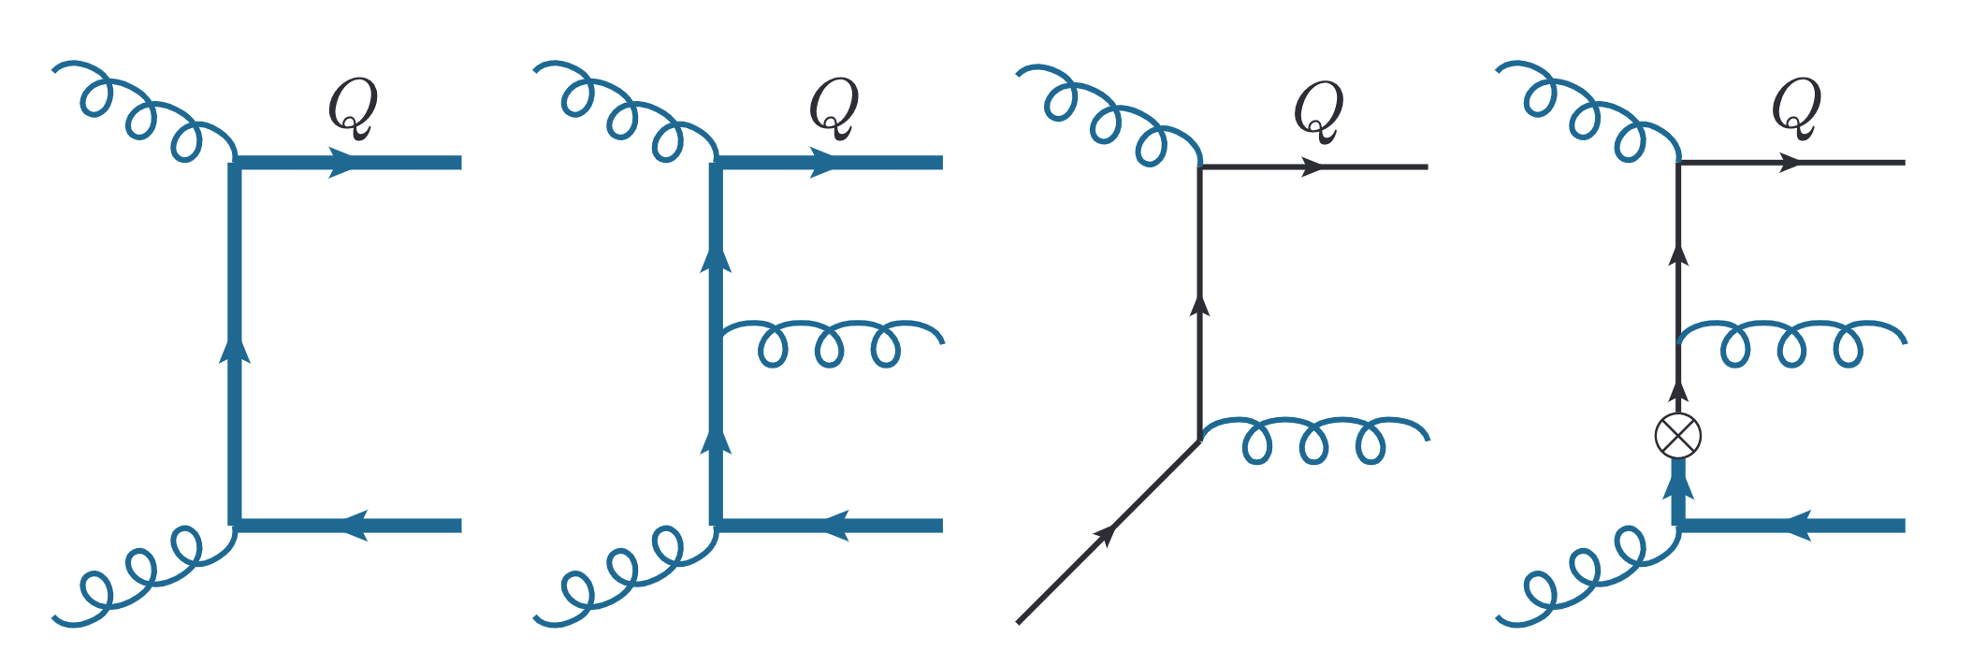

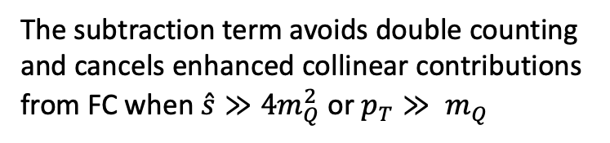


Subtraction and Residual PDFs: Basic idea
Inclusive production of a HQ in pp collisions as an example
The subtraction term avoids double counting
and cancels enhanced collinear contributions
from FC when $\hat{s}≫{4m}_{Q}^{2}$ or $p_{T}≫ m_{Q}$
Collinear splitting $gg→Q\overline{Q}$
LO FC
NLO FC
LO FE
Subtraction
S-ACOT-Massive-Phase-Space (S-ACOT-MPS)
Mass fully retained
in $\hat{σ}$ and $dPS$
Mass fully retained in $dPS$
allows us to get (FE-Subtraction) in one step
Subtraction well defined also in the $p_{T}→0$ limit
FE $−$ Subtraction facilitated by introducing Residual PDF:
Other details in: K. Xie, “Massive elementary particles in the standard model and its supersymmetric triplet Higgs extension.”
https://scholar.smu.edu/hum_sci_physics_etds/7, 2019. PhD Thesis
Subtraction PDF

Slide 9
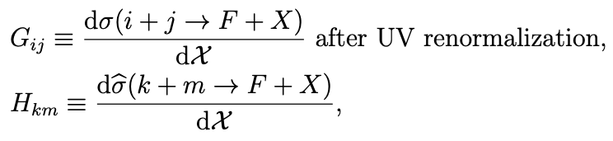
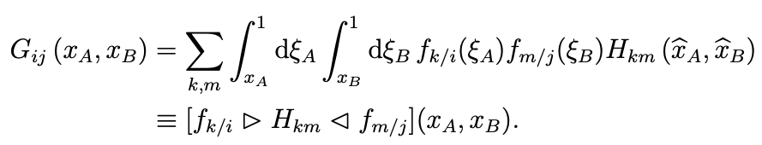

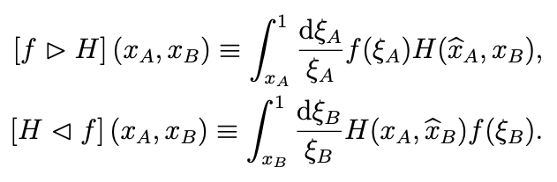
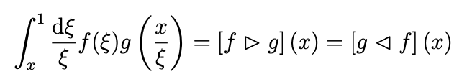
GMVFN Theory framework (pp collisions)
The differential cross section for $p_{A}$ $p_{B}$ $→$ $F + X$ where F contains at least one HQ, can be written
After dσ/d$χ$is UV renormalized, we identify its infrared-safe part d$\hat{\text{σ}}$/d$χ$ by factoring out ``parton-level’’ PDFs
Convolution product with two variables
Convolution product with one variable

Slide 10

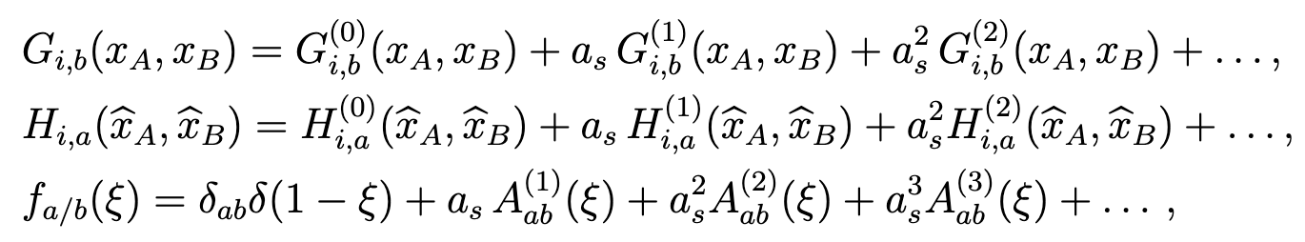



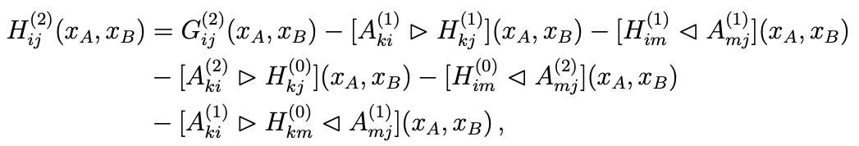
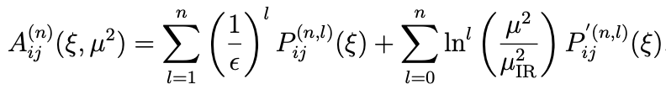
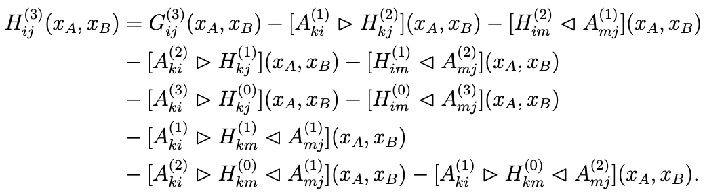
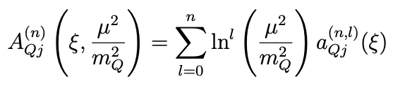


GMVFN Theory framework (pp collisions)
The perturbative expansion of terms leads to
operator-matrix elements (OMEs)
* for $g→Q\overline{Q}$
Substituting these in the previous formula for $G$ and solving for $H^{(k)}$ order by order in $a_{s}$ one obtains
Two forms for the OMEs
*Our convention for the splitting functions
….

Slide 11
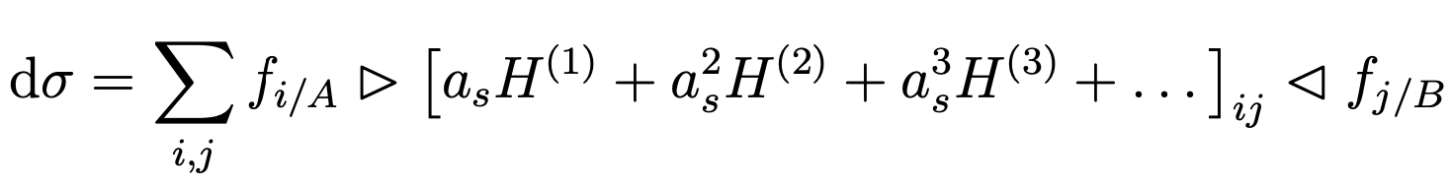
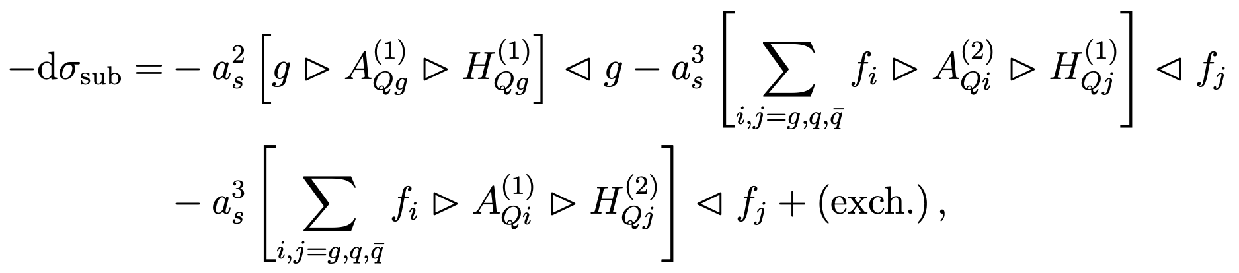
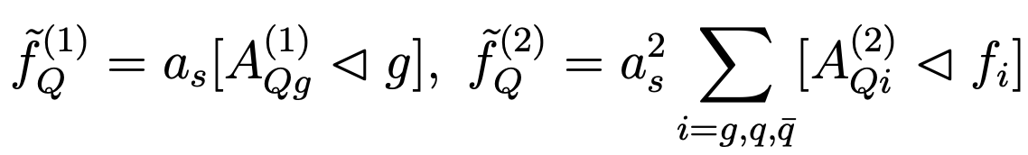
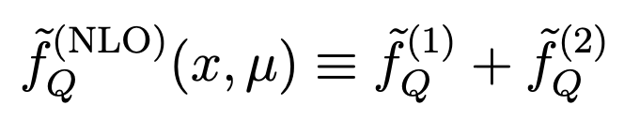
Subtraction PDFs
Once the $H_{ij}^{(k)}$ functions are determined, the hadronic cross section in pp collisions can be written as
Then, the various subtraction (“sub”) terms can be collected as follows:
In DIS, one proceeds in a similar fashion to reshuffle the various contributions in the Wilson coefficient functions.
At this point we can define subtraction HQ PDFs

Slide 12
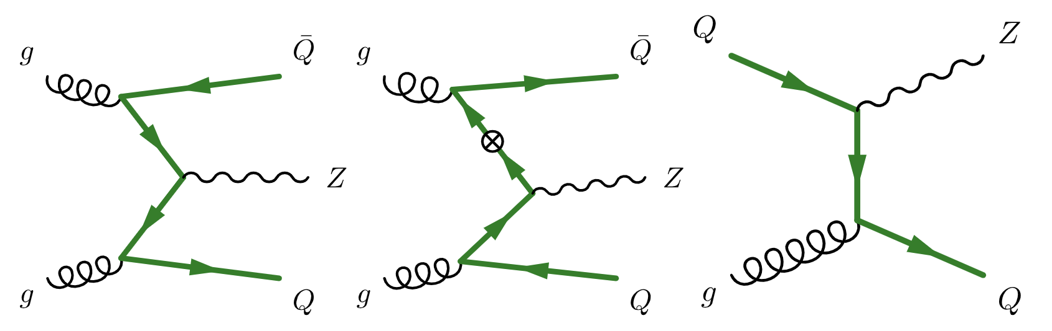
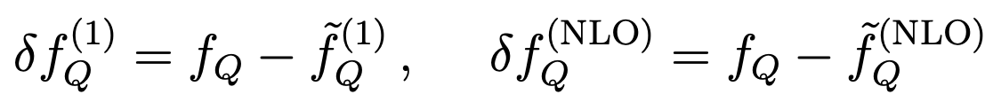
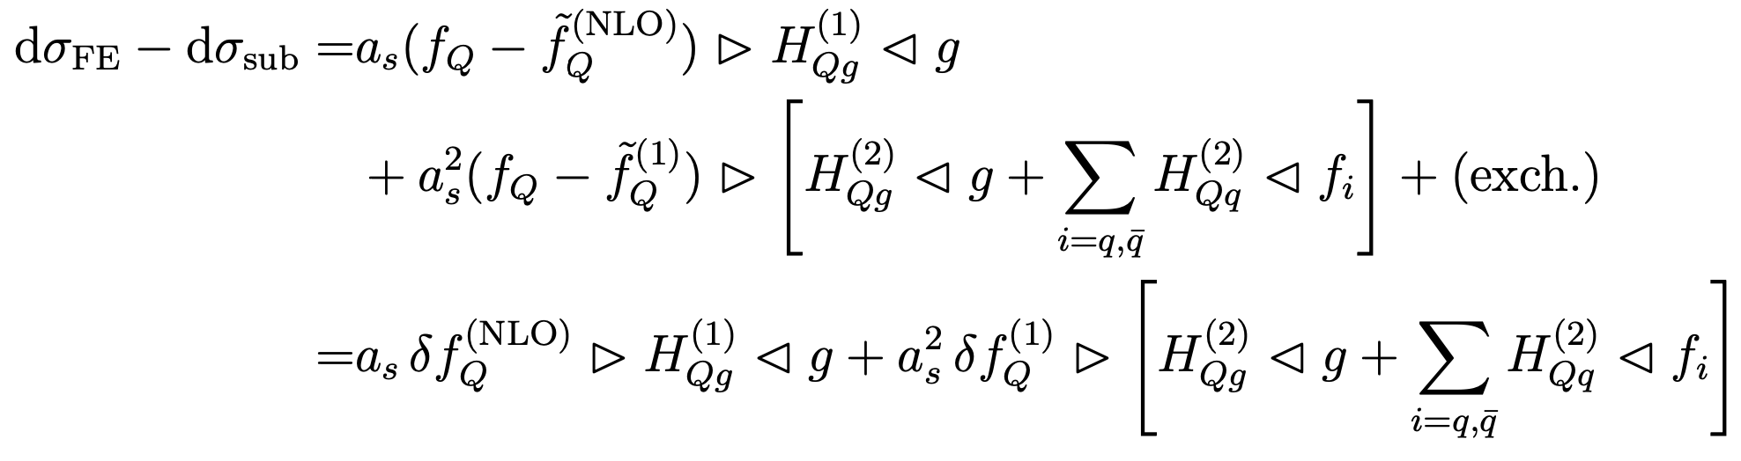
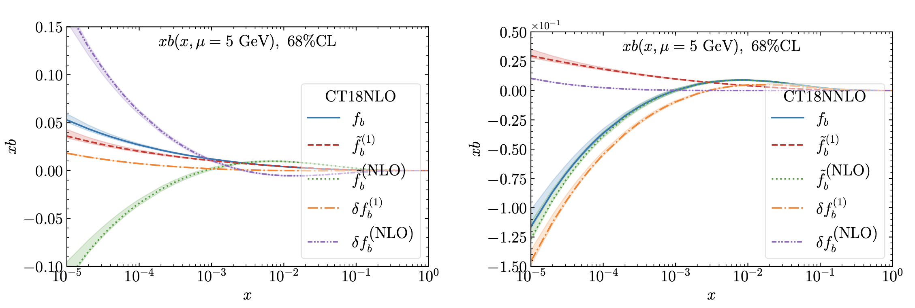
Residual PDFs
FE and SUB share the same matrix elements and
can be combined in one piece in terms of residual PDFs!
HQ, Subtraction and
Residual PDFs near the
b-quark threshold

Slide 13
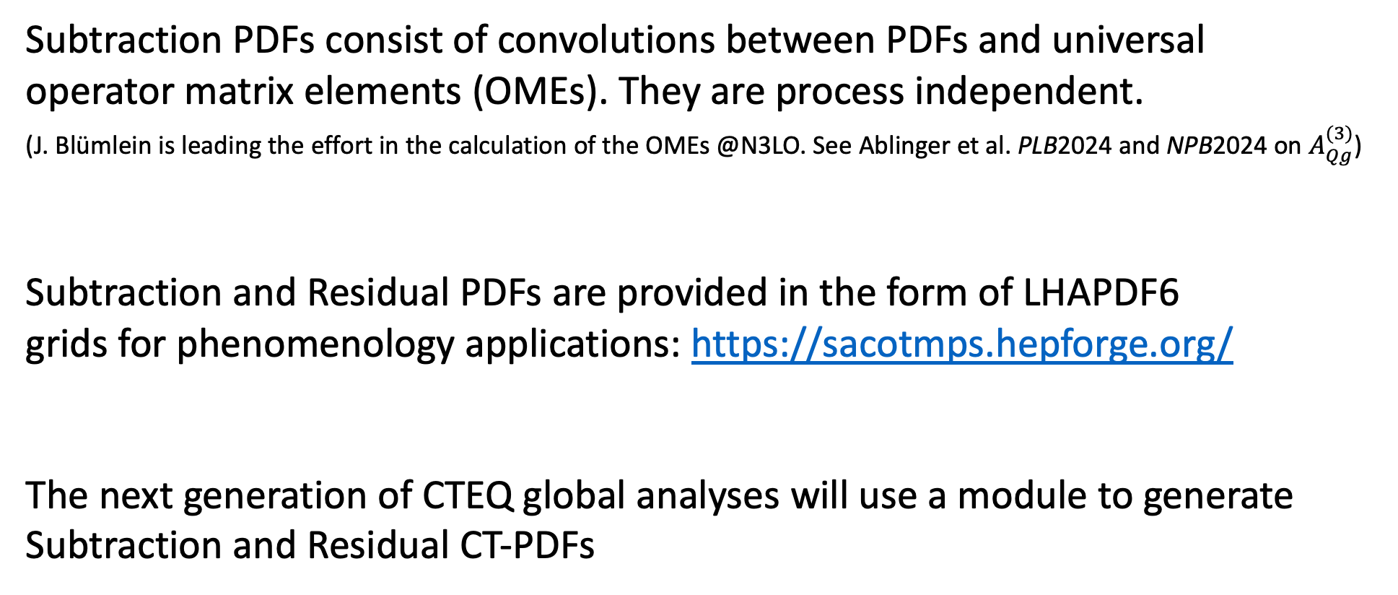
Subtraction and Residual PDFs
Subtraction PDFs consist of convolutions between PDFs and universal
operator matrix elements (OMEs). They are process independent.
(J. Blümlein is leading the effort in the calculation of the OMEs @N3LO. See Ablinger et al. PLB2024 and NPB2024 on $A_{Qg}^{(3)}$)
Subtraction and Residual PDFs are provided in the form of LHAPDF6
grids for phenomenology applications: https://sacotmps.hepforge.org/
The next generation of CTEQ global analyses will use a module to generate
Subtraction and Residual CT-PDFs

Slide 14
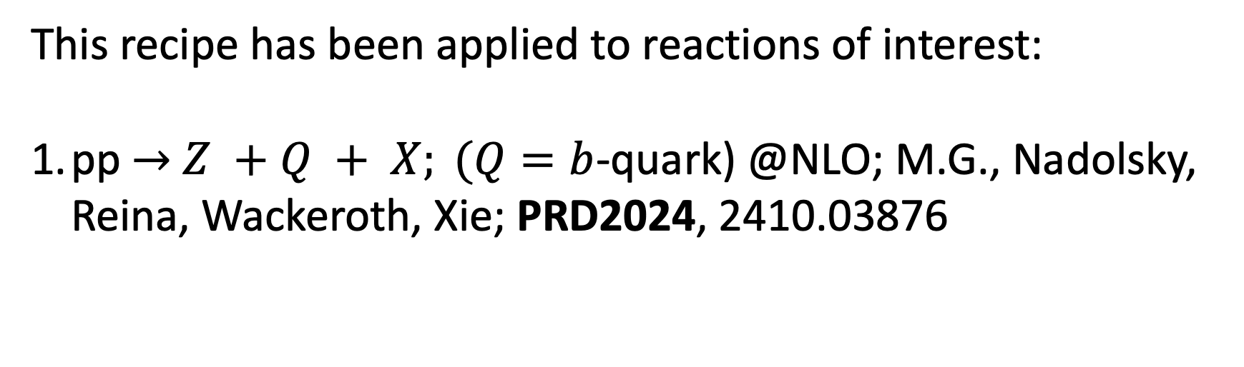
This recipe has been applied to reactions of interest:
pp $→$ $Z +Q + X; (Q=b$-quark) @NLO; M.G., Nadolsky, Reina, Wackeroth, Xie; PRD2024, 2410.03876

Slide 15
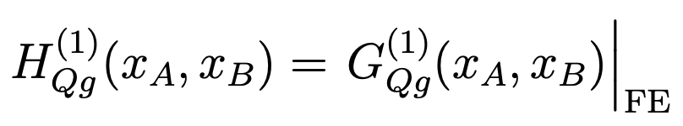
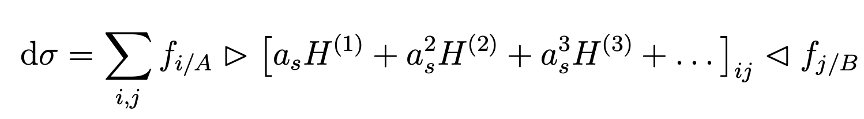
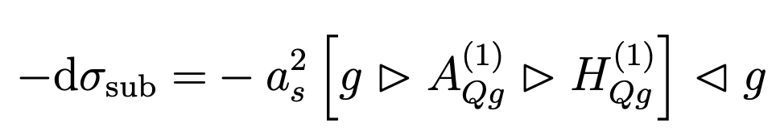
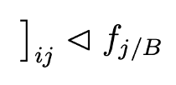



pp$→$Z+Q+X @LO: cancellation pattern
(for $pp→Z+Q+X$ this is $O(α_{s}^{2})$)
FC term
Sub
FE term
Subtraction
FE
Sub
FC

Slide 16
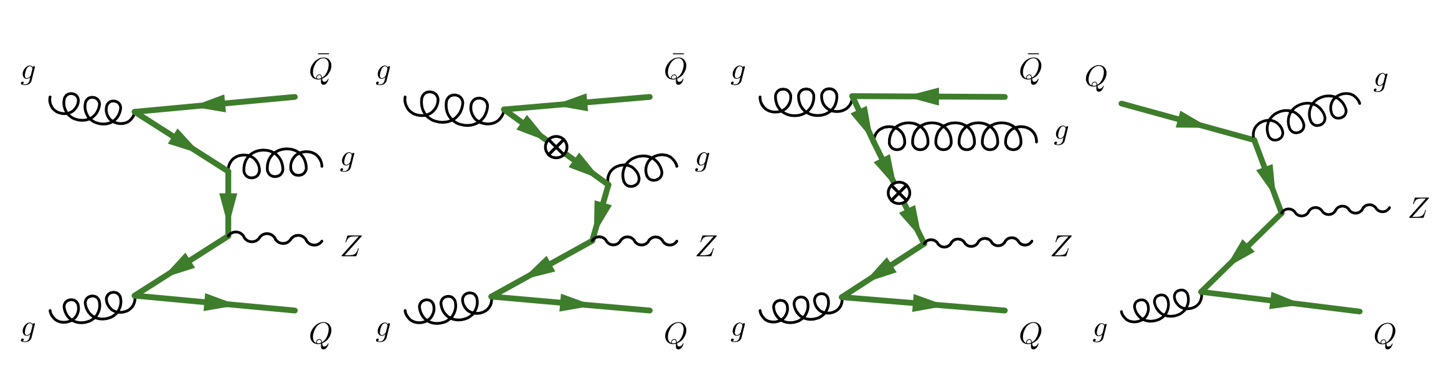
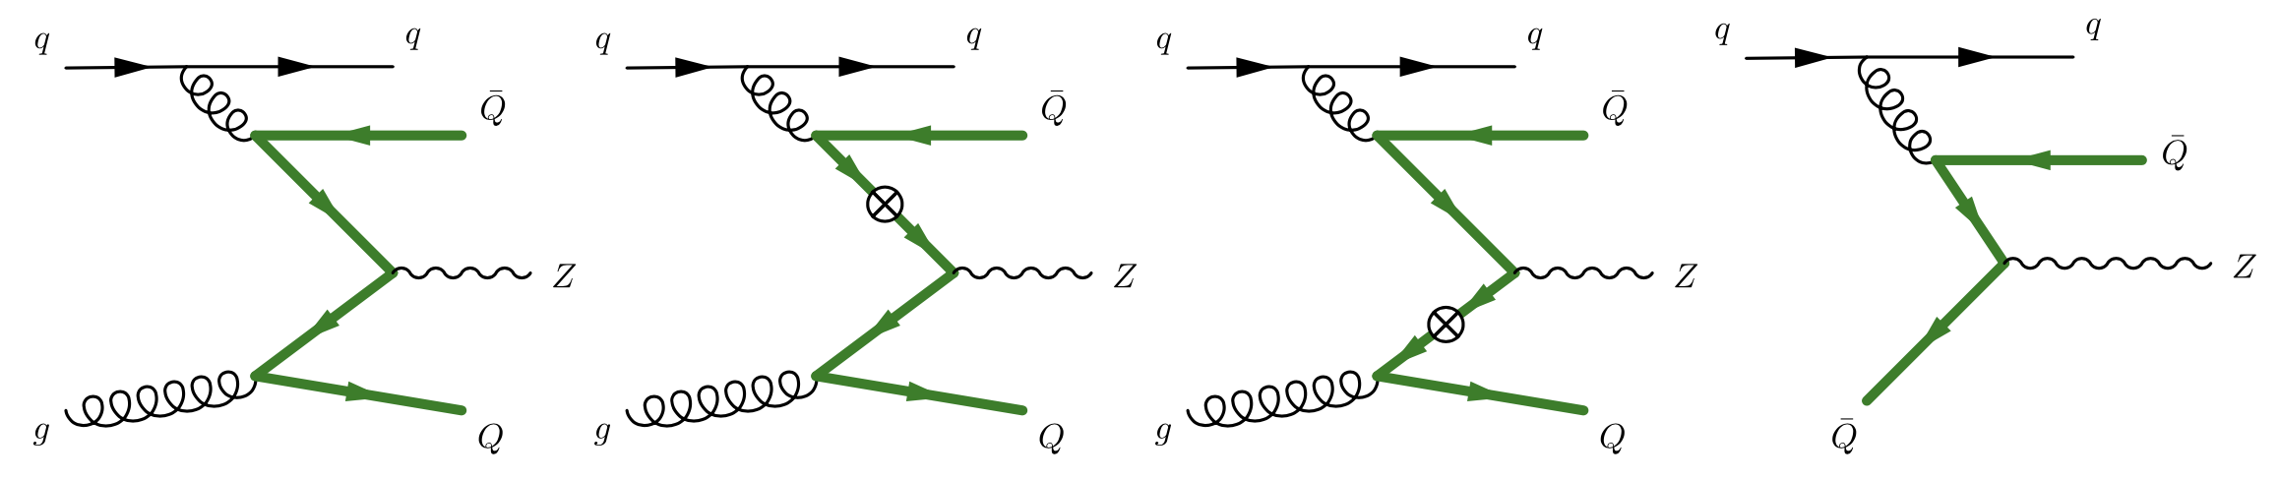
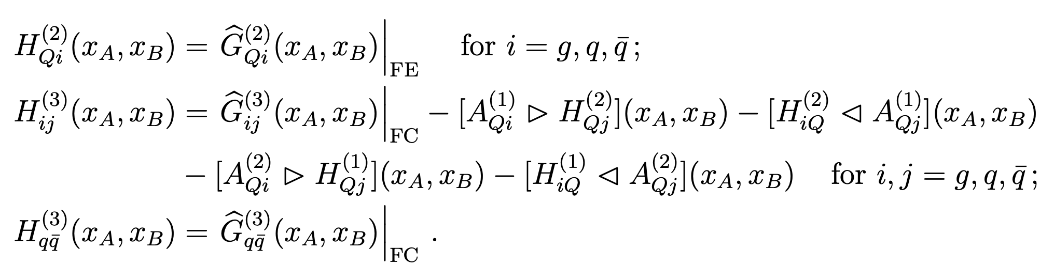


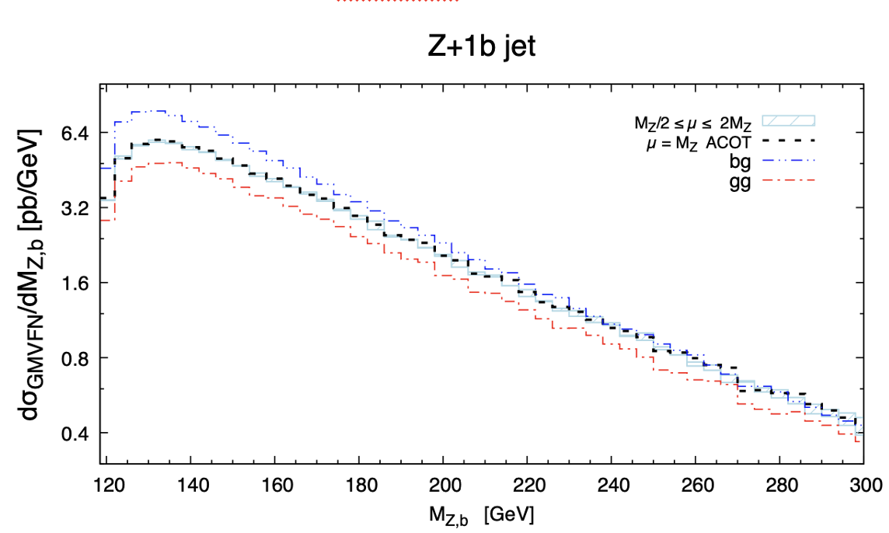
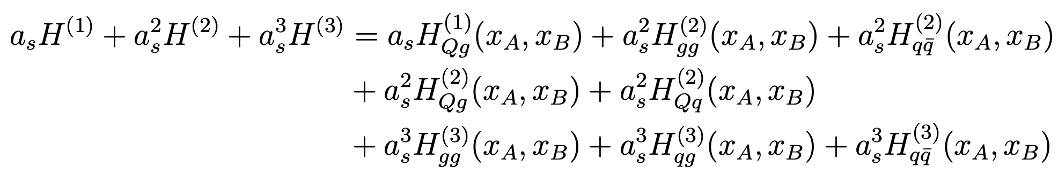

pp$→$Z+Q+X @NLO: cancellation pattern
(for $pp→Z+b+X$ this is $O(α_{s}^{3})$)
FC
FE
Sub
FE
FC
Sub
gg-channel
qg-channel
Virtual diagrams are not shown here,
but are included in the calculation.
2410.03876

Slide 17
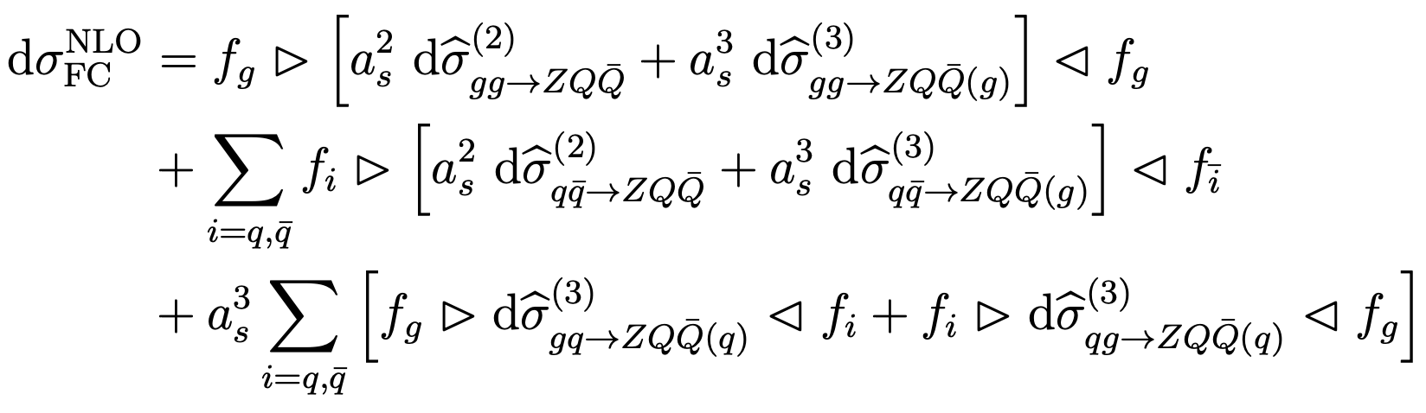
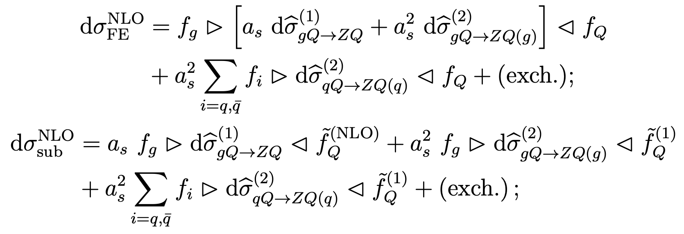
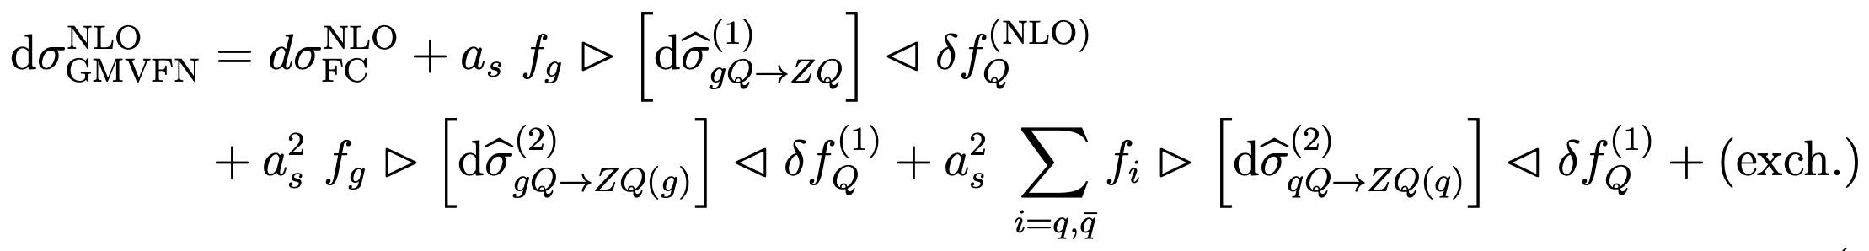
GMVFN scheme Xsec for $pp→Z+Q+X$ @NLO
Equivalently, with the dσFE − dσsub reorganized in terms of HQ PDF residuals we obtain a very simple form
Lowest mandatory order” (LMO) representation at NLO in that it retains only the unambiguous terms up to order $a_{s}^{3}$
required by order-by-order factorization and scale invariance. Any ACOT-like scheme must contain such terms.
2410.03876, PRD 2024

Slide 18
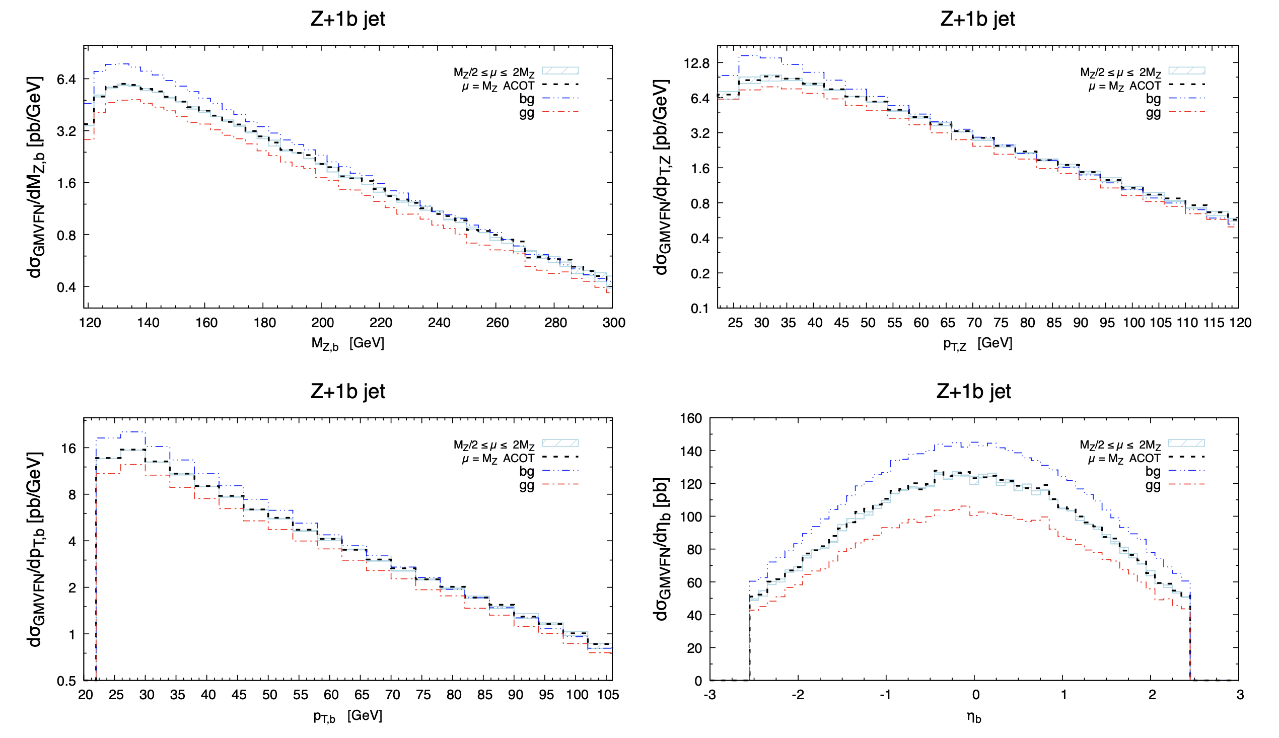
Results: Z+b differential distributions (gg channel)

Slide 19
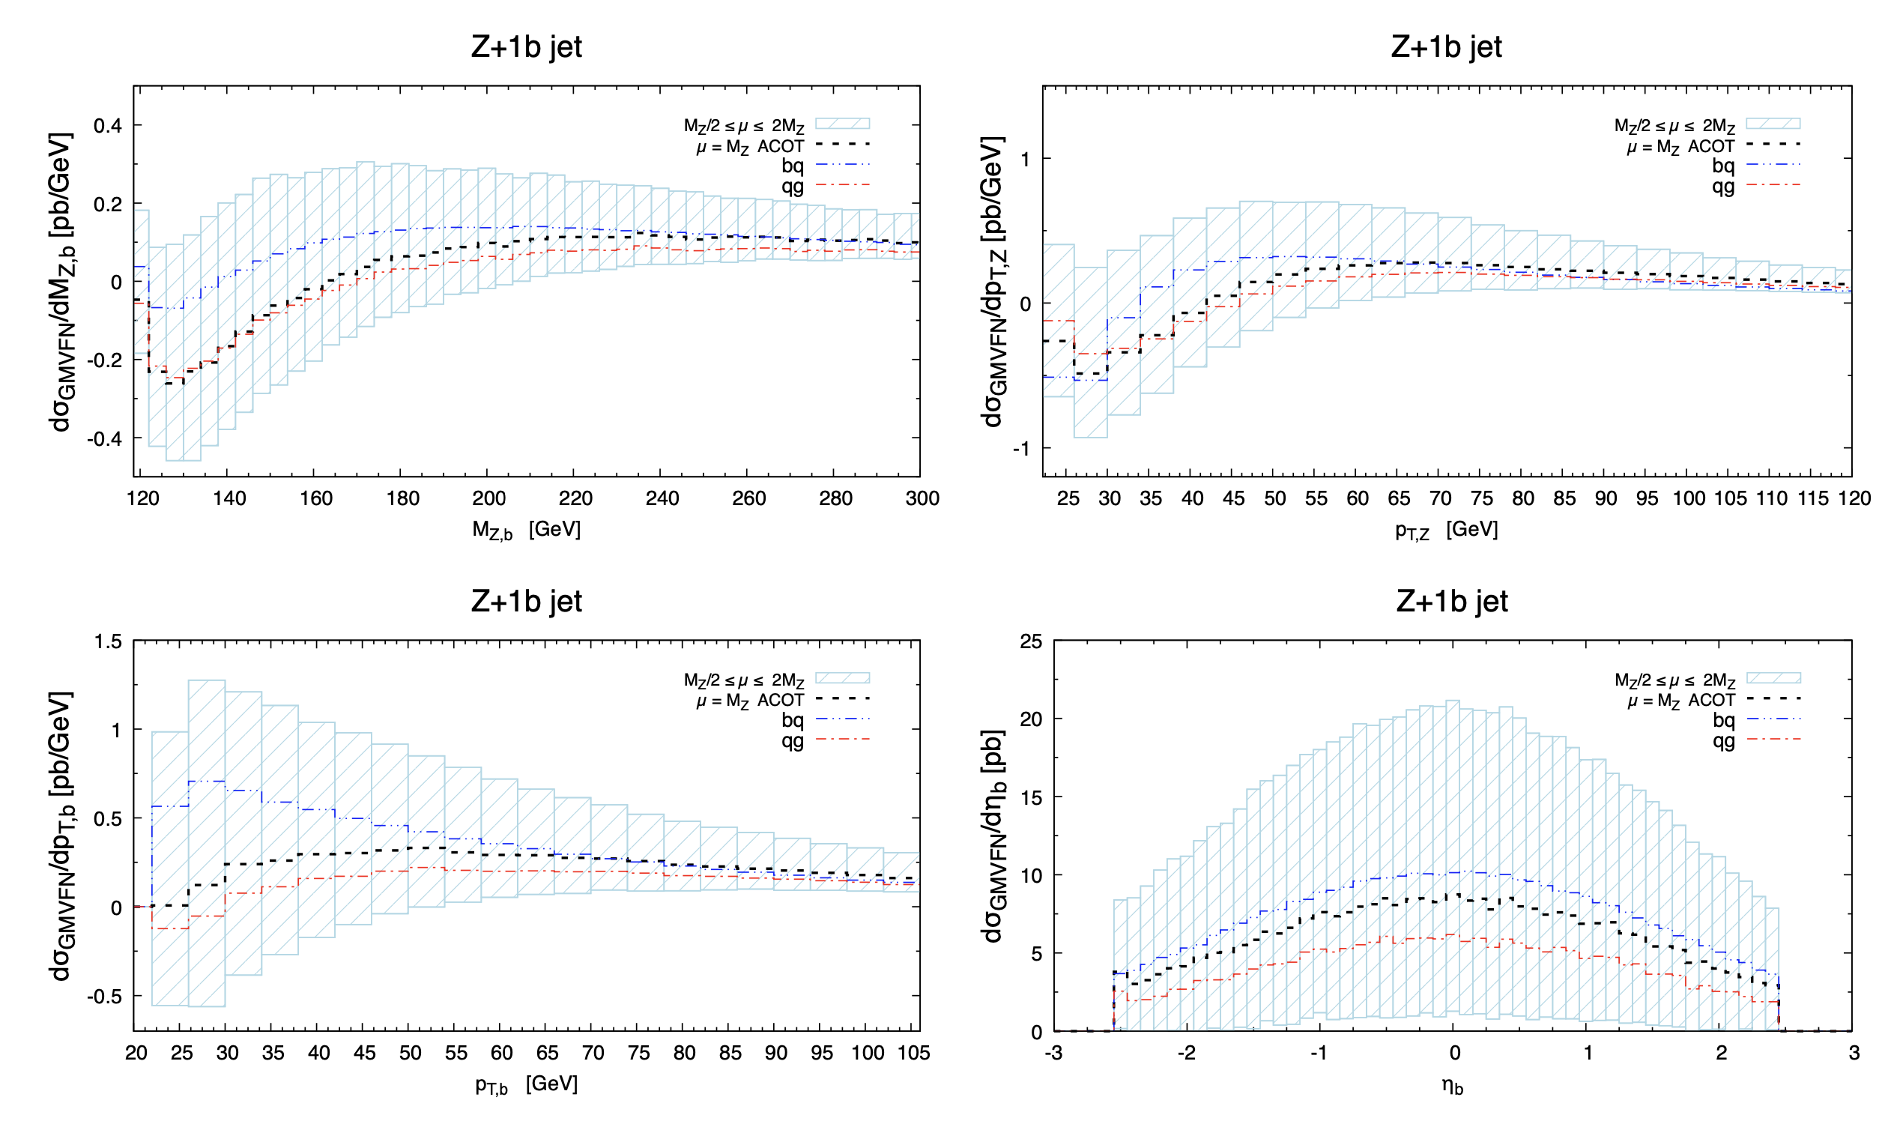
Results: Z+b differential distributions (qg channel)

Slide 20
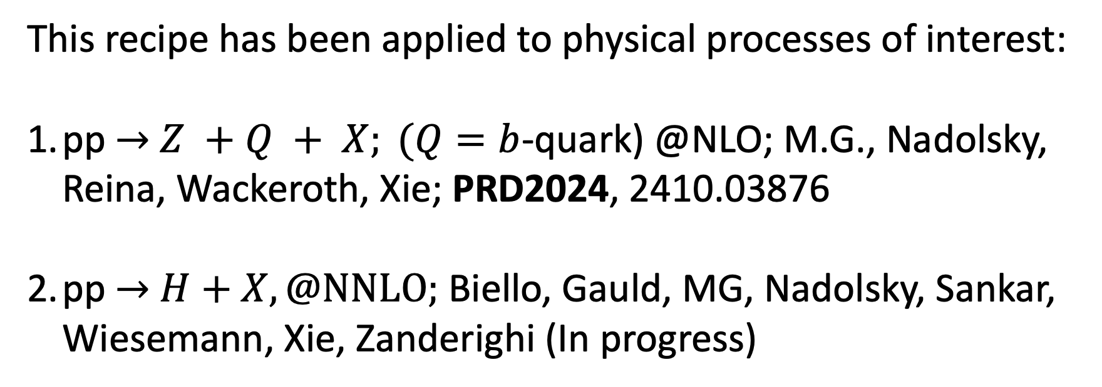
This recipe has been applied to physical processes of interest:
pp $→$ $Z +Q + X; (Q=b$-quark) @NLO; M.G., Nadolsky, Reina, Wackeroth, Xie; PRD2024, 2410.03876
pp $→$ $H+X, @NNLO;$ Biello, Gauld, MG, Nadolsky, Sankar, Wiesemann, Xie, Zanderighi (In progress)

Slide 21
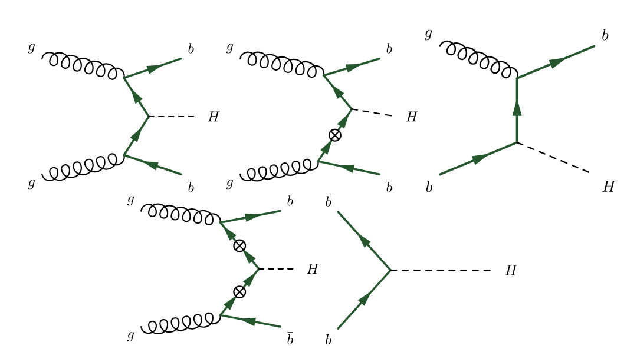
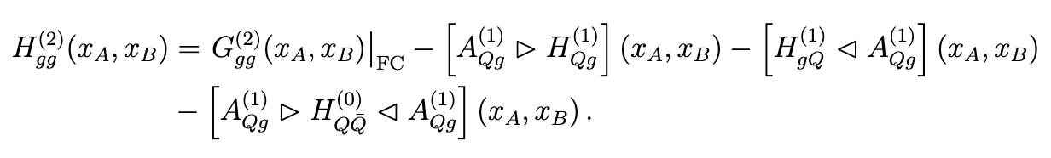
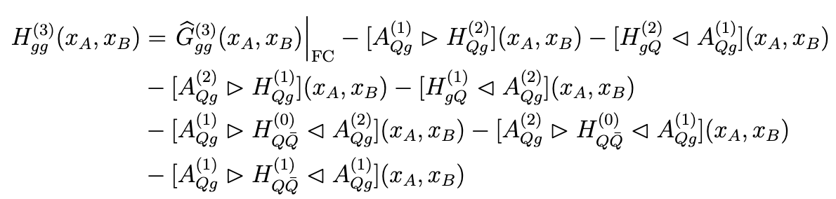
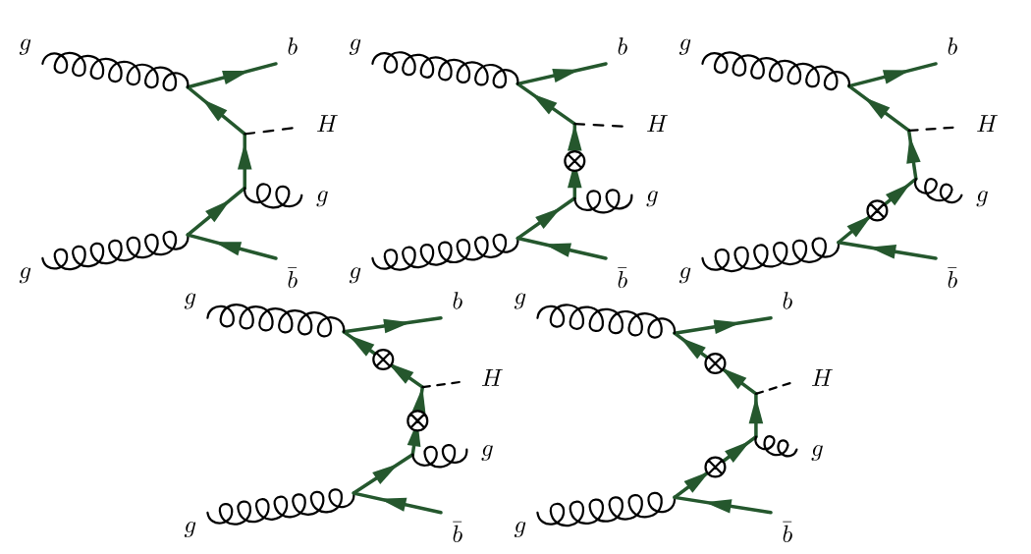
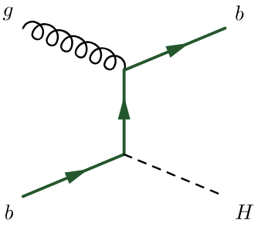

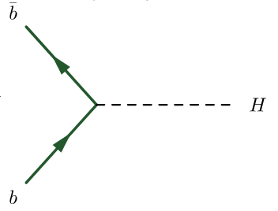

pp$→$H+X @LO, NLO: cancellation patterns
SB
FC
FE
FE
SB
+ …

Slide 22




Flavor-scheme matching in $b\overline{b}H$
The calculation of NNLO corrections in $pp→b\overline{b}H$, with parton shower matching in both massless (5FS) [2402.04025] and massive scheme (4FS) [2412.09510], opens new opportunities to study the flavour-scheme matching in bbH using subtracted and residual PDFs.
State-of-the-art
Only fully-inclusive matched results are known for $b\overline{b}H$ in different schemes:
Santander matching [1112.3478]
FONLL [1508.01529, 1607.00389] with current matching at ${\text{N}}^{3}{\text{LO}}_{5FS}+{\text{NLO}}_{4FS}$ [2004.04752]
NLO + NNLLpart + y_{b} y_{t} matching
[1508.03288, 1605.01733]
Long-term goal
Matching of NNLO+PS 4FS and NNLO+PS 5FS using ACOT-like schemes with subtraction and residual PDFs at fully-differential level with parton-shower matching in the POWHEG fremework with the MiNNLOPS method.
Biello, Gauld, MG, Nadolsky, Sankar,
Wiesemann, Xie, Zanderighi [in progress]
Notes:
We have performed a detailed study of jet observables across the flavour schemes. In order to ensure IR safety in the massless scheme, we used the FASTJET implementation of the Interleaved Flavour Neutralisation algorithm for the b-tagging of the jets in an experimentally reliable definition of the fiducial phase-space. What we observed is that the MiNNLOPS implementation improves the shape of the massless prediction with at least a b-jet since the generation of the events mainly starts with a bottom in the final state in our framework. On the other hand, NNLO corrections in the 4FS are crucial to increase the massive prediction and ensure compatibility between the schemes.

Slide 23




$b\overline{b}H$at the first order
We first performed the S-ACOT matching at the first order by combining:
Flavor Creation (obtained using a ${\text{LO}}_{PS}$ 4FS generator)
Flavor Excitation and corresponding subtraction (obtained by modifying an ${\text{NLO}}_{PS}$ 5FS generator with standard and subtracted PDFs)
(before showering)
Preliminary
Figure by C. Biello and A. Sankar
Notes:
We have performed a detailed study of jet observables across the flavour schemes. In order to ensure IR safety in the massless scheme, we used the FASTJET implementation of the Interleaved Flavour Neutralisation algorithm for the b-tagging of the jets in an experimentally reliable definition of the fiducial phase-space. What we observed is that the MiNNLOPS implementation improves the shape of the massless prediction with at least a b-jet since the generation of the events mainly starts with a bottom in the final state in our framework. On the other hand, NNLO corrections in the 4FS are crucial to increase the massive prediction and ensure compatibility between the schemes.

Slide 24


$b\overline{b}H$at the first order
Fully exclusive matched results interfaced with PYTHIA8 for the parton-shower simulation.
Setup:
CT18NLO+CT18NLOsub
$$m_{b}=4.75 GeV$$
$$m_{H}=125 GeV$$
$\overline{\text{MS}}$ bottom Yukawa with $m_{b}\left(m_{b}\right)=4.18 GeV$ and three-loop running
Standard scale variation via event reweighting in POWHEG.
Preliminary
Preliminary
Figure by C. Biello and A. Sankar
Notes:
We have performed a detailed study of jet observables across the flavour schemes. In order to ensure IR safety in the massless scheme, we used the FASTJET implementation of the Interleaved Flavour Neutralisation algorithm for the b-tagging of the jets in an experimentally reliable definition of the fiducial phase-space. What we observed is that the MiNNLOPS implementation improves the shape of the massless prediction with at least a b-jet since the generation of the events mainly starts with a bottom in the final state in our framework. On the other hand, NNLO corrections in the 4FS are crucial to increase the massive prediction and ensure compatibility between the schemes.

Slide 25

This recipe has been applied to physical processes of interest:
pp $→$ $Z +Q + X; (Q=b$-quark) @NLO; M.G., Nadolsky, Reina, Wackeroth, Xie; PRD2024, 2410.03876
pp $→$ $H+X, @NNLO;$ Biello, Gauld, MG, Nadolsky, Sankar, Wiesemann, Xie, Zanderighi (In progress)
DIS @N3LO in QCD MG, Nadolsky, Xie (In progress)

Slide 26



















DIS @NNLO, @N^3LO: cancellation patterns
S-ACOT-$χ$ @NNLO NC DIS, MG, Nadolsky, Lai, Yuan, PRD 2012
Default GMVFN scheme for DIS in CTEQ PDF analyses
At N^3LO we have (MG, Nadolsky, Xie, In prep.)
$$−$$
$$−$$
$$−$$
S-ACOT-$χ$ @NNLO CC DIS
Phys.Rev.D 105 (2022),
2107.00460; Gao et al.
$$F_{h,g}^{(3)}$$
See also 2504.13317,
by P. Risse et al.

Slide 27

Current bottlenecks for full implementation at NNLO and beyond in QCD
4-loop splitting functions
3-loop $A_{ij}^{(3)}$OMEs in the $x$ space.

Slide 28





Other results using ACOT-like schemes
Charm hadroproduction and Z + c production
at the LHC can constrain the IC contributions.
LHCb Z+c data deserve attention as they can
potentially discriminate gluon functional forms
at $x≥0.2$ and improve gluon accuracy.
For small $x$ below ${10}^{−4}$, higher-order QCD terms
with $ln⁡(1/x)$ dependence grow quickly at factorization
scales of order 1 GeV. FPF facilities like FASERν
will access novel kinematic regimes where both
large-x and small-x QCD effects contribute
to charm hadroproduction rate. [arXiv:2109.10905]
FPF paper 2109.10905
Transverse momentum at central rapidity at LHCb 13TeV
(LHCb data from JHEP 03 (2016) 159).
Error bands are scale uncertainties.
Rapidity distributions of prompt charm at the LHC 13 TeV in the
very forward region (yc > 8). Error band represents the CT18NLO
induced PDF uncertainty at 68% C.L.
NLO theory predictions for the pT and y distributions
obtained with CT18NLO and CT18XNLO PDFs
compared to ${\text{B}}^{\text{±}}$ production data from LHCb 13 TeV
[arXiv:2203.06207]
Theoretical uncertainties at NLO are large (O(50%))
and mainly ascribed to scale variation. This can be
improved by including higher-order corrections
which imply an extension of the S-ACOT-MPS scheme
to NNLO

Slide 29
Concluding Remarks
Developed theory framework to extend ACOT-like GMVFN schemes to pp collisions based on collinear fact., and Subtraction and Residual PDFs.
ACOT-like schemes used to describe Z+b production differentially @NLO in QCD
Work is in progress for Higgs production @NNLO, and DIS @aN^3LO
Important for PDF analyses and to improve current understanding of exp data
Subtraction PDFs provided in the form of LHAPDF grids to for phenomenology

Slide 30
BACK UP

Slide 31


Operator Matrix Elements
From mass factorization on DIS structure functions
The $A_{ij}^{(k)}$ represent the renormalized operator-matrix elements (OME’s) which are defined by
where $O_{l}$ are the renormalized operators which appear in the operator-product
expansion of two electromagnetic currents near the light cone.

Slide 32

Further simplifications in ACOT-type schemes
$δf_{Q}^{(NLO)}$?
Lowest mandatory order” (LMO) representation at NLO in that it retains only the unambiguous terms up to order $a_{s}^{3}$
required by order-by-order factorization and scale invariance. Any ACOT-like scheme must contain such terms.

Slide 33





Further simplifications in ACOT-type schemes
One generally can augment with extra radiative contributions from higher orders with the goal to improve consistency with the specific GMVFN scheme adopted in the fit of the used PDFs. The GMVFN scheme assumed for determination of CTEQ-TEA PDFs with up to 5 active flavors is closely matched with the following additional choices:
1. Evolve αs(μ) and PDFs fi(ξ,μ) with Nf = 5 at μ ≥ mb. The hard cross sections are also evaluated with Nf = 5 in virtual loops both for massive and massless channels. If the virtual contributions are obtained in the Nf = 4 scheme, they should be converted to the Nf = 5 scheme by adding known terms to the hard cross sections.
2. The sums over initial-state light quarks and antiquarks in are extended to also include the b-quark PDF via the introduction of the singlet PDF
3. replace in and in by f^(NLO) and δf^(NLO), respectively.
4. The αs and PDFs must be evolved at least at NLO, although evolution at NNLO is acceptable or even desirable in some contexts.
5. In the hard cross sections inside dσFE − dσsub, dependence on the HQ mass can be eliminated altogether or simplified, producing a difference only in higher-order terms.

Slide 34



Further simplifications in ACOT-type schemes
With the simplifications discussed above, we obtain

Slide 35


Z+b: ACOT vs S-ACOT

