Slide 1

Progress Toward the Discovery of the New Element E120 at LBNL
Jennifer Pore
Lawrence Berkeley National Laboratory
Nuclear and Chemical Science Divisions

Slide 2

Overview
Can we discover new elements?
1
Past Element Discoveries
2
How do we make elements?
3
Recent results
from Berkeley Lab
4
Outlook

Slide 3
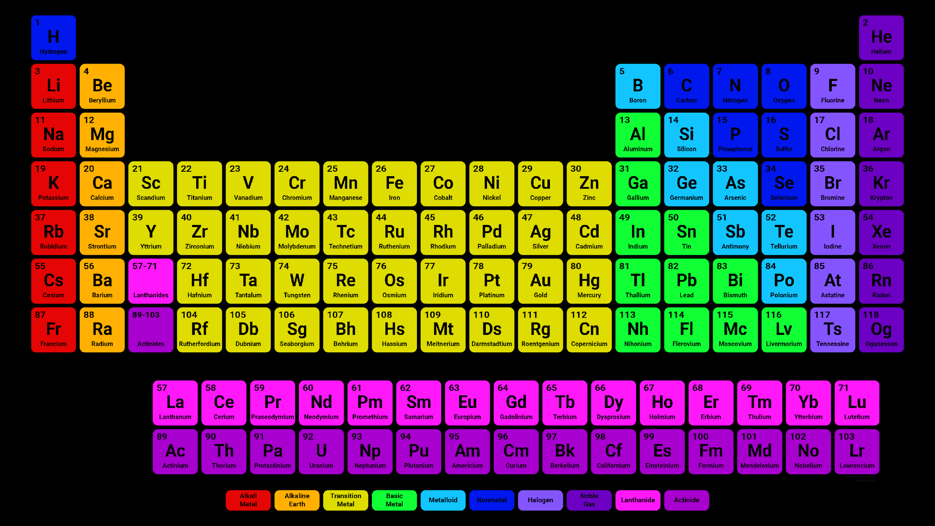
An Outdated Periodic Table
Uun
Uuu
Uub
Uuq
Uuh

Slide 4
Today’s Periodic Table

Slide 5
Today’s Periodic Table
The Newest Elements
2004
2000
2003
2000
2010
2002

Slide 6

Today’s Periodic Table
Can we make more?
119
120
Uue
Ubn

Slide 7

Why do we discover new elements?
New Pieces of the cosmic puzzle
How many protons and neutrons fit in a nucleus?
How are elements made?
What elements are being made in the universe?
How do they interact with the world?
What are the chemical properties?
What can we make with these new building blocks?
Is there an “Island-of-Stability”?

Slide 8
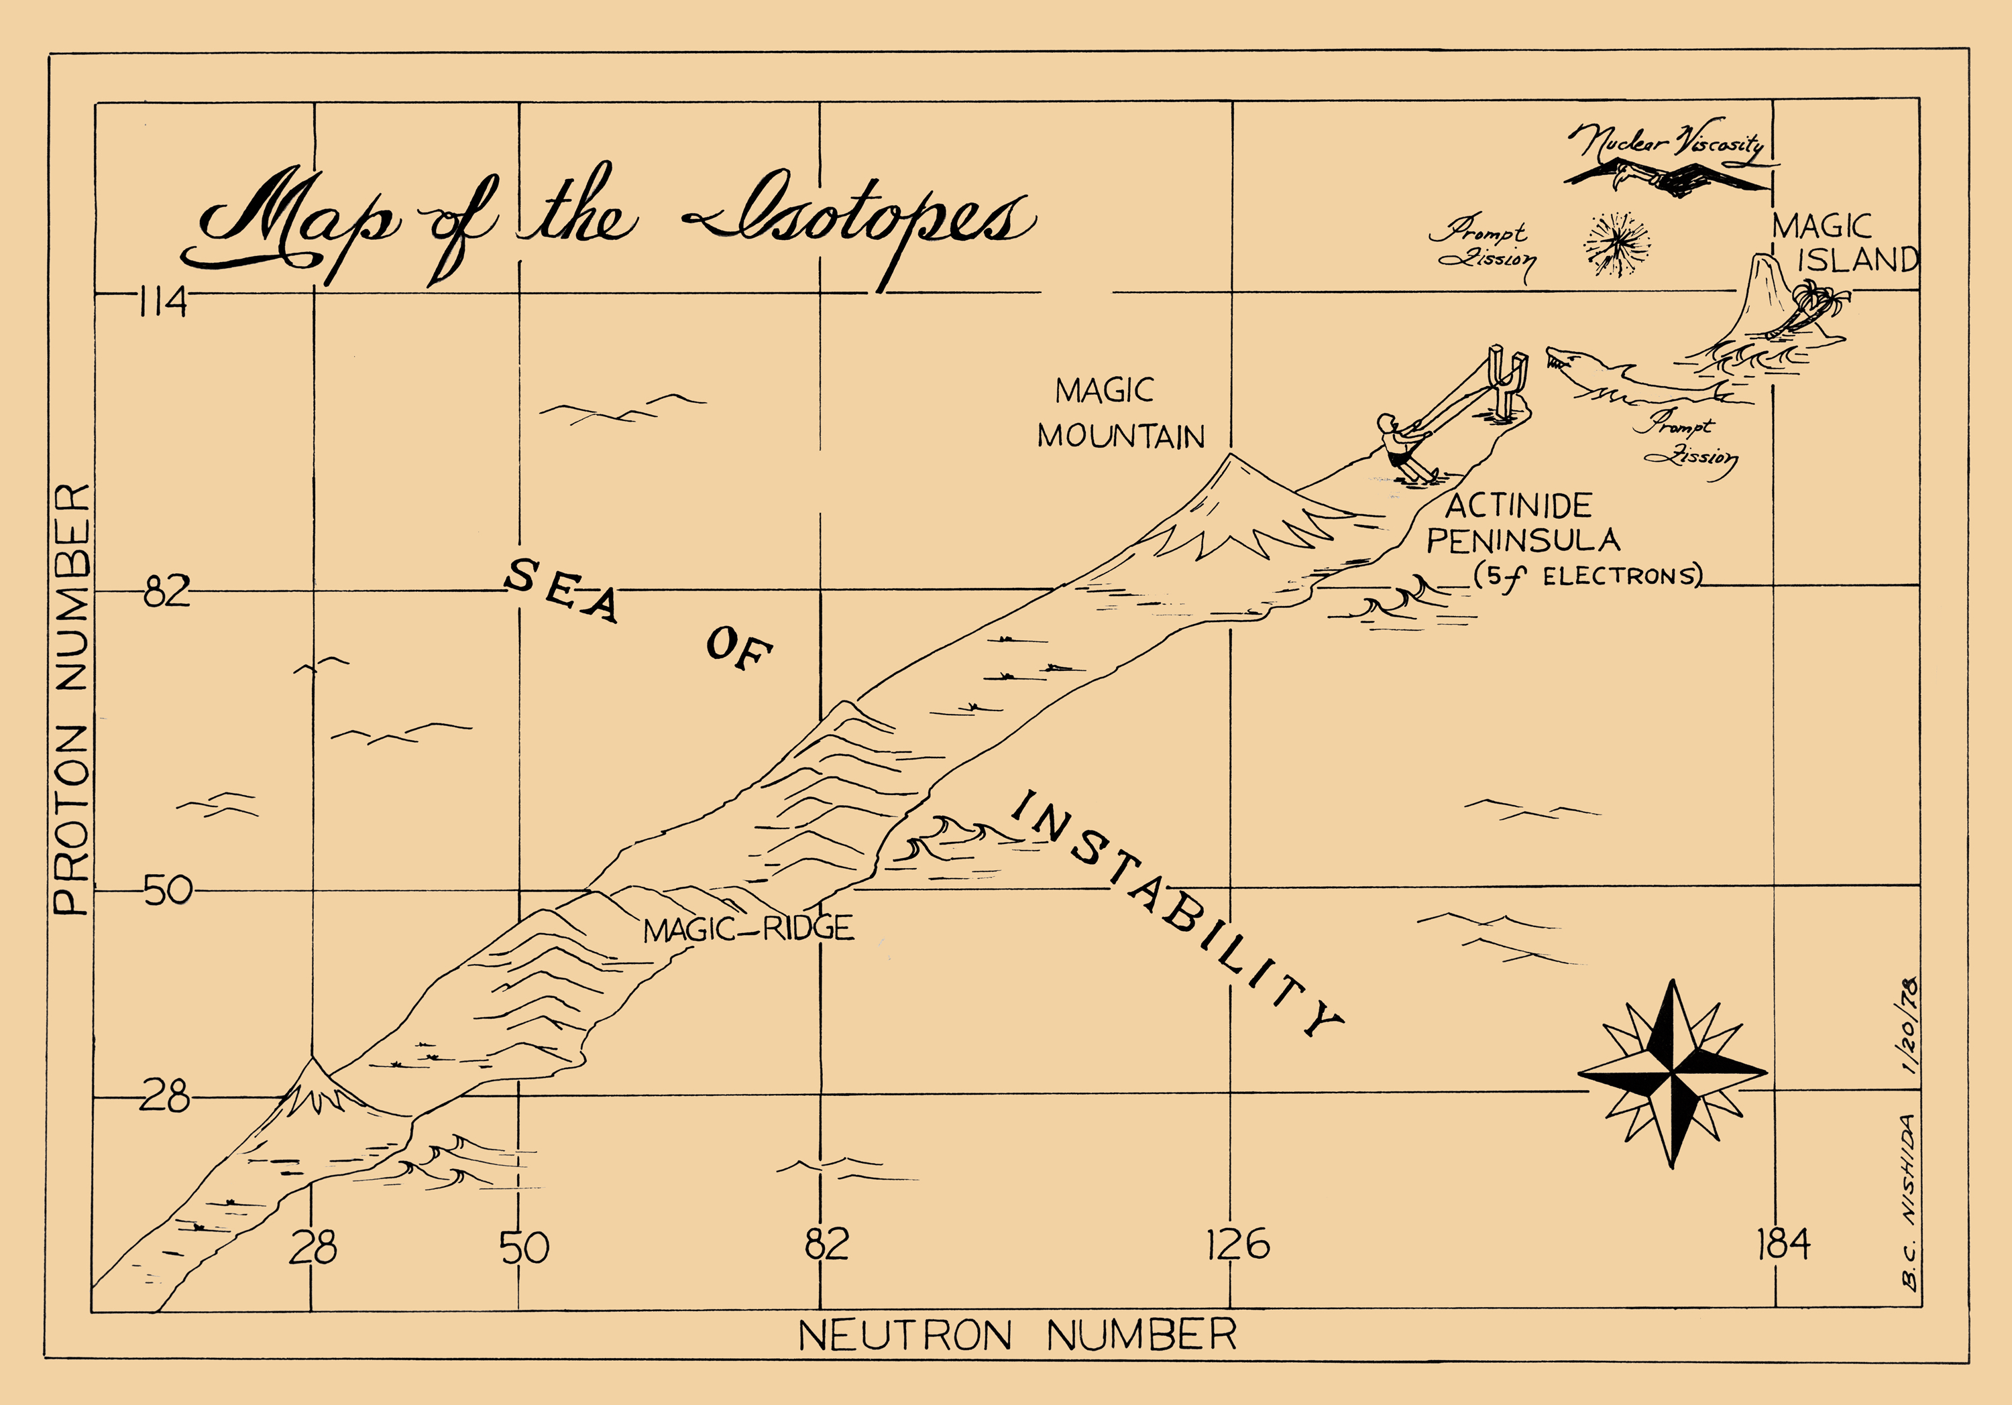
Looking for the “Island of Stability”

Slide 9
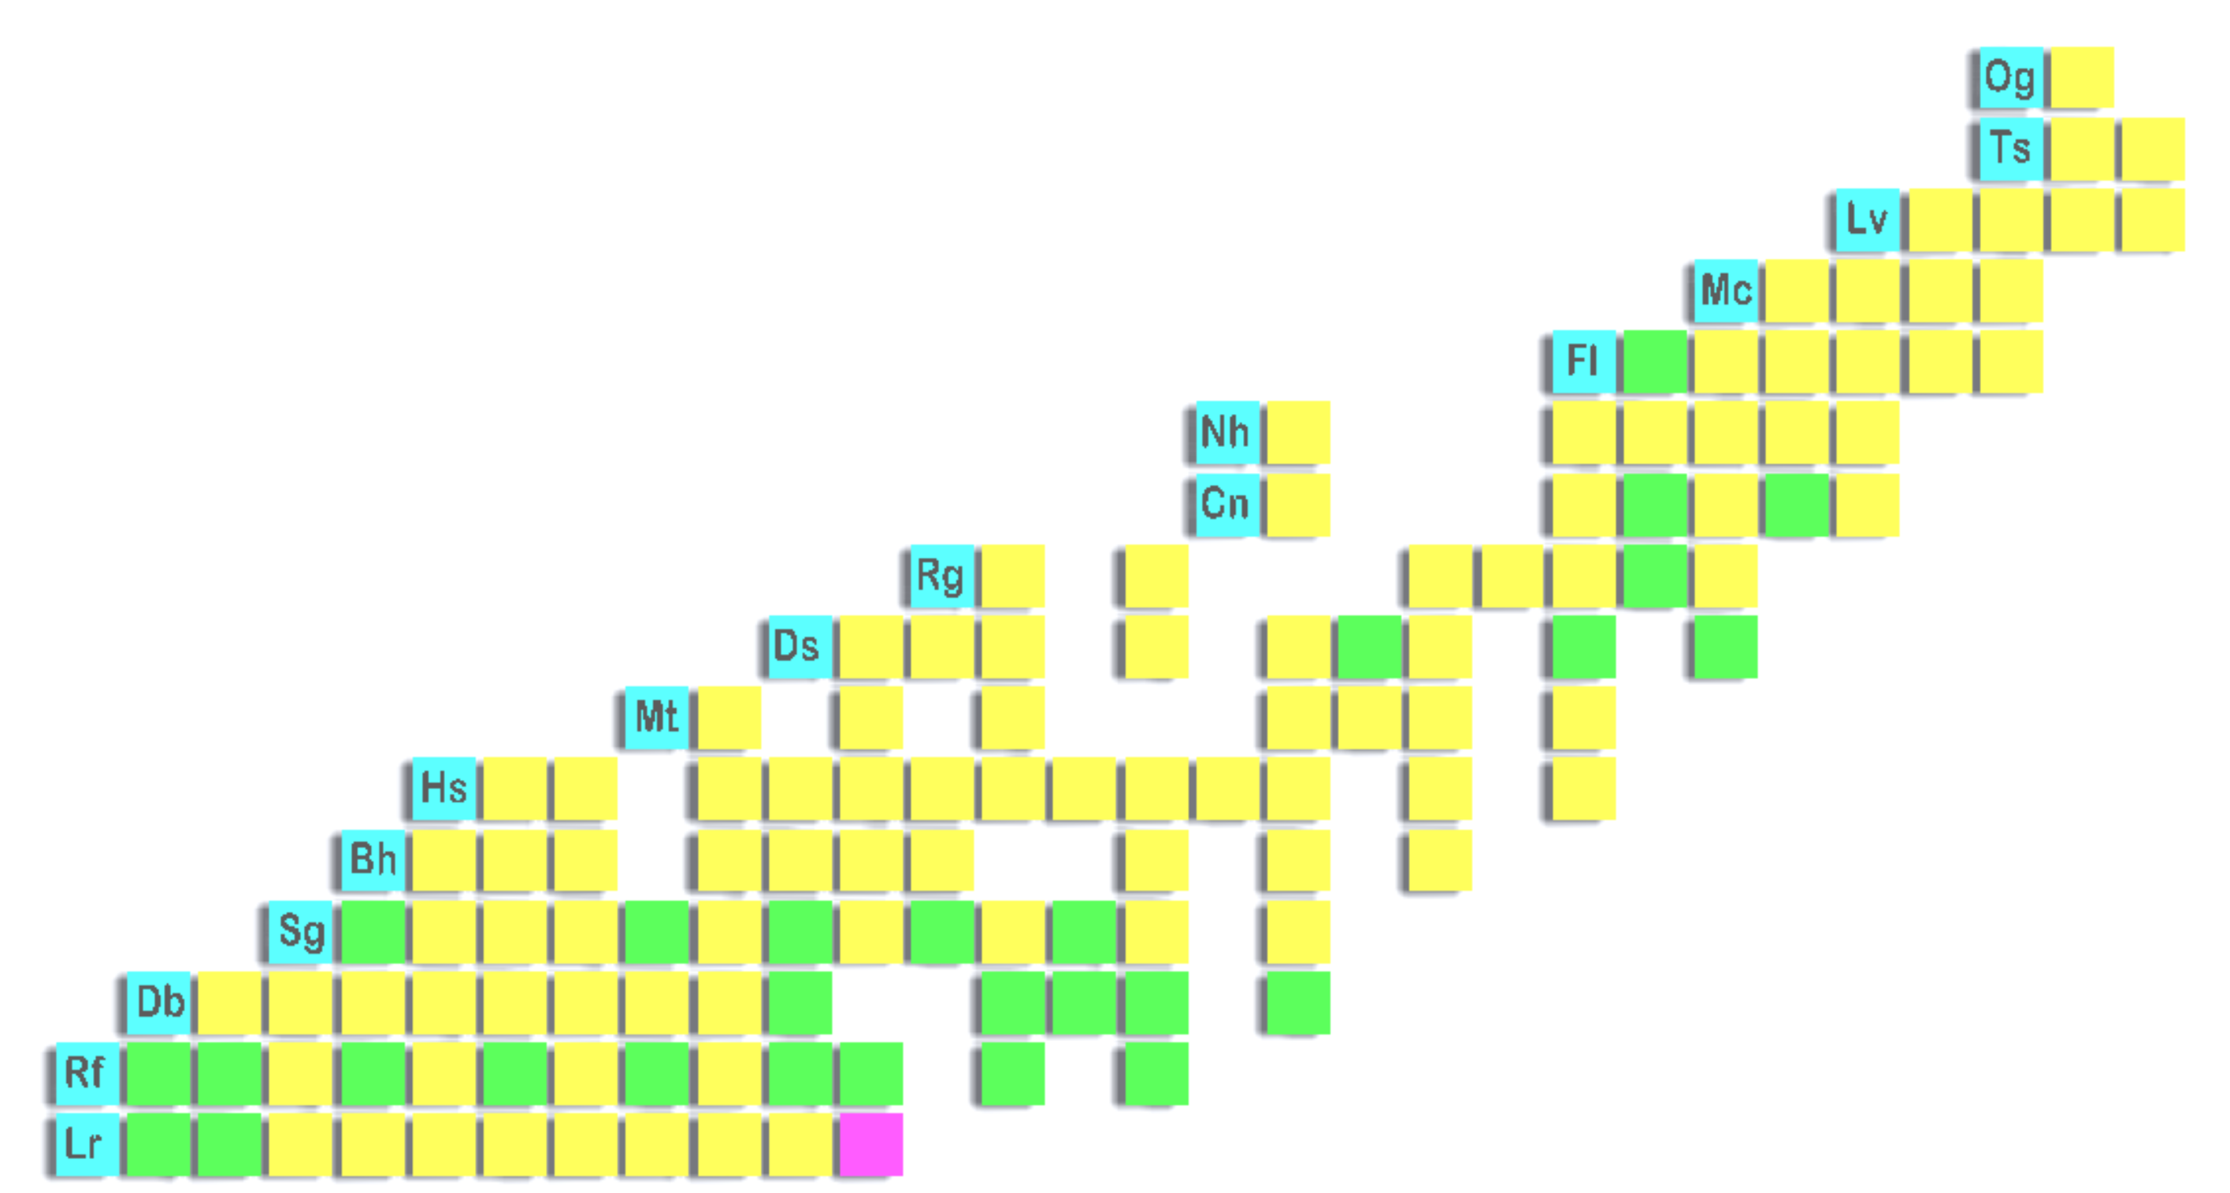
Chart of Nuclides: 2024
Decay Mode
Spontaneous Fission
Electron Capture or β⁺
Alpha
β⁻
Z →
N →
9

Slide 10
How to Make New Elements
⁴⁸Ca (Z=20)
>1 puA
²⁴⁹Cf (Z=98)
10+ mg
E118
Atom-per-week
You Can’t Just Use Any Beam/Target Combination!
10

Slide 11
Chart of Nuclides: 2024
Decay Mode
Spontaneous Fission
⁴⁸Ca+Actinides
Electron Capture or β⁺
Alpha
β⁻
Cold Fusion Region
Z →
Hot Fusion Region
N →
11

Slide 12
Chart of Nuclides: Beyond 2024
Decay Mode
Spontaneous Fission
⁴⁸Ca+Actinides
Electron Capture or β⁺
⁴⁸Ca+²⁵²Es
⁴⁸Ca+²⁵⁷Fm
Alpha
⁴⁸Ca+²⁵⁴Es
β⁻
Cold Fusion Region
Z →
Not enough Es/Fm material can be made
➔ New elements need new techniques
Hot Fusion Region
N →
12

Slide 13
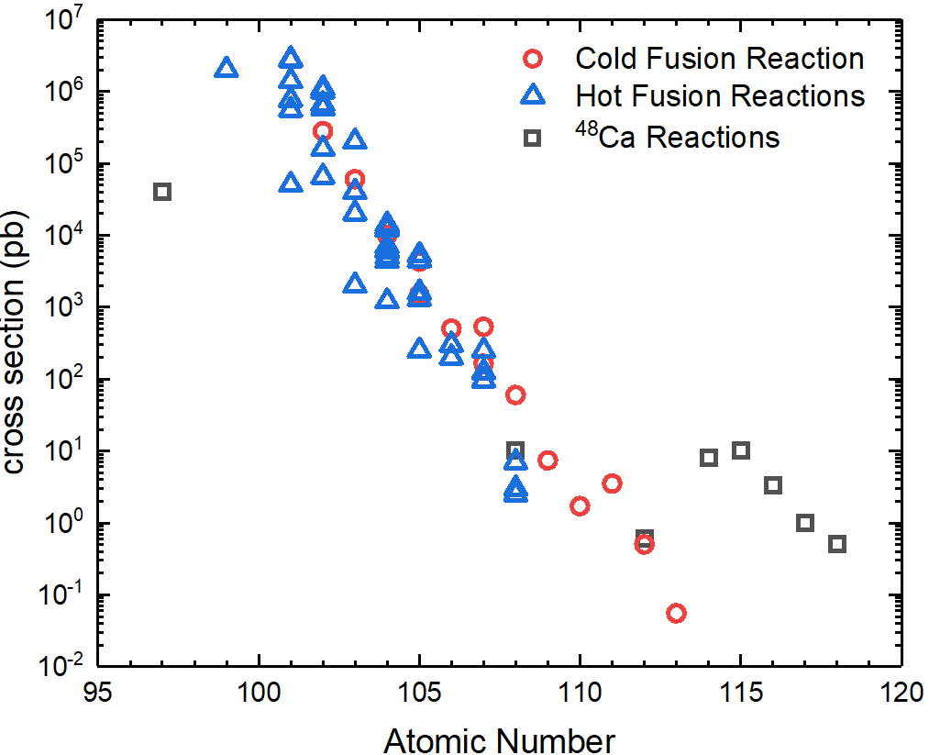



Elements get Harder to Make with ↑ Z
Cold Fusion
transition metals (Ti-Zn) on Lead and Bismuth targets
Hot Fusion
light ions (O-Ar) on actinide targets
Both reaction mechanisms ➔ production rate dropping for new discoveries
⁴⁸Ca+Actinides
Increasing production to E115, then start to decrease
13

Slide 14
What beam should we use?
⁵⁰Ti beams is best for new elements
10⁰
10⁻¹
10⁻²
10⁻³
10⁻⁴
10⁻⁵
10⁻⁶
10⁻⁷
10⁻⁸
10¹
10⁰
10⁻¹
10⁻²
10⁻³
10⁻⁴
10⁻⁵
10⁻¹
10⁻²
10⁻³
10⁻⁴
10⁻⁵
⁵⁰Ti
atom in ~1000 weeks
atom in ~50 weeks
atom in ~6000 weeks
⁵⁰Ti
⁵⁴Cr
⁶⁴Ni
⁵⁴Cr
⁵⁰Ti
⁵⁴Cr
⁵⁸Fe
⁵⁸Fe
⁵⁸Fe
⁶⁴Ni
⁶⁴Ni
114 116 118 120 122 124 126
Z
112 114 116 118 120 122 124 126
Z
116 118 120 122
Z
Adamian, EPJA 41, 235 (2009): https://doi.org/10.1140/epja/i2009-10795-4
Kuzima PRC 85, 014319 (2012): https://doi.org/10.1103/PhysRevC.85.014319
Adamian, PRC 101, 034301 (2020): https://doi.org/10.1103/PhysRevC.101.034301
14

Slide 15
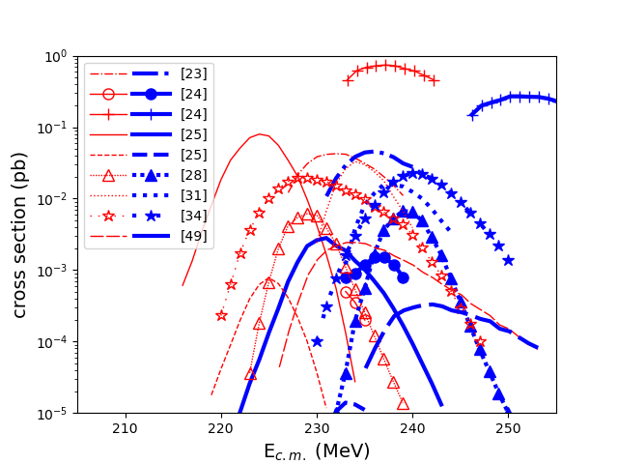
What beam energy do you use?
Cross Section Predictions for ⁵⁰Ti+²⁴⁹Cf
Large disagreement among theoretical models for the same reaction
15

Slide 16
Too Scary: Need a Test Experiment
Decay Mode
Spontaneous Fission
Electron Capture or β⁺
Alpha
β⁻
⁵⁰Ti+²⁴⁴Pu
Need for Proof-of-principle experiments:
Make known SHE through new reaction mechanisms
Z →
N →
16

Slide 17
Towards E120 Feasibility
Proof-of-Principle Experiment: ⁵⁰Ti+²⁴⁴Pu➔²⁹⁰⁻²⁹¹Lv
How much does the cross section change going from ⁴⁸Ca to ⁵⁰Ti?
What is the optimum beam energy for production with ⁵⁰Ti beams?
Is it feasible to search for a new element with this decrease?
Steps required to get there:
Demonstration of high-intensity ⁵⁰Ti beam
Production of ²⁴⁴Pu targets
Have a suitable separator
Design, build and commission a new focal plane detector and detector box
Upgrade BGS DAQ to digital electronics
17

Slide 18
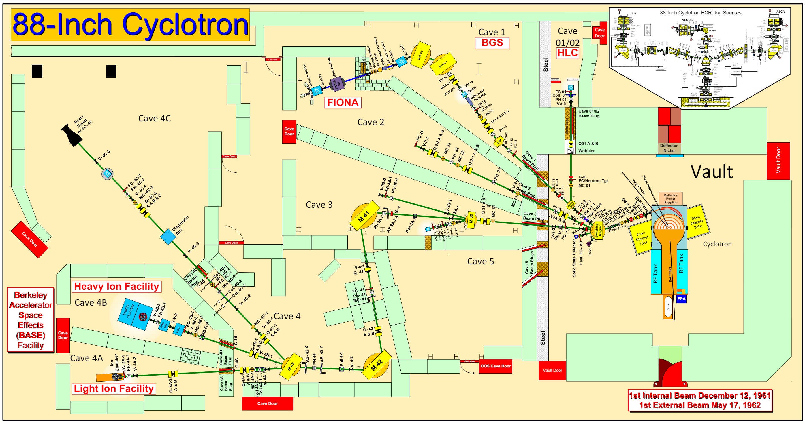
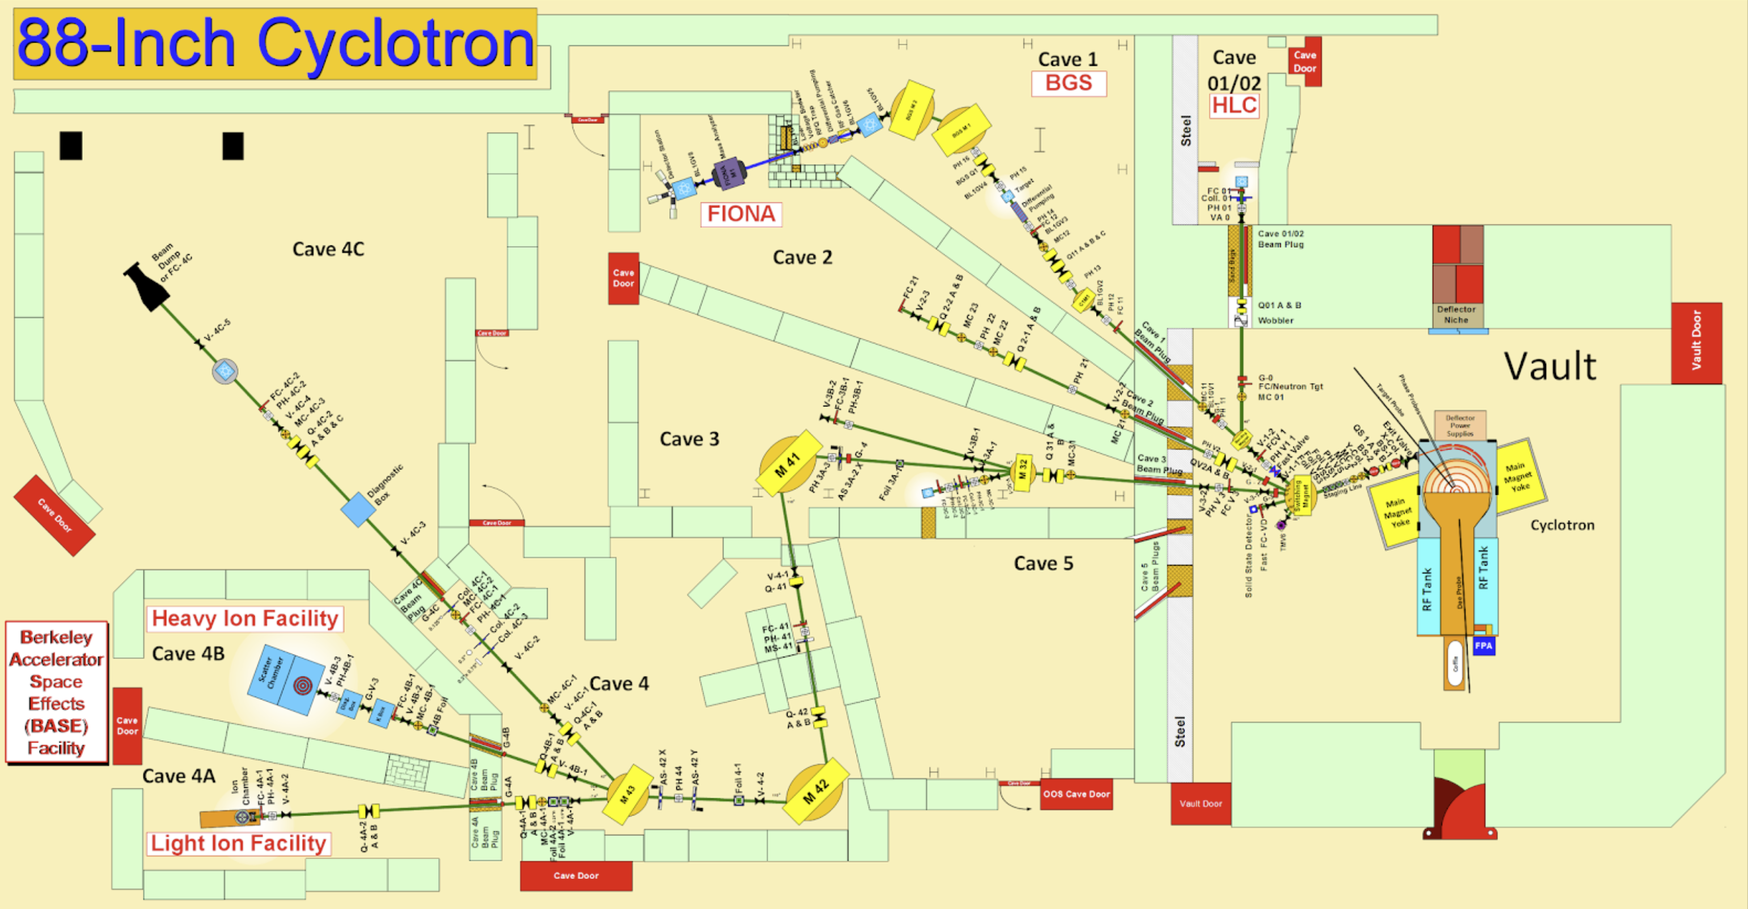
88-Inch Cyclotron Facility
18

Slide 19
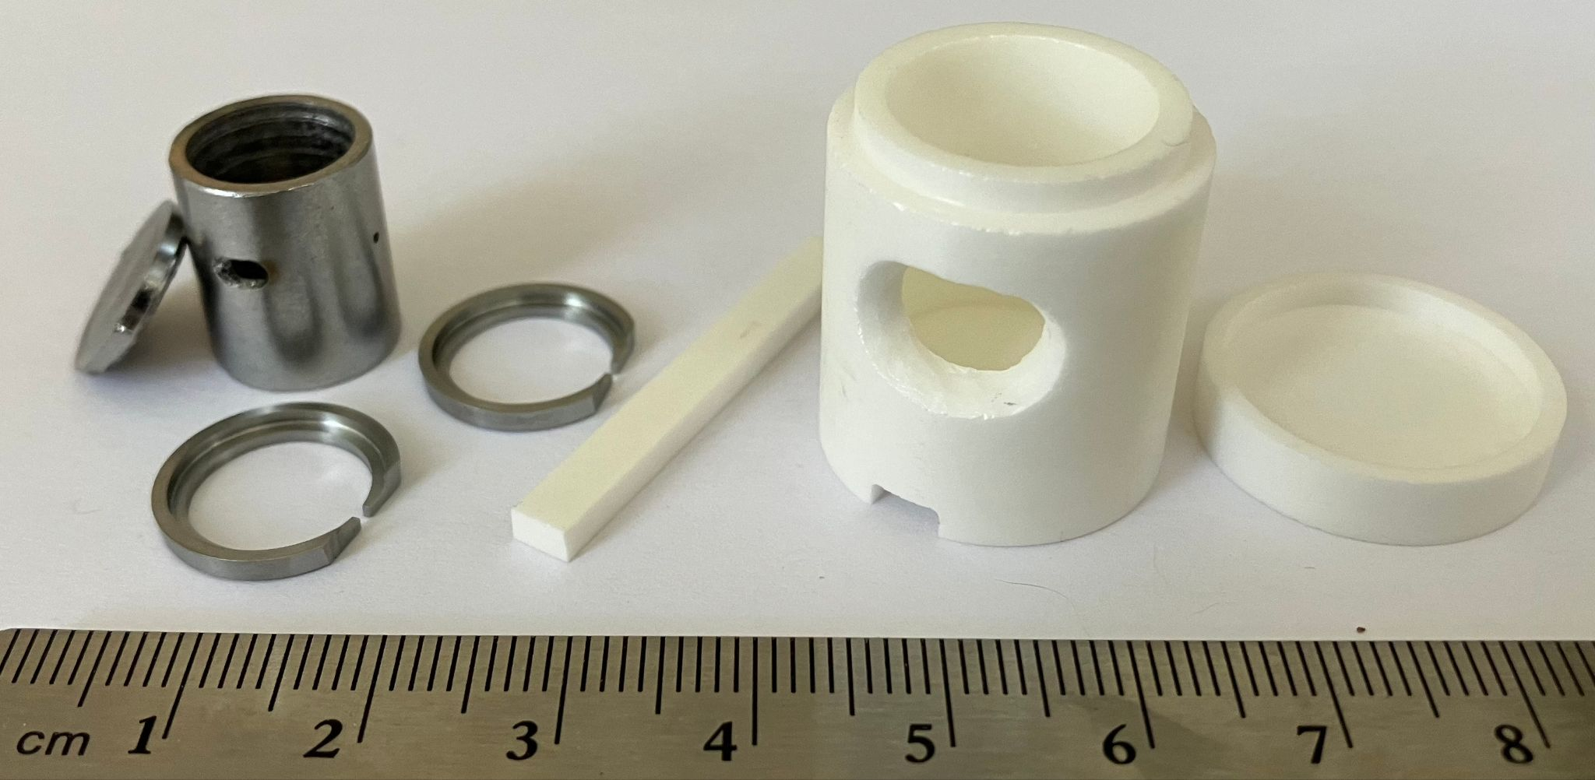

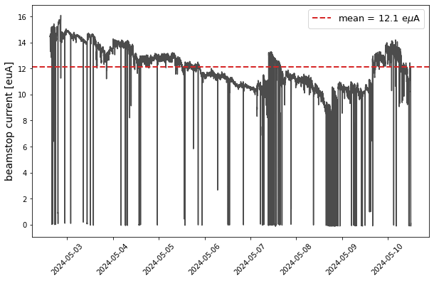
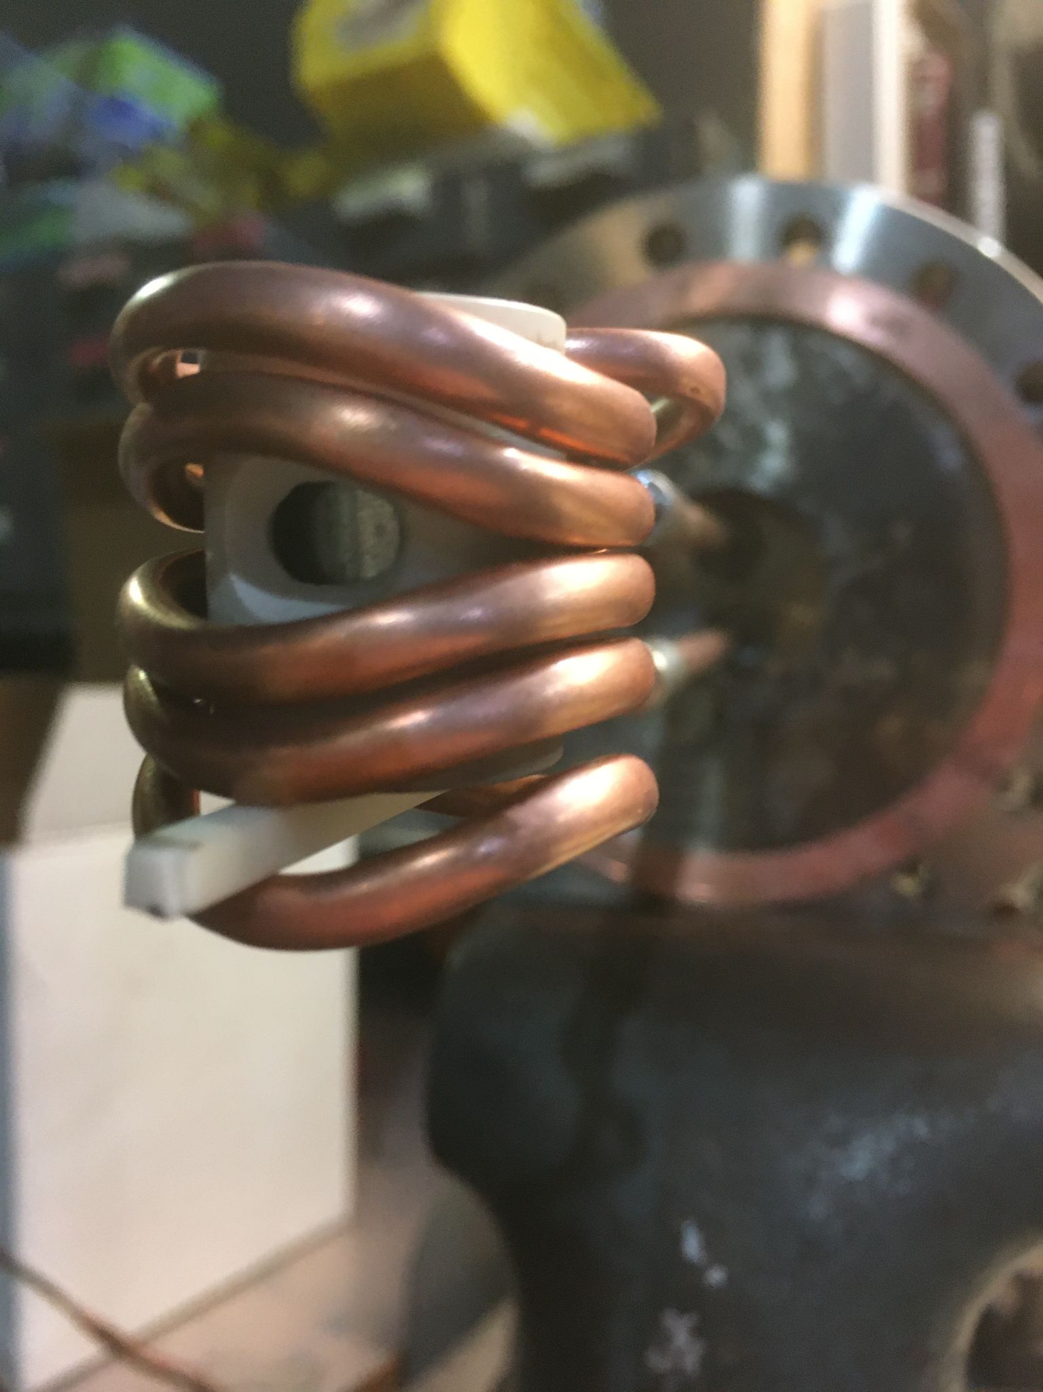
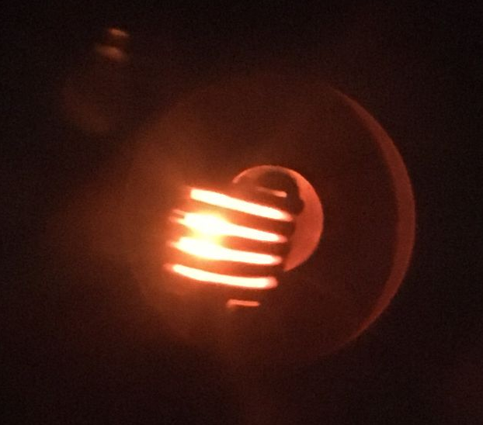
Demonstration of high-intensity ⁵⁰Ti beam
New Inductive oven:
Heating 200-300 kHz
Quick changes (fits through 1.5” ID port)
Has reached >2000 °C on bench, >1700 °C in VENUS
Consumption <3 mg/hr
⁵⁰TiO₂ reduced to metal by
D. Todd et al., NIM A 1072, 270183 (2025).
19

Slide 20
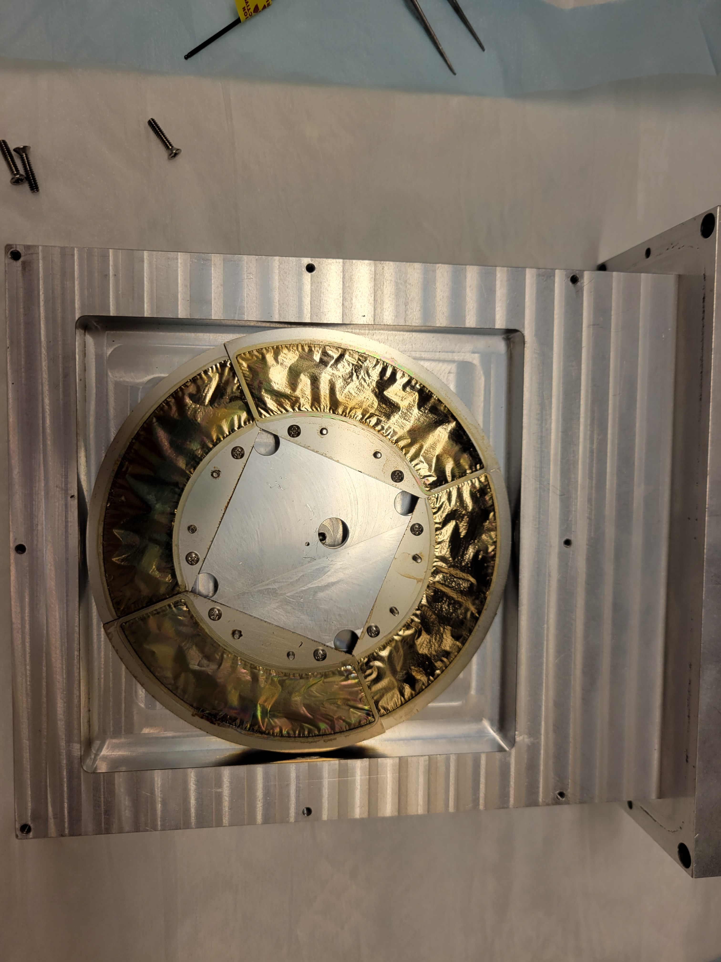

Production of ²⁴⁴Pu targets
Material from NIDC at Oak Ridge National Laboratory
Electroplated onto 2 um Ti at Lawrence Livermore National Laboratory
Targets ≈ 0.435(40) mg/cm²
Beam
Ti
Pu
20

Slide 21
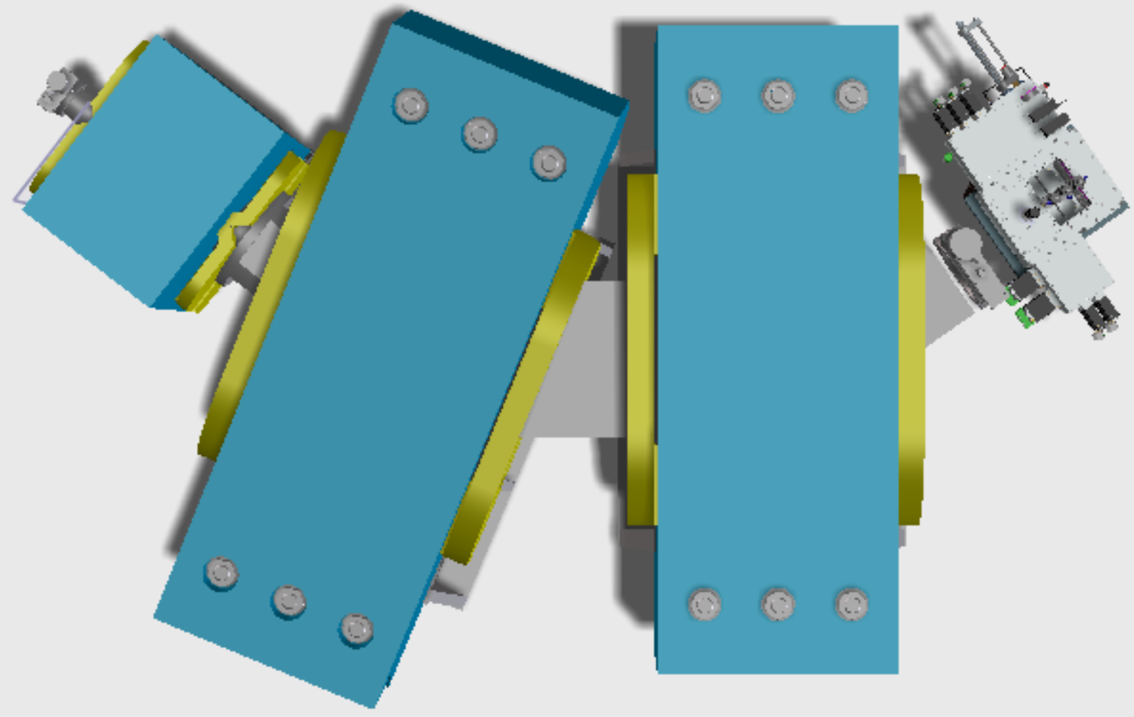
Berkeley Gas-filled Separator
Everything recoils into the BGS
Beam and unwanted reaction products bend more ➔ crash into walls
Superheavy elements directed to a detector
21

Slide 22
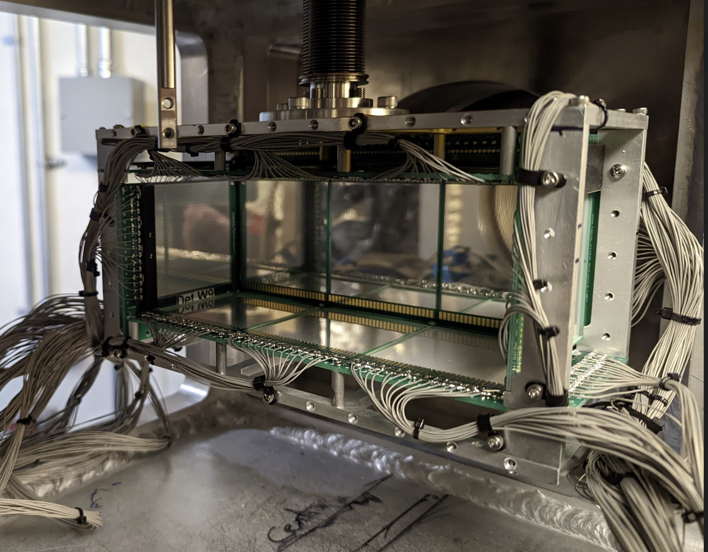
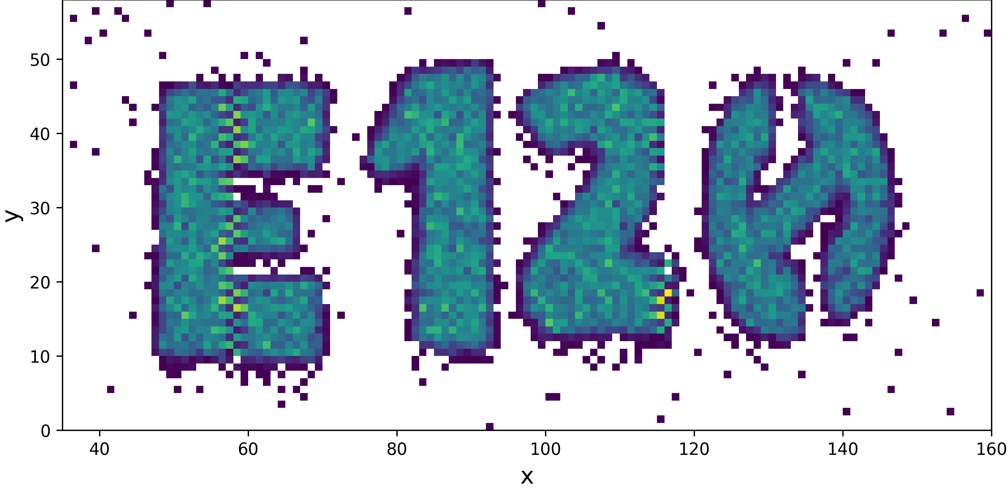

Detector – SHREC
SuperHeavy RECoil (SHREC) detector
Provided by Lund University
6 cm x 18 cm implantation detector surrounded by upstream tunnel
Commissioned using reactions
  ²⁰⁸Pb(⁴⁸Ca,2n)²⁵⁴No
  ²⁴⁴Pu(⁴⁸Ca,3-4n)²⁸⁹⁻²⁸⁸Fl
  ²⁰⁹Bi(⁵⁰Ti,xn)^{259-x}Db
Large-area focal plane detector
22

Slide 23
Checklist
Beam ✅
Target ✅
Separator ✅
Detector ✅
Notes:
inter dilemma of the scientist: humanness vs. objective scientist

Slide 24
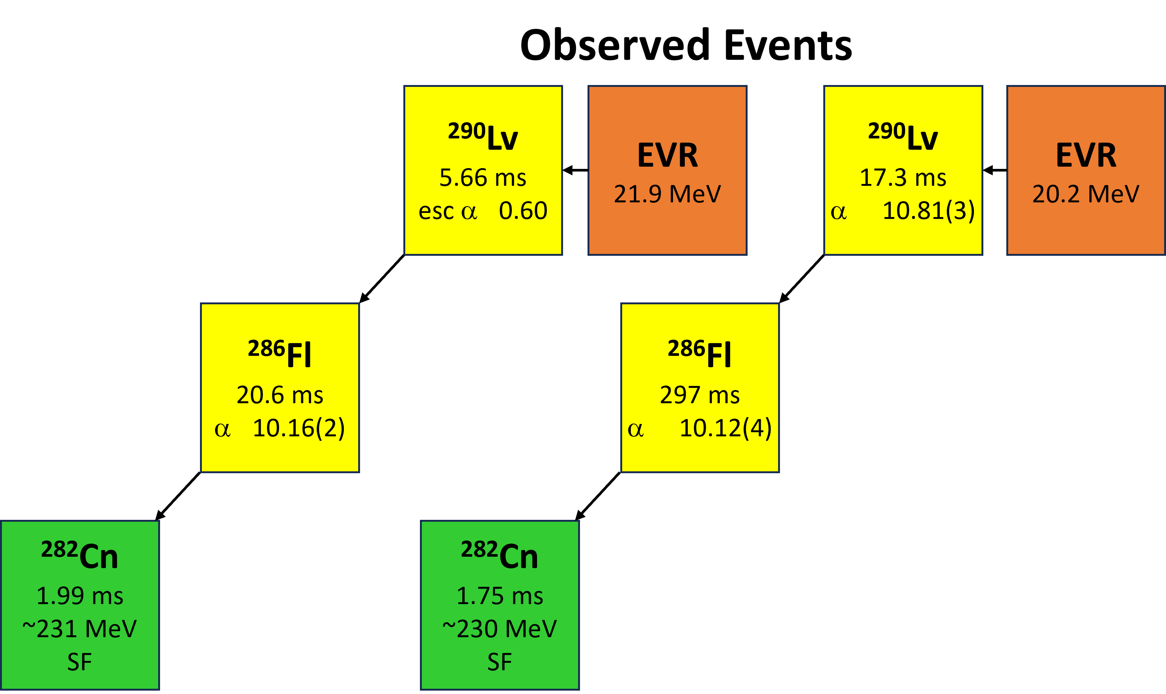
⁵⁰Ti+²⁴⁴Pu Results
Saw 2 atoms of ²⁹⁰Lv in ~22 days
²⁹⁰Lv
8.2 ms
α 10.84
α
²⁸⁶Fl
106 ms
α 10.18
SF 43%
α
²⁸²Cn
0.88 ms
SF
24

Slide 25
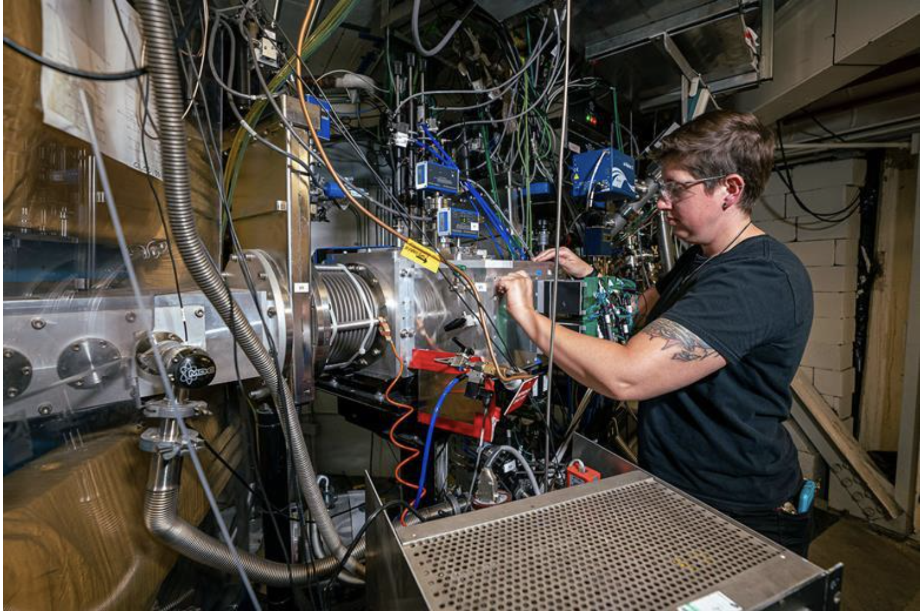
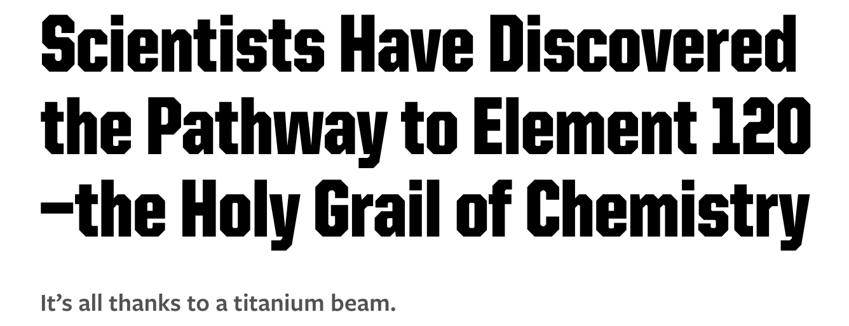

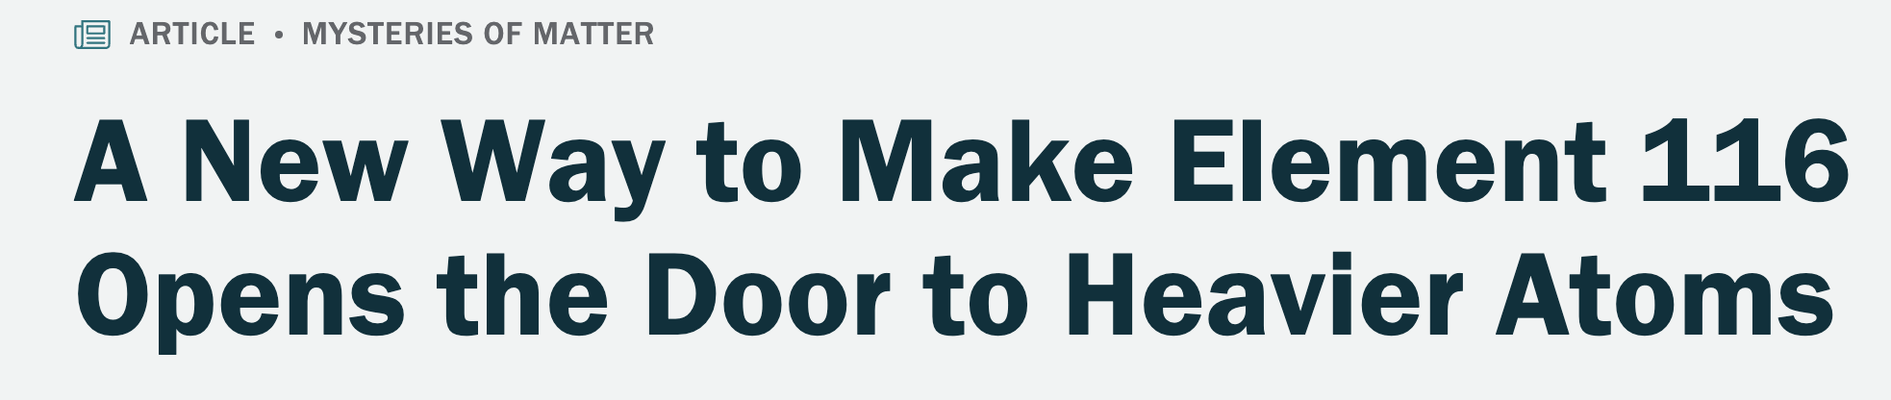
So Much Press!
J.M. Gates et al., PRL 133, 172502 (2024).
25

Slide 26
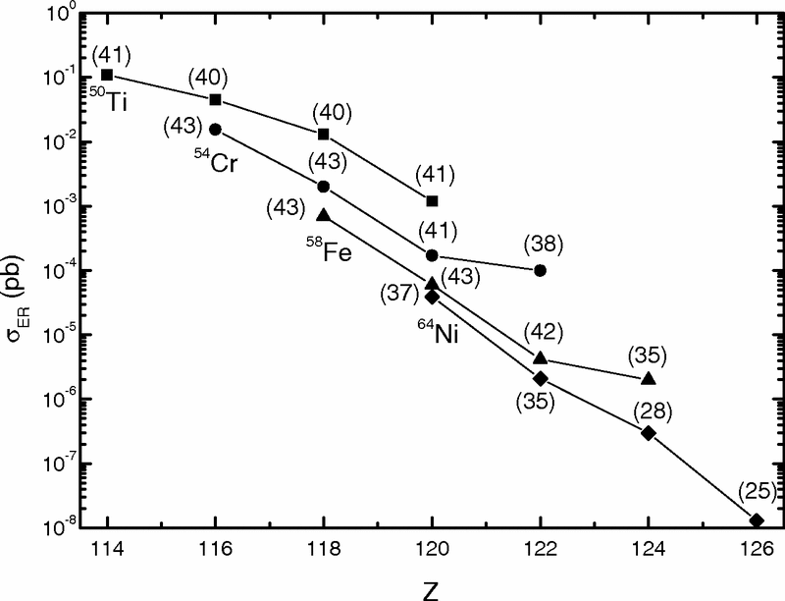
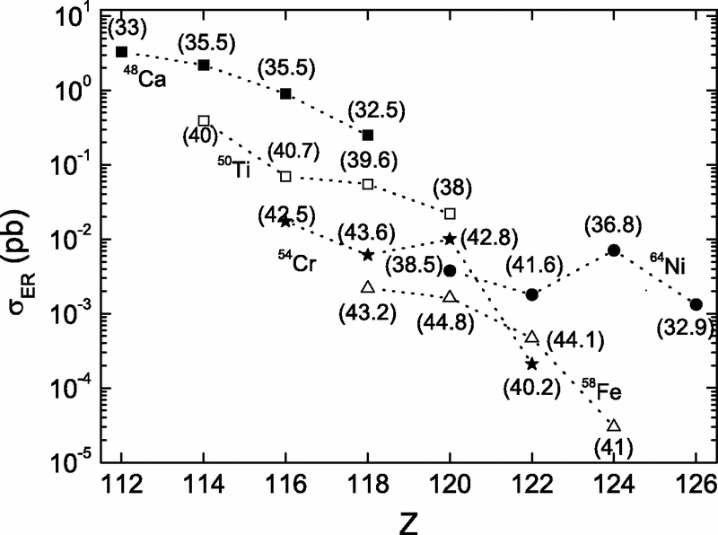
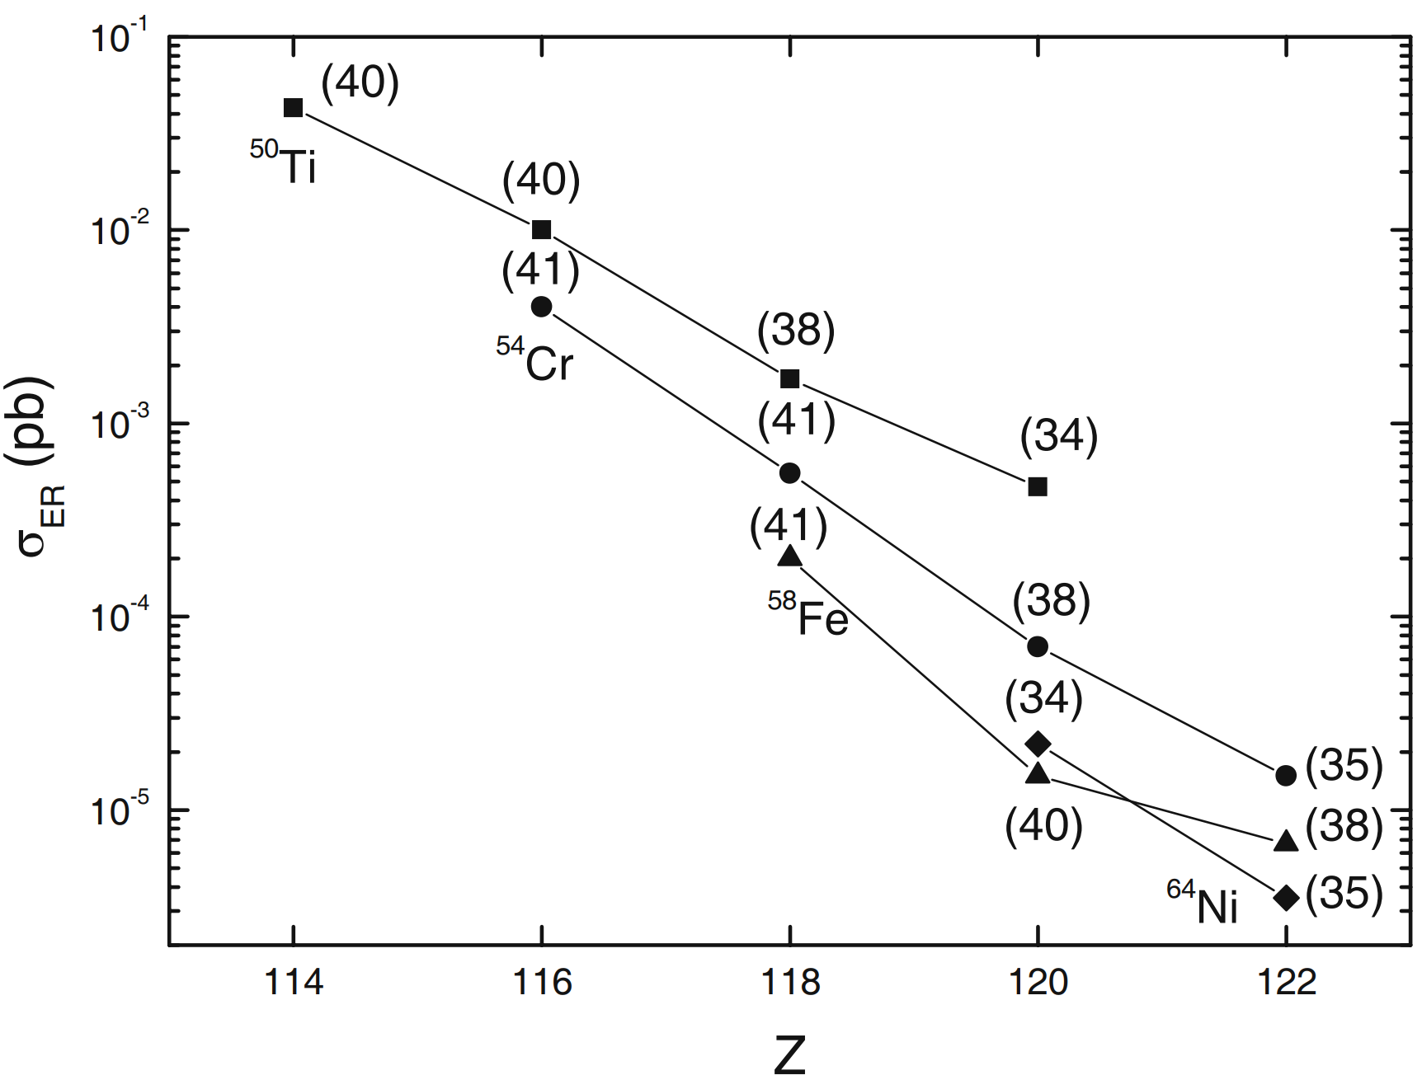

Why is this such a big deal?
$$σ_{prod_4n}=0.44\left(\frac{+0.58}{−0.28}\right)pb$$
Where do we land?
x5 - x50 HIGHER than predictions!
⁵⁰Ti
⁵⁴Cr
⁵⁸Fe
⁶⁴Ni
Adamian, EPJA 41, 235 (2009): https://doi.org/10.1140/epja/i2009-10795-4
Kuzima PRC 85, 014319 (2012): https://doi.org/10.1103/PhysRevC.85.014319
Adamian, PRC 101, 034301 (2020): https://doi.org/10.1103/PhysRevC.101.034301
26

Slide 27
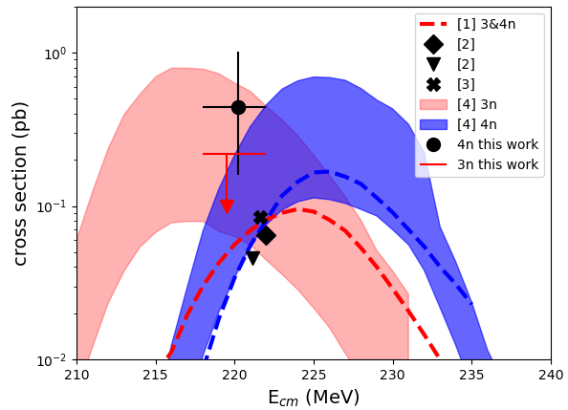
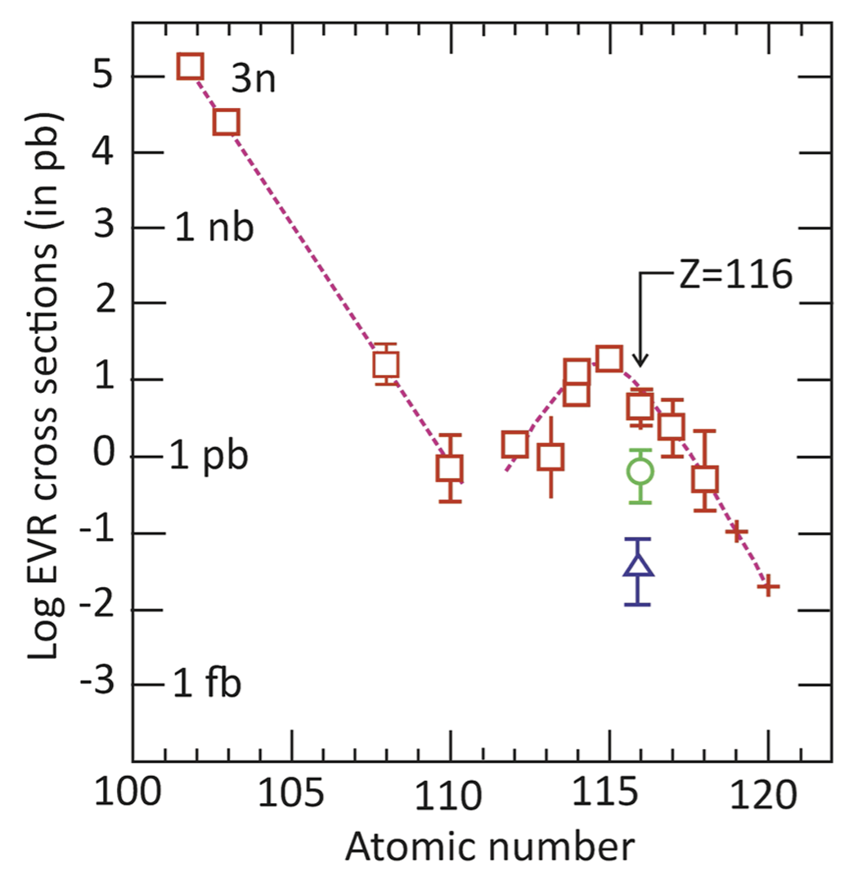
More Measurements
Working on measuring an excitation function
Confirm the Berkeley Results
⁵⁰Ti
⁵²Cr
[1] Zagerabev PRC 78, 034601 (2008): https://doi.org/10.1103/PhysRevC.78.034610
[2] Kuzima PRC 85, 014319 (2012): https://doi.org/10.1103/PhysRevC.85.014319
[3] Adamian, PRC 101, 034301 (2020): https://doi.org/10.1103/PhysRevC.101.034301
[4] T. Cap, private communication
Oganessian: EPJA 60 (2024) 227
27

Slide 28

Toward a Search for E120
New elements are in sight!
Estimate an atom of E119 or E120 could be produced every ≈100-200 days
28

Slide 29











Towards E120 Collaboration
Collaborating institutions who have contributed equipment, materials, and scientific effort
Lawrence Berkeley National Laboratory, USA (23):
J.M. Gates, R. Orford, J.L. Pore, F.H. Garcia, E.M. Lykiardopoulou, E. Leistenschneider, C. Appleton, A. Ard, J.Y. Benitez, M.C. Bishop, C.M. Campbell, R.M. Clark, H.L. Crawford, P. Fallon, J.A. Gooding, M. Grebo, M. Kireeff Covo, R. Krücken, M. McCarthy, L. Phair, E. Rice, A. Sinjari, J.M. Szornel, D.S. Todd, V. Watson
Lund University, Sweden (4)
D. Rudolph, P. Golubev, L.G. Sarmiento, Y. Hrabar
Argonne National Laboratory, USA (2)
C. Müller-Gatermann, D. Seweryniak
Lawrence Livermore National Laboratory, USA (7)
R.A. Henderson, K.E. Gregorich, J.D. Despotopulos, B.N. Sammis, M.A. Stoyer, K. Thomas, P.T. Woody
Oak Ridge National Laboratory, USA (2)
K.P. Rykaczewski, T.T. King
Collaborating institutions who have contributed scientific effort
Oregon State University, USA (1)
A. T. Chemey
San José State University, USA (5)
N.E. Esker, B.M. Barrios, W. Botha, M. Guerrero, P. Vo
Texas A&M University, USA (3)
C.M. Folden III, A.S. Kirkland, J.A. Mildon
University of Liverpool, UK (2)
J. Chadderton, R.-D. Herzberg
University of Manchester, UK (1)
D.K. Sharp
University of Strasbourg, France (3)
M. Bordeau, O. Drovaux, B.J.P. Gall
Paul Scherrer Institute (1)
P. Steinegger

Slide 30
Operations Staff
Administrative
Dorothy Kenlow, Kymba A’Hearn, Tom Gallant
Electrical
Michel Kireeff Covo, Brendan Ford, Nathaniel Bohm, Erik Line
Engineering
Jaime Cruz Duran, David Konyndyk, Collin Anderson
Ion Source
Damon Todd, Janilee Benitez, Miles Chen, Dan Xie
Mechanical
John Garcia, Nathan Seidman, Roman Nieto, Brien Bell, Sean Zhong
Operations
Larry Phair, Mike Johnson, Brien Ninemire
Operators
Nishi Intwala, Nick Brickner, Devin Thatcher, Scott Small, Patrick Coleman
Safety
Jeff Bramble

Slide 31
Questions?

Slide 32
Backups

Slide 33
What beam energy do you use?
Cross Section Predictions for ⁵⁰Ti+²⁴⁹Cf
[23] Zagrebaev, PRC 78, 034610 (2008): https://doi.org/10.1103/PhysRevC.78.034610
[24] Adamian, EPJA 41, 235 (2009): https://doi.org/10.1140/epja/i2009-10795-4
[25] Nasirov, PRC 84, 044612 (2011): https://doi.org/10.1103/PhysRevC.84.044612
[28] K. Siwek-Wilczyńska, PRC 86, 014611 (2012): https://doi.org/10.1103/PhysRevC.86.014611
[31] Liu, PRC 87, 034616 (2013): https://doi.org/10.1103/PhysRevC.87.034616
[34] Zhu, PRC 89, 024615 (2014): https://doi.org/10.1103/PhysRevC.89.024615
[42] Zhang, PRC 109, 014622 (2024): https://doi.org/10.1103/PhysRevC.109.014622
Large disagreement among theoretical models for the same reaction
33

Slide 34
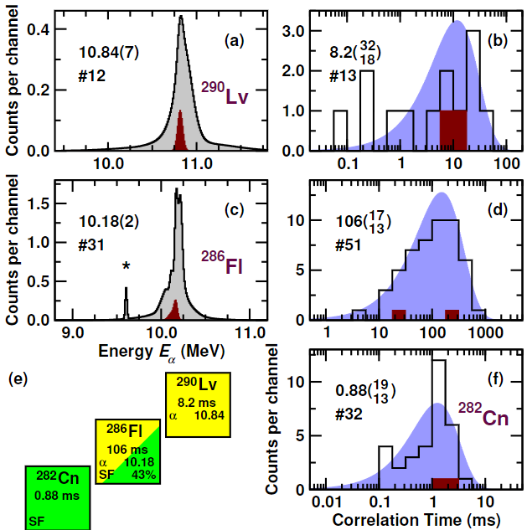
Comparison with Know Decay Chains
First proof that superheavy element could be made with ⁵⁰Ti+actinides

