Slide 1
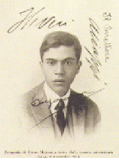
Search for Neutrinoless Double Beta Decay and Tests of Fundamental Physics with the MAJORANA DEMONSTRATOR
Nafis Fuad
On behalf of the MAJORANA Collaboration
CIPANP 2025
June 10, 2025

Slide 3
Neutrinoless Double Beta ($0νββ$) Decay

Slide 4
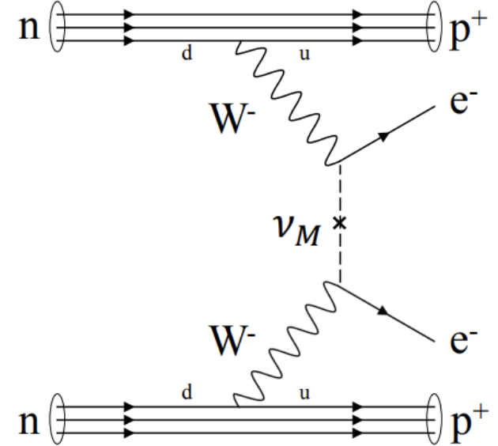
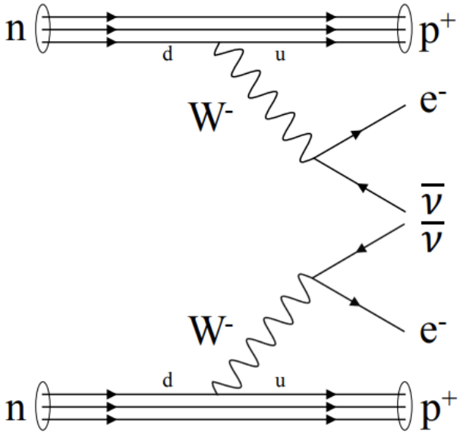
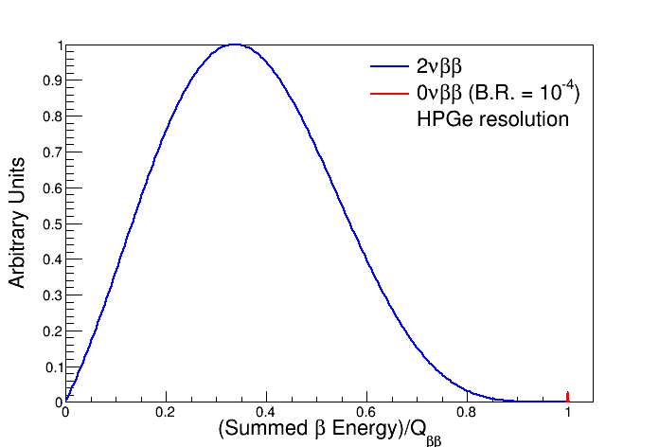
Double Beta ($ββ)$ decays
Only even-even nuclei can go through $ββ$ decays
$β$ decay needs to be energetically prohibited
~100 isotopes predicted to be able to go through $ββ$
~10 isotopes observed to do so
[A. Barabash, 2020]
Neutrinoless double beta ($0νββ$) decay
$$\left(A,Z\right)→\left(A,Z+2\right)+2e^{−}$$
No (anti-)neutrinos to carry away electron energy
Violates lepton number by $ΔL=2$
$$Γ\sim m_{ν}^{2}$$
Two neutrino double beta ($2νββ$) decay
$$\left(A,Z\right)→\left(A,Z+2\right)+2e^{−}+2{\overline{ν}}_{e}$$
Conserves lepton number
First predicted – $T_{\frac{1}{2}}\sim {10}^{17}y$¹
First detected –
${1.1×10}^{20}y$, in ⁸²Se²
${9.0×10}^{20}y$, in ⁷⁶Ge³
Current measurements
$2.38×{10}^{21} y$, in ¹³⁶Xe⁴
$2.02×{10}^{21} y$ , in ⁷⁶Ge⁵
Experimental signature:
Sum energy of two electrons
Continuous spectrum for $2νββ$
Mono-energetic peak at end-point of $2νββ$ spectrum for $0νββ$
M. Goeppert-Mayer, 1935 (PRL 48 512)
S. Elliott et. al., 1987 (PRL 56 2582)
Heidelberg-Moscow experiment, 1987
KAMLAND-Zen, 2012 (PRC 85 045504)
GERDA, 2023 (PRL 131 142501)
End-point = $Δ$(Binding energies of parent and daughter nucleus)
$$T_{\frac{1}{2}}^{0ν}=\frac{1}{G^{0ν}{\left|M^{0ν}\right|}^{2}}⋅{\left(\frac{m_{ββ}}{m_{e}}\right)}^{2}$$
Notes:
0vBB is million times smaller than 2vBB, due to neutrino mass being very small
Many loop level corrections exist, which have measurable effects (e.g. virtual photons leading to internal brehmsstrahlung, x10⁻³ suppression)
Currently left out for next-gen precision experiments, given we observe this process first

Slide 5
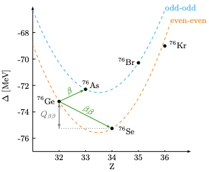
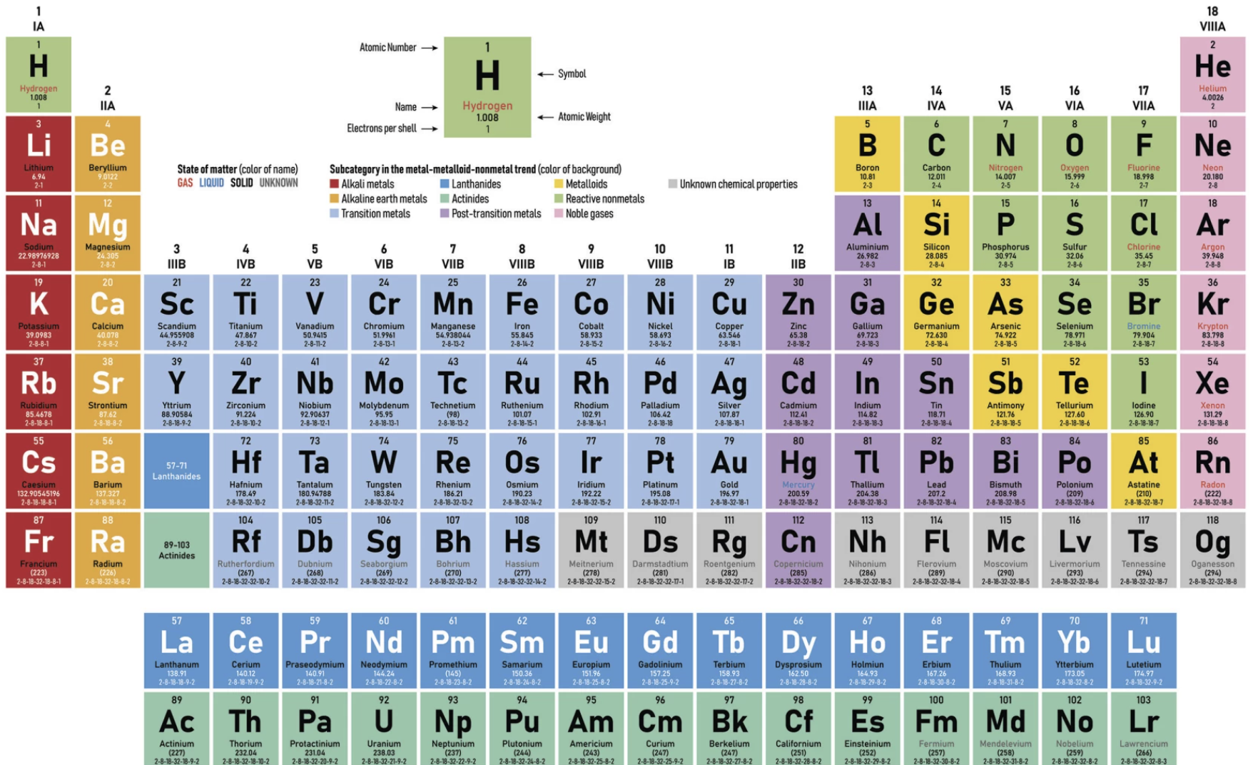
$ββ$ decay in Ge
Why Ge?
Ge is a semi-conductor, well understood signal transportation
Small energy deposition create many signal carriers
$Q_{ββ}$ at low noise region (threshold of Ge detectors ~1 keV)
Well established enrichment and detector manufacturing procedure
Scalable, since modular design possible
Source = Detector
Many isotopes exist : ⁵¹⁻⁹²Ge
Only ⁷⁶Ge go through $ββ$
Detectors made of high-purity Ge (HPGe) crystals (<0.1% impurity)
Natural abundance of ⁷⁶Ge = 7.75%
⁷⁶Ge$→$⁷⁶Se$+2e^{−}{+ }_{0ν}^{2\overline{ν_{e}}}$
$Q_{ββ}$ = 2.039 MeV
$ΔB$inding energy (MeV)
$$ΔZ=2$$
Major experimental
challenges
Detector mass scaling
Detection efficiency
Background rejection
Material cleanliness
Analysis techniques
Energy resolution
GERDA: BI=0.52 cts/keV/t/y $→T_{\frac{1}{2}}>1.8×{10}^{26}y$
MJD: BI = 6.6 cts/keV/t/y $→T_{\frac{1}{2}}>8.3×{10}^{25}y$
LEGEND projection: 0.01 cts/keV/t/y $→T_{\frac{1}{2}}>{10}^{28}y$

Slide 6
The MAJORANA DEMONSTRATOR Experiment (MJD)

Slide 7
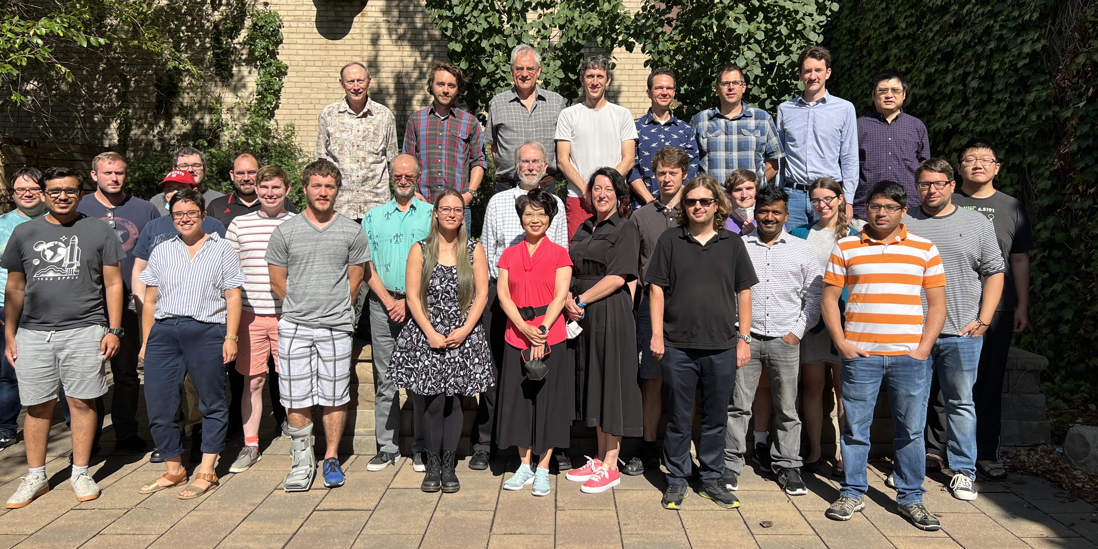
The MAJORANA Collaboration

Slide 8
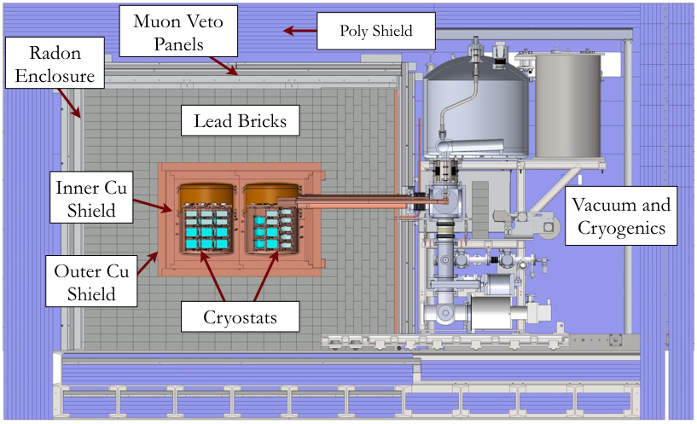
Experimental Set-up
Location: Sanford Underground Research Facility (SURF), Lead, SD, USA
4850 feet underground
Source & Detector: Modular array of high-purity Ge crystals
27.2 kg Ge 88% enriched in ⁷⁶Ge, 13.2 kg natural Ge (7% ⁷⁶Ge)
3 types of HPGe detectors
2 vacuum cryostats (modules) within compact graded shield
7 strings in each cryostat, cooled with liquid Nitrogen (~80K)
Additional shielding for $γ$-rays, neutrons, muons and radons
PPC
^{enr}Ge
Readout electronics
ICPC
^{enr}Ge
BEGe
^{nat}Ge
Notes:
Shielding
$γ$-rays: Cu holders, inner and outer Cu shields and Pb bricks
Neutrons : Borated polyethylene shield
Muons : Plastic scintillator as muon veto
Radon : Radon exclusion box with ultra-low-Radon N₂

Slide 9
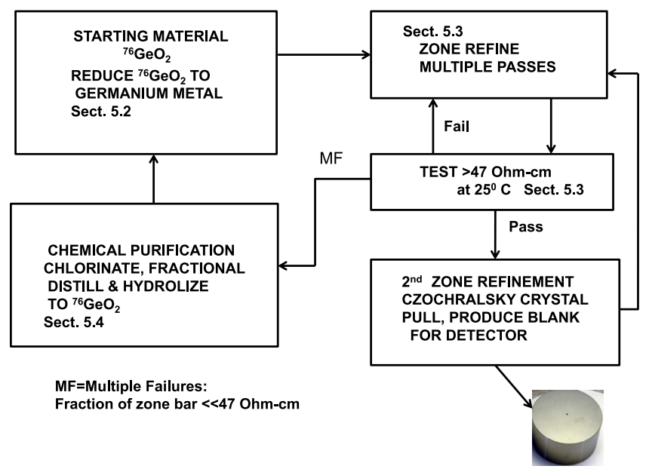
Material Acquisition
NIM A 877 314 (2018)
Natural Ge
Detectors directly purchased from Mirion
Enriched Ge
GeO₂ powder with ~88% enriched in ⁷⁶Ge purchased from ECP
Ge bar extraction, zone-refinement, crystal pulling performed at MJD’s Ge processing plant ESI at Oak Ridge, TN (leads to impurity <0.1%)
Detector manufacturing from the crystals done at ORTEC
Shielded with thick iron during transportation
Details of each step meticulously tracked
Tracking network of various Ge inputs for ONE detector
Created by: S. Schleich, IU

Slide 10
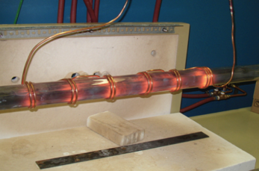
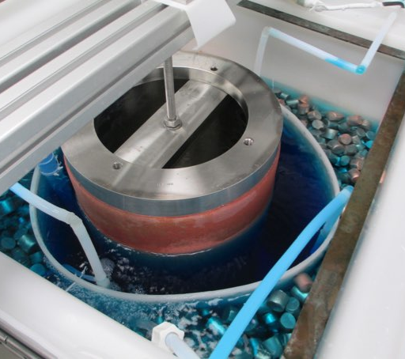
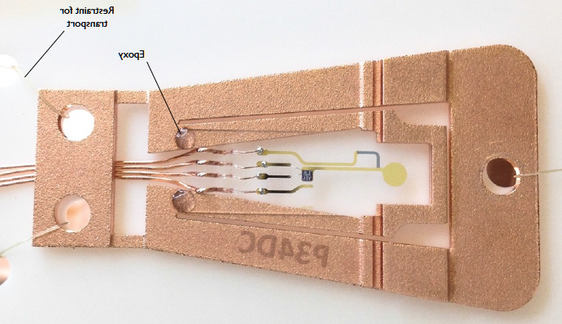
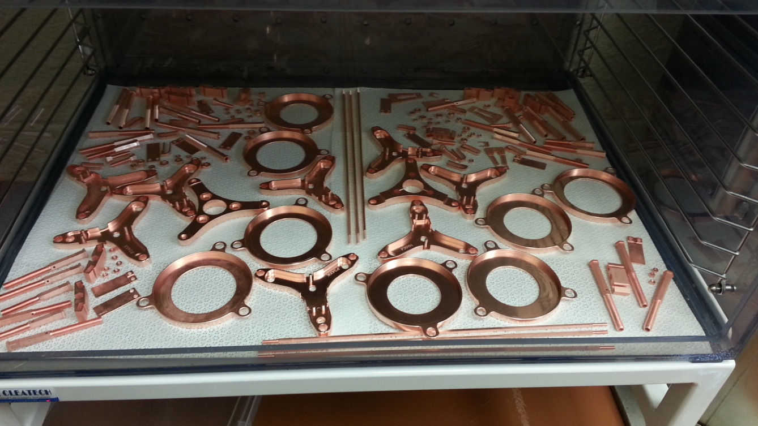
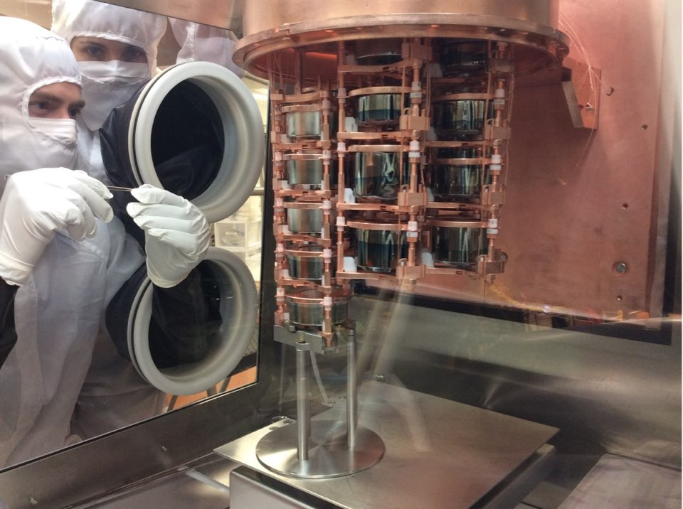
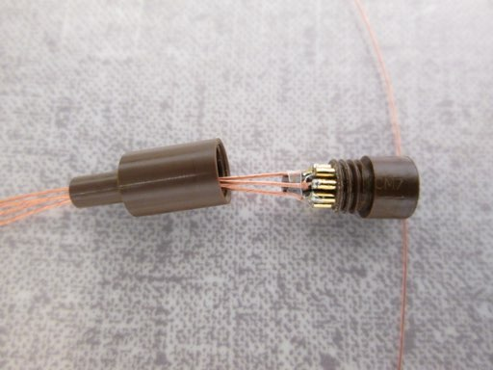
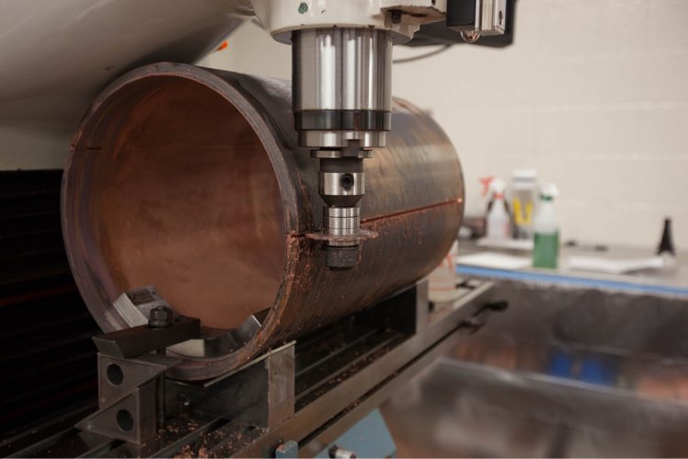
Material Acquisition
Structural Components
Electroformed Cu produced completely underground
Ultra-radiopure due to no above-ground exposure
Low electronic noise
NIM A 828 22 (2016)
JINST 17 T05003 (2022)
Shipping
Restraint
Feedback Resistor
Epoxy
FET

Slide 11
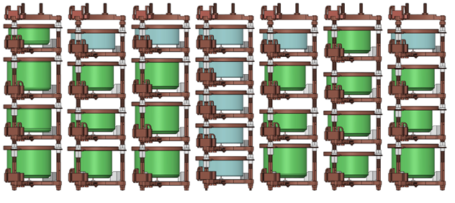
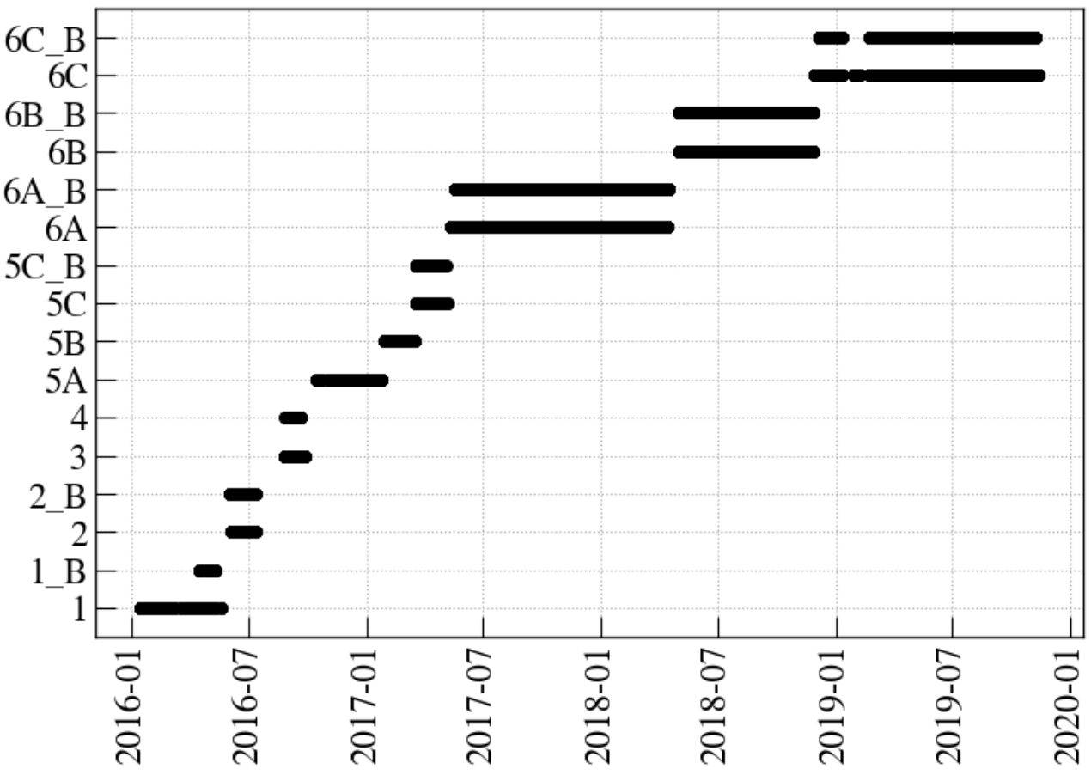
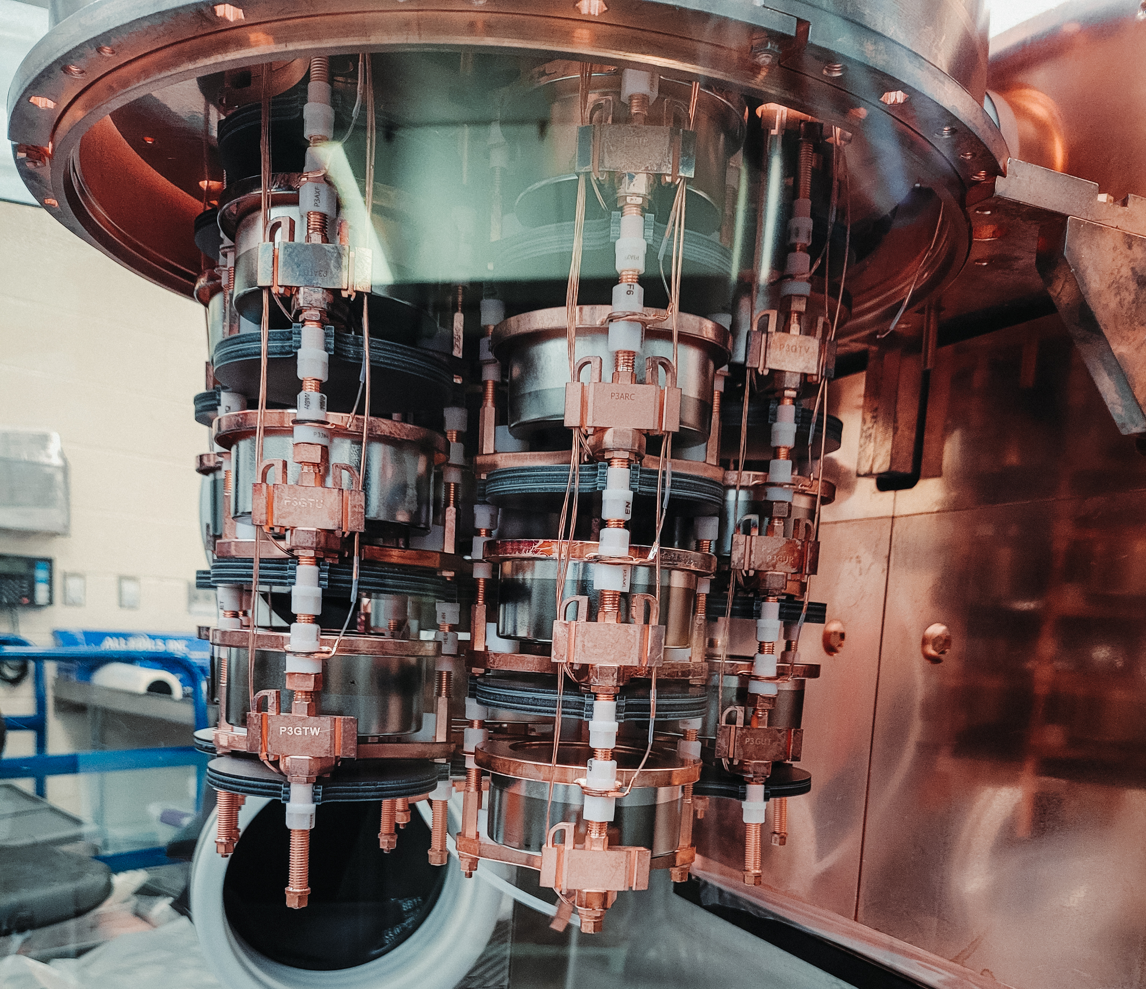
Run Configurations & Timeline
Mar. 2021:
Stopped ^{enr}Ge Operation
Removed all ^{enr}Ge for LEGEND-200
Material Acquisition
&
HPGe processing
Module 1 deployed in shield
2009
…
2015
2016
2017
2018
2019
2020
2021
2022
2023
2024
2025
Module 2 deployed in shield
Cable/Connector Upgrade of Module 2
Removed 5 PPC detectors for LEGEND Testing
Installed 4 LEGEND ICPC Detectors
Continuing operation of Module 2 only with ^{nat}Ge detectors
17 kg Ta disks deployed
MJD physics datasets
Ta disks

Slide 12
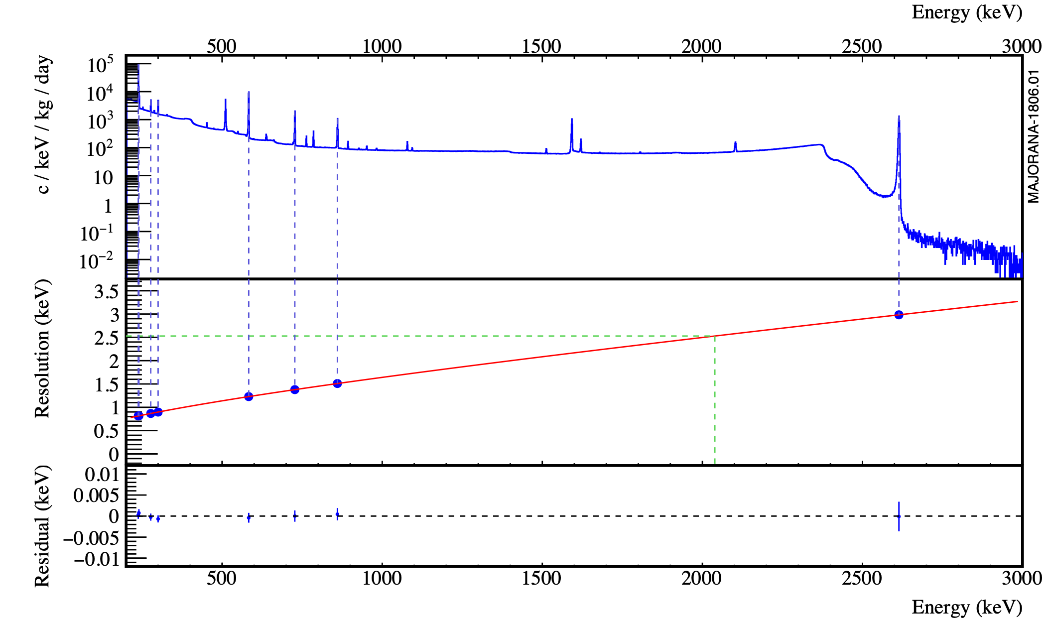
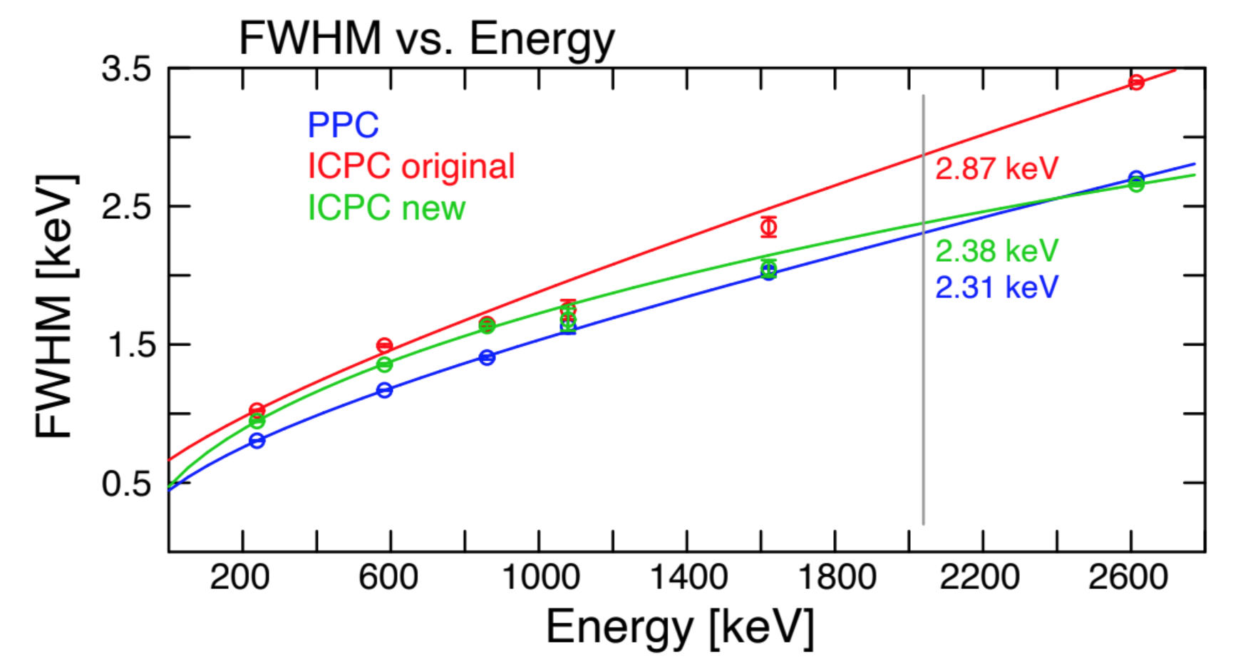
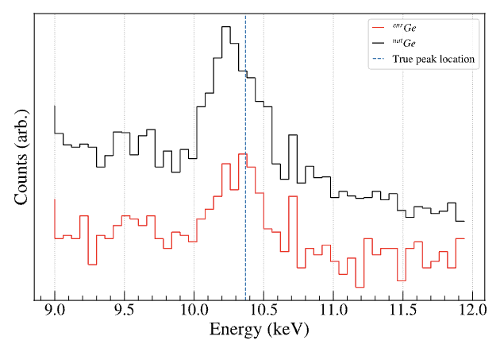
Energy Performance
JINST 17 T05003 (2022)
Calibration done with ²²⁸Th on weekly basis
FWHM = 2.52 keV (0.12%) at $Q_{ββ}^{.^{76}Ge}$ (2.039 MeV)
= ~0.15 keV (1.5%) at ~10 keV
Linearity in calibration (shift<0.2 keV up to 3 MeV)
Low energy (~10 keV) offset:
^{nat}Ge <0.2 keV, ^{enr}Ge <0.1 keV
Comparable resolution among different types of detectors
Energy estimated via optimized trapezoidal filter with ADC non-linearity correction* and charge trapping correction#
228Th Calibration Spectrum
$$Q_{ββ}$$
(Single detector of different types)
* IEEE TNS 68 359 (2021)
# PRC 107 045503 (2023)
$$Q_{ββ}$$
⁶⁸Ge$→$⁶⁸Ga x-rays in MJD (10.37 keV)
Notes:
Charge trapping: Energy degradation due to signal carriers being trapped around impurities and then slowly releasing

Slide 13
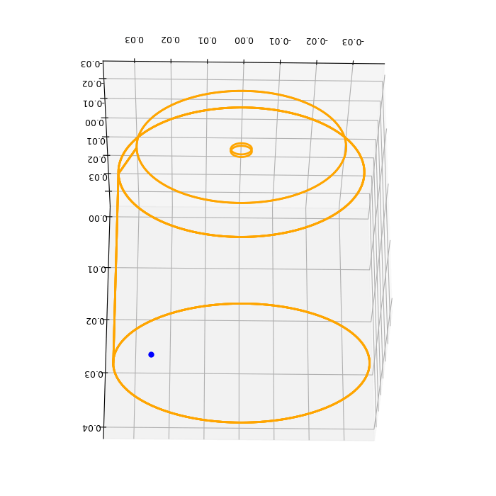
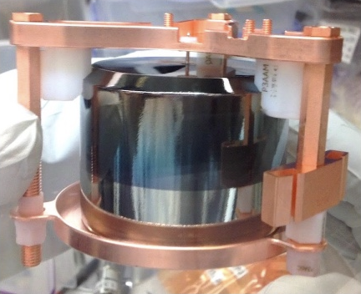
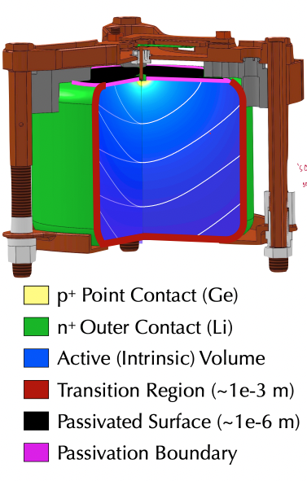
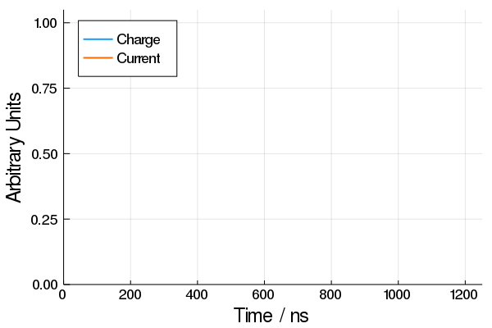
Background Rejection
~5 MeV alphas can get degraded to ~2 MeV in HPGe detector surfaces
Two major backgrounds for $0νββ$ – multi-site events, alphas
Working principle of HPGe detectors
A crystal of HPGe is coated/diffused with Li on all surfaces but one, creates the outer layer (~ 1 mm thick, called n⁺ layer)
Boron implanted p⁺ contact point
Passivation surface made of non-crystalline Ge
Works as a diode –
n⁺ Li⁺ layer at +O(kV)
p⁺ type point contact grounded
Signal generation
Energy depositions create cloud of electron-hole pairs
Holes drift to p⁺ point contact and makes up the majority of the signal, electrons move to n⁺ layer

Slide 14
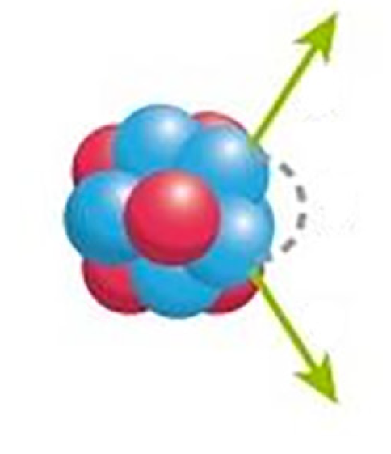
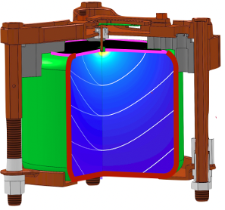
e
~1mm
e
Background Rejection
Multi-site event rejection
$0νββ$ events are single-site and located in the bulk of the detector
The current of the waveforms are used to reject multi-site events (AvsE cut)
Cut removes >90% of true multi-site events
Cut removes >50% of ROI Compton background
PRC 99 065501 (2019)
γ
p⁺ Point Contact (Ge)
n⁺ Outer Contact (Li)
Active (Intrinsic) Volume
Transition Region (~1 mm)
Passivated Surface (~1 μm)
α
EPJC 82 (2022) 226
Detector surface - for particle incident on passivated surface:
DCR cut
Detector surface - for particle incident on surface near point contact:
high AvsE cut
α

Slide 15
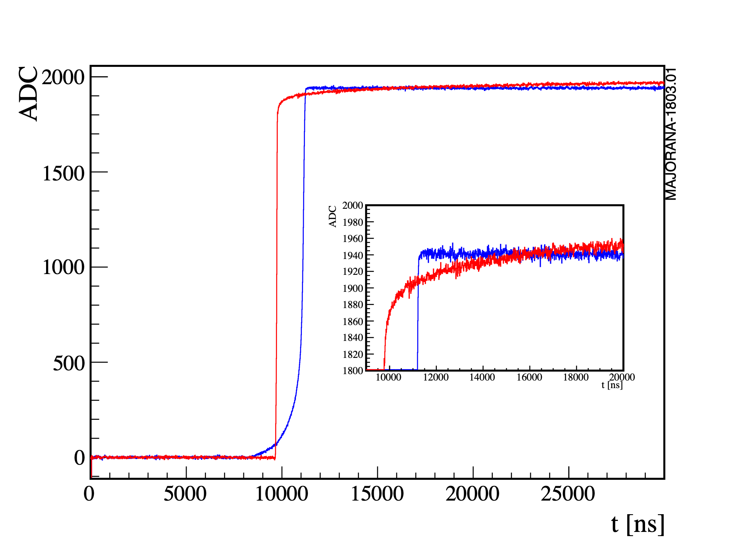
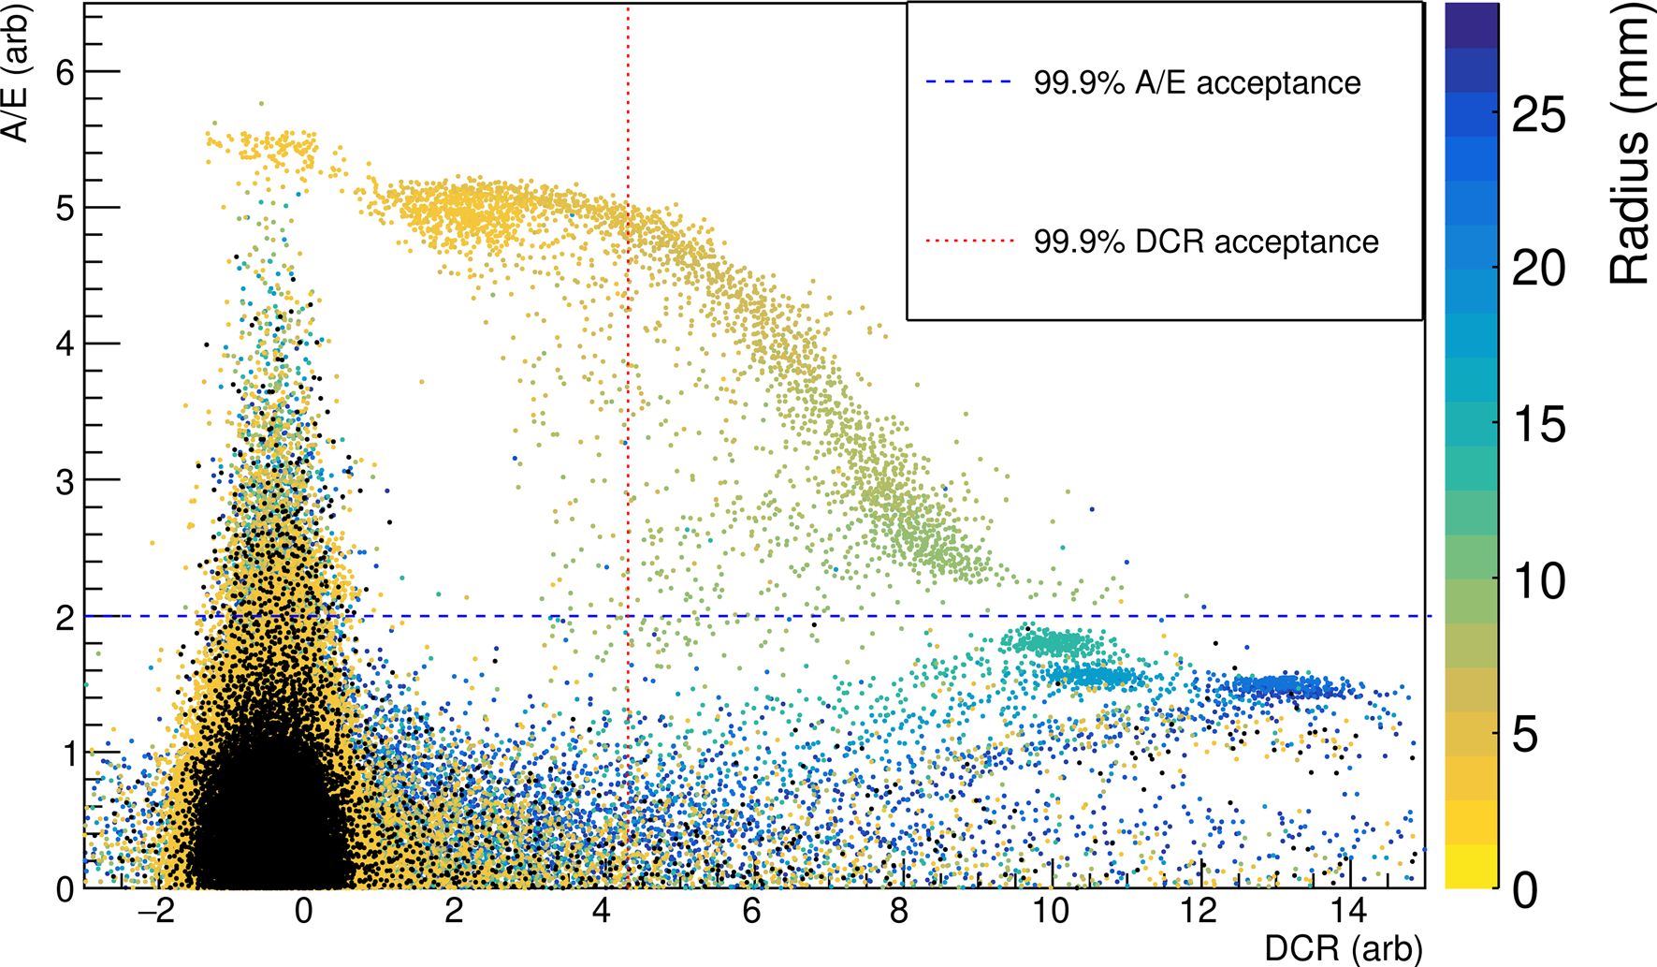
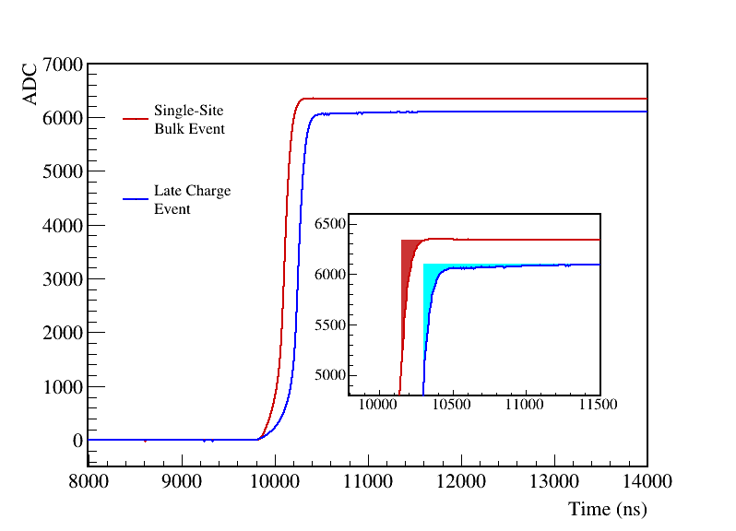
e
~1mm
e
Multi-site events in active volume: AvsE cut
Background Rejection
α
α
Surface events rejection
$α$ events on transition layer, passivated surface and near point contact
Cuts are optimized with 2615 DEP peak and Compton continuum of ²²⁸Th weekly calibration data
If $α$ event is on passivated surface far from point-contact
waveforms becomes 10-100 times slow
cut based on mean rise time (DCR cut) ($ε=0.99)$
If $α$ event is near point-contact
fast risetime of the waveform
cut based on current during the risetime (high AvsE cut) ($ε=0.98)$
If $α$ event is on transition layer
energy lost in the layer
cut based on estimation of uncollected charge for each event (LQ cut) ($ε=0.993)$
Bulk event
Surface alpha event
$α$ event near point contact
α
p⁺ Point Contact (Ge)
n⁺ Outer Contact (Li)
Active (Intrinsic) Volume
Transition Region (~1 mm)
Passivated Surface (~1 μm)
Slow Component
PRC 99 065501 (2019)
EPJC 82:226 (2022)
α

Slide 16
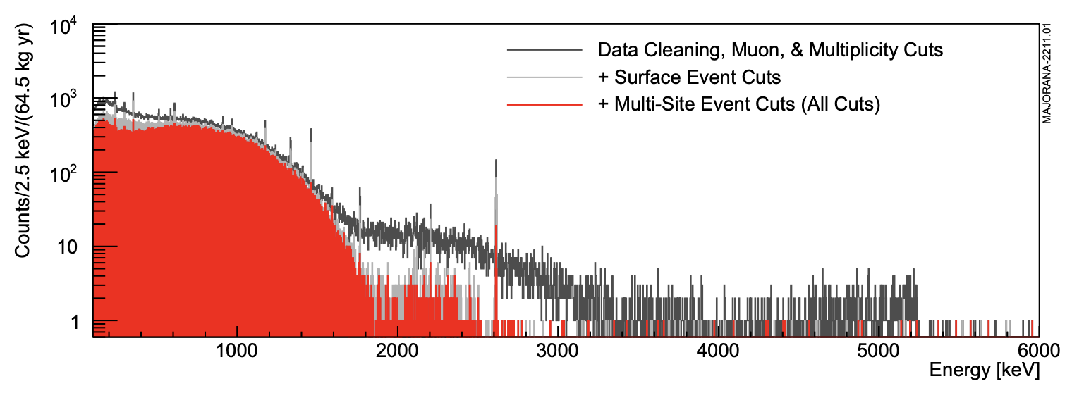
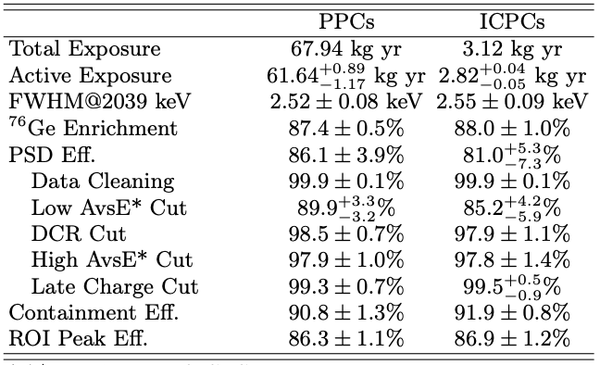
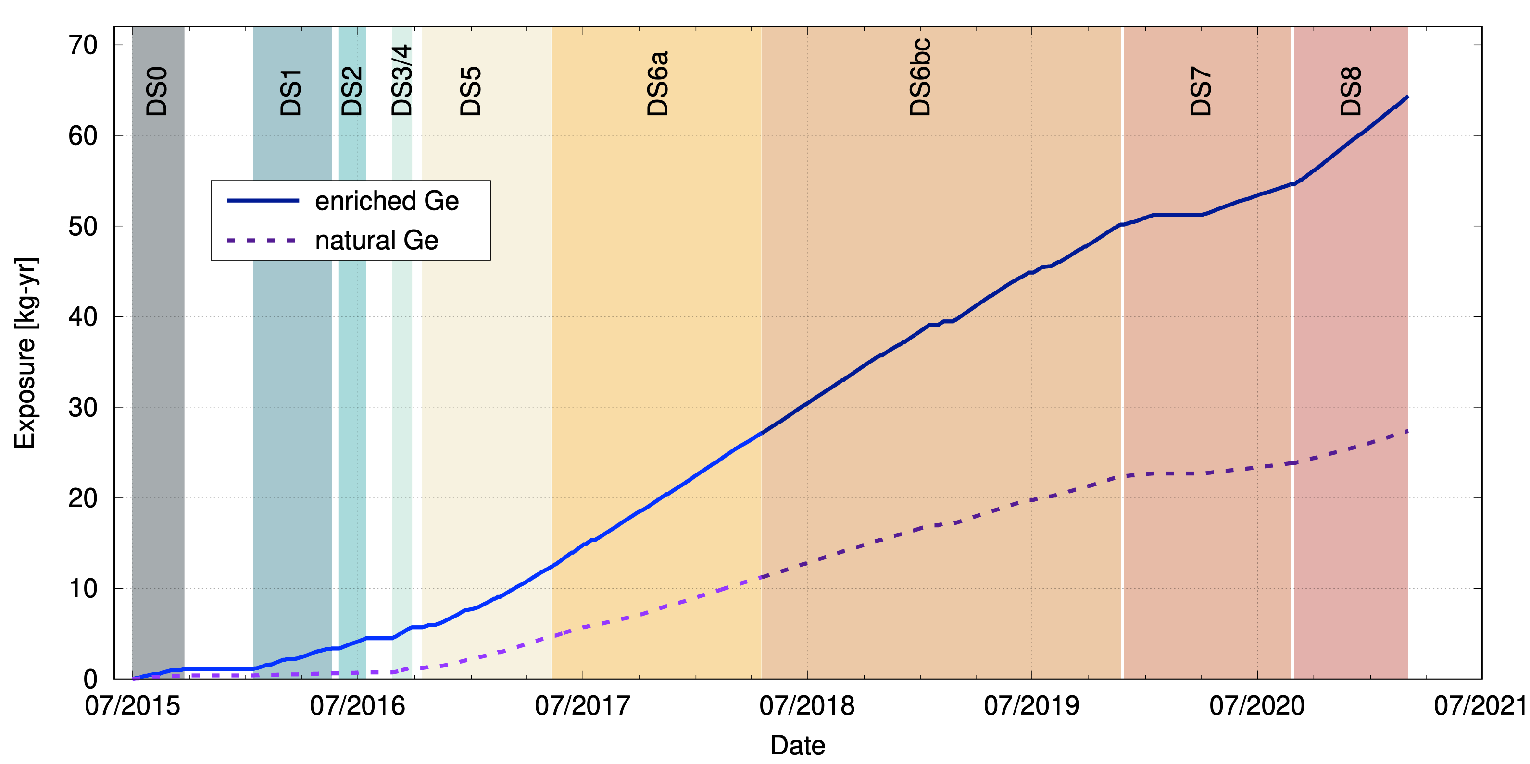
e
~1mm
e
Detector surface: for partial charge deposition in transition dead layer: LQ cut
Final MJD Spectrum
$0νββ$ region
$±5$keV around $Q_{ββ}$
Background region
Final enriched detector active exposure:
64.5 ± 0.9 kg-yr
Background region: 360 keV around ROI, excluding ±5 keV around $Q_{ββ}$
Cut efficiency at $Q_{ββ}=0.863±0.011$
Module 2 Upgrade
First Data Release:
26 kg-yr
Module 2 online
PRL 130 062501 (2023)
Module 1
α

Slide 17
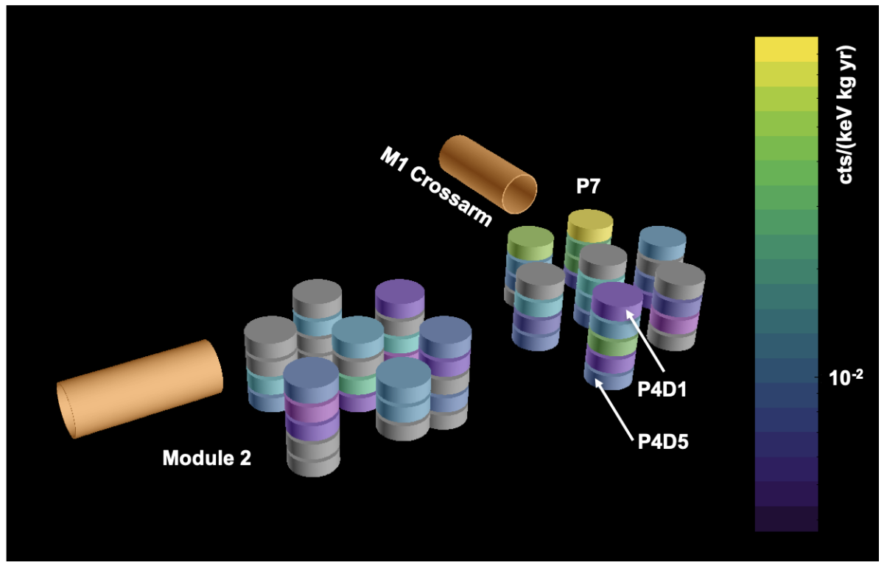
e
~1mm
e
Multi-site events in active volume: AvsE cut
Detector surface: for partial charge deposition in transition dead layer: LQ cut
Background Index Estimation
Assay based
Data based
An extensive radio-assay program was undertaken
Methods: ICPMS, $γ$-ray counting, GDMS, NAA
²³²Th and ²³⁸U chain were measured
MJD already had significantly low background than
previous generations
operating in vacuum cryostat
material cleanliness
shielding during transportation
Background Index (BI) = $0.9±0.36$ cts/keV/t/y
Background window: 360 keV region around $Q_{ββ}$
Background index at 2.039 MeV
Module 1: 7.4 ± 0.7 cts/keV/t/y Module 2: 3.4 ± 0.8 cts/keV/t/y
At low BG configuration:
6.2 ± 0.6 cts/keV/t/y
PRC 110 055804 (2024)
NIM A 828 (2016)
α
Heatmap of 2615 keV peak of ²³²Th in MJD apparatus
Gray detectors are turned off

Slide 18
Results From The MAJORANA DEMONSTRATOR

Slide 19
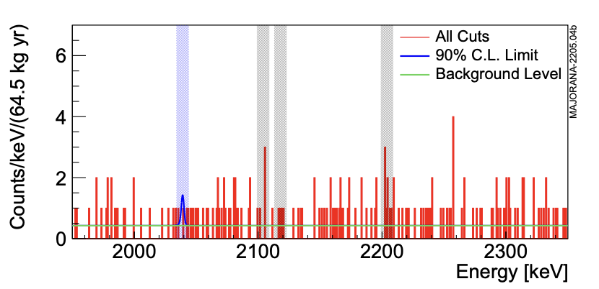
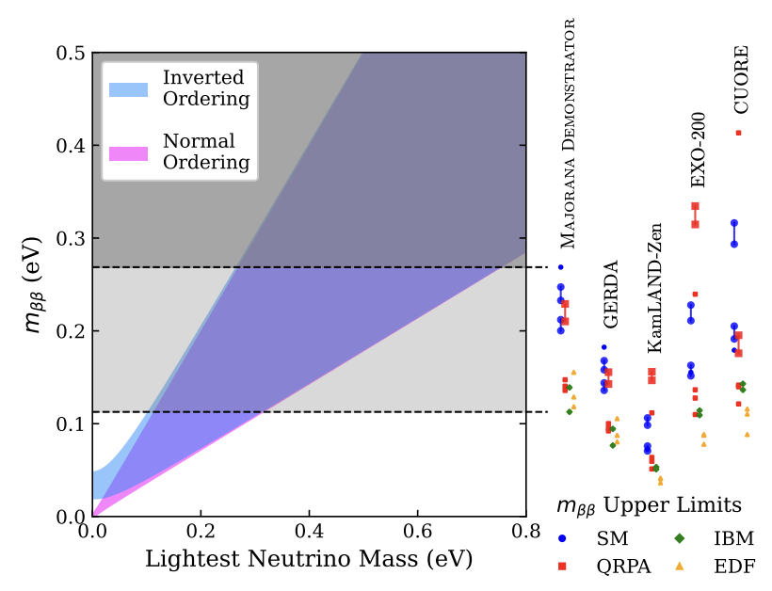
e
~1mm
e
Multi-site events in active volume: AvsE cut
Detector surface: for partial charge deposition in transition dead layer: LQ cut
$0νββ$ Decay Final Result
Effective Majorana mass of neutrinos
$$m_{ββ}=Σ_{i=1}^{3}{\left|U_{ei}\right|}^{2}m_{i}$$
$$113<m_{ββ}<239 eV$$
Nuclear matrix models
QRPA
Shell Model
Interacting Boson Model
Energy Density Functional Model
$$2.66<M_{0ν}<6.34$$
$0νββ$ ROI
Events found in the $Q_{ββ}$ region = 1
Expected background count = 1.52
$0νββ$ half-life results
$0νββ$ in ⁷⁶Ge not observed
Frequentists limits
90% C.L. median sensitivity : $T_{\frac{1}{2}}>8.3×{10}^{25} y$
Feldman-Cousins limit at 90% C.L. : $T_{\frac{1}{2}}>7.2×{10}^{25} y$
Bayesian limits
90% C.I.
flat prior: $T_{\frac{1}{2}}>7.0×{10}^{25} y$
Jeffrey’s prior: $T_{\frac{1}{2}}>1.1×{10}^{26} y$
α
Notes:
Mention- MJD got comparable results with exposure lower by multiple factors

Slide 20
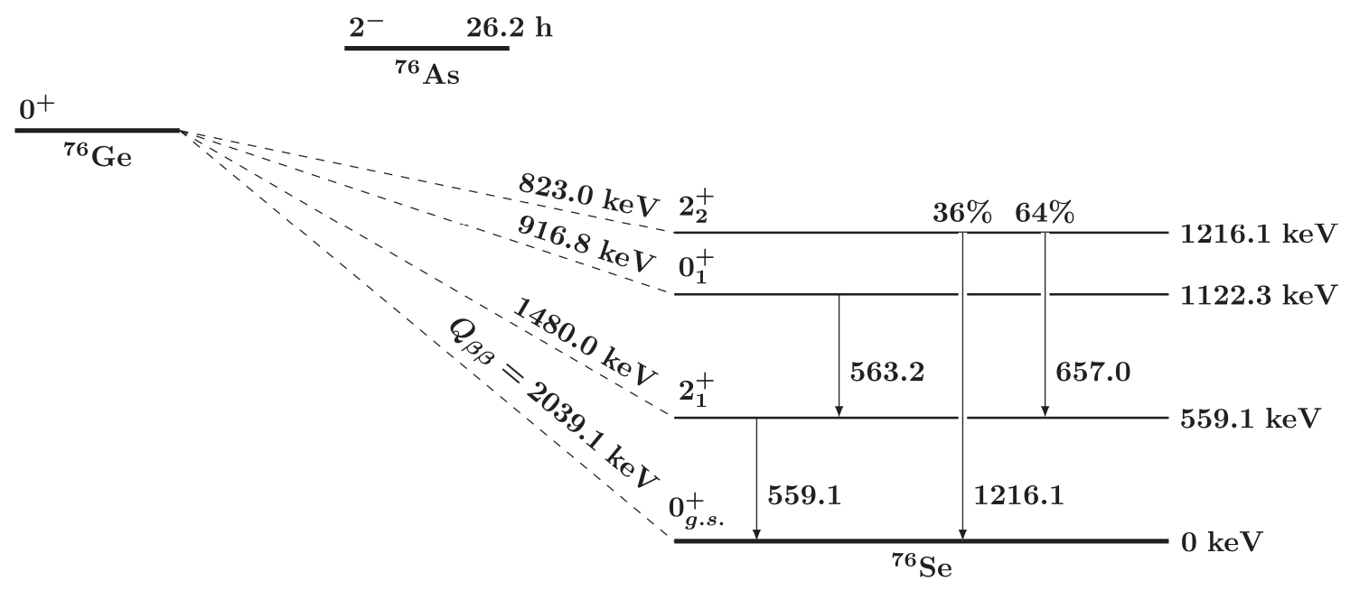
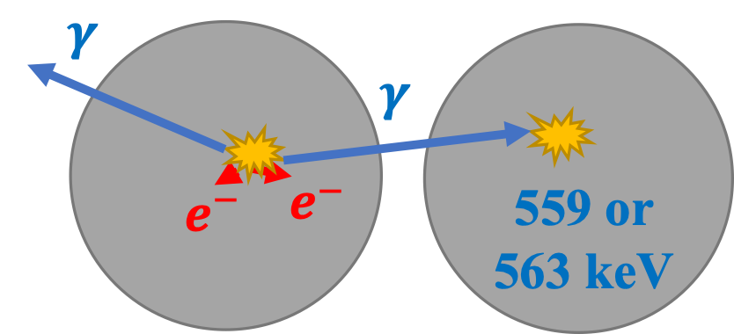
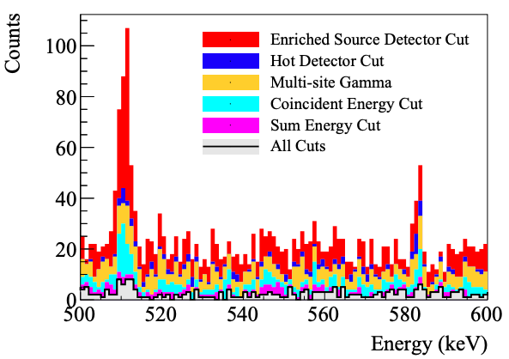
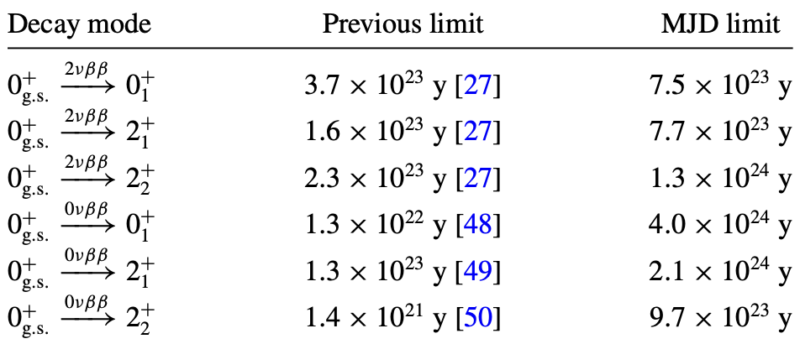
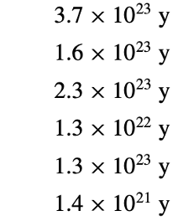
Excited State Decays of ⁷⁶Ge $→$⁷⁶Se*
3 possible final states : ${J_{n}^{π}=2}_{1}^{+}, 0_{1}^{+}, 2_{2}^{+}$
2 decay modes : $0νββ, 2νββ$
Signature: $γ$-rays at 559.1, 563.2, 657.0, 1216.1 keV promptly after the $ββ$ decay
Inherently multi-site events
The most stringent limits to date for ββ to each excited state of ⁷⁶Se
$$1.5 ×{ 10}^{24}y$$
$$3.0 ×{ 10}^{24}y$$
$$0.88 × {10}^{24}y$$
$$7.6 × {10}^{24}y$$
$$3.5 × {10}^{24}y$$
$$6.6 × {10}^{24}y$$
arXiv: 2410:03995

Slide 21
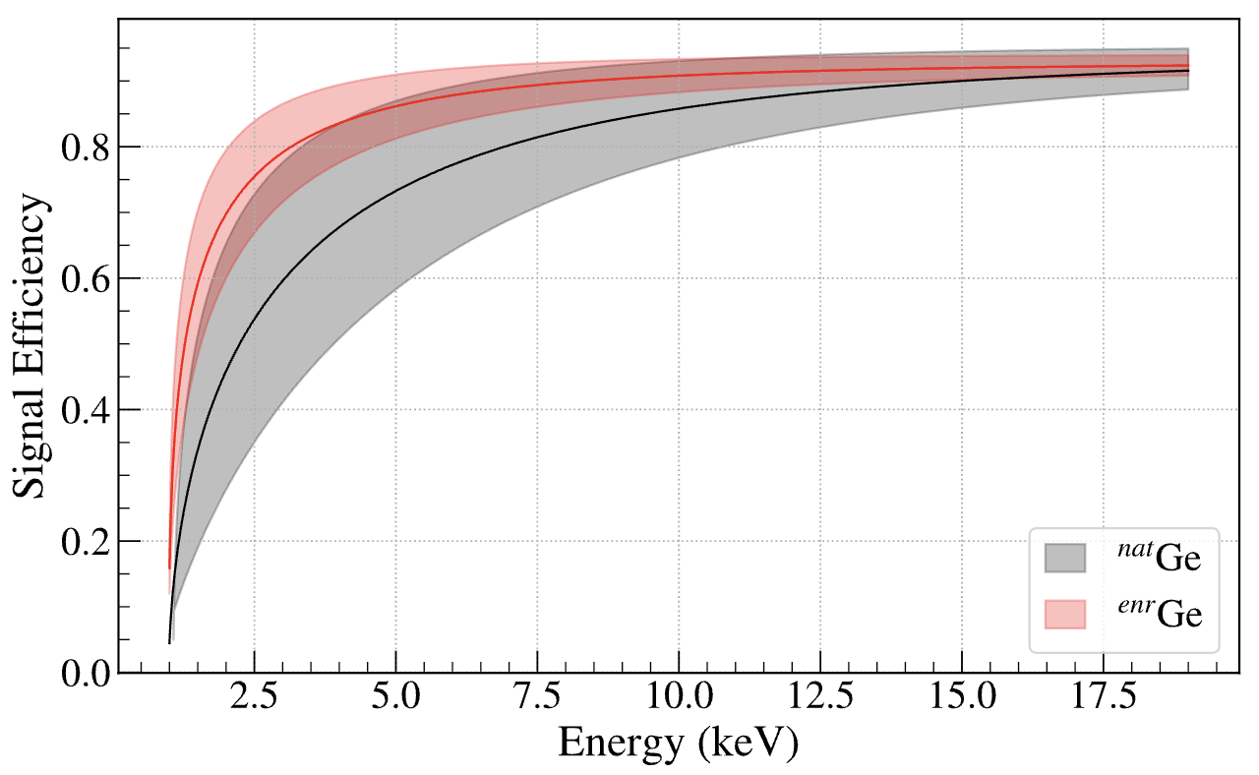
e
~1mm
e
Multi-site events in active volume: AvsE cut
Detector surface: for partial charge deposition in transition dead layer: LQ cut
Broad Physics Program of the MAJORANA DEMNSTRATOR
$ββ$ searches
⁷⁶Ge GS$→$⁷⁶Se GS
⁷⁶Ge GS$→$⁷⁶Se ES
Backgrounds
Cosmogenics
($α,n)$ activations
Muonic activations
Neutron activations
^{180m}Ta decay
Tests of fundamental laws
Baryon number violation
LNV through Majorons
Charge non-conservation
PEP violation
Dark matter
searches
Pseudo-scalar dark matter
Vector dark matter
Fermionic dark matter
Sterile neutrino
Solar axions
Exotic Physics
Lightly ionizing particles
Wave function
collapse
PRL 130 062501 (2023)
PRC 103 015501 (2021)
PRC 105 064617 (2022)
PRD 99 072004 (2019)
PRL 120 211804 (2018)
PRC 105 014617 (2022)
Nat. Phys. 20 1078-1083 (2024)
PRL 118 161801 (2017)
PRL 131 152501 (2023)
PRL 129 239902 (2023)
PRL 129 081803 (2022)
PRL 132 041001 (2024)
Low noise components around the detector
Low threshold of the detectors (~1 keV)
Low background and excellent energy resolution across broad energy region
Signal efficiency reaches ~$ε_{Q_{ββ}}$(=0.863) within 10-15 keV
α

Slide 22
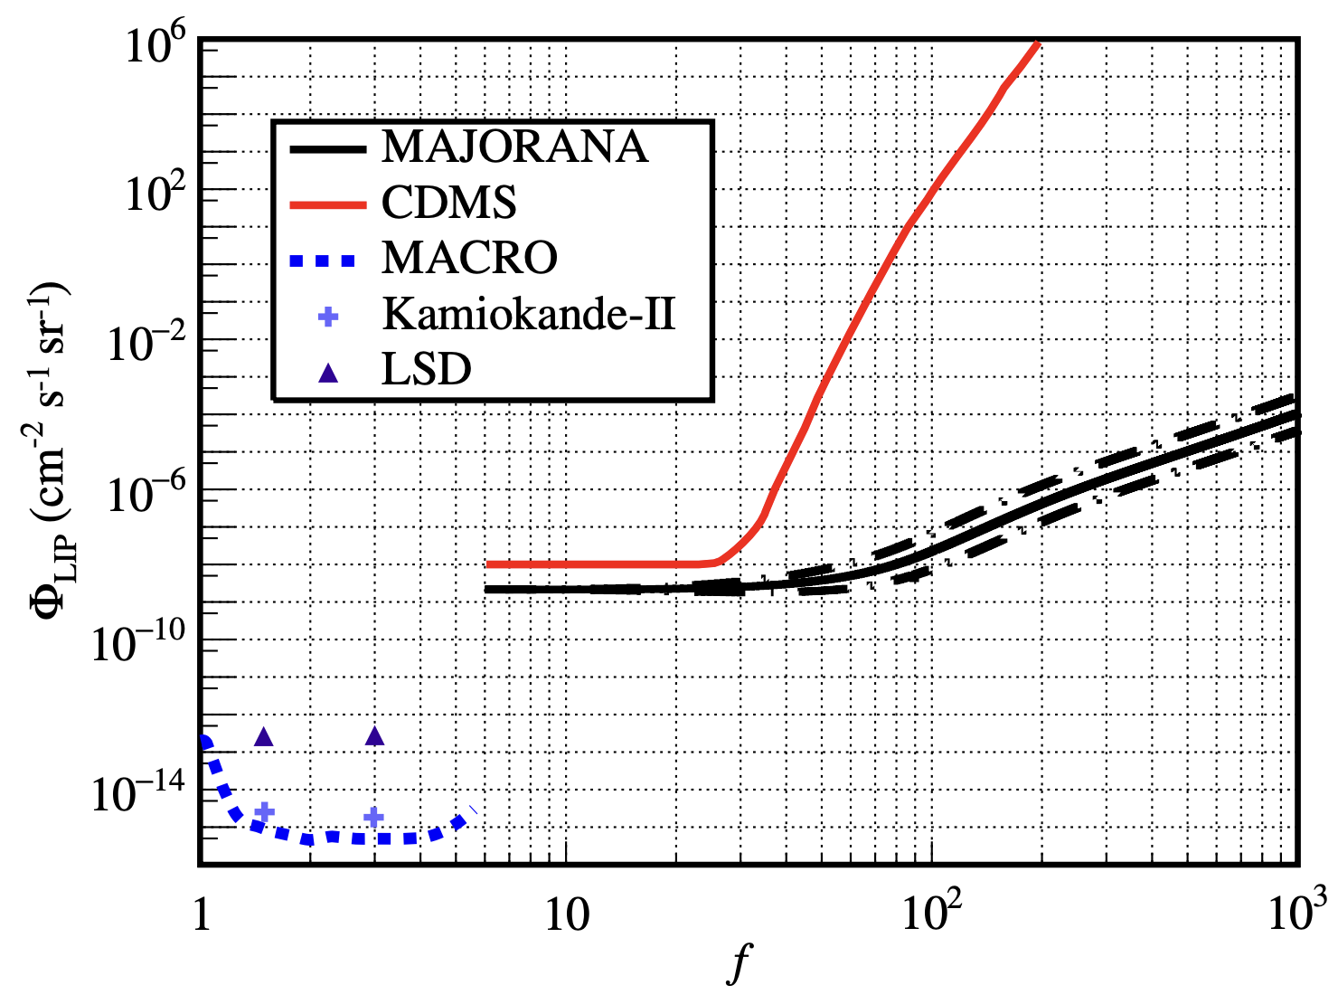
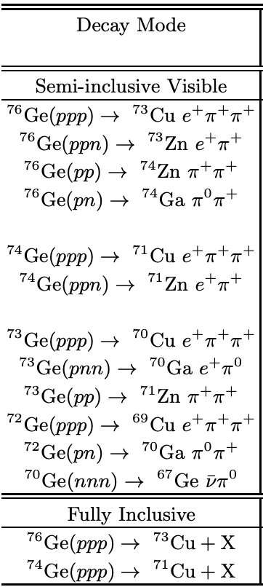
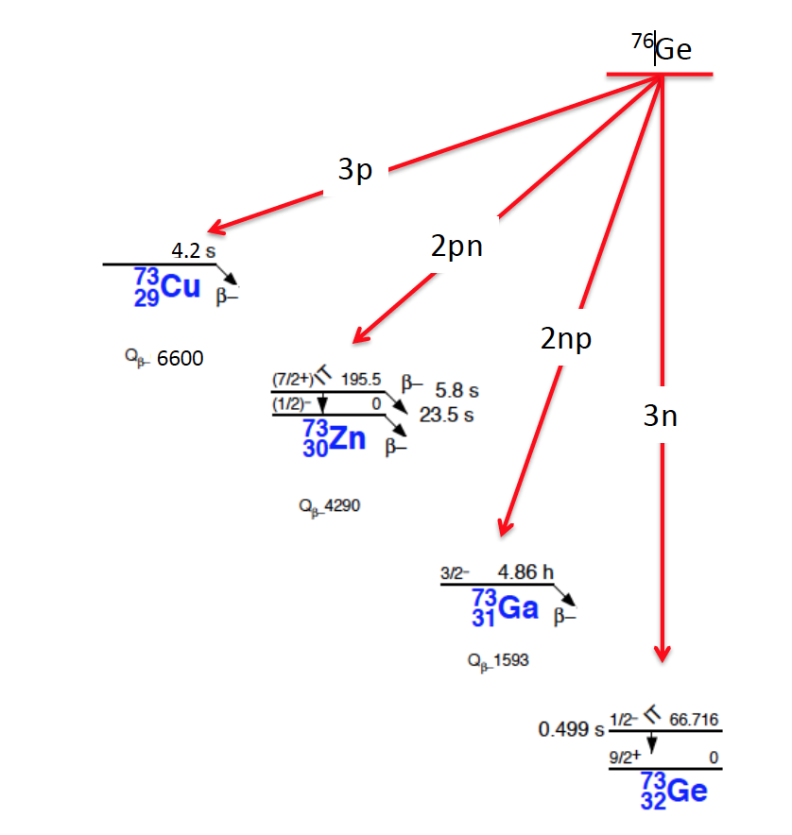
Fractional Charge With LIPs
Baryon Number Violation
With Tri-nucleon Decay
Free fractional charge ($e^{′}=e/f$) forbidden in SM
Existence of such fractional charge would have different magnitude of electro-magnetic interaction (and hence ionization)
First limit set by MJD for any non-accelerator based experiment for electron charge fraction below e/200 and as low as e/1000
P(free fractional charge down to e/1000)<10⁻³
Baryon number violation is one of three Sakharov Conditions
Tri-nucleon decays have $ΔB=3$
Fourteen processes (including two $ΔB=2$ processes) measured
None observed, UL of upper limit for all set to be $T_{\frac{1}{2}}>{10}^{24}y$
$$T_{\frac{1}{2}}>1.84×10^{26}y$$
$$T_{\frac{1}{2}}>1.82×10^{26}y$$
The 90% UL for two tri-nucleon
decay-specific modes
90% UL of LIP flux
with 1$σ$ band
PRL 120 211804 (2018)
arXiv: 2412.16047 (2025)
Notes:
MJD result band is 1 sig
LIP = Lightly Ionizing Particle (i.3. fractional charge makes the EM interactions weaker, so lighter ionization)

Slide 23
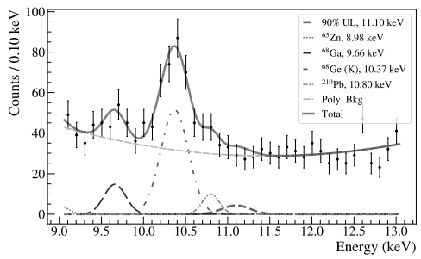
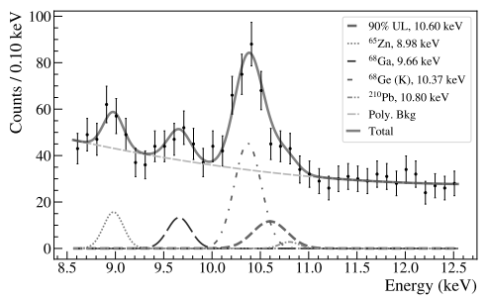
Charge non-conservation and PEP violation
PEP violation
PEP violation through –
External electron (e.g. by pair production) transition to atomic shell
Already existing electron transition to a lower state
Signature: Slightly energy degraded x-rays due to existence of a new electron in the shell (e.g. K-shell x-ray of ⁷⁶Ge shifts to 10.6 keV from 11.1 keV)
Result: Not observed
External e⁻: $\frac{β^{2}}{2}<3.69×{10}^{−4}$, ~1.7x improvement
Internal e⁻: $\frac{β^{2}}{2}<1.03×{10}^{−48}$, ~8x improvement
Charge non-conservation
(Invisible mode)
$e^{−}→ν_{e}\overline{ν_{e}}ν_{e}$
Signature: 11.1 keV peak (K-shell x-ray of Ge, most prominent)
Result: Not observed ($T_{\frac{1}{2}}>2.83×{10}^{25}y$)
(~10x improvement
over previous limit)
Nat. Phys. 20
1078-1083 (2024)
Notes:
Borexino looked for e -> v + gamma (visible mode), halflife set to be 10^28y

Slide 24
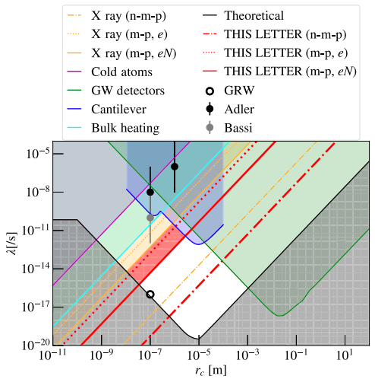
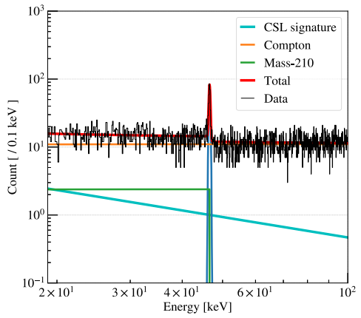
Wave Function Collapse Rate
Models explored –
Continuous Spontaneous Localization (CSL) model
Diosi-Penrose (DP) model
Both involves random process, independent/dependent on particle mass
Signature: 1/E fall of energy spectrum
For $r_{c}={10}^{−7}m$, $λ<{10}^{−19}−{10}^{−12} 1/s$
40-100 times improvement over previous
results
PRL 130 239902 (2023)
Notes:
Lambda = collapse rate
Rc = correlation length
Lower lambda means decoherence happens slower, so the system doesn’t stay quantum for long and we shouldn’t see say double slit experiment result
There has to be a higher limit also so that after mesoscopic scale, it loses the decoherence

Slide 25
Solar Axion
Axions produced by reverse-Primakoff
effect in Sun
Axion-photon coupling constant measured $g_{aγ}<g_{aγ}<1.45×{10}^{−9}GeV^{−1}$ at 95% CL
Improvement upon DAMA limit from
2001
Signature of solar axion
X axis: Time of day (0-24 hr)
Y axis: Energy (0-12 keV)
Z axis: Event rate
Notes:
Lambda = collapse rate
Rc = correlation length
Lower lambda means decoherence happens slower, so the system doesn’t stay quantum for long and we shouldn’t see say double slit experiment result
There has to be a higher limit also so that after mesoscopic scale, it loses the decoherence

Slide 26
^{180m}Ta Half-life
^{180m}Ta is nature’s longest lived isomer
GS is observed to decay with only 8.5 hour half-life
17 kg Ta disks were inserted inside Module 2
Signature: Many $γ$-rays possible based on the daughter nucleus
1 year of data analyzed and published
Result: No observation of ^{180m}Ta decay
$T_{\frac{1}{2}}>0.29×{10}^{18}y$
1-3 orders of magnitude improvement over previous results
Next phase analysis with 3 times more exposure currently on-going
PRL 131 152501 (2023)

Slide 27
On-going Analyses

Slide 28
Cosmogenic Neutron Activations
^{enr}Ge
Neutron activations during transportation and processing
Isotopes produced: ⁴⁹V, ⁵⁵Fe, ⁶⁵Zn, ⁶⁸Ge, ³H etc.
Negligible effect in $0νββ$ ROI
Signature: activated isotopes’ x-rays
Peaks around and below 10 keV
Noise dominated low energy spectrum and extreme low activations of most desired isotopes make it particularly difficult to probe this part of the MJD spectrum
MJD’s extensive ^{enr}Ge tracking database being utilized
PRELIMINARY
^{nat}Ge
PRELIMINARY
Neutron activated cosmogenics spectra of MJD

Slide 29
Background Modeling & BSM Physics Search
Detailed background modelling nearly done, paper coming out soon
BI differ by multiple factors between assay-based projection and MC based analysis
Assay based: 0.9 cts/keV/t/y, Data based: 3.4 – 7.4 cts/FWHM/t/y
Excess ruled out to be coming from near detector components
Improved Frequentist and Bayesian fitting process underway to precisely locate source of excess background
pdfs generated with MaGe, a GEANT-4 based simulation package
Will impact-
$2νββ$ result
BSM searches (e.g. phase space configurations of Majoron, LIV)
Heatmap of 2615 keV peak from ²³²Th in MJD array
PRELIMINARY
Notes:
Mentin non-uniformity of bkg,

Slide 30
Summary & Outlook
The MAJORANA DEMONSTRATOR, a $0νββ$ experiment in ⁷⁶Ge–
Started data taking in 2015 and still continues to do so
2015-2022 $0νββ$ data, 2022-present Ta data
Best energy resolution among $0νββ$ experiments
$0νββ$ half-life lower limit set to be $>8.3×{10}^{25}y$ from 64.9 kg-y exposure
Improved half-life limit for ^{180m}Ta ($>0.29×{10}^{18}y)$
35+ journal articles published on broad range of physics
Late stage analyses currently on-going
Background modeling, BSM searches, cosmogenics
Next-gen experiment LEGEND currently on-going
This material is supported by the U.S. Department of Energy, Office of Science, Office of Nuclear Physics, the Particle Astrophysics and Nuclear Physics Programs of the National Science Foundation, and the Sanford Underground Research Facility.

