Slide 1
Search for new physics
in MINER using
Cryogenic and Non-cryogenic detectors
CIPANP - 2025
Speaker: Sharada Sahoo
Contributors: Mahdi Mirzakhani (TAMU),
Dipanwita Mondal (NISER)
Supervisor: Dr. Rupak Mahapatra

Slide 2
Outline
Introduction to Axion/ Axion Like Particles (ALP) and CENNS
ALP and CENNS expected signal from 1MW TRIGA reactor at Texas A&M
Cryogenic detector
Experimental setup
Data acquisition and data analysis
Future projection at Miner 2.0 @ HFIR, Oak ridge national lab
Non-cryogenic detector
Experimental setup
Data acquisition and data analysis
Future projection at Miner 2.0 @ HFIR, Oak ridge national lab

Slide 3
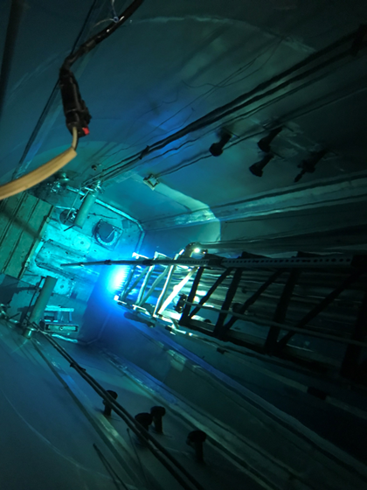
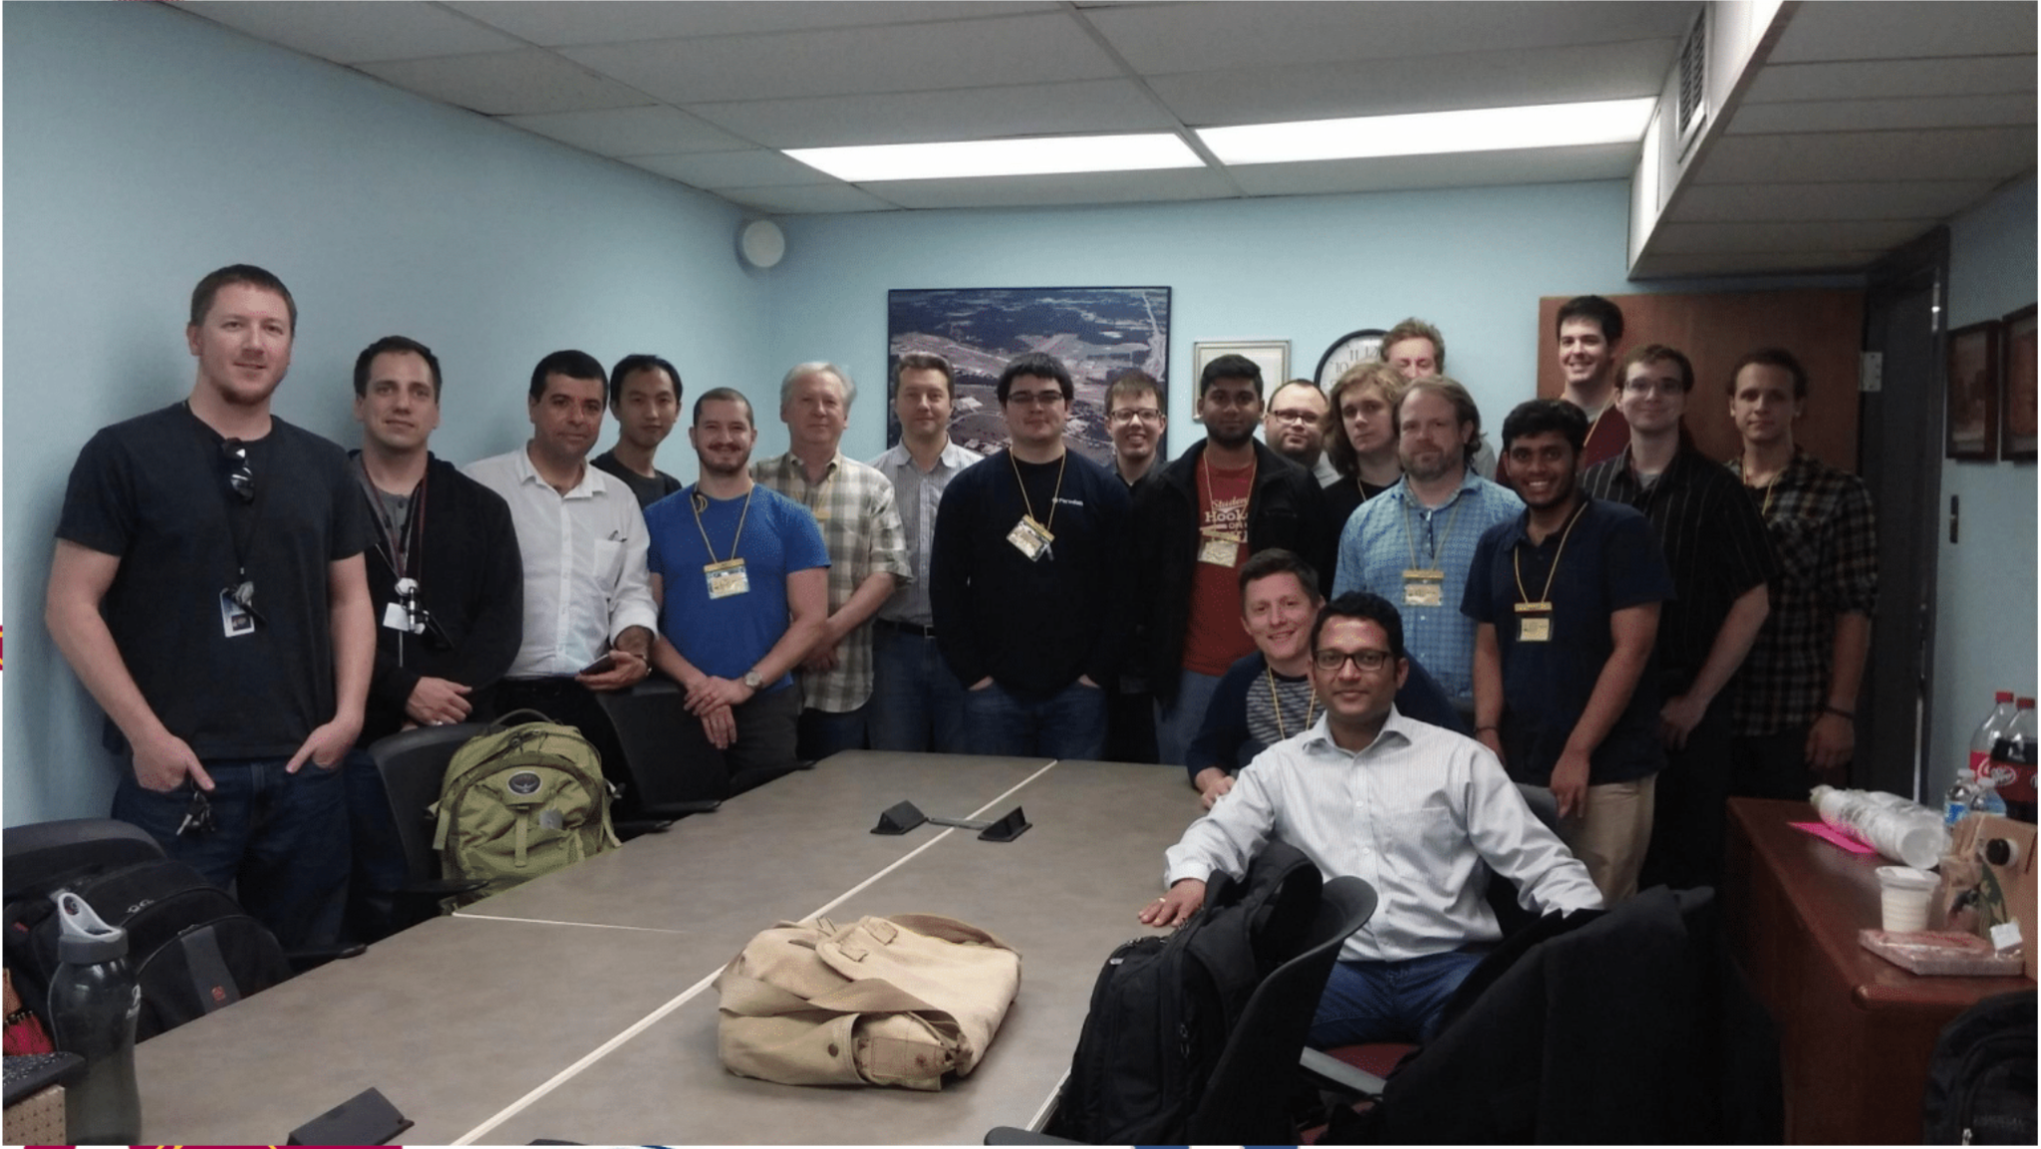
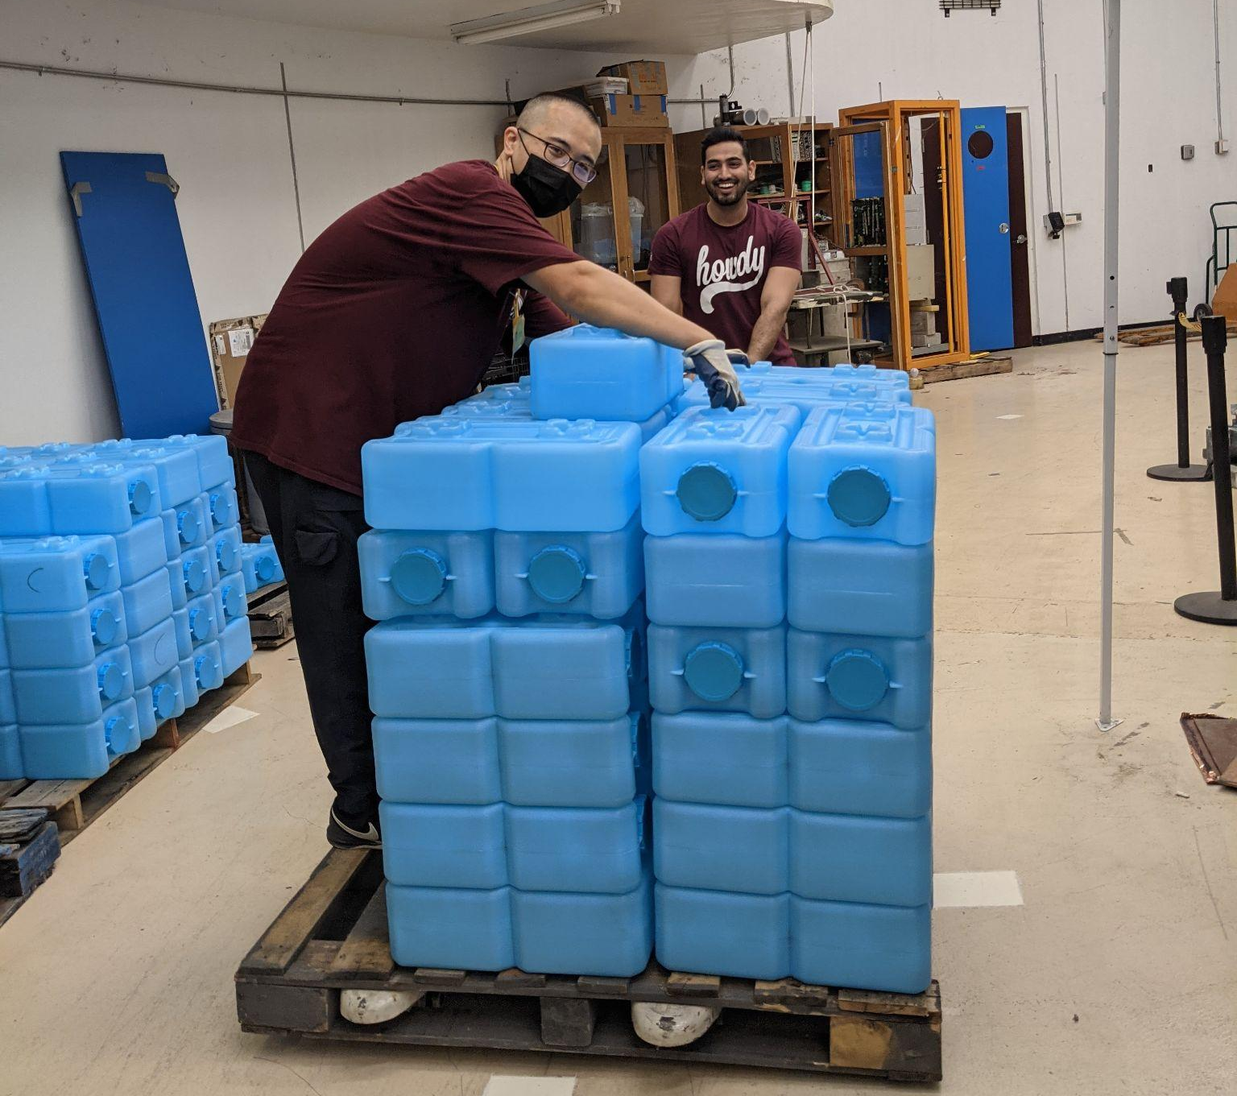
MINER experiment
1 MW TRIGA Reactor, TAMU
Mitchell Institute Neutrino Experiment at Reactor (MINER) collaboration from TAMU, UT- Austin, NISER and USD
Aimed to search for first ever CENNS at reactor.
Also search for WIMP dark matter / axions/ ALP etc..

Slide 4
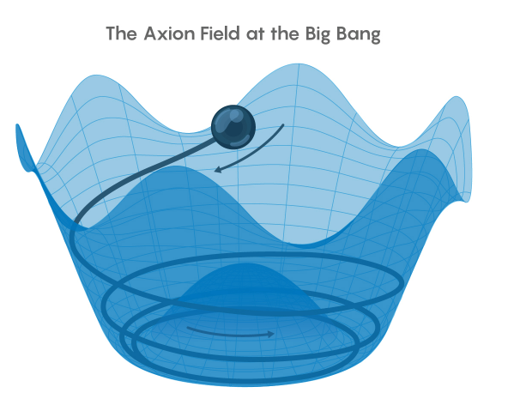
Introduction to Axion/ Axion Like Particles (ALP)
Solves strong CP problem?
Conserving CP symmetry in strong interaction. Imposing 𝛩 < 10⁻¹¹ in the lagrangian of strong interactions and making CP non-conservation term to zero.
What are ALPs?
Breaking of other BSM symmetry (string theory, super-gravity) leads to ALPs creation.
Suitable candidates for dark matter?
Having low interaction cross-section. Also can explain the higher Dark Matter existence in the early universe.
Could also explain matter-antimatter asymmetry?
Only counter-clockwise rotation of 0 < 𝛩 < 360 producing more matter than antimatter in the universe. Finally 𝛩 settling ~ 0 for energy favourable state.
https://arxiv.org/pdf/1910.02080
https://www.quantamagazine.org/axions-would-solve-another-major-problem-in-physics-20200317/
Axion/ ALPs:
Mass: 10⁻¹² - 10¹² eV
Charge: 0
Spin - 0 (pseudoscalar)
Interaction particles: gamma, electron, nucleon, gluon (QCD axion only)
𝛩 < 10⁻¹¹
CP symmetry violation term
(𝜃 + 𝜀)
Notes:
Theory read

Slide 5
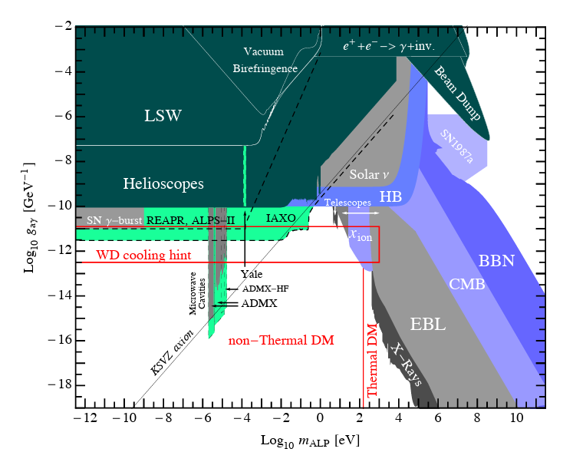
Current ALP search result near the cosmological triangle
Experiments looking for ALPs in the region
NEON detector: 17 Kg NaI(Tl) located at 24 m from 2.8 GW reactor.
Just probing the region with ~ 100 days of reactor data.
DUNE-like detector: (LAr and GAr) near 1.2 MW 120 GeV proton target on graphite.
Plan to cover the cosmological triangle with ~ 7 yr data.
Iso-DAR: 2.26 kton liquid scintillator counter located 17 m from the gamma source.
10 mA of 60 MeV proton produced from cyclotron target on beryllium.
Just probing the region with ~ 10 yrs of data.
CCM - LANL: 5 ton LAr located at 23 m from the source.
100 µA of 800 MeV proton impinge on thick W target producing 0.1 - 1000 MeV photons.
Expected to almost cover the space with ~3 yrs of data.
arxiv:1205.2671

Slide 6
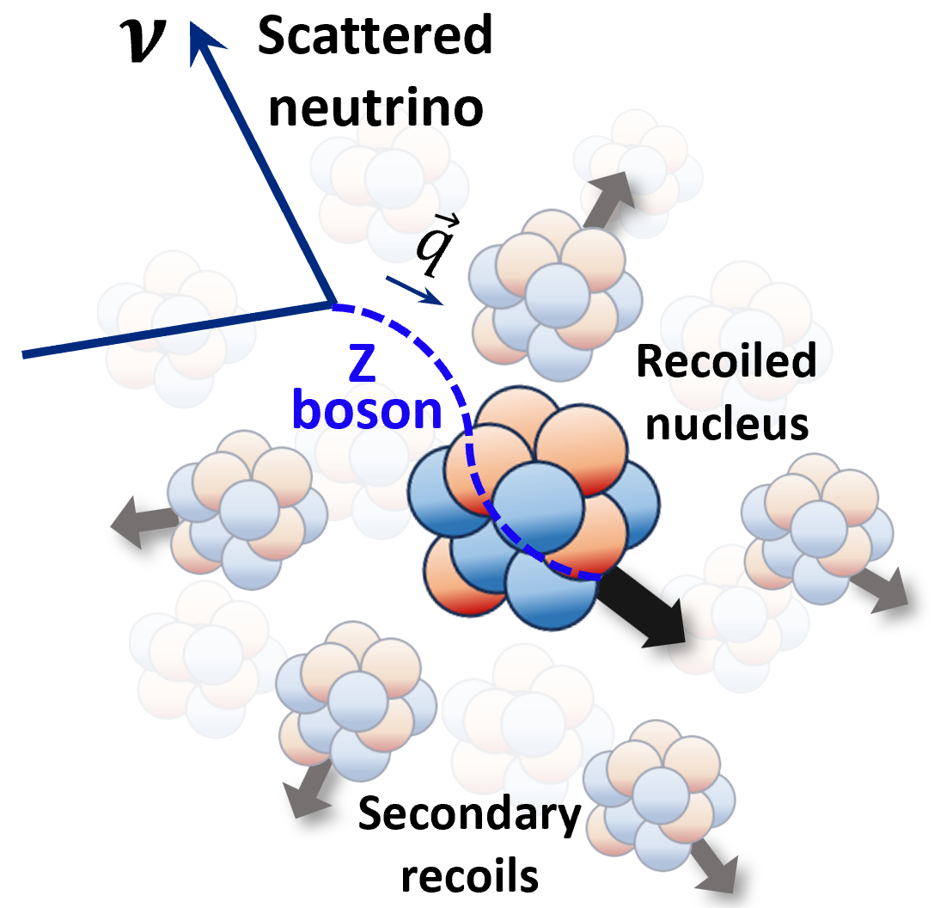
Introduction to CENNS
CENNS: Coherent Elastic Neutrino Nucleus Scattering
Neutrino interacts with the nucleus as a whole
(Combined cross-section from all nucleons)
Low momentum transfer : |q| < 1/R_{Nucleus} ( T < 10 keV)
σ_{Total} = (Σ_{i = 1}^{N} σ_{i})² = N²σ²
Weak interaction mediated by Z boson
Importance:
Confirm the SM prediction
Understand neutrino background in WIMP search
Test for potential sterile neutrino (4th neutrino)
Detection:
COHERENT: First CENNS detection
CONUS: Claiming 1st reactor CENNS detection with 3.7σ significance.
Arxiv: 2501.05206
EPL, 143 (2023) 34001
Notes:
Theory read

Slide 7
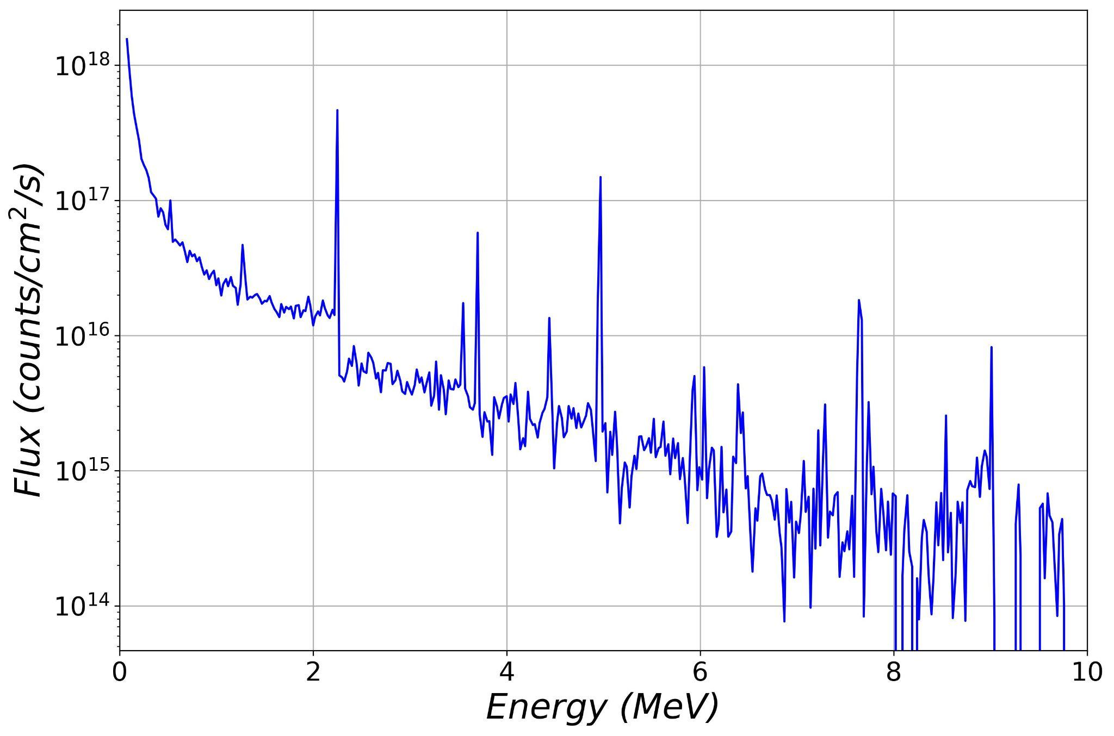
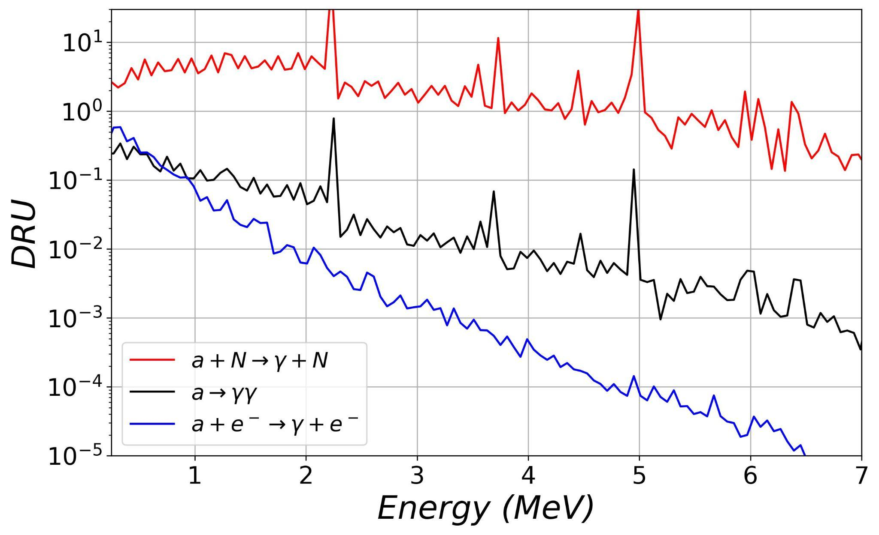
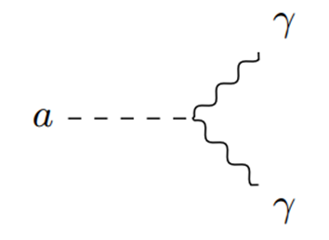
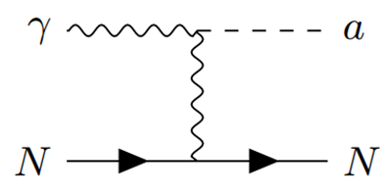
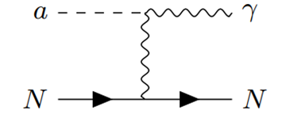
Reactor ALP search - Expected signal
DRU = Counts / (keV.kg.day)
Reactor Gamma flux
Reactor ALP signal at the detector
m_{a}= 1 keV
g_{a𝛾𝛾} = 10⁻³
g_{aee} = 10⁻⁵
Survival
arxiv:2011.07054

Slide 8
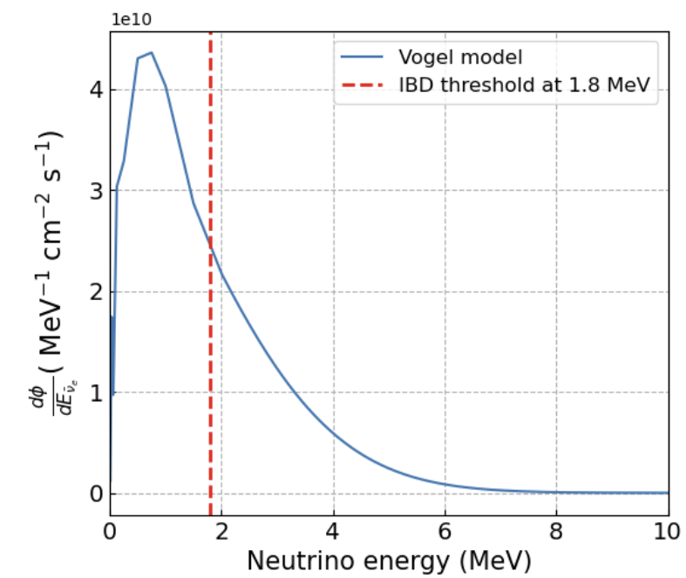
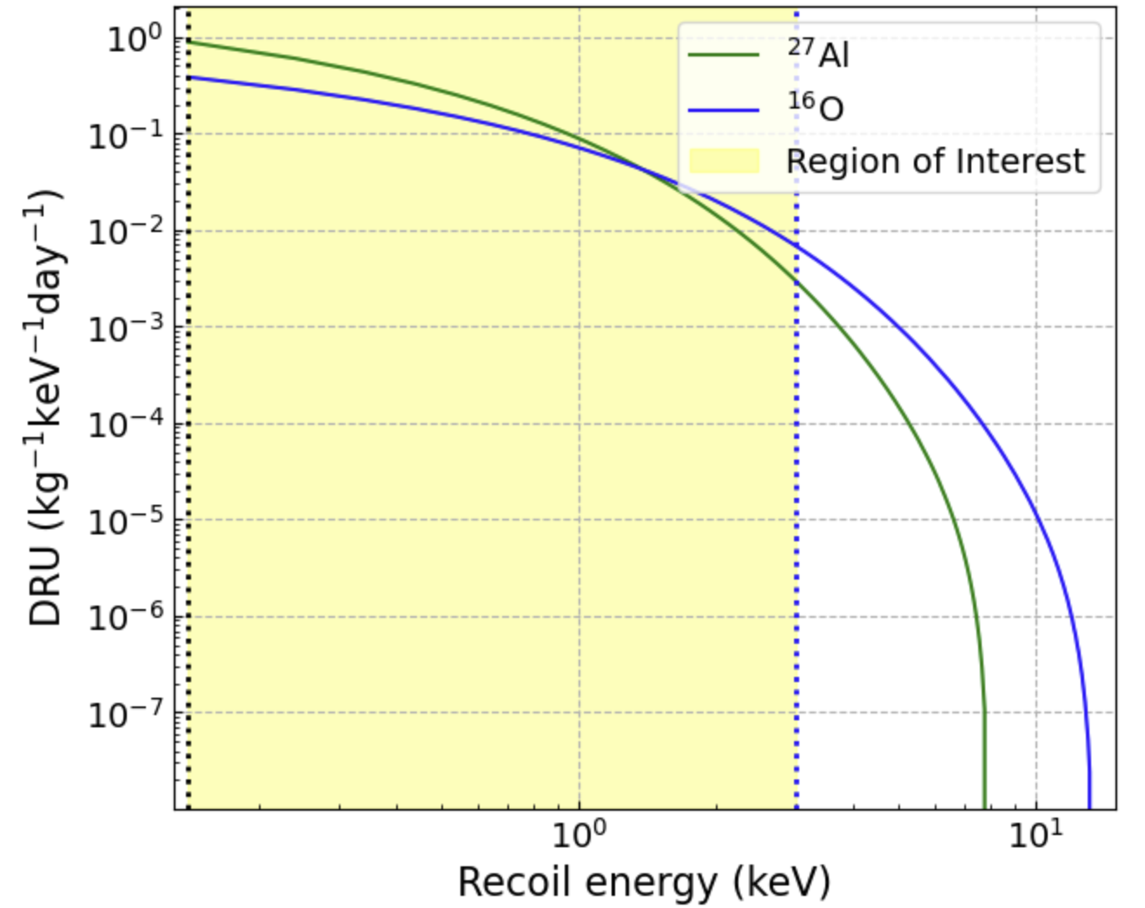
Reactor CENNS search - Expected signal
EPL, 143 (2023) 34001
Reactor Neutrino flux
Reactor Neutrino signal at the detector
140 eV- 3 keV
Reproduced from: JHEP04(2020)054

Slide 9
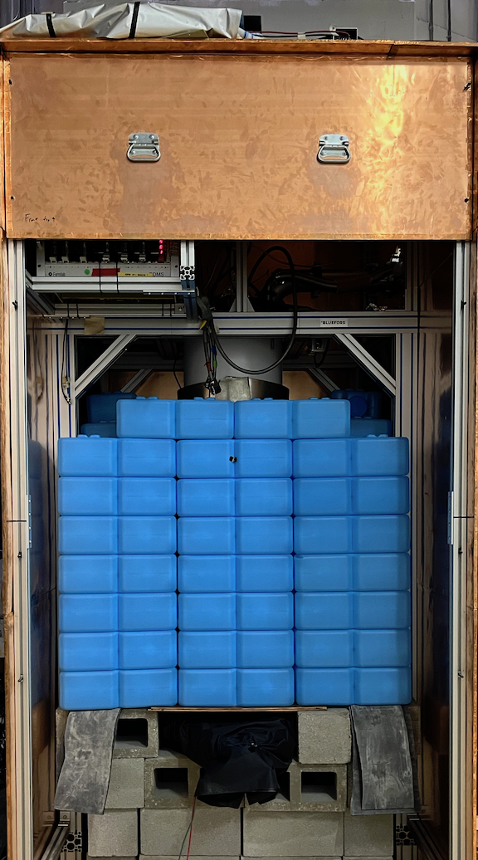
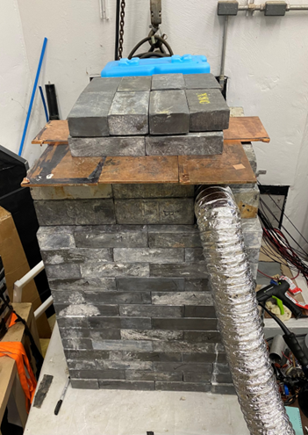
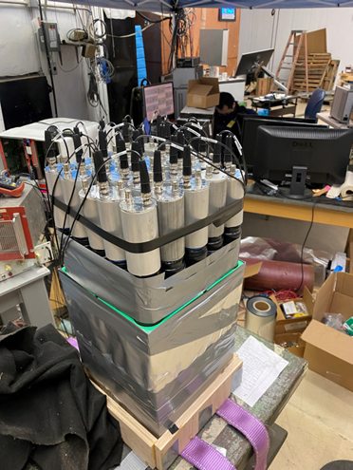
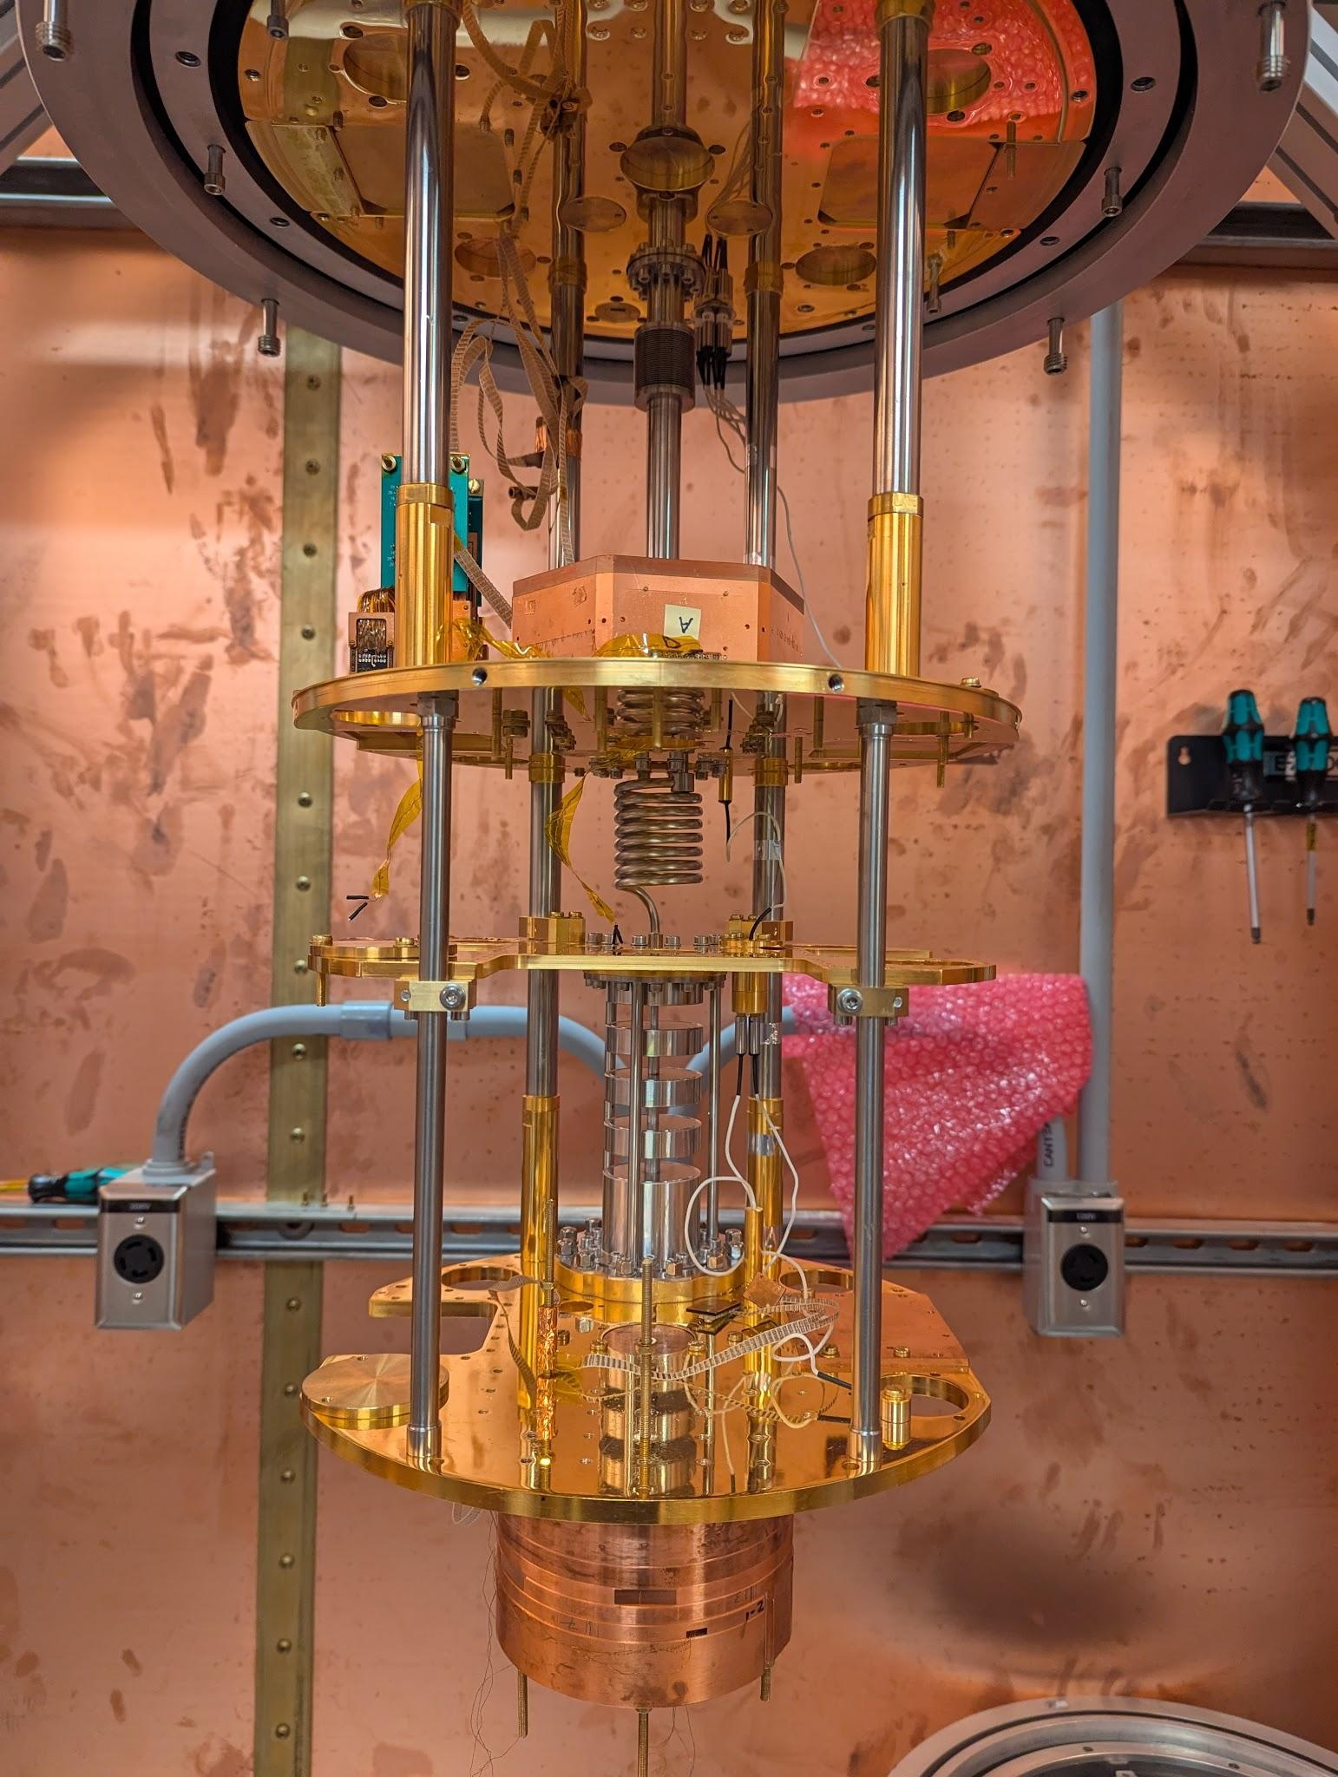
MINER experimental set-up
Non-Cryogenic detectors
Cryogenic detectors
ALPs
CENNS
ALPs

Slide 10
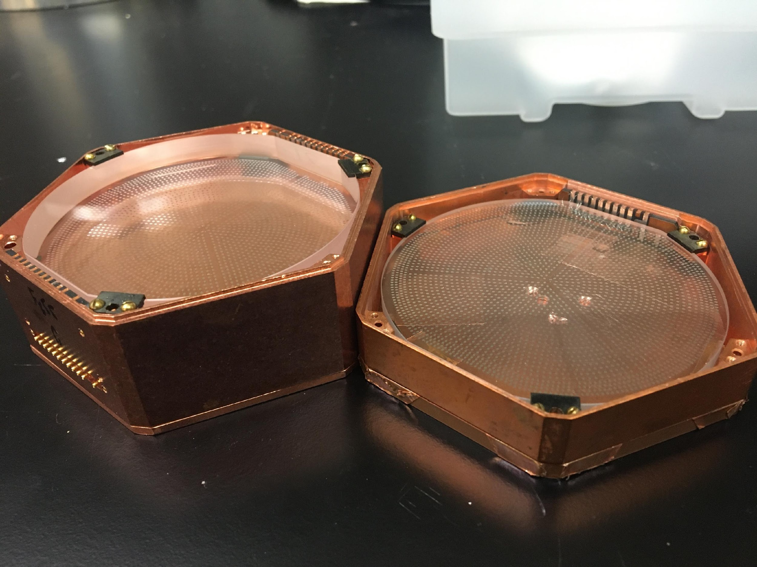
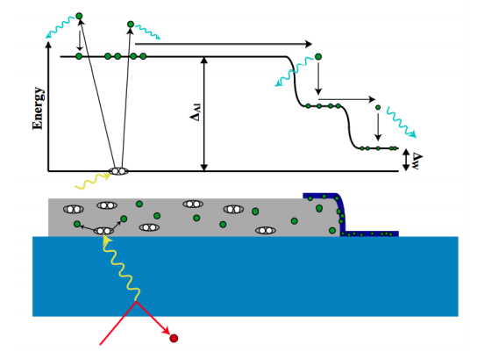
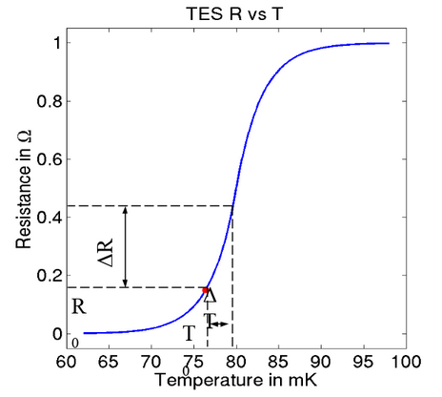
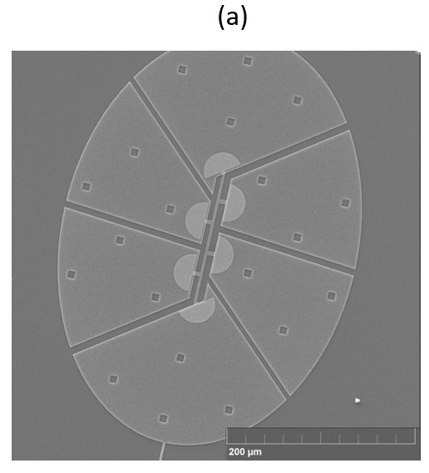
MINER experimental set-up
Energy transportation through phonons
2Δ_{Al}~ 0.36 meV
2Δ_{W} ~ 0.06 meV
< 30 meV
Sapphire
External particle recoils with sapphire and produces phonons.
Phonon travels to W through Al and increases the temperature by a small amount.
Small change in temperature causes huge change in resistance in W.

Slide 11
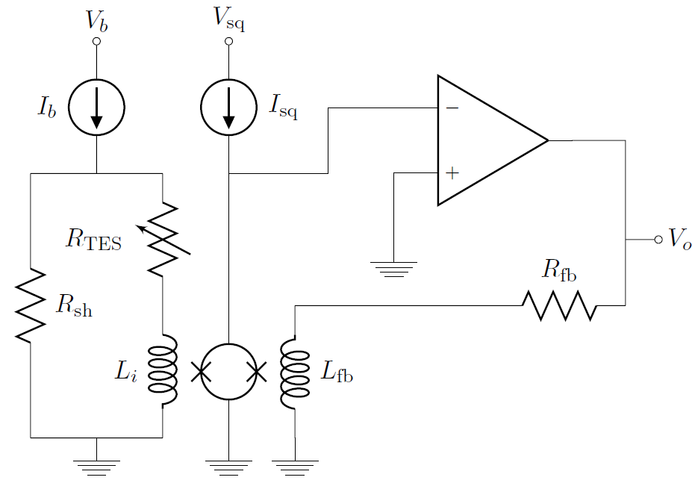
MINER experimental set-up
Current amplification circuit
Small change in temperature causes huge change in resistance in W.
Causes change in current in the voltage biased circuit.
Eventually the current gets amplified by SQUID and the op-amp.

Slide 12
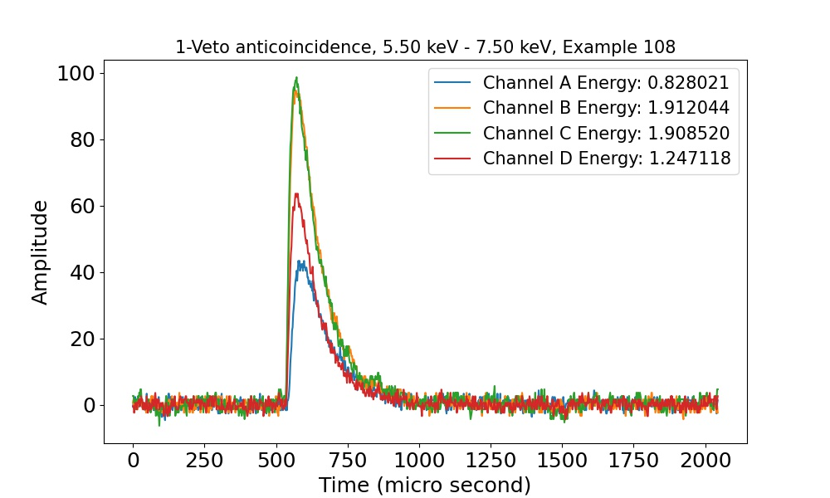
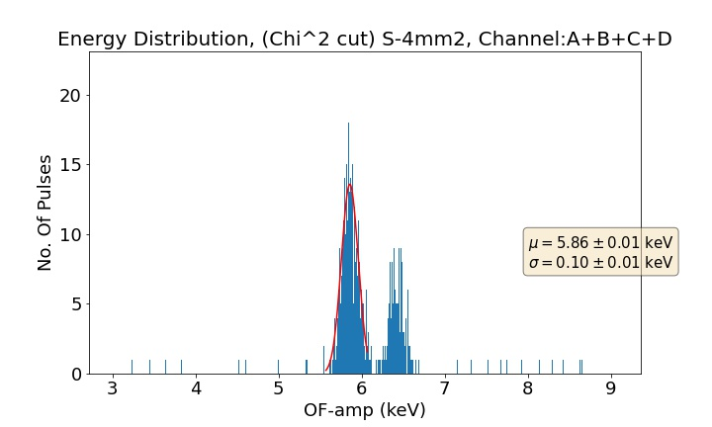
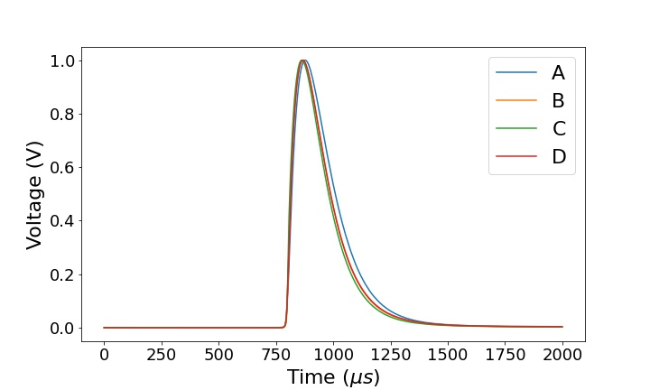
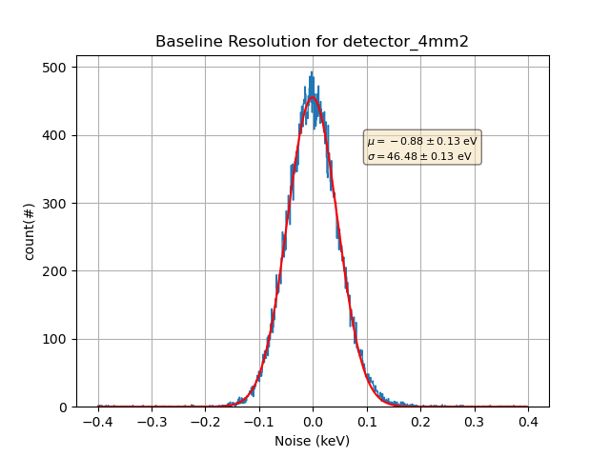
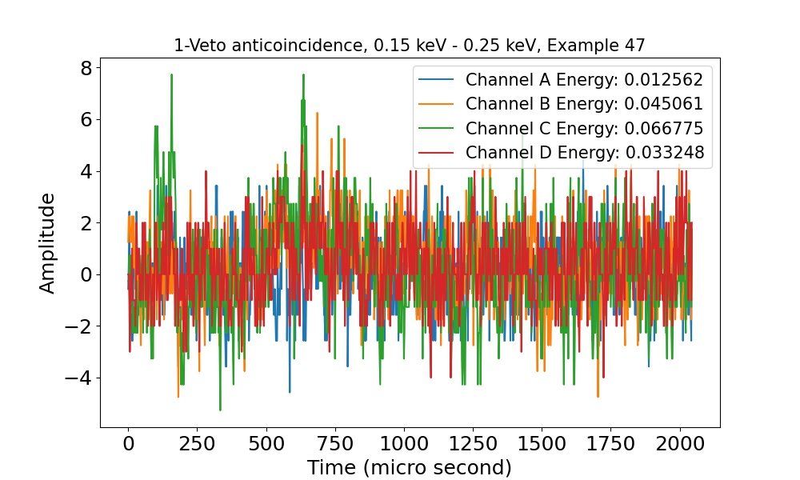
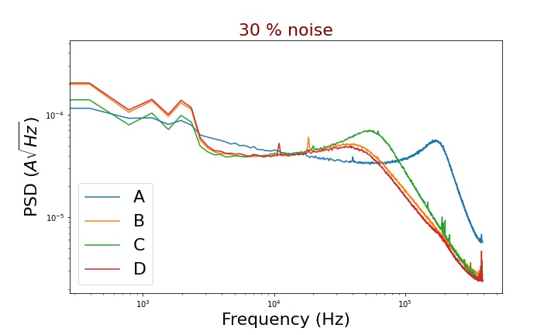
Data analysis flow - Optimal Filter method
Preliminary
Pulse Samples
⁵⁵Fe: 5.89 keV, 6.49 keV
Optimal Filter
Noise Samples

Slide 13
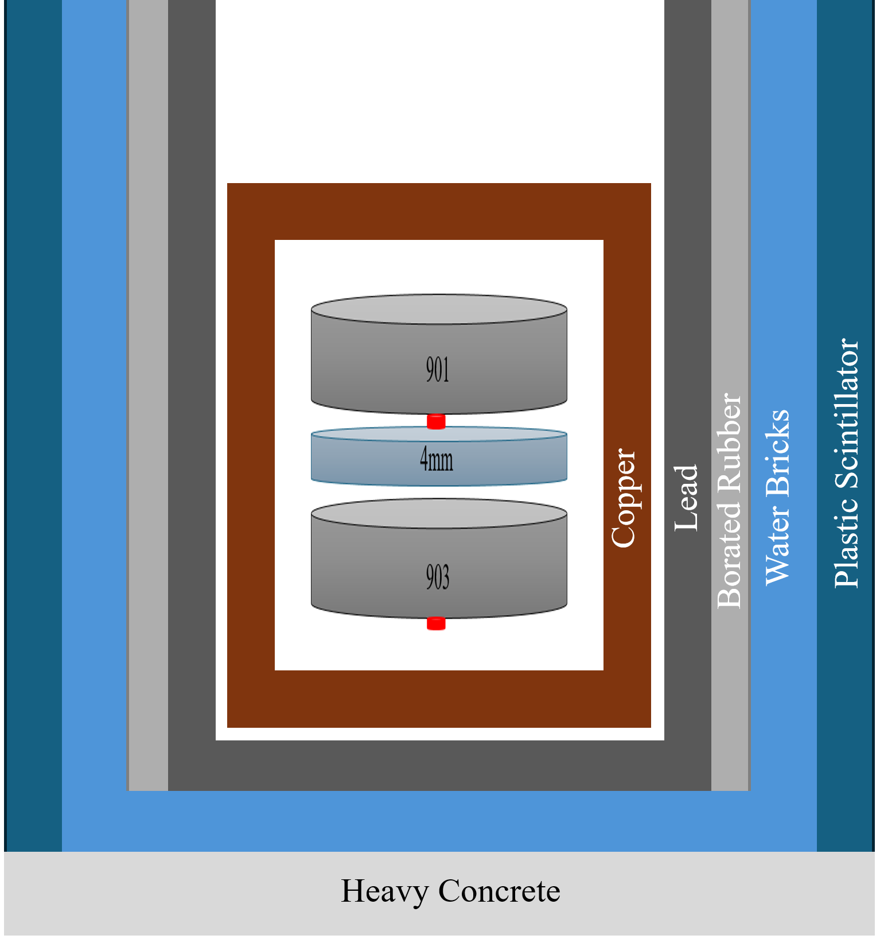
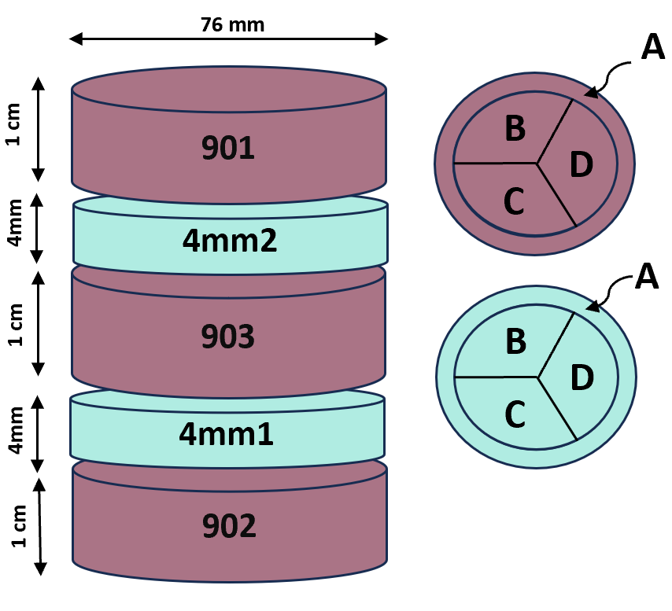
Experiment details
Preliminary
Source:
1 MW TRIGA reactor
NSC, TAMU
4.5 m from the detector
Detector:
Sapphire (Al₂O₃)
1 Main (72 g), 2 Veto, 2 non-operational
8mK operating temperature
Calibration source:
⁵⁵Fe
Energy: 5.89 keV, 6.49 keV
DAQ:
Reactor ON: 2.5 Days
Reactor OFF: 5.5 days
Shielding:
Copper: X rays
Lead: Gamma, Electrons
Borated rubber, water bricks: Neutrons
Plastic scintillator: Veto cosmic muons
Reactor
Fe
4.5 m
Fe

Slide 14
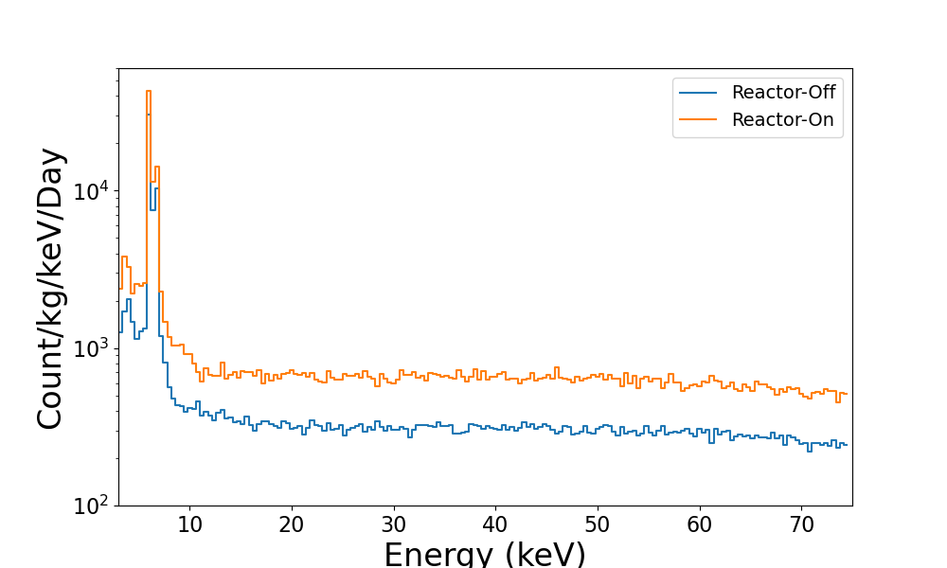
Results - ALP search
Preliminary
Single-scattered Reactor On and OFF spectrum
901
901
4mm2
4mm2
903
903
Single scattering (signal-like)
Multiple scattering (background-like)
DRU (O(10²)) is achieved using the experiment.
Not enough ALP signal observed excess to reactor ON-OFF spectrum.
Sensitivity plot/ exclusion plots were drawn assuming null hypothesis with 90 % confidence level.
arxiv:2011.07054
Notes:
Significance is not estimated. Some artifacts

Slide 15
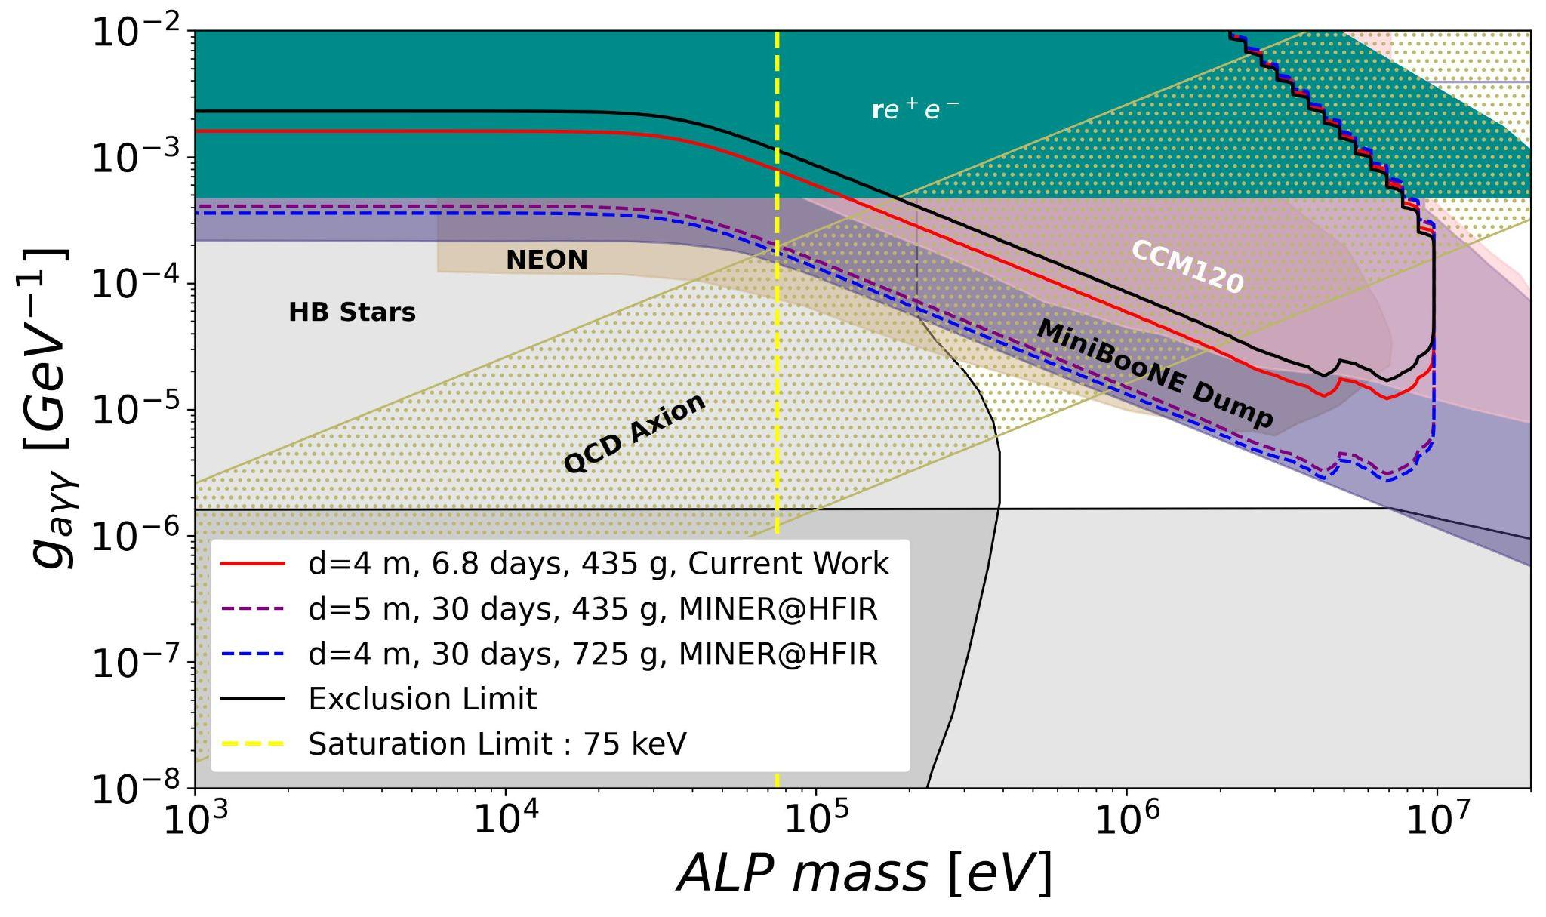
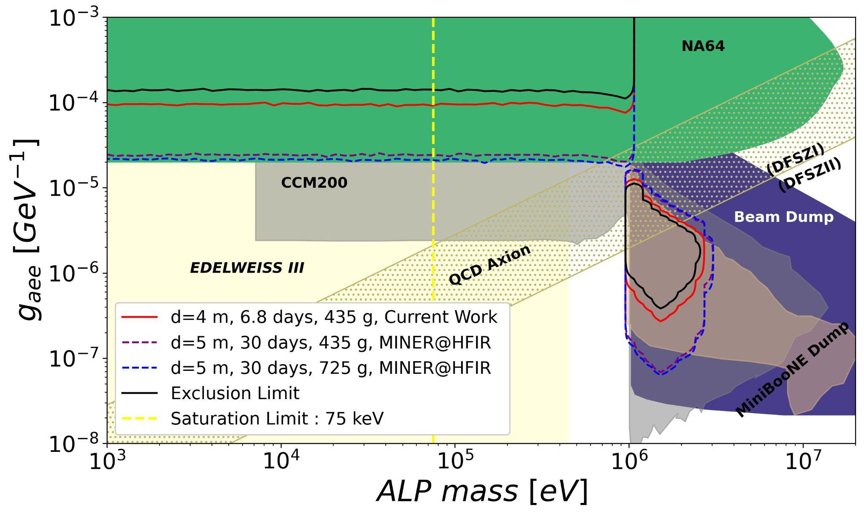
ALP sensitivity
Preliminary
ALP-gamma coupling and ALP-electron coupling:
Confirmed no detection of ALP through both types of coupling in the already explored parameter space.
MINER@HFIR will be sensitive to unexplored cosmological triangle space.
arxiv:2011.07054
Notes:
How will we go beyond the saturation energy?

Slide 16
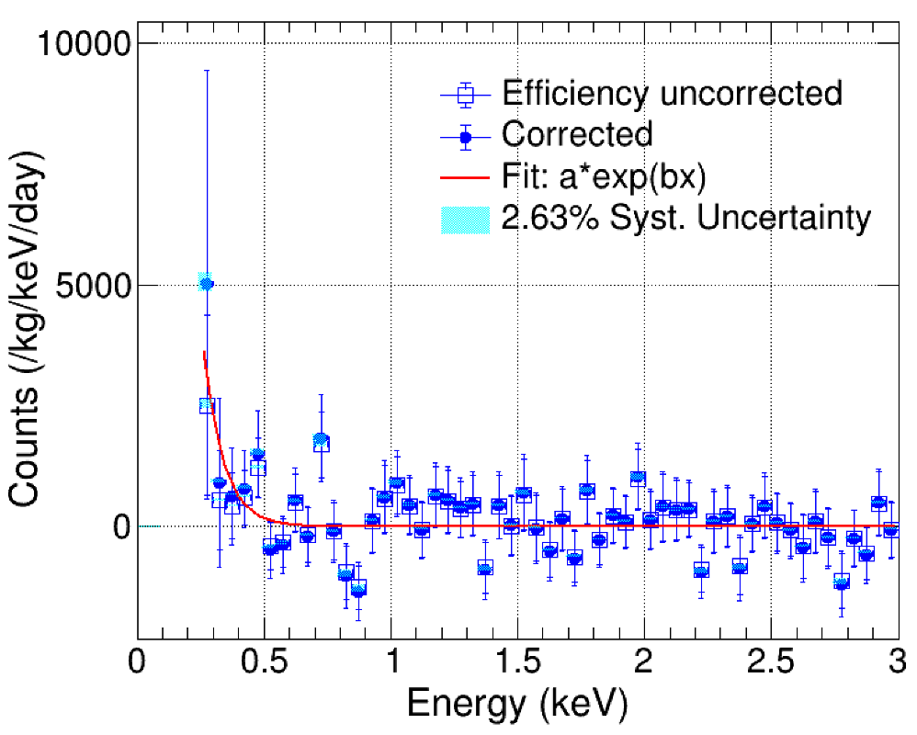
Results - CENNS search
Preliminary
Significance (Z) = N ⁄ √N_{s+b} = 0.0052
Notes:
Null signal hypothesis

Slide 17
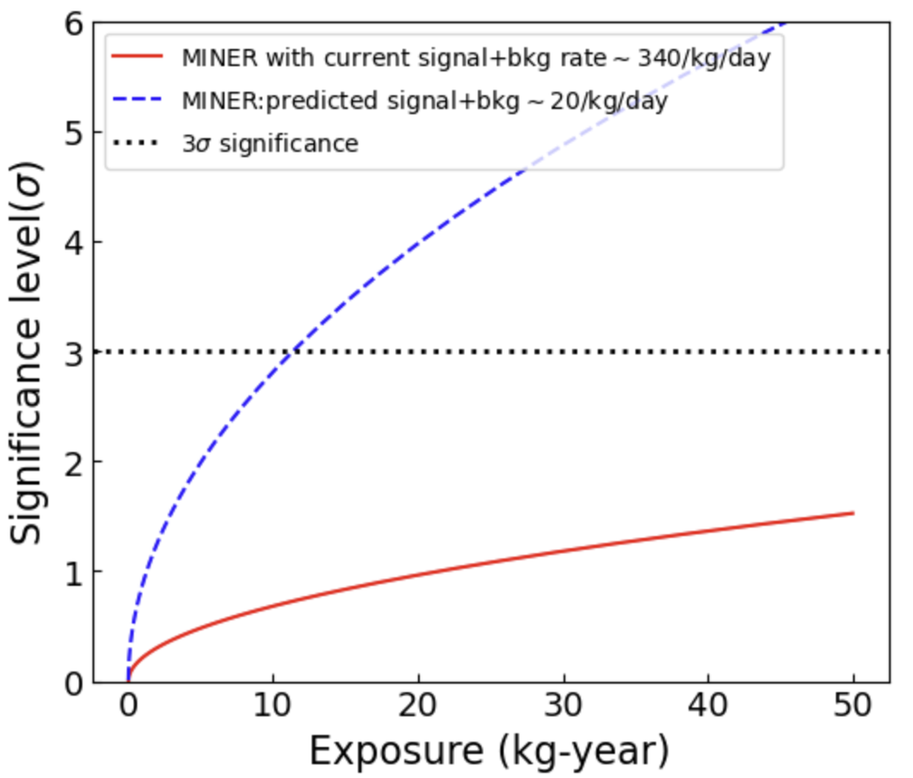
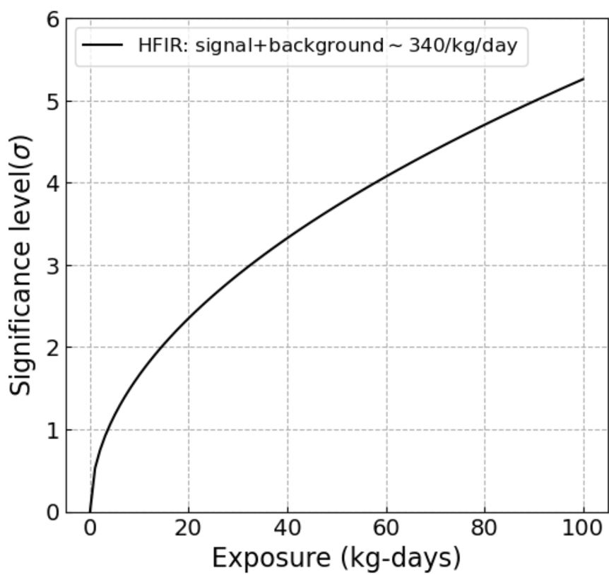
Future detection capability - CENNS search
Preliminary
MINER@TAMU experiment: 1 MW reactor
MINER@HFIR: 85 MW reactor
Current background 340/ Kg/Day background is very high for CENNS discovery at TAMU 1 MW reactor.
Background reduction is needed upto 20 / Kg/day is needed to see any evidence of CENNS at 10 Kg-yr exposure.
But MINER@HFIR (85 MW) reactor would be helpful for discovery of CENNS at only 90 Kg-days of exposure.
Notes:
Null signal hypothesis. Page number.

Slide 18
Non-Cryogenic detector

Slide 19
Experimental set-up using CsI
HV supply
Signal wire
PMT base
PMT
CsI (Tl) Crystal (54, 000 photons/MeV)
Detector Set-Up
Thermal Enclosure
Lead Shielding (4 inch)
HV power
supply
Digitizer
CsI crystal (12” * 2” * 2”)

Slide 20
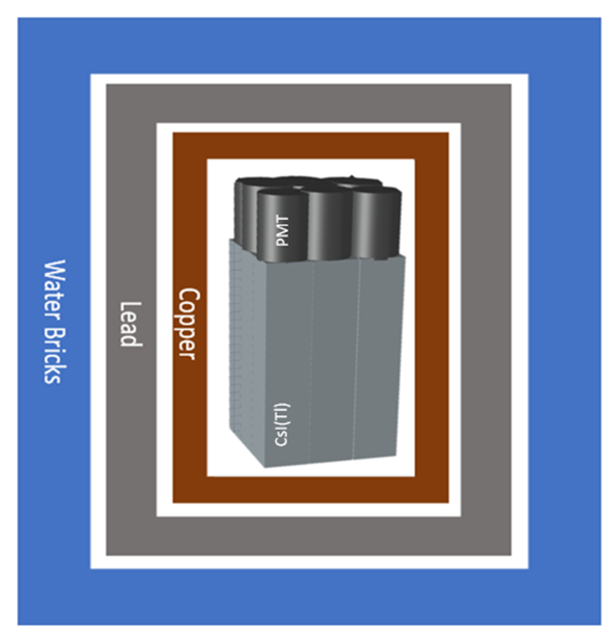
Background rejection
Active Veto
Passive Veto
CsI (Tl)
CsI (Tl)
CsI (Tl)
CsI (Tl)
CsI (Tl)
CsI (Tl)
CsI (Tl)
CsI (Tl)
CsI (Tl)
CsI (Tl)
CsI (Tl)
CsI (Tl)
CsI (Tl)
CsI (Tl)
CsI (Tl)
CsI (Tl)
CsI (Tl)
CsI (Tl)
CsI (Tl)
CsI (Tl)
CsI (Tl)
CsI (Tl)
CsI (Tl)
CsI (Tl)
CsI (Tl)
Inner 9 crystals: Main detector
Outer 16 crystals: Veto detector
4” Pb for gamma shielding
Water bricks for neutron shielding from reactor
Copper for shielding X-rays
True Event: Single Scatter event inside the inner CsI(Tl) crystal, surrounding crystals used as veto.
“Axions/ ALPs interact once with the detector whereas background events may interact multiple times in the detector. ”

Slide 21
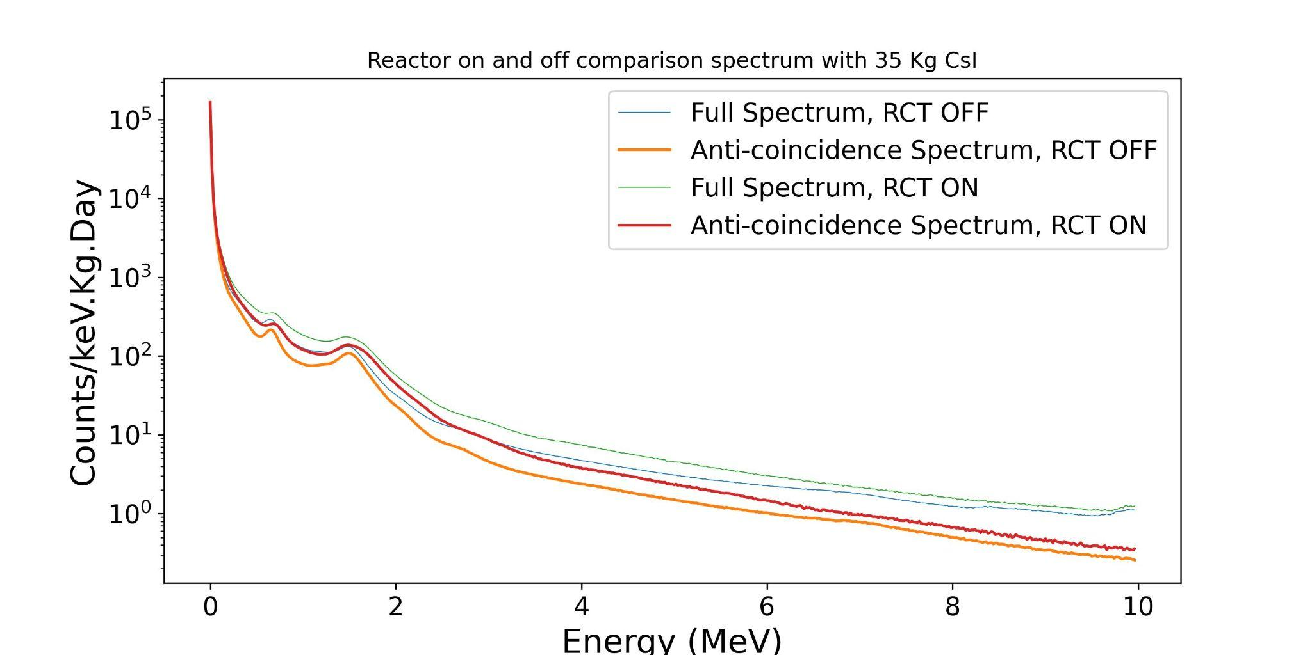
Reactor search using CsI - Result
Preliminary
arxiv:2407.14704
Reactor ON and OFF spectrum were obtained using the CsI (Tl) detector.
Two prominent background;
667 keV - Internal radioactivity of ¹³⁷Cs in CsI crystal
1460 keV - ⁴⁰K radioactive background from environment
<1 DRU after 4 MeV gives enough space for ALP search in those energy regimes

Slide 22
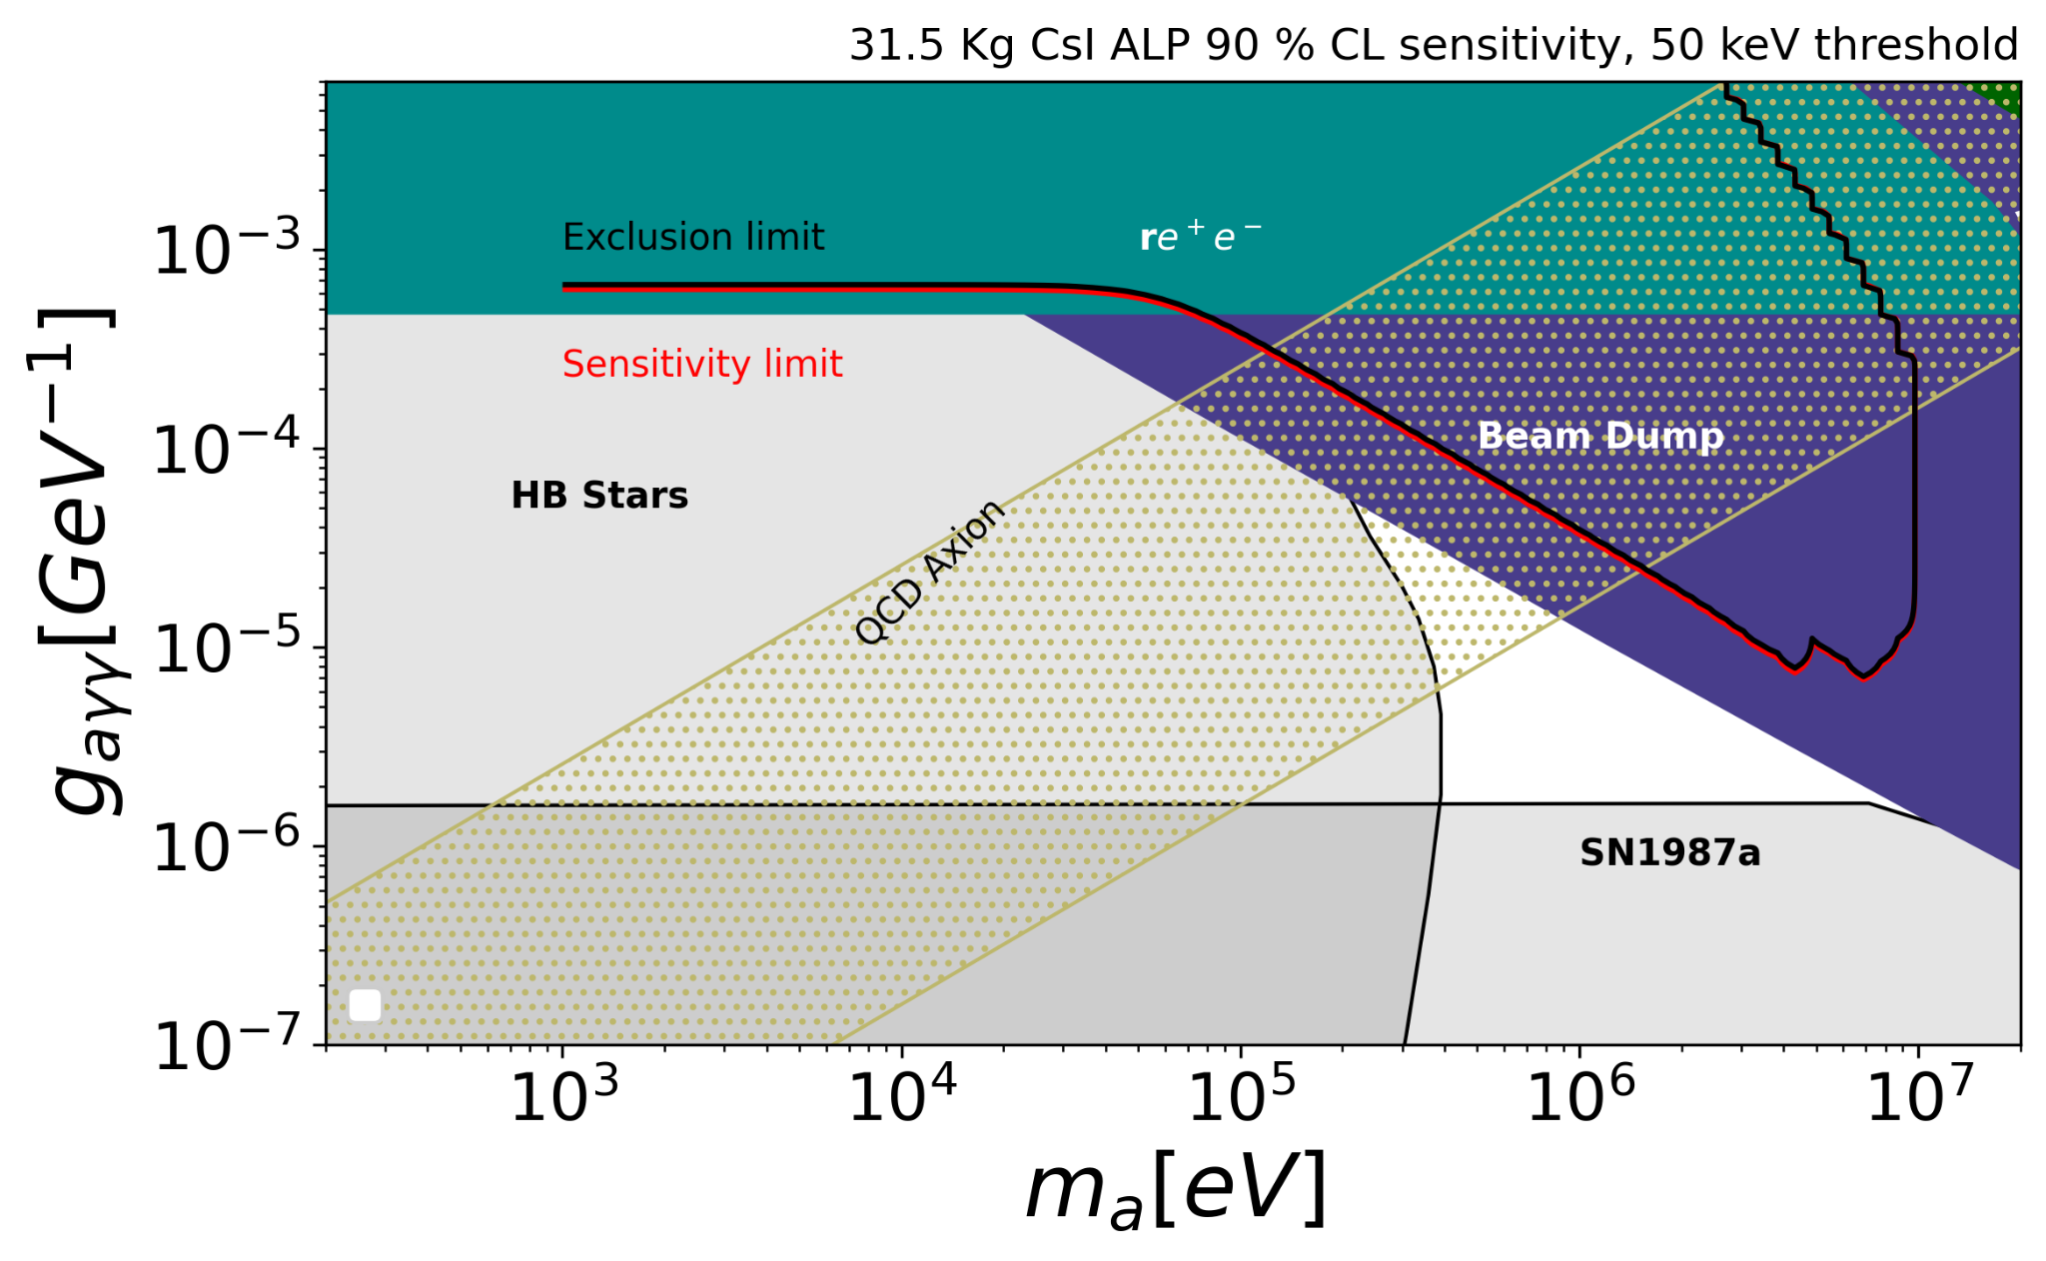
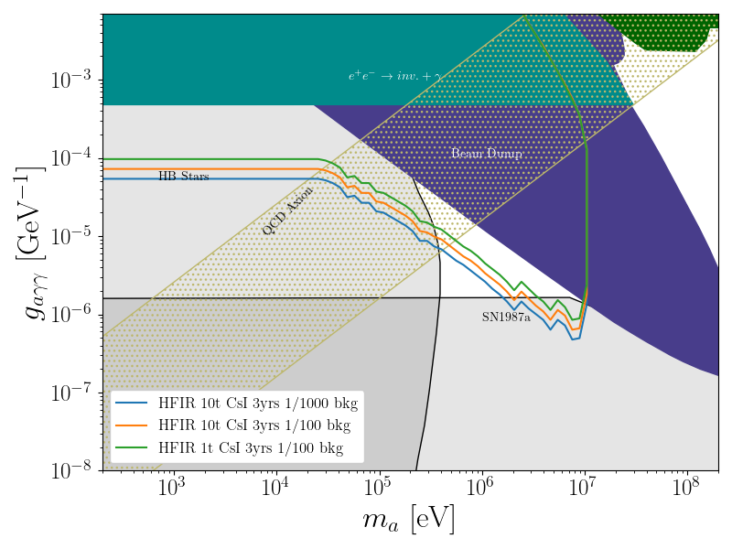
Reactor search using CsI - Exclusion plot
Preliminary
Current Exclusion
Future Sensitivity
arxiv:2407.14704

Slide 23
Conclusion
ALP and CEνNS (Coherent Elastic Neutrino-Nucleus Scattering) search analyses were conducted individually; however, no significant signal was observed with the current background levels and exposure. (Both Cryogenic and Non-Cryogenic)
The successful operation of the prototype motivates expansion of the experiment at HFIR (High Flux Isotope Reactor), Oak Ridge National Laboratory, leveraging the 85 MW reactor power.
Planned upgrades include:
Building a 1-ton scale CsI(Tl) detector for enhanced sensitivity to rare events.
Developing a 1 kg-scale Sapphire detector as a complementary detection technology.
Completed radioactive-source-based search for Axion-Like Particles (ALPs), dark photons, and dark scalars using a 100 kg-scale CsI(Tl) detector at Texas A&M University.
Demonstrated promising sensitivity and scalability toward ton-scale detector development for rare event searches.
Ongoing plans to deploy the detector in a beam-based environment at LANL (Los Alamos National Laboratory) to further probe these exotic particles with enhanced experimental reach.
Notes:
Finish conclusion

Slide 24
Backup

Slide 25
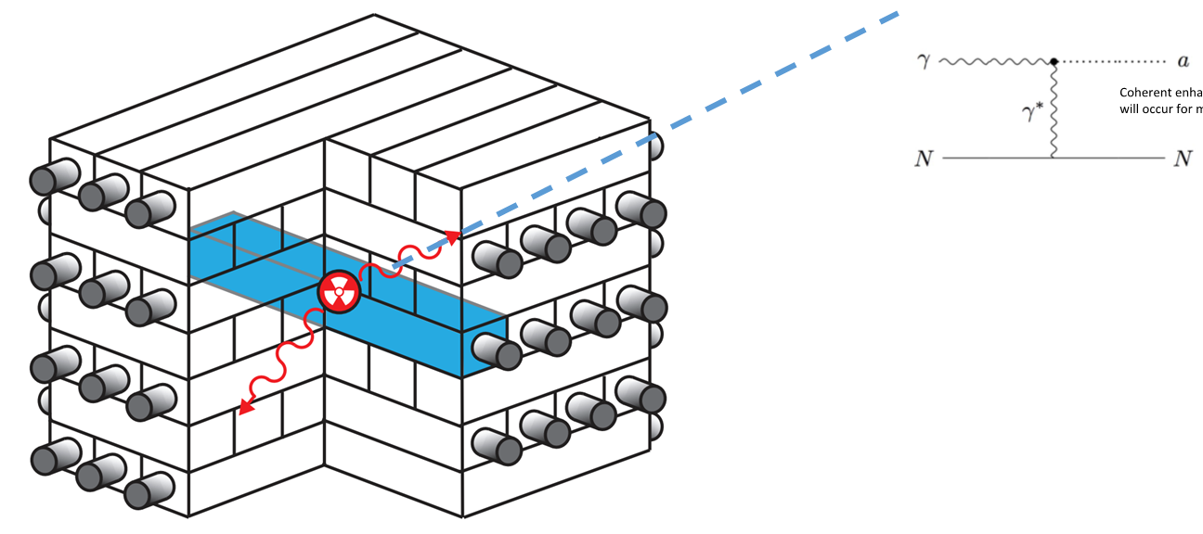
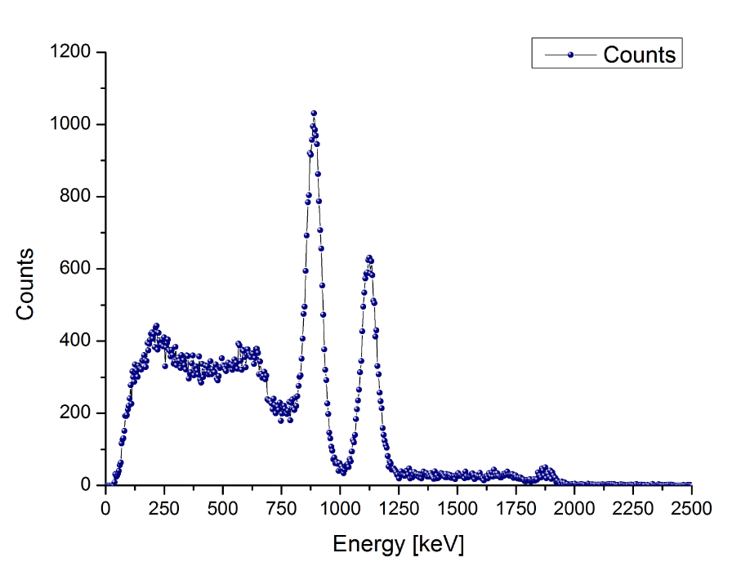
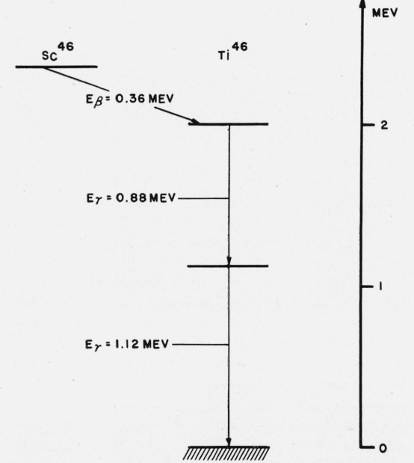
Radioactive based ALP search
Missing Gamma (Absence of 1 gamma)
Gamma can be decayed to Axion like particles by primakoff process.
⁴⁶Sc is used. One decay releases two gammas energy 889 keV and 1120 keV.
Focus will be to tag one gamma and identify the other gamma of the event. Unable to identify the gamma will be termed as “Missing Gamma”.

Slide 26
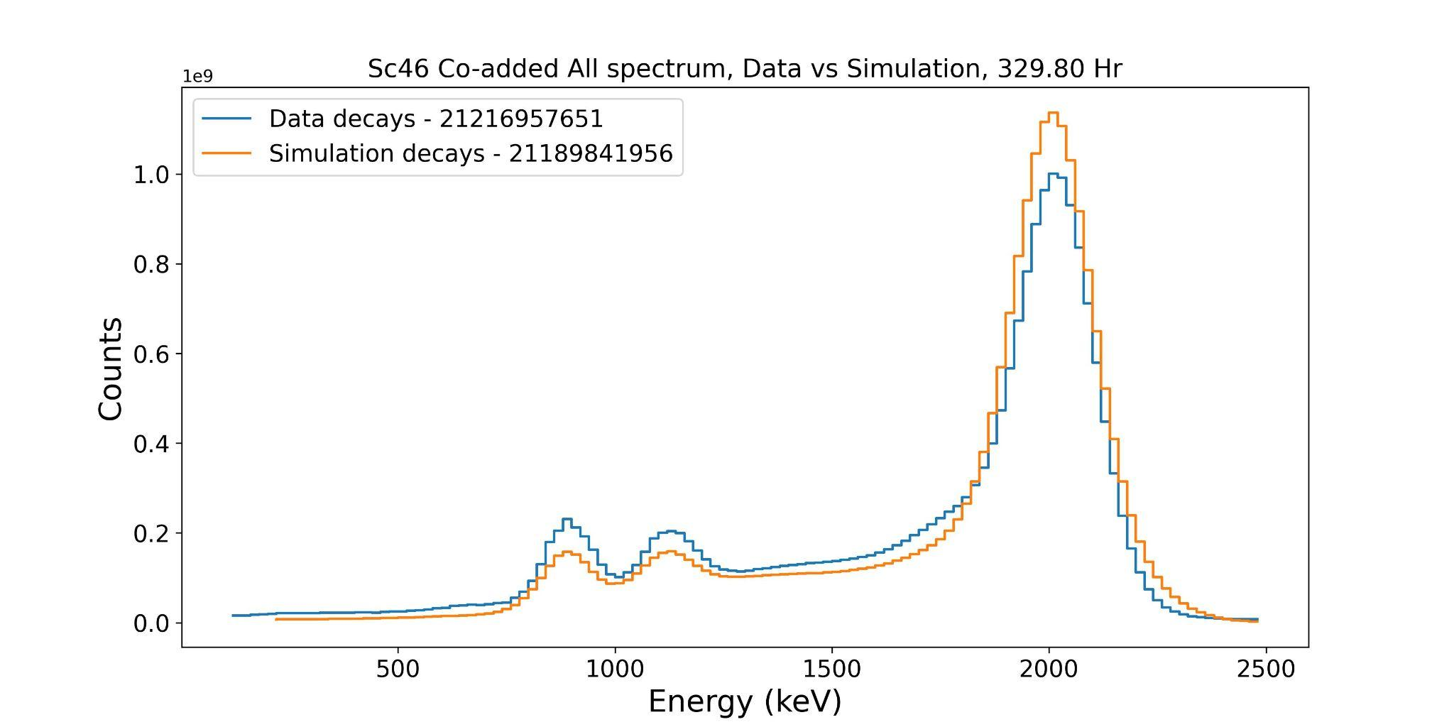
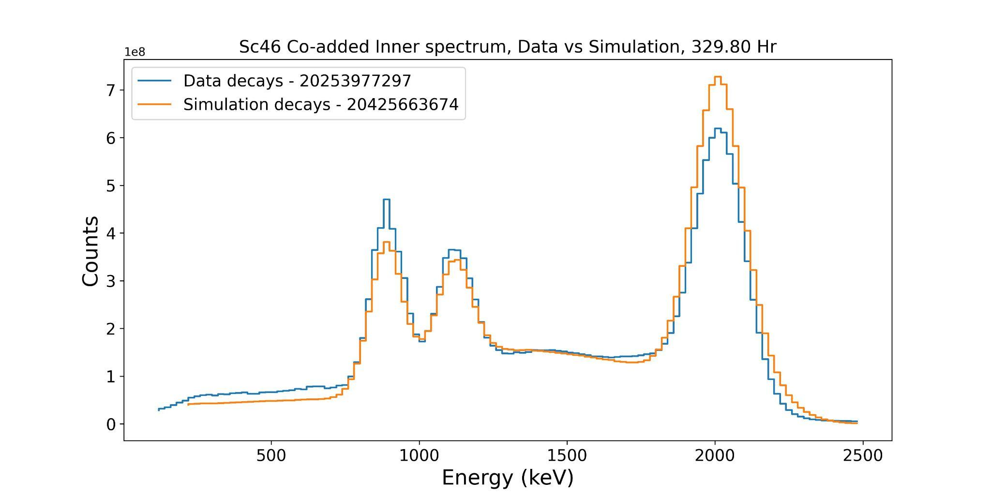
Results and Analysis - ⁴⁶Sc
Preliminary
8 | 7 | 6 | 5 | 4
9 | 20 | 21 | 22 | 3
10 | 19 | 24²⁵ | 23 | 2
11 | 18 | 17 | 16 | 1
12 | 13 | 14 | 15 | 0
Inner 9 combined spectrum and All 25 combined spectrum are shown
3 different peaks
Combined 2 gamma - ~2000 keV
Single 889 keV and single 1120 keV
Containment increasing with detector volume.

Slide 27
False Missing Gamma
Preliminary
Preliminary
 | Percentage | Statistical Uncertainty
Missing gamma events (Tag 1132 keV) | 3.79 | 0.0032
Containment Inefficiency (Simulation) | 2.49 | 0.0033
Pile-up (in the ROI (889 keV)) | 1.16 | 0.015
Radioactive background | 0.137 | 0.001
Remaining excess | 0.003
Possible sources of False Signal:
Containment inefficiency (Calculated from simulation)
Radioactive background falling in the region
Event miss due to DAQ pulse window. It is 10 us.
Cosmics, Neutrons and neutrinos
Dead region in CsI

Slide 28
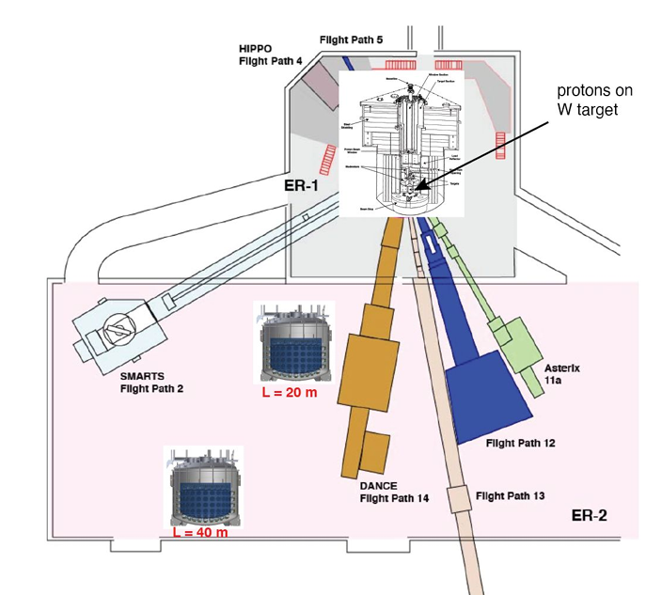
Future scope of the detector - CsI
ALP search at beam, LANL using CsI
Source: Accelerator producing 800 MeV protons at 100 µA rate - impinge on thick W target producing neutrons, 0.1 - 1000 MeV photons and other particles.
Producing ~ 10²³ 𝛾/ 6 weeks of operation.
Placing the Ton scale CsI detector we plan to search for some new physics including ALP, CENNS, WIMP etc..

