Slide 1



W Mass From ATLAS
Pierre-Hugues Beauchemin
On Behalf of the ATLAS Collaboration
Tufts University
15th Conference on the Intersections of Particle and Nuclear Physics, June 9, 2025, Madison (WI)

Slide 2
Plan of the talk
Motivations for measuring M_{W}
General Strategy for measuring M_{W} with high precision
A rich program of ancillary measurements to make the targeted precision possible
Results of the most recent ATLAS (re-)measurement of M_{W}
World combination
Conclusion
Main results from :
Eur. Phys. J. C 78 (2018) 110
Eur. Phys. J. C 84 (2024) 1309
Notes:
Motivation: aim to flesh out too general statements on this topic like
“fundamental parameter of the SM” -> which one?
“can be used for consistency test” -> why
“can be used to probe new physics” -> how come?
A

Slide 3


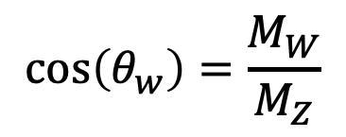
the Mass of the W boson (M_{W})
The mass of the W boson (M_{W}) is a fundamental parameter of the Standard Model
  In the ${SU(2)}_{L}×{U(1)}_{Y}$ theory with one Higgs isodoublet, the mass matrix for vector bosons is:
The W mass can be expressed in terms of other parameters of the theory through fundamental relationships:
$ℒ_{M}^{(VB)}=\frac{v^{2}}{2}\left[\frac{g^{2}}{2}W_{μ}^{+}W^{μ−}+\frac{1}{4}{\left(g^{′}B_{μ}−gW_{μ}^{3}\right)}^{2}\right]=M_{W}^{2}$ $W_{μ}^{+}W^{μ−}+\frac{1}{2}M_{Z}^{2}Z_{μ}Z^{μ}$
where $Z^{μ}=\frac{1}{\sqrt{g^{2}+{g′}^{2}}}$ $\left({−g}^{′}B_{μ}+gW_{μ}^{3}\right)≡W_{μ}^{3}\cos\left(θ_{w}\right)−B_{μ}\sin\left(θ_{w}\right)$
$$\cos\left(θ_{w}\right)=\frac{M_{W}}{M_{Z}}$$
Exact, in the on-mass-shell renormalization scheme
with $\cos^{2}\left(θ_{w}\right)=1−\sin^{2}\left(θ_{w}\right)$
Notes:
We have also: $M_{W}=\frac{1}{2}gv=\frac{ev}{2\sin\left(θ_{W}\right)}$, and $M_{Z}=\frac{v}{2}\sqrt{g^{2}+{g′}^{2}}=\frac{ev}{2\sin\left(θ_{W}\right)\cos\left(θ_{W}\right)}$
There is no unique way to define renormalized parameters, each different counter-term subtraction approach will yield different parameter definitions, each in their own renormalization framework. Such a framework should:
Be simple and applicable to a wide range of process
Allow for renormalized parameters to be automatically gauge-invariant and infrared-free
Can be compared to experimental data directly with precision
The radiative corrections to its tree-level value should be small

Slide 4
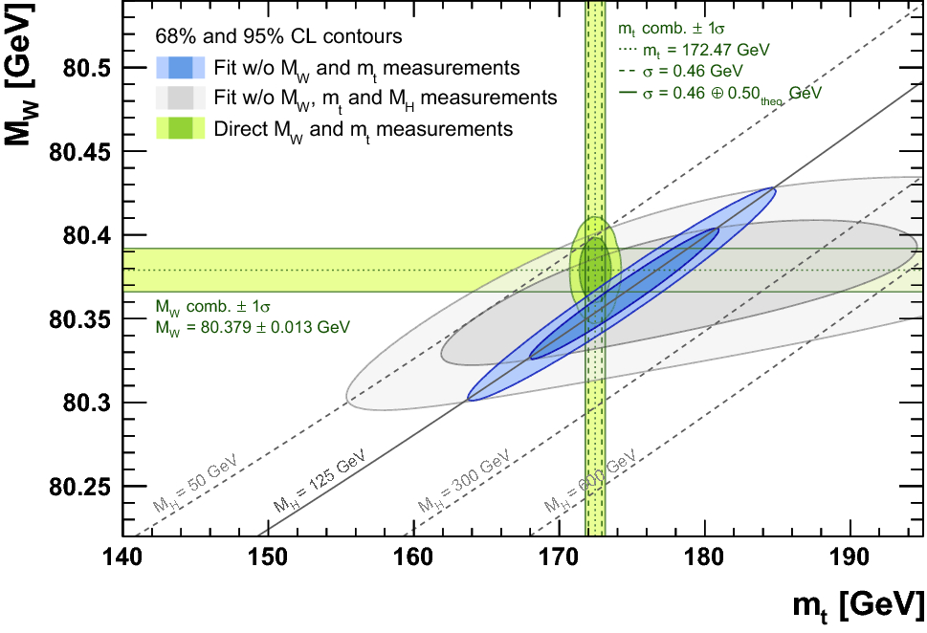
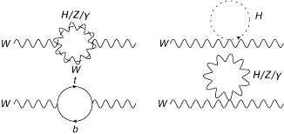
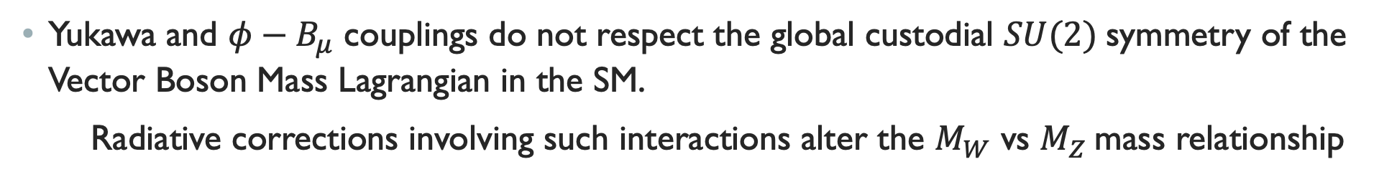

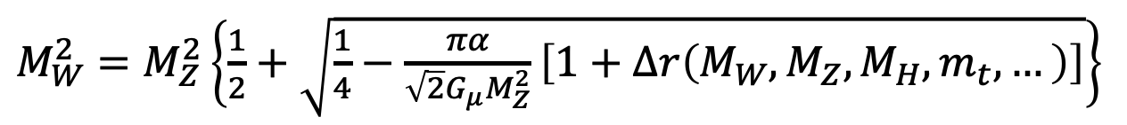
Probing other Mass parameters with M_{W} measurement
Yukawa and $φ−B_{μ}$ couplings do not respect the global custodial $SU(2)$symmetry of the Vector Boson Mass Lagrangian in the SM.
Radiative corrections involving such interactions alter the $M_{W}$ vs $M_{Z}$mass relationship
$M_{W}^{2}=$ $M_{Z}^{2}\left\{\frac{1}{2}+\sqrt{\frac{1}{4}−\frac{πα}{\sqrt{2}G_{μ}M_{Z}^{2}}\left[1+Δr\left(M_{W},M_{Z},M_{H},m_{t},…\right)\right]}\right\}$
Eur. Phys. J. C (2018) 78:675
We can use precise measurements of M_{W} to get precious information about other parameters, including the Higgs boson mass before its discovery.
Notes:
Having a precise measurement enough to be sensitive to these loop corrections of the relationships between the W mass and other parameters of the SM allows probing deep aspects of the theory, getting precious information about other components of the SM.
Often, we see the relationship $M_{W}=\frac{1}{\sin\left(θ_{W}\right)}\sqrt{\frac{πα}{\sqrt{2}G_{F}\left(1+Δr\right)}}$, but since $\sin\left(θ_{W}\right)$ depends on $M_{W}$, the above relationship on the slides is the one to be estimated.
Note finally that the corrections to $M_{W}$ and their dependence on $m_{t}$ and $M_{H}$ will be different in different renormalization schemes. For example, in the $\overline{MS}$ scheme, the dependence of $∆r$ on $m_{t}$ is smaller, and so it is also to many BSM models.

Slide 5
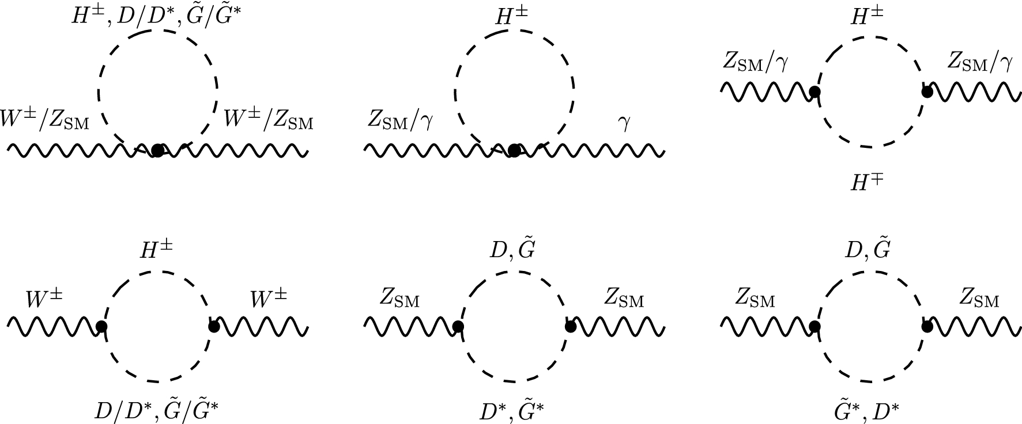

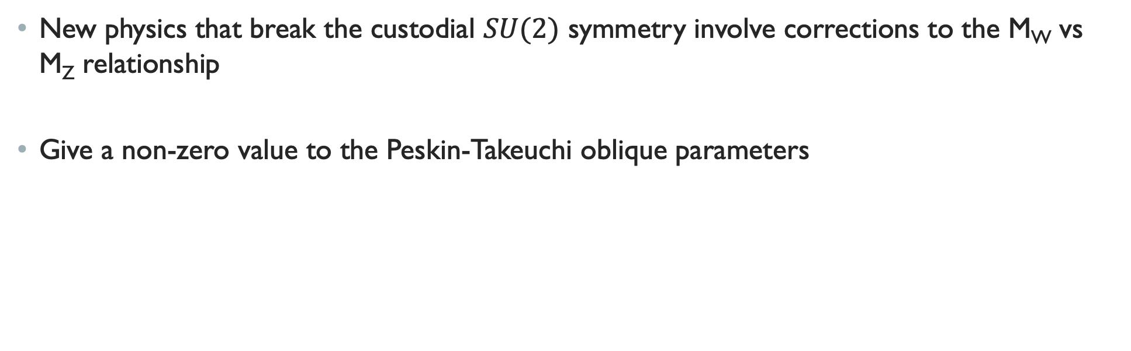


Probing New physics with M_{W} measurement
New physics that break the custodial $SU(2)$ symmetry involve corrections to the M_{W} vs M_{Z} relationship
Give a non-zero value to the Peskin-Takeuchi oblique parameters
BSM correction to G_{F}
$$M_{W}=M_{W,SM}\left[1−\frac{α\left(M_{Z}^{2}\right)}{4\left(c_{W}^{2}−s_{W}^{2}\right)}\left(S−2c_{W}^{2}T−\frac{c_{W}^{2}−s_{W}^{2}}{2s_{W}^{2}}U−\frac{s_{W}^{2}}{2\left(c_{W}^{2}−s_{W}^{2}\right)}∆G\right)\right]$$
Example:
Contribution from Dark Higgs and dark Goldstone Bosons to the T and U parameter impacting M_{W}.
Eur. Phys. J. C (2023) 83:346
Notes:
The oblique parameters (S, T, and U) are used to quantify the effects of new physics on electroweak observables. They effectively describe how new physics modifies the vacuum polarization, which in turn affects the masses of the gauge bosons and other electroweak observables.
Corrections to other electroweak parameters of the SM due to new physics would also given non-zero values the three oblique parameter. For example, the coupling of the w bosons with particles lighter than M_{W} would open up new decay channels and alter $Γ_{W}$.

Slide 6
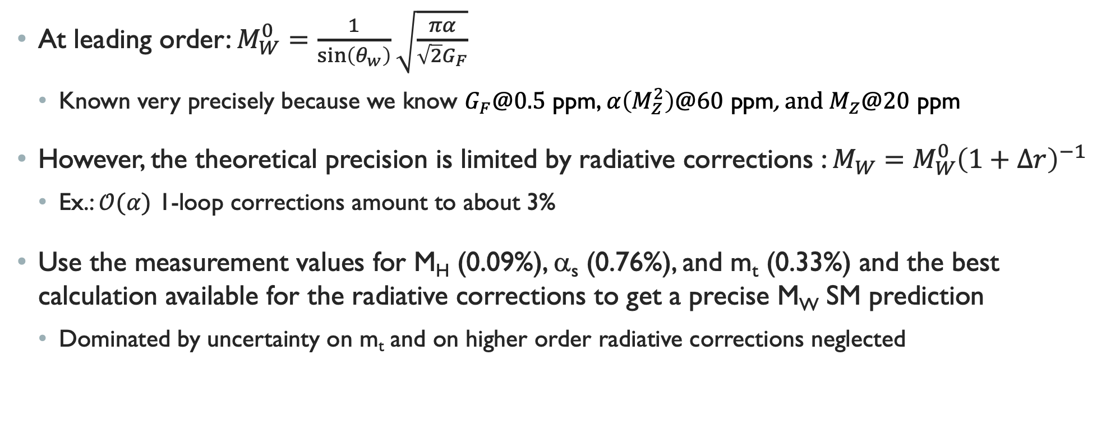

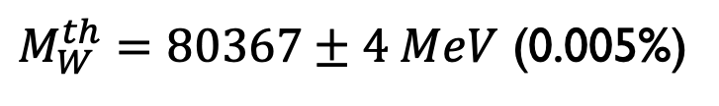
Consistency test: precise measurements and Precise calculation
At leading order: $M_{W}^{0}=\frac{1}{\sin\left(θ_{w}\right)}\sqrt{\frac{πα}{\sqrt{2}G_{F}}}$
  Known very precisely because we know $G_{F}@0.5$ ppm, $α\left(M_{Z}^{2}\right)$@$6\text{0} \text{ppm}$, and$M_{Z}@20$ ppm
However, the theoretical precision is limited by radiative corrections : ${M_{W}=M}_{W}^{0}{\left(1+∆r\right)}^{−1}$
  Ex.: $𝒪(α)$ 1-loop corrections amount to about 3%
Use the measurement values for M_{H} (0.09%), α_{s} (0.76%), and m_{t} (0.33%) and the best calculation available for the radiative corrections to get a precise M_{W} SM prediction
  Dominated by uncertainty on m_{t} and on higher order radiative corrections neglected
$M_{W}^{th}=80367±4 MeV$ (0.005%)
Achieving a M_{W} measurement to a precision of $𝒪(1−10 \left(MeV\right))$ would yield a very stringent test of the SM!
Notes:
Note 1: The M_{W} value refers to the conventional definition according to a Breit-Wigner parametrization with running width.
Note 2: Very high accuracy reached from: full electroweak two-loop corrections, up to four loops in pure fermion-loop corrections, contribution of $𝒪(αα_{s}^{2})$, and leading $𝒪\left(αα_{s}^{3}\right), \text{leading} \text{three}\text{−}\text{loop} \text{contributions} \text{of} 𝒪(G_{μ}^{3}m_{t}^{6}) \text{and} 𝒪(G_{μ}^{2}α_{s}m_{t}^{4})\text{.}$
Note 3: The top mass measurement quoted in the PDG is 172.57±0.27 GeV, a precision of 0.16%. It differs from the pole-mass obtained from cross-section measurements: 172.4±0.7 GeV, a precision of 0.41%. These values differ from the value used in the EWK fit because the latest use combination with D0 that has some tension with other m_{t} measurement, and include an uncertainty on the top-mass definition (pole vs MC). This uncertainty on the top-mass definition is taken to be of 0.52 GeV, giving a final top-mass result used in EWK fit of 172.61±0.25±0.52, i.e. a precision of 0.33%.

Slide 7
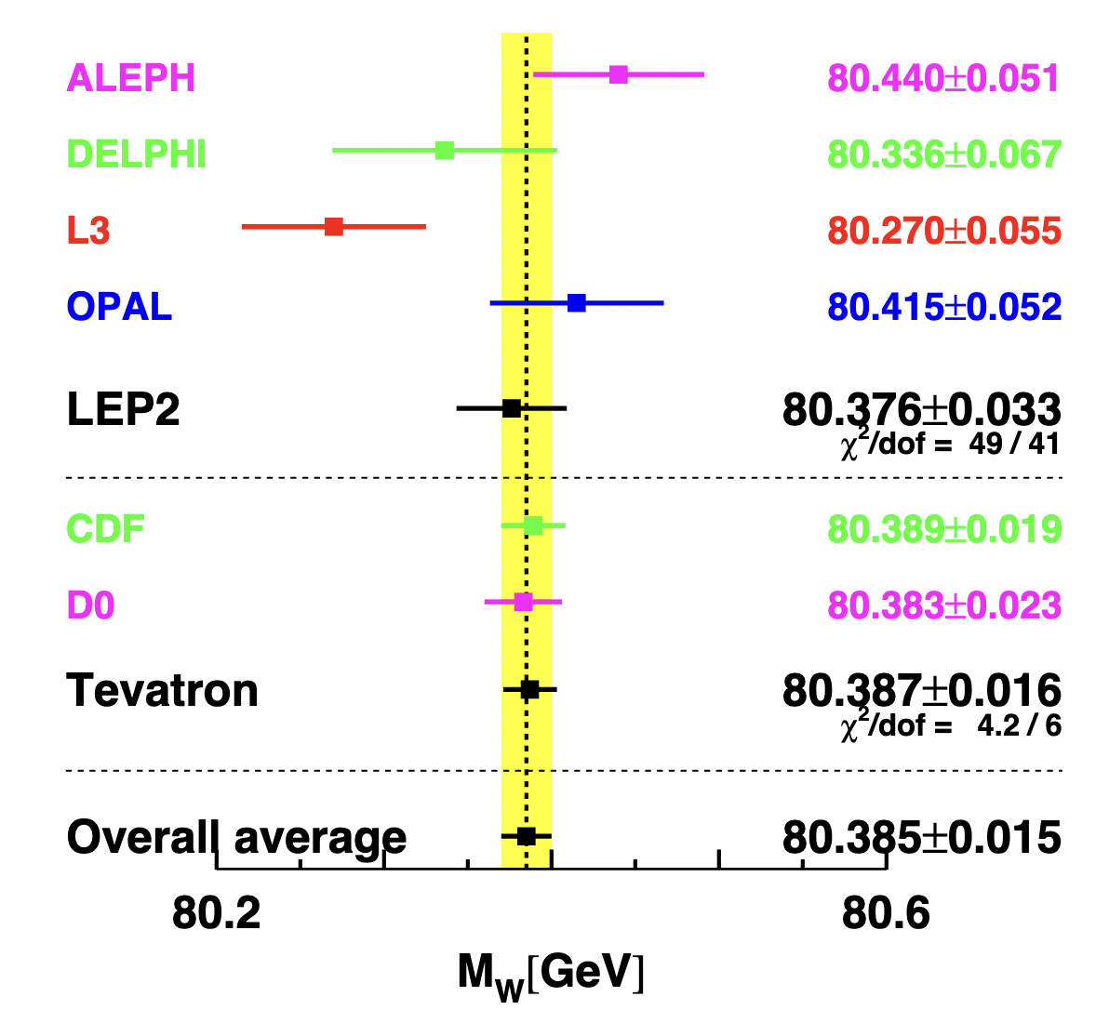
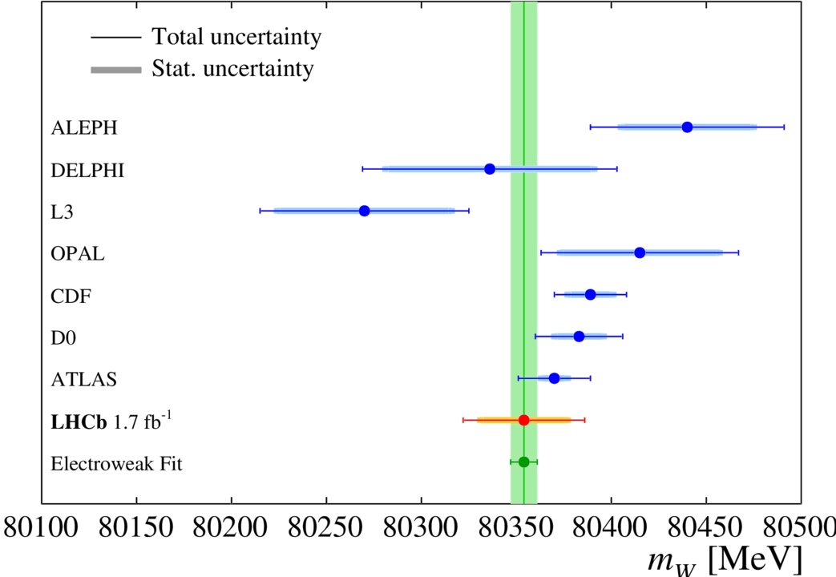
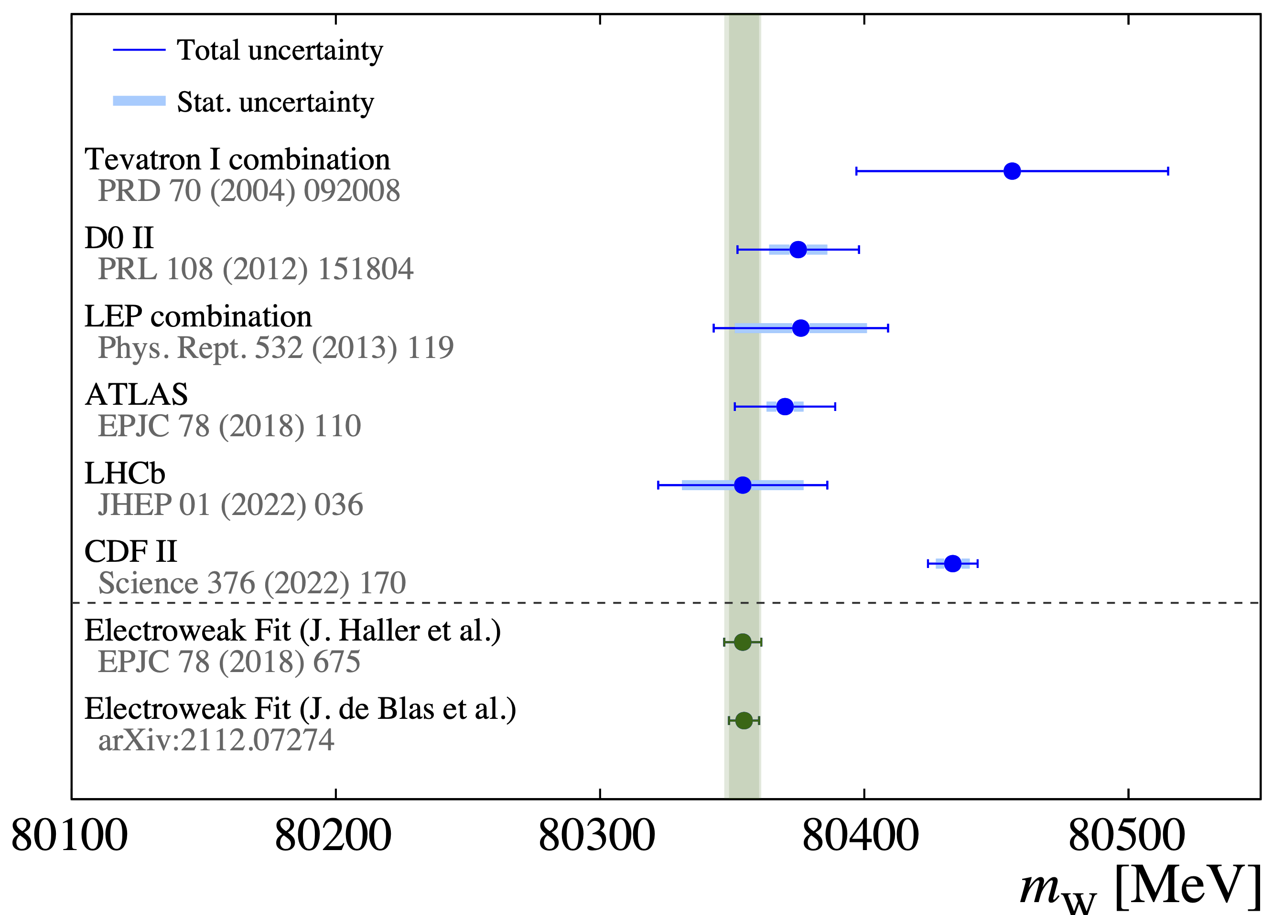

M_{W} Timeline…
Over the last a few years, the HEP experimental community performed a series of ever more precise measurements of M_{W} that, each time, changed the picture…
2013: D0 and CDF
2021: LHCb and ATLAS
2022: New CDF result
Inconsistency between the world most precise measurement (CDF) and the second most precise result (ATLAS) as well as EWK fit results.
What could be the impact of a $δM_{W}^{ATLAS}$ improvement?

Slide 8
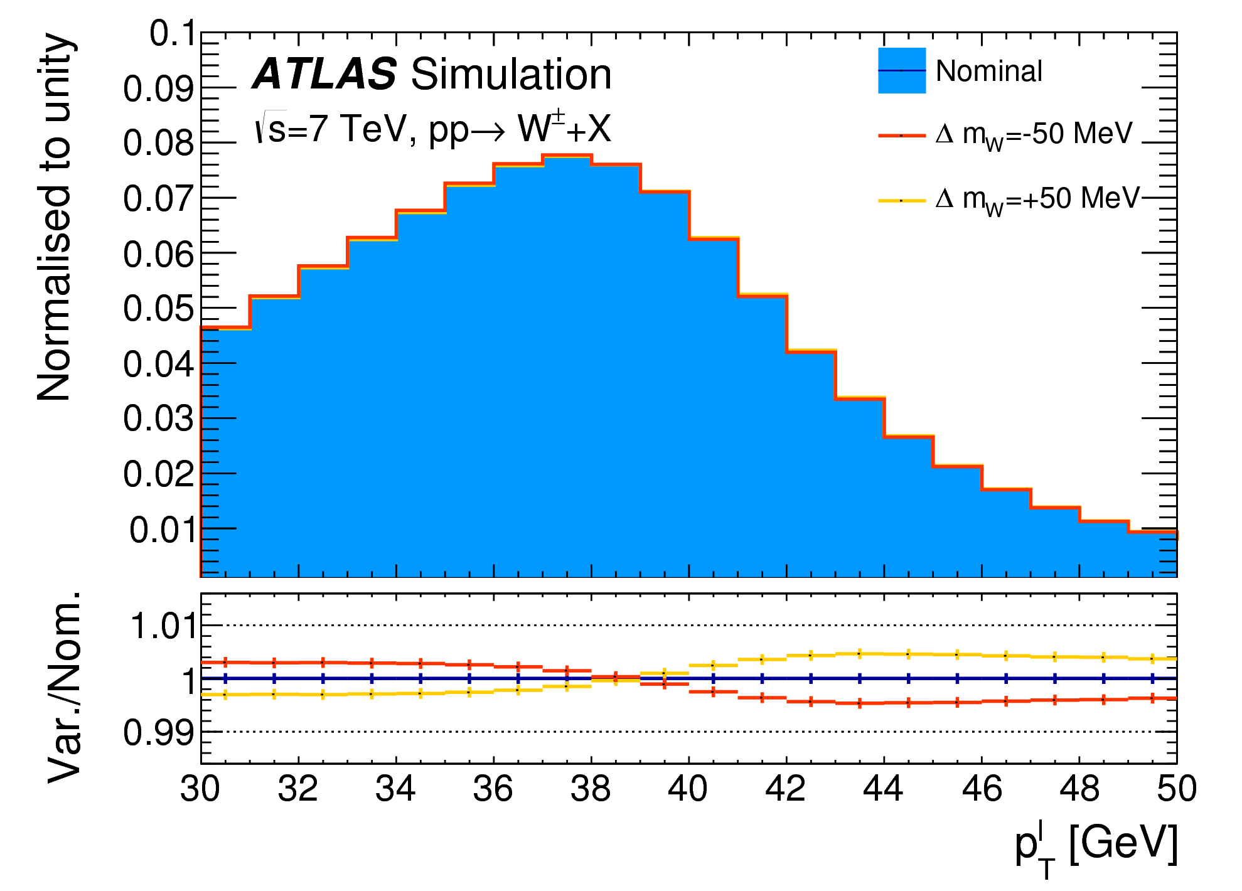
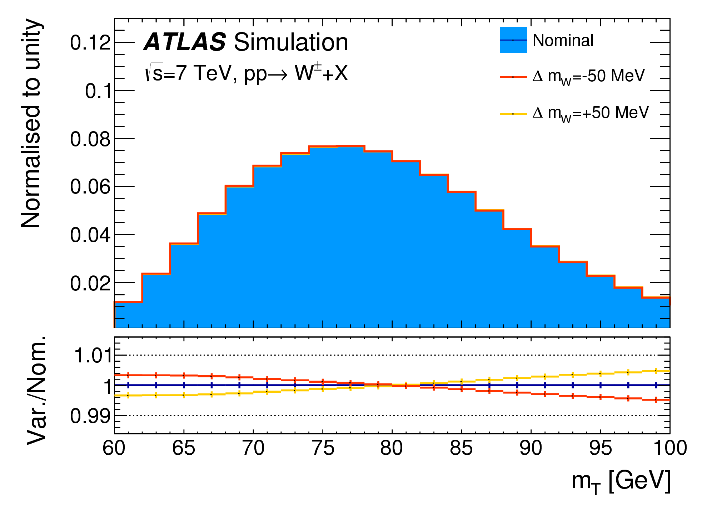
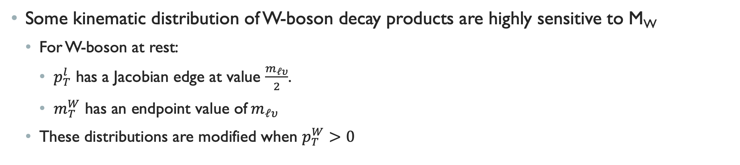

The ATLAS Measurement strategy
Some kinematic distribution of W-boson decay products are highly sensitive to M_{W}
  For W-boson at rest:
    $p_{T}^{l}$ has a Jacobian edge at value $\frac{m_{ℓυ}}{2}$.
    $m_{T}^{W}$ has an endpoint value of$m_{ℓυ}$
  These distributions are modified when $p_{T}^{W}>0$
$m_{ℓυ}$is related to $M_{W}$ through the Breit-Wigner distribution
$$\frac{dσ}{dm}∝\frac{m^{2}}{{\left(m^{2}−M_{W}^{2}\right)}^{2}+m^{4}\frac{Γ_{W}^{2}}{M_{W}^{2}}}$$
Impact of changing M_{W} by ±50 MeV on both templates
Notes:
The templates are generated in steps of 1 to 10 MeV within a range of ±400 MeV around the nominal M_{W} value used in MC samples.

Slide 9
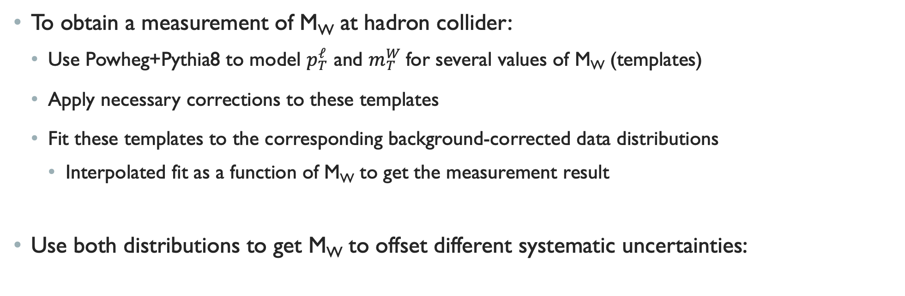
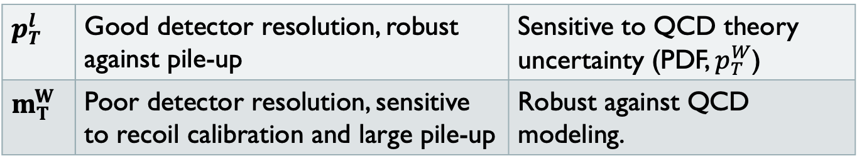
To obtain a measurement of M_{W} at hadron collider:
  Use Powheg+Pythia8 to model $p_{T}^{ℓ}$ and $m_{T}^{W}$for several values of M_{W} (templates)
  Apply necessary corrections to these templates
  Fit these templates to the corresponding background-corrected data distributions
    Interpolated fit as a function of M_{W} to get the measurement result
Use both distributions to get M_{W} to offset different systematic uncertainties:
A good complementarity between the measured observables:
$p_{T}^{l}$ | Good detector resolution, robust against pile-up | Sensitive to QCD theory uncertainty (PDF, $p_{T}^{W}$)
$m_{T}^{W}$ | Poor detector resolution, sensitive to recoil calibration and large pile-up | Robust against QCD modeling.
Notes:
An optimization of the fit range is done a priori, blinding M_{W}.

Slide 10
The precision obtained on M_{W} results from a major undertaking by ATLAS (and the theory community) at understanding QCD, in addition of the detector performance.

Slide 11

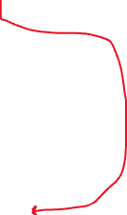
Template corrections
To improve the accuracy of the templates, MC events are reweighted based on a fully differential Drell-Yan cross section in which the dynamic of the boson and the kinematic of its decay products are factorized
Notes:
The first factor is modeled by the formula given in slide 12
The second factor is the differential cross section as a function of the vector boson rapidity
The third factor is the differential cross section for the vector boson transverse momentum in different vector boson rapidity bins. It cannot be based on fixed-order calculation because most of the statistics in the templates correspond to events with very low transverse momentum values in which large logs of the type $\log\left(\frac{M_{W}}{p_{T}^{W}}\right)$ need to be resumed and non-perturbative effects need to be included. The best modelling is obtained from the Pythia 8 generator for Drell-Yan merged to V+jets tuned to p_{T} Z data. The accuracy of this modelling of the vector boson p_{T} spectrum is comparable to an NLO plus parton shower generator setup such as Powheg+Pythia, resummed up to the next-to-leading log accuracy. Predictions from RESBOS, DYRes, and Powheg MiNLO+Pythia were found to be less accurate than the tuned Pythia 8 prediction.
At leading order, where the W and Z are produced with zero transverse momentum, the angular distribution of the lepton decay products depends solely on the polar angle of the leptons in the boson rest frame. Higher-order corrections give rise to sizeable boson p_{T} as well as to azimuthal asymmetries in the angular distribution of the decay leptons. The relative fraction of helicity cross sections for vector boson decay leptons depend on the boson rapidity and transverse momentum (dependence on mass is neglected). This is modeled by DYNNLO and cross checked with Z polarization measurements.

Slide 12
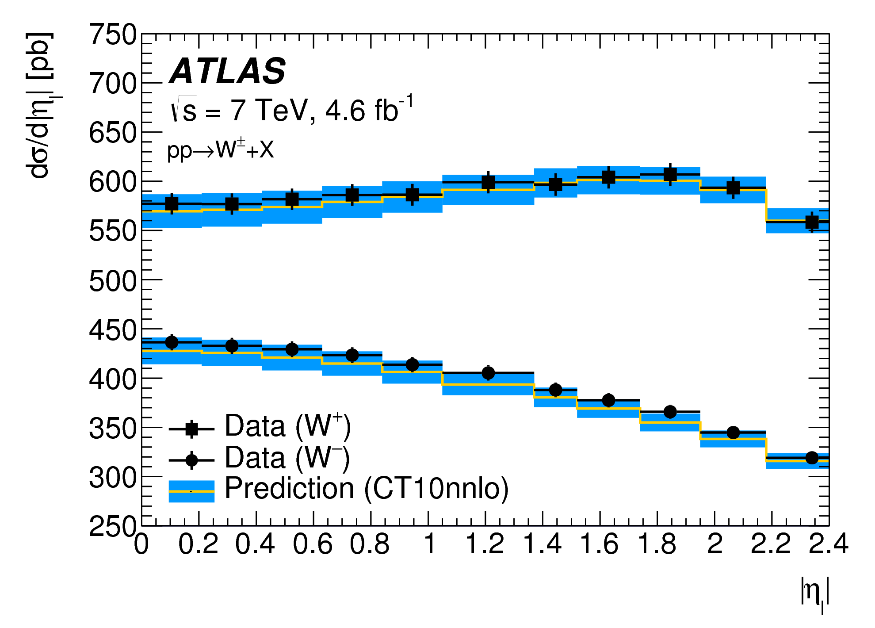
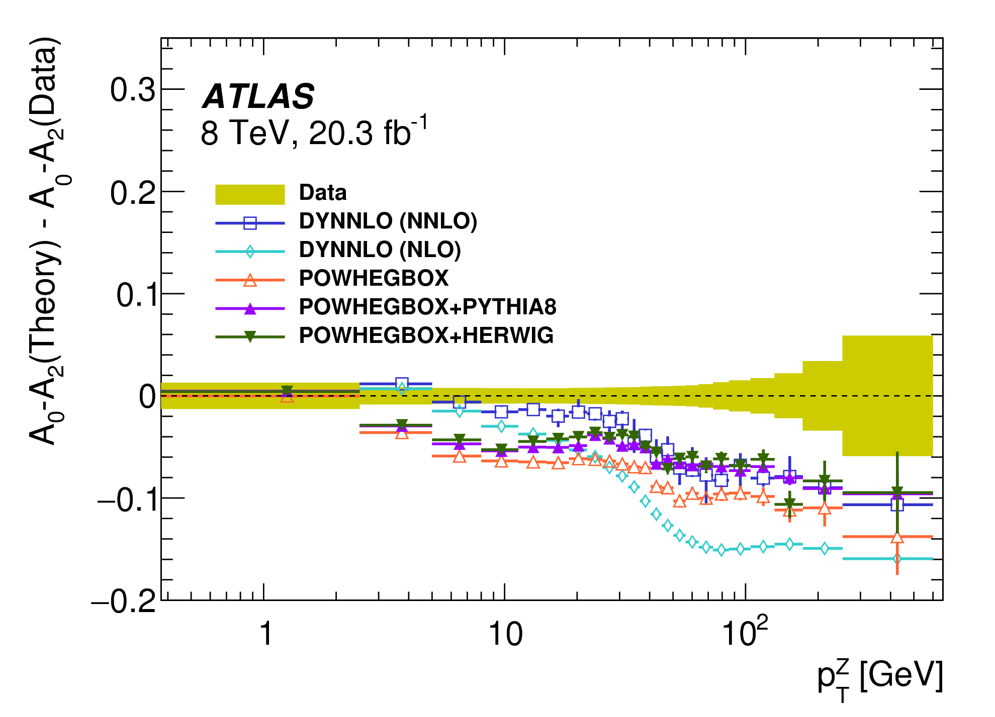
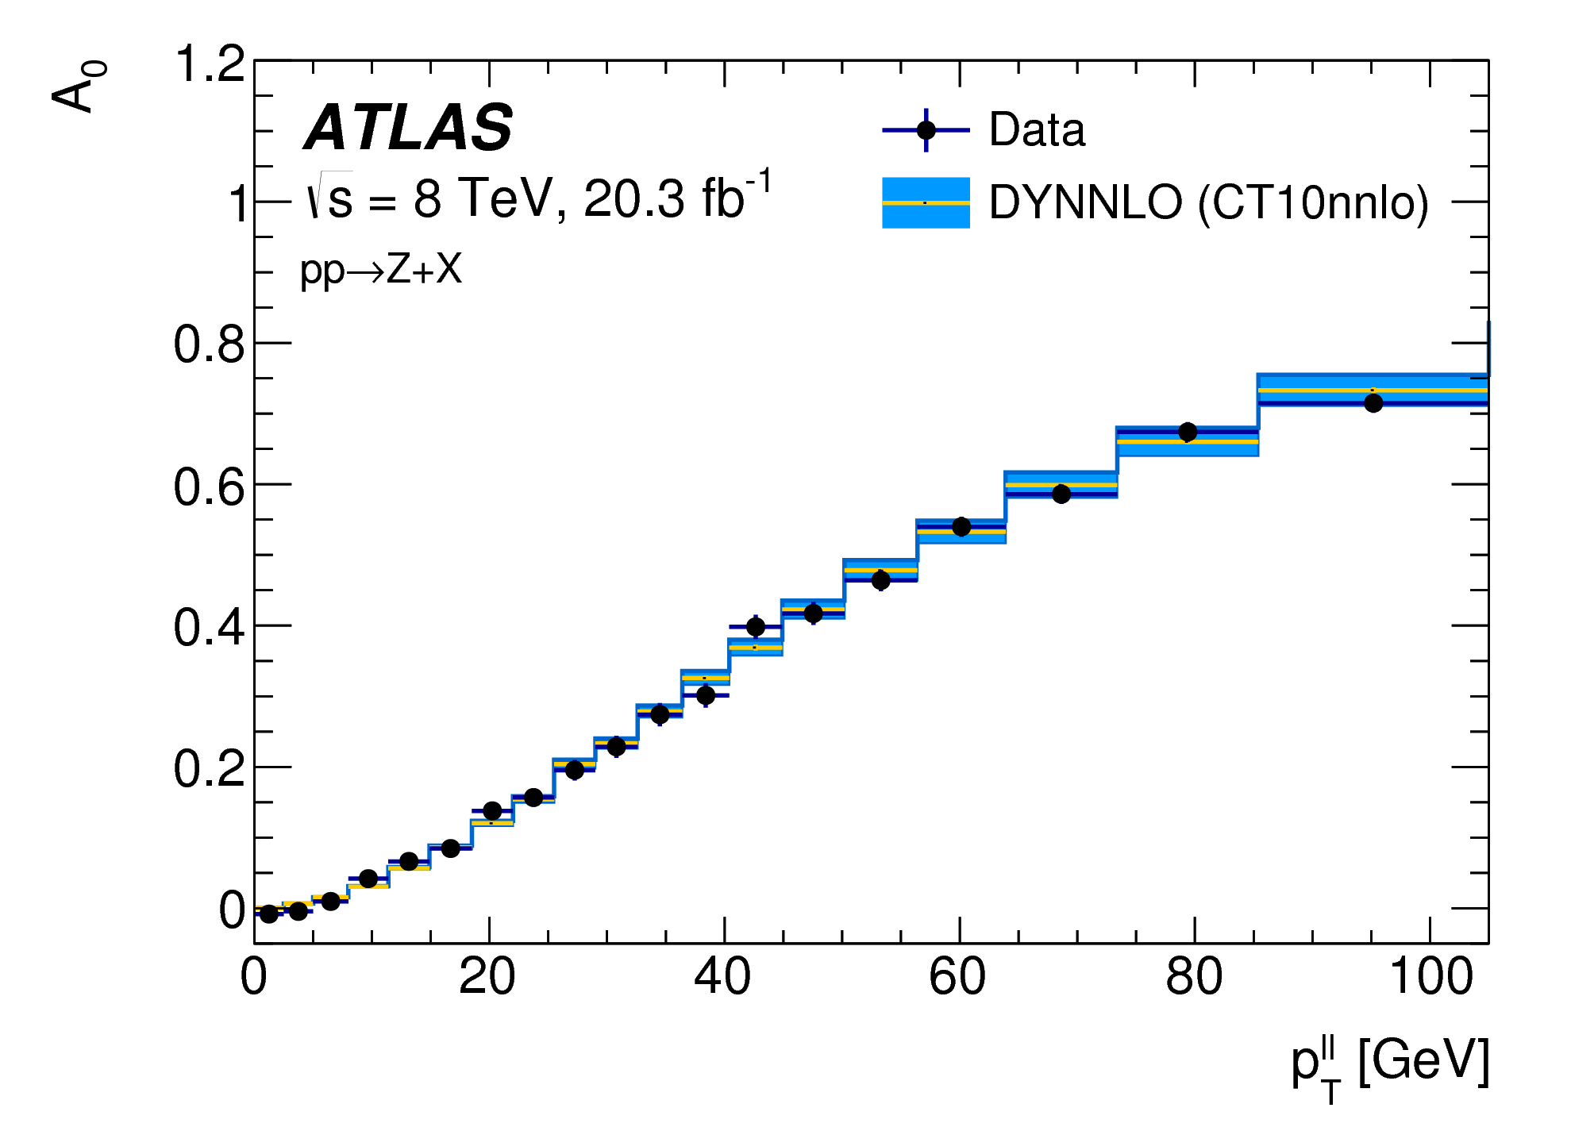
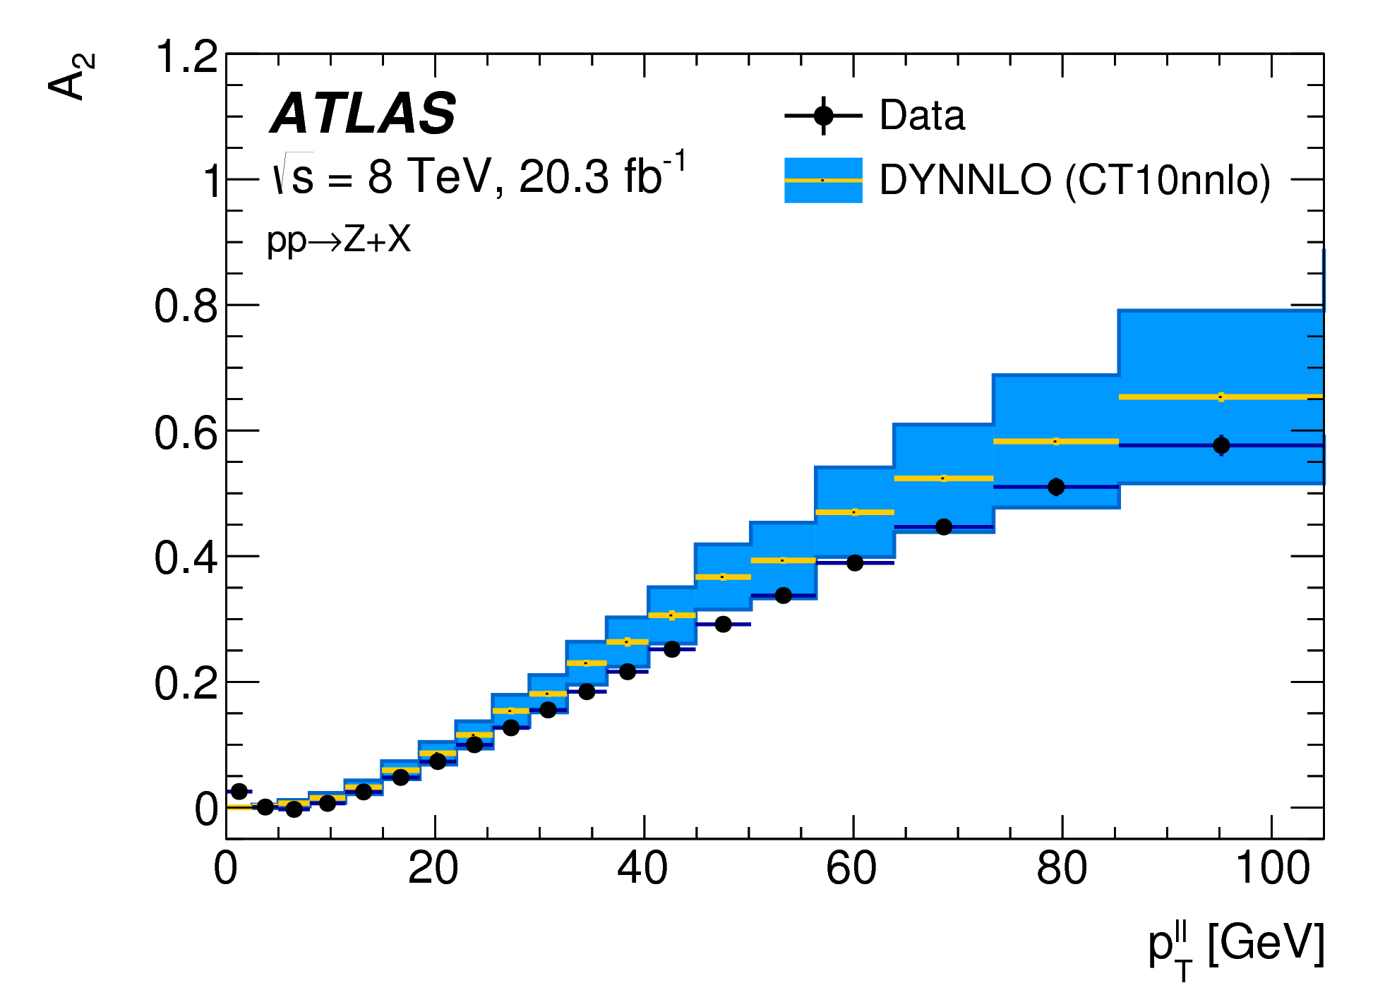
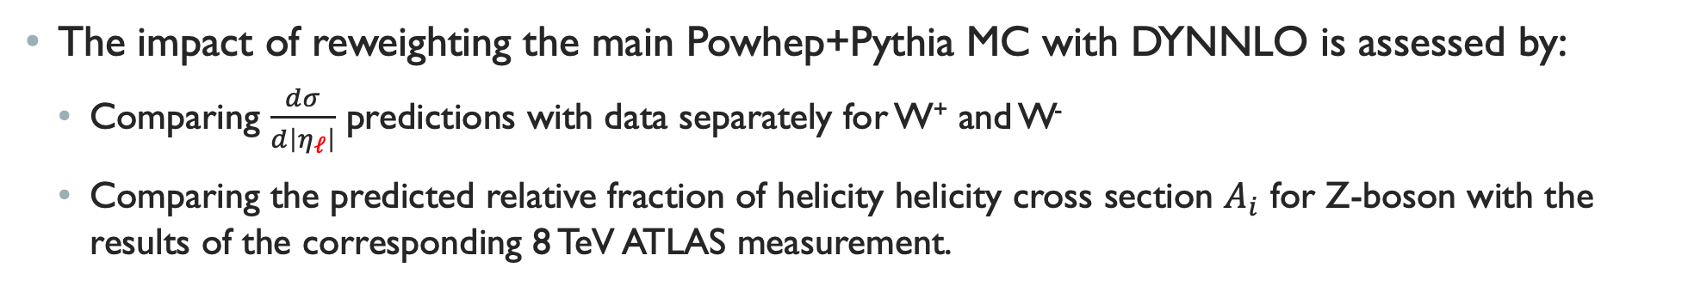


Impact of NNLO reweighting
The impact of reweighting the main Powhep+Pythia MC with DYNNLO is assessed by:
  Comparing $\frac{dσ}{d\left|η_{ℓ}\right|}$ predictions with data separately for W⁺ and W⁻
  Comparing the predicted relative fraction of helicity helicity cross section $A_{i}$ for Z-boson with the results of the corresponding 8 TeV ATLAS measurement.
JHEP 08 (2016) 159
While the W± rapidity and A₀ are well-modeled by the reweighted predictions, A₂ features some tensions
  An extra systematic uncertainty is added to cover the difference between data and MC for A₂
Notes:
The differential eta distribution for Z, W+ and W- was obtained from inclusive Drell-Yan measurements and compared to various PDF hypothesis. CT10nnlo (2018) and CT18 (2024) were retained as central PDF because they featured the best agreement to data for these input measurements. The reason for their success if diagnosed as a weaker suppression of the strange-quark density compared to the up and the down-quark densities for the CT PDFs compared to the others.
Note: A0 essential reflects the relative fraction of qq’bar-W and qg->W and depends a lot on pTW, but not on yW. A4 produces a forward-backward asymmetry and so is sensitive to the direction of the incoming quarks and anti-quarks in qq’bar->W.

Slide 13
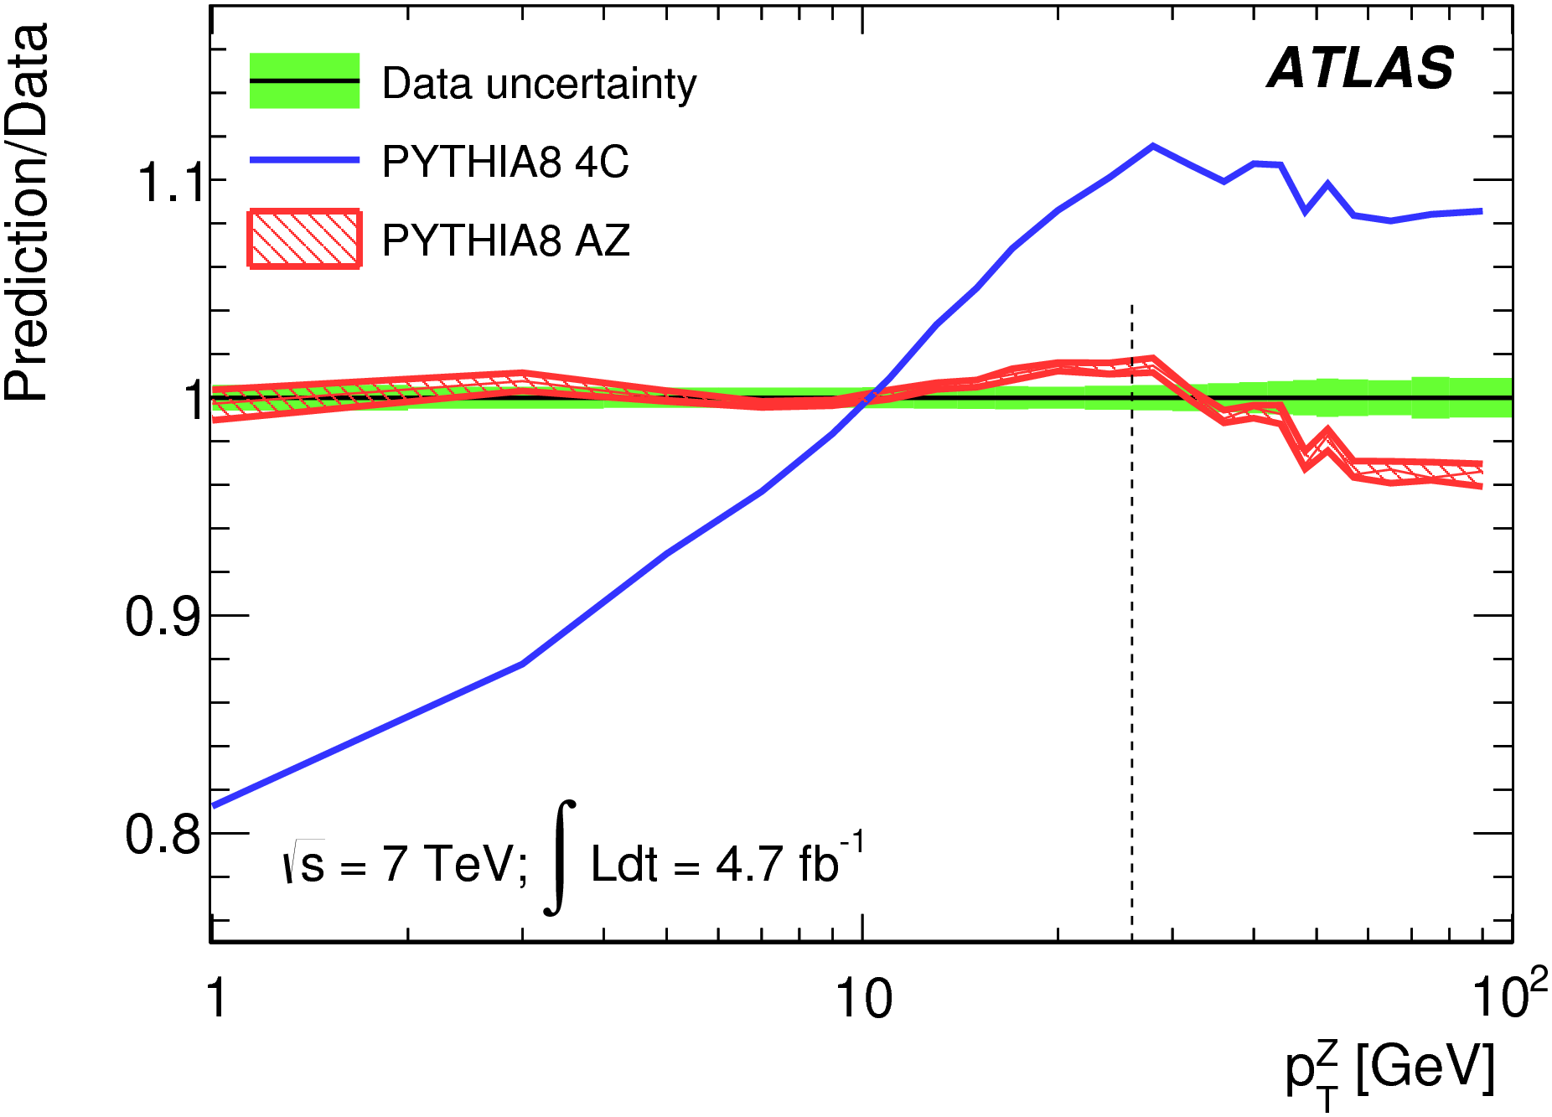
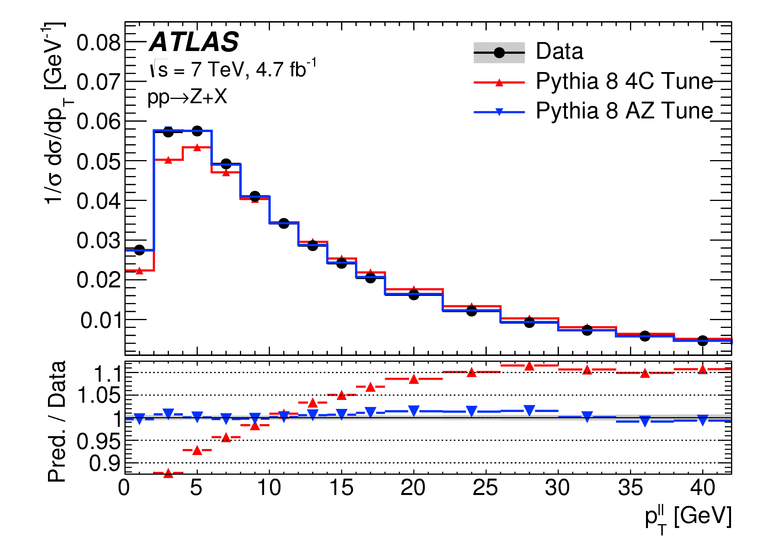
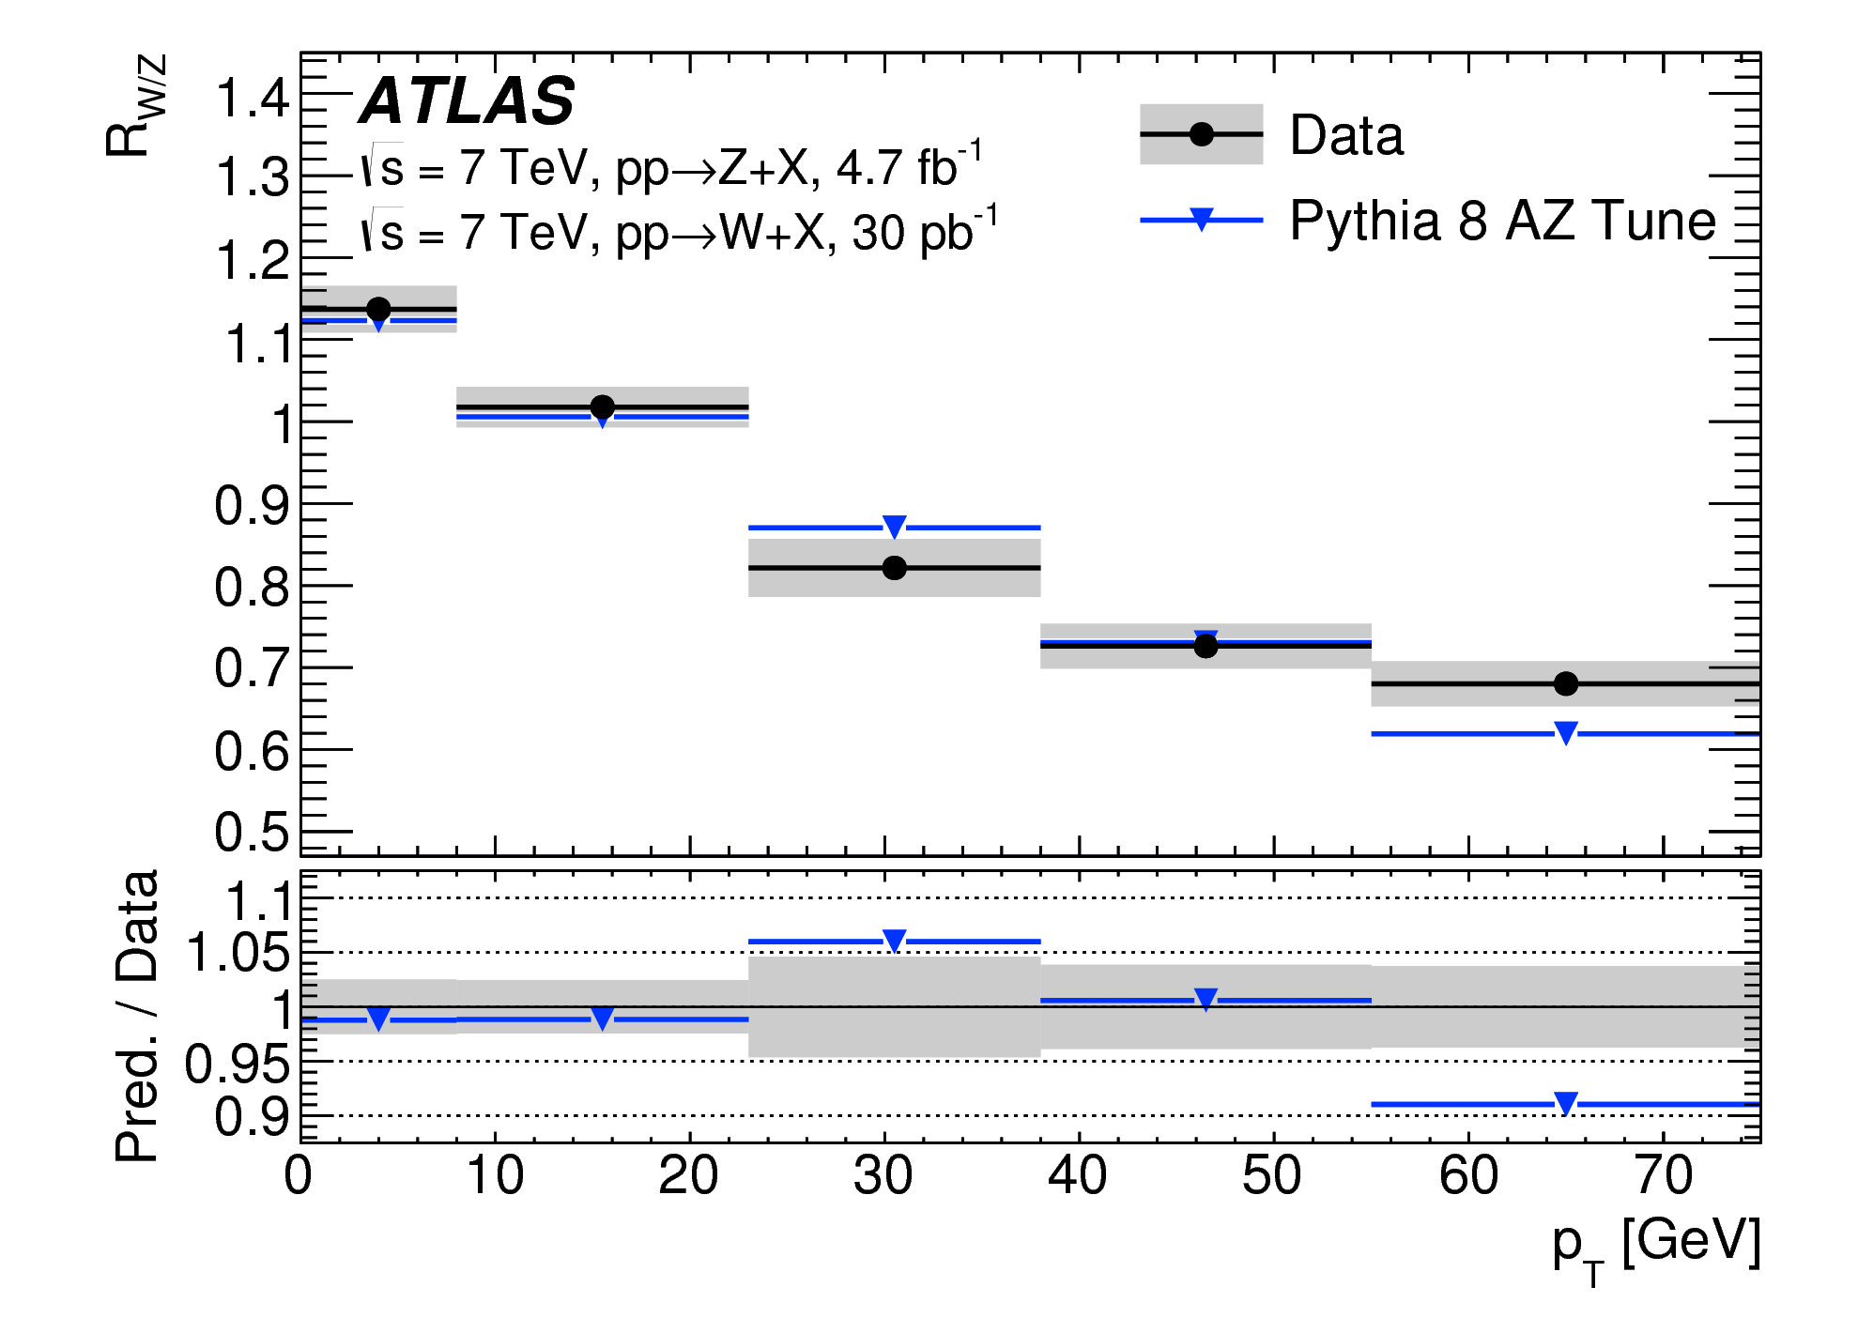
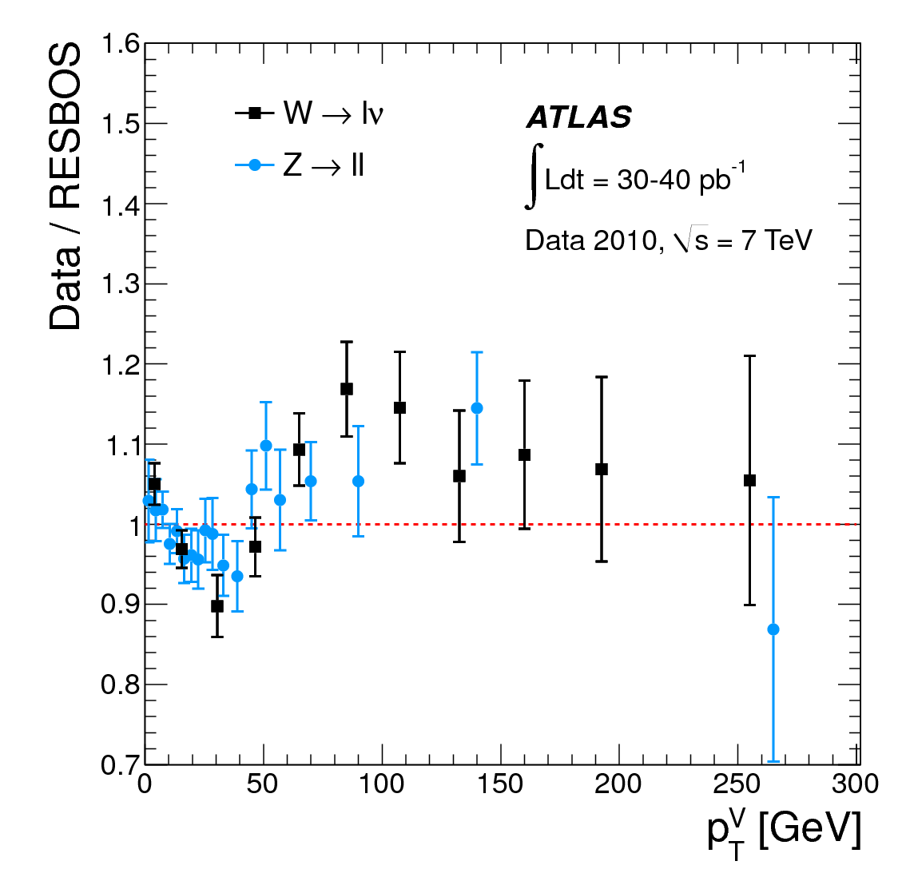
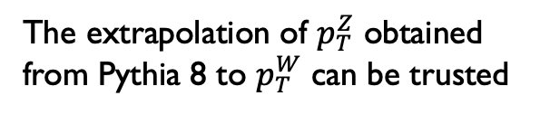

input from previous $p_{T}^{Z}$ and $p_{T}^{W}$ measurements
To control the modelling of the W-boson p_{T} the corresponding Z-boson distribution is used
  Obtain low-p_{T} behavior from fit of simulation to data → Tuning of Pythia 8
  Calculate the ratio of W-boson to Z-boson p_{T} from theory and compare to data
    Precision due to strong correlations between the two
JHEP 09 (2014) 145
Phys. Rev. D 85 (2012) 012005
Impact of tuning Pythia 8 on $p_{T}^{Z}$
The extrapolation of $p_{T}^{Z}$ obtained from Pythia 8 to $p_{T}^{W}$ can be trusted

Slide 14
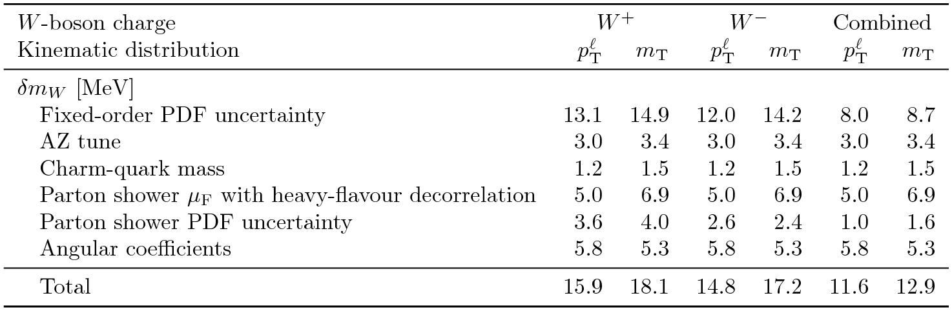
Resulting physics modeling uncertainty
Despite the above reweighting, corrections, and control with ancillary measurements, several sources of residual uncertainties related to the modelling of the strong interaction affecting the dynamic of vector-boson production and decay impact the measurement of M_{W}.
These systematic uncertainties are assessed by reweighting fluctuated predictions and propagating the effect throughout the M_{W} measurement.
Dominant modeling uncertainty from PDF, but strongly anti-correlated between W⁺ and W⁻, which helps constraining them
Notes:
PDF uncertainties estimated from the Hessian method (25 pairs of eigenvectors) for the main PDF set CT10nnlo, as well as by taking the envelop of M_{W} values for MMHT2014 and CT14 NNLO.
For the parton shower:
The eigentunes are used as systematic uncertainties
The model variations between p_{T}^{W} and p_{T}^{Z} and not included in the tune fit:
Charm mass
Factorization scale used to cover higher-order QCD corrections in PS that are decorrelated between W and Z: different amount of heavy-quark initiated production (factorization scale associated to the c qbar -> W process) at scale of mass threshold
PDF variations in PS
Merging process for first radiation in Pythia -> Negligible
Difference in p_{T}^{W} vs p_{T}^{Z} due to the difference between p_{T}-ordering and angular ordering showers -> Negligible
Modelling of the angular coefficient:
Experimental uncertainties on the Ai measurement by ATLAS
Mismodelling of A₂ and propagated to M_{W}.
The strong anti-correlation between W+ and W- PDF uncertainty is due to the fact that an increase in ubar PDF is at the expense of the d PDF which produces opposite effects in the longitudinal polarization of W+ and W-.

Slide 15
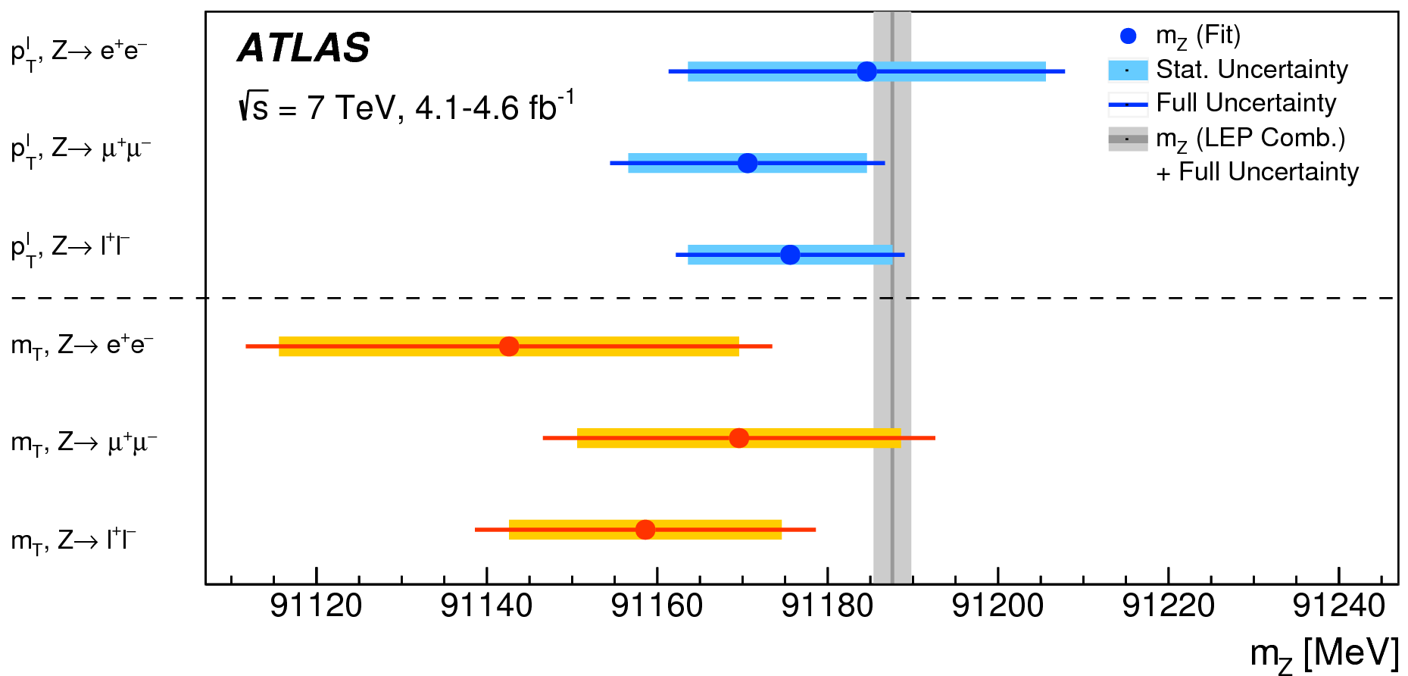
Validation of the measurement strategy
The measurement strategy is tested using Z-boson events to get a measurement of M_{Z}.
  One of the charged leptons from Z-decay is treated as a neutrino
  The precision of this validation is limited by the Z-boson statistics, 10 times smaller than for W-boson
All results are consistent with the LEP measurement results for M_{Z}
⇒ Validate measurement strategy!
Notes:
The uncertainty on the M_{Z} mass from the p_{T} template is about 10 MeV; while it is about 20 MeV for the M_{Z} measurement from the m_{T} template. Both uncertainties are dominated by statistics. The full range of this plot spends only 150 MeV. The estimate is repeated for the positive and the negative lepton neutrification, which are statistically independent for the p_{T} template, but not for the m_{T} one.

Slide 16
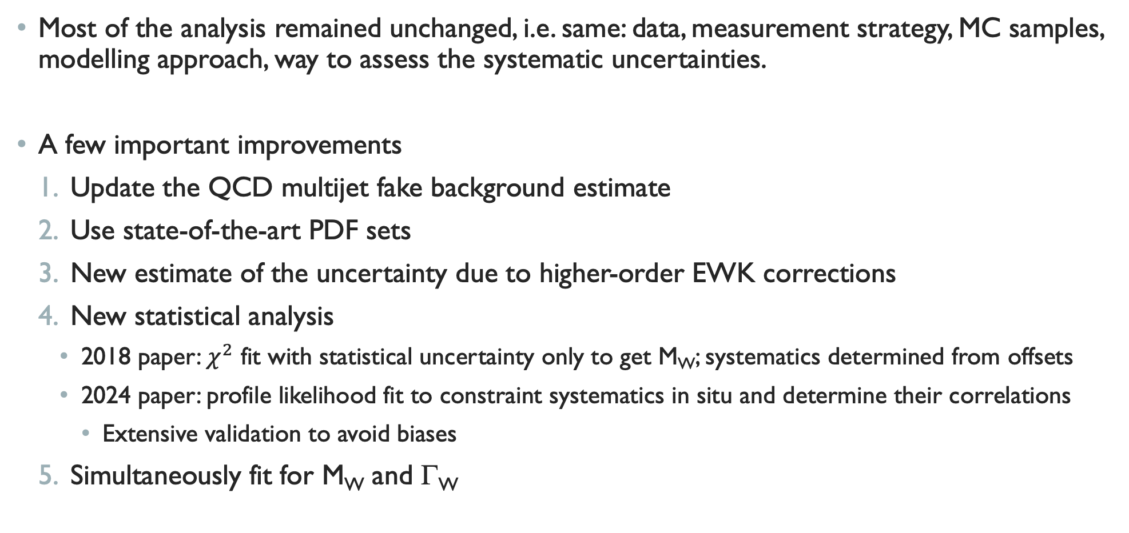
Improvements with the 2024 measurement
Most of the analysis remained unchanged, i.e. same: data, measurement strategy, MC samples, modelling approach, way to assess the systematic uncertainties.
A few important improvements
  Update the QCD multijet fake background estimate
  Use state-of-the-art PDF sets
  New estimate of the uncertainty due to higher-order EWK corrections
  New statistical analysis
    2018 paper: $χ^{2}$ fit with statistical uncertainty only to get M_{W}; systematics determined from offsets
    2024 paper: profile likelihood fit to constraint systematics in situ and determine their correlations
      Extensive validation to avoid biases
  Simultaneously fit for M_{W} and Γ_{W}
Notes:
Note 1: The profile likelihood fit is also a simultaneous fit of all the different M_{W} measurements made in all the different categories for each template. To leave more room for adjustment, the fit range has been increased for both templates. The expectation value of the Poisson distribution used to describe the number of observed event in bin i of the fitted template and in the category j of measurement is assumed to be linear in both the fitted parameter (mass or width) and in the nuisance parameters. The nuisance parameters are expected to be gaussianly distributed.
Note 2: The change to the multijet estimate is related to the better luminosity calculation which decreases the EWK contamination in the control regions, and affected significantly the estimate in the electron channel. Results in the muon channel are not affected. Finally, a better method of propagation of uncertainties on this bkg estimate to the M_{W} results have been used (eigenvector decomposition).
Note 3: In the first measurement, the width was fixed to the SM value with small uncertainty. Now, the fit is redone letting the width floating and fixing the mass to its SM value. Finally, a fit where both parameters are determined is also performed.
Note 4: The way PDF uncertainties are constrained to leave the predicted tuned p_{T}^{Z} unchanged, and propagating only the part of the PDF uncertainty in p_{T}^{W} that is uncorrelated to p_{T}^{Z}. The procedure used
is by effectively equivalent at retuning the Pythia parton on the different PDF tested.

Slide 17
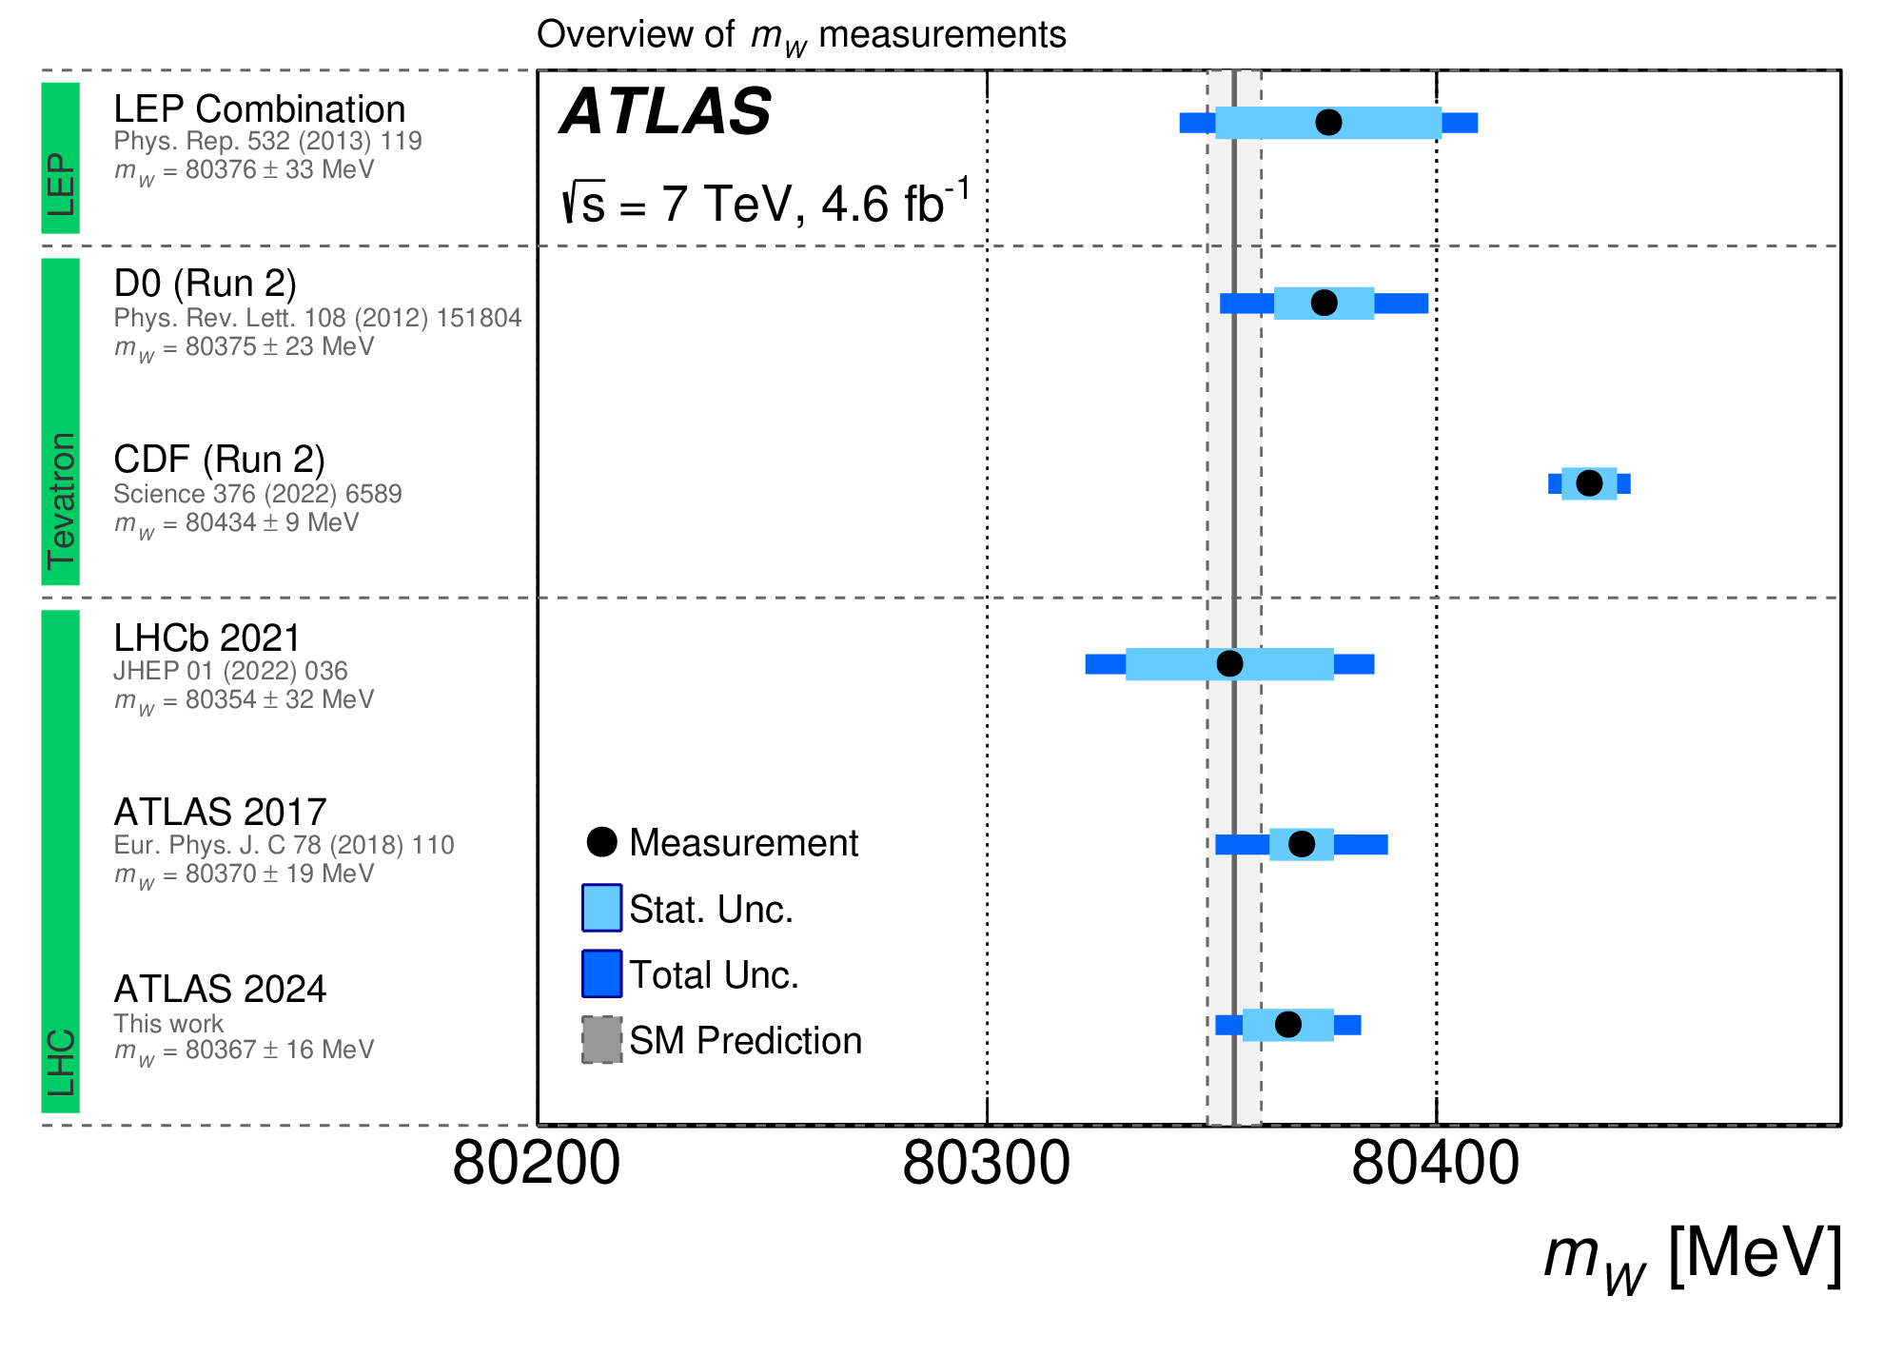
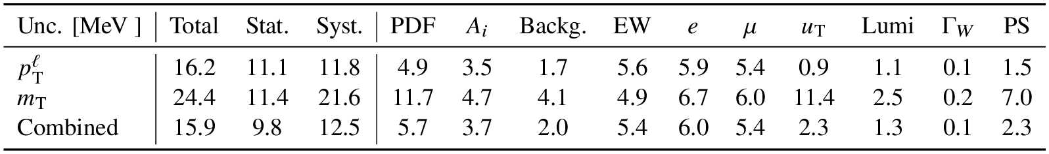
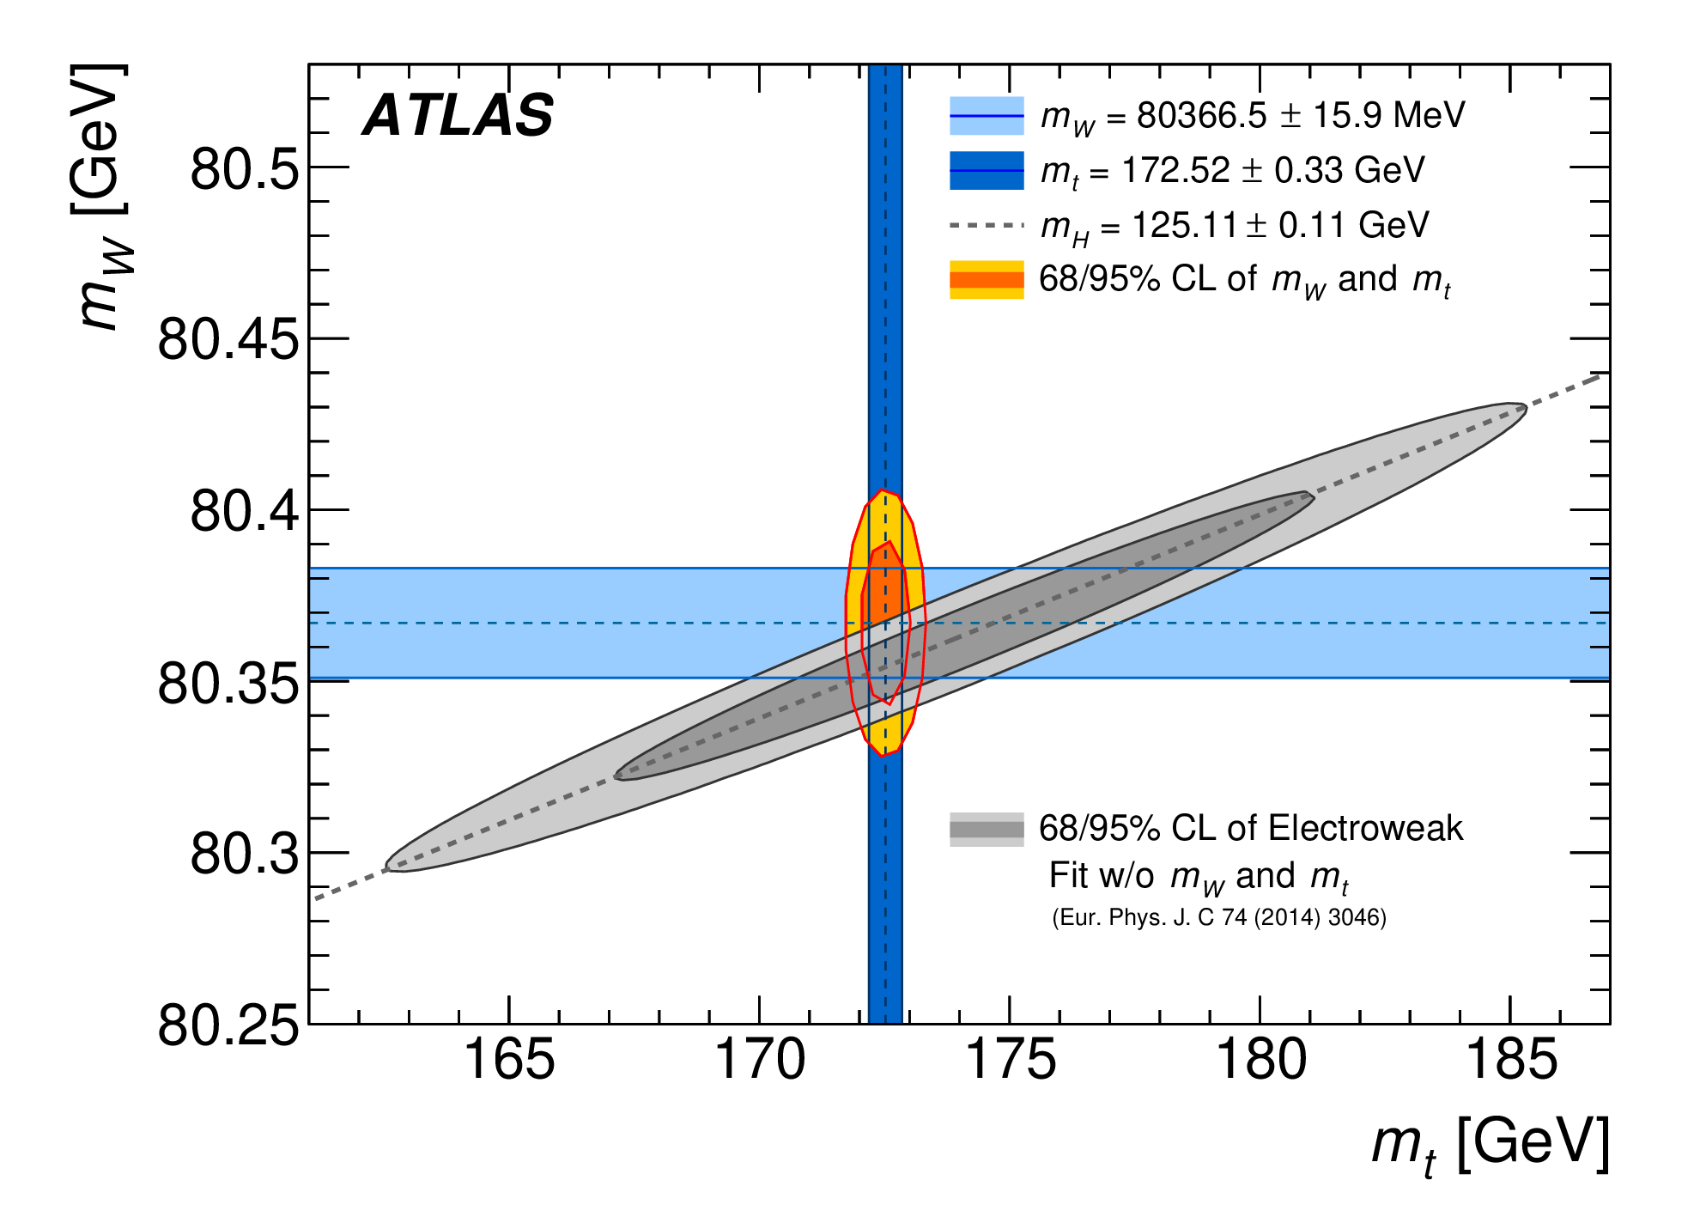
M_{W} measurement results
M_{W} = 80360 ± 9.8 (stat) ± 12.5 (syst) MeV
  New multijet estimate increases M_{W} by 1.9 MeV, but profiling with systematics reduces M_{W} by 16 MeV (1σ); total uncertainty 3 MeV better (15%)
  CT18 is used for central results (more conservative and compatible), improving the PDF uncertainty by 2MeV
Notes:
Total uncertainty improved by 15%.
Note that the statistical uncertainty was 6% in the previous measurement and it is 10% now because the nuisance parameters are not fixed in the new measurement, so the degrees of freedom are lower in the new approach because there are many more parameters to fix from the same data.
Note also that the dependence of the W mass uncertainty on the W width uncertainty is small since $∆M_{W}=−0.06∆Γ_{W}$. The inverse is not true: $∆Γ_{W}=−1.25∆M_{W}$.
Note: The results are worse for the m_{T} than the p_{T}^{l} template because due to the larger uncertainty on the recoil and the limitation of the fit range reduces the impact of the p_{T}^{W} and PDF on p_{T}^{l}.

Slide 18
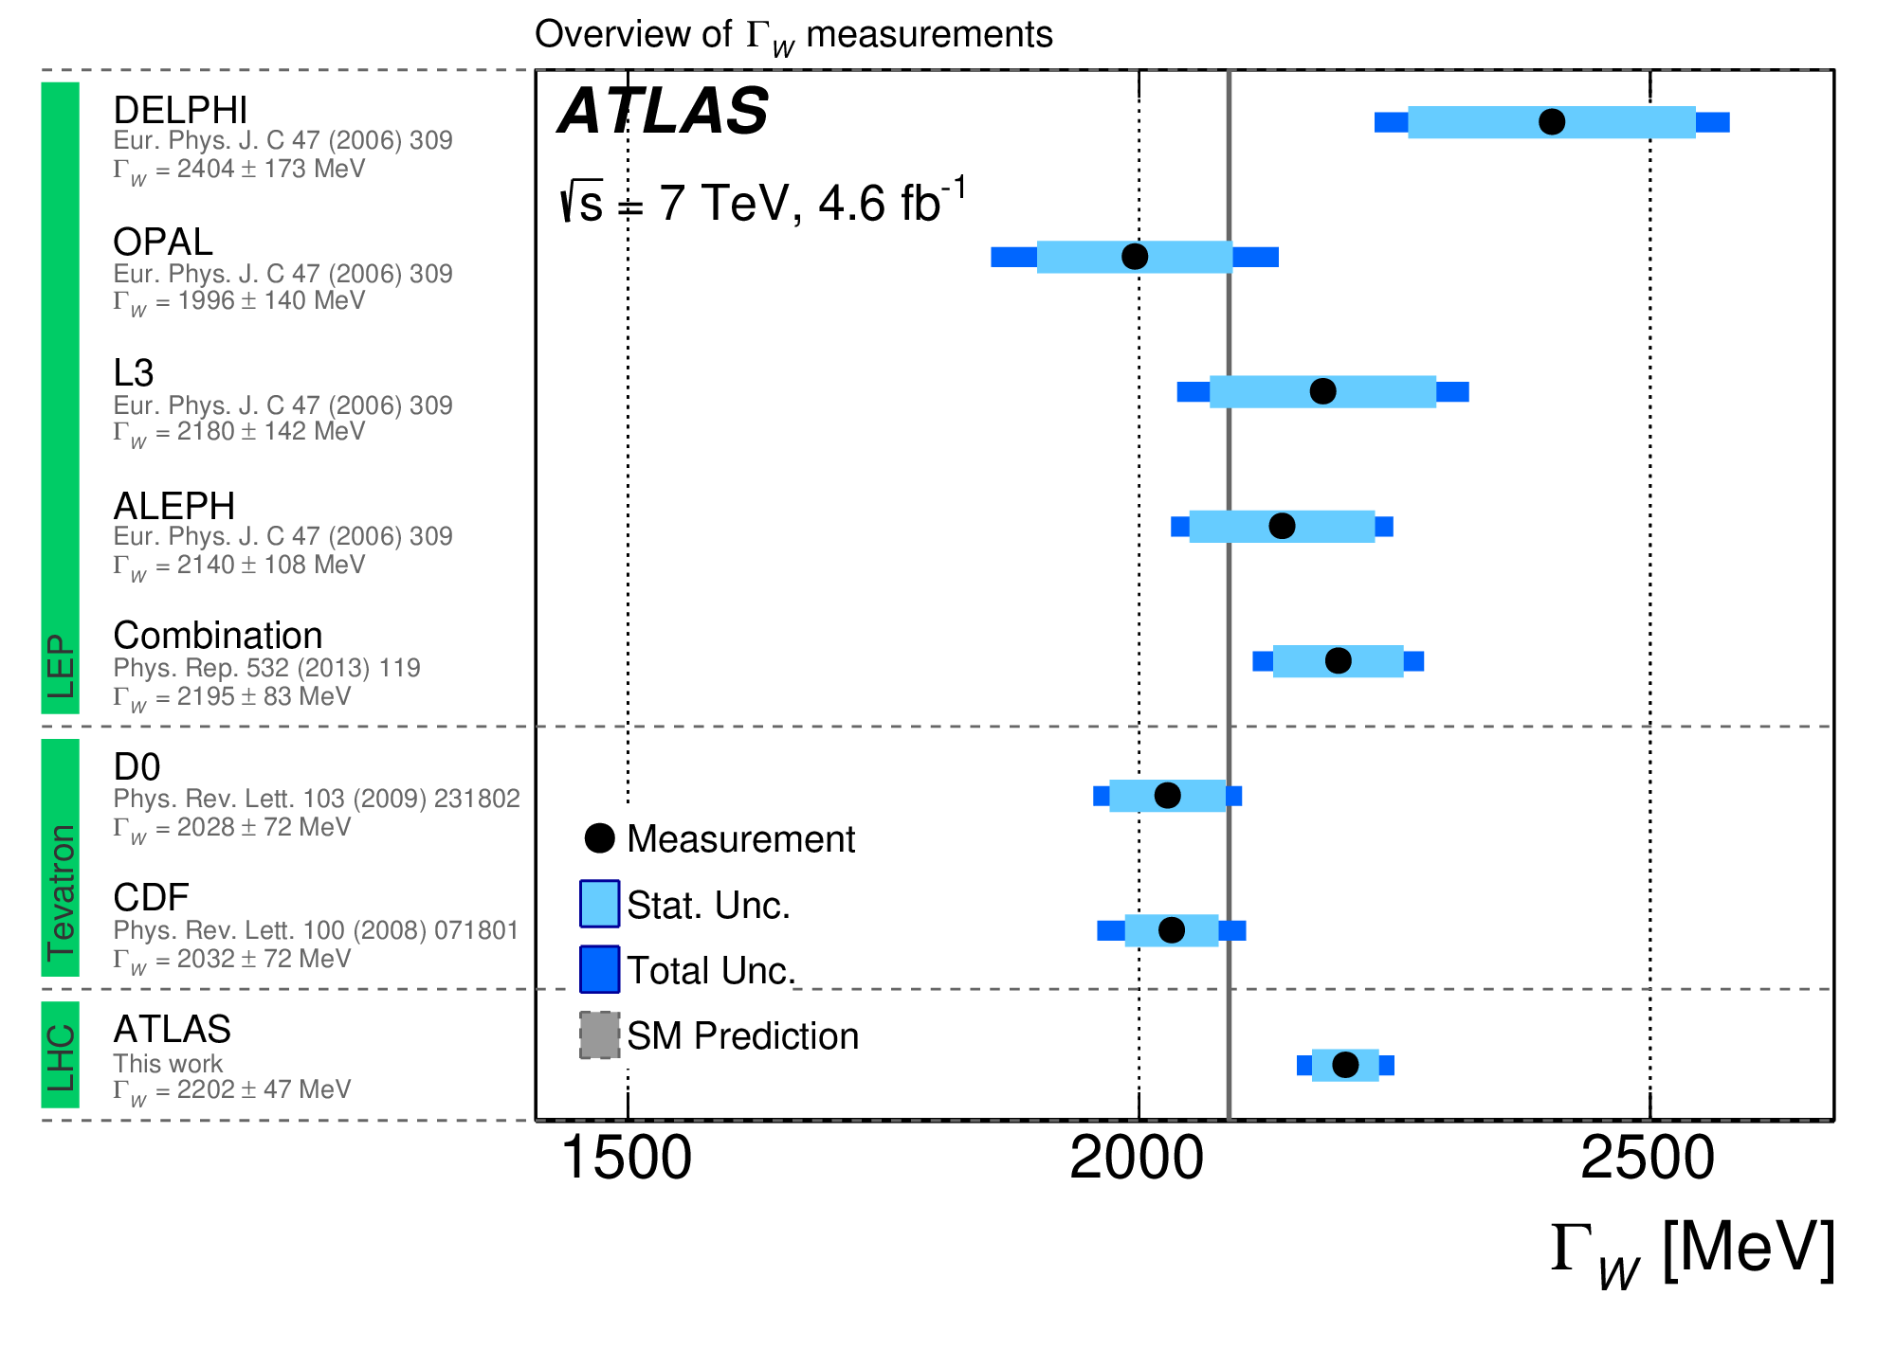
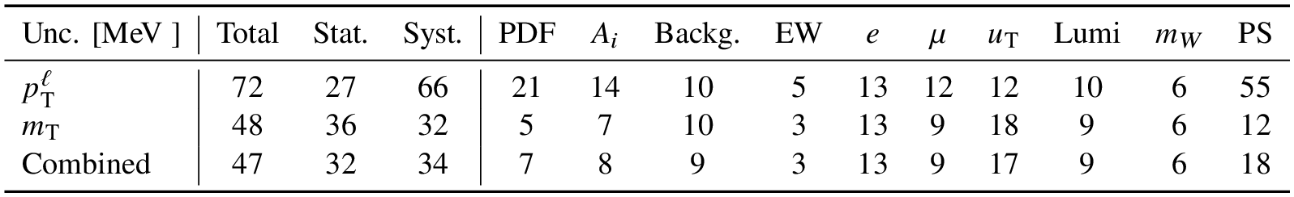
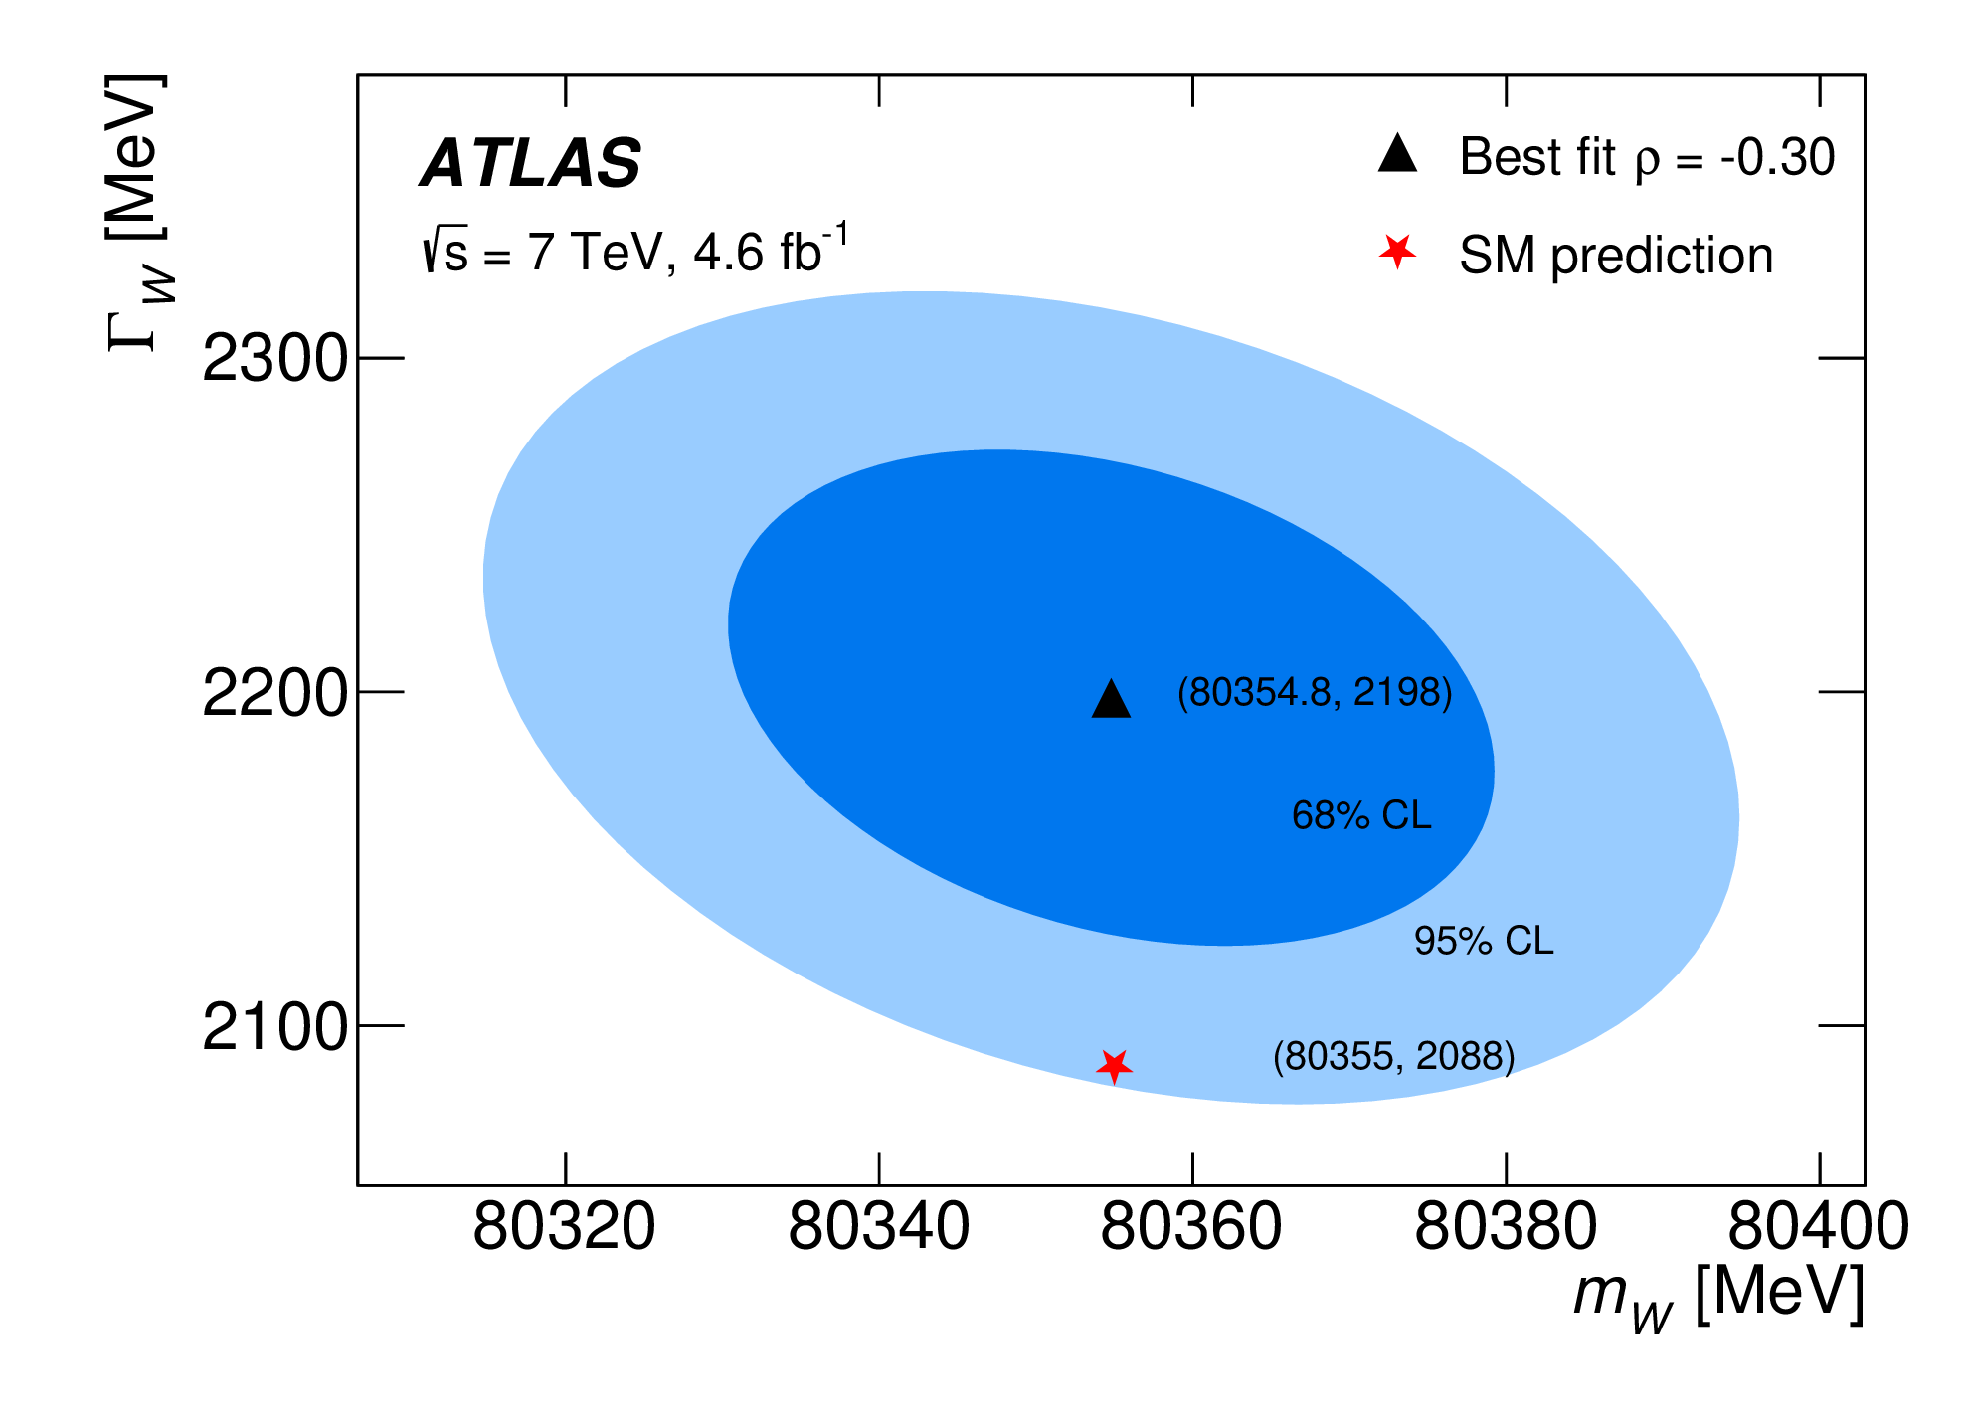
Γ_{W} measurement results
Γ_{W} = 2202 ± 32 (stat) ± 34 (syst) MeV
First determination at the LHC and most precise single measurement result
Some (small) tension with SM expectations and … CDF → Roles inverted
Notes:
For this parameter, the fit to the m_{T} template in more important than for m_{W} because the width varies more in this template (larger sensitivity because the tail of m_{T} is more likely to come from the tail of Breit-Wigner more sensitive to the width).
Note that when both parameters are included in the fit, we noticed that m_{W} moves closer to the SM because the fit wants to reduce the tension with the width. The total uncertainty is also larger because one constraints is removed in the fit, i.e. that the other parameter is set to its SM value.

Slide 19
World combination
arXiv:2308.09417
Combination of measurement results from different experiments can improve the precision of M_{W} by increasing the statistics and offsetting some of the systematic uncertainties.
  Inputs from LEP combined, CDF, D0, ATLAS, and LHCb.
For M_{W}, this is not an easy task because different generators and PDFs have been used in different experimental conditions, differently impacted by the various detector effects.
The combination strategy proceeds in 3 steps:
  Each measurement result is adjusted to a common model including detector emulations
  The correlations between uncertainties are evaluated
  The results are combined for representative PDF sets using the BLUE method
Notes:
The reason why the measurement results are adjusted to a common model is to compare central values on an equal footing and to compare how each result is affected by the same source of uncertainty so to assess correlations.
The common model includes a reweighting of the MW parameter used in the MC to the same mass using, on even-by-event, a Breit-Wigner function, a simplified detector model that allows estimating the impact of small theoretical modification on the measurement results, and different theoretical models to study the impact of theory modification on measurement results.
PDF sensitivity are estimated at parton level before parton shower (negligible impact on PDF uncertainty) using Powheg Wj MiNNLO
The polarization effects are studied with RESBOS-C and RESBOS-CP at NLO+NNLL and NNLO+NNLL accuracy respectively.

Slide 20
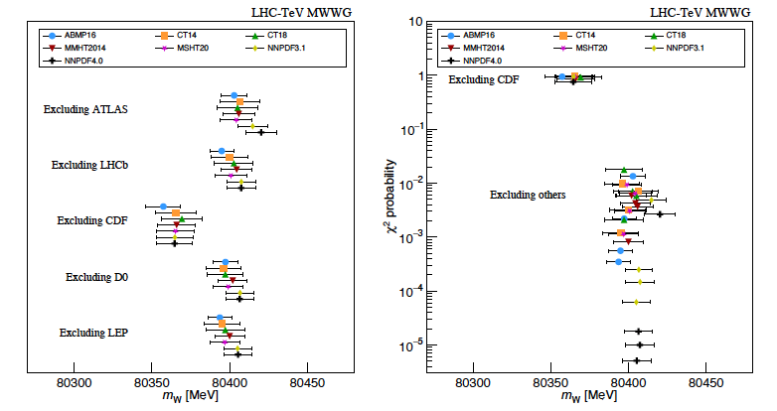

World combination including CDF has a very low compatibility (<0.5%; 3.6-5.2σ)
  Compatibility studies vs PDFs, with best compatibility for CT18
World combination excluding CDF yields: $M_{W}=80,369.2 ±13.3 MeV$
  Compatibility of 91% (CT18), with the relative weight of ATLAS being 42%

Slide 21
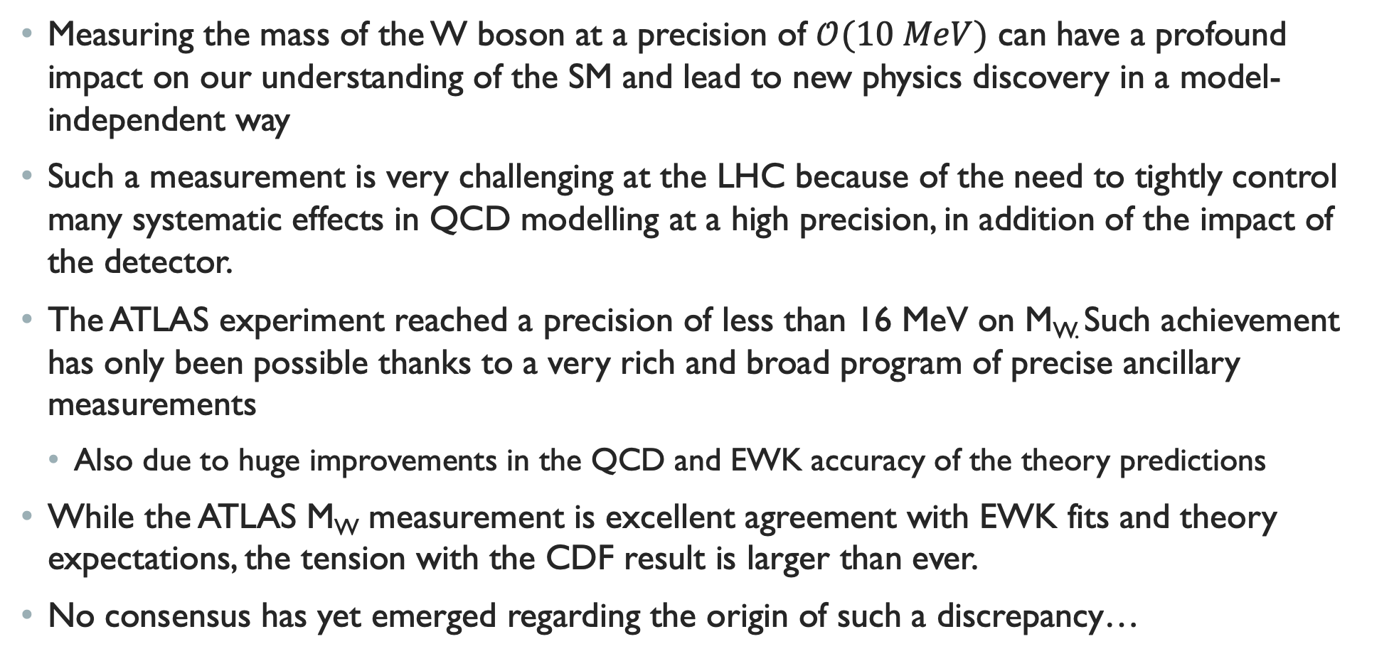
conclusion
Measuring the mass of the W boson at a precision of $𝒪(10 MeV)$ can have a profound impact on our understanding of the SM and lead to new physics discovery in a model-independent way
Such a measurement is very challenging at the LHC because of the need to tightly control many systematic effects in QCD modelling at a high precision, in addition of the impact of the detector.
The ATLAS experiment reached a precision of less than 16 MeV on M_{W.} Such achievement has only been possible thanks to a very rich and broad program of precise ancillary measurements
  Also due to huge improvements in the QCD and EWK accuracy of the theory predictions
While the ATLAS M_{W} measurement is excellent agreement with EWK fits and theory expectations, the tension with the CDF result is larger than ever.
No consensus has yet emerged regarding the origin of such a discrepancy…

Slide 22
Back-up Slides

Slide 23
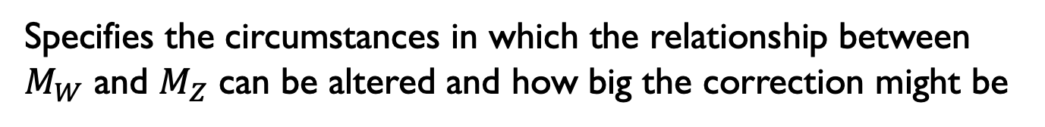
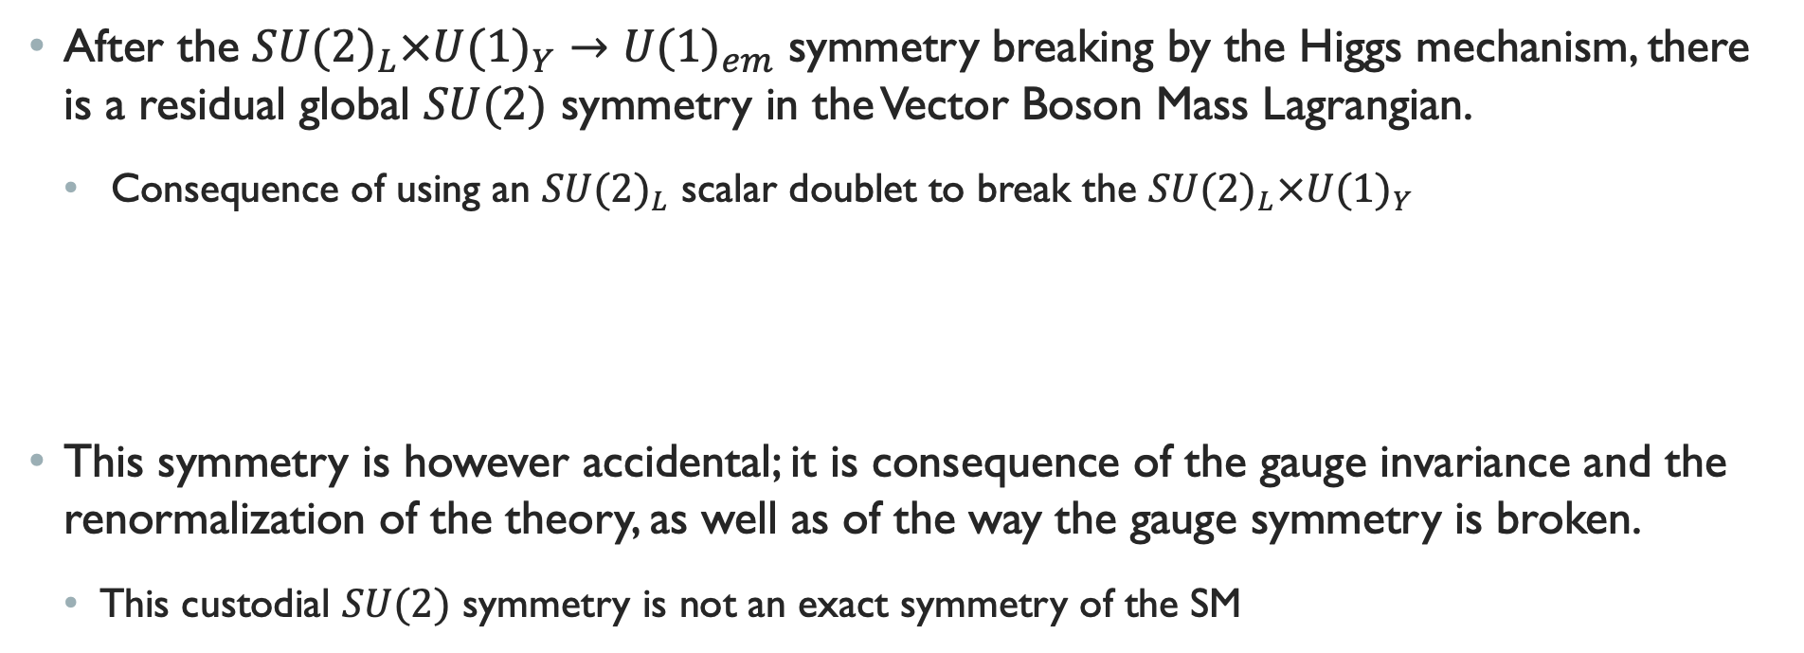
The custodial $SU(2)$symmetry
After the ${SU(2)}_{L}×{U(1)}_{Y}→{U(1)}_{em}$ symmetry breaking by the Higgs mechanism, there is a residual global $SU(2)$ symmetry in the Vector Boson Mass Lagrangian.
  Consequence of using an ${SU(2)}_{L}$ scalar doublet to break the ${SU(2)}_{L}×{U(1)}_{Y}$
This symmetry is however accidental; it is consequence of the gauge invariance and the renormalization of the theory, as well as of the way the gauge symmetry is broken.
  This custodial $SU(2)$ symmetry is not an exact symmetry of the SM
⇒ Explain the stability of the relationship between $M_{W}$ and $M_{Z}$
Specifies the circumstances in which the relationship between $M_{W}$ and $M_{Z}$ can be altered and how big the correction might be
⇒
Notes:
The scalar Higgs field kinematic term is always invariant under a any general O(4) transformation. In general, interaction terms in the Lagrangian would break this symmetry completely, however, in the SM, the requirement of gauge invariance and renormalizability implies that the only scalar self-couplings terms are $V\left(Φ^{T}Φ\right)$, which satisfies this O(4) symmetry. Once the Higgs field develops a vev, this symmetry gets broken to a global O(3) symmetry, which is locally isomorphic to a global SU(2) symmetry. The $Φ$ gauge couplings that ultimately produces the gauge-boson mass matrix is therefore invariant under these SU(2) global transformations. This is the custodial symmetry.
This symmetry is accidental because it is not a fundamental law imposed on the theory, but is a consequence of the way the Higgs mechanism operates in the SM, i.e. is a consequence of the way the Higgs mechanism is structured.

Slide 24
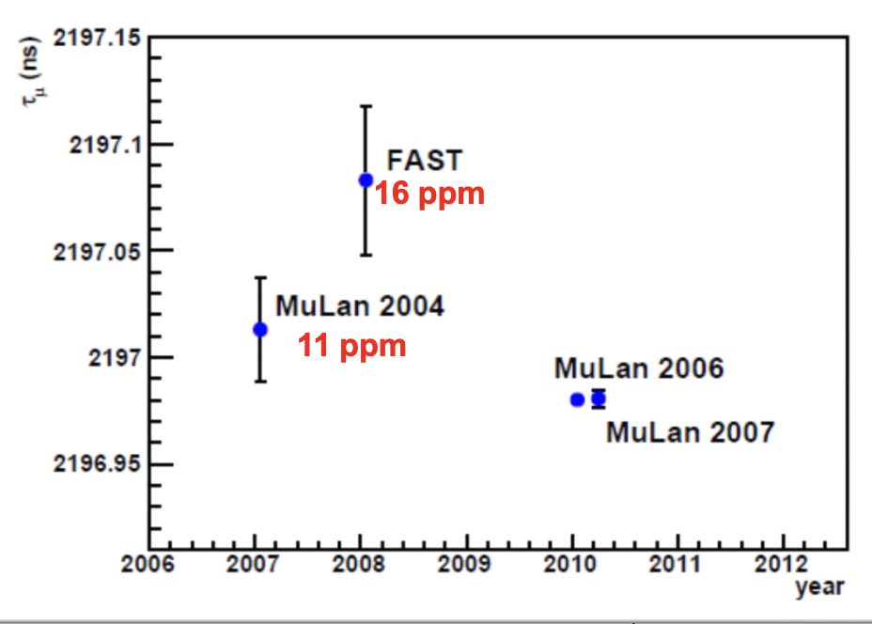
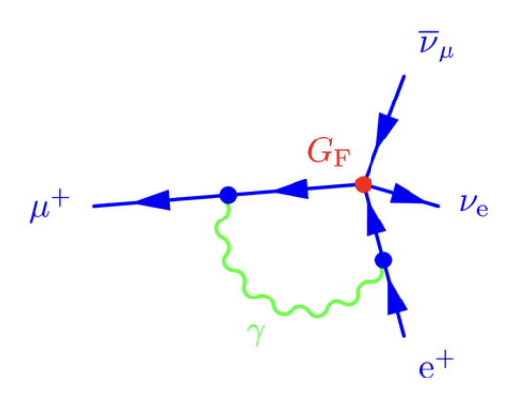
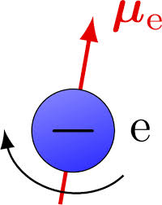
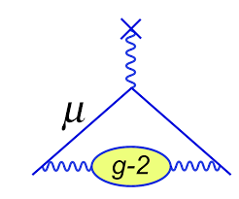
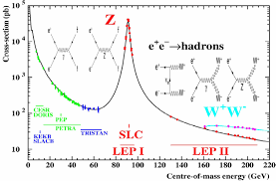
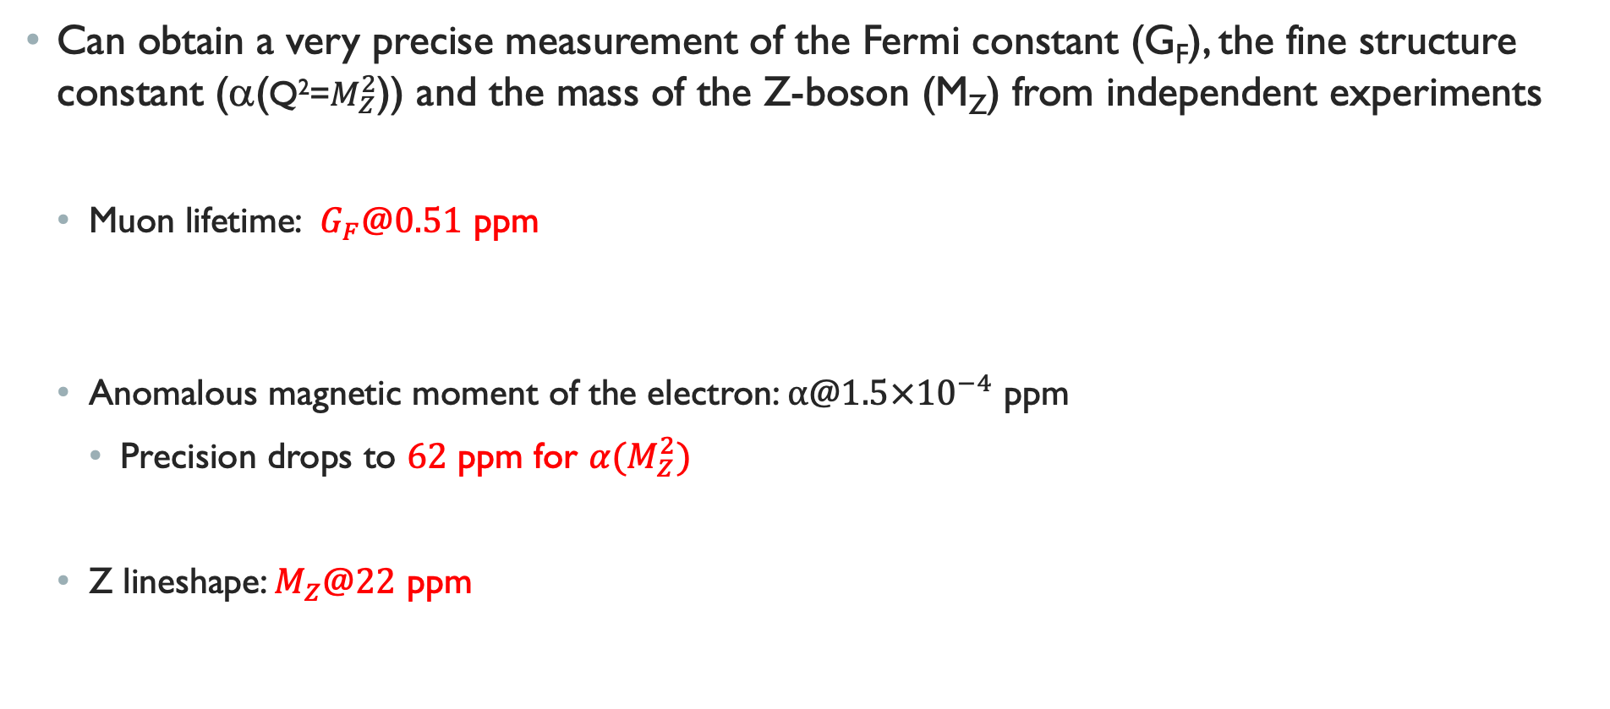
Consistency test: precise measurements and Precise calculation
Can obtain a very precise measurement of the Fermi constant (G_{F}), the fine structure constant (α(Q²=$M_{Z}^{2}$)) and the mass of the Z-boson (M_{Z}) from independent experiments
  Muon lifetime: $G_{F}@0.51$ ppm
  Anomalous magnetic moment of the electron: $α@1.5×{10}^{−4}$ ppm
    Precision drops to $62$ ppm for $α(M_{Z}^{2})$
  Z lineshape: $M_{Z}@22$ ppm
From PDG
Notes:
Note that for the fine-structure constant, another approach to its experimental determination combines measurements of the Rydberg constant and atomic masses with interferometry of atomic recoil kinematics.

Slide 25



Using above values yields a very precise prediction for $M_{W}^{0}=\frac{1}{\sin\left(θ_{w}\right)}\sqrt{\frac{πα}{\sqrt{2}G_{F}}}$
However, the theoretical precision is limited by radiative corrections : ${M_{W}=M}_{W}^{0}{\left(1+∆r\right)}^{−1}$
  Ex.: $𝒪(α)$ 1-loop corrections amount to about 3%
Radiative correction calculation can be fully parametrized in terms of $α, α_{s}, M_{Z}, m_{t},$ and $M_{H}$.
  Smaller precision for M_{H} (0.09%), α_{s} (0.76%), and m_{t} (0.33%).
Using the measurement values for these parameters in the best calculation available for the radiative corrections yields an uncertainty of 4 MeV on the M_{W} SM prediction
  Dominated by uncertainty on m_{t} and on higher order radiative corrections neglected
$$M_{W}^{th}=80.367±0.004 GeV$$
Achieving a M_{W} measurement to a precision of $𝒪(1−10 \left(MeV\right))$ would yield a very stringent test of the SM!
Notes:
Note 1: The M_{W} value refers to the conventional definition according to a Breit-Wigner parametrization with running width.
Note 2: Very high accuracy reached from: full electroweak two-loop corrections, up to four loops in pure fermion-loop corrections, contribution of $𝒪(αα_{s}^{2})$, and leading $𝒪\left(αα_{s}^{3}\right), \text{leading} \text{three}\text{−}\text{loop} \text{contributions} \text{of} 𝒪(G_{μ}^{3}m_{t}^{6}) \text{and} 𝒪(G_{μ}^{2}α_{s}m_{t}^{4})\text{.}$
Note 3: The top mass measurement quoted in the PDG is 172.57±0.27 GeV, a precision of 0.16%. It differs from the pole-mass obtained from cross-section measurements: 172.4±0.7 GeV, a precision of 0.41%. These values differ from the value used in the EWK fit because the latest use combination with D0 that has some tension with other m_{t} measurement, and include an uncertainty on the top-mass definition (pole vs MC). This uncertainty on the top-mass definition is taken to be of 0.52 GeV, giving a final top-mass result used in EWK fit of 172.61±0.25±0.52, i.e. a precision of 0.33%.

Slide 26



Phys. Rev. Lett. 131 (2023) 251802
Many ATLAS measurements have a direct impact on M_{W}, including: $α_{s}$, $m_{top}$, and $M_{H}$
arXiv:2309.12986
Phys. Rep. 1116 (2025) 127-183
Notes:
For the strong coupling: Most precise experimental determination of α_{s}(M_{Z}) to date and first based on N4LLa+N3LO calculation. Largely uncorrelated to other determination of PDF because PDF fits do not include p_{T}^{Z} in Sudakov region

Slide 27



All SM parameters feature relationships that can accurately be predicted and measured
  Indirect measurement for each parameter from the global fit
  To be compared to their direct measurement
Tension in EWK fits would reveal inconsistencies in the theory
A model-independent gateway to new physics
It is crucial to obtain a more precise measurement of M_{W}
  Global fit limited by precision on M_{W} and Γ_{W}
  Measurements of M_{H} and m_{t} are currently more precise than their indirect determination from global EWK fit
  ⇒ Improving their precision won’t increase sensitivity to new physics
Indirect determination of $M_{W}^{Ind}=80.354±0.007 GeV$ more precise than direct determination:
Confirms the $M_{W}^{Meas}$ precision of $𝒪(5 MeV)$
Eur. Phys. J. C (2018) 78:675
Notes:
Constraints on BSM physics from EWK fits are currently limited by measurement precision on W-mass. => Need to be improved.

Slide 28









Reconstructing the relevant kinematic quantities
The kinematic distributions used to obtain a measurement of M_{W} are defined from the W-boson decay products as follow
$$m_{T}=\sqrt{2p_{T}^{ℓ}p_{T}^{miss}\left(1−\cos\left(Δφ\right)\right)}$$
$$p_{T}^{ℓ}$$
and
$${\vec{p}}_{T}^{miss}=−\left({\vec{p}}_{T}^{ℓ}+{\vec{u}}_{T}\right)$$
$${\vec{u}}_{T}=\sum_{i}{{\vec{E}}_{T,i}}$$
Transverse energy deposited by cluster $i$ in the calorimeter, excluding those from charged lepton ($E_{T}=E/\cosh{η}$)

Slide 29

Complications related to An M_{W} measurement
An accurate and precise measurement of M_{W} requires:
  An accurate description of the various QCD effects impacting the kinematic distributions of the W-boson and of decay products
  A good model of the detector distortion of these kinematic distributions
  Control the M_{W} measurement accuracy and precision by comparing results in various $η^{ℓ^{±}}$ regions
The ATLAS Collaboration developed a rich QCD precision measurements program that was put to contribution to this measurement to:
  Derive correction applied to the templates used to extract M_{W}
  Fit model parameters to increase accuracy of theoretical calculations used to derive templates
  Perform cross checks allowing to validate the measurement strategy
  Estimate some of the key systematic uncertainties on the measurement
The precision obtained on M_{W} results from a major undertaking by ATLAS (and the theory community) at understanding QCD, in addition of the detector performance.

Slide 30
The main aspects of the M_{W} measurement directly impacted by QCD are:
  The Parton Distribution Functions
    Imbalance between W⁺ and W⁻ → Measure M_{W} separately for each charge
      40% more W⁺ with a broader rapidity and a softer p_{T}.
    About 25% of all W-boson produced at the LHC involve a heavy quark in the initial state
  The W-boson rapidity and transverse momentum
  The relative fraction of Helicity cross section in Drell-Yan processes
  The modeling of the photon radiation from vector boson decay products
These effects are controlled by:
  Reweighting MC samples to include higher-order QCD and EWK corrections
  Use ancillary Z-boson measurements to calibrate hard-to-model effects
    E.g. low vector boson transverse momentum (resummation, non-perturbative effects)

Slide 31





Modeling of detector effects
The measurement relies on a thorough detector calibration based on Z-boson data studies.
  Correction of the muon muon calibration, resolution, and sagitta bias
  Correction of the electron energy scale and resolution
  Correction to the recoil response and resolution
  Determination of electron and muon efficiency correction using the tag-and-probe method
Muons well-calibrated ($𝒪({10}^{−4})$ precision)
Electrons well-calibrated ($𝒪({10}^{−4})$ precision)
Recoil correction is essential
(1% on response/resolution)
Notes:
Muons:
The kinematic properties of the muons are obtained only from the ID-track so a simple functional correction can be applied to account for imperfect knowledge of detector alignment and resolution, of the magnetic field, and of the amount of passive material in the detector. This is corrected by a muon momentum scale and resolution functional correction applied to MC, and by a sagitta bias correction applied to data. The resolution correction is only on the intrinsic component because the impact of multiple scattering is negligible for the muons of interest.
Uncertainties on muon corrections cover: choice of fitting range, methodological biases, background to Zmm, theoretical modelling of Z p_{T}, non-linearity of the corrections, and material distribution in the ID. Finally, there is an uncertainty on the transfer of the muon momentum scale from Z to W (dominant systematics on muon kinematic corrections).
Uncertainties on efficiency scale factors are dominated by the stats in Zmm tag&Probe and multijet estimate.
Electrons:
The charge mis-ID is not a problem because the rate is low (0.2% in the barrel, 4% in the end-cap), and the impact on W+ and W- is anti-correlated and so cancel in the combination up to the difference in yield of W+ vs W-.
Recoil:
The recoil correction is done in 3 steps:
Pile-up reweigthing
Residual data-to-MC differences in the distribution of SumE*_{T,i} are calculated in bin of Z pT in the data corrected with a ratio of W scale factor to Z scale factor and this is applied to W MC.
The energy scale of the recoil is calibrated from the difference between p_{T}^{ll} + u|| in data and simul, while the resolution is calibrated using the ratio of the u_{perp} rems in data and simul. Once both the parallel and the perpendicular components of u_{T} are corrected, the p_{T}^{miss} is also corrected and so is m_{T}.

Slide 32

Resulting physics modeling uncertainty
Despite the above reweighting, corrections, and control with ancillary measurements, several sources of residual uncertainties related to the modelling of the strong interaction affecting the dynamic of vector-boson production and decay impact the measurement of MW.
These systematic uncertainties are assessed by reweighting fluctuated predictions and propagating the effect throughout the M_{W} measurement.
Dominant modeling uncertainty from PDF, but strongly anti-correlated between W⁺ and W⁻, which helps constraining them
Notes:
PDF uncertainties estimated from the Hessian method (25 pairs of eigenvectors) for the main PDF set CT10nnlo, as well as by taking the envelop of M_{W} values for MMHT2014 and CT14 NNLO.
For the parton shower:
The eigentunes are used as systematic uncertainties
The model variations between p_{T}^{W} and p_{T}^{Z} and not included in the tune fit:
Charm mass
Factorization scale used to cover higher-order QCD corrections in PS that are decorrelated between W and Z: different amount of heavy-quark initiated production (factorization scale associated to the c qbar -> W process) at scale of mass threshold
PDF variations in PS
Merging process for first radiation in Pythia -> Negligible
Difference in p_{T}^{W} vs p_{T}^{Z} due to the difference between p_{T}-ordering and angular ordering showers -> Negligible
Modelling of the angular coefficient:
Experimental uncertainties on the Ai measurement by ATLAS
Mismodelling of A₂ and propagated to M_{W}.
The strong anti-correlation between W+ and W- PDF uncertainty is due to the fact that an increase in ubar PDF is at the expense of the d PDF which produces opposite effects in the longitudinal polarization of W+ and W-.

Slide 33





New PDF baseline: CT18
  Reasonable agreement between results from different PDF sets except NNPDF
  CT10nnlo was the former baseline
Background is small but impact shapes
From the 2018 paper
Impact of the profile likelihood fit on data-to-prediction agreement for the two templates
Notes:
Note 1: The PDF baseline is CT18 mainly because it is the only PDF set that does not include the data used for this M_{W} measurement in its determination. It is also preferred because it is consistent with the results obtained with CT10nnlo, and yields the most conservative PDF uncertainty, with the flexibility to improve it with the fit.
Note 2: The Zee bkg is 2.9% in the W+ channel, but 4.0% in the W- channel because of the different yields between the two W but not the two Z bkg.
Note 3: The multijet bkg is obtained from the template fit method where a simultaneous fit of three distributions, pTmiss, mT, and pTl/mT, of three templates in two jet enriched regions and the signal region is done. The fake templates are obtained from reversed isolation while the signal+EWK and the top templates are obtained from MC. Multiple isolation regions are tested for the fake template, the bkg estimated in each. All these estimates are fitted to a straight line and extrapolated to the signal region isolation for the final multijet bkg estimate.

Slide 34













A plethora of consistency checks
The M_{W} measurement is obtained in various conditions allowing to have a series of independent consistency checks on contributions to the final M_{W} measurement result
  W⁺ vs W⁻
  Different lepton rapidity bins
  Different fit template
  Different lepton channels
  Different fit ranges
$p_{T}^{ℓ}$ template
$m_{T}$ template
Notes:
The boundaries between the different eta bins are driven mainly by experimental and statistical constraints.
Further tests include different <mu> intervals, different intervals of recoil, and by removing the p_{T}^{miss} selection, and different lepton azimuthal bins (not trivial since non-zero W p_{T} yields asymmetry in azimuthal distribution of charged leptons). These allowed showing control in the detector response modelling.
In total, 28 different M_{W} determinations are obtained and combined. The systematic uncertainties feature different size and correlations between each measurements which lead to significant reduction of the overall uncertainties on the final measurement result. Some of these measurements feature strong correlations between two systematics, no correlation for other sources, and anti-correlations for some others, while other measurements feature different patterns. For example, PDF uncertainties are anti-correlated between W+ and W- but fully correlated between electron and muon channels and almost not correlated between p_{T}^{l} and m_{T} templates. On the other hand, the muon calibration uncertainty is not correlated between the electron and muon channel, fully correlated between W+ and W- and anti-correlated in m_{T} due to p_{T}^{miss} vs p_{T}^{l} in m_{T}. Finally, these breakdowns of the measurements not only allows understanding the off-sets of the various systematics and show that we control the measurement results, but it would also point to which correction is wrong if discrepancy were observed. For example, discrepancies between W+ and W- would point to a PDF or p_{T}^{W} mismodelling, while discrepancies between the electron and muon channels would likely indicate a lepton calibration issue, and discrepancies between the templates would reveal a recoil calibration, multijet background or p_{T}^{W} modelling issue.

