Slide 1
Prospects for detecting gamma rays from r-process producing supernovae
Zhenghai Liu (North Carolina State University)
With
Evan Grohs (North Carolina State University)
Kelsey A Lund (North Carolina State University)
Gail C McLaughlin (North Carolina State University)
Moritz Reichert (Universitat de València)
Ian Roederer (North Carolina State University)
Rebecca A Surman (University of Notre Dame)
Xilu Wang (Institute of High Energy Physics,Chinese Academy of Sciences)

Slide 2
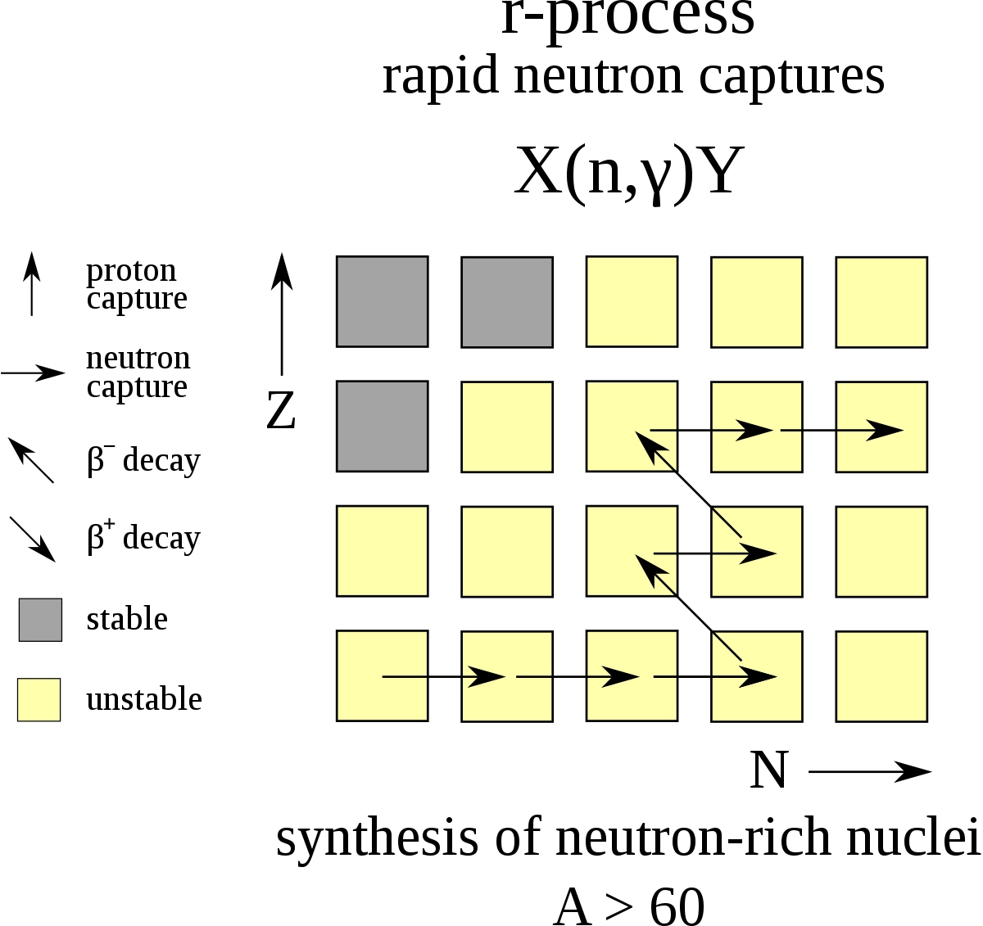
r-process
Elements heavier than iron generally are synthesized in astrophysical sites via different processes.
R-process (rapid neutron capture) is considered a major nucleosynthesis process responsible for forging heavy isotopes.

Slide 3
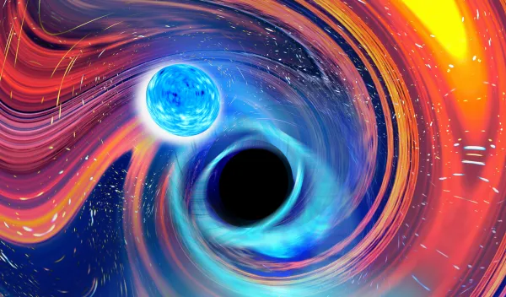
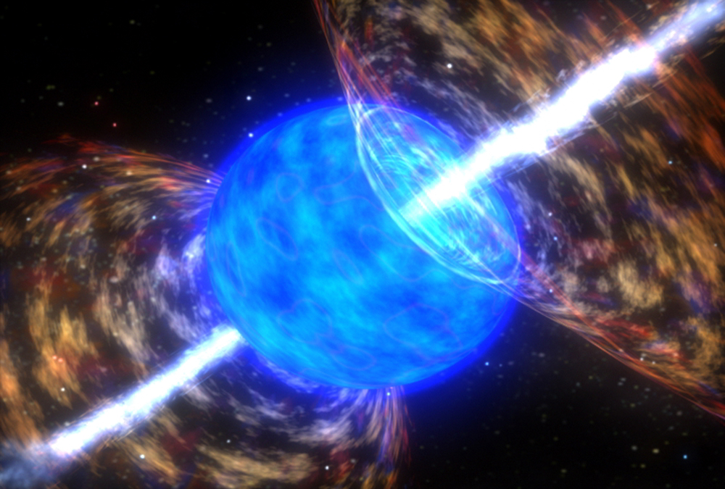
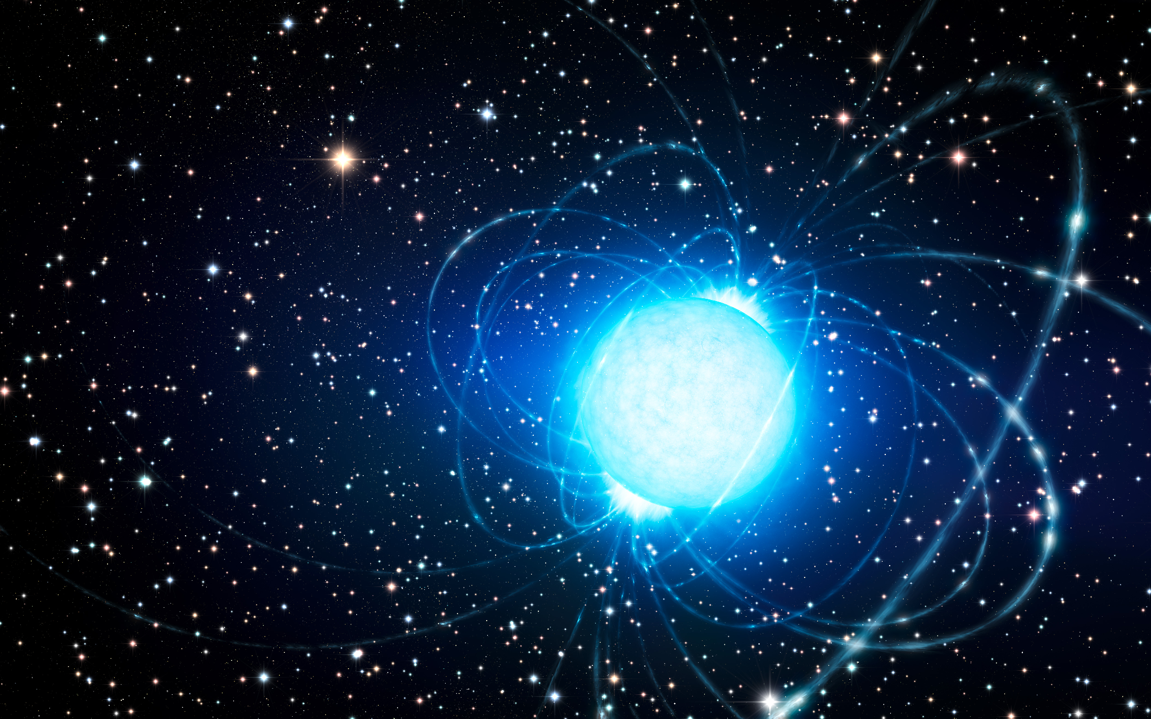
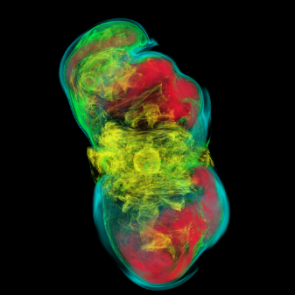
Sites for r-process
GW170817 confirms Neutron Star Mergers (NSM) as r-process sites.
NSM might not be the only r-process site since it requires delay. It might be unable to explain the observed decrease in the Eu/Fe ratio (Côte et. al 2019)
Other candidates include:
Neutron Star-Black Hole Mergers (e.g. Surman et al. 2008)
Collapsar (e.g. Popham et al. 1999)
Magnetar (e.g. Patel et al. 2025)
Magneto-Rotational Supernovae (Nishimura et al. 2015)

Slide 4
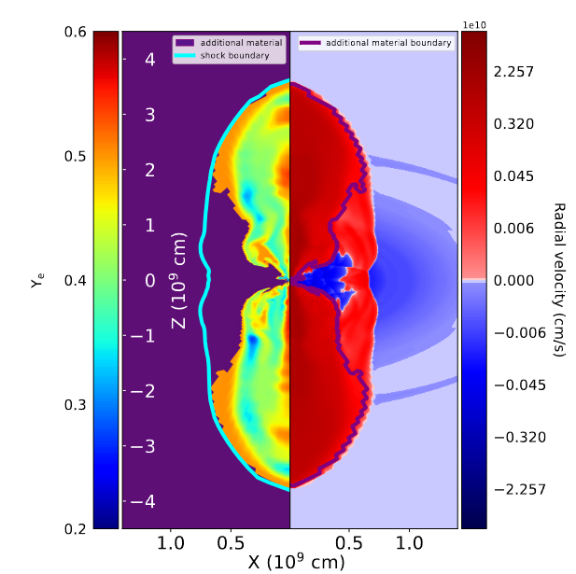
What are Magneto-Rotational SNe?
Magneto-Rotational SuperNovae (MR-SNe) are energetic supernovae that have high (10¹²G) magnetic fields.
These explosions have jets where the r-process could take place.
Liu et.al 2025 (in prep)

Slide 5
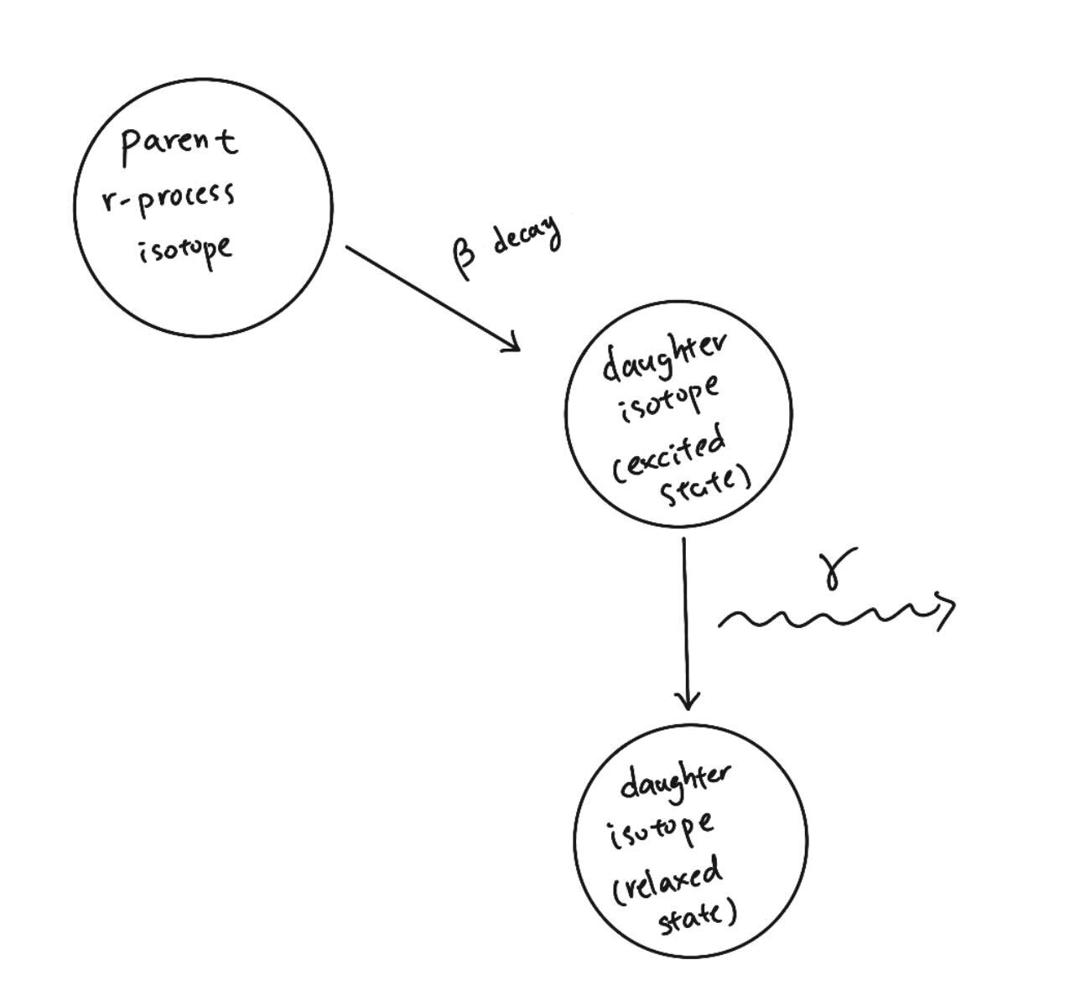
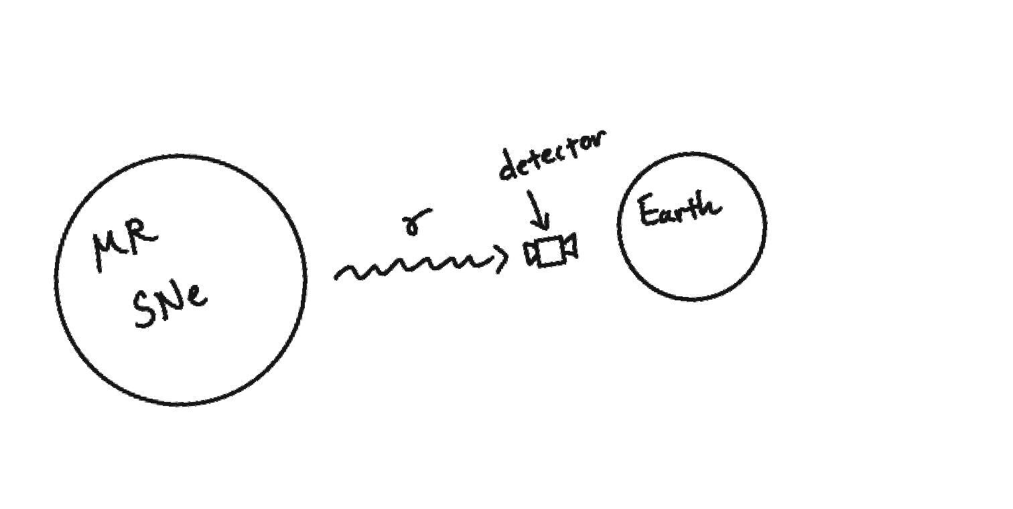
Beta decay related gamma signal from the r-process as a direct probe
The beta decay daughters of the freshly synthesized r-process isotopes will sometimes gamma-decay and release a photon.
This gamma radiation is a direct probe of nucleosynthesis.
With proper instruments, we might be able to observe these gamma signals

Slide 6
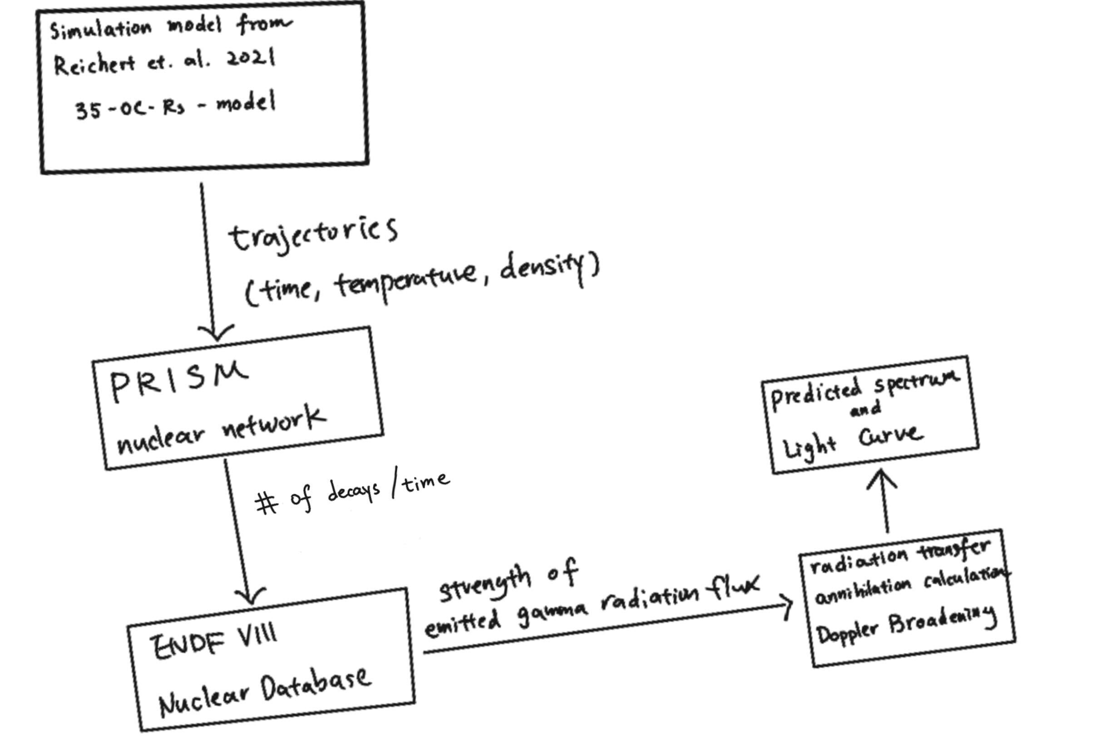
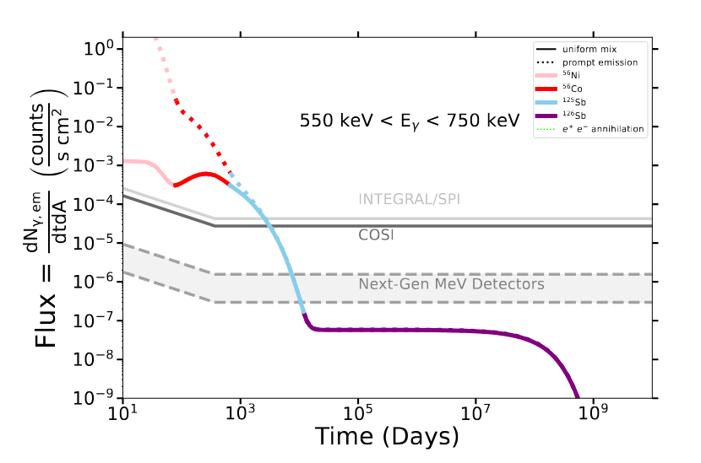
Method
Liu et.al 2025 (in prep)

Slide 7
Future event signal
I want to predict what will the gamma signal looks like if a MR supernova event occurred in our galaxy (progenitor distance = 10 kpc).
Also, I am interested in finding features that could be observed by current and planned gamma ray telescopes.
These features will correspond to specific isotopes.

Slide 8
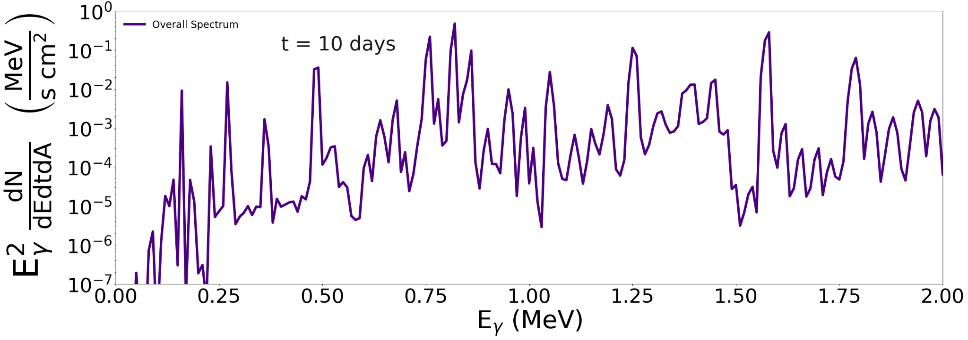
Spectrum at 10 days
The overall spectrum from nuclear decays for an MR-SNe at 10kpc.
Liu et.al 2025 (in prep)

Slide 9
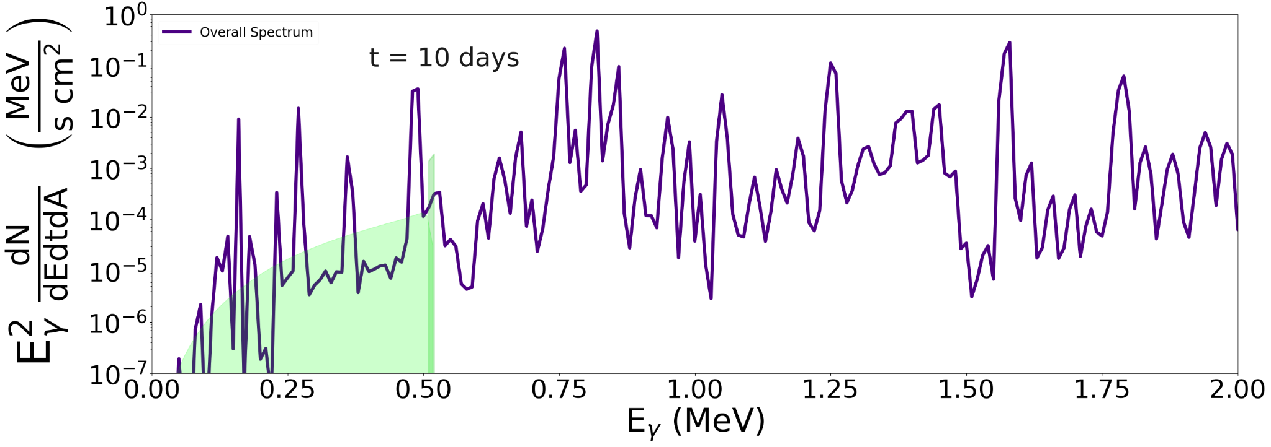
Spectrum at 10 days
The overall spectrum from nuclear decays for an MR-SNe at 10 kpc.
Electron-positron annihilation radiation: Positrons are from: ⁵⁶Co→⁵⁶Fe + e⁺ + 𝞶. e⁺e⁻ pairs form positronium:
Para- positronium (singlet state, 2𝜸)
Ortho- positronium (triplet state, 3𝜸)
Liu et.al 2025 (in prep)

Slide 10
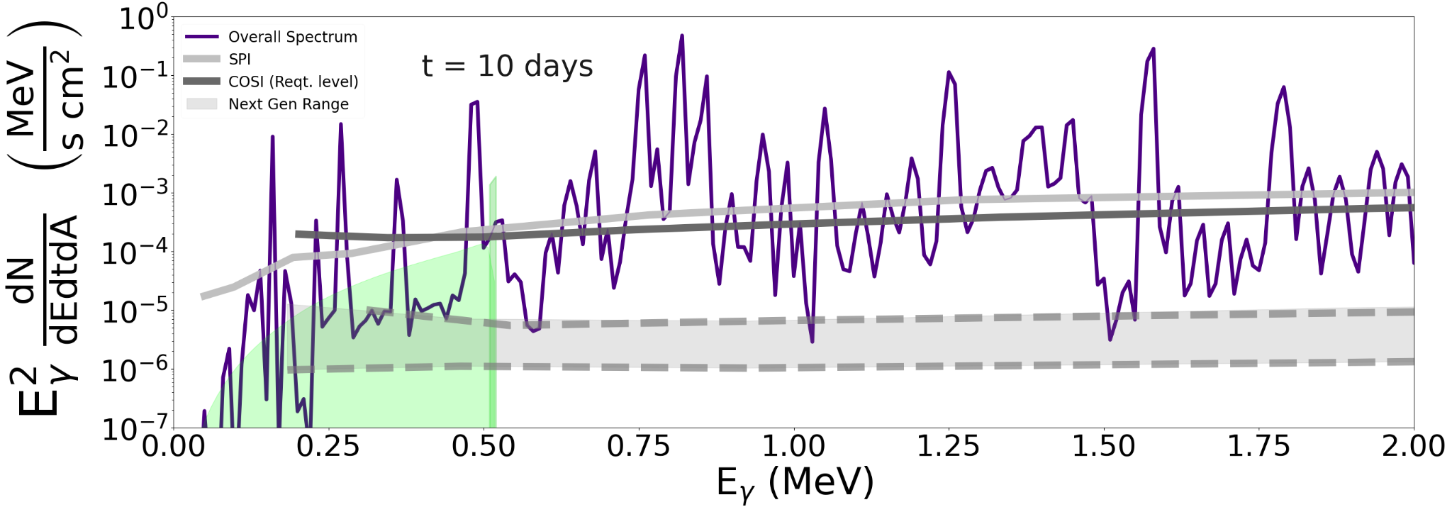
Spectrum at 10 days
The overall spectrum from nuclear decays for an MR-SNe at 10 kpc.
Electron-positron annihilation radiation: Positrons are from: ⁵⁶Co→⁵⁶Fe + e⁺ + 𝞶. e⁺e⁻ pairs form positronium:
Para- positronium (singlet state, 2𝜸)
Ortho- positronium (triplet state, 3𝜸)
Detector sensitivities:
SPI (current, out of service 2025)
COSI (planned in 2027)
GRAMS/AMEGO etc (Next-Generation detectors)
Liu et.al 2025 (in prep)

Slide 11
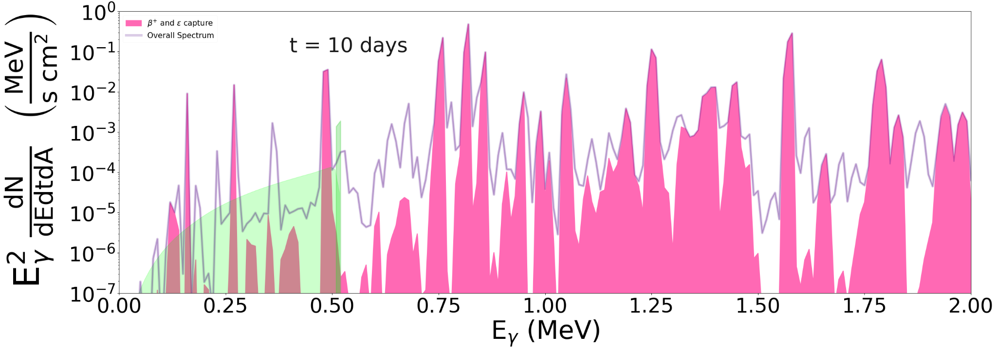
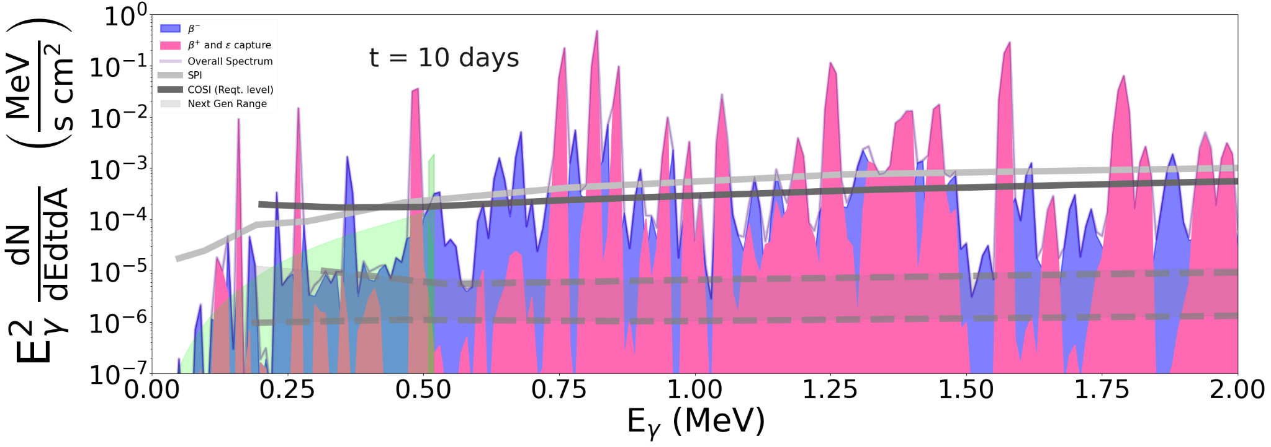
Spectrum at 10 days
Pink Region: Signals that are contributed by beta plus decay or electron capture. These isotopes come from explosive burning and are also expected from regular core-collapse event (such as ⁵⁶Ni or ⁵⁶Co).
Liu et.al 2025 (in prep)

Slide 12
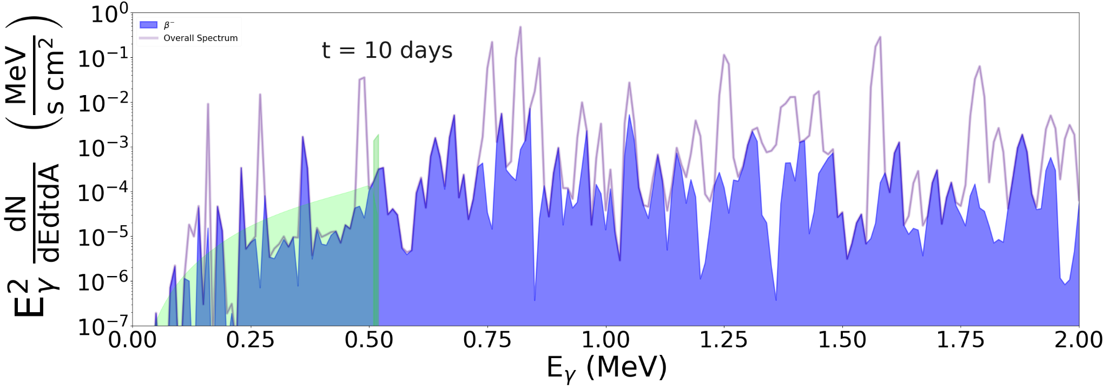
Spectrum at 10 days
Blue Region: Signals that are contributed by beta minus decay. This is the region we are interested in.
Liu et.al 2025 (in prep)

Slide 13
Spectrum at 10 days
Pink Region: Signals that are contributed by beta plus decay or electron capture. These isotopes come from explosive burning and are also expected from regular core-collapse event (such as ⁵⁶Ni or ⁵⁶Co).
Blue Region: Signals that are contributed by beta minus decay. This is the region we are interested in.
Liu et.al 2025 (in prep)

Slide 14
Spectrum at 10 days
Blue Region: Signals that are contributed by beta minus decay.
For each feature in the gamma ray spectrum (binned by energy), we can use ENDF VIII nuclear data base to find the corresponding highest contributing isotope.
Important isotopes at 10 days after explosion are: ¹³²Te , ¹³¹I, ¹³²I (all are near-second peak isotopes).
¹³¹I
¹³²I
⁷²Ga
¹³²Te
Liu et.al 2025 (in prep)

Slide 15
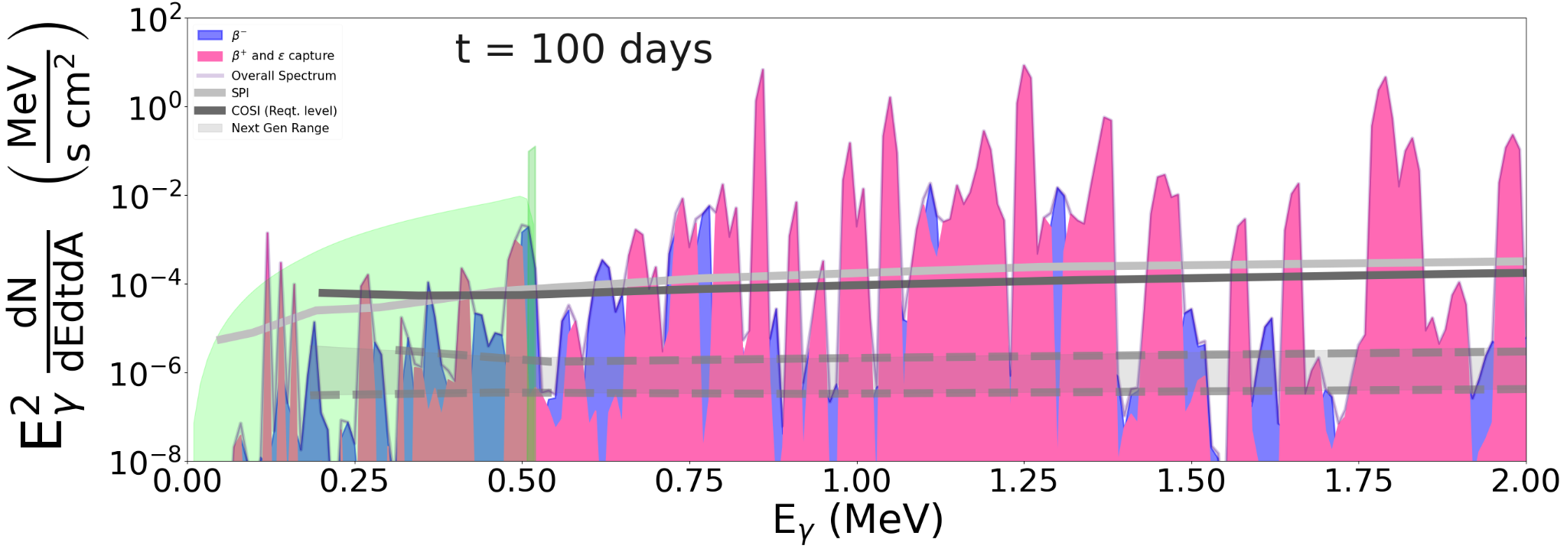
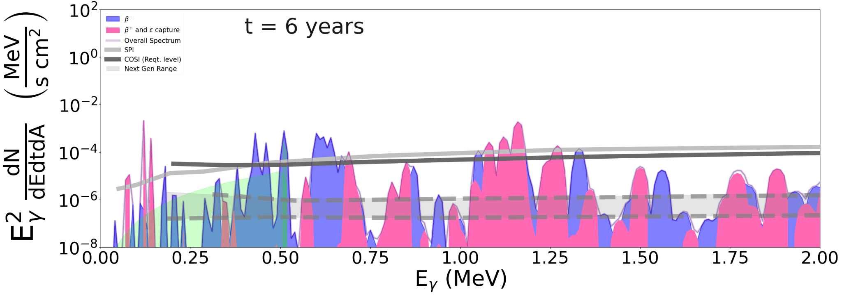
Time evolution
Liu et.al 2025 (in prep)
¹⁰³Ru, ¹⁰⁶Rh
The same can be generalized for other times as well.
We identify near second peak/weak r-process isotopes such as ¹⁰³Ru, ¹⁰⁶Rh, ¹²⁵Sb to be particularly interesting and could have a high possibility of being detected by instruments.
¹⁴⁰La
¹²⁵Sb
¹⁰⁶Rh

Slide 16
Conclusion
-MR-SNe as a subtype of CCSNe may contribute to the Galactic inventory of heavy elements.
-The observation of gamma radiation from beta decays of newly synthesized unstable r-process isotopes would be a direct discovery of r-process formation in a supernova. Alternatively, the absence of such radiation could place a limit on the amount of element production from the r-process.
-Our findings suggest that if an r-process producing supernova event were to occur in our Galaxy, gamma-ray lines (¹³¹I,¹³²I,¹³²Te¹²⁵Sb, ¹⁰⁶Rh, ¹⁰³Ru, ) are above sensitivity levels of gamma-ray telescopes (SPI, COSI, next-generation detectors).

