Slide 1
Recent developments in hydrodynamics simulations
Dekrayat Almaalol
The 15th Conference on the Intersections of Particle and Nuclear Physics (CIPANP)
June 8-13, 2025
at the University of Wisconsin at Madison.
Notes:
645521

Slide 2
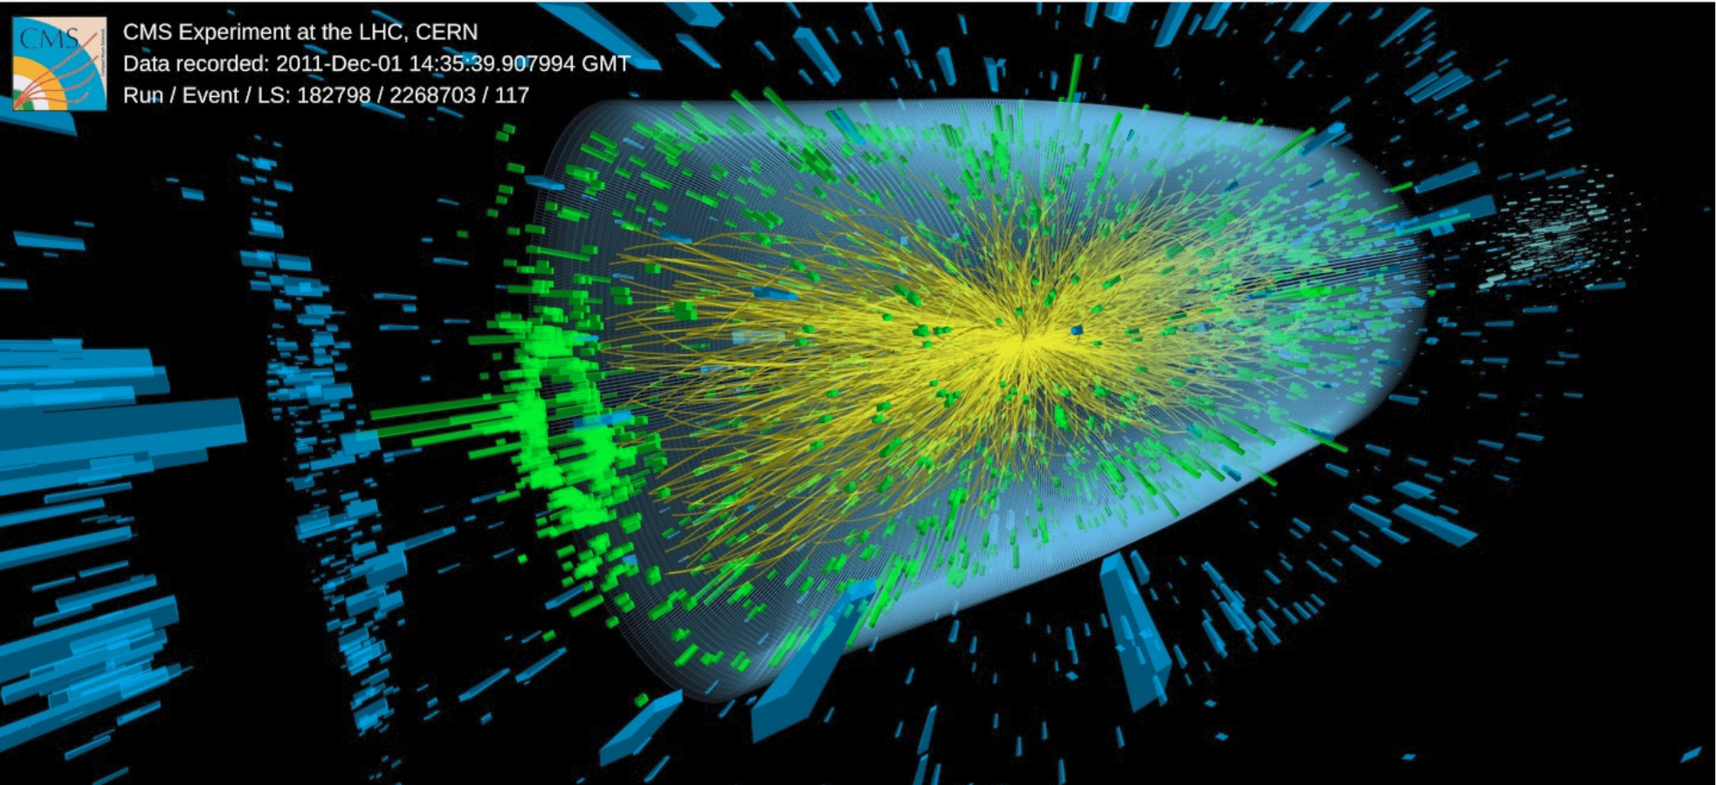
Heavy-ion collisions
Notes:
Uncertainty in the transition, what is observed is used to direct the model
One question central to our understanding of the QCD phase diagram is the existence and the location of the QCD critical point
multistage hydrodynamic approaches applicable for collisions at √sNN ≳ 7 GeV (Section 2) and hadronic transport descriptions suitable for collisions at √sNN ≲ 7 GeV (Section 3).
The predicted multiplicities as well as their fluctuations and correlations depend on the EOS. Establishing this dependence theoretically allows one to connect experimental observations to the QCD EOS
This is not a simple task due to the highly dynamic nature of the collisions, and this chapter will cover several key ingredients needed to complete it. We briefly outline these ingredients below.

Slide 3
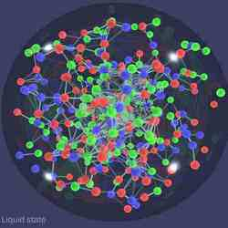
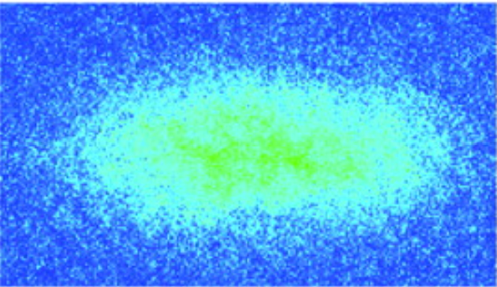
Universality of hydrodynamics in strongly interacting Quantum many body systems

Slide 4
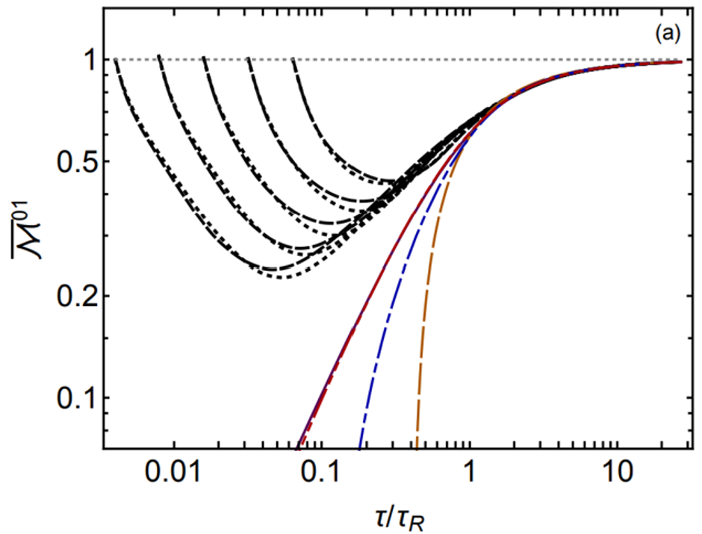
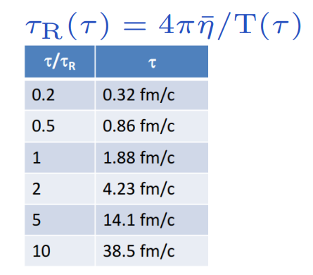
Universality of hydrodynamics in strongly interacting Quantum many body systems

Slide 5
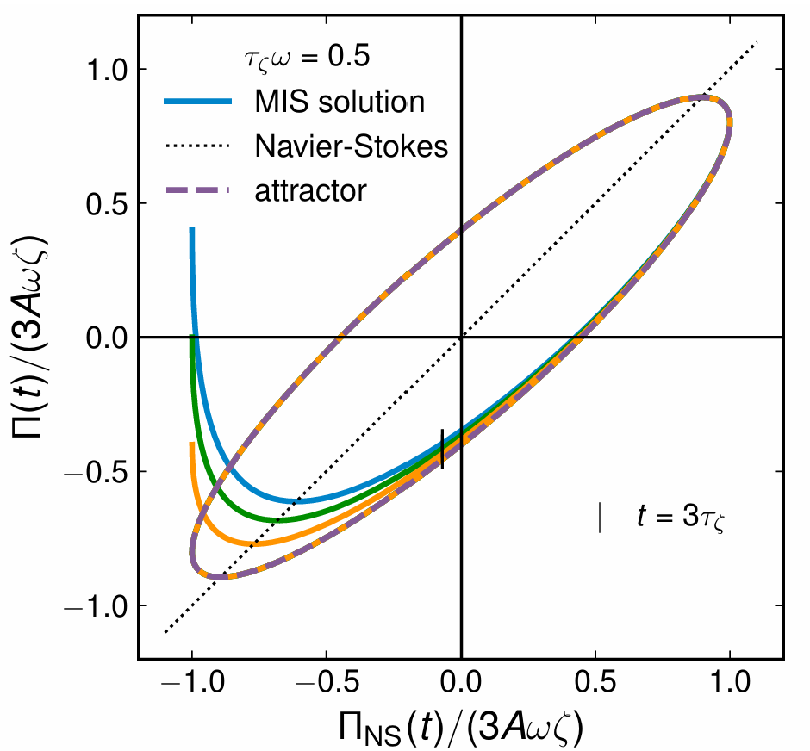
Universality of hydrodynamics in strongly interacting Quantum many body systems

Slide 6
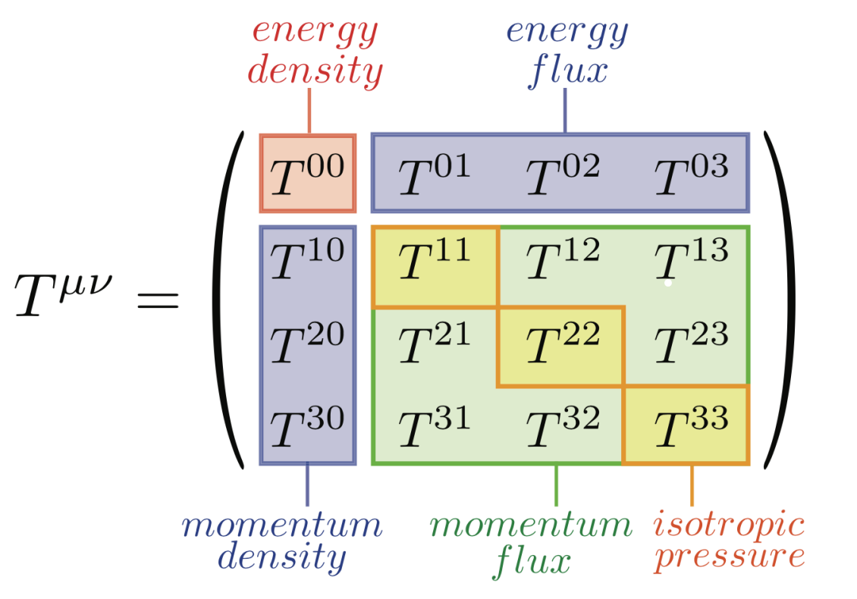
Hydrodynamics as an effective field theory
Notes:
the flow observables we are interested in are mostly patterns in energy and momentum distributions.

Slide 7
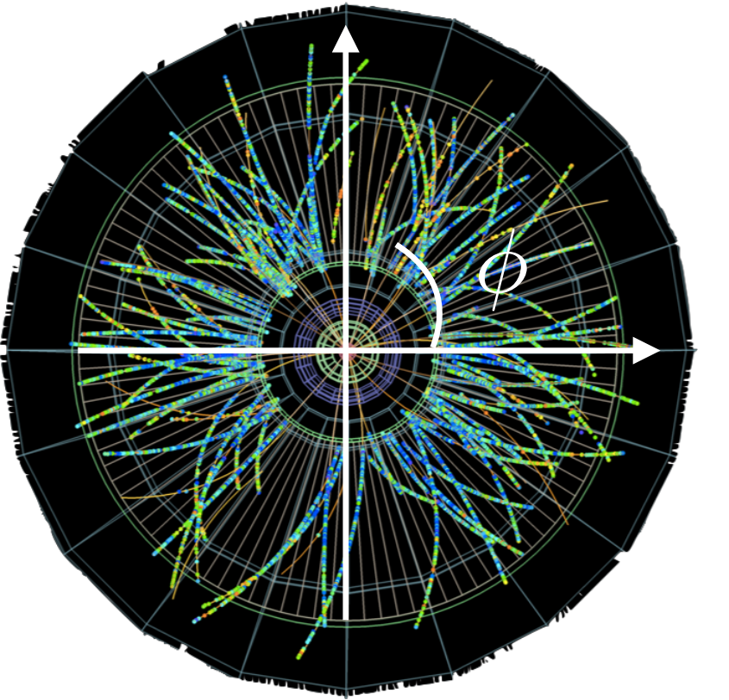
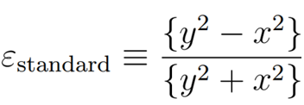
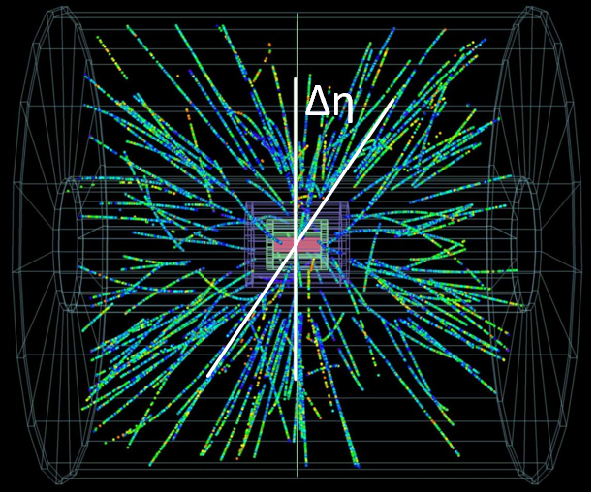
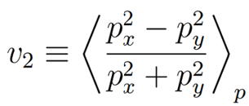
Intuitive picture: hydrodynamics as a geometry response
ΔΦ : Difference in azimuthal angle
Δη : Difference pseudo-rapidity

Slide 8
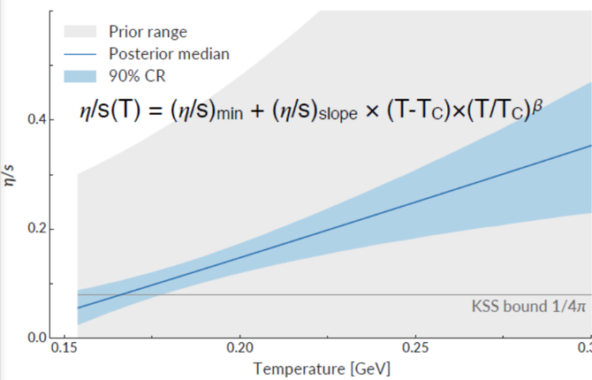
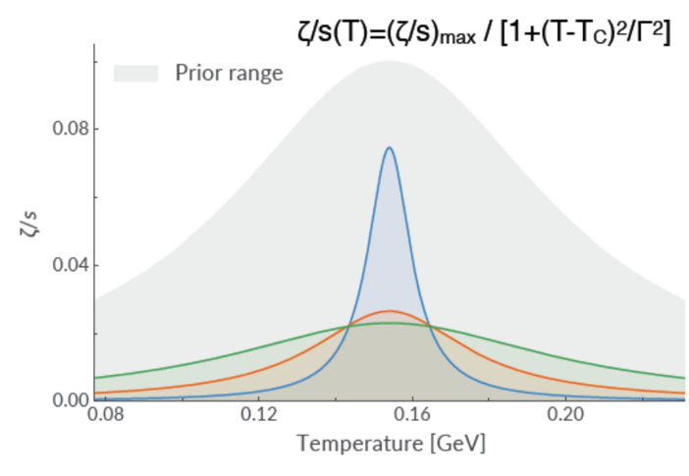
Extracting the QGP transport properties
Notes:
1. the averaged QGP shear viscosity changes with the collision energies, which is slightly larger at the LHC than at RHIC

Slide 9
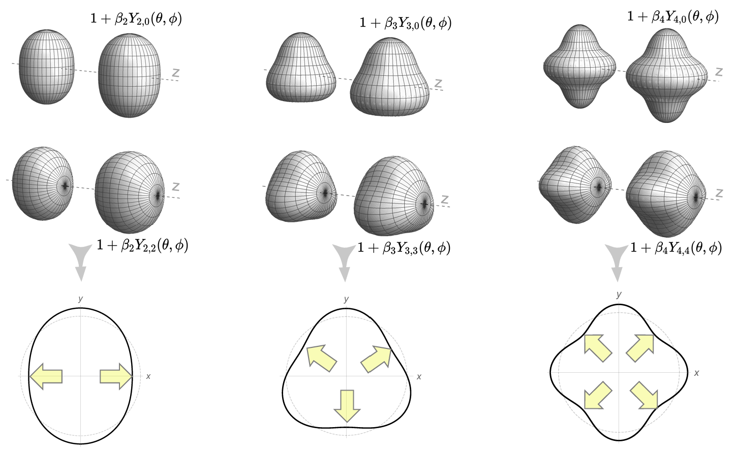
Constraints on Nuclear structure from high energy central collisions

Slide 10
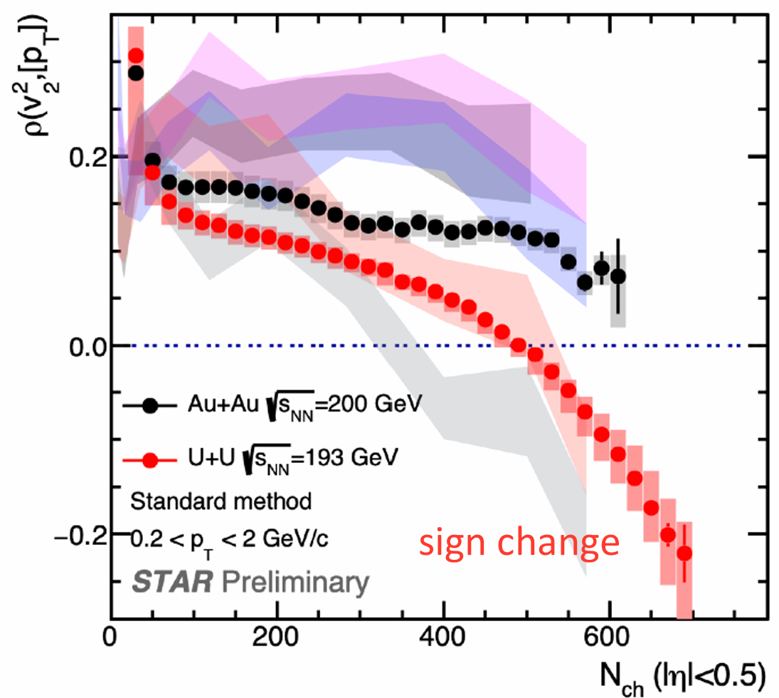
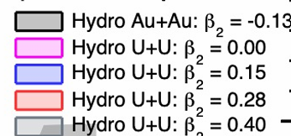
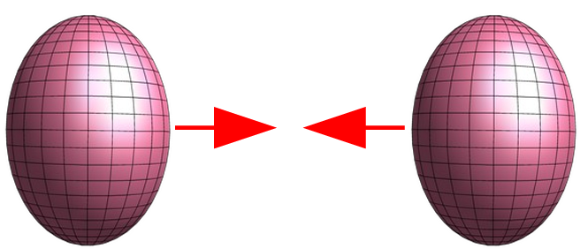
Constraints on Nuclear structure from high energy central collisions

Slide 11
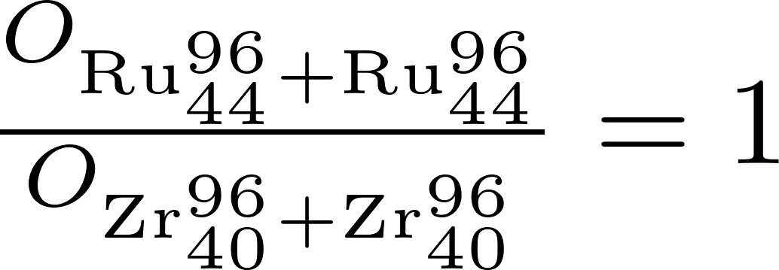
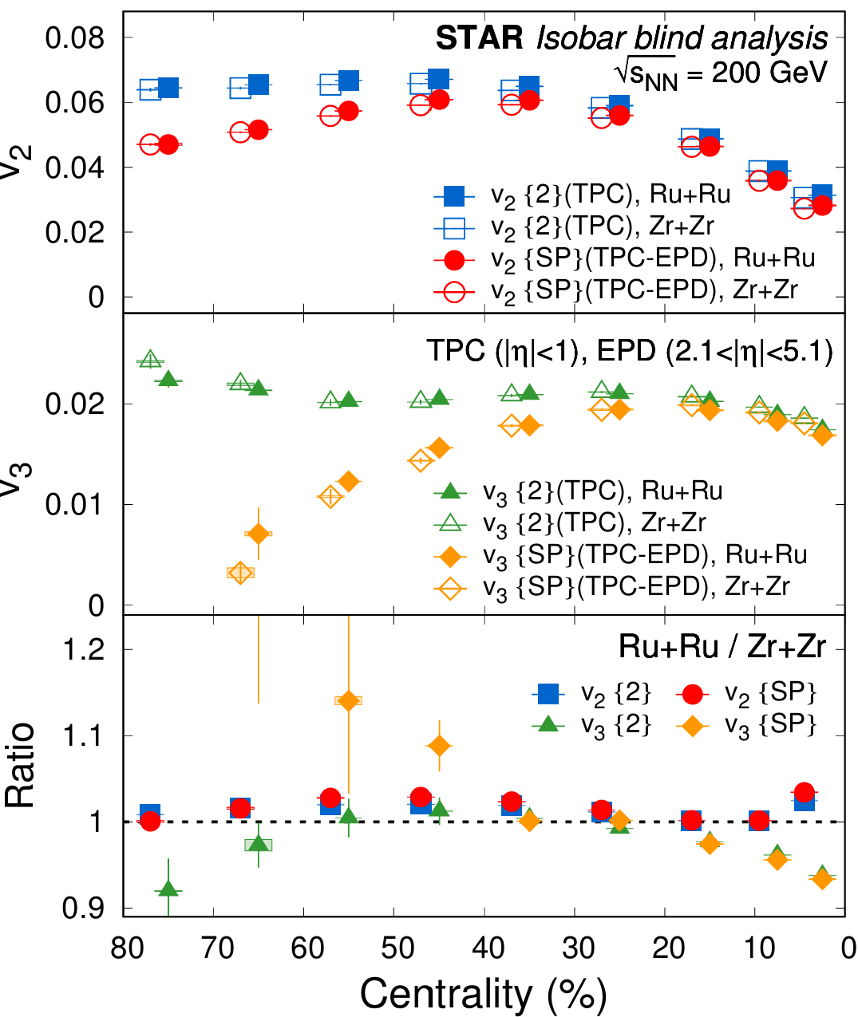
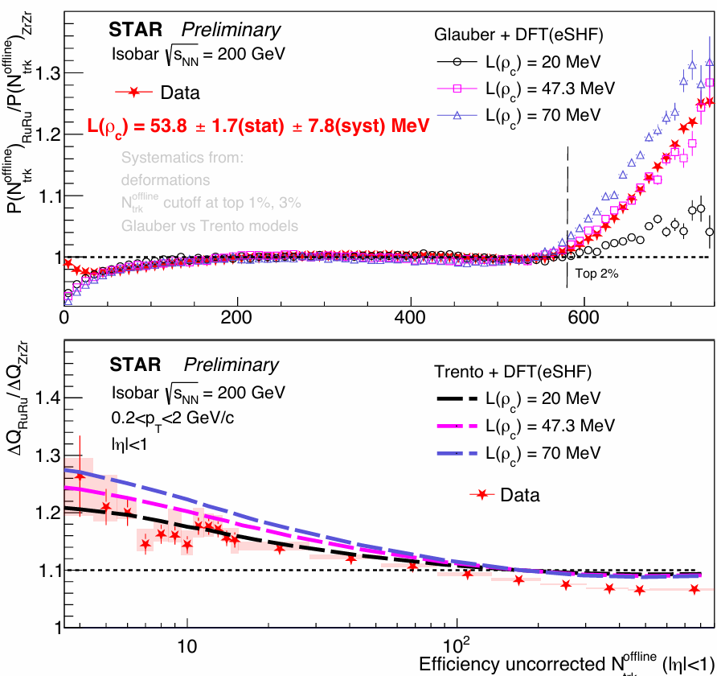
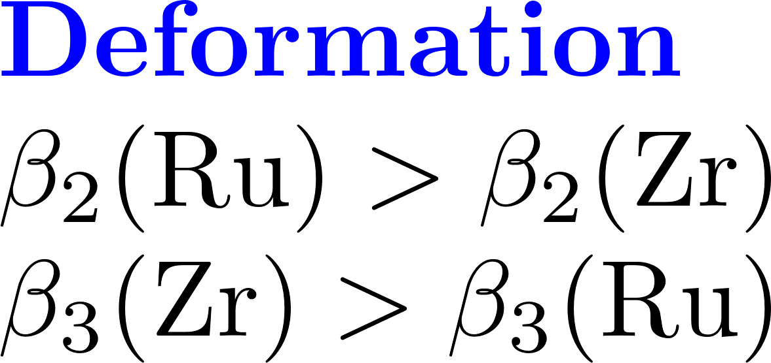
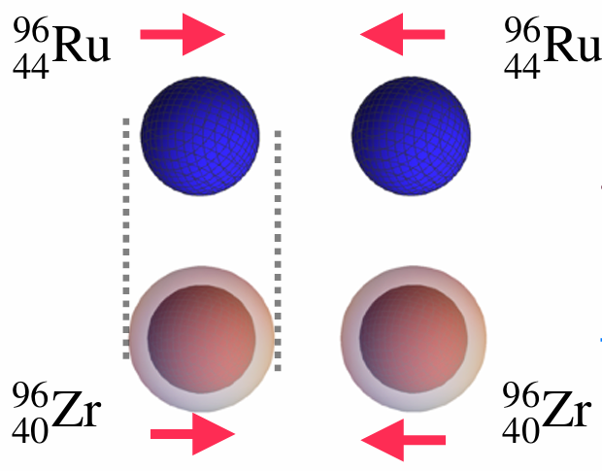
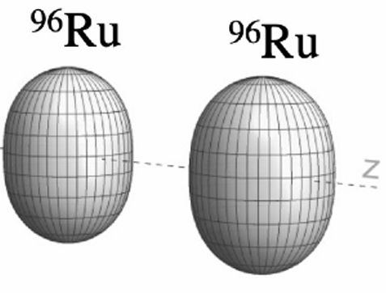
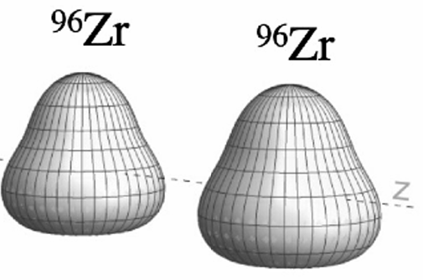
Nuclear structure in hydro simulations

Slide 12
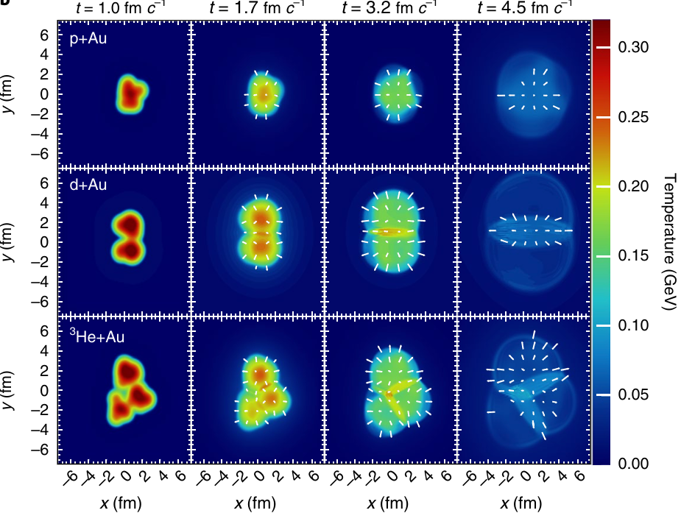
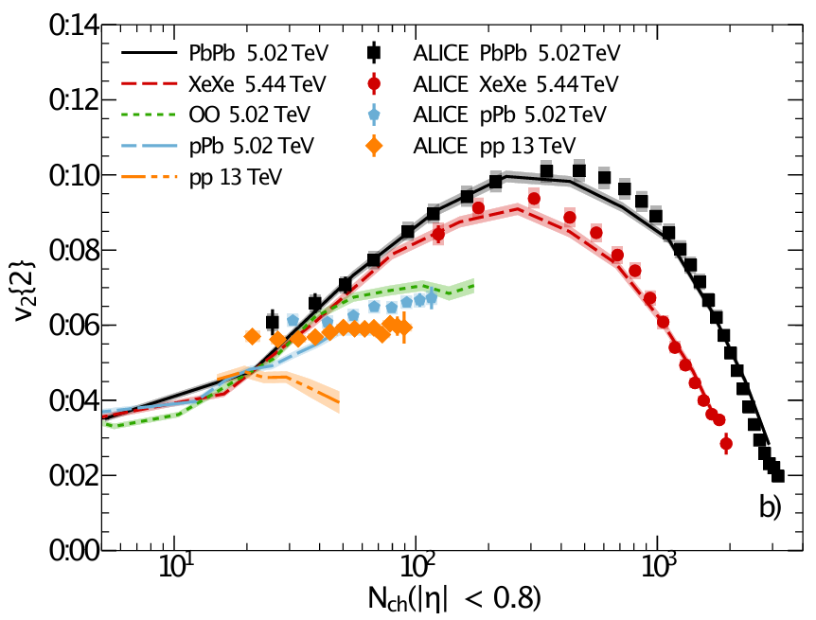
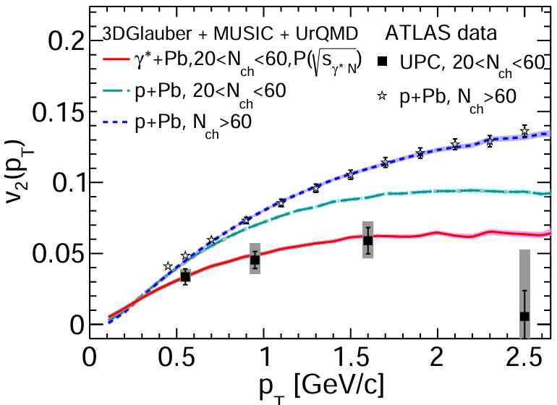
Small systems: Pushing the limits of fluid dynamics?

Slide 13
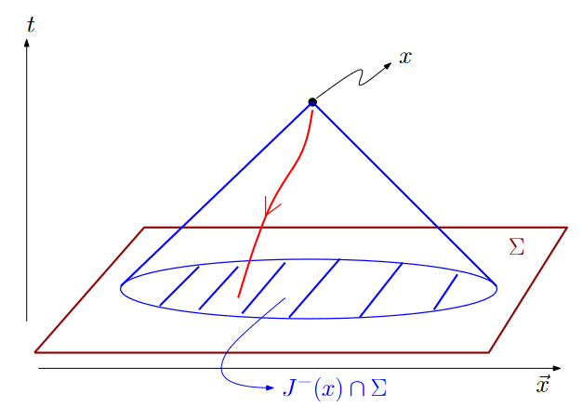
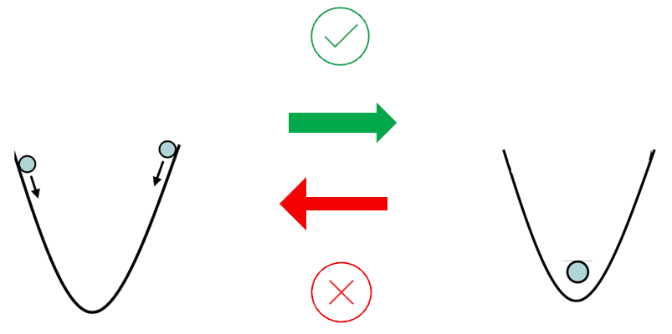
Theory guidance: fundamentals of fluid dynamics
Notes:
The equations of motion must be hyperbolic and the propagation of information must be at most the speed of light [60]. Also, the Cauchy problem must be locally well-posed [61], i.e., given initial conditions one must show that the equations admit a unique solution. (causality, local existence, uniqueness) , This shows why linearized analyses [56, 57] necessarily miss the effects from the other coefficients, {δΠΠ, λΠπ, δππ, τππ, λπΠ}, which contribute to the nonlinear evolution. We note that {η, ζ, τπ, τΠ} are the only coefficients that remain after linearization around equilibrium

Slide 14
Nonlinear causality constraints
6 Necassary
8 sufficient
Notes:
at zero chemical potential/full nonlinear regime/ without any simplifying symmetry or near-equilibrium assumptions.
If a theory is unstable, it will be very difficult to extract any physically meaningful results from it
If the conditions hold, the fluid dynamical evolution is guaranteed to be well defined and causal
Can be checked numerically, to role out IC which violate causality; particularly relevant to constrain the physical assumptions behind modeling IC in QGP simulations
Causality violations has nothing to do with the ability of numerical schemes to produce a solution
1st. Different mechanisms, 2nd distinguish exotic features from superluminal propagation, 3rd. Numerical simulations must be causal.
Previously: 1. breakdown of simulation, 2. manifestly spurious solution, 3. clear non-physical behavior.
Unique smooth solution at later times for both causal and acausal characteristics, linearizing gives an always causal scenario
Linear cannot depend on higher order terms. Nonlinear depend on bulk and shear stress themselves -> must be nonlinear

Slide 15
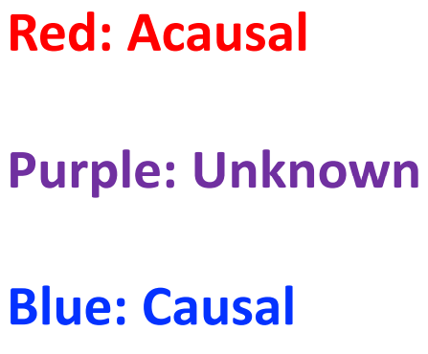
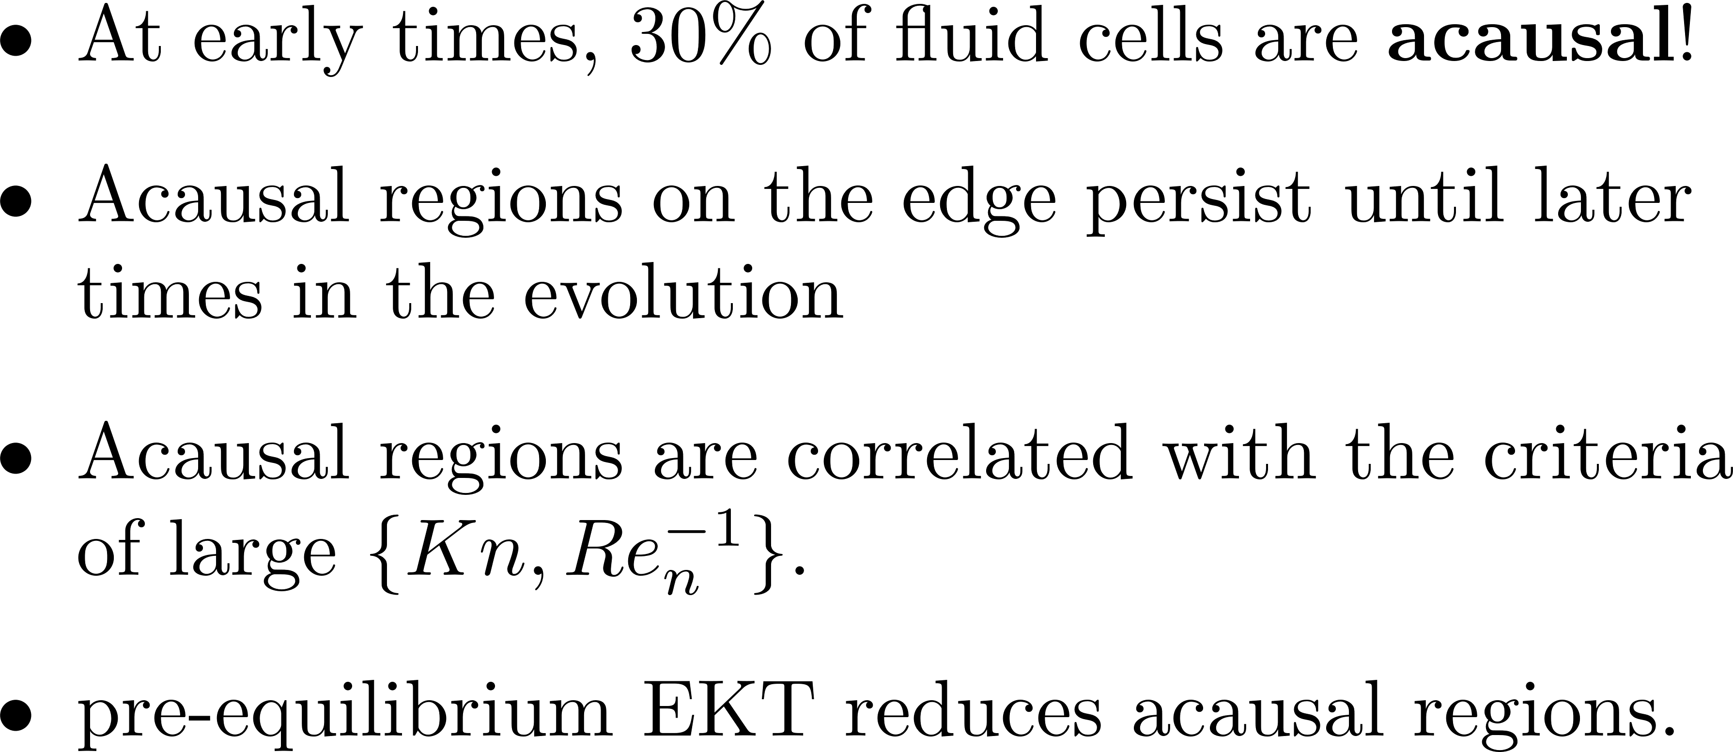
An explicit test of the state-of-the-art models of hydrodynamics against relativity

Slide 16
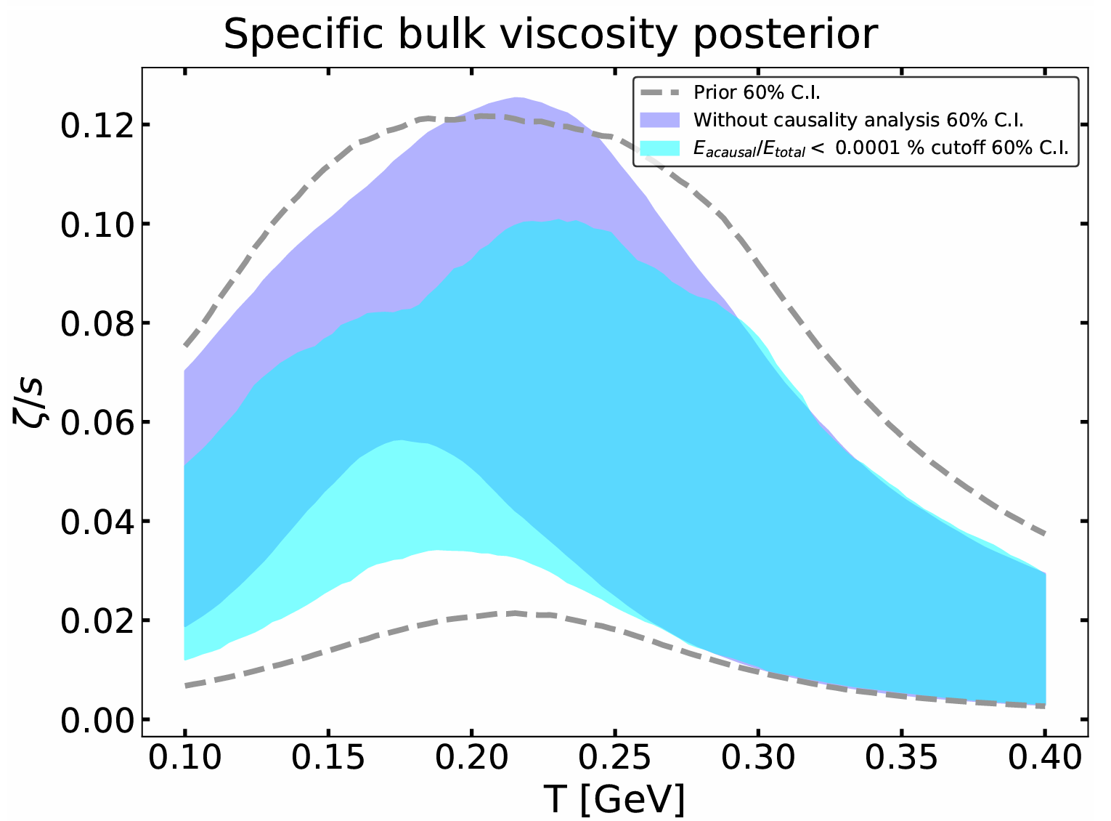
Causality violations: quantification and consequences on the dynamical evolution?
Default regulator
Default regulator

Slide 17
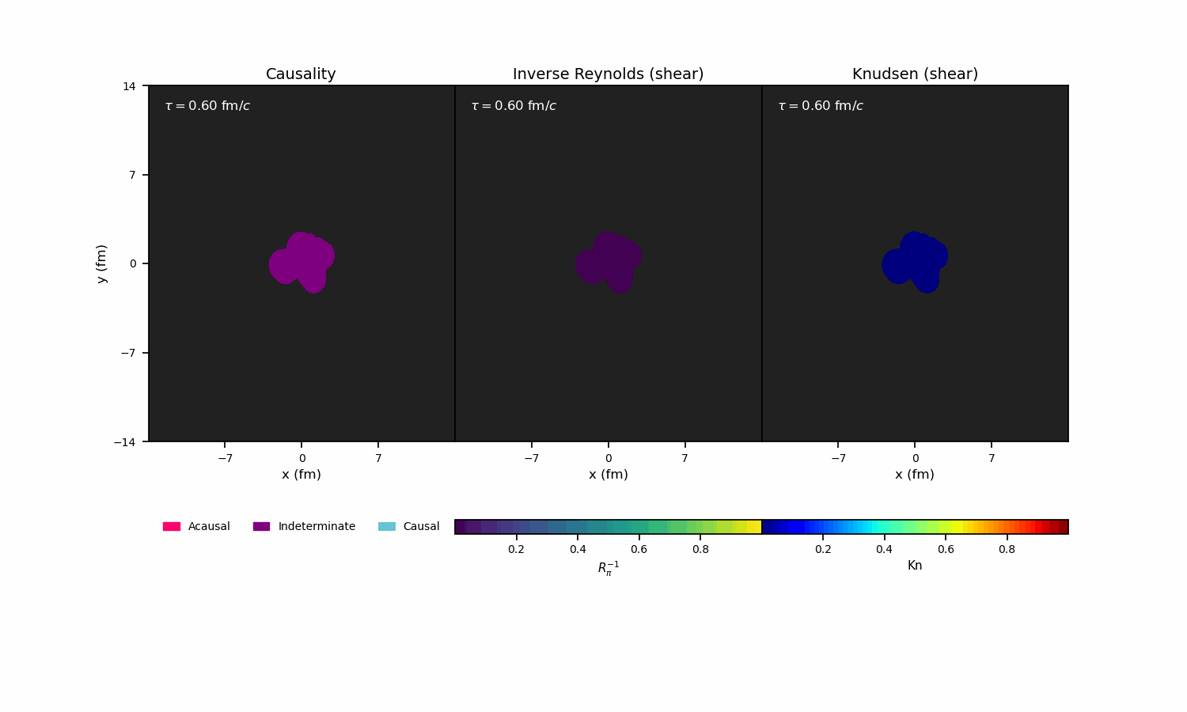
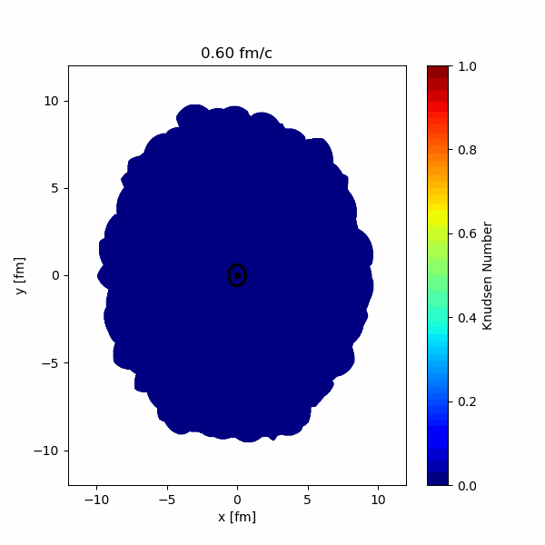
Small systems and Jets in QCD medium-What to expect?

Slide 18
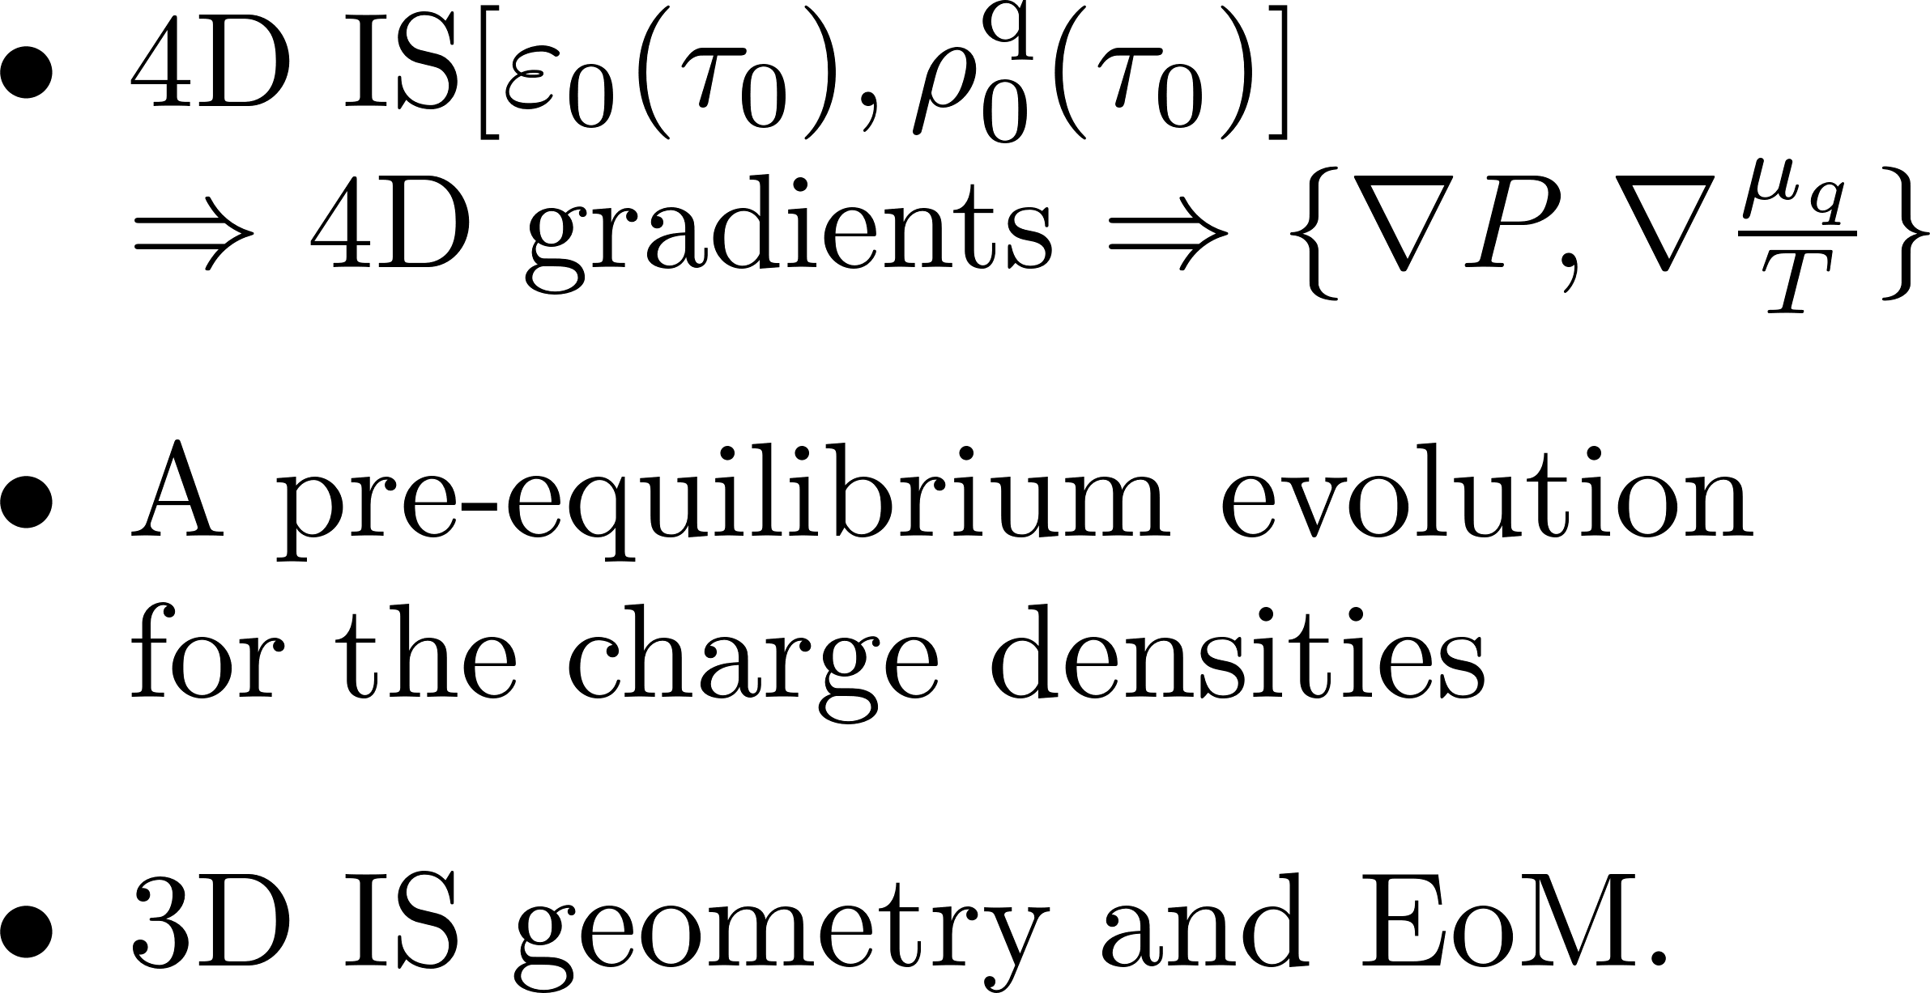
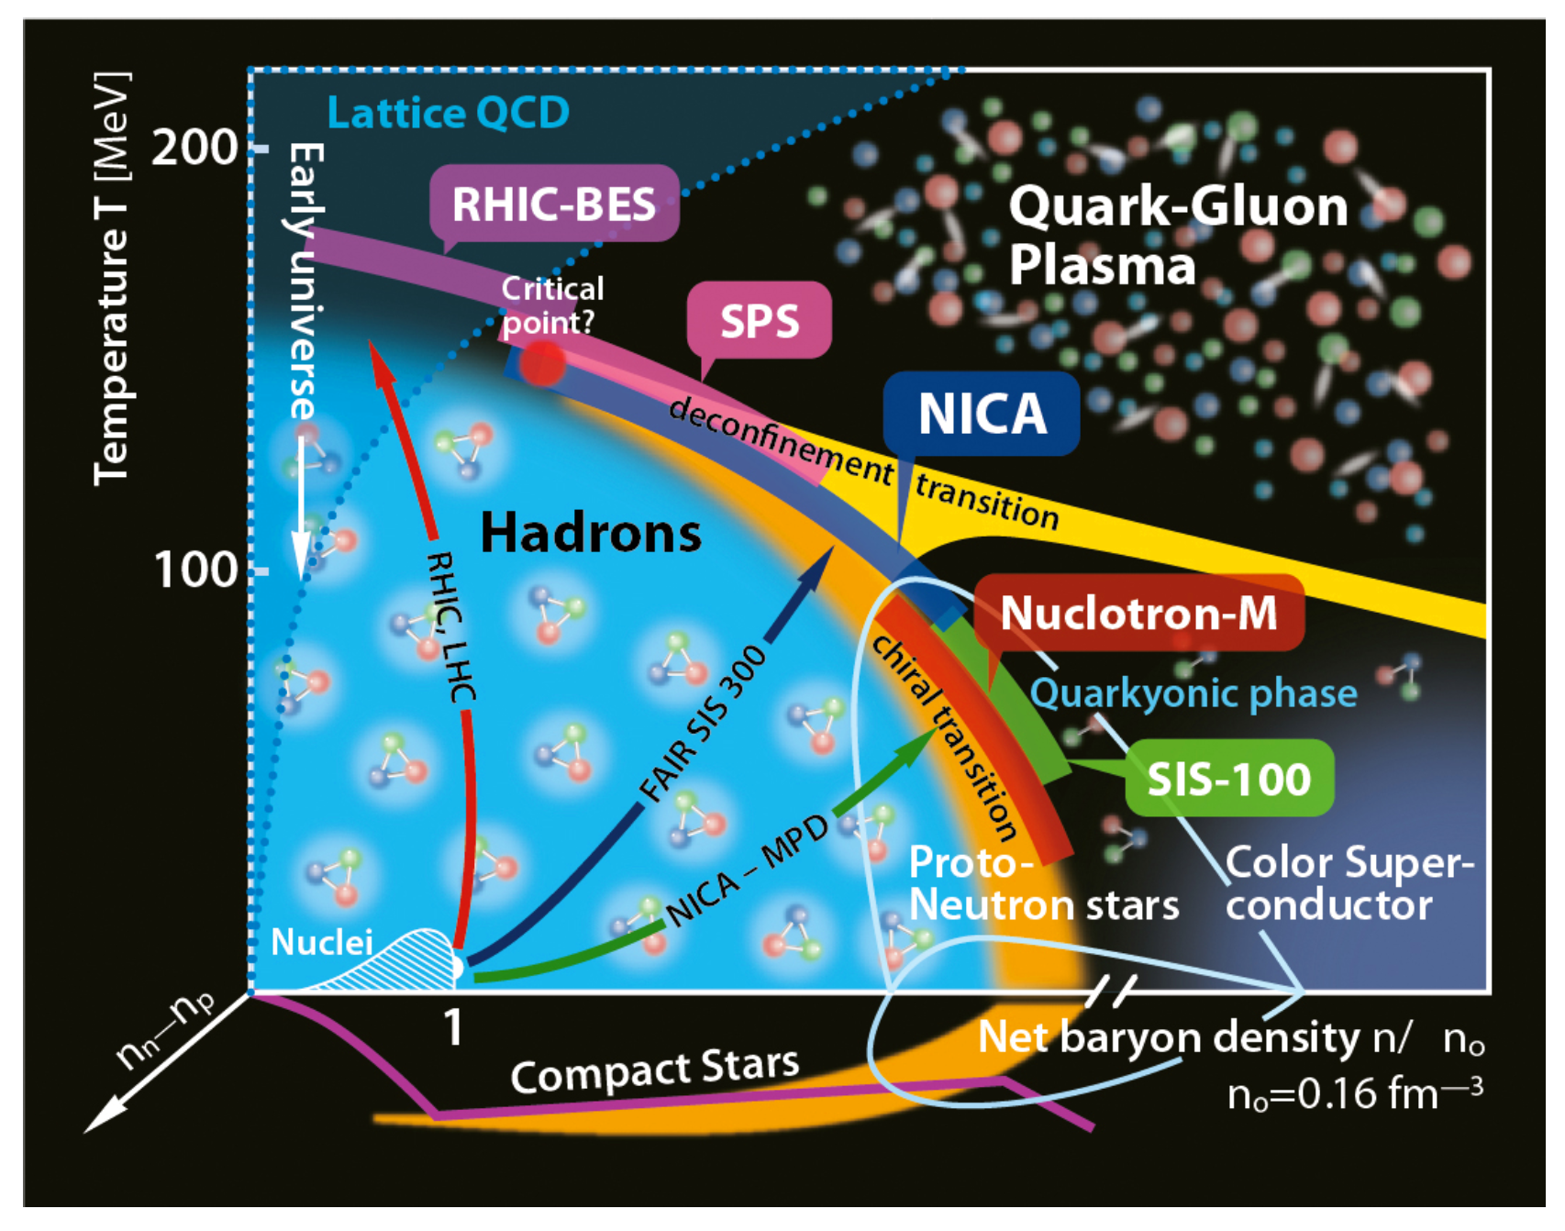
Necessary features of hydro simulations at finite densities

Slide 19
CCAKE 2.0
Conserved Charges HydrodynamiK Evolution
(1+1)D, (2+1)D, (3+1)D simulations
Smoothed Particle Hydrodynamics
Finite BSQ
Parallelized and performance portable
Hyperbolic & cartesian coordinate options
Source Terms
Streamlined EoMs
QCD EoS
EoS Inverter
Plumberg et al., arXiv:2405.09648 (2024)
Accepted in PRC (CCAKE v1)
Noronha-Hostler et al., Phys Rev C 90 (2014)

Slide 20
Multi-component Hydrodynamics as an effective field theory
Notes:
The transport coefficients η, ζ, and κ should be thought of as input parameters for hydrodynamics: like in any effective theory, they can not be evaluated in hydrodynamics itself, but rather need to be computed from the underlying short-distance physics, for example using the Boltzmann equation
Romatschke: If the relaxation time τΠ is not too small, Eq. (2) are the most general shear viscous hydrodynamic equations that are causal and guarantee that entropy can never locally decrease [12]. Formally, Eq. (2) correspond to the relativistic Navier-Stokes equations in the limit τΠ → 0, but contain corrections of higher order in gradients for τΠ > 0.

Slide 21
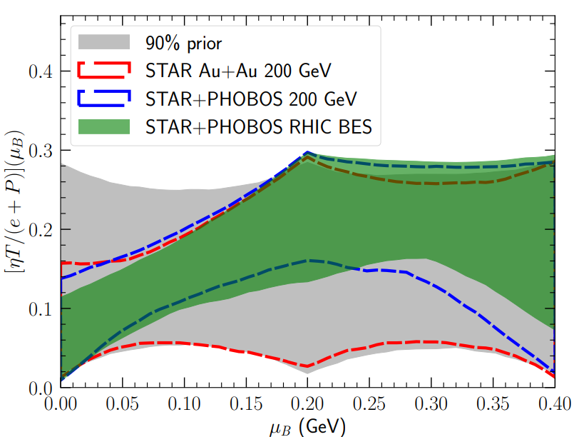
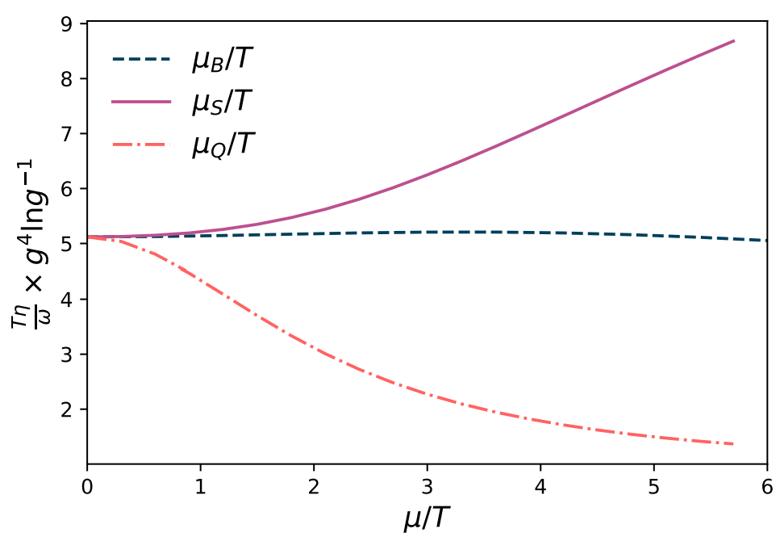
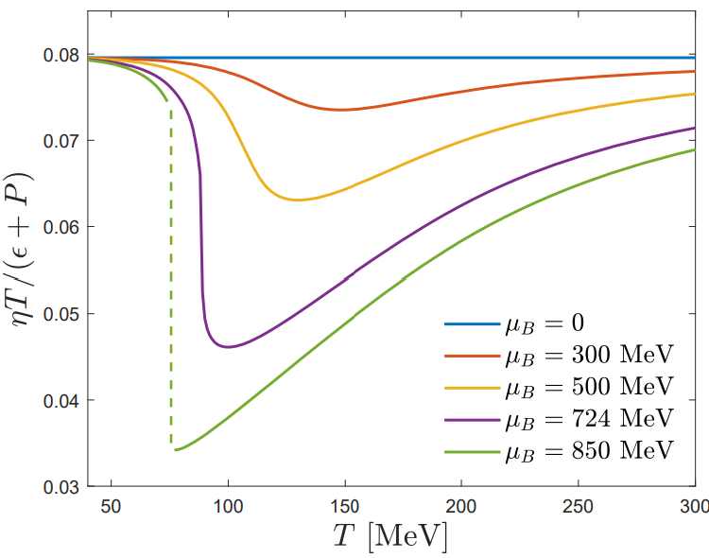
Transport at finite densities: theoretical challenge

Slide 22
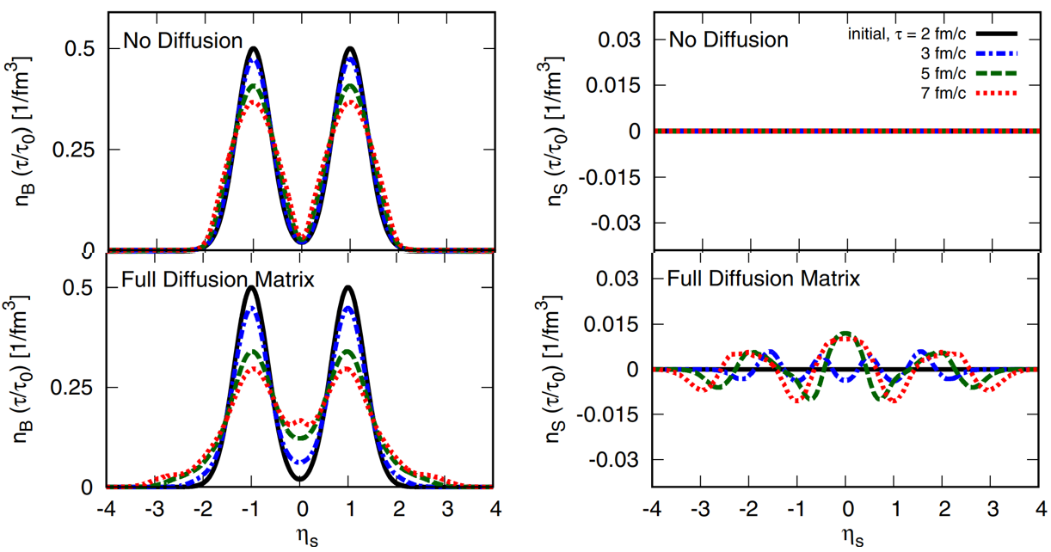
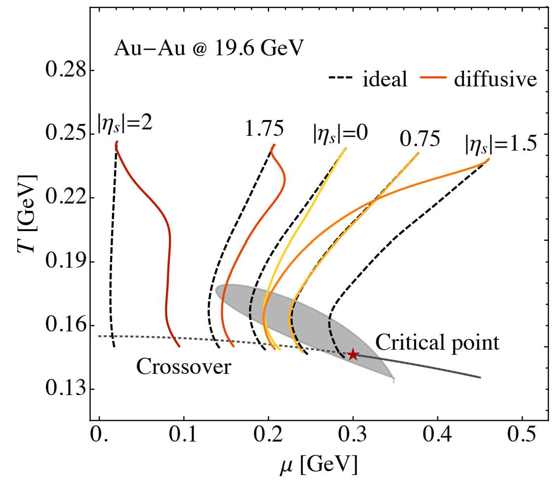
Bulk dynamics || Hydrodynamics with multiple conserved charges

Slide 23
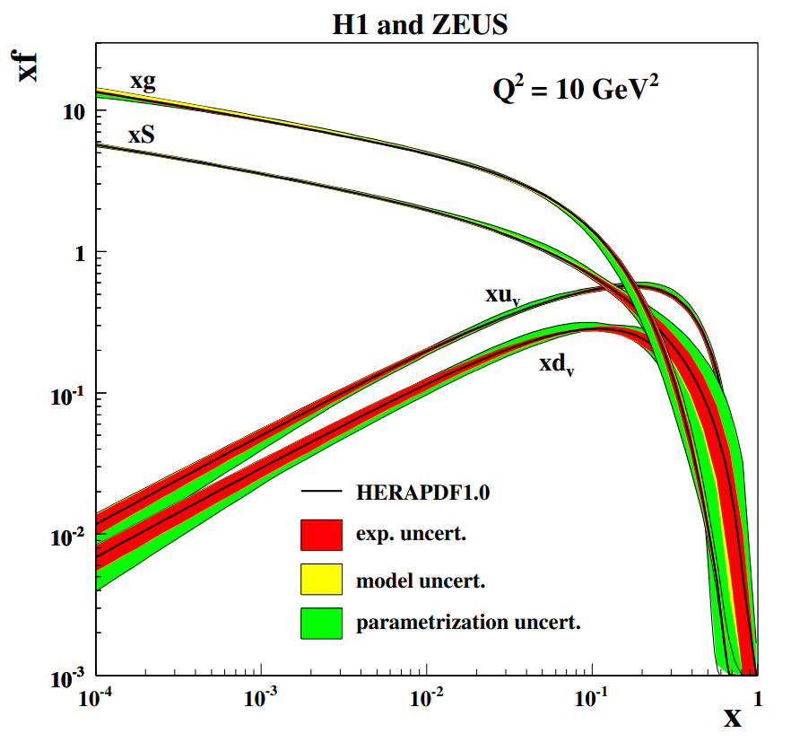
An opportunity | local charge fluctuations at LHC energy
Notes:
Initial
Conserved Charges in Nuclear Geometry

Slide 24
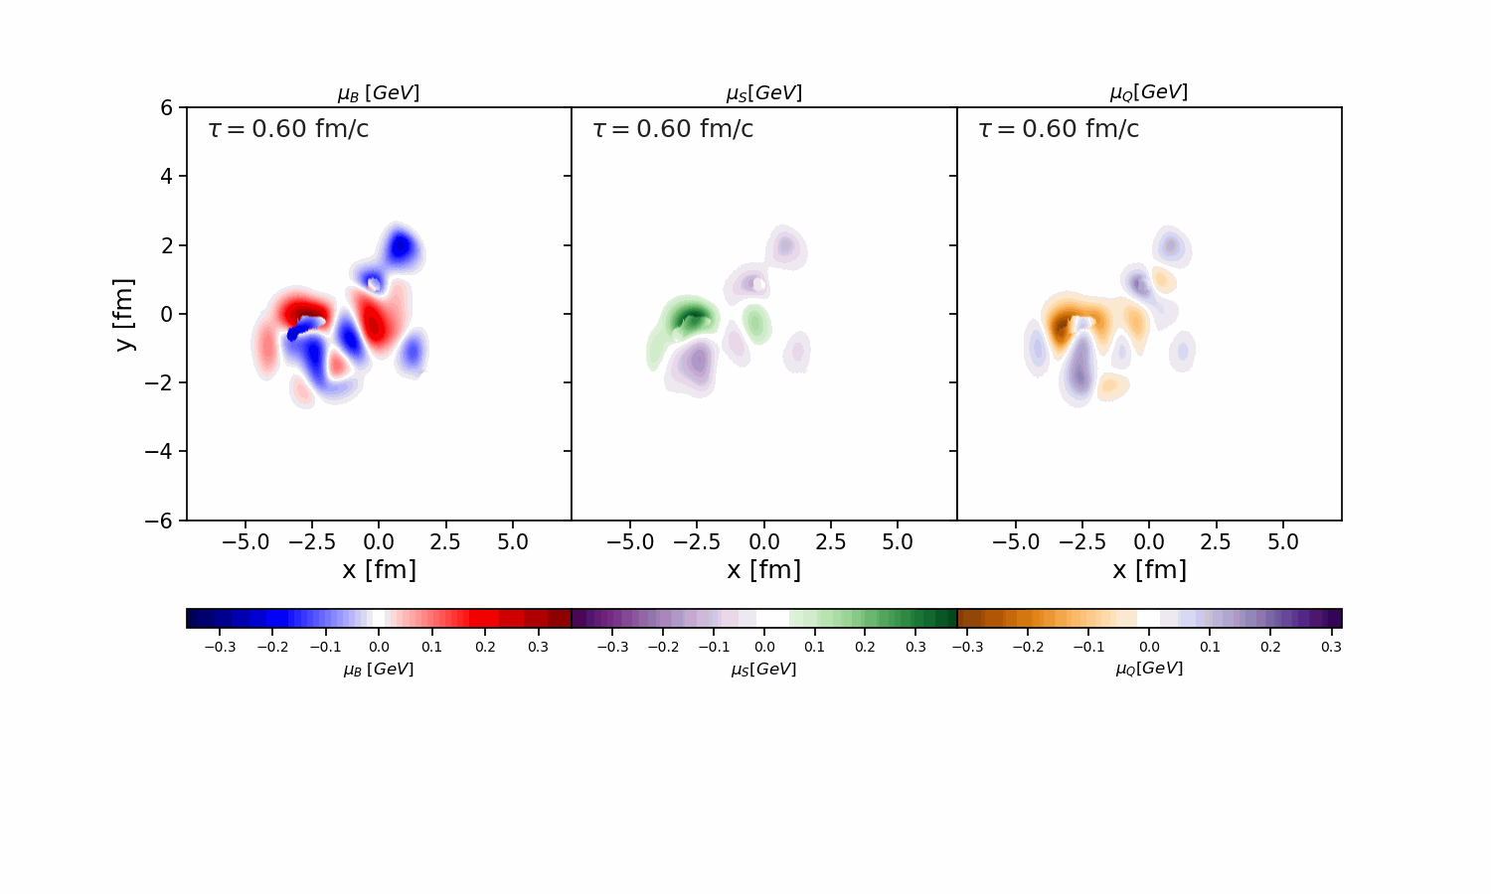
An opportunity | local charge fluctuations at LHC energy
Notes:
Initial
Conserved Charges in Nuclear Geometry

Slide 25
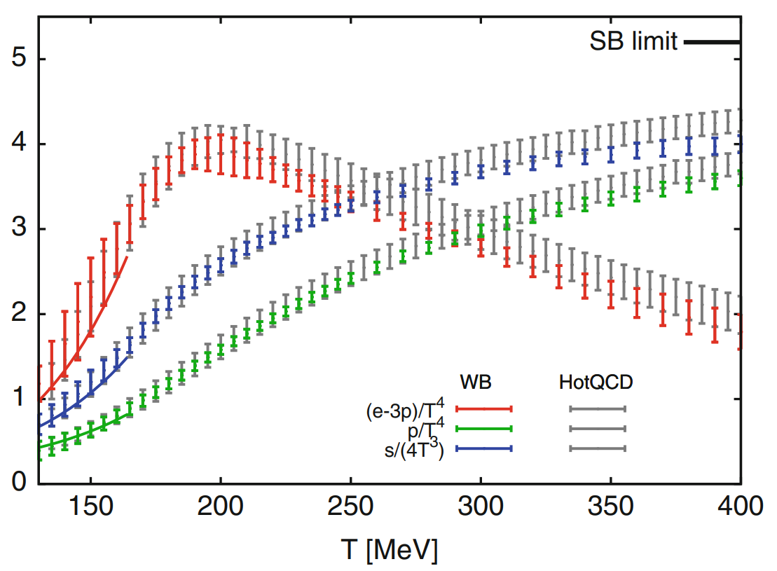
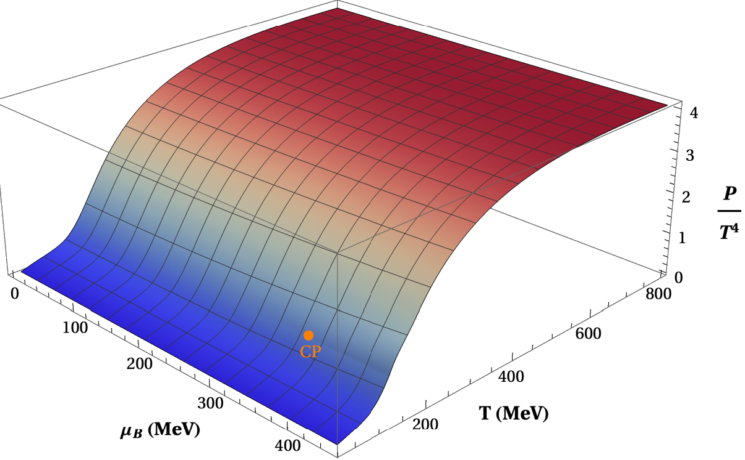
Notes:
Out-of-bound fluid cells that are beyond the each of the Taylor Series, 4D interpolation and root-finding, Accuracy and speed, Thermodynamic derivatives.

Slide 26
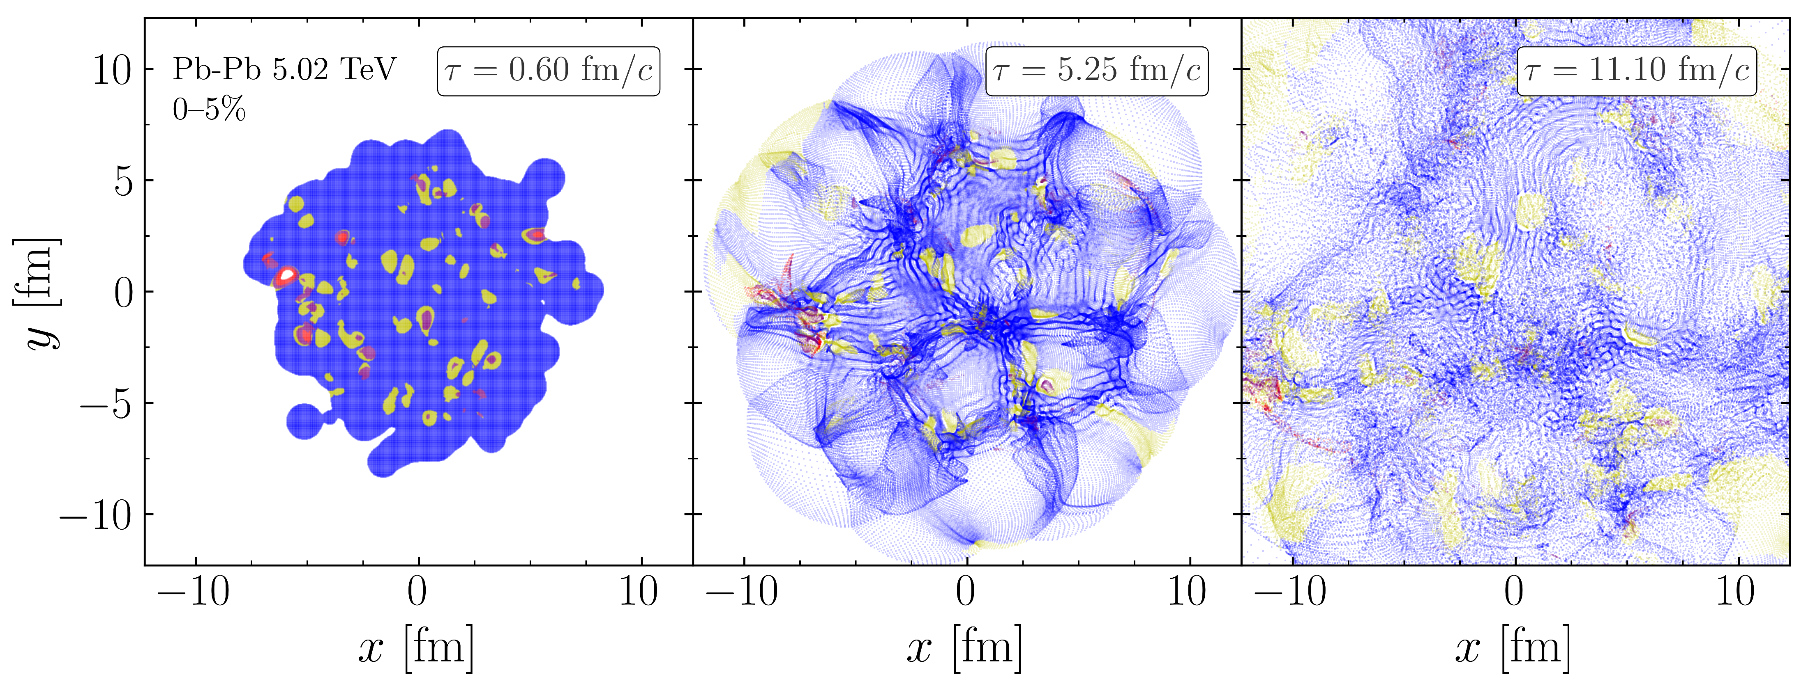
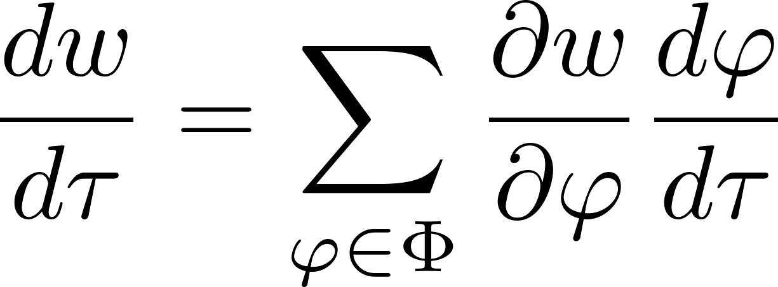
Notes:
Out-of-bound fluid cells that are beyond the each of the Taylor Series, 4D interpolation and root-finding, Accuracy and speed, Thermodynamic derivatives.

Slide 28
Conclusions and remarks

Slide 29
Thank you for your attention

Slide 31
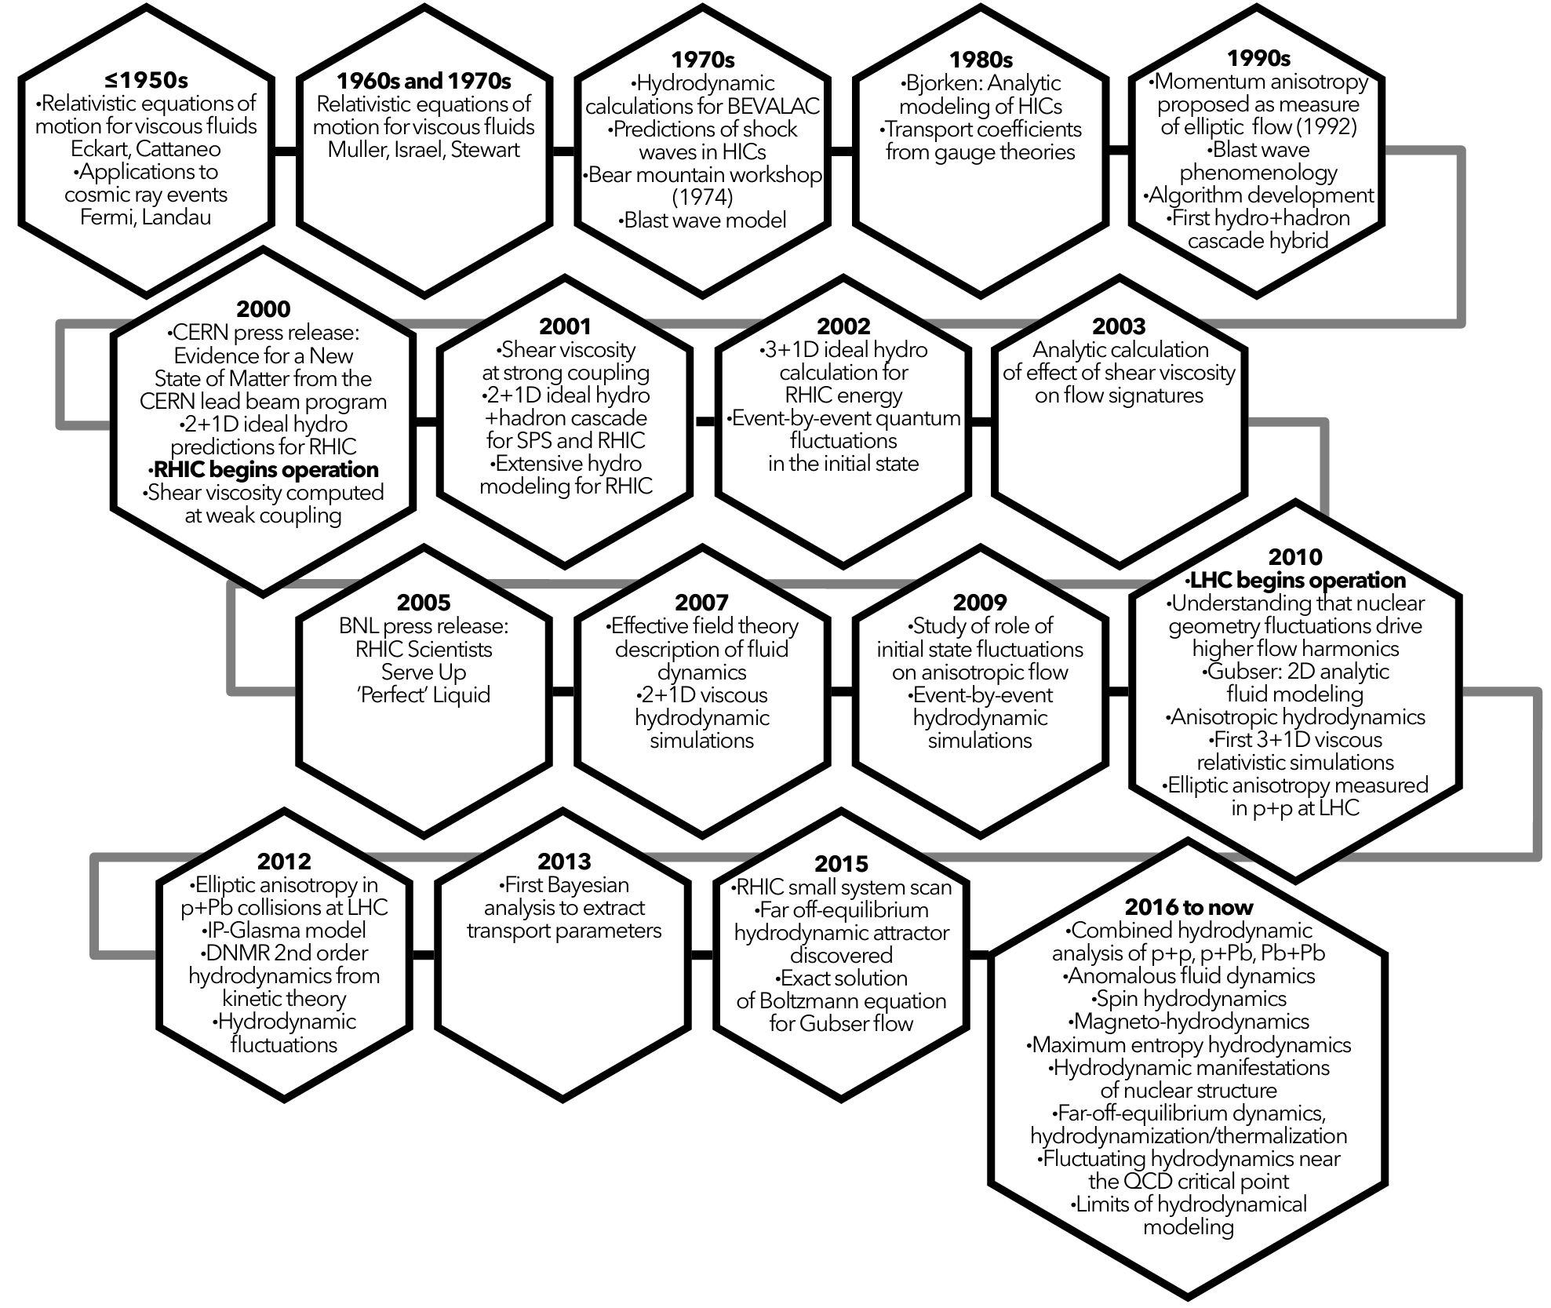
History

Slide 32
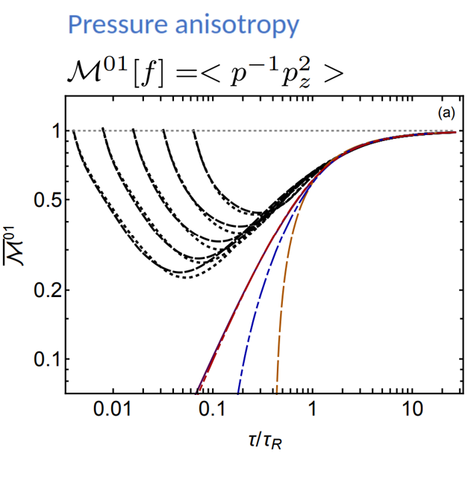
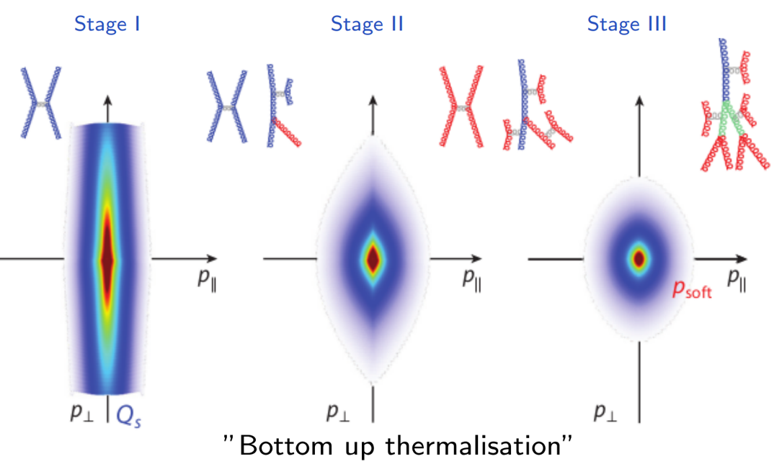
outcome3:Non-equilibrium attractors: Microscopic QCD at weak coupling (EKT)

Slide 33
BIG questions | The phase diagram of strongly coupled matter||towards high density

Slide 34
Non-linear Causality analysis
Pb+Pb 2.76 TeV
p+Pb 5.02 TeV

Slide 35
Intuitive picture: hydrodynamics as a geometry response
ΔΦ : Difference in azimuthal angle
Δη : Difference pseudo-rapidity

