Slide 1
Implications of the composite matter/antimatter hadron structure for Dark Energy and Dark Matter
15th International Conference on the Intersections
of Particle and Nuclear Physics
Madison, Wisconsin
June 12, 2025
Mark Pickrell

Slide 2
Contents:
Introduction
Background of the Science
The Composite Hadron Model
A. Observation
B. Hypothesis
C. Experiment
D. Conclusion
E. Further Experimental Observations
F. Operating Hypothesis – the sCHM
Dark Energy
Dark Matter

Slide 3
I. Introduction
Basis of Talk:
M. Pickrell, “Composite matter/antimatter hadron structure indicated experimentally at the Texas Petawatt Laser Facility,” Phys. Ess. 37(4): 270 (Dec 2024).

Slide 4
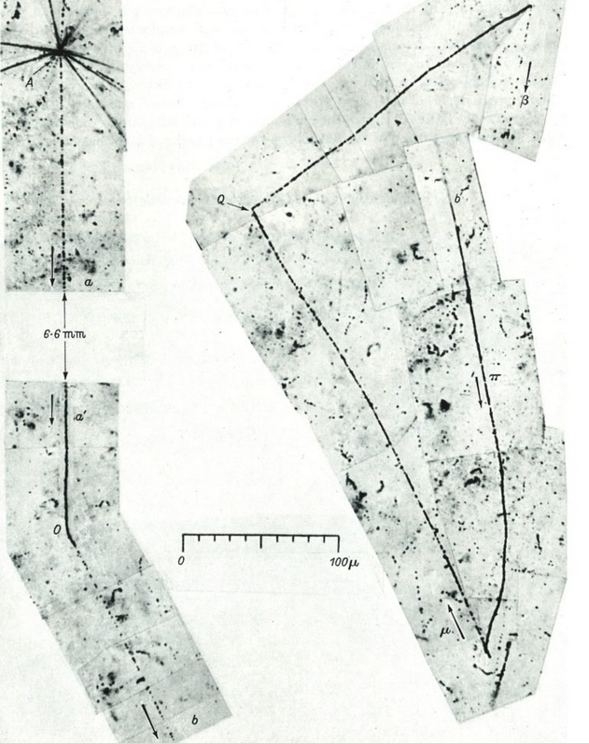
Background -- Matter & Antimatter
Existence of antimatter first hypothesized in 1898 by Arthur Schuster in Nature
In 1928, Paul Dirac’s relativistic version of the Schrodinger wave equation recognizes solutions involving an antielectron; in 1930, Robert Oppenheimer proposed the existence of a “positively charged electron with the same mass”
In 1932, Carl Anderson discovers positrons in cosmic rays; in 1936, Anderson describes electron/positron annihilation, crediting Joliot’s and Thibaud’s 1934 work on radioactive decay
In 1934, Bethe & Heitler theorize that virtual electrons and positrons arise from the “quantum vacuum”
In 1947, Cecil Powell, et al., discover the pion, ultimately understood as a combination of a quark and antiquark, in a cosmic-ray experiment
In 1955, Owen Chamberlain and Emilio Segrè discover the antiproton at Berkeley Radiation Laboratory’s Bevatron
In 1956, Bruce Cork, et al., discover the antineutron at BRL
In 1964, Murray Gell-Mann and George Zweig theorize existence of quarks (as denominated by Gell-Mann)
In 1964, James Cronin, Val Fitch, et al., discover CP violation for K meson decays (demonstrating matter/antimatter subatomic asymmetry)
Positron
K meson to ∏⁺

Slide 5
The Standard Model

Slide 6
Major Known Problems of the Standard Model
Apparent gross matter/antimatter asymmetry in the Universe vs. theorized gross matter/antimatter symmetry
The cause of subatomic matter/antimatter asymmetry (Cronin & Fitch) is not understood
Dark Energy (an energy that causes the increasing size of the Universe and the increasing rate of expansion of the Universe)
Dark Matter (a force that causes an apparent slower-than-expected rotation of galaxies)
The cause of the overwhelming majority of visible mass in the Universe is not explained by the Higgs mechanism

Slide 7
III. The Composite Hadron Model

Slide 8
Observation: In 2008, Hui Chen and others at Lawrence Livermore National Laboratory discovered that “large quantities” of electron/positron pairs are generated when a high-intensity laser strikes a gold target (and can be separated magnetically)
H. Chen, et al., “Relativistic positron creation using ultraintense short pulse lasers,” Phys. Rev. Lett. 102: 105001 (2009).
Chen understood that the electron/positron pairs arise from
the Bethe-Heitler process, from the quantum vacuum
Chen’s experimental result conflicts with our understanding from theory that electron/positron pairs arising from the quantum vacuum are extremely difficult (if not impossible) to separate

Slide 9
Conjecture: positrons exist within ordinary nuclei* Thought experiment: what would hadrons look like under the following parameters:
Gross universal matter/antimatter symmetry (as predicted from theory)
Matter/antimatter asymmetry at the subatomic scale (Cronin & Fitch)
Positrons may exist within ordinary, stable nuclei (from H. Chen, et al.)
Protons, neutrons, and electrons exist as ordinary, observed matter
M. Pickrell, “Hypothesis for a universal matter/anti-matter hadron structure, with resulting cosmology,” HAL 03475258 (December 10, 2021)(pre-print).
*John Wheeler, Richard Feynman’s thesis advisor, first hypothesized the existence of positrons within “ordinary” matter in the 1950s

Slide 10
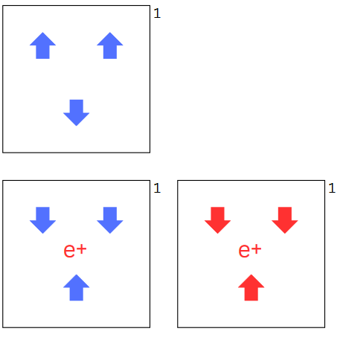
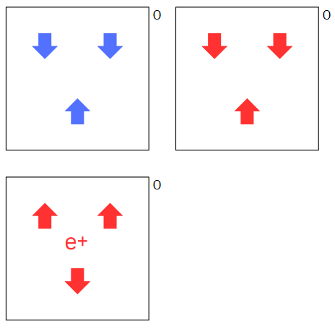
Stable “ordinary” hadrons may be composed of quarks, antiquarks, and positrons (Composite Hadron Model)
Composite proton structures:
Composite neutron structures:
Blue indicates matter; red indicates antimatter
Arrows indicate up or down quarks or antiquarks
e⁺ = positron

Slide 11
Proton-Neutron Conversions in the CHM
Does not involve a flavor change
Instead, involves a loss of a positron by a proton, or the gain of a positron by a neutron
For example:
OR

Slide 12
Prediction from the Composite Hadron Model:
If the positrons generated when high-energy lasers strike a target arise internally from the nucleus, then the target should transmutate
If no transmutation takes places, then the Composite Hadron Model is almost certainly incorrect (i.e., satisfies Popper falsifiability)
Notes:
Shout out to Cambridge physics professor

Slide 13
Experimental Observation:
In 2015, Alexander Henderson observed at the Texas Petawatt Laser Facility that gold targets struck by high-intensity lasers are transmutated in the process -- Au is transmutated into Pt
A.H. Henderson, “Monte-Carlo simulation and measurements of electrons, positrons, and gamma-rays generated by laser-solid interactions,” Rice University, Houston, Texas (January 2015) (doctoral dissertation)(Section 5.4 discusses transmutation observation).*
Henderson’s dataset: DOI//10.6084/m9.figshare.24319894*
Henderson’s comparator: https://www.nndc.bnl.gov/nudat3/getdataset.jsp?nucleus=196Pt&unc=nds*
*With permission of Dr. Henderson

Slide 14
Conclusion:
Alexander Henderson’s observation of transmutation of gold targets by high-intensity lasers indicates that the Composite Hadron Model is correct

Slide 15
The CHM Is Consistent With:
Theorized gross matter/antimatter symmetry in the Universe & observed apparent gross matter/antimatter asymmetry
Matter and antimatter asymmetry at the subatomic scale
Presence of antimatter quarks observed in collider experiments (esp. Bevatron)
Proton-proton chain reactions in stars
Observed generation of positrons and e-/e+ magnetic separation in petawatt laser experiments
Observed hydrogen/helium composition of stars
Observed expansion of the Universe & the increasing rate of expansion of the Universe (i.e., Dark Energy)
Dark Matter that causes the observed, slower-than-expected galaxy rotation
Beta decay (β+ and β-)
Half-lives of radioactive isotopes as a 2nd-order kinetic
Observed increasing half-lives of Voyager fission generator
Observed 511-keV spectral “signature” of the Milky Way

Slide 16
Other Experimental Observations
Tetraquarks and Pentaquarks have been observed at the Large Hadron Collider
LHCb Collaboration, “Observation of J/ΨP resonances consistent with pentaquark state in Λ → J/ΨK- p decays,” Phys. Rev. Lett. 115: 072001 (2015).
LHCb Collaboration, “Observation of an exotic narrow doubly charmed tetraquark,” Nat. Phys. 18: 751-54 (2022).
Antiproton-Proton Bevatron collision (1955)
Showing:
Ten quarks
Pion Decay

Slide 17
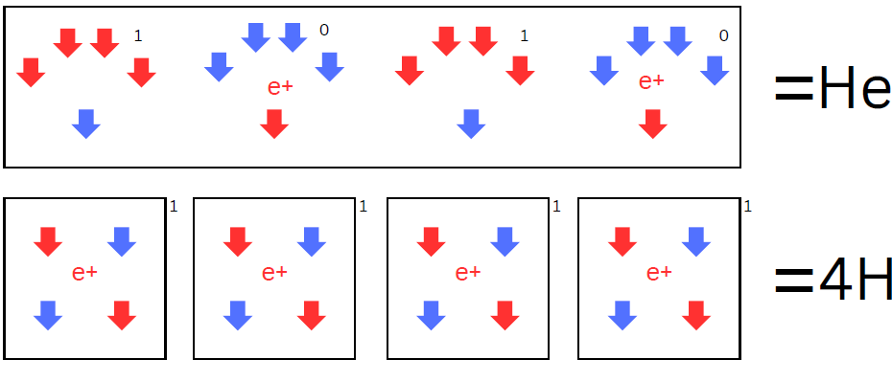
The Simplified Composite Hadron Model
The simplified Composite Hadron Model (sCHM) consists of 1/3-charge particles (currently known as down antiquarks), -1/3-charge particles (currently known as down quarks), and positrons.
The resulting “Universe” (in its smallest repeatable form – electrons are not shown) consists of:
Red shows “antimatter”; Blue shows “matter” (Really, it’s all just observed matter consisting of positively and negatively charged particles)

Slide 18
Fundamental Implications of the sCHM
“Matter” as we understand it is a composite of matter and antimatter, understood in its simplest form as a combination of 1/3-charge and -1/3-charge quarks (currently called down quarks and down antiquarks), combined with positrons, to form nuclei
Proton-to-neutron conversion in proton-proton chain reactions in stars (as well as the C-N-O process) is likely initiated by positron ejection from protons
Neutrinos created as a byproduct of proton-proton chain reactions in stars likely cause the expansion, and the increasing rate of expansion, of the Universe under Einstein’s General Theory (i.e., explains Dark Energy)
Neutrinos generated as a by-product of proton-proton chain reactions in stars are the likely major cause of the observed rate of galaxy rotation (i.e., explains Dark Matter)
Beta decay (both B+ and B-) is likely an external, deterministic phenomenon caused by neutrinos interacting with nuclei
Non-Higgs generation of mass (98% of the mass of the Universe) likely caused by Strong Force binding of asymmetric electrical forces in nuclei (? -- tbd)

Slide 19
IV. Dark Energy under the sCHM

Slide 20
Proton-Proton Chain Reactions in Stars in the Composite Hadron Model
(One variation)

Slide 21
Proton-proton chain reactions as the primary initiating action (?) of the current epoch of the Universe
Each time that a positron is ejected from a proton within a star, it is available to annihilate with a nearby electron
In each annihilation, two 511-keV gamma rays and at least one neutrino are emitted
The neutrino has mass, and it immediately accelerates to nearly the speed of light
Under Einstein’s General Theory, an accelerating object with mass expands spacetime
Therefore, it appears likely that neutrinos emitted as a byproduct of proton-proton chain reactions in stars cause the expansion, and the increasing rate of expansion, of the Universe, in our current epoch

Slide 22
Major Neutrino fluxes
Stellar (source: Sun)
Interstellar (source: other stars in Milky Way)
Intergalactic (source: stars in other galaxies)
Remnant from the Big Bang /First Inflation (?)

Slide 23
V. Measuring Interstellar Neutrinos as potential Dark Matter under the CHM

Slide 24
The Voyager 1 spacecraft is currently “measuring” the interstellar neutrino flux
Early in the Voyager program, it was observed that the craft’s Radioisotope Power Generators were experiencing an unexpected lengthening of their isotope’s (Pu-238) half life
L.A. Packard, “Flight performance of the Voyager electrical power system,” Am. Soc. of Mech. Eng., Washington, DC (1981).
As the crafts have moved away from the Sun (and its particular neutrino flux, by operation of the inverse-square law), their RPGs are powered more and more by the interstellar neutrino flux, consistent with the CHM

Slide 25
Pu-238 Half Lives on Earth

Slide 26
Observed Voyager 1 Pu-238 Half Life (accounting for thermocouple loss of efficiency)
Sources: NASA, Radioisotope Power Systems Reference Book, Washington, DC (2015);
C.E. Whiting & D.F. Woerner, “The Graph becomes the dataset,” Nuclear Technology, 1–8 (2024).

Slide 27
Neutrino Concentration on Earth vs. Interstellar Concentration
Based on the observed Voyager data:
The half life of Pu-238 in the interstellar medium is approximately 136 years
The ratio on Earth of solar neutrinos to interstellar (including intergalactic and Big Bang/First Inflation) neutrinos, expressed as a percentage, is approximately 13%

Slide 28
Questions? Thank You!
Please address questions, comments, criticism to:
mark.pickrell@pickrell.net

