Slide 1

Directional Dark Matter and other Rare Searches with gas TPCs
Dinesh Loomba
CIPANP 2025, Madison
June 12, 2025

Slide 2
Directional DM and other Rare Searches*
These require technology/techniques to:
Particle ID to discriminate signals and backgrounds
Measure directionality of low energy particle tracks
Fiducialize the detector volume
Have flexibility to probe new parameter spaces
Be scalable!
Gas TPCs satisfy many of these requirements…
* X-ray polarimetry, C𝞶NS, nuclear physics, Migdal Effect, etc

Slide 3
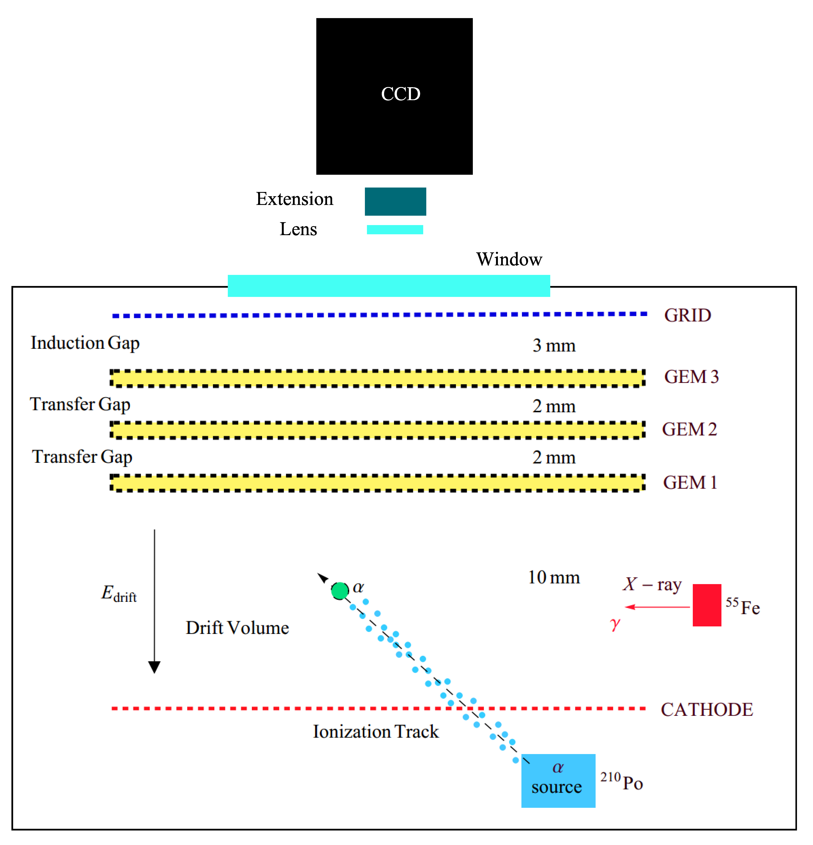
Example that illustrates many of these features:
Optical TPC
≤100 Torr CF₄
High resolution 2D readout with ~160 μm pixels
gas gains ~100,000

Slide 4
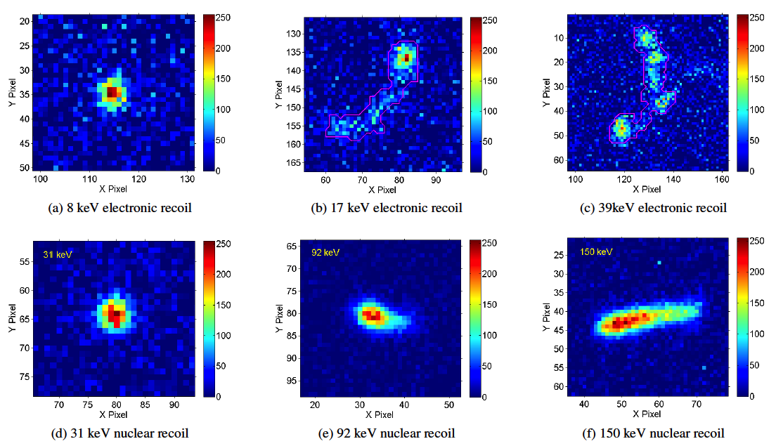
𝞶
ERs
NRs
Phan, et al. Astro Part Phys (2016)

Slide 5
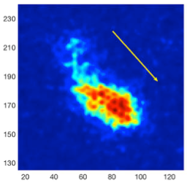
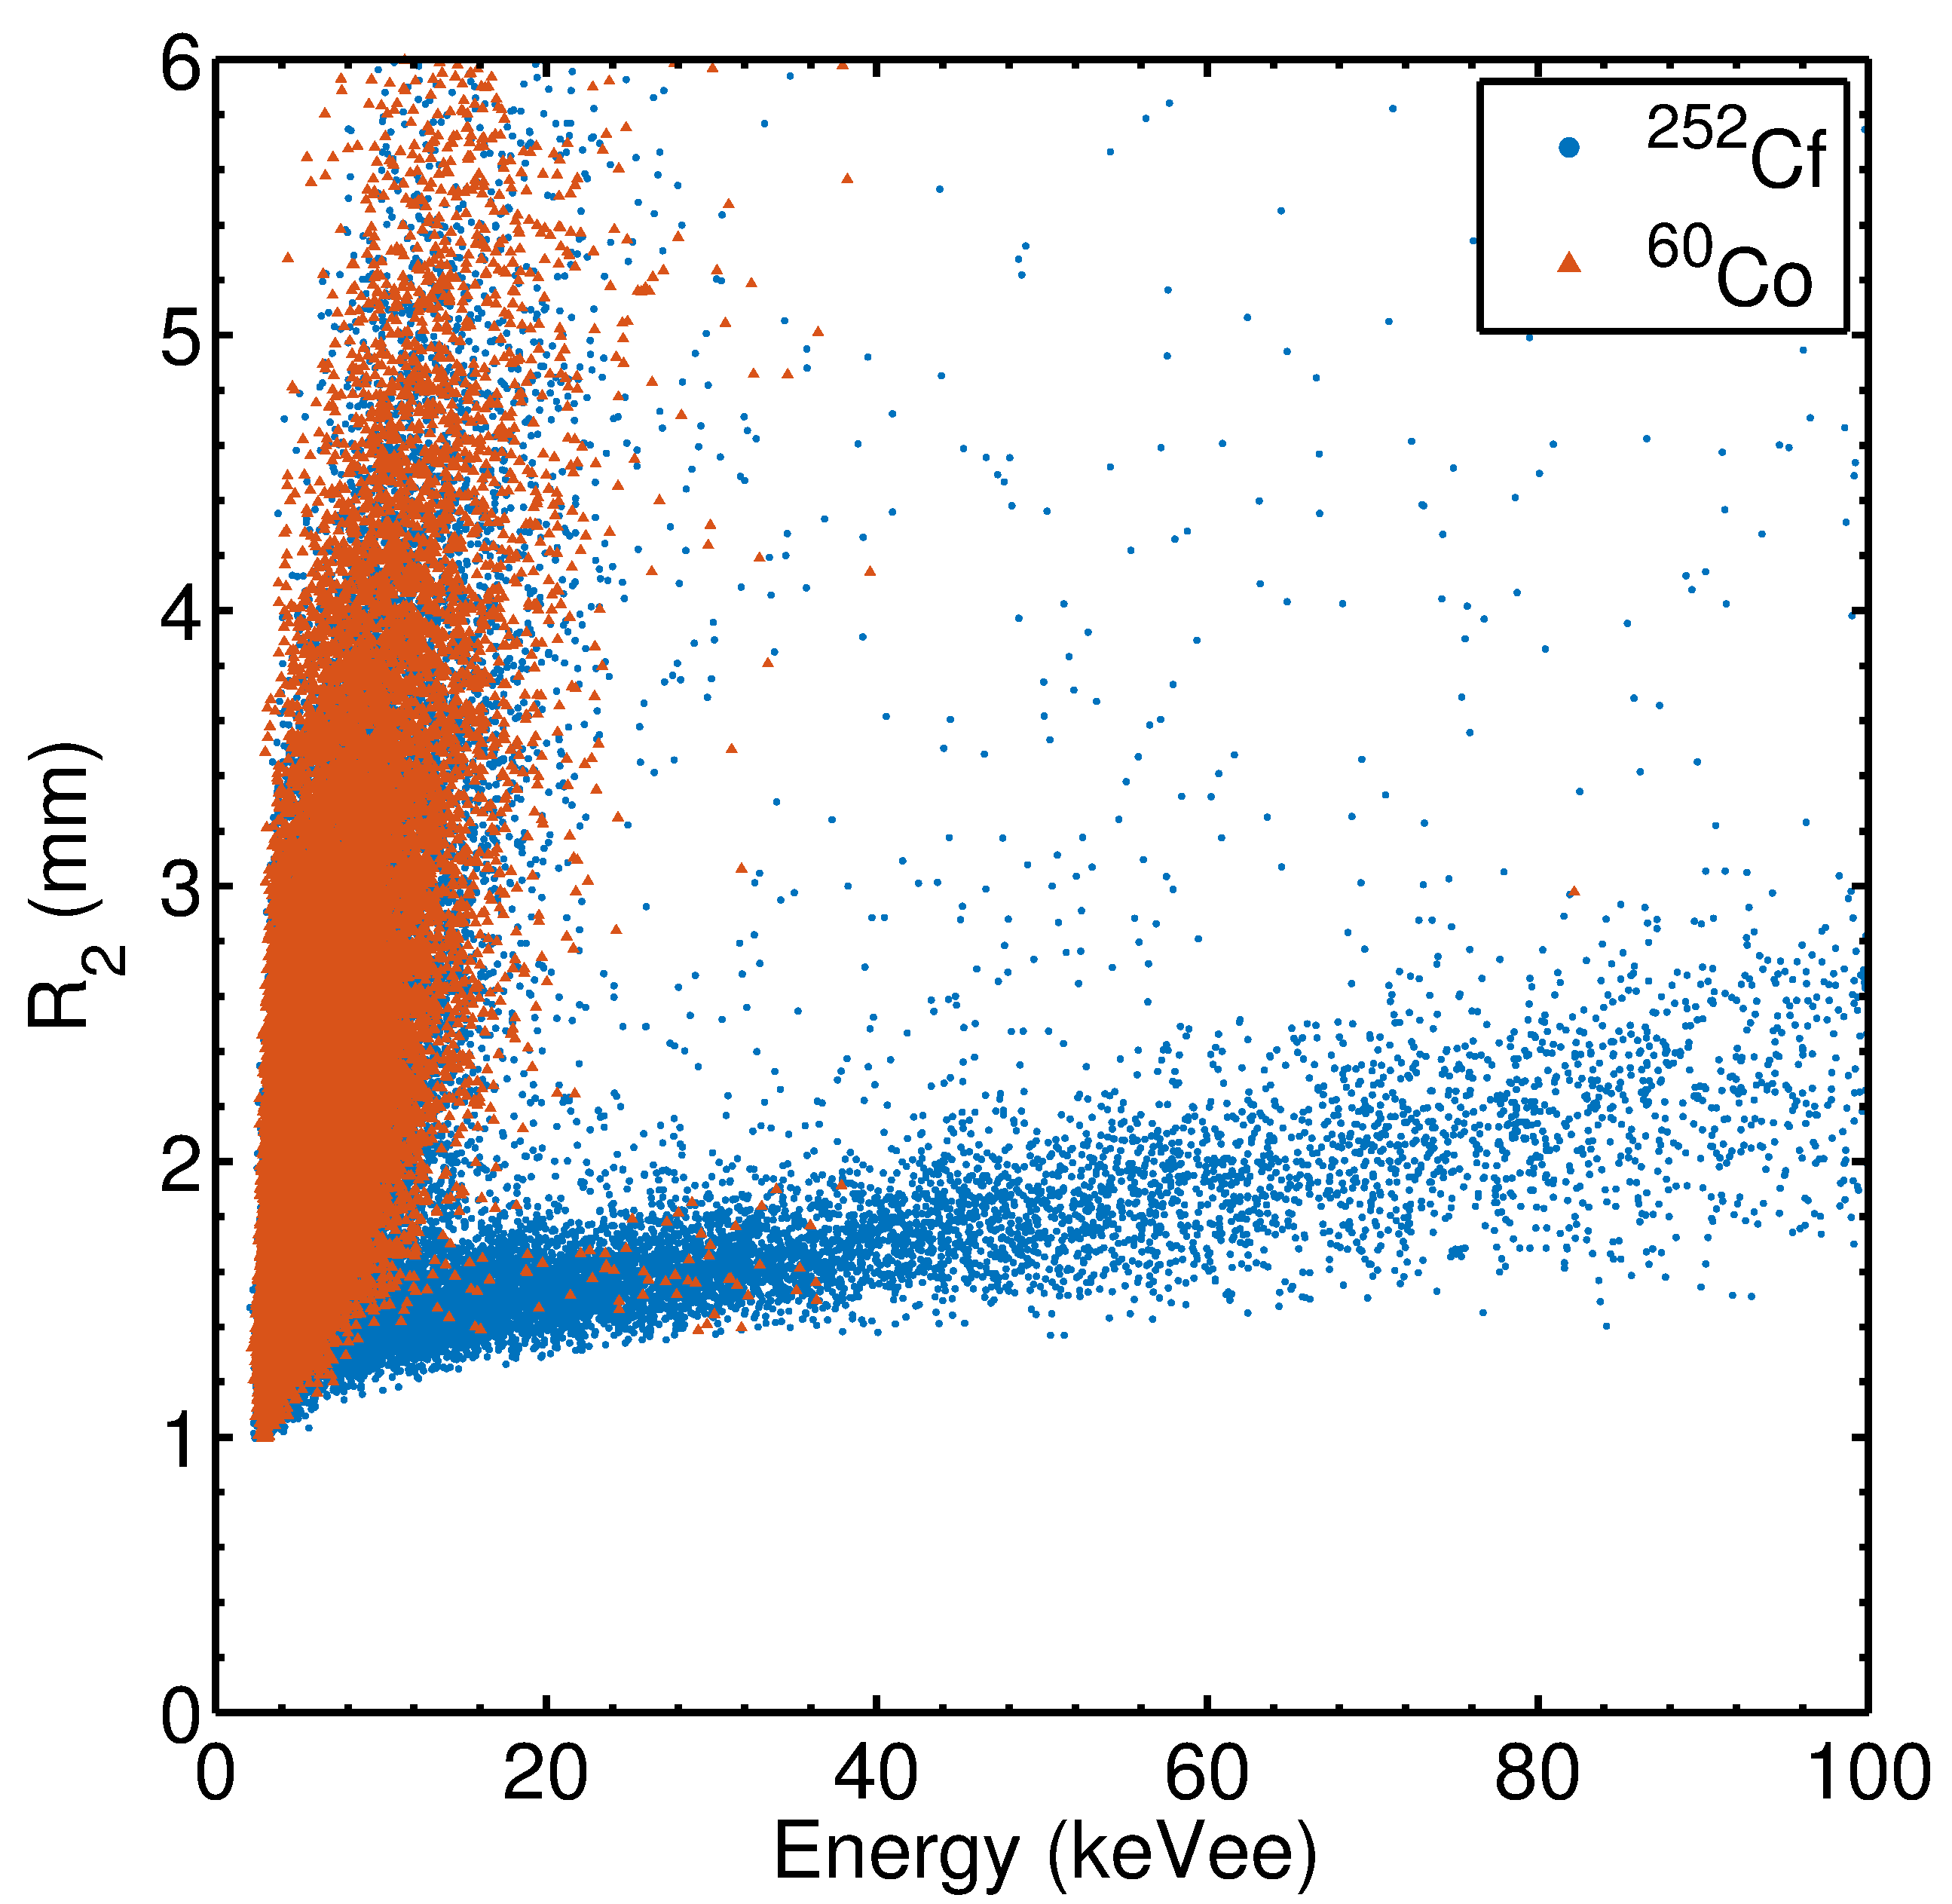
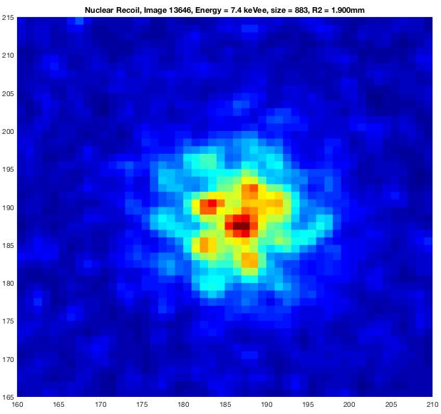
5.9 keV electron
Discrimination using Range vs Energy
Low dE/dx: ERs (γ’s)
~6 mm long
~7 keVee Nuc. Recoil
High dE/dx: NRs
~2 mm
Phan, et al. Astro Part Phys (2016)

Slide 6
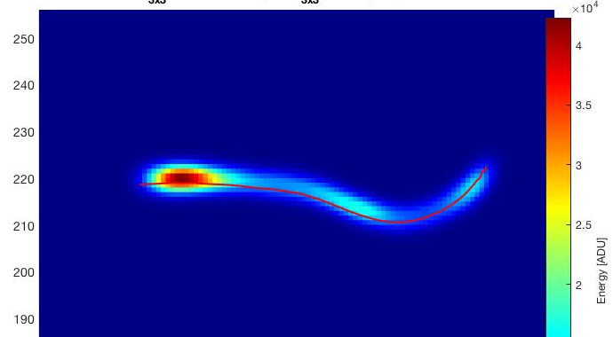
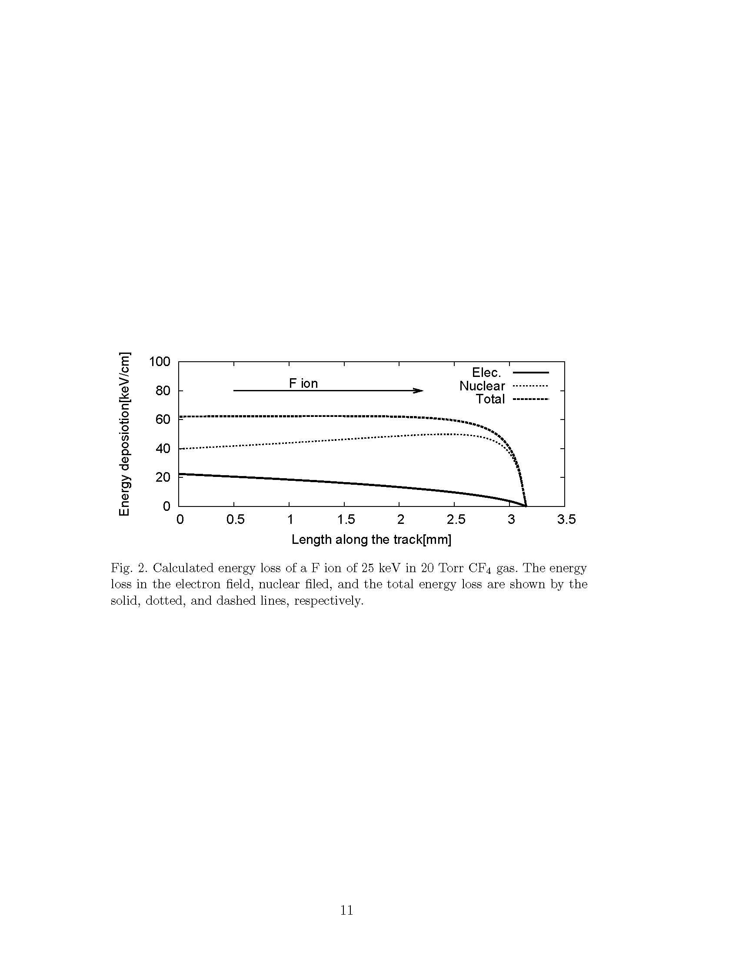
Directionality (NRs)
T
H
Vector directionality
From Tanimori, et al Phys.Lett. B578 (2004)
Hitachi’s work

Slide 7
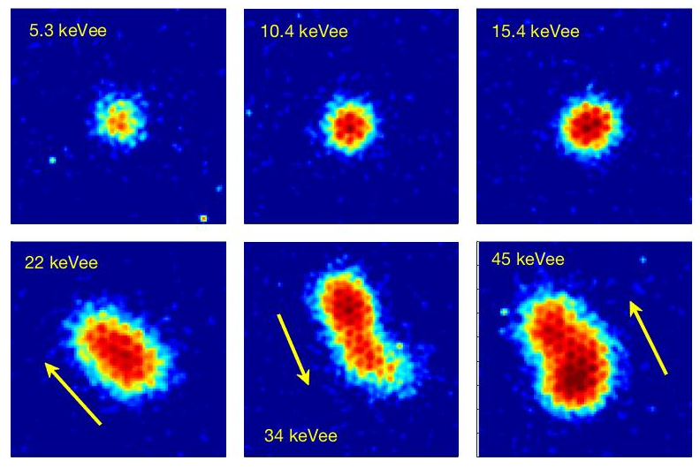
Fluorine Nuclear Recoils
??
?
**High diffusion, σ ~ 0.7mm

Slide 8
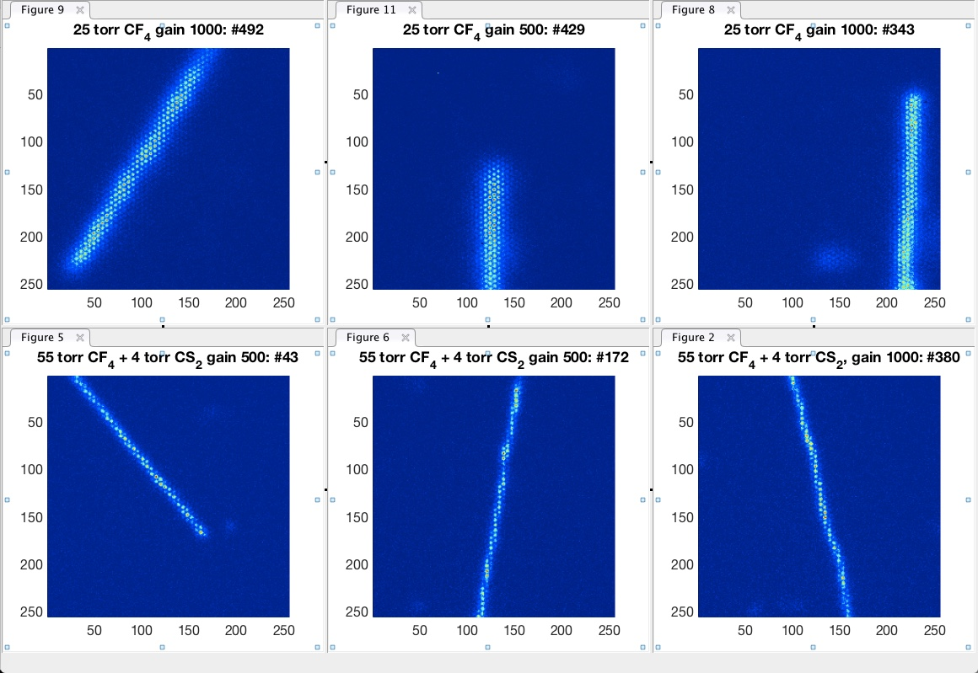

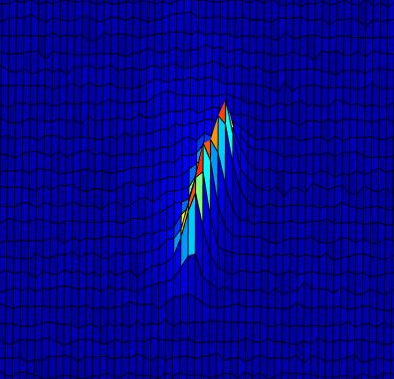
Flexible technology
Flexibility in choice of target A: light targets (He) for 𝞶-fog at m_{χ} ~10 GeV, F for spin-dependent, etc.
~40 Torr CF4
+ 4 Torr CS2
Negative ion drift: target A +CS₂/SF₆ mixtures enable drift with thermal diffusion (Martoff)
E.g. 1 bar He/SF6?
σ ~ 500 um
σ ~ 150 um
Rate
Fluorine NR
P
Pressure is tunable: lower P → lower E_{dir}
σ ~ 150 um
E_{dir} (R_{min})

Slide 9
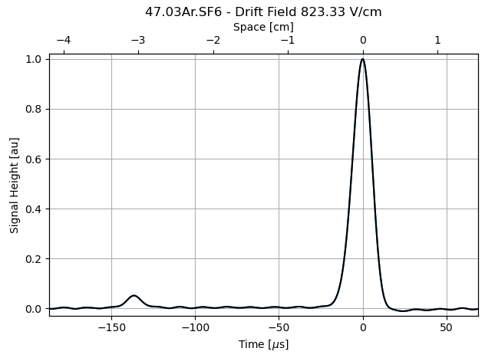
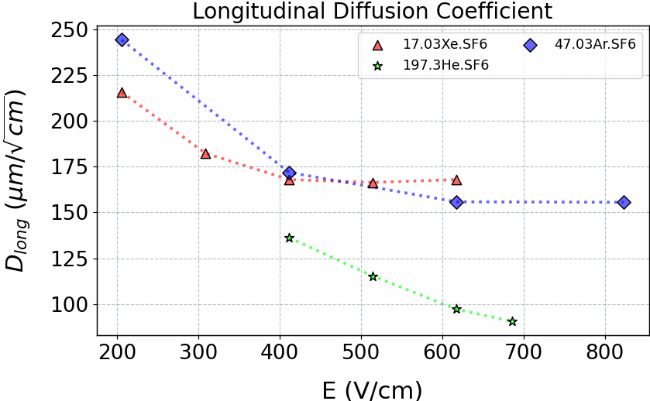
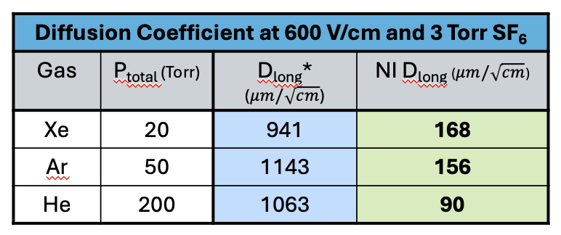
Negative ion (NI) drift in 197/3 He/SF₆:
Two different species =
Z-Fiducialisation!
SF⁻₆ peak
Thermal diffusion
Fiducialization in 3D
Low mobility (3D tracks)
Z-fiducialization
SF⁻₅ peak
PRELIMINARY
Thermal diffusion

Slide 10
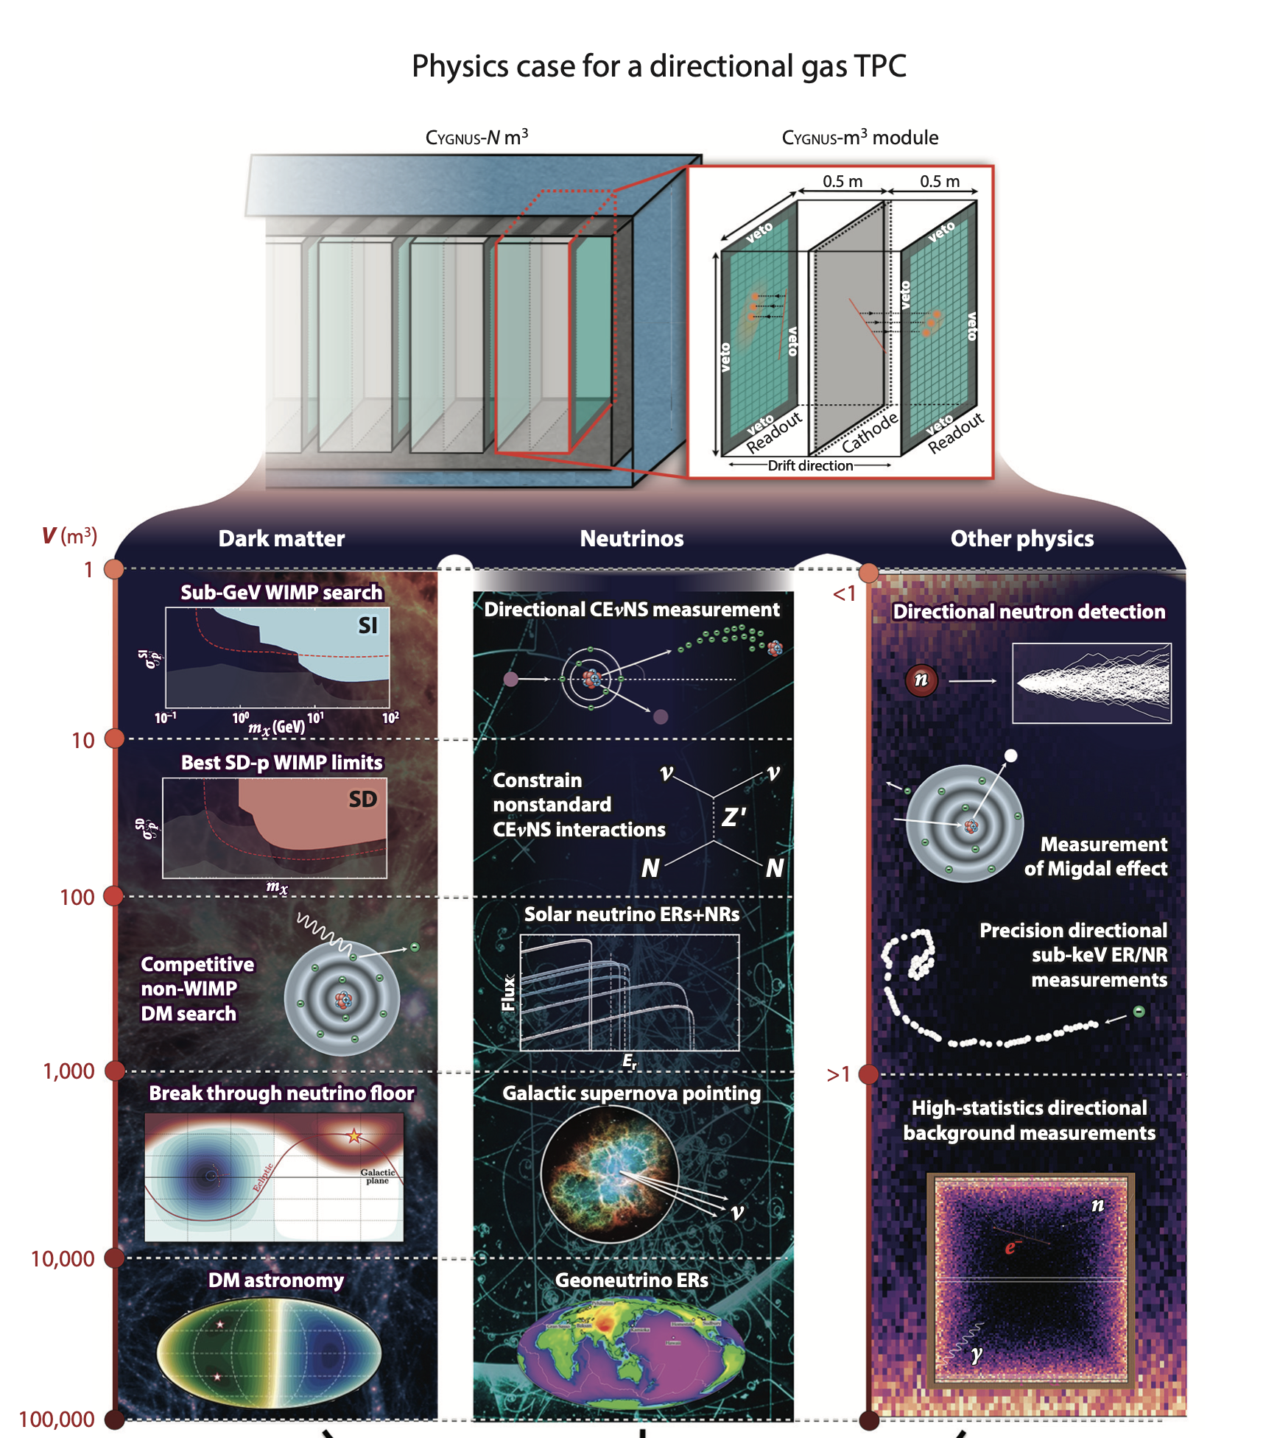
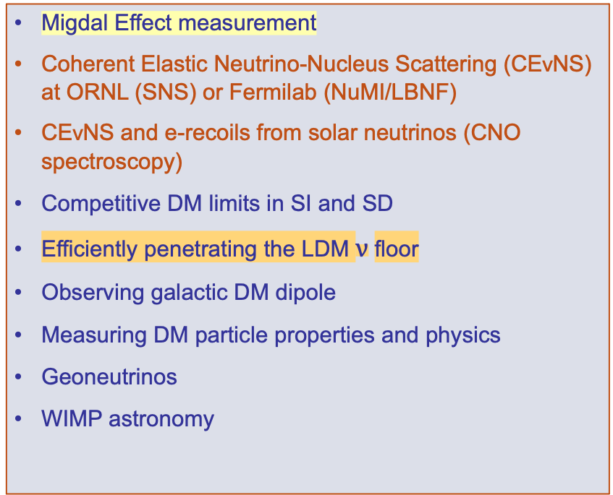
Scale-up with new physics opportunities at each stage
Migdal Effect measurement
Coherent Elastic Neutrino-Nucleus Scattering (CEνNS) at ORNL (SNS) or Fermilab (NuMI/LBNF)
CEνNS and e-recoils from solar neutrinos (CNO spectroscopy)
Competitive DM limits in SI and SD
Efficiently penetrating the LDM $ν$floor
Observing galactic DM dipole
Measuring DM particle properties and physics
Geoneutrinos
WIMP astronomy
Exposure, size
Directional Recoil Detection arXiv:2102.04596 +
CYGNUS: Feasibility of a nuclear recoil observatory with directional sensitivity to dark matter and neutrinos arXiv:2008.12587
From S. Vahsen, UCLA DM2025

Slide 11
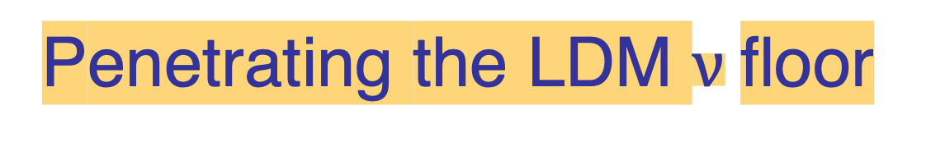
Penetrating the LDM $ν$floor

Slide 12
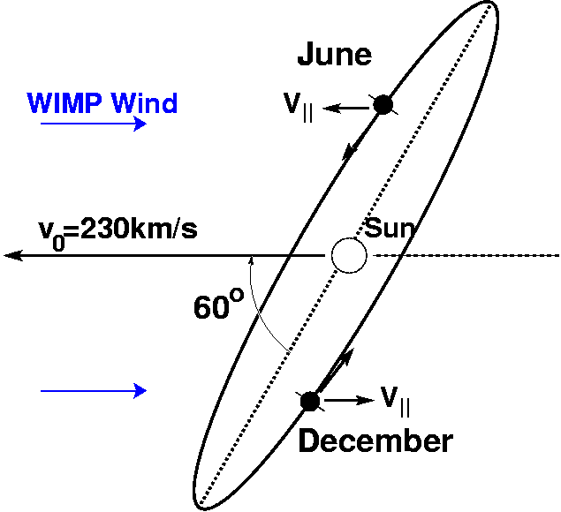

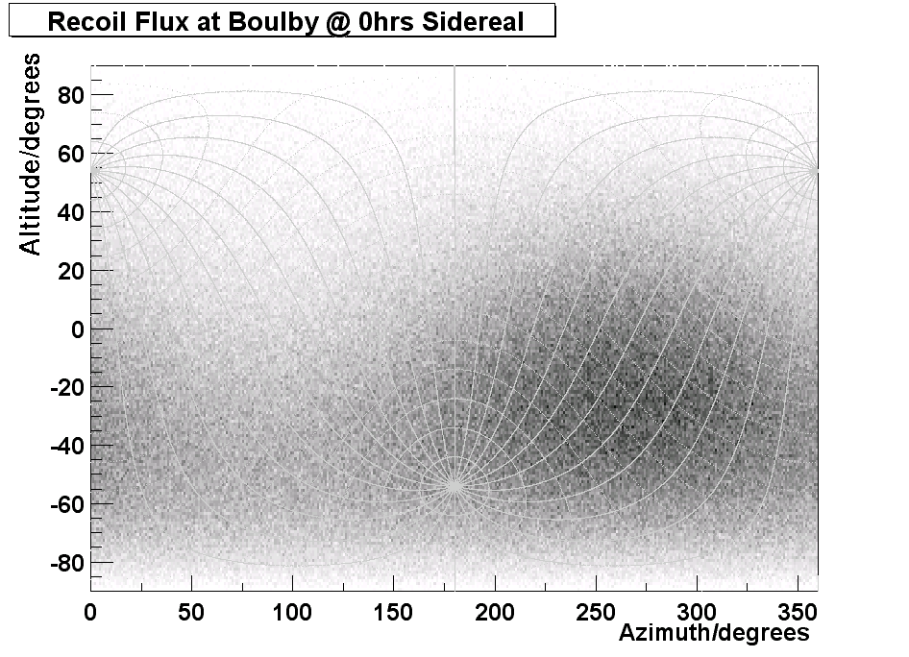
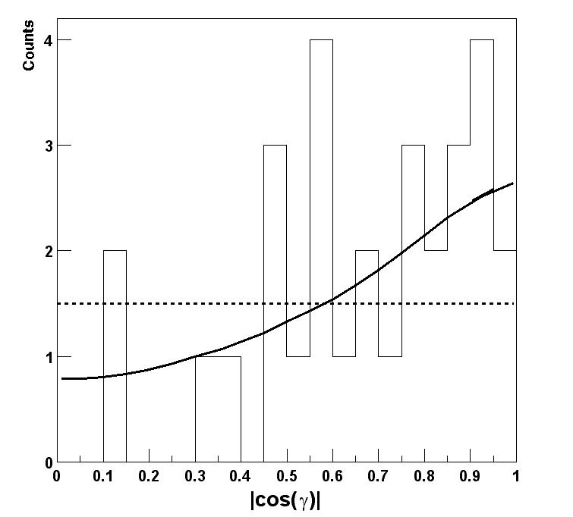
Textbook WIMP signatures
1. Annual modulation
WIMP Wind
12:00h
42º
Cygnus Constellation
Galactic WIMP
Halo
0:00h
2. Sidereal modulation
WIMP
MC ~30 WIMPs to confirm galactic
v₀
γ
isotropic
  Nuclear recoil
cosγ

Slide 13
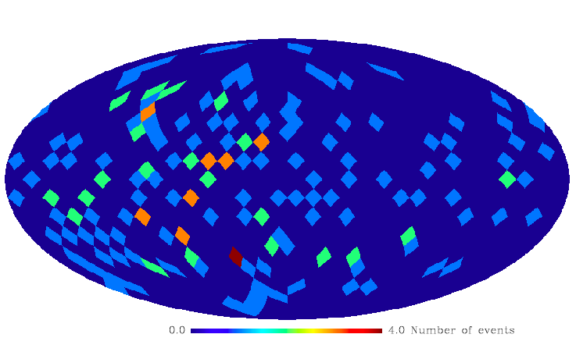
Directionality is powerful even with backgrounds…
100 WIMP + 100 isotropic Bkgd events
Cygnus Constellation (l = 90°,b = 0°)
J. Billard, F. Mayet, J.F. Macías-Pérez, D. Santos, PLB 691 (2010)

Slide 14
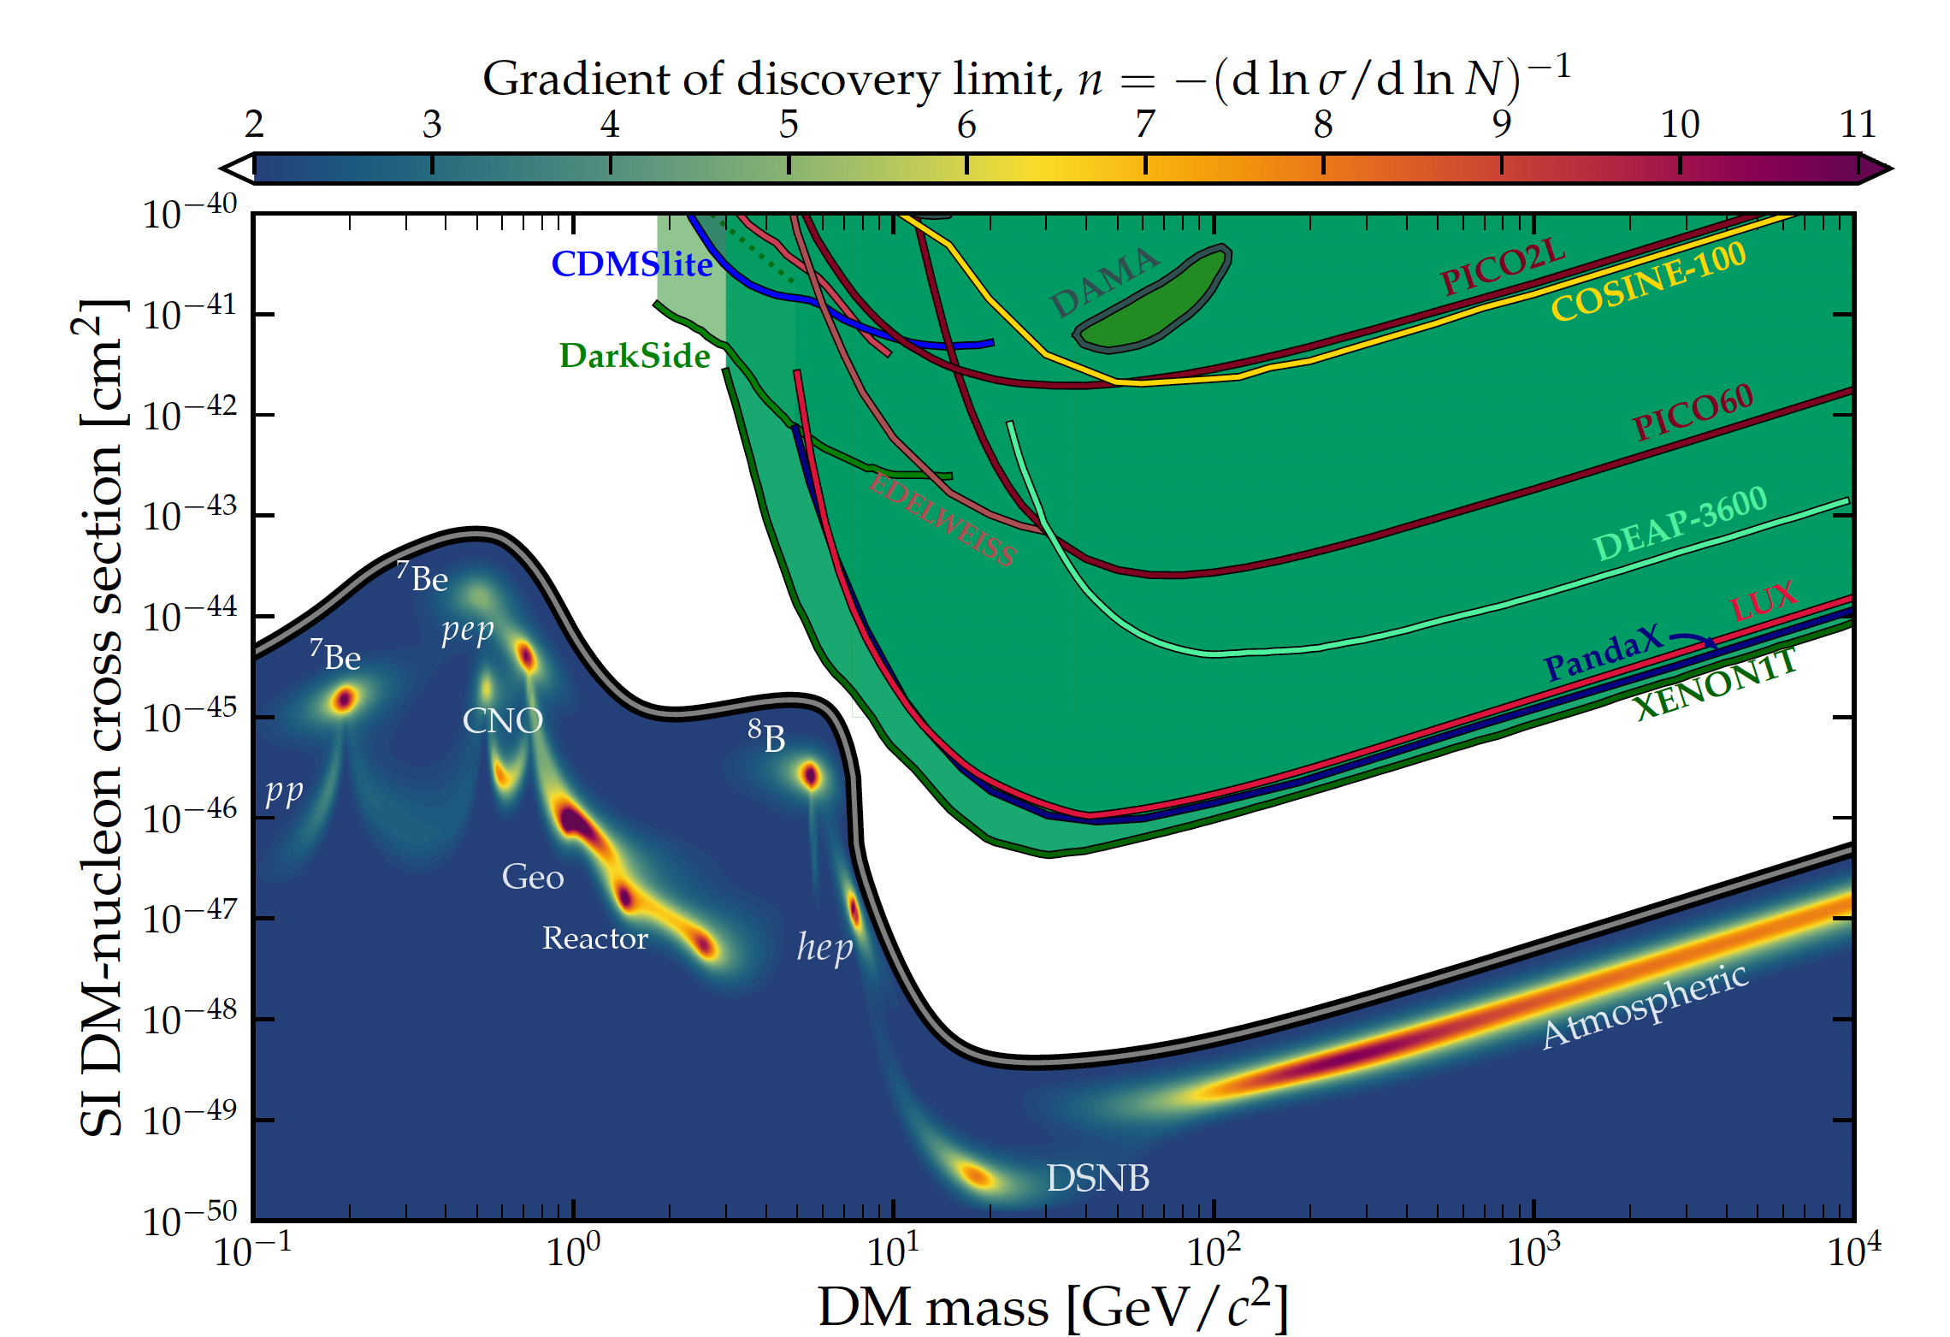
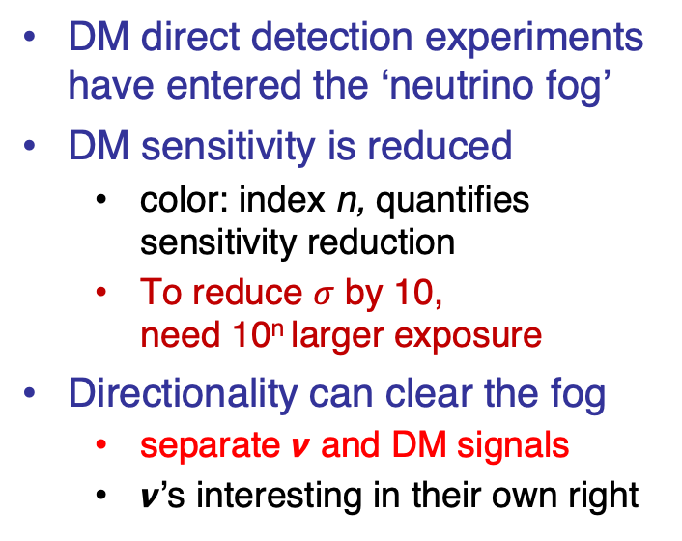
…such as the neutrino fog:
DM direct detection experiments have entered the ‘neutrino fog’
DM sensitivity is reduced
  color: index n, quantifies sensitivity reduction
  To reduce $σ$ by 10,
  need 10^{n} larger exposure
Directionality can clear the fog
  separate 𝞶 and DM signals
  𝞶’s interesting in their own right
Directional
detection
  O’Hare, PRL 127 (2021) and
C. A. J. O'Hare et al., Snowmass White Paper on recoil imaging

Slide 15
Directionality of WIMPs vs solar 𝞶’s
  O’Hare, et al. arXiv:1505.08061(2015)

Slide 16
Requirements:
Discriminating solar 𝞶 for m_{χ} ~10 GeV
(w/ He-target)
Event-level recoil directionality
  angular resolution ≤ 30 degrees
  excellent head/tail sensitivity
Rejection of internal electron backgrounds
  by factor >= 10⁵ for 1000 m³ detector
All of above down to E_{recoil} ~ 5 keV
Energy resolution ~ 10% at 5.9 keV
Timing resolution ~ 0.5 h
NID in He/SF6 to achieve high resolution 3D tracks for Head/Tail recognition!
3d vector
directionality
# detected WIMP events required to exclude 𝝼-hypothesis at 90% CL
Assumptions: m_{χ} = 10 GeV, He:SF₆ gas
https://arxiv.org/abs/2102.04596

Slide 17
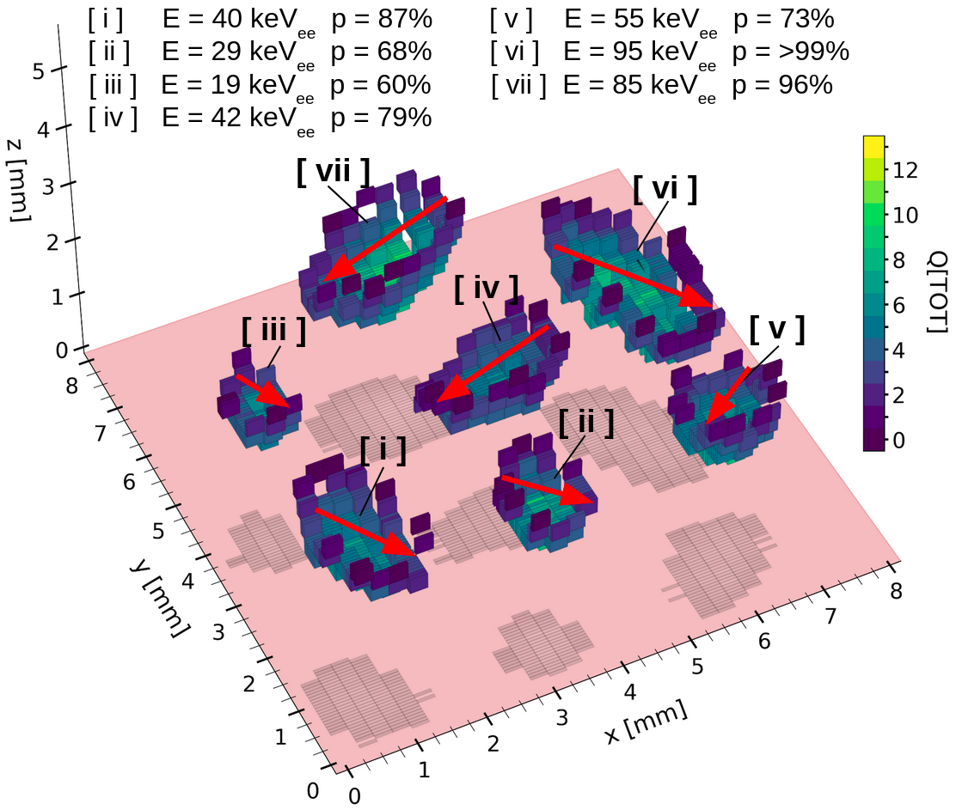
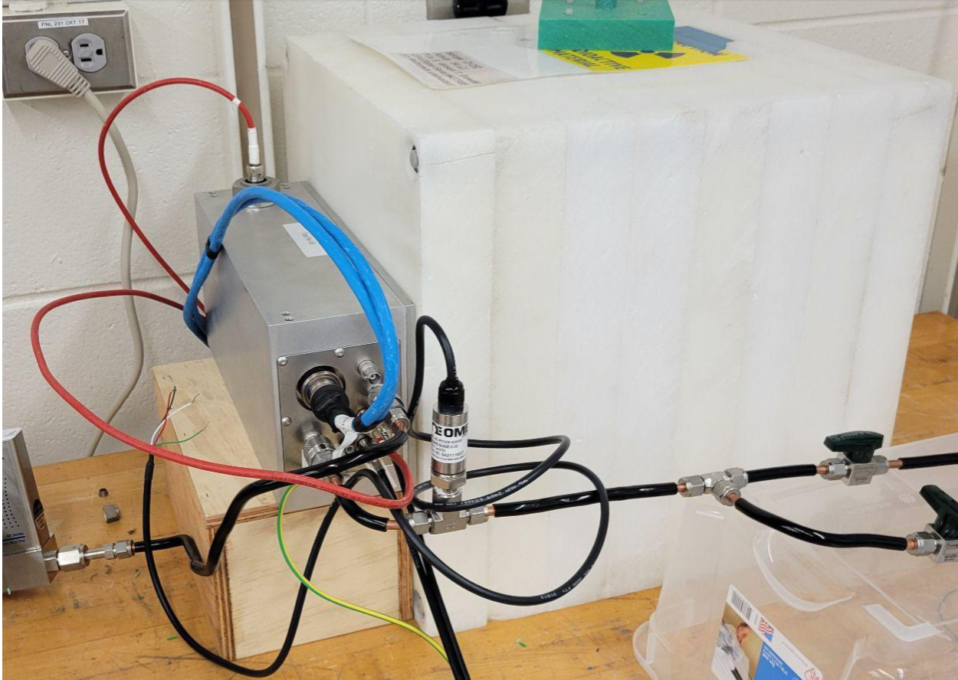

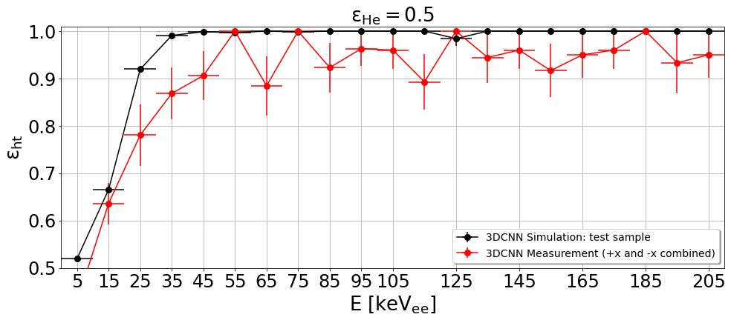
Event-level head/tail via Machine Vision: low gain
Jeff Schueler
neutrons
Preliminary
Measured result is a lower limit, as it will incorrectly identify backscattered events
BEAST pixel-readout TPC
Helium recoil tracks detected in a pixel-readout time projection chamber at low gain (900). Color of voxels indicates ionization density.
𝜀_{ht} = 63.6 +/- 4.3% for 10-20 keV_{ee} recoils → first demonstration of significant event-level head/tail sensitivity below 20 keV_{ee} in measurement (still at low detector gain!). Recently repeated w/ improved in-situ calibration. Analyzing…
Goal: Extend this to 1 keV with negative ion drift gas.
From S. Vahsen, UCLA DM2025
17

Slide 18
Migdal Effect measurement

Slide 19
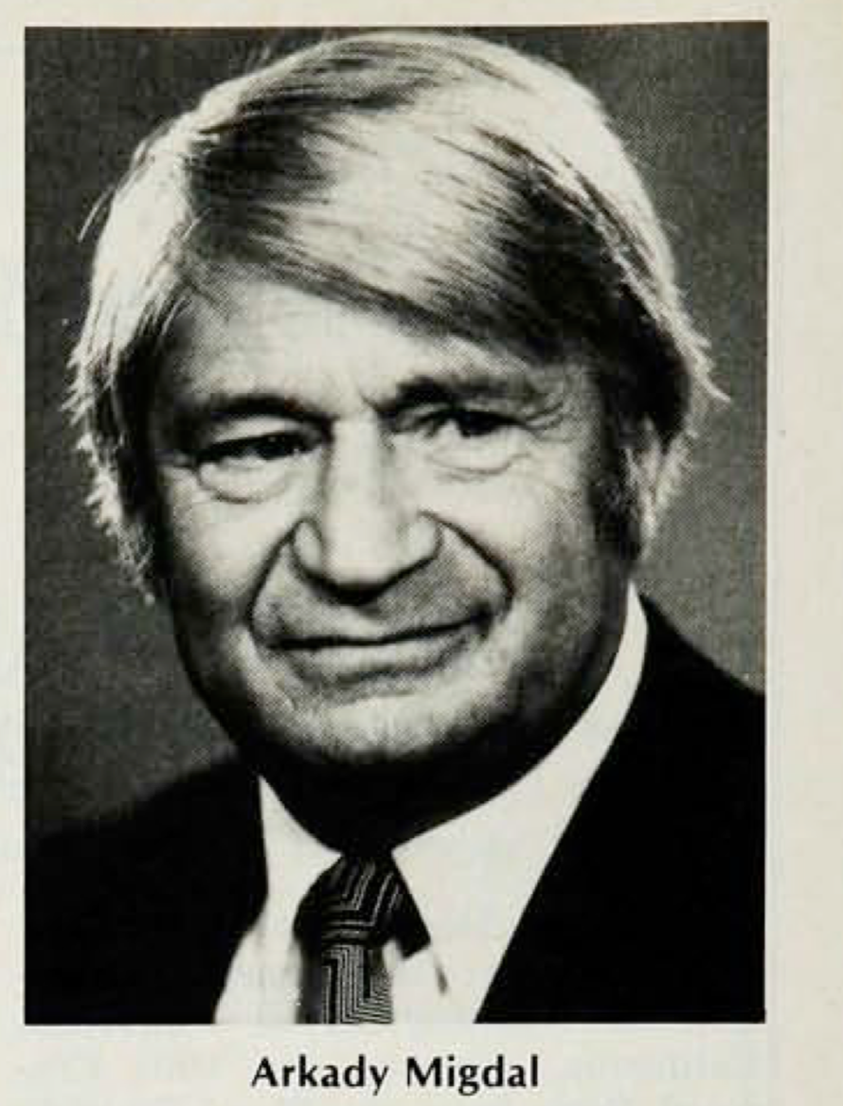
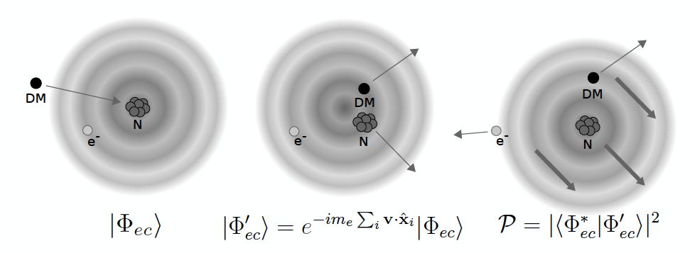
The Migdal Effect
A.B. Migdal, Ionization of atoms accompanying α- and β-decay , J. Phys. USSR 4 (1941) 449
Dolan, Kahlhoefer, and McCabe, PRL121, 101801 (2018)
“…it is usually assumed that the atomic electrons around the recoil nucleus immediately follow the motion of the nucleus. However, it takes some time for the electrons to catch up, which causes ionization and excitation of the recoil atom…”
Ibe, Nakano, Shoji, Suzuki, JHEP, arXiv:1707.07258

Slide 20
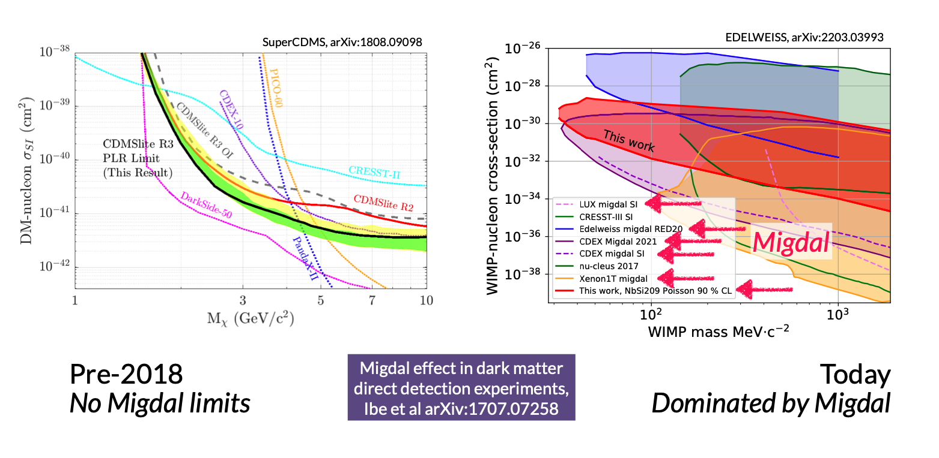

Slide 21

Detecting the Migdal effect
The Migdal effect has not been measured
→ needs validation!
Many efforts underway…
Our aim is to detect the Migdal topology –electron and nuclear recoil tracks sharing a common vertex
→ Challenging!
Migdal topology
P. Majewski, “OTPC for the observation of the Migdal effect in nuclear scattering”, New Horizons in Time Projection Chambers, 2020

Slide 22
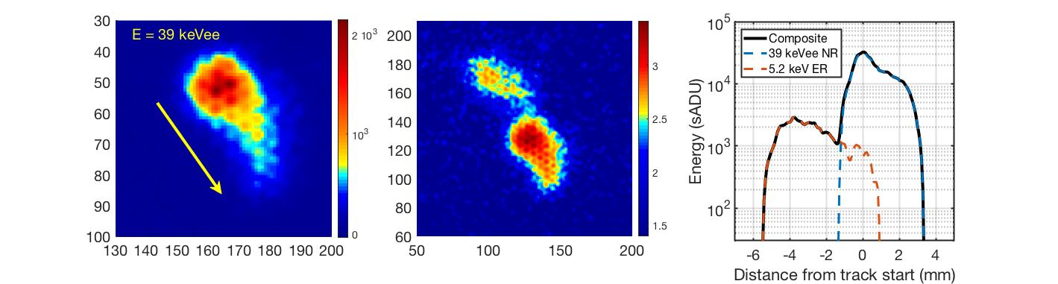
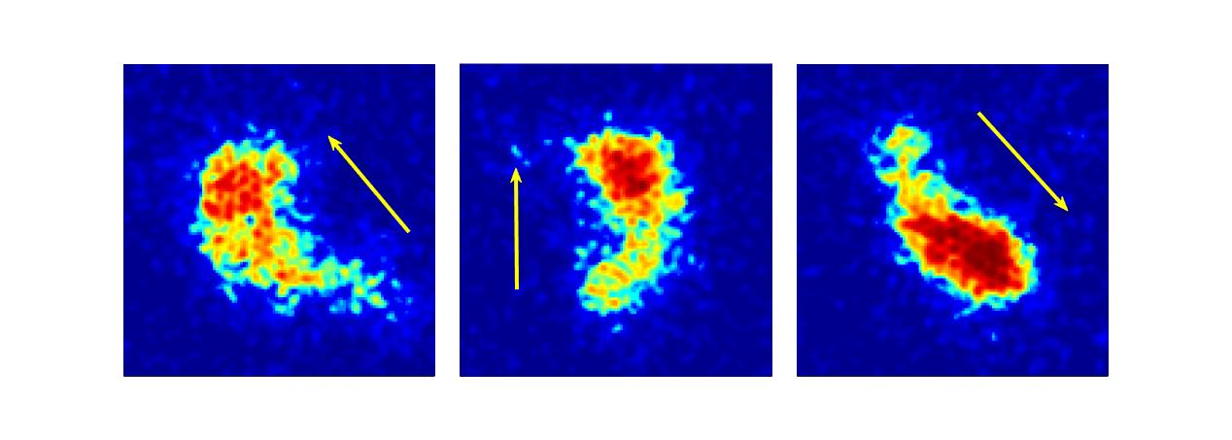
“Migdal Events”
Nuclear Recoil
Migdal
+
=
Electron

Slide 23
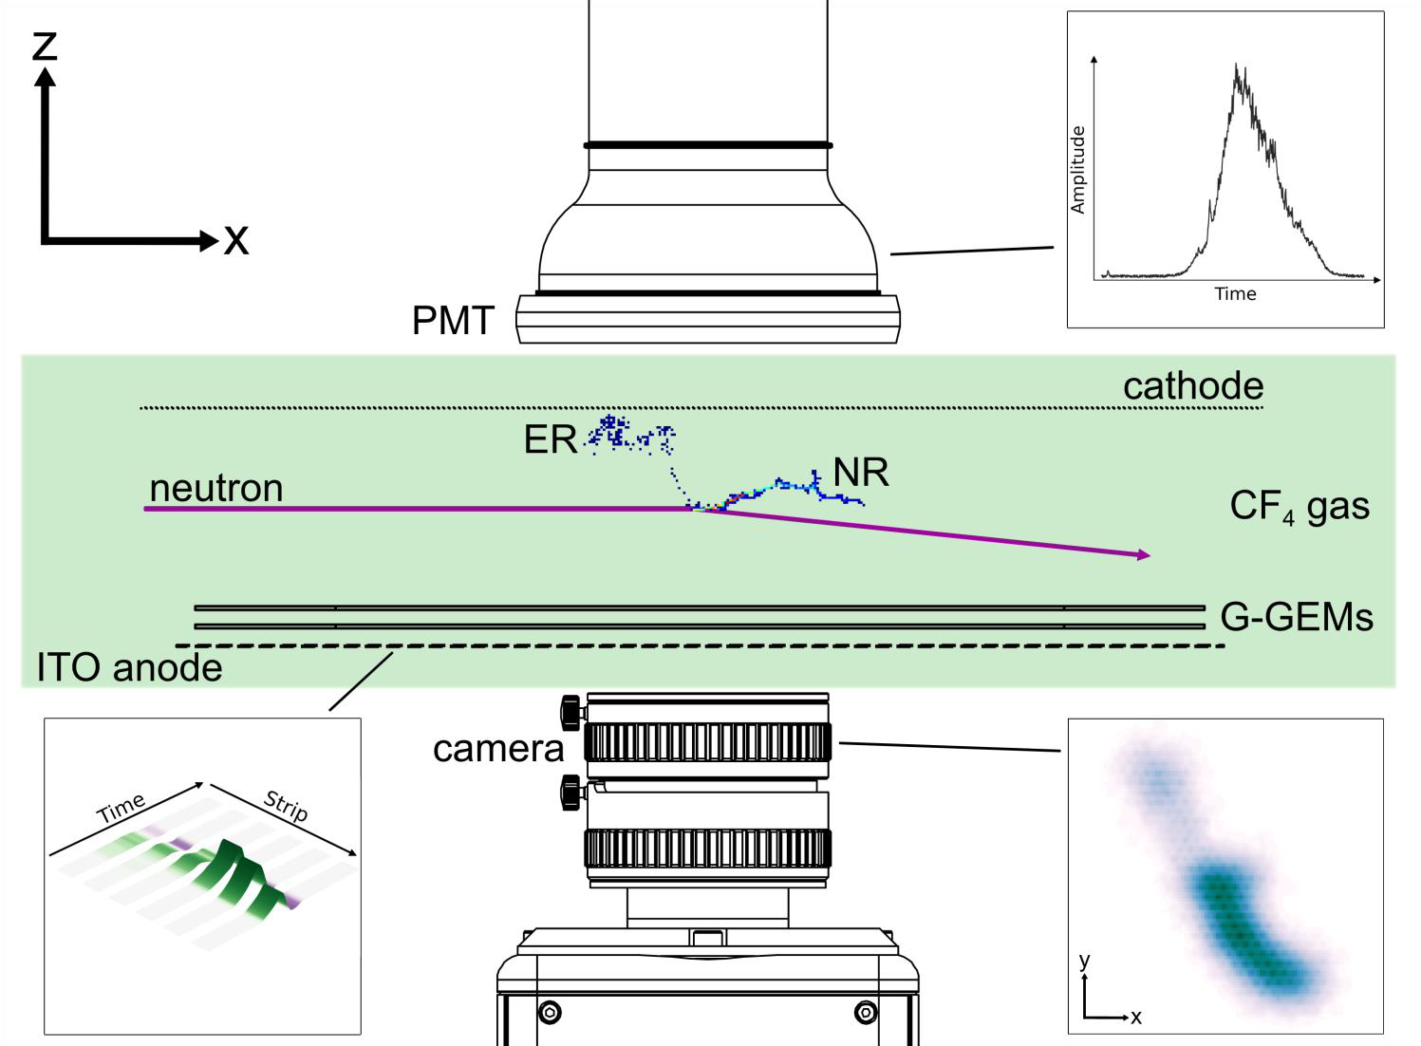
The MIGDAL experiment
Low-pressure gas: 50 Torr of CF₄
  To extend particle tracks
  Minimize gamma interactions
Readout
  Optical : Camera + photomultiplier tube
  Charge: GEMs + 120 ITO anode strips
TPC signal amplification
  2 x glass-GEMs (Cu or Ni cladded)
High-yield neutron generator
  D-D: 2.47 MeV (10⁹n/s)
  Defined beam, “clear” through TPC
Electron and nuclear recoil tracks
  Migdal: NR+ER tracks, common vertex
  Cover dynamic range of NRs and ERs
  5 keV electron threshold 5.9 keV X-rays from Fe-55 for calibration at threshold (5.2 keV photoelectron)
H.M. Araújo et al 2023 Astropart. Phys. 151 102853 https://doi.org/10.1016/j.astropartphys.2023.102853

Slide 24
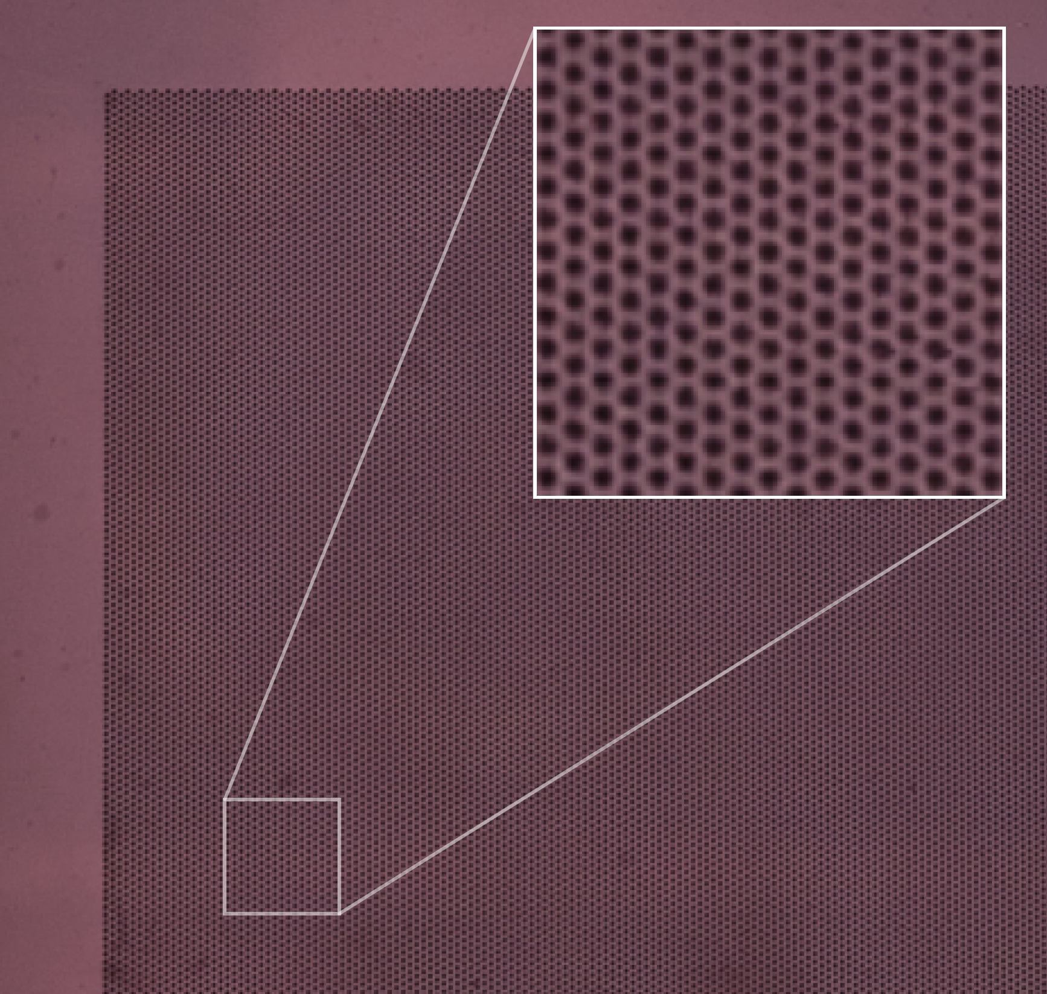
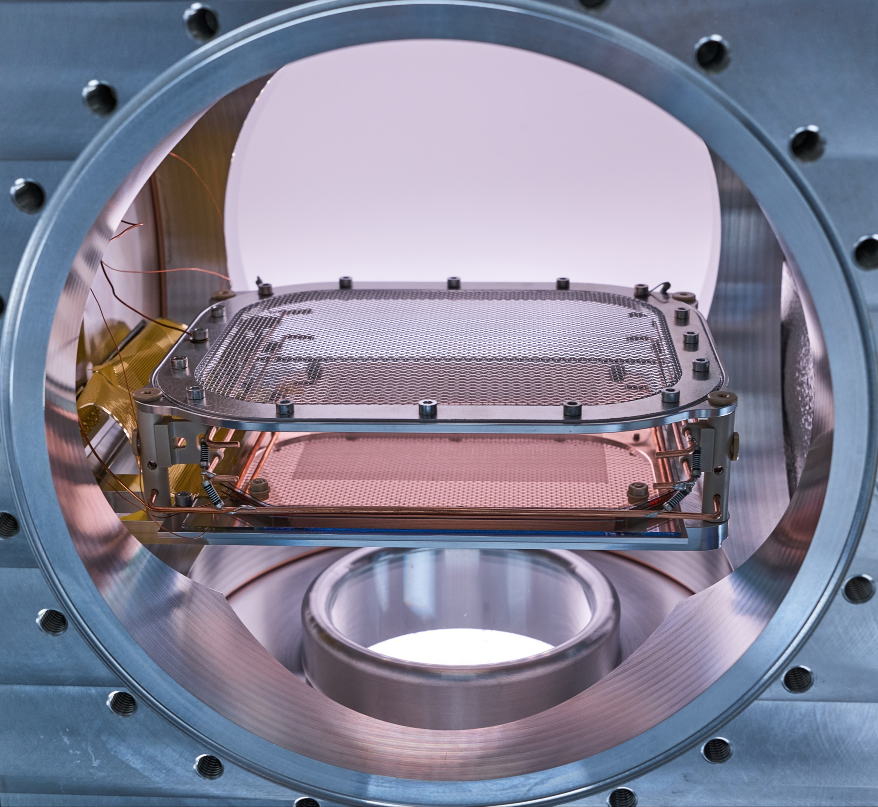
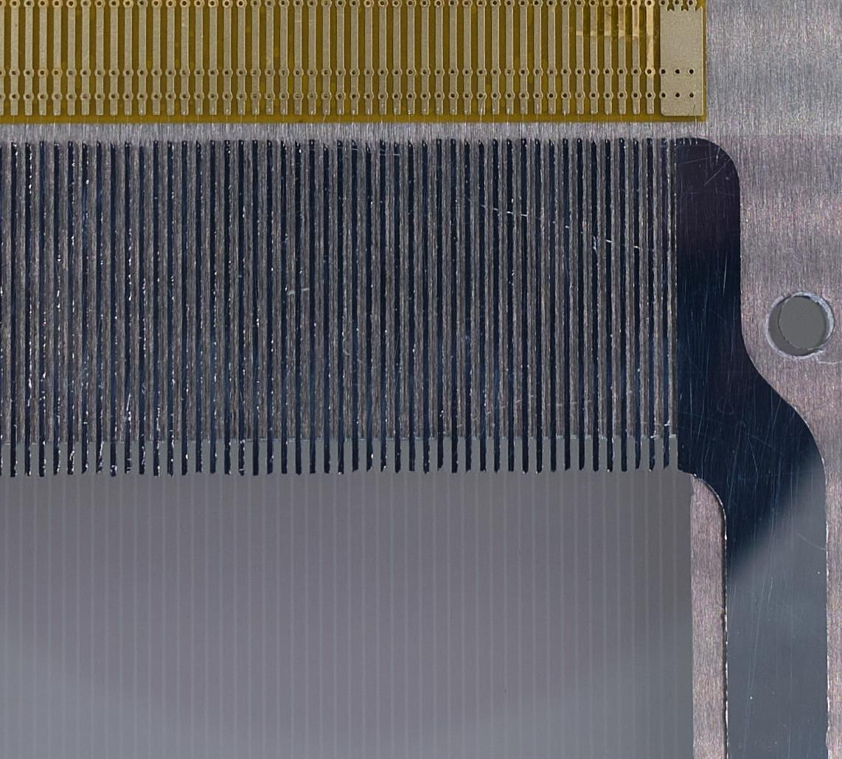
The MIGDAL optical-TPC
Two glass GEMs:
- active area: 10x10 cm²
- thickness: 550 μm
- OD /pitch: 170/280 μm
- active area: 10x10 cm²
- total gain ~10⁵
ITO strips:
- 120 strips
- width/pitch: 0.65/0.83 mm
2 field shaping Cu wires

Slide 25
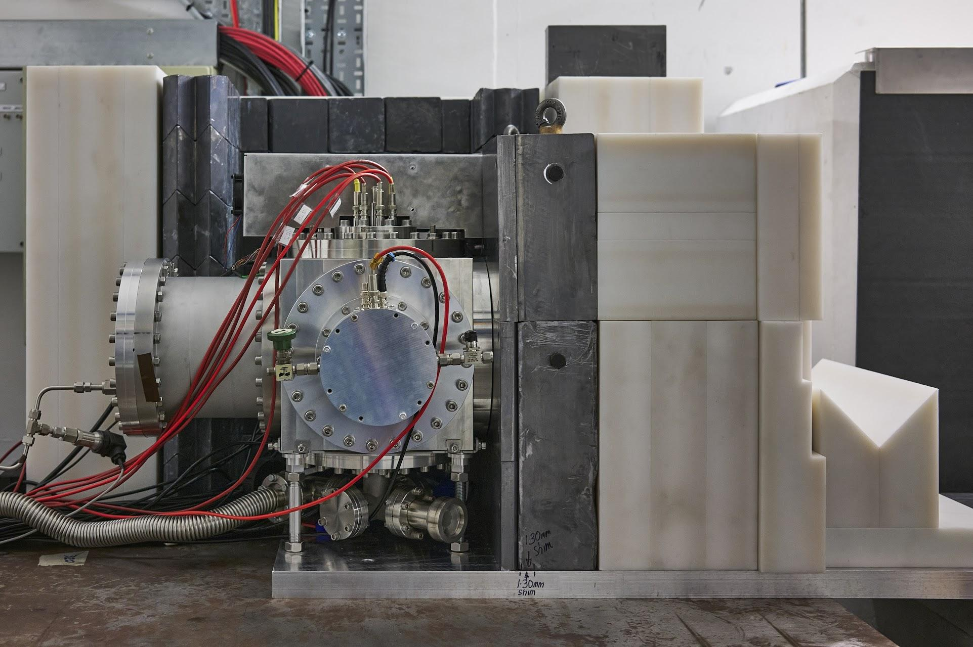
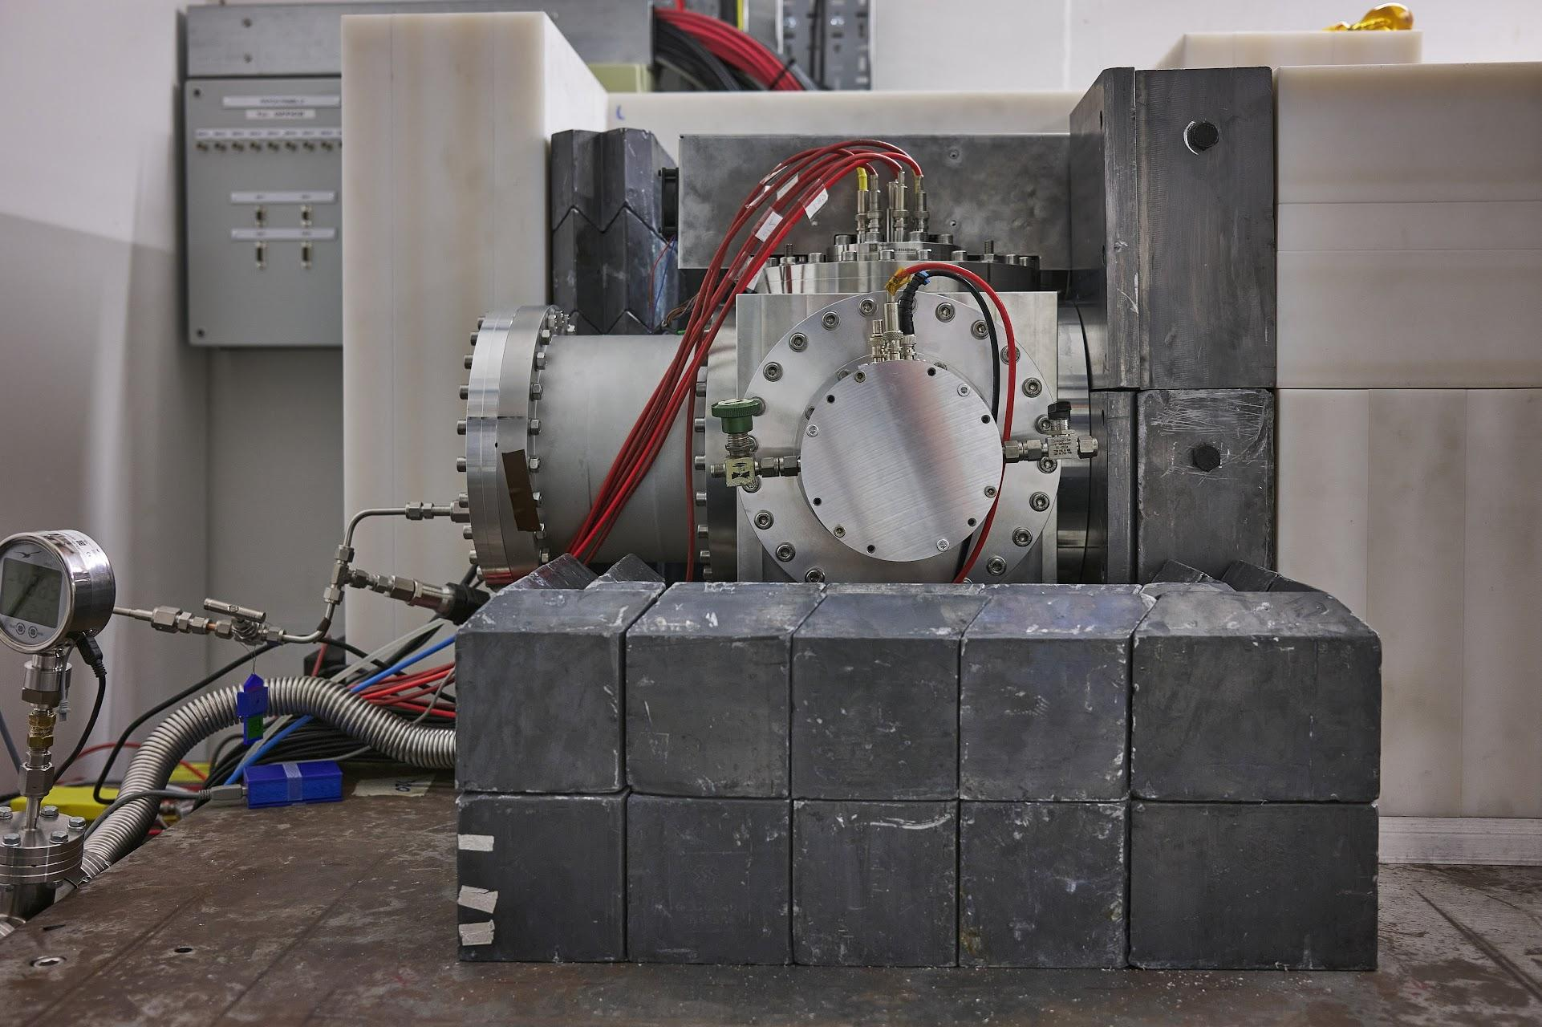
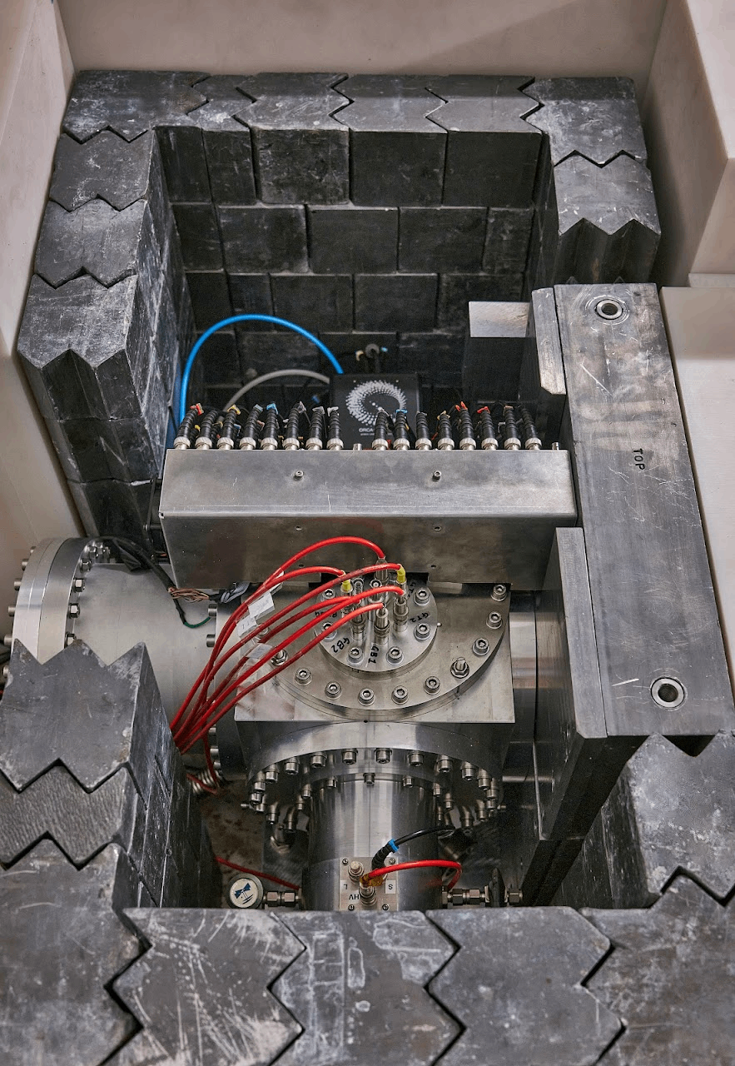
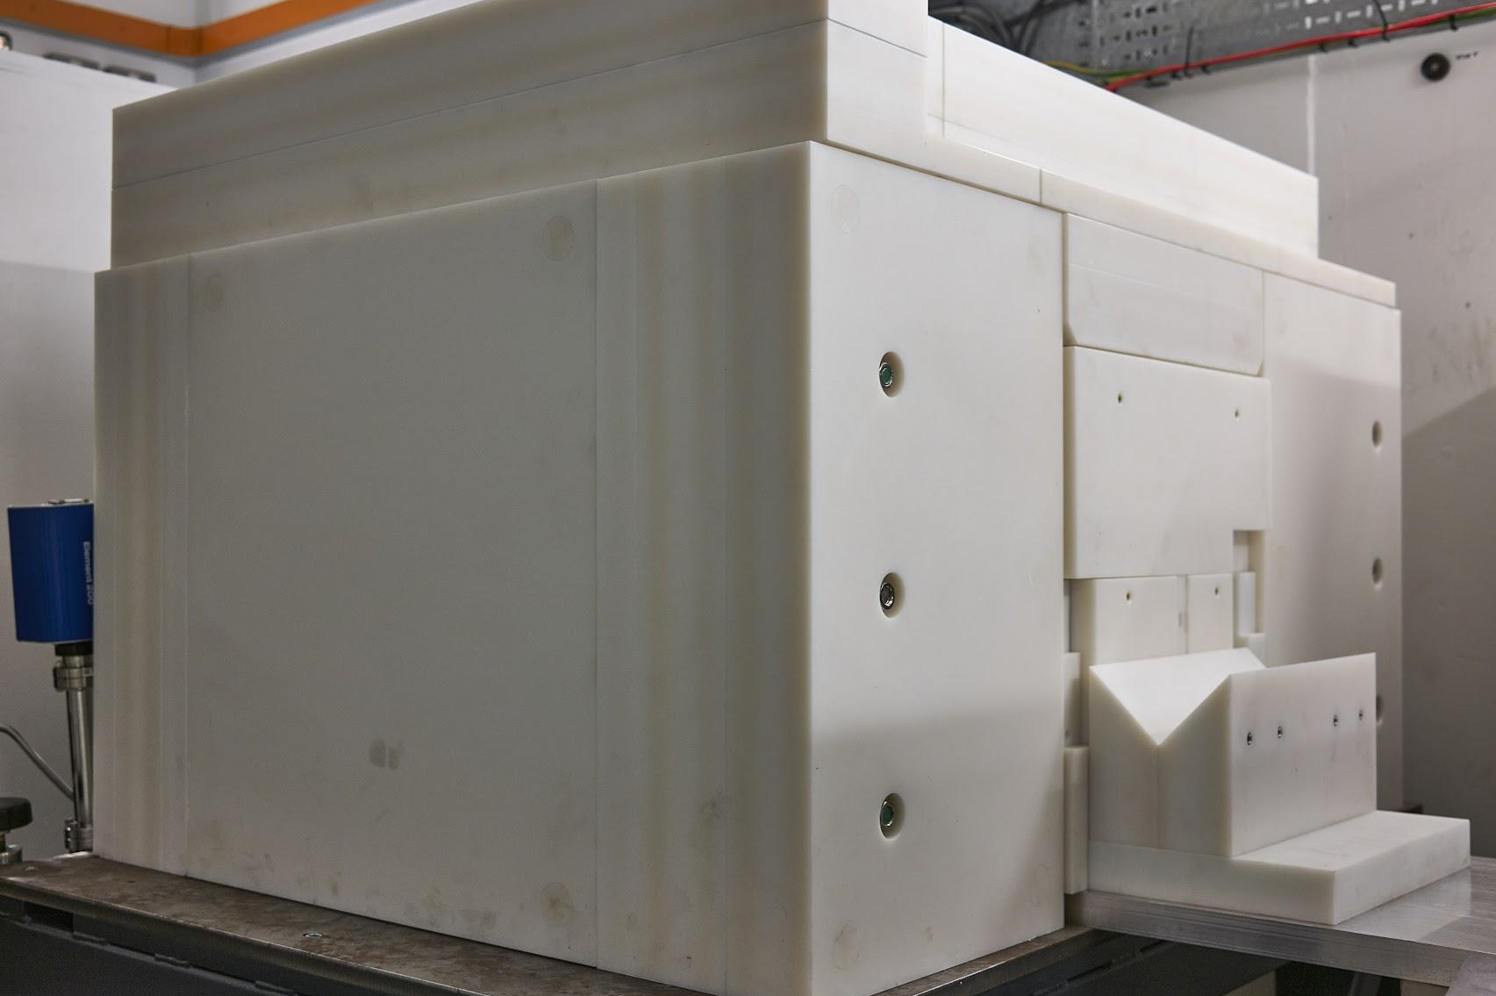
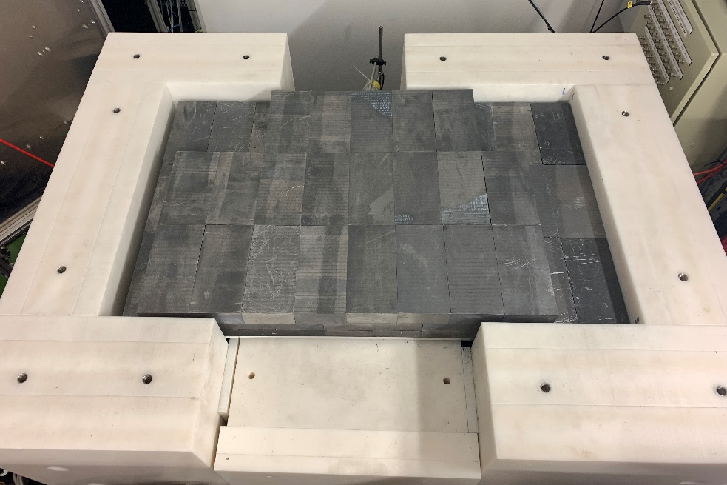
MIGDAL at the Neutron Irradiation Lab for Electronics (NILE) facility at Rutherford Appleton Lab in the UK
D Loomba (MIGDAL)

Slide 26
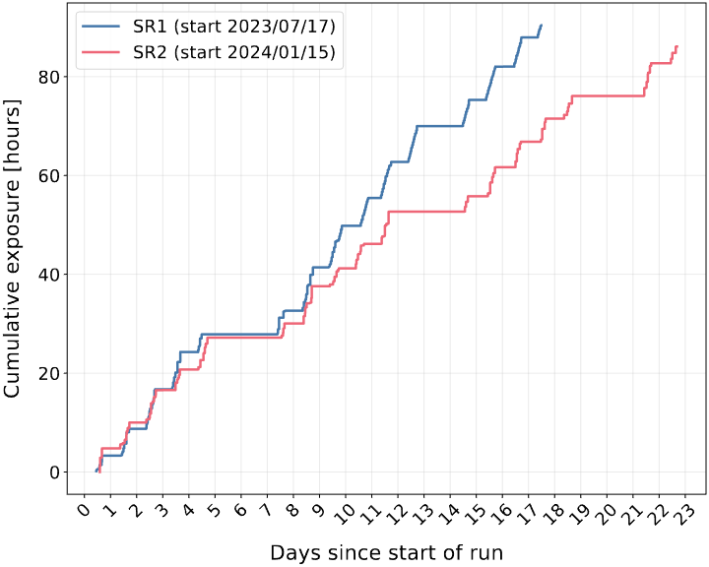
2 Science Runs – Summary
Each accumulated ~90 h of data
  Half the data is blinded
DD generator provided 10⁹ neutrons/sec at 2.5 MeV
Calibration runs with 5.9 keV ERs from ⁵⁵Fe during runs to monitor gain
Problems
  DD generator failed in both SRs ending them prematurely
  DD neutron flux was lower than expected
  Other unexpected detector effects noticed and addressed after SR2
  → DD generator repaired and is now ready for SR3

Slide 27
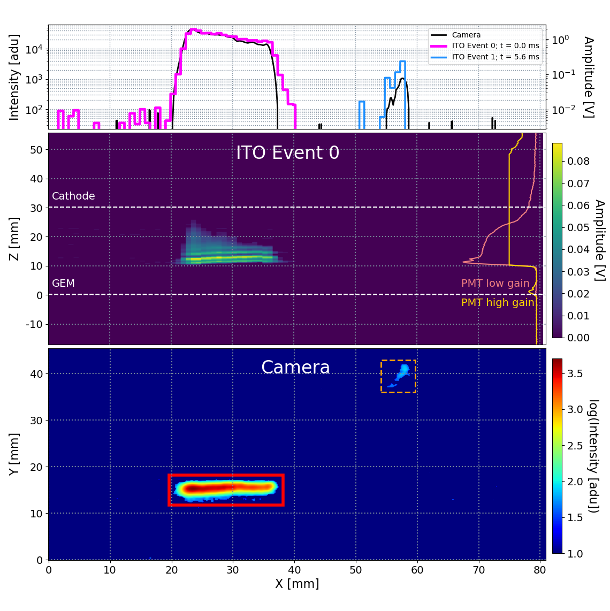
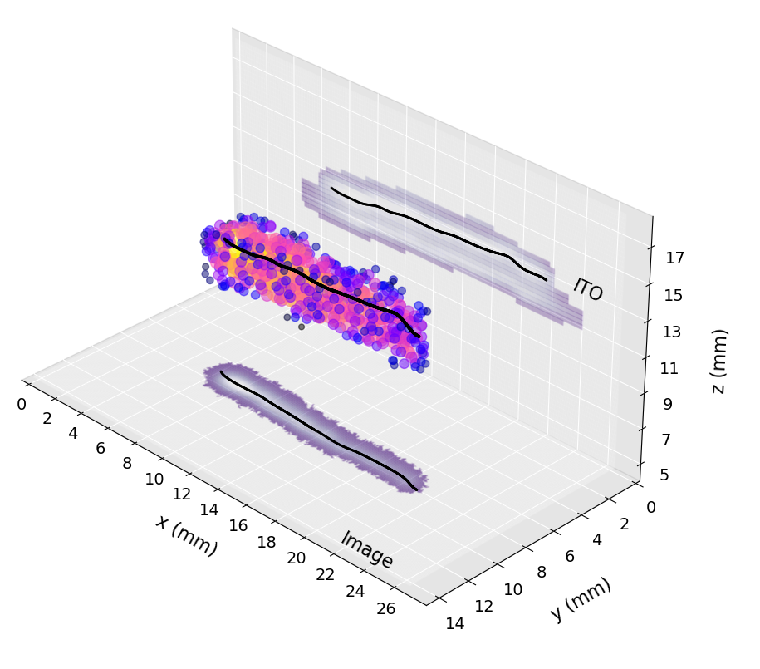

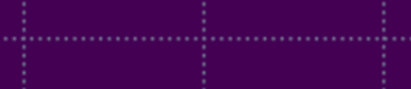
3D Reconstruction of Events
Strip Readout
Z [mm]
2ns/sample over 1μs
Z [mm]
Y [mm]
Coincident Electron
X [mm]
Y [mm]
8ms integration
X [mm]
Tilly,E., et al. (2023). 3D track reconstruction of low-energy electrons in the MIGDAL low pressure optical time projection chamber. JINST, 18, C07013

Slide 28
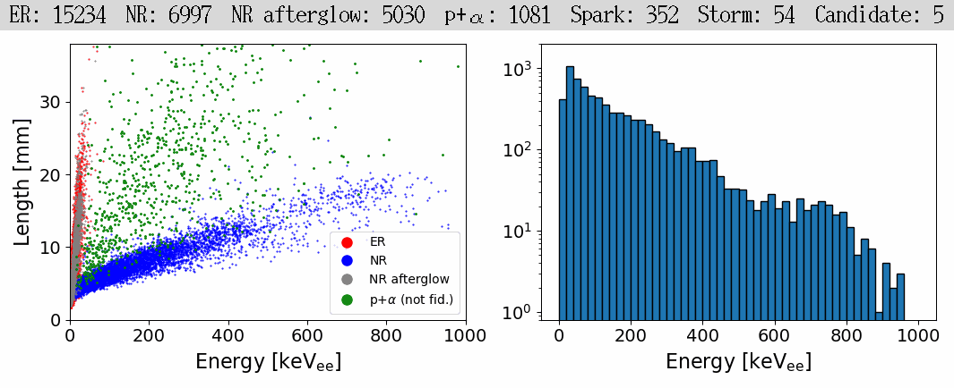
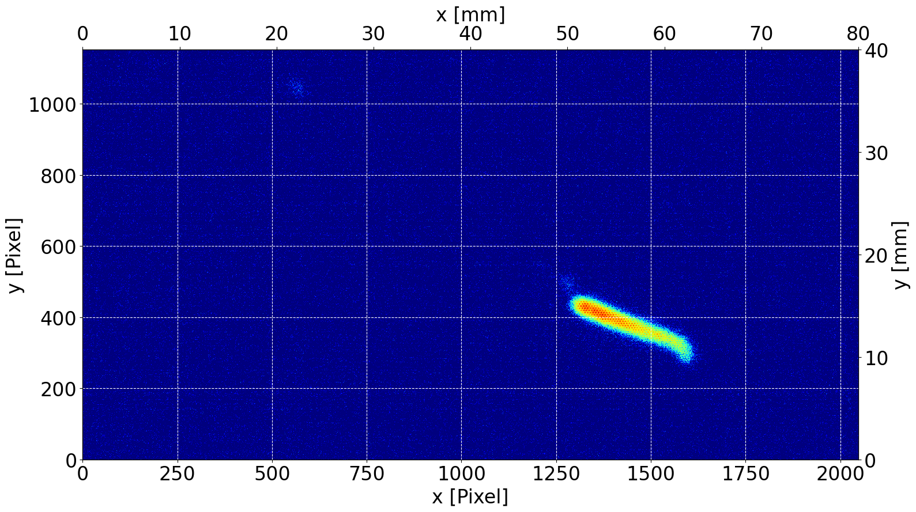
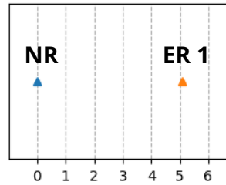
Track Finding/ID
In Real Time*!
Machine learning object detection algorithm using YOLOv8 (https://github.com/ultralytics/ultralytics) finds and categorizes events in real time
  available at https://zenodo.org/records/12628437
Trained on real data; i.e. no sim-2-real gap
Can identify tracks from a variety of species: NR, ER, Alpha/proton, etc
* This animation is sped up
Migdal-like Event Topology
NR
ER
ER
ITO timing
ER
NR
Schueler, J., et al. (2025). Transforming a rare event search into a not-so-rare event search in real-time with deep learning-based object detection. Phys. Rev. D, 111, 072004.
Coincident C recoil + ⁵⁵Fe e⁻ recoils

Slide 29
Real-time analysis of CMOS data with YOLO (You Only Look Once)
Applied to unblinded dataset consisting of ~20 million 2,048 x 1,152 images at 120 fps
(2) Find frames containing at least 1 ER/NR pair
(~25,000 frames)
(1) Initial sample of (~20 million frames)
d ~ 36mm
d ~ 3mm
(3) Filter frames based on other criteria (~600 frames)
→ No longer a rare event search! These camera-only candidates require full 3D reconstruction using the ITO+PMT to derive final Migdal candidates

Slide 30
R&D for a MIGDAL Phase II

Slide 31
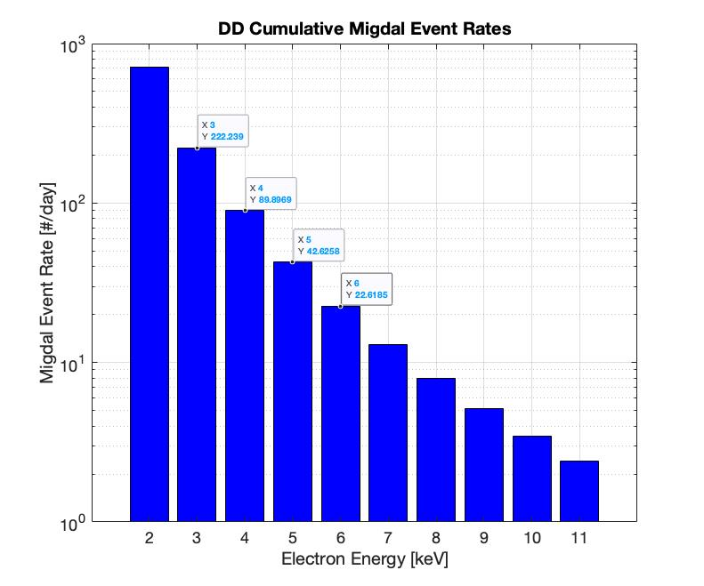
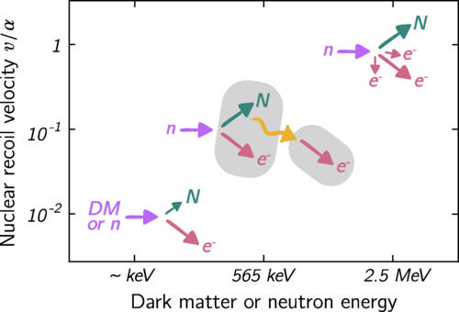
MIGDAL Phase II - Motivation
Probing lower NR/ER energies → higher rates
Will require better spatial resolution → NID
NI-OTPC results motivate
this R&D
D Loomba (MIGDAL)

Slide 34



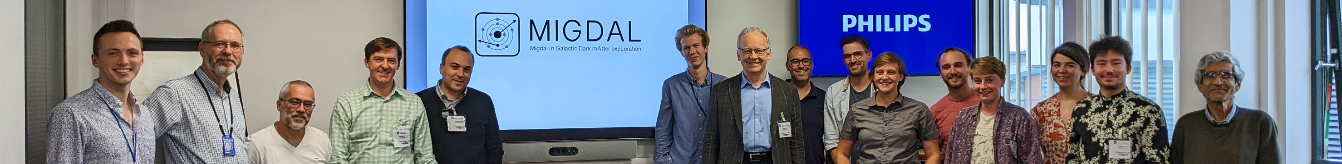

Summary
MPGD-based low pressure gas TPCs have provided large improvements in sensitivity, and opened the door to many new Techniques (NI-OTPCs) and Applications (Migdal, C𝞶NS, solar 𝞶’s,)
CYGNUS: an observatory for DM and neutrinos. A world-wide effort towards scaling-up with MPGD TPCs (arXiv:2008.12587)
MIGDAL experiment underway, with results coming soon…
CPAD GIRA Award (E.Tilly)

Slide 35
Backups

Slide 36
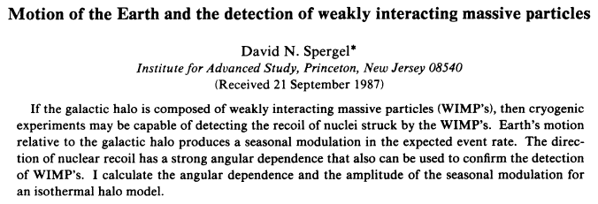

Theoretical Studies
Sidereal modulation is about an order of magnitude larger than annual modulation
Huge body of literature on directionality (non-standard halo models, real detector responses, various statistical tests, presence of backgrounds, etc, etc)
The result of this work is that of order 10’s - 100’s of events are needed to confirm a DM signal
(Lewin, Smith, Krauss, Copi, Green, Morgan, Gondolo, Billard, O’Hare, and many others)

Slide 37

Experiment installation in the NILE bunker
Lead shield
  10 cm
Borated HDPE shield
  20 cm
Collimator HDPE+ lead
  30 cm long
MIGDAL experiment fully assembled at NILE

Slide 38



Charge readout(!) NI-TPC
Advantages of a NI charge readout TPC:
Achieving high dynamic range does not require high gas gains
Gas mixtures can be optimized for target atoms w/o worrying about light yield
The detector will be built and characterized in the next year or two
D Loomba (MIGDAL)

Slide 39




















Long term CYGNUS Vision: Multi-site Galactic Recoil Observatory with directional sensitivity to WIMPs and neutrinos
https://arxiv.org/abs/2008.12587
CYGNUS-KM
Kamioka, Japan
He:SF₆(CF₄)
Strip readout
CYGNUS-UK
Boulby, UK
He:SF₆
GEM+wire
readout
CYGNUS-US
SURF, USA
He:CF₄:X
Strip readout
CYGNO/INITIUM
Gran Sasso, Italy
HeCF₄(SF₆)
sCMOS+PMT
readout
CYGNUS-ANDES
New proposal
t.b.d.
CYGNUS-Oz
Stawell, Australia
R&D leading
to 1-10 m³

Slide 40
5.9 keV ER tracks
Results:
5.9 keV ⁵⁵Fe
~100-300 keV NR tracks
At 30 Torr, these tracks are well resolved with clear directionality (arrows)

Slide 41





Gamma backgrounds have small dE/dx, large fluctuations: high signal-to-noise is important
And 3D should help

Slide 42


Directionality results from Cf-252 exposure:
Nuclear recoil energy spectrum
2D circular histogram of vector recoil directions, after cuts
Cf-252
Directionality threshold: axial, vector
For 100 GeV WIMP ~54 events needed to locate source (90% CL)

Slide 43

~18 events needed to point back to the source…
Cf-252
…after quality cuts on ~40 events randomly chosen from dataset with vector directionality

Slide 44


Latest Results from DRIFT:
gamma rejection better than ~ 2x10⁻⁷ (90% CL)
Zero bkgds in signal region!
zero backgrounds thanks to thin-film cathode and fiducialization, resulting in new limits
zero backgrounds thanks to thin-film cathode and fiducialization, resulting in new limits

