Slide 1


Final Results from the Muon g-2 Experiment at Fermilab
June 11, 2025
New
Esra Barlas-Yucel
on behalf of the Muon g-2 Collaboration

Slide 2
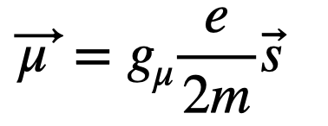
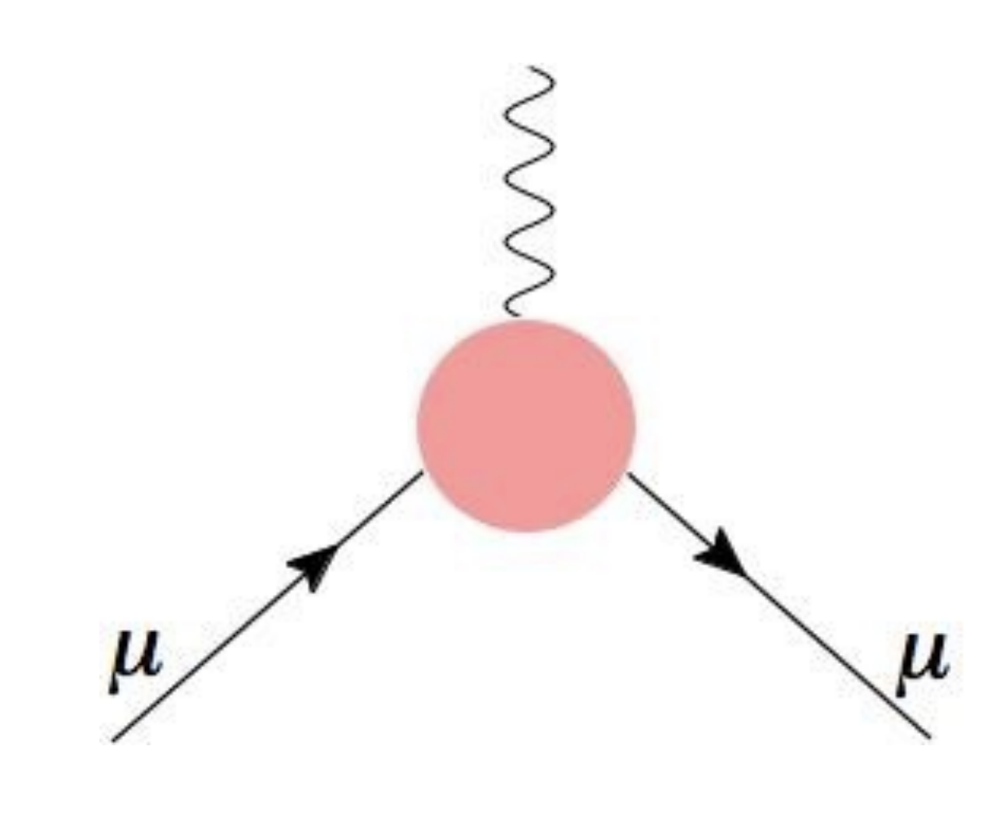
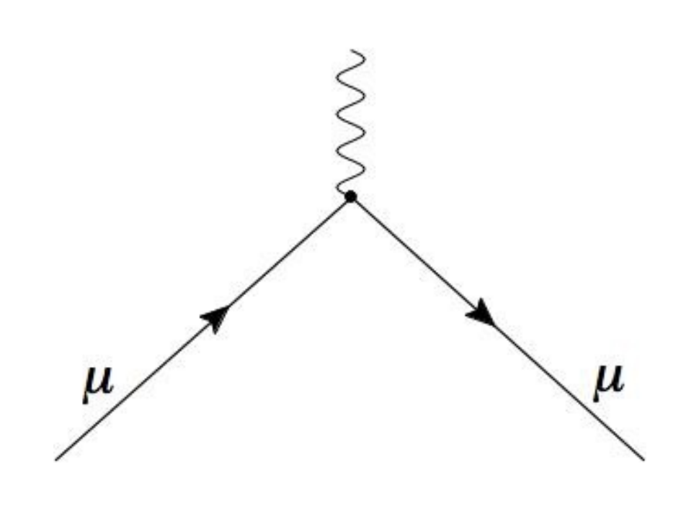
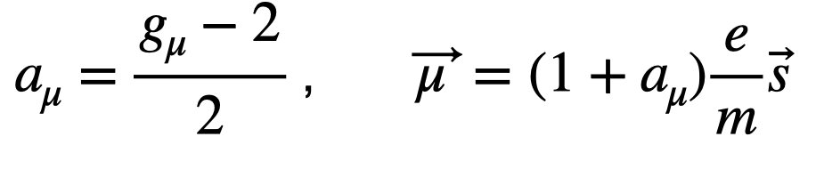
Muon Magnetic Moment and Defining the Anomaly
Magnetic Moment of Muon
A charged particle with spin generates its own magnetic moment:
g: Proportionality constant between spin and magnetic moment
Dirac: g=2
Quantum corrections: g>2
Anomalous Magnetic Moment of Muon
Measuring this anomaly could tell us if there are new particles or forces that contribute to $a_{μ}$

Slide 3
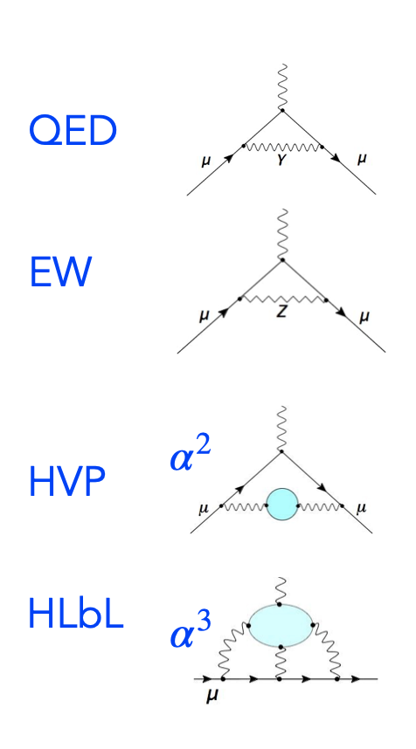
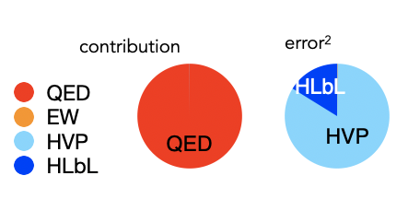
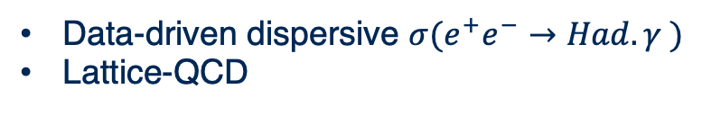
Standard Model Prediction of the Anomaly
Muon g-2 Theory Initiative was formed to determine SM value of $a_{μ}$. Produce a consensus theoretical value which is comparable to the experimental value
$$a_{μ}=a_{μ}(QED)+a_{μ}(EW)+a_{μ}(hadronic)$$
Data-driven dispersive ${σ(e}^{+}e^{−}→Had. γ )$
Lattice-QCD
Dispersive (using dispersion relations and real data constraints)
Lattice-QCD
QED and EW contributions are very well-known with small uncertainties
Hadronic contribution error dominates the uncertainty budget
Details on Theory Overview was given by Shaun Lahert on Tuesday Precession Physics Session!

Slide 4
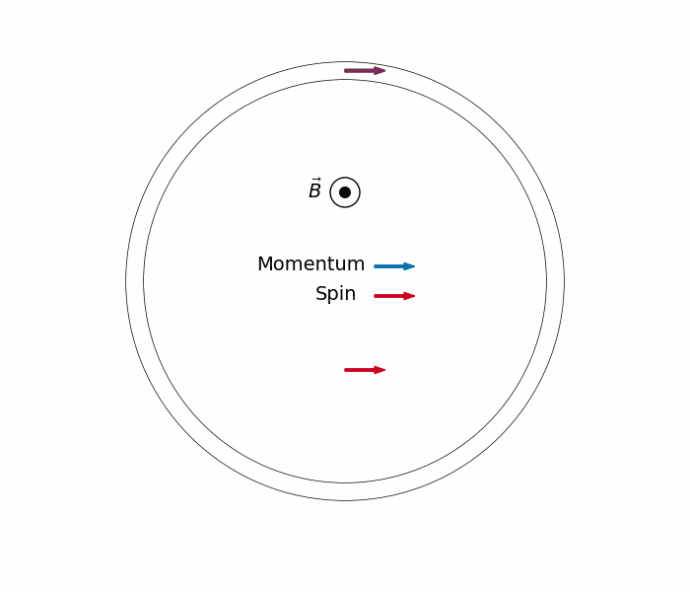
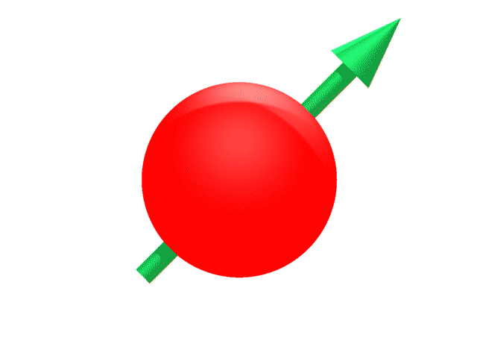


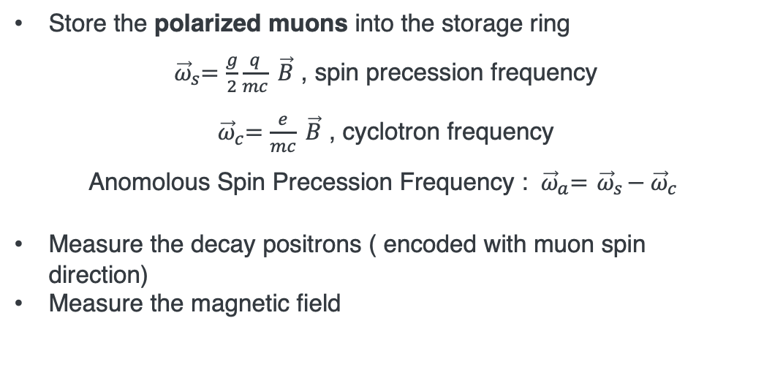
Measuring the Anomaly: Core Concepts
Store the polarized muons into the storage ring
${ \vec{ω}}_{s}=\frac{g}{2}\frac{q}{mc} \vec{B}$ , spin precession frequency
${ \vec{ω}}_{c}=\frac{e}{mc} \vec{B}$ , cyclotron frequency
Anomolous Spin Precession Frequency : ${ \vec{ω}}_{a}={ \vec{ω}}_{s}−{ \vec{ω}}_{c}$
Measure the decay positrons ( encoded with muon spin direction)
Measure the magnetic field
$$g>2$$
B
$${ \vec{ω}}_{a}=a_{μ}\frac{e}{mc}\vec{B}$$
Obtain the anomaly

Slide 5
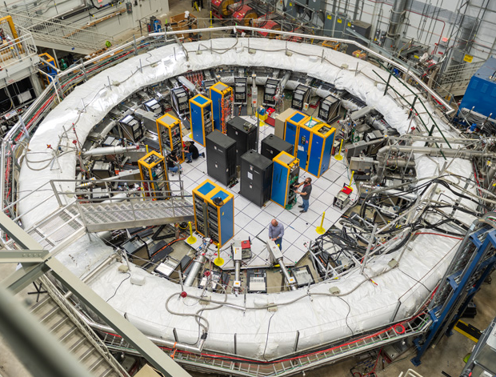
Muon g-2 Experiment at Fermilab

Slide 6
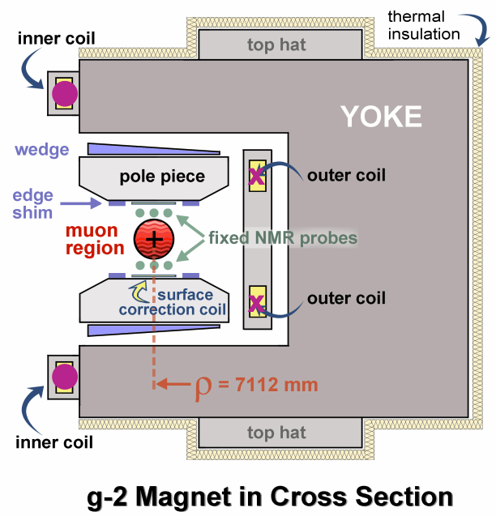


Storing the Muons: Magnet
$$μ$$
Superconducting C shaped magnet
Provides 1.45T B field (vertical and uniform)
Creates a weak horizontal focusing of the beam
B
Field uniformity is crucial

Slide 7
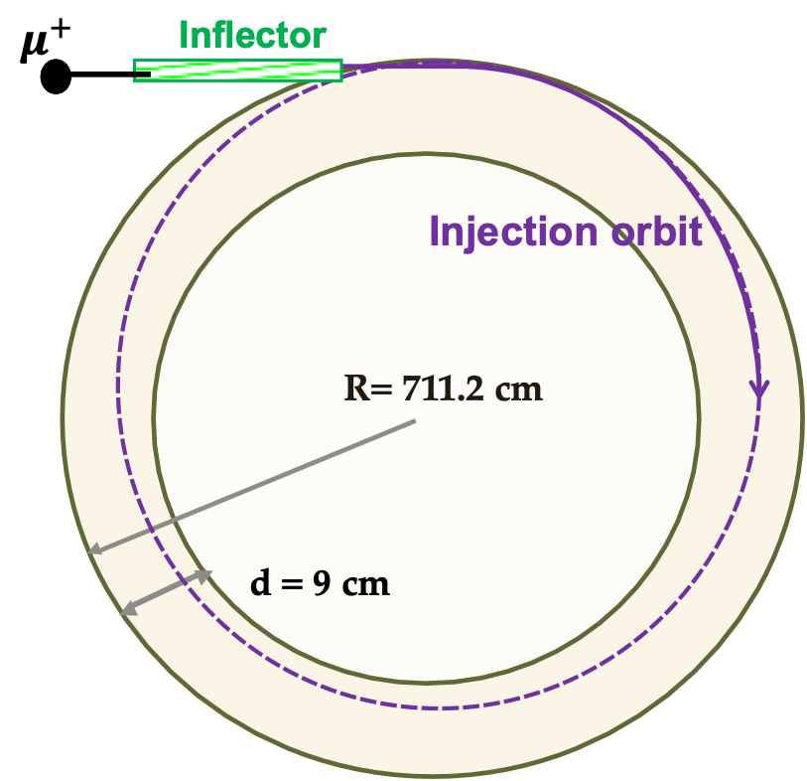
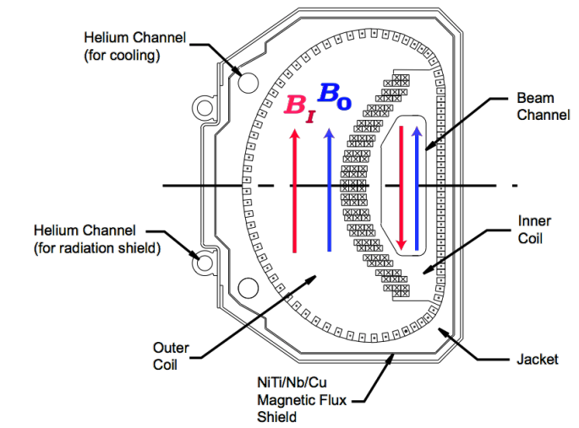
Storing the Muons: Inflector
  Super conducting magnet
  Cancels B field(1.45T) in the magnet gap and let the beam enter the storage ring without being deflected
  They are at r=77mm outside central closed orbit

Slide 8
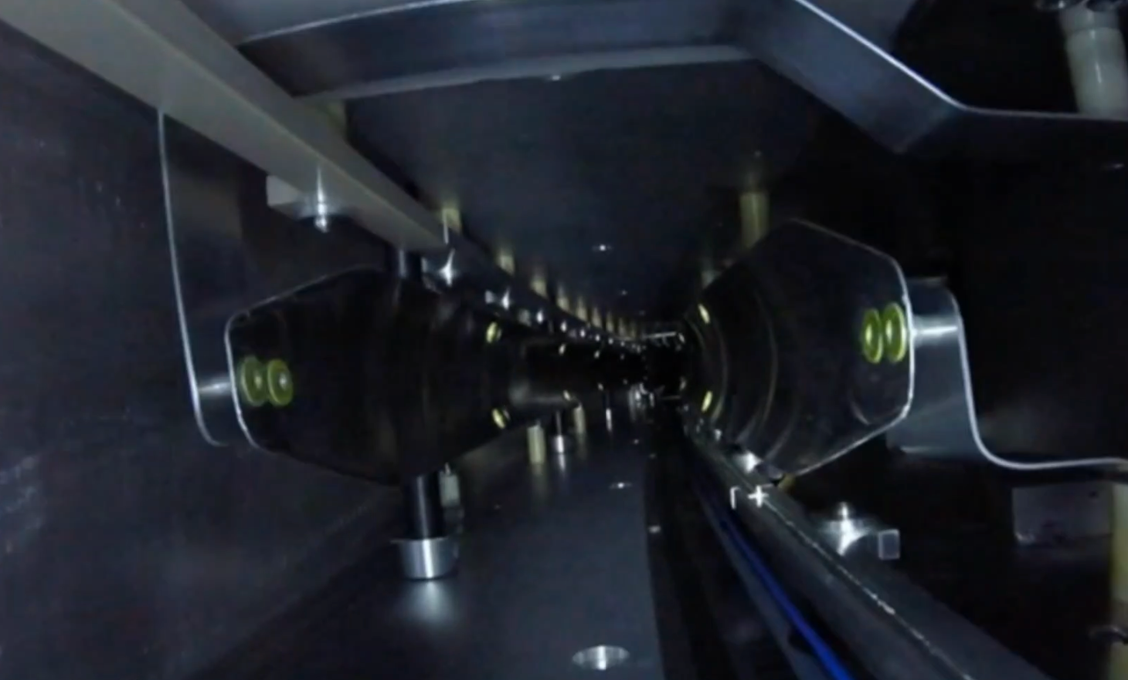
Storing the Muons: Kickers
Magnetic Kickers
Kick the muons into ideal orbit to center them (~200 G field)
Use 10.8 mrad pulsed kicks (<149 ns)

Slide 9
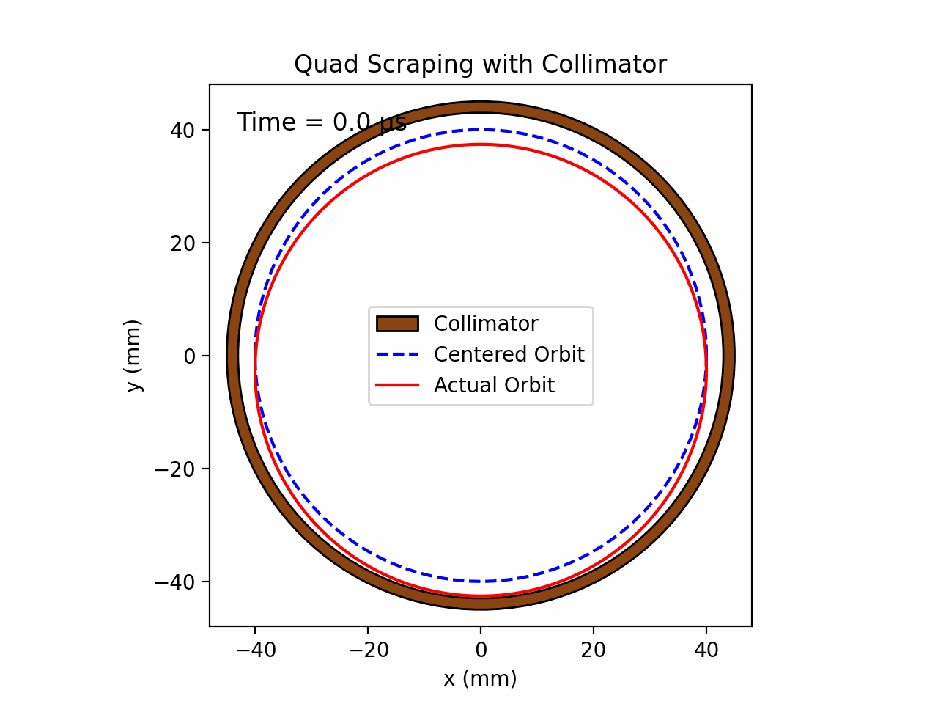
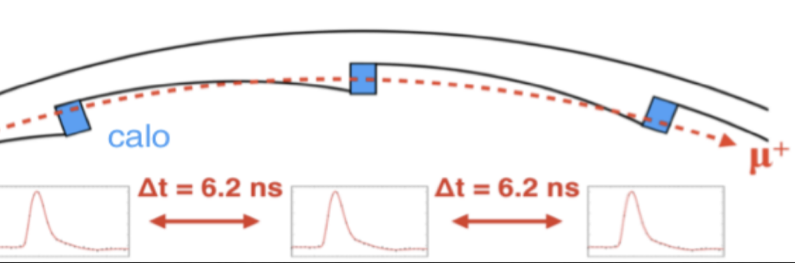
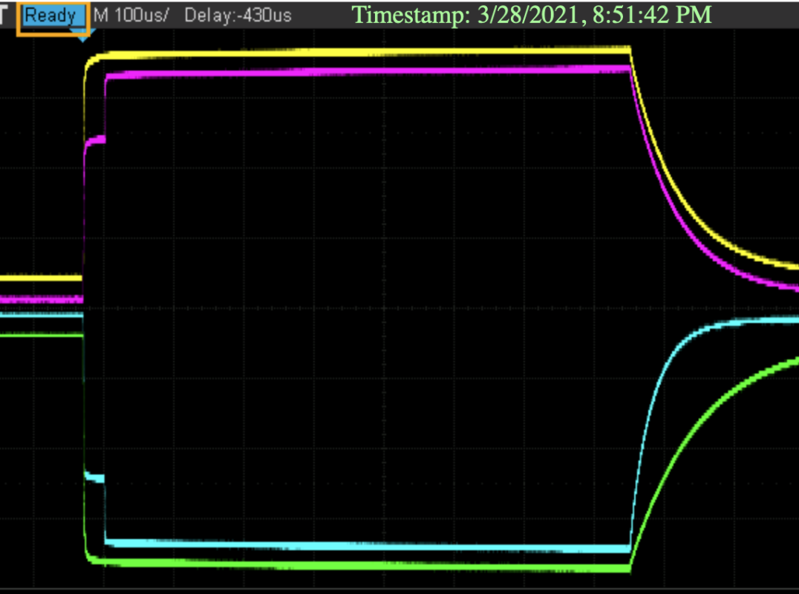
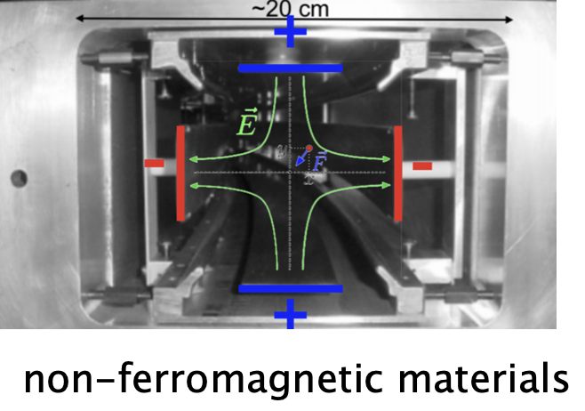
Storing the Muons: Electrostatic Quadrupoles
4 sets of Electrostatic quadrupoles which cover 43% of the ring
Provides vertical beam focusing (minimizes beam “breathing” and improves the muon orbit stability)
Scrap the beam to reduce muon loss rate (edge muons)
  Asymmetrical pulsing at 13.1-18.2 kV ( for only 7 us)
Lost Muons
Notes:
Minimized the electric field contribution running at magic momentum p = 3.094 GeV/c
Describe muon loss rate here a bit more

Slide 10
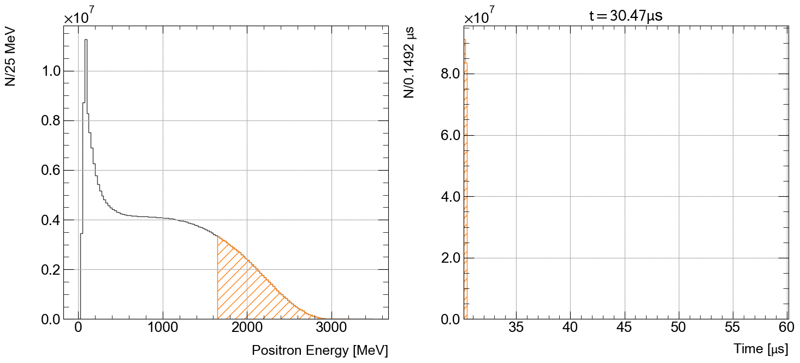
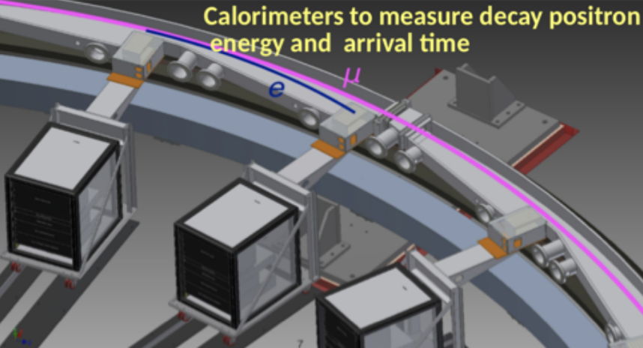
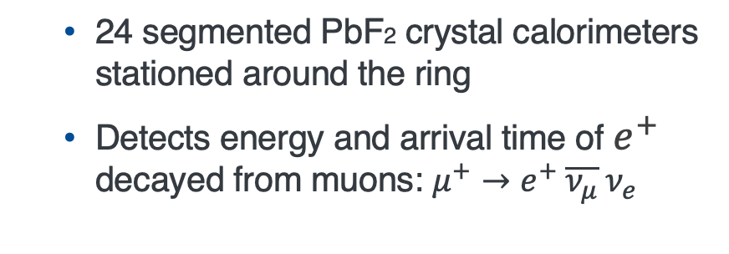
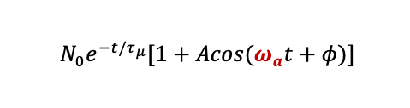
Measuring the Muon Decays: Calorimeters
  24 segmented PbF2 crystal calorimeters stationed around the ring
  Detects energy and arrival time of $e^{+}$ decayed from muons: $μ^{+}→e^{+} \overline{ν_{μ}} ν_{e}$
$N_{0}e^{−t/τ_{μ}}[1+Acos(ω_{a}t+φ)]$
Due to parity violation, counts of high energy e⁺ oscillates, as spin points towards & away from calorimeters

Slide 11
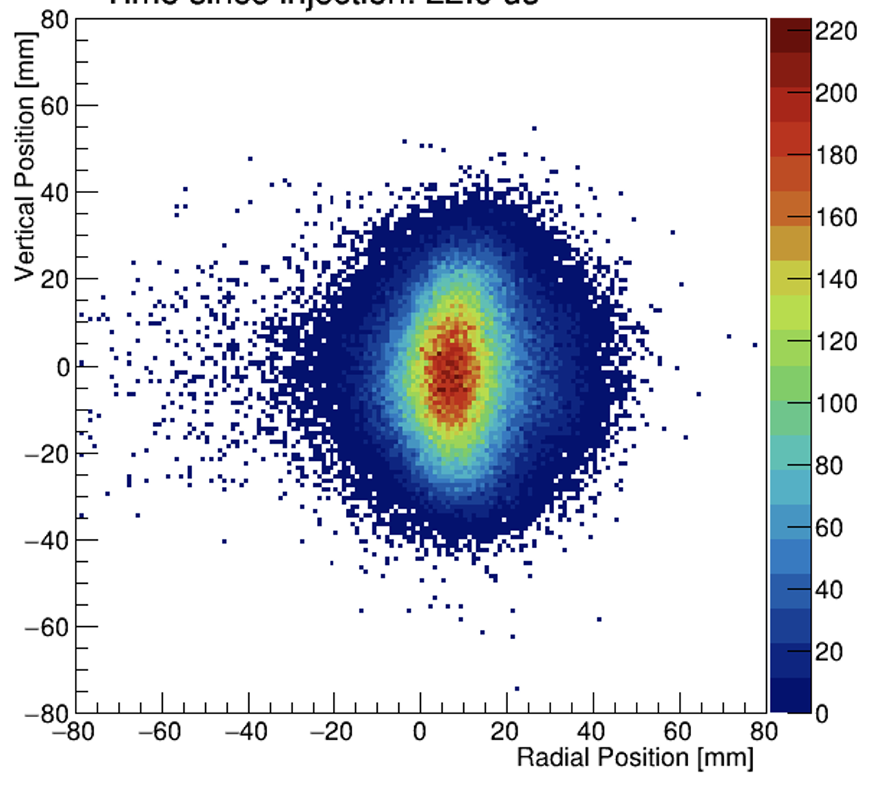
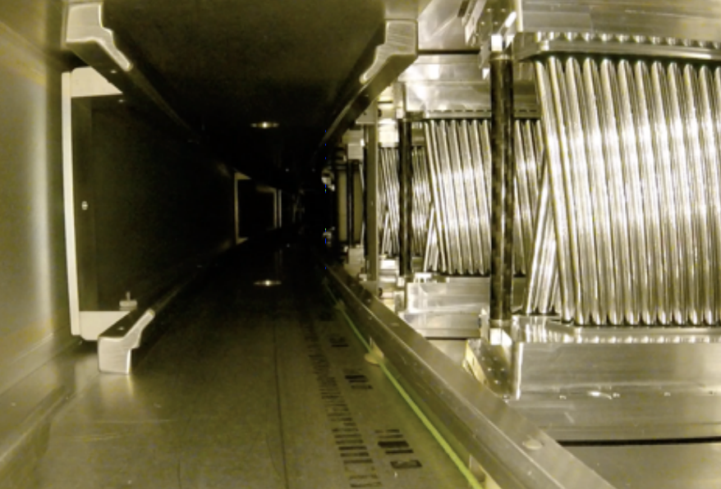
Reconstructing the Muon Profile: Trackers
2 straw-tracker stations
8 modules per station each with 128 straws
Reconstruct muon beam profile from positron trajectories to:
  Calculate BD corrections
  Weight the magnetic field by muon distribution

Slide 12
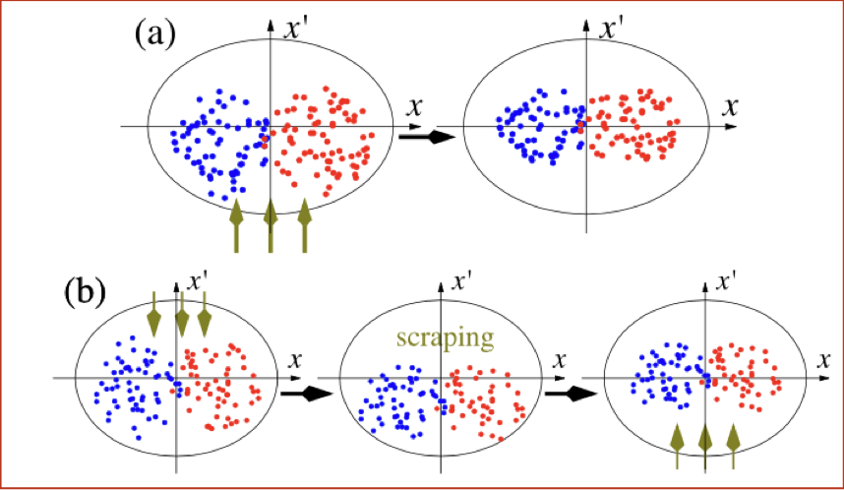
Storing the Muons: RF-matching System
New
RF voltage was superimposed to the quad voltage (Run5/6)
Damp beam dynamics oscillations and scrap the beam
RF Voltage
Move the centroid of the beam
Scrap the beam

Slide 13
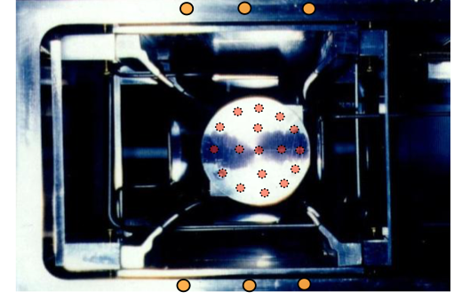
Measuring the Magnetic Field: NMR Probes
Fixed NMR Probes
  Nuclear Magnetic Resonance (NMR) Probes
  378+ probes located on vacuum chamber
  Measure the magnetic field while muons are inside the storage ring
Mobile NMR Probes
  17 probes on a motorized cart (Trolley)
  Circles around the ring on periodically (3-7 days)
  Measures the magnetic field in the storage region
  Used to calibrate FP measurements

Slide 14
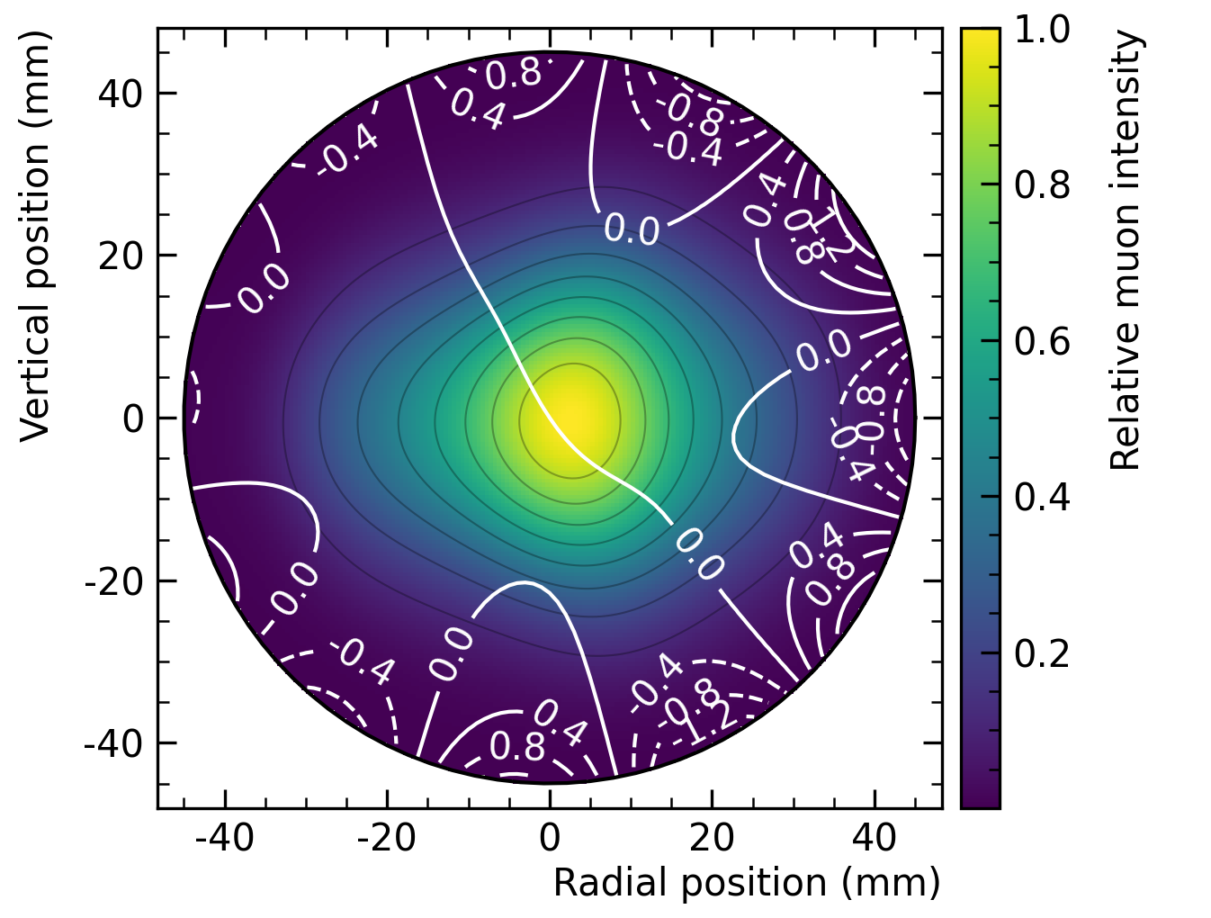
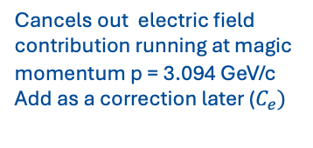
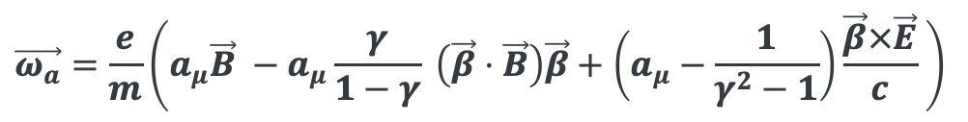



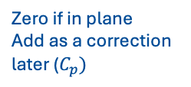
Measuring the Muon Anomaly
Bargmann-Michel-Telegdi Equation
$$\vec{ω_{a}}=\frac{e}{m}\left(a_{μ}\vec{B} −a_{μ}\frac{γ}{1−γ} \left(\vec{β}⋅\vec{B}\right)\vec{β}+\left(a_{μ}−\frac{1}{γ^{2}−1}\right)\frac{\vec{β}×\vec{E}}{c} \right)$$
Zero if in plane
Add as a correction later ($C_{p})$
Cancels out electric field contribution running at magic momentum p = 3.094 GeV/c
Add as a correction later ($C_{e})$
$$ω_{a}=a_{μ}\frac{e}{mc} B$$
Magnetic field in terms of precession frequency of protons
$${\tilde{ω}}_{p}^{′}=γ_{p}^{′}B$$
Precession frequency is from positron time distribution
$$a_{μ}= \frac{ω_{a}}{{\tilde{ω}}_{p}^{′}} \frac{μ_{p}^{′}}{μ_{B}} \frac{m_{μ}}{m_{e}}$$
CODATA(known up to 22 ppb)
Average magnetic field weighted by muon distribution

Slide 15
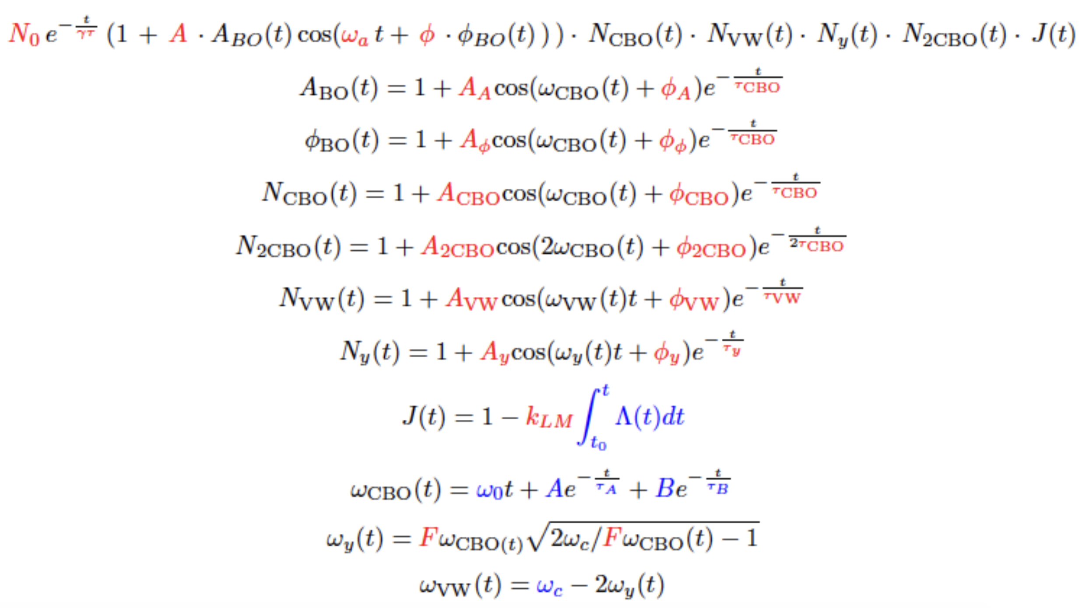
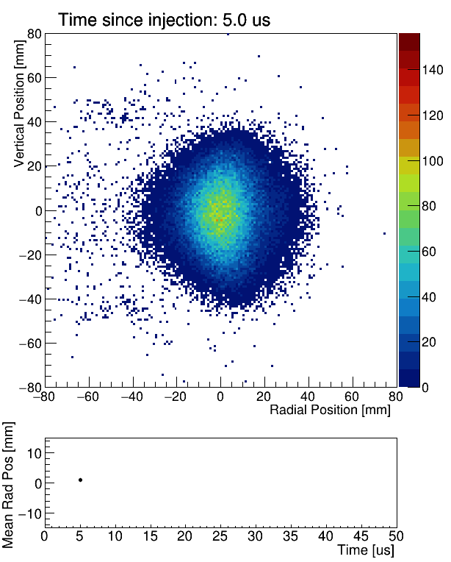


Spin Precession Frequency
$$a_{μ}= \frac{ω_{a}}{{\tilde{ω}}_{p}^{′}} \frac{μ_{p}^{′}}{μ_{B}} \frac{m_{μ}}{m_{e}}$$
Simplest form with only decay and g-2 oscillation
$N\left(t\right)=N_{0} e^{−t/τ} \left[1+A\cos{(ω_{a}t −φ_{0})}\right]$
Full Form with beam & detector effects
  Mismatch between the phase space of the incoming beam and the storage ring acceptance leads to coherent betatron oscillation(CBO)
  Time dependent modulation
Details on precession frequency analysis by Scott Israel
TODAY at 2:00 PM !

Slide 16
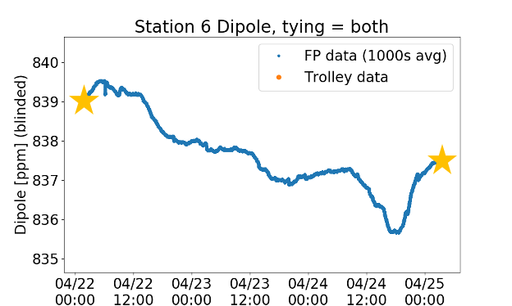
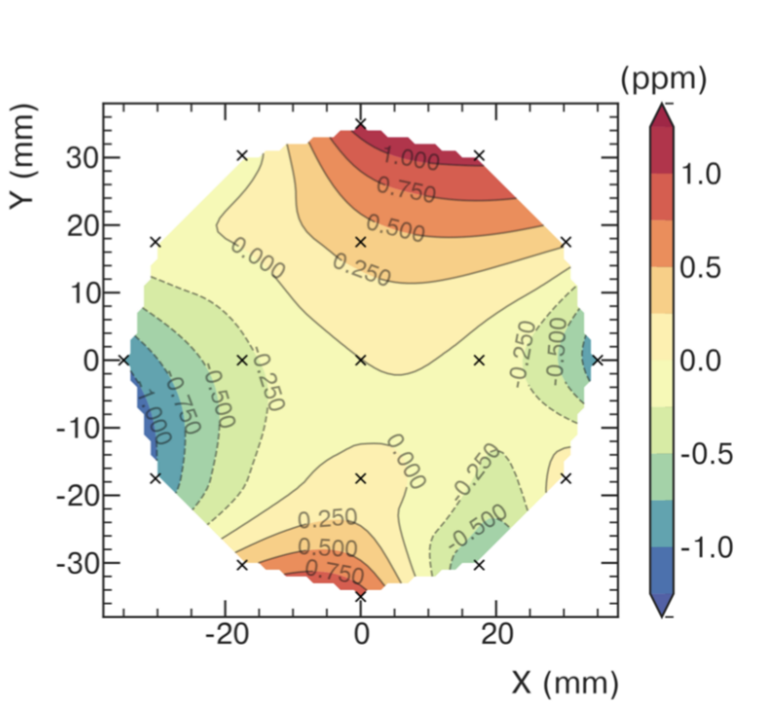
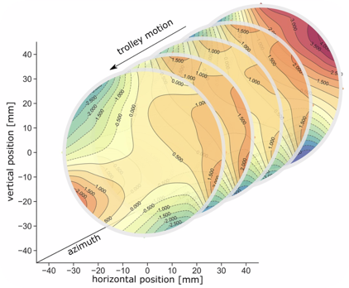

Magnetic Field Seen by Muons
$$a_{μ}= \frac{ω_{a}}{{\tilde{ω}}_{p}^{′}} \frac{μ_{p}^{′}}{μ_{B}} \frac{m_{μ}}{m_{e}}$$
azimuthally averaged field
To determine magnetic field seen by muons at all times:
Use fixed probes to interpolate the field between trolley runs
Measure muon distribution with trackers and propagate around the ring using simulation frameworks
Obtain muon weighted magnetic field
Details on field measurement by David Kessler
TODAY at 2:30 PM !

Slide 17
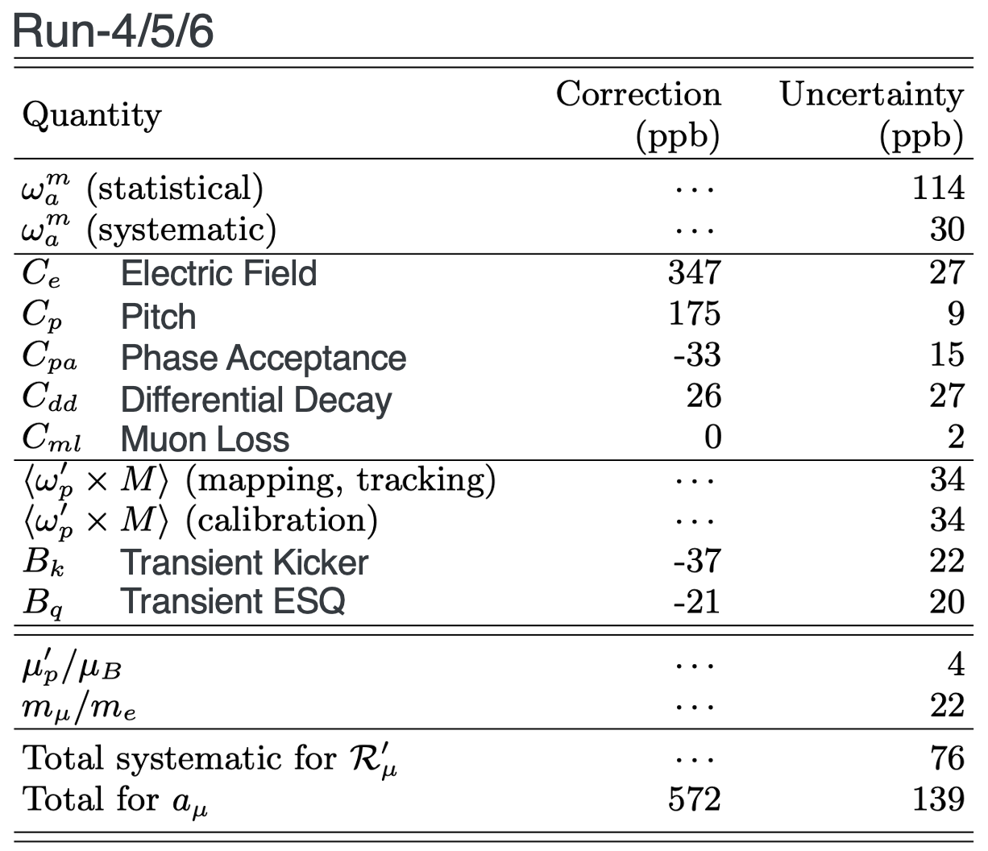
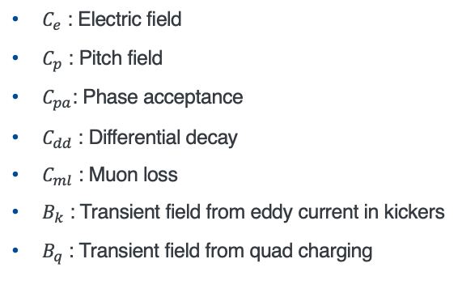
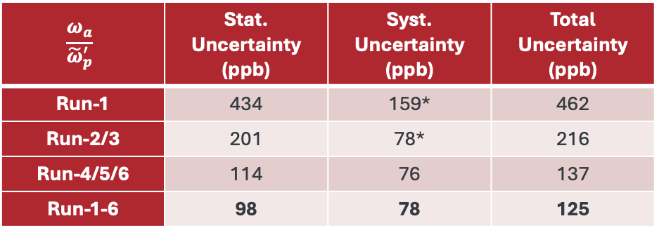
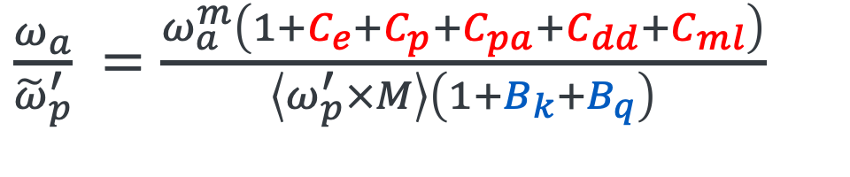
Corrections and Systematics
Momentum changes
Beam Dynamics Corrections
$C_{e}$ : Electric field
$C_{p}$ : Pitch field
$C_{pa}$: Phase acceptance
$C_{dd}$ : Differential decay
$C_{ml}$ : Muon loss
$B_{k}$ : Transient field from eddy current in kickers
$B_{q}$ : Transient field from quad charging
$\frac{ω_{a}}{{\tilde{ω}}_{p}^{′}} =\frac{ω_{a}^{m}\left(1+C_{e}+C_{p}+C_{pa}+C_{dd}+C_{ml}\right)}{\left\langle ω_{p}^{′}×M\right\rangle \left(1+B_{k}+B_{q}\right)}$
Phase changes
Transient Magnetic Field Corrections
Largest corrections: Electric field and pitch effects
Uncertainties: Contribute roughly equally to total error
Surpassed our TDR precision goal (sys. + stat.)
$$\frac{ω_{a}}{{\tilde{ω}}_{p}^{′}}$$ | Stat. Uncertainty (ppb) | Syst. Uncertainty (ppb) | Total Uncertainty (ppb)
Run-1 | 434 | 159* | 462
Run-2/3 | 201 | 78* | 216
Run-4/5/6 | 114 | 76 | 137
Run-1-6 | 98 | 78 | 125

Slide 18
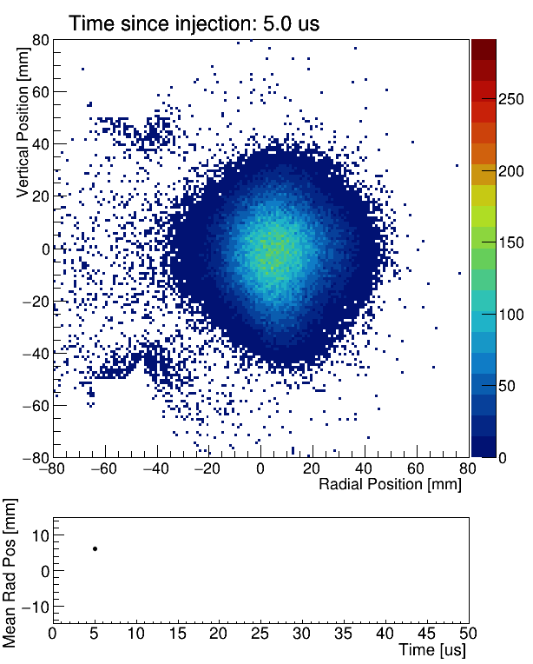

RF Effect on Beam Oscillation
An Example to Run-4/5/6 Improvements
10x reduction in horizontal CBO amplitude
5x reduction in vertical CBO amplitude
4x reduction in muon loss rate
Better centered muon distribution
NoRF
HRF
$$\frac{p−p(\text{magic})}{p(\text{magic})}$$

Slide 19

New Muon g–2 Result
With Run-2/3 result, uncertainty was halved
New result from Run-4/5/6 data reduced uncertainty by another 1.8 times
Combined Fermilab average is the most precise measurement of $a_{μ}$
$a_{μ}(\text{Run}\text{−1}\text{to}\text{6})=0.001165920705(148)$
$a_{μ}\left(\text{exp}\right)=0.001165920715(145)$

Slide 20
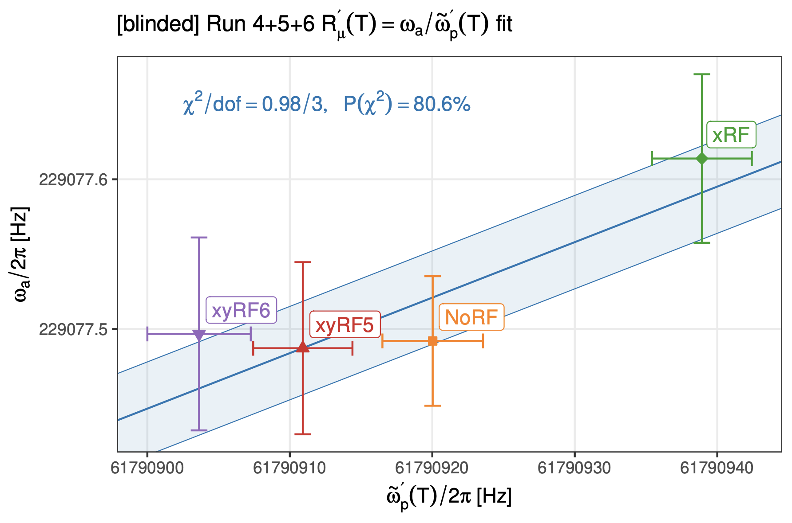
Consistency Checks

Slide 21
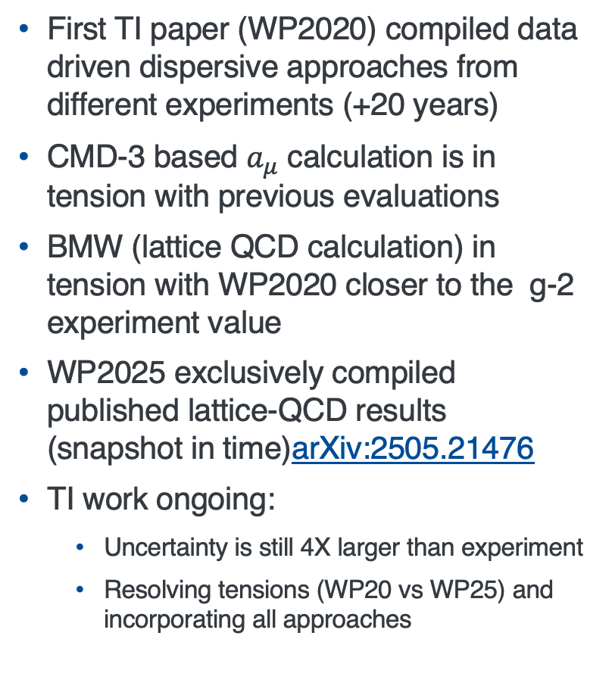
Theory Prediction of the Anomaly
First TI paper (WP2020) compiled data driven dispersive approaches from different experiments (+20 years)
CMD-3 based $a_{μ}$ calculation is in tension with previous evaluations
BMW (lattice QCD calculation) in tension with WP2020 closer to the g-2 experiment value
WP2025 exclusively compiled published lattice-QCD results (snapshot in time)arXiv:2505.21476
TI work ongoing:
  Uncertainty is still 4X larger than experiment
  Resolving tensions (WP20 vs WP25) and incorporating all approaches
The ranges shown (in light green) in the LO-HVP e⁺e⁻ section represent the spread of values across different measurements or calculations and should not be interpreted as statistical uncertainties in the conventional sense. Theory section adapted from WP 2025.
Details on discrepancy between HVP contributions was given by Kim Maltman on Tuesday Precession session

Slide 22
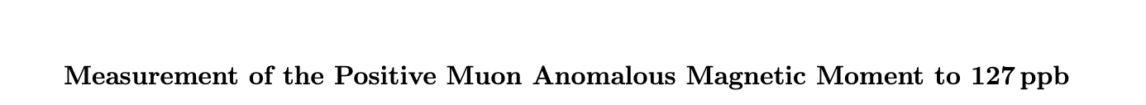
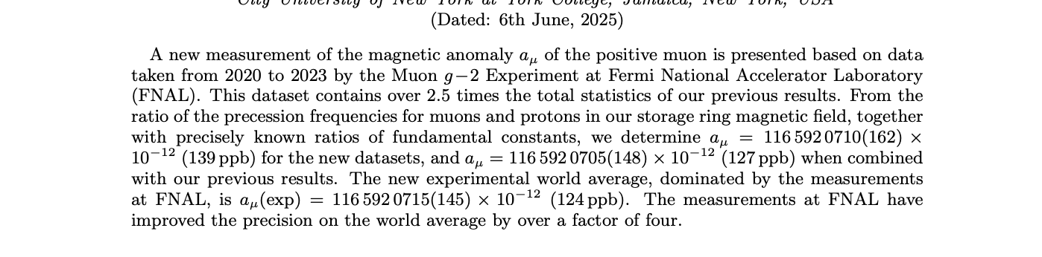

Outlook
Fermilab has announced final result for $a_{μ}$ with record precision
More analysis on the way: Muon EDM, CPTLV and Dark Matter
J-PARC g-2/EDM experiment will begin in the next few years
$e^{+}e^{−}$ collider community working on understanding the CMD-3 discrepancy
MuonE experiment aims to directly measure $a_{μ}^{HVP−LO}$ (see Dinko Počanić’s talk on Tuesday Precession Physics Session)
Result Paper @ Arxiv: https://arxiv.org/abs/2506.03069

Slide 23



Thanks for listening!

Slide 24









Muon g-2 Collaboration
US Universities
  Boston
  Cornell
  UIUC
  James Madison
  Kentucky
  Massachusetts
  Michigan
  Michigan State
  Mississippi
  North Central College
  Regis
  Trinity
  Virginia
  Washington
  York CUNY
US National Labs
  Argonne
  Brookhaven
  Fermilab
China
  Shanghai Jiao Tong
Germany
  Dresden
  Mainz
Italy
  Frascati
  Molise
  Naples
  Pisa
  Roma Tor Vergata
  Trieste
  Udine
Korea
  CAPP/IBS/KAIST
Russia
  Budker/Novosibirsk
United Kingdom
  Lancaster/Cockcroft
  Liverpool
  Manchester
  University College London
176 collaborators
34 Institutions
7 countries
Muon g-2 Collaboration Meeting @ Elba, Italy
May 2019

Slide 25
Extras

Slide 26

Producing Muon Beam @ Fermilab Muon Campus

Slide 27

Muon g-2/EDM Experiment at J-PARC
A new different approach to measure muon g-2 at J-PARC
Low emittance muon beam
No strong focusing, E=0
Positron tracking detector (silicon strip sensors)
Electric field will be eliminated by using reaccelerated thermal muon beam
Lower momentum muon beam + compact storage region with highly uniform magnetic field
Tracking detector for decay positrons —> reduced pile-up + able to measure the momentum direction of positrons.
Expects to start late 2020s

Slide 28


E-field and Pitch Correction

Slide 29




Corrections: Time-Dependent Mean Phase
S. Corrodi, Release talk
Time-dependent phase changes of the muon ensemble bias $ω_{a}^{m}$
Phase Acceptance $C_{pa}$
Detector Acceptances x Beam Motion
Differential Decay $C_{dd}$
Momentum-dependent muon lifetime x
phase-momentum correlations
Muon Loss $C_{ml}$
Mechanical muon losses
Optional photo credit/caption

Slide 30



Magnetic Field Calibration
S. Corrodi, Release talk
with respect to shielded protons in a spherical sample: $ω_{p}^{′}$
in-situ
NMR probes in the
”trolley’s magnetic environment”
water-based cylindrical Calibration Probe
Cross-calibrations
³He magnetometer
J-PARC Muon g-2/EDM continuous-
wave based NMR calibration probe
Material effect
sample shape
$$ω_{p}^{′}:$$
shielded protons in a spherical sample

Slide 31

From Run-2/3 to Run-4/5/6 : What’s Improved?
Additional Measurements and Improved Modeling
Spin Precession - $ω_{a}=ω_{a}^{m}(1+C_{e}+C_{p}+C_{pa}+C_{dd}+C_{ml})$
  Additional measurements to identify a residual slow term in the calorimeter data
  Improved the BD modeling
Beam Dynamics - $ω_{a}=ω_{a}^{m}(1+C_{e}+C_{p}+C_{pa}+C_{dd}+C_{ml})$
  A new detector -MiniScifi- to further improve our understanding of the beam movement
  Improvements in analyses techniques to reduce uncertainties
  Simulation based estimations to pin down beam injection related systematics
B field - ${\tilde{ω}}_{p}^{′}=\left\langle ω_{p}^{′}×M\right\rangle \left(1+B_{k}+B_{q}\right)$
  Additional measurements to improve spatial-model of Kicker Transient Magnetic Field
  A new cross calibration of the NMR probes
  A new measurement to better understand the trolley systematics
Applied all these new knowledge to earlier results
  Correction over Run-2/3 +89 ppb with a slight increase on uncertainty (70 ->78 ppb)

Slide 32



Run-4/5/6: Superior Statistics, Additional Measurements
S. Corrodi, Release talk
and simulation efforts allowed for many cross-checks and gain new insights
To combine our results: use this Run-4/5/6 knowledge for Run-1/2/3
Identified an Intensity-Dependent Gain Sag
with a magnitude below our stability design goal (10⁻⁴)
however, phase-shifted oscillation at $ω_{a}$ leads to larger sensitivity than orig. estimated
Resolved puzzle of residual slow terms in $ω_{a}$-fits
Run-2/3: +47 ppb $±$ 24 ppb
(Run-1: +50 ppb$±$ 29 ppb)
Improved spatial-model of Kicker-Transients
Additional, dedicated measurement after muon storage periods
similar cross-checks for transient fields from ESQ ($B_{Q}$), confirmed used model
Run-2/3: +19 ppb $±$ 23 ppb
*on $a_{μ}$, correction on $B_{k}$ has opposite sign
Identified and corrected a sign error
in one (of three) contribution to the Differential Decay Correction ($C_{dd}^{beamline}$)
Run-2/3: magnitude of $C_{dd}^{beamline}:$ 12 ppb to 20 ppb
Run-2/3: +32 ppb $±$17 ppb
*uncertainty due to method not sign error
All these correction have the same sign. Run-2/3 total +89 ppb
Total Run-2/3 uncertainty: from 70 ppb to 78 ppb

Slide 33


Slide 34

Characteristic Storage Ring Frequencies (Run-1)

