Slide 1
Tracking the baryon quantum number with heavy-ion collisions
Chun Yuen Tsang, Kent State University
Email: ctsang@bnl.gov
CIPANP 2025
Based on arXiv:2408.15441 (Submitted to Science)
and PLB 860 (2025) 139205.
Supported in part by:

Slide 2
What carries baryon number, valence quark vs. baryon junction?
Valence quark
Baryon junction [1, 2]
[1]: Nucl. Phys. B 85, 442–460 (1975).
[2]: Nucl. Phys. B 123, 507–545 (1977)
Chun Yuen Tsang, CIPANP 2025

Slide 3
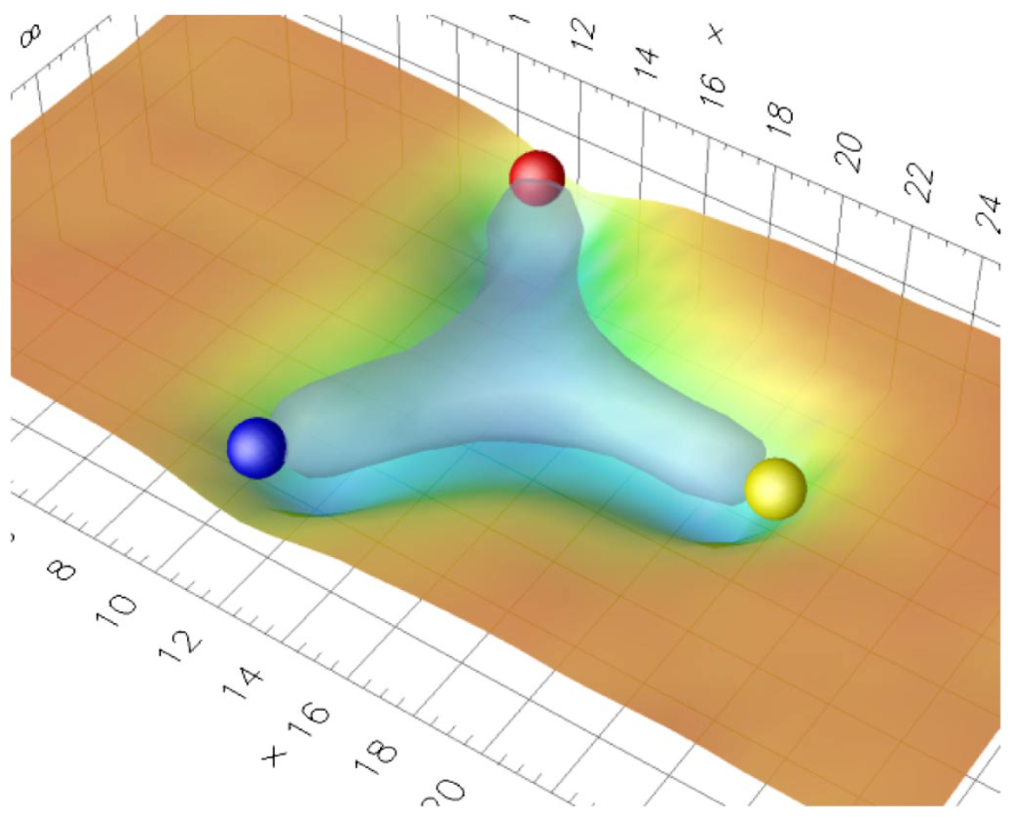
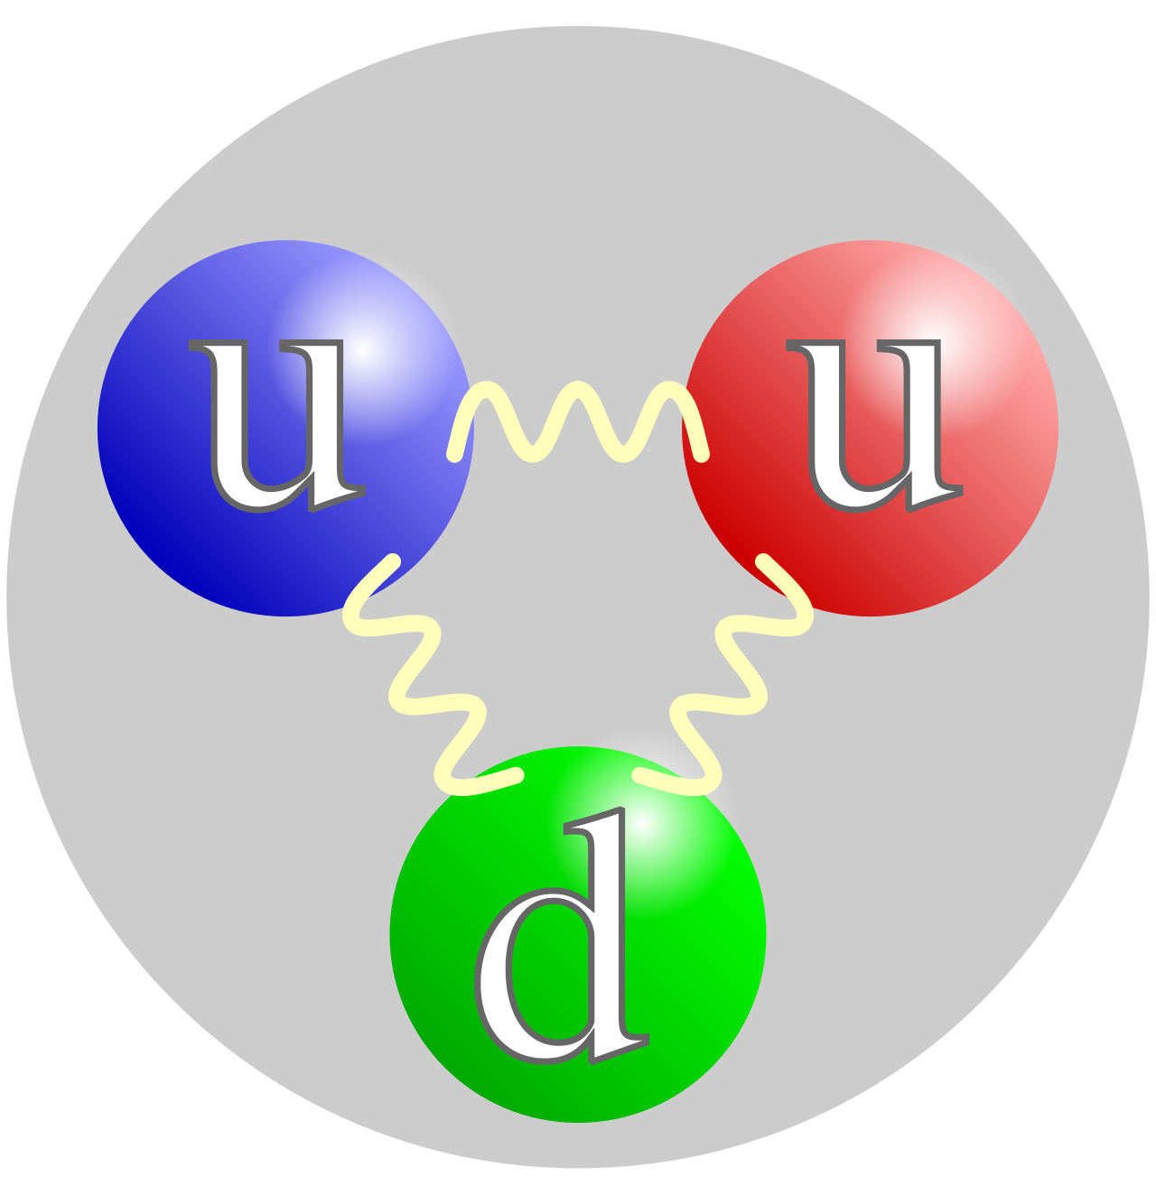
Theoretical considerations for baryon junction
Lattice calculations suggested the formation of a Y-shaped color flux tube.
PRL. 86, 18 (2001)
PRD. 65, 114509 (2002)
Figure from PRD. 76, 114512 (2007)
“there is only one way to construct a gauge-invariant state vector of a baryon from quarks and gluons”
Quote from PLB 378, 238 (1996)
Figure from https://en.wikipedia.org/wiki/Quark
Chun Yuen Tsang, CIPANP 2025

Slide 4
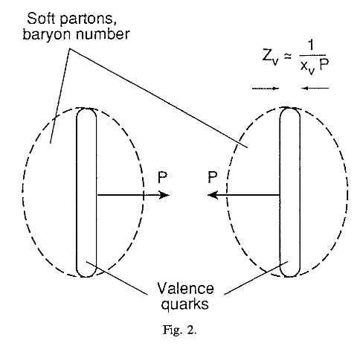
Baryon transport from various mechanisms
Figure from PLB 378, 238 (1996)
Carrier | Composed of | Momentum | Carry electric charge? | Stopped by interaction | Depends on quark flavor
Junction | Gluons | Low | No | Relatively Easy | No
Valence quark | Quarks | High | Yes | Relatively Hard | Yes
Chun Yuen Tsang, CIPANP 2025

Slide 5
Baryon transport from junction
Four methods to test the hypothesis:
Net-Baryon vs. Net-Electric charge difference in Isobar collisions
Net-proton in photonuclear collisions
Net-proton yield as a function of rapidity in hadronic Au+Au collisions
Quark flavor dependence of baryon transport (PLB 860 (2025) 139205).
Chun Yuen Tsang, CIPANP 2025

Slide 6
Baryon transport from junction
Four methods to test the hypothesis:
Net-Baryon vs. Net-Electric charge difference in Isobar collisions
Net-proton in photonuclear collisions
Net-proton yield as a function of rapidity in hadronic Au+Au collisions
Quark flavor dependence of baryon transport (PLB 860 (2025) 139205).
Chun Yuen Tsang, CIPANP 2025

Slide 7
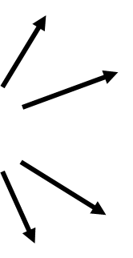
Method 1: Net-Baryon (B) vs. Net-Charge (Q)
Charged mesons (pions and kaons): Carry Q and not B
Proton: Carry B and Q
Neutron: Carry B and not Q
Question: B/𝑄*Z/A =??? 1 (at |y| < 0.5)
y = 0 (C.M.)
Charged
mesons
Y_{Beam}
y = -0.5
y = 0.5
Proton
Neutron
$B=\left(N_{p}−N_{\overline{p}}\right)+\left(N_{n}−N_{\overline{n}}\right)$
$Q=\left(N_{π^{+}}^{}+N_{K^{+}}^{}+N_{p}\right)−\left(N_{π^{−}}^{}+N_{K^{−}}^{}+N_{\overline{p}}\right)$
Chun Yuen Tsang, CIPANP 2025

Slide 8
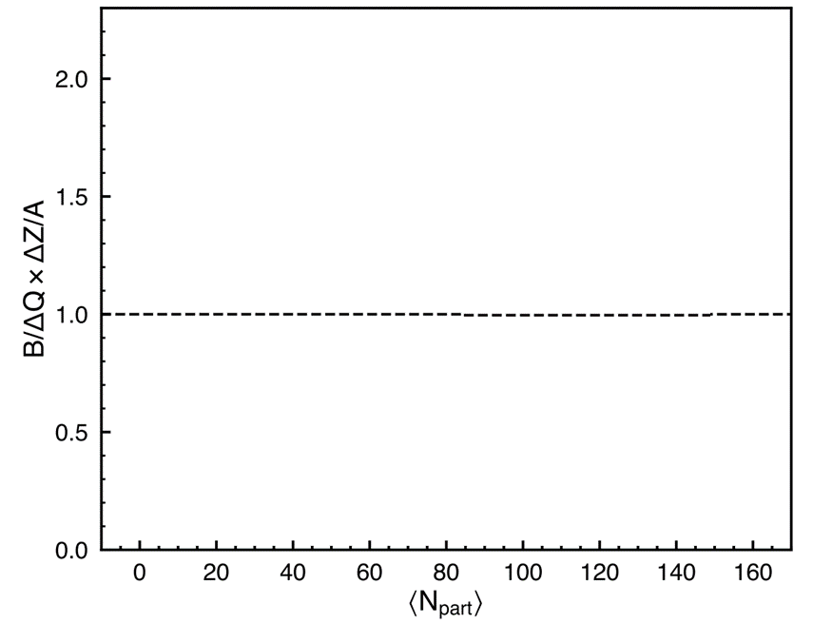
Expected values of B/𝑄*Z/A for different carriers
Expectation for junction: Somewhere above 1
y = 0 (C.M.)
B/𝑄*Z/A
Naïve expectation for valence quark as carrier = 1
Y_{Beam}
y = -0.5
y = 0.5
$B_{init}$=A*Const.
$Q_{init}$=Const*Z.
(B/𝑄*Z/A)_{init} = 1 => (B/𝑄*Z/A)_{final} ~ 1 if B and Q shared same carrier.
For junction, B is enhanced so B/𝑄*Z/A > 1.
Tot. Baryon = A*Const
Tot. p = Tot. Baryon*Z/A
$B=\left(N_{p}−N_{\overline{p}}\right)+\left(N_{n}−N_{\overline{n}}\right)$
$Q=\left(N_{π^{+}}^{}+N_{K^{+}}^{}+N_{p}\right)−\left(N_{π^{−}}^{}+N_{K^{−}}^{}+N_{\overline{p}}\right)$
Chun Yuen Tsang, CIPANP 2025

Slide 9
Net-Baryon number $(B)$
$B=\left(N_{p}−N_{\overline{p}}\right)+\left(N_{n}−N_{\overline{n}}\right)$
Primordial (anti-)neutron yields estimation [1],
$N_{n}^{pri}=N_{\overline{p}}^{pri}\sqrt{\frac{N_{d}}{N_{\overline{d}}}}, N_{\overline{n}}^{pri}=N_{p}^{pri}\sqrt{\frac{N_{\overline{d}}}{N_{d}}}$.
Fraction of feed-down (anti-)proton taken from Ref. [2].
Feed-down yields estimated with data driven method [3].
Data driven estimation of proton feed-down fraction -> Weighted sum of hyperon yields.
$Λ:Ξ:Ω$ yield ratios from THERMUS model estimation.
Estimate feed-down neutrons from scaled hyperon yields.
[1]: arXiv:2408.15441
[2]: PRC. 79 (2009) 34909
[3]: PRL. 97, 152301 (2006)
Chun Yuen Tsang, CIPANP 2025

Slide 10
Complications in Net-Charge $(Q)$
$Q=\left(N_{π^{+}}^{}+N_{K^{+}}^{}+N_{p}\right)−\left(N_{π^{−}}^{}+N_{K^{−}}^{}+N_{\overline{p}}\right)$,
Small quantity. Measuring individual yields gives unusable $Q$.
$N_{π^{+}}^{}$ is large, moderate fractional uncertainty still means large absolute uncertainty.
$N_{π^{+}}^{}−N_{π^{−}}$ is small. Error propagation -> absolute uncertainty grows.
$Q=Small value±$ large sys. Error.
Solution: $ΔQ=Q\left(Ru+Ru\right)−Q(Zr+Zr)$ [1].
[1]: Eur. Phys. J. C (2024) 84:590
Chun Yuen Tsang, CIPANP 2025

Slide 11
Net-Charge difference $(ΔQ)$
$ΔQ={\left[\left(N_{π^{+}}^{}+N_{K^{+}}^{}+N_{p}\right)−\left(N_{π^{−}}^{}+N_{K^{−}}^{}+N_{\overline{p}}\right)\right]}_{Ru}−{[]}_{Zr}$,
Define $R2_{π}=\frac{{\left(N_{π^{+}}^{}/N_{π^{−}}^{}\right)}_{Ru}}{{\left(N_{π^{+}}^{}/N_{π^{−}}^{}\right)}_{Zr}}$,
Let $N_{π}=0.5×\left(N_{π^{+}}^{}+N_{π^{−}}^{}\right)$, then change of variable [1],
$ΔQ≈N_{π}\left(R2_{π}−1\right)+N_{K}\left(R2_{K}−1\right)+N_{p}\left(R2_{p}−1\right)$.
Double ratio cancels sys. Uncertainty => reduction in sys. Uncertainty for $ΔQ$.
[1]: Eur. Phys. J. C (2024) 84:590
Phys.Lett.B 853 (2024) 138680
Chun Yuen Tsang, CIPANP 2025

Slide 12
Revisited observable: B/$Δ$𝑄*$Δ$Z/A
Expectation for junction: Somewhere above 1
y = 0 (C.M.)
Ru or Zr
For Ru, A = 96, Z = 44
For Zr, A = 96, Z = 40
Naïve expectation for valence quark as carrier = 1
Y_{Beam}
y = -0.5
y = 0.5
$B_{init}$=A*Const.
${ΔQ_{init}= Q}_{init} (Ru−Zr)$=Const*ΔZ.
(B/Δ𝑄*ΔZ/A)_{init} = 1 => (B/Δ𝑄*ΔZ/A)_{final} ~ 1 if B and Q shared same carrier.
For junction, B is enhanced so B/Δ𝑄*ΔZ/A > 1.
Tot. Baryon = 96*Const
Tot. p = Tot. Baryon*Z/A
$B=\left(N_{p}−N_{\overline{p}}\right)+\left(N_{n}−N_{\overline{n}}\right)$
$Q=\left(N_{π^{+}}^{}+N_{K^{+}}^{}+N_{p}\right)−\left(N_{π^{−}}^{}+N_{K^{−}}^{}+N_{\overline{p}}\right)$
Chun Yuen Tsang, CIPANP 2025

Slide 13
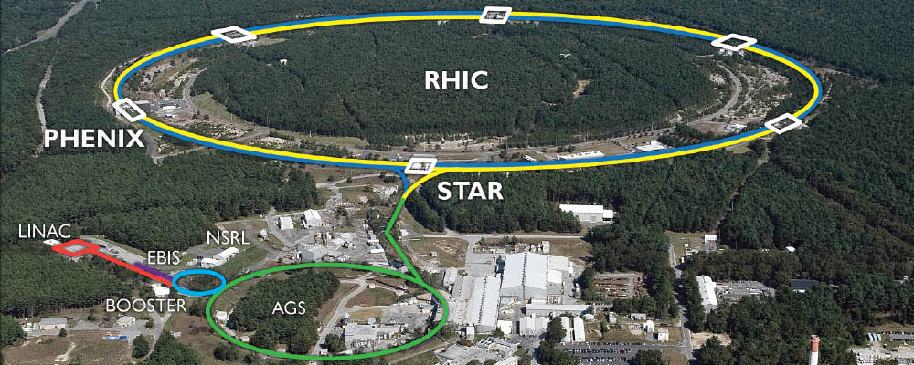
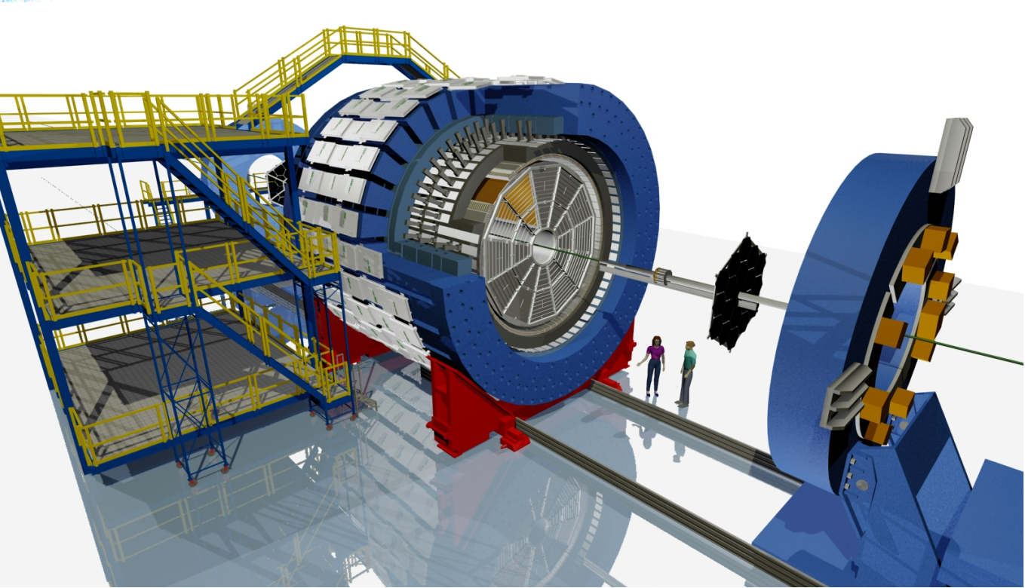
RHIC and STAR detector
RHIC: Relativistic heavy-ion collider.
Accelerate ions to collide at $\sqrt{s_{NN}}=200 GeV$
STAR detector
Identify and measure momentum of charged particles.
Image URL: https://science.osti.gov/np/facilities/user-facilities/rhic/
Chun Yuen Tsang, CIPANP 2025

Slide 14
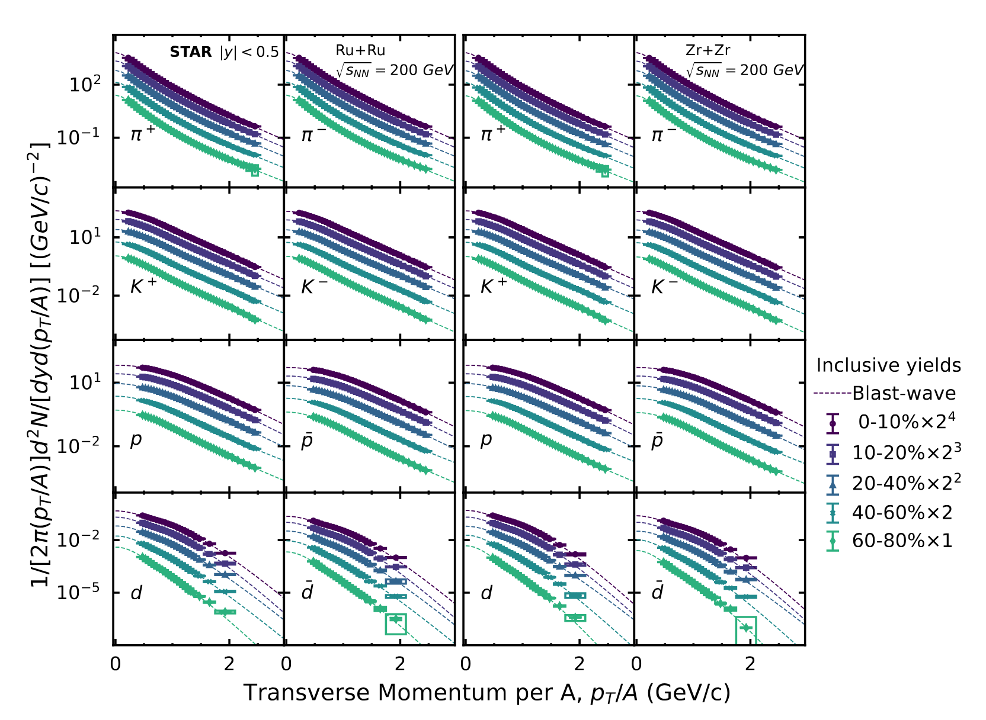
Spectra from Isobar Collisions
Figure from arXiv:2408.15441

Slide 15
Double ratio R2s
Figure from arXiv:2408.15441
$$ΔQ≈N_{π}\left(R2_{π}−1\right)+N_{K}\left(R2_{K}−1\right)+N_{p}\left(R2_{p}−1\right)$$
Chun Yuen Tsang, CIPANP 2025

Slide 16
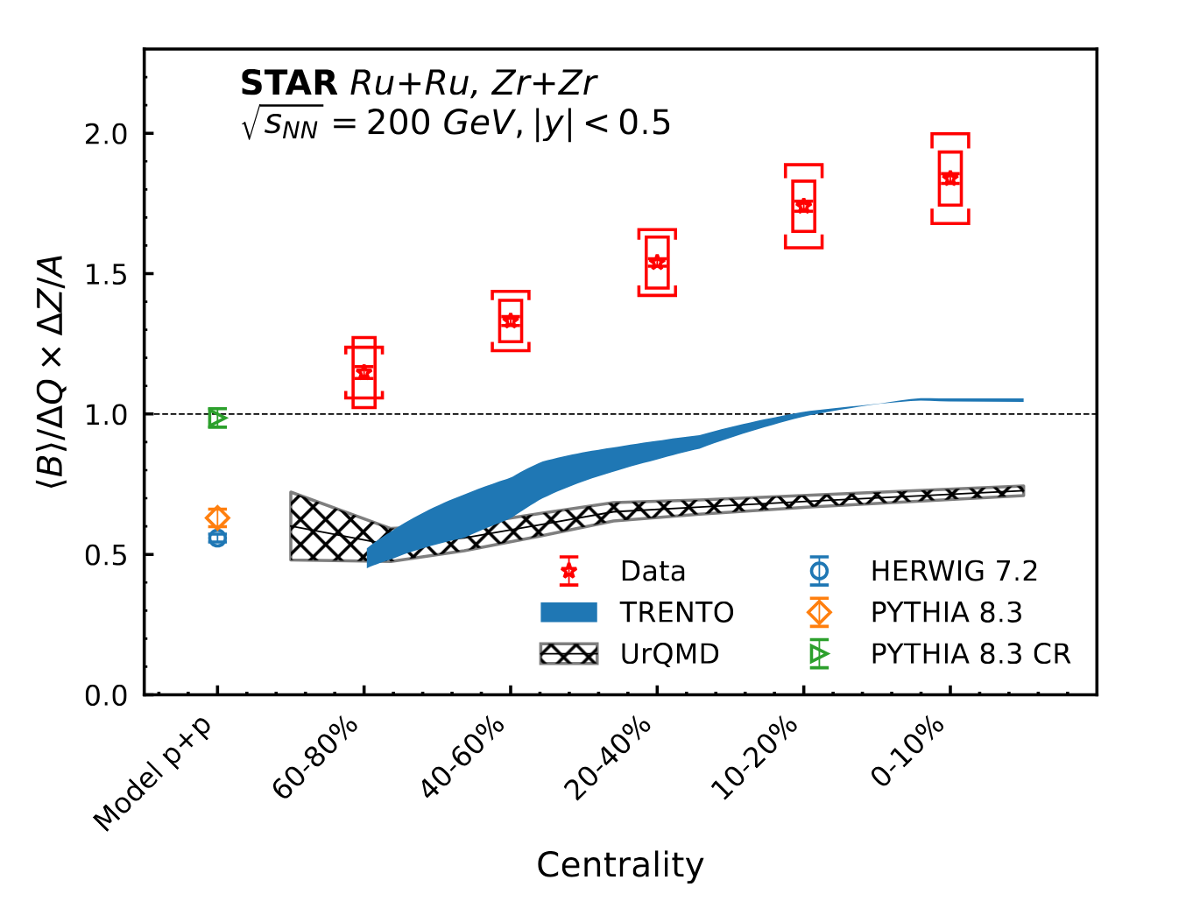
Experimental result on Net-Charge and Net-Baryon
$\text{B}\text{/}\text{Δ}\text{Q}\text{∗}\text{ΔZ}\text{/}\text{A}>1.$
PTYHIA, Herwig 𝑝 + 𝑝 (B/Q*Z/A, Z=A=1) [1] and UrQMD [2] cannot describe our data.
Peripheral collision show lower $\text{B}\text{/}\text{Δ}\text{Q}$ values.
Similar trend from Trento model [3].
Trento model estimates (B/Δ𝑄*ΔZ/A)_{init} from nuclear geometry only. No parton interaction!.
Trend partially explained by nuclear geometry.
[1]: Eur. Phys. J.C. 80 5, 452 (2020)
[2]: J. Phys. G. 25, 1859 (1999)
[3]: PRC 105, L011901 (2022)
[4]: arXiv:2408.15441
Figure from Ref. [4]
Chun Yuen Tsang, CIPANP 2025

Slide 17
Baryon transport from junction
Four methods to test the hypothesis:
Net-Baryon vs. Net-Electric charge difference in Isobar collisions
Net-proton in photonuclear collisions
Net-proton yield as a function of rapidity in hadronic Au+Au collisions
Quark flavor dependence of baryon transport (PLB 860 (2025) 139205).
Chun Yuen Tsang, CIPANP 2025

Slide 18
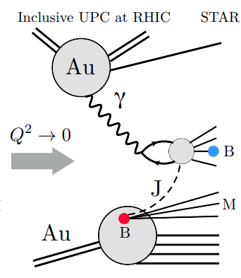
Net-Baryon in photonuclear collisions
Quasi-real $γ→q\overline{q}$.
Interact with a junction or quark in target Au nucleus.
Regge theory: $dN/dy∝e^{−α_{B}δy}$ [1],
$δy= y_{beam}−y$.
$α_{B}$ sensitive to what kind of things are interacting [1].
If valence quark picture is true:
Few baryons are transported far away from $y_{beam}$.
Larger ${|α}_{B}|$ than junction picture.
$dN/dy$ drops fast when $α_{B}$ is large.
Figure from Ref. [1]
[1]: Eur. Phys. J. C (2024) 84:590
Chun Yuen Tsang, CIPANP 2025

Slide 19
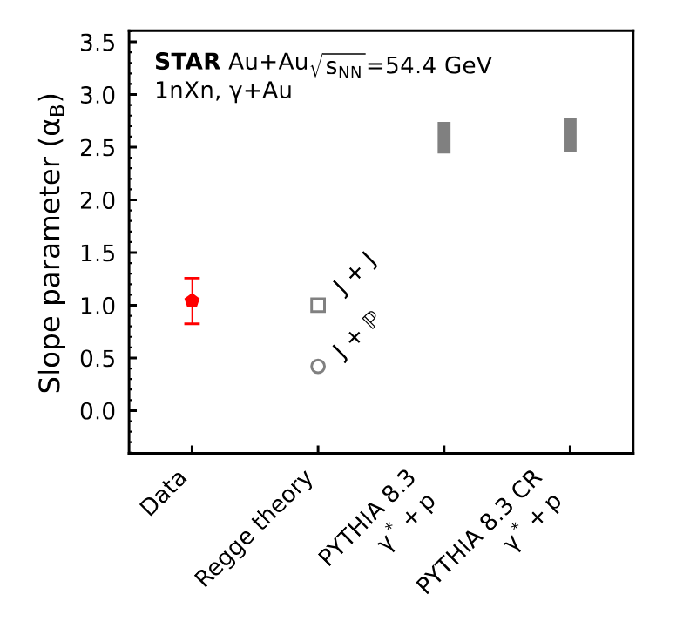
Expectations of $α_{B}$ from various pictures.
Regge theory: $dN/dy∝e^{−α_{B}δy}$
PYTHIA-8.3 and 8.3 CR predicts larger $α_{B}$.
Neither simulates junction interactions.
8.3 CR includes a junction-like mechanism in final-state hadronization [1].
Theory of junction interaction predicts smaller $α_{B}$ [2].
J+J: Junction-junction interaction.
J+P: Junction-pormeron interaction.
Note: smaller $α_{B}$ -> dN/dy do not drop quickly with increasing $δy$ -> Enhanced stopping.
[1] JHEP 08, 003 (2015). 1505.01681.
[2] Phys. Lett. B 378, 238–246 (1996).nucl-th/9602027.
Chun Yuen Tsang, CIPANP 2025

Slide 20
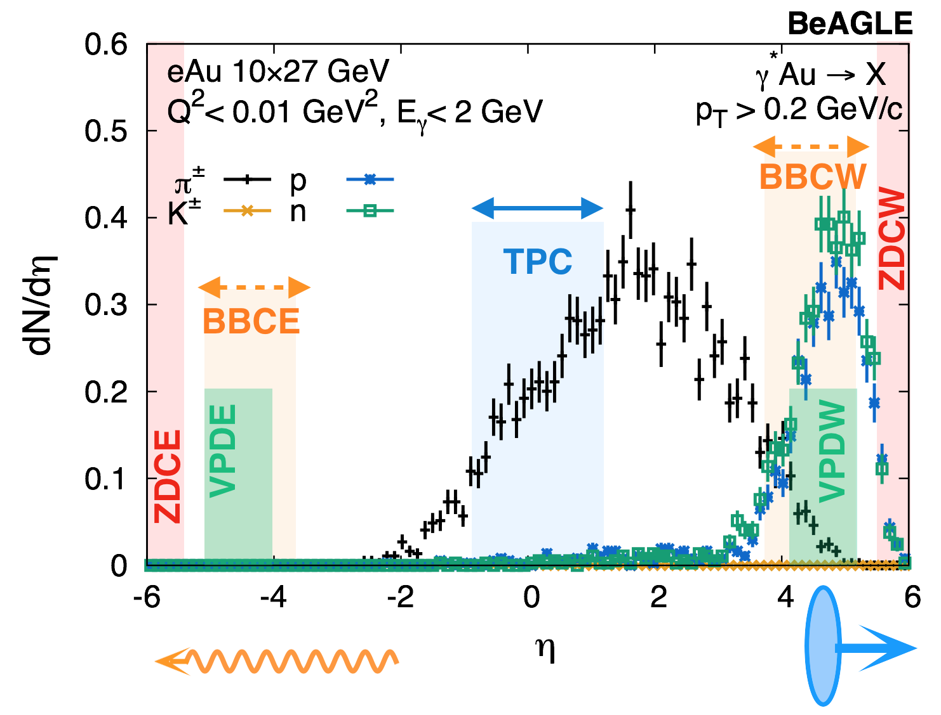
Selecting photonuclear events in Au + Au collisions at $\sqrt{s_{NN}}$ = 54.4 GeV
Asymmetric collision: target can only be traveling in one direction
Select events with,
Single neutron (1n) on ZDC east (ZDCE)
No activity in BBC east
Multiple neutron (Xn) on ZDC west (ZDCW)
Activity in BBC west
|V_{z}(VPD) - V_{z}(TPC)| > 10 cm
vice versa (east ⬄ west)
TLDR: Lots of activity on one side, but nothing on the other.
Figures from Eur. Phys. J. C (2024) 84:590
BeAGLE: PRD 106, 012007 (2022)
Chun Yuen Tsang, CIPANP 2025

Slide 21
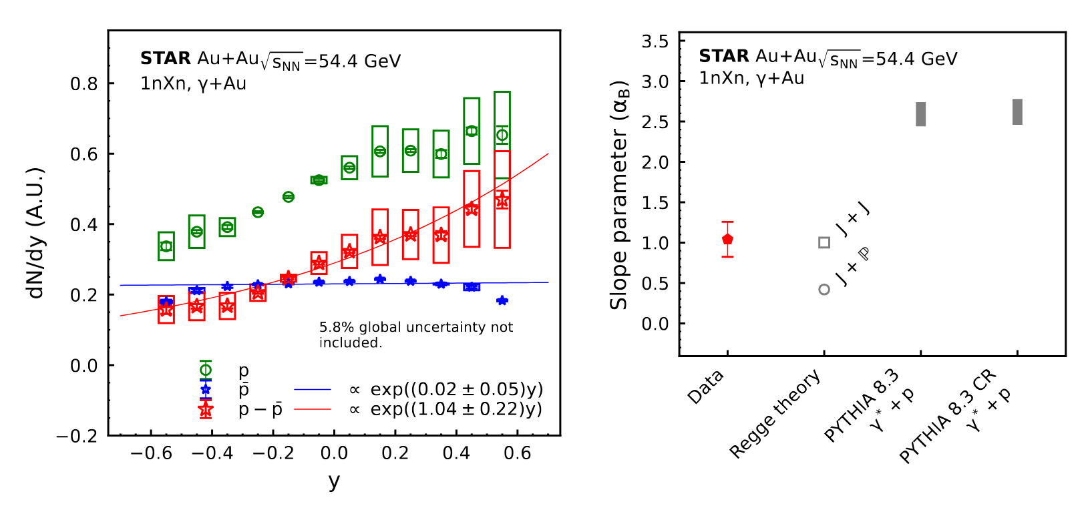
Net-proton yield in Au + Au collisions at $\sqrt{s_{NN}}$ = 54.4 GeV
Measured $dN/dy{\left.​\right|}_{y=0}∝exp\left(−\left(α_{B}=1.04±0.22\right)δy\right)$.
PYTHIA-8.3 and 8.3 CR overestimate $α_{B}$.
Consistent with theory estimation of junction interaction.
Figure from arXiv:2408.15441
Chun Yuen Tsang, CIPANP 2025

Slide 22
Baryon transport from junction
Four methods to test the hypothesis:
Net-Baryon vs. Net-Electric charge difference in Isobar collisions
Net-proton in photonuclear collisions
Net-proton yield as a function of rapidity in hadronic Au+Au collisions
Quark flavor dependence of baryon transport (PLB 860 (2025) 139205).
Chun Yuen Tsang, CIPANP 2025

Slide 23
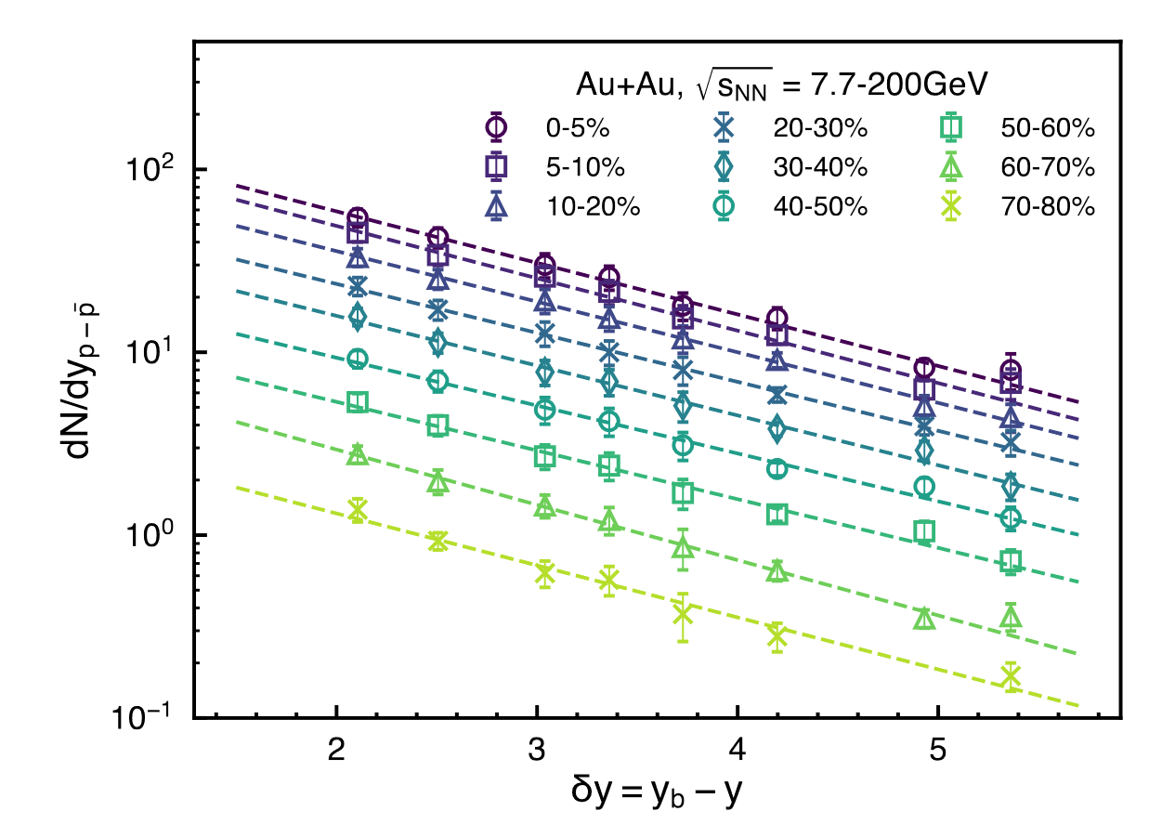
Net-proton yield at mid-rapidity as a function of beam rapidity in hadronic Au+Au collisions
$Au+Au$ BES-I data
Figure from Eur. Phys. J. C (2024) 84:590
Regge theory: $dN/dy∝e^{{−a}_{B}δy}$.
$δy= y_{beam}−y$.
For hadron:
$dN/dy∝e^{{−a}_{B}{(y}_{beam}−y)}+e^{{−a}_{B}{(y}_{beam}+y)}$.
Symmetric target and projectile.
If we fix y = 0, $dN/dy∝e^{{−a}_{B}y_{beam}}$
Measured $a_{B}≈0.65$.
Chun Yuen Tsang, CIPANP 2025

Slide 24
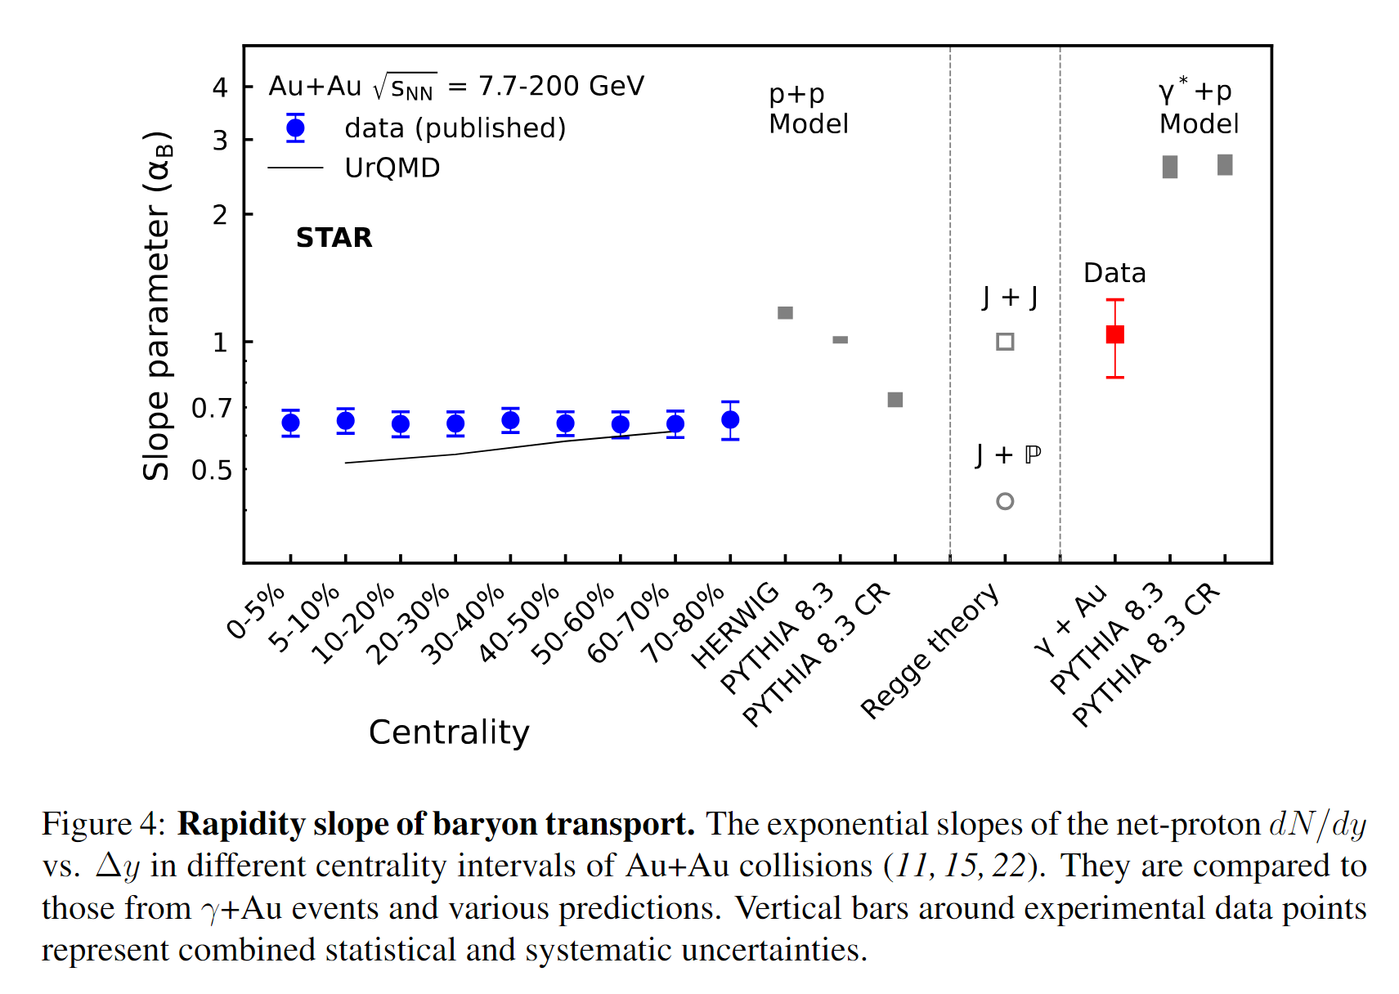
Net-proton exponential slope ($α_{B}$)
Measured $a_{B}≈0.65$.
Too small (flat) compared to PYTHIA and HERWIG predictions [1].
Slope does not depend on centrality
Valence quark transport is expected to depend on multiple scatterings and thus on centrality.
UrQMD shows centrality dependence [1].
Figure from Ref. [1]
Chun Yuen Tsang, CIPANP 2025
[1]: arXiv:2408.15441

Slide 25
Baryon transport from junction
Four methods to test the hypothesis:
Net-Baryon vs. Net-Electric charge difference in Isobar collisions
Net-proton in photonuclear collisions
Net-proton yield as a function of rapidity in hadronic Au+Au collisions
Quark flavor dependence of baryon transport (PLB 860 (2025) 139205).
Chun Yuen Tsang, CIPANP 2025

Slide 26
A step beyond net-protons: Net-hyperons Baryons with valence s-quark(s)
Net-proton plot from a few slides ago
Can we re-make this plot, but with net- $Λ, Ξ, Ω$ instead of net-proton?
Expectation: Same $a_{B}$ for $Λ^{0}(uds), Ξ^{−}(dss), Ω^{−}(sss)$ in junction picture as junction should be flavor independent

Slide 27
A step beyond net-protons: Net-hyperons
Complication:
Below s-quark threshold $dN_{Y−\overline{Y}}/dy{\left.​\right|}_{\left|y\right|<0.5}=0$ vs. model prediction $e^{{−a}_{B}Y_{beam}}$ > 0.
$dN_{Y−\overline{Y}}/dy{\left.​\right|}_{\left|y\right|<0.5}$depends on both baryon stopping AND s-quark production rate.
Solution: Factor out s-quark effects → Normalize by production rate:
$dN_{Y−\overline{Y}}/dy{\left.​\right|}_{\left|y\right|<0.5}/$(s-quark production rate) $∝???e^{{−a}_{B}Y_{beam}}$
How to estimate s-quark production rates?

Slide 28
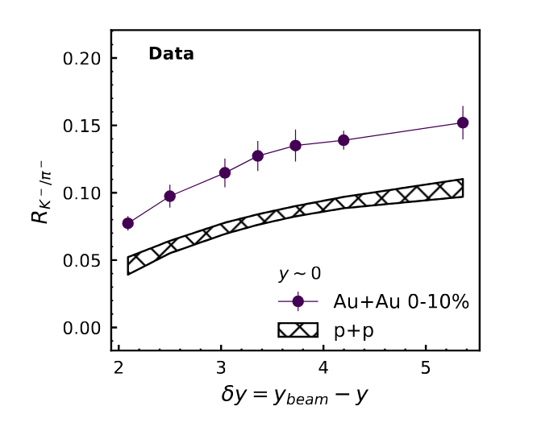
$R_{K^{−}/π^{−}}^{}$ratio as a proxy for s-quarks production
$K^{−}(s\overline{u})$ and $π^{−}(u\overline{d})$.
Divide net-hyperons by ${\left(R_{K^{−}/π^{−}}^{}\right)}^{n}$.
n is number of valence s-quark.
$R_{K^{+}/π^{+}}^{}$not used. $K^{+}$is enhanced by associated production.
$p+N→Λ+K^{+}+N$.
Try $R_{K^{−}/π^{−}}^{}$from both Au+Au and p+p.
p+p has no QGP.
Figure from PLB 860 (2025) 139205

Slide 29
$dN_{B−\overline{B}}/dy{\left.​\right|}_{\left|y\right|<0.5}/R_{K^{−}/π^{−}}^{}$v.s. $y_{beam}$ with STAR data [1-4] $R_{K^{−}/π^{−}}^{}$ from Au+Au 0-10%
Figures from PLB 860 (2025) 139205
Data from
[1]: PRL. 98 (2007) 062301
[2]: PRL. 108 (2012) 072301
[3]: PRC. 102 (3) (2020) 034909
[4]: PRC. 83 (2011)024901

Slide 30
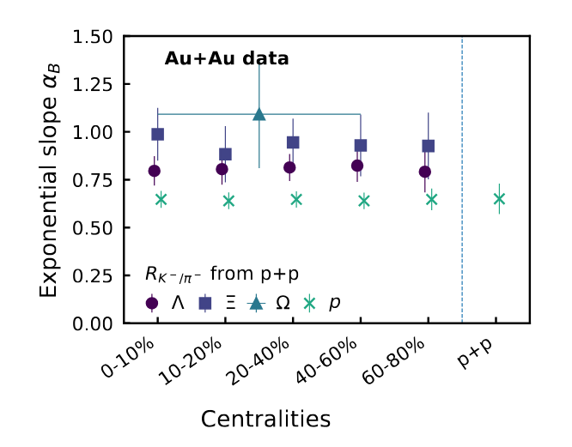
$a_{B}$ for $Λ^{0}, Ξ^{−}, Ω^{−}$, $dN_{B−\overline{B}}/dy{\left.​\right|}_{\left|y\right|<0.5}∝e^{{−a}_{B}Y_{beam}}$
Independent of centrality.
$a_{B}$ for $Λ^{0}, Ξ^{−}, Ω^{−}$ are within uncertainties of each other.
$a_{B}$ for $Λ^{0}, Ξ^{−}, Ω^{−}$ are larger than that for proton, but no more than twice the uncertainty.

Slide 31
PYTHIA doesn’t work well

Slide 32
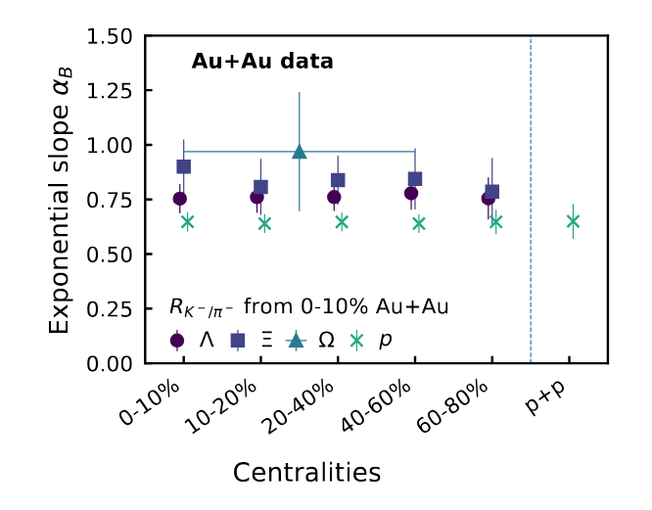
Conclusion
$α_{B}$from hadronic Au+Au < naïve quarks model predictions.
$α_{B} f$rom $γ+Au$ < naïve quarks model predictions.
$α_{B}$ from $Λ^{0}, Ξ^{−}, Ω^{−}$ are within uncertainties of each other.
$\text{B}\text{/}\text{Δ}\text{Q}\text{∗}\text{ΔZ}\text{/}\text{A}>1$ on Ru+Ru and Zr+Zr collisions at $\sqrt{s_{NN}}$ = 200 GeV.
Inconsistent with predictions from models (UrQMD, PYTHIA, HERWIG) with valence quark picture.
Our results disfavor the assertion that valence quarks carry the baryon number.
Chun Yuen Tsang, CIPANP 2025

Slide 33
Thanks

Slide 34
Backup slides

Slide 35
Baryon transport from various mechanisms
Valence quarks carry most of the momentum.
contracted into thin “pancakes”.
Less time to interact => less stopping at mid-rapidity.
Junction carries lower momentum.
Made of low-x gluons
Enhanced baryon transport to mid-rapidity
Not made of quarks -> Stopping is independent of quark flavor
Figure from PLB 378, 238 (1996)
Chun Yuen Tsang, CIPANP 2025

Slide 36
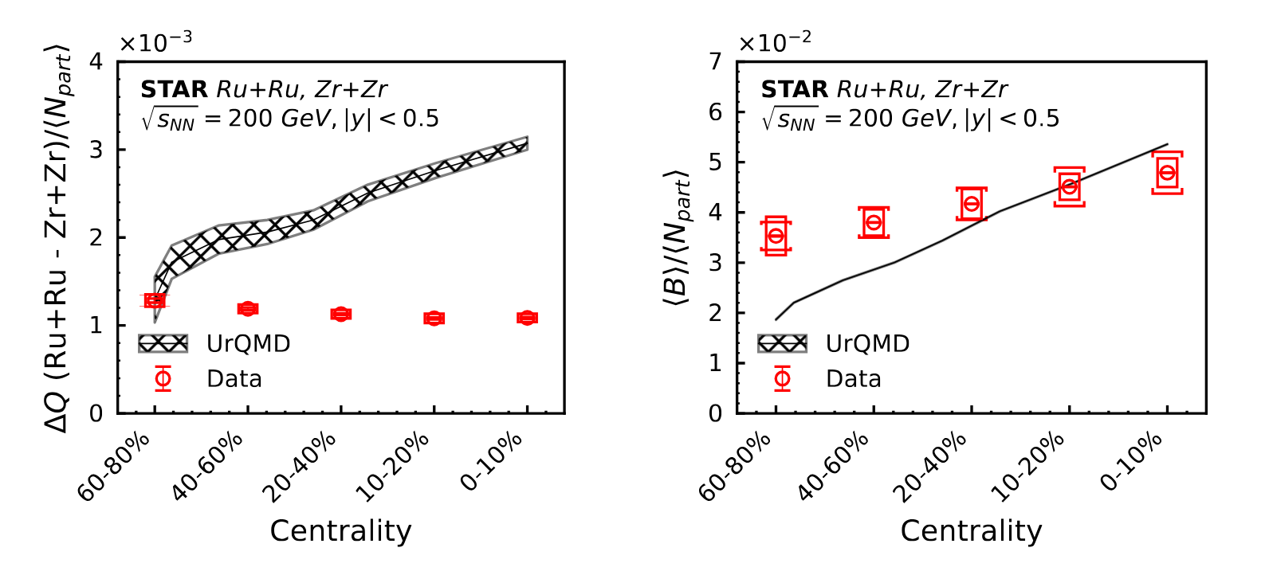
Measured B and $Δ$Q

Slide 37
STAR detector
Time Projection Chamber (TPC)
Track curvature => momentum (p)
Energy loss per unit length (dE/dx) => charge state.
p and dE/dx provides particle identification
Time-Of-Flight (TOF)
Extends momentum
Pile-up rejection
Vertex Position Detector (VPD)
One on the east and one on the west.
Averaged time of particle detection on both sides => vertex position.
Zero Degree Calorimeter (ZDC)
Detect forward neutrons for event selection
Beam-Beam counter (BBC)
Detector forward and backward beam fragments
Magnet
TPC
TOF
VPD
BBC
ZDC 18 m
Chun Yuen Tsang, CIPANP 2025

Slide 38
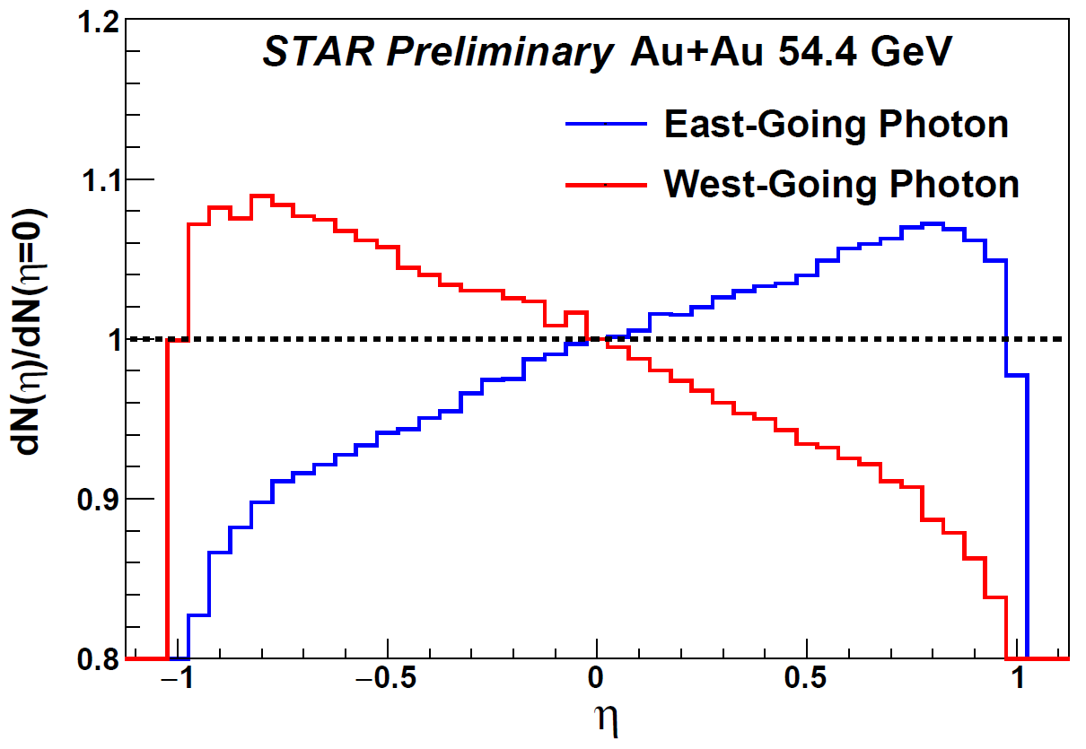
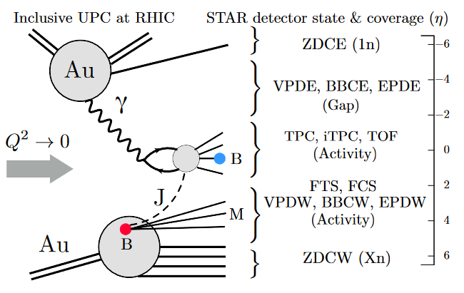
Rapidity asymmetry in $γA$-rich events
J. D. Brandenburg, N. Lewis,
P. Tribedy, Z. Xu, arXiv:2205.05685 (2022)
Chun Yuen Tsang, CIPANP 2025

Slide 39
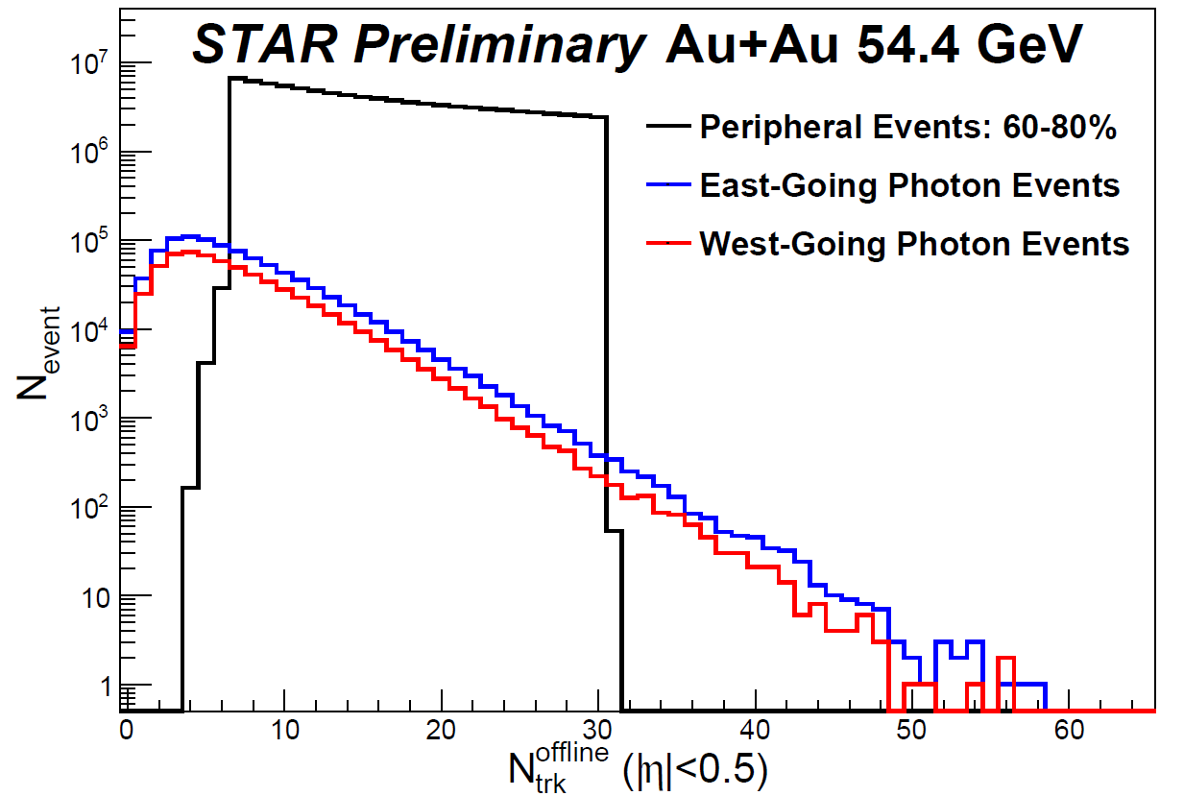
Defining $γA$ and $AA e$vent classes
Most photonuclear events have low multiplicity, consistent with very peripheral $Au+Au$ collisions
Using $60−80\%$ peripheral collisions as a baseline and to estimate behavior of peripheral background
Chun Yuen Tsang, CIPANP 2025

Slide 40
A+A background estimation

Slide 41
Include data from other reactions.
Phys. Rev. C, 78:034918, 2008
J. Phys. G, 32:427–442, 2006
Phys. Lett. B, 728:216–227, 2014.
Phys. Rev. Lett., 111:222301, Nov2013
Phys. Rev. C, 75:064901, 2007
Eur. Phys. J. C, 71:1594
Phys. Rev. C, 66:054902, 2002
Phys. Rev. C, 88:044910, Oct 2013
Eur. Phys. J. C, 71:1655,2011

Slide 42
Comparison to PYTHIA
PYTHIA: no baryon junction in incoming protons
Baryons produced mainly through “popcorn” mechanism
CR Mode 2: allow dynamical formation of baryon junction prior to hadronization
Courtesy: Rongrong Ma

Slide 43
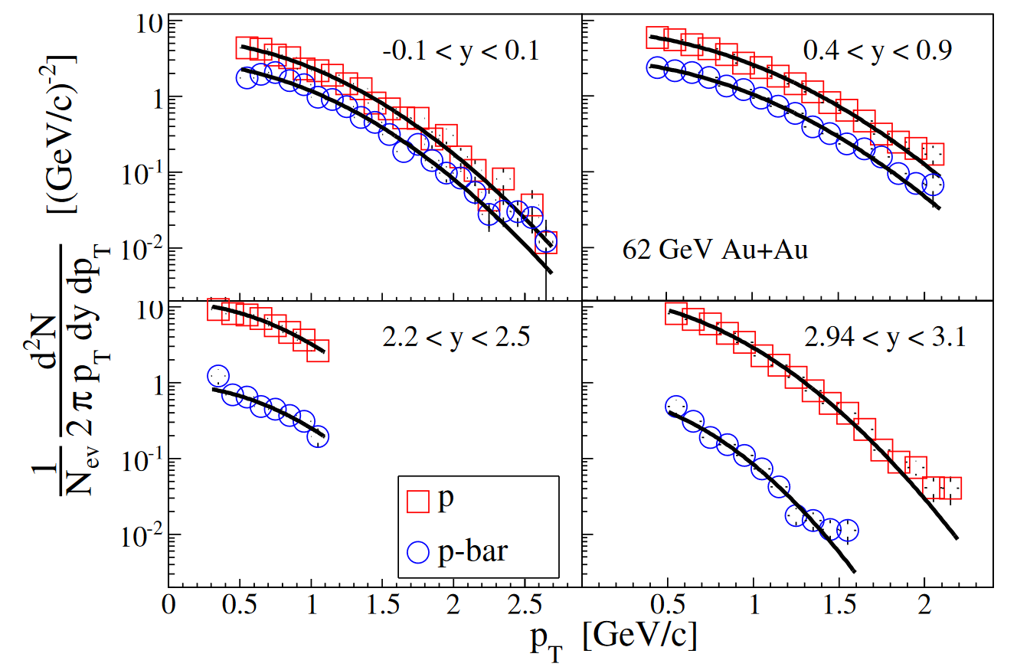
Net-Baryon at mid-rapidity
Net-Baryon = $p −\overline{p}$
More baryons than antibaryons, even at midrapidity
Expected yield of $p −\overline{p}$ is low
Collision time is too short for a lot of valence quarks to be stopped
BRAHMS Collaboration, Phys. Lett. B 677, 267-271 (2009)
Notes:
Some protons produced in proton-antiproton pairs, some baryons come from the colliding nuclei

Slide 44
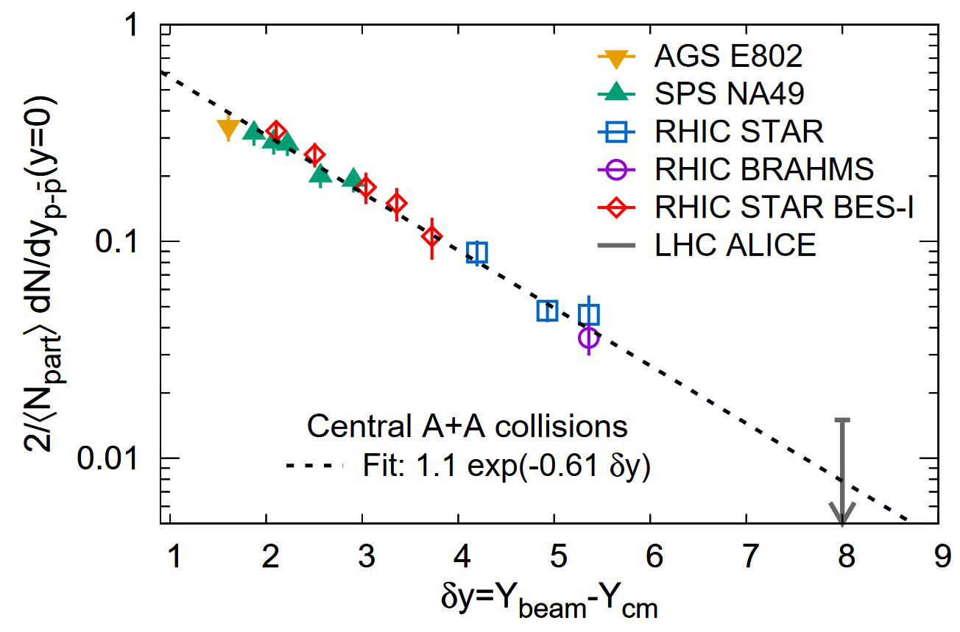
Net-Baryon at mid-rapidity
Changes with collision energy
Higher energy => Less interaction time
Normalized net-Baryon yield at mid-rapidity shows a clear exponential dependence on $δy$
Exponential factor too small to be explained by the valence quark picture
C. Shen and B. Schenke, PRC 105, 064905 (2022)
J. D. Brandenburg, N. Lewis,
P. Tribedy, Z. Xu, arXiv:2205.05685 (2022)

Slide 45
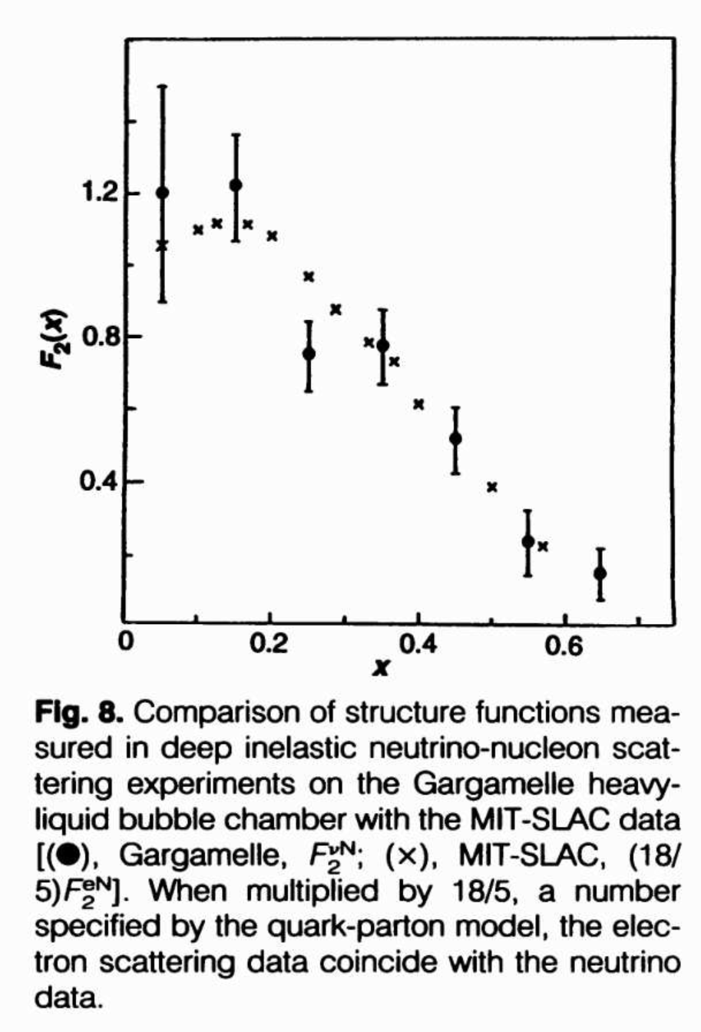
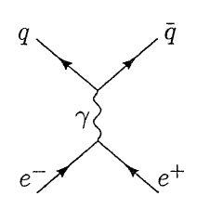
Electric charge of quarks
Riordan, Science 1992
M. E. Peskin, D. V. Schroeder, An Introduction to Quantum Field Theory, Addison-Wesley Publishing Company, 1995
Chun Yuen Tsang, CIPANP 2025

Slide 46
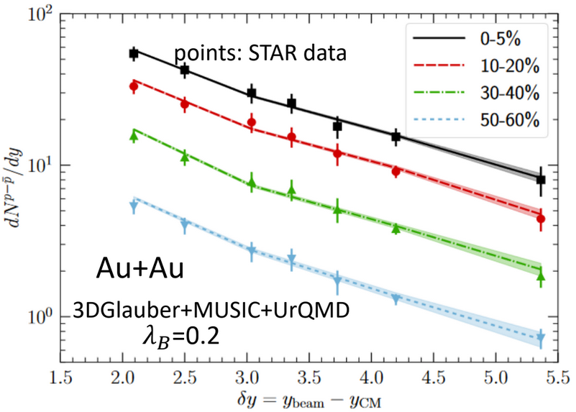
String junction model
3D hybrid model: $GLAUBER+MUSIC+URQMD$ Model
String junction where the baryon charge of the string can fluctuate towards the center of the string with tuning parameter $λ_{B}$
$λ_{B}=0.2$reproduces the $dN/dy$of net-protons at STAR
C. Shen and B. Schenke, PRC 105, 064905 (2022)
Plot from Wenbin Zhao, BES-Tea Seminar 2022
Chun Yuen Tsang, CIPANP 2025

Slide 47
Net-Charge and Net-Baryon at $|y|<1.0$, Predicted by UrQMD
Courtesy: Z. Tang
Chun Yuen Tsang, CIPANP 2025

Slide 48
Virtuality of ultra-peripheral Au + Au
Screenshot of J. D. Brandenburg, N. Lewis, P. Tribedy, Z. Xu, arXiv:2205.05685 (2022)

Slide 49
Soure: Z.W. Lin https://indico.cfnssbu.physics.sunysb.edu/event/113/contributions/723/attachments/140/201/sbu-baryon-stopping.pdf

