Slide 1
Physics with the Helicity-flip Suppressed, Transverse Asymmetries in Bhabha scattering
Dave Mack (Jefferson Lab)
CIPANP 2025
Madison, WI
June 12, 2025

Slide 2
Introduction

Slide 3
Overview
Jefferson Lab, a 12 GeV polarized electron, fixed target facility, is developing a polarized positron injector.
For more information on the polarized e+ source, see the link at Positron beams at Ce+BAF
A positron beam facility at Jlab would enable a detailed study of Bhabha scattering
(e⁺ e⁻ → e⁺ e⁻ ) in the relatively unexplored CM mass range of 10 to 100 MeV/c2 .
Targets consisting of atomic electrons will permit practical e⁺e⁻ luminosities of 10³⁵ to 10³⁶.
(The cross sections are also surprisingly large due to the small value of s.)
The resulting high count rates, combined with Jlab’s superb expertise in spin manipulation, would enable Bhabha transverse polarization measurements of unprecedented precision.
Although Bhabha scattering is arguably one of the most well studied reactions in particle physics, the transverse asymmetries are largely unexplored, and interesting questions can still be addressed.

Slide 4
Purely Leptonic Reactions Accessible at JLab
Currently, only one purely leptonic reaction is accessible at Jlab: Moeller scattering (e⁻ e⁻ → e⁻ e⁻).
With the planned e⁺ injector, two more will become available:
Bhabha scattering (e⁺ e⁻ → e⁺ e⁻), and
Sub-threshold di-muon production (e⁺ e⁻ → μ⁺ μ⁻)*
I will focus on polarized Bhabha scattering (e⁺ e⁻ → e⁺ e⁻) in this talk for reasons that will become clear.
*i.e., only possible by scattering on relativistic electrons in the inner shells of high Z nuclei.

Slide 5
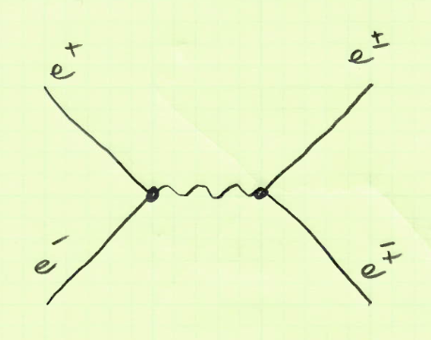
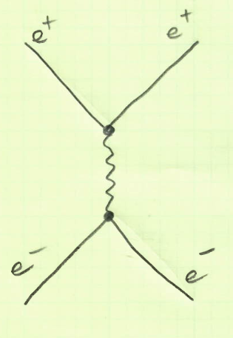
Bhabha Scattering: e⁺ e⁻ → e⁺ e⁻
s-channel
The s-channel amplitudes are constrained by the spin of the exchanged particle:
In the Standard Model (SM), the exchanged boson is effectively a γ or Z⁰
(ie, spin = 1).
Beyond the SM (BSM), other particles can be exchanged (eg, spin = 0).
Of the 3 purely leptonic reactions I mentioned on the last slide, only Bhabha scattering features the interference between s- and t-channel amplitudes.
t-channel

Slide 6
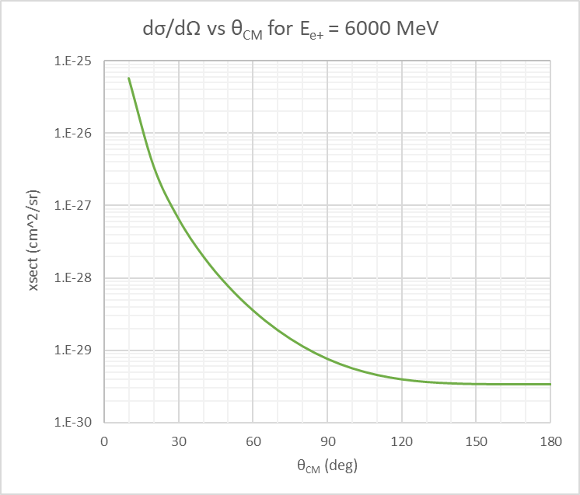
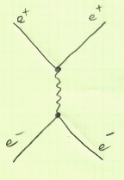
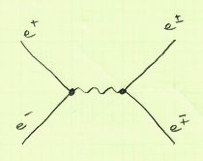
Bhabha dσ/dΩ vs θ_{CM}
The differential xsect has 2 regions:
The forward, t-channel dominated regime would in principle provide very large xsects.
The backward regime accesses s-channel annihilation, as well as interference of s- and t-channel exchange.
For 6 GeV positron beam energy, the backward xsects are still quite large by Jlab standards (a few μB/sr).
t-channel
dominated
scattering
s-t
Dominated
interference
s-channel
dominated
annihilation

Slide 7
Helicity Amplitudes Notation
F_{ij}^{kl} represents the amplitude for transition between initial state “ij” and final state “kl” (ie, F_{e+e-}^{e+e-} = F_{initial}^{final} )
The indices are “L” or “R”, so there are at most 2x2x2x2 = 16 helicity amplitudes.
You may often see it written as F_{ij} ( ie F_{initial}) since the final e⁺e⁻ polarizations are generally not measured.
This implies a summation over the 4 final helicity states (LR, RL, LL, and RR).
I will write it as F_{ij}^{kl},s to denote the s-channel contribution, or F_{ij}^{kl},t to denote the t-channel contribution.

Slide 8
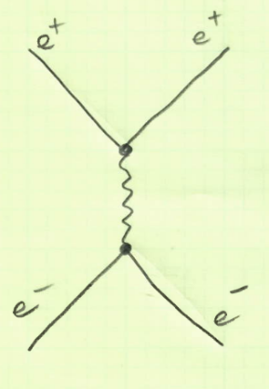
The t-channel Helicity Amplitudes
In the t-channel, helicity is largely conserved at each vertex, with flip probabilities suppressed by one or two factors of 1/γ = 2m_{e}/E_{cm} .
Unsuppressed scatterings are LR→LR, RL→RL, LL→LL, and RR→RR.
High energy collider papers typically treat the matrix as
if it were purely diagonal (the so-called m_{e} → 0 limit).
 | Final e+e- helicity
Initial e+e- helicity |  | LR | RL | LL | RR
 | LR | F_{LR}^{LR},t | 0 | 0 | 0
 | RL | 0 | F_{RL}^{RL},t | 0 | 0
 | LL | 0 | 0 | F_{LL}^{LL},t | 0
 | RR | 0 | 0 | 0 | F_{RR}^{RR},t

Slide 9
The t-channel Helicity Amplitudes
In the t-channel, helicity is largely conserved at each vertex, with flip probabilities suppressed by one or two factors of 1/γ = 2m_{e}/E_{cm} .
Unsuppressed scatterings are LR→LR, RL→RL, LL→LL, and RR→RR.
For fixed target e⁺ experiments at Jlab with ppm-level statistical errors, the SM off-diagonal terms will be important even at a beam energy of 10 GeV (ie, γ ~ 100).
High energy collider papers typically treat the matrix as
if it were purely diagonal (the so-called m_{e} → 0 limit).
 | Final e+e- helicity
Initial e+e- helicity |  | LR | RL | LL | RR
 | LR | F_{LR}^{LR},t | 0 | 0 | 0
 | RL | 0 | F_{RL}^{RL},t | 0 | 0
 | LL | 0 | 0 | F_{LL}^{LL},t | 0
 | RR | 0 | 0 | 0 | F_{RR}^{RR},t
 | Final e+e- helicity
Initial e+e- helicity |  | LR | RL | LL | RR
 | LR | F_{LR}^{LR},t | ~1/γ² | ~1/γ | ~1/γ
 | RL | ~1/γ² | F_{RL}^{RL},t | ~1/γ | ~1/γ
 | LL | ~1/γ | ~1/γ | F_{LL}^{LL},t | ~1/γ²
 | RR | ~1/γ | ~1/γ | ~1/γ² | F_{RR}^{RR},t

Slide 10
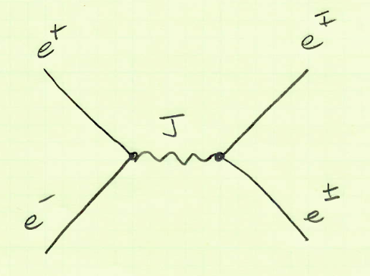
s-channel Constraints on Exchanged J
e⁺
e⁻
s-channel annihilation filters the spin of the exchanged boson:
LR
J_{z} = -+1
(SM vectors)
RL
Adapted from G. Moortgat-Pick et al.,
Phys. Rept. 460:131-243, 2008

Slide 11
s-channel Constraints on Exchanged J
e⁺
e⁻
s-channel annihilation filters the spin of the exchanged boson:
LR
J_{z} = -+1
(SM vectors)
RL
LL
J_{z} = 0
(SM Higgs,
BSM scalars)
RR
The SM Higgs coupling to the small electron mass is 3E-6, so the
amplitude of the above diagram would be 1E-11 hence unmeasureably small.
Adapted from G. Moortgat-Pick et al.,
Phys. Rept. 460:131-243, 2008

Slide 12
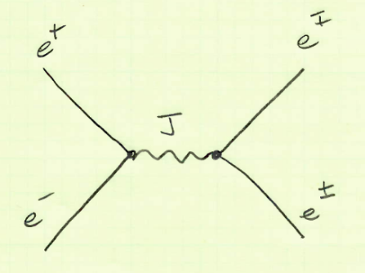
The SM s-channel Helicity Amplitudes
In the s-channel, only scatterings consistent with the exchange of a spin = 1 gamma or Z are allowed in first order, with exceptions suppressed by factors of 1/γ = 2m_{e}/E_{cm} .
The unsuppressed scatterings are the 4 combinations of LR or RL.
In the m_{e} → 0 limit, the SM s-channel amplitudes
are zero for LL or RR.
 | Final e+e- helicity
Initial e+e- helicity |  | LR | RL | LL | RR
 | LR | F_{LR}^{LR},s | F_{LR}^{RL},s | 0 | 0
 | RL | F_{RL}^{LR},s | F_{RL}^{RL},s | 0 | 0
 | LL | 0 | 0 | 0 | 0
 | RR | 0 | 0 | 0 | 0

Slide 13
The SM s-channel Helicity Amplitudes
In the s-channel, only scatterings consistent with the exchange of a spin = 1 gamma or Z are allowed in first order, with exceptions suppressed by factors of 1/γ = 2m_{e}/E_{cm} .
The unsuppressed scatterings are the 4 combinations of LR or RL.
In the m_{e} → 0 limit, the SM s-channel amplitudes
are zero for LL or RR.
For fixed target e⁺ experiments at Jlab, we will of course use the exact 1st order QED helicity amplitudes.
 | Final e+e- helicity
Initial e+e- helicity |  | LR | RL | LL | RR
 | LR | F_{LR}^{LR},s | F_{LR}^{RL},s | 0 | 0
 | RL | F_{RL}^{LR},s | F_{RL}^{RL},s | 0 | 0
 | LL | 0 | 0 | 0 | 0
 | RR | 0 | 0 | 0 | 0
 | Final e+e- helicity
Initial e+e- helicity |  | LR | RL | LL | RR
 | LR | F_{LR}^{LR},s | F_{LR}^{RL},s | ~1/γ | ~1/γ
 | RL | F_{RL}^{LR},s | F_{RL}^{RL},s | ~1/γ | ~1/γ
 | LL | ~1/γ | ~1/γ | ~1/γ² | ~1/γ²
 | RR | ~1/γ | ~1/γ | ~1/γ² | ~1/γ²

Slide 14
Unsuppressed s-channel Helicity Amplitudes with a BSM Scalar
BSM scalars | Final e+e- helicity
Initial e+e- helicity |  | LR | RL | LL | RR
 | LR | ~1/γ² | ~1/γ² | ~1/γ | ~1/γ
 | RL | ~1/γ² | ~1/γ² | ~1/γ | ~1/γ
 | LL | ~1/γ | ~1/γ | F_{LL}^{LL},s | F_{RR}^{RR},s
 | RR | ~1/γ | ~1/γ | F_{RR}^{LL},s | F_{RR}^{RR},s
Polarization observables containing the helicity amplitudes F_{LL}^{LL}, F_{LL}^{RR}, F_{RR}^{RR}, or F_{RR}^{LL} seem potentially interesting for BSM scalar searches, because the SM vector exchange backgrounds are suppressed by 1/γ².
Let’s hunt for an appropriate observable.

Slide 15
Helicity Amplitudes in Bhabha Scattering
4|M|² = +|F_{LR}|² + |F_{RL}|² + |F_{LL}|² + |F_{RR}|²
Unpolarized xsect
An unpolarized energy scan of the xsect at backward angles could search for scalars. But barring a resonance between E_{cm} = 10-100 MeV/c², the sensitivity would be low since the SM vector backgrounds in the s-channel would be large, i.e,
|F_{LR}|² + |F_{RL}|² >> |F_{LL}|² + |F_{RR}|²
These slides are adapted from:
“Polarized positrons and electrons at the linear collider”,
G. Moortgat-Pick et al., Phys. Rept. 460:131-243,2008,
https://arxiv.org/abs/hep-ph/0507011

Slide 16
Helicity Amplitudes in Bhabha Scattering
4|M|² = +|F_{LR}|² + |F_{RL}|² + |F_{LL}|² + |F_{RR}|²
+ P_{e-}^{L}( +|F_{RL}|² + |F_{RR}|² – |F_{LR}|²– |F_{LL}|² )
+ P_{e+}^{L}( -|F_{RL}|² + |F_{RR}|² + |F_{LR}|² – |F_{LL}|² )
+ P_{e-}^{L} P_{e+}^{L} ( - |F_{RL}|² + |F_{RR}|² - |F_{LR}|² + |F_{LL}|² )
Unpolarized xsect
Longitudinal polarization only
Adding L polarization alone would not greatly expand the Bhabha physics program:
The longitudinal single spin asymmetries A_{LU} or A_{UL} are parity violating, and at tree level are only O(10) ppb. Low energy constraints on BSM sources of parity violation are already excellent thanks to Atomic PV on Cesium, E158, and Q-weak. The Hall A Moeller experiment will improve on the purely leptonic constraints. And frankly, a competitive PV measurement with few % precision and only 50 nA of polarized e+ beam would require 1000’s of years.
The double spin asymmetry A_{LL} is large, essentially a SM candle that could be used for polarimetry.

Slide 17
Helicity Amplitudes in Bhabha Scattering
4|M|² = +|F_{LR}|² + |F_{RL}|² + |F_{LL}|² + |F_{RR}|²
+ P_{e-}^{L} ( +|F_{RL}|² + |F_{RR}|² – |F_{LR}|²– |F_{LL}|² )
+ P_{e+}^{L} ( -|F_{RL}|² + |F_{RR}|² + |F_{LR}|² – |F_{LL}|² )
+ P_{e-}^{L} P_{e+}^{L} ( - |F_{RL}|² + |F_{RR}|² - |F_{LR}|² + |F_{LL}|² )
Unpolarized xsect
Longitudinal polarization only
Transverse polarization introduces the interference of helicity amplitudes, and would be insanely enriching.
None of the asymmetries implied here have apparently ever been deliberately measured.
+ P_{e-}^{T} ( +2Re(F_{RL}F_{LL}* + F_{RR}F_{LR}*) cos(φ_{m} – φ)
-2Im(F_{RL}*F_{LL} - F_{RR}*F_{LR}) sin(φ_{m} - φ) )
+ P_{e+}^{T} ( -2Re(F_{LR}F_{LL}* + F_{RR}F_{RL}*) cos(φ_{p} – φ)
-2Im(F_{LR}*F_{LL} - F_{RR}*F_{RL}) sin(φ_{p} - φ)
+ P_{e-}^{T} P_{e+}^{T} ( -2Re(F_{RR}F_{LL}*)cos(φ_{m} – φ_{p})
-2Im(F_{RR}*F_{LL})sin(φ_{m} – φ_{p})
- 2Re(F_{LR}F_{RL}*)cos(φ_{m}+φ_{p}-2φ)
+2Im(F_{LR}*F_{RL})sin(φ_{m}+φ_{p}-2φ) )
+ P_{e+}^{L} P_{e-}^{T} ( -2Re(+F_{RL}F_{LL}* - F_{RR}F_{LR}*)cos(φ _{m} – φ)
+2Im(F_{RL}*F_{LL} + F_{RR}*F_{LR})sin(φ _{m} – φ) )
+ P_{e+}^{T} P_{e-}^{L} ( +2Re(F_{LR}F_{LL}* - F_{RR}F_{RL}*)cos(φ_{p} – φ)
+2Im(F_{LR}*F_{LL} + F_{RR}*F_{RL})sin(φ_{p} – φ) )
Require Transverse polarization
(including L-T asymmetries)

Slide 18
Summary Table of the Transverse Asymmetries
Don’t despair, I hate formula-filled slides too!
To make transverse asymmetries less overwhelming, let me reduce those 12 asymmetries to only 4, by dropping
the PV ones, and any redundant ones (assuming no CP violation), and giving them easy and obvious names:
Transverse Asymmetry | Proportional to These Helicity Amplitudes | φ Dependence | Suppression in SM | Comment
A_{TT} | - 2Re(F_{LR}F_{RL}*) | cos(φ_{m}+φ_{p}-2φ) | Unsuppressed. | SM candle for polarimetry.
A_{TT}’ | -2Re(F_{RR}F_{LL}*) | cos(φ_{m} – φ_{p}) | 1/γ² | Sensitive to scalar exchange which produces unsuppressed double helicity flip. My article is in (slow!) preparation.
A_{TU} | -2Im(F_{LR}*F_{LL} - F_{RR}*F_{RL}) | sin(φ_{p} - φ) | α/γ (two-photon) | For annihilation channels, Wen et al find these useful to search for BSM sources of unsuppressed single helicity flip.* I find A_{LT} in Bhabha to be insensitive to BSM scalar exchange.
A_{LT} | -2Re(+F_{RL}F_{LL}* - F_{RR}F_{LR}*) | cos(φ _{m} – φ) | 1/γ
* X-K Wen et al, PRL 131, 241801 (2023).

Slide 19
The Double Spin Asymmetry, A_{TT}’ (a highly unusual transverse asymmetry, sensitive to BSM scalar exchange)

Slide 20
T Polarized e⁺ Beam, T Polarized e⁻Target
Yield_{TT}(θ, φ) ~ -Re(F_{RR}F_{LL}*)cos(φ_{m} – φ_{p}) - Im(F_{RR}*F_{LL})sin(φ_{m} – φ_{p})
- Re(F_{LR}F_{RL}*)cos(φ_{m}+φ_{p}-2φ) + Im(F_{LR}*F_{RL})sin(φ_{m}+φ_{p}-2φ)
PC PV
φ_{p} is the azimuthal polarization angle of the e⁺ beam.
φ_{m} is the azimuthal polarization angle of the e⁻ in the target.
For this observable, the cosine terms are PC and therefore dominant. We will ignore the PV terms.

Slide 21
T Polarized e⁺ Beam, T Polarized e⁻Target
Yield_{TT}(θ, φ) ~ -Re(F_{RR}F_{LL}*)cos(φ_{m} – φ_{p})
- Re(F_{LR}F_{RL}*)cos(φ_{m}+φ_{p}-2φ)
Again, the two asymmetries implied above are:
A_{TT :} The term Re(F_{LR}F_{RL}*) cos(φ_{m}+φ_{p}-2φ) has no helicity suppression, hence the asymmetry is relatively large. We will use this observable for polarimetry to tell us the product of polarizations P_{e-}^{T} P_{e+}^{T}.
A_{TT}’ : The term Re(F_{RR}F_{LL}*) cos(φ_{m} – φ_{p}) is doubly helicity suppressed, and will be the focus of the rest of this section.

Slide 22
A_{TT} and A_{TT’}
Yield_{TT}(θ, φ) ~ A_{TT}’ cos(φ_{m} – φ_{p}) + A_{TT} cos(φ_{m}+ φ_{p}-2φ)

Slide 23
A_{TT} and A_{TT’}
Yield_{TT}(θ, φ) ~ A_{TT}’ cos(φ_{m} – φ_{p}) + A_{TT} cos(φ_{m}+ φ_{p}-2φ)
To simplify this a bit, use rotational invariance to always define the e- transverse polarization axis as 0:
Yield_{TT}(θ, φ) ~ A_{TT}’ cos(φ_{p}) + A_{TT} cos(φ_{p}-2φ)
The relatively large A_{TT} signal oscillates like cos(2φ).

Slide 24
A_{TT} and A_{TT’}
Yield_{TT}(θ, φ) ~ A_{TT}’ cos(φ_{p}) + A_{TT} cos(φ_{p}-2φ)
The much, much smaller A_{TT}’ signal is a monopole, ie, independent of the φ_{e+} .

Slide 25
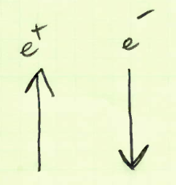
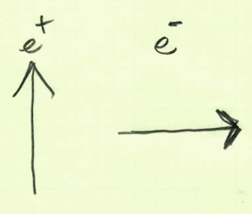
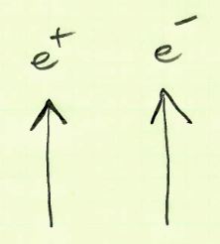
A_{TT} and A_{TT’}
Yield_{TT}(θ, φ) ~ A_{TT}’ cos(φ_{p}) + A_{TT} cos(φ_{p}-2φ)
A_{TT}’ is unique: it is the only transverse polarization observable which, for fixed φ_{m} – φ_{p},
survives integration over φ and thus contributes a tiny amount to the total cross section.
This signal reverses when φ_{m} or φ_{p} is reversed. (below)
cos(φ_{m} – φ_{p}) = +1
cos(φ_{m} – φ_{p}) = -1
cos(φ_{m} – φ_{p}) = 0

Slide 26
Explicit Bhabha QED Helicity Amplitudes
I could not find any published calculations of A_{TT}’ . But Hikasa and others have published the following 1st order helicity amplitudes for non-vanishing electron mass.*
Hikasa Term | Helicity Amplitudes | Approximate Analytic Expression (setting β = 1 for readability)
1 | F_{RL}^{RL} = F_{LR}^{LR} = | e² [ 2/(1-cosθ)) - 1 ](1+cosθ)
2 | F_{RL}^{LR} = F_{LR}^{RL} = | e² [ 1/γ² - (1-cosθ) ]
3 | F_{LL}^{RL} = F_{RR}^{RL} = -F_{LL}^{LR} = -F_{RR}^{LR} = -F_{RL}^{LL} = -F_{RL}^{RR} = F_{LR}^{LL} = F_{LR}^{RR} | e² (1/γ)[ 1/(1-cosθ) - 1 ]sinθ
4 | F_{RR}^{RR} = F_{LL}^{LL} = | e² [ 4/(1-cosθ) – (1+cosθ)/γ² ]
5 | F_{RR}^{LL} = F_{LL}^{RR} = | e² (1/γ²)[ –(1+cosθ) ]
If BSM scalars exist, the major effect would be a helicity unsuppressed s-channel contribution to Terms 4 and 5.
* K. Hikasa, PRD 33 (1986) 3203
(see Appendix D)

Slide 27
A_{TT}’ Calculation in the SM
To calculate A_{TT}’, I need to expand the initial-indices-only shorthand of “F_{RR}F_{LL}”:
“F_{RR}F_{LL}”= F_{RR}^{LR}F_{LL}^{LR} + F_{RR}^{RL}F_{LL}^{RL} + F_{RR}^{LL}F_{LL}^{LL} + F_{RR}^{RR}F_{LL}^{RR}
Because Term 3 is suppressed much more than the factor of 1/γ naively suggests,
the dominant SM contribution is from the latter two Term4*Term5 products, F_{RR}^{LL}F_{LL}^{LL} + F_{RR}^{RR}F_{LL}^{RR} .
F_{LL}^{LL} and F_{RR}^{RR} are ~ e² 4/(1 – cosθ) : unsuppressed t-channel exchange
F_{LL}^{RR} and F_{RR}^{LL} are ~ -e² (1 + cosθ)/γ² : suppressed s-channel exchange + potential BSM physics
J = 1
+
t-channel
(unsuppressed)
s-channel
(suppressed by 1/γ² for F_{LL}^{RR} and F_{RR}^{LL} )

Slide 28
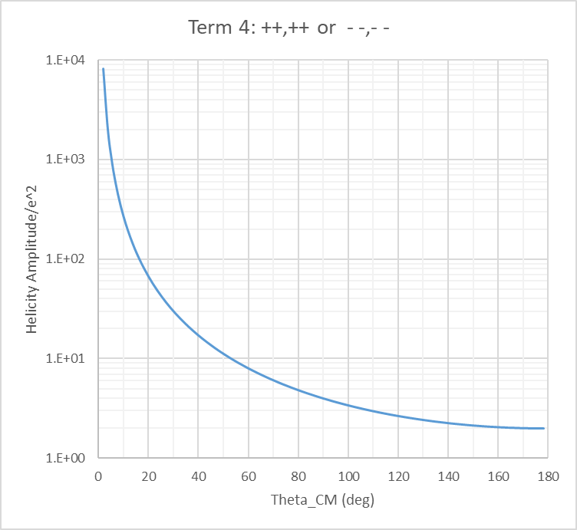
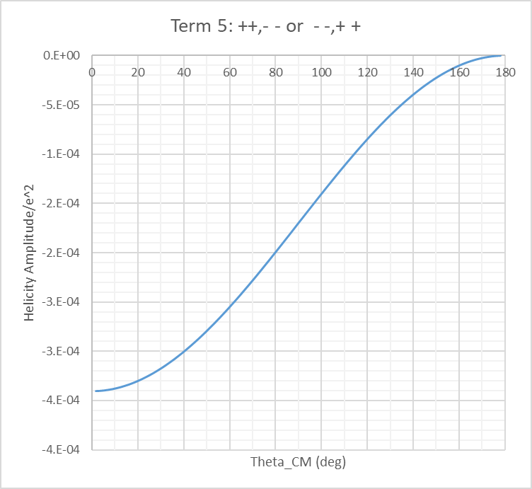
Magnitudes of Terms 4 and 5 at Backward Angles
A_{TT}’ is proportional to the product Term4*Term5.
Term 5 is highly helicity suppressed if J = 1 particles like photons are exchanged.
Term 5 is not helicity suppressed when J = 0 particles are exchanged.
“s-channel SM-suppressed amplitude”
O(1E-4)
“t-channel carrier wave”
O(1)

Slide 29
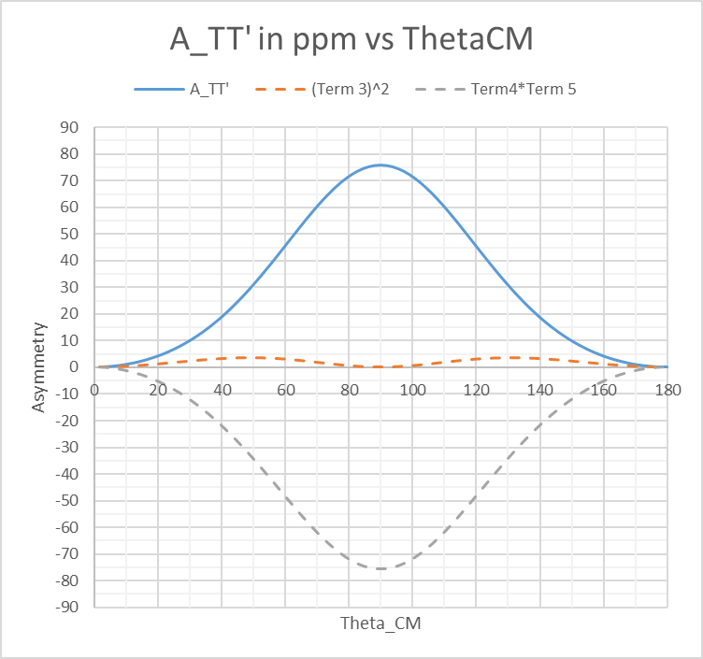
A_{TT}’ Result in the SM
Here is the asymmetry using the exact 1st order QED helicity amplitudes:
The asymmetry is fairly small, ~75 ppm at 6 GeV at 90deg.
There is no zero crossing.
(For what it’s worth, I note that 1/γ² is 167 ppm.)
The sign convention for this asymmetry
was [ Yield(+1,+1) – Yield(-1,+1) ]/Sum

Slide 30
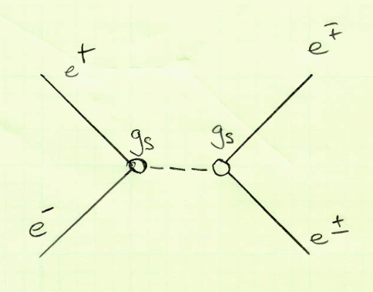
Adding a BSM Scalar to A_{TT}’
I added the BSM scalar amplitude in a manner suggested in the old Hikasa reference.
However, to eventually publish a plot of projected exclusion in scalar coupling vs mass, and compare to modern papers, I need to incorporate the propagator. This is a work in progress.
The dominant scalar contribution to A_{TT}’ will be thru doubly suppressed amplitudes F_{LL}^{RR} and F_{RR} ^{LL}
F_{RR}^{LL} = F_{LL} ^{RR} = - e²(1 + cosθ)/γ² + g_{s}²*propagator
then
A_{TT}’ ~ F_{RR}^{LL}F_{LL}^{LL} + F_{RR}^{RR}F_{LL}^{RR} would be approximately
2[4e²/(1 – cosθ)] *[ -e² (1 + cosθ)/γ² + g_{s}²*propagator ]
* K. Hikasa, PRD 33 (1986) 3203
(page 3208)

Slide 31
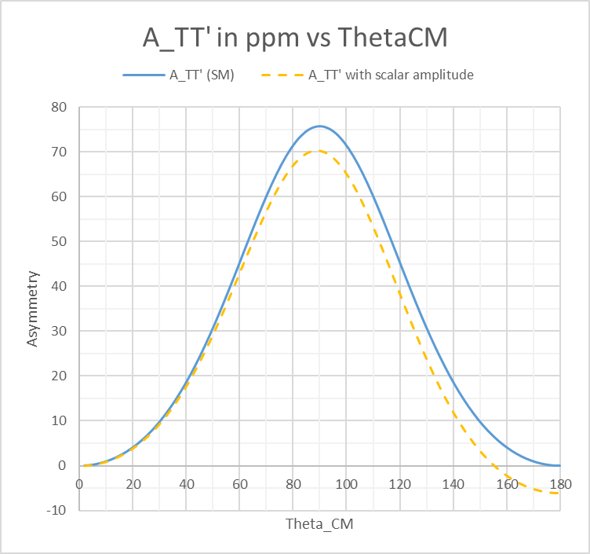
A_{TT}’ Including a BSM Scalar Amplitude
Very preliminary.
For E = 6 GeV, which corresponds to E_{cm} ~ 77.5 MeV/c².
The scalar mass was set to 25 MeV/c², and a coupling g_{s} = 1E-3.
Comments:
This plot is representative of
the Mass << E_{cm} scenario.
The other two scenarios are:
Mass >> E_{cm}
(contact interaction, less sensitive)
and
Mass ~ E_{cm}
(resonance, much more sensitive).

Slide 32
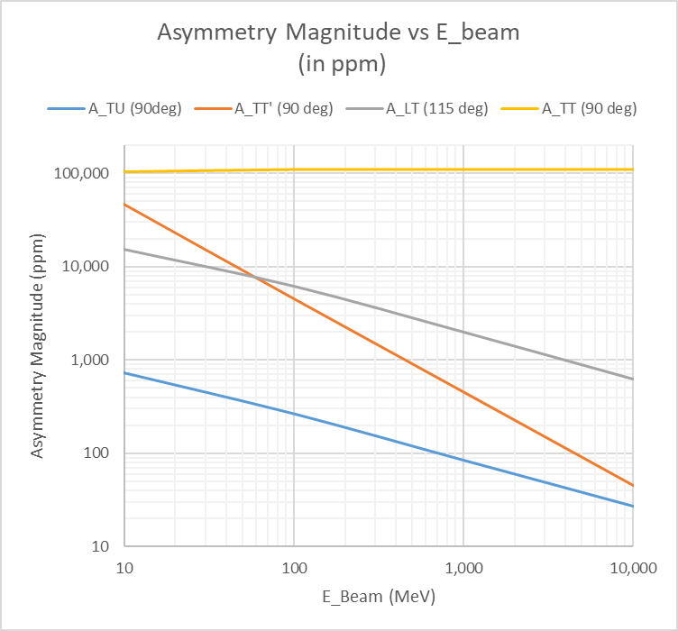
Transverse Asymmetry Magnitudes vs E_{beam}
This plot gives an idea
of the magnitude variation expected for these helicity-suppressed asymmetries.
A_{TT} ~ 0.11
A_{LT} ~ 1/γ
A_{TT}’ ~ 1/γ²
A_{TU} ~ α/γ

Slide 33
Transverse Asymmetry Magnitudes vs E_{beam}
This plot gives an idea
of the magnitude variation expected for these helicity-suppressed asymmetries.
Below 100 MeV,
A_{TT}’ and A_{LT} become larger than 1%.
We will likely make the first measurements of these asymmetries in the future e+ injector, years before GeV-scale positrons are available in Hall C.
A_{TT} ~ 0.11
>1%
A_{LT} ~ 1/γ
A_{TT}’ ~ 1/γ²
A_{TU} ~ α/γ

Slide 34
Transverse Asymmetry Magnitudes vs E_{beam}
This plot gives an idea
of the magnitude variation expected for these helicity-suppressed asymmetries.
Below 100 MeV,
A_{TT}’ and A_{LT} become larger than 1%.
We will likely make the first measurements of these asymmetries in the future e+ injector, years before GeV-scale positrons are available in Hall C.
A_{TT} ~ 0.11
>1%
A_{LT} ~ 1/γ
A_{TT}’ ~ 1/γ²
A_{TU} ~ α/γ
International Workshop on Low Energy e± Physics at Jefferson Lab (LEEPP@JLab)
Nov 3-7, 2025

Slide 35
Summary
A_{TT}’ : I find this asymmetry to be sensitive to light J = 0 particle exchange (which is a BSM source of unsuppressed, double helicity flip).
A_{LT} : I find this double-spin asymmetry is not sensitive to light J = 0 particle exchange.
By analog to the work of Wen et al, it may be sensitive to BSM sources of unsuppressed, single helicity flip, referred to in their work as SMEFT dipole operators.

Slide 36
extras

Slide 37
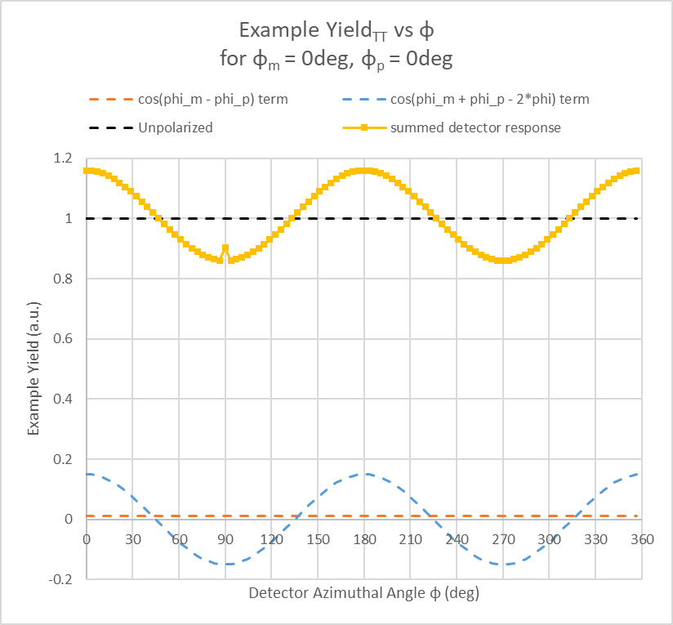
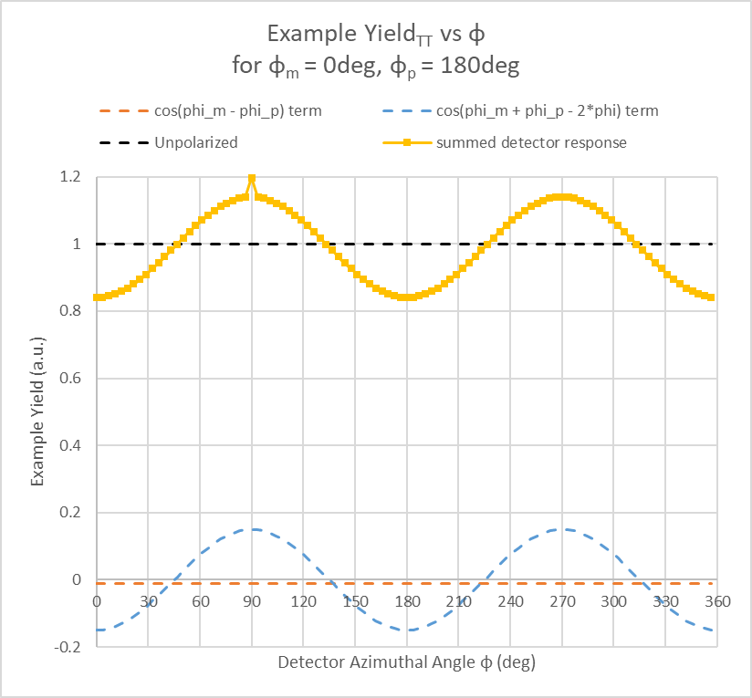
Can We Actually Pull Out the A_{TT}’ Signal?
Target e- polarization fixed at 0deg. Reversing the e+ polarization reverses all asymmetries.
A_{TT}
represented
by big signal.
I injected an instrumental
asymmetry
as a multiplicative factor
A_{TT}’
represented
by small,
monopole signal.

Slide 38
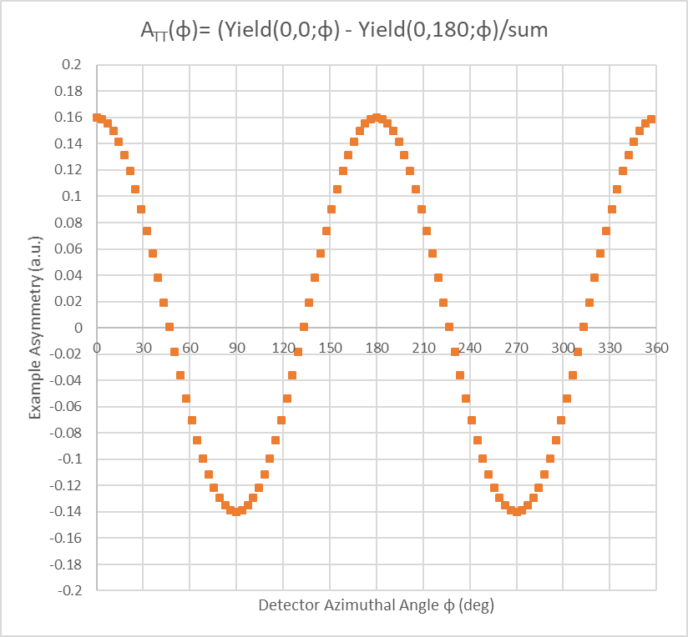
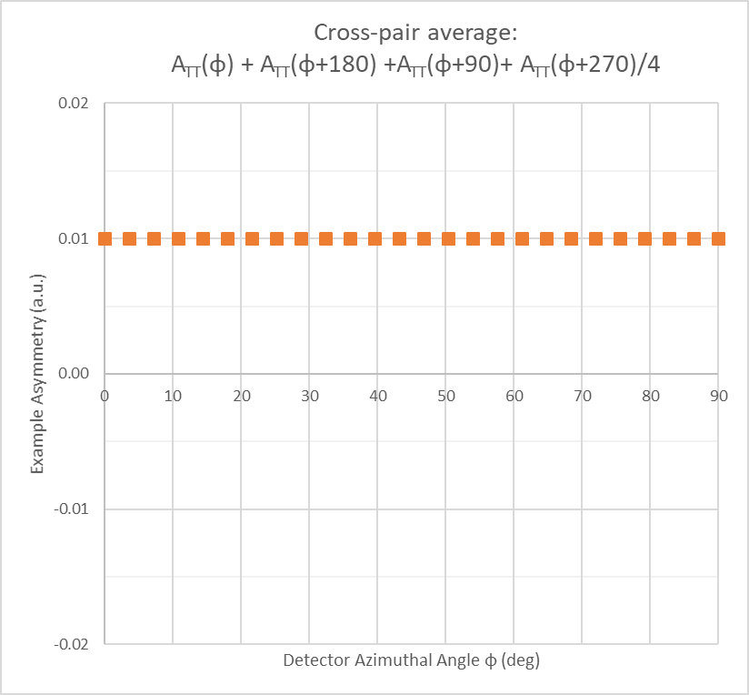
Can We Actually Pull Out the A_{TT}’ Signal?
Calculating the asymmetry after reversing the e+ polarization:
Averaging over the azimuthal angle in principle
cancels the large cos(2φ) asymmetry, leaving A_{TT}’.
Extraction of A_{TT}’ looks feasible
provided cancellation of the cos(2φ)
asymmetry is excellent.
Instrumental asymmetry
as a multiplicative factor
of course cancels exactly:
A = (gN⁺ - gN⁻)/(gN⁺ + gN⁻) = (N⁺ - N⁻)/(N⁺ + N⁻)

Slide 39
But What About Nonlinearity?
Keep in mind, the cos(2φ) term is 4 orders of magnitude larger than the monopole signal of A_{TT}’!
A quick study suggests nonlinearity as large as 1% would not be a serious issue if it is the same for all detector channels.
But a differential nonlinearity between detectors at the +-1% level would break the azimuthal asymmetry. This is potentially serious since I find the resulting leakage into the monopole reverses just like the physics signal of interest when φ_{m} or φ_{p} is reversed:
The brute force solution would be to design highly linear detectors, use beam intensity noise to measure the remaining small nonlinearity for each detector φ bin, then make corrections.

Slide 40
But What About Nonlinearity?
A more elegant and robust solution would be, for half the experiment, to shift the phase of the cos(2φ) signal by 90 degrees. Thus, while the A_{TT}’ signal is held constant, background peaks in a detector would become troughs in the same detector, and vice versa.
The following would largely cancel the cos(2φ) background, as well as any broken symmetries induced by nonlinearity:
A_{TT}’ ~ [Y(+0°,+0°) + Y(+90°,+90°)] – [Y(0°,+180°) + Y(+90°, -90°)]
Original A_{TT}’ calculation
Revised A_{TT}’ calculation
So we’d need to be able to do slow reversals which alternate between Horizontal and Vertical transverse polarization, while adjusting the target polarization angle by 90° as well.
This needs much more study. But I think I have identified the most serious issue with A_{TT}’, and have a tentative solution.

Slide 41
H running (Tgt angle also H) | φ_{p}
φ_{m} |  | 180 | 0
 | 180 | φ_{m}-φ_{p} = 0 (φ_{m}+φ_{p} = 0) | 180 (180)
 | 0 | -180 (180) | 0 (0)
 | φ_{p}
φ_{m} |  | 180 | 90 | 0 | -90
 | 180 | φ_{m}-φ_{p} = 0 (φ_{m}+φ_{p} = 0) | 90 (90) | 180 (180) | -90 (90)
 | 90 | -90 (-90) | 0 (180) | 90 (90) | 180 (0)
 | 0 | -180 (180) | -90 (90) | 0 (0) | 90 (-90)
 | -90 | 90 (90) | -180 (0) | -90 (-90) | 0 (-180)
V running (Tgt angle also V) | φ_{p}
φ_{m} |  | 90 | -90
 | 90 | 0 (180) | 180 (0)
 | -90 | -180 (0) | 0 (-180)
ATT’ with excellent cos(2phi) cancellation =
(Yellow+Orange) – (Green+Yellow-green)
The unused “90 (90)” blocks above would be null tests for ATT’.
As can be seen on the right, these null settings do not occur in normal
H or V running setups.

Slide 42
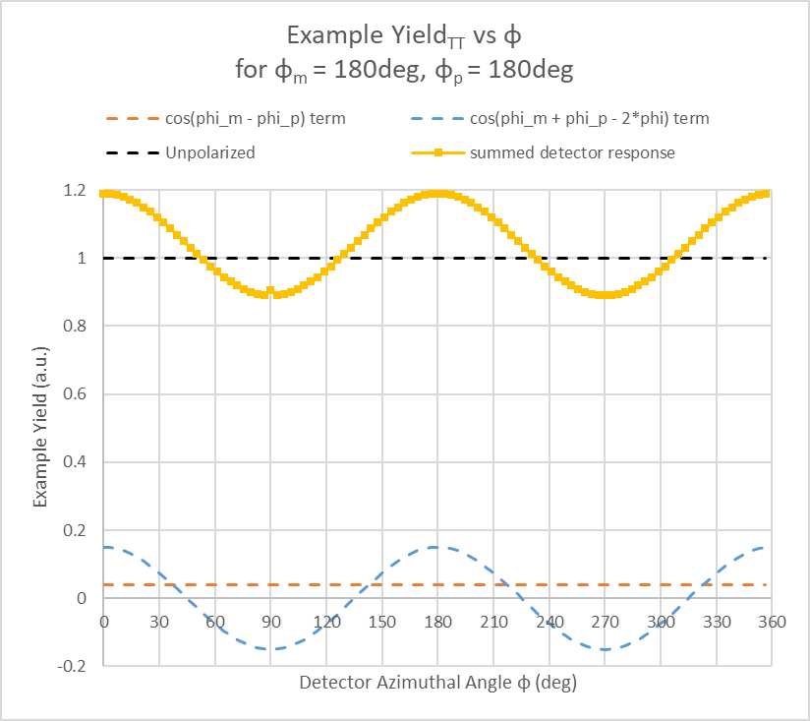
At any fixed φ
Flip e+,
reverse signal
Flip e-,
reverse signal

Slide 43
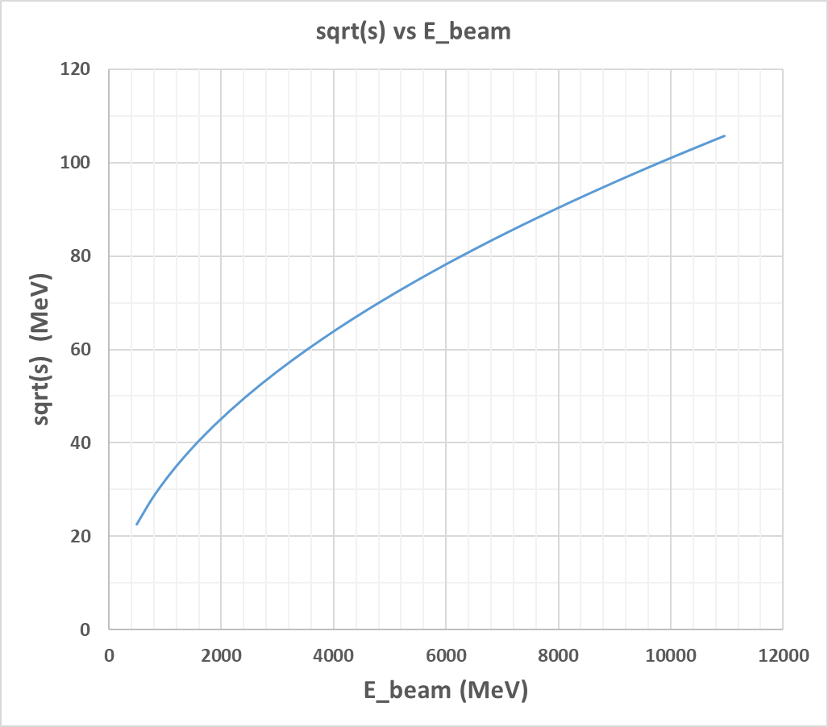
E_{cm} in Bhabha Scattering in Jlab Fixed Target Kinematics
At a 12 GeV CEBAF, the CM energy range will be ~20-105 MeV/c².
E_{cm} = sqrt(s) = sqrt(2m_{e}² + 2E_{beam}*m_{e})
~ sqrt(E_{beam})
Notes:
due to the sqrt factor above, it takes a roughly 100 MeV change in E_{beam} to produce a 1 MeV change in E_{cm}.
(Hold that thought for later!)
since the differential xsect contains a factor of 1/s, and s is small, the xsect is large by Jlab standards, O(1)-O(100) muB/sr at 90deg CM.

Slide 44
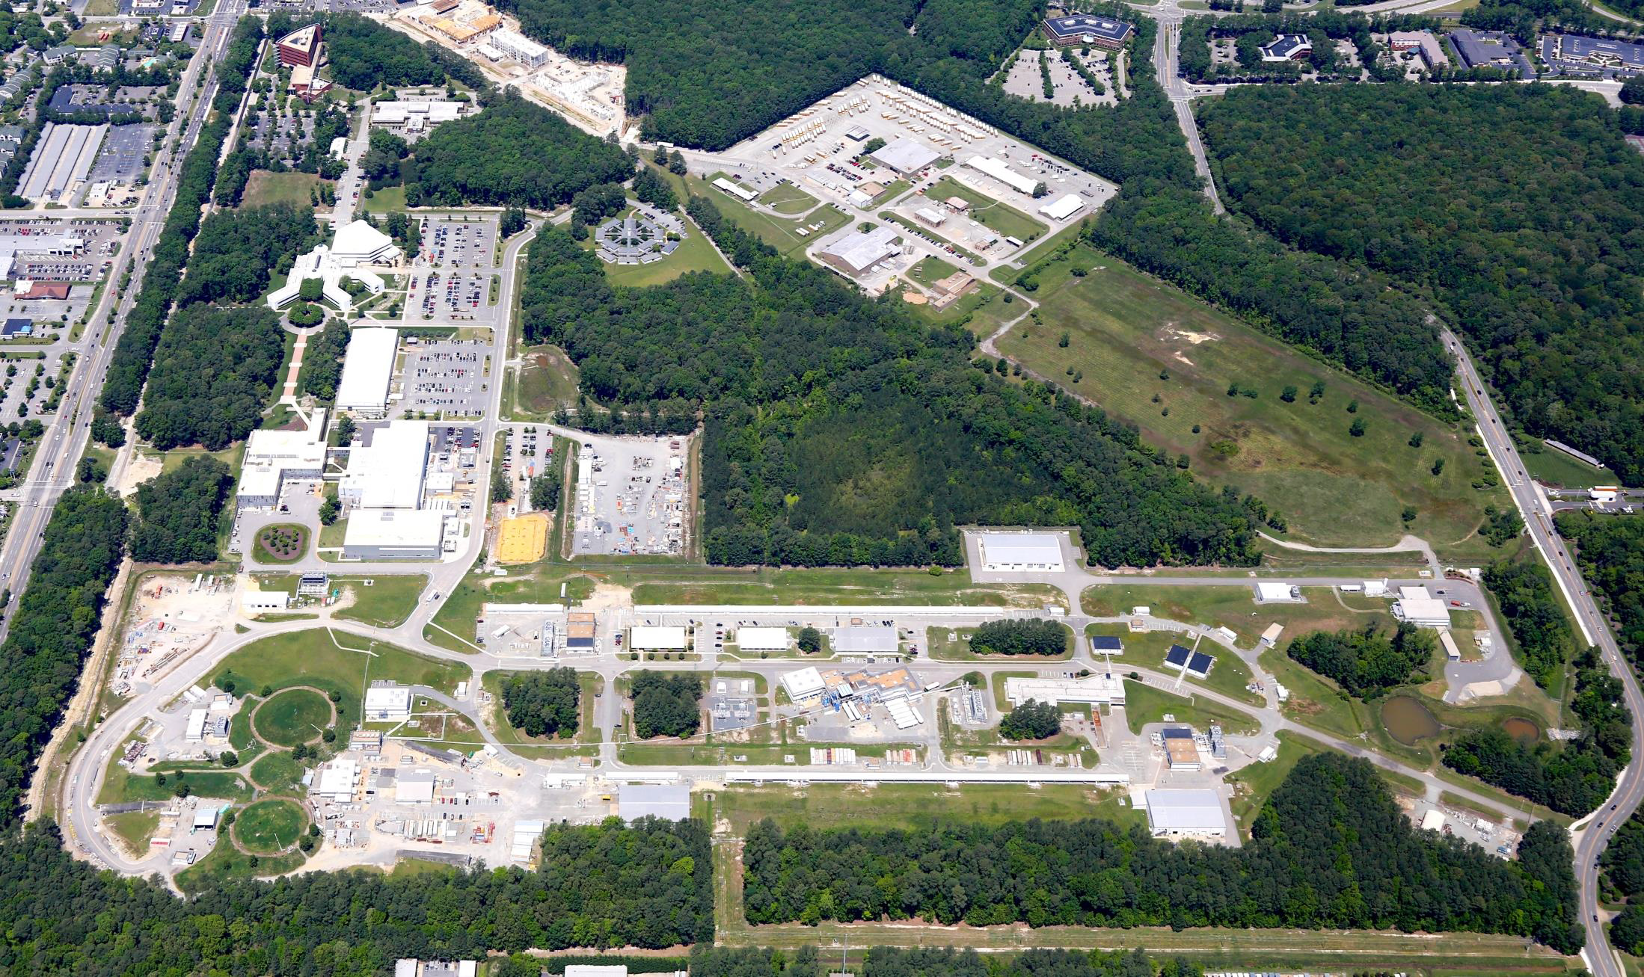
Jlab 12 GeV CW Electron Accelerator

Slide 45
Capability With a Future Positron Injector
Machine Parameter | Electrons | Positrons
Hall Multiplicity | 4 | 1 or 2
Energy (ABC/D) | 11/12 GeV | 11/12 GeV
Beam Repetition | 249.5/499 MHz | 249.5/499 MHz
Duty Factor | 100% cw | 100% cw
Unpolarized Intensity | 170 µA | > 1 µA
Polarized Intensity | 170 µA | > 50 nA
Beam Polarization | > 85% | > 60%
Fast/Slow Helicity Reversal | 1920 Hz/Yes | 1920 Hz/Yes
!
See talk by Joe Grames at https://indico.jlab.org/event/819/ from the March 2024 PWG Workshop.
There were also many talks on future experiments and related theory calculations.

Slide 46
The Double Spin Asymmetry, A_{LT} (perhaps useful for BSM dipole interactions)

Slide 47
A_{LT}(θ, φ)
A_{LT}(θ, φ) ~ P_{e+}^{L} P_{e-}^{T} [ -Re(F_{RL}F_{LL}* - F_{RR}F_{LR}*)cos(φ _{m} – φ) + Im(F_{RL}*F_{LL} + F_{RR}*F_{LR})sin(φ _{m} – φ) ]
A_{TL}(θ, φ) ~ P_{e+}^{T} P_{e-}^{L} [ +Re(F_{LR}F_{LL}* - F_{RR}F_{RL}*)cos(φ_{p} – φ) + Im(F_{LR}*F_{LL} + F_{RR}*F_{RL})sin(φ_{p} – φ) ]
PC PV
Let’s focus for now on the PC observable in which the e⁺ beam is L polarized, and the e- target is T polarized:
A_{LT} : The term -Re(F_{RL}F_{LL}* - F_{RR}F_{LR}*)cos(φ _{m} – φ) is singly helicity suppressed, decreasing like 1/γ . This will be the focus of the rest of this section.
Note that A_{LT} has a remarkable complementarity with A_{TU}: the former’s PC part measures the Real(F_{RL}F_{LL}* - F_{RR}F_{LR}*) while the latter measures the Imaginary(F_{RL}F_{LL}* - F_{RR}F_{LR}*).

Slide 48
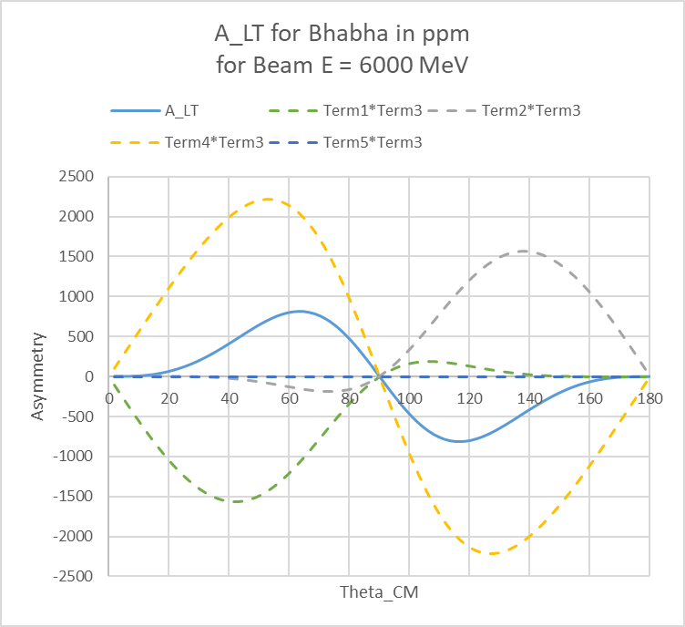
A_{LT} vs θ_{cm}
Using the same Hikasa helicity amplitudes:
Despite significant cancellation, the asymmetry is not small by JLab standards, ~800 ppm at 6 GeV.
This is ~2 orders of magnitude larger than A_{TT}’ at the same beam energy.
There is also a zero crossing at 90degCM.
A scalar interaction would evade the helicity suppression in F_{RR}^{LL} and F_{LL}^{RR} . So what does that sensitivity look like?

Slide 49
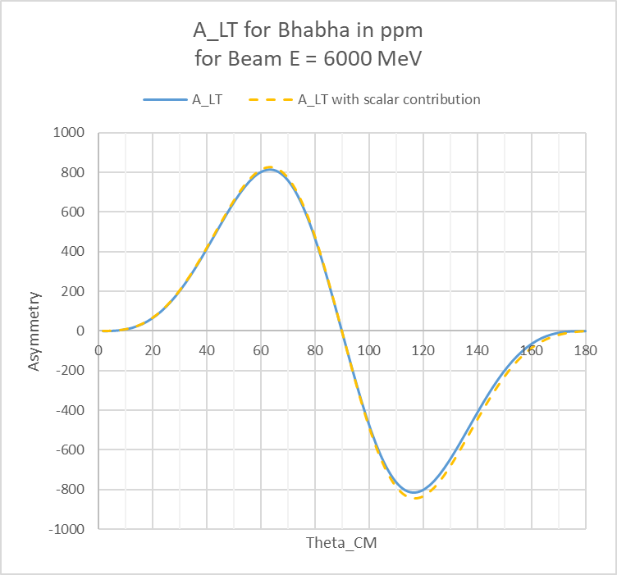
A_{LT} vs θ_{cm}
After inserting a large scalar interaction of 4f_{s}²p² = 0.02
in the helicity amplitudes F_{RR}^{LL} and F_{LL} ^{RR} :
Oof! This is much less sensitive than A_{TT}’.
Handwavingly, A_{LT} appears to be 3 orders of magnitude less sensitive than A_{TT}’.
Most of that is because the SM background in A_{LT} is ~2 orders of magnitude larger.
The remaining reason: our beloved carrier wave, the 1-photon exchange amplitude, is unfortunately helicity suppressed even when the scalar amplitude is not.
It’s never been measured!

