Slide 1
Wrangling Complex Notebook
Workflows with Floability
Douglas Thain, on behalf of the Floability team:
Saiful Islam, Talha Aziz, Shahadat Hossain, Raza Ahmad,
Furquan Baig, Tanu Malik, Kevin Lannon, Shaowen Wang
Throughput Computing 2025
Madison, WI July 2024

Slide 2
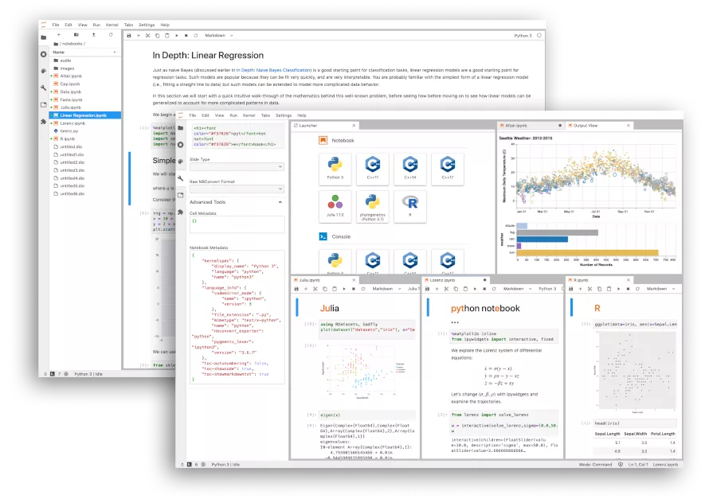
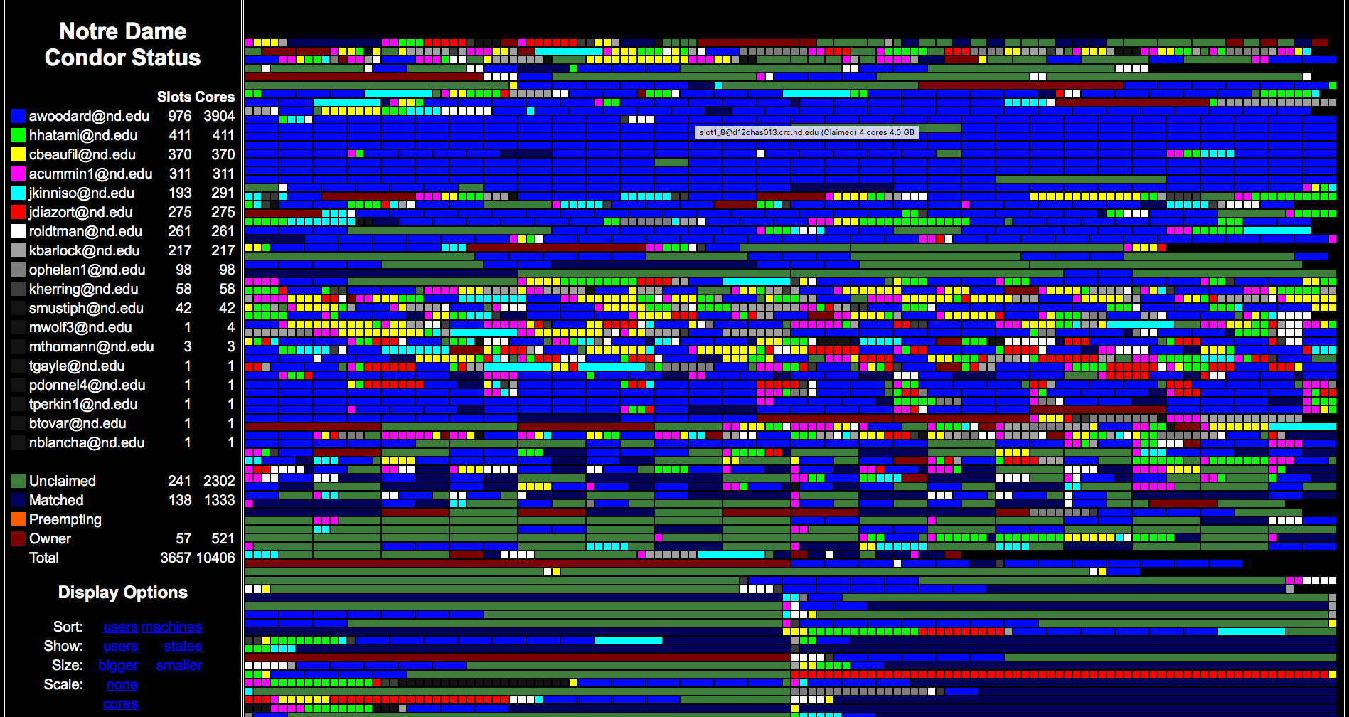
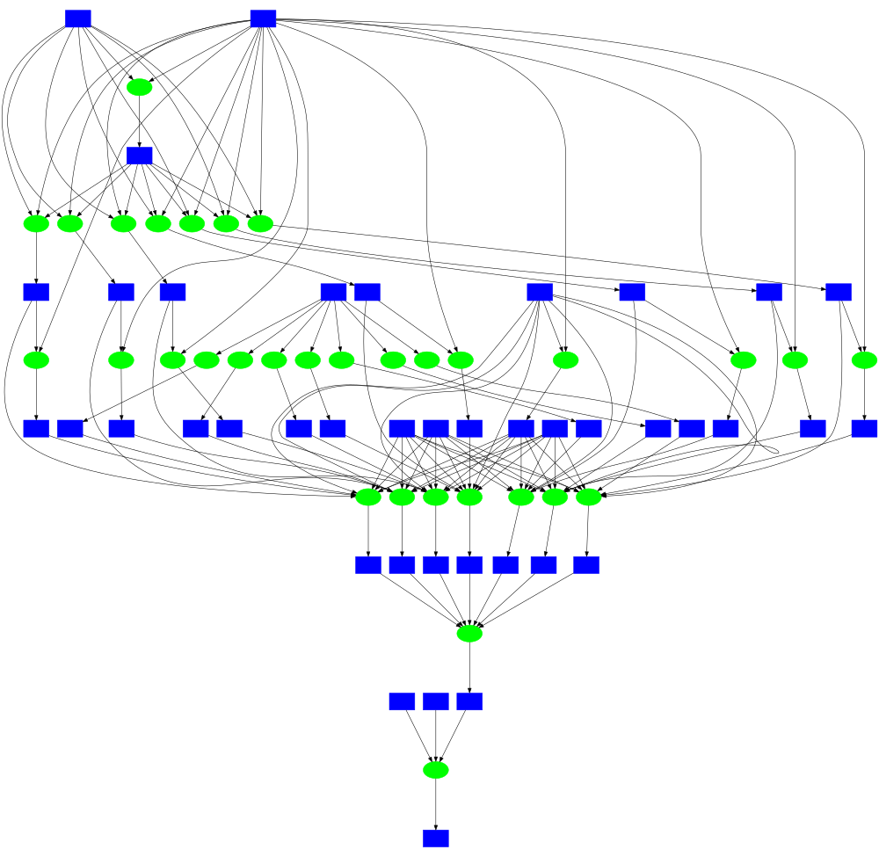
Two Different Worlds of Computing?
Interactive Notebooks
Graphical, Interactive, Personal, Limited
High Throughput Workflows
Scripting, Batch, Shared, Scalable

Slide 3
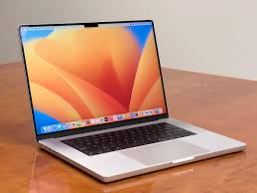
Nobody* Starts with High Throughput!
They begin by writing Python in a notebook on the laptop.
And then they share and publish that notebook with others.
After a while… they bump up against the limits of one node.
???

Slide 4
The Floability Project aims to enable the rapid and portable deployment of notebooks expressing complex scientific workflows across a wide range of cyberinfrastructure.
CSSI Frameworks: From Notebook to Workflow and Back Again

Slide 5
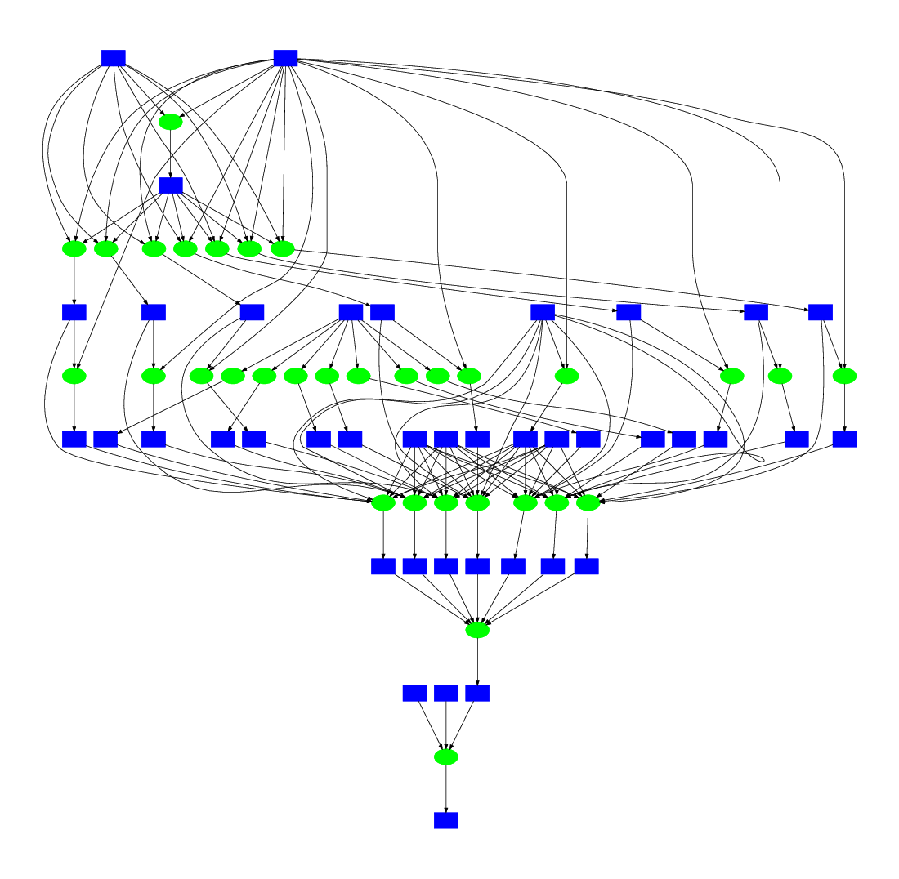
You cannot deploy a notebook workflow
effectively without all the supporting environment.
Notebook
Notebook
"Just run this workflow!"
Workflow
Software
Data
HPC Cluster
HPC Cluster
Workflow Runs
at Facility A
Workflow Fails
at Facility B

Slide 6
Workflow
Backpack
A backpack contains everything needed
to deploy a notebook workflow at large scale.
Notebook
Workflow
Software
Data
Cluster Specs

Slide 7
HPC Cluster
(HTCondor, SLURM, UGE,...)
Floability deploys a backpack into a facility.
2. interact
Head Node
Notebook
Notebook
Worker Nodes
Workflow
Workflow
Worker Code
Software
Software
Software
Data
1. deploy
Data
Resources
Cluster Specs
Backpack
Computing Facility

Slide 8
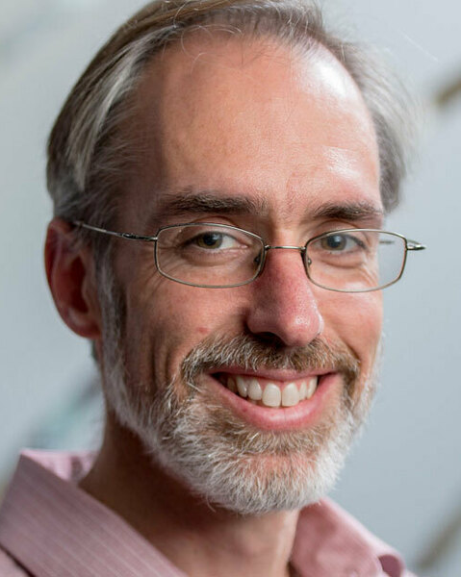
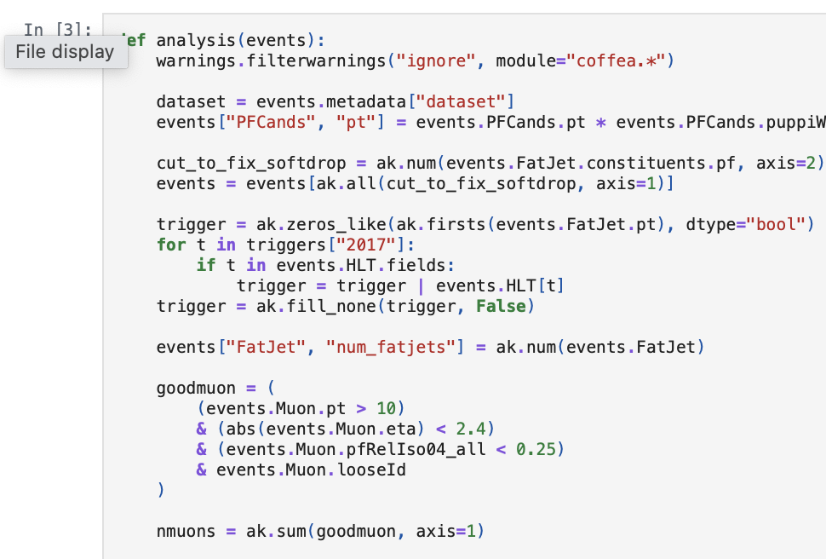
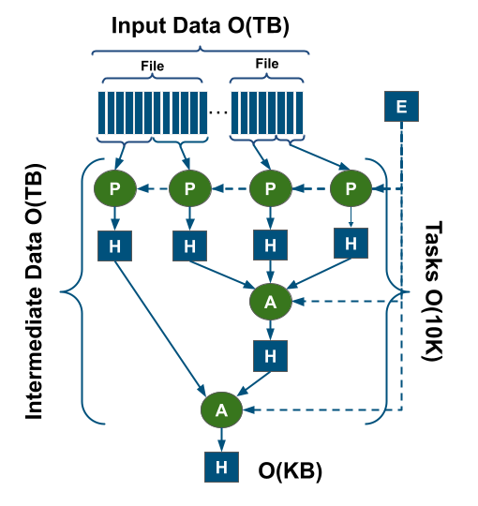
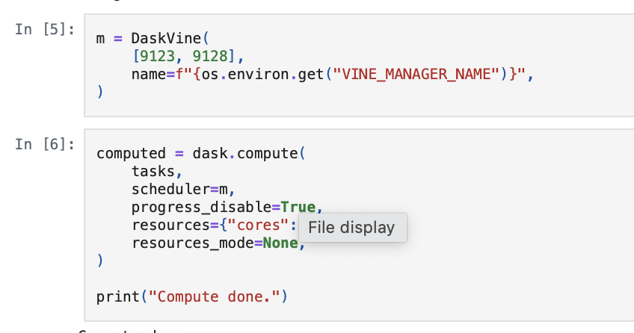
Example: DV5 CMS Analysis Application
http://dx.doi.org/10.1109/SC41406.2024.00068
Kevin Lannon
Connor
Moore
Consumes 1.5TB Data
Submits 17K Tasks
Uses 2400 cores, 200 nodes.

Slide 9
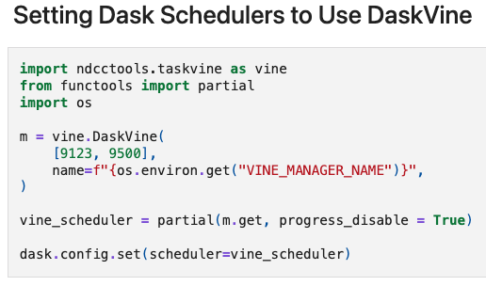
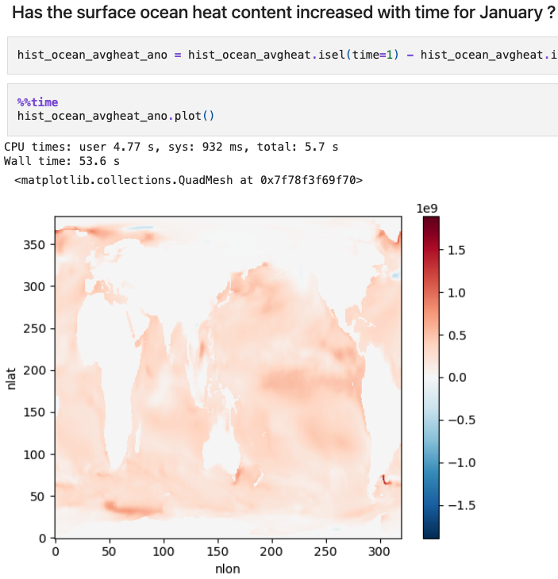
Example: Surface Ocean Heat (CESM2)
https://github.com/floability/floability-examples/tree/main/cesm_oceanheat
Harsha Hampapura
Data: CESM2 LENS 1850-2100
Tasks: 2800+ parallel jobs
Tools: Xarray + Dask/TaskVine
Notebook Size: 1.3 MB
Backpack Size: 1.5 MB

Slide 10
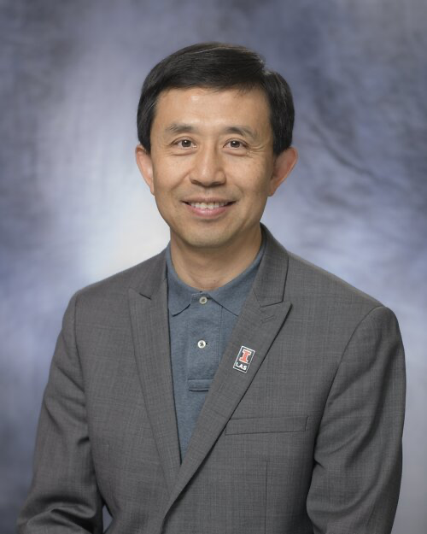
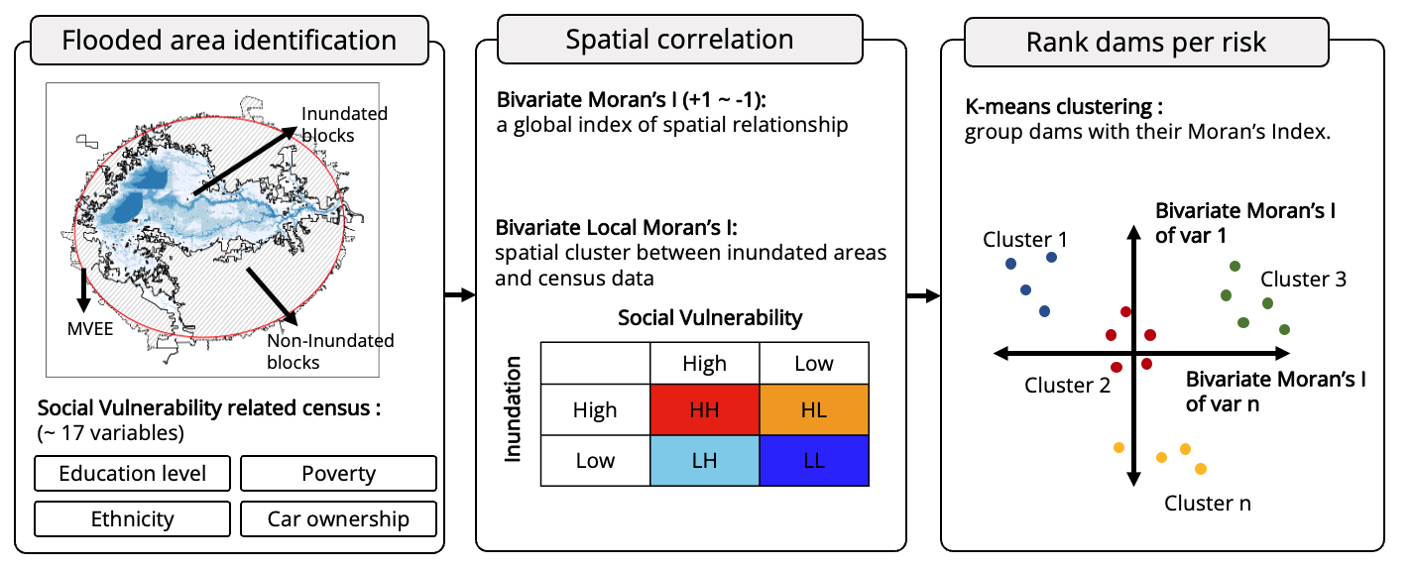
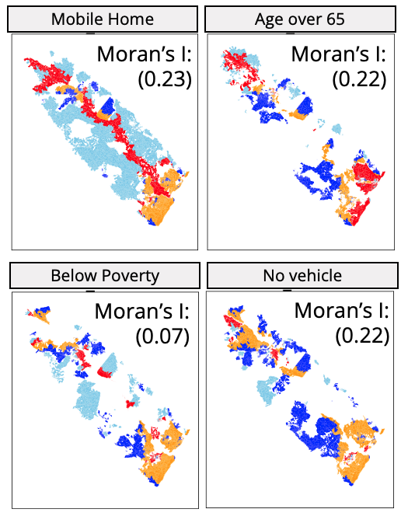
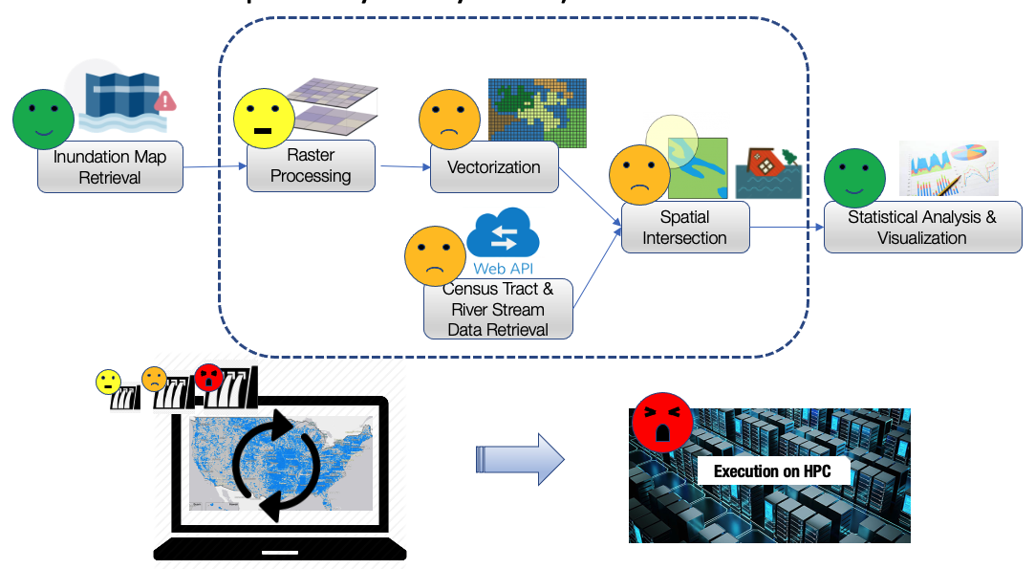
Example: Aging Dams Simulation Workflow
https://github.com/floability/floability-cli/tree/distributed-iguide-gis-aging-dams/example/iguide-gis-aging-dams
Analyze Downstream Impacts of Dam Failures to Critical Infrastructure, Vulnerable Populations & Ecosystems
Furquan Baig
Shaowen
Wang
Modularized steps
(Flooded area identification)
Backpack captured but not distributed (yet)

Slide 11
So What's Actually in a Backpack? (V1)
https://github.com/floability/floability-examples/tree/main/cms-physics-dv5
workflow
cms-physics-dv5.ipynb
software
environment.yml
worker-environment.yml
data
data.yml
samples/qcd/…/nano_mc2017_11.root
samples/diboson/…/nanomc2017_6.root
compute
compute.yml

Slide 12
So What's Actually in a Backpack? (V1)
https://github.com/floability/floability-examples/tree/main/cms-physics-dv5
workflow
cms-physics-dv5.ipynb
software
environment.yml
worker-environment.yml
data
data.yml
samples/qcd/…/nano_mc2017_11.root
samples/diboson/…/nanomc2017_6.root
compute
compute.yml

Slide 13
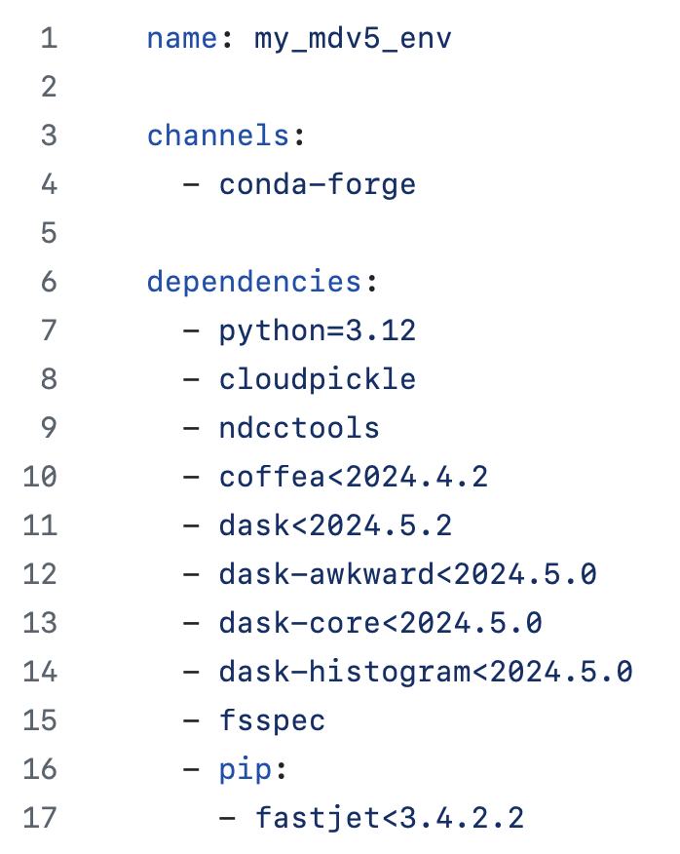
So What's Actually in a Backpack? (V1)
https://github.com/floability/floability-examples/tree/main/cms-physics-dv5
workflow
cms-physics-dv5.ipynb
software
environment.yml
worker-environment.yml
data
data.yml
samples/qcd/…/nano_mc2017_11.root
samples/diboson/…/nanomc2017_6.root
compute
compute.yml

Slide 14
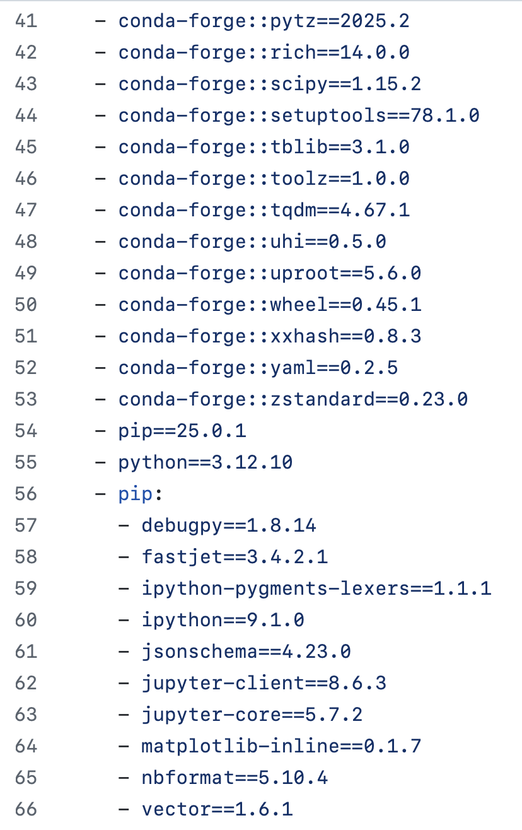
So What's Actually in a Backpack? (V1)
https://github.com/floability/floability-examples/tree/main/cms-physics-dv5
workflow
cms-physics-dv5.ipynb
software
environment.yml
worker-environment.yml
data
data.yml
samples/qcd/…/nano_mc2017_11.root
samples/diboson/…/nanomc2017_6.root
compute
compute.yml

Slide 15
How do you find software/data deps?
Use the SciUnit technology to instrument a running notebook to observe the Python dependencies of the manager/worker.
Fils, Gabriel, Zhihao Yuan, and Tanu Malik. "Sciunits: Reusable research objects." In 2017 IEEE 13th International Conference on e-Science (e-Science), pp. 374-383. IEEE, 2017.

Slide 16
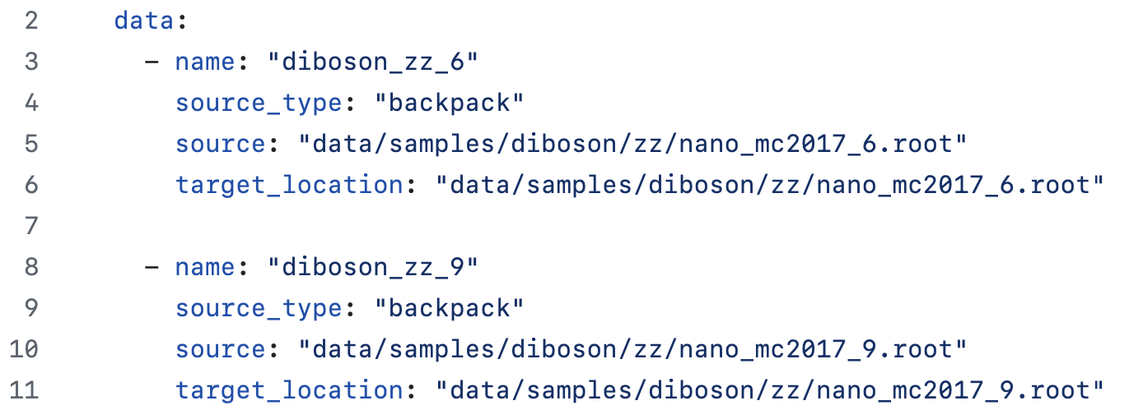
So What's Actually in a Backpack? (V1)
https://github.com/floability/floability-examples/tree/main/cms-physics-dv5
workflow
cms-physics-dv5.ipynb
software
environment.yml
worker-environment.yml
data
data.yml
samples/qcd/…/nano_mc2017_11.root
samples/diboson/…/nanomc2017_6.root
compute
compute.yml
Opportunity to connect Pelican!

Slide 17
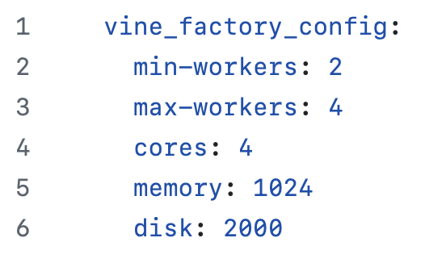
So What's Actually in a Backpack? (V1)
https://github.com/floability/floability-examples/tree/main/cms-physics-dv5
workflow
cms-physics-dv5.ipynb
software
environment.yml
worker-environment.yml
data
data.yml
samples/qcd/…/nano_mc2017_11.root
samples/diboson/…/nanomc2017_6.root
compute
compute.yml
400

Slide 18
Workflow
Data Specs
Software Specs
Resource Specs
1. Deploy
Backpack
copy
fetch
install
provision
floability instance
$$$
$$$
Workflow
data
worker
tarball
vine_factory
floability
manager
tarball
dynamically
submit
workers
manager software environment
batch system
2. Interactive
Access
notebook kernel
data
batch job
worker software environ
manager
connect
worker

Slide 19
Deployment is a Work in Progress
Workflow | ND CRC | Purdue Anvil | UT Stampede3 | AWS Cluster | OSPool
DV5 | ✔️ | ✔️ | ✔️ | ✔️
DConv | ✔️ | ✔️ | ✔️ | ✔️
CTrend | ✔️ | ✔️ | ✔️ | ✔️
CESM Ocean Heat | ✔️ | ✔️ | ✔️ | ✔️
Montage | ✔️
https://github.com/floability/floability-examples

Slide 20
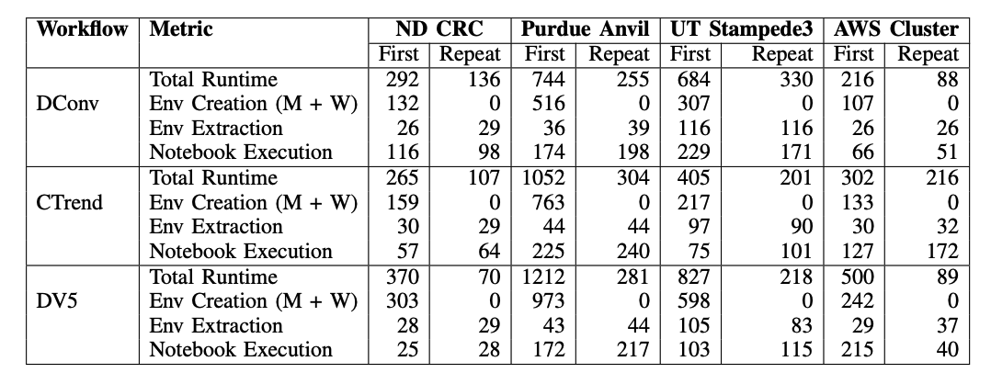
Deployment to Multiple Sites: floability run

Slide 21
floability.github.io
Overall Project Status:
Year one of a four year translational project.
MVP of the Floability tool is published via Conda:
conda install -c conda-forge floability
Currently gathering and testing applications at multiple sites.
OSPool – Need to be able to connect from worker to manager.
Looking for applications and (brave) initial users.

Slide 22
Looking Ahead to New Challenges
Evaluate "Whole Workflow" Requirements
Find more ways to say NO prior to execution: available disk space, worker capacity, network utilization, cluster architecture…
Reconciling Interactive and Batch Allocation
The interactive allocation is not useful without the batch allocation, and vice versa. Both have limited capacity to be managed!
Capture Site Specializations
Every facility is a snowflake. Can we capture functional differences (network, storage, policy) between facilities in a constructive way?
Exploit Concurrency in Notebook Structure
Instead of writing in a parallel framework, can we infer independent tasks from the cell structure itself?

Slide 23
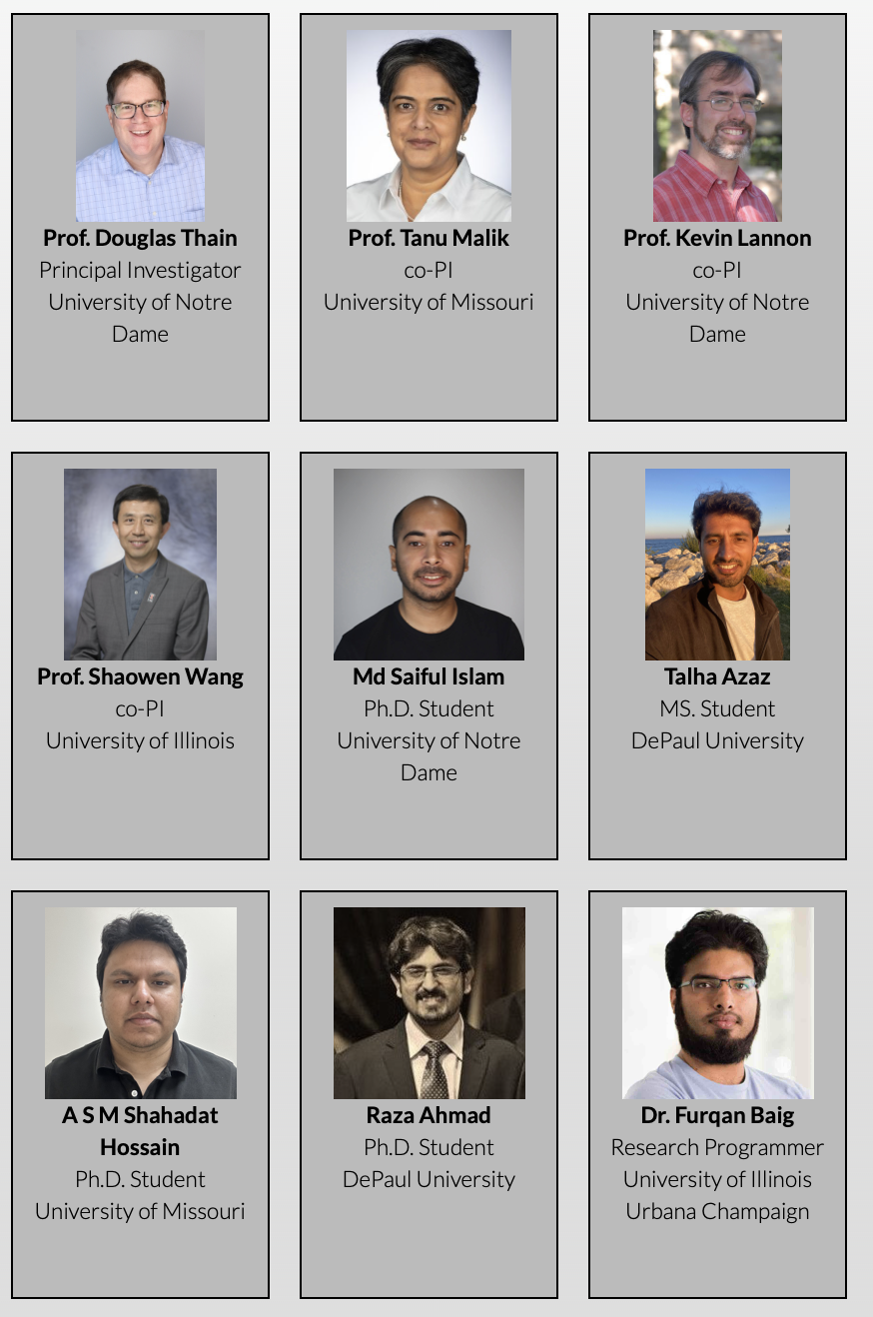
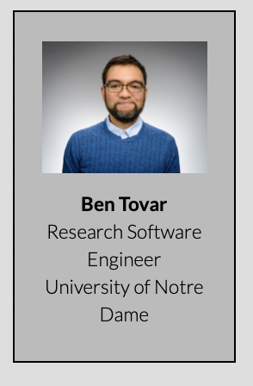
floability.github.io
conda install -c conda-forge floability
This work was supported in part by NSF grant 2411436 CSSI Frameworks: From Notebook to Workflow and Back Again

