Slide 1
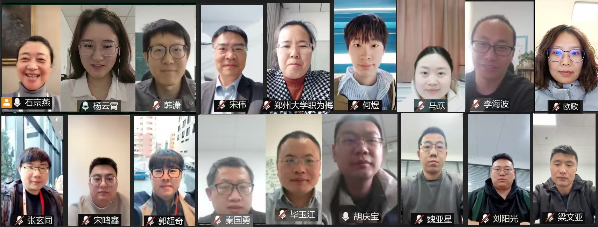
From Backend to Interactive Based on HTCondor
Jingyan Shi
shijy@ihep.ac.cn
Computing Center, Institute of High Energy Physics, Chinese Academy of Science
On Behalf of the INK Team
Throughput Computing 2025
Notes:
、

Slide 2
Outline
Interactive aNalysis worKbench (INK)
1
Motivation
2
Design and Development
3
Current Status and Next Steps
4
Summary

Slide 3
Traditional HEP Batch System Workflow
Start
Characteristics
Closed environment
Offline Processing
Backend Resource Utilization
Limitations
Requires SSH access to login nodes for coding / debugging
User direct file access limited to login node
Interactive tools (VSCode, Jupyter, etc.) strain login node resources
No real-time job monitoring or control after submission
Results only available after the job completion
ssh login node
Edit program
debug program
N
Successful?
Y
Edit job script
Submit batch job
Waiting
N
Job finished?
Y
Check the result
End

Slide 4
Evolving HEP Analysis Requirements
Start
Login mode changed
new terminal tool
New shell
Demand for new development tools
Feature-rich development tool like VSCode，Jupyter, Pycharm over basic terminal
Need for AI-assisted coding(copilot)
Demand for debugging & execution
Online plotting and result sharing
Simplified, on-demand runtime environment setup (esp. for new comer)
Runtime environments switching on demand
ssh login node
Code tool changed：
VSCode
AI copilot
Edit program
debug program
Debugging mode changed
Jupyter
Online ploting
result sharing
N
Successful?
Y
Edit job script
Submit batch job
Job tracing
Intermediate result
adjustments
Waiting
N
Job finished?
Y
Check the result
End

Slide 5
Evolving HEP Analysis Requirements
Job Execution Paradigm
Real-time job tracking and monitoring
Dynamic parameter adjustments
Examples:
Partial Wave Analysis:
Geant4 Simulation:
Computing and storage resource Access
Anytime, anywhere
Run task anytime, anywhere
Access data file anytime, anywhere
Analysis facility
Loosely definition: infrastructure and services that provide integrated data, software and computational resources to execute on or more elements of analysis workflow
Batch system: infrastructure of AF
Transition from “Closed & Backend” to “Open & Frontend”
Data clean
Parameter Optimization
Result Visualization
Taken from https://hepsoftwarefoundation.org/activities-archive/analysisfacilitiesforum.html

Slide 6
INK: Interactive aNalysis worKbench
Visionary goal
Scientific research with just a network connection
Shift backend / offline computing and storage resources to the frontend / interactive for enhanced accessibility
Enable flexible integration of resources and applications
Provide customized interactive tools for HEP experiments
Offer plus-and-play deployment solution for the HEP computing sites
Immediate goal
Scientific research with just a web page
Provide web-based interactive analysis tool based on HTCondor cluster
Leverage web technologies : VSCode, Jupyter, Rootbrowse, VNC, Enode
Run on the dedicated HTCondor job slot : no interference each other
Enable external file system access
Files could be accessed via web page directly
Upload / Download / View
Provide web-based Eshell terminal for command-line interactions

Slide 7
Key Development Challenges
Loose and flexible software architecture
Customizable: each HEP experiment configure its own resource and applications
Configurable: resources allocation, applications, default settings
Ready-to-use deployment for site
Secure authentication & authorization
Support diverse methods (SSO, token, passwd, commercial account)
Secure for the computing and storage resource usage
Maintain consistent access policies for external/internal users
Seamless resource & application integration
Various resources integration: HTCondor, Slurm, Kubernetes, EOS, Lustre etc.
Flexible application integration mechanism

Slide 8
Loose and Flexible Architecture
User Interface
Frontend
SSO
Viewer adaptor
Layer
Web page Template
User interactive module
Info / Parameter Configuration
User Permission DB
User Identity
Menu Template
Image/table display
Plugin template
Bussiness Layer
Password Access
File Access API
App. Running API
Computing Usage API
File System Adapter
App. Adapter
Computing Resource Adapter
Backend
Endpoint Conversion/Transfer
Resource Supply Layer
Storage / Computing Pool
INK Modular Architecture

Slide 9
INK Modular Architecture
Hierarchical layers structure
Separation of frontend and backend
Frontend:
User interface layer: user way to connect resource
Web-based portals
User software
Viewer adapter layer: user portal generator
Backend:
Business logic layer: standardized API for the frontend interaction
Adapter layer: integrates diverse resources (compute, storage, applications）

Slide 10
Authentication and Authorization
Authentication
INK leverages the cluster’s existing authentication mechanism(SSO, IAM, Password etc.)
Mutual trust established among INK components
Authorization
Dedicated INK user permission database governs
Available resources
Allowed Applications
Resources access rights

Slide 11
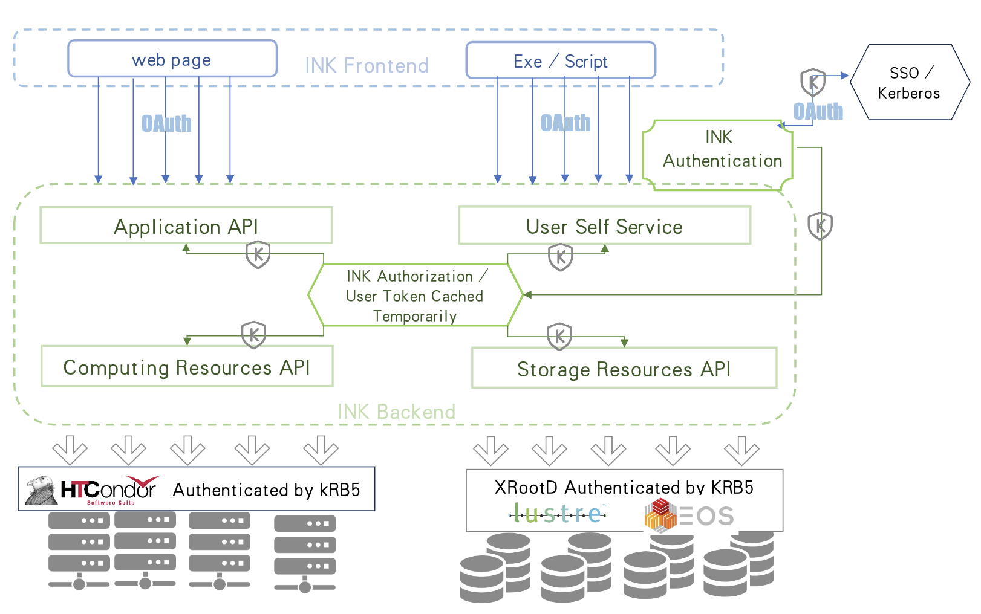
INK Authentication and Authorization at IHEP
IHEP cluster authentication
Kerberos 5
user authentication
Computing & storage usage
HTCondor & XRootD
OAuth for INK frontend/ backend authentication
A authorization mechanism developed
Kerberos 5 service provides short-term user ticket
INK caches and refreshes user tokens during the job execution

Slide 12
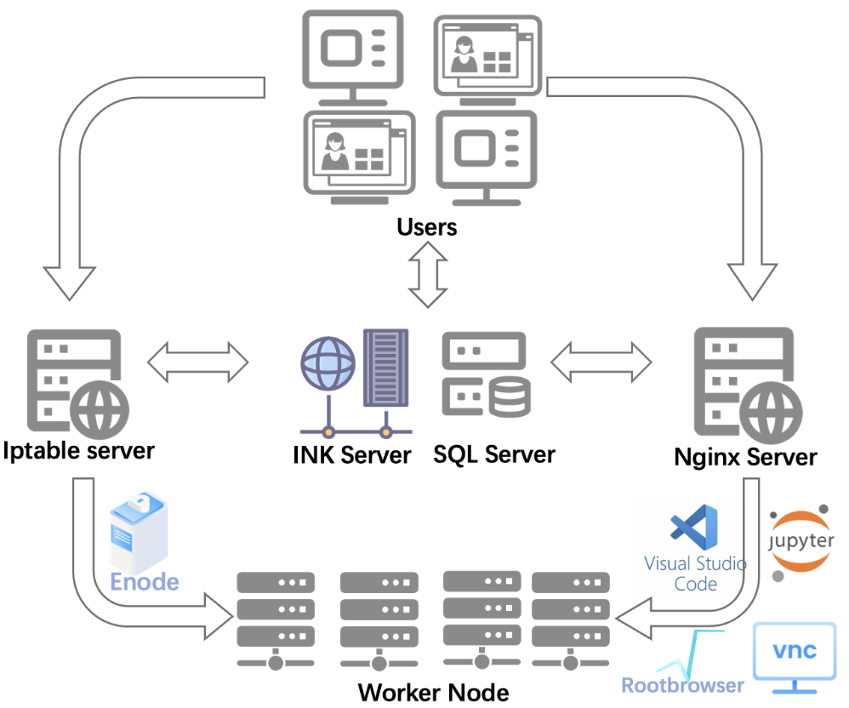
Run Application ON Worker Node
Connecting to applications running on worker nodes via port forwarding
Nginx Server: handle port forwarding for VSCode, Jupyter, VNC, and Rootbrowser
Iptable Server: handle port forwarding for Enode
File stream connection between file storage and frontend
For file upload / download
Files viewer running inside browser
Fits files
Root files
Port forwarding for application running at worker node

Slide 13
Customization for Experiments (Ongoing Work)
Resources and applications database records:
Experiment-specific configuration
Resources of the experiments
Applications of the experiments
User–specific configuration
Personalized resources and applications permission →
Each experiments has its own INK web page
Each user has his own INK web page

Slide 14
Current Status
Publicly accessible at https://ink.ihep.ac.cn
Test release: Feb. 2025
First official release: Mar. 2025
IHEP user access the web page directly without any extra work
1 cpu core with 6GB memory for each job slots
Limit 24 hours walltime for the INK job
Each user can run one of each job type
Provide special job slots for some special exp. user
Bigger memory
More CPU cores
Quite positive user feedback received!

Slide 15
Next Steps
Accessible by the user/Exp. software directly
Customization for the different Exp.
Typical Exp. Application shown to the only Exp. user
Typical exp. runtime environment setup behind Applications
Typical exp. workflow for data processing
Open Sourcing: Target release by the end of 2025

Slide 16
Summary
Traditional batch system face limitations (Offline, closed and backend) for HEP data analysis now
INK focus on providing an interactive usage of the cluster
Provides users with a “frontend usage” for “backend resources”
Received positive feedback from users since the first release published
Further development is ongoing based on the HEP requirements
Comments and suggestions are welcomed

Slide 17
Acknowledgement
We extend our sincere gratitude to the HTCondor team for their steadfast support over the years, with special thanks to Greg for his invaluable assistance!

Slide 18
Thank You!
Questions?

Slide 19
Backup

Slide 20
https://ink.ihep.ac.cn -- video

