Slide 1
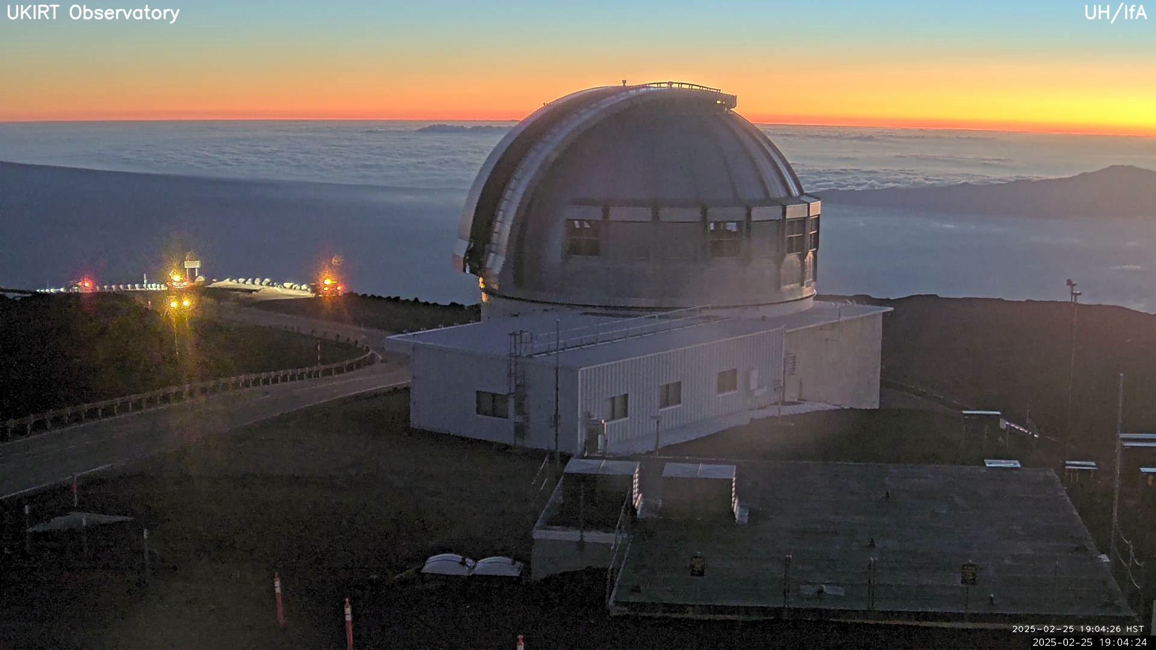
Pelican and NDP - Open Access to Astronomy Data
HTC25

Slide 2
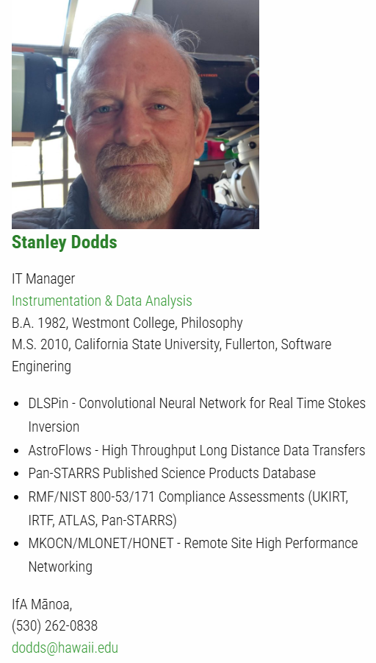
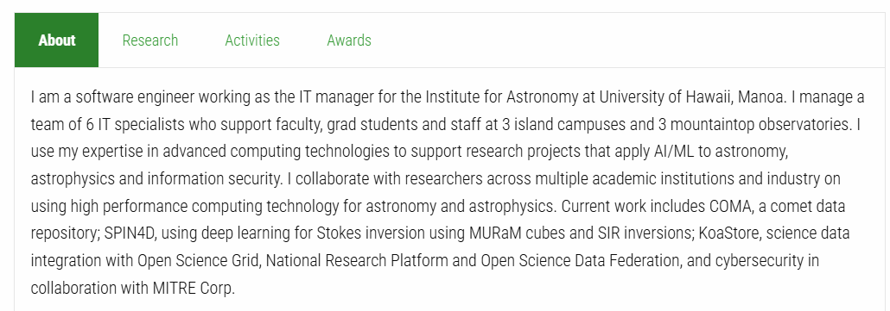
Introduction
Curt Dodds
Institute for Astronomy
University of Hawaii, Manoa
dodds@hawaii.edu

Slide 3
A Challenge from Miron
Last year (HTC24) Miron gave me a challenge.
He asked me to identify one end to end use case using OSDF to stage data to OSPool or NRP for compute.

Slide 4
SPIN4D Project
Critical Early DKIST Science: Spectropolarimetric Inversion
in Four Dimensions with Deep Learning (SPIN4D)
Xudong Sun¹, Kai Yang¹, Jiayi Liu¹, Yannik Glaser¹, Lucas Tarr², Matthias Rempel³, Sarah Jaeggli², Tom Schad², S. C. Dodds¹, Peter Sadowski¹,
¹University of Hawaii Manoa ²National Solar Observatory ³High Altitude Observatory
NSF #2008344
http://dtn-itc.ifa.hawaii.edu/spin4d/DR1/

Slide 5
SPIN4D Project
Objective
Develop deep convolutional neural networks (CNNs) for estimating the physical properties of the solar photosphere for Daniel K. Inouye Solar Telescope (DKIST) observations.
Method
Simulation (MURaM): 25x25x8 Mm volume, 16x16x12 km spatial resolution, 6 solar-hours at 40s cadence, 6 initial conditions*
Synthesize Stokes profiles (SIR) of Fe₁ lines at 630 and 1565 nm
Train a set of CNNs that can rapidly infer the 4D MHD state vectors from (DKIST) images

Slide 6
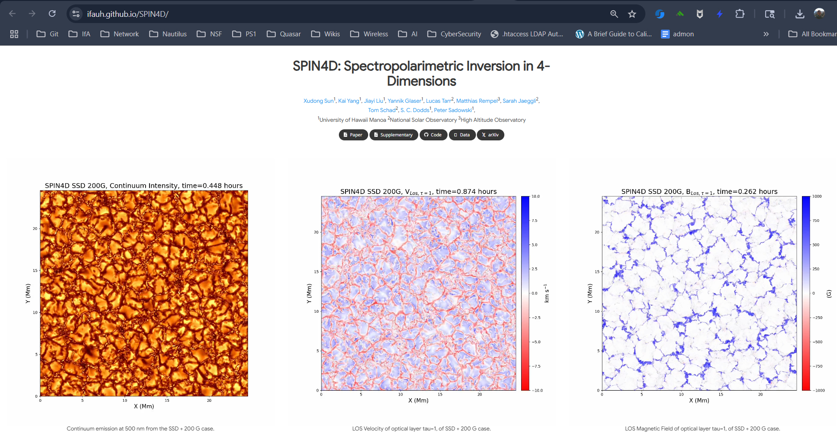

Slide 7
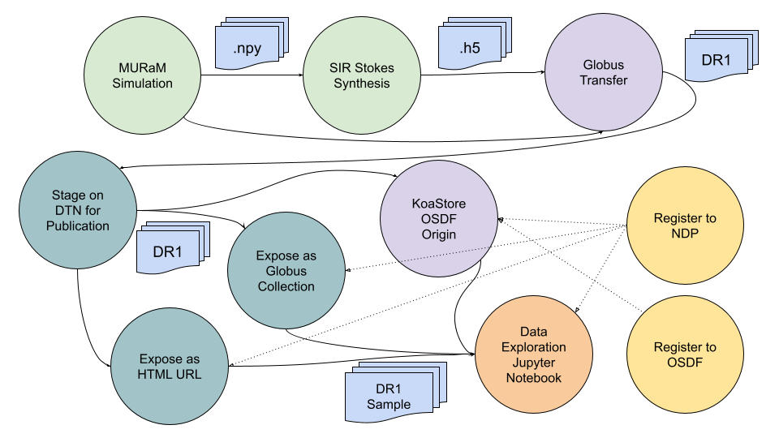
SPIN4D Data Release 1 (DR1) Data Flow Diagram

Slide 8
National Data Platform (NDP)

Slide 9
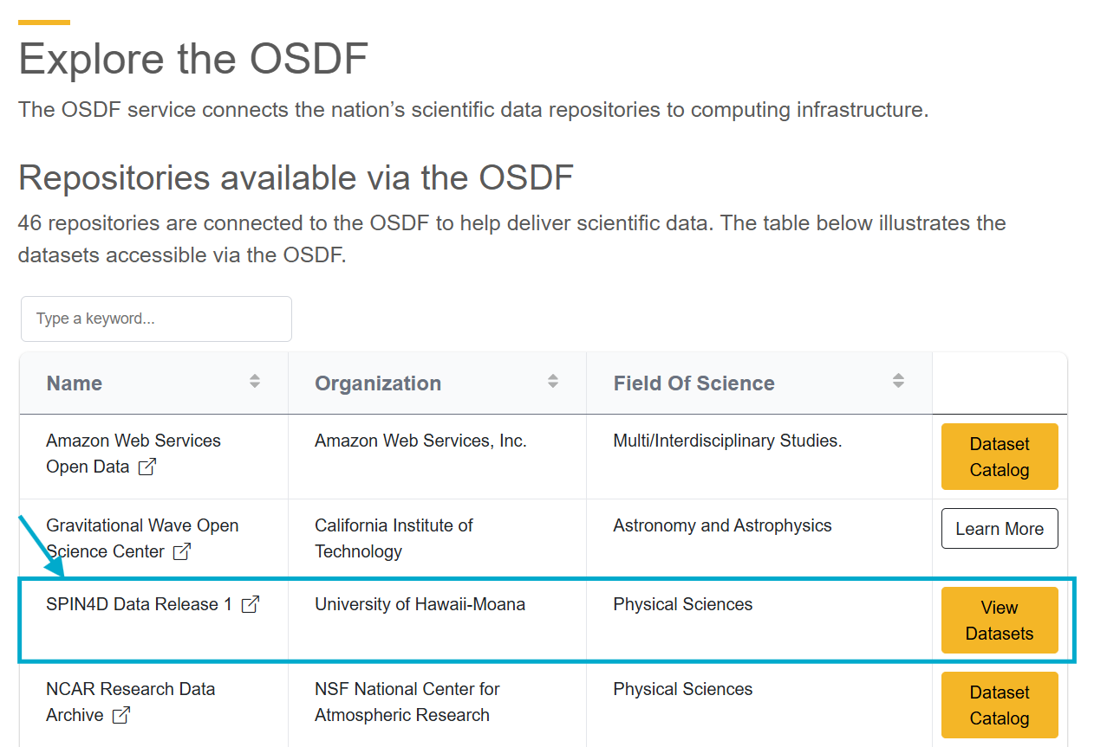
Open Science Data Federation (OSDF)

Slide 10
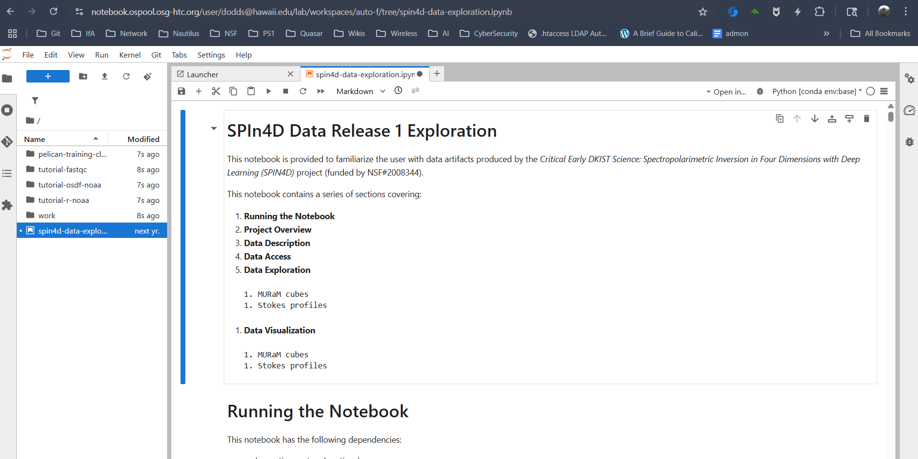
Jupyter Notebook

Slide 11
Astronomy Data Access Patterns
Interactive Search and Download (not scalable)
Bulk Download by Arrangement (not scalable or repeatable)
Scripted Search and Download (time sink, slow)
Cloud Data + Service (vendor lock, cost?, egress performance)
Private Cloud Data + Service (Rubin Science Platform)
Data Broker (Rubin/LSST, NDP)
Science Content Distribution Network (OSDF+Pelican)

Slide 12
Bulk Download by Arrangement
Email Bernie at Space Telescope Science Institute
Ask him to prepare a download manifest for 600TB of TESS data. (55d@1Gbps)
Receive a tarball of 1,770 shell scripts each with ~2,800 curl commands
Write a script to partition the execution of curl commands into 52 “sectors”
Manually run each sector script to copy from STScI to our Baltimore DTN
Manually copy (lftp) from Baltimore DTN to Hawaii storage cluster
Get pulled away by new priorities
Frustrated PI assigns a grad student to finish the work

Slide 13
Scripted Search and Download
astroquery.mast
https://astroquery.readthedocs.io/en/latest/mast/mast.html
https://spacetelescope.github.io/mast_notebooks/notebooks/multi_mission/large_downloads/large_downloads.html
Large query results fail due to lack of compute or storage resources. If it works at all, data transfer takes a long time (days, months).

Slide 14
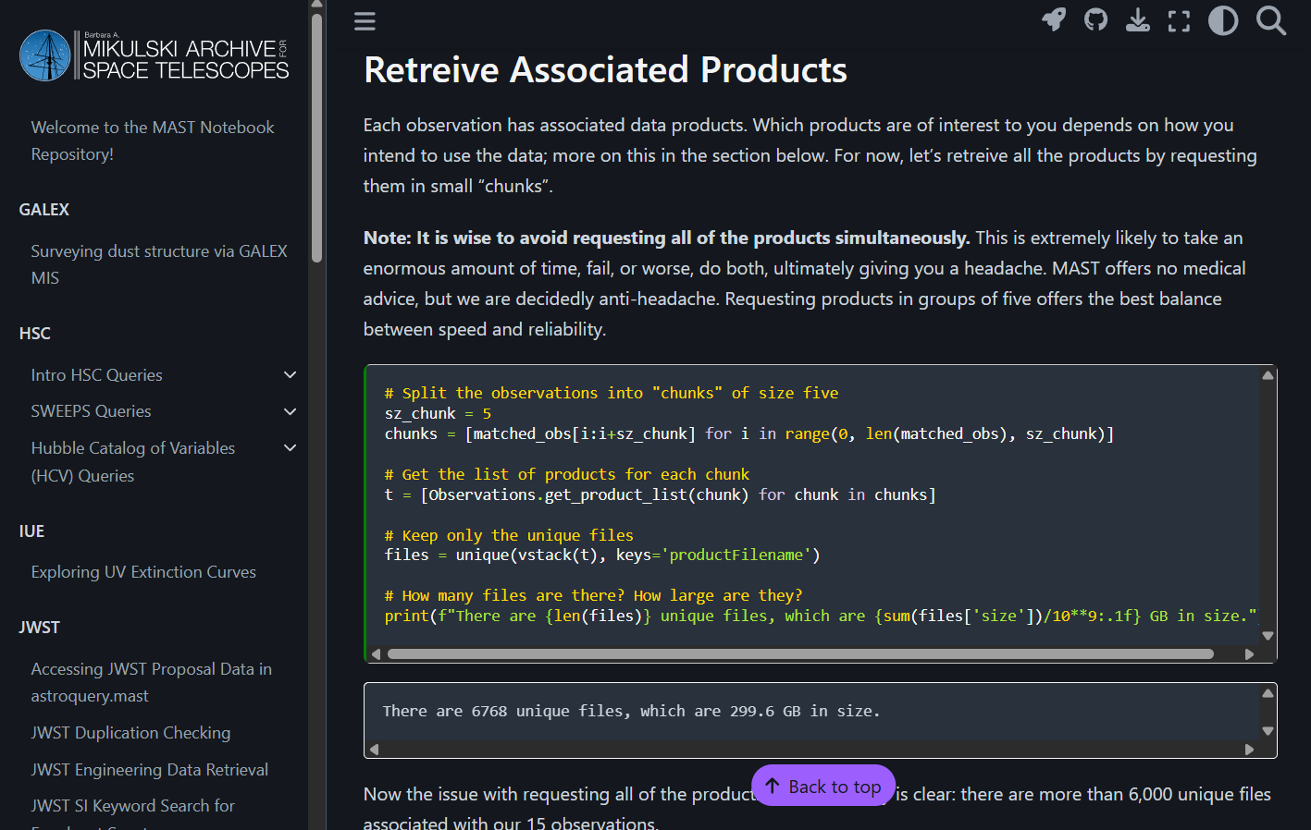

Slide 15
Cloud Data + Services
Space Telescope Science Institute + AWS
https://registry.opendata.aws/collab/stsci/
https://spacetelescope.github.io/mast_notebooks/notebooks/multi_mission/galex_panstarrs_bulk_download/galex_panstarrs_bulk_download.html

Slide 16
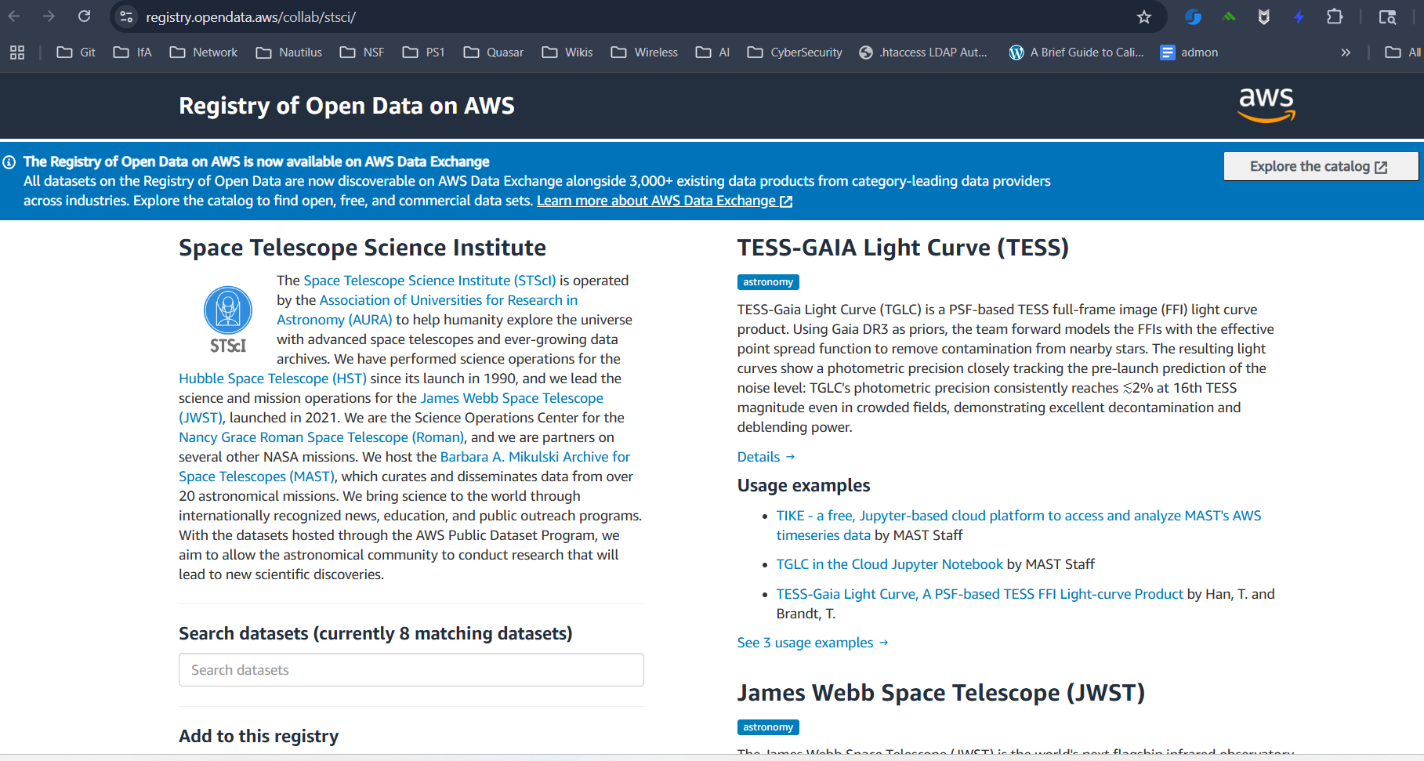
Cloud Data + Services

Slide 17
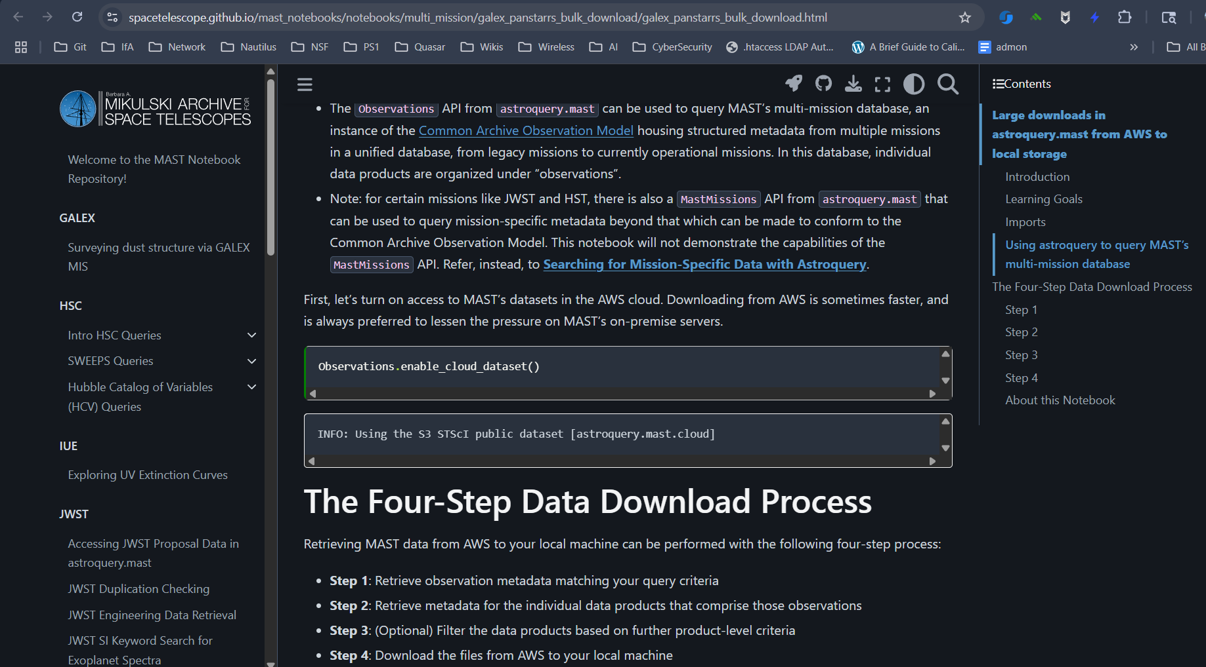
Cloud Data + Services

Slide 18
Private Cloud Data + Services
Rubin Science Platform
https://data.lsst.cloud/
SkyPatrol 2.0 (ASAS-SN)
http://asas-sn.ifa.hawaii.edu/skypatrol/

Slide 19
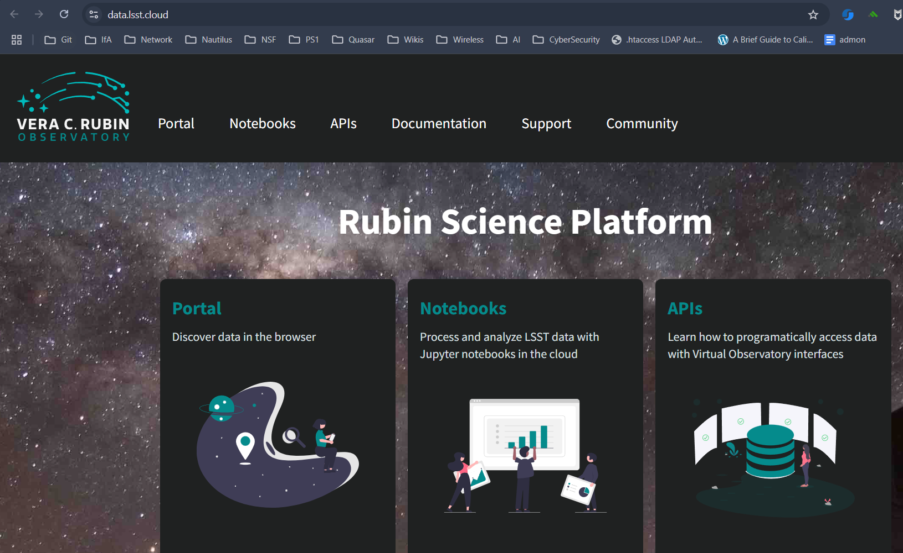

Slide 20
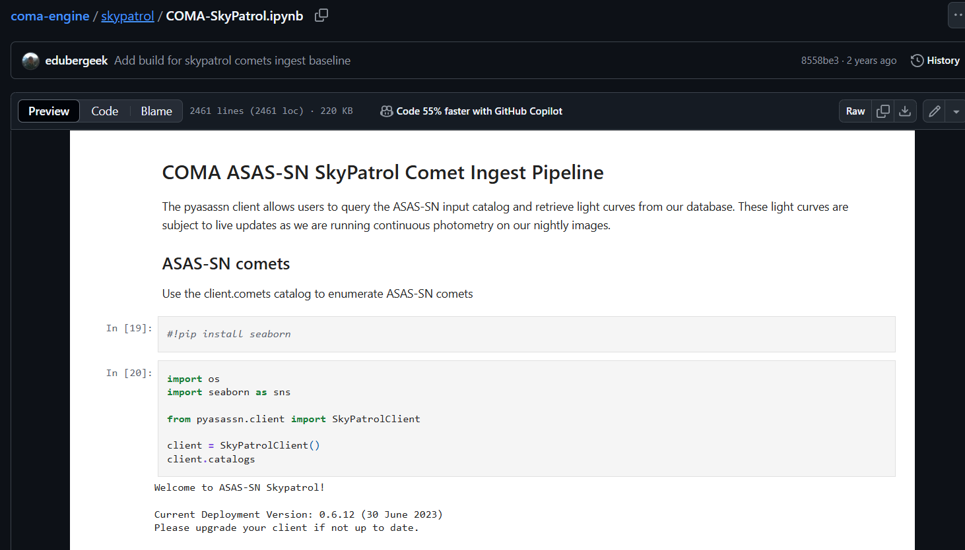

Slide 21
Data Broker
Time-domain Astronomy (event-driven)
E.g. LIGO detections, comet “activity”, supernovae, near-Earth objects, variable stars
Rubin Science Platform: ANTARES Broker (US) + downstream specialized brokers
NDP Endpoint: Kafka Service

Slide 22
National Data Platform Endpoint
Deploy on-prem with my on-prem data (sounds familiar)
Docker Compose: https://github.com/sci-ndp/scidx-api
Kubernetes (new, WIP)
CKAN Data Portal, registry integrated with the central NDP registry
Kafka Streaming (“Data Broker” service)
JupyterHub
Pelican?

Slide 23
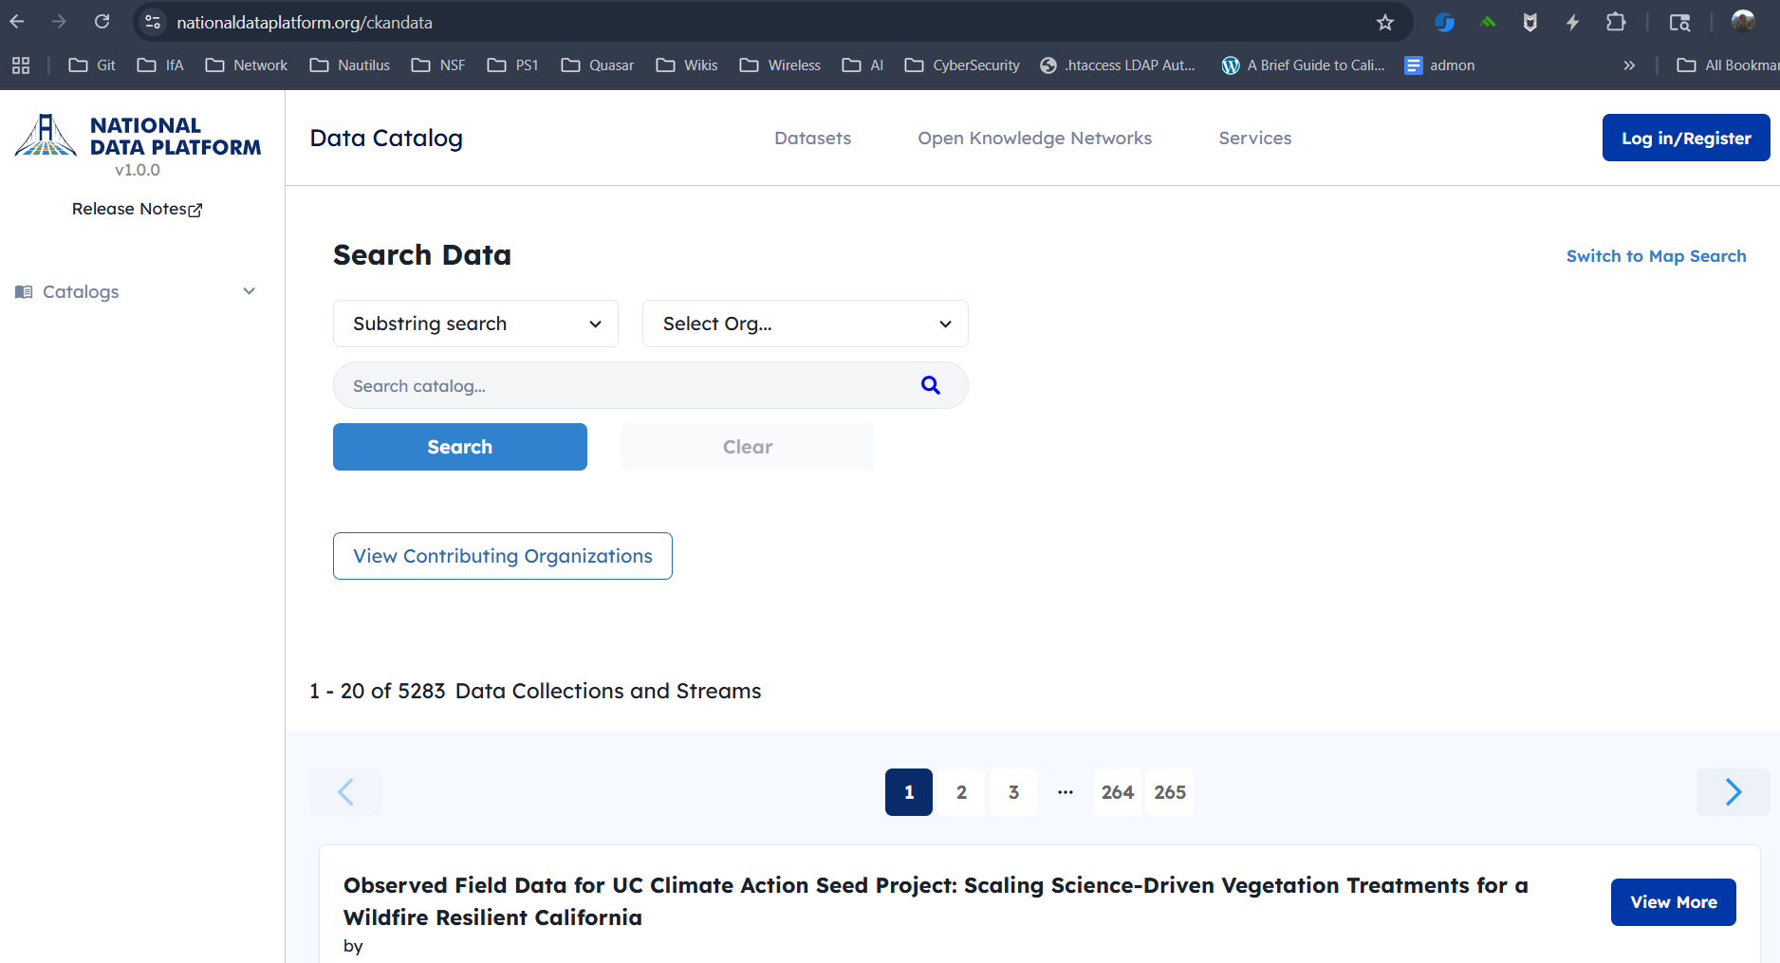

Slide 24
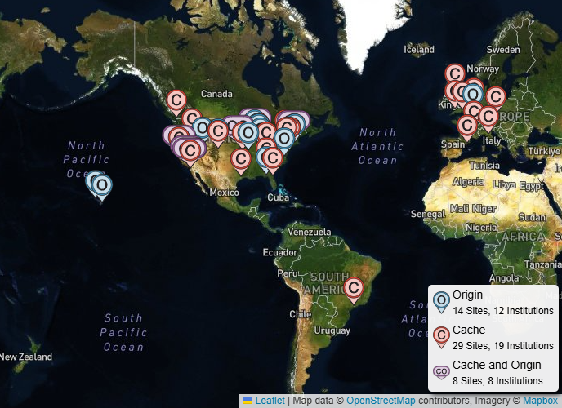
Content Distribution Network for Science

Slide 25
HTC25: New Challenges
NDP/Pelican Integration???
Data Discovery
Use NDP for data discovery (of Pelican URLs)
Explicit Pelican URLs in NDP datasets
Data Access
Add Pelican data origin to NDP Endpoint
Teaching
Use OSPool for Notebooks and Pelican for data staging in NDP “Classrooms”

Slide 26
HTC25: New Challenges
AI/ML on OSPool GPUs
High Throughput ML
Hyperparameter Search
Ablation Study
ML Batch Inference
Data Access
Pelican Dataset “Subsetting”
Pelican Dataset Streaming

Slide 27
HTC25: New Challenges
Teaching Astronomy with Jupyter Notebooks
30 (100?) students
30 (100?) Jupyter Notebooks
“Put a monkey at the top of the tree and the others will follow” - Miron
Find myself one instructor “monkey”

Slide 28
Data Discovery is a Hot Mess
National Data Platform
National Science Data Fabric
NAIRR Pilot
NCAR DASH - https://data.ucar.edu/
Amazon Open Science
Google Cloud Public Datasets
…

