Slide 1

Expanding Access to Computing: CENVAL-ARC with OSG
Sarvani Chadalapaka
Director of CIRT
sarvani@ucmerced.edu

Slide 2
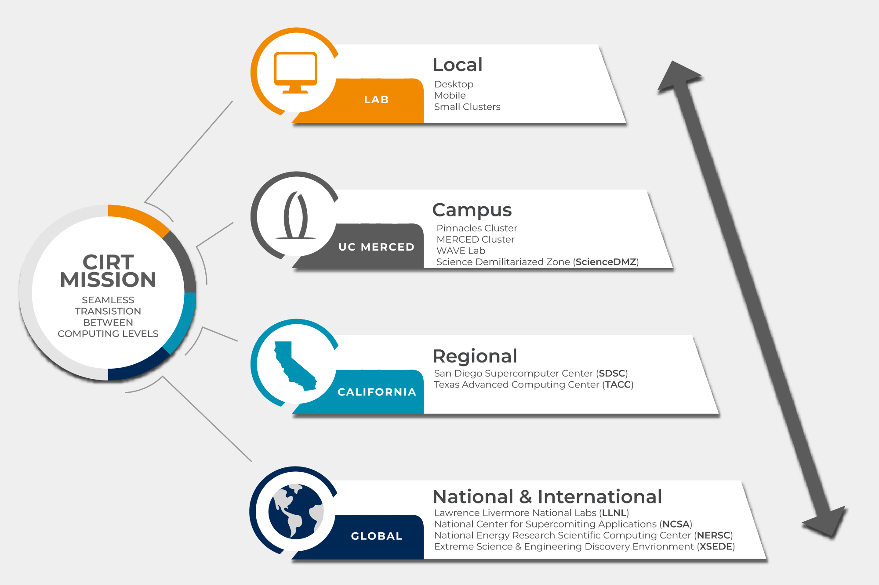
UC Merced’s Cyberinfrastructure and Research Technologies (CIRT) Mission
Bring research computing, high-speed networking, and advanced visualization to campus researchers across all disciplines.
Foster a research environment where scholars effortlessly navigate across computational tiers, supported by cutting-edge technological solutions and educational resources.
Serving as a reliable and strategic ally to the university's research cohort, we construct resilient cyberinfrastructure to enhance the institution's research endeavors.

Slide 3
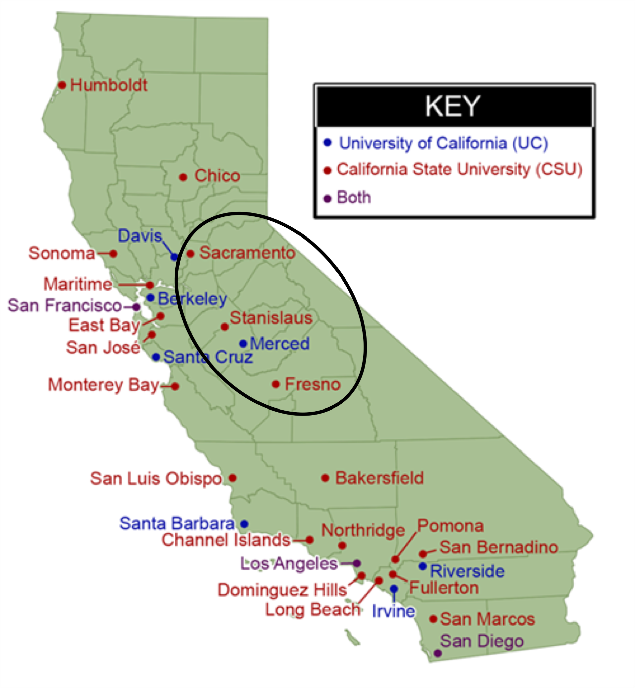

CENVAL-ARC: Central Valley Accessible Research and Computational Hub
NSF CC* Regional Computing Grant Proposal ($1M)
Deploying nodes at UCM to facilitate research across UCM and CSUs in Central Valley. Partner institutions
  CSU Fresno
  CSU Sacramento
  CSU Stanislaus
Participating grants for 100 students in Central Valley for Annual Research Computing Symposium
CENVAL-ARC is supported by NSF under the Office of Advanced Cyberinfrastructure CC* Regional Computing award No. 2346744

Slide 4
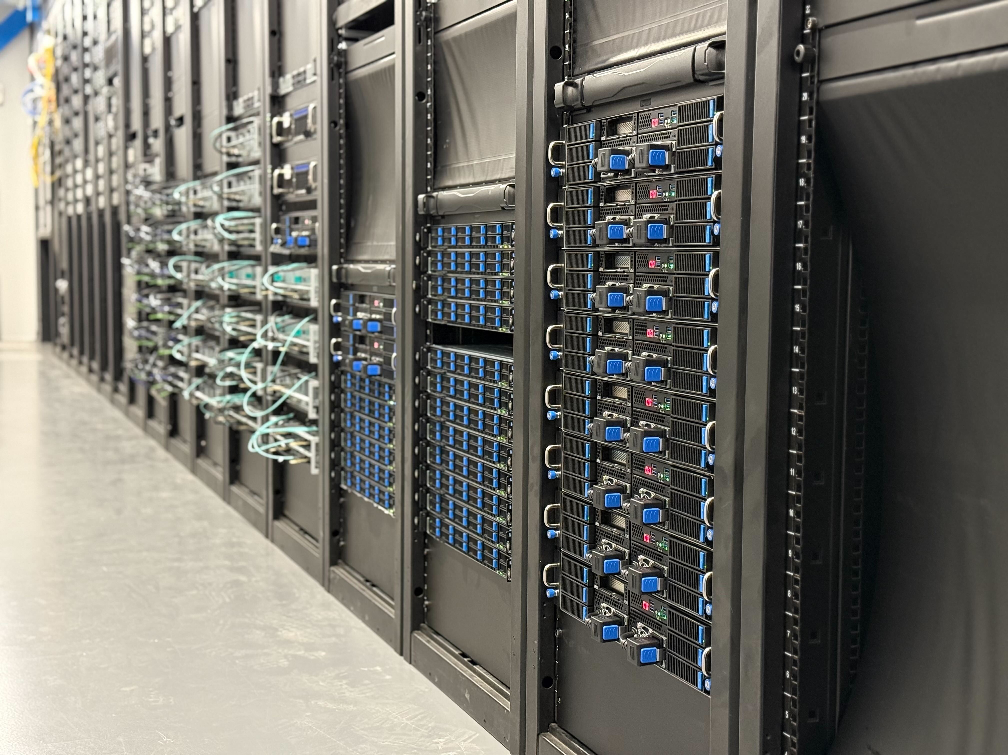
Two Pillars of CENVAL-ARC
  Pillar-1: HPC Infrastructure
  Pillar-2: Symposium & Training

Slide 5
CENVAL-ARC Hardware
Node Configuration | Compute Node | Bigmem Node
Number of CPU Nodes | 8 | 4
Number of GPU Nodes | 8 | -
CPUs | 2x Intel 32-Core Xeon Gold 6530 2.1GHz - 270W | 2x Intel 32-Core Xeon Gold 6530 2.1GHz - 270W
CPU Node RAM | 256GB | 1TB
Node-local Storage | 1TB M.2 NVMe Data Center Solid State Drive (110mm) | 1TB M.2 NVMe Data Center Solid State Drive (110mm)
GPU | 2x NVIDIA L40S GPUs per node (48GB GDDR6 Passive Dual Slot GPU) | -
GPU Node RAM | 256GB | -
GPU Node-local Storage | 1TB M.2 NVMe Data Center Solid State Drive (110mm) | -

Slide 6
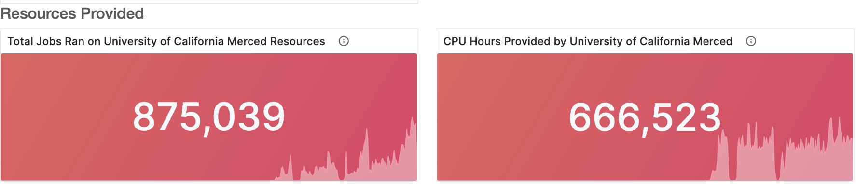
CENVAL-ARC Hardware on OSG
Compute Nodes | 32-core Intel with 256GB RAM | 2
Big Memory Nodes | 16-core Intel with 1TB/2TB RAM | 1
GPU Nodes | 32-core Intel with 4x A30 GPUs | 1

Slide 7

Why we chose OSG
Alignment with CC* requirements
Pre-proposal and Deployment Support
Training and onboarding support

Slide 8
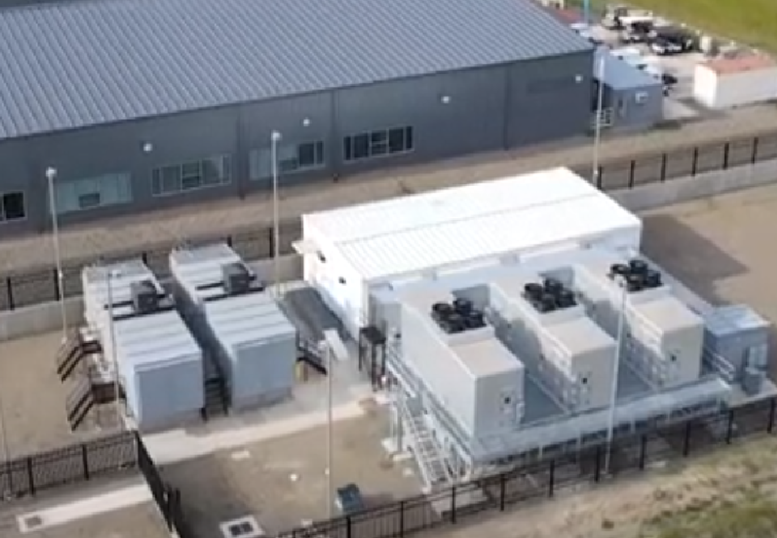
How OSG Set Us Up for Success
Early and ongoing collaboration with OSG support teams (thank you!) helped shape our architectural decisions.
OSG provided training materials, onboarding help, and hosted job submission demos at our CENVAL-ARC Symposium.
Letters of support for CC* proposal

Slide 9

The population we serve and the gaps
CENVAL faculty juggle heavy teaching loads, are grant-constrained, and often lack access to local research computing support.
Learning how to run code on distributed systems is not a small ask—it needs repeated, scaffolded exposure.
That’s where intermediate infrastructure + OSG becomes essential.

Slide 10
Integration Process and Architecture Decisions
We designed 20% our compute nodes (CPU, bigmem, GPU) to be available for OSG use.
The process included:
  Local resource configuration for HTCondor compatibility
  Coordinating with OSG to validate job submission and throughput
We faced typical challenges: networking/firewall tuning, coordination with internal OIT teams

Slide 11

Training and Support at the CENVAL-ARC symposium
OSG led hands-on workshops at the CENVAL-ARC Symposium, demystifying job submission and data movement.
Our attendees—mostly teaching faculty—were excited but overwhelmed. Many hadn’t had a chance to explore anything like this before.
Faculty from CENVAL said this was the first time they’d seen a practical path to using shared cyberinfrastructure.

Slide 12
What Institutions Like Ours Need: Opportunities for Impactful Support
More hands-on OSG led bootcamps
Peer mentorship networks - connect new OSG users with experienced ones in similar domains
Recognition mechanisms: when a campus integrates with OSG, help them tell that story

