Slide 1
Experiments and expansions: Leveraging PATh tools and NAIRR resources in ML workflows
Ian Ross
HTC25 2025.06.05

Slide 2
PATh ML supplement
~1 year supplement to PATh to “profile the effects of…training and inference on distributed, heterogeneous capacity”
Use htcondor annexes to run training jobs into National AI Research Resource (NAIRR)
Intentionally shuffle training runs between sites at epoch boundaries to test resilience and impact of heterogeneity
Compare models trained in distributed fashion to baseline (single-node trained) versions
Exercise our technologies to see how they operate in a heterogeneous “AI” setting while establishing single-point access to NAIRR compute
Microscoft Copilot prompt: A cartoon image of a pelican and a condor holding hands over a landscape made of computer chips at sunset

Slide 3
NAIRR in a nutshell
“The National Artificial Intelligence Research Resource (NAIRR) is a concept for a shared national research infrastructure to bridge this gap by connecting U.S. researchers to responsible and trustworthy Artificial Intelligence (AI) resources, as well as the needed computational, data, software, training, and educational resources to advance research, discovery, and innovation.” From nairrpilot.org
We applied for, and received, allocations at 6 computational resources for this experiment.
Expanse, Bridges-2, Anvil, Delta, Jestream2, AWS

Slide 4
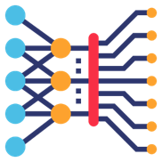
PATh supplement, workflow and science case
Objectives:
Characterize the impact of training models and ensembles across heterogeneous resources
Advance PATh Access Point capabilities to reduce the barrier of entry and support ML workloads in distributed and heterogeneous environments like NAIRR
Domain benchmark from Gitter lab: Training a protein language model for use in protein engineering:
Eval
Epoch 1
Eval
Eval
Epoch 2
Eval
…
Training (Resource A)
Training (Resource B)
Eval
Epoch 3
Eval
Training (Resource C)
Epoch 4
Training (Resource D)
Eval
Eval
Training (Resource E)
…
Eval
Epoch 5
Eval
Comparison of n model training path permutations
MQHTYPAQLRRFGQA
MQHTYLAQLMRWGTH
MQHTYPAQLMRTTTA
…
…
MQHTPPAQLMQFGTA
MQHTSPAFLMRFGTA
MAHTYPAQLMRAGTA
(~20h/epoch
on A100)
(~1min/epoch)
Pretrain protein LLM using ~10M biophysical simulations
~40GB on disk
Pretrained Model
Finetune using ~100 experimental measurements of protein sequence mutations
Model capable of more accurate predictions than training on the limited experimental data directly.

Slide 5
PATh supplement, status
Training process working on Delta, Expanse, Bridges-2, OSPool, CHTC
Took longer than anticipated to iron out wrinkles to get consistent epochs
In parallel – adapting a DAG generator to ease management and organization while further probing our stack
Plenty more to come on this…

Slide 6
Annexes, NAIRR resources, and lessons learned
Overall, things worked fairly well…
Documentation, annex creation, htcondor-cli, all good with a few odd snares (to come)
Bit of a pain to manage and organize across 6 different sites (plus CHTC and OSPool), each with their own documentation and quirks and policies.. As Doug said yesterday, “Every facility is a snowflake”
Storing apptainer image and data in OSDF – great success!

Slide 7
Annexes, NAIRR resources, and lessons learned
Long epochs make for painful mistakes and awful iterative development
Hard to understand failures and idle jobs.
Would love annex create –-mem 128GB instead of annex create –mem_mb 131072 to be consistent with RequestMemory=128GB
+JobDurationCategory = "Medium" default on all jobs on ap40
With epochs taking 18-25 hours, this one was a big headache before I realized what was happening
Organization and management is a pain (and we want to be introspective), so…

Slide 8
Overview of “MLDAG”
Objective:
Adapt Thinh Nguyen’s work from last summer to generate DAGs for the heterogeneous resource experiment
Shish-kebab DAGs, with NAIRR resource shuffling via annex
Less about a production-level tool and more about recognizing shortcomings, pain points, and capabilities in current system.
And also retaining my sanity…
Sidequest:
Understand needs and patterns in common “experiment” workflows like hyperparameter sweeps

Slide 9
Overview of “MLDAG”
An “experiment” consists of x “training runs”, each of which consists of y epochs of training, handled within n training jobs (nodes) within the training run
The training runs likely differ based in user-specified ways (targeted resources, hyperparameters, …)
Each training job has a common submit definition with differences captured in VARS
E.g. targets a different NAIRR resource, but this is unlikely to be a common pattern… so I’ll ignore it (although the utility supports resource specific configuration)
Each node can also be associated with an evaluation job to “check in” with the training process

Slide 10
Experiment configuration and DAG generation
Experiment.yaml file to capture:
Name of the experiment
Template for submit description
Variables that either define training run behavior (total number of epochs, epochs per job) or define possible values variables can take in order to define the shape of the experiment.
DAG generation script will:
Sets (and fans out) the variables and combinatorics
Create Training Runs for each combination of variables
Define job nodes with appropriate VARS
Optional special sauce and useful (to me) defaults
Site-specific resources requests with site targeting and shuffles
Random seed and unique ID per training runs
Handles for service node definitions, PRE- and POST-scripts

Slide 11
name: "Global Pretraining"
submit_template: |
universe = container
container_image = osdf:///ospool/ap40/data/ian.ross/metl_global.sif
request_disk = {resource.disk}
request_memory = {resource.mem_mb}
request_cpus = {resource.cpus}
request_gpus = {resource.gpus}
gpus_minimum_memory = {resource.gpu_memory}
gpus_minimum_capability = 7.5
…
executable = /bin/python
transfer_executable = false
arguments = pretrain.py --learning_rate=$(alpha)
…
queue
vars:
epochs:
value: 30
type: value
description: "Number of epochs to train for"
epochs_per_job:
value: 5
type: value
description: "Number of epochs to train in each job"
alpha:
start: 0
stop: 10
step: 1
type: range
description: "learning rate example"

Slide 12
name: "Global Pretraining"
submit_template: |
universe = container
container_image = osdf:///ospool/ap40/data/ian.ross/metl_global.sif
request_disk = {resource.disk}
request_memory = {resource.mem_mb}
request_cpus = {resource.cpus}
request_gpus = {resource.gpus}
gpus_minimum_memory = {resource.gpu_memory}
gpus_minimum_capability = 7.5
…
executable = /bin/python
transfer_executable = false
arguments = pretrain.py --learning_rate=$(alpha)
…
queue
vars:
epochs:
value: 30
type: value
description: "Number of epochs to train for"
epochs_per_job:
value: 5
type: value
description: "Number of epochs to train in each job"
alpha:
start: 0
stop: 10
step: 1
type: range
description: "learning rate example"
These get filled in by specific values for each NAIRR
resource that get passed in during the DAG generation, if any. Defaults can be set for more general usage.

Slide 13
name: "Global Pretraining"
submit_template: |
universe = container
container_image = osdf:///ospool/ap40/data/ian.ross/metl_global.sif
request_disk = {resource.disk}
request_memory = {resource.mem_mb}
request_cpus = {resource.cpus}
request_gpus = {resource.gpus}
gpus_minimum_memory = {resource.gpu_memory}
gpus_minimum_capability = 7.5
…
executable = /bin/python
transfer_executable = false
arguments = pretrain.py --learning_rate=$(alpha)
…
queue
vars:
epochs:
value: 30
type: value
description: "Number of epochs to train for"
epochs_per_job:
value: 5
type: value
description: "Number of epochs to train in each job"
alpha:
start: 0
stop: 10
step: 1
type: range
description: "learning rate example"
These get filled in by specific values for each NAIRR
resource that get passed in during the DAG generation, if any. Defaults can be set for more general usage.
Just standard VAR usage, but must match definition in “vars” field

Slide 14
name: "Global Pretraining"
submit_template: |
universe = container
container_image = osdf:///ospool/ap40/data/ian.ross/metl_global.sif
request_disk = {resource.disk}
request_memory = {resource.mem_mb}
request_cpus = {resource.cpus}
request_gpus = {resource.gpus}
gpus_minimum_memory = {resource.gpu_memory}
gpus_minimum_capability = 7.5
…
executable = /bin/python
transfer_executable = false
arguments = pretrain.py --learning_rate=$(alpha)
…
queue
vars:
epochs:
value: 30
type: value
description: "Number of epochs to train for"
epochs_per_job:
value: 5
type: value
description: "Number of epochs to train in each job"
alpha:
start: 0
stop: 10
step: 1
type: range
description: "learning rate example"
These get filled in by specific values for each NAIRR
resource that get passed in during the DAG generation, if any. Defaults can be set for more general usage.
Just standard VAR usage, but must match definition in “vars” field
Get slotted into VARS within the dag, along with some other internal
bookkeeping variables:
JOB run0-train_epoch1 default_pretrain.sub
VARS run0-train_epoch1 epoch="1" run_uuid="d35b3ea9" ResourceName="default"
VARS run0-train_epoch1 epochs=”30" epochs_per_job=”5" run_number="0" alpha="0"
JOB run1-train_epoch1 default_pretrain.sub
VARS run1-train_epoch1 epoch="1" run_uuid="c3062075" ResourceName="default"
VARS run1-train_epoch1 epochs=”30" epochs_per_job=”5" run_number=”0" alpha="1”
…

Slide 15
Annex-creating Service node hackery
Annexes require a consumable job before creation which complicates automated flow
Hack:
PRESCRIPT that drops an annex creation “request” into a directory
Add MY.TargetAnnexName = ”unique_annex_name” to submit description
Create a service node that watches and acts on those requests
Hooks directly into the annex create/add codepaths within the htcondor-cli
…but hands-off annex creation feels icky…
Two-factor authentication at many of the NAIRR sites
Costly mistakes - don’t want it to “go rogue” and burn allocation.

Slide 16
“MLDAG” status
Very much a exploratory prototype, but initial implementation is done
Ongoing dogfooding
Plenty of edges to sand off but proving useful
Documentation and more testing
Other feature requests or experimentation?
…I don’t have a picture of my dog eating dogfood, so my dog as food will have to do

Slide 17
“MLDAG” - Lessons learned
Leveraging annexes within a DAG is tricky
It’s not hard to create these VAR expansion (hyper)parameter sweep-type DAGs, but there’s not a “recommended” way to do it.
So anybody who needs to do it does it differently
Wishlist:
SUBDAG-scoped VARS available at nodes
Macros for DAG composition with vars percolating to nodes?
subdag alpha, beta from parameters.txts

Slide 18
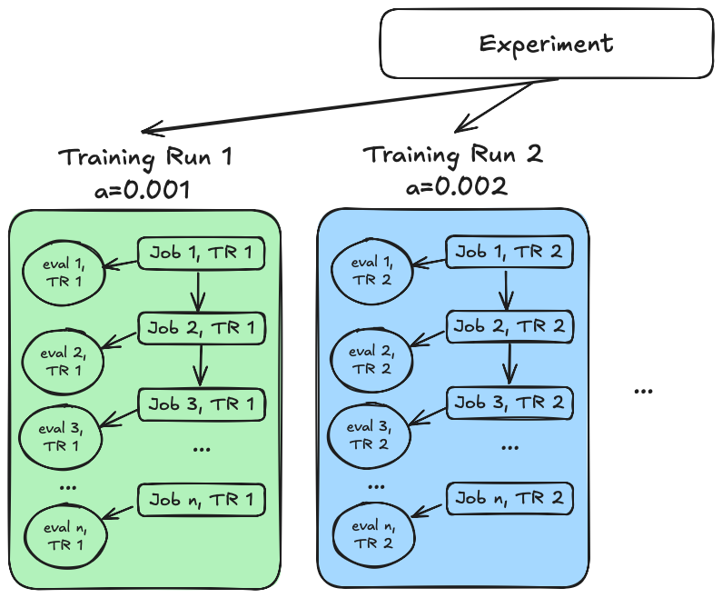
The current dag (more or less)
…
PARENT run0-train_epoch0 CHILD run0-train_epoch1
PARENT run0-train_epoch0 CHILD run0-eval_epoch1
PARENT run0-train_epoch1 CHILD run0-train_epoch2
PARENT run0-train_epoch1 CHILD run0-eval_epoch2
…
VARS run0-train_epoch0 epoch=1 a=0.001
VARS run0-train_epoch1 epoch=2 a=0.001
PARENT run1-train_epoch0 CHILD run1-train_epoch1
PARENT run1-train_epoch1 CHILD run1-eval_epoch2
PARENT run1-train_epoch1 CHILD run1-train_epoch2
PARENT run1-train_epoch1 CHILD run1-eval_epoch2
…
VARS run1-train_epoch0 epoch=1 a=0.002
VARS run1-train_epoch1 epoch=2 a=0.002
…
Not hard to write a script to generate these, but why should everybody need to?

Slide 19
A nicer approach?
train.subdag
…
PARENT {run}-train_epoch0 CHILD {run}-train_epoch1
PARENT {run}-train_epoch0 CHILD {run}-eval_epoch1
PARENT {run}-train_epoch1 CHILD {run}-train_epoch2
PARENT {run}-train_epoch1 CHILD {run}-eval_epoch2
VARS {run}-train_epoch0 epoch=1 a={a}
VARS {run}-train_epoch1 epoch=2 a={a}
VARS {run}-train_epoch2 epoch=3 a={a}
…
workflow.dag
GEN SUBDAG train_flow train.subdag run, a from \
1, 0.001 \
2, 0.002 \
…
PARENT init CHILD train_flow
Variables available to all nodes within a subdag
Expansion of parameter sweeps tucked nicely away
Especially with messy combinatorics

Slide 20
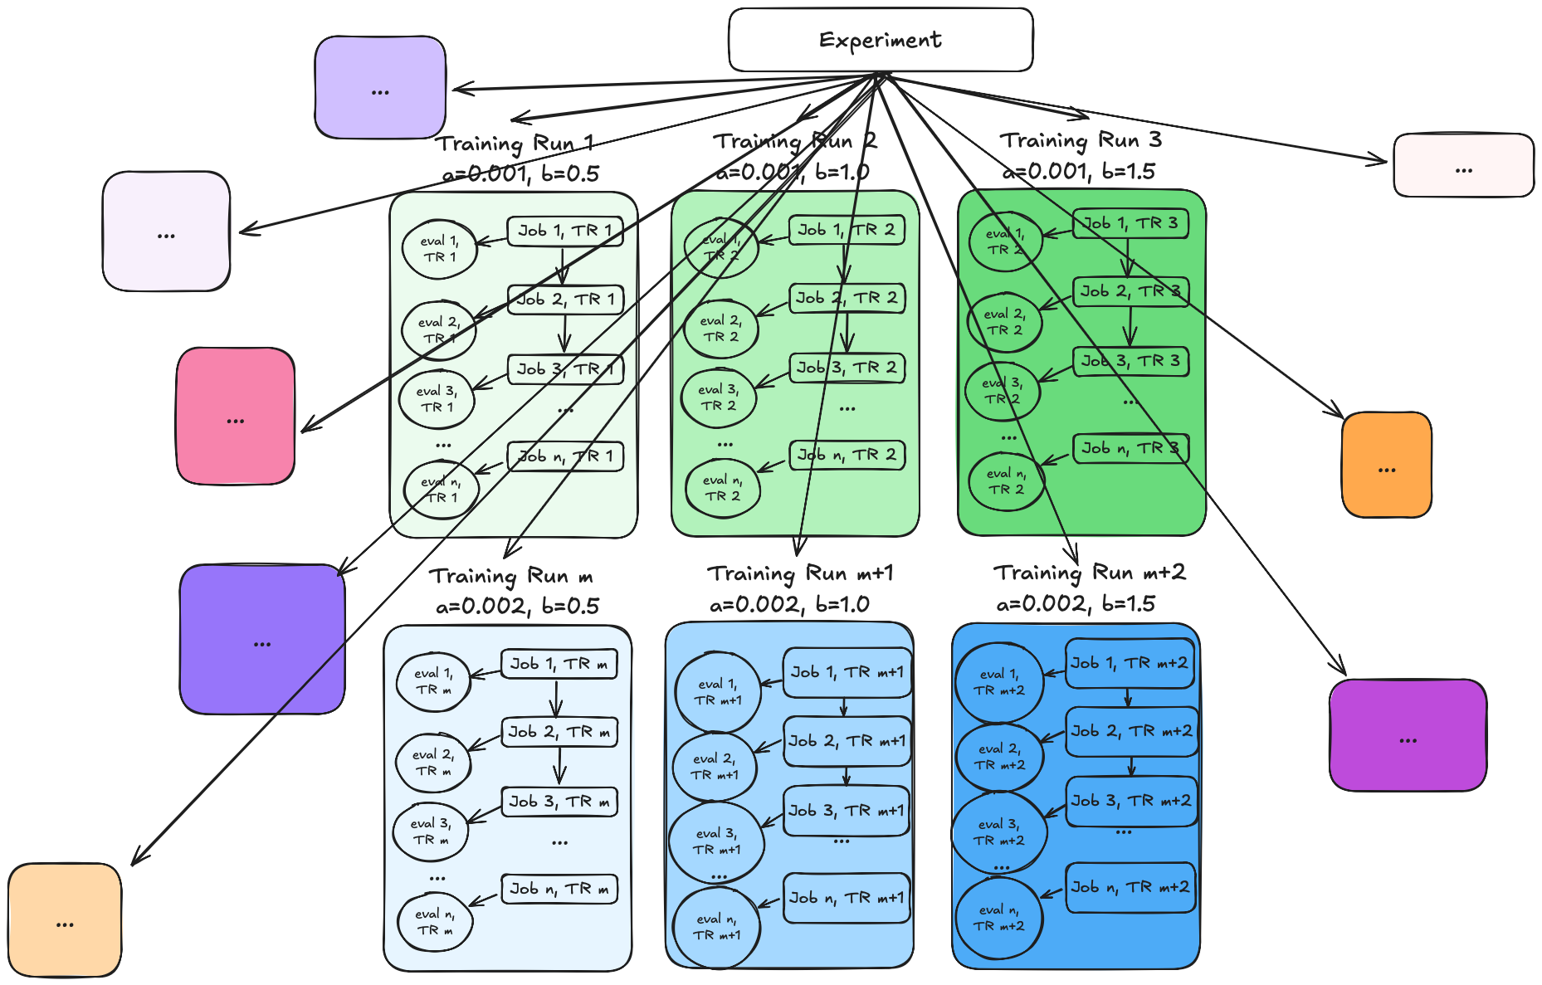
A nicer approach?
train.subdag
…
PARENT {run}-train_epoch0 CHILD {run}-train_epoch1
PARENT {run}-train_epoch0 CHILD {run}-eval_epoch1
PARENT {run}-train_epoch1 CHILD {run}-train_epoch2
PARENT {run}-train_epoch1 CHILD {run}-eval_epoch2
VARS {run}-train_epoch0 epoch=1 a={a}
VARS {run}-train_epoch1 epoch=2 a={a}
VARS {run}-train_epoch2 epoch=3 a={a}
…
workflow.dag
GEN SUBDAG train_flow train.subdag a, b from \
0.001 to 0.1 by 0.001 \
0.5 to 5 by 0.5
…
PARENT init CHILD train_flow
GEN SUBDAG train_flow train.subdag run, a from \
1, 0.001 \
2, 0.002 \
…
PARENT init CHILD train_flow
Variables available to all nodes within a subdag
Expansion of parameter sweeps tucked nicely away
Especially with messy combinatorics

Slide 21
Conclusions
HTCondor Annex integration with (some) NAIRR sites works as expected
As long as you know your code and read the site-specific documentation
Many users have hand-grown DAG generators (especially for hyperparameter sweeps)
Some new DAG features (variables available to certain “regions” of a DAG and some queue from inspired macros could prevent wheel reinvention (and simplify certain patterns)

Slide 22
Acknowledgements
This project is supported by the National Science Foundation under Cooperative Agreements OAC-2030508. Any opinions, findings, conclusions or recommendations expressed in this material are those of the authors and do not necessarily reflect the views of the National Science Foundation.

