Slide 1
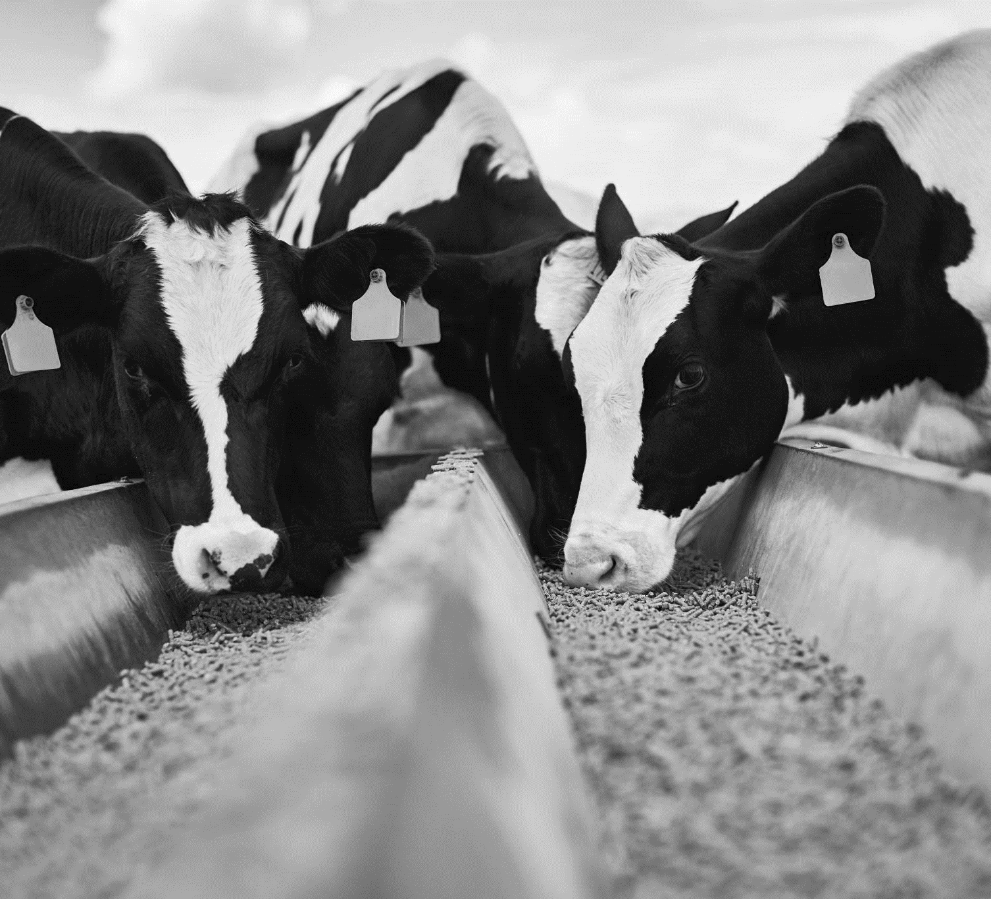
Utilizing HTCondor, Pelican, and DAGMan workflows for high-throughput phenotyping in dairy cattle
Ariana Negreiro
Department of animal & dairy sciences
PhD candidate University of Wisconsin-madison
Advisor: Dr. Joao Dorea
Notes:
**associated***
Don’t use causal statement

Slide 2
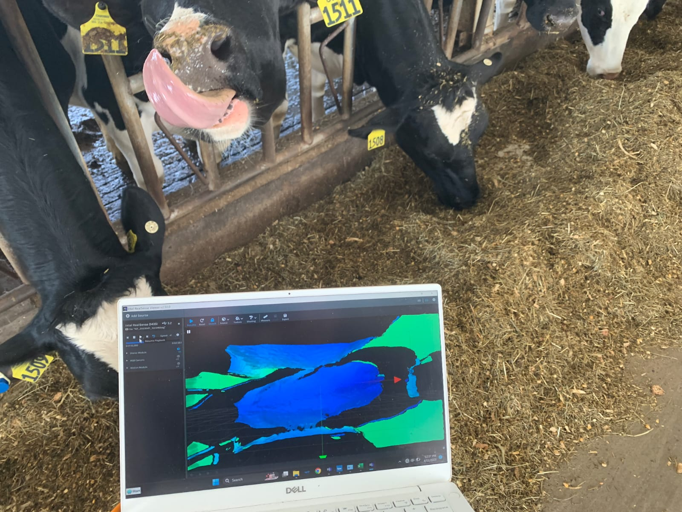
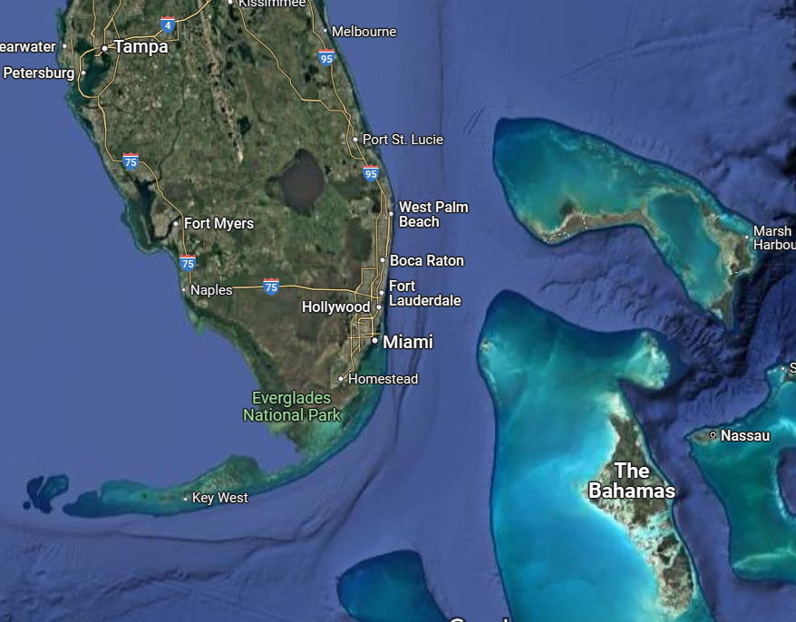
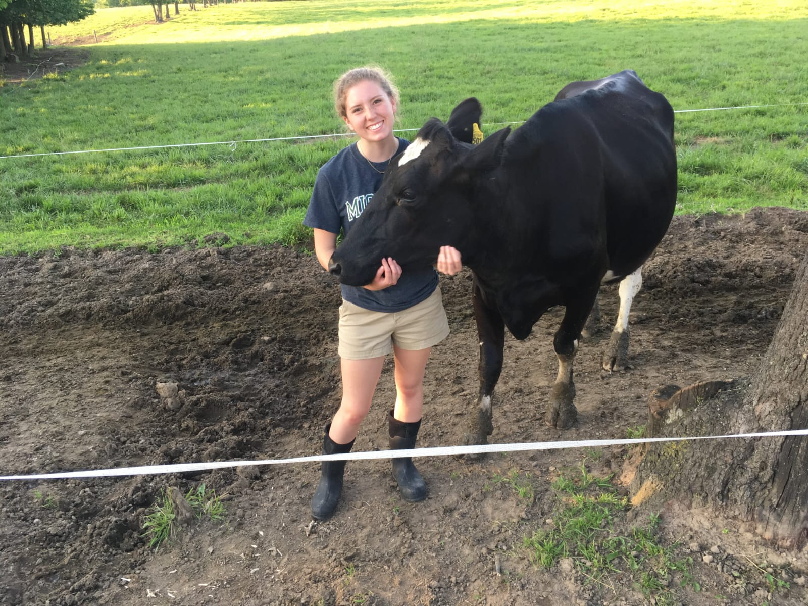
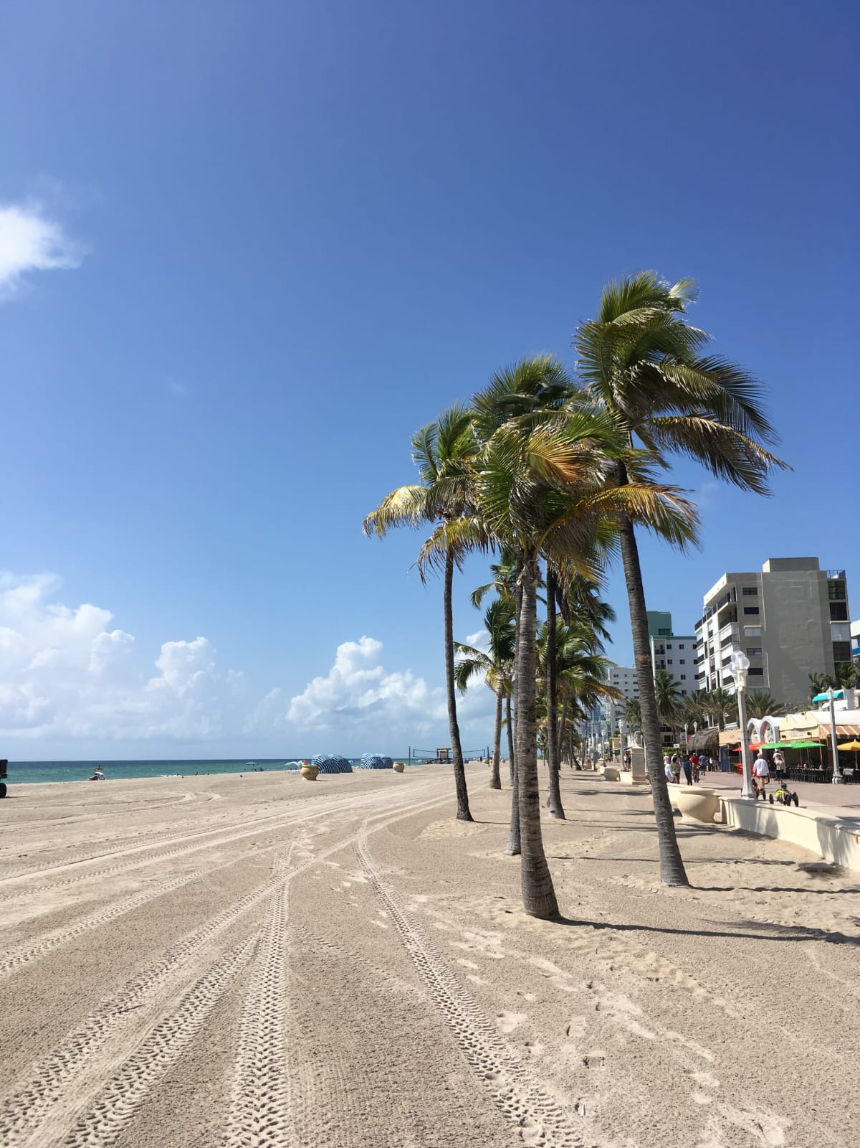
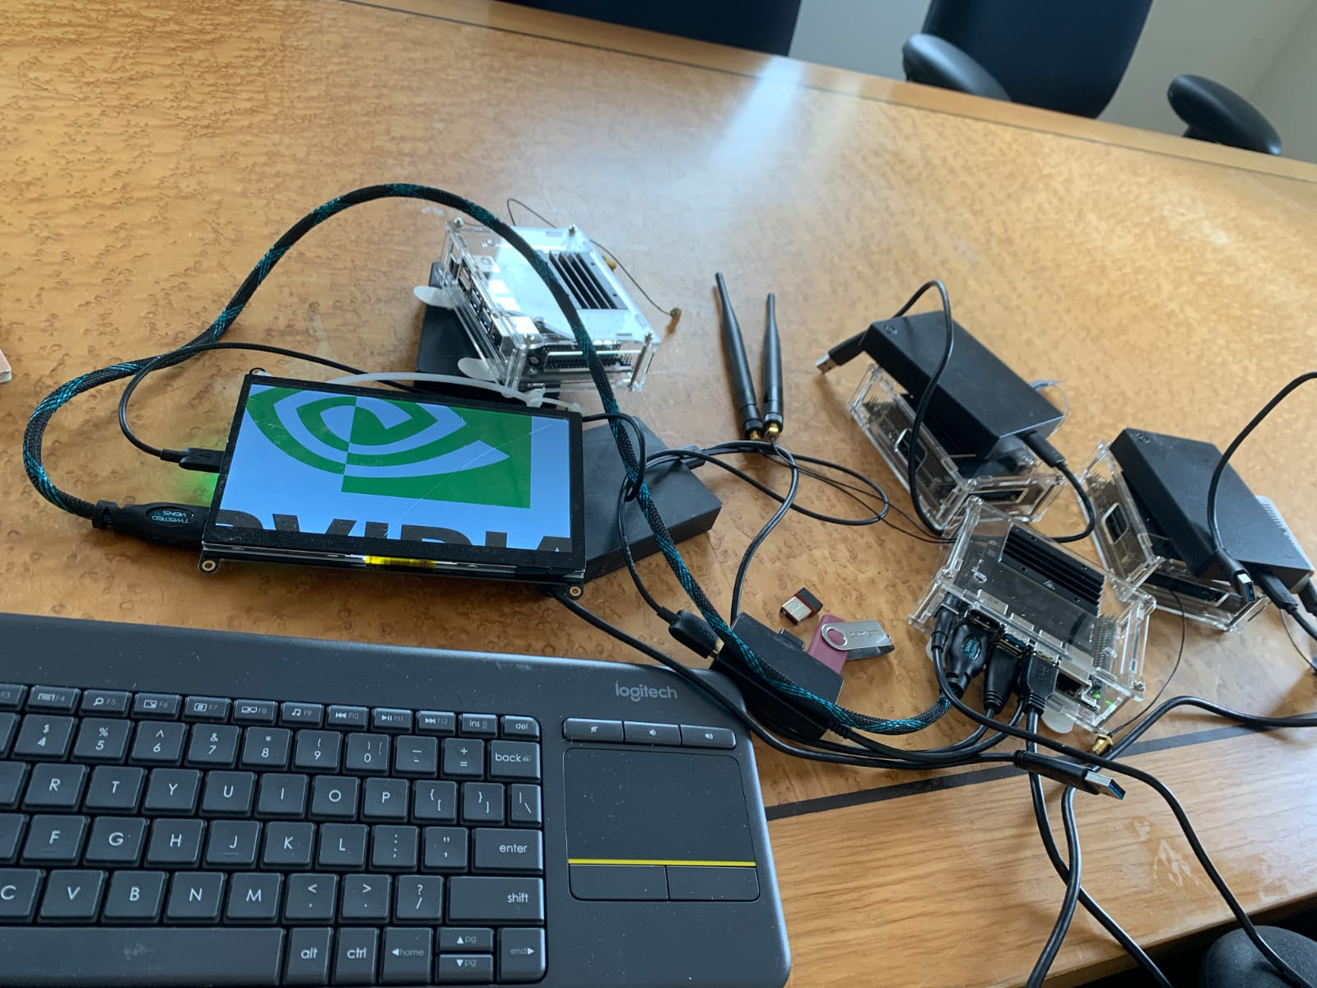
My Background
Throughput Computing 2025
1
Notes:
RESEARCH: Your/your group's general research interests/objectives/questions. You want to give enough context that people can understand your computing or the examples you want to present, but you usually don’t need to dive into specifics of your methodology.

Slide 3
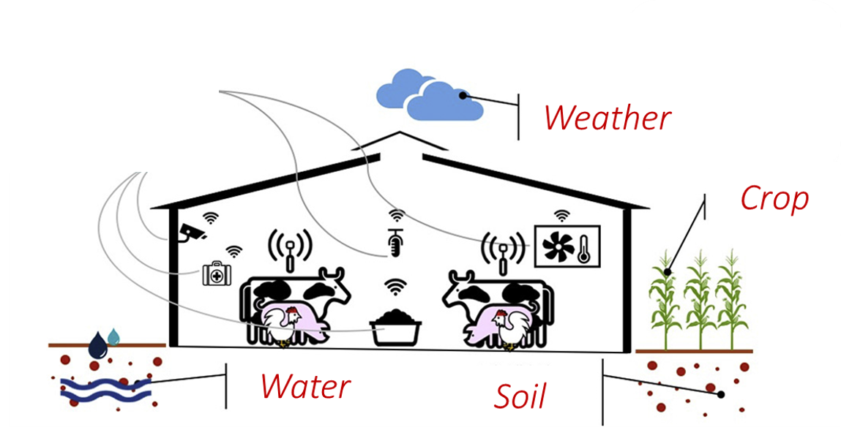
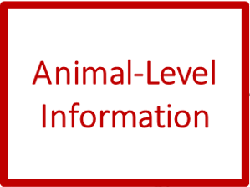
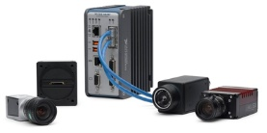
Digital Livestock Lab
Research applications of machine learning and computer vision for farm management and genetic selection
Sensors:
Wearable
Cameras
IR Spec.
RFID
Sound
Housing
Animal Identification
Animal Behavior
Body Weight
BCS/Composition
Milk Components
Milk Yield
Estrus Event
Feed Intake
Feed Efficiency
Disease Risks
Tullo et al., 2019
Throughput Computing 2025
2
Notes:
RESEARCH: Your/your group's general research interests/objectives/questions. You want to give enough context that people can understand your computing or the examples you want to present, but you usually don’t need to dive into specifics of your methodology.

Slide 4
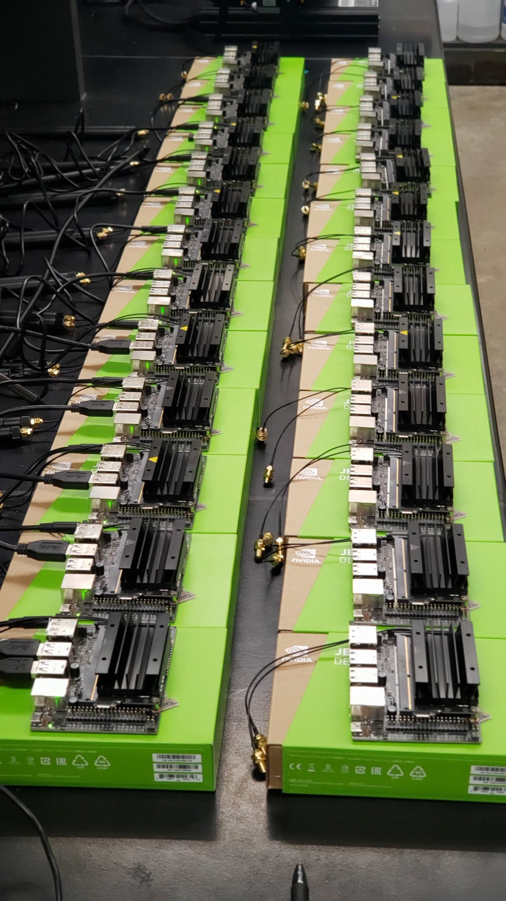
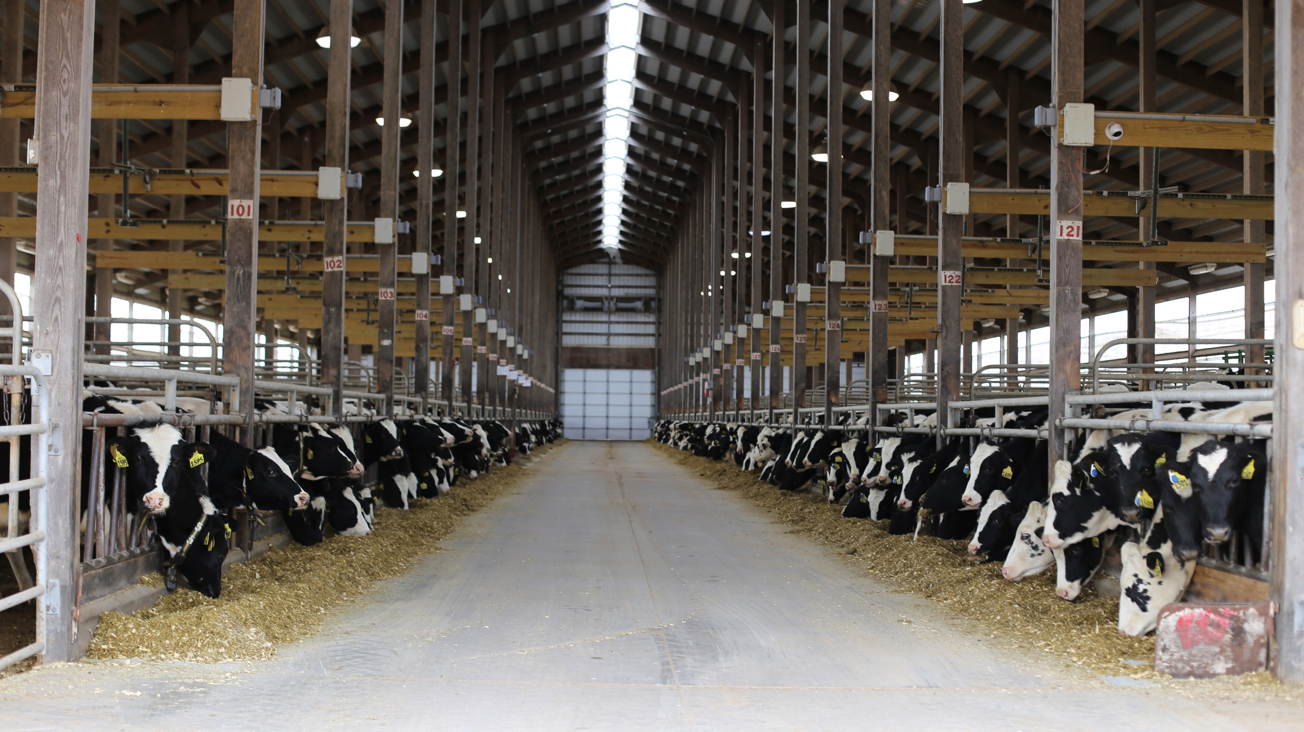
USDA Project: Heifer Identification &
Growth Monitoring
Throughput Computing 2025
3
Notes:
**give overview of what’s happening with this trial
Highlight that this is from the USDA grant.
Put context on the USDA grant before this *** put timeline, describe project more

Slide 5
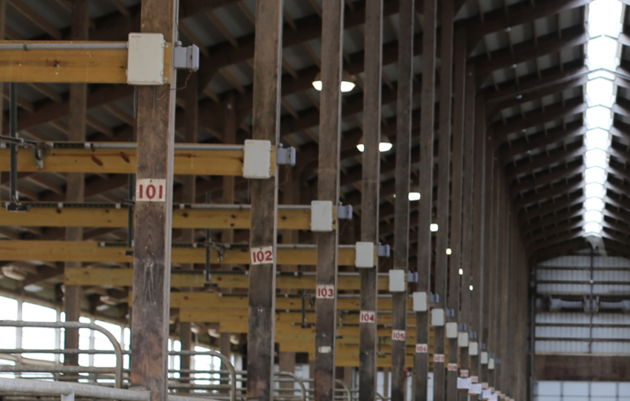
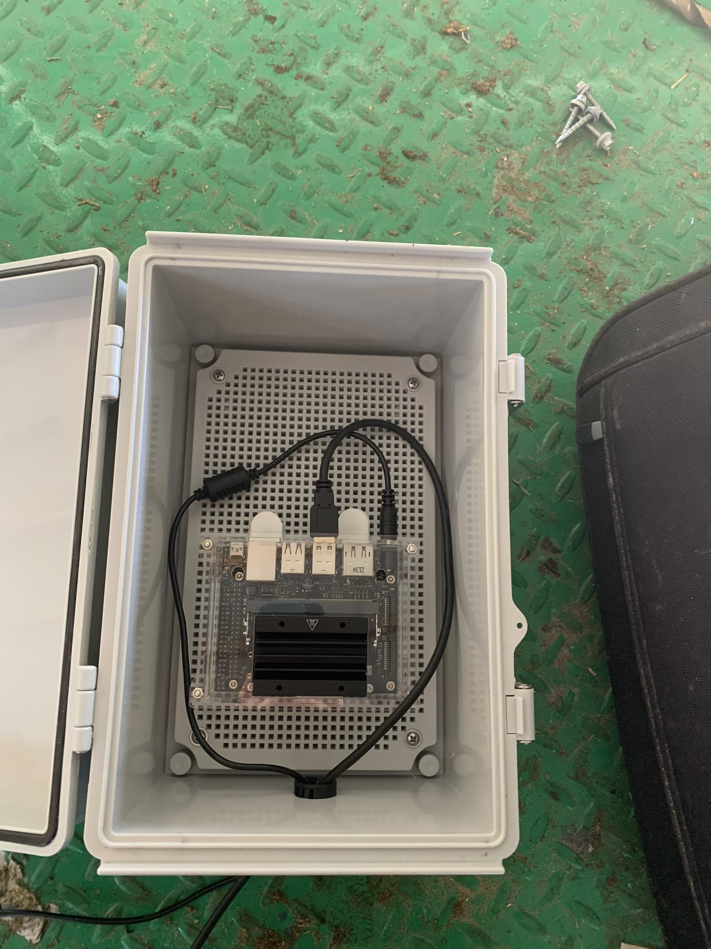
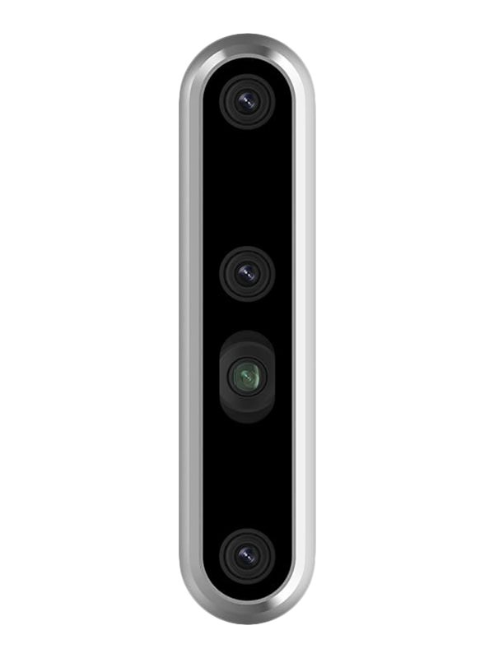
USDA Project: Heifer Identification &
Growth Monitoring
Throughput Computing 2025
4
Notes:
**give overview of what’s happening with this trial
Highlight that this is from the USDA grant.
First step for any phenotyping system and for my program
*generate a depth image for this page
Mention genomics, mammary development
Put context on the USDA grant before this *** put timeline, describe project more

Slide 6
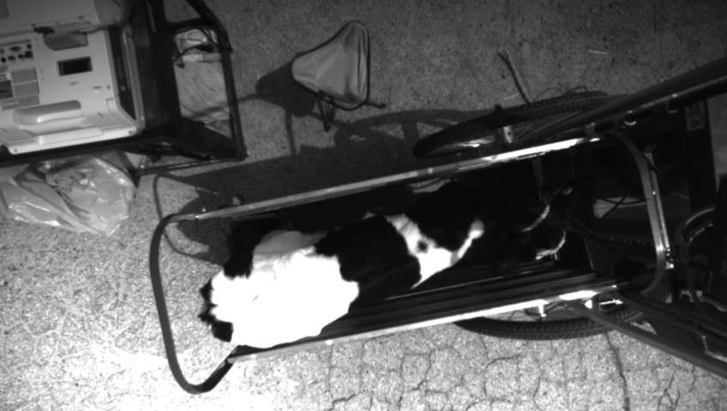
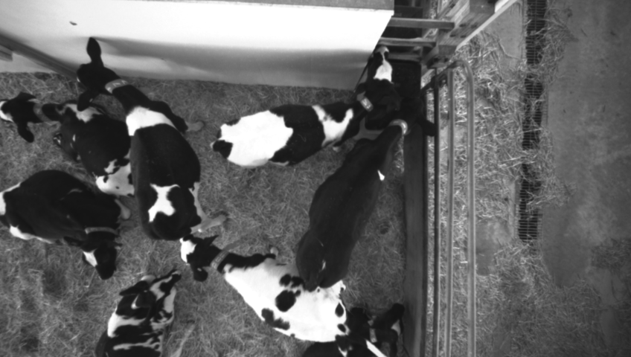
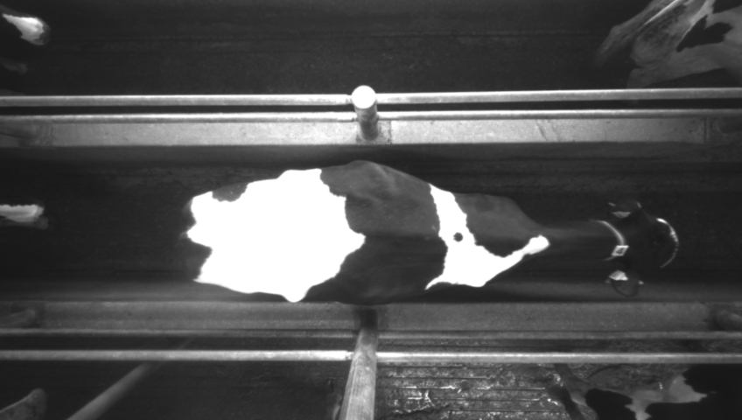
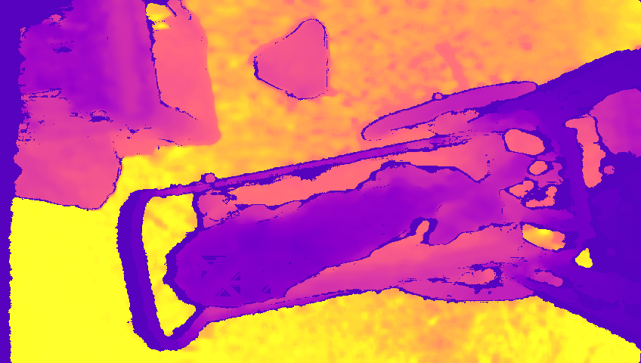
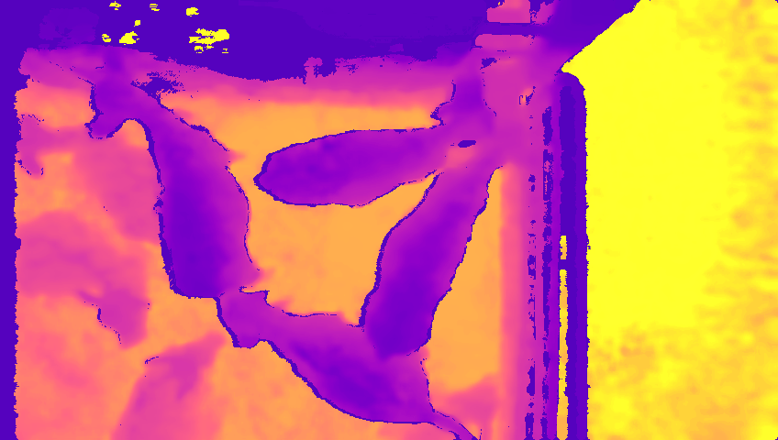
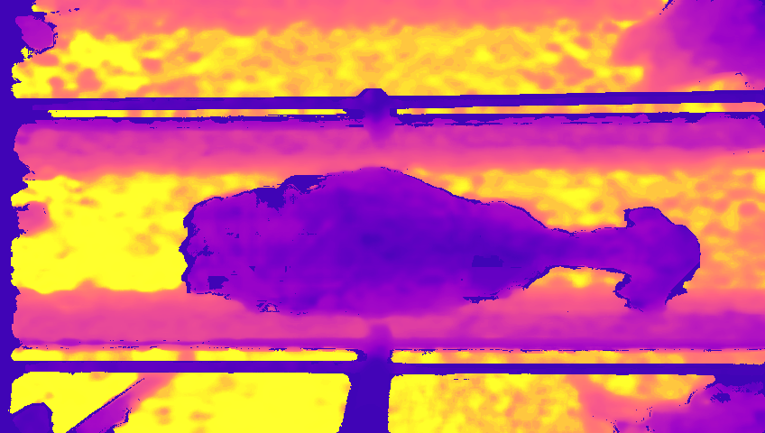
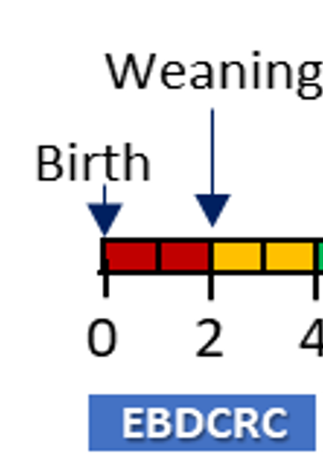
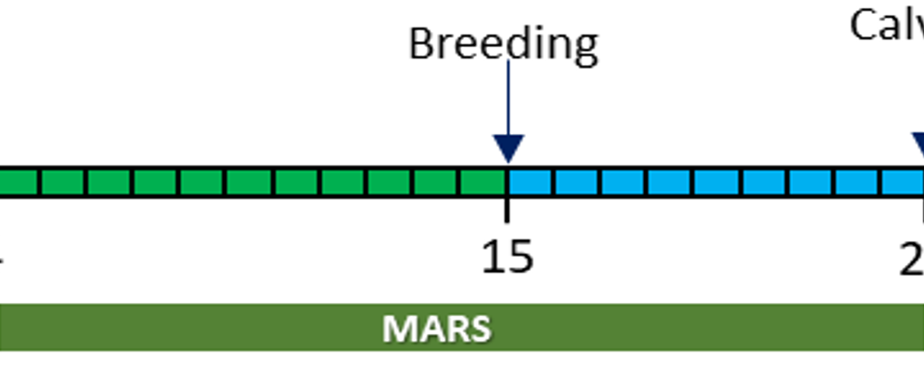
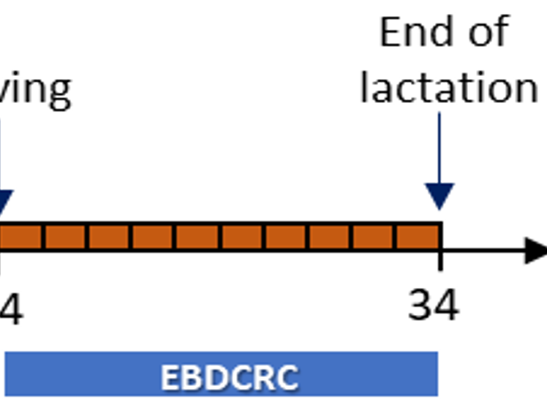
USDA Project Timeline
Throughput Computing 2025
5
Notes:
*mention and explain depth imaging*

Slide 7
USDA Project Timeline
> 200 TB of data
> 15,000,000 images
Throughput Computing 2025
6

Slide 8
Data Processing Pipeline
Individual ID
Feature extraction
Segment Body
Good Bad Classifier
Image Pre-processing
Extract Frames
Uses pretrained deep learning model for inference
Uses pretrained deep learning model for inference
Throughput Computing 2025
7

Slide 9
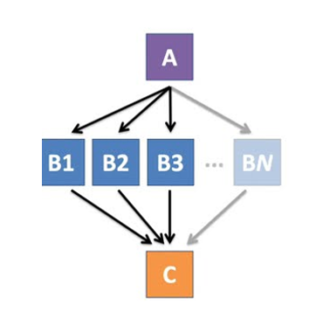
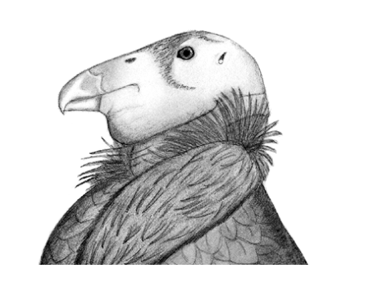
CHTC Resources
HTCondor
Pelican
DAGMan
Throughput Computing 2025
8
Notes:
RESEARCH: Your/your group's general research interests/objectives/questions. You want to give enough context that people can understand your computing or the examples you want to present, but you usually don’t need to dive into specifics of your methodology.

Slide 10
DAGMan Workflow
https://www.youtube.com/watch?v=1MvVHxRs7iU
Throughput Computing 2025
9
Notes:
*mention and explain depth imaging*

Slide 11
DAGMan Workflow
Input data transferred via Pelican from external storage servers
A1
E1
A: extract frames
B: segment animal body
C: filter out bad images
D: preprocess images
E: individual identification
F: extract features
A2
B1
D1
E2
A3
C
F
E3
A4
B2
D2
E4
A5
Throughput Computing 2025
10
Notes:
*mention and explain depth imaging*

Slide 12
DAGman Workflow
Batch organization
Python script reads the batch information, then generates the .dag file and cleanup script
Throughput Computing 2025
11
Notes:
*mention and explain depth imaging*

Slide 13
Data Processing Pipeline
Individual ID
Feature extraction
Segment Body
Good Bad Classifier
Image Pre-processing
Extract Frames
Throughput Computing 2025
12

Slide 14
Growth-Related Features
Extracted Biometrics:
Circularity
Area
Volume
Heights
Widths
Length
Throughput Computing 2025
13

Slide 15
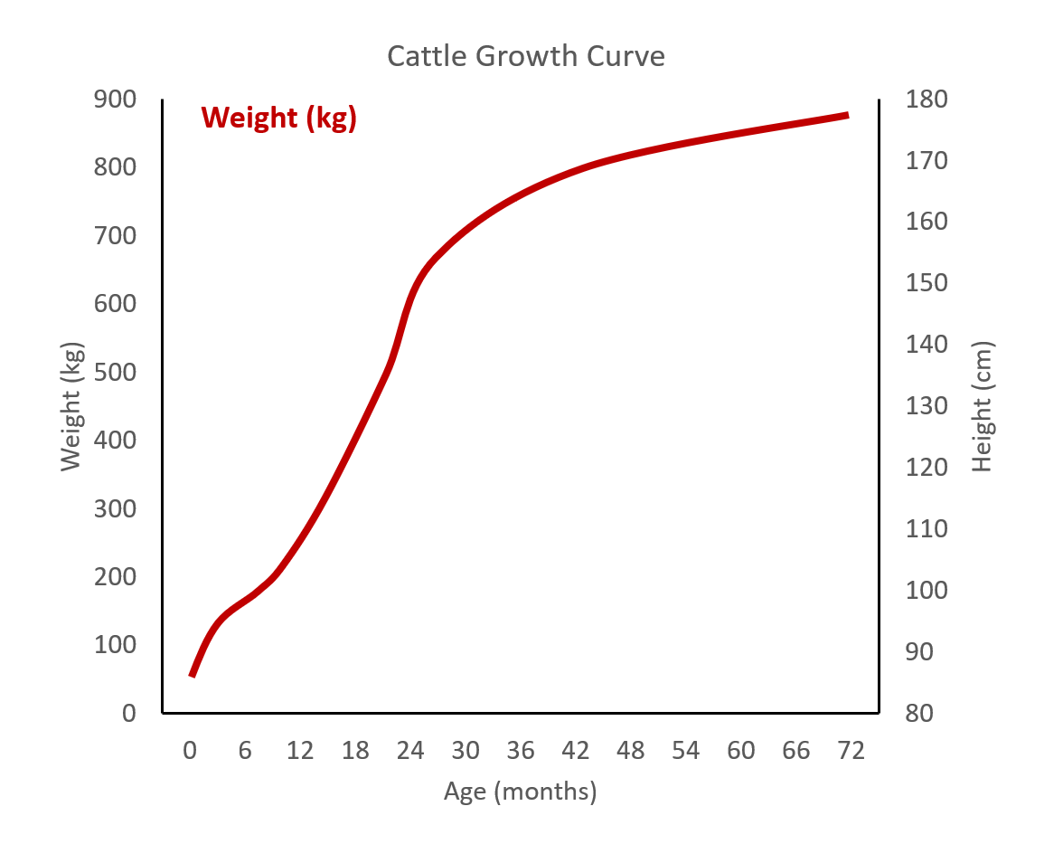
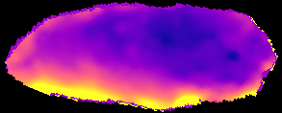
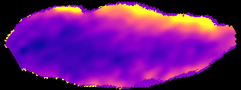
Growth-Related Features
Calf 1
Calf 2
Weight (kg)
3 months
6 months
+ 60 kg
+ 60 kg
Throughput Computing 2025
14

Slide 16
Growth-Related Features
Calf 1
Calf 2
Height (calf 1)
Height (calf 2)
Weight (kg)
3 months
6 months
+ 60 kg
+ 120 cm
+ 60 kg
+ 90 cm
Throughput Computing 2025
14

Slide 17
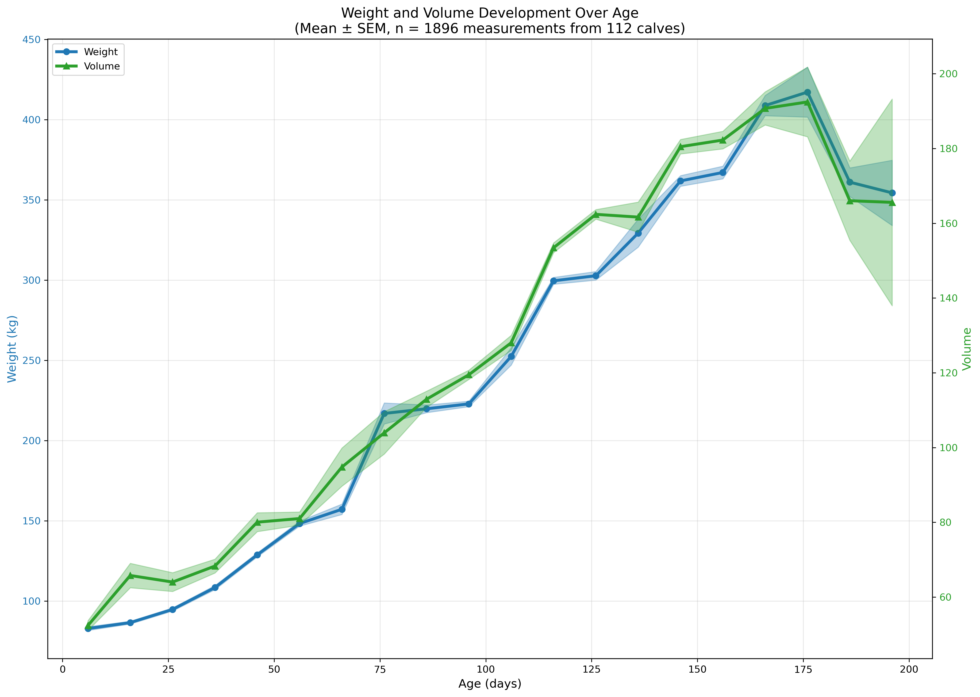
Biometrics vs Extracted Features
Weight vs. Volume
R² = 0.97
Unique calves: 109
Age Range: 1-297 days
Original # of records: 657,776
Records with corresponding weights: 7,351
Throughput Computing 2025
15
Notes:
** bring back the figures on growth curves, look at the parameters of the curve and how they are related to lactation performance

Slide 18
Longitudinal Growth Curve Estimation
Pipeline processed so far
DAGMan Jobs: 44,845
DAGMan Wall Clock Hours: 24,999
DAGMan CPU Hours: 11,920
~25% processed
Throughput Computing 2025
16

Slide 19
CHTC Takeaways
Advantages
CHTC staff is incredibly helpful and has been available to help us troubleshoot issues and create solutions to any problems (especially Dr. Andrew Owen)
The resources and support available through CHTC has allowed me to perform this large-scale, novel research that otherwise would not be possible
Current Limitations
Data transfer and storage has been a personal struggle, which was facilitated by utilizing Pelican
Throughput Computing 2025
17

Slide 20
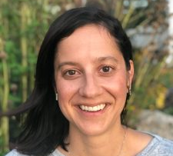
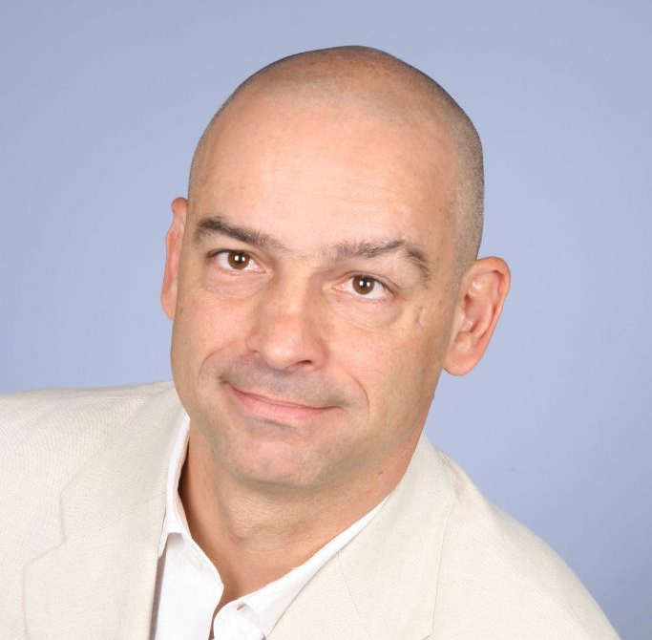
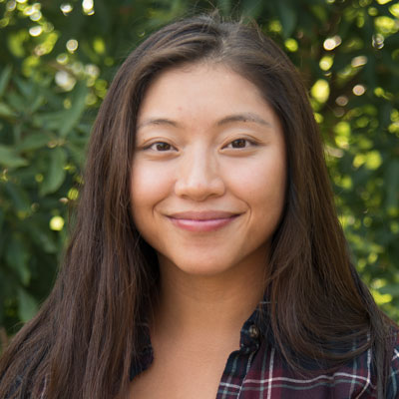
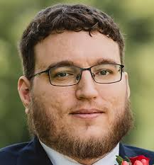
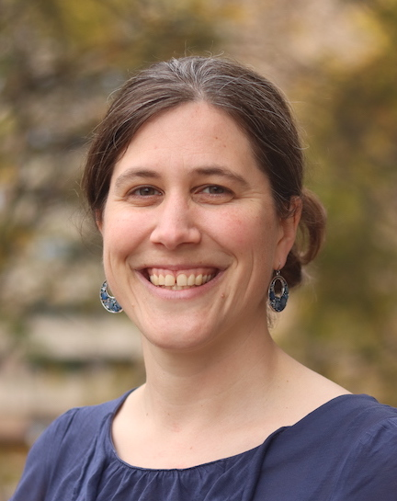
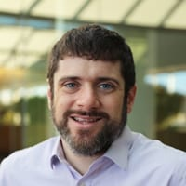
Thank you!
Thank you!
DALL-E
Email: negreiro@wisc.edu

