Slide 1
Welcome to HTC25
Madison, WI
June 2-6, 2025

Slide 2
More than 120 in-person attendees
More than 300 remote registrations
More than 70 guests joining us for the 40 years celebration tomorrow

Slide 3
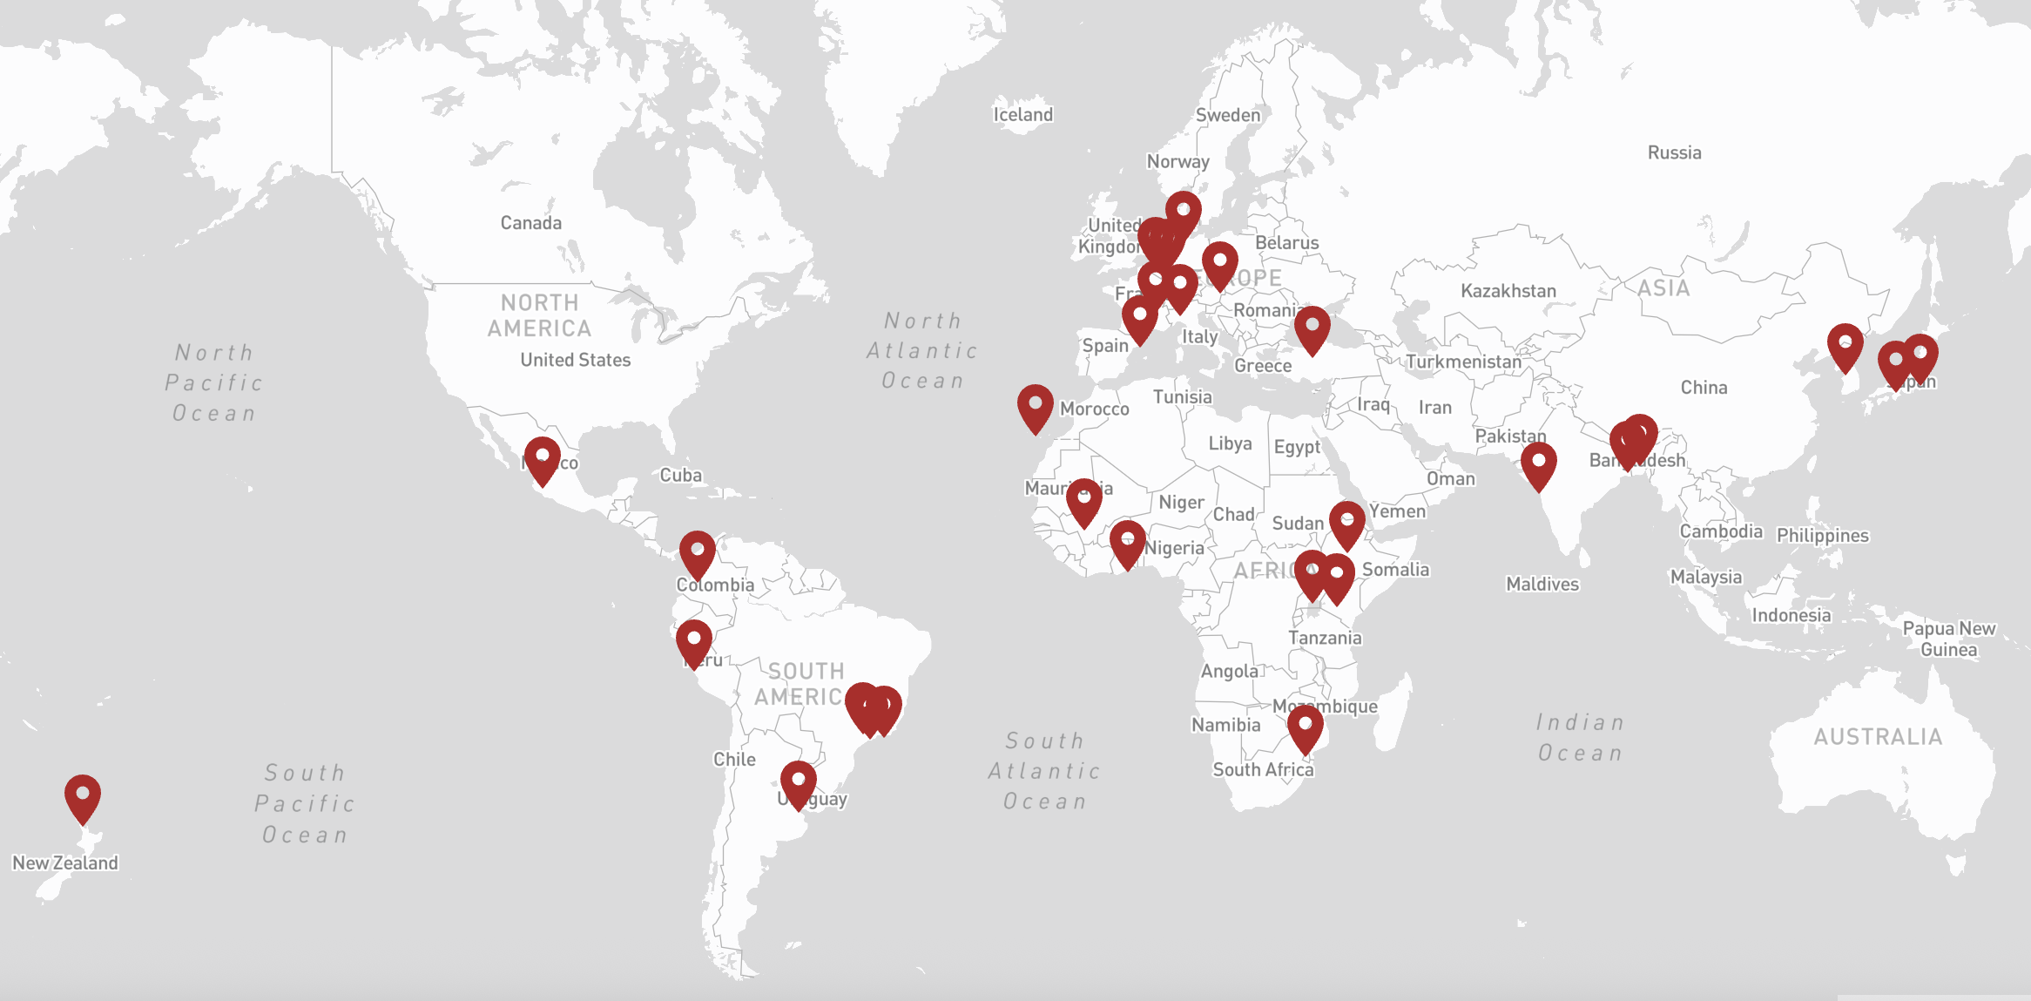
remote registrations
from 30 international
institutions

Slide 4
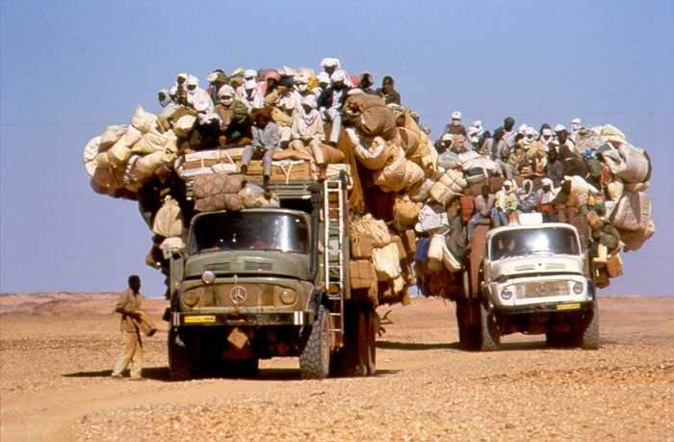
Thank you for joining us
Together we build a thriving
Throughput Computing community

Slide 5
Navigating the PATh forward
Miron Livny
UW-Madison Vilas Research Professor
John P. Morgridge Professor of Computer Science
UW-Madison Center for High Throughput Computing
Morgridge Institute for Research

Slide 6
40 years of (HT)Condor
5 years of PATh
2 years of Pelican
20 years of OSG

Slide 7
Center for High Throughput Computing (CHTC) Vision – Distributed High Throughput Computing and Research Computing Facilitation are powerful enablers of scientific discovery
“… many fields today rely on high-throughput computing for discovery.”

Slide 8
What is the value proposition of throughput computing for researchers with AI workloads?

Slide 9
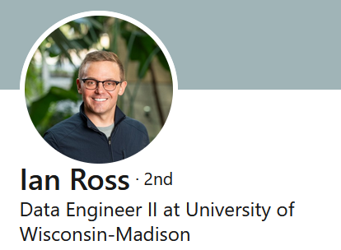
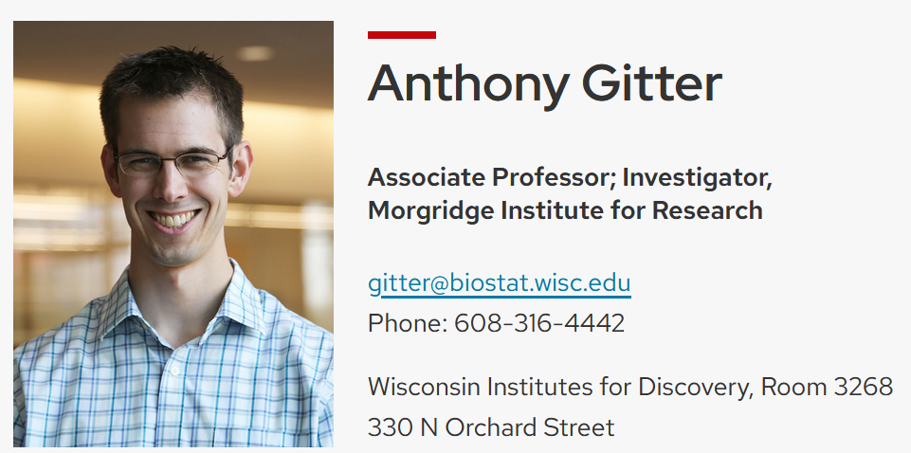
Professor Tony Gitter is now a PATh co-PI
Dr. Ian Ross is now the PATh AI coordinator
PATh was awarded a supplement as a NAIRR pilot demonstration project
PATh joined NAIRR as collaboration resource

Slide 10
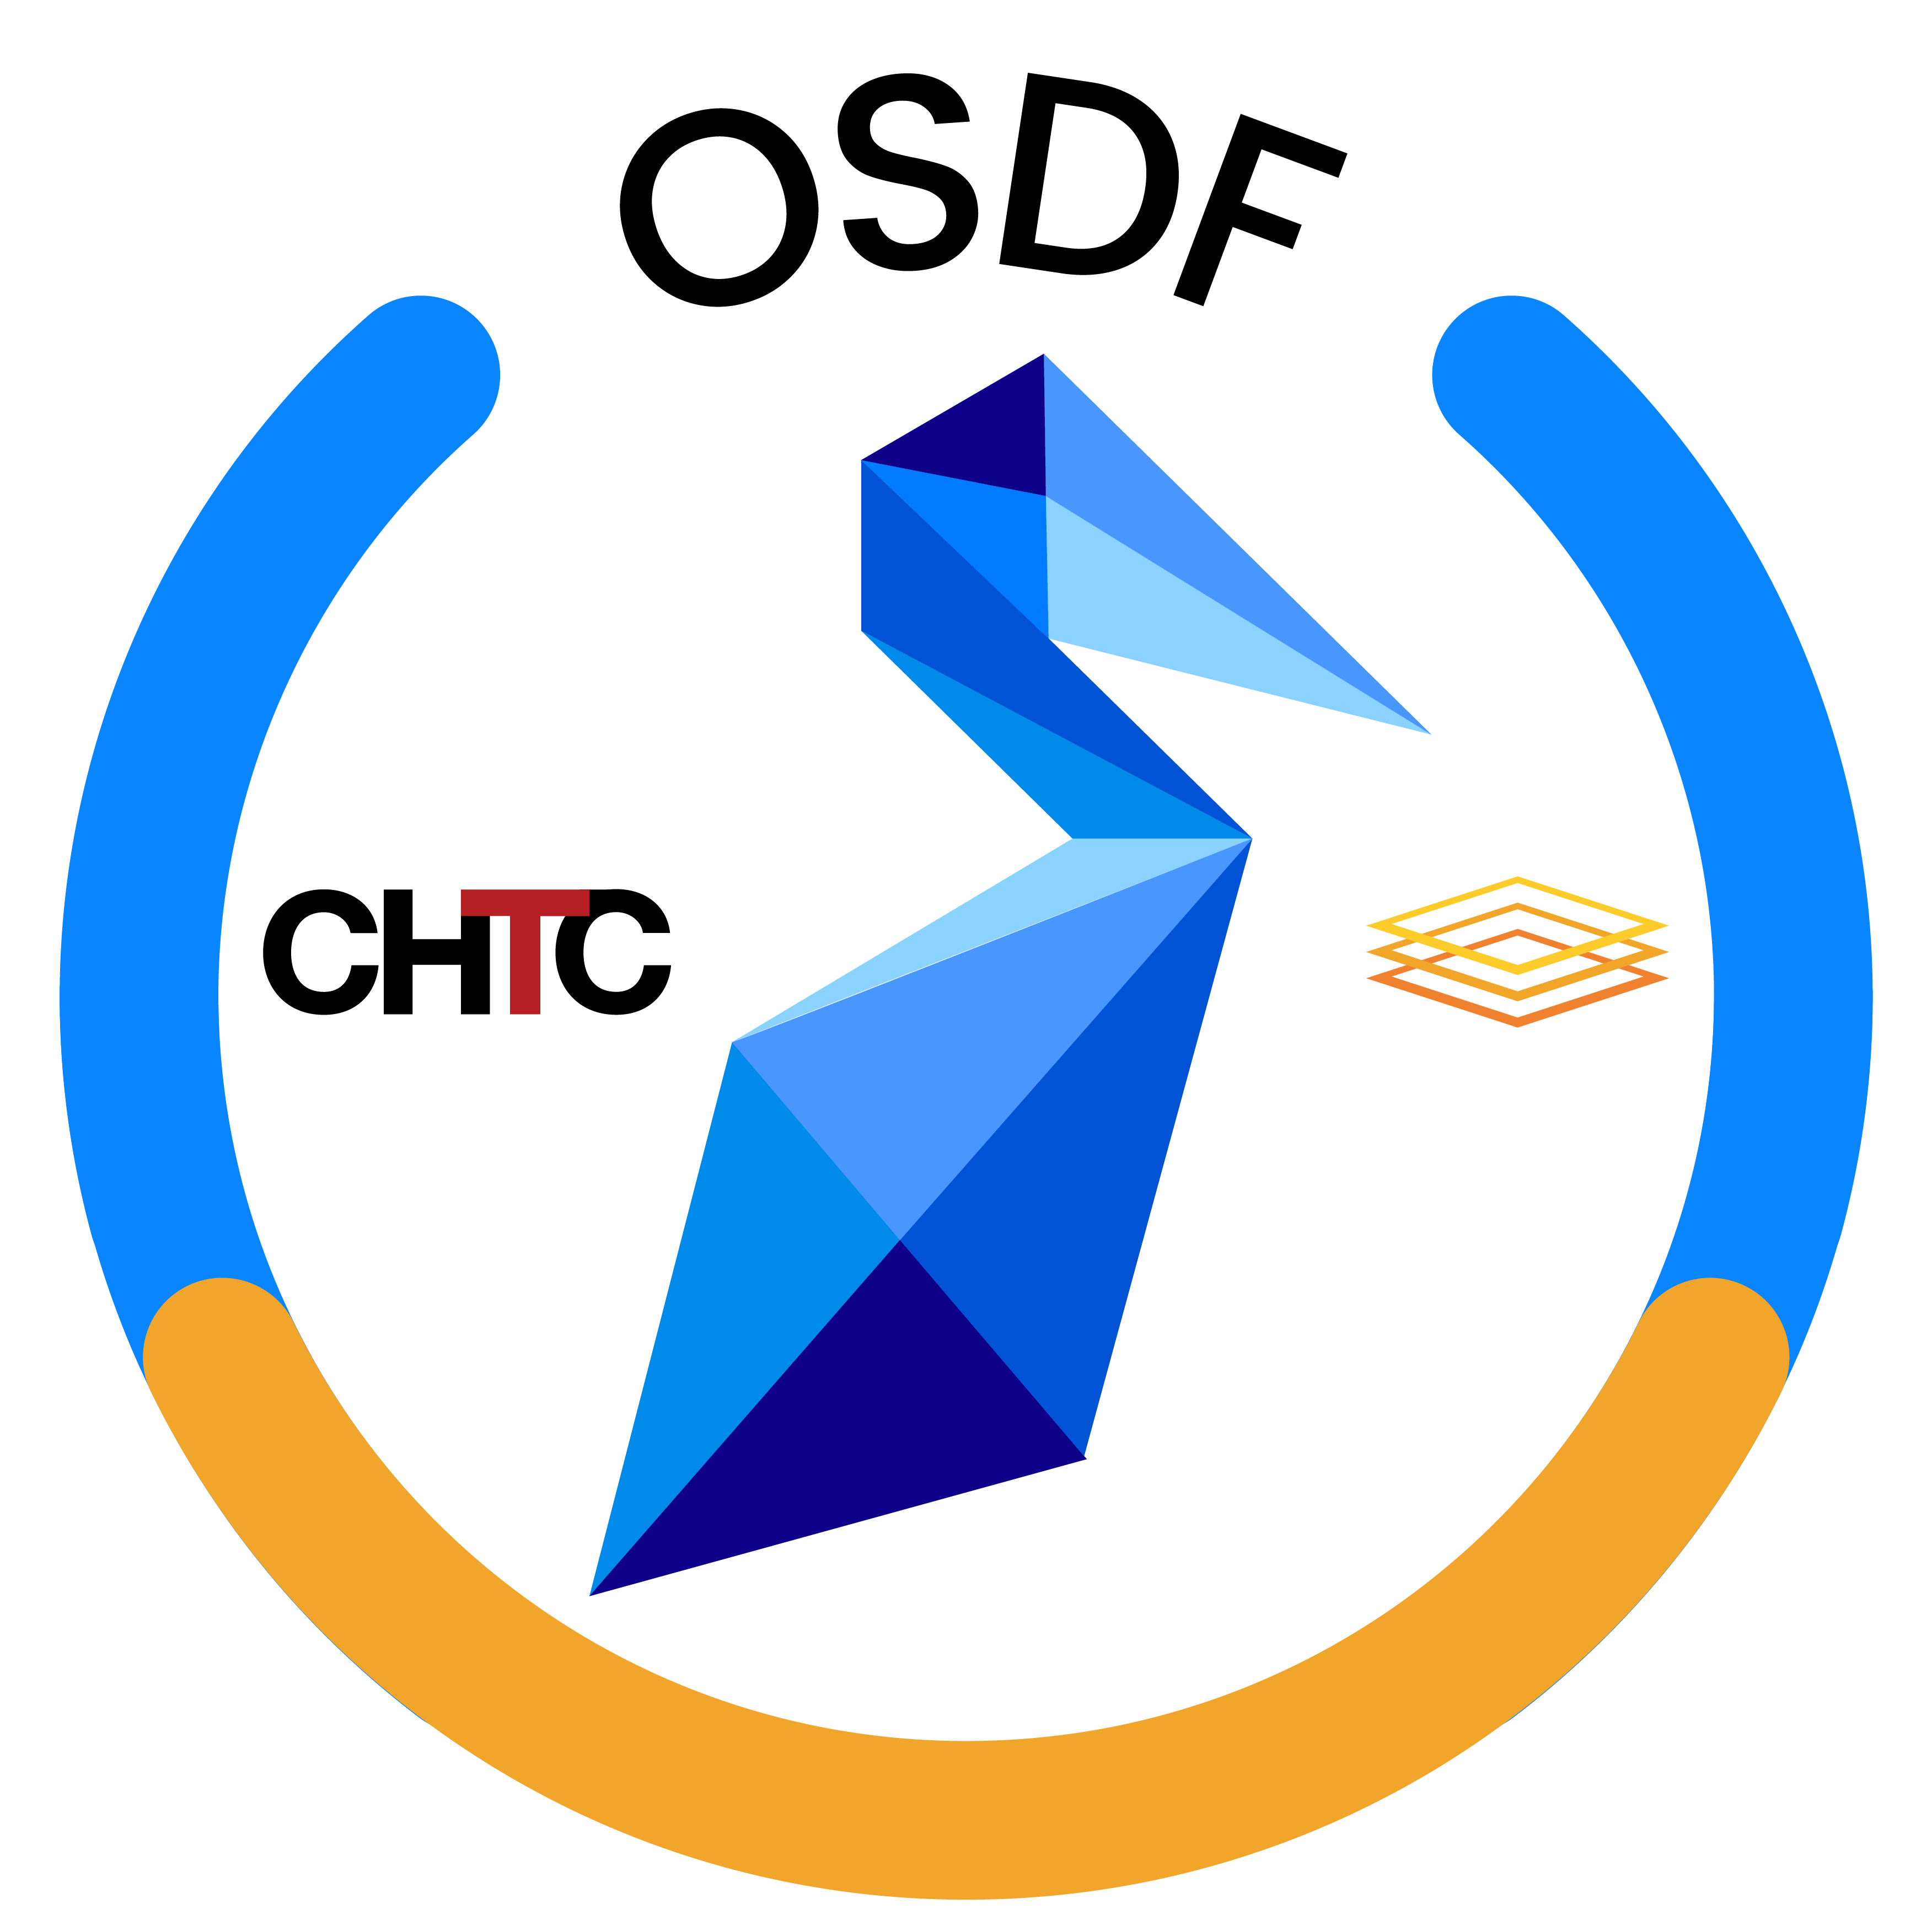
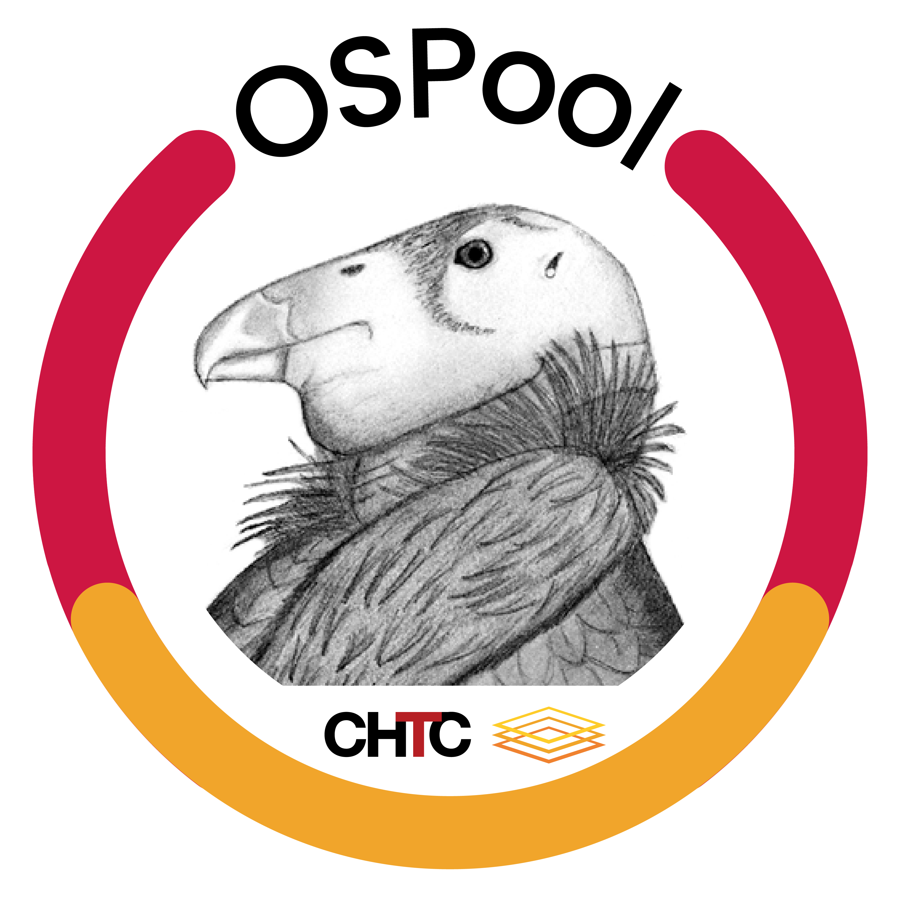
OS
Facilitation
Team
Facilitation

Slide 11
Translational (Computer) Science
Feedback
Laboratory – Where Innovation and development happens
(2-5 years)
Locale – Where services are deployed and operated
(5-10 years)
Communities – Where services enable science
(10 + years)
Innovate Technologies and Methodologies
Deploy Services
Build Communities

Slide 12
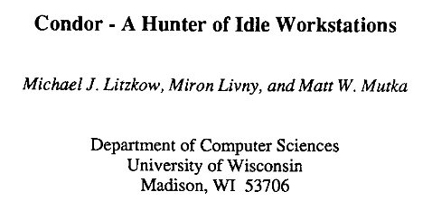
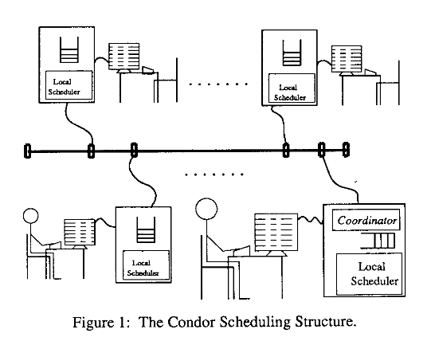
Published
1987

Slide 13
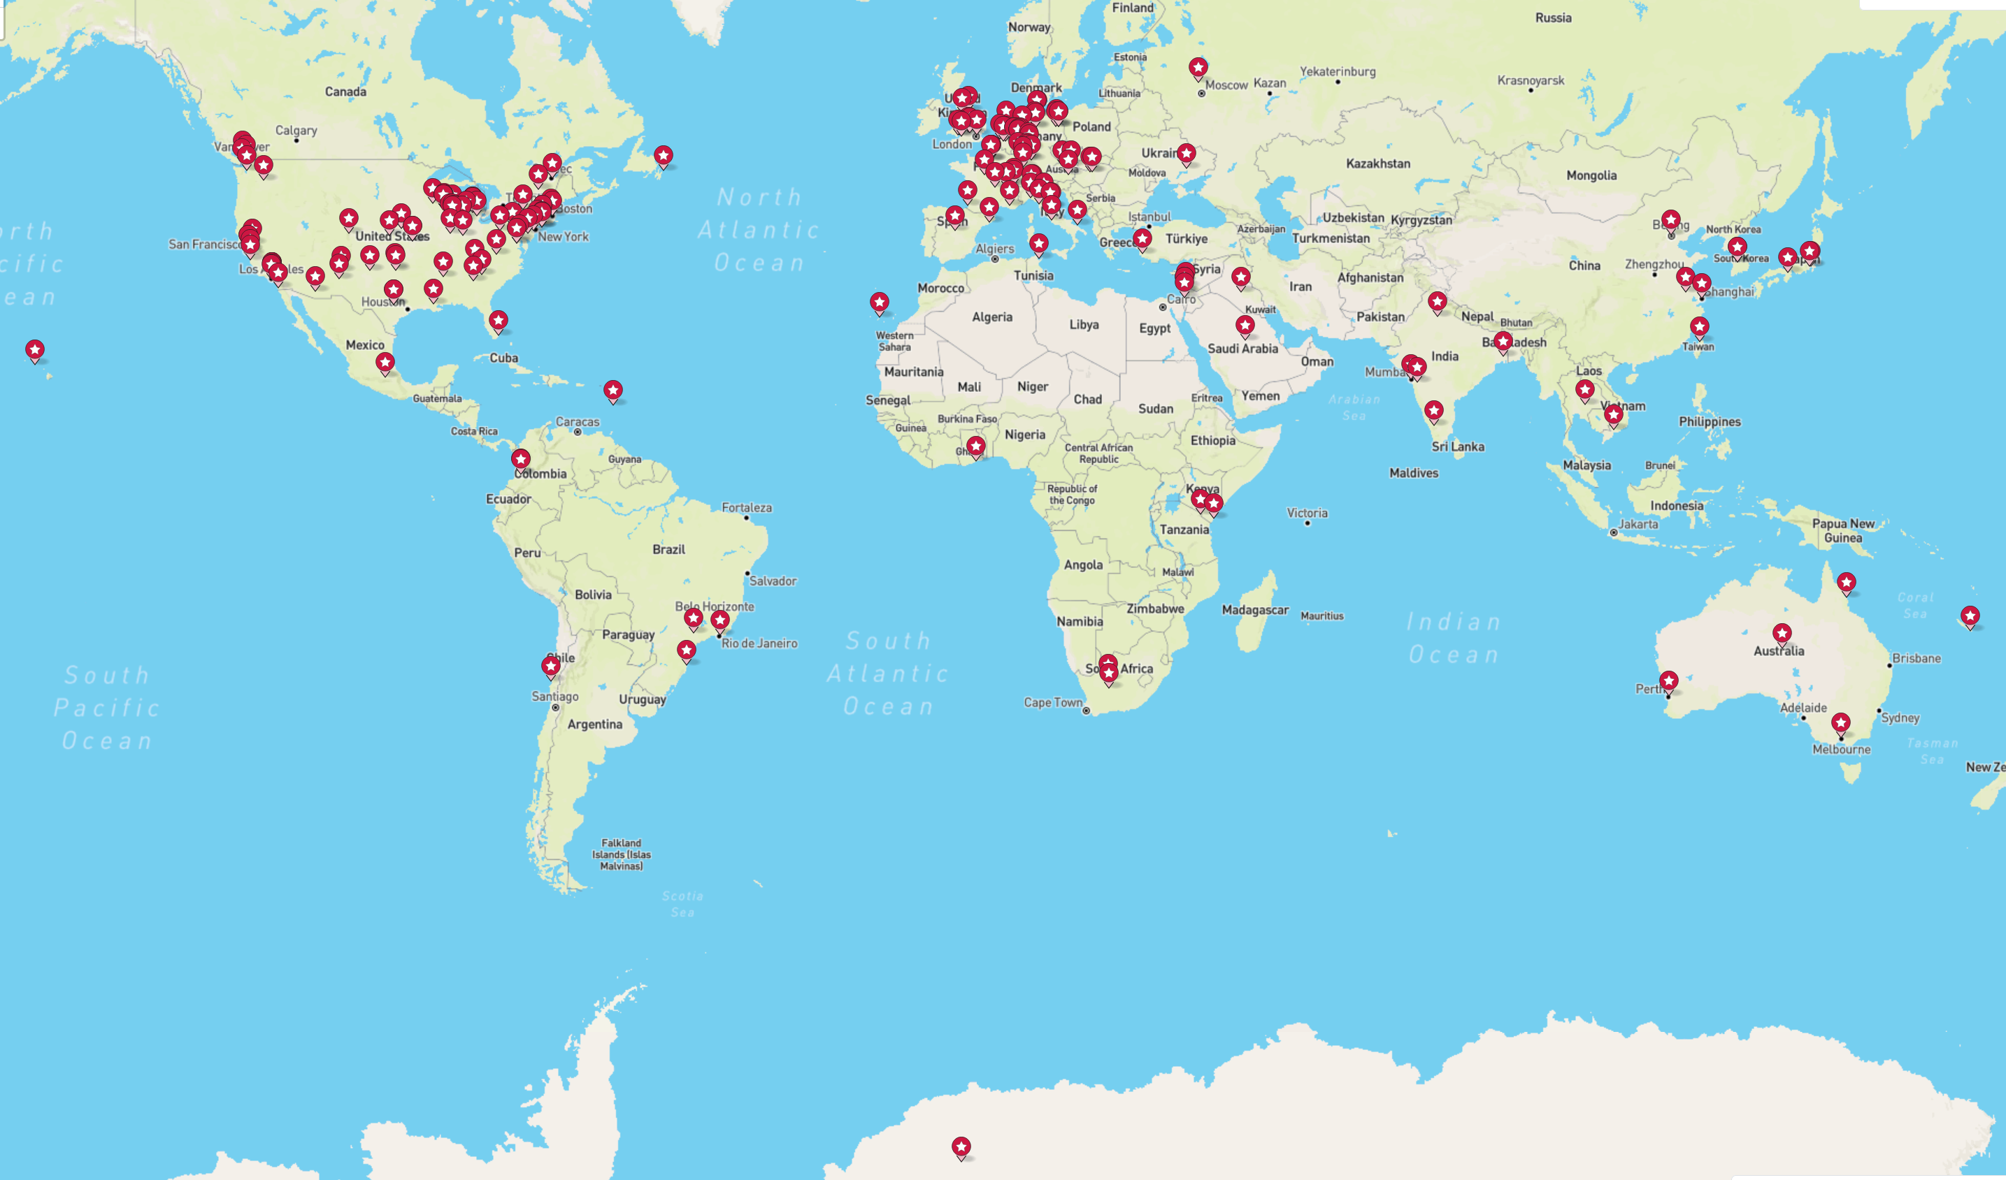
187 Registered HTCondor systems

Slide 14
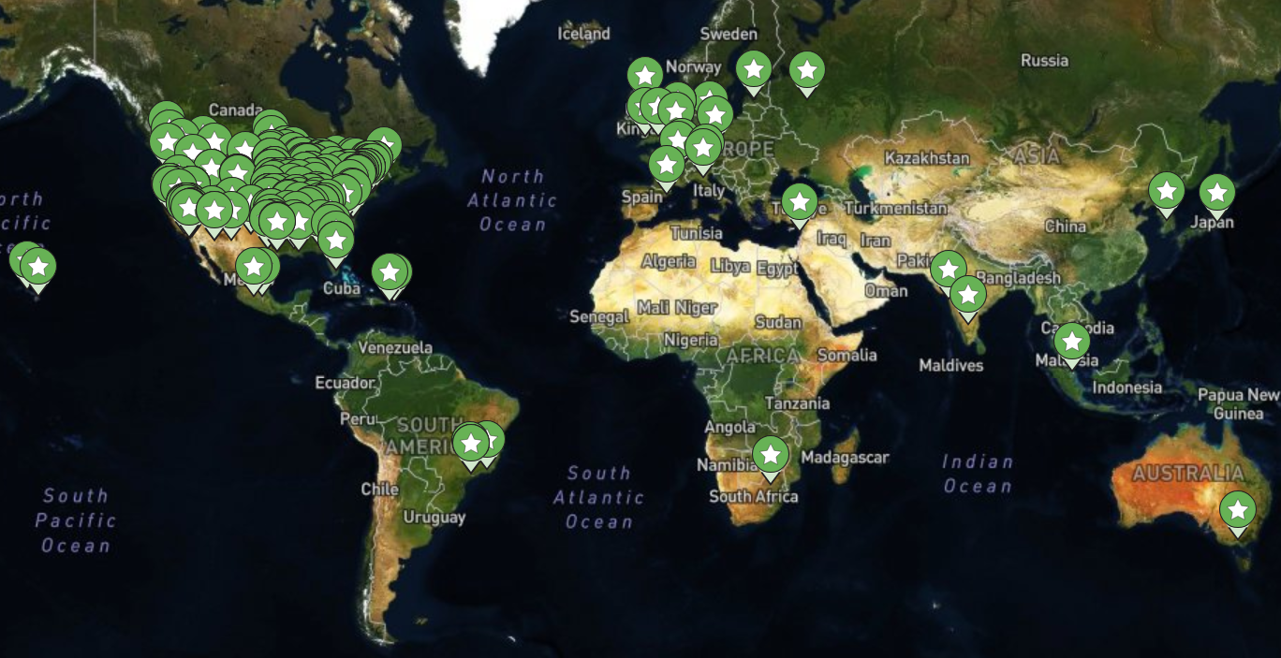
The Locale - Sites with deployed
258 Sites
168 Institutions

Slide 15
LIGO-Virgo-KAGRA Announce the 200th Gravitational Wave Detection of O4!
When asked about the contributions of the PATh project to this milestone, Dr. Stuart Anderson who serves as the LIGO Scientific Computing Lead responded” Yes, most definitely!” adding “FYI, most, but not quite all, of the O4 detections (and rapid follow-up analysis, i.e., skymaps and other parameter estimation) were made using HTCondor.”. Digging deeper into the value of PATh to LIGO, Stuart pointed out that “Both LIGO Observatories and the central data processing/archive site at CIT use HTCondor heavily for both online low-latency processing and deep offline searches. You can also say that all of the NSF funded LIGO Scientific Collaboration computing centers in the US run HTCondor, i.e., UWM and PSU. We also sweep up cycles from other NSF facilities in the US via HTCondor glideins, as is the case for international computing resources.”
In March-25 the International Gravitational Wave Network (IGWN) HTCondor world-wide pool served more than 2.9 M job that consumed more than 7M core hours serving more than 60 users via 5 HTCondor Access Points operated by LIGO.
Last week, the OSDF delivered the IGWN pool more than 1.1M objects for a total of 1.8 PB of data.

Slide 16
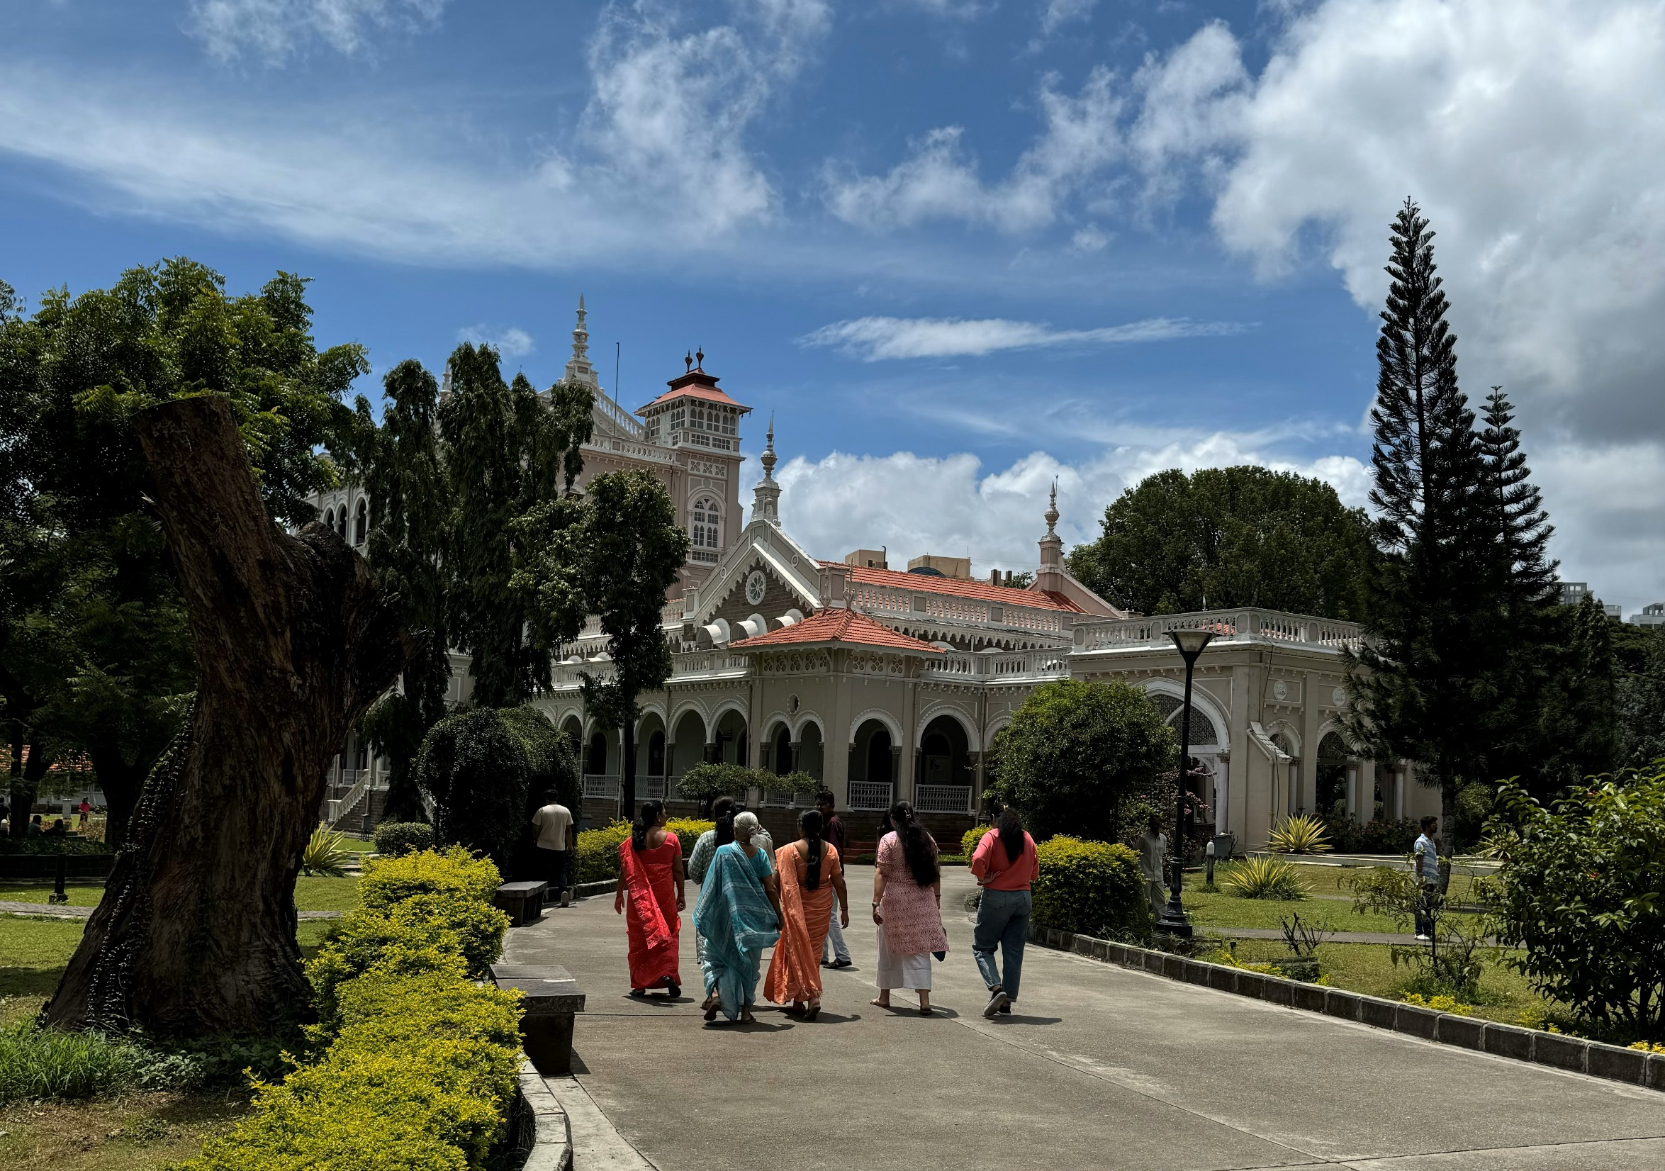
Aga Khan Palace,
Pune, India (09/2024)

Slide 17
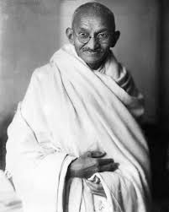
Mohandas Karamchand Gandhi
(2 October 1869 – 30 January 1948)

Slide 18
Building a lasting relationship with a community requires an
evolving value proposition
and
mutual trust

Slide 19
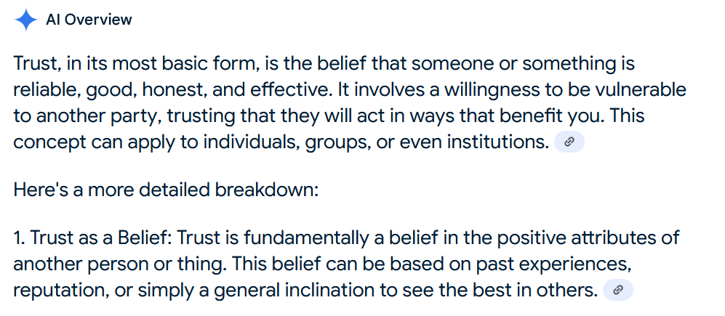

Slide 21
Do we believe that our technologies, methodologies and services are Trustworthy?
Do the communities/organizations that adopt (deploy, use, depend on) our technologies, methodologies and services believe that they are Trustworthy?

Slide 22
Does an owner/administrator of an Object Store that allows an OSDF Origin to perform GET and PUT operations trust the OSDF to follow the Object Access policy of the Store?
Who got access to the Object
Who provided the Object?
Does a consumer who requests the Pelican Client to GET or PUT a named Object trust the integrity of the Client?
Is the Object delivered identical to the Object stored?
Is the Object stored identical to the Object provided?

Slide 23
Is Trust a mutual relationship?

Slide 24
How to effectively communicate the value proposition of our services?

Slide 25
What is “the value message” to a specific class of audience?
How do we communicate the value message to different audiences?
What will be effective to quantify about our value?
What can we measure and collect?
How much do we trust our data collection (monitoring) and reporting mechanisms?
How quickly can we respond to a request for quantitive information?

Slide 26
osg-htc.org/services/open_science_pool.html

Slide 27
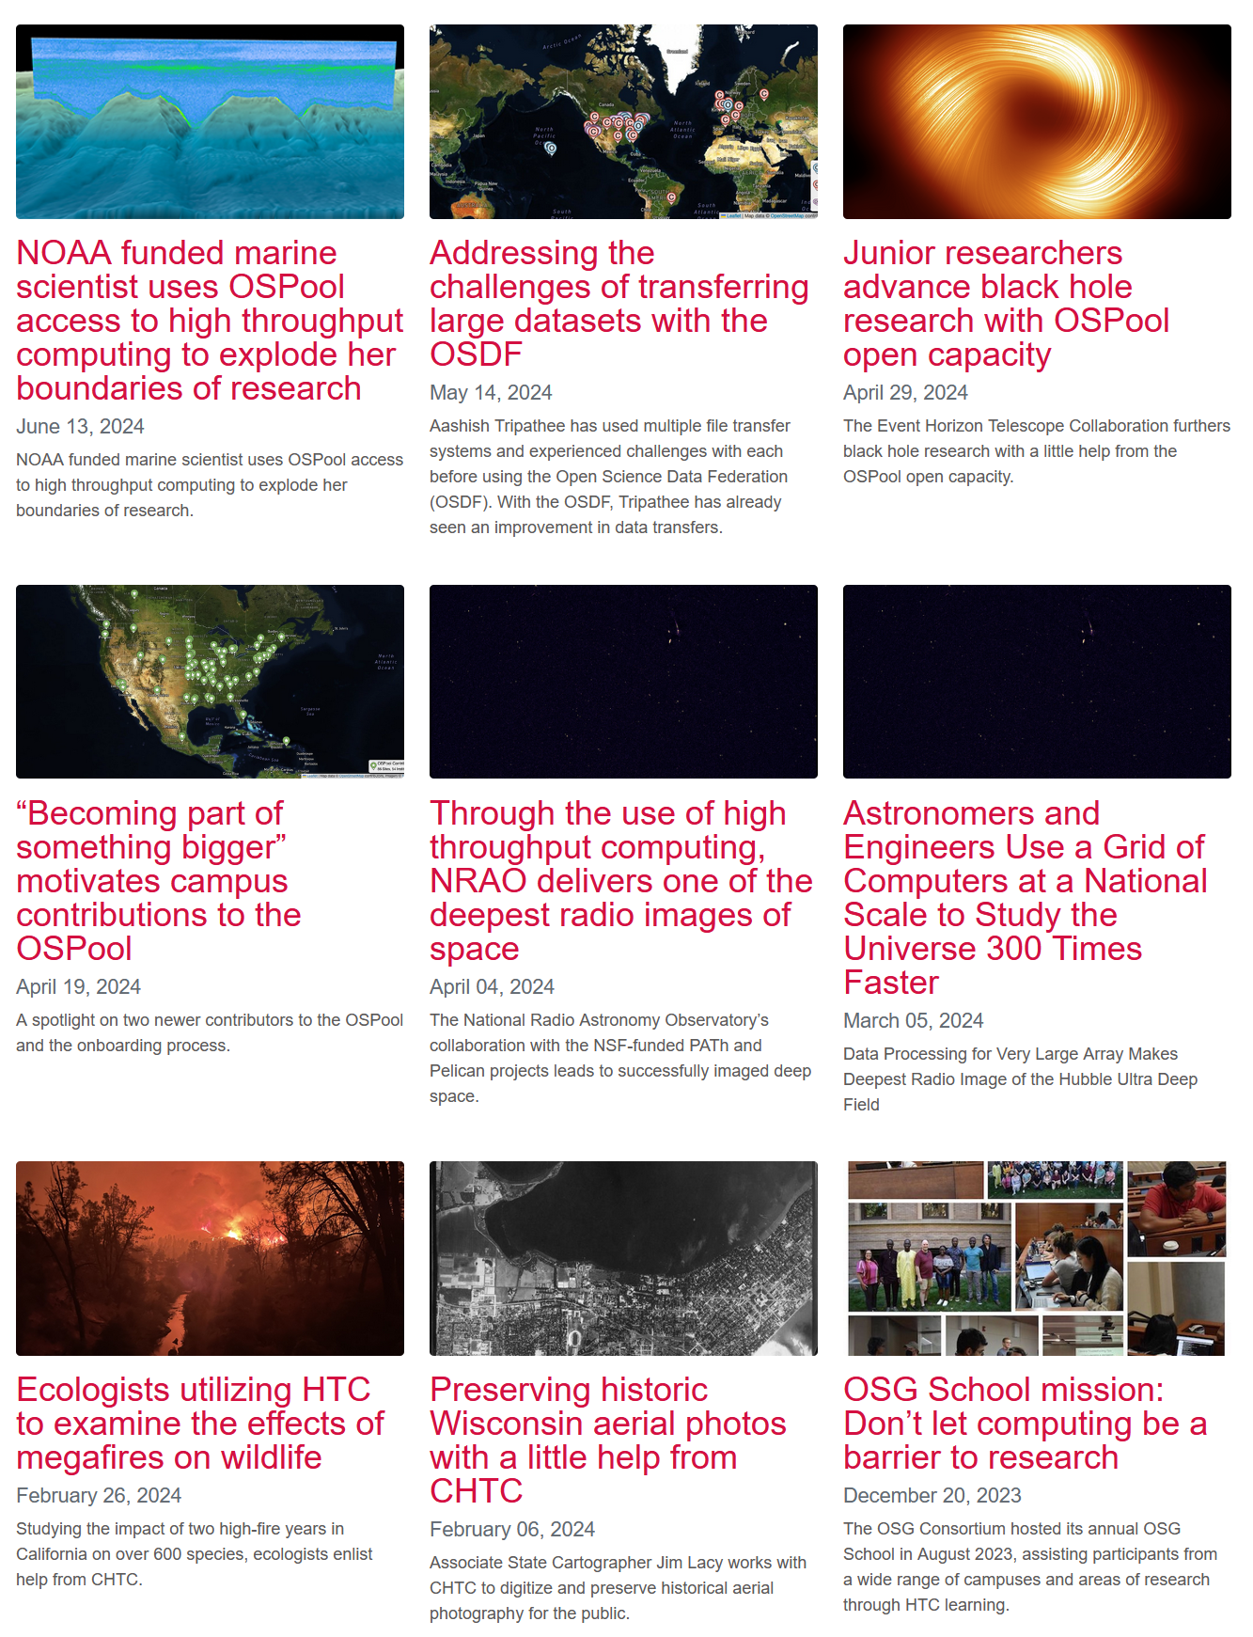

Slide 30
https://path-cc.io/contact/
This work is supported by the National Science Foundation under Cooperative Agreements OAC-2030508, OAC-2331480. Any opinions, findings, conclusions or recommendations expressed in this material are those of the authors and do not necessarily reflect the views of the National Science Foundation.

