Slide 1

State of OSG
Frank Würthwein
OSG Executive Director
UCSD/SDSC
June 2nd 2025

Slide 2
20th Anniversary of OSG
2005

Slide 3
~500 jobs/day
~100GB
Growth in 20 years
Institutions ~ 10x
Data movement ~ 1Mx
# of jobs/day ~ 1,000x
26 Institutions

Slide 4
OSG as a Distributed Infrastructure
How do Institutions join today vs 20 years ago?

Slide 5
Different Service Options
Compute
  OSPool
  More than a dozen Private Pools
    From few 1,000 to few 100,000 cores per pool
  “Pools are filled” in many different ways …
    gWMS submits to
      Hosted CE
      RPM installed CE
    glidein container managed by site
    User submitted glidein
    Kubernetes provisioner
    … probably forgot some …
Data
  Data Origins
  Data Caches
Many Provisioning
Mechanisms
to choose from.

Slide 6
Can join at different layers of the stack
Join a Pool via a provisioning mechanism
Join the NRP Kubernetes infrastructure
Have PNRP operate your hardware from IPMI up
OSPool
Other HTCondor Pool
Join pool via provisioning mechanism
NRP CE
Kubernetes
Join the existing NRP Kubernetes infrastructure
Operating System
IPMI, Firmware, BIOS
Have the NSF funded PNRP project operate your hardware via IPMI
Hardware
Institutions differ in the effort they have to join, and the control they desire after joining.
  Minimal effort & control => IPMI
  Maximal effort & control => join pool(s) via hosted CE & gWMS

Slide 7
Effort Needed to Exercise Control
Data Center
Networking Infrastructure
Hardware maintenance
Cybersecurity
System support
  OS, batch system, storage system, middleware, …
User support
Management & budget
An example business
model may look as follows:
Campus budgets 4FTE
Charge faculty ~40% of
hardware costs for 6 years
of operations.
~$2M/year in
hardware to break even.
e.g. 100 nodes with 8GPUs each
$100k per node avg purchasing costs
Nodes have 5 year warranty
and are operated for 6 years,
$6667 per node/year in operations.
100 x $6667 = $667k
100/6 = 17 nodes to purchase/year
$1.7M hardware budget annually

Slide 8
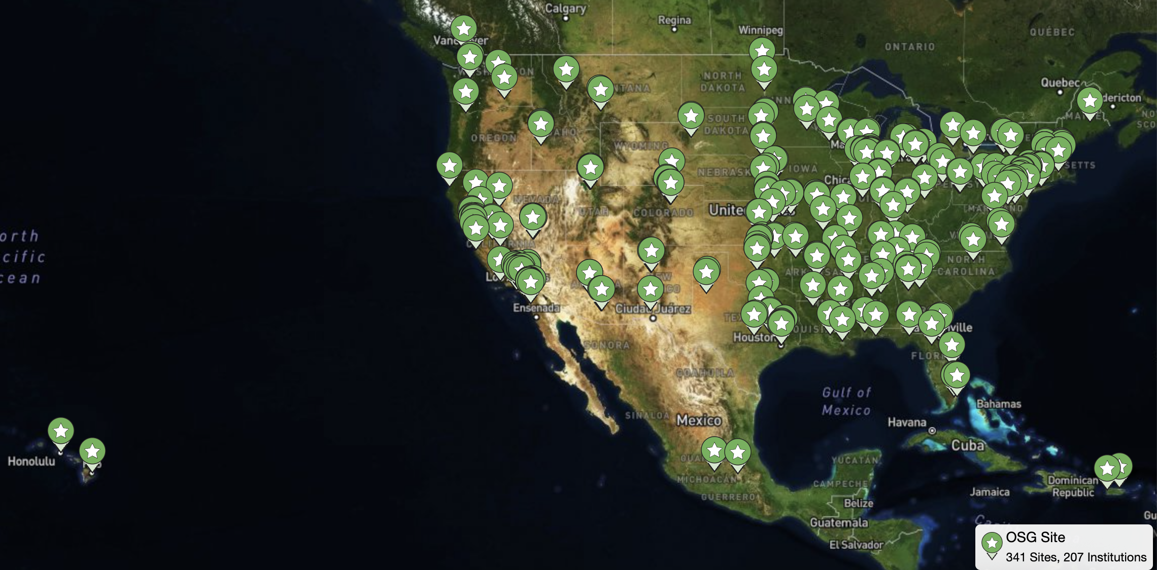
OSG Today
207 Institutions integrate resources

Slide 9
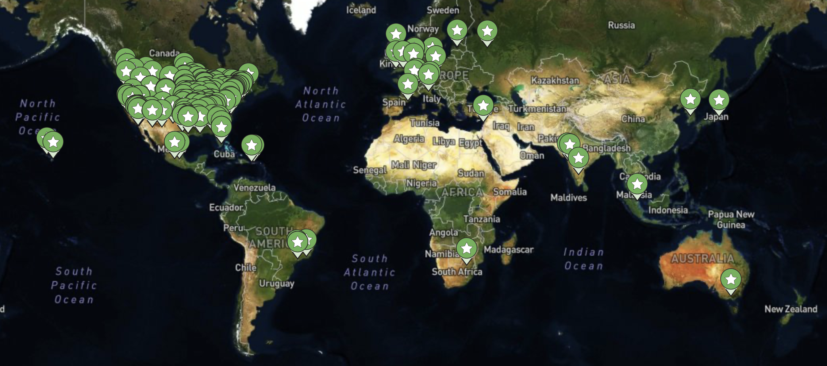
International Institutions
Following the NSF rules, any US scientist may request that
their international collaborators are integrated into OSG
For historic reasons, we do not count institutions that we engage with only because of the LHC

Slide 10
Open Science Data Federation

Slide 11
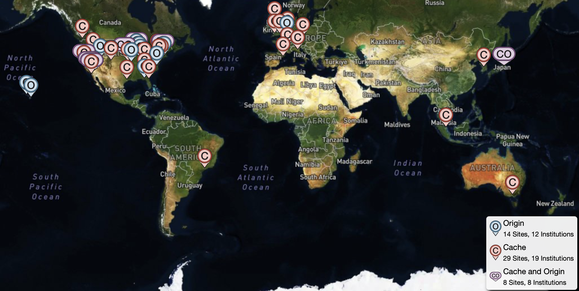
39 Institutions Contribute to OSDF Today
22 Origins and 37 caches across 5 continents
Notes:
this does not include institutions registered in gFactory but not topology ….

Slide 12
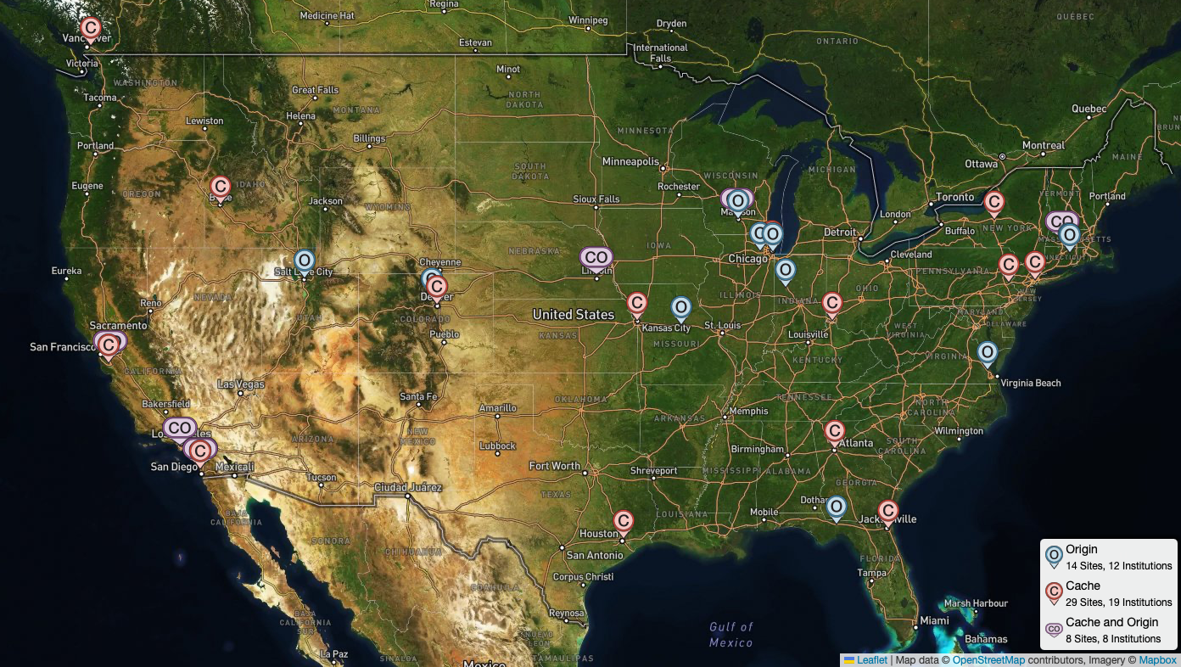
Zoomed in on Continental USA
Data stored on Origins
is accessed via caches
150PB data accessed last year
Data stored on Origins
is accessed via Caches.
24.9 PB read in June 2024
on average:
10 Gigabytes/second
114PB accessed in 12 months
On average 80 files per second
Roughly 40Gbit/sec averaged over the year

Slide 13
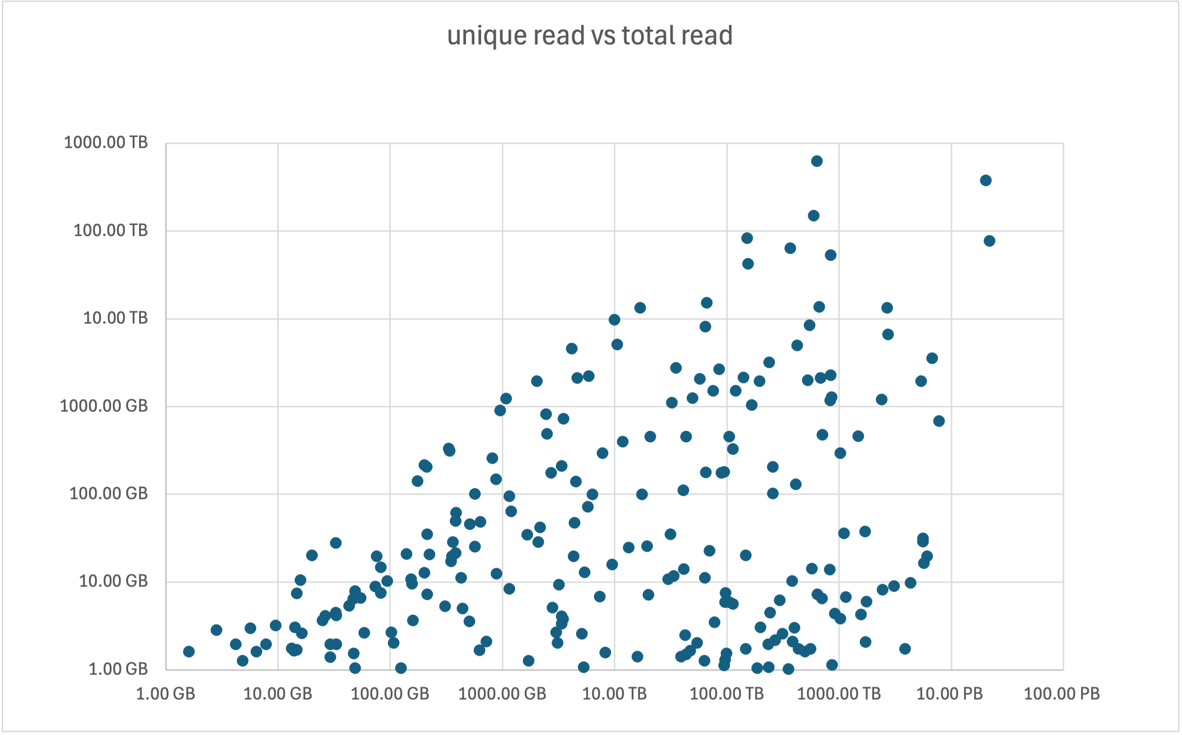
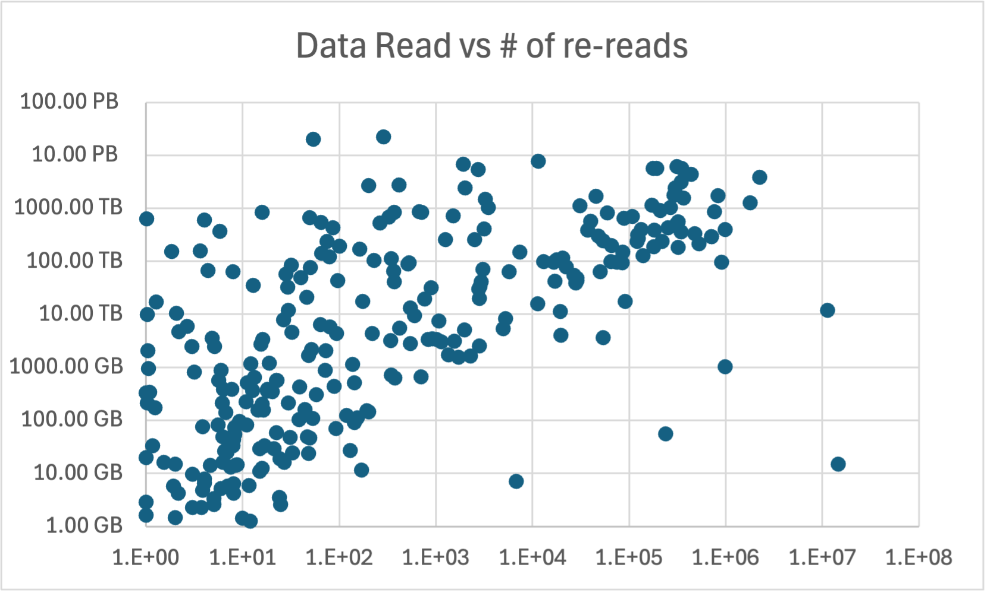
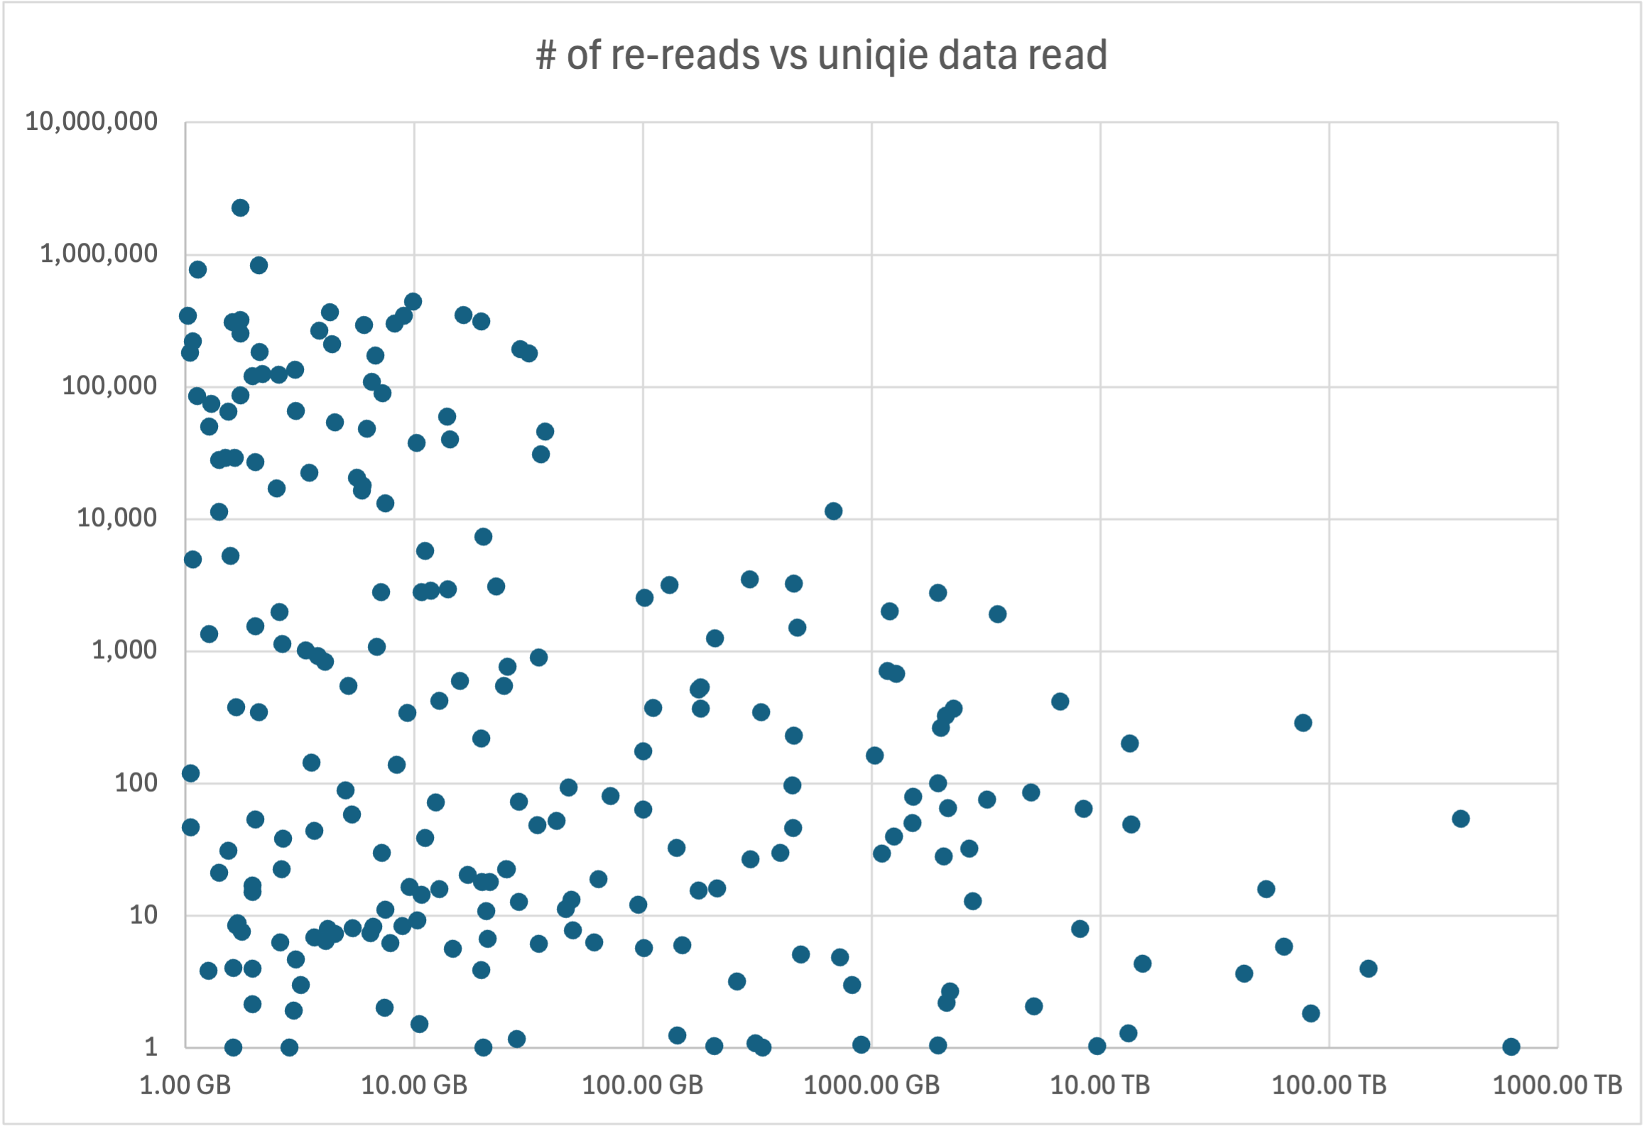
Fun Facts on Usage
26 top level directories with >1PB data read.
  17 OSPool users & LIGO (4), IceCube, NRP(2), KOTO, CHTC
40 top level directories with >1TB unique data read.
  6 OSPool users, 2 NRP users, CHTC & lots of collaborations: LIGO (9), LHCb, NRAO (4), EHT, XENON, JLAB, GlueX, REDTOP, Einstein Telescope, KOTO, SBND, SBN, Microboone, DES
Collaborations tend to have larger volumes of unique data.
OSPool user access smaller volumes more often.

Slide 14
Open Science Store
… a new concept
The CC* storage awards have a 20% contribution to the community requirement.
We now have 4 such awards that have given us storage space to manage.
We have started giving out allocations on that storage that meet NSF strategic goals
  SAGE data
  Internet Routing data
  Internet Telescope data
  Burn3D data commons
  NOAA Fisheries data
  Pelican Facilitation
  NDP Facilitation
  Astronomy data from IUCA
This is strictly in prototyping stage … we are not yet open for business more broadly … contact us if you are interested in being a prototype user of OSStore.

Slide 15
Dare we predict the future?
Reach 1,000 colleges with resources integrated
Complete the token transition and “capability based authentication” not just within PATh services but globally.
Strong growth in OSDF to support an open data ecosystem of many projects that build on each other and creatively compete with each other.
Integration of instruments, sensors & IoT
  Including their digital twins
More compute & data in the Classrooms
  Various types of AI as a service composed into distributed systems deployed via automated workflows
More innovations in cybersecurity
  A continuum from open to private to regulated
We will see more change during the next 20 years
than the last 20 years

Slide 16
Summary & Conclusion
OSG is celebrating its 20th birthday this summer.
  Scale increased between 10x and 1Mx depending on metric.
  Much more diverse services & ways to integrate into OSG today than even 5 years ago.
We exceeded 200 institutions offering resources via OSG
  We are now accounting NRP institutions correctly
OSDF usage continues to grow in breadth
  Lot’s of science collaborations
  Lot’s of individual users
  Lot’s of use from many pools, including OSPool
Open Science Store is available in prototype mode

Slide 17

Acknowledgements
This work was partially supported by the NSF grants OAC-2112167, OAC-2030508, OAC-1841530, OAC-1836650, the CC* program, and in kind contributions by many institutions including ESnet, Internet2, and the Great Plains Network.
Notes:
PNRP = 2112167, PATh = 2030508, CESER award = 1841530, iris-hep = 1836650

