Slide 1
The Pelican in Flight: Delivering Throughput Data

Slide 2
Pelican and Throughput Computing
The Pelican Project builds a software platform that delivers data to throughput computing.
The OSDF (Open Science Data Federation) is a global deployment of the platform.

Slide 3
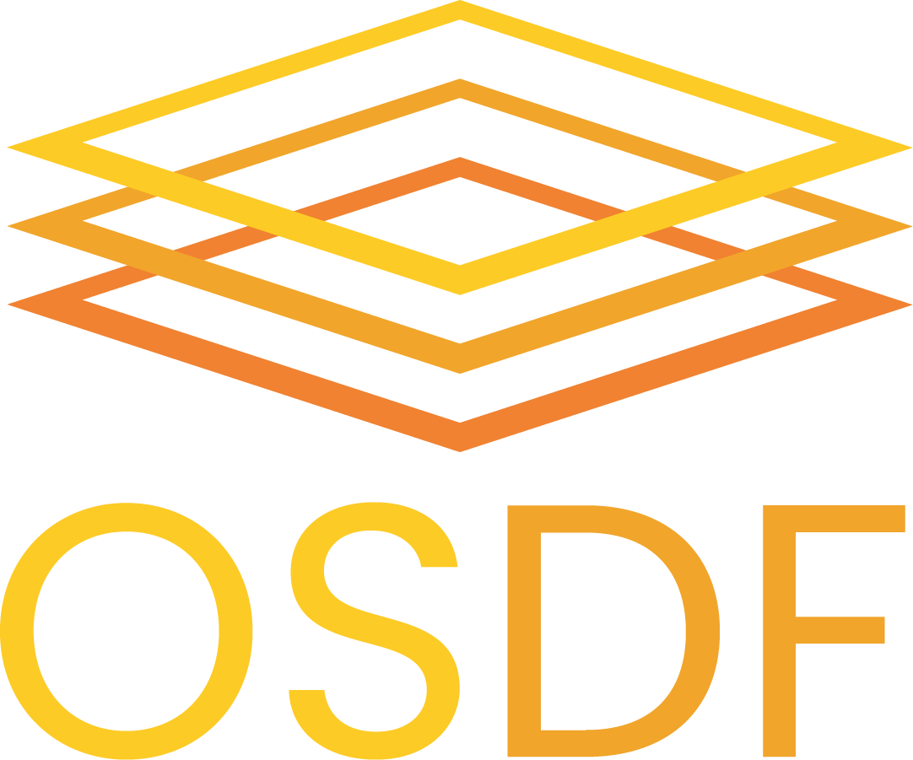
What is the ?
… By Analogy…
+
“Netflix for Science”
Allowing computational workloads to stream data

Slide 4
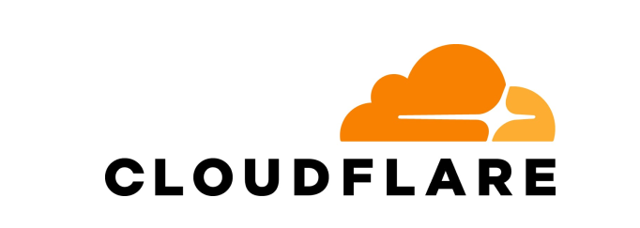
What is the ?
… By Analogy…
+
“Cloudflare for Science”
Infrastructure for scaling access to your storage

Slide 5
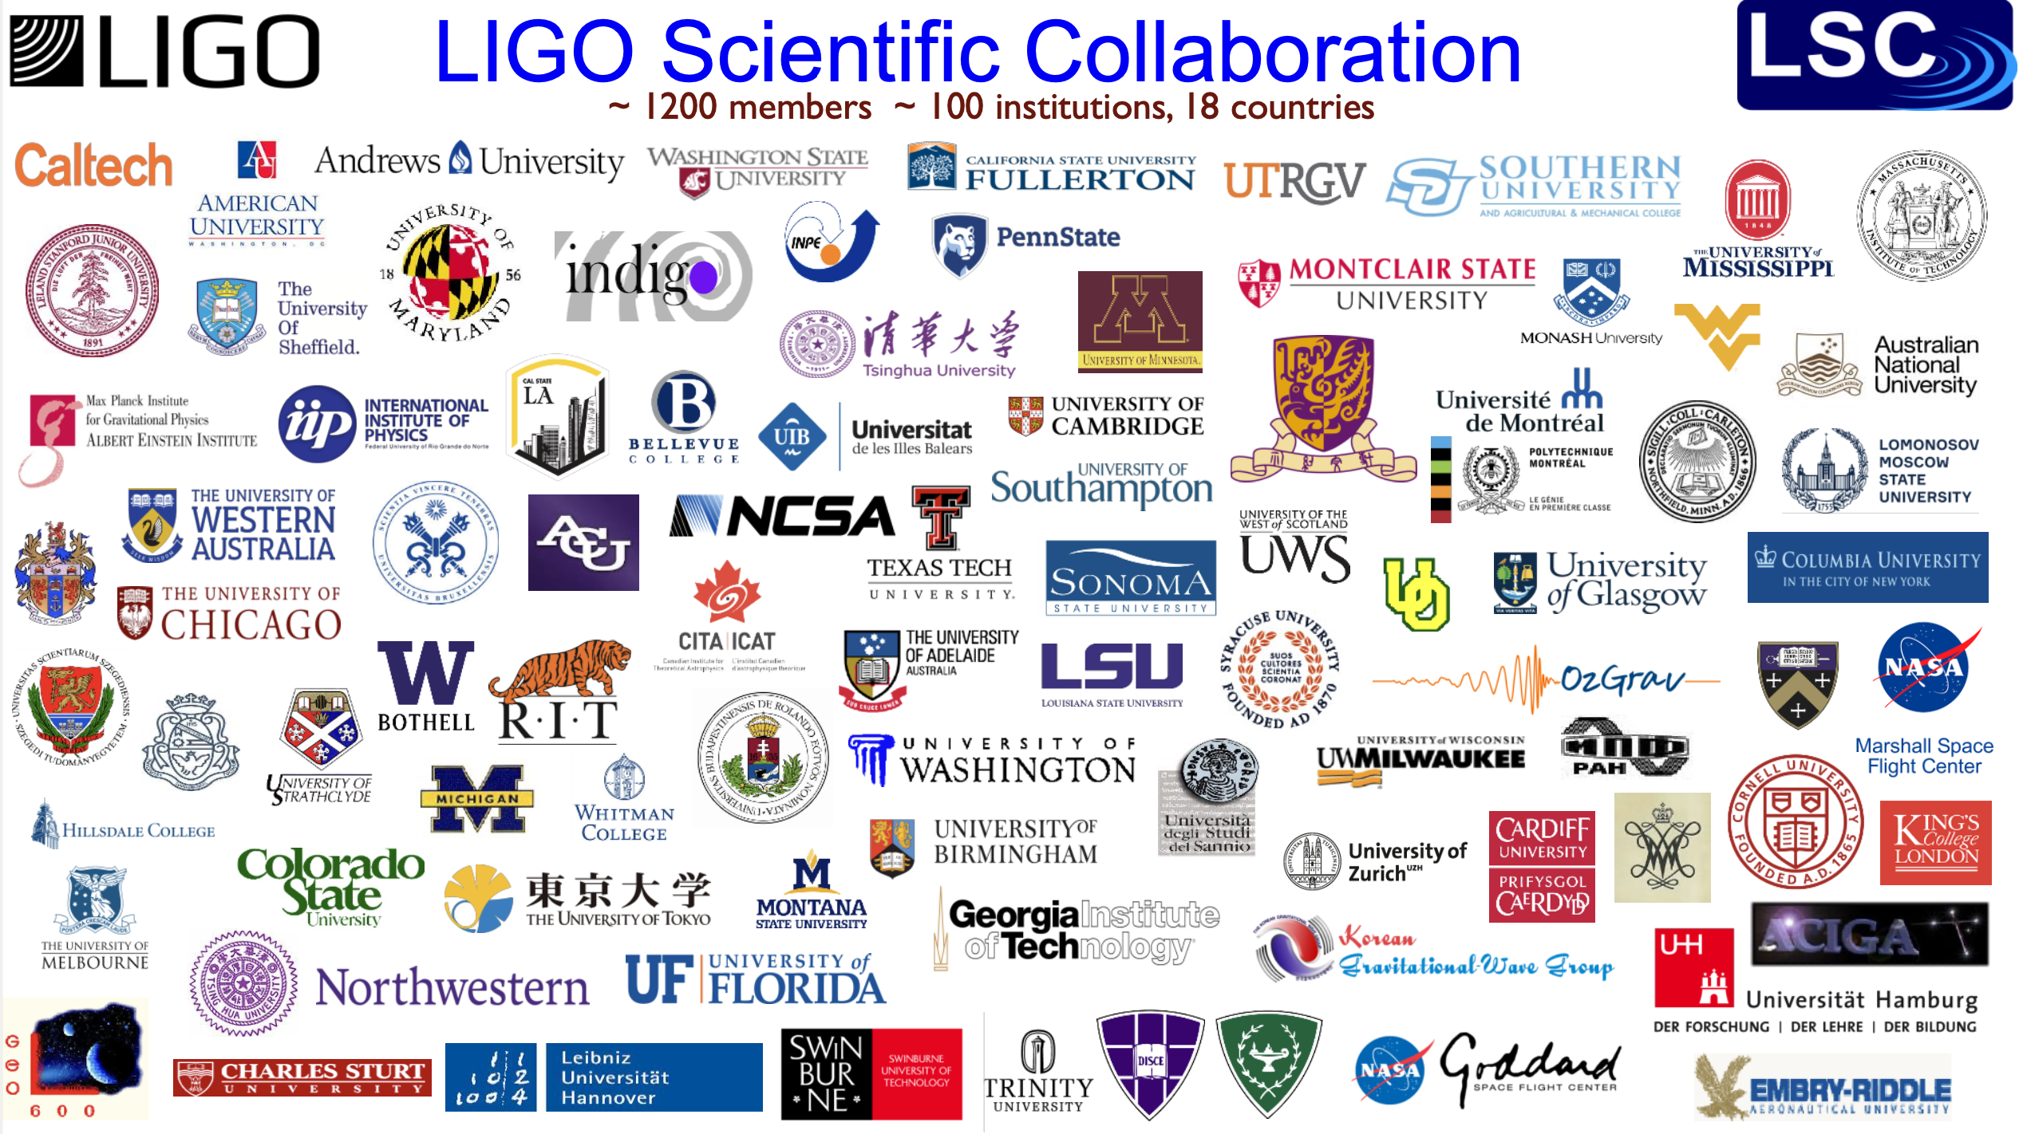
enabling science
The LIGO collaboration stores their interferometer data at Caltech.
Scientists around the world want to access and use it from the computing they have access to.
LIGO wants to enable science beyond the (finite) compute capacity at Caltech.
LIGO has connected their proprietary and public data to the OSDF.
Any browser, python notebook, or compute cluster access LIGO data via the OSDF.
In 2024, LIGO moved 27PB of objects; 200TB of unique data.

Slide 6
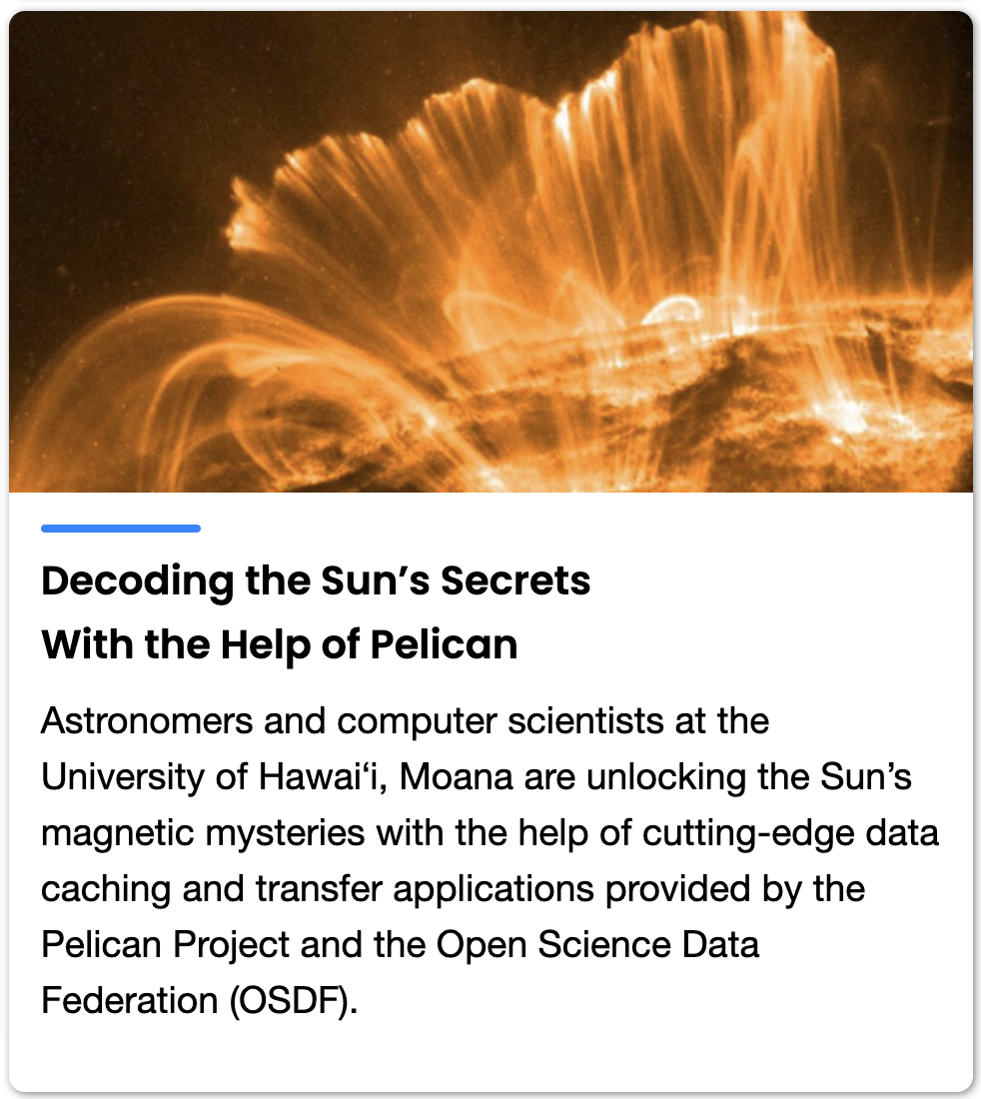
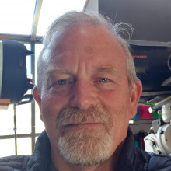
Not just “the big guys”
Research Highlight – U. Hawaii
At U. Hawaii, an individual PI - Curt Dodds – uses their CC*-funded storage to share data from the SPIN4D project
doi:10.5281/zenodo.13879854
If you use the SPIN4D notebook to explore their dataset, you use the OSDF!
https://github.com/ifauh/spin4d-data/blob/v0.5/spin4d-data-exploration.ipynb
Check out Curt Dodd’s talk on Friday.
https://pelicanplatform.org/news/2024/12/20/sun-secrets

Slide 7
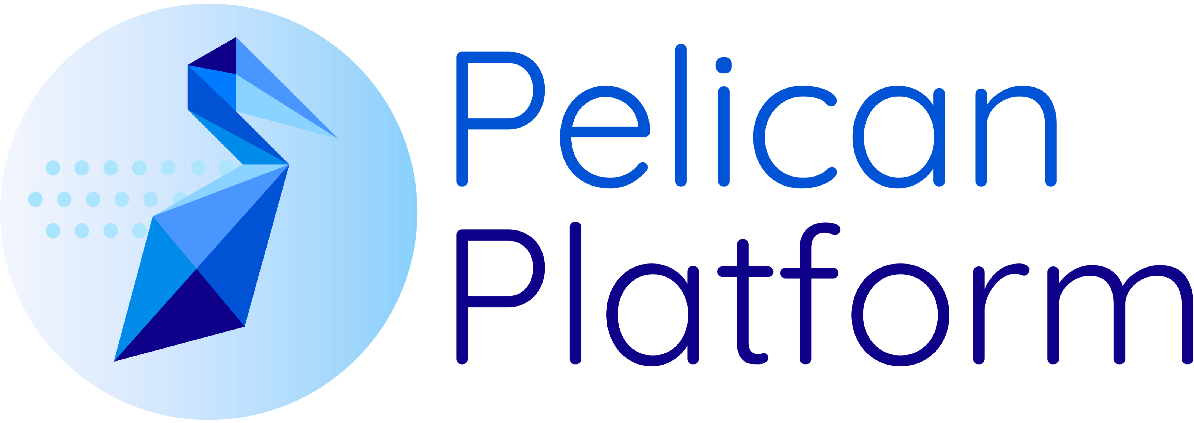
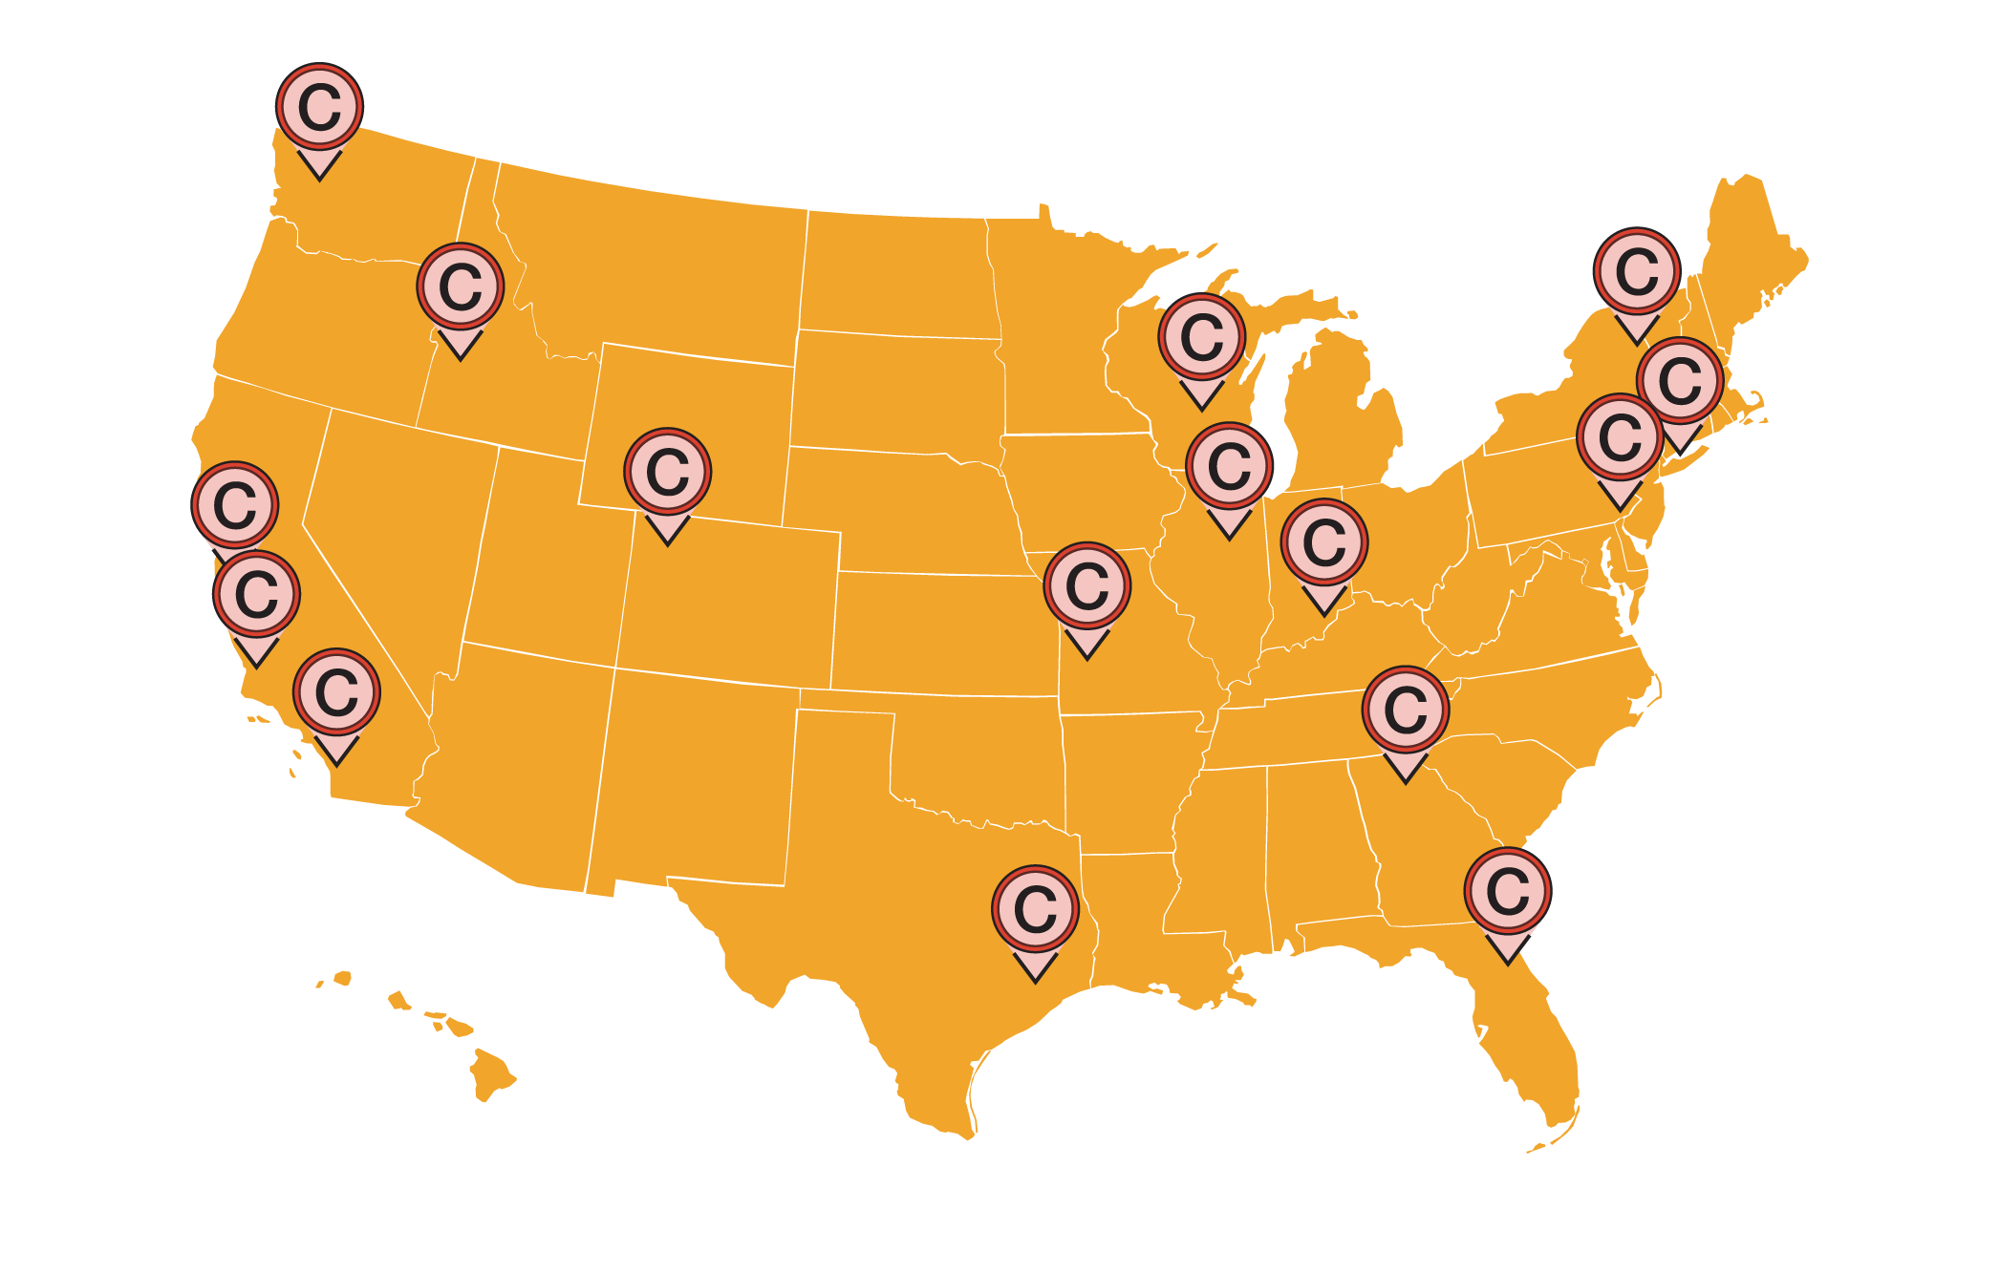
OSDF - A national
object delivery service
Operated by PATh (NSF #2030508)
OSDF is powered by the
Pelican software
(NSF #2331480).
Object
Store
Layer
Manager
Value Proposition
Shares your data (Objects) with authorized consumers.
Manages the load of Object reuse on your Object Store.
Fuses Objects from diverse Object Stores through a common namespace and API.
Stages Objects in network-embedded storage.
Who can benefit?
Open to any US researcher, data (object) provider, or computing facility.
Origin
Who is using the OSDF?
Workloads that have significant reuse and redelivery of objects at remote autonomous Object Stores.
Object Stores with limited capacity or egress costs.
NOAA: Via AWS OpenData
NSF: NCAR, NRAO, LIGO, EHT
DOE: FNAL (LHC, DUNE), JLab, Fusion
Key concepts
Object: both data & non-data objects (containers, models, libraries).
Object Store: a S3-compatible endpoint, filesystem, or HTTP webserver.
Origin: connects an Object Store with national infrastructure. Objects are moved from (GET) and to (PUT) the store through Origin.
Object
Staging
(Caching)
Layer
Cache
Object
Consumer
Layer
Client
>140
PB moved
>3.5B
Objects delivered
34 caches throughout the world, at points of presence within major compute centers and the global R&E networks (ESNet, Internet2).
In the last 12 months.

Slide 8
– Core Concepts

Slide 9
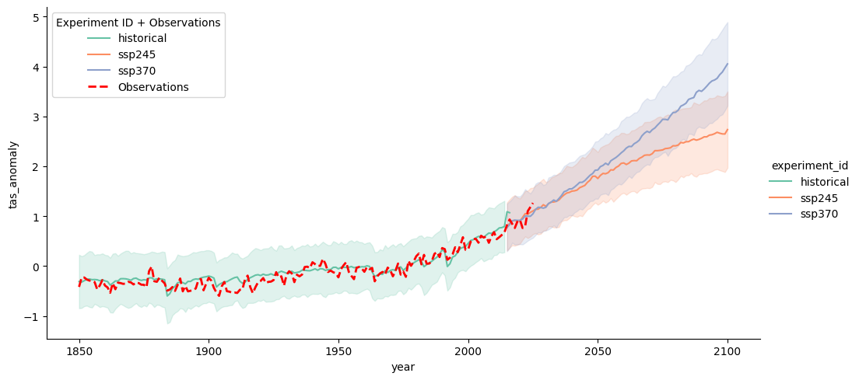
Researcher uses a Jupyter Notebook to create a visualization that requires two objects:
NCAR
OSDF Director
(Namespace)
AWS
Open Data
NCAR
AWS-Open
Data
OSDF Origin
(AWS-Opendata/US-west-2)
OSDF Origin
(NCAR)
US-West-2
OSDF Cache
Jupyter Notebook
[1] Pelican Get (OSDF, NCAR/…
Pelican Client
[2] Pelican Get (OSDF, AWS-…
[3] Visualize (…
NCAR/ rda/harshah/osdf_data/HadCRUT.5.0.2.0.analysis.summary_series.global.monthly.zarr
rda/harshah/osdf_data/HadCRUT.5.0.2.0.analysis.summary_series.global.monthly.zarr @ NCAR Object Store
- cmip6-pds/CMIP6/CFMIP/NCAR/CESM2/aqua-4xCO2/r1i1p1f1/Amon/co2mass/gn/v20190816 @ AWS Open Data Object Store
AWS-OpenData/US-West-2/cmip6-pds/CMIP6/CFMIP/NCAR/CESM2/aqua-4xCO2/r1i1p1f1/Amon/co2mass/gn/v20190816

Slide 10
What happened in the last year?

Slide 11
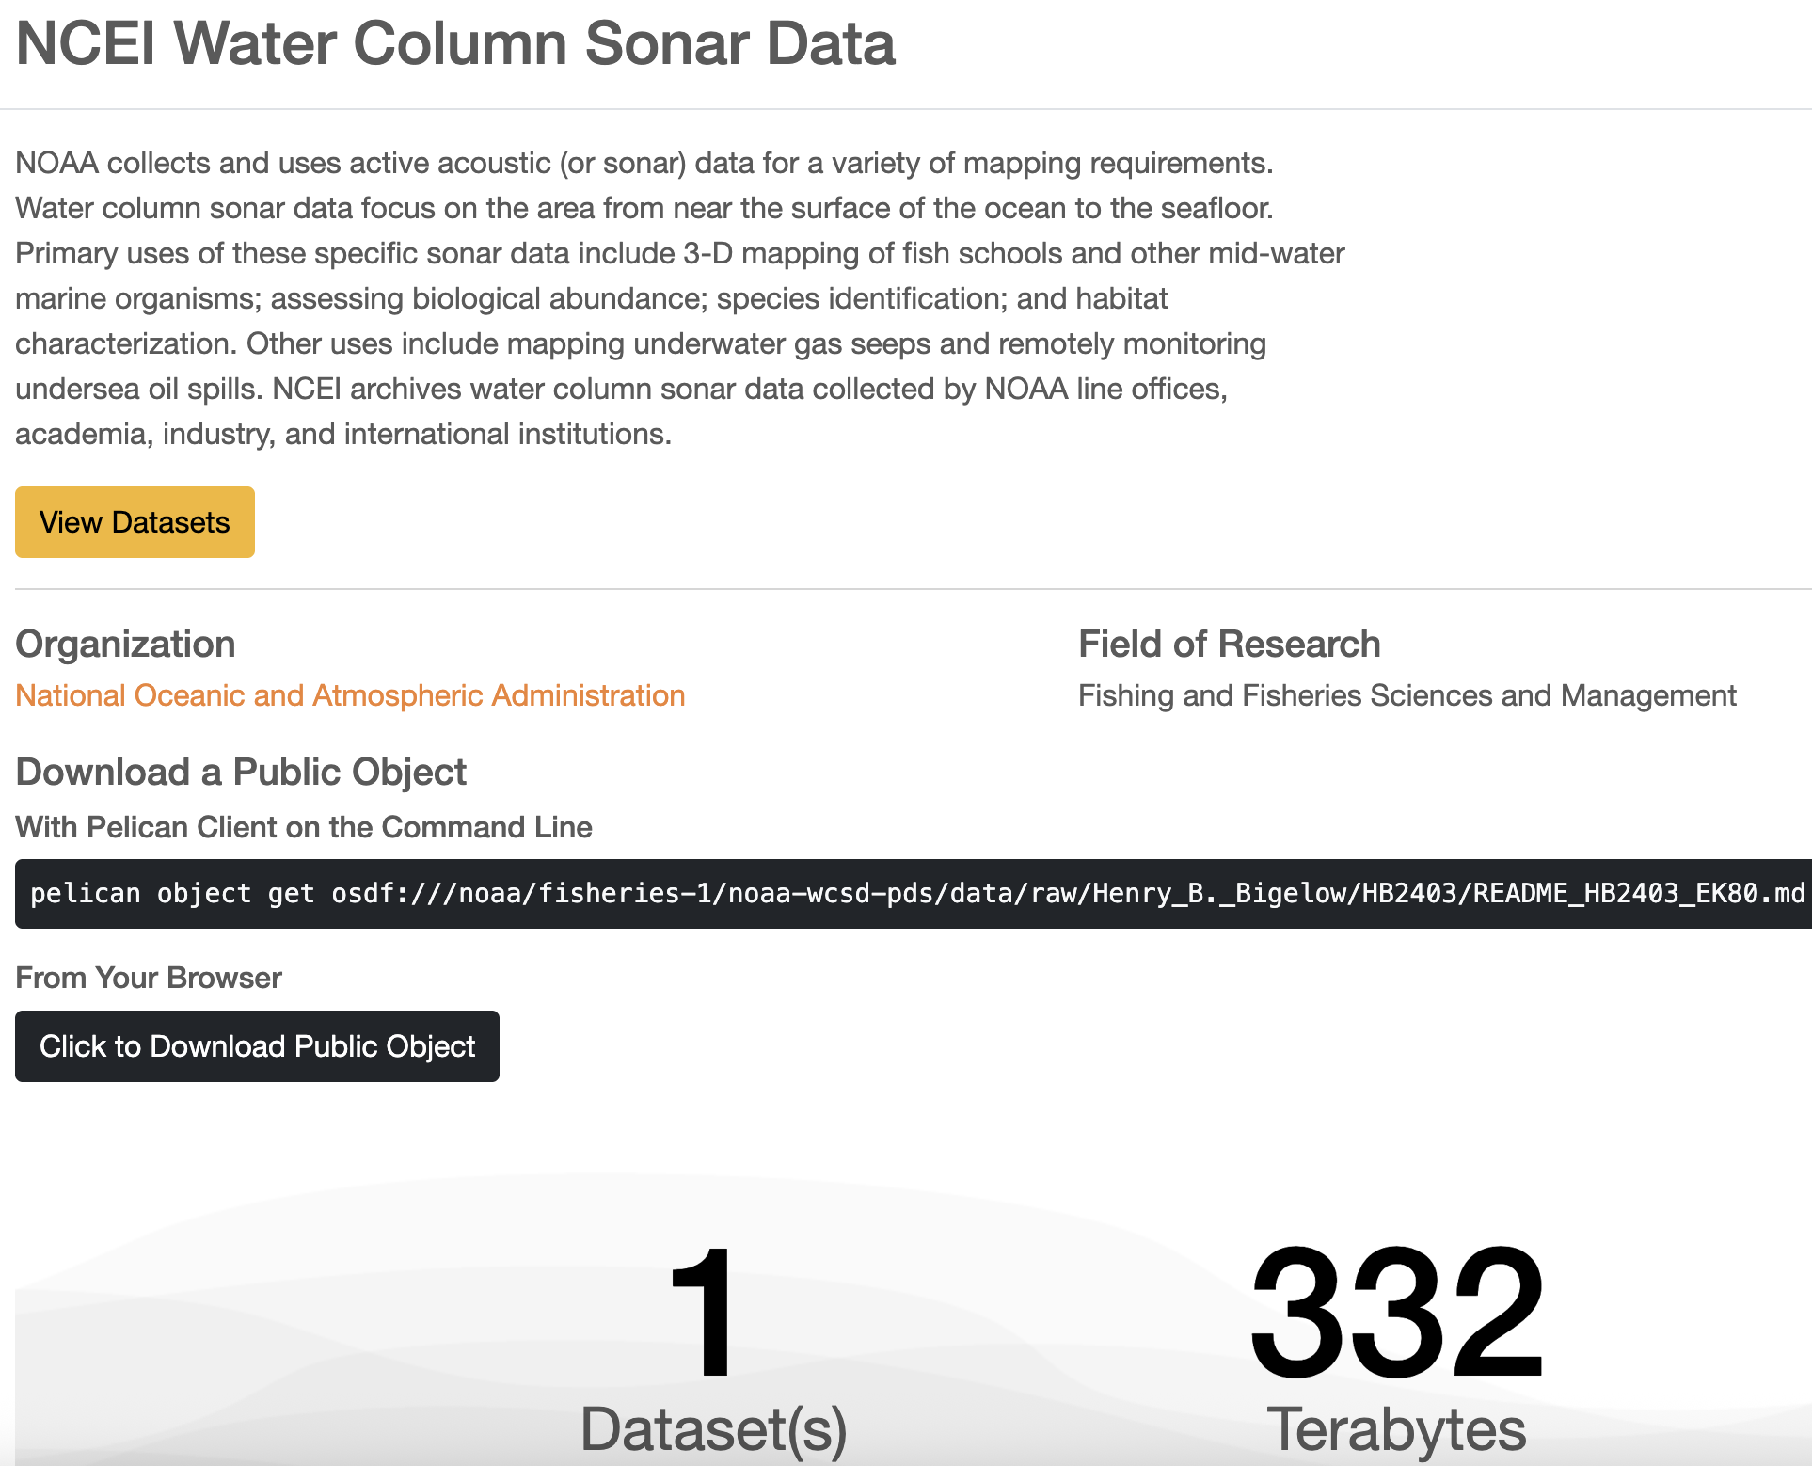
Clients
Explore the OSDF at https://osg-htc.org/services/osdf/data
Command line: End-to-end checksumming, token auto-discovery.
HTCondor Plugin: Extensive monitoring reporting, end-to-end checksums.
Python library / FSSpec: First official release! Integrates with the “data science” ecosystem.
Web Browser: Simple object download. Browser-based OAuth2 support in-progress.

Slide 12
End-to-end checksumming
Object Store
O
Objects (O) travel from the object store through the data federation and to the client.
A copy may be made at the cache for repeated access.
Ultimately, a copy of the object is made on disk by the client
New (v7.16): the client will also calculate the object’s checksum (C) as it is downloaded.
Origin
$
Cache
O
Client
C
O

Slide 13
End-to-end checksumming
Object Store
O
C
Objects (O) travel from the object store through the data federation and to the client.
A copy may be made at the cache for repeated access.
Ultimately, a copy of the object is made on disk by the client
New (v7.16): the client will also calculate the object’s checksum (C) as it is downloaded.
New (v7.16): the client will request a copy of the server-side checksum (C) in the object store and compare the two, failing the transfer on mismatch.
Origin
$
O
Cache
C
Client
C
C
O

Slide 14
Innovating in Authorization
Origin
Who is the origin talking to?
Originally, the client acquired a token (T) which was used to authorize the request to the cache.
If the cache does not have the object, it will forward the request to the origin.
Conveniently, the same token can also be forwarded to the origin to authorize the cache’s request.
Problem: How does the origin distinguish a cache from a “badly behaved client”?
Cannot prevent cache bypass!
T
Cache
T
Client
T

Slide 15
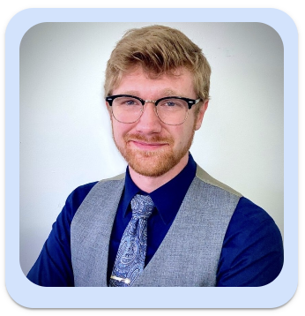
Innovating in Authorization
For more information about authorization, see Justin’s talk later today!
Origin
New!
Caches receive a token (T) from the registry service.
The token identifies the bearer as a service part of the federation.
Origins can require:
A request be performed by a known service (T),
On behalf of an authorized client (T).
Clients can no longer talk directly to origins, pretending to be a cache!
Registry
T
T
T
Cache
T
T
Client
T

Slide 16
💪Powering Storage Backends
For more about our summer plans for the Globus backend, see the presentation today by our summer fellow, William.
Each origin is configured with a plugin based on the object store type:
S3: Allows integration with AWS and compatible services. Support for write, object listings, and an overhaul of error handling in the last year.
HTTP: Connects generic web servers to the data federation. Read-only.
Globus: Connects a Globus collection to the federation. Read-only.
xroot: Full-featured! The “native language” of the XRootD server.
POSIX: Still the most popular!
What happens when an “overly enthusiastic user” launches a large workload with little reuse?
The “throttling” component purposely slows the user requests to protect the object store.
Object store protection is a core value proposition provided by the OSDF, even without reuse.
New: The throttle is now multi-user aware. Only the “overly enthusiastic user” is slowed, not every user.
Much to do: When HTCSS manages the workload, there’s plenty of opportunities for the AP to be aware

Slide 17
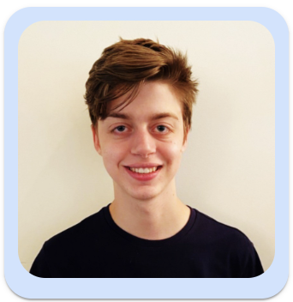
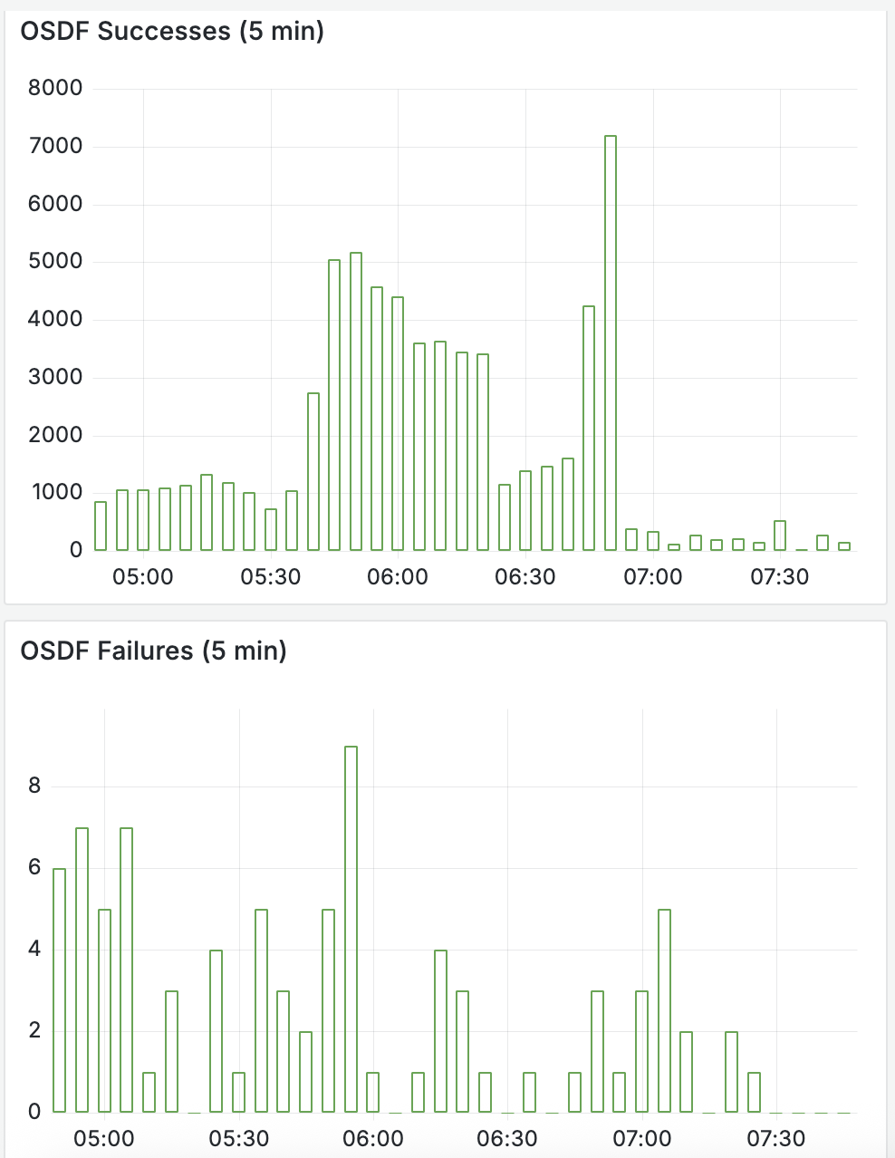
Keeping a Close Eye on You
For a deeper dive in monitoring, check out Patrick’s talk on Wednesday.
We’ve historically drowned in monitoring data – most of it not useful for operations.
We leverage reports from the HTCondor plugin to understand the “typical user experience” for the OSPool.
The OSPool APs aggregate these per-file documents and we can turn these into reports or charts.
Assumption: The OSPool is distributed enough that it provides a “good proxy” for a random user.
Has been essential for spotting common failure cases which have identified ~half dozen serious bugs.
TODO: Working to better separate “infrastructure problems” (random EOF) from “user problems” (404 file not found).

Slide 18
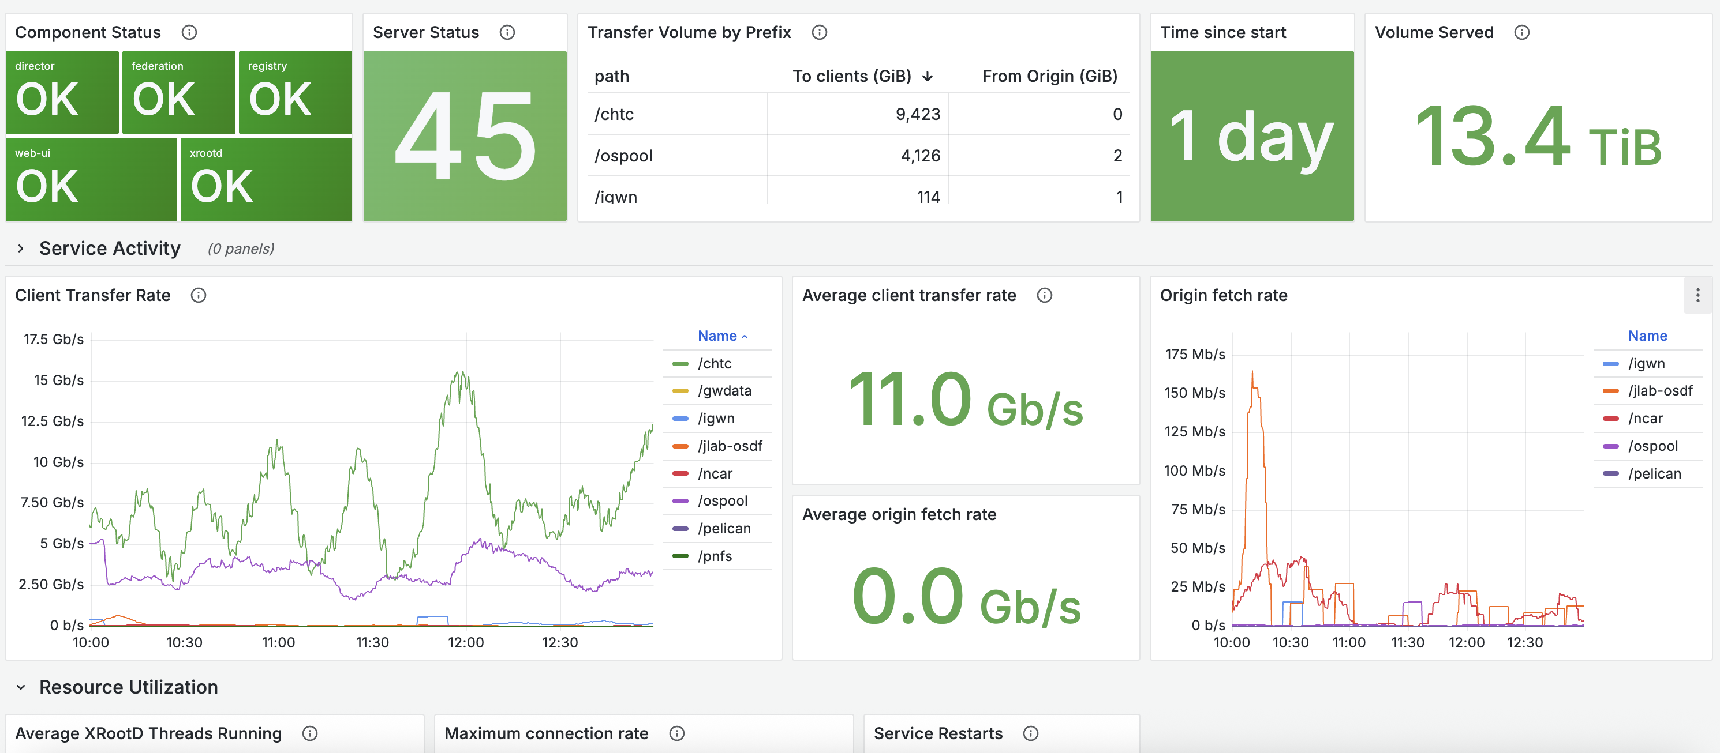
Keeping a Close Eye on You
For a deeper dive in monitoring, check out Patrick’s talk on Wednesday.
We still maintain various internal dashboards, typically Grafana-based.
Pushing more toward identifying errors and problems – less “big pretty numbers”.

Slide 19
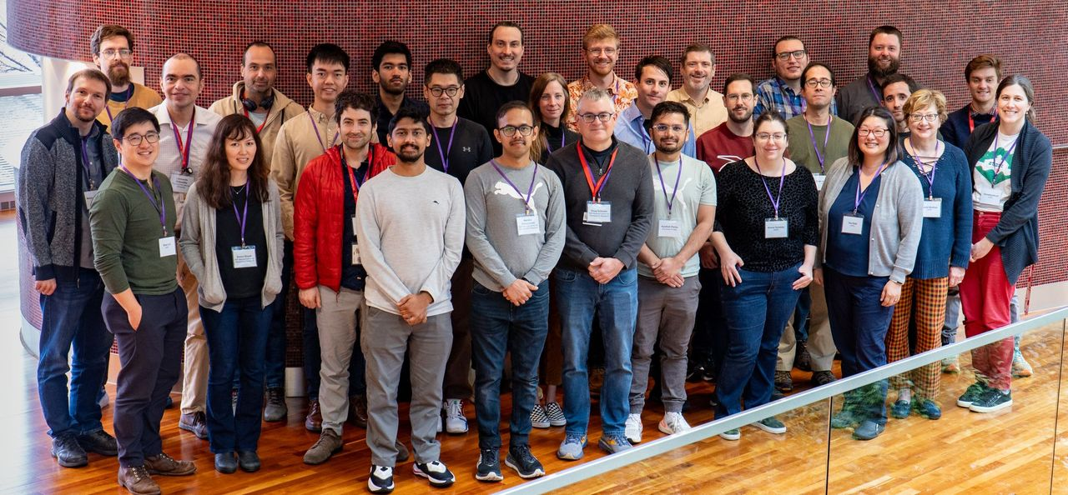
NDC Pathfinders
Pelican was funded as part of NSF’s “National Data Cloud” for Climate initiative in 2023.
The NDC brings together a broad set of domain science and cyberinfrastructure projects, allowing one to assemble end-to-end approaches spanning the vertical stack of expertise.
The NDC Pathfinders collaboration consists of Pelican and 4 earth science-driven projects that aim to show potential approaches (“paths”) through the NSF-funded cyberinfrastructure.
NDC Pathfinders Collaboration at Madison in 2024. https://ndc-pathfinders.org/

Slide 20
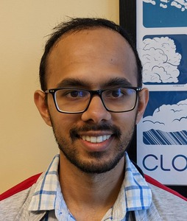
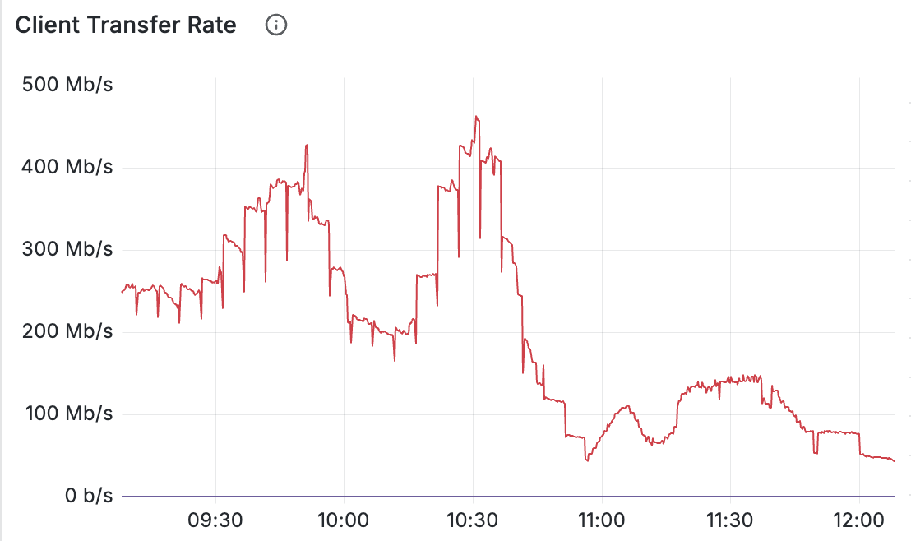
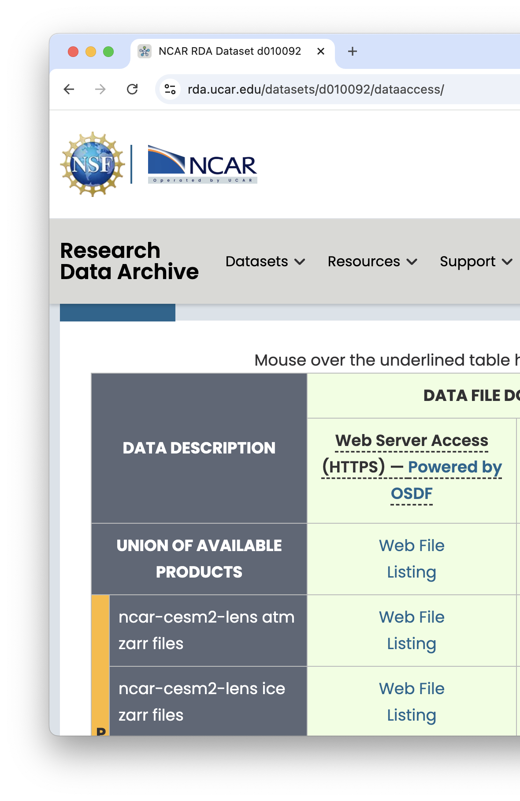
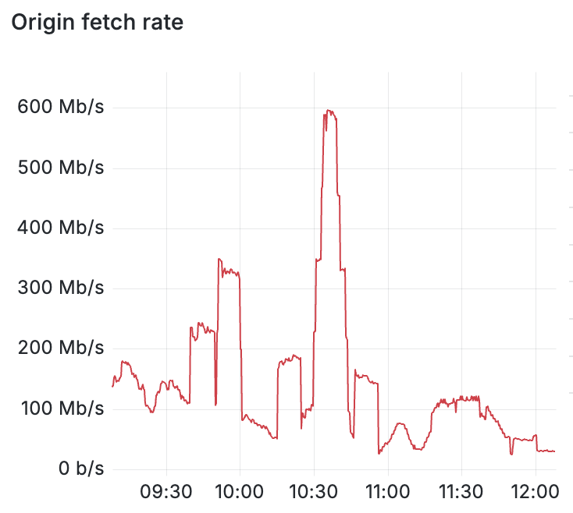
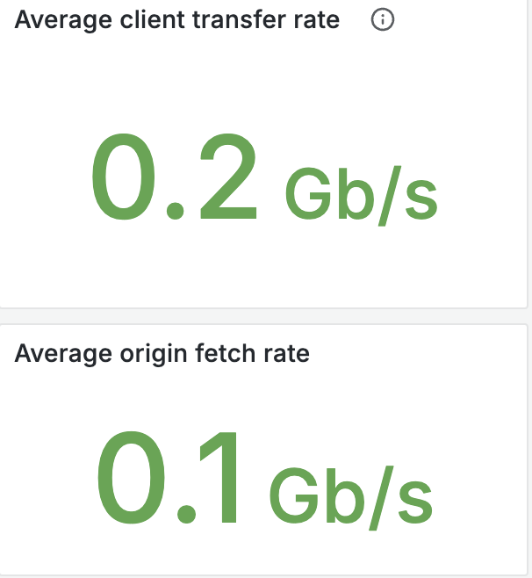
NCAR Research Data Archive
To learn more about using the NCAR data via OSDF, see Harsha’s talk tomorrow.
View from a single OSDF cache
NCAR’s part in the NDC Pathfinders is to make its data available through the OSDF and to inspire its community on how to leverage it.
In May 2025, NCAR’s Research Data Archive (RDA) switched all its HTTP-based download links to use the OSDF.
More importantly, Harsha Hampapura has been developing material for the community demonstrating how the OSDF can be leveraged via environments including Jupyter, OSPool, and Dask.

Slide 21
NAIRR
For an NDP / OSDF / Pelican example, check out Curt Dodd’s talk on Friday.
Pelican is one of the data-centric projects of the National AI Research Resource (NAIRR) Pilot. We collaborate with the National Data Platform, which builds out data analysis services on top of the NRP.
Our plans:
Provide technology (Python FSSpec library) to allow common AI tools (PyTorch) to stream from the OSDF.
Ensure NAIRR datasets are available via the OSDF.
With PATh, show the the vision of Throughput machine learning to train ensembles of models and high throughput inference.
Watch this space!

Slide 22
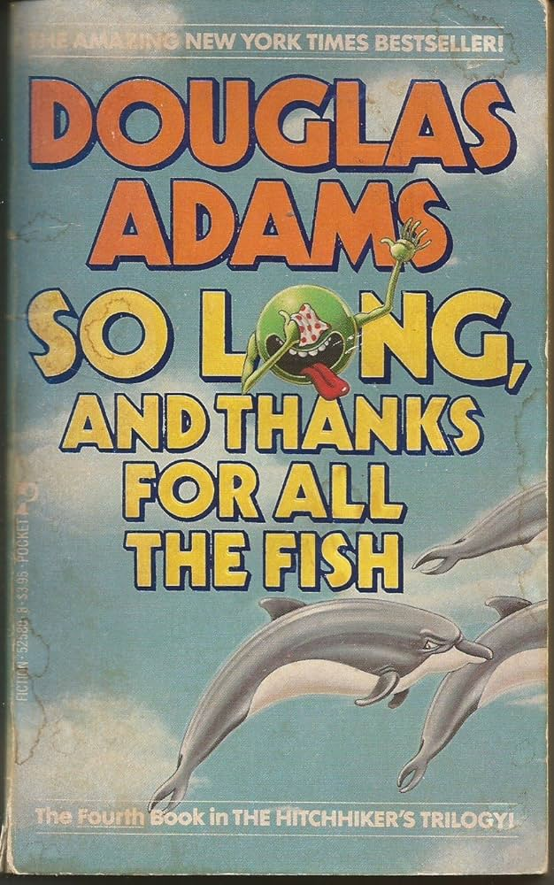
Retiring the old OSDF
Before the Pelican Project was funded, the OSDF was built “one patch at a time”:
2011: The AAA project (NSF #1104664) developed a file cache based on the XRootD software.
2015: Started by deploying XRootD-based caches for the Stash filesystem @ UChicago.
2020: Grew into a generic system for multiple origins. Leveraged WLCG services for GeoIP and OSG Topology for cache discovery.
2023: Pelican Project started, re-engineering the federation components while keeping OSDF operational.
2025: Retired the pre-Pelican components in OSDF!
Image from https://www.amazon.com/So-Long-Thanks-all-Fish/dp/0671525808

Slide 23
The View from Above

Slide 24
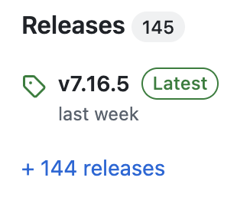
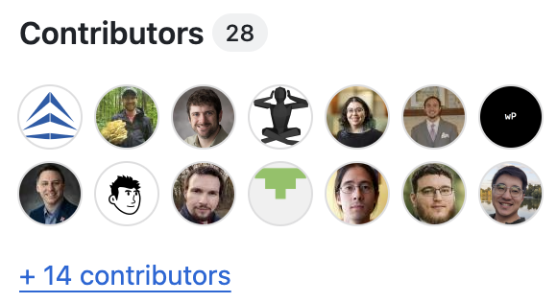
🎂Pelican is now >1 yr old🎂
The Condor Project is 40; the OSG Consortium is 20; the Pelican Project is 1.
The “translational CS” loop is just starting!
The laboratory is churning out new ideas – still iterating on fundamental concepts.
The local – the OSDF – is now 100% Pelican.
We are rapidly building out the community.

Slide 25
Who is the Community?
The “locale” is the data federation. Who is the community?
OSPool users leveraging the OSDF for powering computational workflows across the nation.
UW-Madison researchers using the ‘UWDF’ for on-campus data.
Collaborations, like LIGO, distributing data to large-scale workloads.
Individual PIs publishing & sharing their own datasets.
Scientists reading out community datasets (NCAR data).
You are an essential part of this project!
Broadening the community makes Pelican better!

Slide 26
We Love Feedback!
Pelican sits at the “infrastructure layer” and is not always visible to the user.
We value your participation in events like HTC25 – please strike up a conversation with a Pelican!

Slide 27
Questions?
This project is supported by the National Science Foundation under Cooperative Agreements OAC-2331480. Any opinions, findings, conclusions or recommendations expressed in this material are those of the authors and do not necessarily reflect the views of the National Science Foundation.

Slide 28
Backup – Things Coming Up in 2025!
As you meet with us in the coffee breaks this week, ask about any of these upcoming development topics for the next year:
Improved cache storage management as part of the Kingfisher project.
Deployment of high-availability central components.
Origins behind firewalls – no incoming connectivity.
User-shareable “collections”.
Write-through caches
Cache integration with S3 storage
Finish Globus integration

