Slide 1




Gene Regulatory Networks at work
Prakriti Garg
Roy Lab
Wisconsin Institute for Discovery
University of Wisconsin-Madison, WI, USA 53715
Throughput Computing in the Biology and Life Sciences Community
Jun 2nd 2025
https://github.com/Roy-lab
roylab.discovery.wisc.edu
Notes:
Hi everyone! I am Prakriti Garg, an incoming PhD student in Biomedical Data Science program at UW-Madison. I will be continuing my research under Professor Sushmita Roy. I would like to thank the meeting organizers for this wonderful opportunity to present our lab’s work in Gene Regulatory Networks.

Slide 2
Gene Regulatory Network (GRN): control machinery of cells
Gene
Genes
Gene Regulatory Network
Regulator
Target
Control which genes are expressed where and when
X
Y
X regulates Y
Notes:
So, first of all, what is GRN?
Let’s consider this piece of DNA that codes a gene and let’s denote this as a blue circle. We know that genes don’t work alone but rather interact with other genes within molecular networks. The specific network that we are most interested are what are called gene regulatory networks, which control what genes are activated when and where. Edges in this network are directed and in the ideal setting means that X controls Y or X regulates Y.

Slide 3
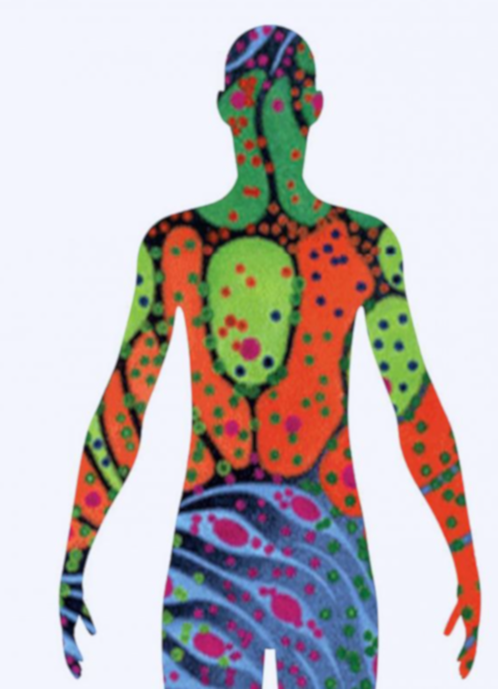
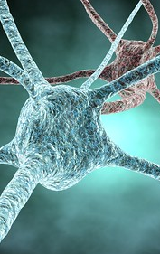
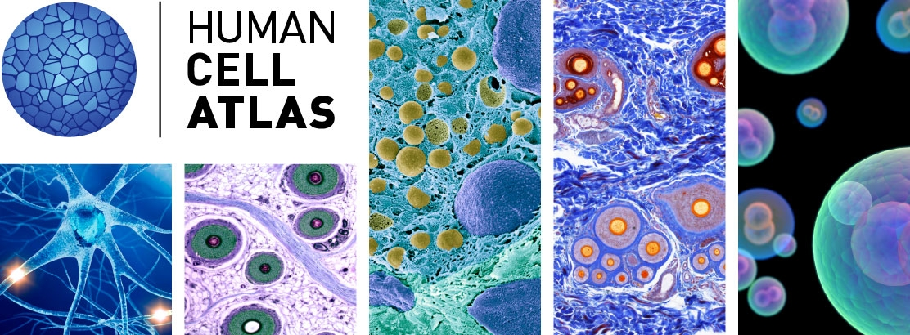
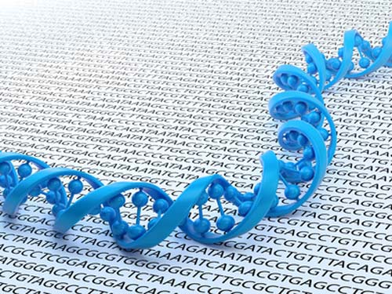
The human body has trillions of cells
Image credit: NHGRI, NIH Hubmap, Human cell atlas
Notes:
Genes are found in every cell of body. A key ingredient for understanding human disease or heath conditions is to understand the cell types. Understanding the cellular context is essential for improving our understanding of health and disease processes.

Slide 4


Different cell types have different networks
skin cell
blood cell
neuronal cell
Notes:
Another aspect of context comes from the fact that humans are multi-cellular organisms and we have many cell types and each of these can have a different underlying network.

Slide 5
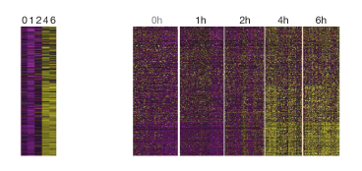
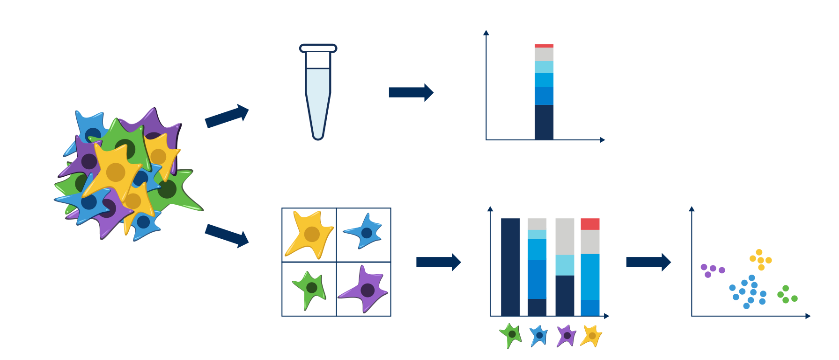
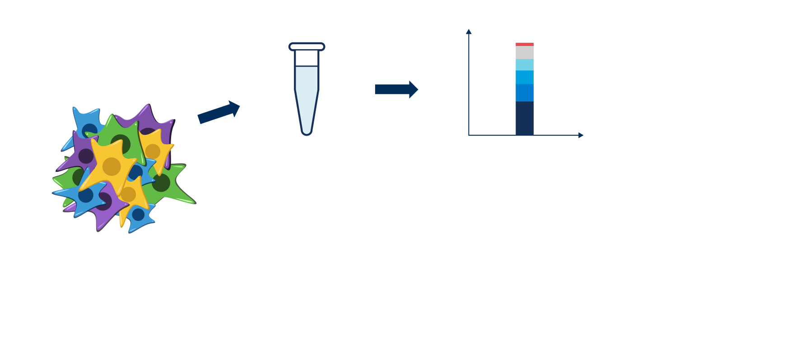
Single cell omics
Bulk
Genes
Genes
Single-cell
Cells
Figures: 10X Genomics; Shalek AK et al., Nature 2014
Notes:
How to study GRNs? How to obtain data to apply computational techniques?
One approach is bulk omics – where all cells are mixed – and we get average exp profile across all cells. Naturally this has a downside that we cannot differentiate the diff cell types.
A more widely used approach is single cell omics – where each of the cell is profiled separately. This helps in building cell type specific GRNs, trajectory inference and what not.
These expression values reflect how active each gene is within the cell. Interestingly, all cells have genes but the difference lies in the fact that diff cells have diff genes activated!

Slide 6
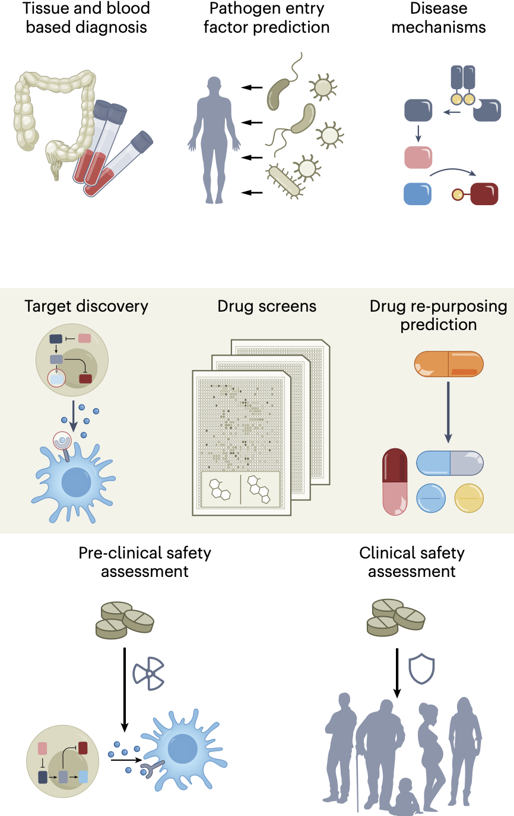
Impact of single cell omics
Rood, J.E., Maartens, A., Hupalowska, A., Teichmann, S.A., Regev, A., 2022. Impact of the Human Cell Atlas on medicine. Nat Med 28, 2486–2496. https://doi.org/10.1038/s41591-022-02104-7
Notes:
Advances in single cell omics data collection and methods to analyze them have already made significant impact in understanding human health and disease conditions. This is described in this review which talks about how single cell genomics has helped advance our understanding for many diseases including cancer and covid19.

Slide 7
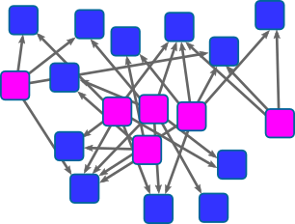
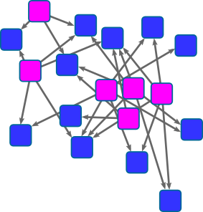
Defining GRNs on lineages from single cell omic data
What are the cell types?
How are they related?
C₀
How accurate are the GRNs?
C₀
How do GRNs change?
C₁
C₁
C₂
C₂
What is their GRN?
C₃
C₃
Notes:
In particular, let’s think about the questions we need to answer to examine GRNs on a cell lineage or a trajectory.

Slide 8
Defining GRNs on lineages from single cell omic data
What are the cell types?
How are they related?
C₀
C₀
How accurate are the GRNs?
How do GRNs change?
C₁
C₁
C₂
C₂
C₃
What is their GRN?
C₃

Slide 9
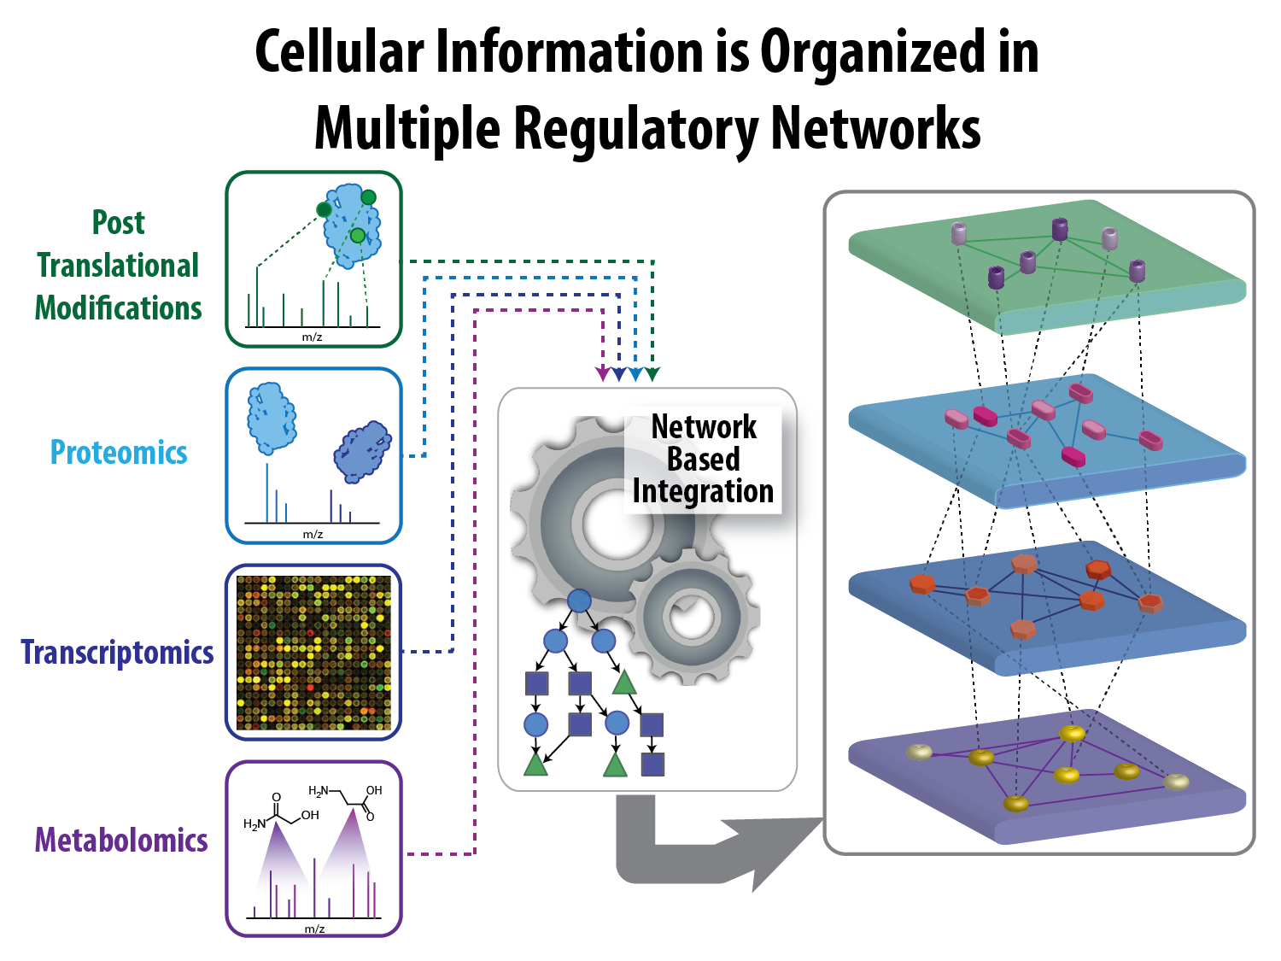
Network inference 101
Node measurements
Gene Regulatory Network
GRN inference
…
…
 | E1 | E2 | E3 | E4 | E5 | E6 | E7
G1 | 8.82 | 9.09 | 6.43 | 8.11 | 7.13 | 7.55 | 9.18
G2 | 0.0 | 0.15 | 0.07 | 0.0 | 0.08 | 0.0 | 0.0
G3 | 0.0 | 0.0 | 0.0 | 0.0 | 0.1 | 0.08 | 0.26
G4 | 2.83 | 1.92 | 2.33 | 0.86 | 2.17 | 2.53 | 3.19
G5 | 2.0 | 1.32 | 1.13 | 0.72 | 1.25 | 1.17 | 2.27
G6 | 12.41 | 10.72 | 10.23 | 8.59 | 8.08 | 8.92 | 11.61
G7 | 0.02 | 0.68 | 0.0 | 0.0 | 0.0 | 0.0 | 0.0
G8 | 0.69 | 0.95 | 1.09 | 0.97 | 0.71 | 0.44 | 0.76
G9 | 0.11 | 0.22 | 0.12 | 0.21 | 0.24 | 0.2 | 0.43
Nodes
Unsupervised learning
Graph structure and parameter learning
…
Notes:
The problem of GRN inference is to take high throughput datasets that measure something about the nodes in our network and infer connectivity, signs, directionality on the edges. In the language of network biology this is an unsupervised learning problem where we need to learn both the structure and parameters of the graph and be able to say something about the overall state of a system using the network we infer.

Slide 10
Inferring GRNs for diverse systems

Slide 11
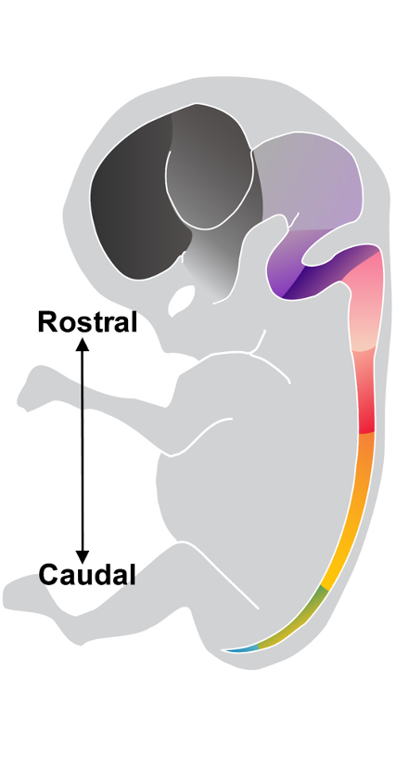
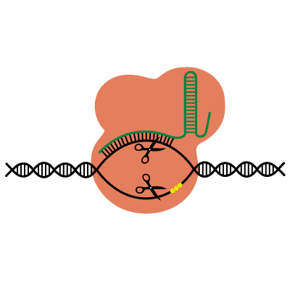
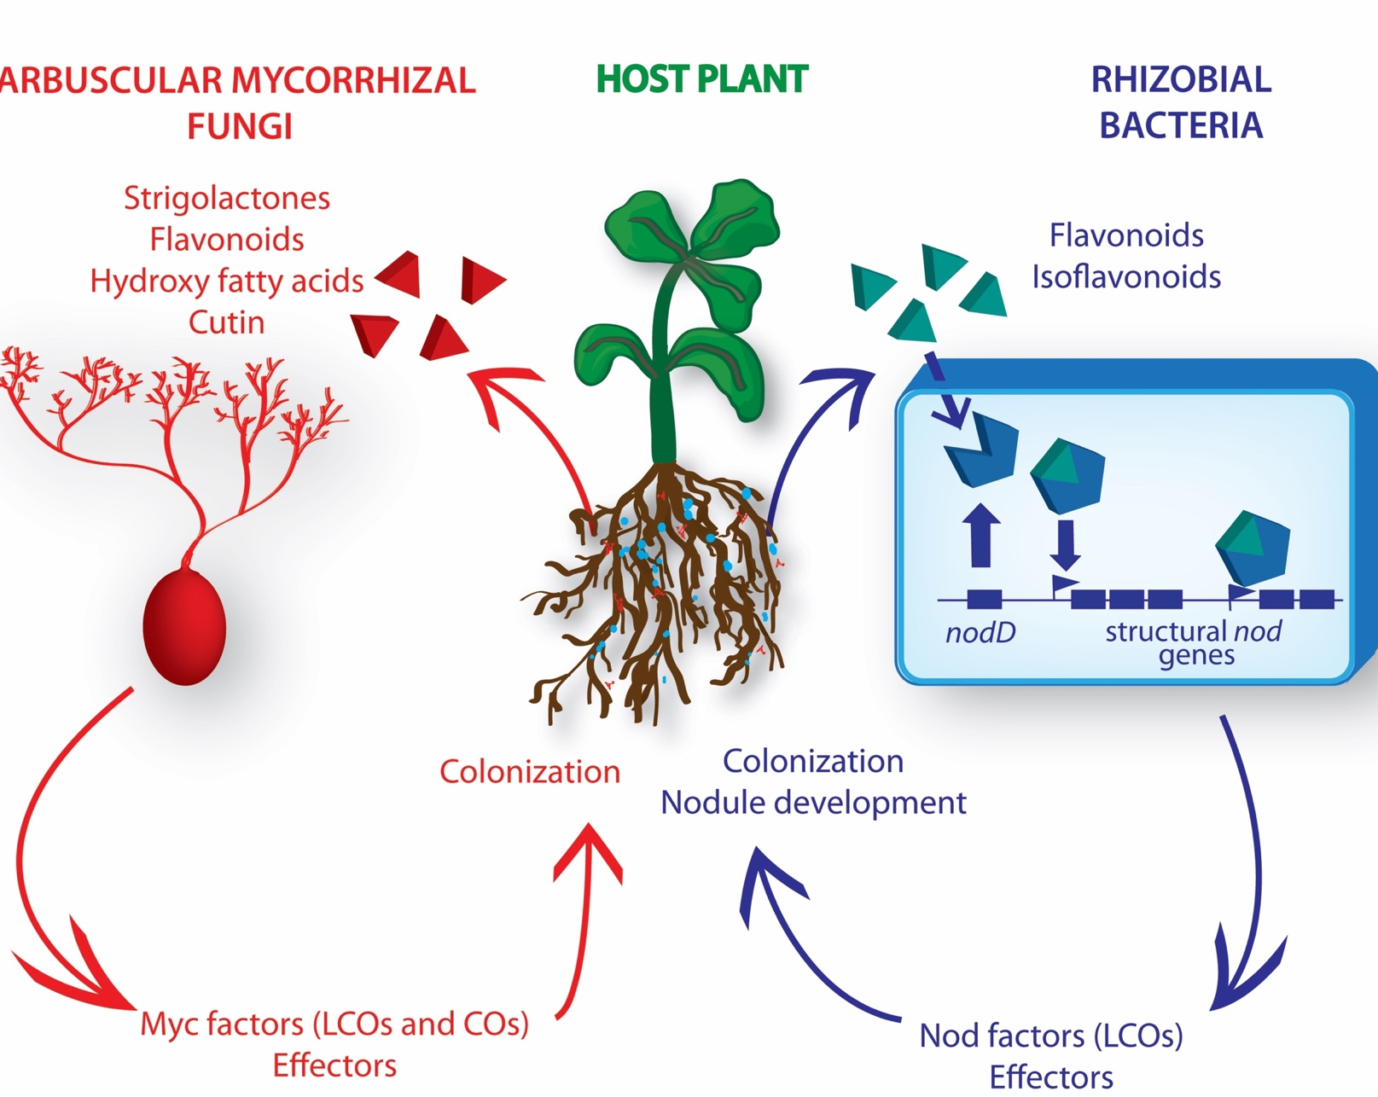

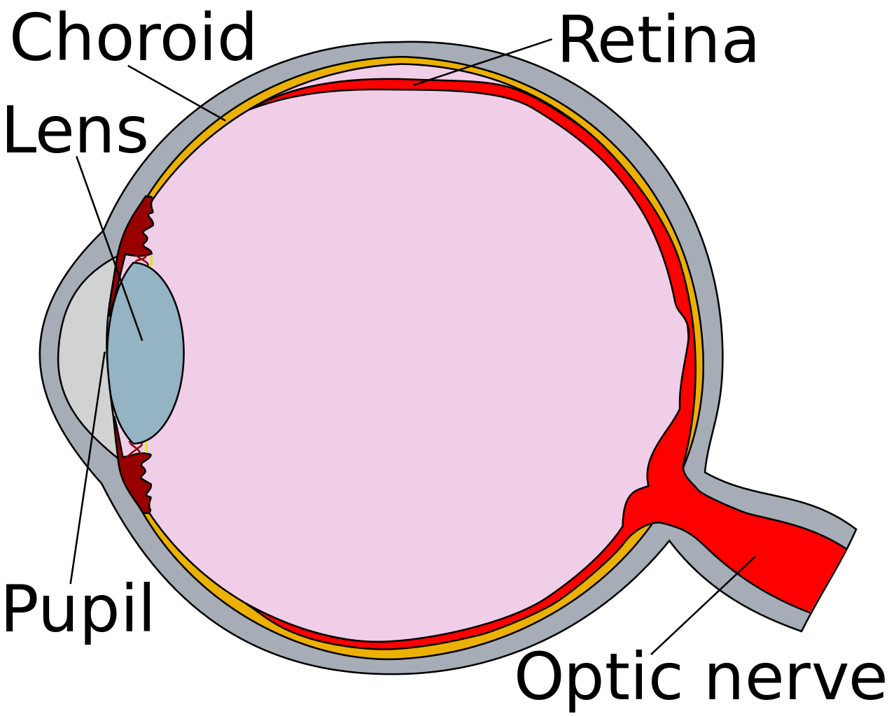

Examining cell type-specific GRNs in many systems
Oct4
cMyc
Sox2
Klf4
2-3 wks
Cellular reprogramming
Early brain/spinal cord development
Nitrogen fixation
Gene editing in the retina
Picture credits: Sridharan lab, Ane lab, Ashton lab, CDC, Wikipedia

Slide 12
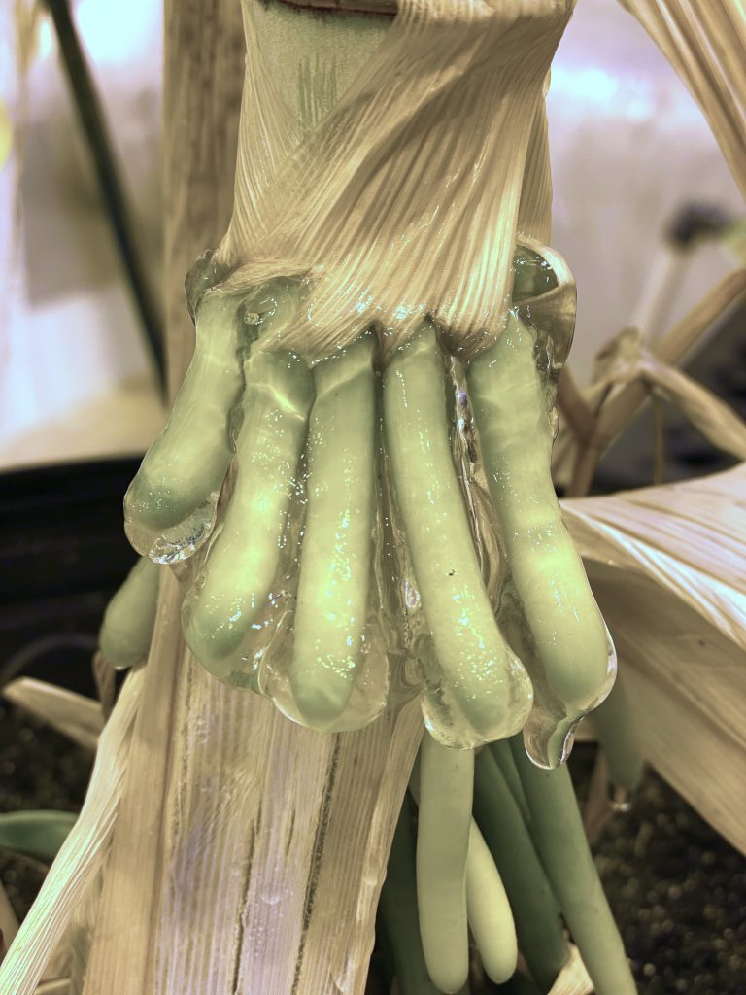
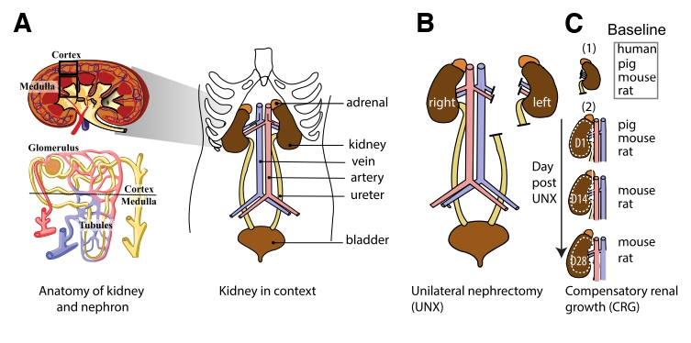
Two examples of how GRNs can help disentangle biological complexity
Enabling plants to fix nitrogen with aerial roots
Understand Compensatory Renal Growth in kidney
Notes:
Without further adieu, I would like to touch upon two very interesting and ongoing use cases of how GRNs can help disentangle biological complexity.

Slide 13

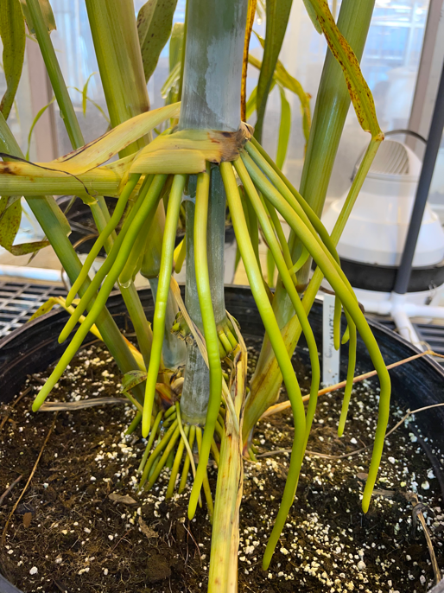
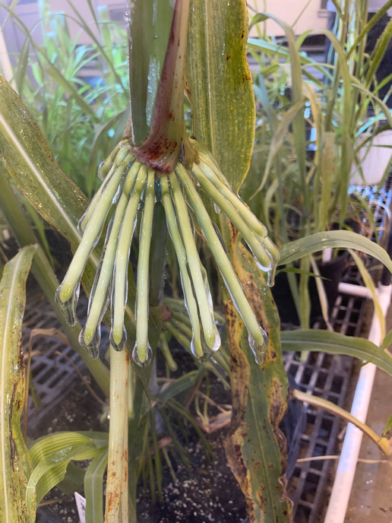
Nitrogen fixation in plants
Heavy use of fertilizers for crops is not sustainable
Sorghum aerial root without mucilage
Water treatment
How can we make use of Nitrogen-fixation trait from the air and make it more efficient?
~ 1 hour
Understand the molecular and cellular mechanisms controlling N-fixation trait in sorghum
Sorghum aerial root with mucilage
soNar - Sorghum Nitrogen-fixation in Aerial Roots
Notes:
Nitrogen is a critical nutrient required for all life and especially for plants, where the deficiency of N results in stunted growth and development of crop plants and compromises yield.
The most common strategy to alleviate the limitation of Nitrogen availability is to use synthetic fertilizers.
But heavy use of fertilizers for crops is not sustainable:
It not only increases the cost of production,
but also increases the environmental footprint (in forms of the energy needed for synthetic fertilizers production, nitrate leaching and the production of greenhouse gases)
It turns out that some cereals (like corn and sorghum) can acquire N from the air. Their aerial roots produce mucilage (gel) after water treatment, like rains, and this mucilage hosts N-fixing bacteria that acquire N from the air, and some landraces are able to acquire up to 82% of their N like this.
The question is: How can we make use of this trait of N-fixation from the air and make it more efficient to reduce the dependence on synthetic fertilizers and improve the economic and environmental sustainability of bioenergy production?
So we need to understand the molecular and cellular mechanisms controlling N-fixation in the mucilage produced by aerial roots using scRNA-seq data
This project is called soNar – soNar Nitrogen-Fixation in Aerial Roots.
Which plant genes control the development of aerial roots?
What molecular mechanisms allow mucilage production and degradation?
What is the role of microbes in degrading the mucilage, nitrogen-fixation, and delivery of fixed nitrogen to the plant?

Slide 14
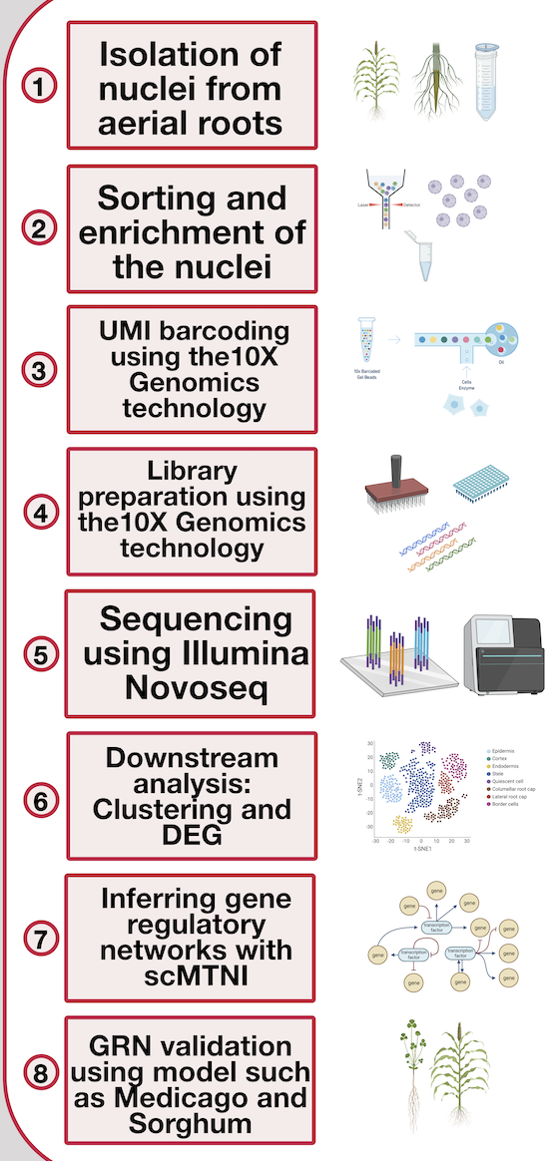


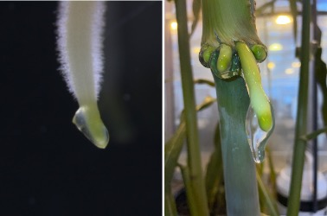
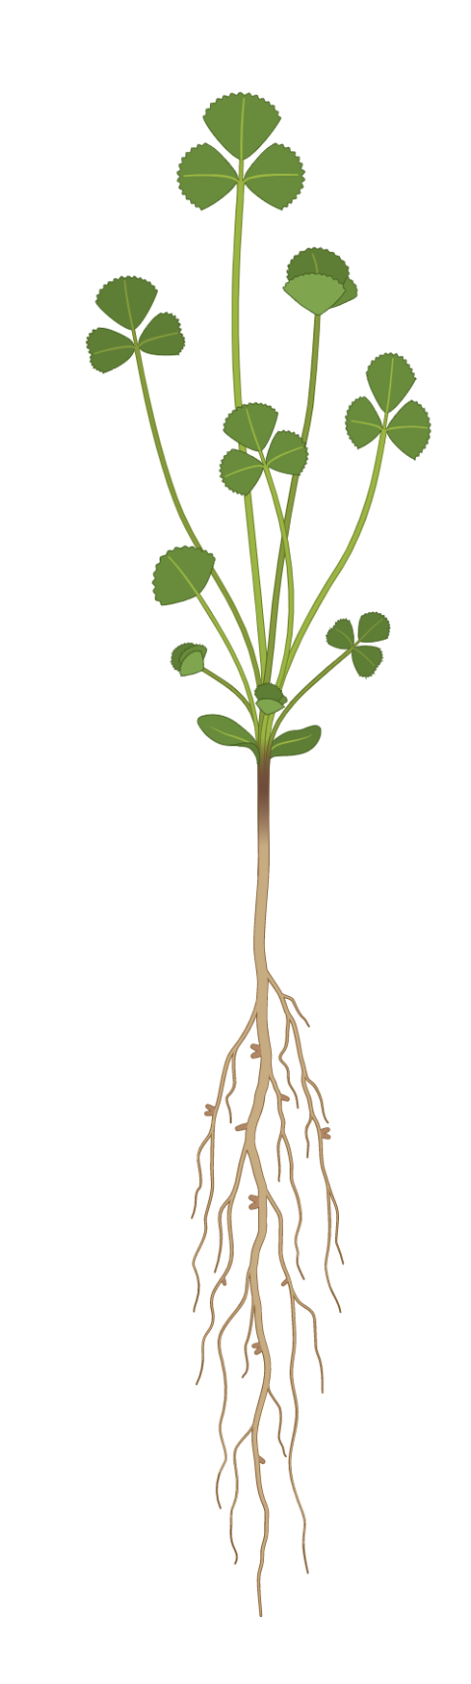
Single-nuclei RNA-seq experimental setting
Using Medicago truncatula as a system to validate mucilage and border cells production
Jean Michel-Ané
Rafael Venado
Mucilage produced by roots in S. bicolor
A legume species
Well annotated genome
Available scRNAseq studies: Kirst Lab; Cervantes-Perez et al. 2022; Ye et al. 2022
Available transformation protocols
1st approach to validate GRN or other genes
Notes:
To answer that questions our collaborators from Ane Lab set up the single-nuclei RNA-seq experiment for the nuclei isolated from aerial roots, and using 10X Genomics and Illumina Novoseq provided us with snRNA-seq data.
Our lab performs this part with downstream analysis and inferring the gene regulatory networks, which I’m going to talk about in more details in a moment.
What I should also mention is that even though our main species of interest is Sorghum and Maize, their life cycle is very long and transformation protocols are complex and time consuming, so the validation of any predictions on those species would take years.
Which is why it was decided to use M.truncatula as model organism, a system to validate mucilage and border cells production.

Slide 15
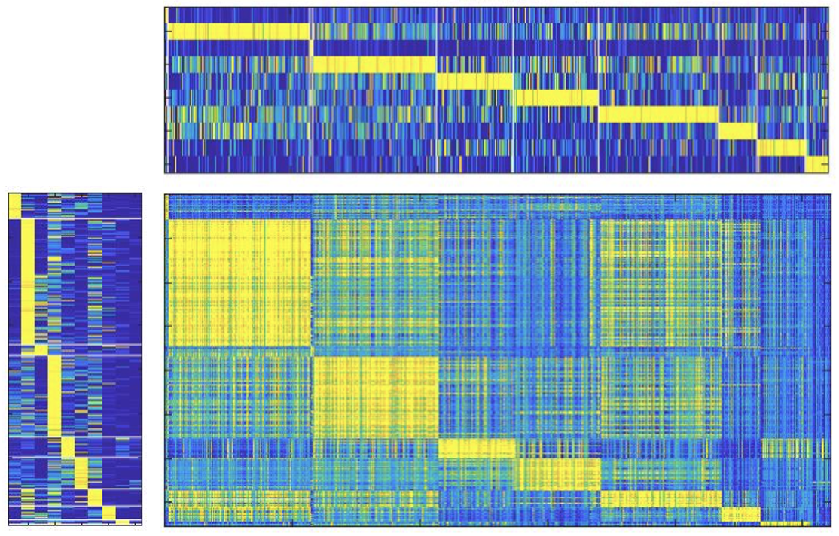
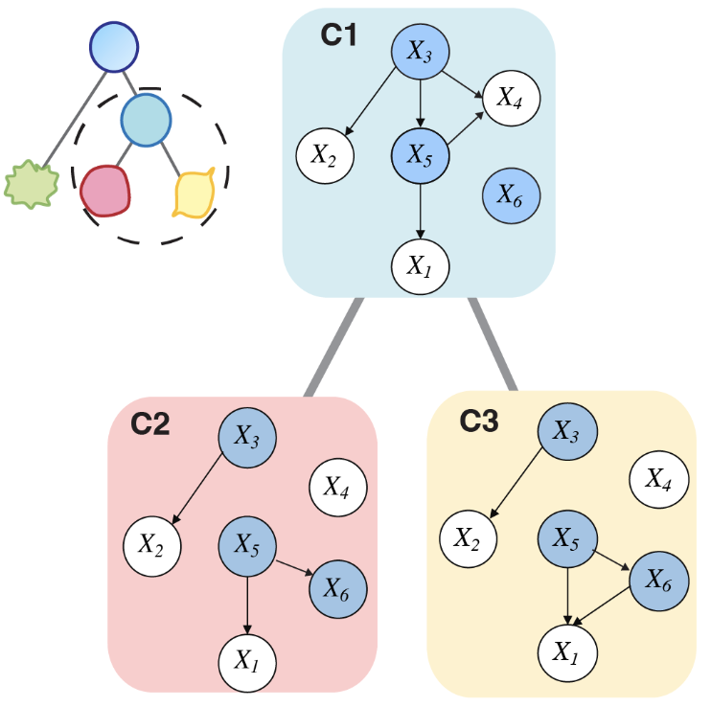
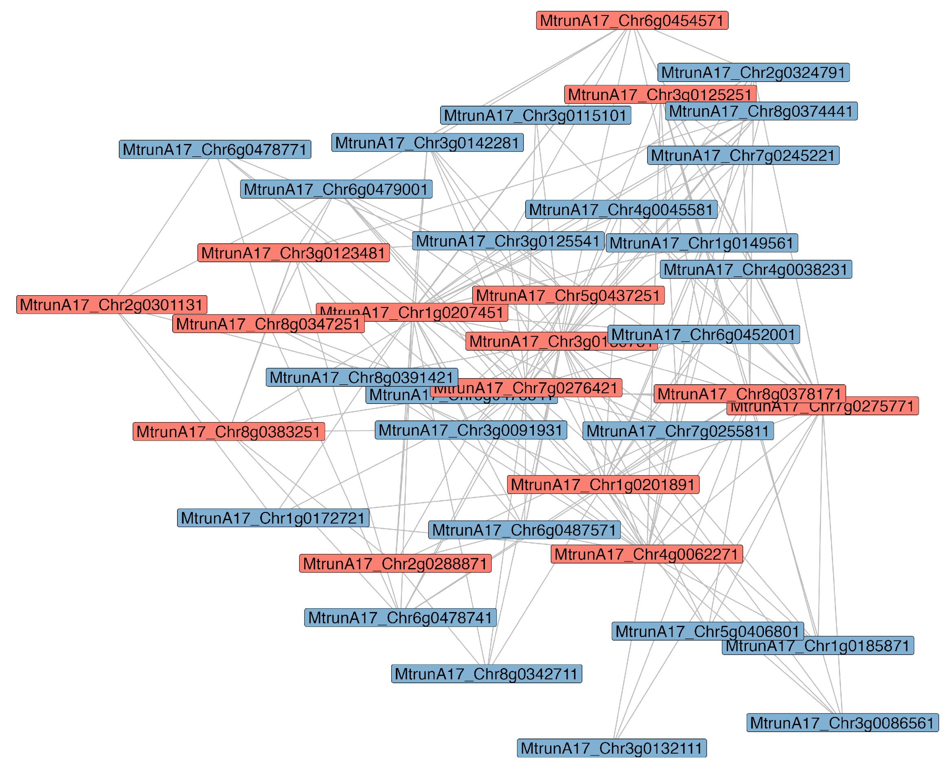
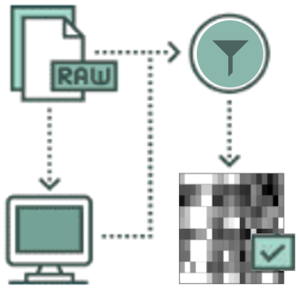
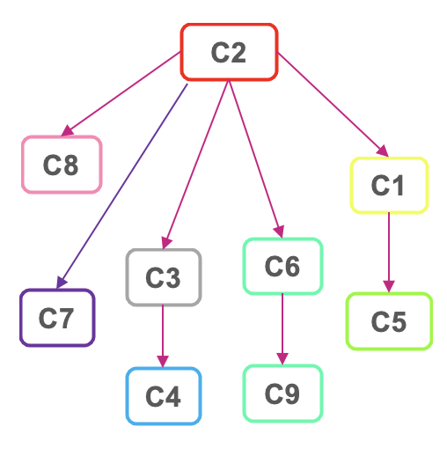
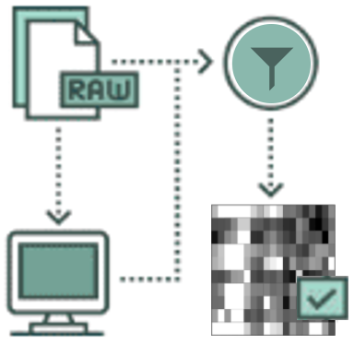
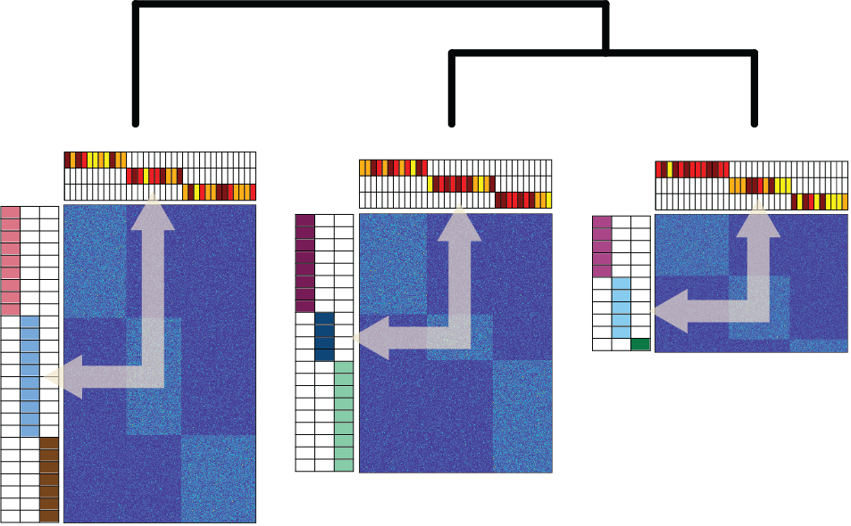
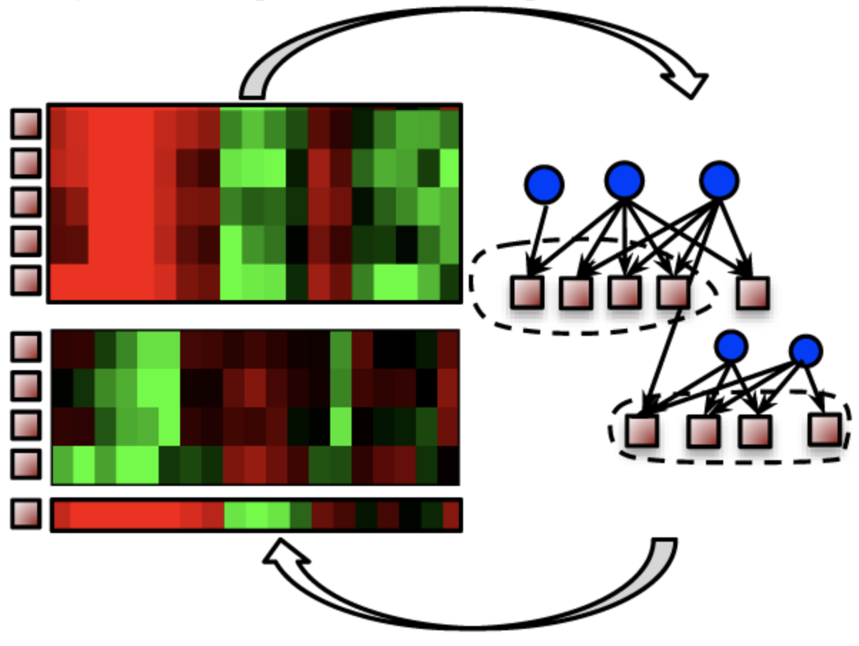
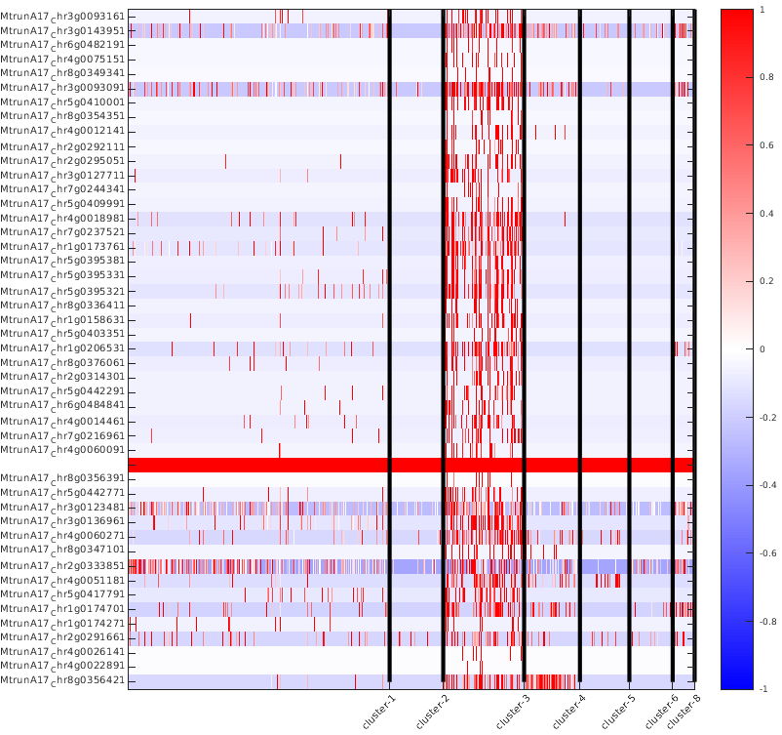
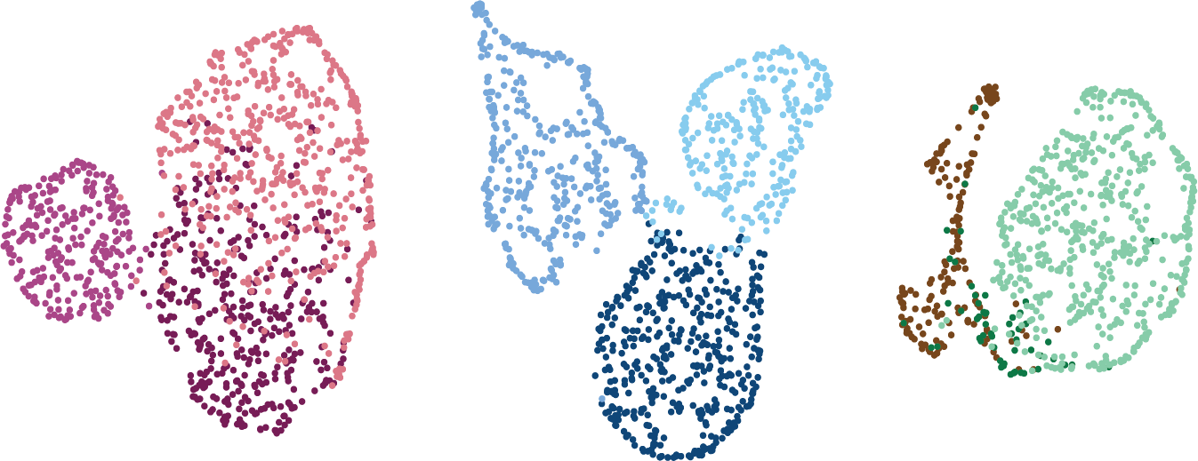
Overall analysis pipeline
Data preprocessing & QC
Cluster and annotate cell types
Infer lineage tree
Infer cell type-specific GRNs
Identify key regulators in GRNs
Sorghum
1
1
Maize
Medicago
NMF
scMTNI
2
2
Medicago
Maize
Sorghum
MERLIN
TMF
3
G_{A}
G_{B}
G_{C}
Method
Medicago
Maize
Sorghum
MRTLE
Notes:
For each species we have two samples: Dry (without mucilage) and Wet (when plants are making mucilage)
Did some data preprocessing and Quality control (QC):
Removed low-expression features, low-depth cells
Performed depth normalization and variance stabilization as per the Pagoda2 pipeline
Merged the dry and wet samples together to make a single expression matrix (across the union of genes)
So we want to find this
That requires us to first find the cell types
Then find the GRNs associated with each of these cell types
So the first question is how do we define the cell types? For that we’re using NMF

Slide 16
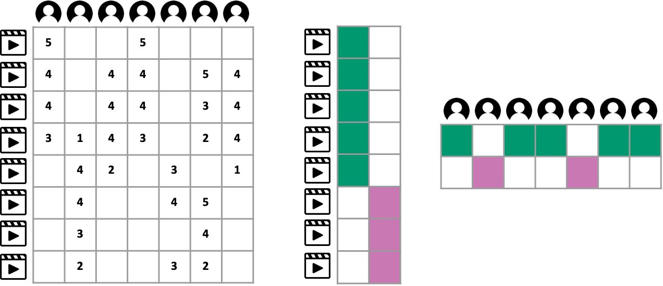




Non-negative matrix factorization (NMF)
Lee and Seung Adv. Neur. In. 2001
Notes:
Here’s what NMF does …
Just as you can factor a number to two smaller numbers, you can factor a large matrix into two smaller matrices.
The smaller factor matrices can be used to co-cluster the row-entities to the column entities.
Let’s consider the Netflix challenge where we are given a matrix of user and movie ratings
And assume that there are two groups of users interested in two different types of movies.
NMF allows us to identify these groups from the lower dimensional matrices as depicted by the colors green and purple.
The goal of NMF is to find two lower-dimensional factors U and V that well-approximates the input matrix X when multiplied together.

Slide 17
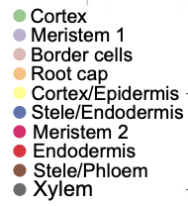
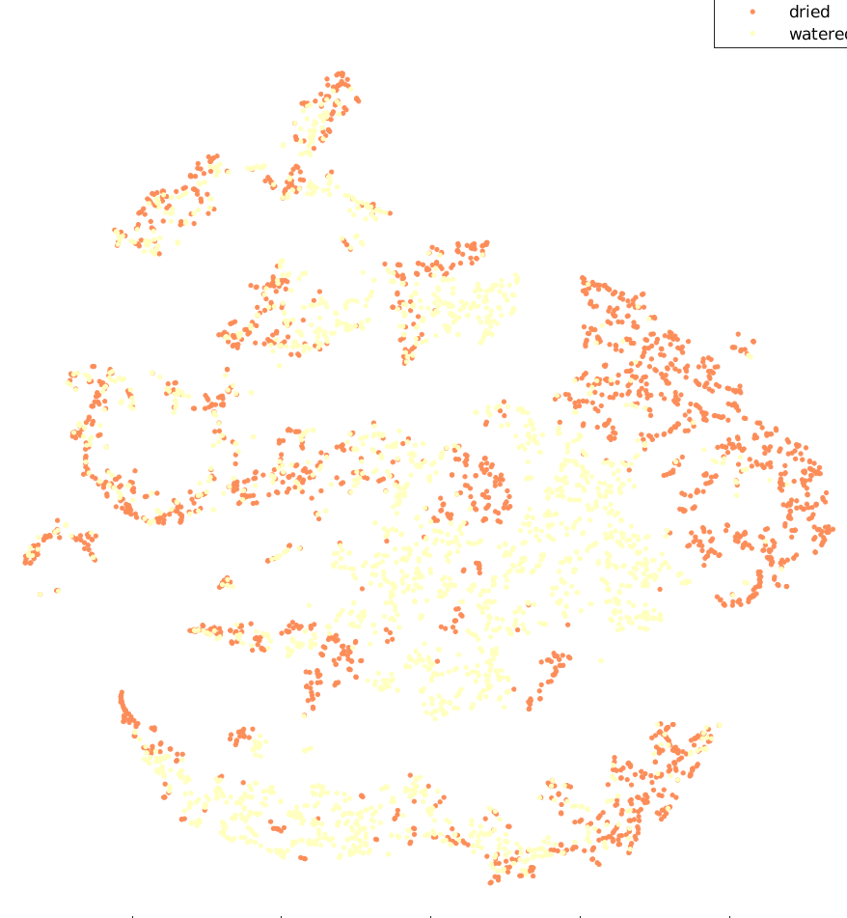
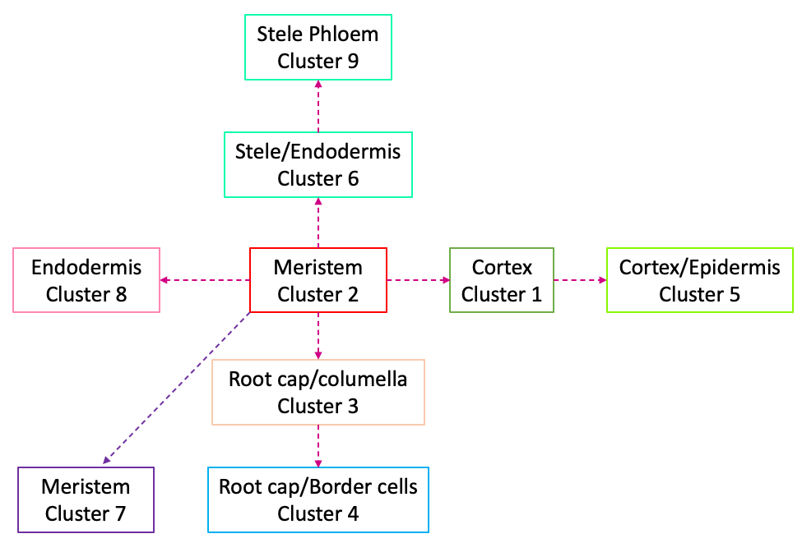
Identifying cell clusters with simple NMF and DE genes
M. truncatula
1
2
3
4
5
6
7
8
9
10
dry
wet
cell
Notes:
So here’s the result of applying NMF on our data, this is tSNE visualization of our data (which is another 2D visualization tool).
Each dot is a cell, each color corresponds to different cell type.
Together with Rafael we came up with what are the cell types of each cluster and what is their relationship to each other – the lineage tree

Slide 18
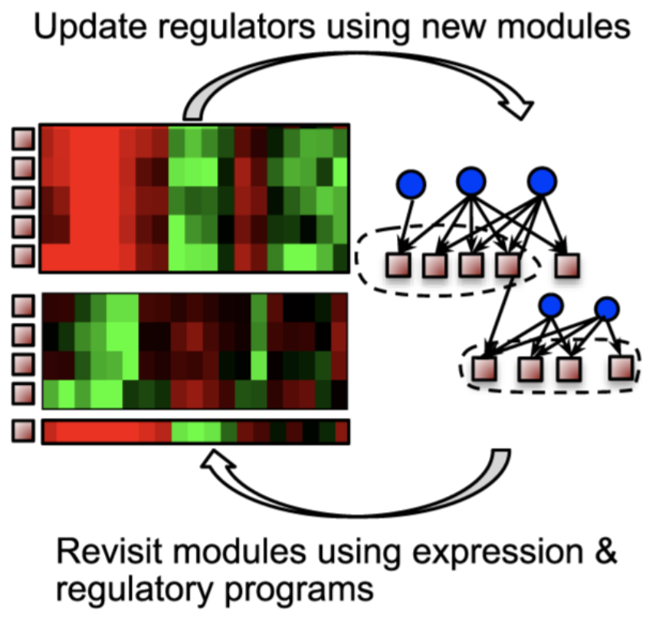
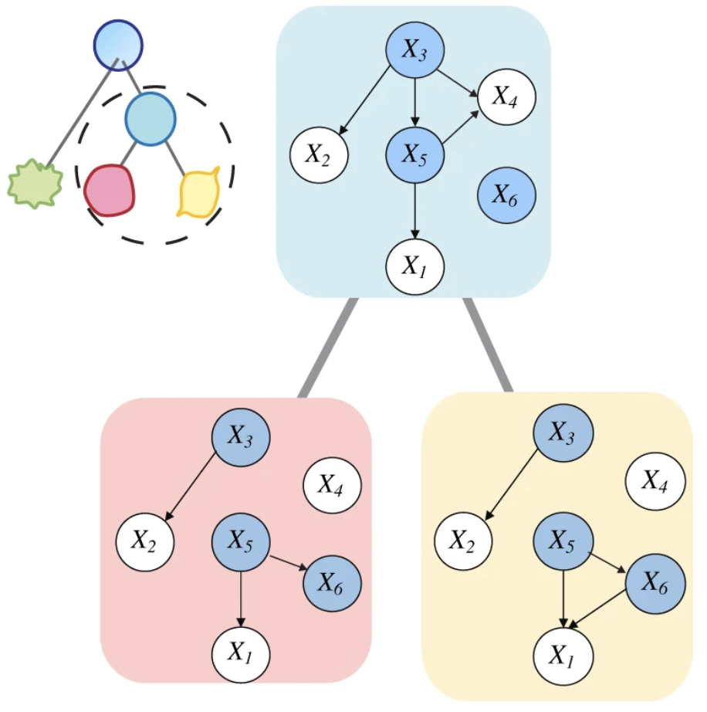
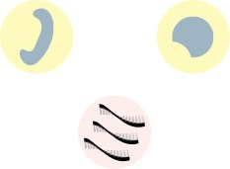
Gene regulatory network inference
Modular regulatory network learning with per gene information (MERLIN)
Single-cell Multi-Task Network Inference (scMTNI)
Cell type specific GRN
Trans-Regulatory GRN
Roy S. et al. Integrated Module and Gene-Specific Regulatory Inference Implicates Upstream Signaling Networks, 2013
Zhang, S., Pyne, S., Pietrzak, S. et al. Inference of cell type-specific gene regulatory networks on cell lineages from single cell omic datasets, 2023
Notes:
Now that we’ve defined the cell types we need to find what the GRNs are.
trans basically represents TFs to genes interactions.
I am going to use two tools for looking at this problem.
One, MERLIN, is going to work with all the data together
(MERLIN combines per-gene and per-module regulatory network inference methods.
It infers both module memberships of genes, and regulators for individual genes and modules. It is based on a probabilistic graphical model.)
And another, scMTNI, is going to use more cell type specific data and the lineage information and produce cell type specific regulatory networks.
(scMTNI takes as input a cell lineage tree and cell type-specific scRNA-seq data and outputs a set of cell type-specific gene regulatory networks for each cell type on the cell lineage tree.
The output networks of scMTNI are analyzed using two dynamic network analysis methods:
edge-based k-means clustering and
Latent Dirichlet Allocation (LDA) based topic models to identify key regulators and subnetworks associated with a particular cell cluster or a set of clusters on a branch)

Slide 19
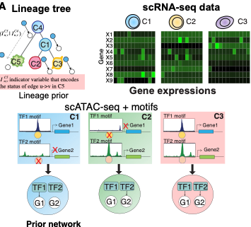
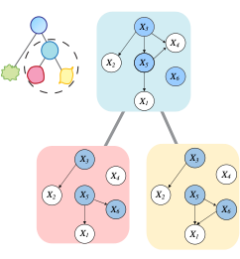
Single-cell Multi-Task Network Inference (scMTNI)
Input
Output
Code: https://github.com/Roy-lab/scMTNI
Paper: Zhang, S., Pyne, S., Pietrzak, S. et al. Inference of cell type-specific gene regulatory networks on cell lineages from single cell omic datasets, 2023

Slide 20
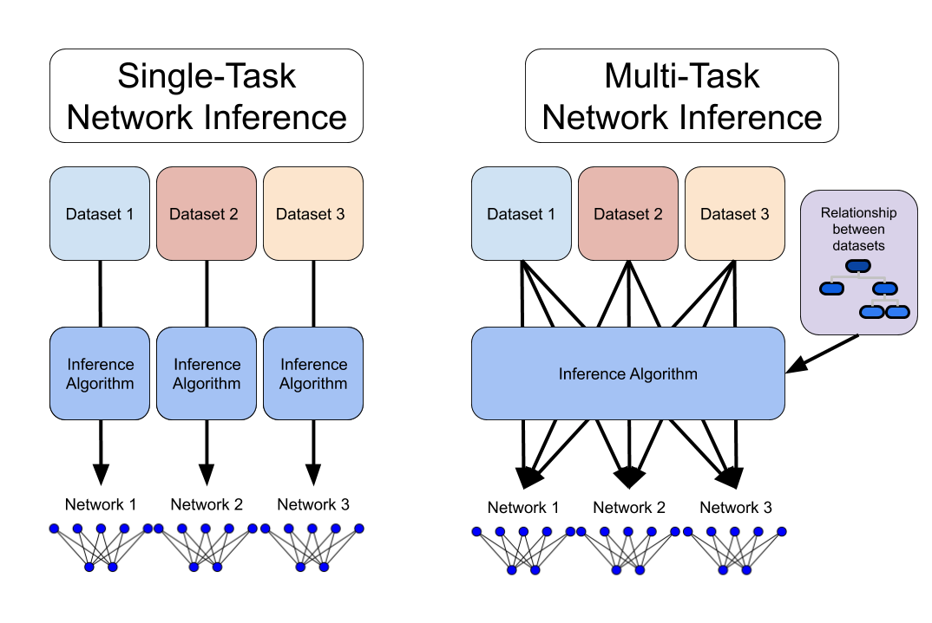
Multi-task vs Single-task Network inference
C₁
C₂
C₃
C₁
C₂
C₃
Notes:
A naïve approach is to use single-task inference on each dataset (Assume each dataset is a cell type), infer a network independently and compare the differences across the networks. However, this approach does not exploit the relatedness across datasets and might be susceptible to spurious relationships especially for rare cell types with a small number of cells. A second approach is to leverage the relationships among the cell types using multi-task learning during network inference for each cell type.

Slide 21
Single-cell Multi-Task Network Inference (scMTNI)
Input
Output
Learns regulators on per-target basis
Multiple subsamples (~100)
Ex: for sorghum - 36,800 jobs
If we run this locally: 200+ days!!
and this is only for 1 species and 1 tool
When will we actually see the real-world impact?!
Condor to the rescue! Took ~2 days
Notes:
cannot parallelize a lot locally because there are other people too in lab sharing limited local resources.
1 job on condor:
Time taken: ~ 8 mins
Memory usage: 1.5 GB

Slide 22
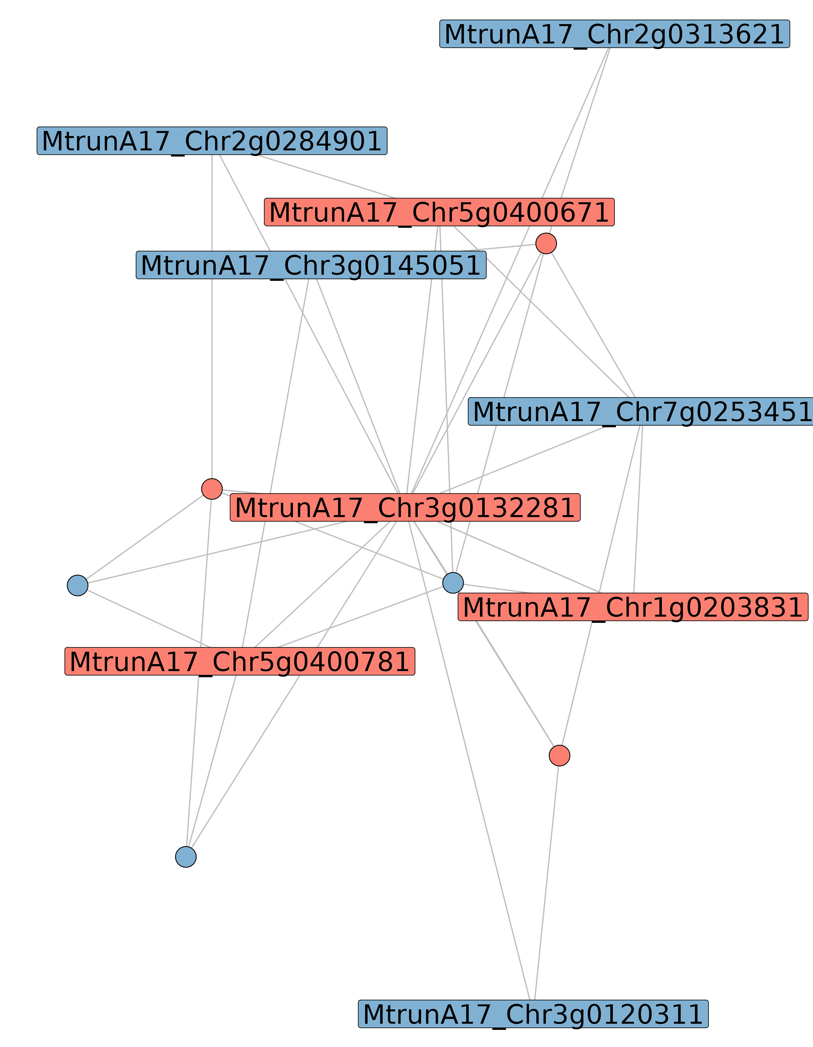
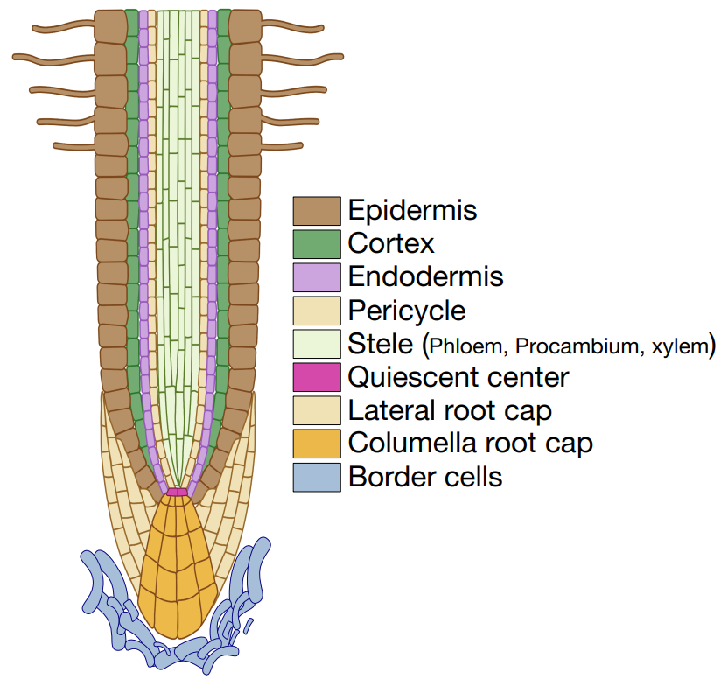


Identify key regulators for mucilage production
Border cells
produce the mucilage
Regulator(s) of interest: MtrunA17_Chr3g0132281
Notes:
So we’re using a variety of tools:
We’re using different GRN inference tools and combining their outputs together and we’re coming up with what we think cell type specific GRNs and key regulators.
And just to give you an example here’s sth that we think is interesting which actually Rafael is now testing in the lab.

Slide 23
Conclusions
We have analyzed single cell dataset of Medicago, Maize, Sorghum to identity key root cell types
  Select regulators validated in the lab for Medicago!
Multi-species comparative analysis to identify conserved and diverged regulators for root cap, aerial root formation
Notes:
Then we want to compare across species and here’re we’re using different comparative genomics tools
Apply TMF (Tree-guided non-negative Matrix Factorization) to identify potentially more matched cell clusters
Apply MRTLE (Multi-species Regulatory neTwork LEarning) per cell type across species

Slide 24

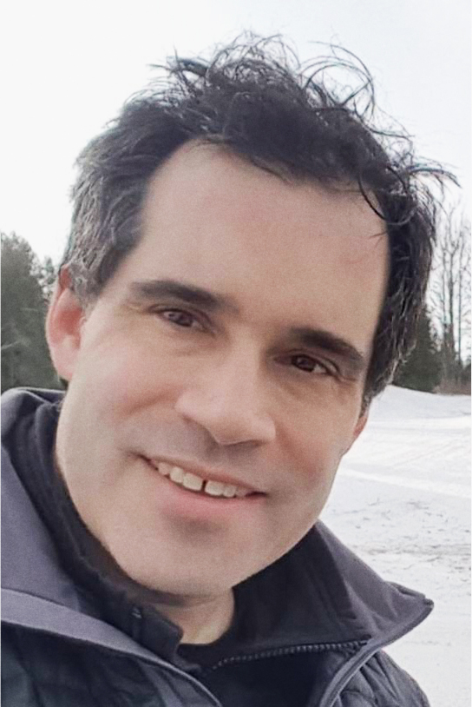

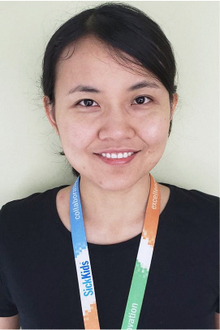
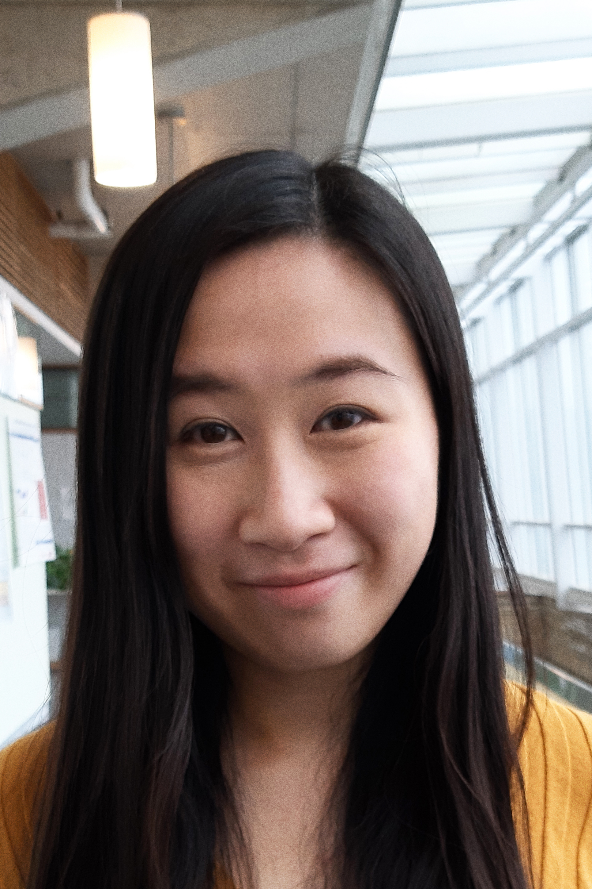
Compensatory renal growth (CRG)
What is Compensatory Renal Growth (CRG)?
GRNs can help disentangle CRG
Evolution can help transfer knowledge from model organisms to human
Junha Shin
Michael
Wilson
Mathieu
Lemaire
Huayun
Hou
Cadia
Chan
Notes:
This is hard to study directly in humans as generating human dataset for UNX is very sensitive and legal for obvious reasons
But kidney structure and function is conserved across vertebrates like mouse, rat, pig and therefore with our collaborators we have developed a kidney dataset that profiles both gene expression and accessibility in same nuclei across mammals like human, mouse, rat, and other species which can significantly improve our understanding.
Understanding the molecular mechanism behind triggering CRG could help identify high risk factors for poor outcomes and improve insights with clinical ramifications.

Slide 25
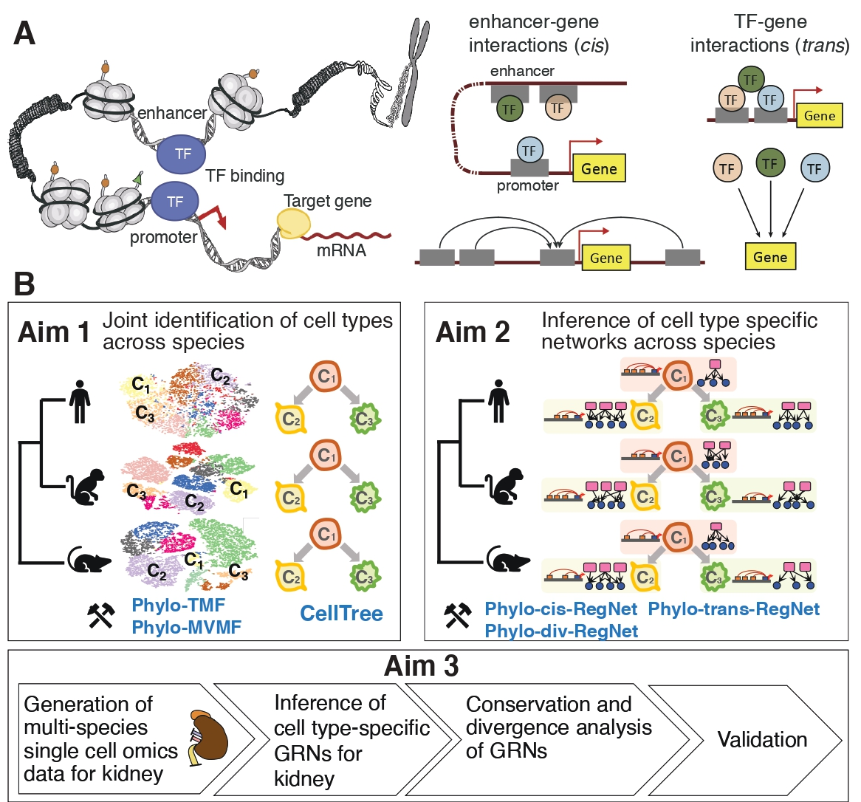

Using GRN evolution to understand Compensatory renal growth (CRG)
NMF, TMF, scCisInt
scMTNI, MERLIN, MRTLE
Notes:
Existing methods make use of only 1-to-1 orthologs which significantly reduces the number of genes one could use. And also most methods don’t take into account phylogenetic relationships across species. We will consider both.

Slide 26
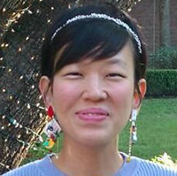
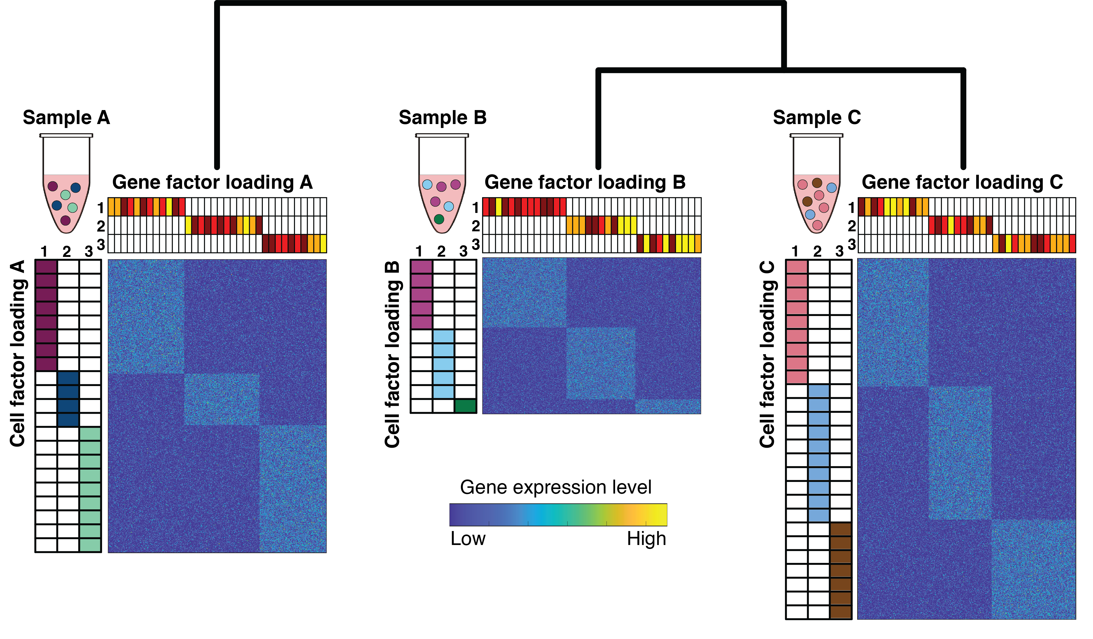



Development of integrative machine-learning algorithm for in-depth study of single-cell data from platforms
Erika Da-Inn
Lee
Tree-guided non-negative Matrix Factorization (TMF)
Relationship tree of the samples
V^{(root)T}
V^{(parent)T}
2D
early
3D
early
2D
late1
3D
late1
2D
late2
3D
late2
k factors
V^{(A)T}
V^{(B)T}
V^{(C)T}
U^{(B)}
U^{(A)}
U^{(C)}
scRNA-seq data per samples
$$arg\min_{U^{\left(∗\right)}{,V}^{\left(∗\right)}}{\sum_{d=1}^{D}{\left[{\left\|X^{\left(d\right)}−U^{\left(d\right)}V^{\left(d\right)⊺}\right\|}_{F}^{2}\right]}+α\sum_{c}{{\left\|V^{\left(c\right)}−V^{Pa\left(c\right)}\right\|}_{F}^{2}} }$$
Notes:
To enable the integrative analysis of the complex multi-species multi-time-points datasets, we developed a novel multi-task matrix factorization algorithm, namely Tree-guided non-negative Matrix Factorization (TMF).
TMF is a matrix factorization algorithm while incorporating the relatedness of multiple samples using given the tree structure among them, and the goal of TMF is to find the lower-dimensional factors of the cell-side (U) and gene-side (V) that well-approximates the input sample-specific matrix (X) when multiplied together.
These smaller factor matrices can be used to find the integrated cell clusters across different samples and also the identification of differentially expressed genes with patterns across the samples.

Slide 27




Non-negative Matrix Factorization (NMF)
Movies
Movie ratings matrix
Users
5 | 4 | 4 | 3
 |  |  | 1 | 4 | 4 | 3 | 2
 | 4 | 4 | 4 | 2
5 | 4 | 4 | 3
 |  |  |  | 3 | 4 |  | 3
 | 5 | 3 | 2 |  | 5 | 4 | 2
 | 4 | 4 | 4 | 1
$${\left\| X −UVT \right\|}^{2}$$
Notes:
Let’s briefly look over how TMF works.
You might remember the Netfilx challenge example for explaining NMF, which is factorizing the movie ratings matrix into users and movies.
The key point is that NMF allows to identify the groups from the lower dimensional matrices as depicted by the colors green and purple.

Slide 28

Tree-guided non-negative Matrix Factorization (TMF)
Relationship tree between the samples
V^{root}
V^{parent}
5 | 4 | 4 | 3 | 2
 |  |  | 1 | 1 | 4 | 3 | 2
 | 4 | 4 | 4 | 2
5 | 4 | 4 | 3
 |  |  |  | 3 | 4 |  | 3
 | 5 | 3 | 2 |  | 5 | 4 | 2
 | 4 | 4 | 4 | 1
5 | 4 | 3 | 3
 |  |  |  | 3 | 1 | 3 | 2
 | 4 | 3 | 4 | 2 | 1
 |  |  |  | 1 | 4 | 2 | 3
5 | 5 | 4 | 4
5 | 5 | 4 | 3
 |  |  | 3 | 4 | 4 | 3 | 2
 |  |  | 4 | 3 |  | 4
5 | 5 | 5 |  |  | 2
 |  |  | 3 | 3 | 4 |  | 3
3 | 5 | 4 | 2 |  | 1 | 1 | 2
$$\sum{\left[{\left\|X −UVT\right\|}^{2}\right]+α\sum{{\left\|V−V^{parent}\right\|}^{2}}}$$
Notes:
TMF expands the non-negative matrix factorization into multiple matrices which are sharing one-side of the matrix.
For example, let assume we are integrating movie rating matrices from 3 different OTT platforms like Netfilx, hulu and YouTube,
where the users are different, but the movie lists are same across platforms.
The shared sibling movie-side factors are regularized by the hypothetical factor matrix on parent node, which forces sibling factors more similar than the others.
Finally, the algorithm generates the multiple low dimensional factors to reveal the shared sub-structure across in multiple platforms, which corresponds to the user groups, and those-related movie groups.

Slide 29

Applying TMF to human multiome kidney dataset
For 1 TMF run
with 23 sample matrices
#cells 1k-25k (total 204k cells) with shared 19k genes
  memory usage is ~60G per run
  Time
We compute this for 3-5 different alphas and 5 rand inits
  results in 4 (k nums) X 5 (alphas) X 5 (rand inits) = 100 runs
Without condor, e.g. for 1 k=25, all runs would take
  41hr * 5 (alphas) * 5 (rand inits) = 1025hrs = 42.7 days!!

Slide 30
Two examples of how GRNs can help disentangle biological complexity
Enabling plants to fix nitrogen with aerial roots
Understand Compensatory Renal Growth in kidney
Notes:
GRNs specify regulatory connections bw sequence elements, TFs and target genes.

Slide 31


Directions in lab
Gene Regulatory Networks
3D genome organization
Evolution of gene regulation
Y
X₁
X₂
Y
X₁
X₂
Y
MERLIN
MERLIN-P
MERLIN-P-TFA
DRMN
HiC-Reg
GRiNCH
Arboretum-Hi-C
RIPPLE
MRTLE
Arboretum
MUSCARI
Doğan, Ezgi Süheyla, and Chang Liu. “Three-Dimensional Chromatin Packing and Positioning of Plant Genomes.” Nature Plants, vol. 4, no. 8, Aug. 2018, pp. 521–29.
Notes:
We have been interested in different aspects of gene regulation and have developed different tools to examine these aspects. In particular, we are interested in developing tools to infer genome scale GRNs, understanding 3D genome organization and also how gene regulation changes over long time scales such as evol time scales.
Reference: https://docs.google.com/presentation/d/1SSSqY7xIX4QPJmZ6RsAOQIKi0GwyRNQD/edit?slide=id.p3#slide=id.p3

Slide 32







Rest of Roy Lab and Acknowledgements
Collaborators
Lab @ WID
UW Madison
University of Florida
Matias Kirst
Wilfred Vermerris
Rupa Sridharan
Randolph Ashton
Kris Saha
Xinyu Zhao
Jean-Michel Ane
David Gamm
Josh Coon
Michael Sussman
Ophelia Venturelli
Marisa Otegui
Cornell University
Clare Casteel
U of Toronto/Sickkids
Michael Wilson
Jennifer Mitchell
Mathew LeMaire

Slide 33

Modular regulatory network learning with per gene information (MERLIN)
Code: https://github.com/Roy-lab/merlin
Paper: merlin paper
Notes:
MERLIN learning framework for inferring regulatory module networks. The algorithm starts with an initial set of expression clusters and candidate regulators and iterates between learning regulatory programs for each gene, and revisiting the module membership. The final inferred network is the output of MERLIN comprising the per-gene regulatory programs and the module membership of each gene.
our approach learns separate regulatory programs for each gene, but constrains the network using a probabilistic graphical model such that genes in the same module have similar, but not identical, regulatory programs. Furthermore the algorithm learns both the network structure and network parameters that can be used to predict expression in a test condition.

