Slide 1
Computing Requirements and Challenges for Muon Collider Detector Simulation
Mark Larson
The University of Chicago
June 4, 2025
HTC25
Mark Larson
1

Slide 2
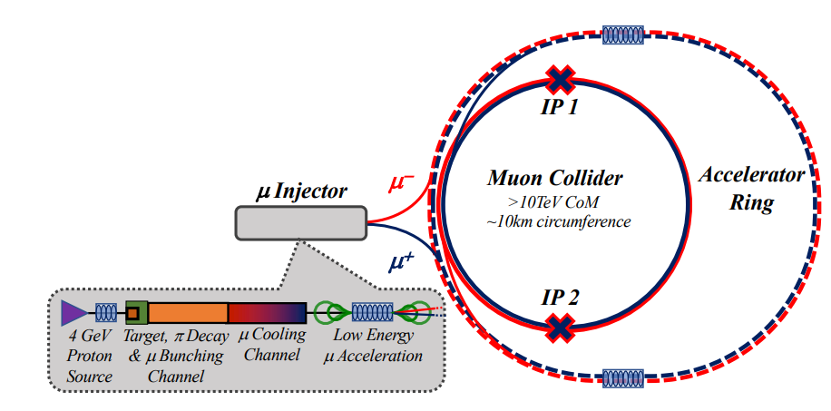
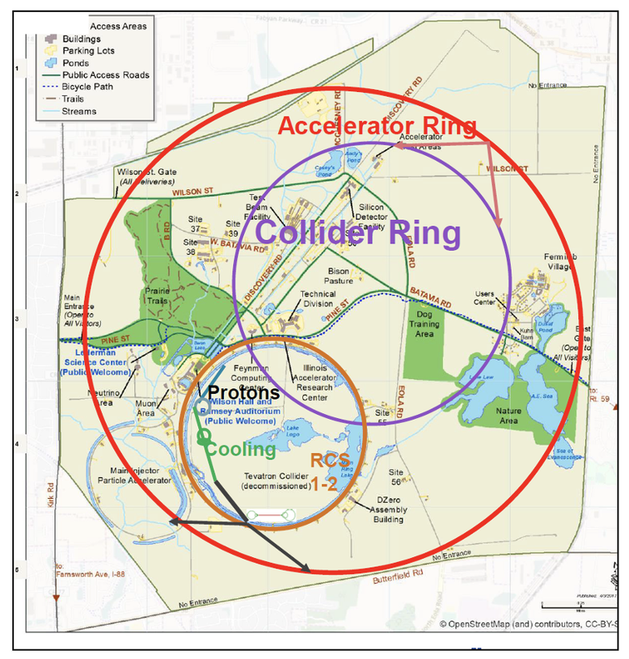
Why Build a Muon Collider?
Muons provide unique opportunities and challenges for building the next high energy collider – massive, fundamental particle, however, unstable
Combines high luminosity, high energy, and precision measurements, unlike previously built colliders
arXiv:2209.01318
arXiv:2303.08533
Muon Collider Computing Requirements & Challenges
2

Slide 3
Beam-Induced Background
Main challenge – computing and detector – from Beam-Induced Background (BIB)
High energy muon decays absorbed by tungsten nozzle, resulting in constant shower of low energy particles in detector
$𝓸\left({10}^{5}\right) μ$ decays / meter / event → $𝓸({10}^{8})$ BIB particles / event
Single Beam Muon Decay:
Our Goal: demonstrate we can efficiently reconstruct physics objects in presence of BIB
$$e^{+}$$
$$e^{−}$$
$$γ$$
$$n$$
arXiv:2203.07964
Muon Collider Computing Requirements & Challenges
3

Slide 4
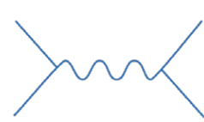
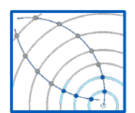
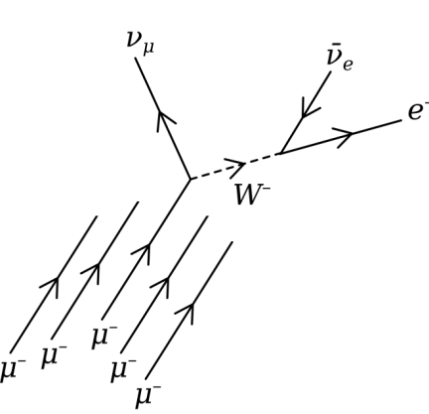
Simulation Workflow
Signal Generation
(MadGraph, WHIZARD)
Signal Simulation
Reconstruction (same tools as digitization + ACTS, Pandora)
Overlaying Signal + BIB Hits
Digitization
(MarlinWrapper, key4hep, Gaudi, LCIO)
BIB Generation
(FLUKA)
BIB Simulation (Geant4, DD4Hep)
Muon Collider Computing Requirements & Challenges
4

Slide 5
Computing Requirements & Resources
CPU Time:
Simulation: BIB takes up to 24 hours / event, $μ^{+}μ^{−}$ signal $ℴ(10$min$)$ / event
BIB overlay: ~5 mins / event, very IO intensive
Full reconstruction (100% BIB): $ℴ(1$ day$)$ / event
Memory:
Up to 32 GB/event – increases with more advanced reconstruction algorithms
Disk:
Without BIB: 1 MB/event (throughout all chains)
100% BIB overlay: 20 GB/event, SimHits only
Major Computing Clusters:
lxplus, DESY, INFN, global analysis facilities
OSG (dedicated resources), Fermilab LPC
Storage:
OSG, INFN have dedicated storage
Data Management:
Many data formats, files to keep track of across different clusters
Person Power:
Lack of dedicated funding → lack of dedicated computing staff
Muon Collider Computing Requirements & Challenges
5

Slide 6
Solutions to General Computing Challenges
BIB Simulation:
Simulate, and split 1 BIB event into large number of files, randomly select some percentage of these to be used for overlay
Accelerate using heterogenous computing (GPUs, FPGAs), train a generative ML algorithm
Reconstruction:
Apply reconstruction level cuts to minimize BIB fake objects
Reconstruct objects from only some sub-detectors
Run reconstruction only in large cone around truth objects
Data Management:
Rucio could provide a community-based, ground up solution
Muon Collider Computing Requirements & Challenges
6

Slide 7
Experience with the OSG / Condor
Running Condor jobs on OSG for full simulation workflow with 10% BIB overlay, accessing already generated BIB simulation files through CernVM-File System (cvmfs)
Our study: more advanced reconstruction, extended timing windows (more BIB hits)→ requires significantly more memory
Challenges:
Require ~15 GB of BIB files per event for 100% overlay
Up to$\sim 48$ GB RAM for reconstruction (10% overlay), previously saw scaling by factor of 6x from 10% → 100% BIB
Storage: final reconstructed files ~60 MB/event
Solutions:
Use only part of the detector
Process 1 event / job
Storage Options: ~50 TB available for future collider work, already half used
Remaining Question: How to scale up to 100% BIB when testing new configurations, reconstruction methods
Muon Collider Computing Requirements & Challenges
7

Slide 8
Conclusions
Muon collider has many unique computing challenges driven by Beam-Induced Background, different data formats
Need to continue optimizing simulation, overlay, reconstruction
OSG as a dedicated resource has proven extremely useful
Novel ideas are required to address remaining challenges introduced with new reconstruction techniques
Use of ML, heterogenous computing resources could provide solutions
See muoncollider.us and muoncollider.web.cern.ch for more info!
Thank you!
Muon Collider Computing Requirements & Challenges
8

