Slide 1
Duct Tape, DAGs, and Determination:
Snakemake at the Edge of HTCondor
or
"I Brought a Snake to a Bird Fight"
Justin Hiemstra

Slide 2
The two types of "Research Software"
Type 1
Type 2
(AI generated)
(AI generated)
(AI generated)

Slide 3
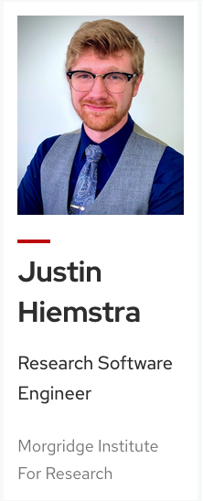


The two types of "Research Software"
Type 1
Type 2
(AI generated)
(AI generated)
(AI generated)

Slide 4


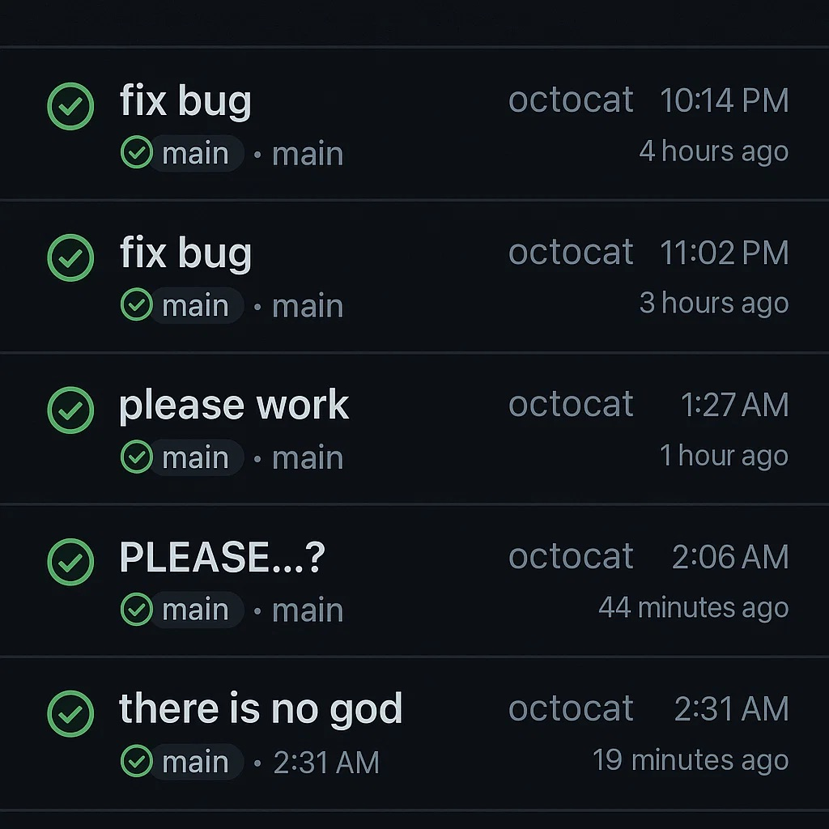
The two types of "Research Software"
Type 1
Type 2
(AI generated)
(AI generated)
(AI generated)

Slide 5
This is a story of running other people's "type 2" research software at scale

Slide 6
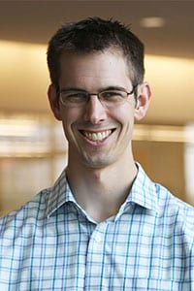

SPRAS – The "Signaling Pathway Reconstruction Streamliner"
There is…

Slide 7
SPRAS – The "Signaling Pathway Reconstruction Streamliner"
There is a lot of experimental protein-protein interaction data

Slide 8
SPRAS – The "Signaling Pathway Reconstruction Streamliner"
There is a lot of experimental protein-protein interaction data
It is often difficult to know which path from one node to another is the most likely "signaling pathway"

Slide 9
SPRAS – The "Signaling Pathway Reconstruction Streamliner"
There is a lot of experimental protein-protein interaction data
It is often difficult to know which path from one node to another is the most likely "signaling pathway"
There are many published "type 2" algorithms that try to answer this question, but few are widely adopted

Slide 10
SPRAS – The "Signaling Pathway Reconstruction Streamliner"
What if we created a tool that streamlined running as many of these algorithms as possible?

Slide 11
SPRAS – The "Signaling Pathway Reconstruction Streamliner"
What if we created a tool that streamlined running as many of these algorithms as possible?
"All problems in computer science can be solved by another level of indirection, except for the problem of too many layers of indirection." – David Wheeler

Slide 12
SPRAS – The "Signaling Pathway Reconstruction Streamliner"
What if we created a tool that streamlined running as many of these algorithms as possible?
"By indirections find directions out" - Polonius, Hamlet

Slide 13
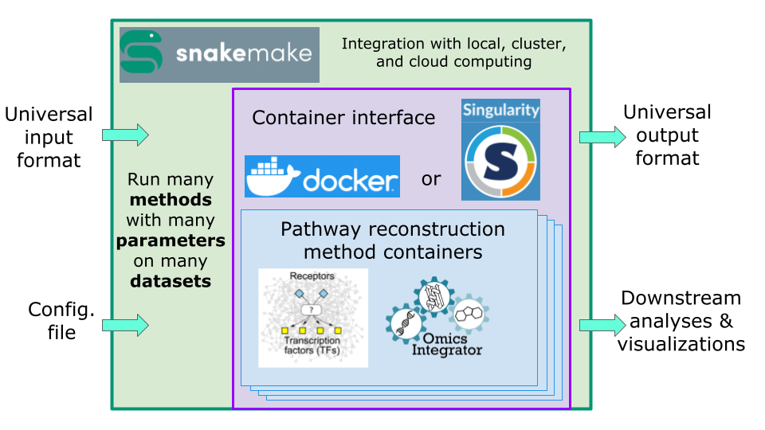
Finding Directions Out

Slide 14
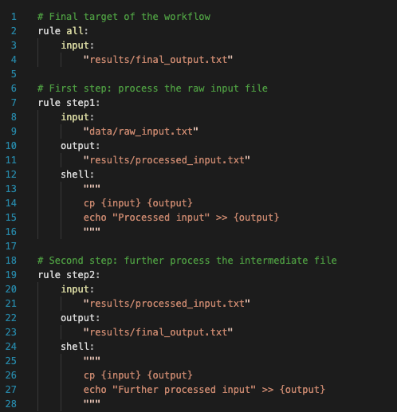

Workflow Management
Rule-based & declarative
Dependency resolution – builds a DAG of work
Capable of job skipping
Pythonic
Widely used in the Bioinformatics community

Slide 15
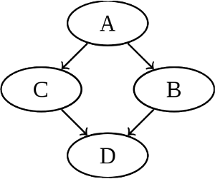
Workflow Management
Data1
Data2
Rule-based & declarative
Dependency resolution – builds a DAG of work
Capable of job skipping
Pythonic
Widely used in the Bioinformatics community
Derived1
Derived2

Slide 16
Why not just use DAGMan?
SPRAS existed before any attempt to integrate with HTCondor
An early design constraint was to keep the overall architecture flexible without requiring that SPRAS users have access to HTCondor

Slide 17
What would it take…

Slide 18
What would it take…
… to run one algorithm with SPRAS on one dataset as only one job on one EP?

Slide 19
What would it take…
… to run one algorithm with SPRAS on one dataset as only one job on one EP?
Containerize the software
Create a submit file
Submit
Solve problems, squash bugs
goto 3;

Slide 20
What would it take…
… to run one algorithm with SPRAS on one dataset as only one job on one EP?
Containerize the software
Create a submit file
Submit
Solve problems, squash bugs
goto 3;
The first appreciable hurdle was that containerizing SPRAS itself introduced a need to run nested containers

Slide 21
Nested Containers in the OSPool
EP Container
SPRAS Container
- HTCondor Software
- EP Config
- Other stuff (probably, but not my interest)
- SPRAS
- Python
- Snakemake
- Job inputs
Algorithm Container
- Whatever this "type 2" research code needs to run
- Derived job inputs

Slide 22
Nested Containers in the OSPool
EP Container
Nested containers in a heterogeneous, unprivileged environment took me a while to figure out
SPRAS Container
- HTCondor Software
- EP Config
- Other stuff (probably, but not my interest)
- SPRAS
- Python
- Snakemake
- Job inputs
Algorithm Container
- Whatever this "type 2" research code needs to run
- Derived job inputs

Slide 23
Nested Containers in the OSPool
EP Container
Nested containers in a heterogeneous, unprivileged environment took me a while to figure out
Docker is not your friend, but Apptainer is
Barring significant architectural changes meant converting Docker→ .sif in the job
A very opaque, difficult environment to develop in/for
The secret: starting apptainer from "unpacked" .sif images (--sandbox)
SPRAS Container
- HTCondor Software
- EP Config
- Other stuff (probably, but not my interest)
- SPRAS
- Python
- Snakemake
- Job inputs
Algorithm Container
- Whatever this "type 2" research code needs to run
- Derived job inputs

Slide 24
Nested Containers in the OSPool
EP Container
Nested containers in a heterogeneous, unprivileged environment took me a while to figure out
Docker is not your friend, but Apptainer is
Barring significant architectural changes meant converting Docker→ .sif in the job
A very opaque, difficult environment to develop in/for
The secret: starting apptainer from "unpacked" .sif images (--sandbox)
Everything is simple when you know how
SPRAS Container
- HTCondor Software
- EP Config
- Other stuff (probably, but not my interest)
- SPRAS
- Python
- Snakemake
- Job inputs
Algorithm Container
- Whatever this "type 2" research code needs to run
- Derived job inputs

Slide 25
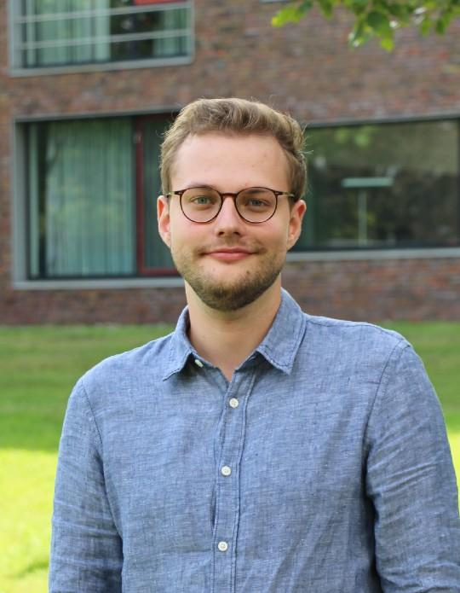
Teaching the Snake to Fly The Bird
Jannis Speer @ University of Dortmund
The next step was getting Snakemake to manage its own "jobs"
Luckily, right around this time Snakemake made an "Executor" plugin interface
To my surprise, I wasn't the only one working on this!
This lets Snakemake submit each of its "jobs" as an HTCondor job using the Python bindings
The Executor manages/monitors jobs and output so it knows when to submit the next unit of work
Original HTCondor Executor Author

Slide 26
Access Point
Execution Point
Snakemake
Shared Filesystem

Slide 27
Access Point
Execution Point
Snakemake
1. Convert "snake job" into submit file
Constructs args to pass to self at the EP. These scope EP snakemake to run only this job
Shared Filesystem
Submit File

Slide 28
Access Point
Execution Point
Snakemake
1. Convert "snake job" into submit file
Constructs args to pass to self at the EP. These scope EP snakemake to run only this job
2. Place the job
Shared Filesystem
Submit File

Slide 29
Access Point
Execution Point
Snakemake
3. Snakemake is re-invoked at the EP args that trigger "this job"
1. Convert "snake job" into submit file
Constructs args to pass to self at the EP. These scope EP snakemake to run only this job
Snakemake
job-specific arguments
2. Place the job
Shared Filesystem
Submit File

Slide 30
4. Snakemake at the AP monitors remote job for completion and checks locally for output
Access Point
Execution Point
Snakemake
3. Snakemake is re-invoked at the EP args that trigger "this job"
1. Convert "snake job" into submit file
Constructs args to pass to self at the EP. These scope EP snakemake to run only this job
Snakemake
job-specific arguments
2. Place the job
Shared Filesystem
Submit File

Slide 31
Access Point
Snakemake
5. When output is complete, move onto next job using previous output as new input

Slide 32
Shared Filesystems, Shared Suffering

Slide 33
Shared Filesystems, Shared Suffering
When you assume a shared filesystem, you make an @$$ out of you, me and the rest of the cluster

Slide 34
Shared Filesystems, Shared Suffering
When you assume a shared filesystem, you make an @$$ out of you, me and the rest of the cluster
It looked like Snakemake already had had a runtime flag for me
--shared-fs-usage none
Would it work for me off the shelf??

Slide 35
no

Slide 36
What exactly does this option do?
Some of the "job-specific" args are modified to switch absolute paths to relative → A promising thing to see!
It does try to handle transferring input/output and the executable… just in the wrong way

Slide 37
Snakemake Transfer Model
Snakemake
Remote Execution Point
Executor

Slide 38
Snakemake Transfer Model
Snakemake
1. Transfer input
Remote Execution Point
Executor

Slide 39
Snakemake Transfer Model
Snakemake
1. Transfer input
Remote Execution Point
2. Hand off job
Executor

Slide 40
Snakemake Transfer Model
Snakemake
1. Transfer input
Remote Execution Point
2. Hand off job
Executor
3. Translate Snakemake execution into remote execution and run

Slide 41
Snakemake Transfer Model
Snakemake
1. Transfer input
Remote Execution Point
2. Hand off job
Executor
3. Translate Snakemake execution into remote execution and run

Slide 42
Adjusted Snakemake Transfer Model*
(*required upstream changes – Snakemake maintainers are really great to work with!)
Snakemake
Executor
HTCondor
Remote Execution Point
1. Hand off job, telling the executor plugin the executor knows how to transfer its own input/output
2. The executor adds these to transfer_input_files,
transfer_output_files
3. HTCondor does its thing and everyone's happy

Slide 43
Liftoff
After working through all these (more nuanced than I'm presenting) issues over the course of a few months… things started working
But there were still two things that annoyed me about the setup
Running condor_watch_q doesn't pick up jobs submitted after the initial invocation
If I shut my laptop…

Slide 44
"Snakemake Long"
Access Point
"Snakemake Long" (submit)
Execution Point

Slide 45
"Snakemake Long"
Access Point
"Snakemake Long" (submit)
Execution Point
"Snakemake Long" (execute)
1. "Snakemake Long" submits a local universe job

Slide 46
"Snakemake Long"
Access Point
2. The same script is re-invoked in a way that launches regular snakemake with the executor
"Snakemake Long" (submit)
Execution Point
"Snakemake Long" (execute)
1. "Snakemake Long" submits a local universe job
Snakemake

Slide 47
"Snakemake Long"
Access Point
2. The same script is re-invoked in a way that launches regular snakemake with the executor
"Snakemake Long" (submit)
Execution Point
"Snakemake Long" (execute)
3. The rest of the setup looks the same – the executor submits snake jobs from the local universe job
1. "Snakemake Long" submits a local universe job
Snakemake

Slide 48
Next Steps
The file transfer mechanisms we've discussed are binary – everything comes from a shared fs or nothing comes from it

Slide 49
Next Steps
The file transfer mechanisms we've discussed are binary – everything comes from a shared fs or nothing comes from it
Snakemake doesn't provide a good way to remap file mounts/names between AP→EP?

Slide 50
Next Steps
The file transfer mechanisms we've discussed are binary – everything comes from a shared fs or nothing comes from it
Snakemake doesn't provide a good way to remap file mounts/names between AP→EP?
SPRAS jobs still pull algorithm containers within the job – this is bad

Slide 51
Next Steps
The file transfer mechanisms we've discussed are binary – everything comes from a shared fs or nothing comes from it
Snakemake doesn't provide a good way to remap file mounts/names between AP→EP?
SPRAS jobs still pull algorithm containers within the job – this is bad
We also want to monitor the inner container's resources

Slide 52

Next Steps
The file transfer mechanisms we've discussed are binary – everything comes from a shared fs or nothing comes from it
Snakemake doesn't provide a good way to remap file mounts/names between AP→EP?
SPRAS jobs still pull algorithm containers within the job – this is bad
We also want to monitor the inner container's resources
I haven't even touched getting this to work with my other favorite bird

Slide 53
One key takeaway
"Condor already handles problem X, so just do Y in your workflow" is a dangerous sentiment
There's a lot of value in designing your tools to fit the researcher's needs instead of demanding they fit their workflows to your tools
Just because you have a distributed hammer doesn't mean everything has to look like a thumb

Slide 54
Useful Links
SPRAS:
https://github.com/reed-CompBio/spras
HTCondor Snakemake Executor:
https://github.com/htcondor/snakemake-executor-plugin-htcondor
Jannis's Original Snakemake Executor:
https://github.com/jannisspeer/snakemake-executor-plugin-htcondor

Slide 55
Acknowledgement
This material is based upon work supported by the National Science Foundation under Cooperative Agreements DBI-2233968. Any opinions, findings, and conclusions or recommendations expressed in this material are those of the author(s) and do not necessarily reflect the views of the National Science Foundation.

