Slide 1
Monitoring in the OSDF
Patrick Brophy

Slide 2
Who am I?
A very recent UW Madison graduate
2024 CHTC Fellow
Research Software Engineer at The Morgridge Institute for Research

Slide 3
Story Time
Hard to say. It happens when I’m stressed out and overwhelmed
Don’t worry I’ll be able to use my tools to measure them
Well sometimes I feel like I can’t think normally. Or my thinking is really slow.
Hey Doc, I’m not sure what’s wrong, but something is not right.
Well that’s too bad.
What are your symptoms?
How long has this been going on?
Oh I don’t bring them with me.
Hmm. Let me check your vitals
Notes:
Just like our doctor, we can’t guess what’s wrong in the OSDF:
we need tools that let us listen, measure, and diagnose.
Monitoring is our stethoscope.
It’s how we make sense of a complex, distributed system—whether you're a user trying to run workflows, an operator keeping services healthy, or a stakeholder looking at the big picture.

Slide 4
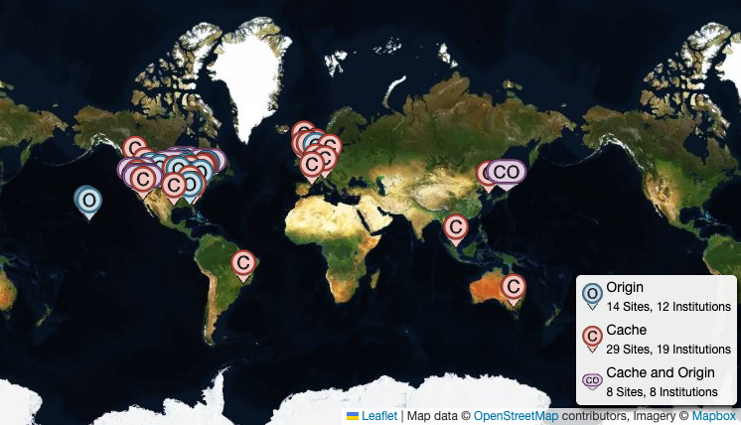
Monitoring is How We Diagnose the OSDF
OSDF is massive and distributed
Failures are often subtle, systemic, or intermittent
Guesswork doesn't scale, we need observability

Slide 5
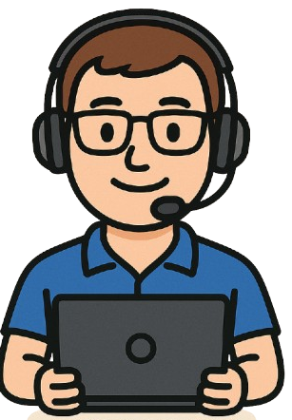
Monitoring for Different Needs
Are we making an impact?
Is OSDF helping me?
Is my service healthy?
What needs attention?
Who’s using OSDF?
Why did my workflow fail?
Researcher
Operator
Stakeholder
Notes:
The OSDF supports a wide range of users, and each group has very different needs when something goes wrong—or even when things are working, but not optimally.
Let’s start with researchers, especially our power users. When their workflows fail, they want answers fast. They’re asking: Why did it fail? Can I fix it? Is OSDF helping me move data efficiently, or is something in the infrastructure slowing me down?
Next we have operators, these are the sysadmins running the caches, origins, and central services. They’re asking a completely different set of questions: Is my service up? Are users getting what they need from it? Where are the bottlenecks? What kind of traffic am I seeing? They’re responsible for keeping the system healthy on a day-to-day basis.
And finally, stakeholders, people like my boss, your boss, funding agencies, they're looking at this from a broader view: Is the OSDF being used? What kind of scientific work is it enabling? Are we doing a good job with the resources we’ve been given? They want high-level, reportable evidence of value
Monitoring is what connects all of these perspectives. It turns individual service logs and metrics into insight that is tailored to what each group actually needs.

Slide 6
Monitoring = Measurable Trust
We can’t improve what we don’t measure
Monitoring is the foundation for reliability, trust, and growth
Without it, we're guessing and reactive, not responsive
Notes:
Monitoring gives us a foundation to build from. It helps make OSDF more reliable over time. It helps build trust, between users and the infrastructure, between operators and the tools they manage, and between the project and the folks supporting it.
Without this kind of observability, we tend to operate in the dark. We rely on gut instinct or wait for someone to notice a problem. That can work in small systems, but for something as complex and distributed as OSDF, it’s just not sustainable

Slide 7
A Bird's Eye View
Notes:
To understand how we monitor the OSDF, we first need a picture of what we’re monitoring. This is a very simplified view of the OSDF’s architecture. We have a researcher requesting data through the Pelican client, which retrieves data from Origins or Caches, with the Director coordinating access. It's highly distributed, so understanding what's happening across all these services at once, that’s the challenge monitoring is here to solve.

Slide 8
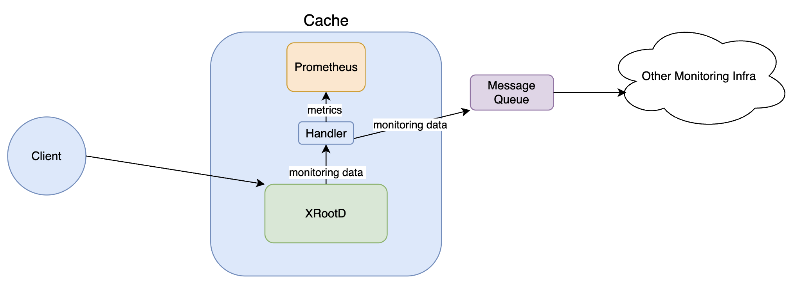
How does it all happen?
Client Transfer Data
Summary & Detailed Records
Notes:
Zooming inside a cache, we can understand how monitoring data is collected. The heart of the data is XRootD. XRootD emits monitoring data and Pelican captures it.
Pelican processes this data into Prometheus metrics and also forwards the raw data to a message queue so that it can be processed in other monitoring infrastructure.
Each cache and origin embeds an instance of Prometheus. With this we can do integrate into visualization tools like Grafana and also use this data within the Web UI.
Additionally, client transfer statistics are collected using Condor.

Slide 9
Monitoring Data - Summary Records
Summary records allow us to answer:
Is the service up?
How effectively is the cache serving data? (Current connections, total bytes in and out)
How is the service utilizing machine resources? (CPU, memory, disk)
Are there any bottlenecks or errors in data transfer or file operations?
This data gives both users and operators a high-level snapshot of service health and efficiency.
This data also helps demonstrate to users how well the OSDF infrastructure supports high-throughput, reliable data access.
Operators can quickly identify issues such as degraded performance, resource exhaustion, or failing components.
Notes:
Now that we understand how the data is produced

Slide 10
Monitoring Data - Detailed Records
These records capture a significantly more detailed view
Every read, open, close, the amount bytes per transfer
Questions they answer:
Operational Insights:
How busy is the cache with IO?
What happened to the cache between time 1 and time 2?
These records can be used to construct histograms
We can perform surgical analysis on a service

Slide 11
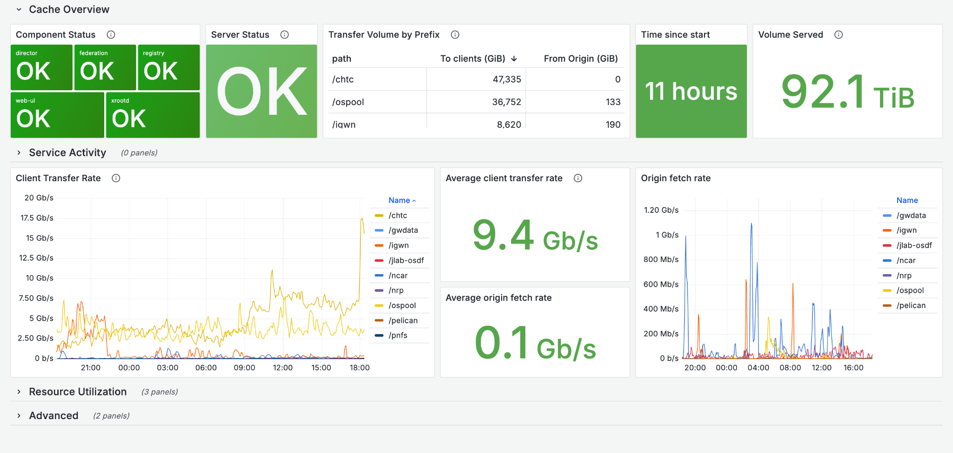
Dashboard
Notes:
Both the summary and detailed data is stored in Prometheus, enabling easy integration with visualization tools like Grafana. The sample dashboard shown here is for a cache service and provides operators with an at-a-glance view of system health and performance. By combining high-level summary metrics with detailed per-component data, we can both monitor general trends and quickly diagnose anomalies or inefficiencies in the service’s behavior. This layered approach enhances situational awareness and supports faster operational responses.

Slide 12
Client Transfer Data
Using condor_history we are able to look at individual transfer data.
This transfer data is stored into ElasticSearch for further analysis and reporting.
Notes:
I didn’t forget about our client transfer data. This data is recorded into ClassAds and we can retrieve them using condor history. We also pipe this data using condor ad stash and into elastic search.
Elastic search allows us to hook up tools like Kibana that we can use to answer questions about overall client performance.

Slide 13
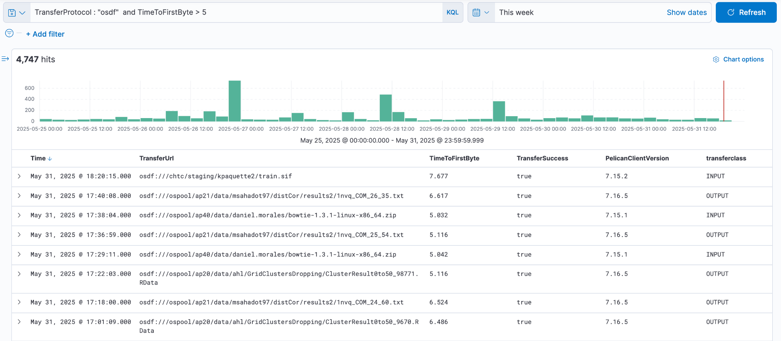
Explore transfer data
Notes:
For example, we can look at how many OSDF transfers had a time to first byte greater than 5 seconds. Kibana makes this trivial and allows our operators to gain insight into what is going on at the transfer level.

Slide 14
What about reporting?
Notes:
That was a lot of data—and it’s a lot to take in. So let’s pause for a moment and catch our breath.
At this point, you might be asking yourself: What about reporting? With all this data flowing through our monitoring systems, how do we make it accessible and meaningful to the people who need it most?
Our stakeholders need a way to understand what’s happening within the OSDF without diving into the raw, technical details. They need a clear, concise, and digestible view of the system’s health and performance. At the same time, our operators need a mechanism to communicate ongoing challenges, trends, and achievements. Reporting bridges that gap. It provides a structured way to translate complex operational data into insights that inform decision-making, foster accountability, and support collaboration across technical and non-technical audiences.

Slide 15
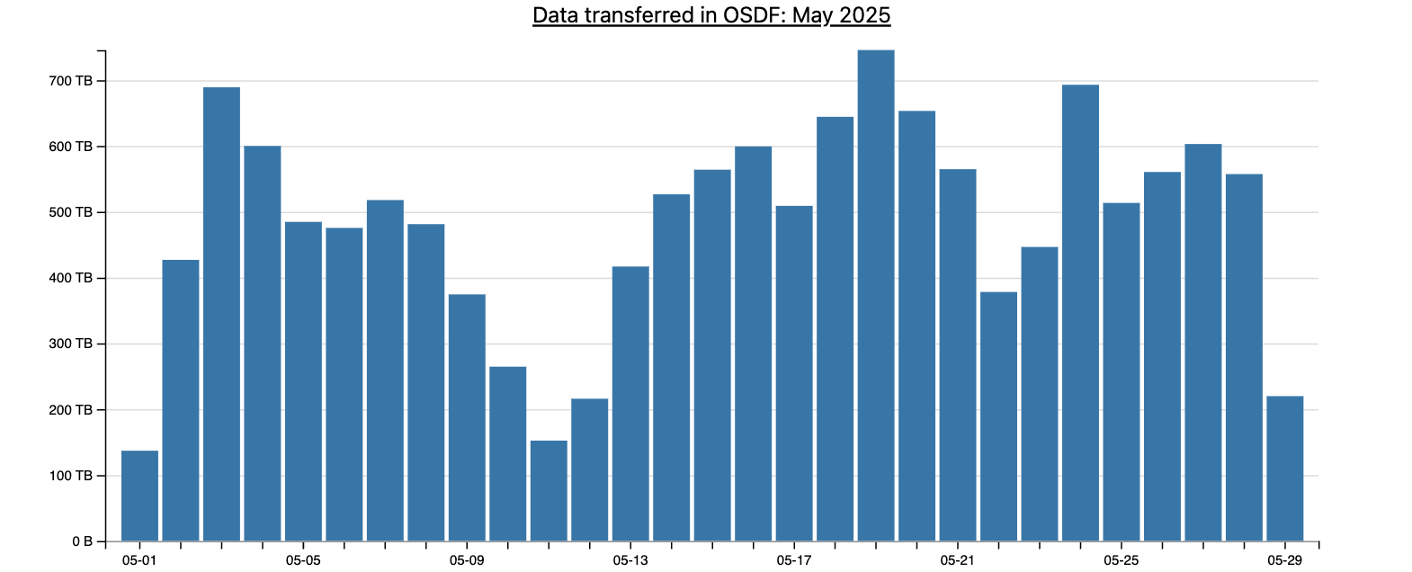
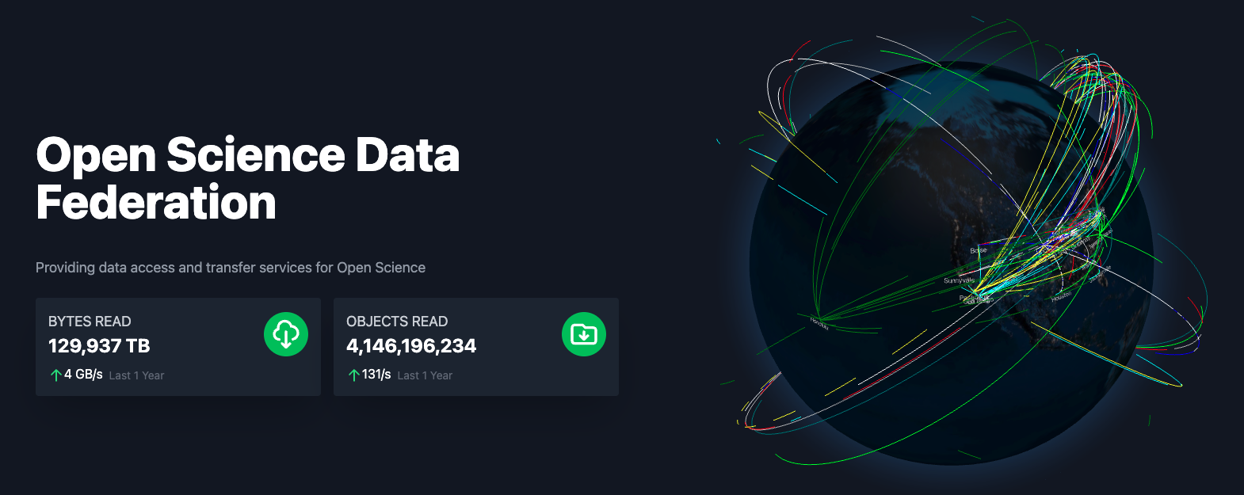
Reports
All of this monitoring data eventually translates into reports
We can generate reports to inform our stakeholders about the impact of the OSDF
Notes:
These reports serve as a bridge between our technical operations and our stakeholders—providing clear, data-driven insights into how the infrastructure is performing. They highlight successes, such as throughput improvements or expanded coverage, showcasing the tangible impact of our work. At the same time, they provide a high-level overview of system failures, anomalies, and areas for improvement. This comprehensive visibility not only fosters transparency but also empowers stakeholders to make informed, strategic decisions—whether about resource allocation, future development priorities, or funding. In short, the reports transform raw operational data into actionable intelligence that supports the long-term growth and sustainability of the OSDF.

Slide 16
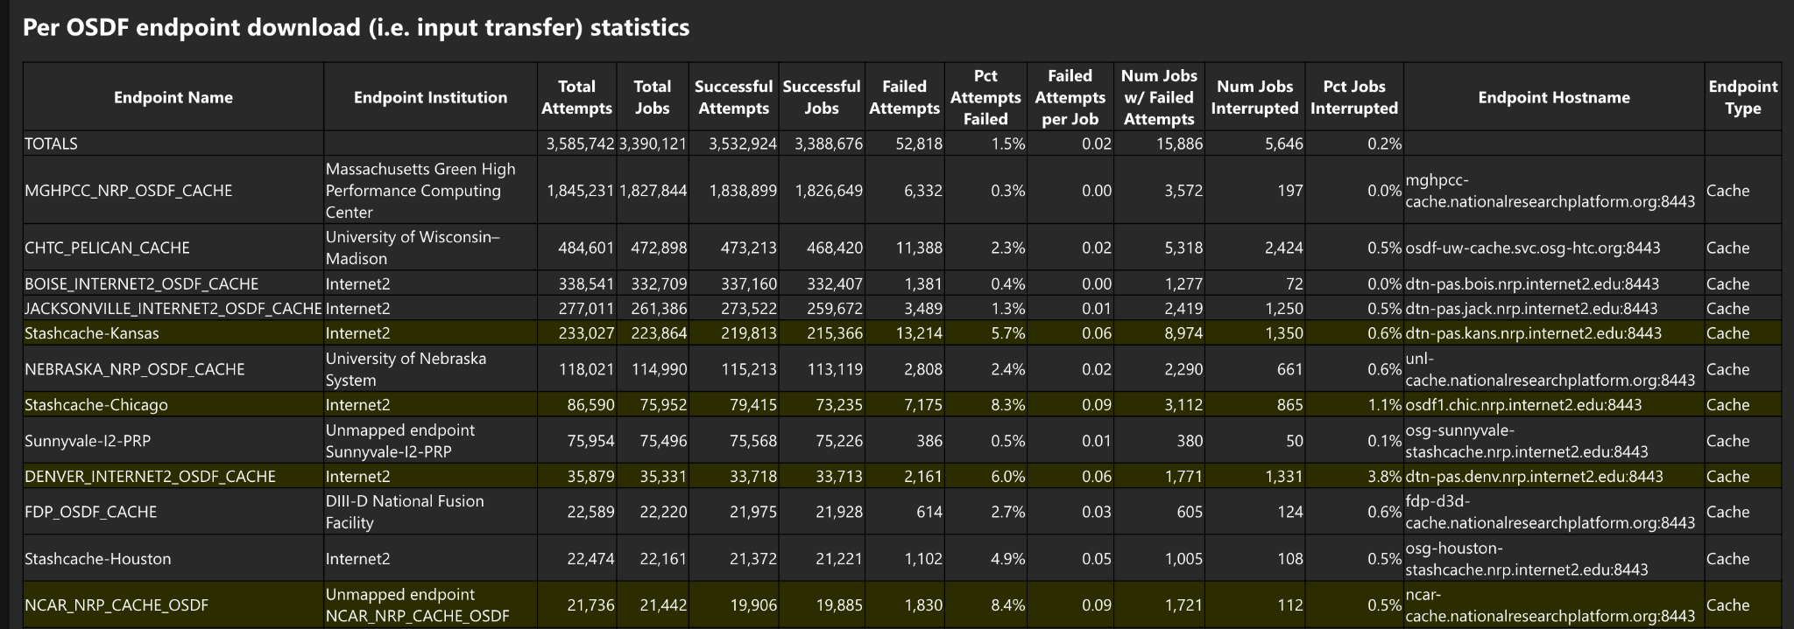
Reports
Notes:
So this is an example OSDF report that gets sent to me each day. This gives our admins a very quick way to interpret if something broken in the OSDF. Because of the scale of the traffic, we can make the assumption that these reports can give a rough estimate of the user experience of the OSDF. These reports allow our team to work quickly to find and fix bugs to make the OSDF more reliable.

Slide 17
Forward Looking
There is still a lot of work to be done:
Where did the client fail?
Why did that transfer take so long?
Who is using my Origin?
Other questions:
Better reports to filter out “user problems” (i.e. object not found)
We also have lots of unknown unknowns!
Notes:
Hopefully I have motivated you to understand the value that monitoring creates. However there is still more work to done. We want to be able to answer questions like what services did my client interact with and where did it fail? Being able to answer this allow us to quickly point at failing components. Next we want to be able answer questions like who is using my origin? This would provide our stakeholders and operators to understand both the value of the data we are delivering to them and the access patterns of users.

Slide 18
Questions?
This project is supported by the National Science Foundation under Cooperative Agreements OAC-2331480. Any opinions, findings, conclusions or recommendations expressed in this material are those of the authors and do not necessarily reflect the views of the National Science Foundation.

