Slide 1
Translational Computer Science
Miron Livny
UW-Madison Vilas Research Professor
John P. Morgridge Professor of Computer Science
UW-Madison Center for High Throughput Computing
Morgridge Institute for Research

Slide 2
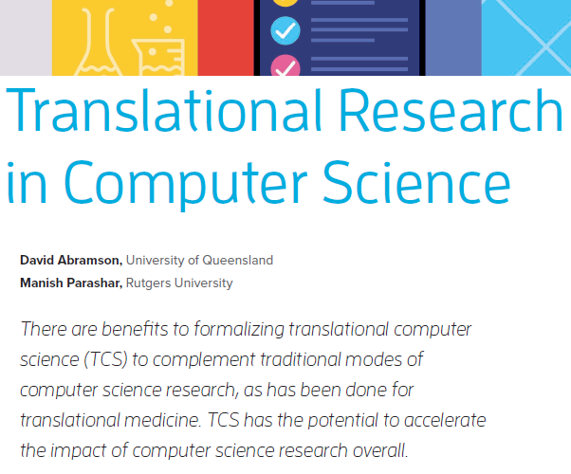
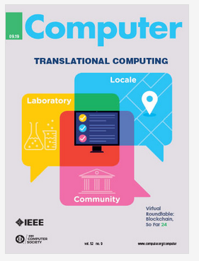
2019

Slide 3
Translational (Computer) Science
Feedback
Laboratory – Where Innovation and development happens
(2-5 years)
Locale – Where services are deployed and operated
(5-10 years)
Communities – Where services enable science
(10 + years)
Innovate Technologies and Methodologies
Deploy Services
Build Communities

Slide 4
Building a lasting relationship with a community requires an
evolving value proposition
and
mutual trust

Slide 5
How to effectively communicate the value proposition of our services?

Slide 6
What is “the value message” to a specific class of audience?
How do we communicate the value message to different audiences?
What will be effective to quantify about our value?
What can we measure and collect?
How much do we trust our data collection (monitoring) and reporting mechanisms?
How quickly can we respond to a request for quantitive information?

Slide 7
