Slide 1
Research Facilitation Project
Kashika Mahajan

Slide 2
htcondor job status
condor_q
condor_history
gives human readable description of a particular job
concise information
________________
Only information about one job
limited options
jobs/batches that are in queue
batch and no-batch options
formatting options
________________
extra effort for concise information
Completed and Removed jobs are both considered DONE
jobs that are ‘DONE’
can filter output by different attributes
formatting options
________________
extra effort for concise information
A lot of information to sift through
and many more tools!

Slide 3
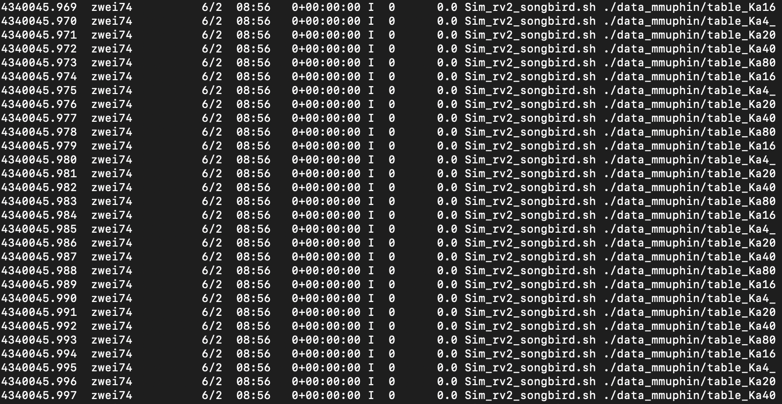
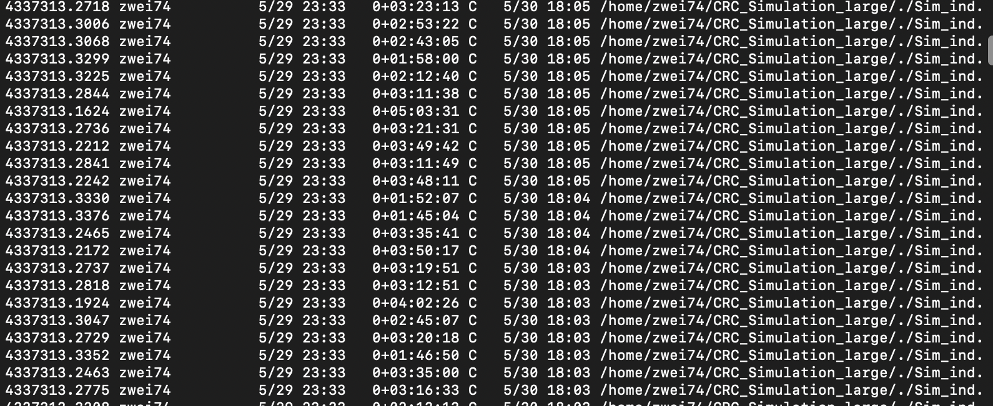
Problem
Researchers want to know how their job is doing without having to dig for details

Slide 4
Objective of Project
Make a tool (or tools) that gives researchers simple feedback about their workload status
Visual_
Process_
Evaluative_

Slide 5
Getting Started with First Steps
Initial Plan
Identify key metrics we can use to evaluate the status of a job list
Understand what does a workflow doing “good”, “maybe” and “bad” mean
Targets:
1. Define clearly what parameters we are evaluating a job list’s status on
2. Create tools to extract data about the job attributes
3. Analyse previous jobs and identify statistics are important to the researcher
4. Define the best way to form a deliverable
We want your input!

Slide 6
Acknowledgements
This material is based upon work supported by the National Science Foundation under Grant No. 2030508. Any opinions, findings, and conclusions or recommendations expressed in this material are those of the author(s) and do not necessarily reflect the views of the National Science Foundation.

