Slide 1
Research Computing Facilitation
Principles for AI and Beyond
Christina Koch, CHTC/PATh Research Computing Facilitation Lead
HTC26 – June 9, 2026

Slide 2
Where we’ve been…
🎉
Research Computing Facilitation is a teenager!
  Originated name and principles of facilitation in 2013
  Impetus: It’s not enough to have technologies and infrastructure – facilitation is key to deliver impact for campuses.
At UW – Madison, 700+ researcher/student interactions last year, across 80 departments and centers.
In the OSPool, 200+ projects in the last year, completing 360 million jobs.

Slide 3
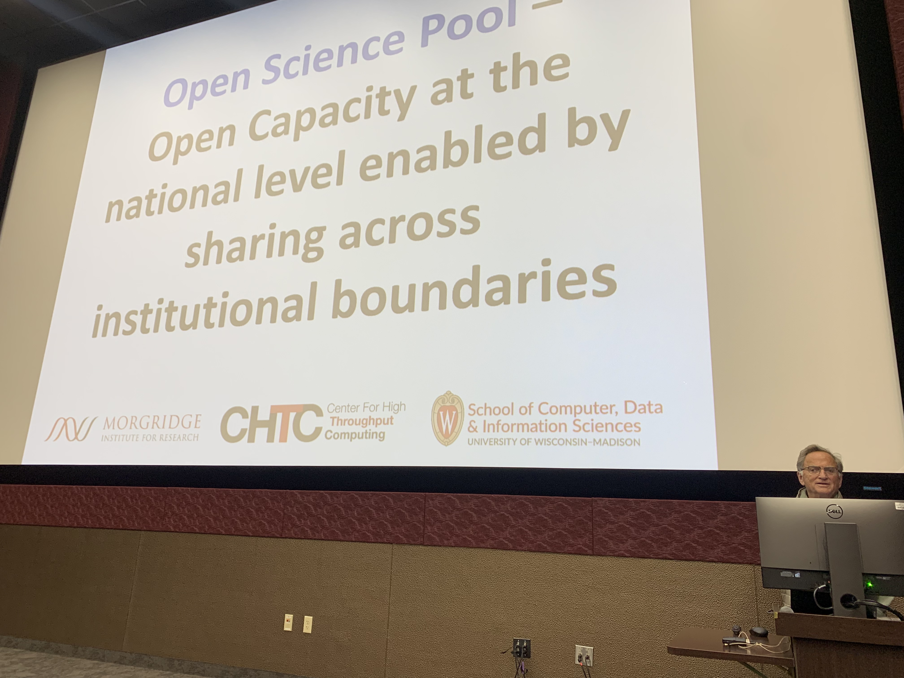
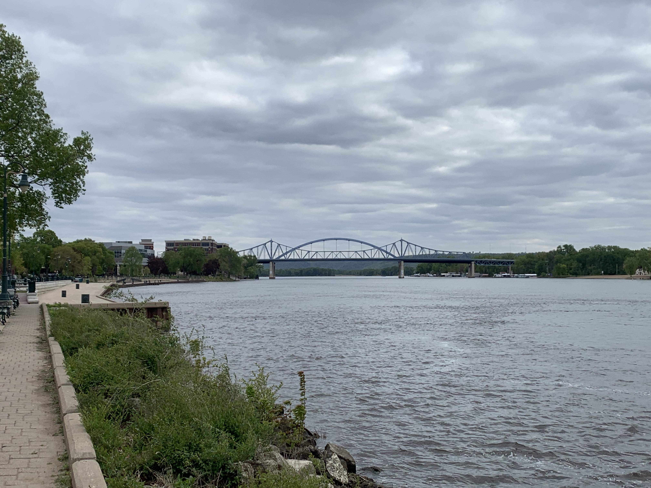
Where we’ve been…
We want to support facilitation efforts and these kinds of teaching and research outcomes at every campus.
In the last 9 months, presented to 7 different campuses/groups interested in HTC/facilitation.
  Let us know if you want to learn more!

Slide 4
What is facilitation?
Leveraging of human capabilities to advance research and teaching outcomes through computing.
Principles:
  Mutually beneficial partnerships, grounded in trust relationships
  Clear ownership of responsibilities and outcomes
  Technology agnostic, concept driven
  Relies on other skillsets (infrastructure, software engineering, etc.)
A methodology to be developed, tested and improved, alongside our technologies.
Notes:
https://library.educause.edu/-/media/files/library/2016/5/erb1602.pdf

Slide 5
How has facilitation life changed as a result of agentic AI?

Slide 6
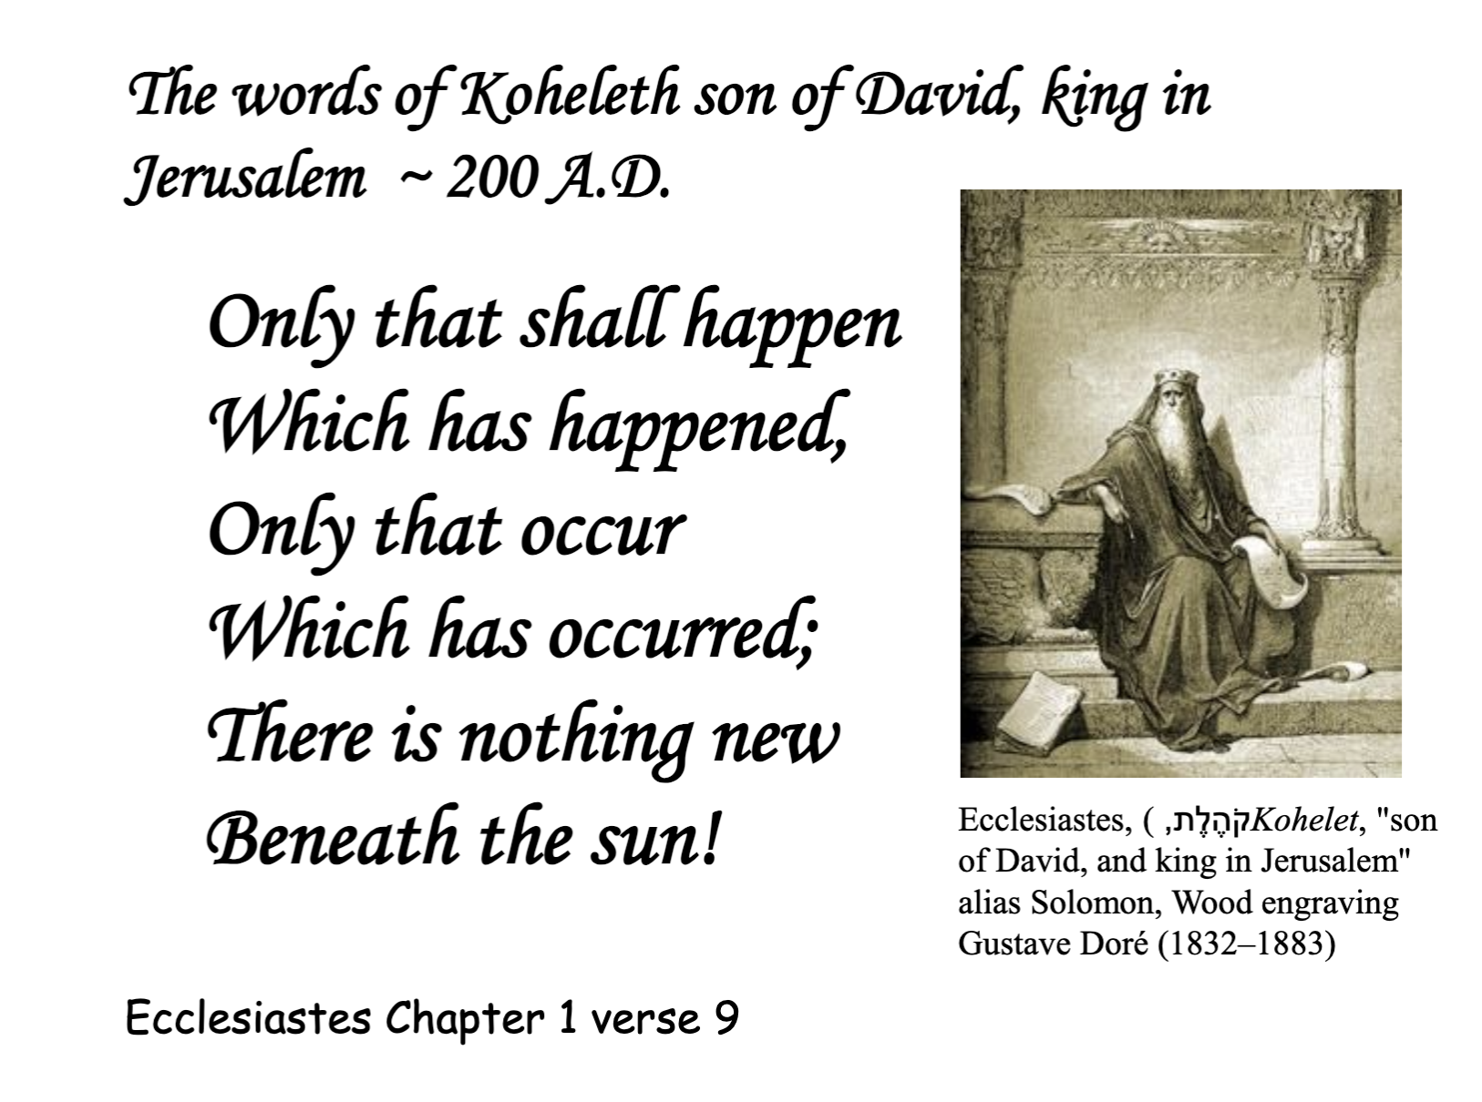

Slide 7
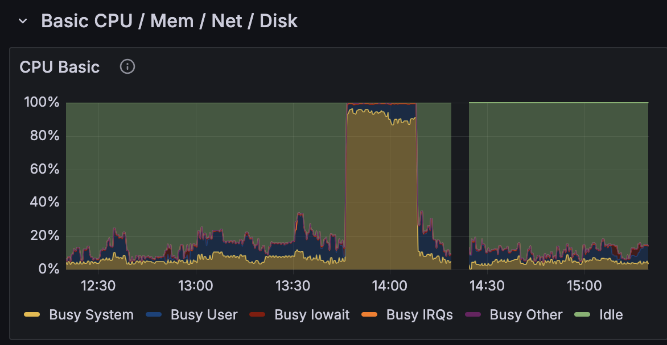
Struggles on the login node
Preventing users from running CPU/memory intensive processes on the login node.
Agents
  Don’t know the rules.
  Obscure what is being run.
  Also use CPUs!
We are working on system limits and user education.
🗣️ Come to Ian’s talk on Friday to learn more!

Slide 8
Agents as coding helpers
Users consistently use agents to generate code and commands to run on our systems.
Results are…mixed.
  Some models hallucinate inputs.
  Other models use obscure or deprecated options from the manual.
  Can use site-specific options in the wrong place.
  Some good results!
  Some disasters!
Still need good documentation and examples.
🗣️ Come to Brian’s talk on Wednesday to learn more!

Slide 9
Communication challenges
Researchers will reach for an agent, rather than emailing RCFs
  User can get immediate answers
  Can mean that we don’t hear about issues promptly
When we do get an email, it’s not the original issue.
  One user’s agent did provide a good answer!
  But sometimes it obscures what’s really happening.
It’s helpful if someone TELLS us that they used an agent.
My NetID cannot submit new jobs since ~14:30 CDT on May 13. Symptoms:
< long list here >
Looks like an OAuth/SciTokens credd issue on ap2001. Could you check the condor_credd daemon health or my account's OAuth ALLOW_WRITE entry?
No user is going to come up with that suggestion on their own!

Slide 10
Nothing new under the sun
We had all of these problems before
Struggles on the login node: This problem has existed forever. Communicating how to share is universal.
Agents as coding helpers: Researchers have been running commands they don’t understand since the dawn of time –using either copy-paste code from Stack Overflow or the lab’s ‘how to use the cluster’ protocol.
Communication challenges: Users have always wanted immediate feedback and sent cryptic emails.

Slide 11
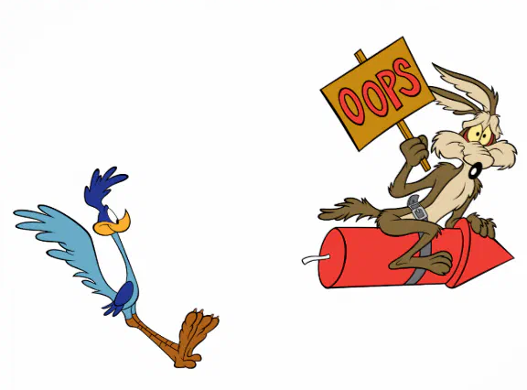
Well, sort of
In general, agents have accelerated the problems we had before or made them bigger.
  More processes on the login node, weird code that doesn’t work.
Edge cases are now much more common and accessible.
  Much easier to break things in weird ways.

Slide 12
Lessons learned
These are all things we should be doing anyway:
  Educating researchers about the responsibilities of using a shared computing system.
  Continuing to build relationships with researchers and provide good guidance (via documentation, one-on-one help, etc.) on how to use our systems.
  Improve our technologies and their usability
The acceleration of the “old problems” via AI agents have forced us to grow and improve.

Slide 13
Looking to the future
Facilitation is needed now, more than ever.
  Instrumental in enabling computing powered outcomes at any campus.
  A reference point for how we support research and teaching in the face of a changing computing and cultural world.
We have years of experience…and are still at the beginning of what’s possible.
  There are new and fascinating opportunities ahead!
What would you need to get facilitation to your campus? How can we partner to make it happen?

Slide 14
What about “AI” workloads?
Next talk!!

Slide 15
Acknowledgements
This work is supported by NSF under Cooperative Agreement OAC-2030508 as part of the PATh Project. Any opinions, findings, and conclusions or recommendations expressed in this material are those of the author(s) and do not necessarily reflect the views of the NSF.

